Slide 1
Tuesday 9th December 2025

Slide 2


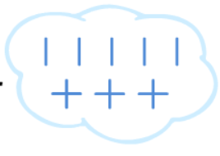

Morning Challenges:
Name writing
N O P Q R S T UV W X Y Z

Slide 3
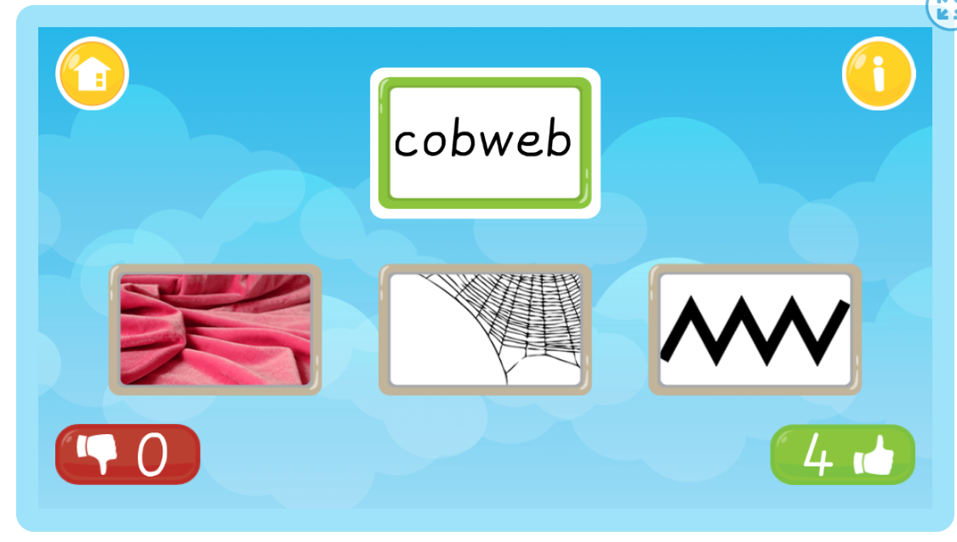
TBAT: review air and ear
Tuesday 9th December 2025
Match Cards (Phase 3) - Online Phonics Game

Slide 4

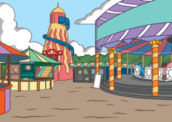


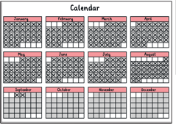



Which Picture?
TBAT: review air and ear
Tuesday 9th December 2025
Teach
Which picture matches the word that Robot Rick is saying?
Perfect
X
You could do some physically active learning here instead with the Level 3 Week 9 Blending Song.
Click me for Kit’s teaching tips!
Next

Slide 5
Which Picture?
TBAT: review air and ear
Tuesday 9th December 2025
Teach
Which picture matches the word that Robot Rick is saying?
X
You could do some physically active learning here instead with the Level 3 Week 9 Blending Song.
Perfect
Click me for Kit’s teaching tips!
Next

Slide 6
Which Picture?
TBAT: review air and ear
Tuesday 9th December 2025
Teach
Which picture matches the word that Robot Rick is saying?
Perfect
X
You could do some physically active learning here instead with the Level 3 Week 9 Blending Song.
Click me for Kit’s teaching tips!
Next

Slide 7
Which Picture?
TBAT: review air and ear
Tuesday 9th December 2025
Teach
Which picture matches the word that Robot Rick is saying?
X
You could do some physically active learning here instead with the Level 3 Week 9 Blending Song.
Perfect
Click me for Kit’s teaching tips!
Next

Slide 8
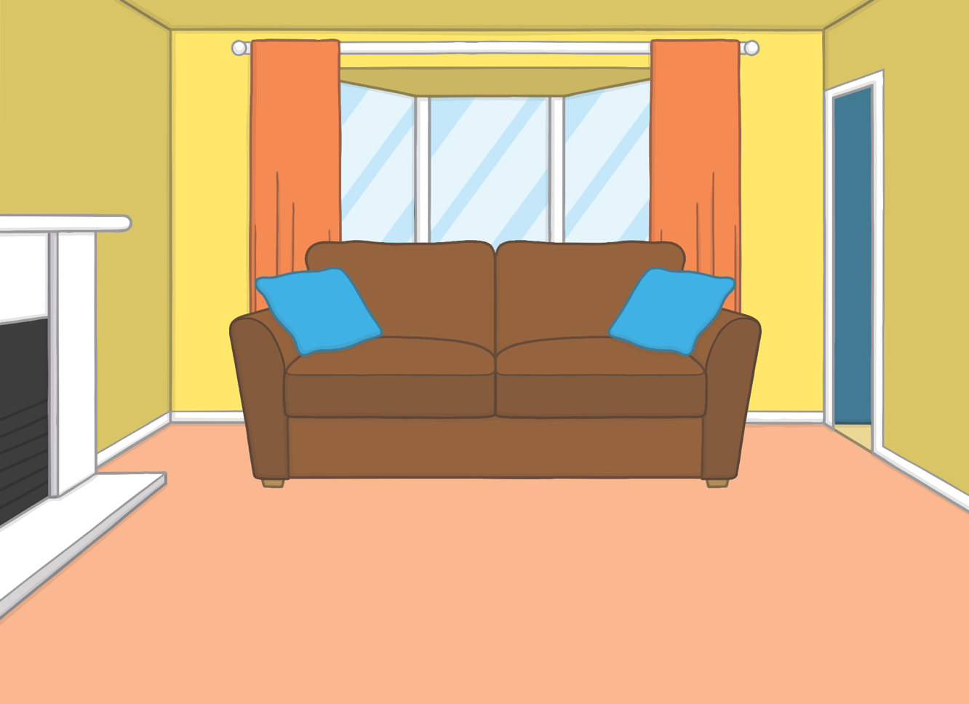



TBAT: review air and ear
Tuesday 9th December 2025
Teach
It was the weekend and Kit and Sam were looking forward to playing outside in the garden. Mum said, “The weather forecast is looking good!”

Slide 9
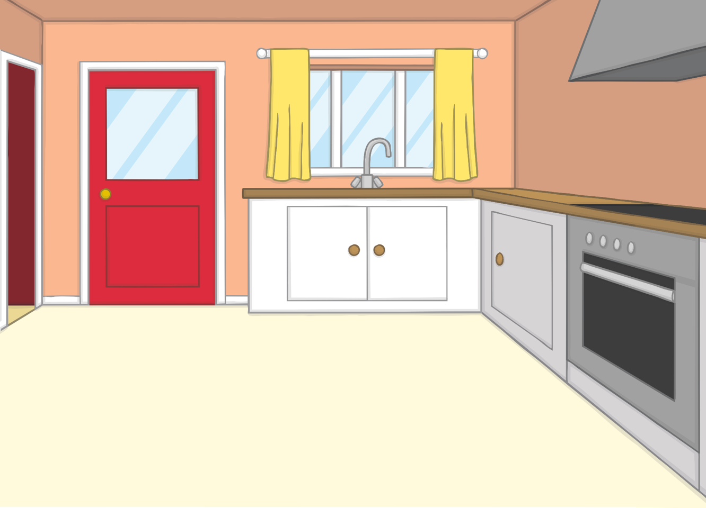
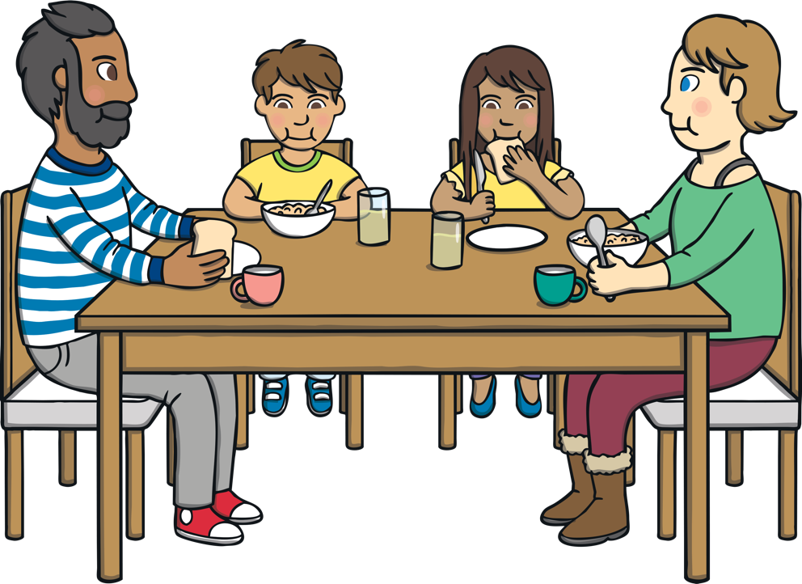
TBAT: review air and ear
Tuesday 9th December 2025
Teach
“I hope the sun comes out soon,” said Kit after he had eaten his breakfast.
“Don’t worry, I know a game we can play if it is still cloudy outside,” said Sam excitedly.

Slide 10


Words in the Clouds
TBAT: review air and ear
Tuesday 9th December 2025
Practise
Sam invites Kit to play ‘I Spy’ with the clouds.
Which words can Sam see in the clouds?
X
Remember to use the sound buttons to sound out and blend to read each word.
Click me for Robot Rick’s learning tips!

Slide 11
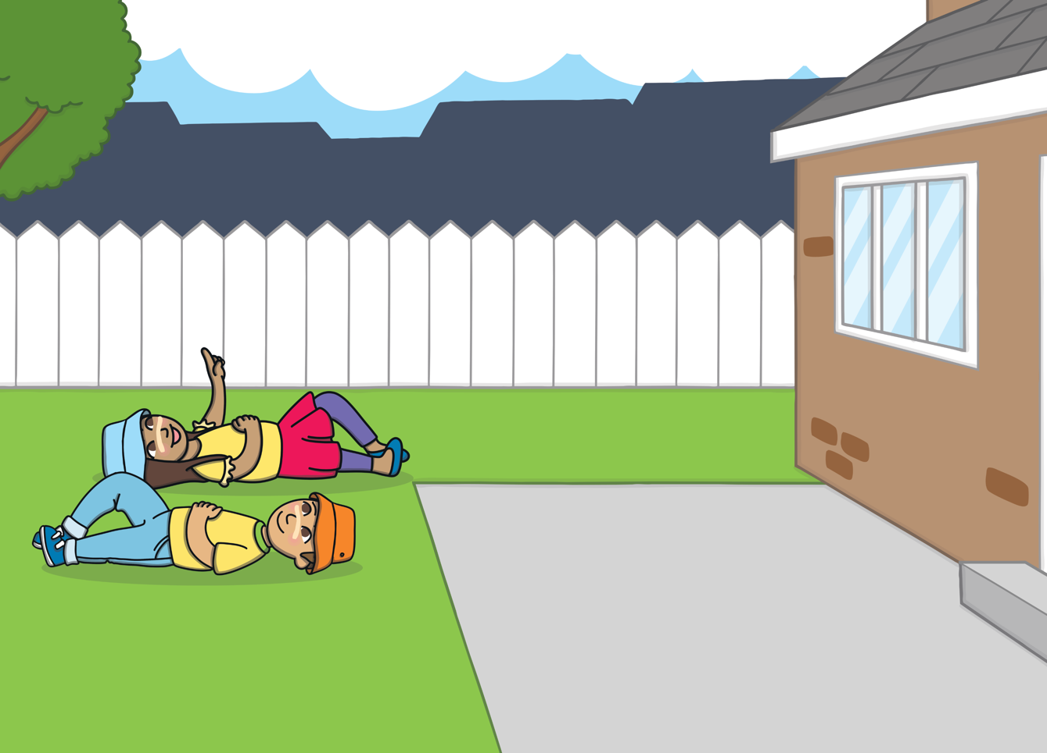

TBAT: review air and ear
Tuesday 9th December 2025
chair
Practise
Check

Slide 12

TBAT: review air and ear
Tuesday 9th December 2025
beard
Practise
Check

Slide 13
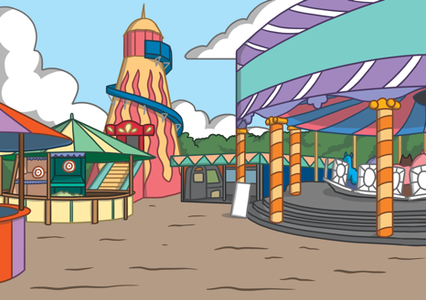
TBAT: review air and ear
Tuesday 9th December 2025
fair
Practise
Check

Slide 14

TBAT: review air and ear
Tuesday 9th December 2025
tear
Practise
Check

Slide 15

TBAT: review air and ear
Tuesday 9th December 2025
hair
Practise
Check

Slide 16

TBAT: review air and ear
Tuesday 9th December 2025
gear
Practise
Check

Slide 17
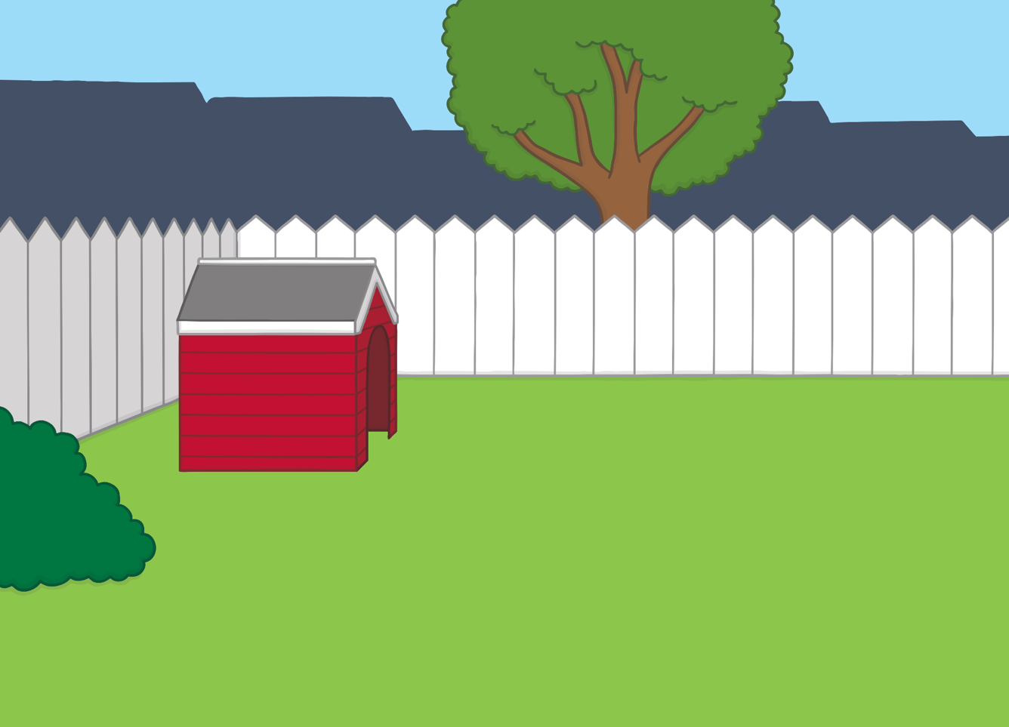


TBAT: review air and ear
Tuesday 9th December 2025
Apply
The sun had started to shine. Kit and Sam put on their sun cream and sun hats. They skipped happily around the garden.

Slide 18
TBAT: review air and ear
Tuesday 9th December 2025
Apply
Kit and Sam were excited to see the sun shine at last. Can you read the sentences to find out what they did in the garden?

Slide 19
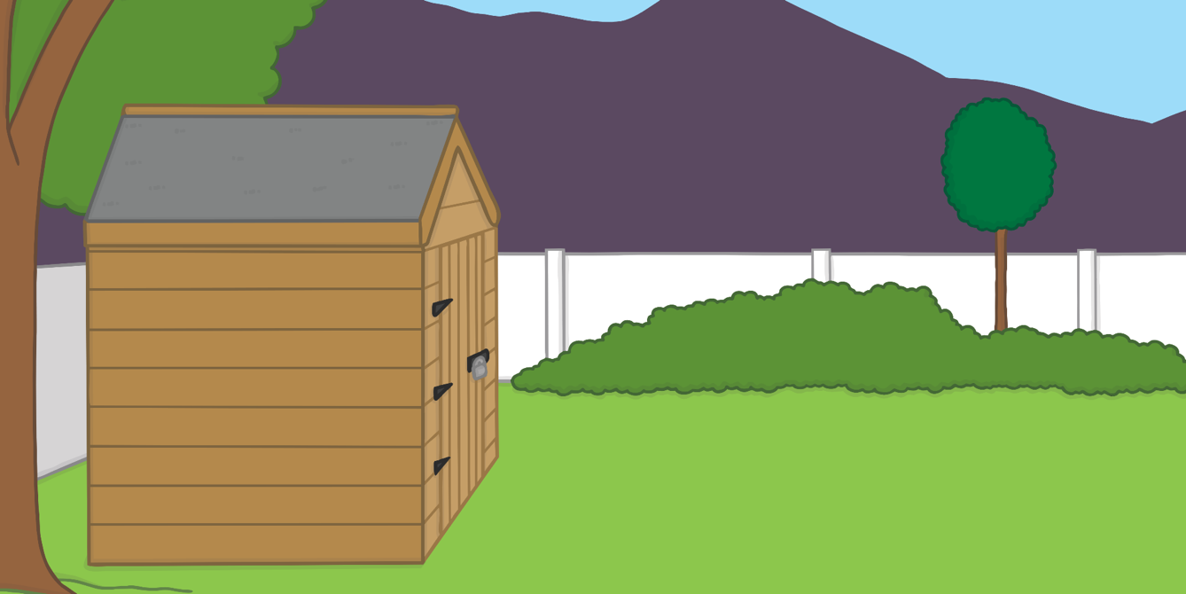
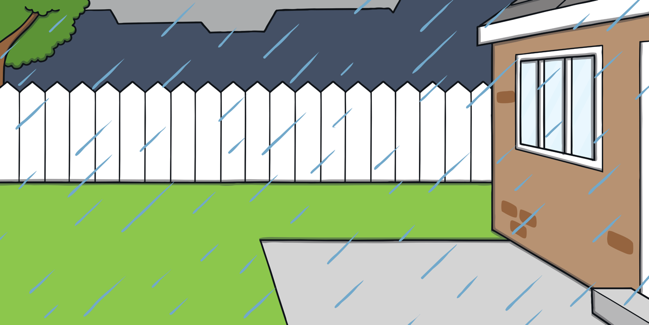
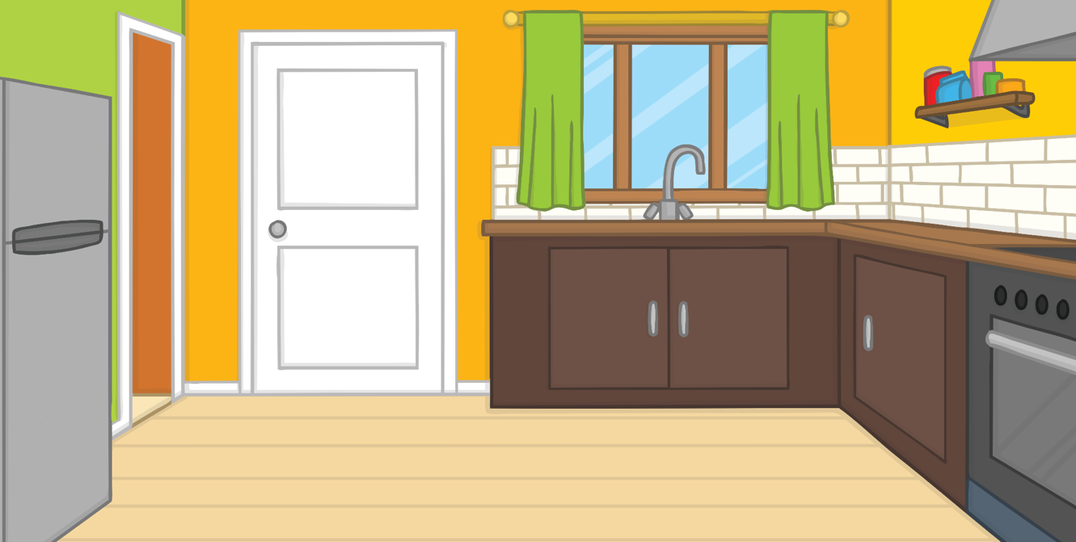
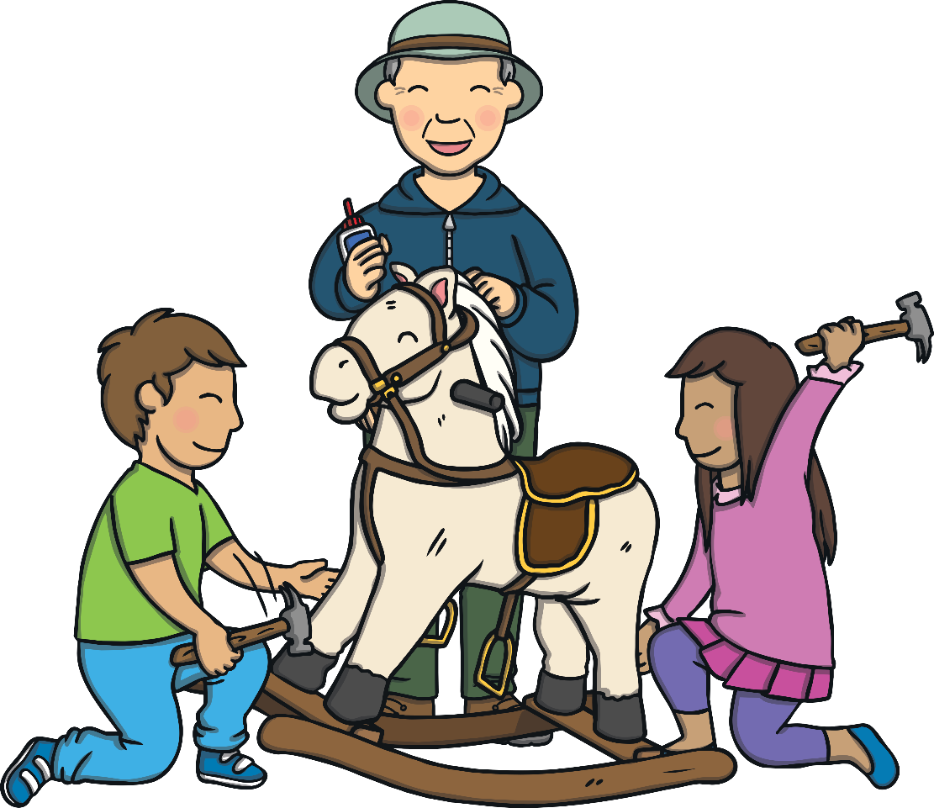


Oh Dear!
TBAT: review air and ear
Tuesday 9th December 2025
Apply
Can you sing this alphabet song along with Kit? (To the tune of the traditional alphabet song)
A, B, C, D, E, F, G,
Sing the alphabet with me.
H, I, J, K, L, M, N,
Have a rest and start again.
O, P, Q, R, S, T, U,
Come along and sing it too.
Sing V, W, X and Y,
Z is last so say goodbye.
A ‘Let’s Read Together!’ Book

Slide 20



TBAT: review air and ear
Tuesday 9th December 2025
Apply
Kit and Sam wait for the sun to appear.
Sound Buttons On/Off
Show

Slide 21
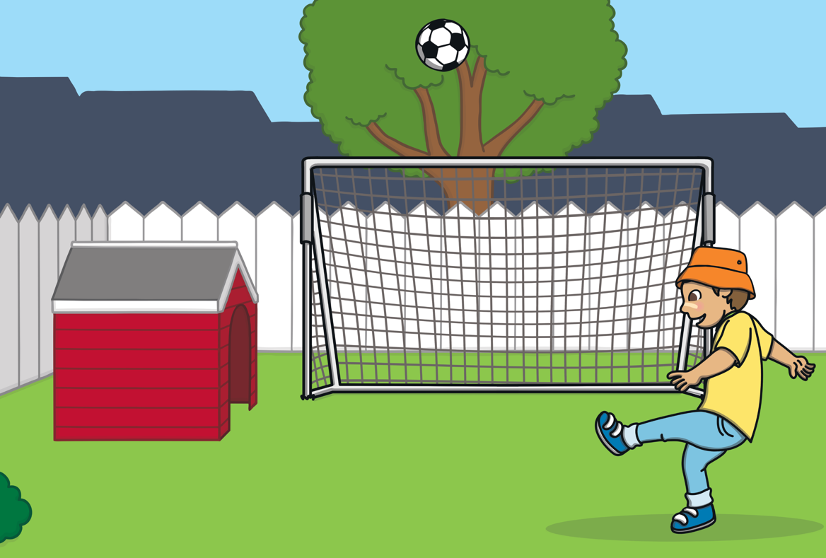
TBAT: review air and ear
Tuesday 9th December 2025
Apply
Kit is in goal. He kicks high, mid-air.
Sound Buttons On/Off
Show

Slide 22
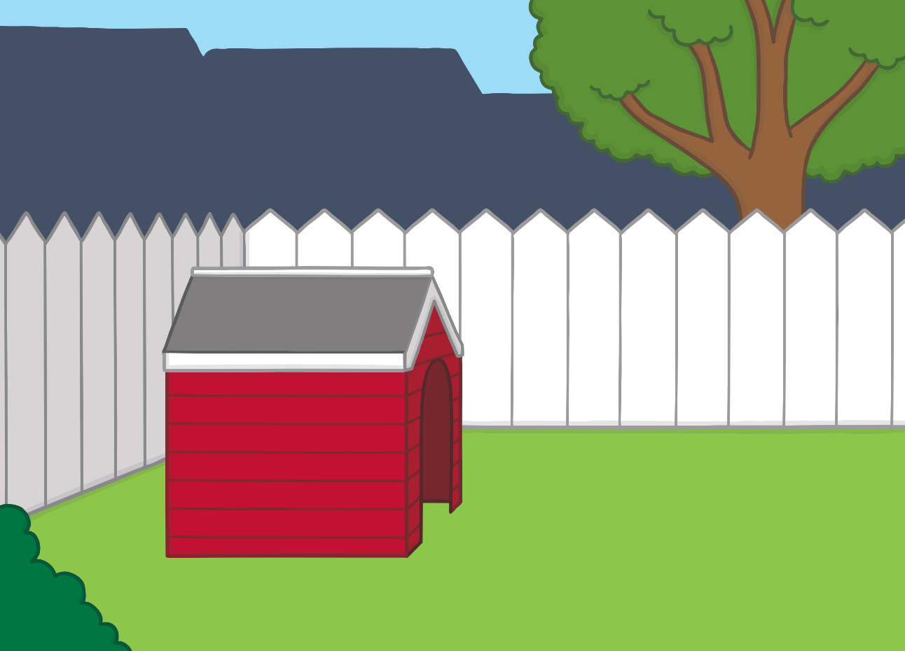

TBAT: review air and ear
Tuesday 9th December 2025
Apply
Sam is too near to the shed. She hits it.
Sound Buttons On/Off
t
BANG!
Show

Slide 23
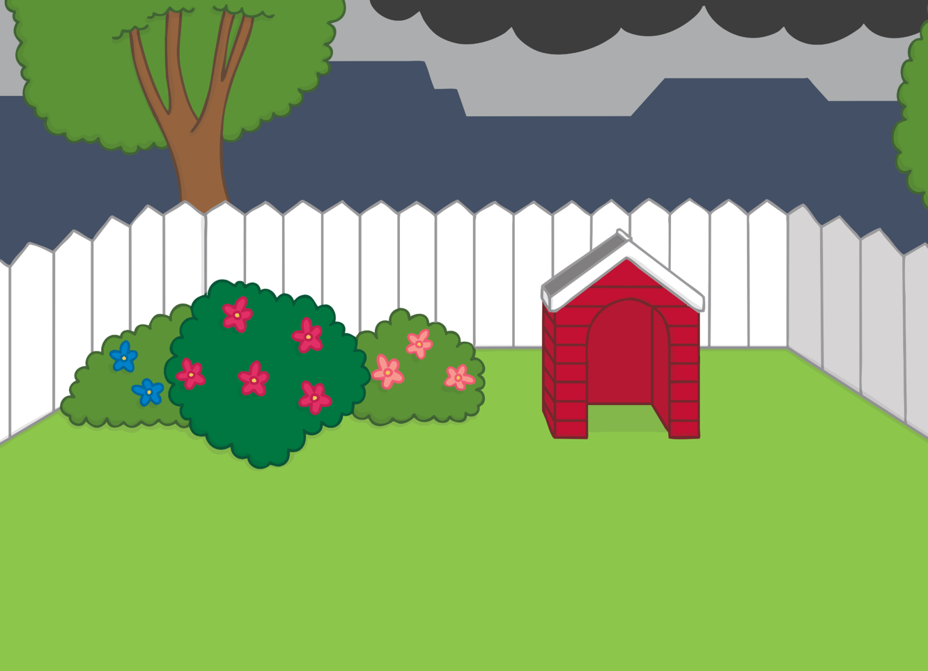
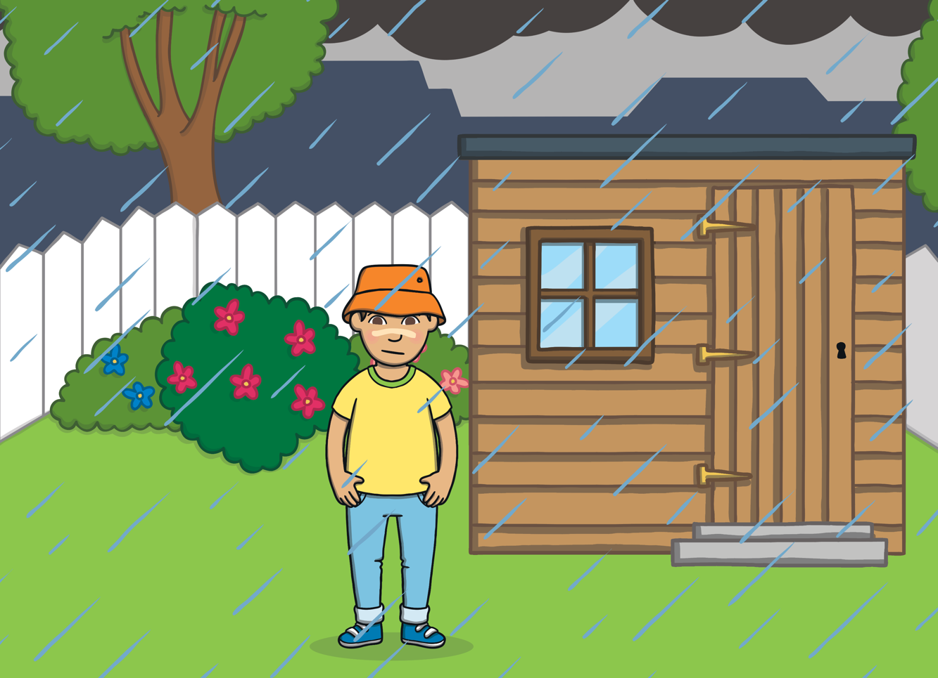
TBAT: review air and ear
Tuesday 9th December 2025
Apply
Kit can hear the rain on the shed roof.
Sound Buttons On/Off
Show

Slide 24
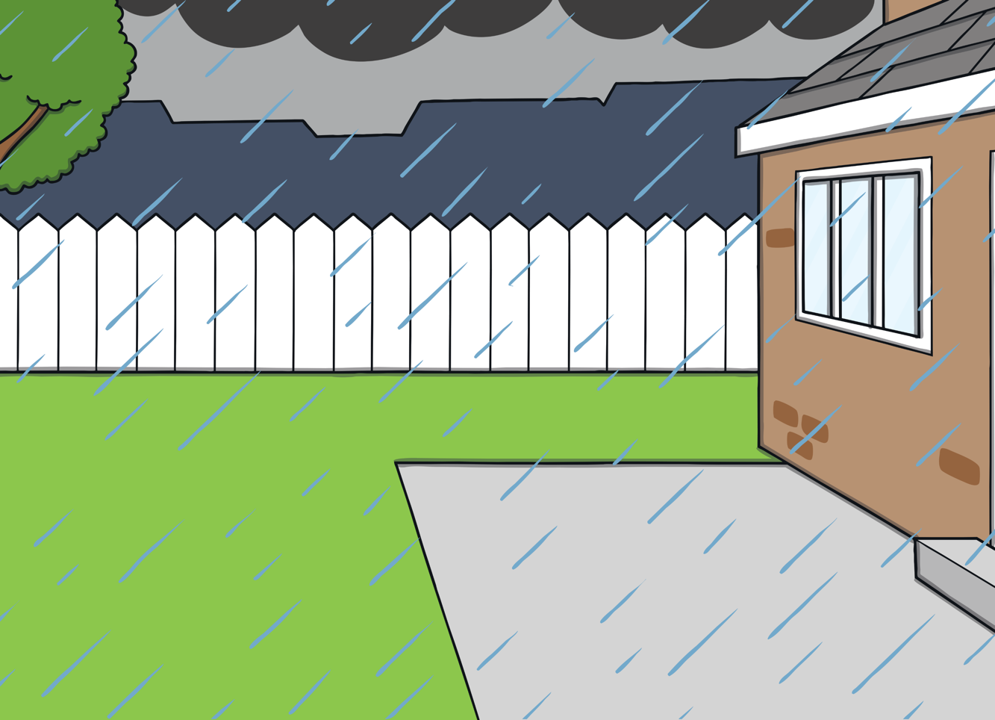

TBAT: review air and ear
Tuesday 9th December 2025
Apply
“I can see the rain too!” fears Sam as it gets dark.
Sound Buttons On/Off
Show

Slide 25
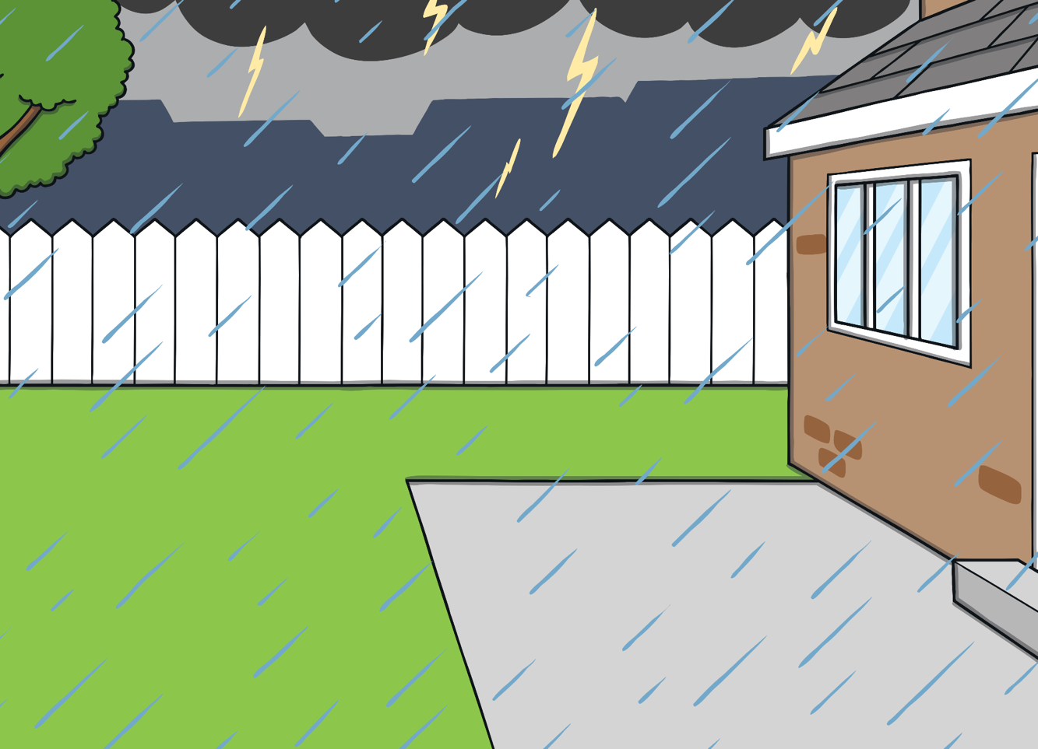
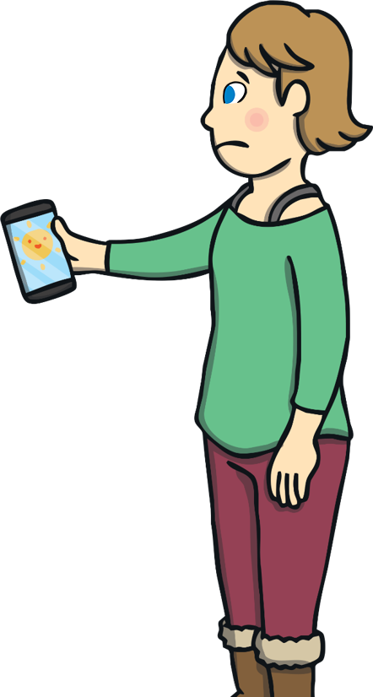

TBAT: review air and ear
Tuesday 9th December 2025
Apply
The pair are all wet. It is not fair!
Sound Buttons On/Off
Oh dear!
Show

Slide 26
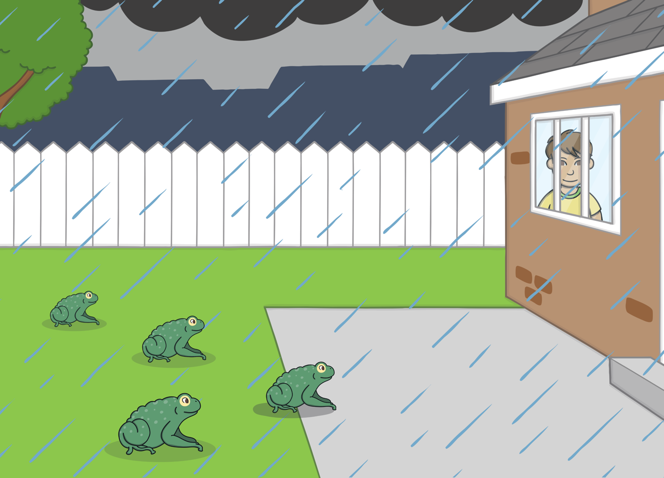
TBAT: review air and ear
Tuesday 9th December 2025
Apply
“That was a surprise!” said Mum, as the rain started to pour.
“Oh well,” said Kit as he looked outside, “it’s nice weather for toads!”

Slide 27
TBAT: review air and ear
Tuesday 9th December 2025
Write a sentence using these words.
chair fair hear
Challenge: use more than one.

Slide 28
TBAT: consolidate knowledge of days of the week and months of the year.
Tuesday 9th December 2025
3 in 3 - Sort the words into days of the week and months of the year.
Days of the week | Months of the year
Friday
Wednesday
May
Saturday
June
October

Slide 29
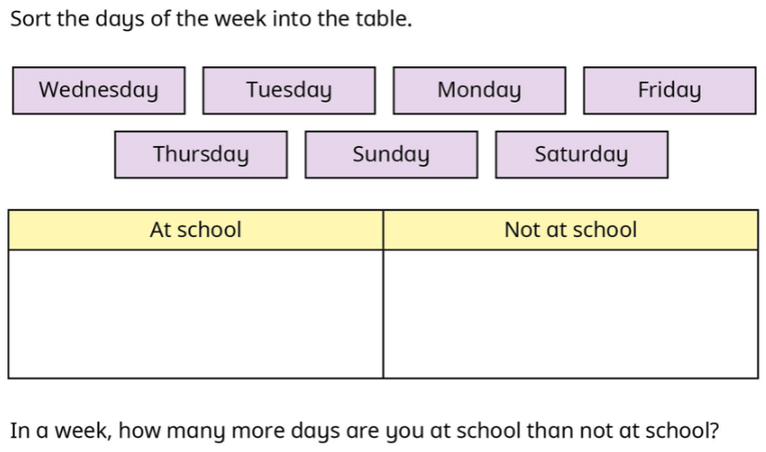

TBAT: consolidate knowledge of days of the week and months of the year.
Tuesday 9th December 2025
Blue/ Green

Slide 30

TBAT: consolidate knowledge of days of the week and months of the year.
Tuesday 9th December 2025

Slide 31
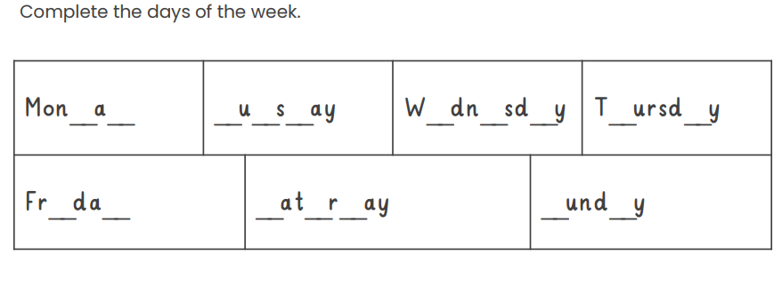
TBAT: consolidate knowledge of days of the week and months of the year.
Tuesday 9th December 2025

Slide 32
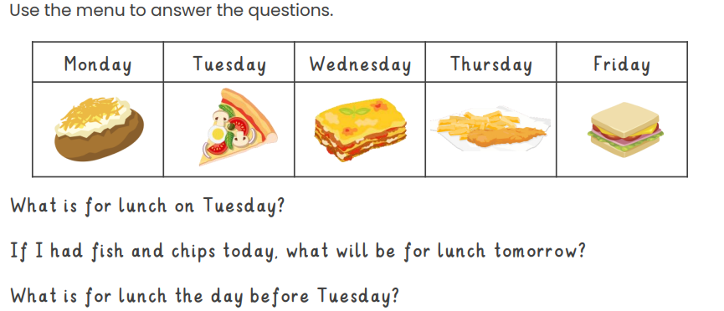
TBAT: consolidate knowledge of days of the week and months of the year.
Tuesday 9th December 2025

Slide 33
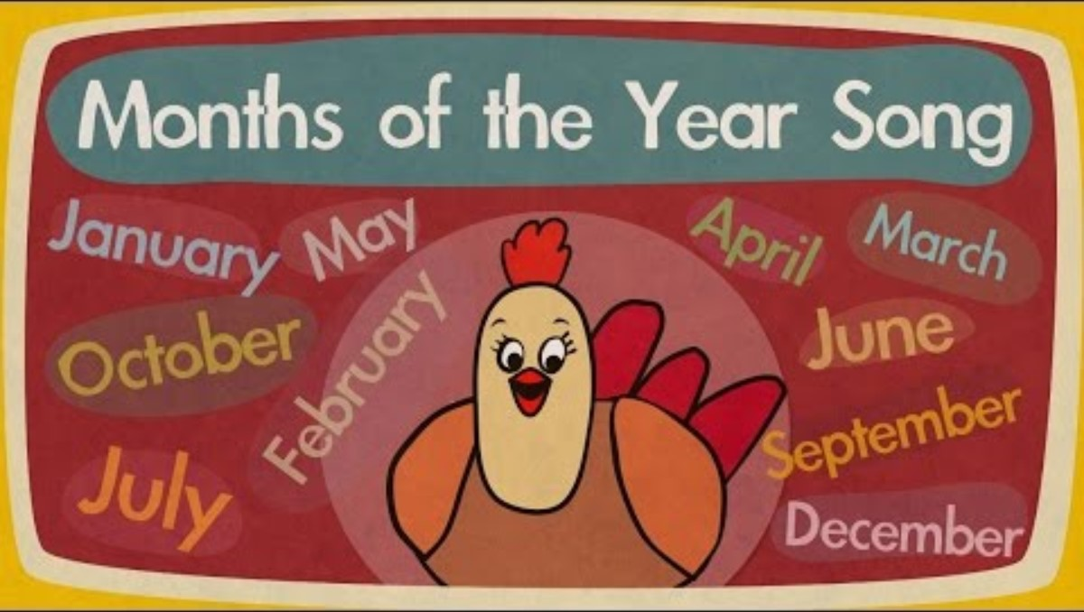
TBAT: consolidate knowledge of days of the week and months of the year.
Tuesday 9th December 2025

Slide 34
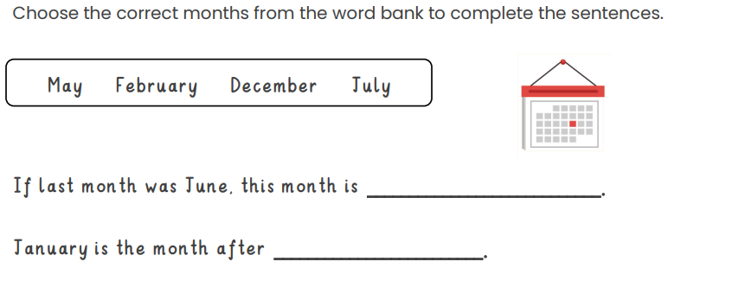
TBAT: consolidate knowledge of days of the week and months of the year.
Tuesday 9th December 2025

Slide 35
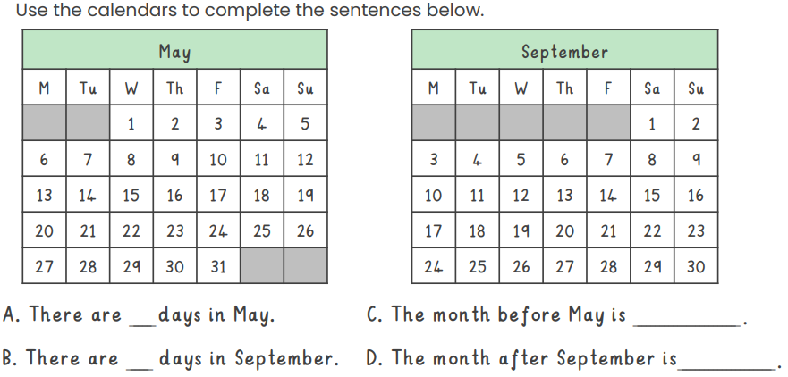
TBAT: consolidate knowledge of days of the week and months of the year.
Tuesday 9th December 2025

Slide 36
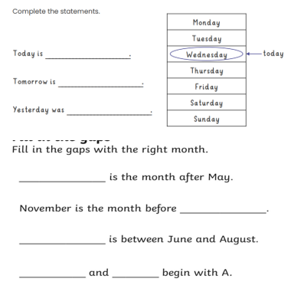
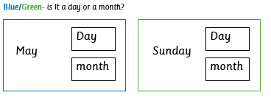
TBAT: consolidate knowledge of days of the week and months of the year.
Tuesday 9th December 2025
Independent:

Slide 37
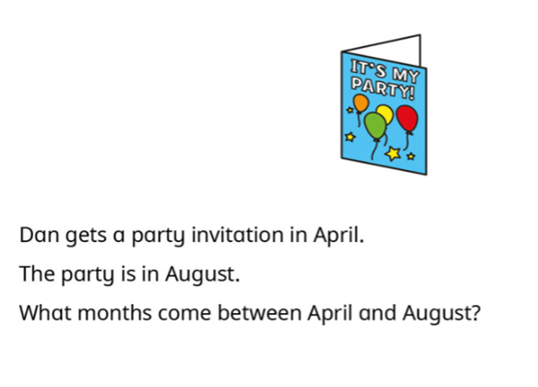
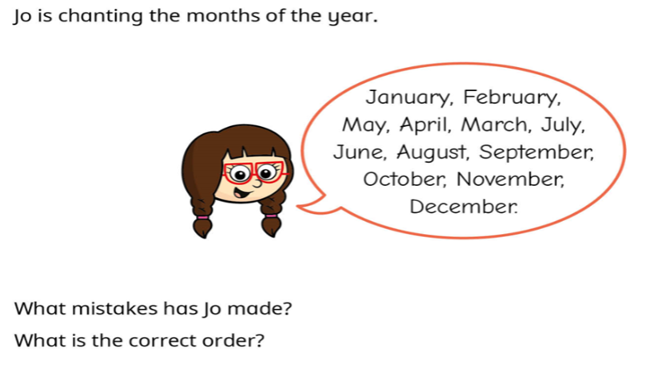
TBAT: consolidate knowledge of days of the week and months of the year.
Tuesday 9th December 2025
Reasoning problem:
Challenge:

Slide 38
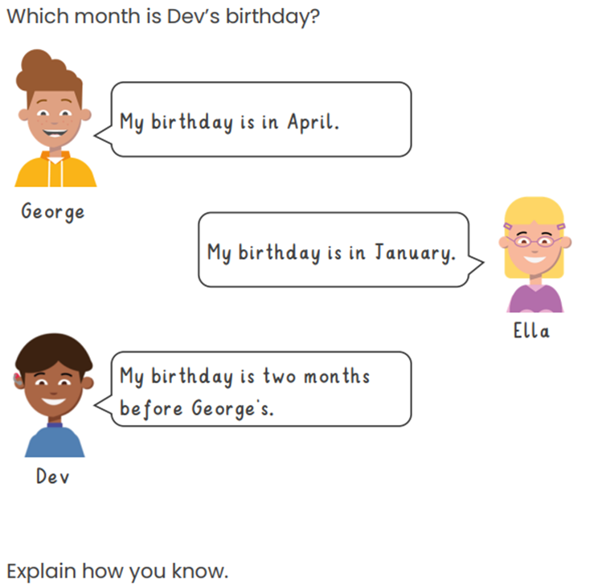
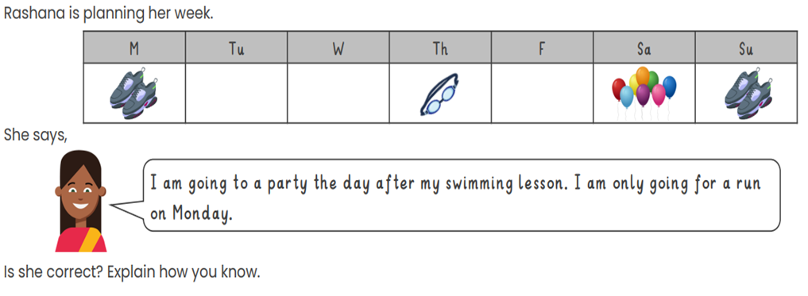
TBAT: consolidate knowledge of days of the week and months of the year.
Tuesday 9th December 2025
Mastery:
Mastery with greater depth:

Slide 39

Break

Slide 40
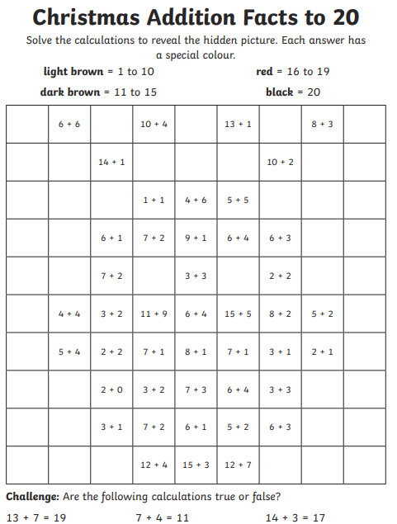
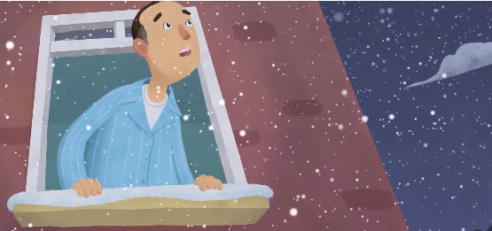
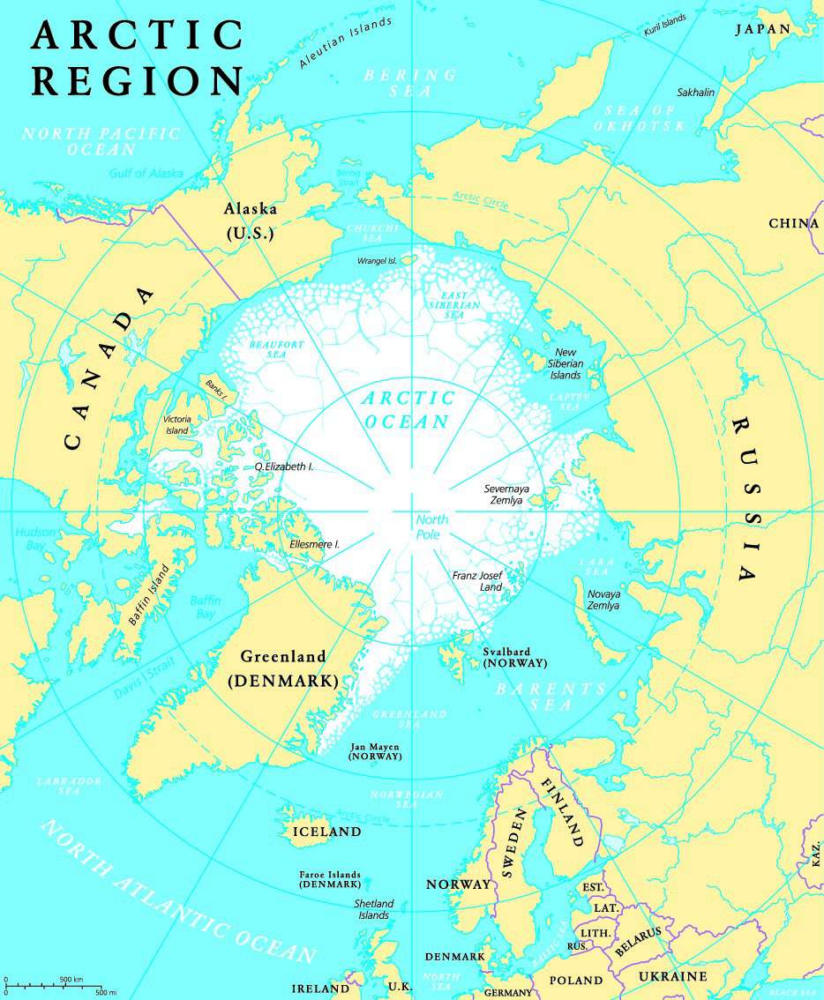

Independent Challenges:
Narrative Zone
Maths Zone
Write a sentence to say what is happening in the picture.
Addition to 20 colouring.
Enquiry Zone
Creative Zone
Find the North Pole on the map, globe or in an Atlas.
Create a handprint Christmas tree.

Slide 41

Lunch

Slide 42
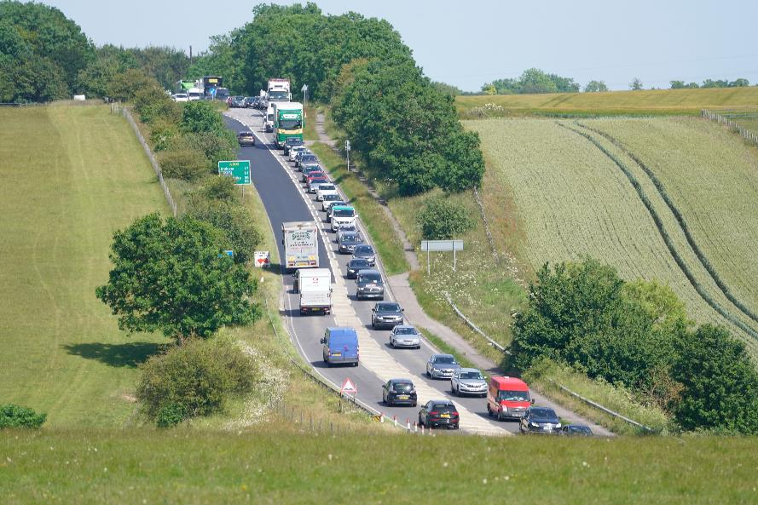

Unit 2: Transport and Travel
Lesson 9: Why can we only find some types of transport in certain areas?

Slide 43
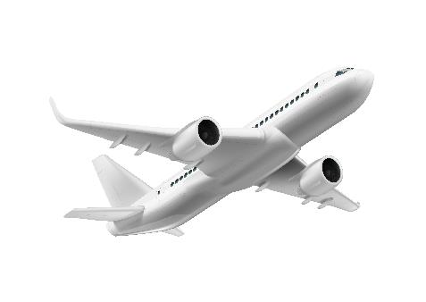
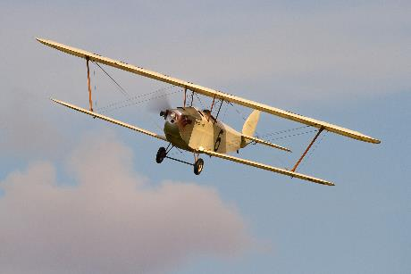
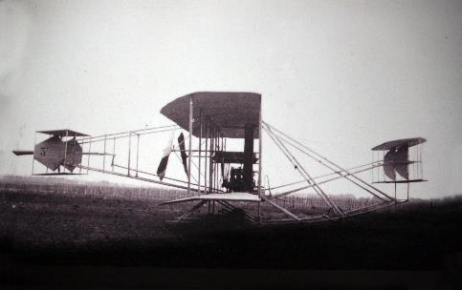
KQ: Why can we only find some types of transport in certain areas?
Tuesday 9th December 2025
Lesson 9:
4 in 4
A glider is an ____________________.
aircraft without an engine aircraft with an engine
Circle the oldest aeroplane.
Notes:
Knowledge quiz 2.8: Pupils complete this in the Additional resource: Knowledge quizzes booklet to assess their knowledge retention from the previous lesson. They write their score in the chart also provided in the additional resource.

Slide 44
KQ: Why can we only find some types of transport in certain areas?
Tuesday 9th December 2025
Lesson 9:
4 in 4
An aeroplane is powered by ____________.
wind steam an engine
The Wright brothers invented the first aeroplane. True or false?
true false

Slide 45

Tuesday 9th December 2025
How has transport changed over time?
Notes:
Revisit the main enquiry question and the learning journey so far.

Slide 46
Tuesday 9th December 2025
How do we travel around today?
How has road transport changed?
1
6
What transport did people use in the past?
How have bicycles changed since they were first invented?
2
7
How have boats changed over time?
How has air travel changed over time?
3
8
How were the first trains different from trains today?
Why can we only find some types of transport in certain areas?
4
9
How did trains change people's lives?
How have humans travelled in space?
5

Slide 47
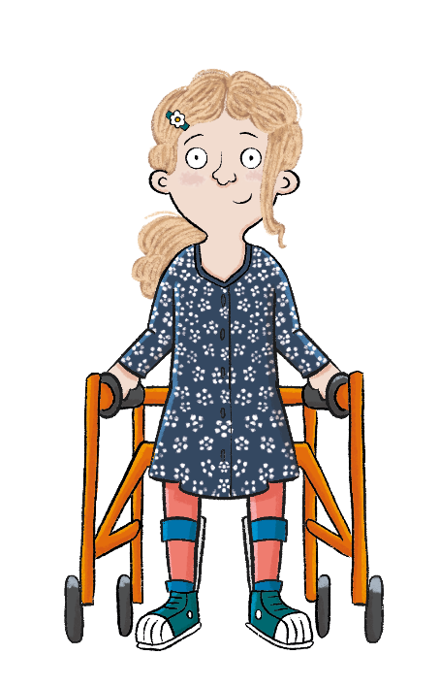
KQ: Why can we only find some types of transport in certain areas?
Tuesday 9th December 2025
Lesson 9:
In this lesson, we are exploring how transport has changed in our local area.
Notes:
Introduction: Share the lesson statement and key term. Then share key knowledge and other key vocabulary with pupils—you may want to add images to the teaching slides to support exemplification and understanding of these words.

Slide 48
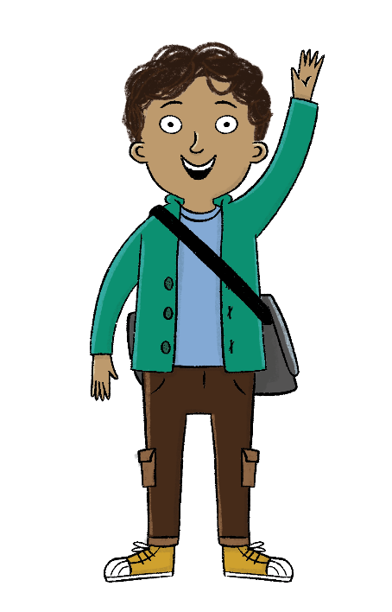
KQ: Why can we only find some types of transport in certain areas?
Tuesday 9th December 2025
Lesson 9:
The key term for this lesson is
traffic.
Traffic is all the vehicles travelling on the roads.
Notes:
To support the concept of the key term ‘traffic’, show pictures or videos of busy roads with lots of traffic.

Slide 49

Why can we only find some types of transport in certain areas?
Tuesday 9th December 2025
Lesson 9:
Some types of transport are only used in certain areas.
Underground railways were built in cities to help cut down on traffic.
Transport in our local area has changed.
advantages
canal
disadvantages
funicular
traffic

Slide 50
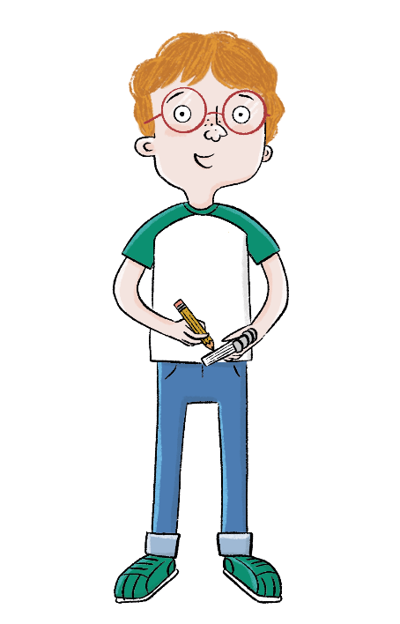
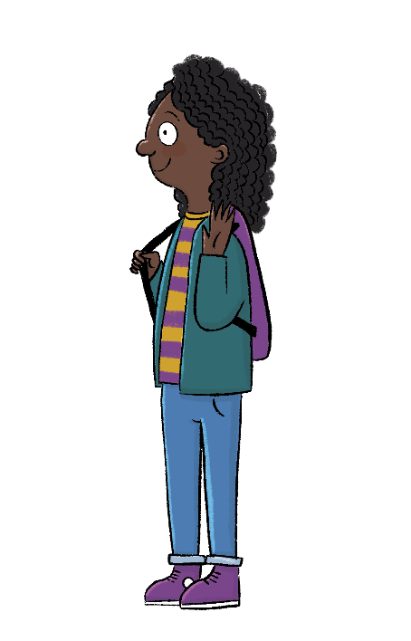
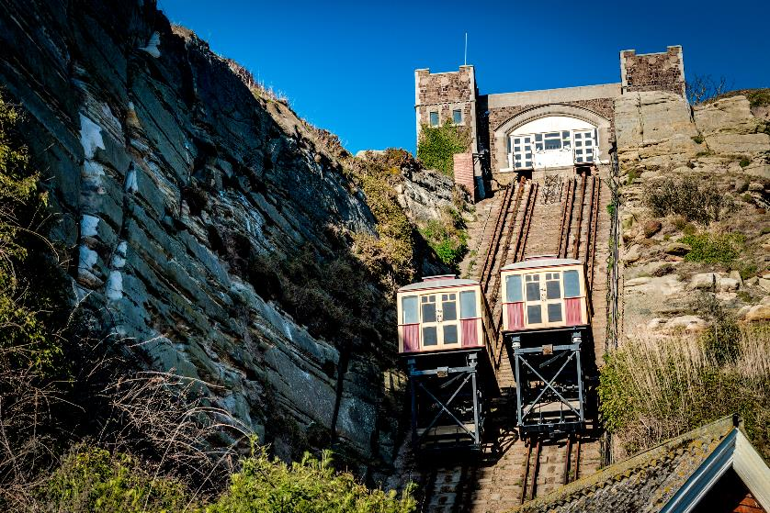
KQ: Why can we only find some types of transport in certain areas?
Tuesday 9th December 2025
Lesson 9:
Blue / Green
Do you know what this is?
What do you notice about where it is built?
Notes:
Talk task: Ask pupils to look at the picture on the slide and discuss with their partner the questions: ‘Do you know what this is?’ and ‘What do you notice about where it is built?’. Explain that funicular railways were built to transport people up hillsides (often holiday makers). Ask if they have ever seen or been on a funicular railway. Look at the next slide and ask the same questions. After pupils have discussed with their partners, explain that canals are like rivers but, unlike rivers, they were built by people to transport goods. Canals are quite narrow and not very deep so only certain types of boats can travel by canal.

Slide 51
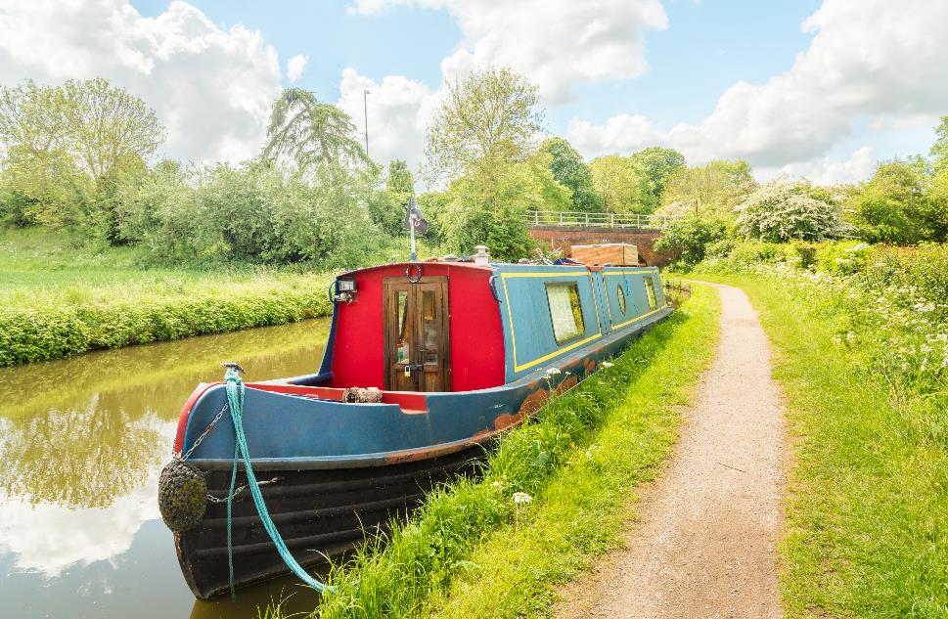
KQ: Why can we only find some types of transport in certain areas?
Tuesday 9th December 2025
Blue / Green
What kind of water is it on?
Do you know what this is?

Slide 52


Types of transport
KQ: Why can we only find some types of transport in certain areas?
Tuesday 9th December 2025
Lesson 9:
Some types of transport are only used in certain areas.
A funicular railway is only built up a hillside.
Some types of boats can only travel on canals.
Notes:
Read: ‘Types of transport’. This information explains that some types of transport, like canal boats or funicular railways, are only used in certain areas. You could show pupils videos of funicular railways and canal boats to support comprehension.

Slide 53

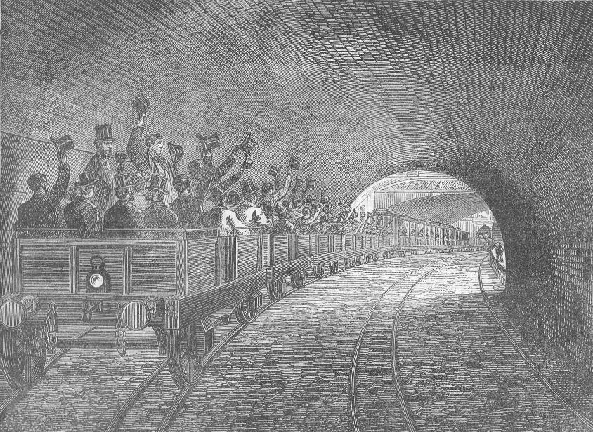
KQ: Why can we only find some types of transport in certain areas?
Tuesday 9th December 2025
Lesson 9:
Look at this image from 1863.
What type of transport is this? Where is it?
Notes:
Talk task: Ask pupils to examine the image and discuss the questions: ‘What type of transport is this?’ and ‘Where is it?’. Take feedback as a whole class and explain to pupils that the image shows the London Underground, as it was in 1863. You may wish to show pupils images and videos of modern-day London Underground to support their understanding.

Slide 54
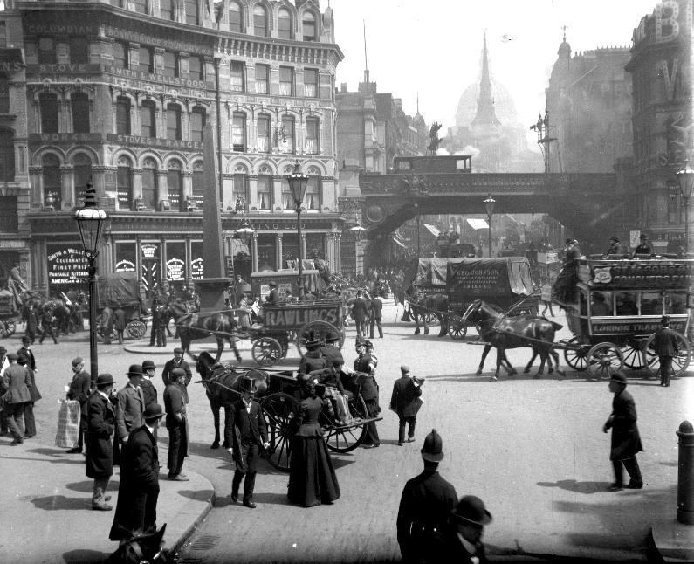
The underground railway
KQ: Why can we only find some types of transport in certain areas?
Tuesday 9th December 2025
Lesson 9:
As cities got bigger, their streets became busy with horse drawn carriages, buses, and trams.
To help cut down the traffic in London, a railway was built underneath the streets.
Notes:
Read: ‘The underground railway’ slides. Explain the invention of the underground railway. Refer back to the Transport timeline additional resource to show when underground railways were invented. You could show pupils the London Underground section of the following video: https://www.youtube.com/watch?v=MuDAUa0XSHI. (Oxford University Press is not responsible for content available on third-party websites. The content of these websites may have changed since publication.)

Slide 55
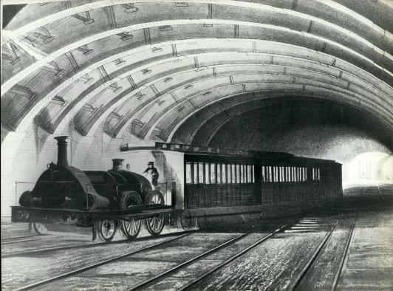

The underground railway
KQ: Why can we only find some types of transport in certain areas?
Tuesday 9th December 2025
Lesson 9:
The world’s first underground railway opened in 1863 in London.
Today, London’s underground railway carries around lots of people every day!

Slide 56

Sort the sentences by whether they are an advantage or disadvantage of having an underground.
KQ: Why can we only find some types of transport in certain areas?
Tuesday 9th December 2025
Lesson 9:
There is no other traffic.
It is quick.
It can be expensive.
It is very crowded.
It helps cut down on traffic above ground.
Notes:
Group task: Discuss the advantages and disadvantages of the London Underground using the information on the slide, the images and any ideas pupils may think of from the videos you have watched. Share ideas as a whole class. Pupils should then use the Additional resource: Advantages and disadvantages to work together to sort the advantages and disadvantages and stick them into their Workbooks. Challenge pupils by asking them to either write any additional ideas the class came up with into their Workbook, or to write all the answers straight into their Workbook. Pupils will be supported to complete this task by their partner and the whole-class group work. Answers are provided on the following slide.

Slide 57

KQ: Why can we only find some types of transport in certain areas?
Tuesday 9th December 2025
Sort the sentences by whether they are an advantage or disadvantage of having an underground.
Lesson 9:

Slide 58

Transport in our local area
KQ: Why can we only find some types of transport in certain areas?
Tuesday 9th December 2025
Lesson 9:
What transport do we see in our local area?
Why don’t we see funicular railways?
Why don’t we have underground trains?
Notes:
Read: ‘Transport in our local area’. (You should have added the images of a mode transport in your local area and relevant questions to this slide.) Read through the information you researched on a mode of transport in your local area and its history. When comparing the image of your local area in the past to modern day, possible questions you could ask are: Which image is from today and which is the past? How do you know? What modes of transport can you see? What has changed from the past to present? Ideally, take pupils to that area where they could experience it first-hand.

Slide 59
Draw a type of transport in our local area from the past.
KQ: Why can we only find some types of transport in certain areas?
Tuesday 9th December 2025
Lesson 9:
Notes:
Write: In their Workbooks pupils draw a type of transport in your local area from the past and a type of transport in your local area from today. To challenge pupils, ask them to label their images. As a support, print out the type of transport to hand out on tables to assist pupils with their drawings.

Slide 60
Draw a type of transport in our local area from today.
KQ: Why can we only find some types of transport in certain areas?
Tuesday 9th December 2025
Lesson 9:

Slide 61

Why can we only find some types of transport in certain areas?
KQ: Why can we only find some types of transport in certain areas?
Tuesday 9th December 2025
Lesson 9:
What types of transport are found in our local area?
How has transport changed in our local area?
Notes:
Learning review: Using the teaching slides, talk partners tell each other a response to the questions. Add further review questions if you wish to.

Slide 62
Why can we only find some types of transport in certain areas?
Tuesday 9th December 2025
Lesson 9:
Some types of transport are only used in certain areas.
Underground railways were built in cities to help cut down on traffic.
Transport in our local area has changed.
advantages
canal
disadvantages
funicular
traffic

Slide 63

Christmas Fayre

