Slide 1
Tuesday 16th December 2025

Slide 2
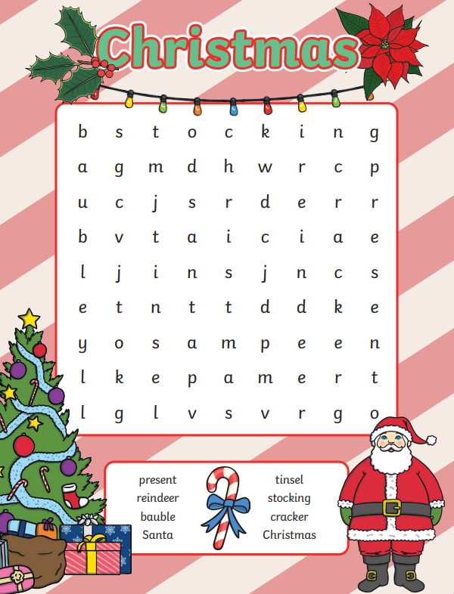
Morning Challenges:

Slide 3




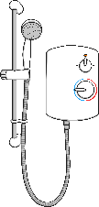


Which Stocking?
Santa needs some help putting the presents into the correct stocking.
Say the name of each object and listen to the initial sound to help you find the correct present for each stocking.
er
ch
ar
ai
air
oi
Click the presents to check if you are right.

Slide 4
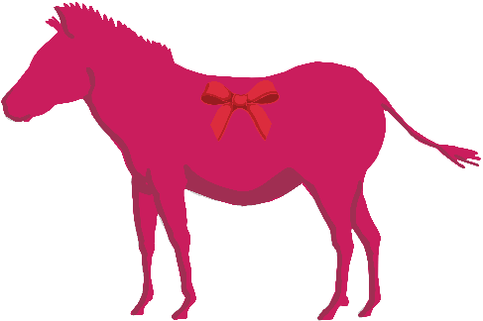






A Mighty Mix-Up
Oh no! The elves have muddled up all of the presents and labels.
Help to sort them out by reading each one. Click each label to check!
tent
spoon
zebra
bench
earrings
hairbrush
snail

Slide 5









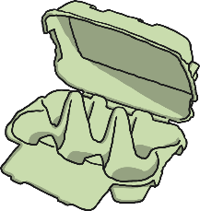
Make the Cake
Can you help Mrs Claus to make the Christmas cake?
The ingredients for the cake have real words on. Can you find them?
Click the ingredients to check if you are right.
stand
grap
link
cloip
drink
powb
jump
fresh
peshing
kearger
maich

Slide 6
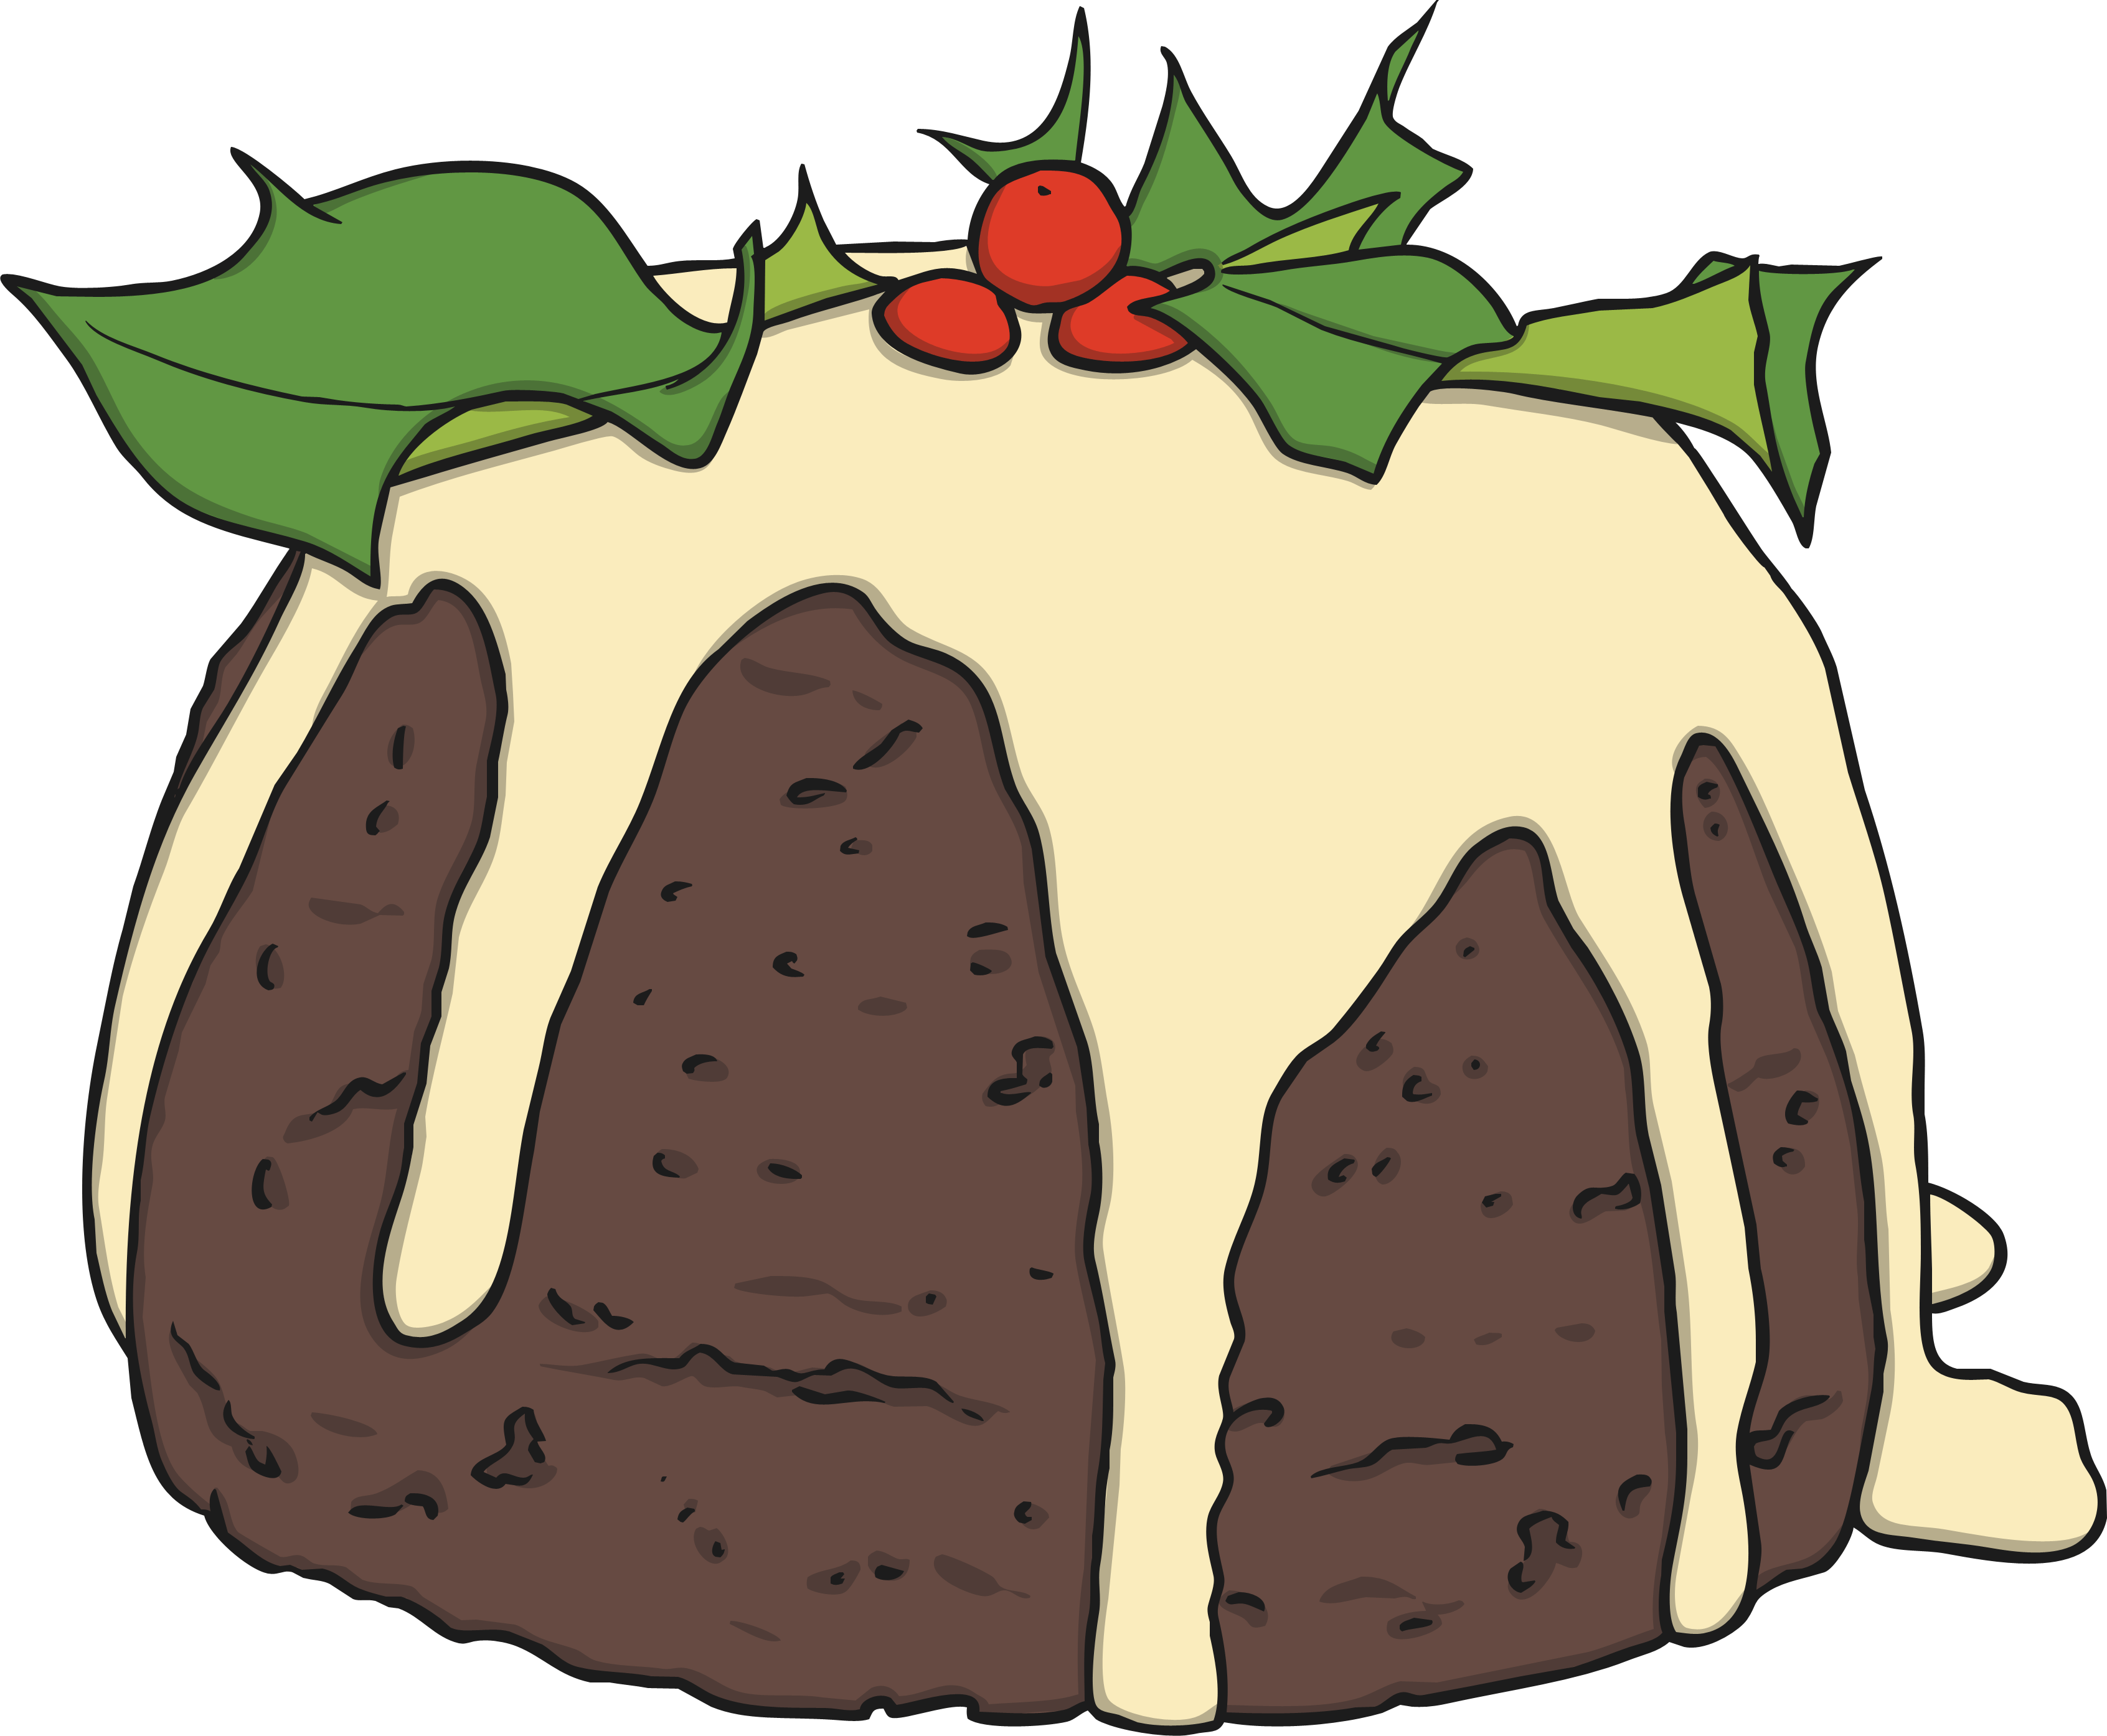

Click on the Christmas puddings to find hidden elves and words to read.
Hidden Elves
were
lift
sixth
crush
burnt

Slide 7
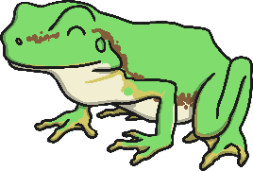








Robbie the Reindeer
Robbie the Reindeer likes to collect things that have the ‘r’ sound.
Sound out the names of each object, then find all of the ones that have this sound. Click on the pictures you think belong to Robbie to check if you are correct.
r

Slide 8
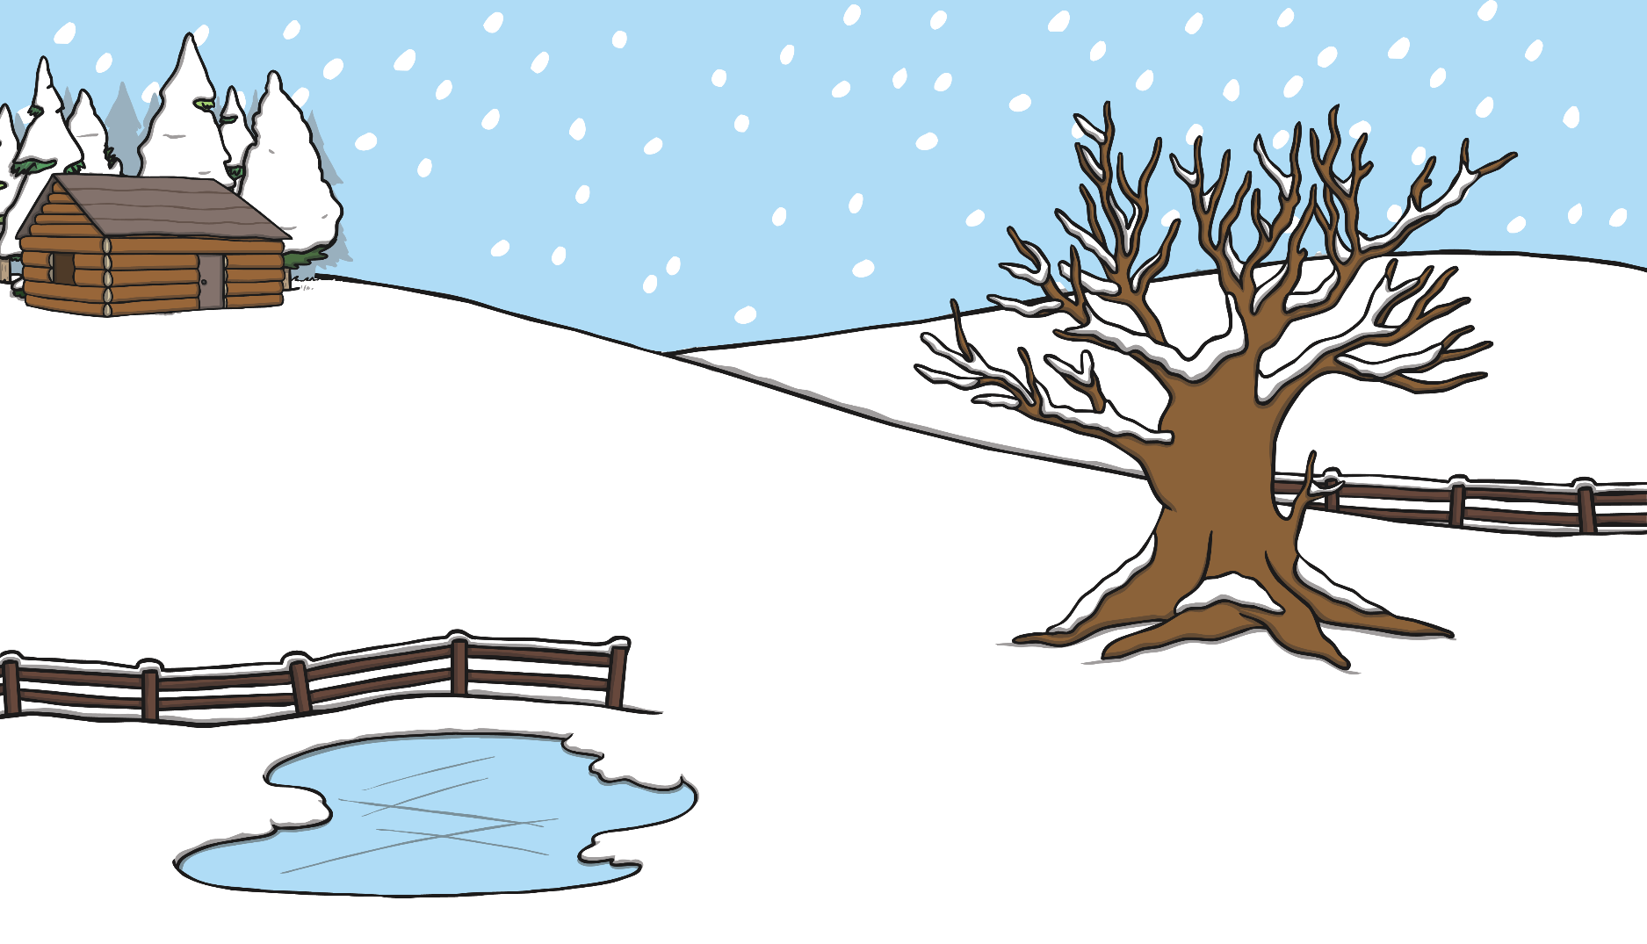





Help Santa
Help Santa to read and answer the questions on his way to the cabin. Click on the signposts in order when you have read them.
Did a shark ever jump up a tree?
Are you afraid of thunderstorms?
Is the moon green?

Slide 9


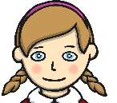





Sorting Snowmen
Help to sort out the snowmen’s words.
Say each word, listening carefully to the sounds. Which picture do they need to match with? Click each object to check if you were correct.
driftwood
melting
star
swim
pond
blink

Slide 10


Spell the Words

Slide 11
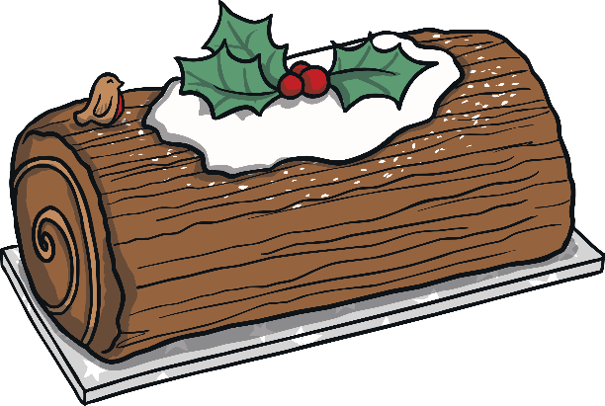




Read the words…
chicken
spot
out
thank
next

Slide 12





A Letter to Father Christmas
Help Amber to spell the words in her Christmas list.
Click each picture to check!
Dear Father Christmas,
I have been a very good girl. These are the things I would like for Christmas:
hamster
snail
chair
helmet
Thank you very much. I will leave you a drink and a mince pie and some carrots for the reindeer.
Lots of love,
Amber

Slide 13

Christmas cards inserts
Who is your card being sent to?
What message could you write?
Sign your name beautifully at the bottom.

Slide 14
TBAT: retell a story.
3 in 3
Where should the full stops go?
Father Christmas visited the house He left presents
The sleigh flew into the sky Father Christmas said, “Merry Christmas!”
Twas the Night Before Christmas Animation Story - Twinkl

Slide 15
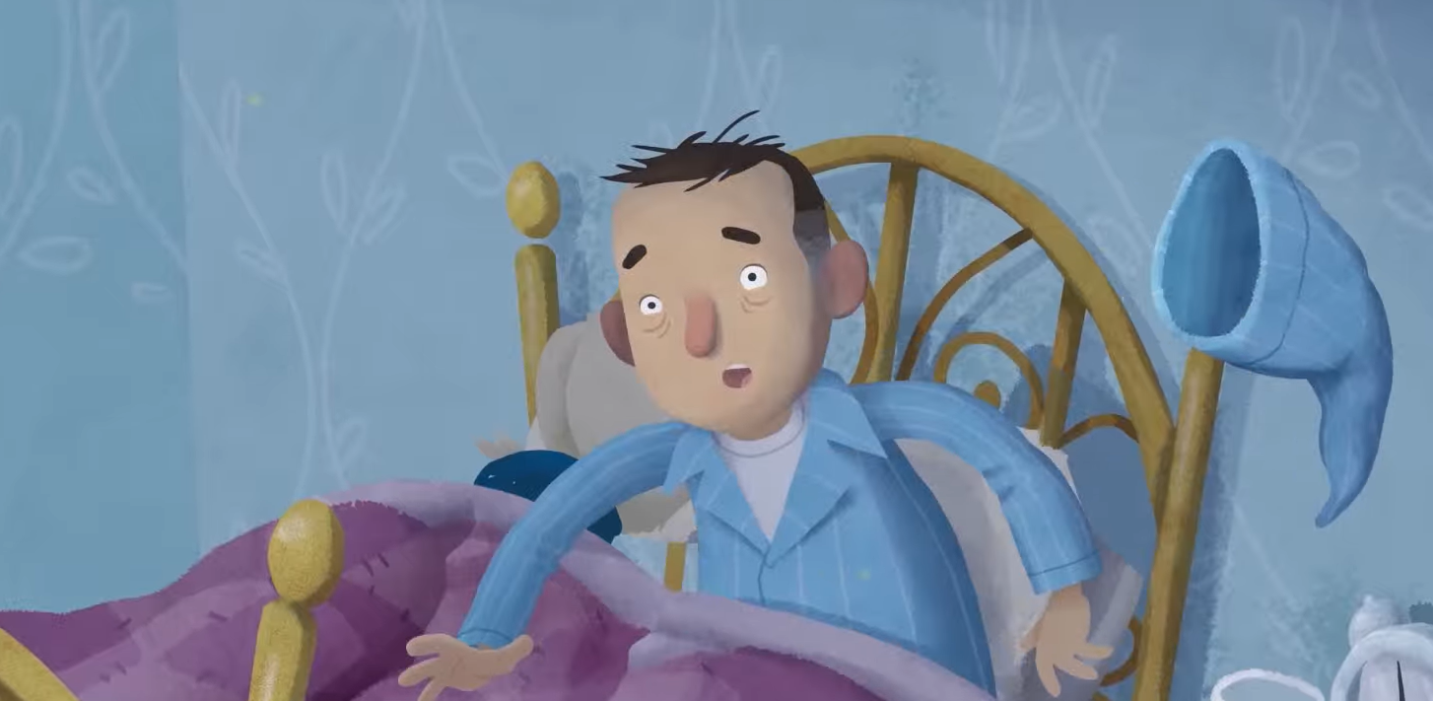
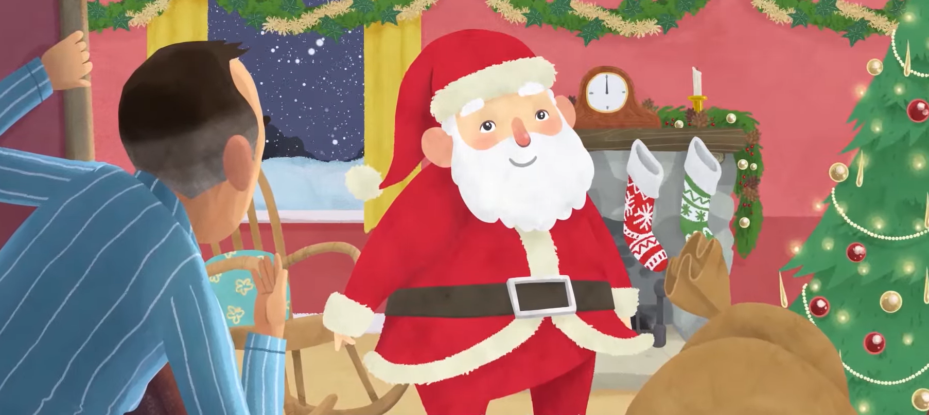
Today we will retell the story of ‘Twas the night before Christmas’
TBAT: retell a story.
Blue / Green
How do you think the man is feeling at these points in the story? Why?
I think he is feeling… because…

Slide 16
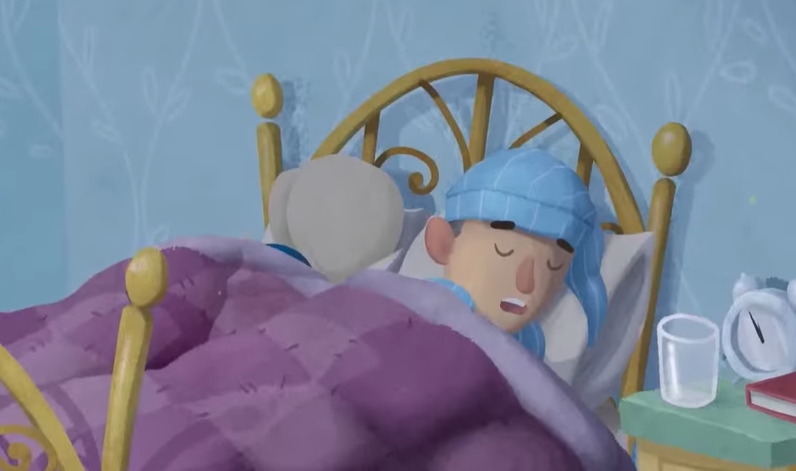
TBAT: retell a story.
What sentence can you think of to say what is happening at the beginning of the story?

Slide 17
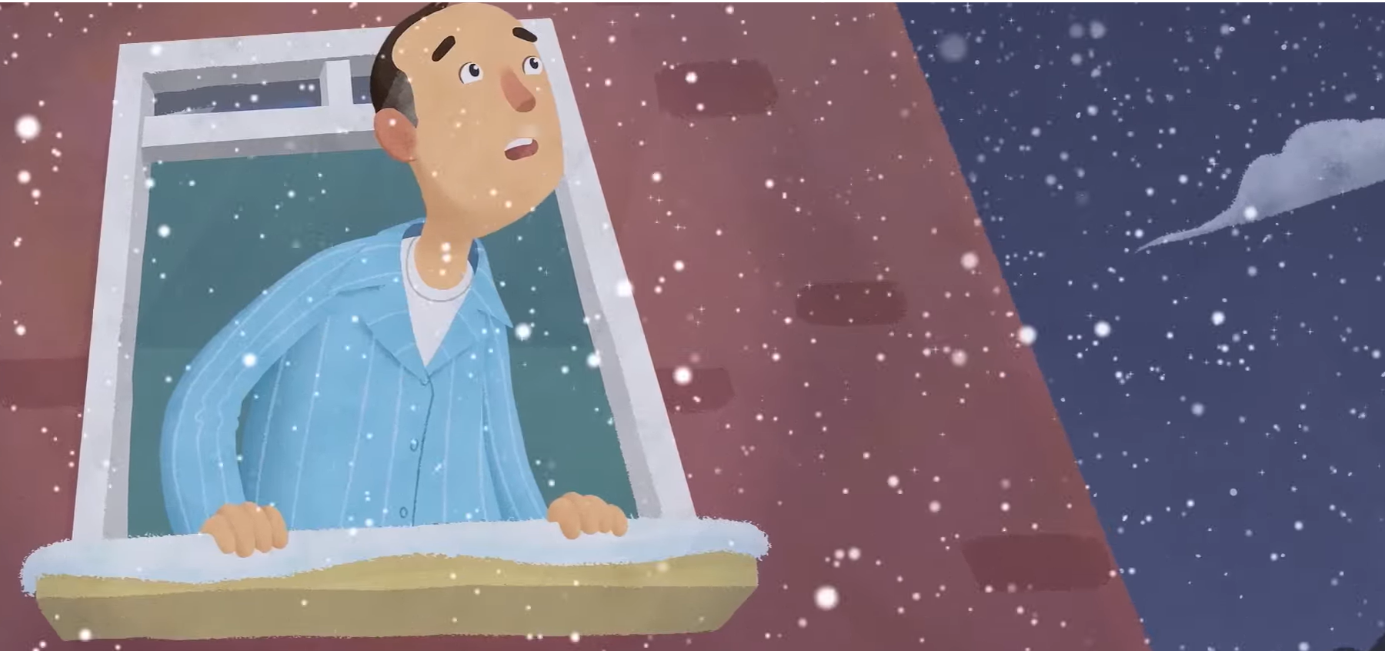
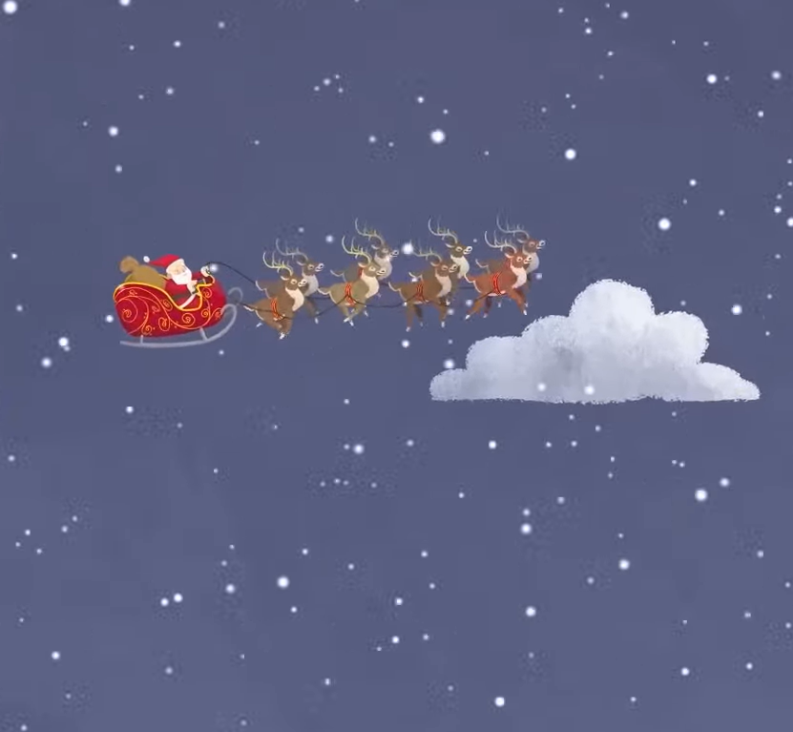
TBAT: retell a story.
Think of a sentence to say what happens next.

Slide 18
Think of a sentence to say what happened after that.
TBAT: retell a story.

Slide 19
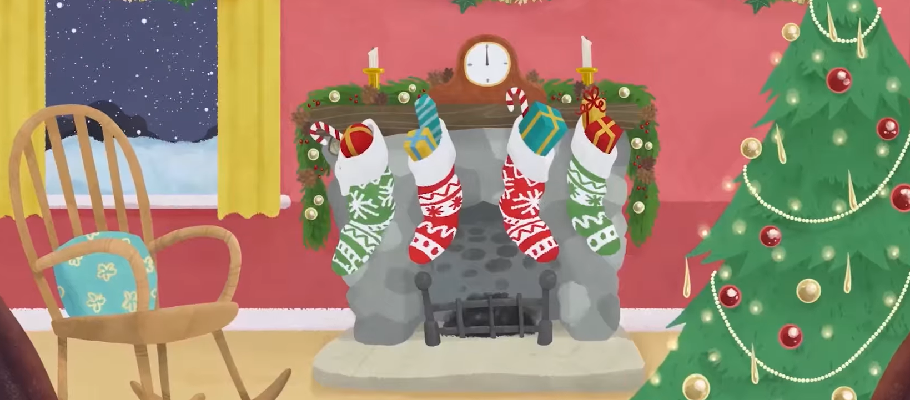
What happened next?
TBAT: retell a story.

Slide 20
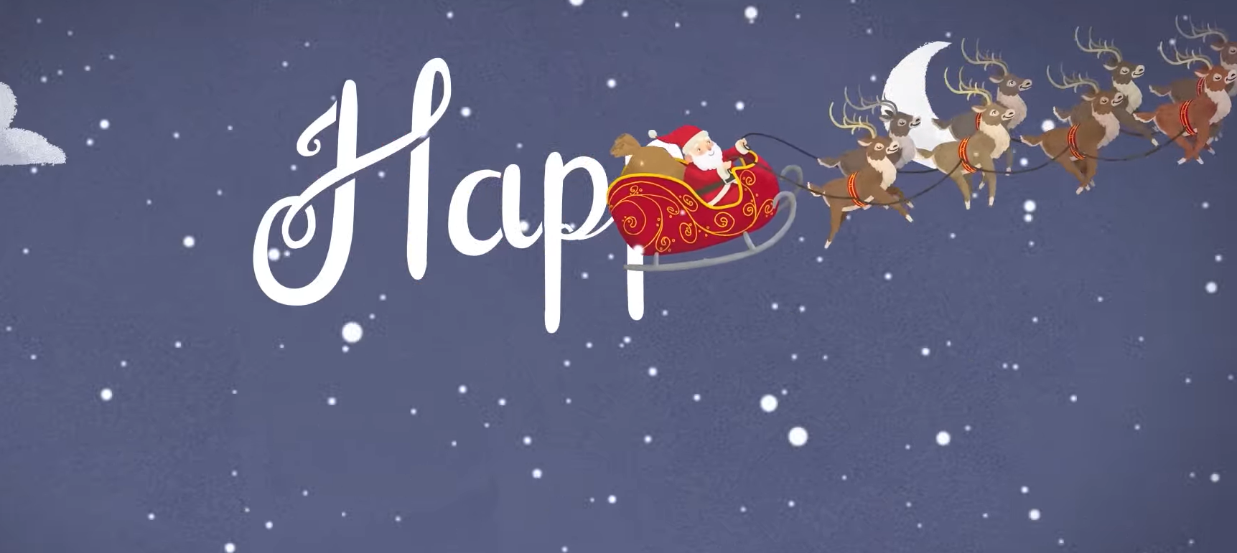
Think of a sentence to say what happened at the end.
TBAT: retell a story.

Slide 21
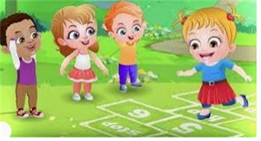
Break

Slide 22

Lunch

Slide 23
3 in 3 What were the names of the brothers who created the first engine powered plane? Wright brothers Wrong brothers What was the first type of air craft? hot air balloon glider How long did the first engine powered flight last? 12 minutes 12 seconds
KQ: How have humans travelled in space?

Slide 24
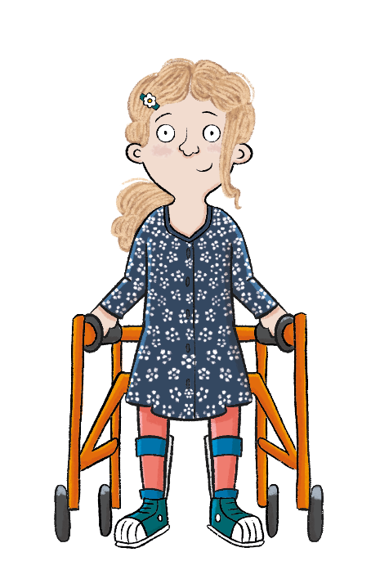
KQ: How have humans travelled in space?
Lesson 10:
In this lesson, we are finding out how far humans have travelled in space.
Notes:
Introduction: Share the lesson statement and key term. Then share key knowledge and other key vocabulary with pupils—you may want to add images to the teaching slides to support exemplification and understanding of these words. Before the content of the lesson begins, look again at the Transport timeline additional resource with pupils.

Slide 25
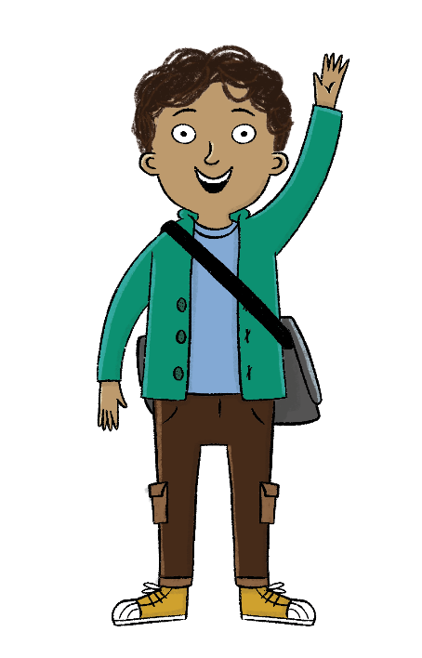
KQ: How have humans travelled in space?
Lesson 10:
The key term for this lesson is
spacecraft.
A spacecraft is a vehicle that travels in space.

Slide 26
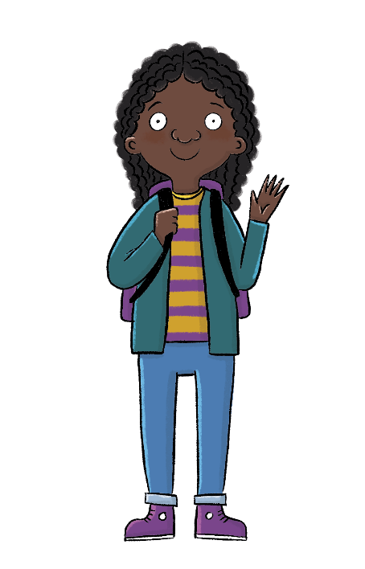
How have humans travelled in space?
Lesson 10:
Neil Armstrong became the first person to step onto the Moon in 1969.
Scientists sent a buggy, called a rover, to take videos of Mars.
Scientists are working hard to send humans to Mars one day.
scientists
space
spacecraft

Slide 27
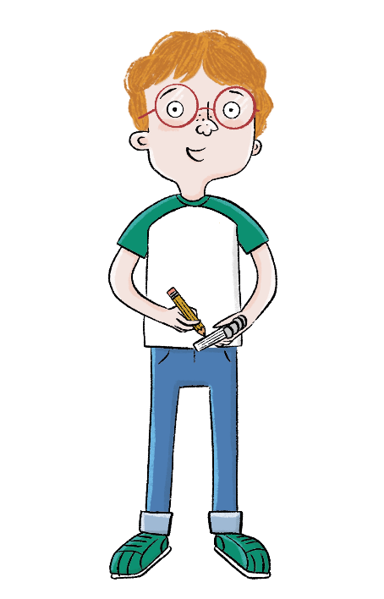
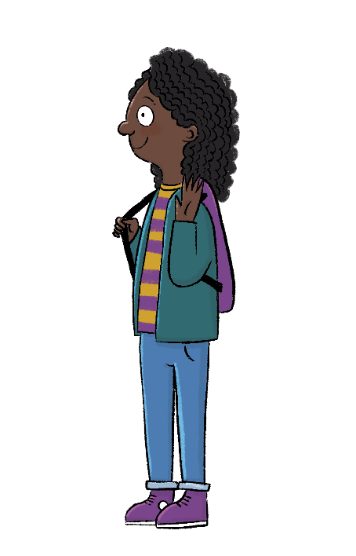
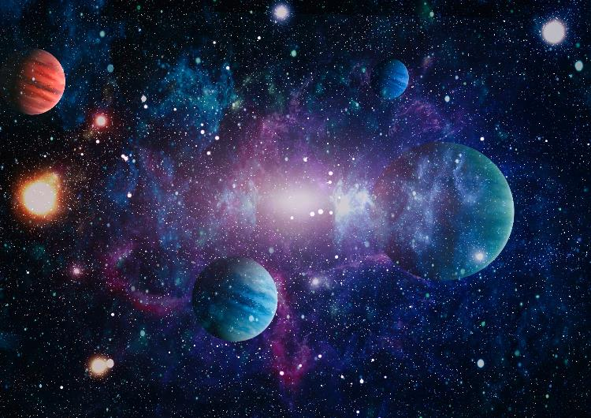
KQ: How have humans travelled in space?
Lesson 10:
Blue / Green
Where is this?
How would you travel there?
Would you want to travel there?
Notes:
Talk task: Ask pupils to discuss the questions: ‘Where is this?’ with their partner. Take feedback as a class. Then ask pairs to discuss: ‘How would you travel there?’. Open up ideas with the whole class, then look back to the unit timeline and point out when space rockets were first invented.

Slide 28
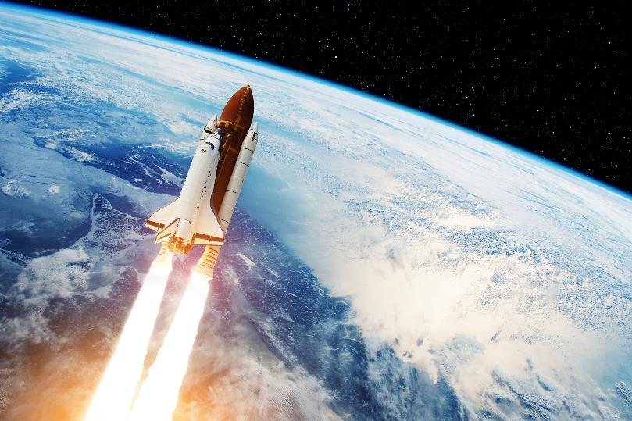
Space travel over time
KQ: How have humans travelled in space?
Lesson 10:
Over time, space travel has got better and better.
Spacecrafts are travelling further and further away from Earth.
Notes:
Read: ‘Space travel over time’ slides which explain the early developments in space travel. Discuss with pupils how it took a very long time to design a spacecraft that was able to travel to the Moon, and even longer to ensure humans were safe to travel inside.

Slide 29
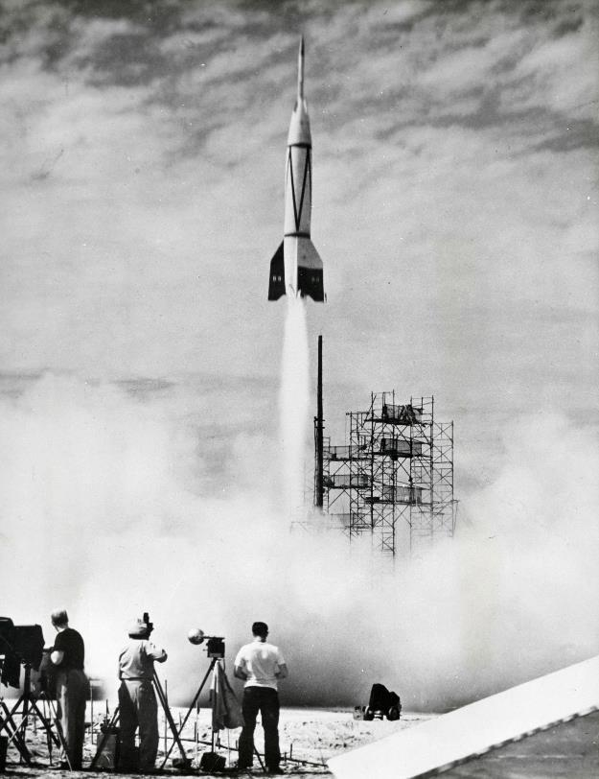
Space travel over time
KQ: How have humans travelled in space?
Lesson 10:
The first space rocket entered space in 1942.
It didn’t land anywhere, and nobody was inside.
In 1961, the first spacecraft travelled into space with a human passenger on board.

Slide 30
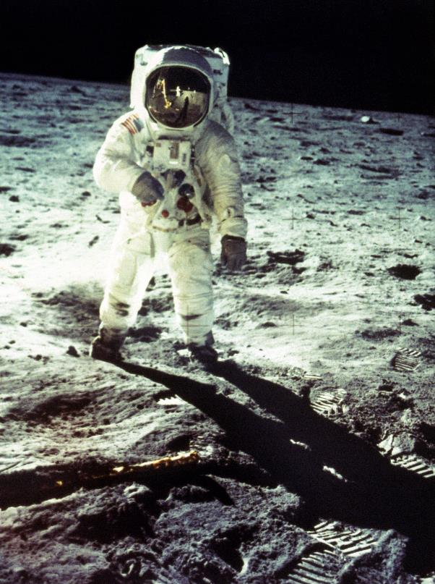
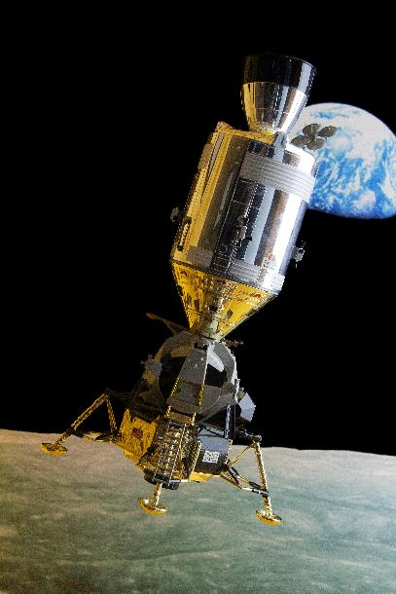
Space travel over time
KQ: How have humans travelled in space?
Lesson 10:
In 1969, an American called Neil Armstrong became the first person to stand on the Moon.

Slide 31
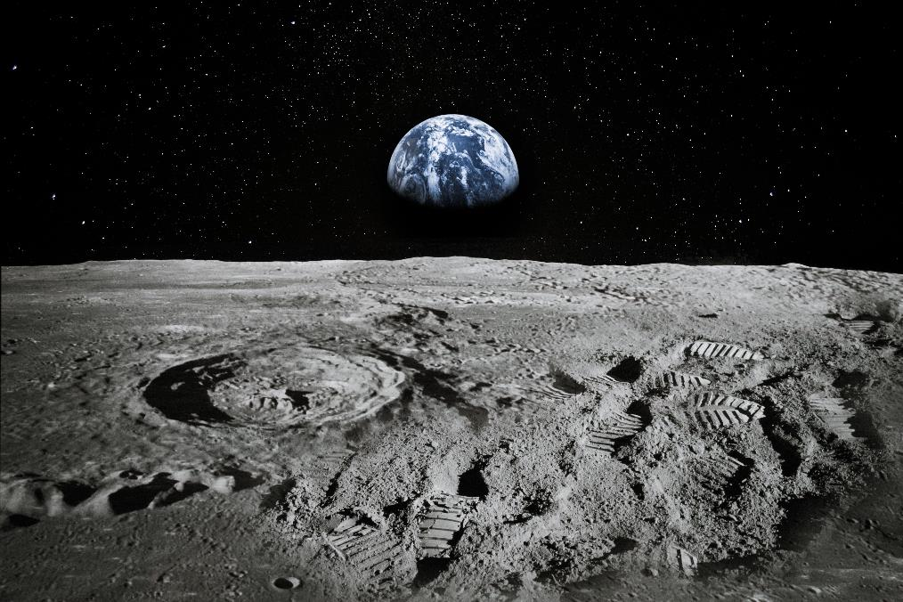
KQ: How have humans travelled in space?
Lesson 10:
Blue / Green
How do you think he felt being the first person on the Moon?
Why?
WATCH: Footage from the 1969 Apollo 11 moon landing
Notes:
Talk task: Ask pupils to answer the questions: ‘How do you think Neil Armstrong felt being the first person on the Moon?’ and ‘Why?’ with their partners. Show pupils a video of the first landing on the Moon on the NASA website: https://www.nasa.gov/mission_pages/apollo/videos (Oxford University Press is not responsible for content available on third-party websites. The content of these websites may have changed since publication). Ask: ‘How do you think people felt watching this?’

Slide 32
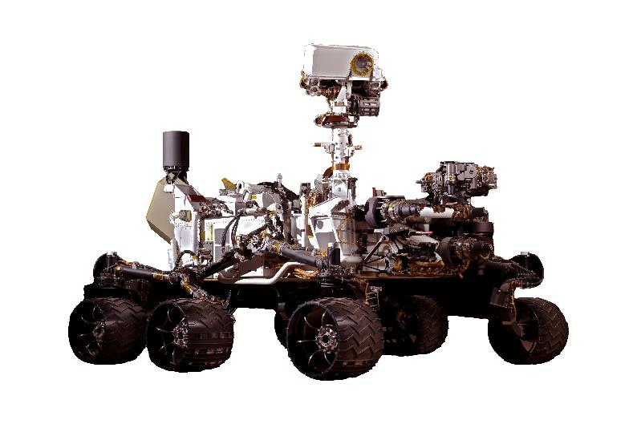
Space travel over time
KQ: How have humans travelled in space?
Lesson 10:
In 2021, a spacecraft landed on Mars. A little buggy, called a rover, was sent out from the spacecraft. The rover sent a video back to Earth.
Nobody was inside the rover, but scientists are working hard so that one day humans will land on Mars.
Notes:
Read: ‘Space travel over time’ slides. This section explores modern space travel. You may wish to ask pupils how far they think humans or spacecrafts have travelled from Earth before reading through the information. After reading, you could ask pupils questions such as: ‘Has a human landed on Mars yet? Why not?’ and ‘Why do you think scientists want to explore Mars?’.

Slide 33
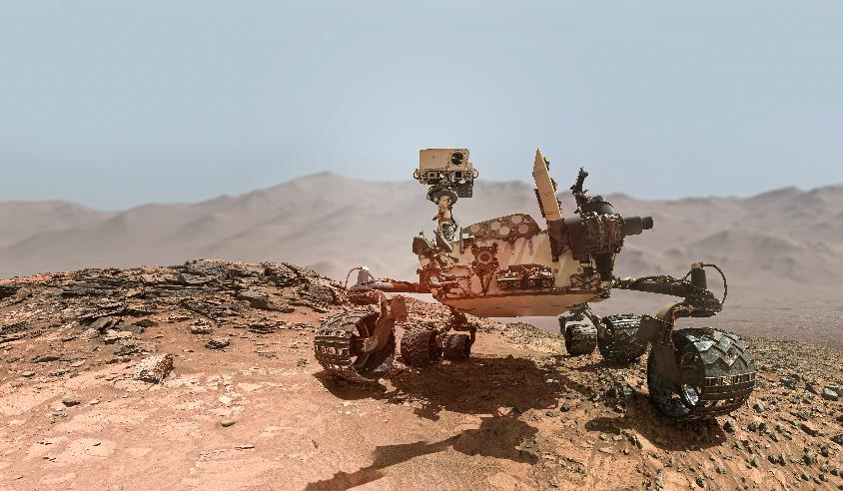
KQ: How have humans travelled in space?
Lesson 10:
What does Mars look like?
What do you think the weather is like there?
Notes:
Talk task: Ask pupils to discuss the questions: ‘What does Mars look like?’ and ‘What do you think the weather is like there?’ with their partners. Pupils may liken Mars to a desert or beach because of the sandy looking ground. This may mean they also believe that Mars is warmer than Earth and you should explain that Mars is actually further away from the Sun than the Earth, meaning it’s colder. Use a picture of the Solar System to illustrate this point.

Slide 34
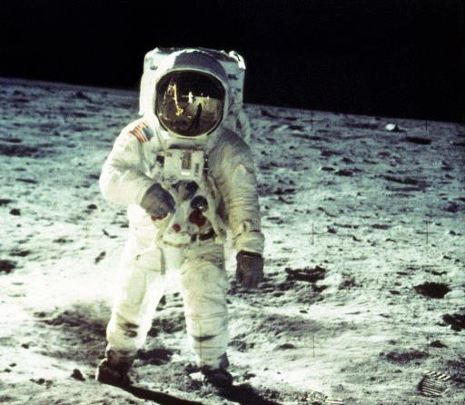
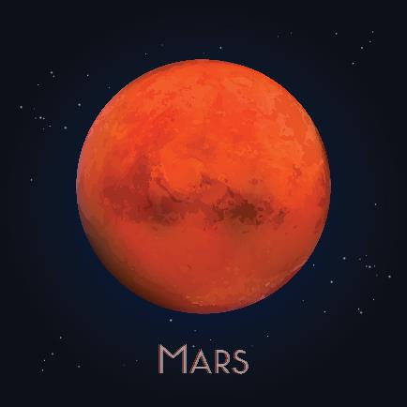
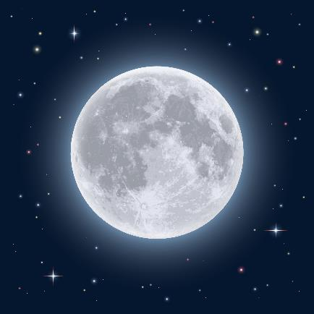
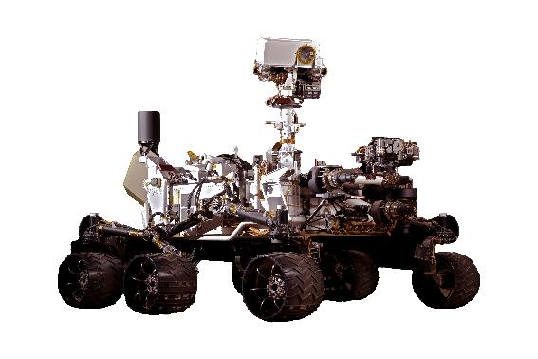
Draw lines to show who landed where.
KQ: How have humans travelled in space?
Lesson 10:
Mars
Moon
Notes:
Write: Pupils should complete the activity in their Workbooks by matching the images to show who landed on what. You may wish to talk through the images and their names as a class before pupils begin. To challenge pupils, see if they can remember the names for each of the ‘who’ images and label them.

Slide 35
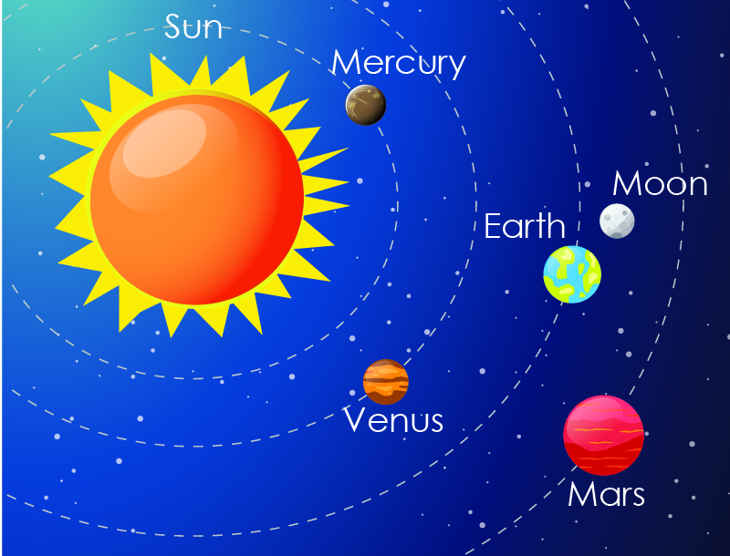
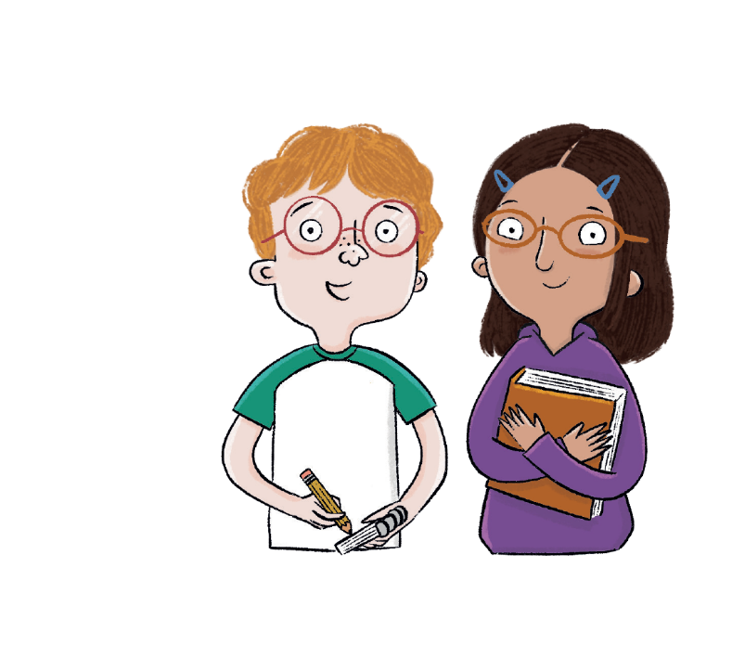
How have humans travelled in space?
KQ: How have humans travelled in space?
Lesson 10:
Where have humans explored in space?
Notes:
Learning review: Using the teaching slides, talk partners tell each other a response to the questions. Add further review questions if you wish to.

Slide 36
KQ: How have humans travelled in space?
Lesson 10:
Knowledge quiz
The first rocket entered space in _______.
1942 1972
Who was the first person to walk on the Moon?
Neil Armstrong Amy Johnson
What sent a video of Mars back to Earth?
a rover a person
People have travelled to Mars. True or false?
true false
Notes:
Knowledge quiz 2.10: Pupils complete this in the Additional resource: Knowledge quizzes booklet to assess their knowledge retention from this lesson. They write their score in the chart also provided in the additional resource.

Slide 37

How have humans travelled in space?
Lesson 10:
Neil Armstrong became the first person to step onto the Moon in 1969.
Scientists sent a buggy, called a rover, to take videos of Mars.
Scientists are working hard to send humans to Mars one day.
scientists
space
spacecraft

Slide 38

How has transport changed over time?
Notes:
Enquiry question: Pupils should now respond to the enquiry question: How has transport changed over time? This could be in the form of an extended piece of writing, an oral presentation, an annotated poster, or another format of your choice which best suits your class. For further information to help support pupils to answer the main enquiry question, please refer to the Enquiry Question Teacher Support document.

