Slide 1
Monday 8th December 2025

Slide 2


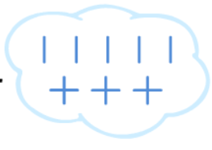

Morning Challenges:
Name writing
N O P Q R S T UV W X Y Z

Slide 3
TBAT: Review /oo/ /yoo/ sounds and split digraphs
Monday 8th December 2025

Slide 4










Monday 8th December 2025

Slide 5




Monday 8th December 2025

Slide 6
TBAT: Review /oo/ /yoo/ sounds and split digraphs
Monday 8th December 2025
Sort by phoneme ‘u’
music
human
stupid
jumping
trunk
pumpkin

Slide 7
prize
TBAT: Review /oo/ /yoo/ sounds and split digraphs
Monday 8th December 2025

Slide 8
slide
TBAT: Review /oo/ /yoo/ sounds and split digraphs
Monday 8th December 2025

Slide 9
even
TBAT: Review /oo/ /yoo/ sounds and split digraphs
Monday 8th December 2025

Slide 10
crawl
TBAT: Review /oo/ /yoo/ sounds and split digraphs
Monday 8th December 2025

Slide 11
brownie
TBAT: Review /oo/ /yoo/ sounds and split digraphs
Monday 8th December 2025

Slide 12
cute
TBAT: Review /oo/ /yoo/ sounds and split digraphs
Monday 8th December 2025

Slide 13
stone
TBAT: Review /oo/ /yoo/ sounds and split digraphs
Monday 8th December 2025

Slide 14
rescue
TBAT: Review /oo/ /yoo/ sounds and split digraphs
Monday 8th December 2025

Slide 15
blue
TBAT: Review /oo/ /yoo/ sounds and split digraphs
Monday 8th December 2025

Slide 16
blew
TBAT: Review /oo/ /yoo/ sounds and split digraphs
Monday 8th December 2025

Slide 17
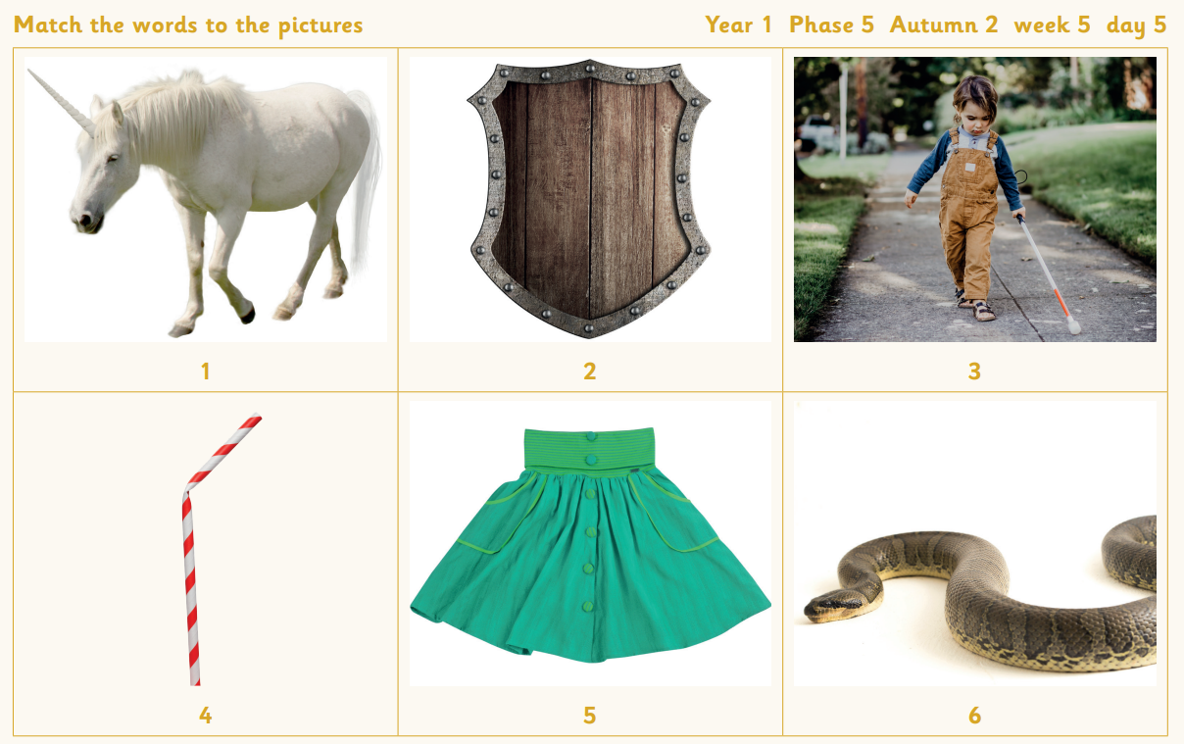
skirt unicorn child snake shield straw
TBAT: Review /oo/ /yoo/ sounds and split digraphs
Monday 8th December 2025

Slide 18

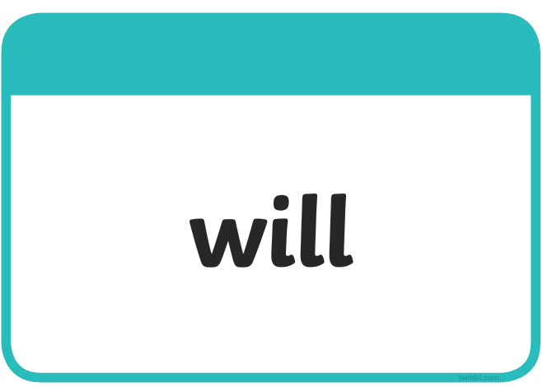


TBAT: Review /oo/ /yoo/ sounds and split digraphs
Monday 8th December 2025
water
want
pure
sure

Slide 19






TBAT: Review /oo/ /yoo/ sounds and split digraphs
Monday 8th December 2025

Slide 20





TBAT: Review /oo/ /yoo/ sounds and split digraphs
Monday 8th December 2025

Slide 21




TBAT: Review /oo/ /yoo/ sounds and split digraphs
Monday 8th December 2025

Slide 22






TBAT: Review /oo/ /yoo/ sounds and split digraphs
Monday 8th December 2025
sh

Slide 23


write
TBAT: Review /oo/ /yoo/ sounds and split digraphs
Monday 8th December 2025

Slide 24
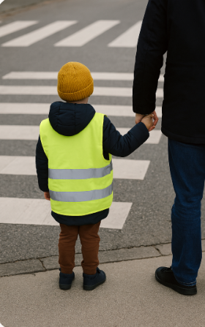
KQ: Can I keep safe around strangers?
Monday 8th December 2025
3 in 3 – Name three things this child is doing to keep themselves safe by the road.

Slide 25

KQ: Can I keep safe around strangers?
Monday 8th December 2025
What is a stranger?

Slide 26

KQ: Can I keep safe around strangers?
Monday 8th December 2025
Blue/Green
What do you already know about if a stranger asks you to go with them?
Who should you find if you get lost?

Slide 27




Slide 28
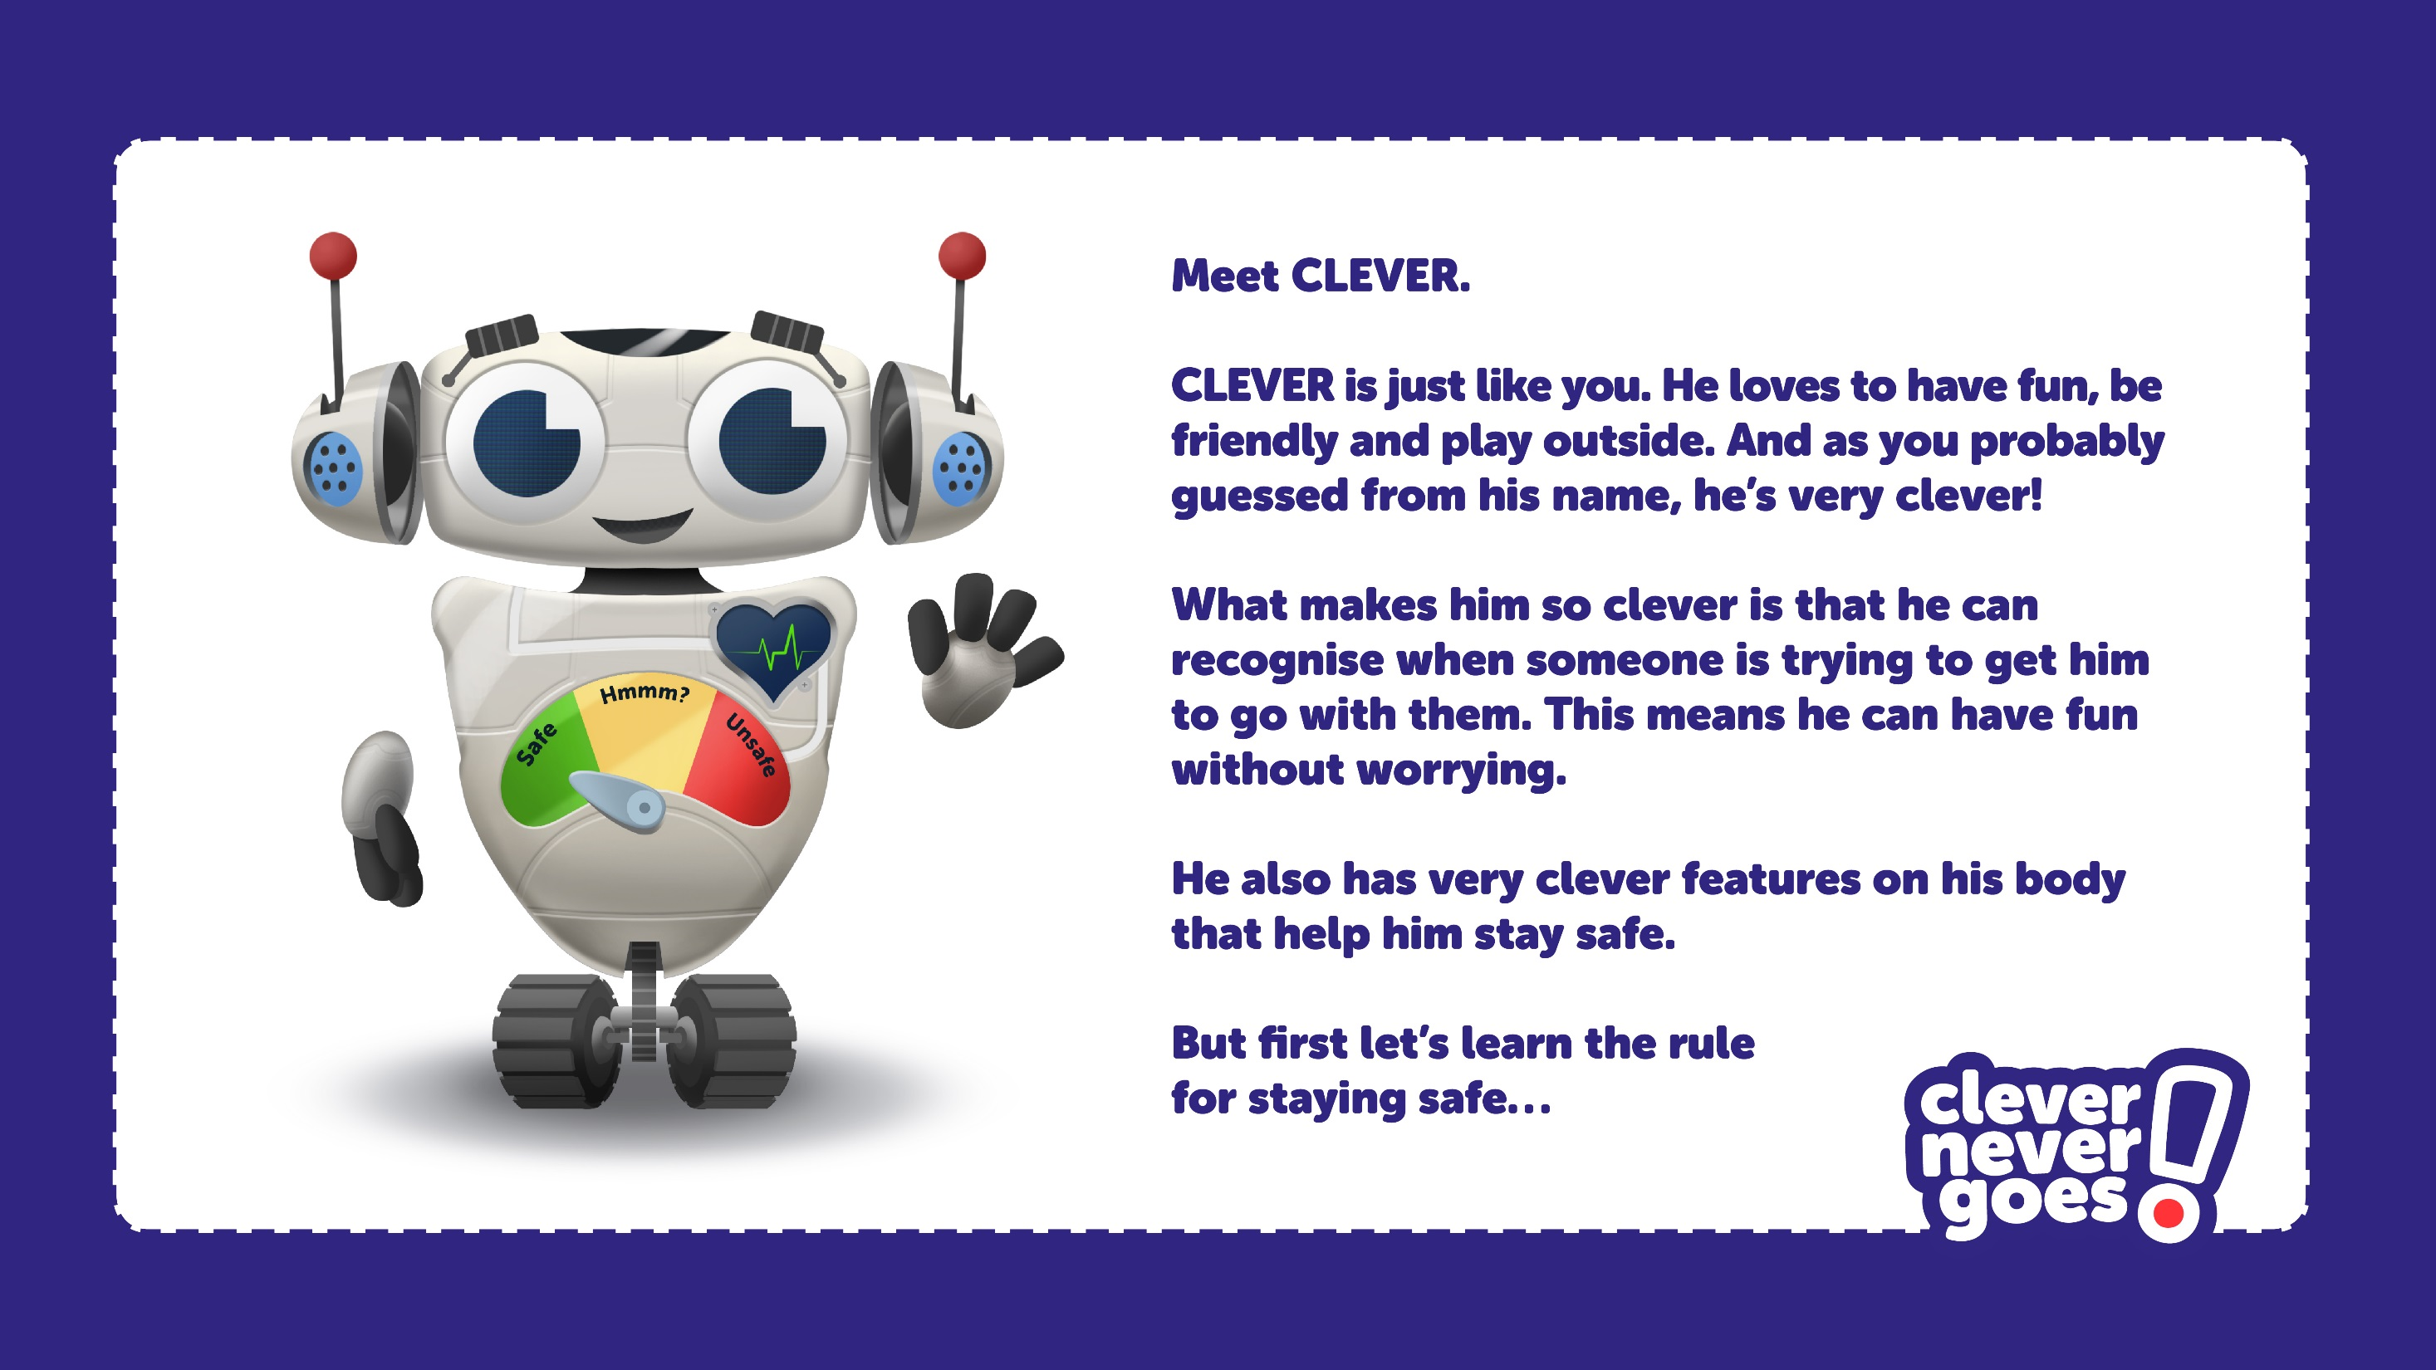

Slide 29


Slide 30
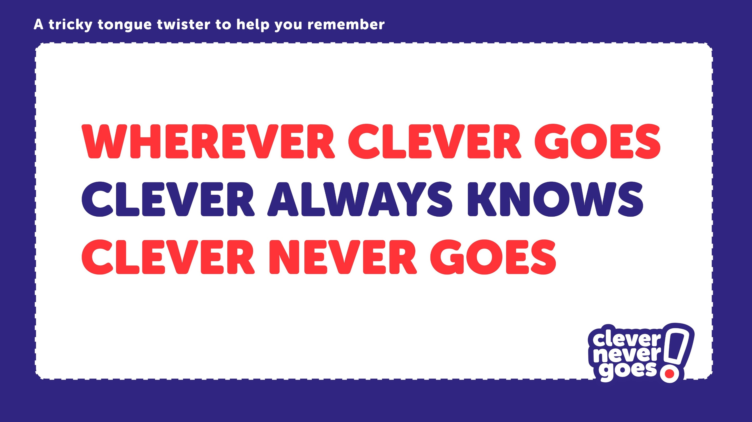

Slide 31

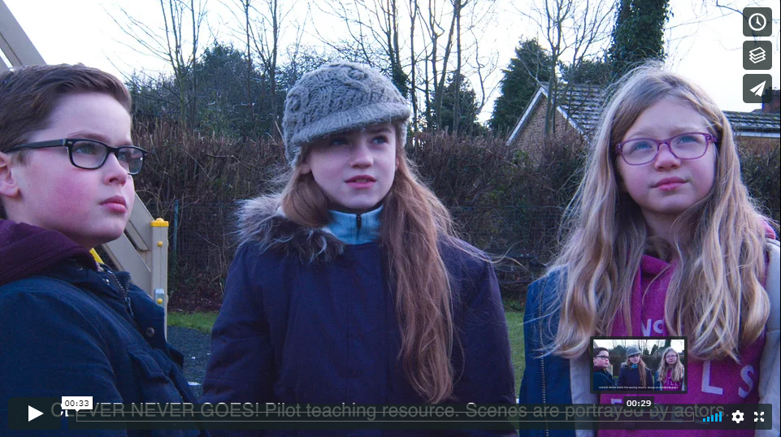
Click on the image or go to: https://vimeo.com/272919654
to play the first “Go-Spotting” film.
The film is password protected (password = “clever”).

Slide 32
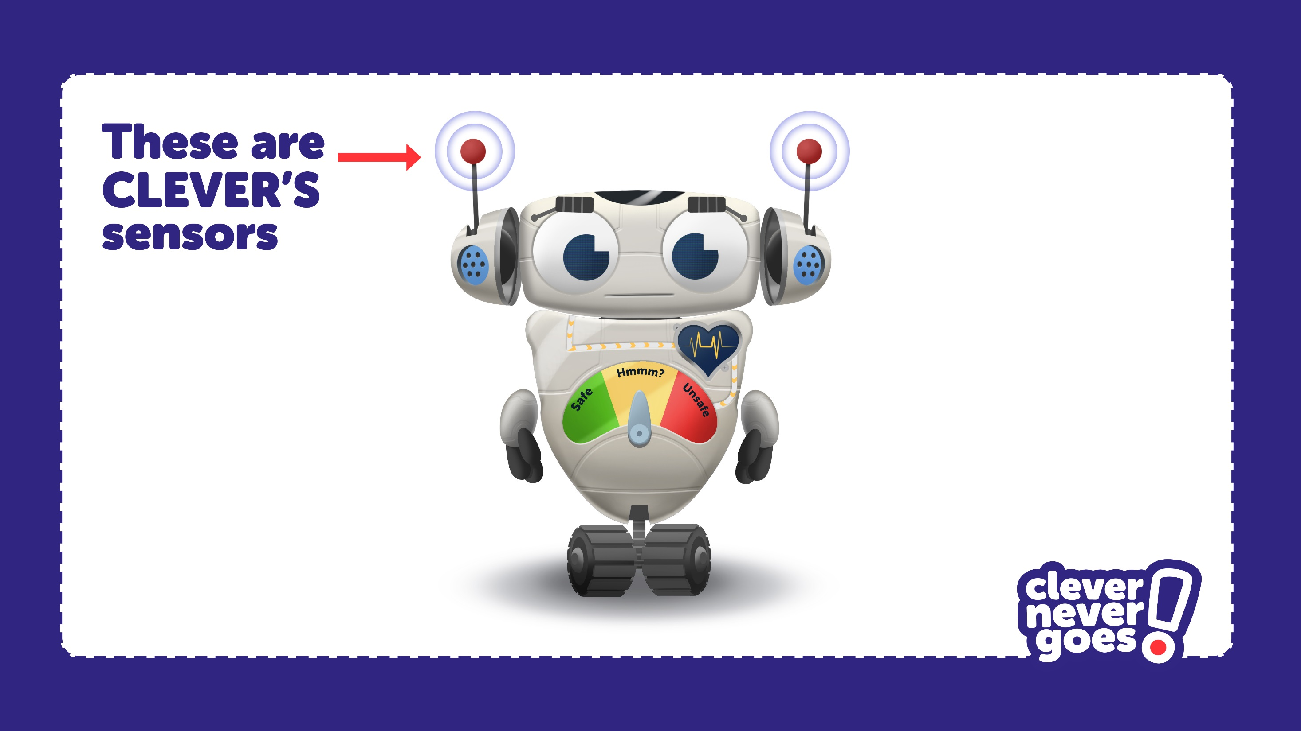

Slide 33
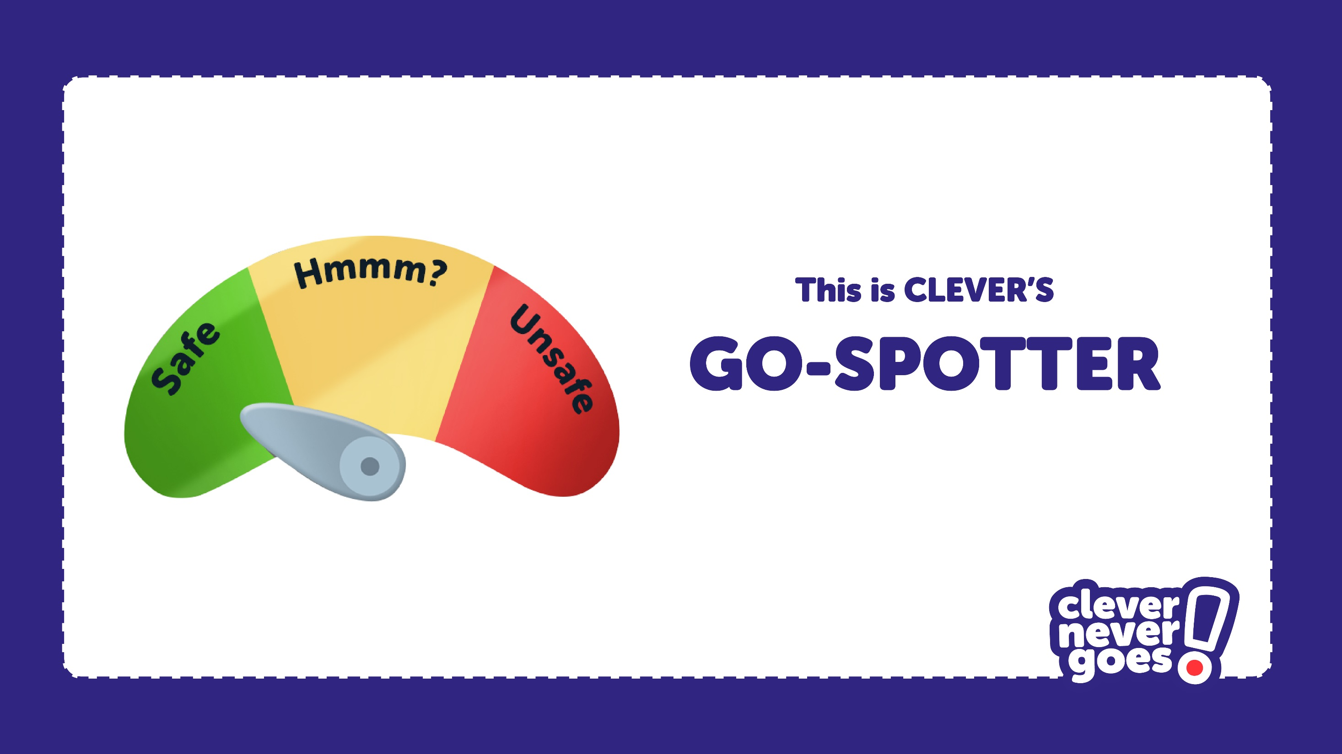

Slide 34
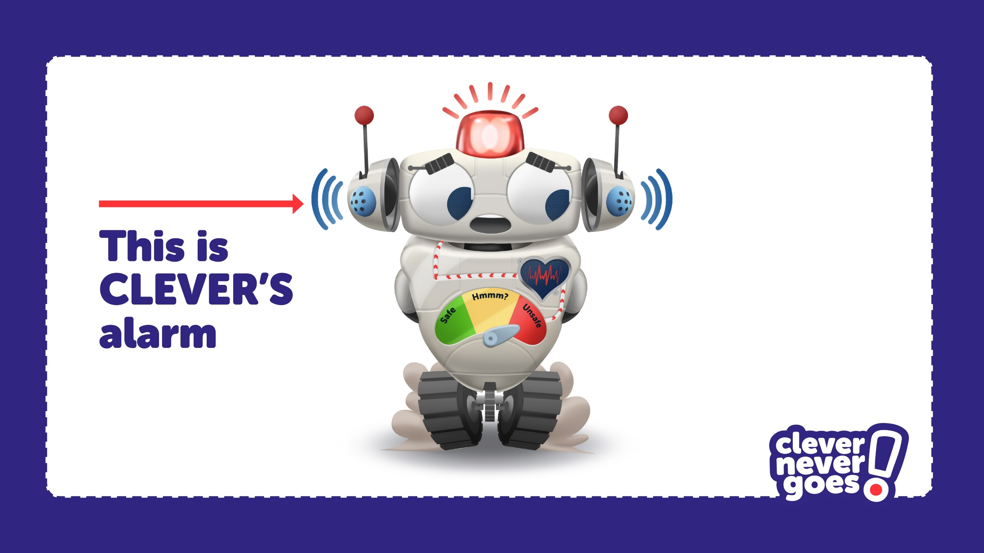

Slide 35
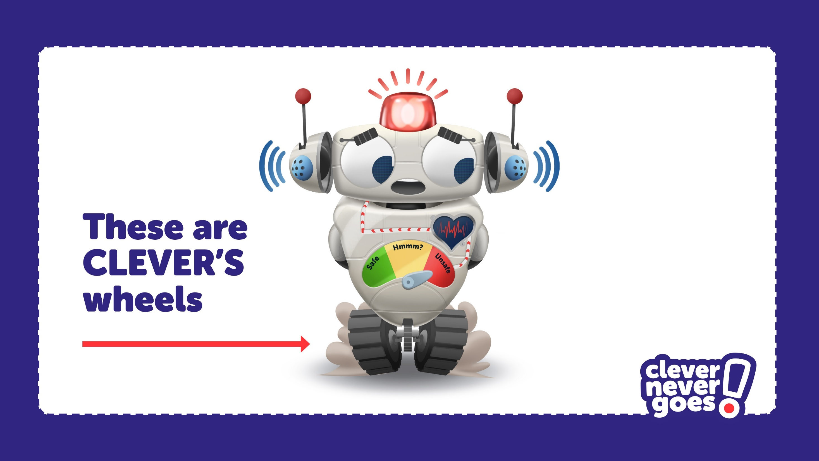

Slide 36
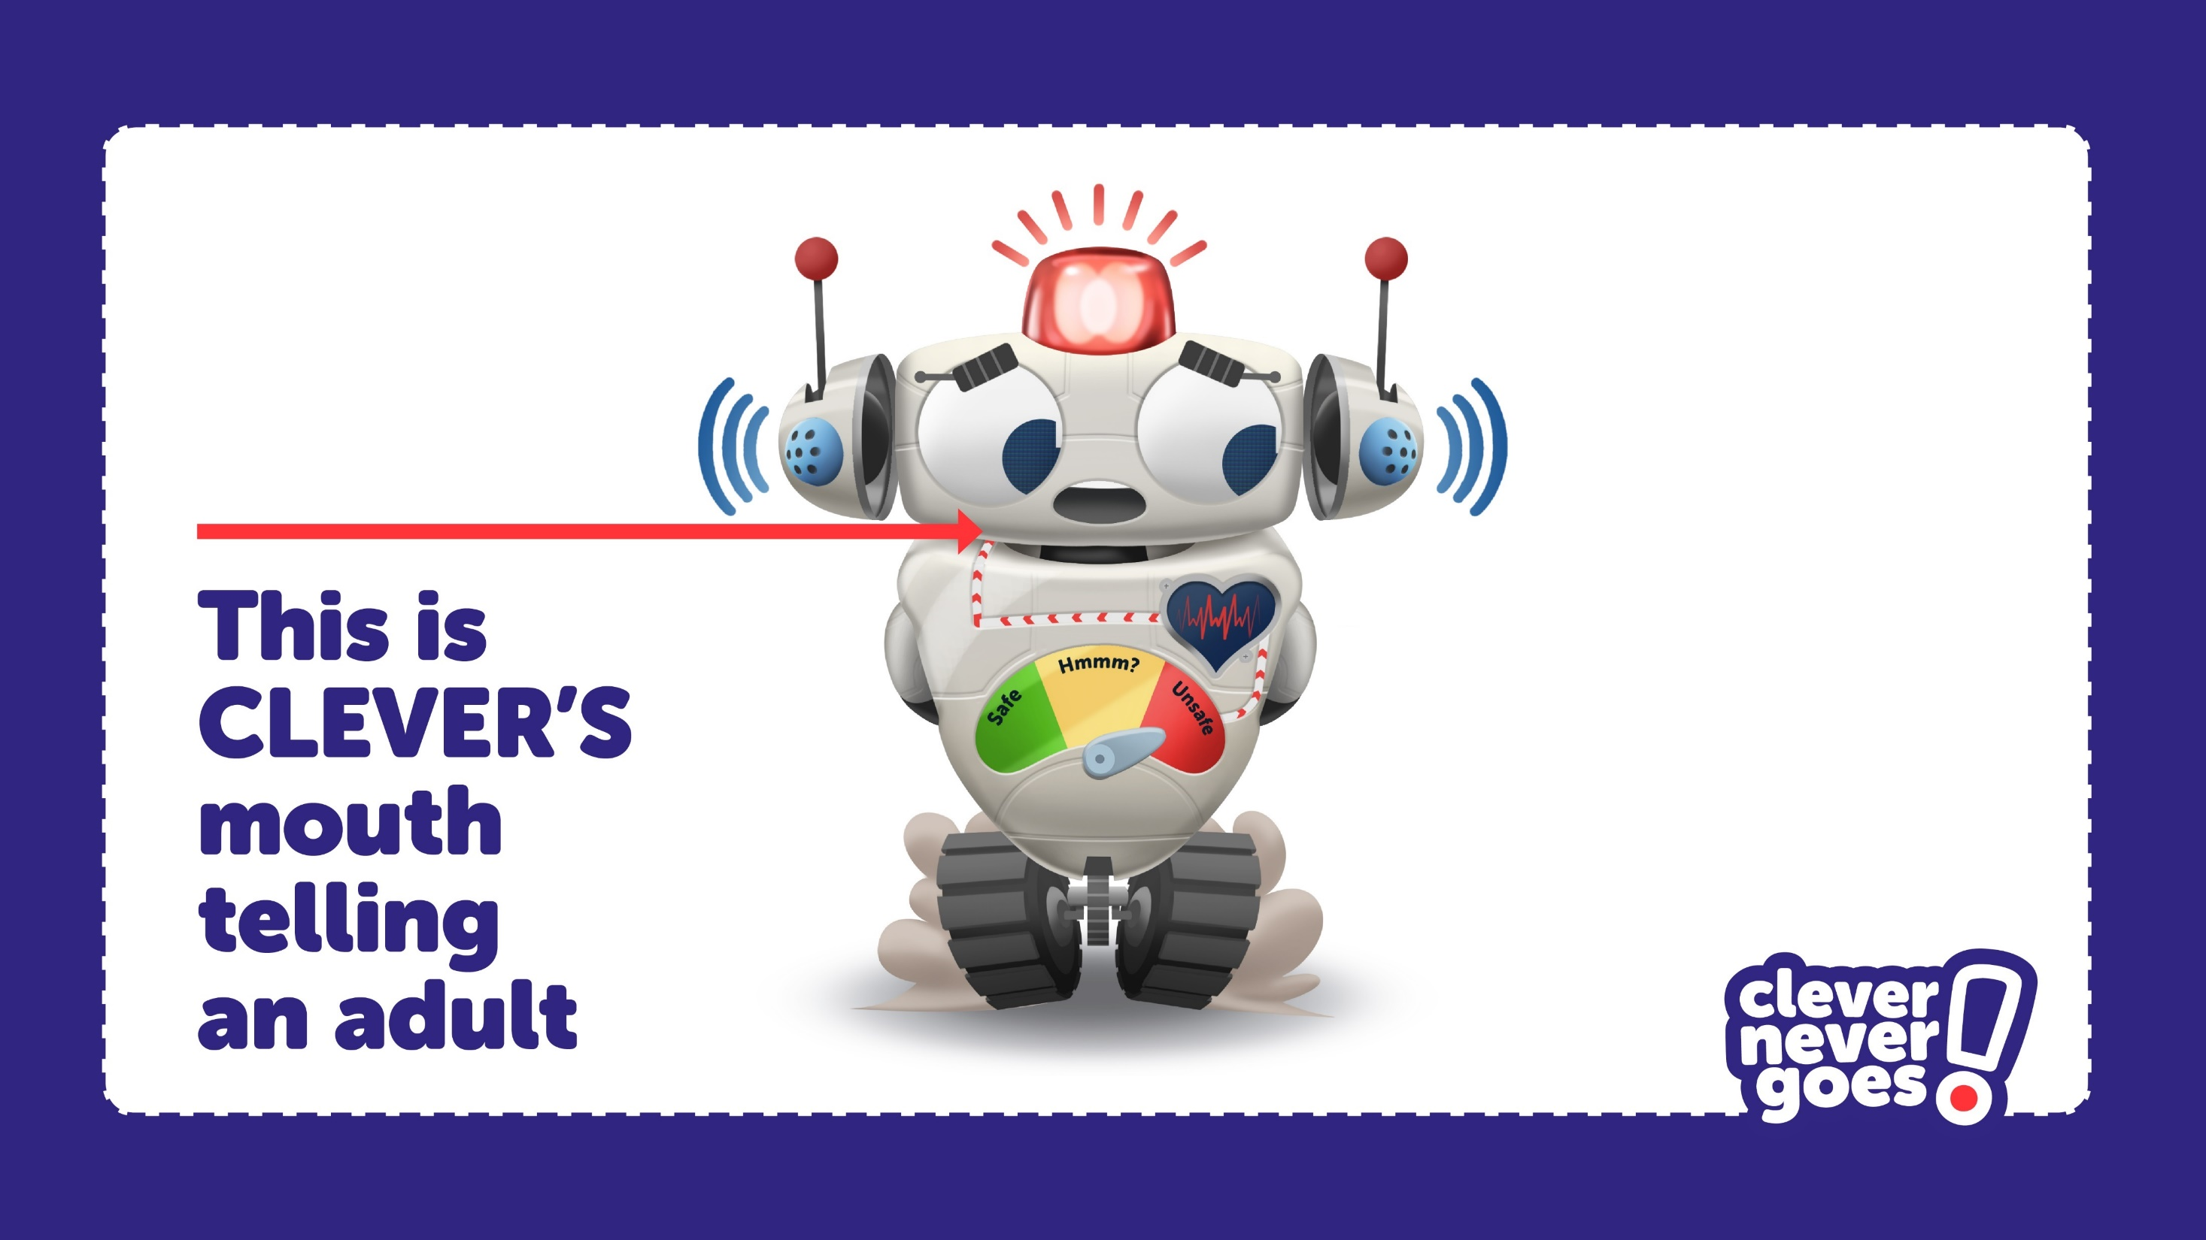

Slide 37
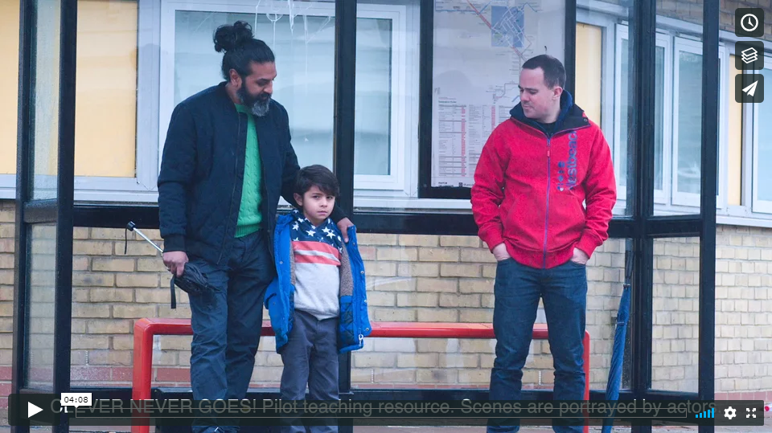
Click on the image or go to: https://vimeo.com/272920337
to play all 8 “Go-Spotting” films.
The film is password protected (password = “clever”).

Slide 38

What should you do if a stranger tries to get you to go with them?

Slide 39
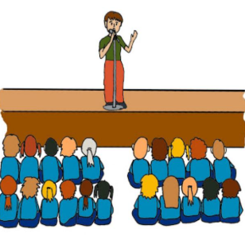
Assembly

Slide 40
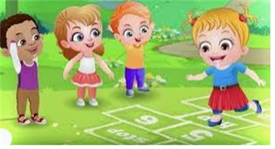
Break

Slide 41
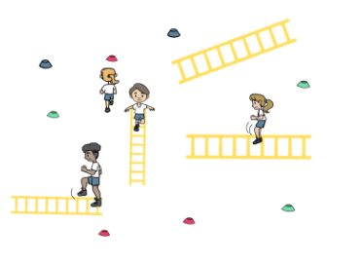
TBAT: explore co-ordination and combination jumps.
Monday 8th December 2025
Warm Up- Up the ladder

Slide 42
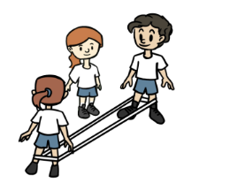
TBAT: explore co-ordination and combination jumps.
Monday 8th December 2025
Skill Development
French Skipping

Slide 43
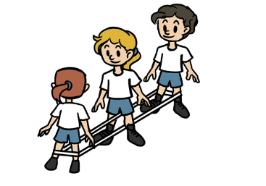
TBAT: explore co-ordination and combination jumps.
Monday 8th December 2025
Skill Development
Rainbow Rhyme

Slide 44
TBAT: explore co-ordination and combination jumps.
Monday 8th December 2025
Plenary
Discuss with a partner,
How can you keep a consistent rhythm?

Slide 45

Lunch

Slide 46
TBAT: Sequence events in a story.
3 in 3
Add the three capital letters:
i had a lovely time playing with henry on saturday.
on thursday, i had an ice cream.
i am going to london in june.

Slide 47
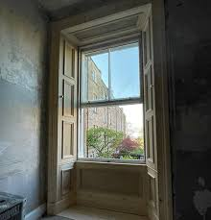
TBAT: Sequence events in a story.
Monday 8th December 2025
Vocabulary
‘Twas – It was
Stirring – awake and moving
St Nicholas – Father Christmas
Nestled – curled up and snug
Sugar plums - sweets
Clatter – crashing noise
Shutter –
Sash -

Slide 48
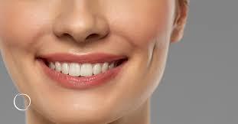
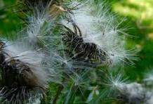
TBAT: Sequence events in a story.
Monday 8th December 2025
Lustre – shiny or glowing
Rapid - quick
Coarsers – quick horses
Pedlar – Someone who travelled around with a bag selling things.
Dimples -
Broad - wide
Plump - fat
Down of a thistle -

Slide 49
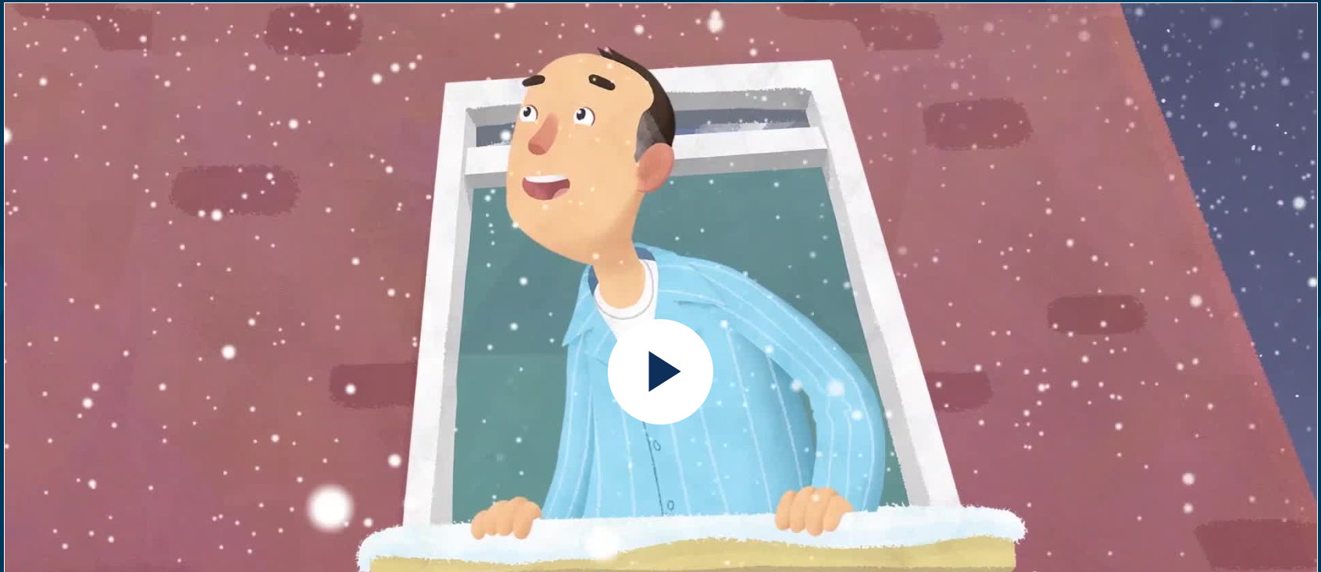
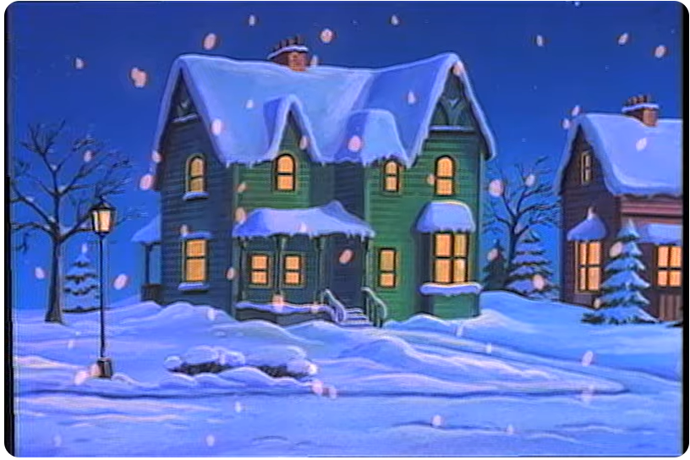
TBAT: Sequence events in a story.
Monday 8th December 2025
Twas the Night Before Christmas Animation Story – Twinkl
TWAS THE NIGHT BEFORE CHRISTMAS - YouTube

Slide 50
TBAT: Sequence events in a story.
Monday 8th December 2025
Blue / Green
Summarise what has happened in the story.
Who is telling the story?
What woke him up?
What did he see?
What did he hear?
Challenge: Do you think he told anyone what he had seen? Why?

Slide 51
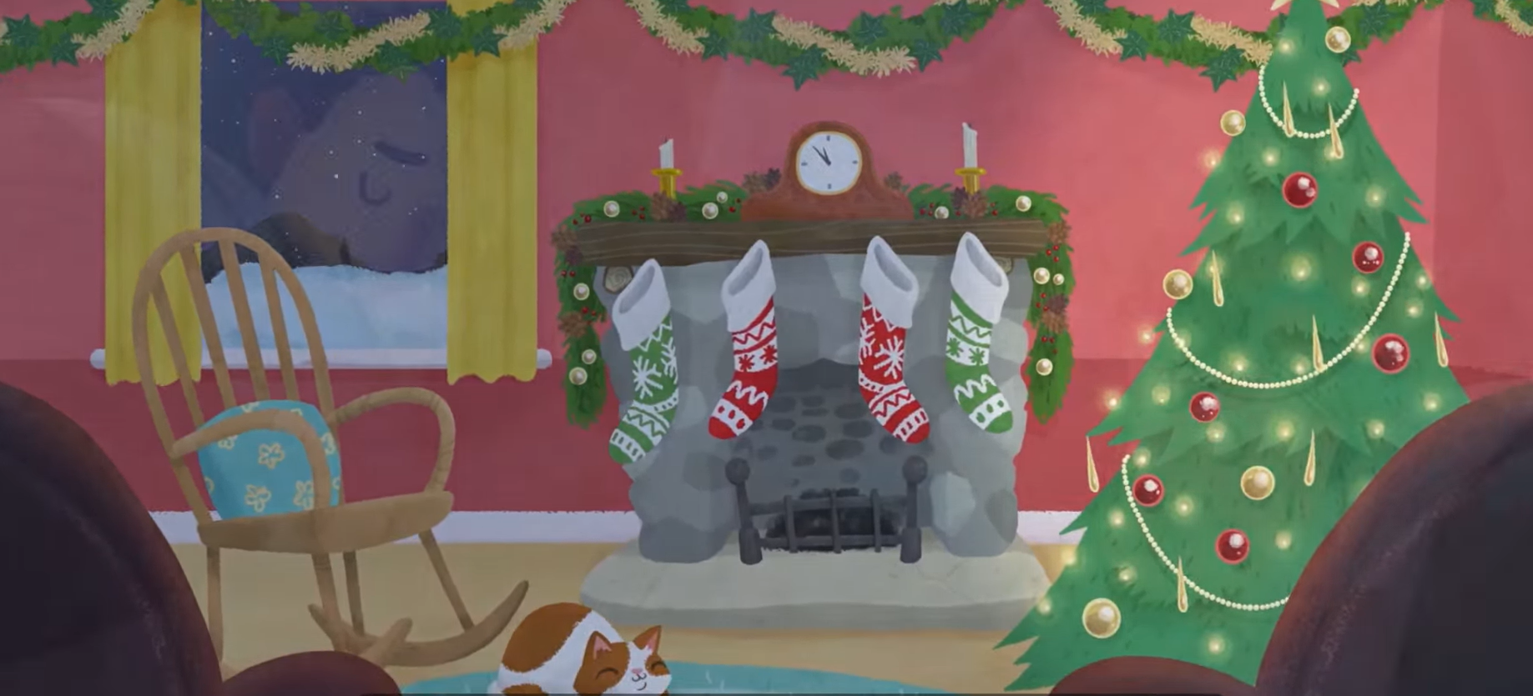
What happened at first?
TBAT: Sequence events in a story.
Monday 8th December 2025

Slide 52
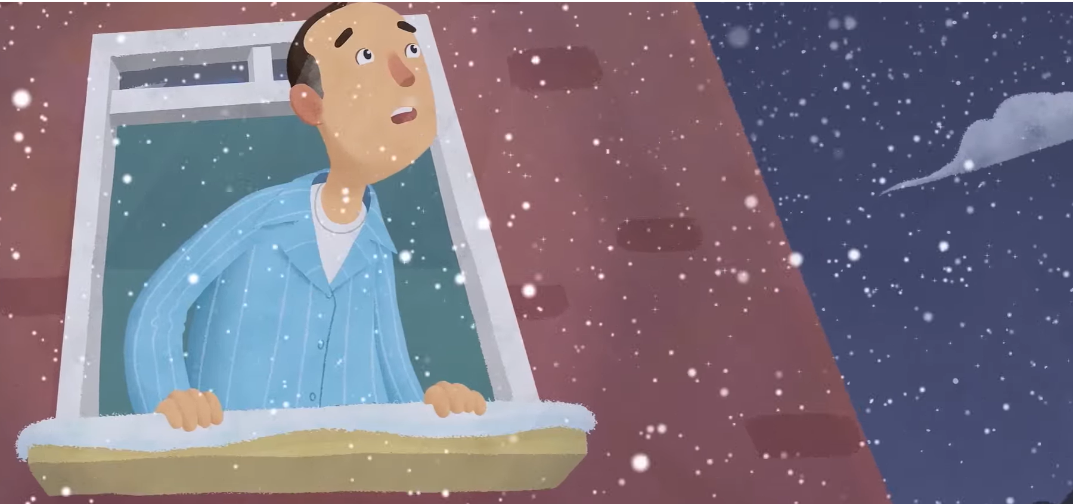
What happened next?
TBAT: Sequence events in a story.
Monday 8th December 2025

Slide 53
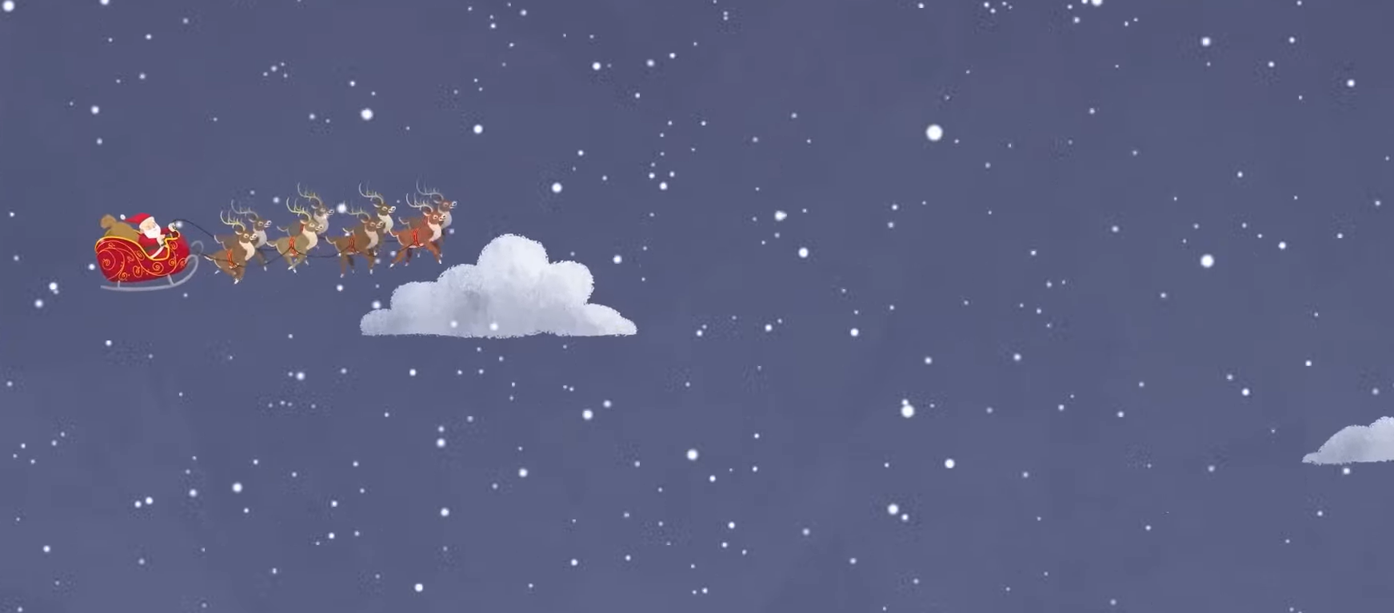
What did he see?
TBAT: Sequence events in a story.
Monday 8th December 2025

Slide 54
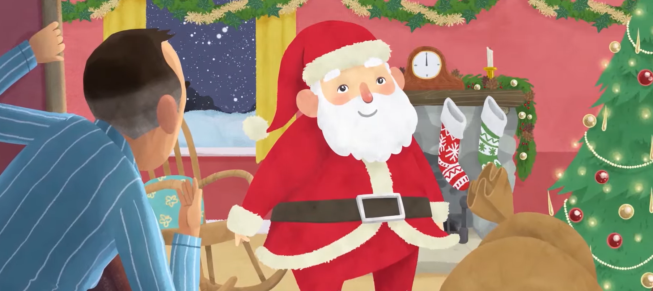
What happened after that?
TBAT: Sequence events in a story.
Monday 8th December 2025

Slide 55
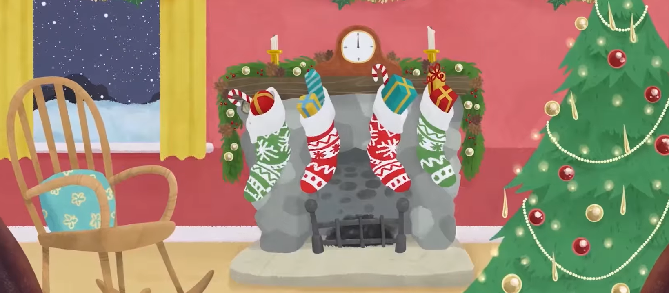
What happened next?
TBAT: Sequence events in a story.
Monday 8th December 2025

Slide 56
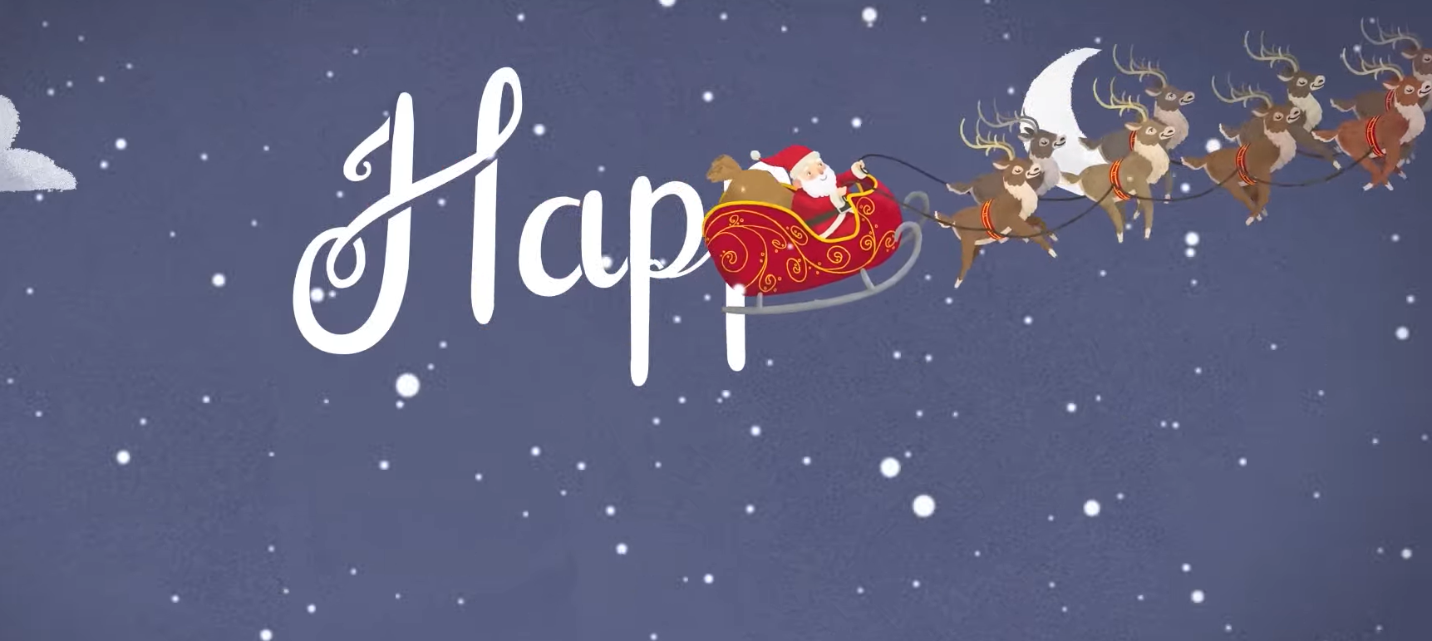
What happened at the end?
TBAT: Sequence events in a story.
Monday 8th December 2025

Slide 57
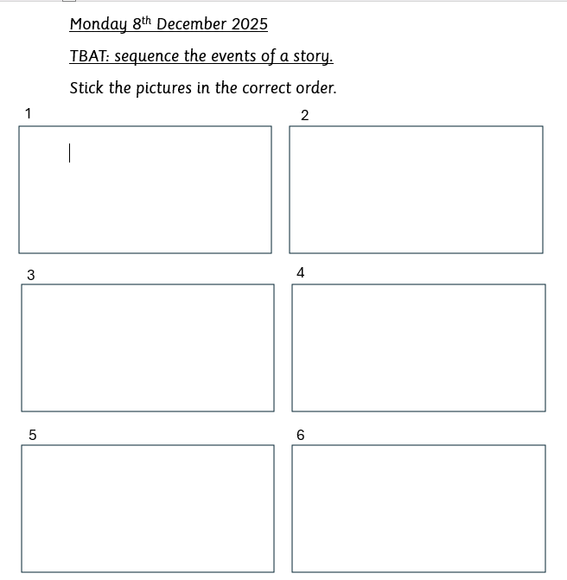
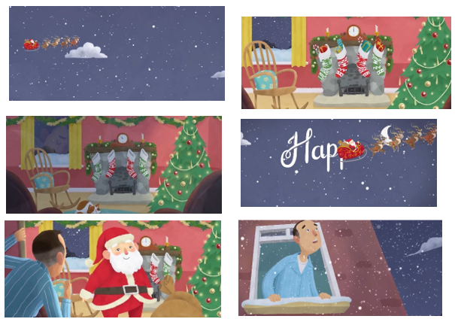
TBAT: Sequence events in a story.
Monday 8th December 2025
Challenge:
Write a short summary to say what the story is about.

Slide 58
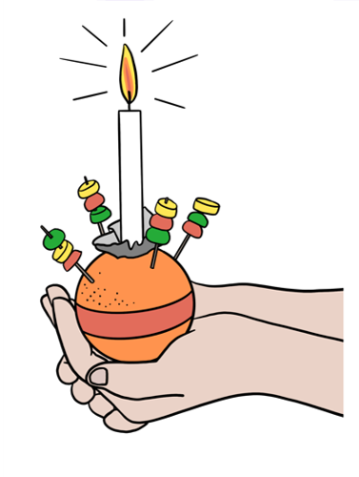
KQ: How do different Christians celebrate Christmas in the UK.
Monday 8th December 2025
3 in 3 – Can you remember what these parts of a Christingle represent?
candle
sweets
orange

Slide 59

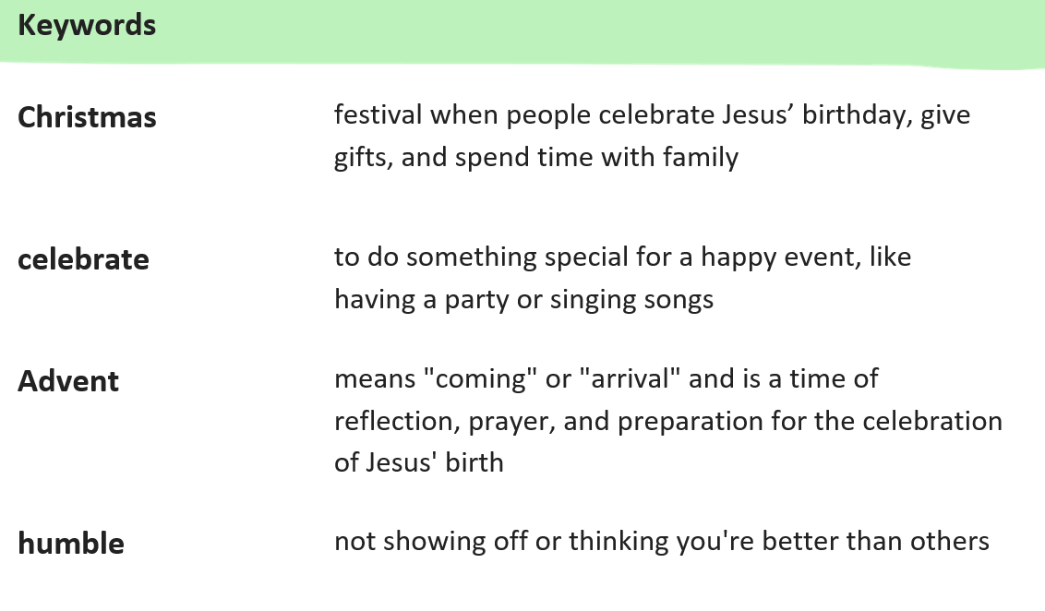

KQ: How do different Christians celebrate Christmas in the UK.
Monday 8th December 2025

Slide 60
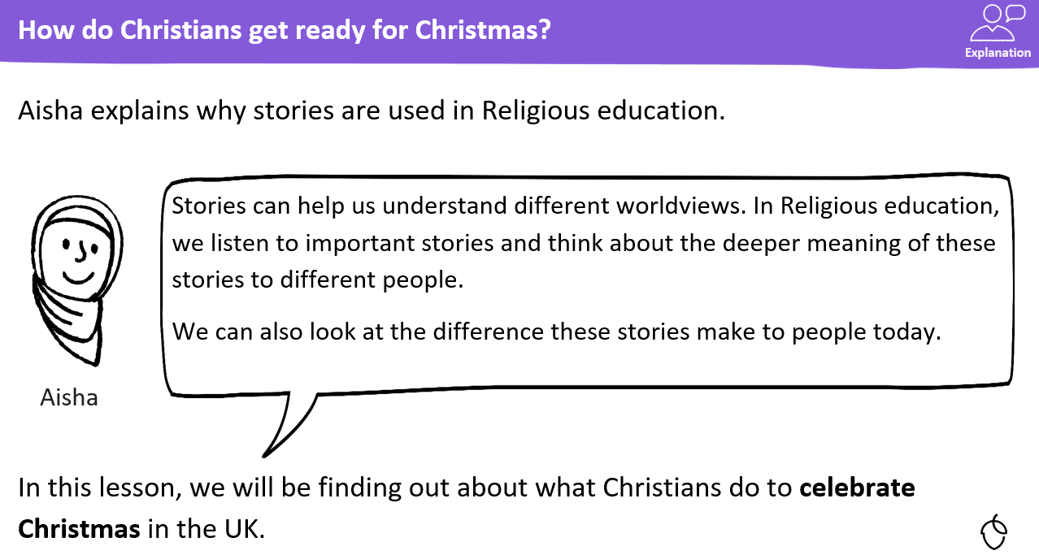
KQ: How do different Christians celebrate Christmas in the UK.
Monday 8th December 2025

Slide 61

KQ: How do different Christians celebrate Christmas in the UK.
Monday 8th December 2025
Blue/ Green
How do you celebrate in the weeks leading up to Christmas?
How do you celebrate Christmas day?

Slide 62
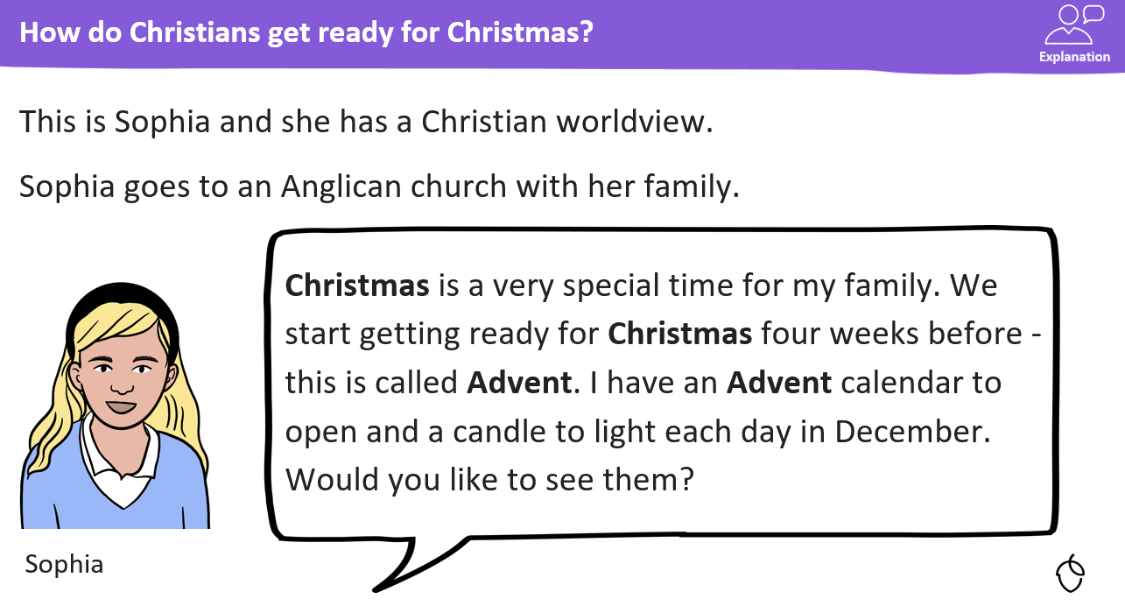
KQ: How do different Christians celebrate Christmas in the UK?
Monday 8th December 2025

Slide 63
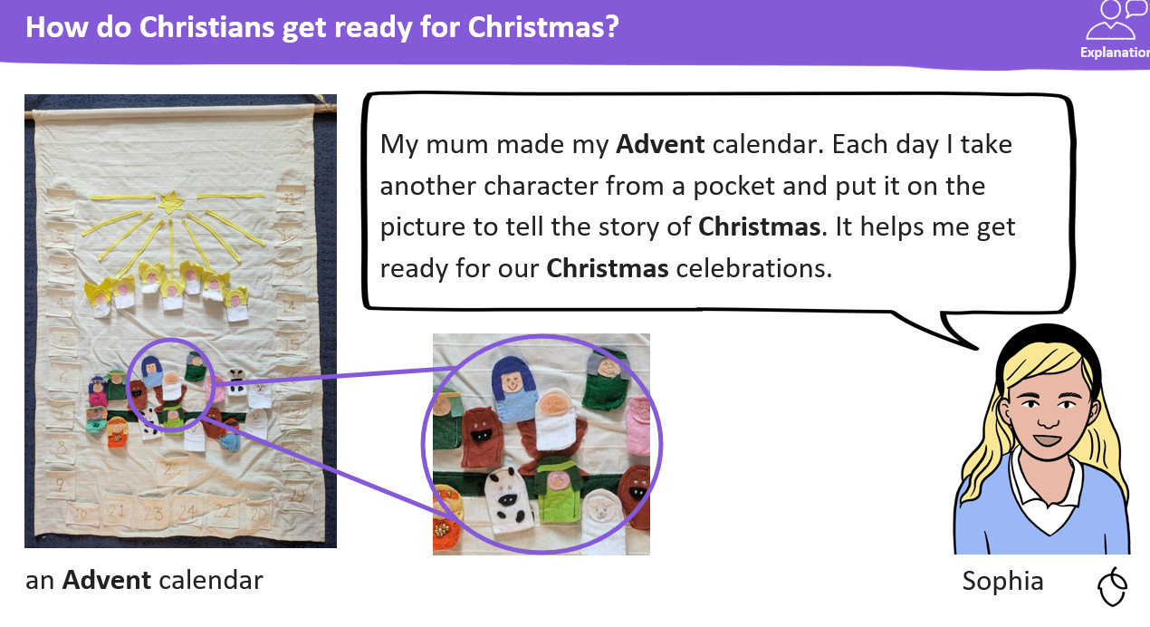
KQ: How do different Christians celebrate Christmas in the UK?
Monday 8th December 2025

Slide 64
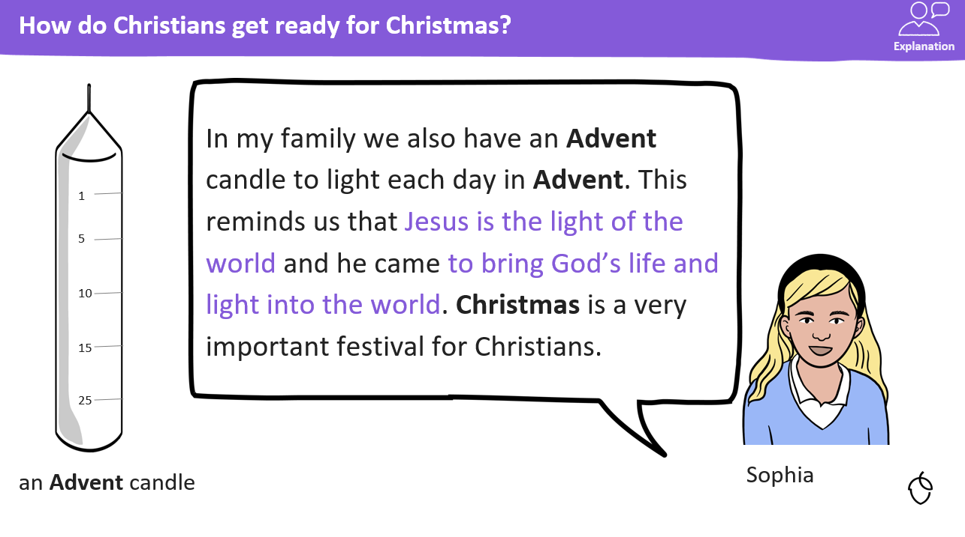
KQ: How do different Christians celebrate Christmas in the UK?
Monday 8th December 2025

Slide 65
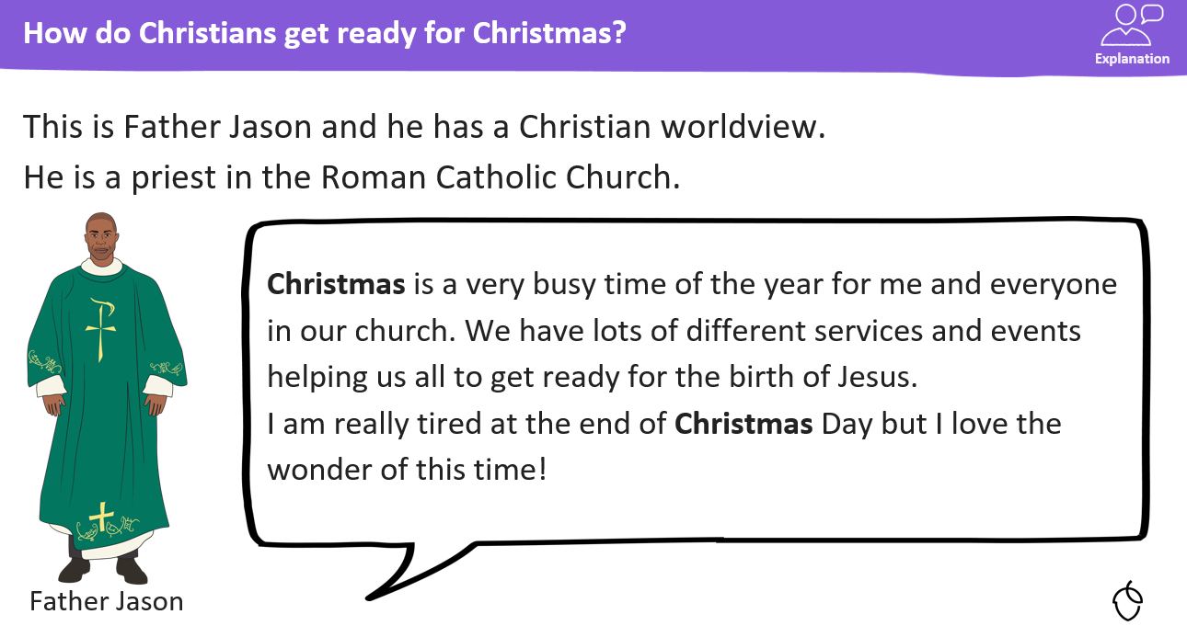
KQ: How do different Christians celebrate Christmas in the UK?
Monday 8th December 2025

Slide 66
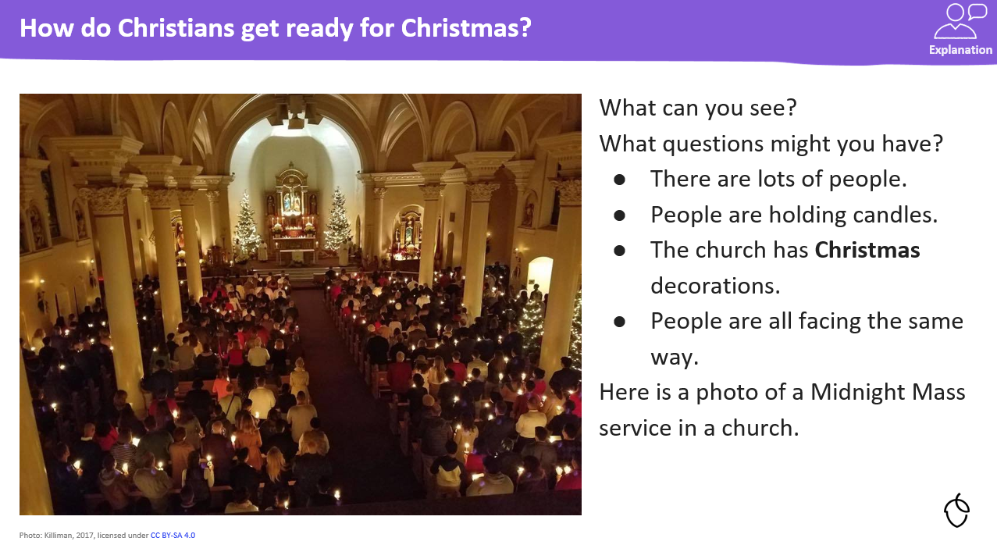
KQ: How do different Christians celebrate Christmas in the UK?
Monday 8th December 2025
This photograph shows the Midnight Mass service in Father Jason’s church.

Slide 67
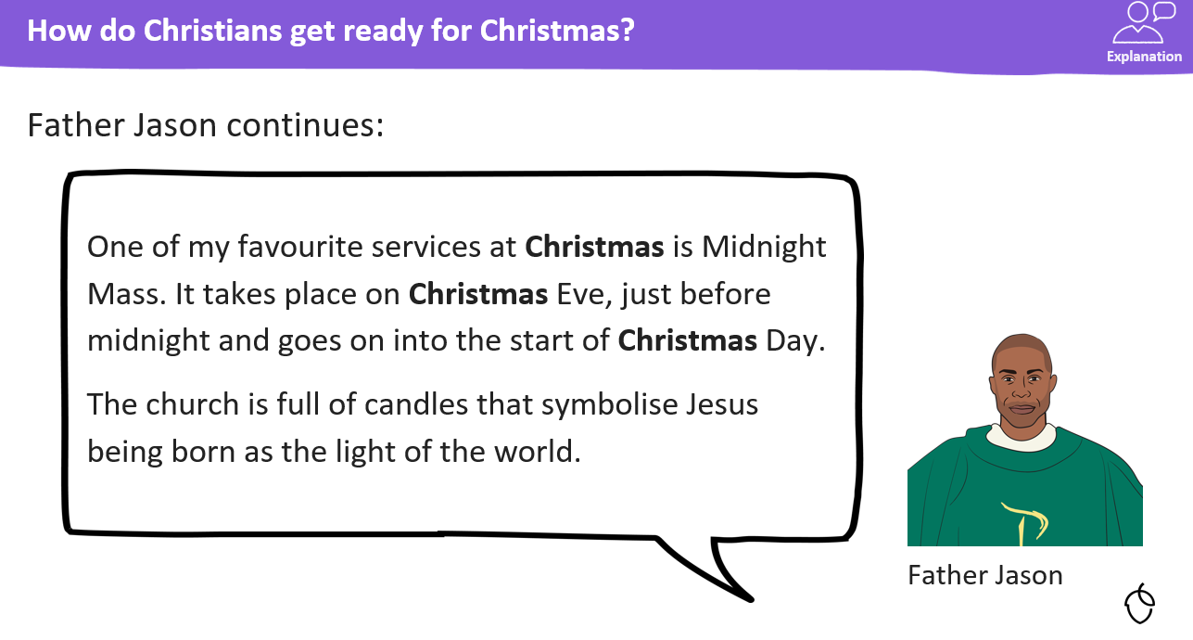
KQ: How do different Christians celebrate Christmas in the UK?
Monday 8th December 2025

Slide 68
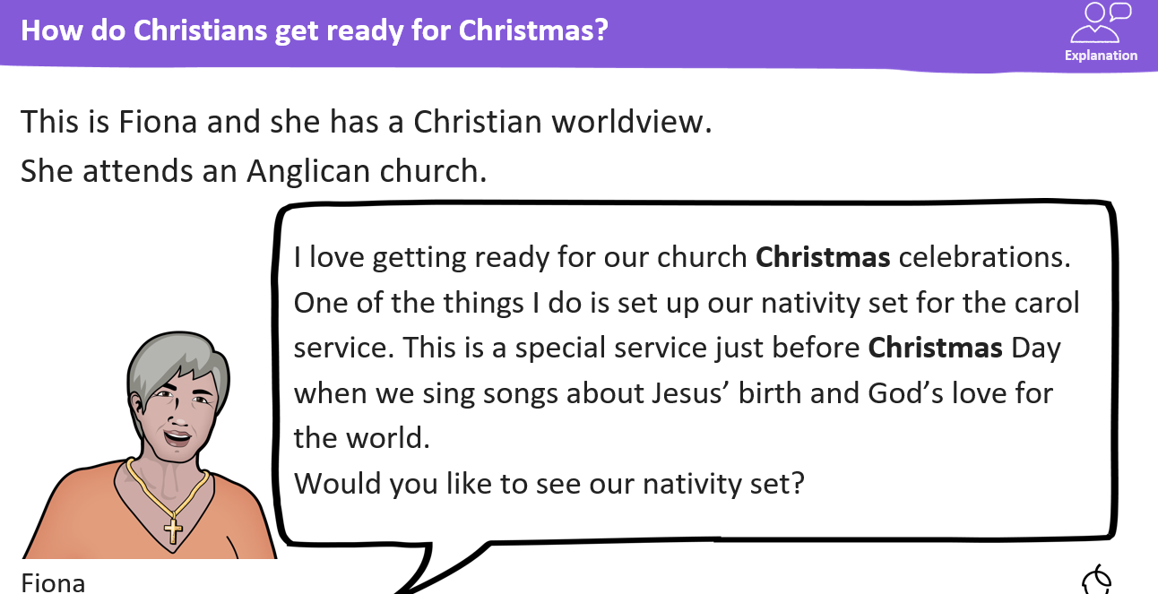
KQ: How do different Christians celebrate Christmas in the UK?
Monday 8th December 2025

Slide 69
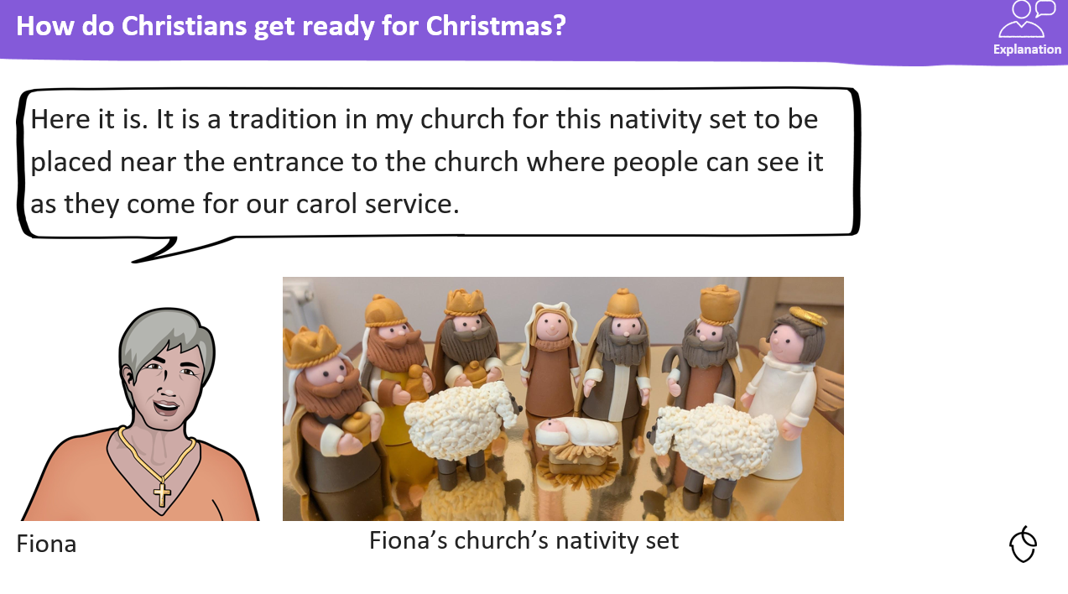
KQ: How do different Christians celebrate Christmas in the UK?
Monday 8th December 2025

Slide 70
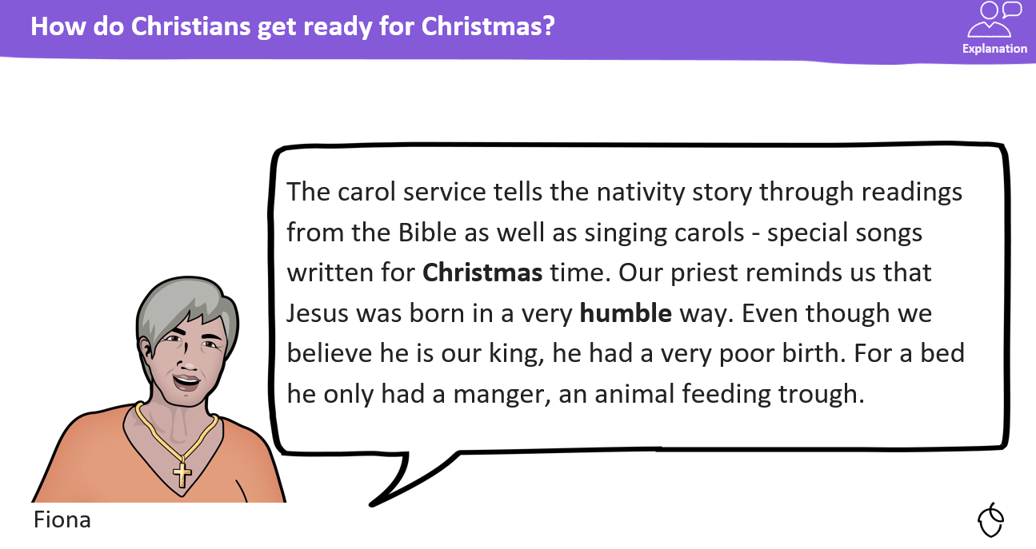
KQ: How do different Christians celebrate Christmas in the UK?
Monday 8th December 2025

Slide 71
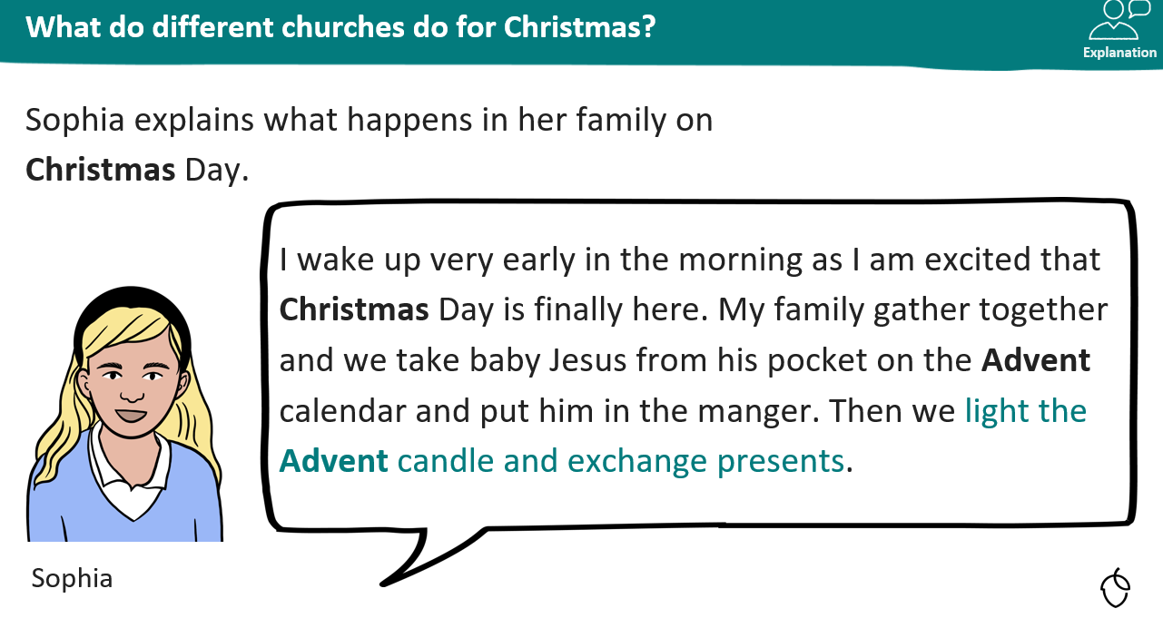
KQ: How do different Christians celebrate Christmas in the UK?
Monday 8th December 2025

Slide 72
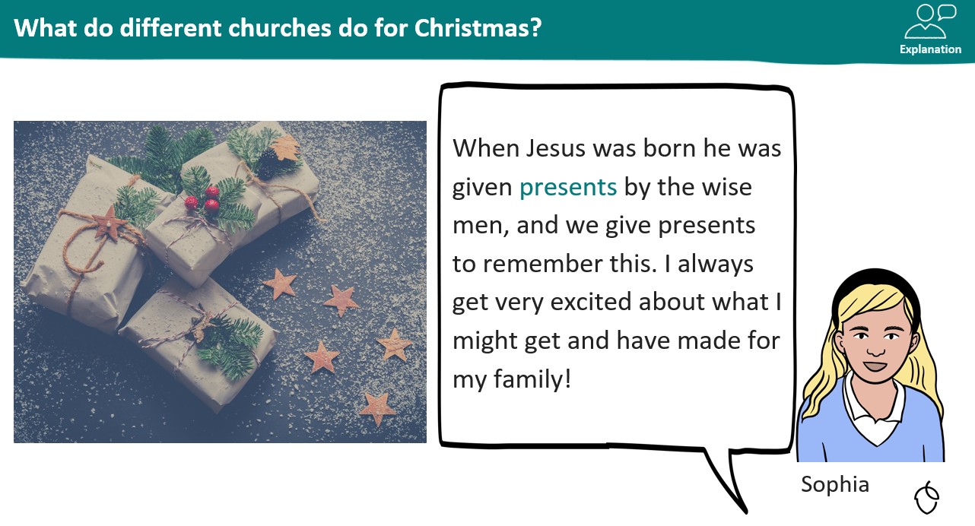
KQ: How do different Christians celebrate Christmas in the UK?
Monday 8th December 2025

Slide 73
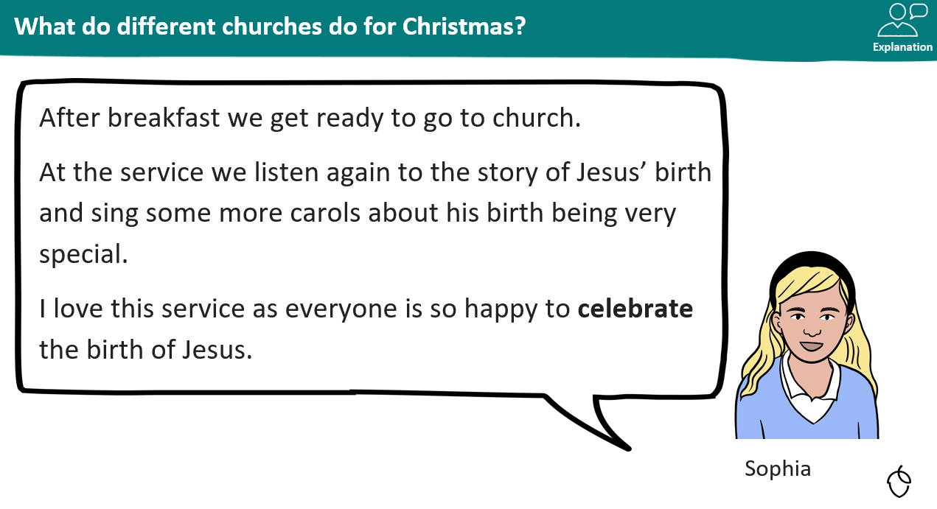
KQ: How do different Christians celebrate Christmas in the UK?
Monday 8th December 2025

Slide 74
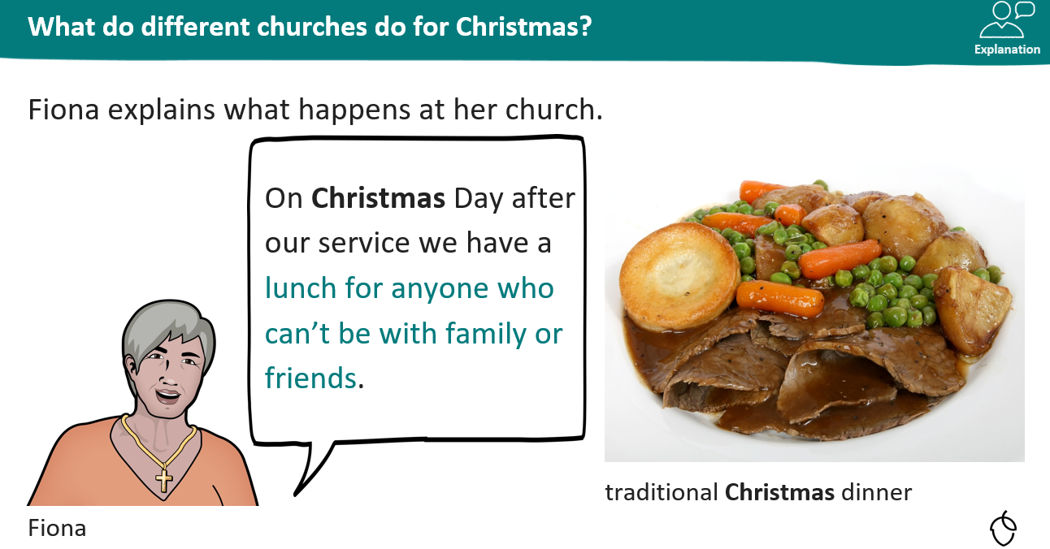
KQ: How do different Christians celebrate Christmas in the UK?
Monday 8th December 2025

Slide 75
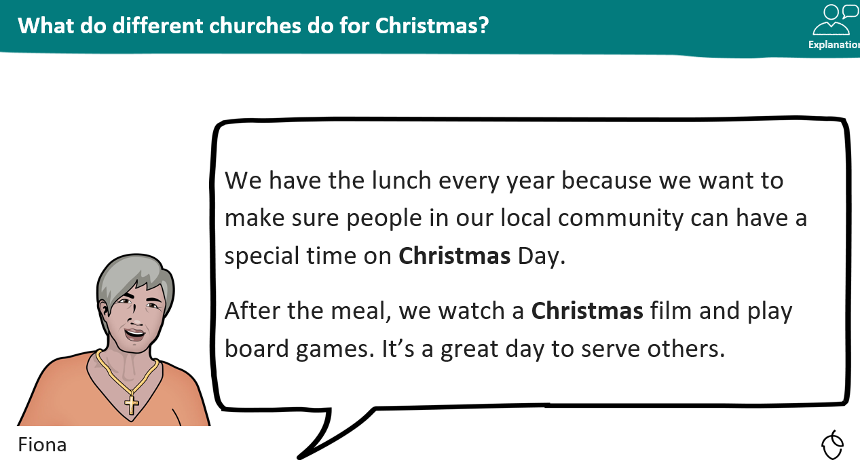
KQ: How do different Christians celebrate Christmas in the UK?
Monday 8th December 2025

Slide 76
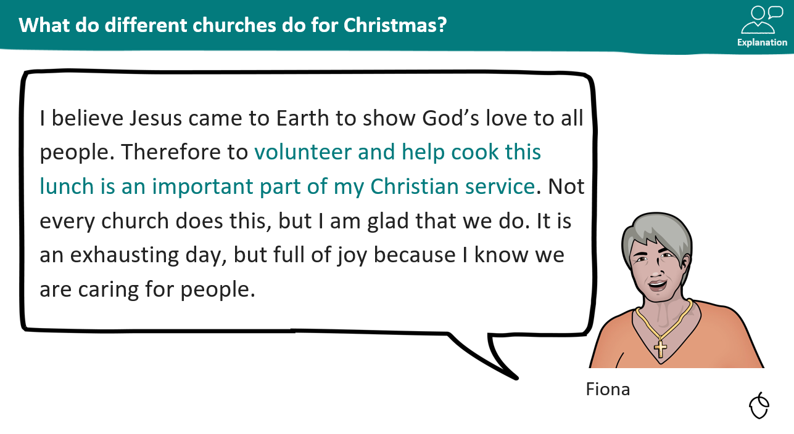
KQ: How do different Christians celebrate Christmas in the UK?
Monday 8th December 2025

Slide 77
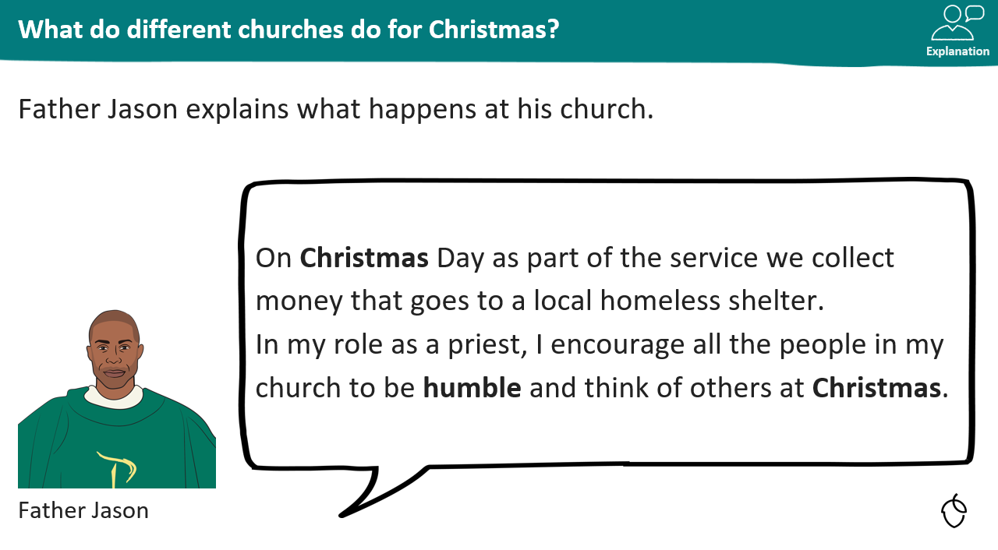
KQ: How do different Christians celebrate Christmas in the UK?
Monday 8th December 2025

Slide 78

KQ: How do different Christians celebrate Christmas in the UK?
Monday 8th December 2025

Slide 79

KQ: How do different Christians celebrate Christmas in the UK?
Monday 8th December 2025

Slide 80

KQ: How do different Christians celebrate Christmas in the UK?
Monday 8th December 2025

Slide 81

TBAT: evaluate a structure.
Monday 8th December 2025

Slide 82

TBAT: evaluate a structure.
Monday 8th December 2025
5 in 3

Slide 83


TBAT: evaluate a structure.
Monday 8th December 2025
Blue/ Green-Discuss with your partner, what is wrong with this picture?
unstable wobbly secure

Slide 84

TBAT: evaluate a structure.
Monday 8th December 2025
Vocabulary

Slide 85

TBAT: evaluate a structure.
Monday 8th December 2025
We need to look at the criteria we set out at the beginning of the unit.
Have we successfully met each criteria?

Slide 86
TBAT: evaluate a structure.
Monday 8th December 2025
What do you think went well when building your windmill?

Slide 87
TBAT: evaluate a structure.
Monday 8th December 2025
What could you improve if you were to make it again?

Slide 88




Independent Challenges:
Narrative Zone
Maths Zone
Write a sentence to say what is happening in the picture.
Times tables maze.
Enquiry Zone
Creative Zone
Find the North Pole on the map, globe or in an Atlas.
Make a paper chain snowman.

