Slide 1
Monday 15th December 2025

Slide 2
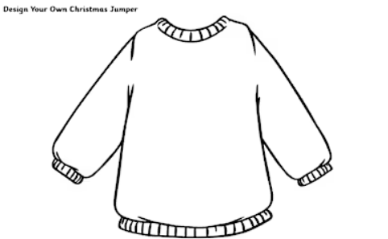
Morning Challenges:
Monday 15th December 2025
Design a Christmas jumper.

Slide 3
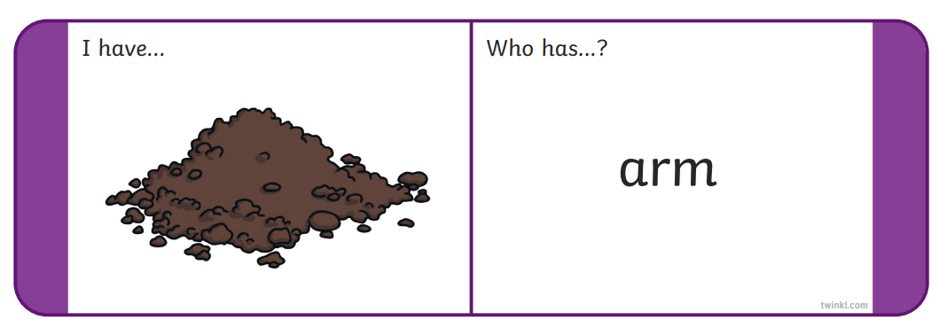
Odd And Bob (Phase 4) - Online Phonics Game
Monday 15th December 2025
Phase 3 loop cards

Slide 4
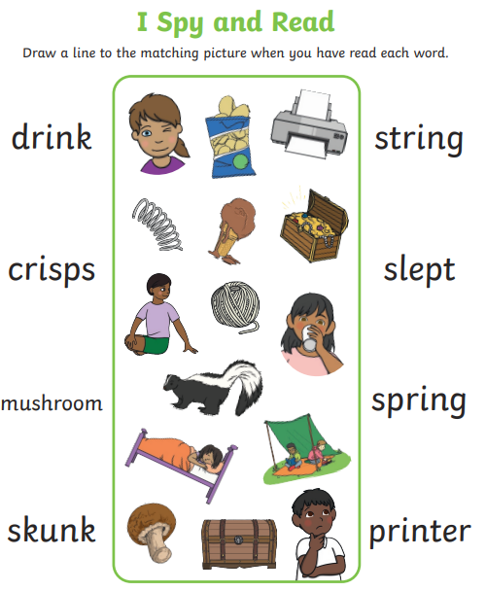
Monday 15th December 2025

Slide 5
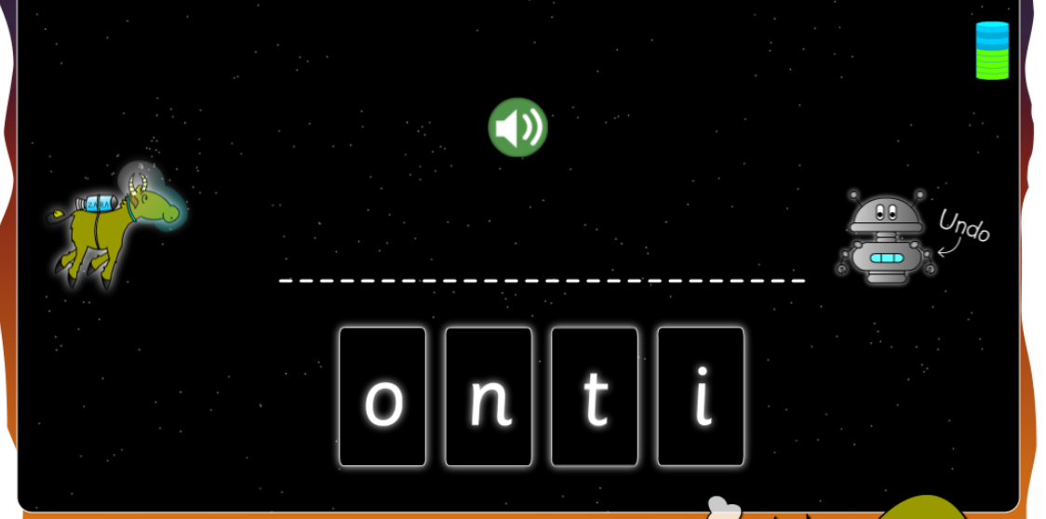
Monday 15th December 2025
Spell Tricky Words Game

Slide 6
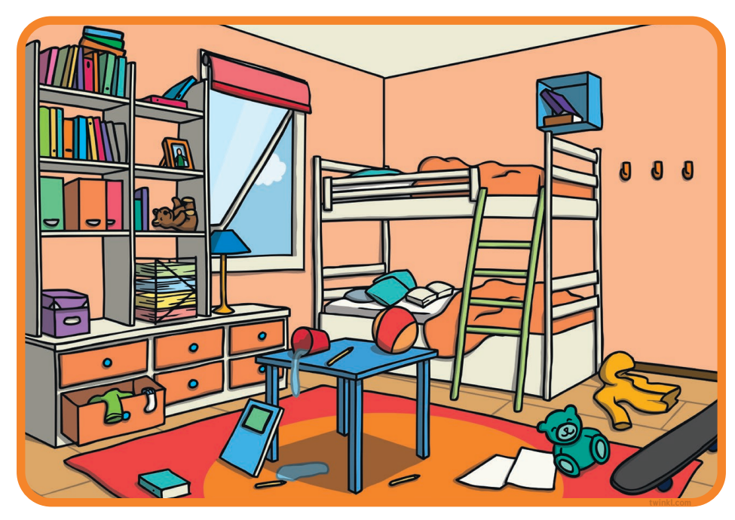

Blue/Green - What dangers can you see?
KQ: How do I keep safe at school?
Monday 15th December 2025
What things can you
think of that can be
unsafe at home?
dangerous unstable fall trip

Slide 7
KQ: How do I keep safe at school?
Monday 15th December 2025
Rules for staying safe at home
Close drawers and cupboard doors.
Keep small children away from cooking.
Don’t leave things on the floor.
Store medicines and cleaning liquids away from children and animals.
Keep matches away from small children.
Store sharp knives safely.
Notes:
These are a few rules for minimising and avoiding dangers in the home. Read them out one at a time and for each one, ask pupils why this is a rule and what would be the consequences if it was broken. Pupils may be able to add to the list.

Slide 8

KQ: How do I keep safe at school?
Monday 15th December 2025
Are medicines safe or not?
Notes:
Ask pupils about the medicines in their house. Ask them if they have a special place to keep medicines. Ask if any pupils have been given medicines to make them better when they have been poorly. Establish that medicines and tablets can be really good because they can make us well again, and even save lives. Some pupils may refer to this. Explain to pupils that all medicines have rules about how they are taken; when these safety rules are not followed, medicines can be harmful.

Slide 9
KQ: How do I keep safe at school?
Monday 15th December 2025
Medicine rules
Never take medicines unless they are given to you by your parents, a nurse, a doctor or your safe adult.
Never play with medicines.
Never take more than you are told to take.
Medicines must be stored in a safe place, out of the reach of young children.
Never touch, taste or
take anything you think
could be dangerous.
Notes:
Read through these rules, making sure that pupils understand. After each rule, ask pupils why this is a rule and ask them what the consequences of breaking the rule could be. Keep emphasising that medicines are really important in helping poorly people get better by fighting the germs which cause infections and diseases, but that taking too much or too little of a medicine, or taking it when it hasn’t been prescribed for you, can make people very ill! Tell pupils that medicines should be treated seriously and stored safely in the home. Tell pupils that medicine cabinets should be kept away from small children; the next slide will consider why.

Slide 10
KQ: How do I keep safe at school?
Monday 15th December 2025
Keep them away from children!
If medicines are good, why do we have to store them away from young children?
Notes:
Remind pupils that medicines are very powerful as they can help cure, treat and heal people from all sorts of pain and sickness. However, reiterate that we have to be very careful about which medicines we take and how much we take. If we don’t follow the rules we could get very sick. Help pupils to understand that very young children won’t understand all of this, and they might think tablets are sweets or medicines are drinks.

Slide 11
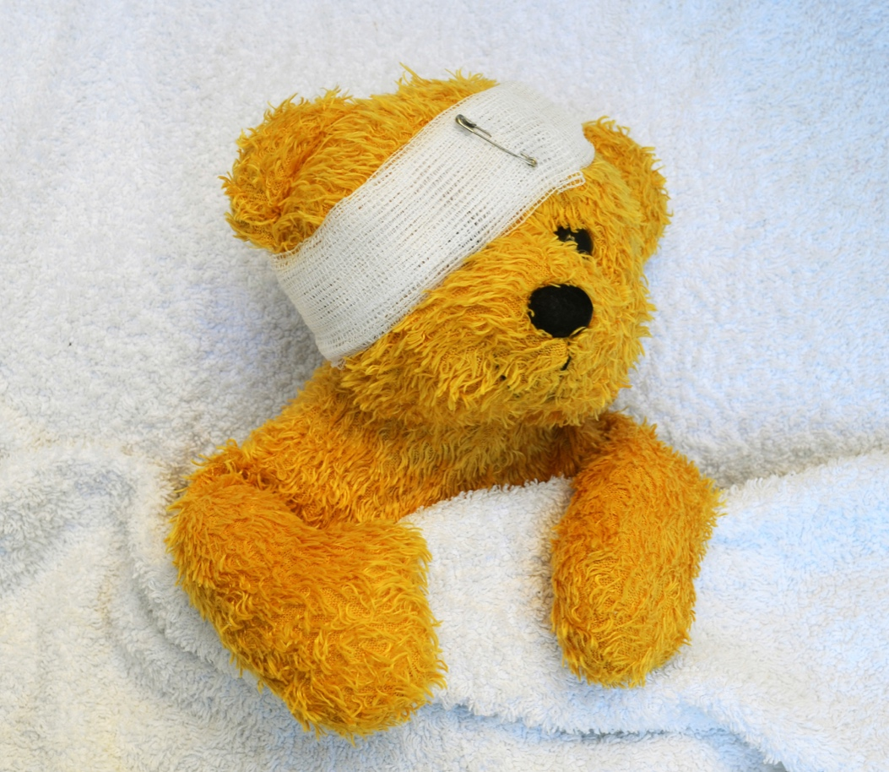
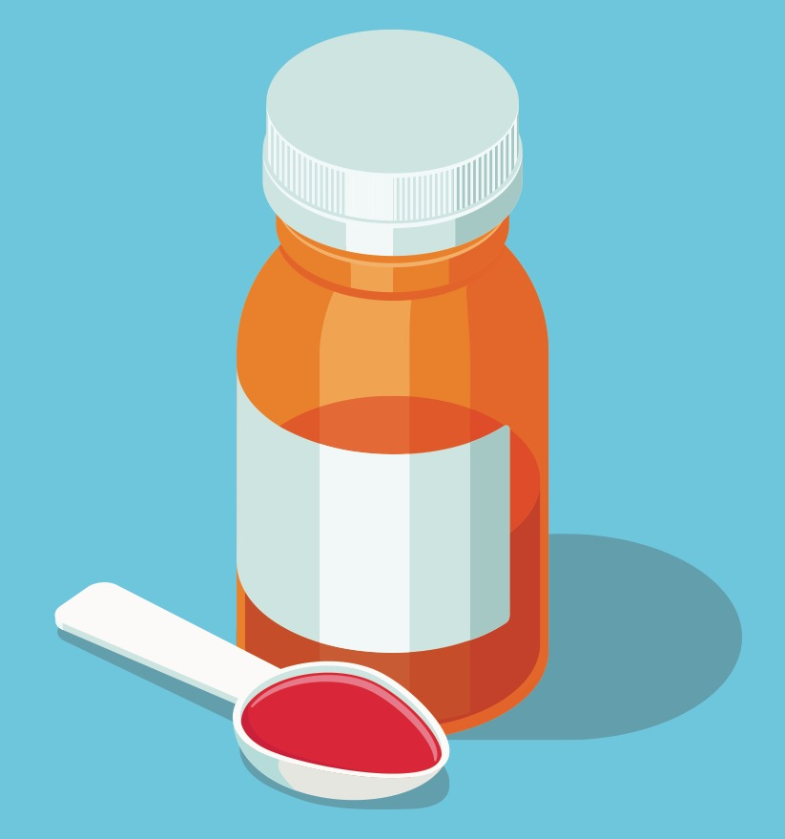
KQ: How do I keep safe at school?
Monday 15th December 2025
Poor Teddy
Teddy is poorly. He has banged his head and it hurts! The doctor says he must take this medicine.
Notes:
Read through the slide with pupils and introduce Teddy. Explain to pupils that medicine is prescribed by a doctor but made and dispensed (explain this) by pharmacists, who are specially trained to know all about medicines and using them safely.
Sit pupils in a circle, then ask for a volunteer to pretend that they are the pharmacist and ask for another volunteer to be Teddy’s owner. Distribute props. Tell pupils that Teddy’s owner has just arrived at the pharmacist to collect Teddy’s medicine. She or he must ask for it. The pharmacist must find the medicine and tell Teddy’s owner how much medicine to take and how often. Tell them that as they are the pharmacist, they can decide on the instructions for how many spoonfuls Teddy should take and how many times a day. Before handing it over, they should check that the medicine has Teddy’s name on it because it’s especially for him and no one else. They must also tell Teddy’s owner that Teddy MUST take the medicine until it’s all gone. You could role-play this with a pupil first, to model.

Slide 12
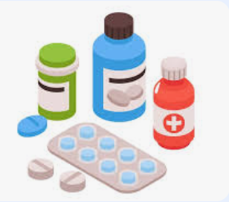
KQ: How do I keep safe at school?
Monday 15th December 2025
Why is it important that you only take medication that is for you?

Slide 13
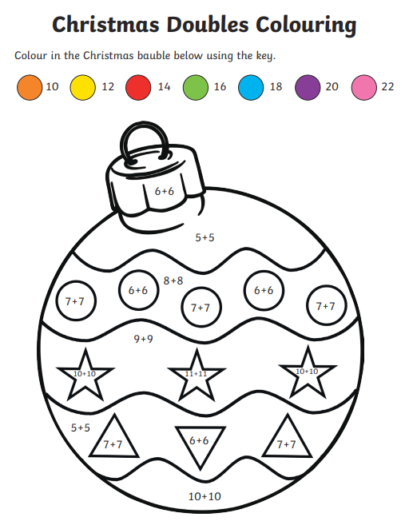
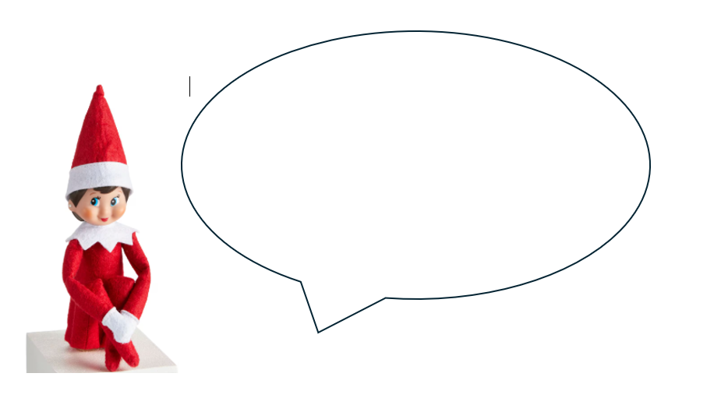
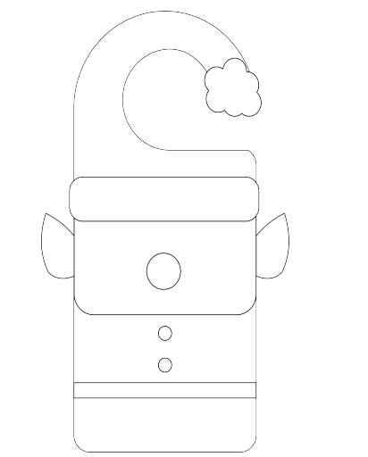
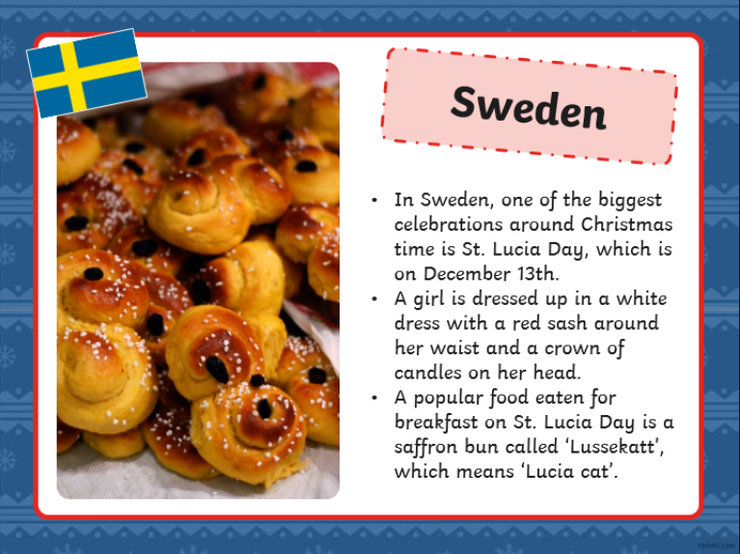
Independent Challenges:
Narrative Zone
Maths Zone
If the elf could talk, what do you think he would say to you?
Christmas doubles colouring
Enquiry Zone
Creative Zone
Explore some more Christmas traditions from around the world.
Find them on the globe
Make an elf door hangar.

Slide 14
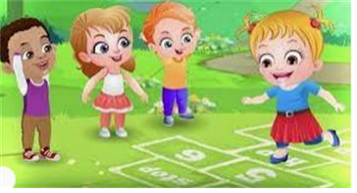
Break

Slide 15
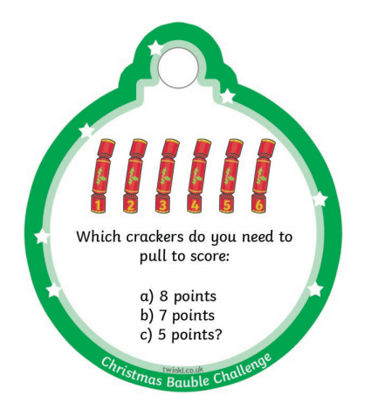
Monday 15th December 2025

Slide 16
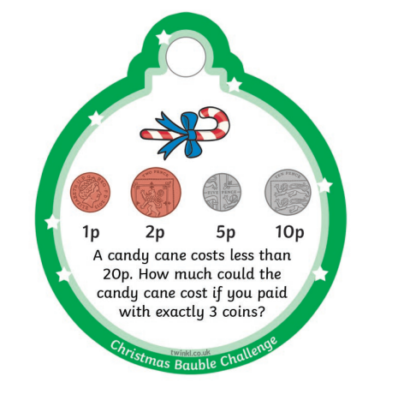
Monday 15th December 2025

Slide 17
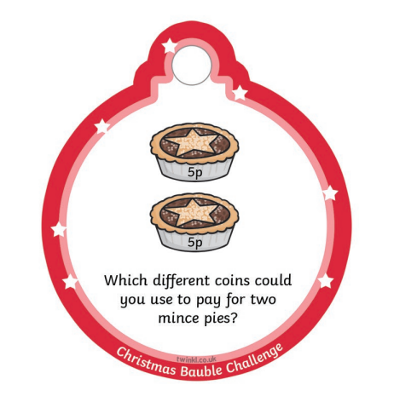
Monday 15th December 2025

Slide 18
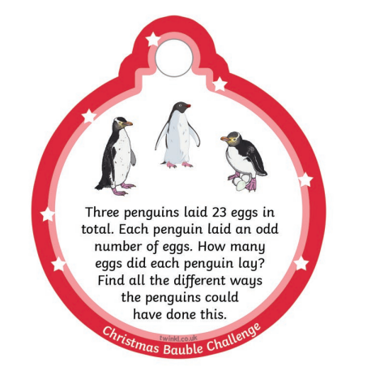
Monday 15th December 2025

Slide 19
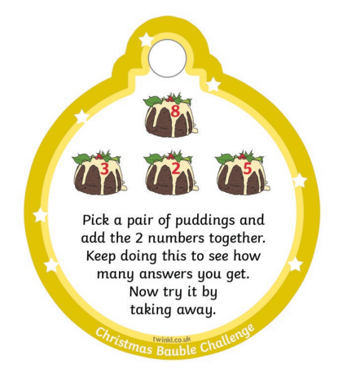
Monday 15th December 2025

Slide 20
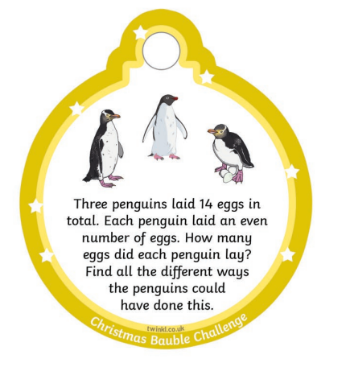
Monday 15th December 2025

Slide 21

Lunch

Slide 22
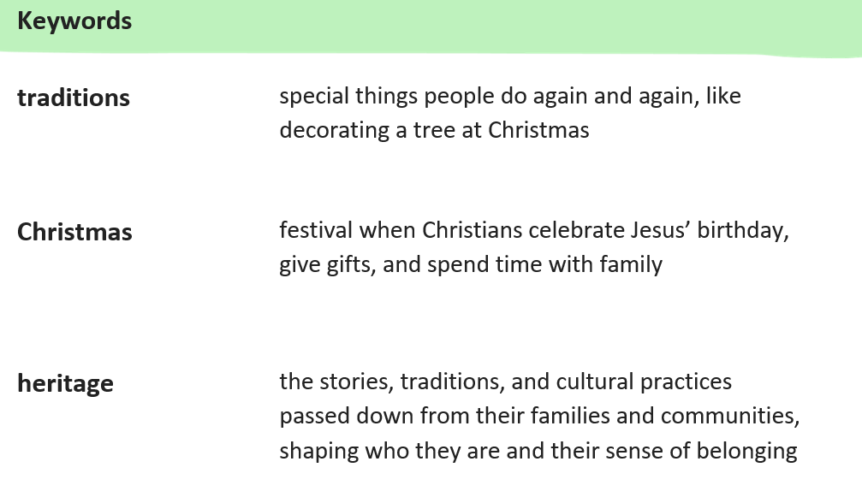
KQ: How do Christians around the world celebrate Christmas?
Monday 15th December 2025

Slide 23
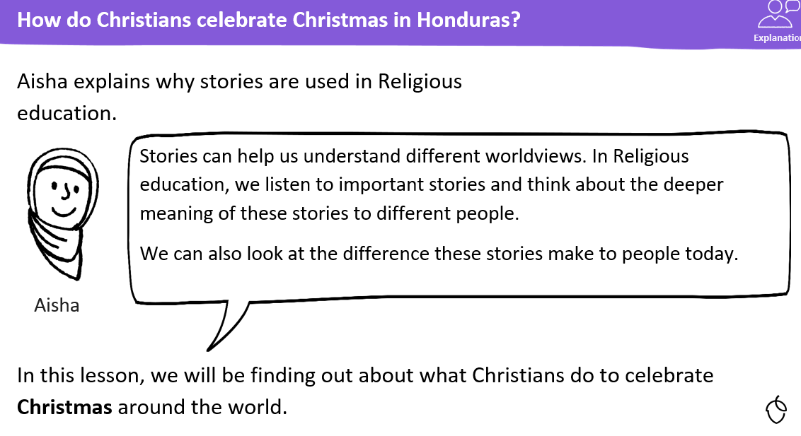
KQ: How do Christians around the world celebrate Christmas?
Monday 15th December 2025

Slide 24
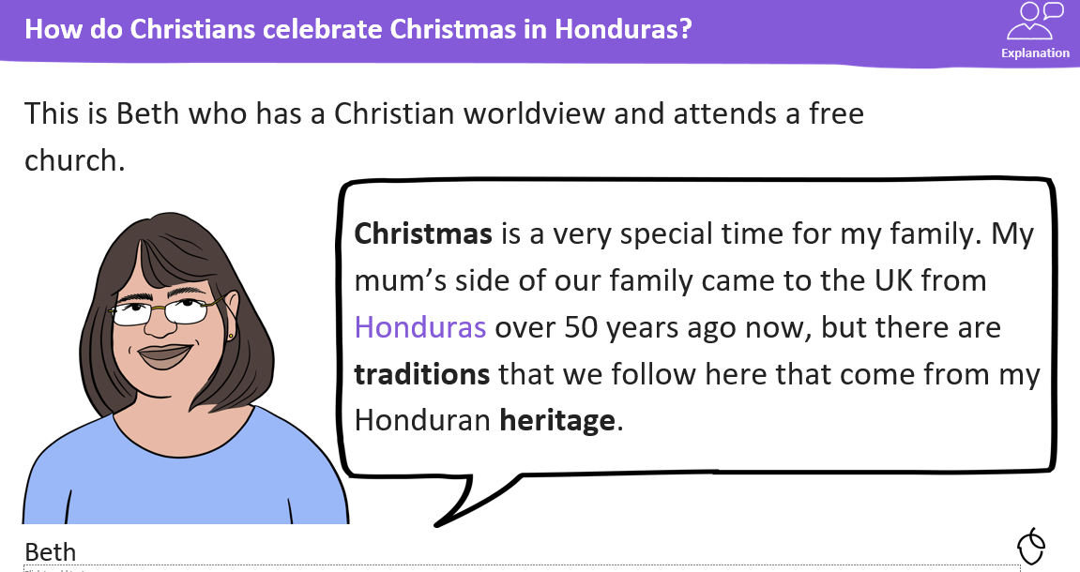
KQ: How do Christians around the world celebrate Christmas?
Monday 15th December 2025

Slide 25
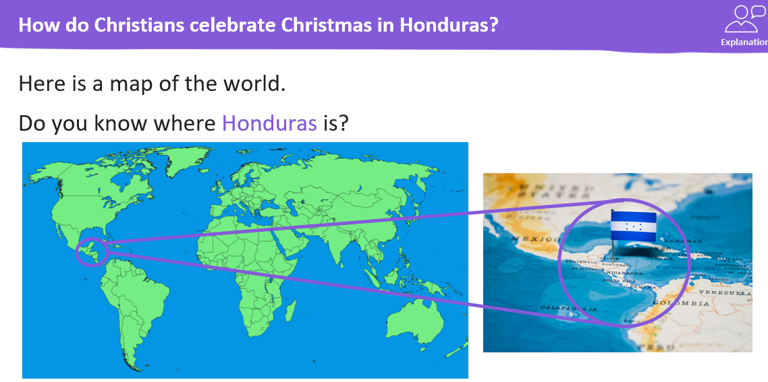
KQ: How do Christians around the world celebrate Christmas?
Monday 15th December 2025

Slide 26
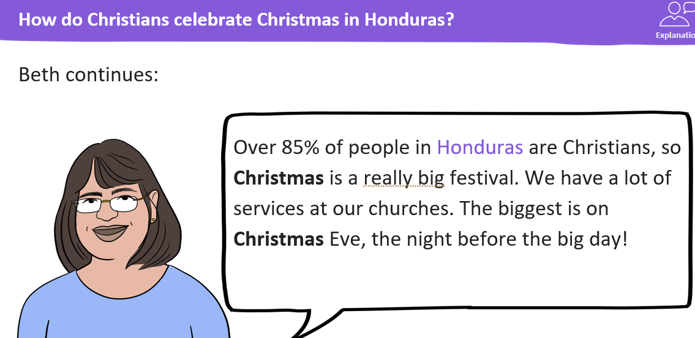
KQ: How do Christians around the world celebrate Christmas?
Monday 15th December 2025

Slide 27
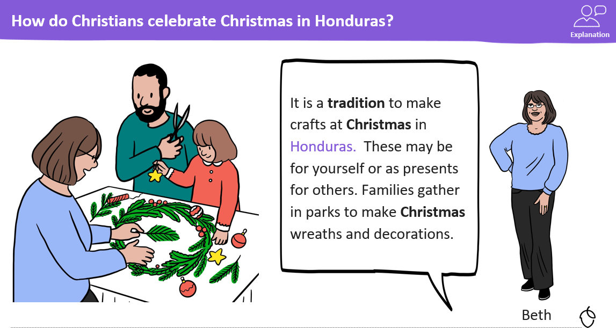
KQ: How do Christians around the world celebrate Christmas?
Monday 15th December 2025

Slide 28
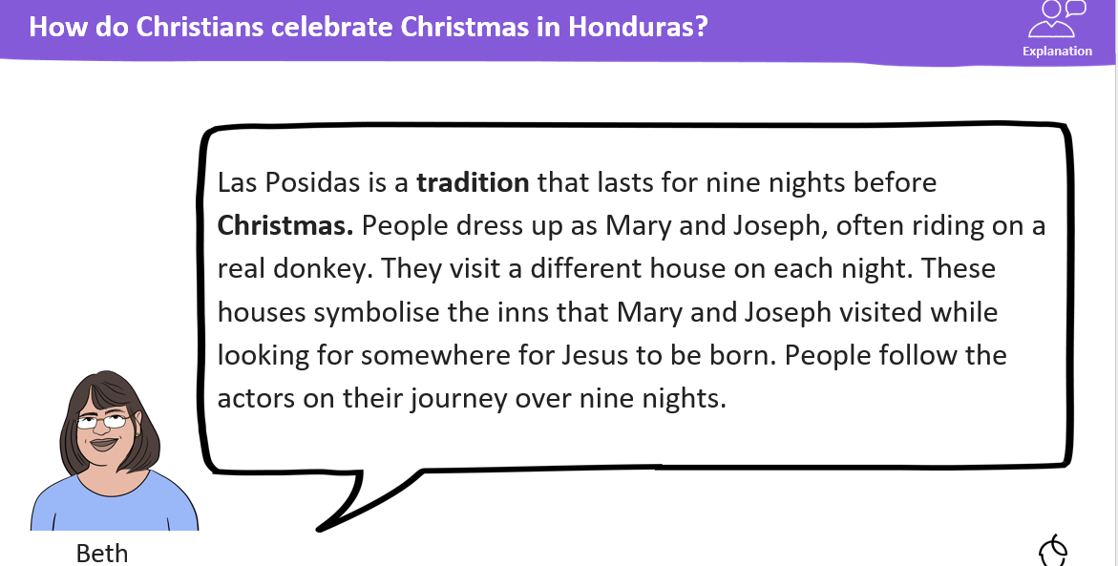
KQ: How do Christians around the world celebrate Christmas?
Monday 15th December 2025

Slide 29
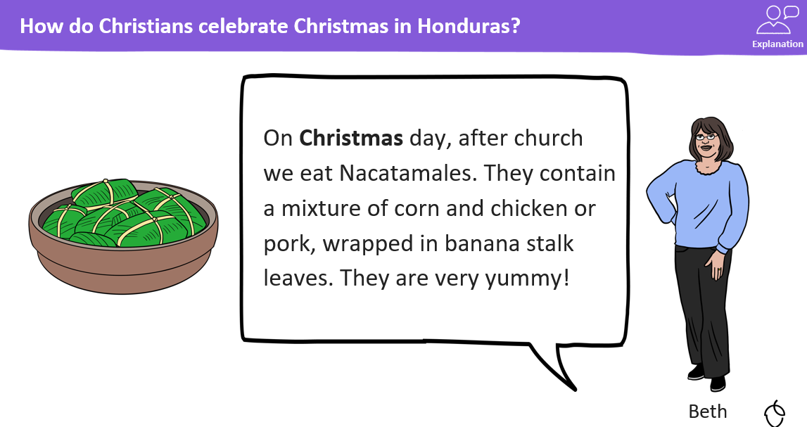
KQ: How do Christians around the world celebrate Christmas?
Monday 15th December 2025

Slide 30
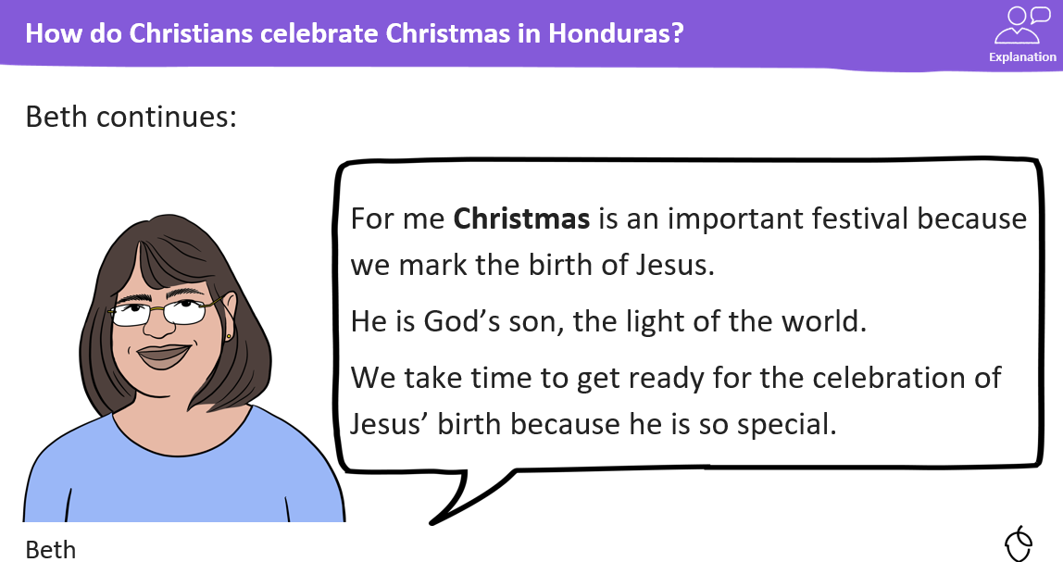
KQ: How do Christians around the world celebrate Christmas?
Monday 15th December 2025

Slide 31
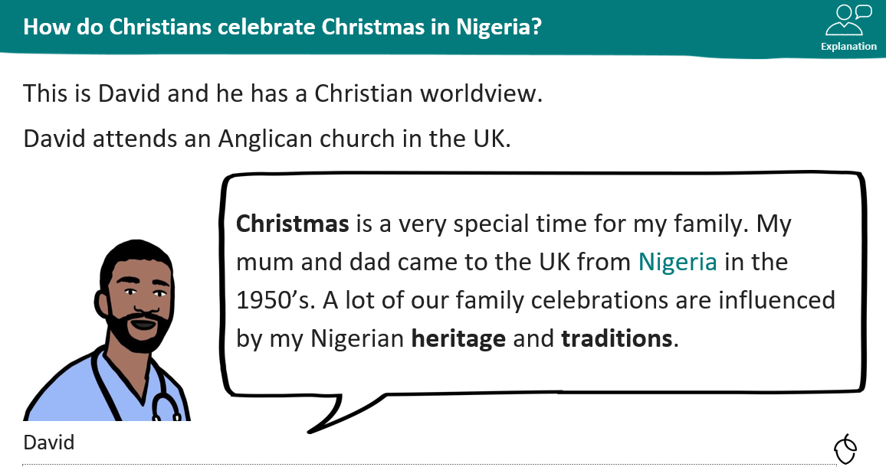
KQ: How do Christians around the world celebrate Christmas?
Monday 15th December 2025

Slide 32
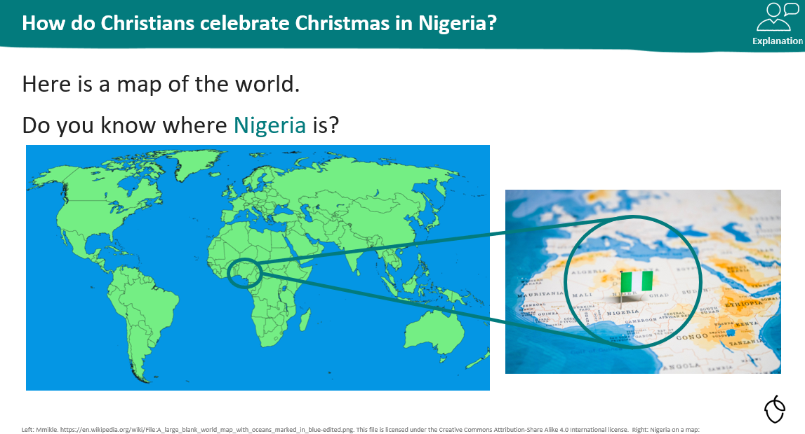
KQ: How do Christians around the world celebrate Christmas?
Monday 15th December 2025

Slide 33
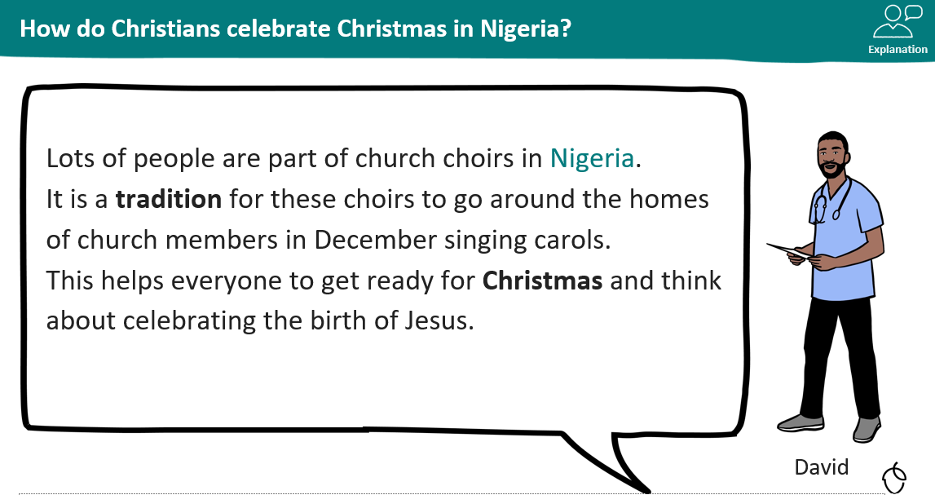
KQ: How do Christians around the world celebrate Christmas?
Monday 15th December 2025

Slide 34
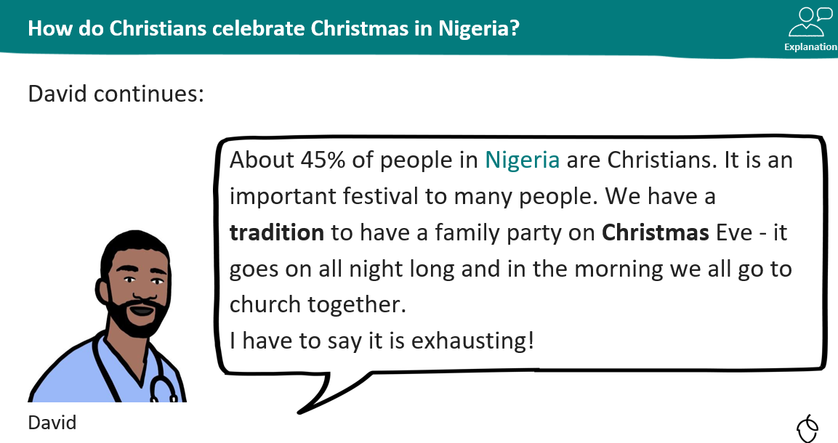
KQ: How do Christians around the world celebrate Christmas?
Monday 15th December 2025

Slide 35
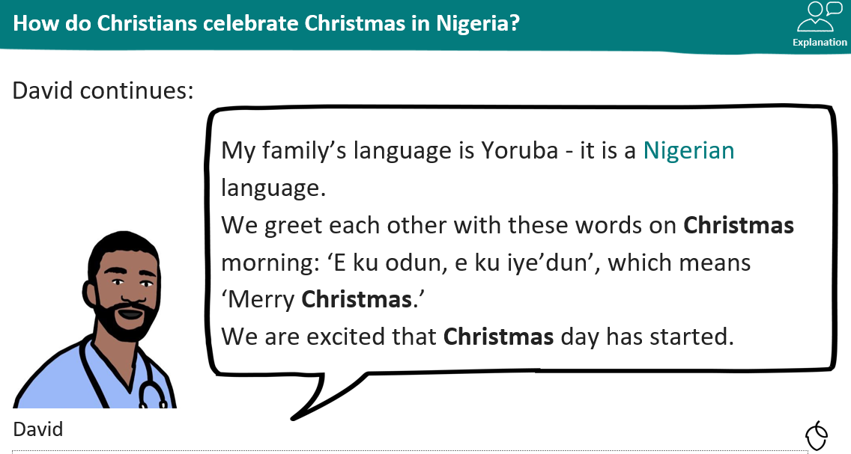
KQ: How do Christians around the world celebrate Christmas?
Monday 15th December 2025

Slide 36
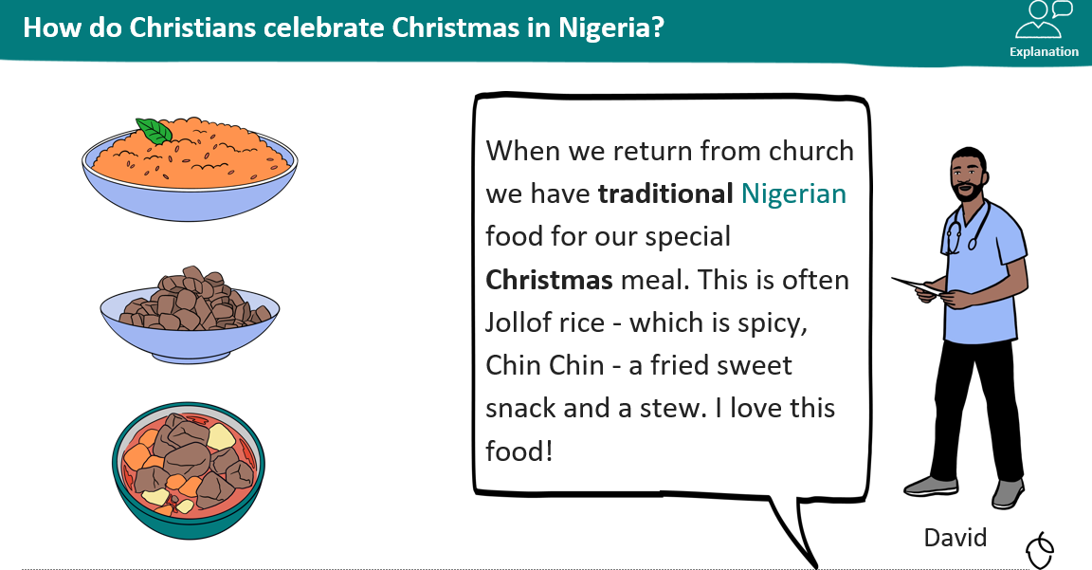
KQ: How do Christians around the world celebrate Christmas?
Monday 15th December 2025

Slide 37
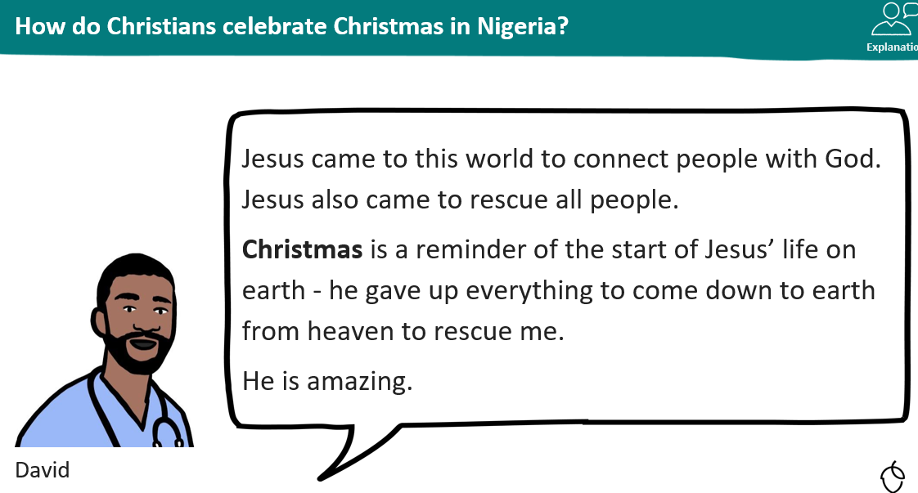
KQ: How do Christians around the world celebrate Christmas?
Monday 15th December 2025

Slide 38
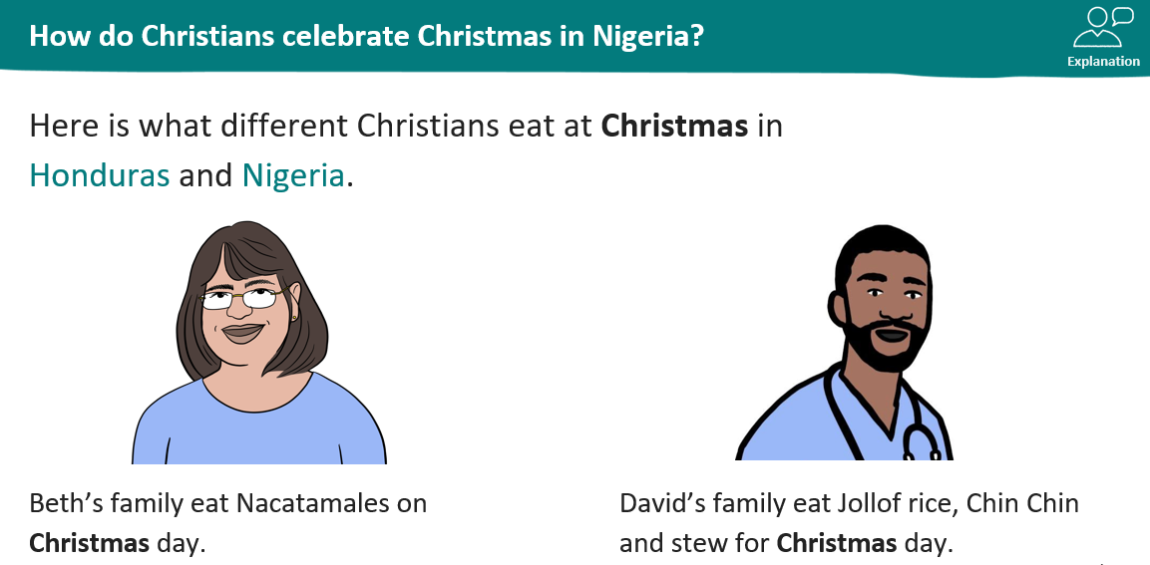
KQ: How do Christians around the world celebrate Christmas?
Monday 15th December 2025
How is this different from what we eat st Christmas in the UK?

Slide 39
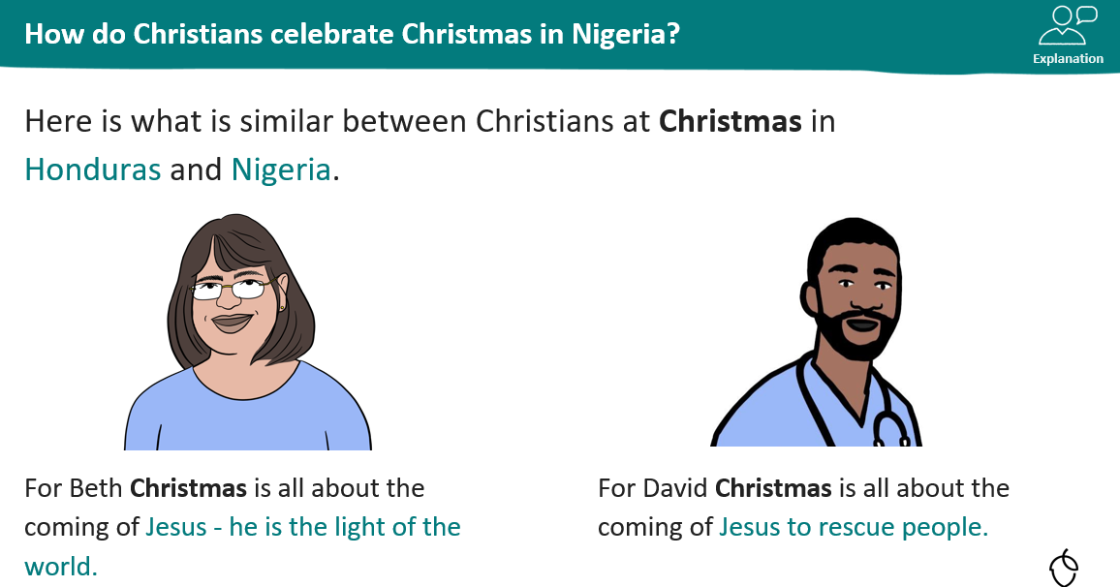
KQ: How do Christians around the world celebrate Christmas?
Monday 15th December 2025

Slide 40
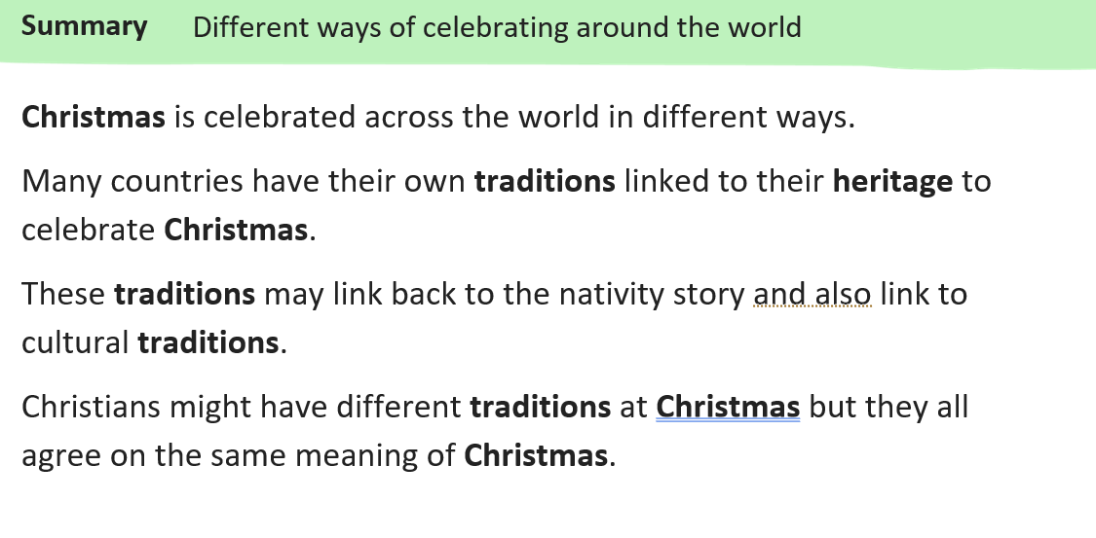
KQ: How do Christians around the world celebrate Christmas?
Monday 15th December 2025

