Slide 1
Wednesday 19th November 2025

Slide 2


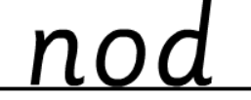
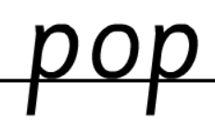
Morning Challenges:
Name writing

Slide 3
TBAT: read o-e /oa/ words

Slide 4
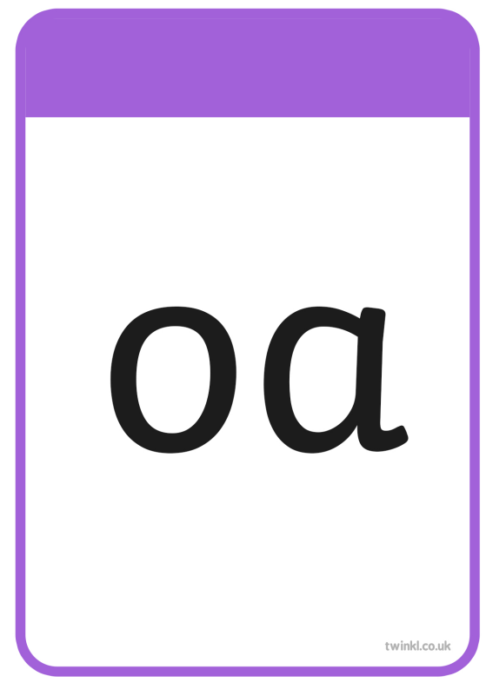


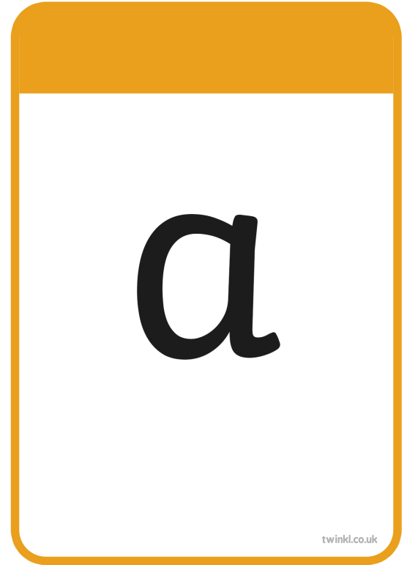
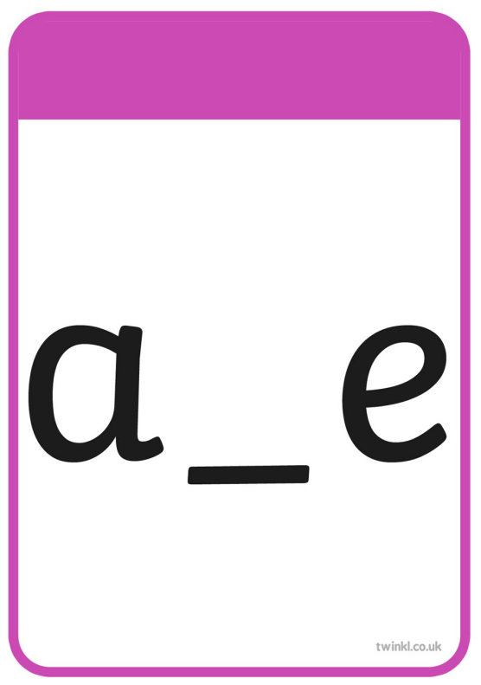





Slide 5
TBAT: read o-e /oa/ words
float

Slide 6
TBAT: read o-e /oa/ words
open

Slide 7
TBAT: read o-e /oa/ words
post

Slide 8
TBAT: read o-e /oa/ words
painting

Slide 9
TBAT: read o-e /oa/ words
found

Slide 10
TBAT: read o-e /oa/ words
belt

Slide 11



Slide 12
TBAT: read o-e /oa/ words
home

Slide 13
TBAT: read o-e /oa/ words
woke

Slide 14
TBAT: read o-e /oa/ words
stone

Slide 15
TBAT: read o-e /oa/ words
note

Slide 16
TBAT: read o-e /oa/ words
those

Slide 17
TBAT: read o-e /oa/ words
explode

Slide 18


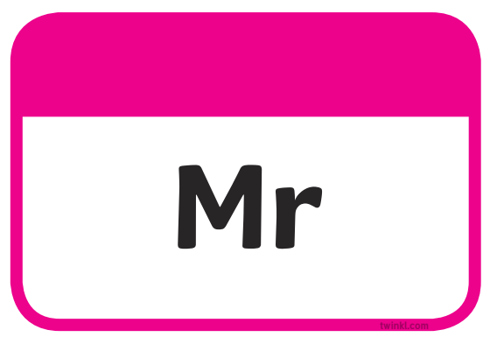

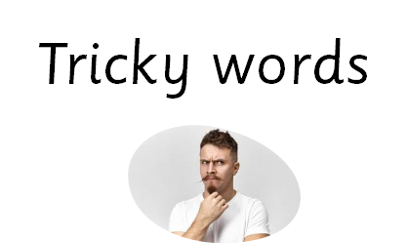


sh

Slide 19
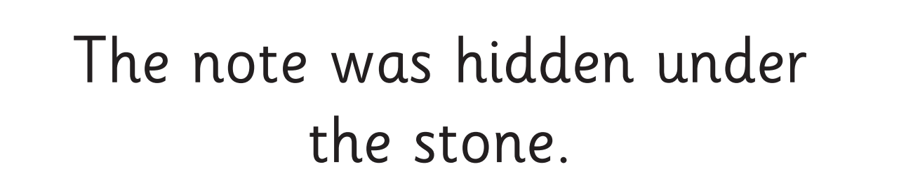

Slide 20
Write a sentence using these words
should
Challenge:
Use more than one word in your sentence.
home woke

Slide 21
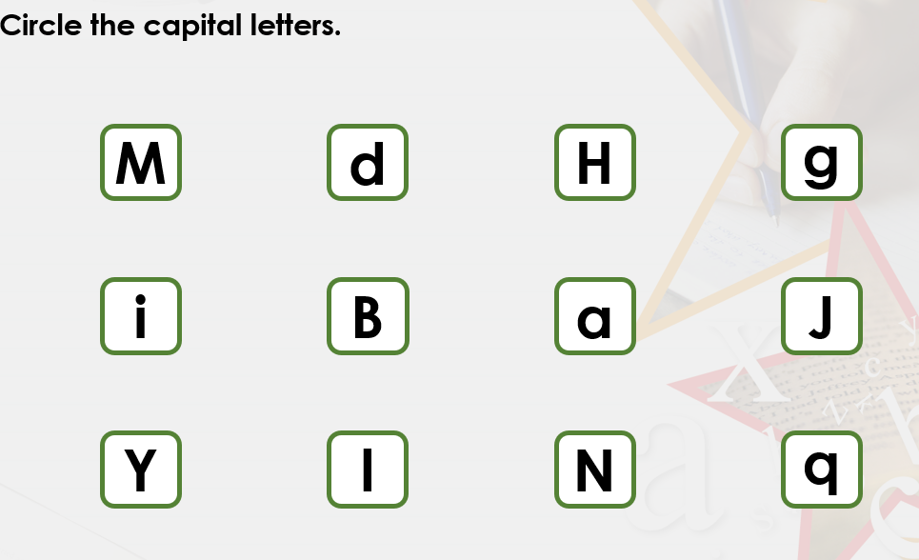
TBAT: use capital letters at the start of sentences and for I
3 in 3
Challenge: can you think of the capital letters for the other letters?

Slide 22
Blue/green
TBAT: use capital letters at the start of sentences and for I
When should we use a full stop?
We should use a full stop…
When should we use a capital letter?
We should use a capital letter …

Slide 23
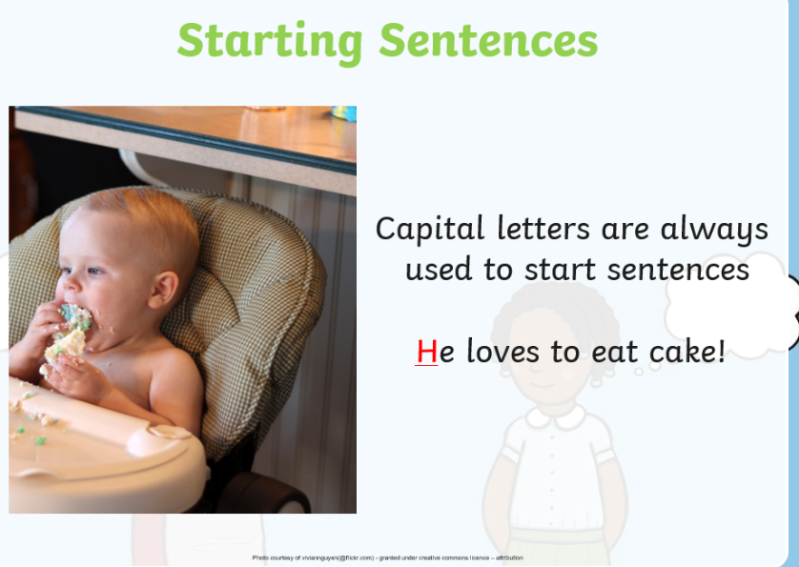
TBAT: use capital letters at the start of sentences and for I

Slide 24
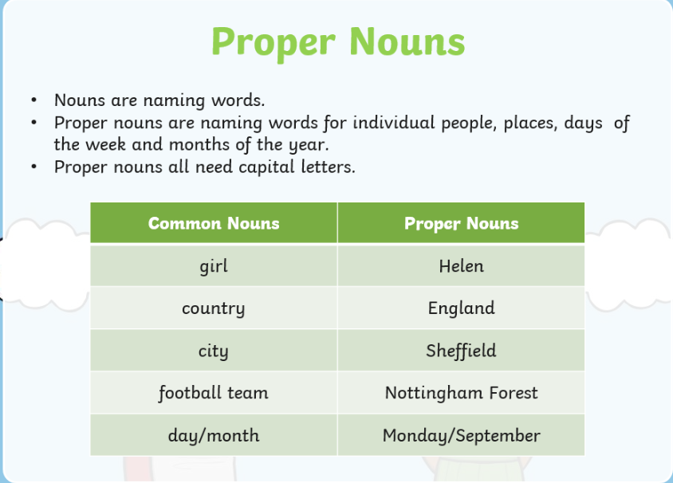
TBAT: use capital letters at the start of sentences and for I

Slide 25
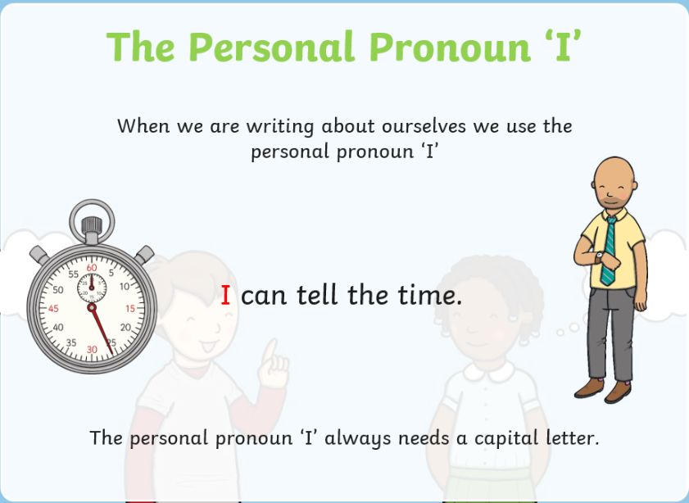
TBAT: use capital letters at the start of sentences and for I

Slide 26
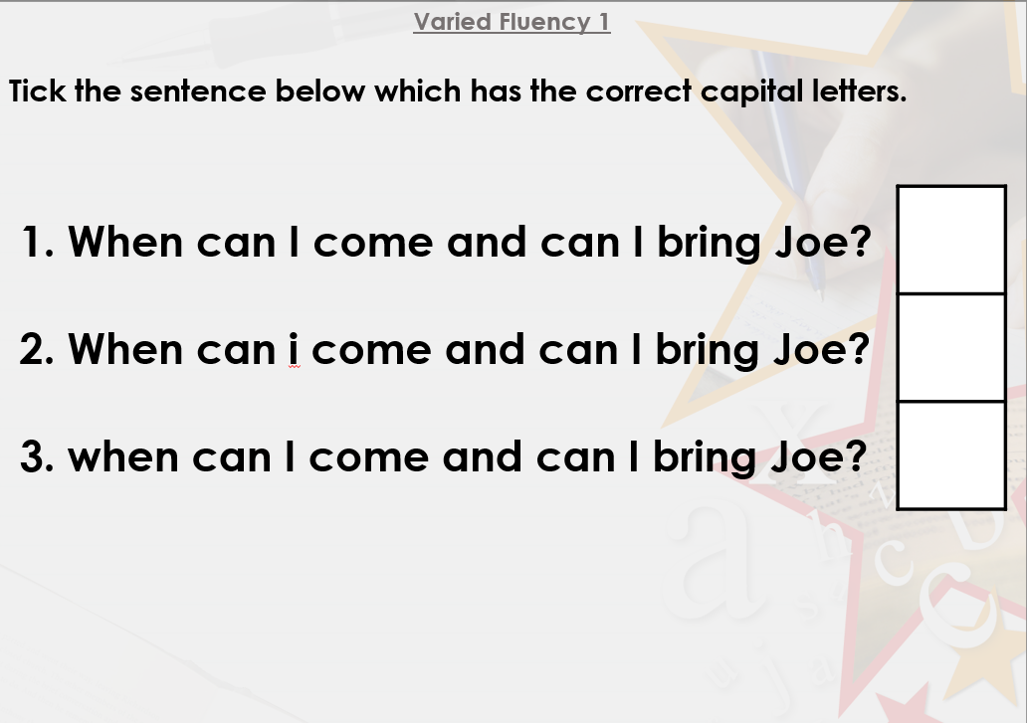
TBAT: use capital letters at the start of sentences and for I

Slide 27
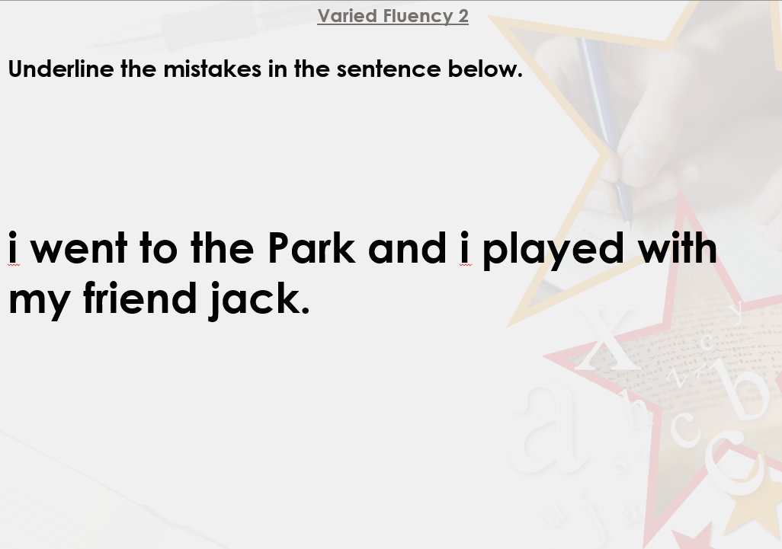
TBAT: use capital letters at the start of sentences and for I

Slide 28
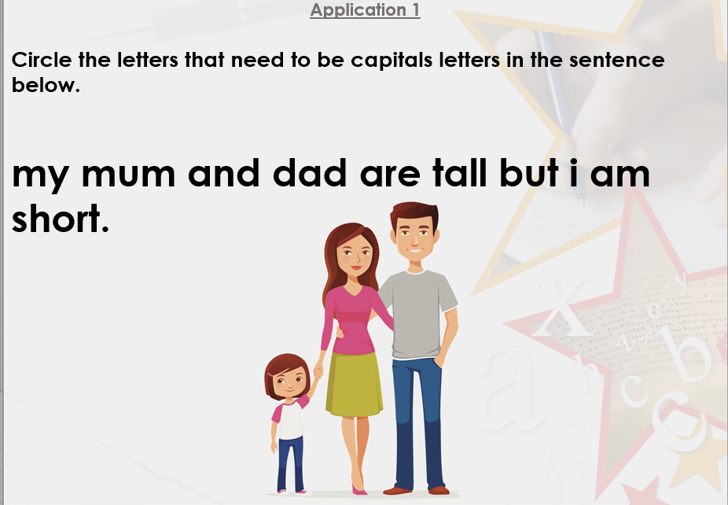
TBAT: use capital letters at the start of sentences and for I

Slide 29
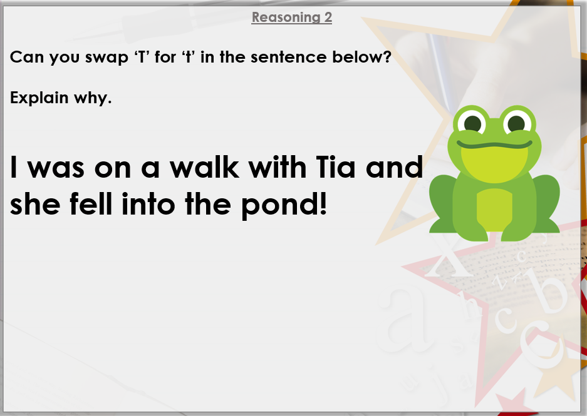
TBAT: use capital letters at the start of sentences and for I

Slide 30
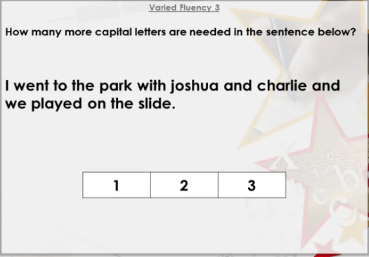
TBAT: use capital letters at the start of sentences and for I

Slide 31
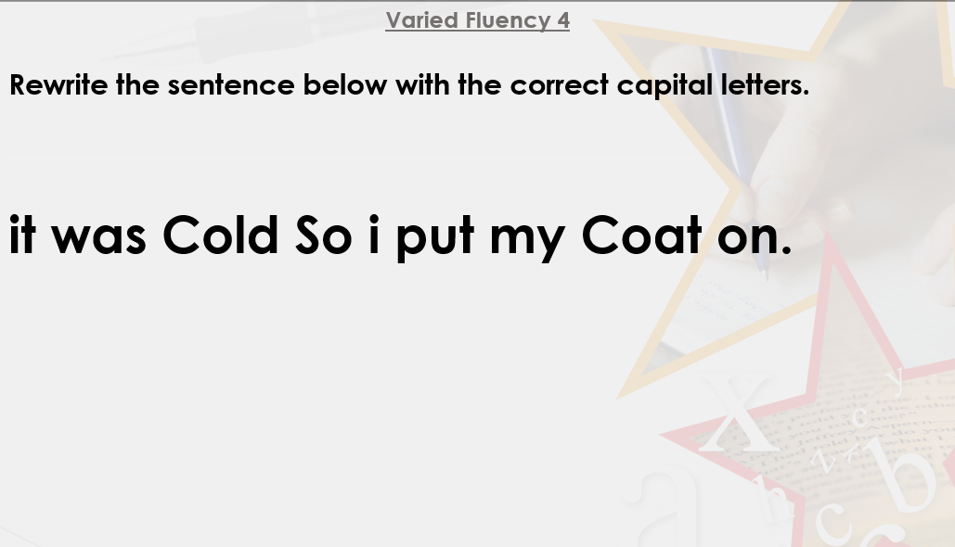
TBAT: use capital letters at the start of sentences and for I

Slide 32
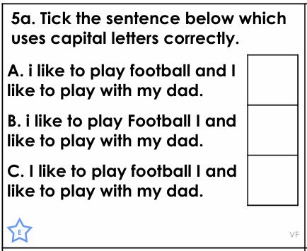
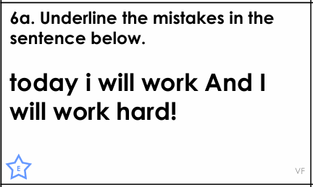
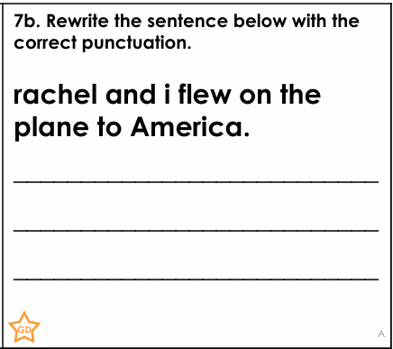
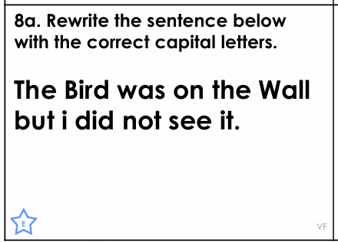
TBAT: use capital letters at the start of sentences and for I

Slide 33
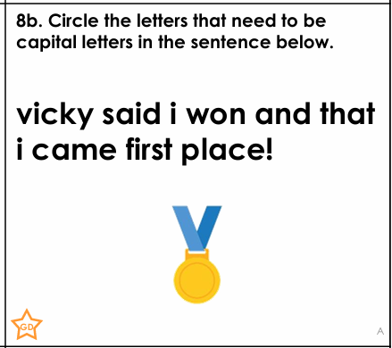
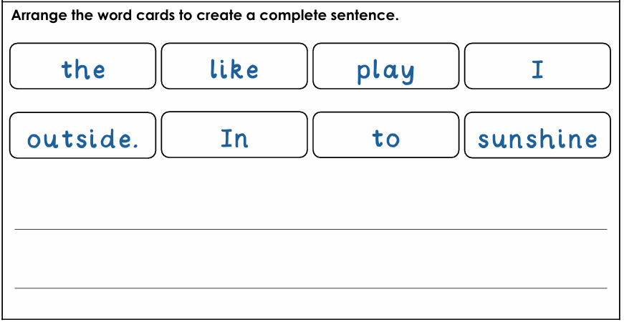
Challenge:

Slide 34
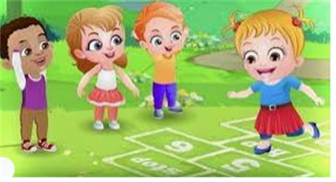
Break

Slide 35
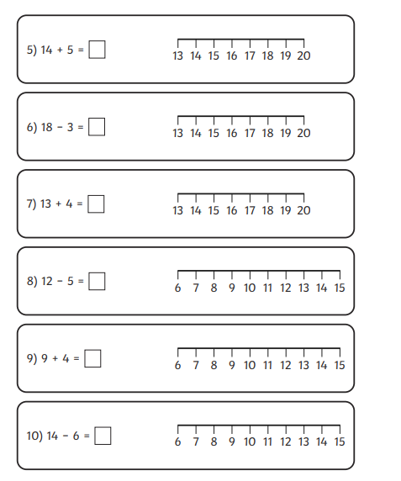
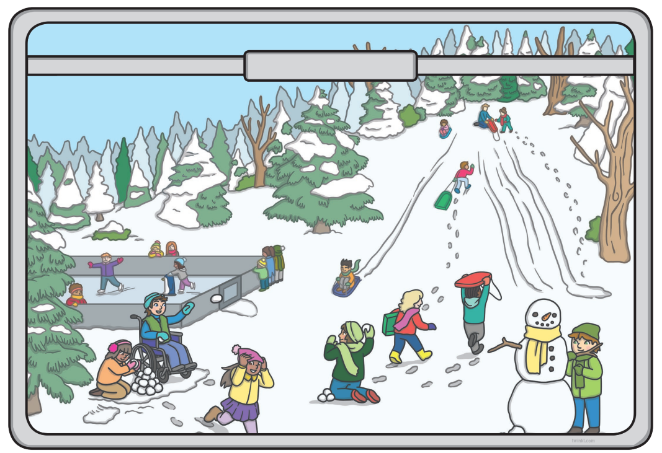
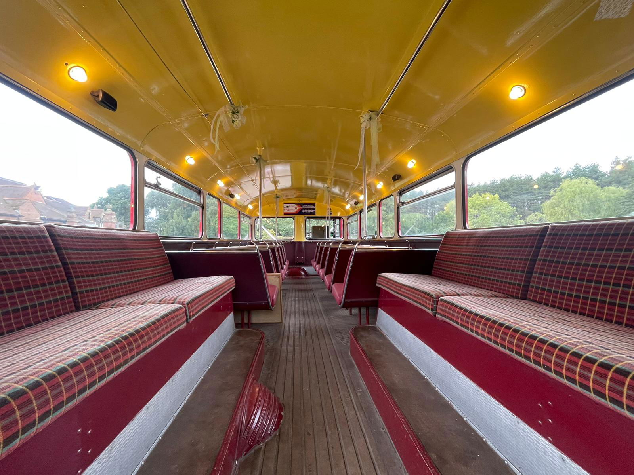
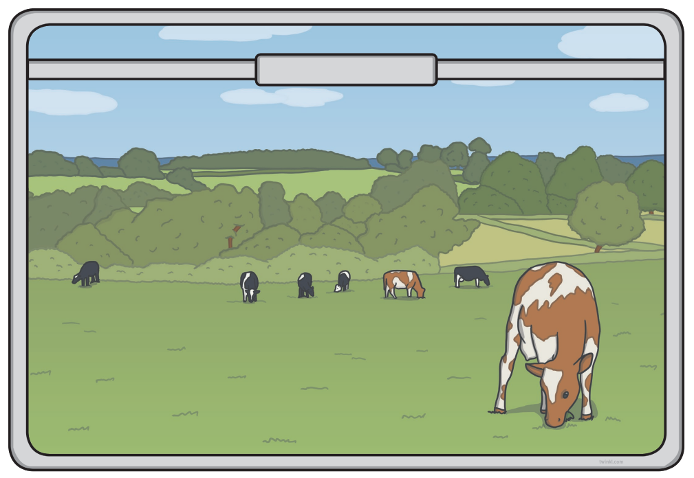
Independent Challenges:
Narrative Zone
Maths Zone
Describe what you can see out of the train window.
Use the number line to complete the calculations.
Enquiry Zone
Creative Zone
Use the pictures to predict how many people can sit on the bus.
Draw and then paint something you could see out of the train window

Slide 36

Lunch

Slide 37
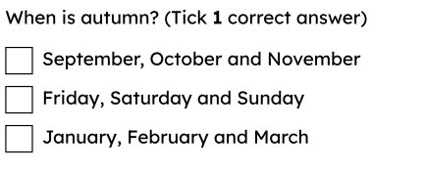
KQ: Can I describe the weather in Autumn?
Wednesday 19th November 2025
Entry question:

Slide 38
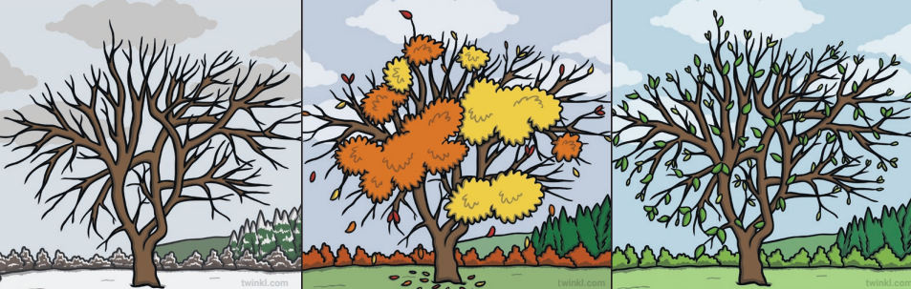
KQ: Can I describe the weather in Autumn?
Wednesday 19th November 2025
3 in 3- Which season are these tress likely to be seen in?
Challenge: Explain how you know.

Slide 39



KQ: Can I describe the weather in Autumn?
Wednesday 19th November 2025
Blue/ Green- Does this image make you think of Autumn?
This image does/does not make me think of Autumn because..........

Slide 40
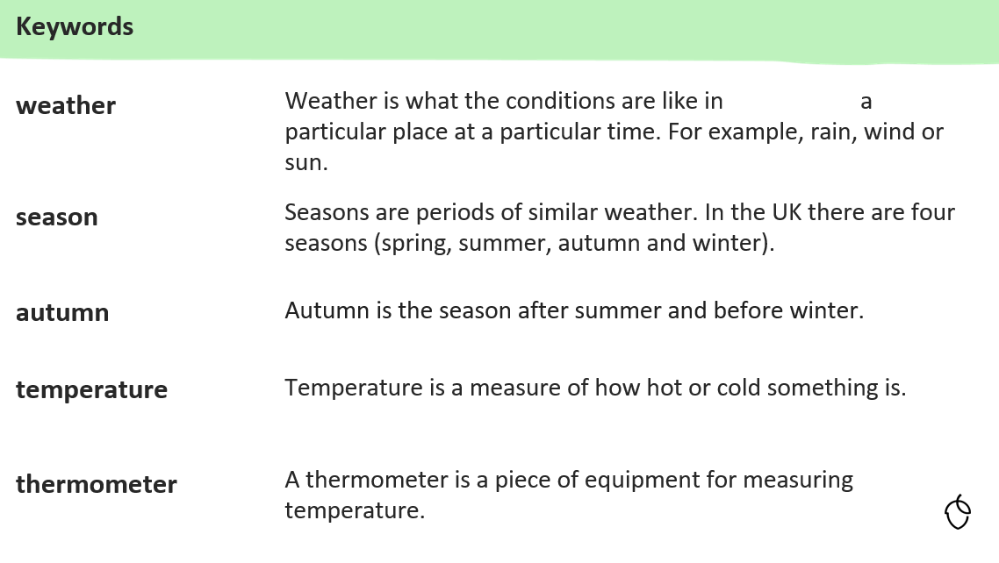
KQ: Can I describe the weather in Autumn?
Wednesday 19th November 2025

Slide 41
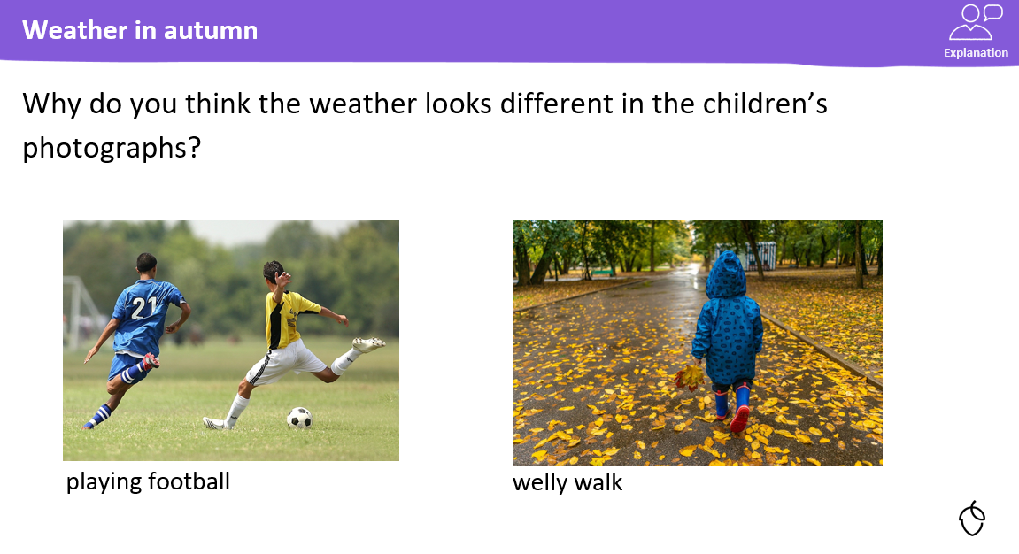
KQ: Can I describe the weather in Autumn?
Wednesday 19th November 2025

Slide 42
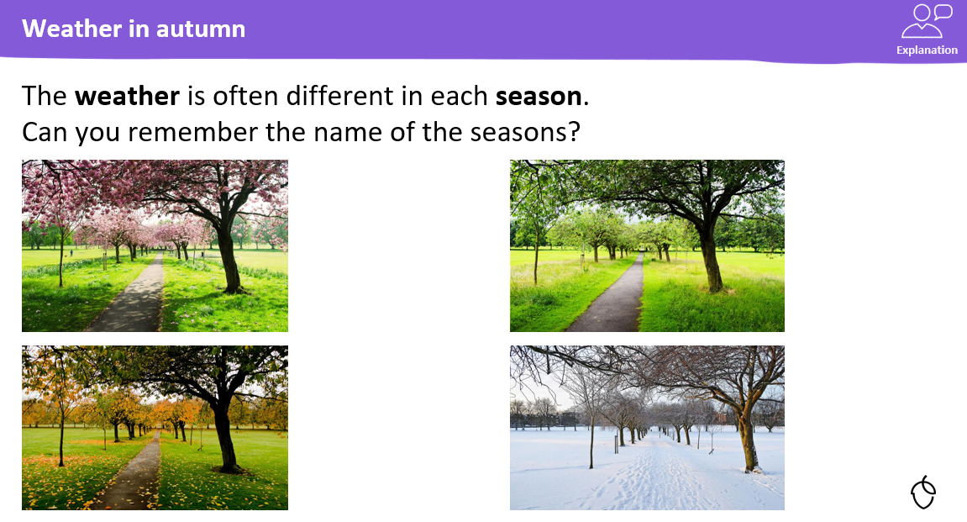
KQ: Can I describe the weather in Autumn?
Wednesday 19th November 2025

Slide 43
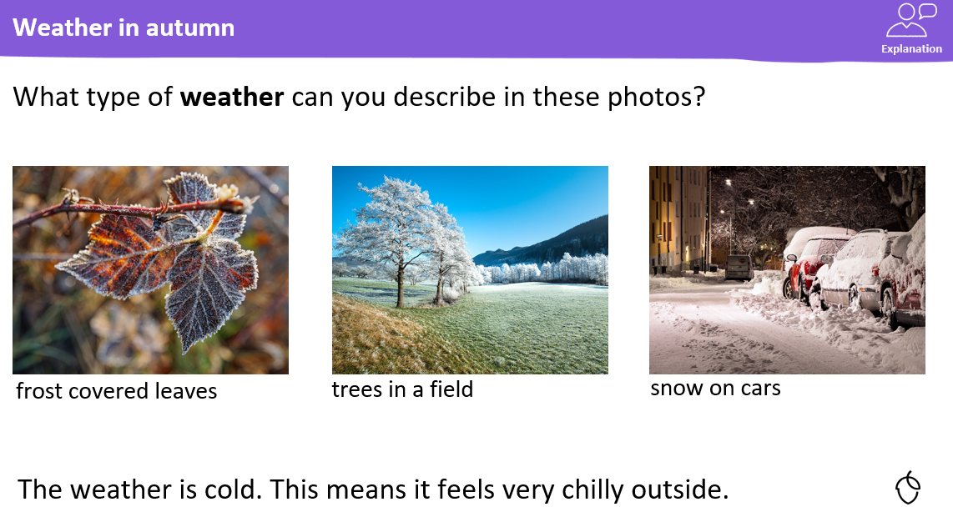
KQ: Can I describe the weather in Autumn?
Wednesday 19th November 2025

Slide 44
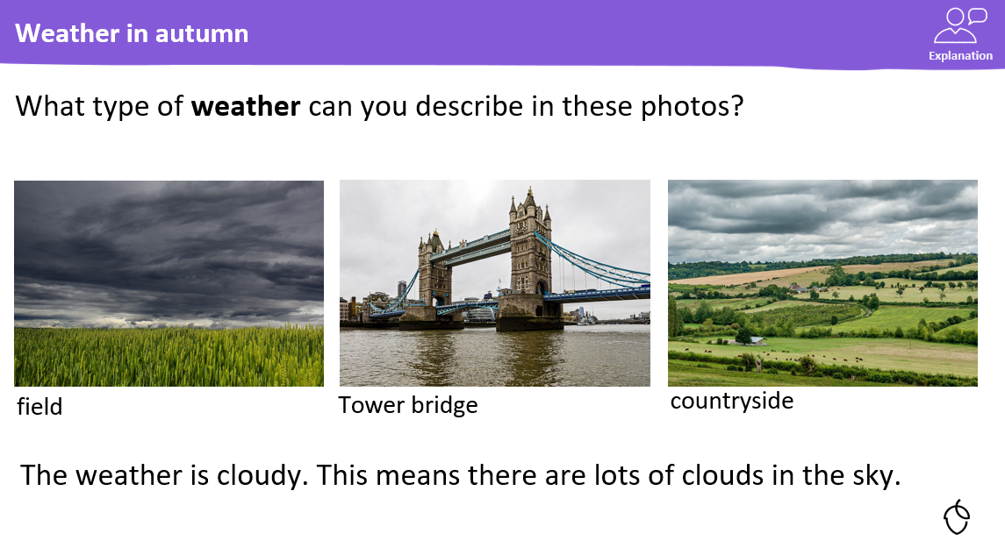
KQ: Can I describe the weather in Autumn?
Wednesday 19th November 2025

Slide 45
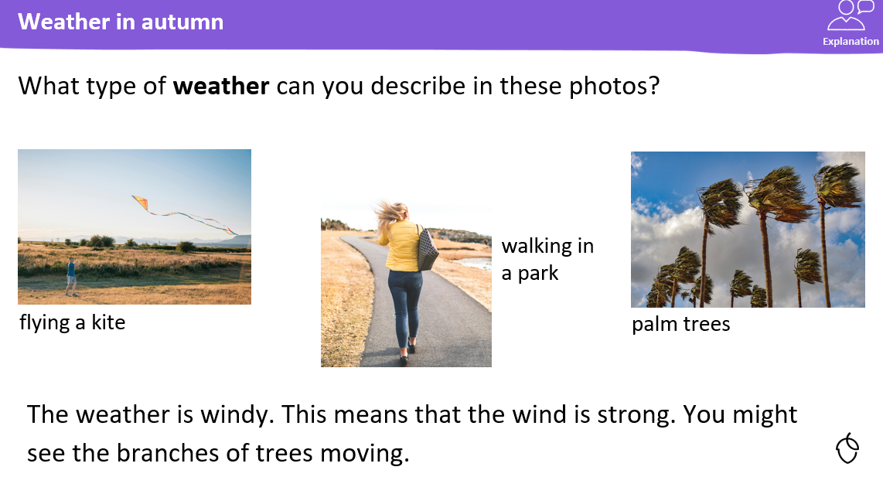
KQ: Can I describe the weather in Autumn?
Wednesday 19th November 2025

Slide 46
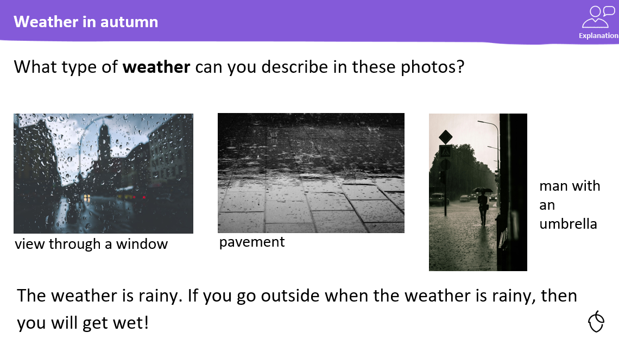
KQ: Can I describe the weather in Autumn?
Wednesday 19th November 2025

Slide 47
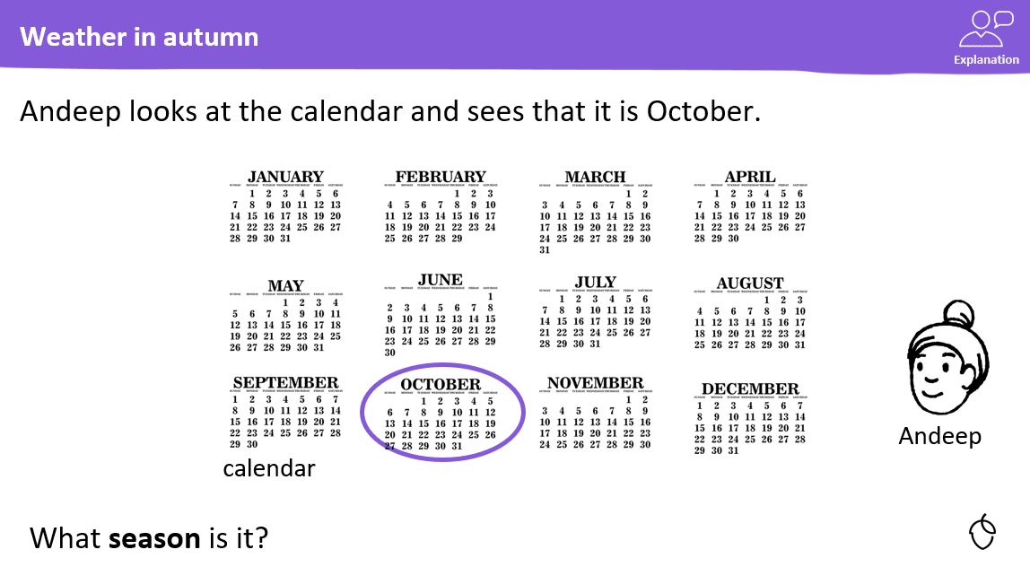
KQ: Can I describe the weather in Autumn?
Wednesday 19th November 2025

Slide 48
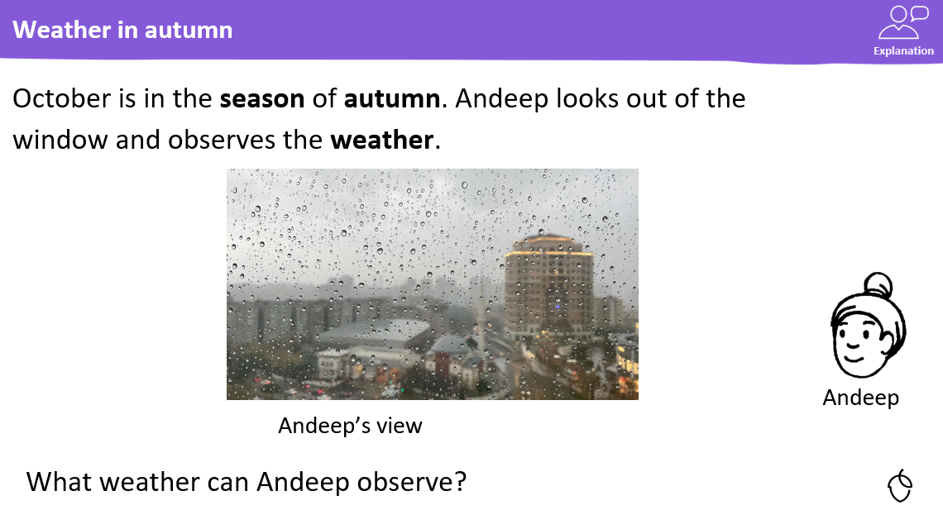
KQ: Can I describe the weather in Autumn?
Wednesday 19th November 2025

Slide 49
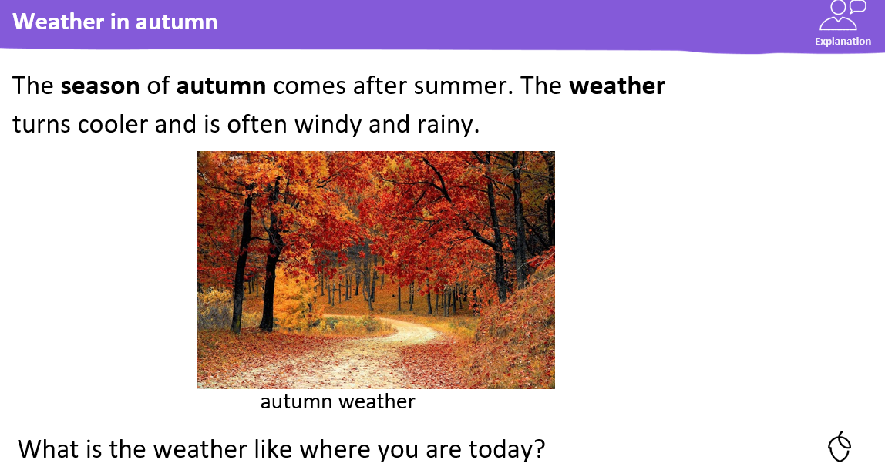
KQ: Can I describe the weather in Autumn?
Wednesday 19th November 2025

Slide 50
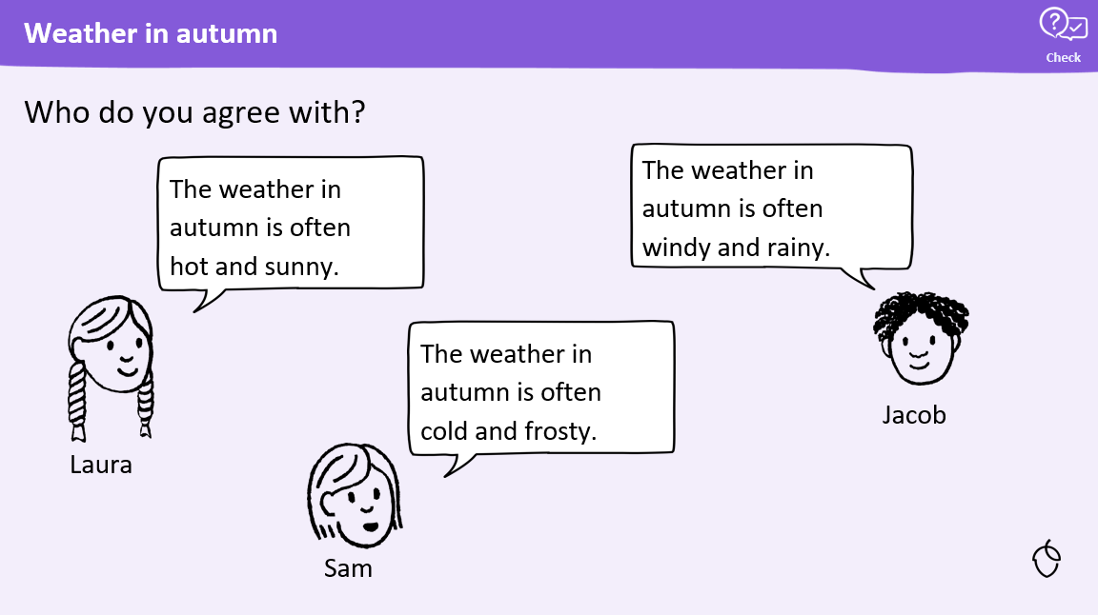
KQ: Can I describe the weather in Autumn?
Wednesday 19th November 2025

Slide 51
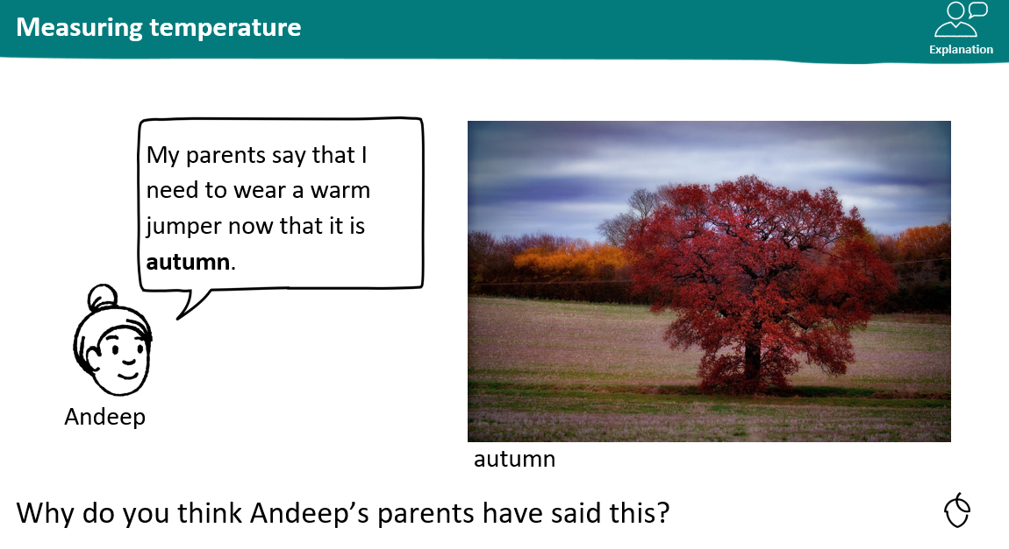
KQ: Can I describe the weather in Autumn?
Wednesday 19th November 2025

Slide 52
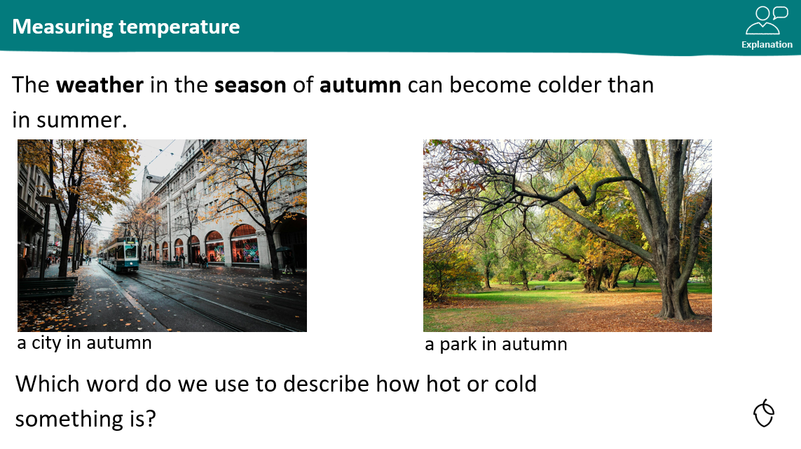
KQ: Can I describe the weather in Autumn?
Wednesday 19th November 2025

Slide 53
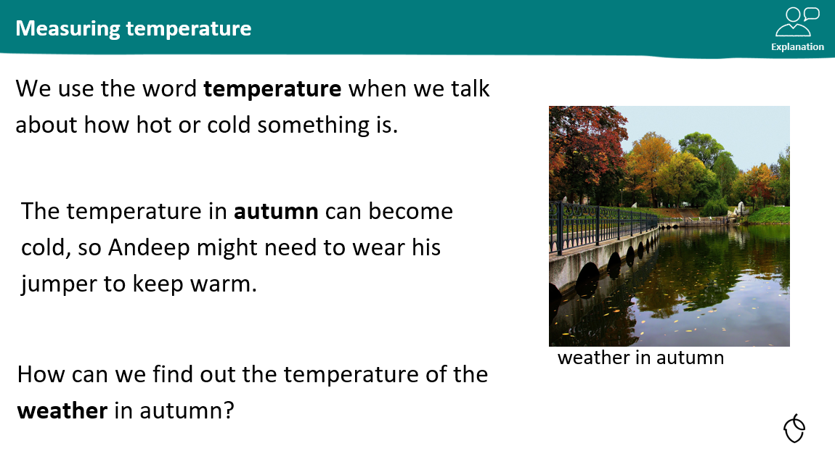
KQ: Can I describe the weather in Autumn?
Wednesday 19th November 2025

Slide 54
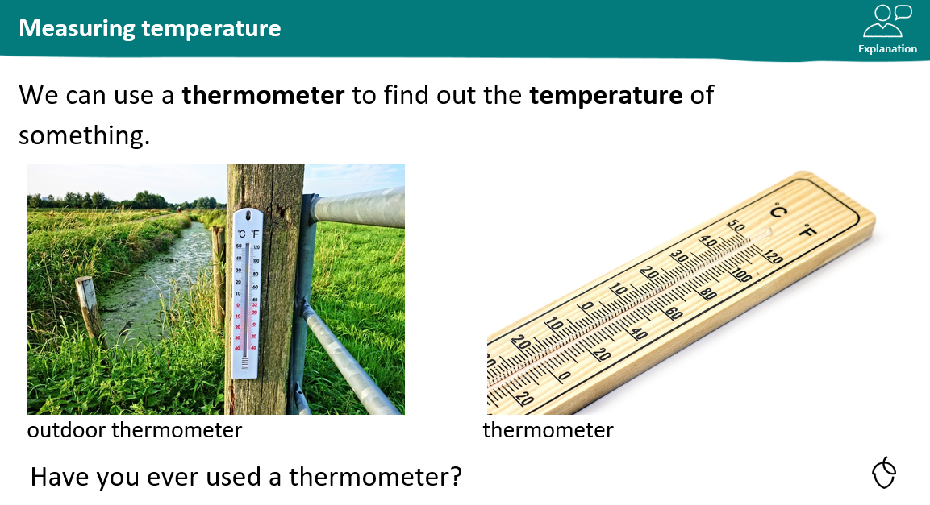
KQ: Can I describe the weather in Autumn?
Wednesday 19th November 2025

Slide 55
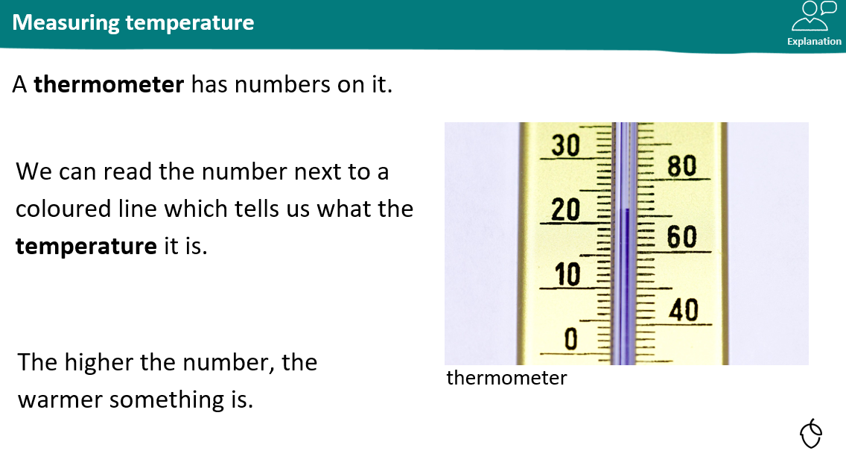
KQ: Can I describe the weather in Autumn?
Wednesday 19th November 2025

Slide 56
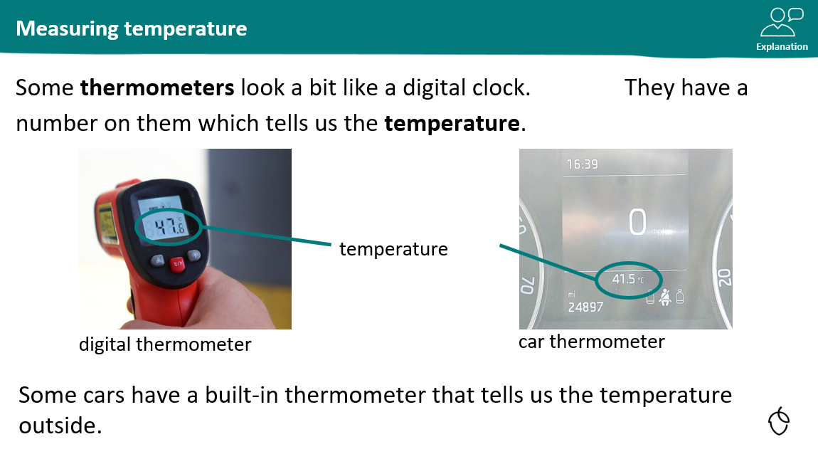
KQ: Can I describe the weather in Autumn?
Wednesday 19th November 2025

Slide 57
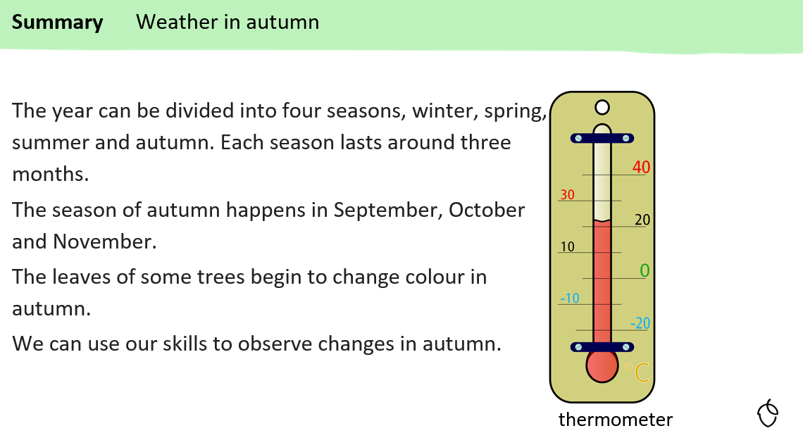
KQ: Can I describe the weather in Autumn?
Wednesday 19th November 2025

Slide 58
KQ: Can I describe the weather in Autumn?
Wednesday 19th November 2025
Independent:
Challenge:
 | Wednesday | Thursday | Friday
Draw
Write
Temp:
Which day was the warmest?
Which was the coldest?

Slide 59
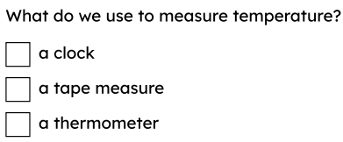
KQ: Can I describe the weather in Autumn?
Wednesday 19th November 2025
Exit question:

