Slide 1
Wednesday 12th November 2025

Slide 2



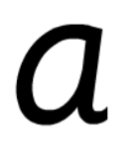
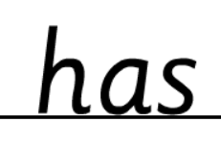
Morning Challenges:
Name writing

Slide 3
TBAT: read words with a /ai/

Slide 4



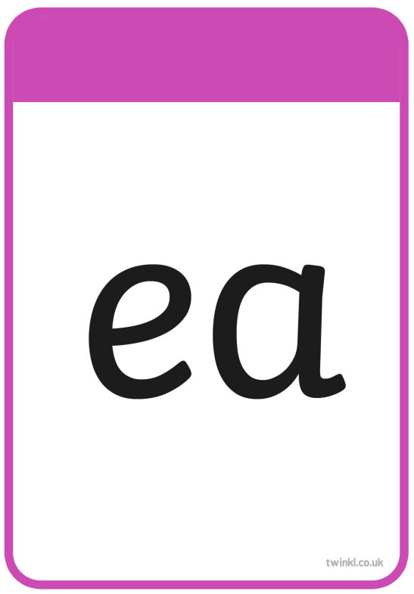



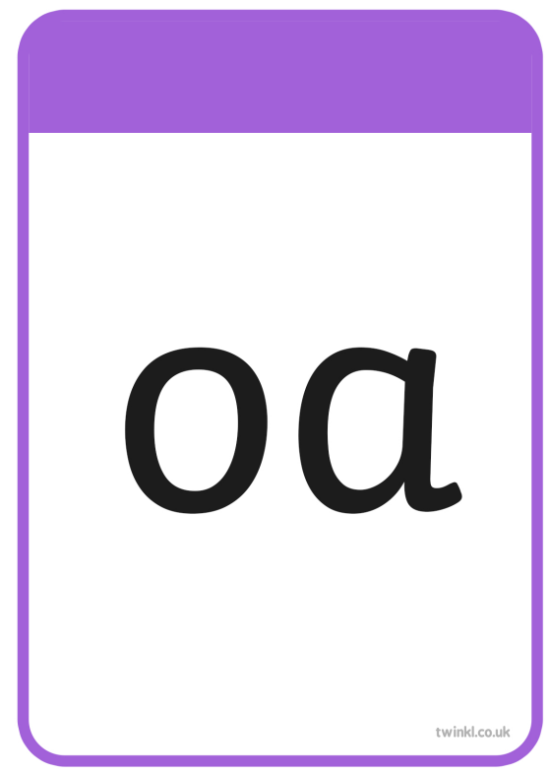



Slide 5
TBAT: read words with a /ai/
Wednesday 12th November 2025
child

Slide 6
TBAT: read words with a /ai/
Wednesday 12th November 2025
tiger

Slide 7
TBAT: read words with a /ai/
Wednesday 12th November 2025
most

Slide 8
TBAT: read words with a /ai/
Wednesday 12th November 2025
spark

Slide 9
TBAT: read words with a /ai/
Wednesday 12th November 2025
blink

Slide 10
TBAT: read words with a /ai/
Wednesday 12th November 2025
shampoo

Slide 11








Slide 12


TBAT: read words with a /ai/
Wednesday 12th November 2025

Slide 13
TBAT: read words with a /ai/
Wednesday 12th November 2025
p-a-p-er

Slide 14
TBAT: read words with a /ai/
Wednesday 12th November 2025
l-a-t-er

Slide 15
TBAT: read words with a /ai/
Wednesday 12th November 2025
ch-a-s-i-ng

Slide 16
TBAT: read words with a /ai/
Wednesday 12th November 2025
basic

Slide 17
TBAT: read words with a /ai/
Wednesday 12th November 2025
baking

Slide 18
TBAT: read words with a /ai/
Wednesday 12th November 2025
acorn

Slide 19
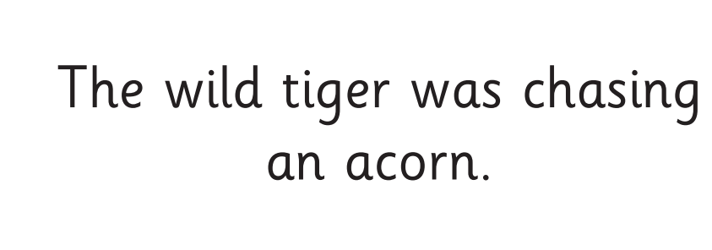
TBAT: read words with a /ai/
Wednesday 12th November 2025

Slide 20


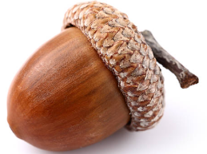
Write a sentence using these words
TBAT: read words with a /ai/
Wednesday 12th November 2025
Ms
basic
acorn

Slide 21
3 in 3
2nd
^{16th}
5th
sixteenth
second
fifth
Ordinal Numbers | Jack Hartmann Ordinal Numbers Song
Notes:
Do Now: Practise saying ordinal numbers to 20
Line 20 pupils up facing the door. The whole class practises saying each pupil’s position in the line. Concentrate on the teen ordinal numbers, as pupils may not have encountered these words yet.

Slide 22
To identify and continue number patterns, adding and subtracting one and two
increase
decrease
pattern

Slide 23
Identifying number patterns
What is happening in this pattern?
How do you know?
Notes:
New Learning: Identifying number patterns
Use the slide, or concrete cubes, to show a representation of a number pattern increasing by one each time.
What is happening in this pattern? How do you know?
This pattern is adding one each time. I know because I can see the ones are getting one greater each time.
Tell pupils that we will call this an increasing pattern because the numbers are becoming greater in value. Show the same pattern using jumps on a number line on the next slide. Recap that each number in the pattern is one greater than the previous one.
On the next slide (or using concrete cubes), show a number pattern decreasing by two each time. Ask pupils to discuss what is happening in this pattern.
The pattern is getting two smaller each time. I can see there are two more ones missing for each number in the pattern.
Tell pupils that we call this a decreasing pattern because the numbers are getting smaller in value. Show the pattern on a number line on the next slide.
Repeat with other examples and have pupils identify whether they are increasing or decreasing and by how much. Model these using concrete manipulatives.

Slide 24
Identifying number patterns
Here is the same pattern, shown on a number line.
It is increasing by one each time.
0
1
2
3
4
5
6
7
8
9
10
11
12
13
14
15
16
17
18
19
20
Notes:
New Learning: Identifying number patterns
Use the slide, or concrete cubes, to show a representation of a number pattern increasing by one each time.
What is happening in this pattern? How do you know?
This pattern is adding one each time. I know because I can see the ones are getting one greater each time.
Tell pupils that we will call this an increasing pattern because the numbers are becoming greater in value. Show the same pattern using jumps on a number line on the next slide. Recap that each number in the pattern is one greater than the previous one.
On the next slide (or using concrete cubes), show a number pattern decreasing by two each time. Ask pupils to discuss what is happening in this pattern.
The pattern is getting two smaller each time. I can see there are two more ones missing for each number in the pattern.
Tell pupils that we call this a decreasing pattern because the numbers are getting smaller in value. Show the pattern on a number line on the next slide.
Repeat with other examples and have pupils identify whether they are increasing or decreasing and by how much. Model these using concrete manipulatives.

Slide 25
Identifying number patterns
What is happening in this pattern?
How do you know?
Notes:
New Learning: Identifying number patterns
Use the slide, or concrete cubes, to show a representation of a number pattern increasing by one each time.
What is happening in this pattern? How do you know?
This pattern is adding one each time. I know because I can see the ones are getting one greater each time.
Tell pupils that we will call this an increasing pattern because the numbers are becoming greater in value. Show the same pattern using jumps on a number line on the next slide. Recap that each number in the pattern is one greater than the previous one.
On the next slide (or using concrete cubes), show a number pattern decreasing by two each time. Ask pupils to discuss what is happening in this pattern.
The pattern is getting two smaller each time. I can see there are two more ones missing for each number in the pattern.
Tell pupils that we call this a decreasing pattern because the numbers are getting smaller in value. Show the pattern on a number line on the next slide.
Repeat with other examples and have pupils identify whether they are increasing or decreasing and by how much. Model these using concrete manipulatives.

Slide 26
Identifying number patterns
Here is the same pattern, shown on a number line.
It is decreasing by two each time.
0
1
2
3
4
5
6
7
8
9
10
11
12
13
14
15
16
17
18
19
20
Notes:
New Learning: Identifying number patterns
Use the slide, or concrete cubes, to show a representation of a number pattern increasing by one each time.
What is happening in this pattern? How do you know?
This pattern is adding one each time. I know because I can see the ones are getting one greater each time.
Tell pupils that we will call this an increasing pattern because the numbers are becoming greater in value. Show the same pattern using jumps on a number line on the next slide. Recap that each number in the pattern is one greater than the previous one.
On the next slide (or using concrete cubes), show a number pattern decreasing by two each time. Ask pupils to discuss what is happening in this pattern.
The pattern is getting two smaller each time. I can see there are two more ones missing for each number in the pattern.
Tell pupils that we call this a decreasing pattern because the numbers are getting smaller in value. Show the pattern on a number line on the next slide.
Repeat with other examples and have pupils identify whether they are increasing or decreasing and by how much. Model these using concrete manipulatives.

Slide 27

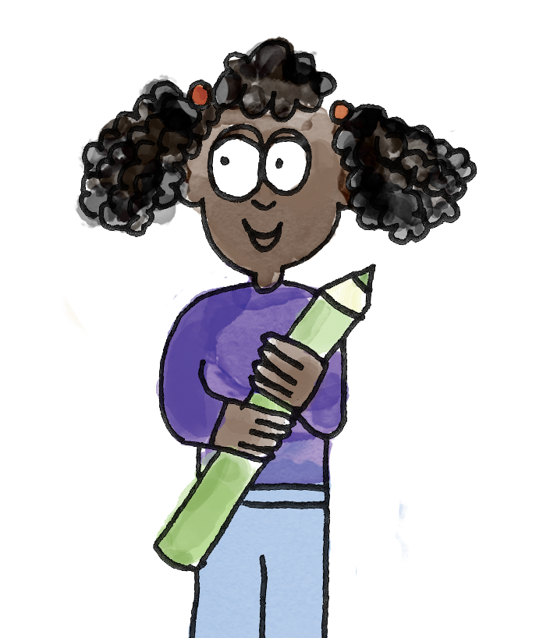
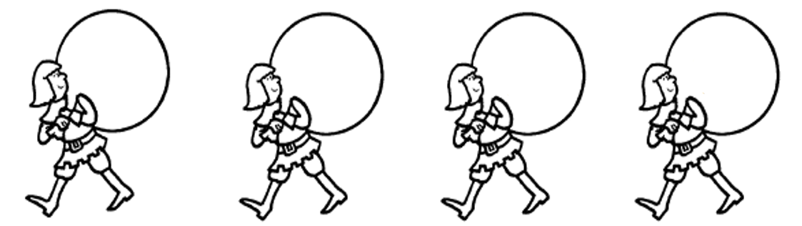
Identifying number patterns
The pattern is decreasing, because the numbers are becoming smaller in value each time.
Each number has one fewer one than the number before. That means the pattern is decreasing by one each time.
8
7
6
5
increase decrease pattern
Notes:
Talk Task: Identifying number patterns
Pupils will need enough manipulatives to represent each number in the patterns on the Task Sheet. Pupils take it in turns to represent the numbers in each pattern. Pupil A says whether the pattern is increasing or decreasing. Pupil B says by how much the pattern is increasing or decreasing. Pupils swap roles for the next pattern. Model the language and establish the expectation of speaking in complete sentences.

Slide 28

Fill in the missing numbers and describe the pattern
6, 8,…..., 12 .....
B/G
15, 14,13, …..., 11, …...
Increase decrease pattern
Notes:
Talk Task: Identifying number patterns
Pupils will need enough manipulatives to represent each number in the patterns on the Task Sheet. Pupils take it in turns to represent the numbers in each pattern. Pupil A says whether the pattern is increasing or decreasing. Pupil B says by how much the pattern is increasing or decreasing. Pupils swap roles for the next pattern. Model the language and establish the expectation of speaking in complete sentences.

Slide 29
Completing and continuing number patterns
Pattern A
Pattern B
?
10
11
12
13
Notes:
Develop Learning: Completing and continuing number patterns
Explain that pupils will now move on from identifying patterns to continuing them. Focus their attention on Pattern A on the slide. Remind pupils that they saw this pattern in the New Learning. Create each number in the pattern using concrete cubes.
What number will come next in this pattern? How do you know?
The next number would be 14 because the pattern is increasing by one each time and one more than 13 is 14.
What number would come before ten in this pattern? How do you know?
Now ask pupils to look at Pattern B.
What is the missing number in this pattern? How could you check?
We need to find the pattern. It’s increasing by two each time, so I think the missing number is 12. Yes, because if I add two more to that, it’s 14, and that’s the next number in the pattern.

Slide 30
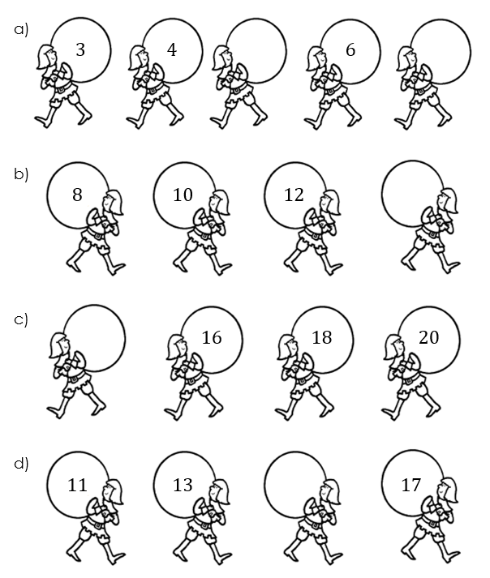
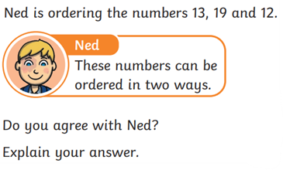
To identify and continue number patterns, adding and subtracting one and two
Use concrete manipulatives to represent the number patterns.
Fill in the missing numbers.
RP:
Notes:
Independent Task: Completing and continuing number patterns
Pupils complete the Task Sheet, representing the patterns using concrete manipulatives, identifying whether they are increasing or decreasing, and filling in the missing values.
Possible adaptations:
Some pupils may need pictorial representations of the abstract numbers in the patterns.
Some pupils may benefit from the additional challenge of identifying patterns which increase and decrease by three.

Slide 31
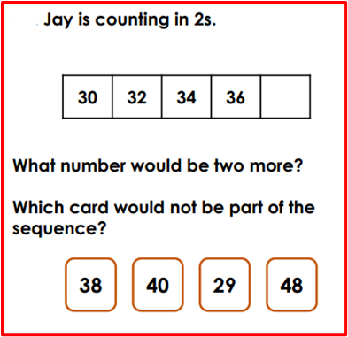
Challenge

Slide 32
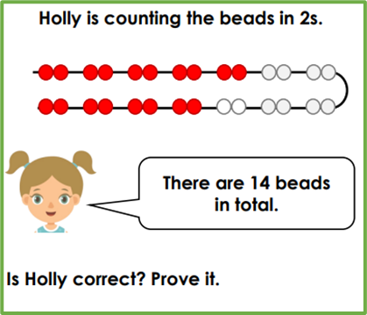
Mastery

Slide 33
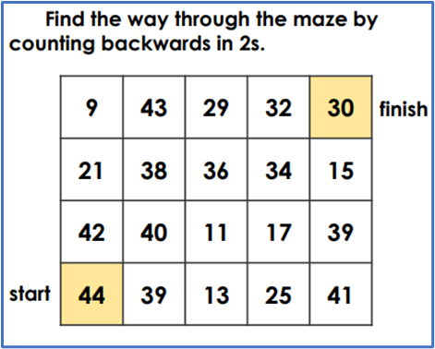
Mastery with greater depth:

Slide 34
Continuing patterns in words
eleven, twelve, thirteen, _____________
_____________, ten, twelve, fourteen
Notes:
Plenary: Continuing patterns in words
Ask a pupil to read aloud the first pattern.
Is the pattern increasing or decreasing?
Which number comes next in the pattern?
Give pupils time to discuss before taking responses, supporting pupils in using vocabulary accurately. Repeat for the second pattern, asking pupils to identify the number at the start.

Slide 35
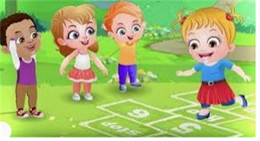
Break

Slide 36
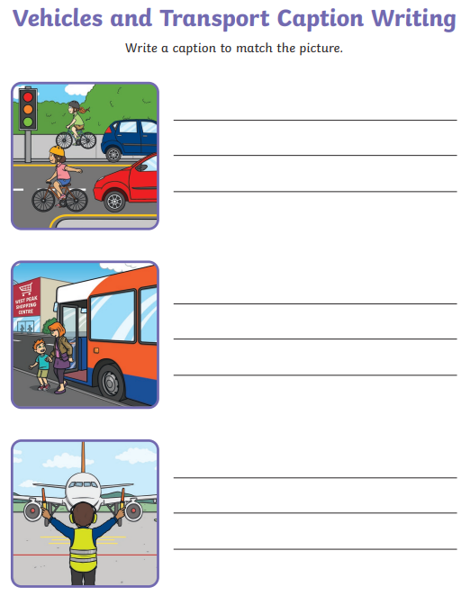
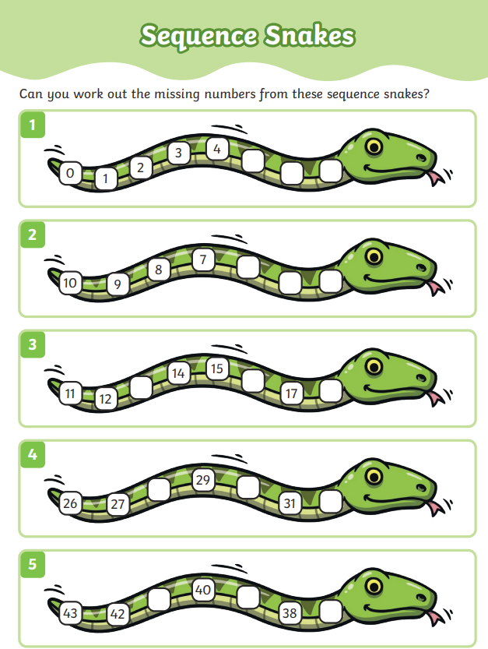
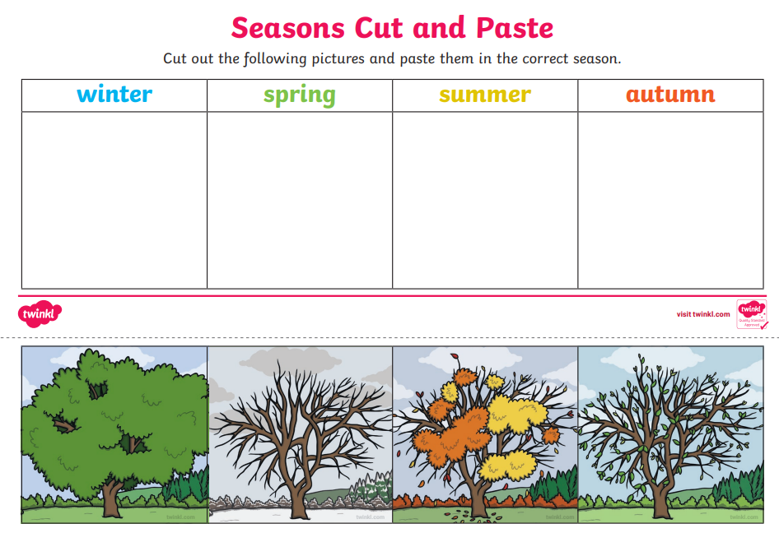
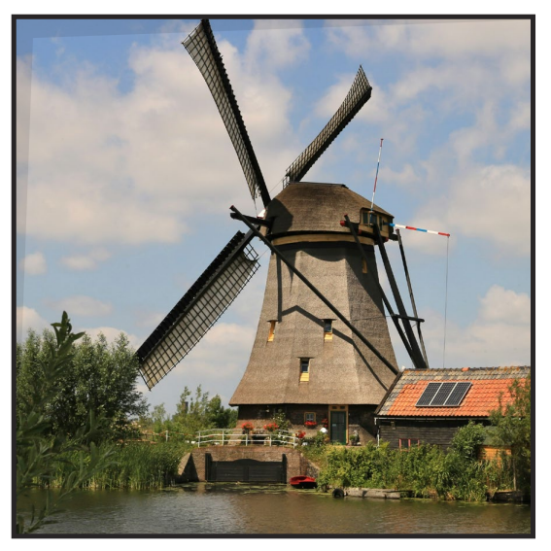
Independent Challenges:
Narrative Zone
Maths Zone
Sequencing snakes activity.
Write captions about the transport.
Enquiry Zone
Creative Zone
Create a water colour painting of a windmill.

Slide 37

Lunch

Slide 38
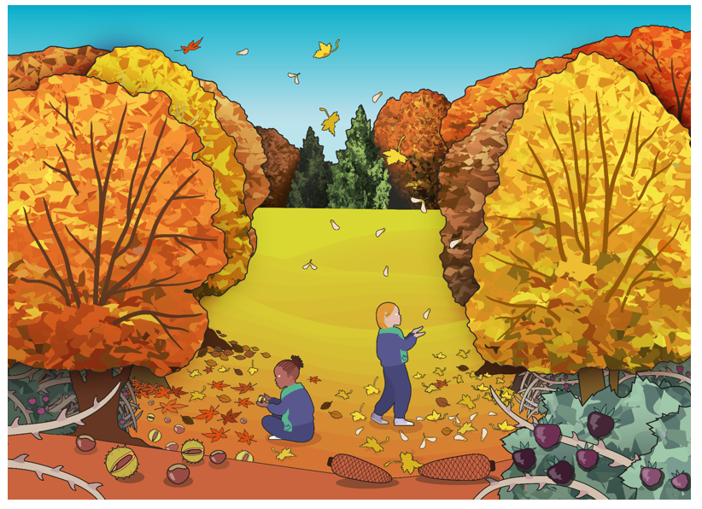
KQ: Can I spot signs of Autumn?
Wednesday 12th November 2025
Entry question:
Do you know what season this is?
What can you see that makes you think that?

Slide 39



KQ: Can I spot signs of Autumn?
Wednesday 12th November 2025
3 in 3 – Can you name the weather symbols?
Challenge: What season might you see this type of weather the most?

Slide 40
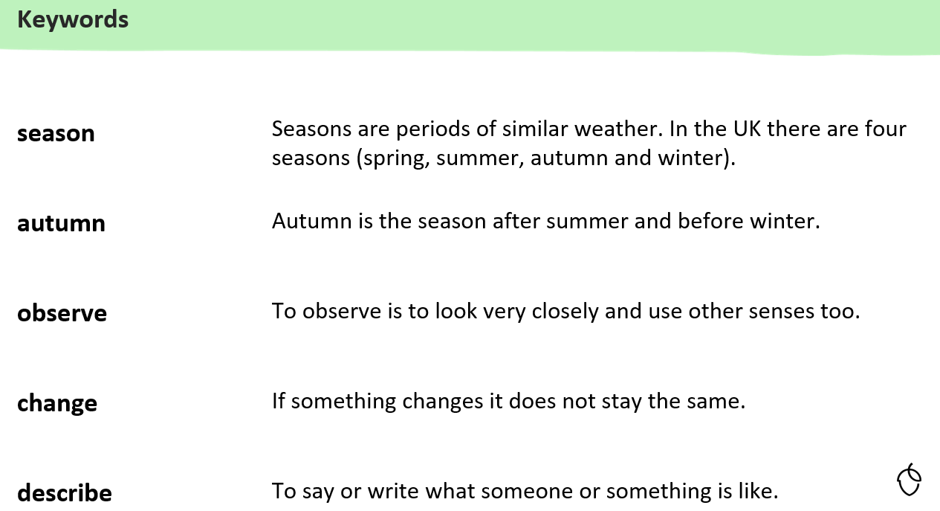
KQ: Can I spot signs of Autumn?
Wednesday 12th November 2025

Slide 41
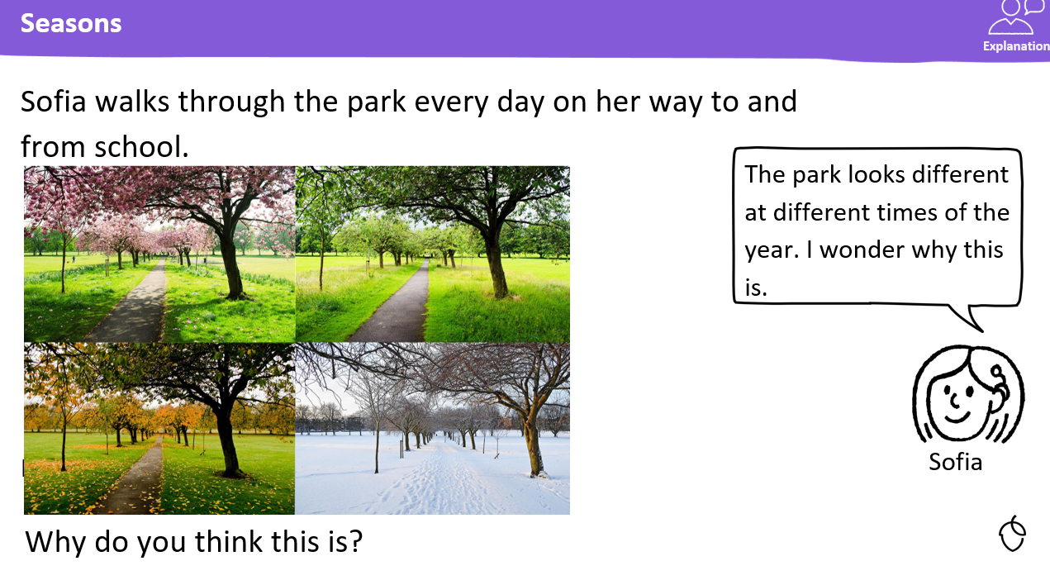
KQ: Can I spot signs of Autumn?
Wednesday 12th November 2025

Slide 42
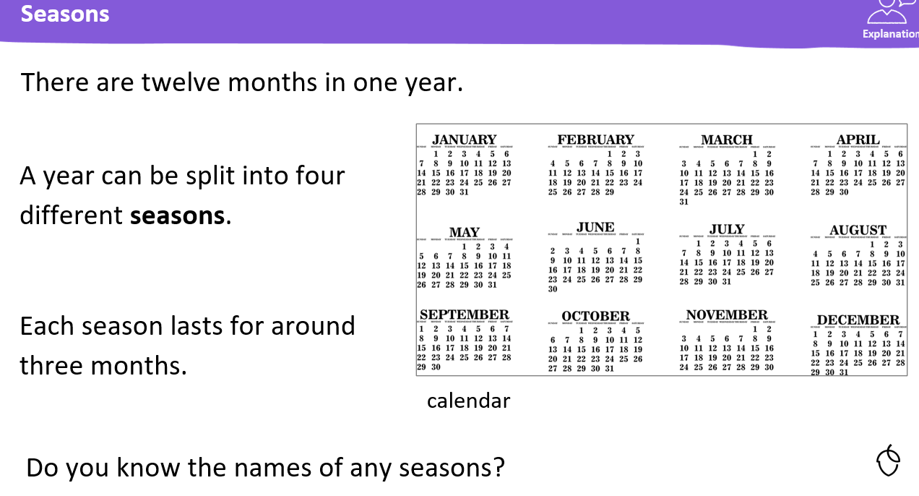
KQ: Can I spot signs of Autumn?
Wednesday 12th November 2025

Slide 43
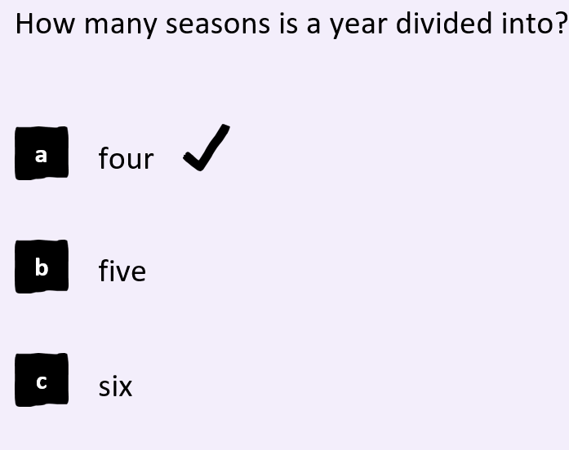
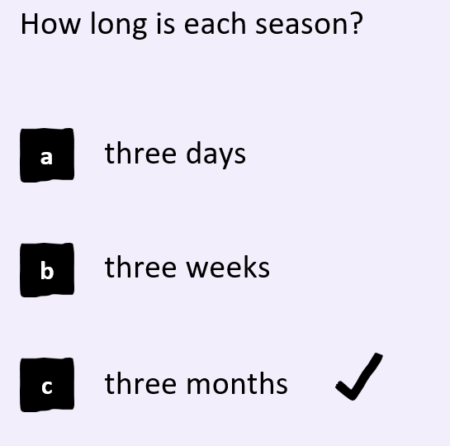
KQ: Can I spot signs of Autumn?
Wednesday 12th November 2025
Blue
Green

Slide 44
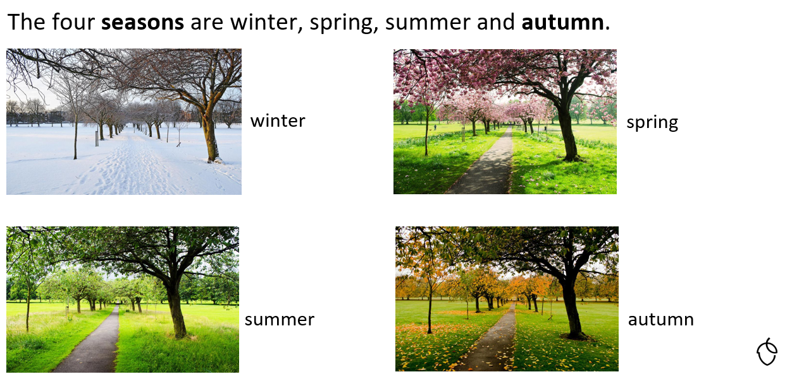
KQ: Can I spot signs of Autumn?
Wednesday 12th November 2025

Slide 45
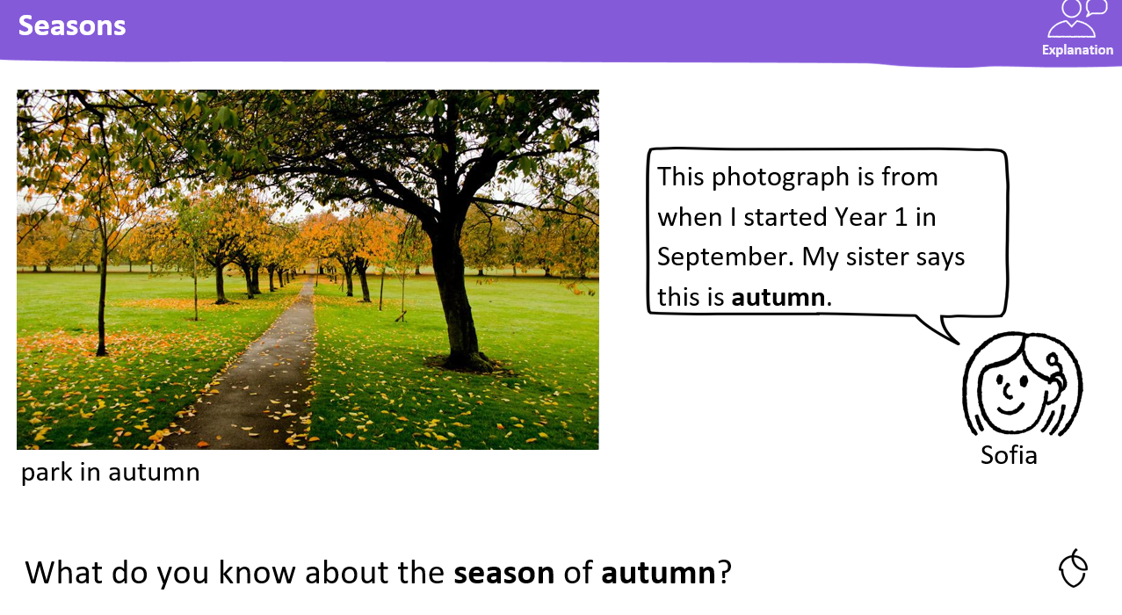
KQ: Can I spot signs of Autumn?
Wednesday 12th November 2025

Slide 46
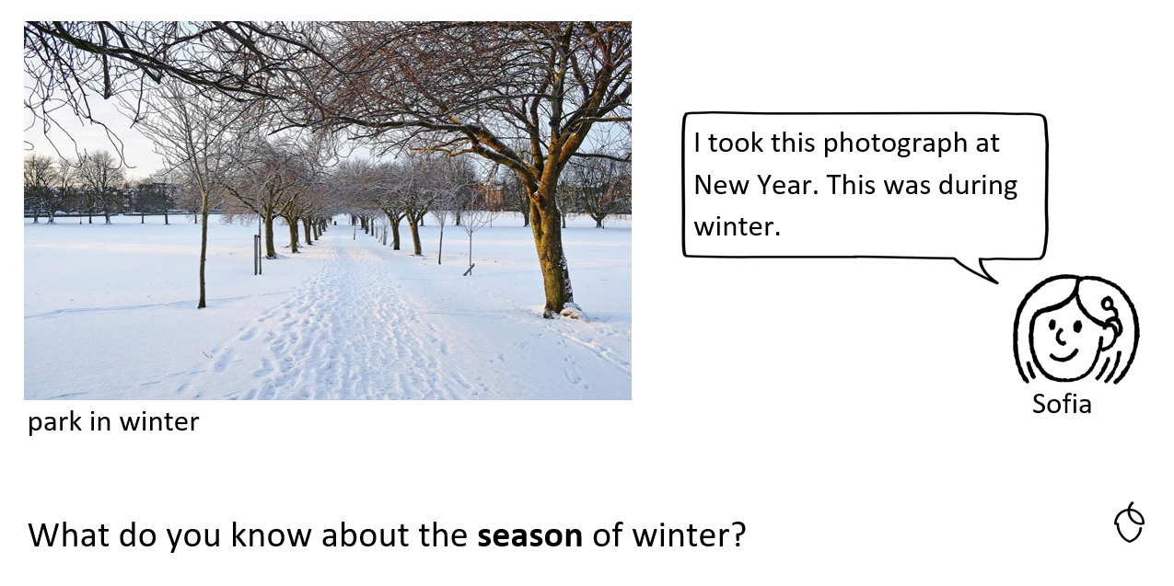
KQ: Can I spot signs of Autumn?
Wednesday 12th November 2025

Slide 47
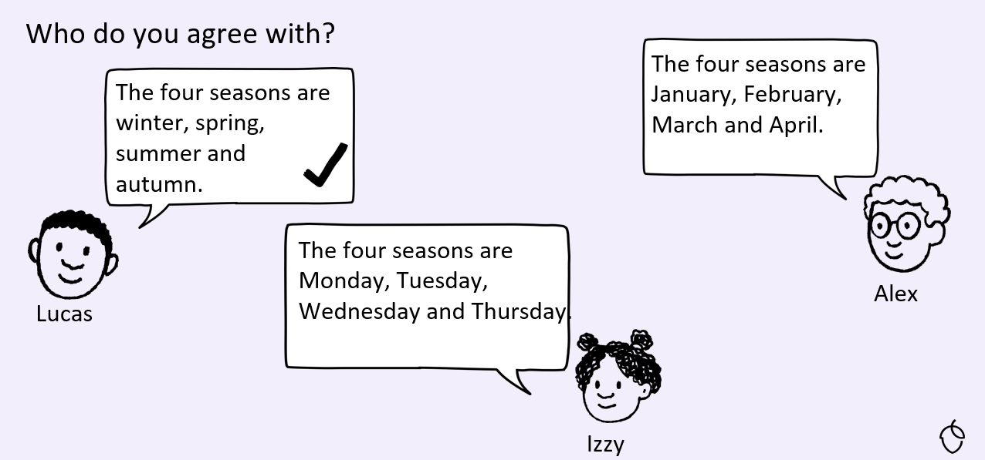
KQ: Can I spot signs of Autumn?
Wednesday 12th November 2025

Slide 48
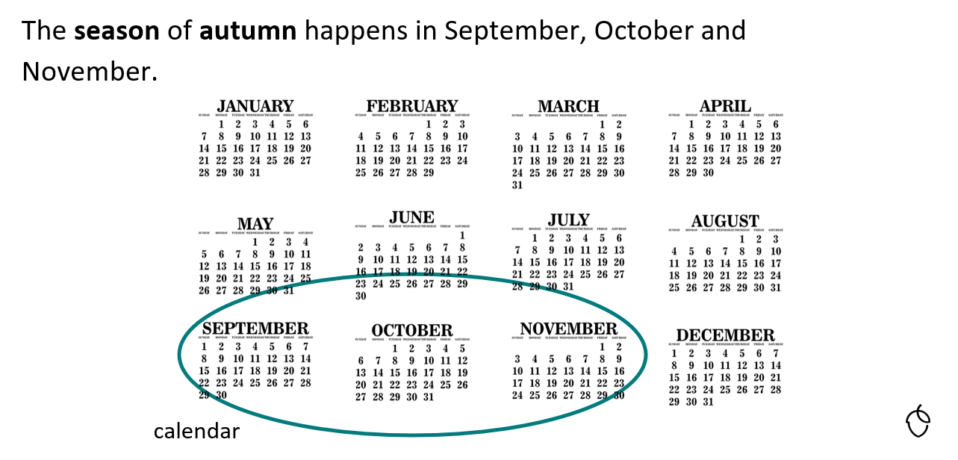
KQ: Can I spot signs of Autumn?
Wednesday 12th November 2025

Slide 49
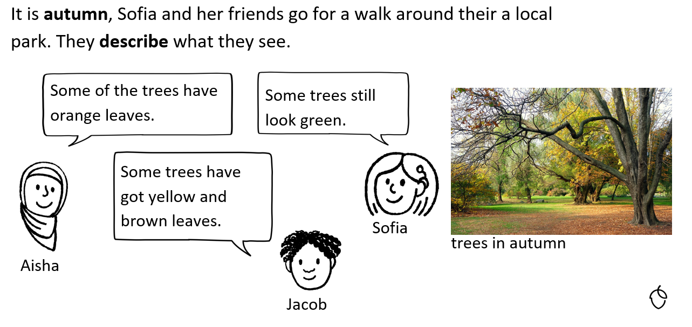
KQ: Can I spot signs of Autumn?
Wednesday 12th November 2025

Slide 50
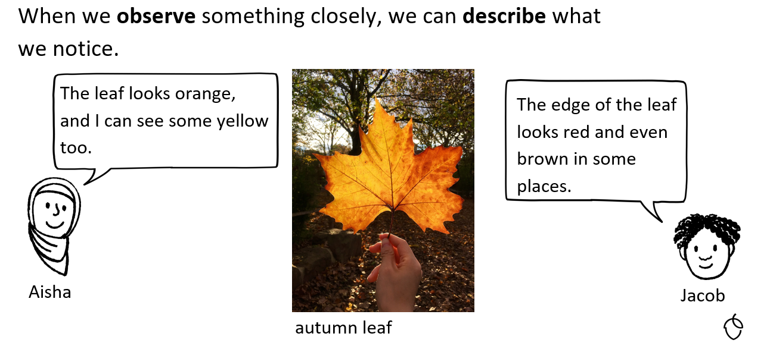
KQ: Can I spot signs of Autumn?
Wednesday 12th November 2025

Slide 51
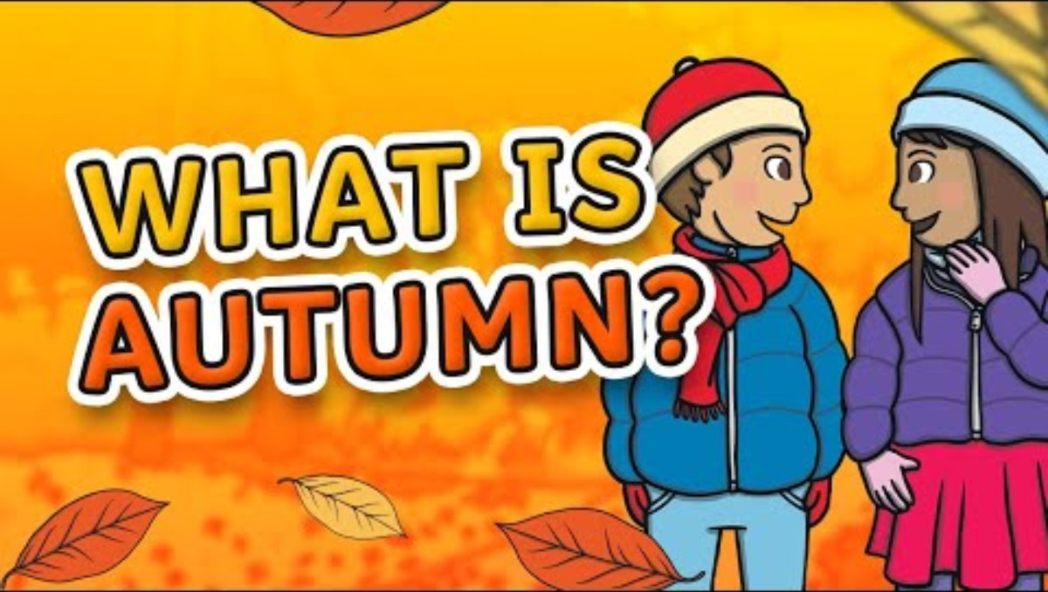
KQ: Can I spot signs of Autumn?
Wednesday 12th November 2025

Slide 52
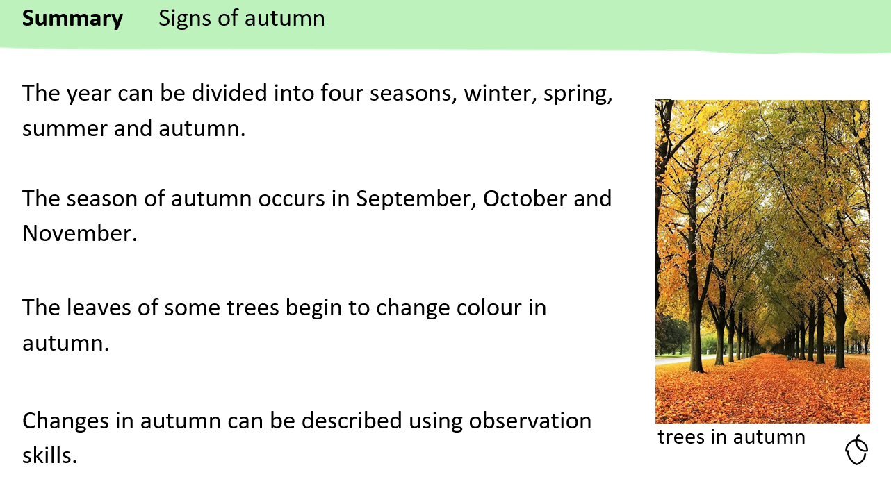
KQ: Can I spot signs of Autumn?
Wednesday 12th November 2025

Slide 53
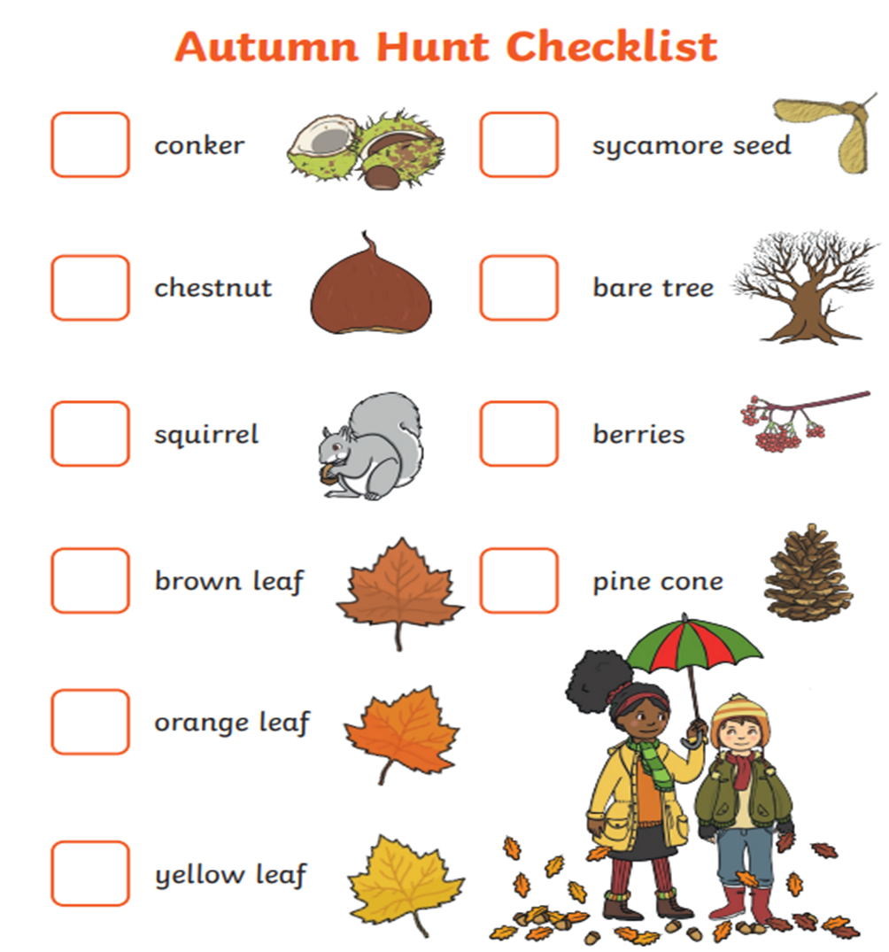

KQ: Can I spot signs of Autumn?
Wednesday 12th November 2025
Independent:
Challenge:
Is this a photo of Autumn time?
How do you know?

Slide 54
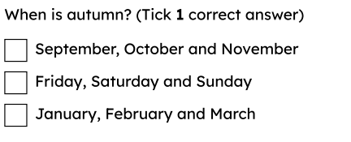
KQ: Can I spot signs of Autumn?
Wednesday 12th November 2025
Exit question:

Slide 55
Independent Challenges:
Narrative Zone
Maths Zone
Sequencing snakes activity.
Enquiry Zone
Creative Zone
Create a water colour painting of a windmill.

