Slide 1
Tuesday 18th November 2025

Slide 2


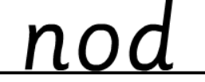
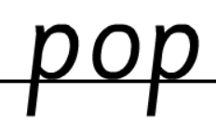
Morning Challenges:
Name writing

Slide 3
TBAT: read i-e /igh/ words

Slide 4
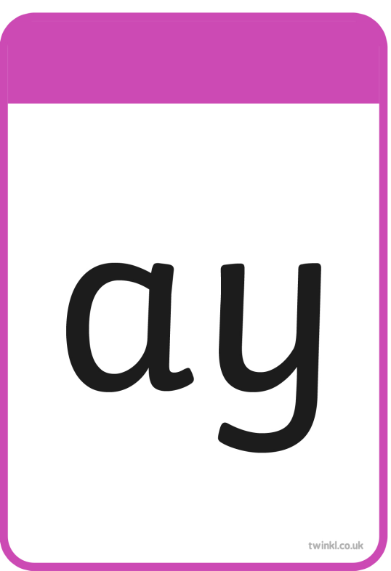
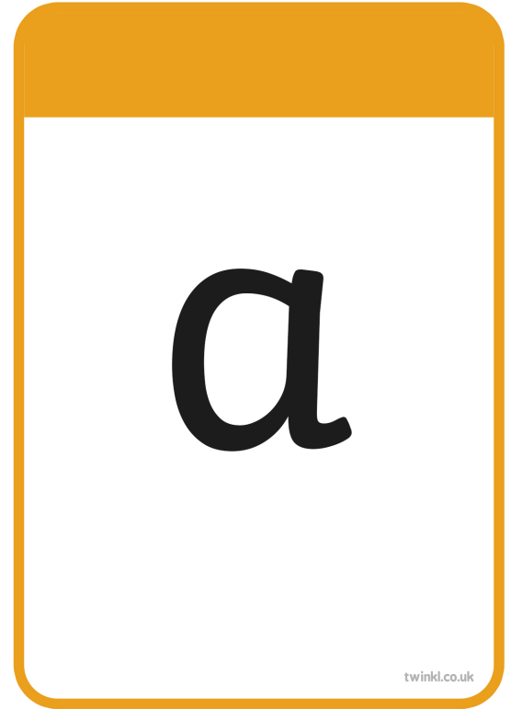
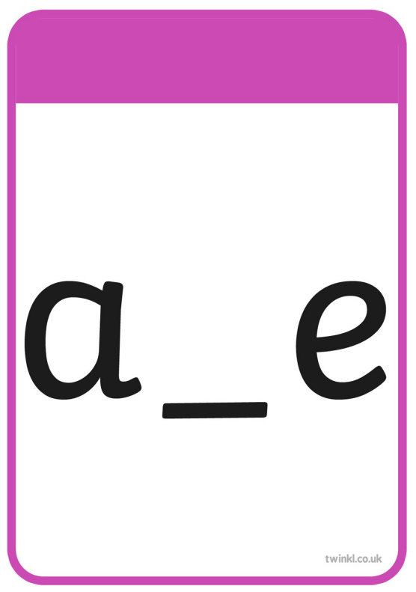




Slide 5
TBAT: read i-e /igh/ words
fright

Slide 6
TBAT: read i-e /igh/ words
child

Slide 7
TBAT: read i-e /igh/ words
tie

Slide 8
TBAT: read i-e /igh/ words
powder

Slide 9
TBAT: read i-e /igh/ words
milk

Slide 10
TBAT: read i-e /igh/ words
steep

Slide 11

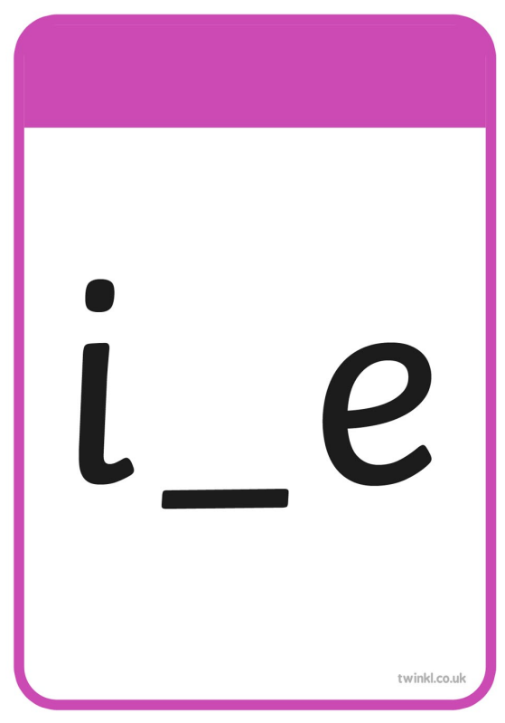

Slide 12
TBAT: read i-e /igh/ words
time

Slide 13
TBAT: read i-e /igh/ words
ripe

Slide 14
TBAT: read i-e /igh/ words
inside

Slide 15
TBAT: read i-e /igh/ words
prize

Slide 16
TBAT: read i-e /igh/ words
slide

Slide 17
TBAT: read i-e /igh/ words
like

Slide 18


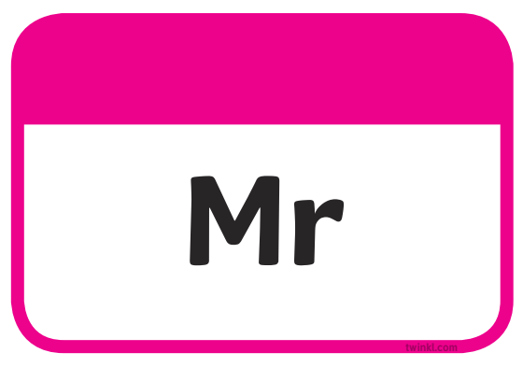


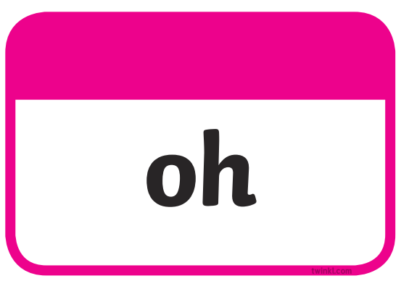


Slide 19
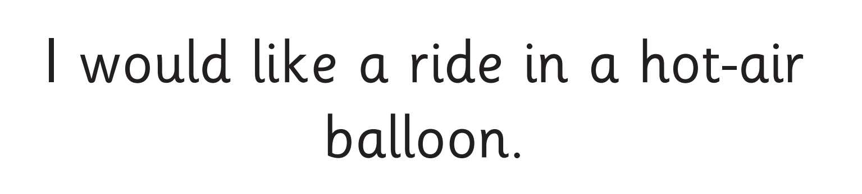
TBAT: read i-e /igh/ words
I would like a ride in a hot air balloon.

Slide 20
Write a sentence using these words
TBAT: read i-e /igh/ words
would
Challenge:
Use more than one word in your sentence.
time like

Slide 21
Number bonds to 7
5 in 3
0
4
7
3
1
5
7
2
6
7
1
5
Notes:
Do Now: Number bonds to 7
Pupils use a part-whole model and seven cubes to complete the Do Now task. They represent each part-whole model and fill in the missing number in each one. When a part is missing, they represent the whole using cubes and then move the correct number of cubes into a part to find the other part. This is intended to prepare pupils for Lessons 3 and 4.

Slide 22
TBAT: add by counting on using a number line or number track
number track
first
now
more
then
represent
add
equation
number line

Slide 23


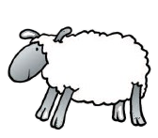

Can you think of some addition stories for these images?
part plus part is equal to whole
+
=
Notes:
New Learning: Counting on using a number track
Recap the work from Year 2, in which pupils learnt the addition structure of combining two parts to make a whole. Pupils will learn another type of story now, where they start with an amount and add on to it.
Use the next slide to roleplay the scenario with pupils, modelling counting the group of 11 children, then counting on (without recounting all) to add the two pupils.
How could we represent this story if we didn’t have the children here?
Pupils explore making their own models of the situation using manipulatives and drawings. Concrete, pictorial, and abstract representations are all valid ways of showing this story. Discuss and make links between different representations with pupils, including part-whole models, counter and cube representations, bead strings and number tracks/number lines.
Now model the story on a number track, placing a counter or finger at 11 and then counting on two spaces to represent the additional children. Explain that counting on is used when we are adding small numbers. Model another example of an augmentation story, such as the one on the next slide, where one, two or three elements are being added to a number, not exceeding 20 in total. For each example, model it on a number track as well as showing other representations.

Slide 24
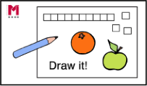
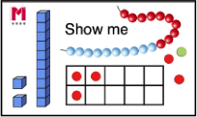
Counting on using a number track
First, there were eleven children sitting on the carpet.
Then, two more children came and sat down.
Now, how many children are there?
1 | 2 | 3 | 4 | 5 | 6 | 7 | 8 | 9 | 10 | 11 | 12 | 13 | 14 | 15 | 16 | 17 | 18 | 19 | 20
part plus part is equal to whole
+
=
Notes:
New Learning: Counting on using a number track
Recap the work from Year 2, in which pupils learnt the addition structure of combining two parts to make a whole. Pupils will learn another type of story now, where they start with an amount and add on to it.
Use the next slide to roleplay the scenario with pupils, modelling counting the group of 11 children, then counting on (without recounting all) to add the two pupils.
How could we represent this story if we didn’t have the children here?
Pupils explore making their own models of the situation using manipulatives and drawings. Concrete, pictorial, and abstract representations are all valid ways of showing this story. Discuss and make links between different representations with pupils, including part-whole models, counter and cube representations, bead strings and number tracks/number lines.
Now model the story on a number track, placing a counter or finger at 11 and then counting on two spaces to represent the additional children. Explain that counting on is used when we are adding small numbers. Model another example of an augmentation story, such as the one on the next slide, where one, two or three elements are being added to a number, not exceeding 20 in total. For each example, model it on a number track as well as showing other representations.

Slide 25
Counting on using a number track
First, there were nine pencils in the pot.
Then, I put in three more.
Now, how many pencils are in the pot?
1 | 2 | 3 | 4 | 5 | 6 | 7 | 8 | 9 | 10 | 11 | 12 | 13 | 14 | 15 | 16 | 17 | 18 | 19 | 20
part plus part is equal to whole
+
=
Notes:
New Learning: Counting on using a number track
Recap the work from Year 2, in which pupils learnt the addition structure of combining two parts to make a whole. Pupils will learn another type of story now, where they start with an amount and add on to it.
Use the next slide to roleplay the scenario with pupils, modelling counting the group of 11 children, then counting on (without recounting all) to add the two pupils.
How could we represent this story if we didn’t have the children here?
Pupils explore making their own models of the situation using manipulatives and drawings. Concrete, pictorial, and abstract representations are all valid ways of showing this story. Discuss and make links between different representations with pupils, including part-whole models, counter and cube representations, bead strings and number tracks/number lines.
Now model the story on a number track, placing a counter or finger at 11 and then counting on two spaces to represent the additional children. Explain that counting on is used when we are adding small numbers. Model another example of an augmentation story, such as the one on the next slide, where one, two or three elements are being added to a number, not exceeding 20 in total. For each example, model it on a number track as well as showing other representations.

Slide 26
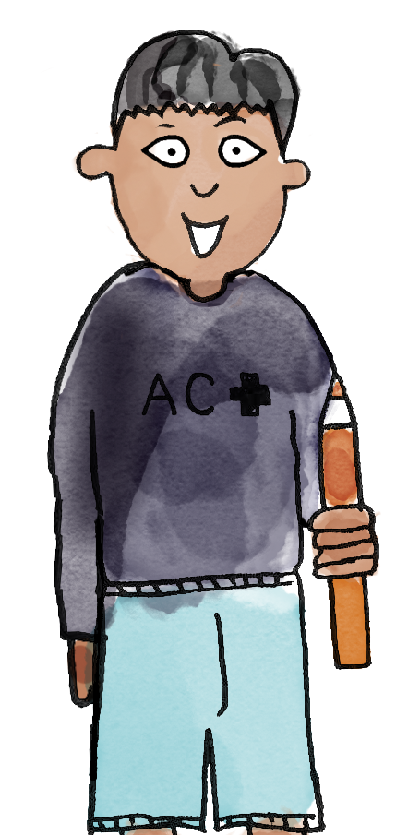
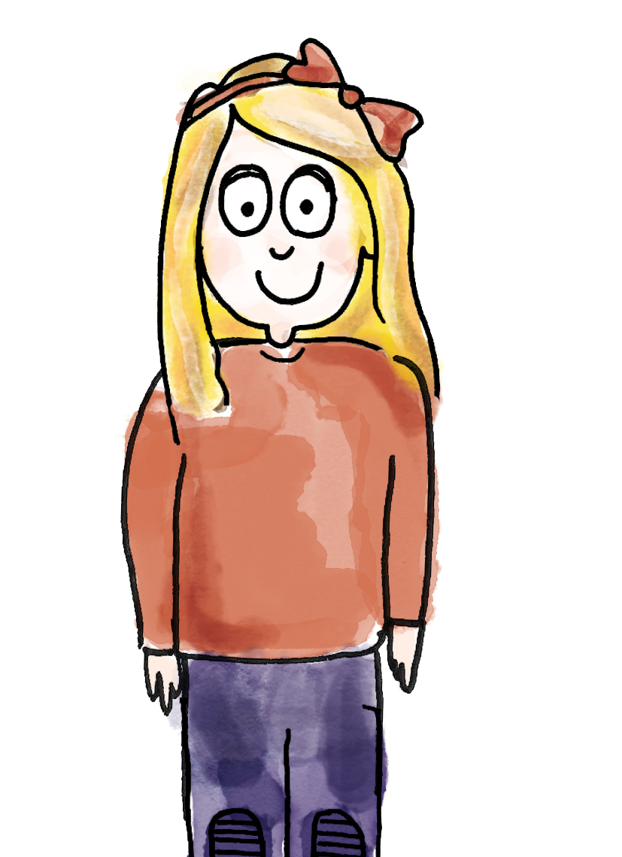
Counting on using a number track
First, there were 14 children in the playground.
Then, two more children went out to play.
Now, how many children are in the playground?
So, first there were 14 children. Then, two more children went out to play.
Now, there are 16 children on the playground..
14
2
1 | 2 | 3 | 4 | 5 | 6 | 7 | 8 | 9 | 10 | 11 | 12 | 13 | 14 | 15 | 16 | 17 | 18 | 19 | 20
first now then represent equation more add
number track number line
Notes:
Talk Task: Counting on using a number track
Pupils have two sets of number cards 10−17 and 1−3 (preferably with each set in a different colour so pupils can easily pick one of each) and a 1−20 number track.
Pupil A picks a card 10−17. Pupil B picks a card 1−3. Show the example of a ‘first, then, now’ story on the slide. Pupil A asks a ‘first, then, now’ story question, based on the modelled example, using the numbers they have chosen. Pupil B represents the story on the number track, finding the first addend (one of the numbers being added) and then moving their finger/counter along the correct number of places to complete the addition. They say the story and the answer. Pupils then swap roles.

Slide 27
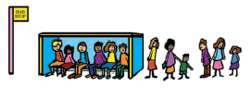
Counting on using a number line
First | Then | Now
 | + | ?
First, there were 12 people at the bus stop.
Then, two more people arrived.
Now, how many people are waiting at the bus stop?
0
1
2
3
4
5
6
7
8
9
10
11
12
13
14
15
16
17
18
19
20
Notes:
Develop Learning: Counting on using a number line
Explain that we can also use a number line to represent addition, but that this time we need to find the starting amount and then make jumps. Model another augmentation story involving a teen number and an addend of one, two or three. Model finding the first addend on the number line and ensure pupils can answer questions such as:
How many jumps do I need to make? Which way along the number line do I jump?
You need to make two jumps to the right because the numbers get bigger to the right and we need to add.
What number sentence would represent this story?
On the next slide, show the story as an abstract equation (12 + 2 = 14), ensuring pupils understand what the ‘+’ shows here, and can explain what each number represents, in relation to the story. Finally, represent the same relationship on a part-whole model.

Slide 28
Counting on using a number line
0
1
2
3
4
5
6
7
8
9
10
11
12
13
14
15
16
17
18
19
20
14
part plus part is equal to whole
12
2
14
+
=
2
12
Notes:
Develop Learning: Counting on using a number line
Explain that we can also use a number line to represent addition, but that this time we need to find the starting amount and then make jumps. Model another augmentation story involving a teen number and an addend of one, two or three. Model finding the first addend on the number line and ensure pupils can answer questions such as:
How many jumps do I need to make? Which way along the number line do I jump?
You need to make two jumps to the right because the numbers get bigger to the right and we need to add.
What number sentence would represent this story?
On the next slide, show the story as an abstract equation (12 + 2 = 14), ensuring pupils understand what the ‘+’ shows here, and can explain what each number represents, in relation to the story. Finally, represent the same relationship on a part-whole model.

Slide 29
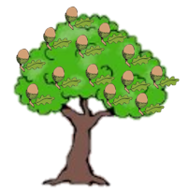

TBAT: add by counting on using a number line or number track
Recording ‘first, then, now’ stories
First | Then | Now
 | + | ?
0
1
2
3
4
5
6
7
8
9
10
11
12
13
14
15
16
17
18
19
20
part plus part is equal to whole
+
=
Notes:
Independent Task: Recording ‘first, then, now’ stories
Pupils interpret the pictures on the Task sheet to tell maths stories. They then represent the story on the number line and write the corresponding abstract equation.
Possible adaptations:
Some pupils will find it helpful to represent the stories using concrete manipulatives.
Given a number line with some jumps from a starting point marked on, some pupils could make their own stories and write the corresponding equations.

Slide 30
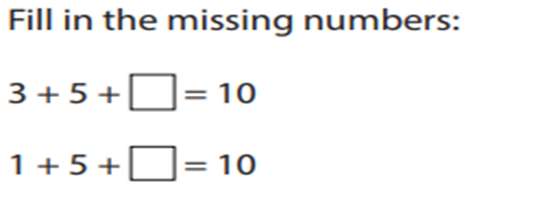
To add by counting on using a number line or number track
Challenge:
Notes:
Independent Task: Recording ‘first, then, now’ stories
Pupils interpret the pictures on the Task sheet to tell maths stories. They then represent the story on the number line and write the corresponding abstract equation.
Possible adaptations:
Some pupils will find it helpful to represent the stories using concrete manipulatives.
Given a number line with some jumps from a starting point marked on, some pupils could make their own stories and write the corresponding equations.

Slide 31
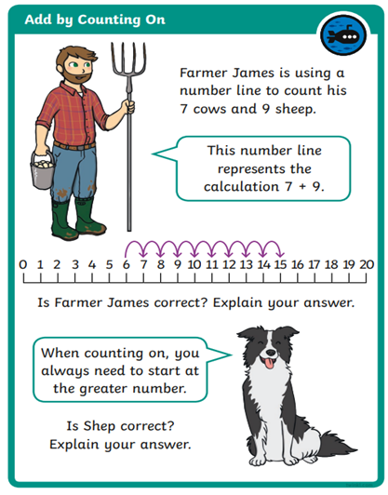
To add by counting on using a number line or number track
Mastery:
Notes:
Independent Task: Recording ‘first, then, now’ stories
Pupils interpret the pictures on the Task sheet to tell maths stories. They then represent the story on the number line and write the corresponding abstract equation.
Possible adaptations:
Some pupils will find it helpful to represent the stories using concrete manipulatives.
Given a number line with some jumps from a starting point marked on, some pupils could make their own stories and write the corresponding equations.

Slide 32
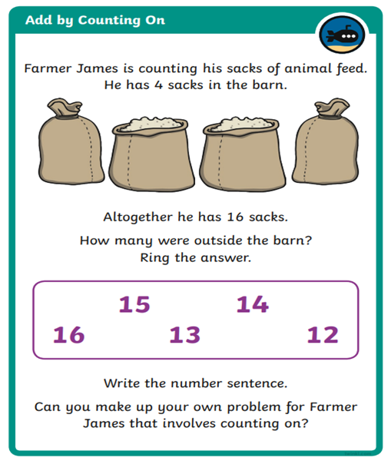
To add by counting on using a number line or number track
Mastery with greater depth:
Notes:
Independent Task: Recording ‘first, then, now’ stories
Pupils interpret the pictures on the Task sheet to tell maths stories. They then represent the story on the number line and write the corresponding abstract equation.
Possible adaptations:
Some pupils will find it helpful to represent the stories using concrete manipulatives.
Given a number line with some jumps from a starting point marked on, some pupils could make their own stories and write the corresponding equations.

Slide 33
Unexpected unknown
First, there were 11 people standing at the
bus stop.
Then, some more people came along.
Now, there are 13 people at the bus stop.
How many people came along?
Notes:
Plenary: Unexpected unknown
Tell the story on the slide, where the unknown is in a non-standard position.
Pupils discuss the story with a partner and model the story to find the unknown.

Slide 34
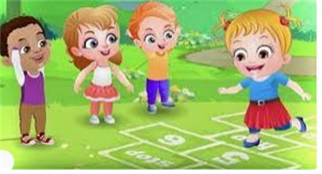
Break

Slide 35
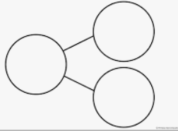
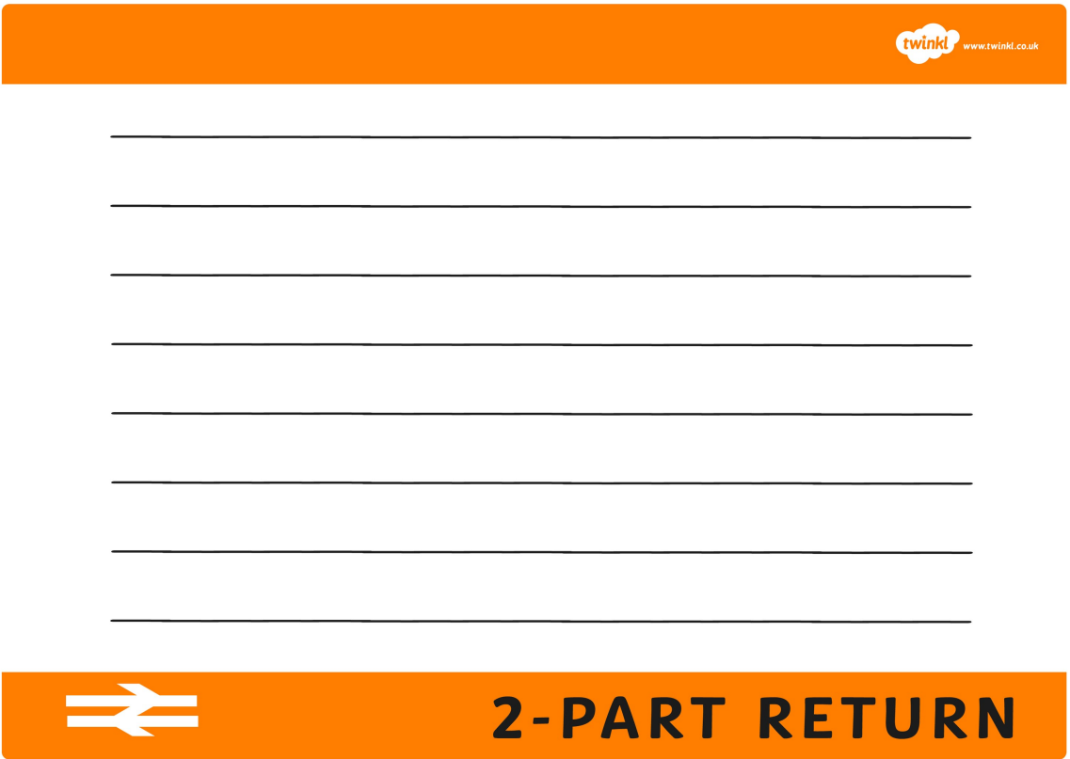
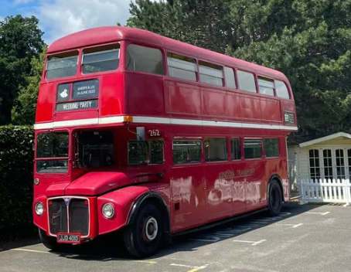

Independent Challenges:
Narrative Zone
Maths Zone
Where would you go if you had a free train ticket and why?
Use the part whole model to practise addition and subtraction to 20.
Use the part whole model to practise addition and subtraction to 20.
Use the part whole model to practise addition and subtraction to 20.
Use the part whole model to practise addition and subtraction to 20.
Use the part whole model to practise addition and subtraction to 20.
Use the part whole model to practise addition and subtraction to 20.
Use the part whole model to practise addition and subtraction to 20.
Enquiry Zone
Creative Zone
What are the differences between the vintage bus and a modern bus?
Use the correct colours to create a picture of Autumn.

Slide 36
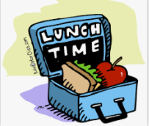
Lunch

Slide 37
KQ: How did trains change people's lives?
Lesson 5:
4 in 4
The first trains were called ____________.
locomotives goods
The first trains were powered by ___________.
electricity diesel steam
Who drove the first passenger locomotive?
Richard Trevithick Queen Victoria George Stephenson
Modern trains are powered by steam. True or false?
true false
Notes:
Knowledge quiz 2.4: Pupils complete this in the Additional resource: Knowledge quizzes booklet to assess their knowledge retention from the previous lesson. They write their score in the chart also provided in the additional resource.

Slide 38

KQ: How did trains change people's lives?
How has transport changed over time?
Notes:
Revisit the main enquiry question and the learning journey so far.

Slide 39
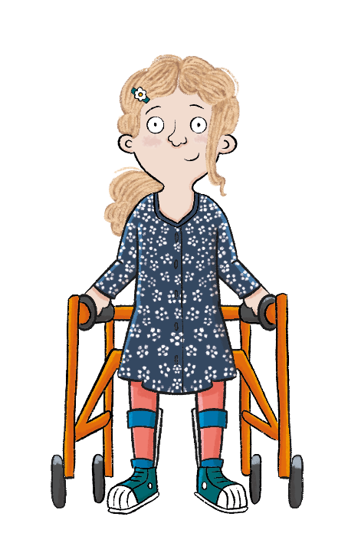
KQ: How did trains change people's lives?
Lesson 5:
In this lesson, we are finding out about the ways that trains changed people’s lives.
Notes:
Introduction: Share the lesson statement and key term. Then share key knowledge and other key vocabulary with pupils—you may want to add images to the teaching slides to support exemplification and understanding of these words.

Slide 40
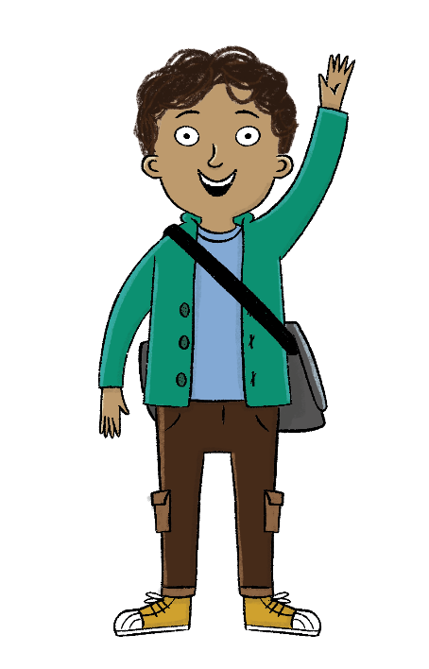
KQ: How did trains change people's lives?
Lesson 5:
The key term for this lesson is
station.
A station is a building where trains or buses stop.
Notes:
To support understanding of the key term ‘station’, show pupils images and videos. If you managed to take pupils on a train trip in previous lesson, refer to the stations you visited.

Slide 41
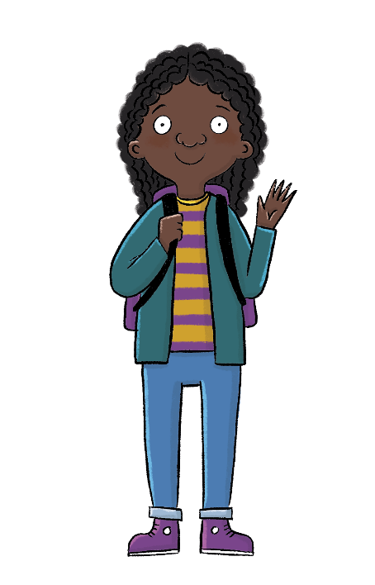
How did trains change people's lives?
Lesson 5:
Trains could transport people and goods faster and further away.
People could go on holiday to the seaside.
Towns grew up around train stations.
cheaply
station

Slide 42
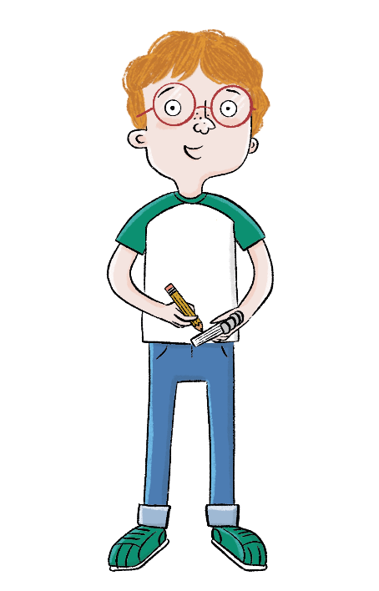
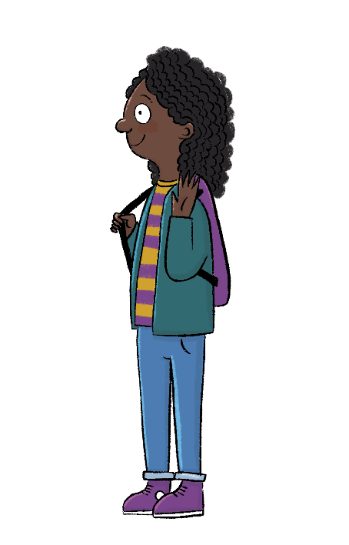
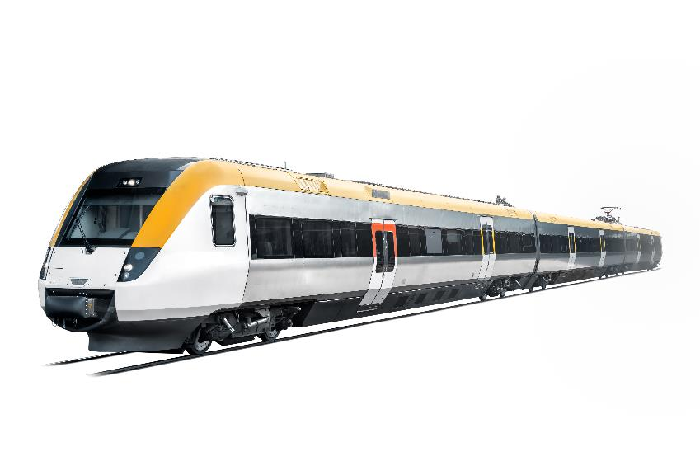
KQ: How did trains change people's lives?
Lesson 5:
Blue / Green
Do you think travelling by train is better or worse than travelling by car?
Have you ever been on a train?
Notes:
Talk task: Pupils ask each other the questions ‘Have you ever been on a train?’, ‘Do you think travelling by train is better or worse than travelling by car?’. If some pupils haven’t travelled by train, ask them to explain if they’d like to or not, and their reasons why. After pupils have discussed with their partners, share ideas as a class. If you managed to take a class train journey last lesson, change the first question to ‘Did you like travelling by train? Why?’.

Slide 43
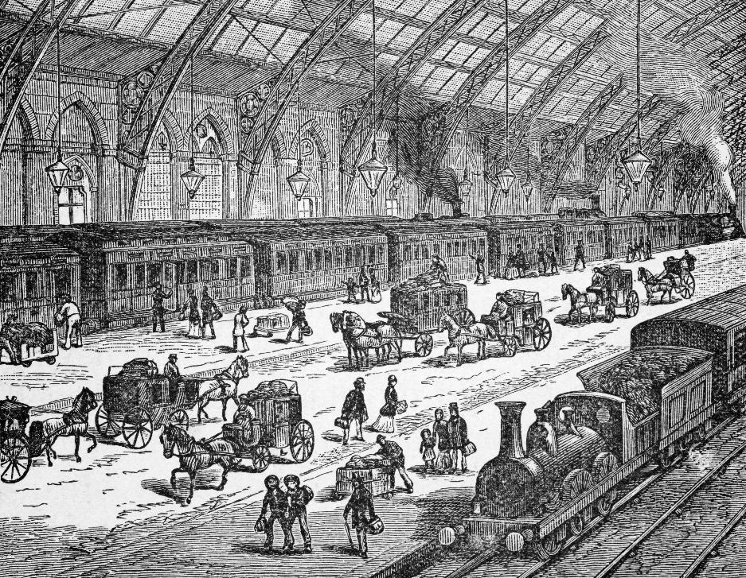
The history of trains
KQ: How did trains change people's lives?
Lesson 5:
People could travel quickly and cheaply for the first time by train. People could now travel to lots more places.
Notes:
Read: ‘The history of trains’ slides. Discuss how the train had a big impact on people’s lives as it enabled them to travel quickly and cheaply so they could have holidays, which made the seaside a popular place. Emphasise that another big change was that towns were created, or got larger, where new railway stations were built.

Slide 44
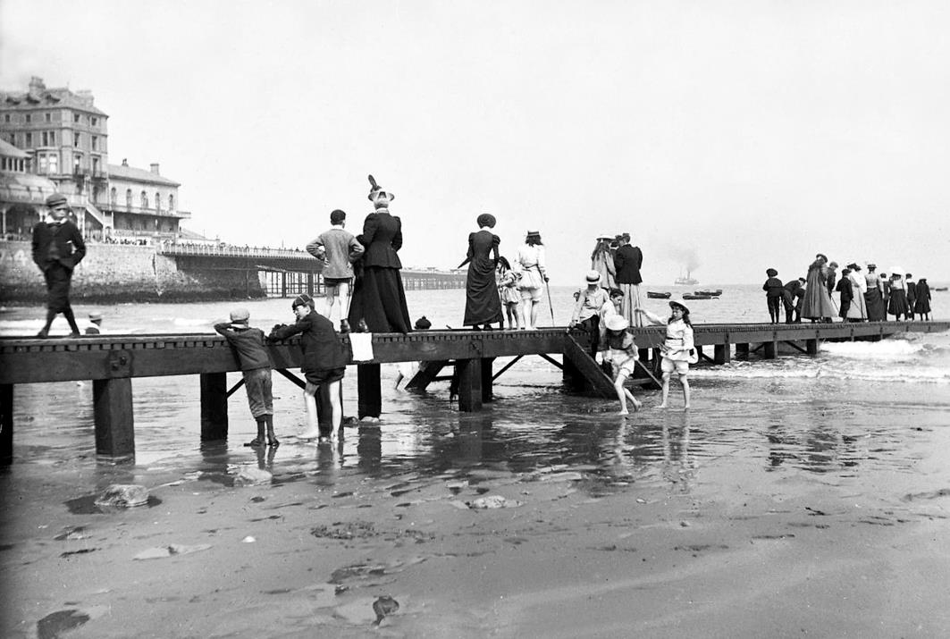
The history of trains
KQ: How did trains change people's lives?
Lesson 5:
People who had never been on holiday before could visit the seaside.
Seaside towns became very busy and popular.

Slide 45
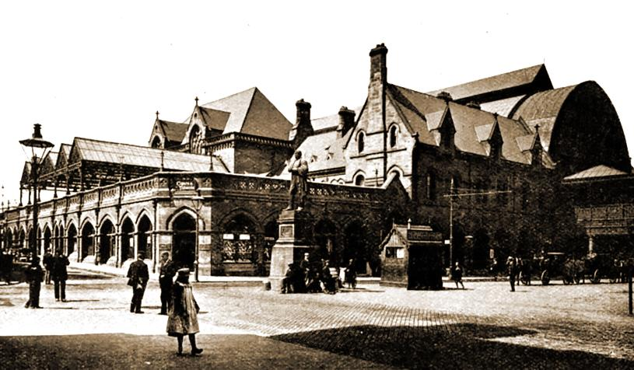
The history of trains
KQ: How did trains change people's lives?
Lesson 5:
Railway stations were built all over the country.
Towns often became much bigger after a railway station was built, for example Crewe and Swindon.
Middlesbrough is a town that was built because a railway station was built there.

Slide 46
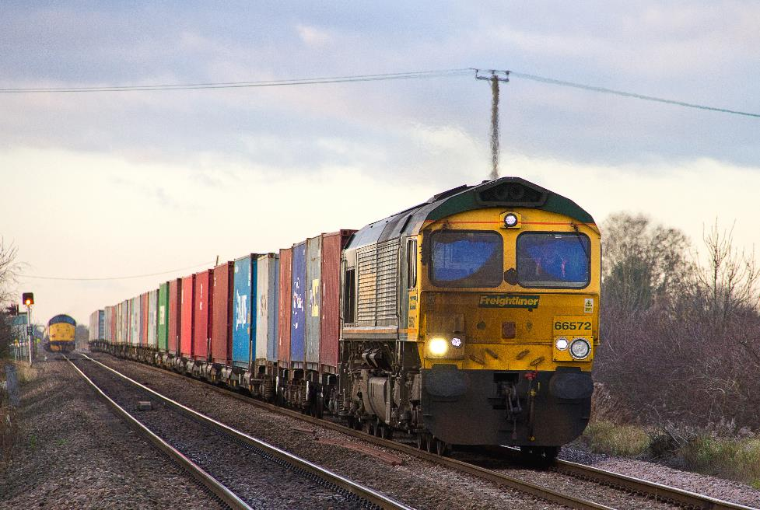
The history of trains
KQ: How did trains change people's lives?
Lesson 5:
Trains meant goods as well as people could travel faster and further than before.
Notes:
Read: ‘The history of trains’ final slide. Remind pupils that ‘goods’ means ‘things’ and explain that trains could move goods around more quickly. This meant that people could get hold of things from far away much more quickly. It helped people sell products to far more places as well. If possible, use a trainset to model transportation of goods from one side of the classroom to the other.

Slide 47
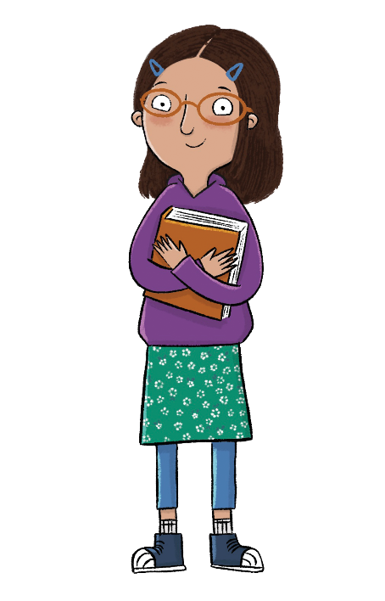
How did trains change people's lives?
Lesson 5:
How do you think life would be different today if trains had not been invented?
Notes:
Learning review: Using the teaching slides, talk partners tell each other a response to the questions. Add further review questions if you wish to.

Slide 48
How did trains change people's lives?
Lesson 5:
Trains could transport people and goods faster and further away.
People could go on holiday to the seaside.
Towns grew up around train stations.
cheaply
station

