Slide 1
Monday 17th November 2025

Slide 2


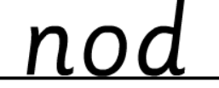
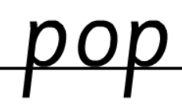
Morning Challenges:
Name writing

Slide 3
TBAT: read a-e /ai/ words

Slide 4


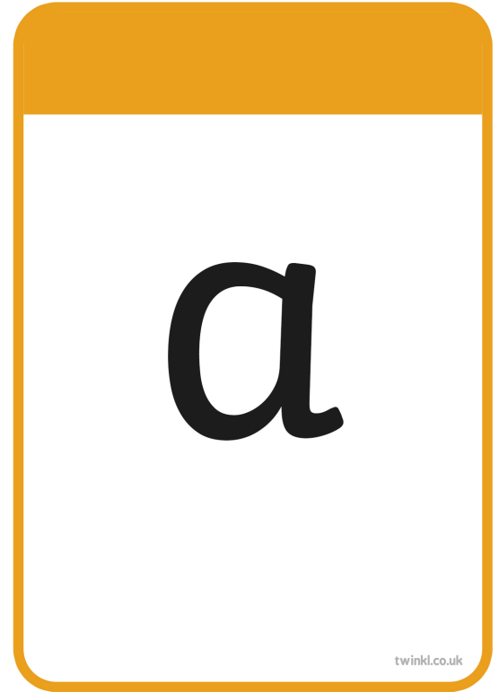





Slide 5
TBAT: read a-e /ai/ words
crayon

Slide 6
TBAT: read a-e /ai/ words
train

Slide 7
TBAT: read a-e /ai/ words
chasing

Slide 8
TBAT: read a-e /ai/ words
lamp

Slide 9
TBAT: read a-e /ai/ words
think

Slide 10
TBAT: read a-e /ai/ words
cartoon

Slide 11
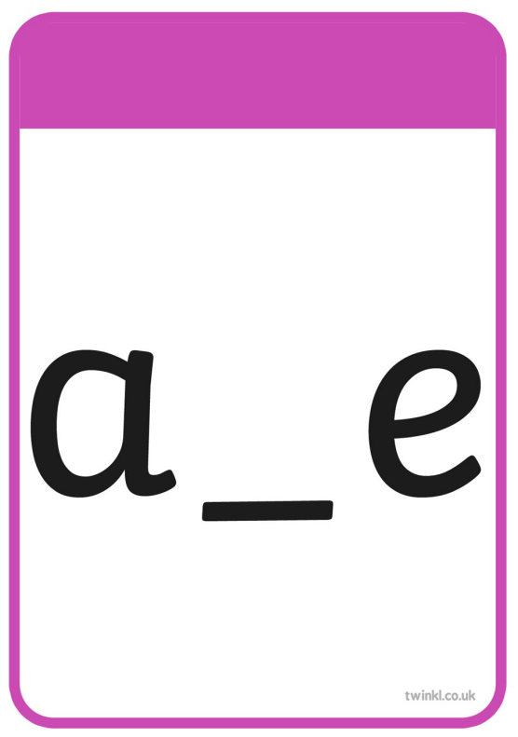


Slide 12
TBAT: read a-e /ai/ words
made

Slide 13
TBAT: read a-e /ai/ words
same

Slide 14
TBAT: read a-e /ai/ words
game

Slide 15
TBAT: read a-e /ai/ words
snake

Slide 16
TBAT: read a-e /ai/ words
amaze

Slide 17
TBAT: read a-e /ai/ words
take

Slide 18

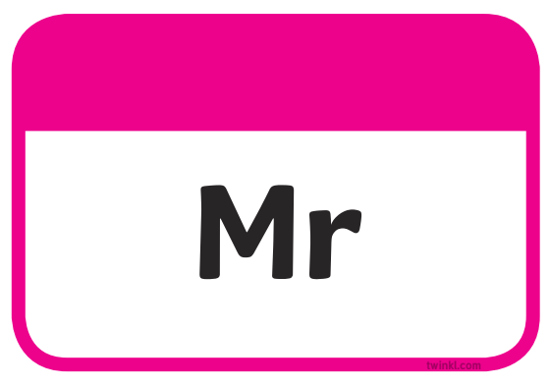




Slide 19
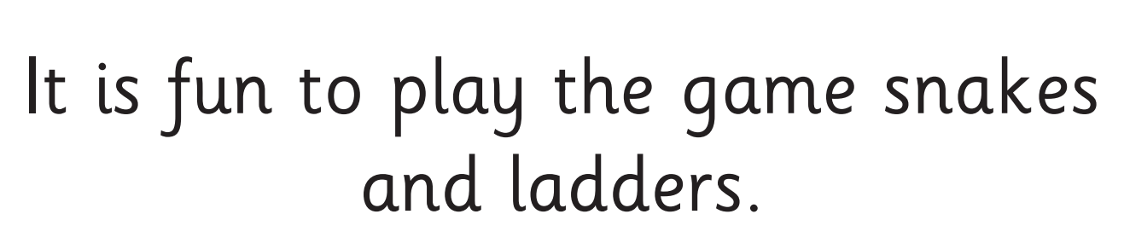
TBAT: read a-e /ai/ words

Slide 20
Write a sentence using these words
TBAT: read a-e /ai/ words
could
Challenge:
Use more than one word in your sentence.
same take

Slide 21
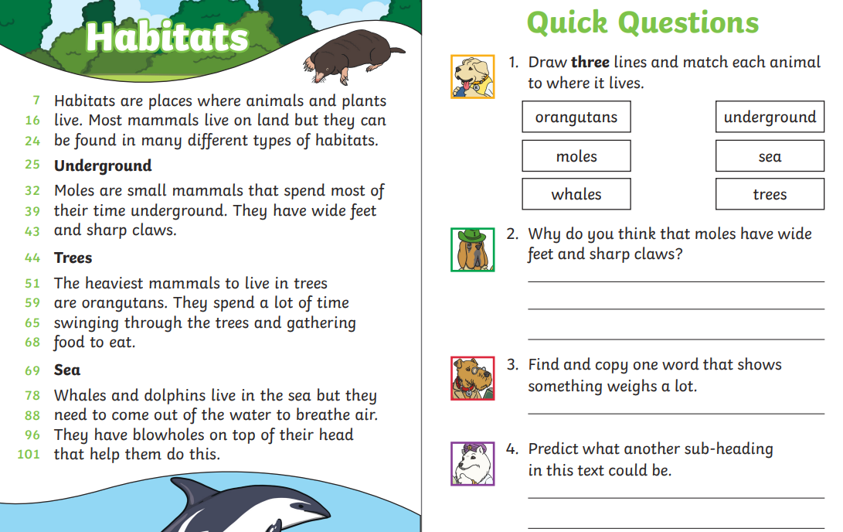
TBAT: recognise the structure of a story
3 in 3

Slide 22
Let's look at how the story is structured
TBAT: recognise the structure of a story

Slide 23
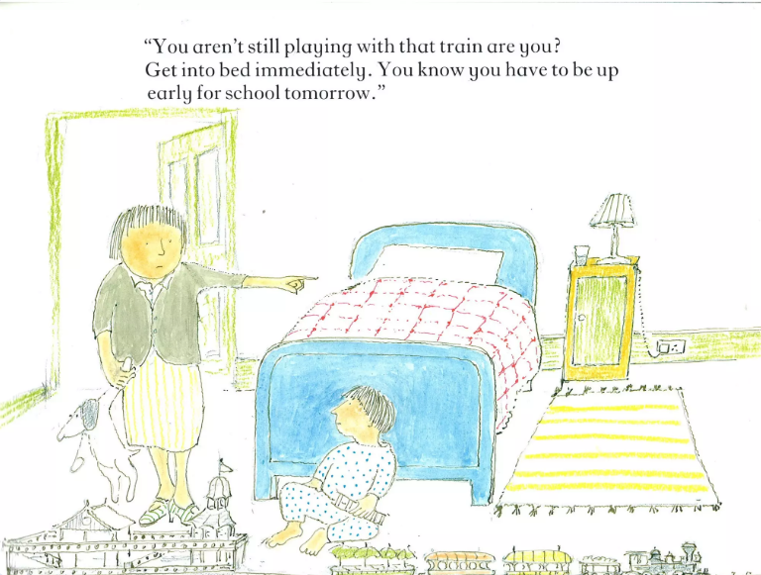
TBAT: recognise the structure of a story

Slide 24
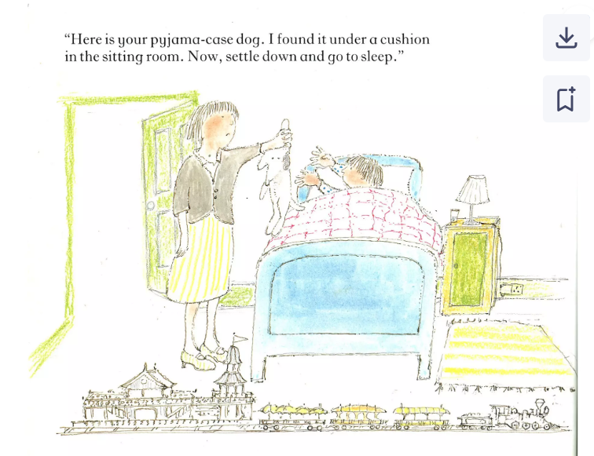
TBAT: recognise the structure of a story

Slide 25
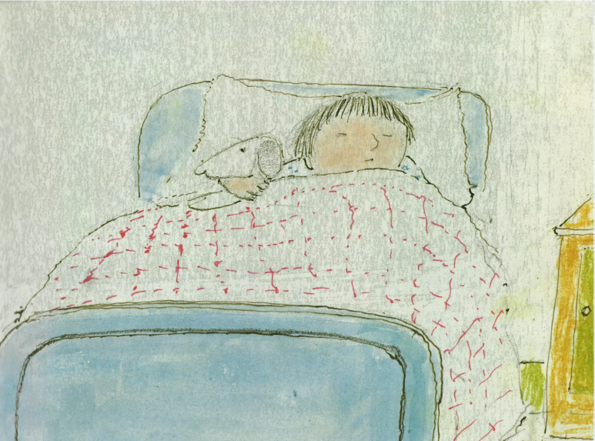
TBAT: recognise the structure of a story

Slide 26
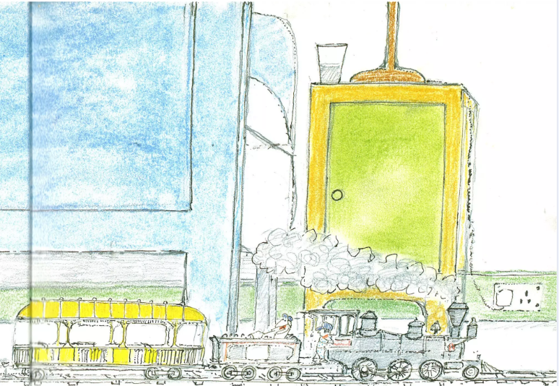
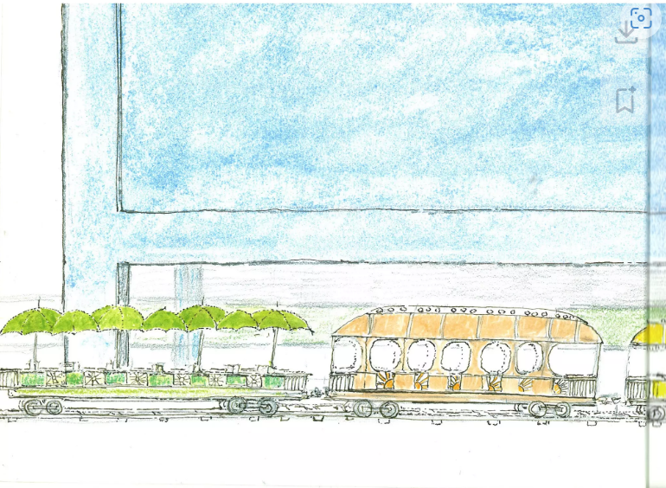
TBAT: recognise the structure of a story

Slide 27
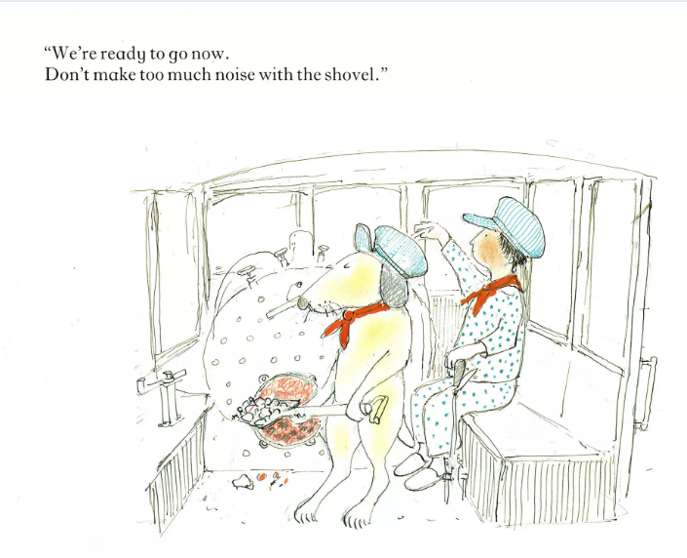
TBAT: recognise the structure of a story

Slide 28
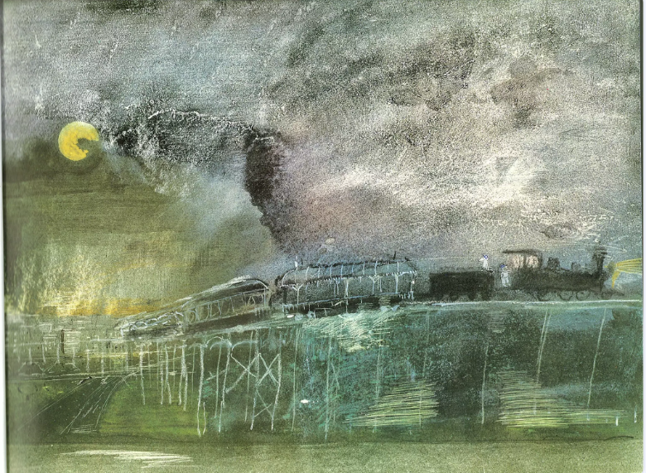
TBAT: recognise the structure of a story

Slide 29
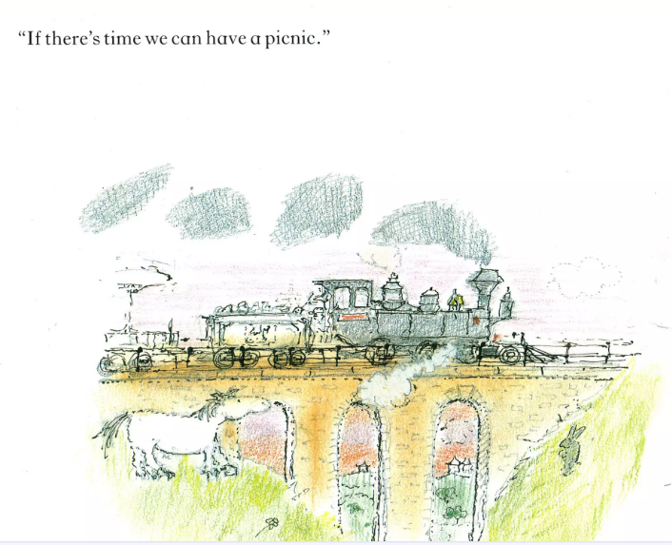
TBAT: recognise the structure of a story

Slide 30
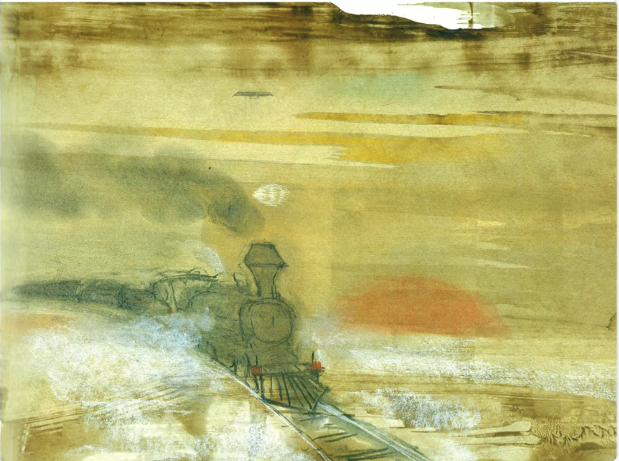

Slide 31
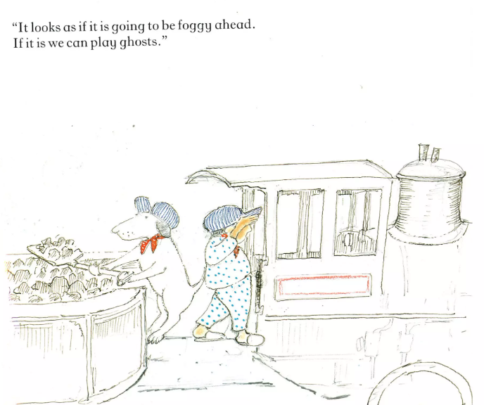
TBAT: recognise the structure of a story

Slide 32
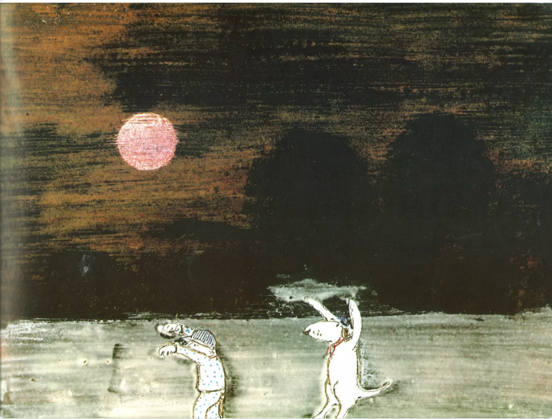
TBAT: recognise the structure of a story

Slide 33
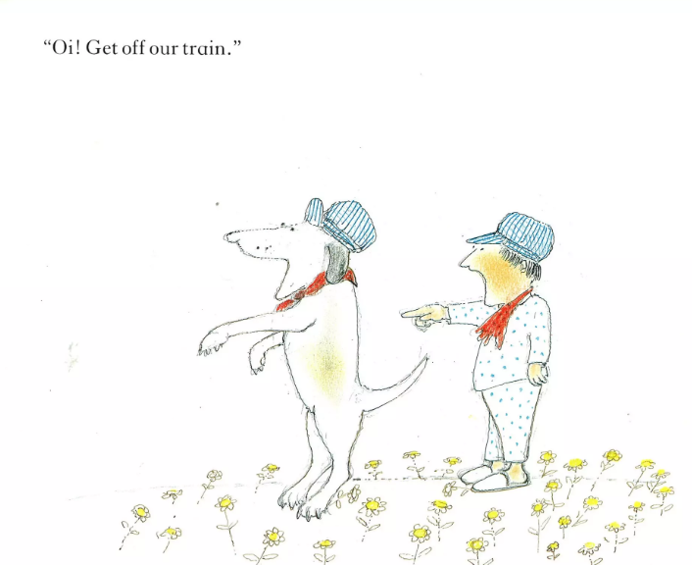
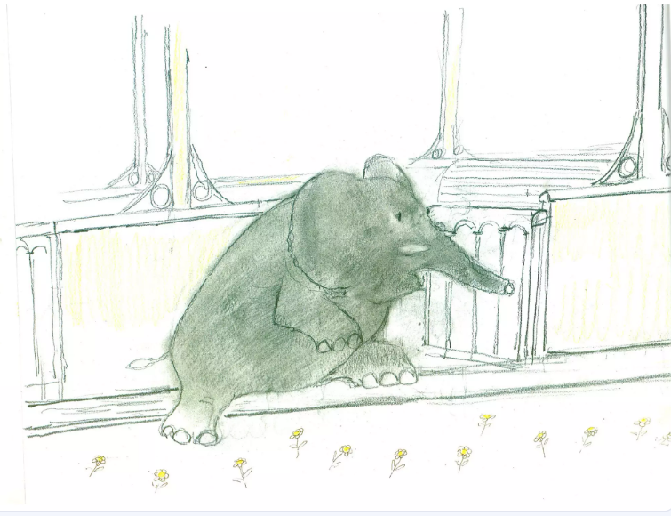
TBAT: recognise the structure of a story

Slide 34
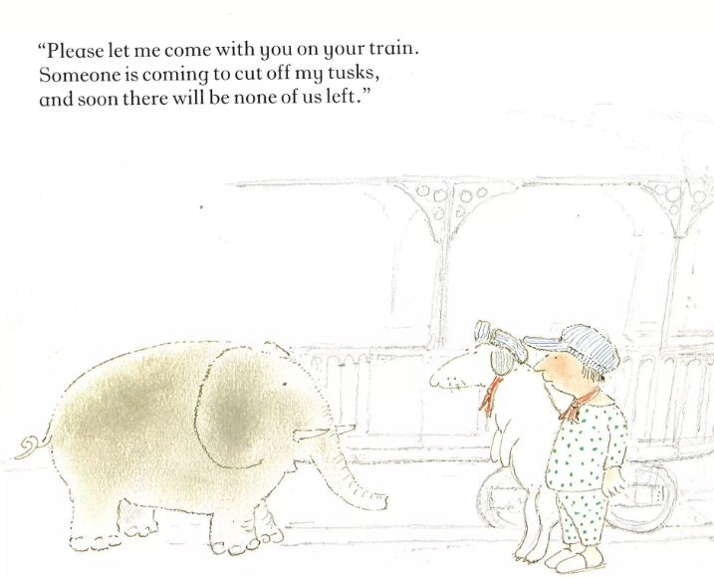

TBAT: recognise the structure of a story

Slide 35
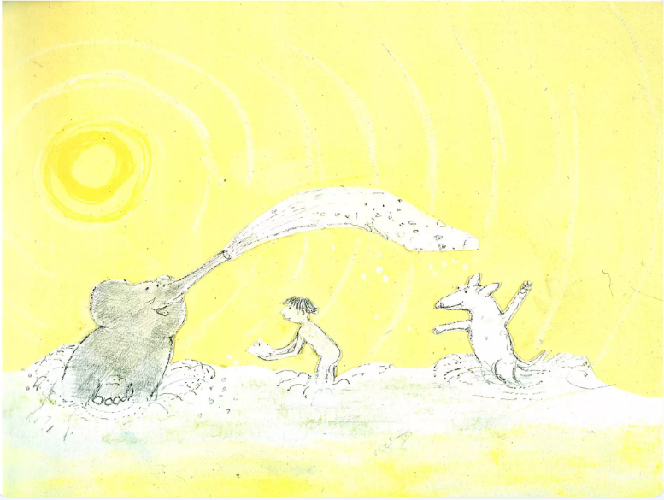
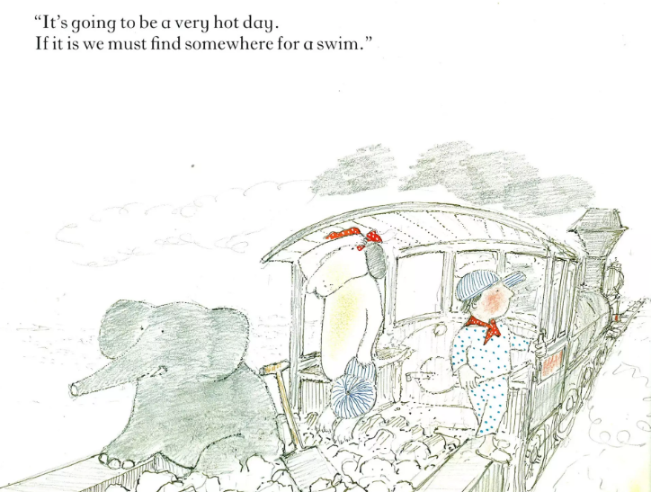
TBAT: recognise the structure of a story

Slide 36
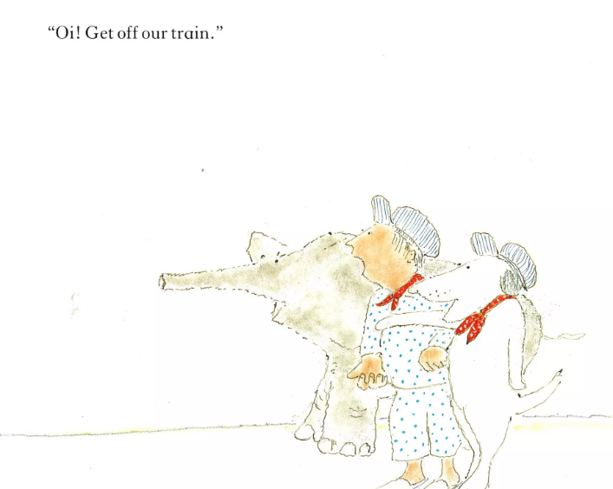
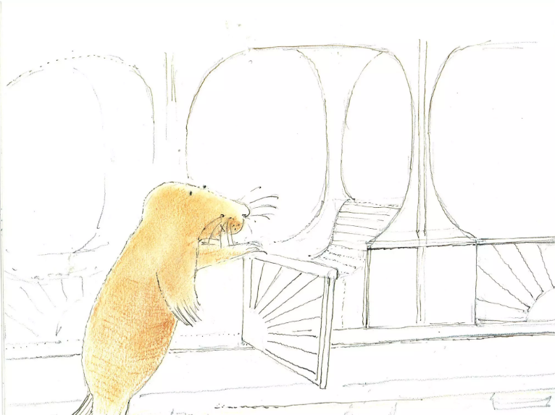
TBAT: recognise the structure of a story

Slide 37
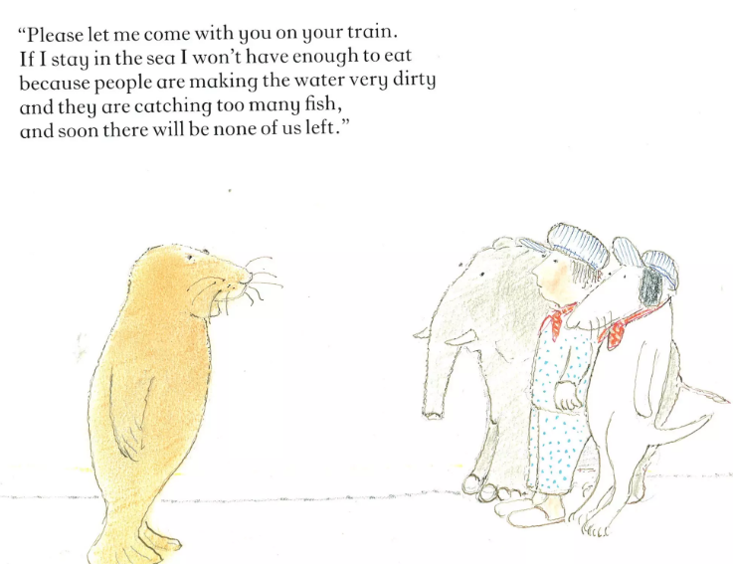
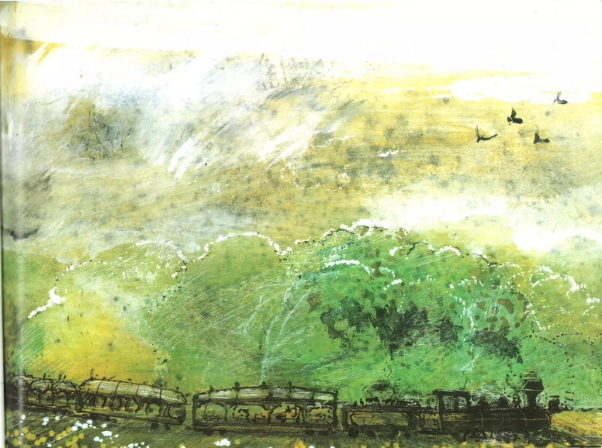
TBAT: recognise the structure of a story

Slide 38
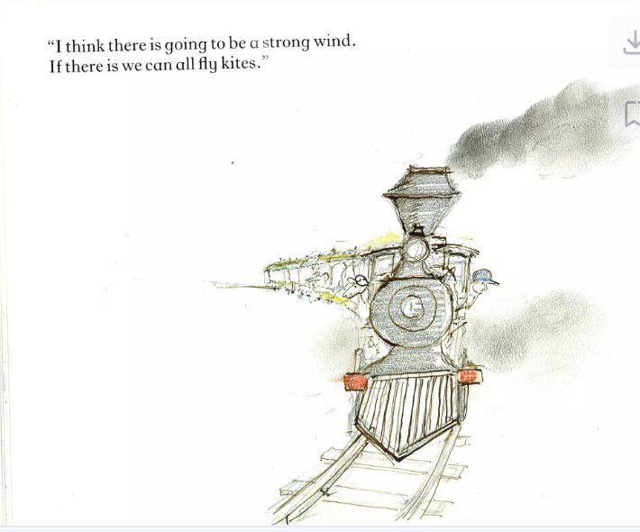
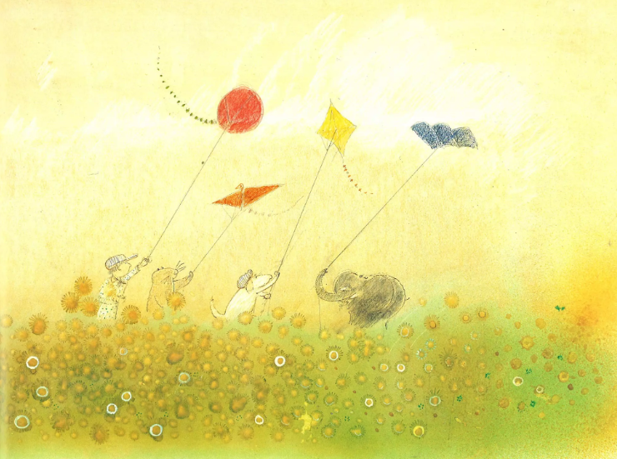
TBAT: recognise the structure of a story

Slide 39
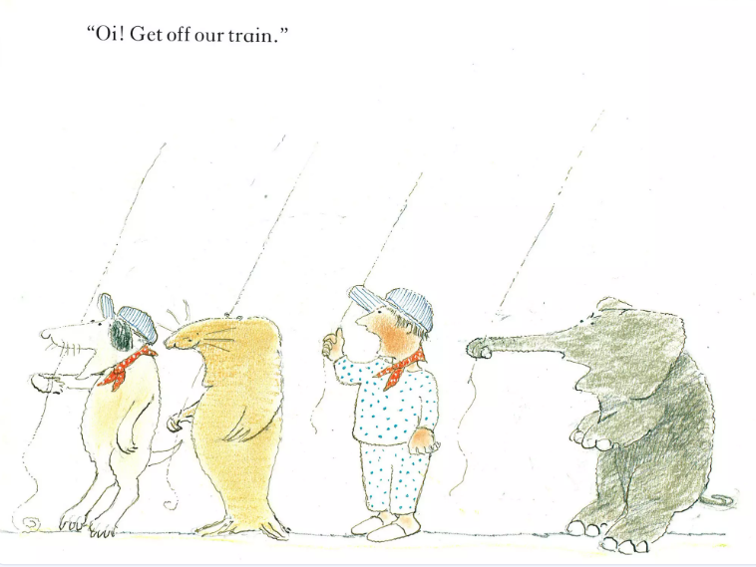
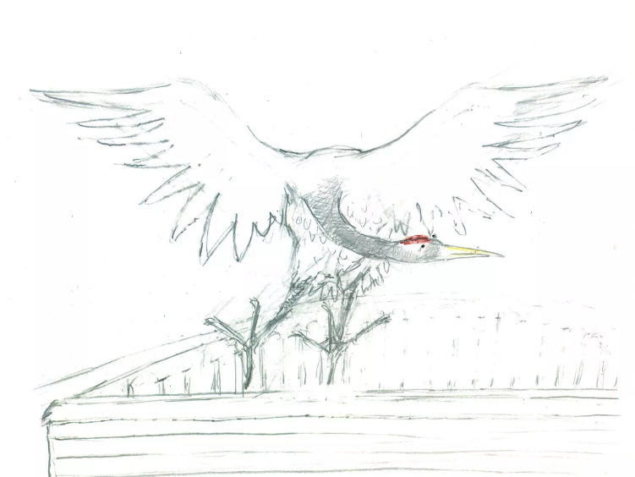
TBAT: recognise the structure of a story

Slide 40
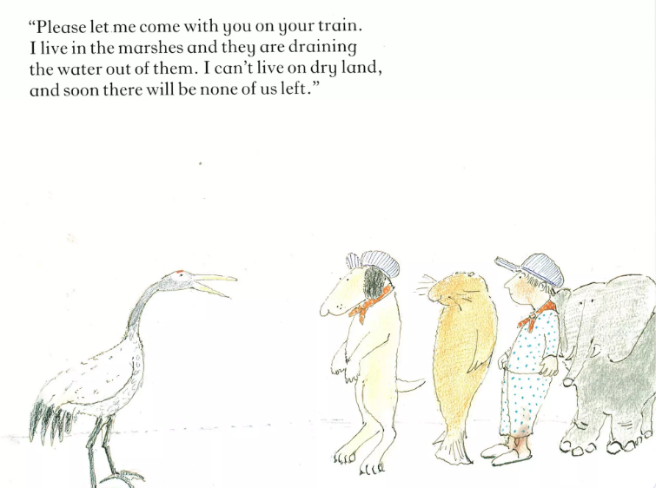
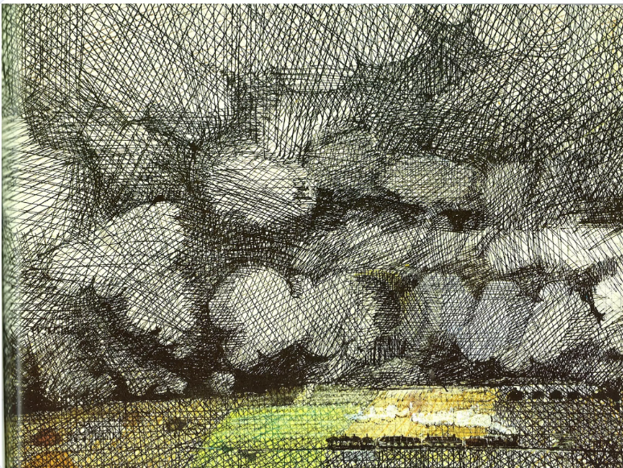
TBAT: recognise the structure of a story

Slide 41
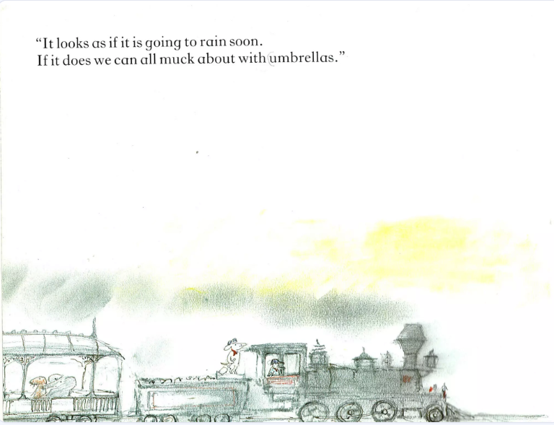
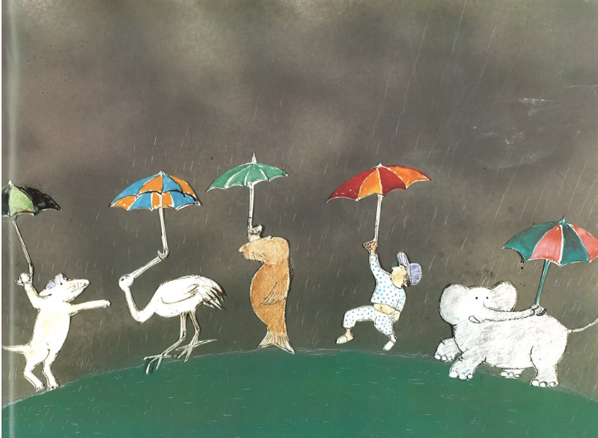
TBAT: recognise the structure of a story

Slide 42
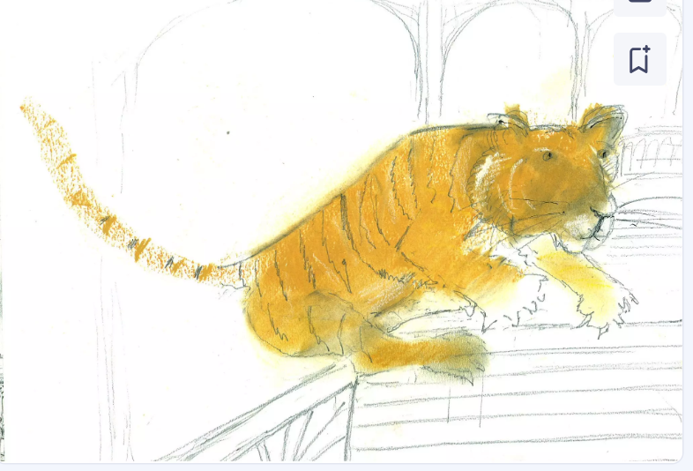
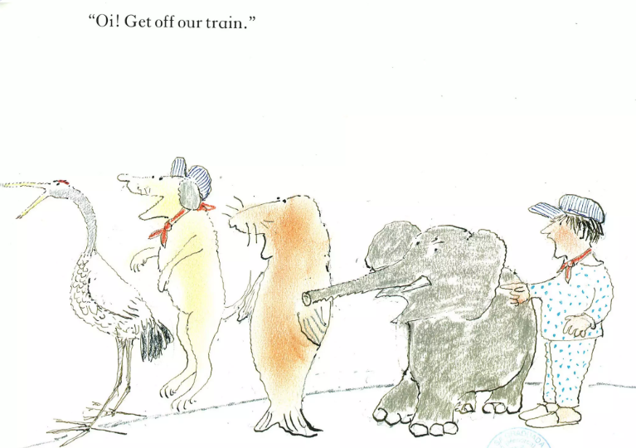
TBAT: recognise the structure of a story

Slide 43
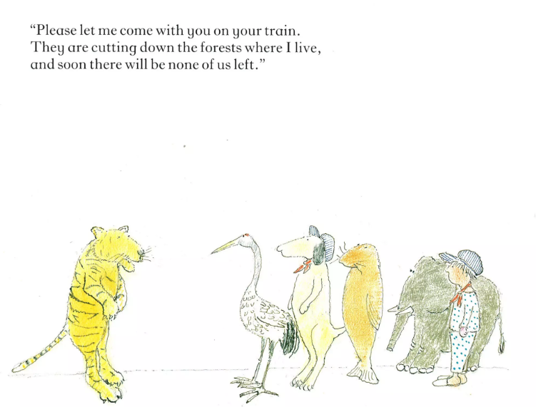
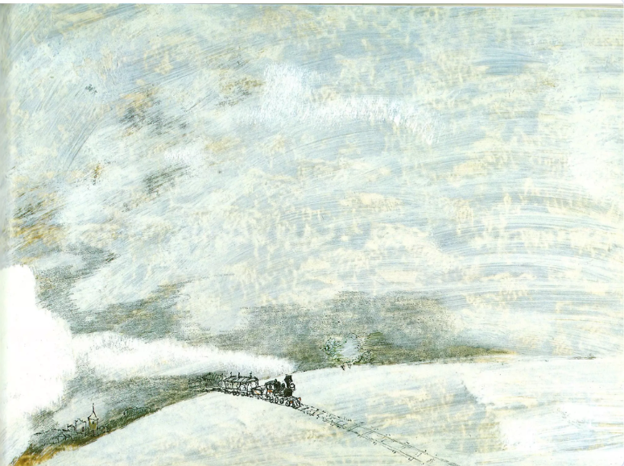
TBAT: recognise the structure of a story

Slide 44
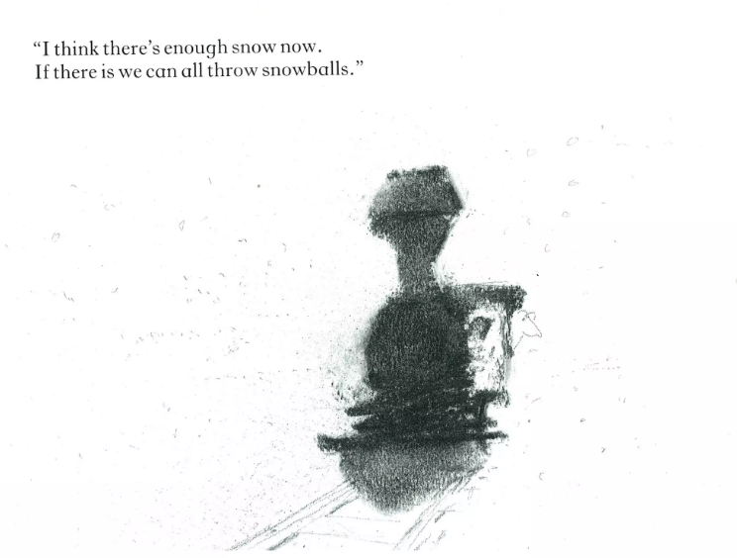
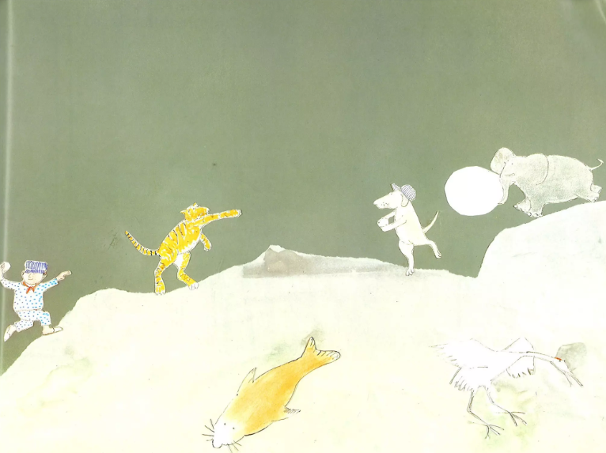
TBAT: recognise the structure of a story

Slide 45
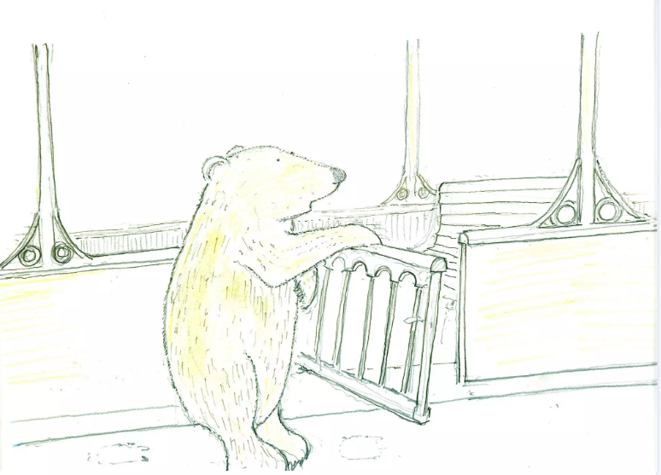
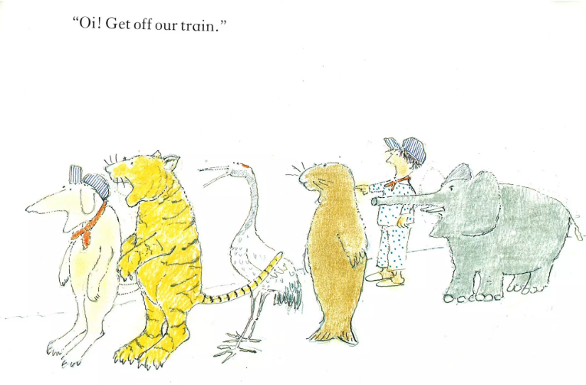
TBAT: recognise the structure of a story

Slide 46
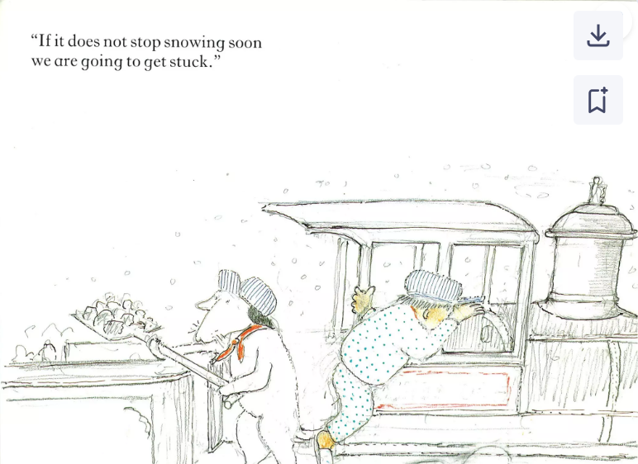
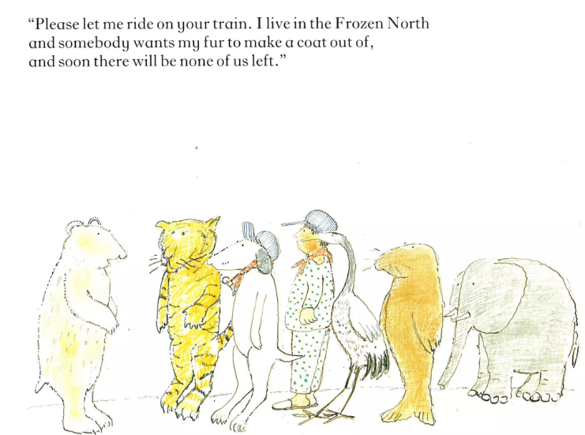
TBAT: recognise the structure of a story

Slide 47
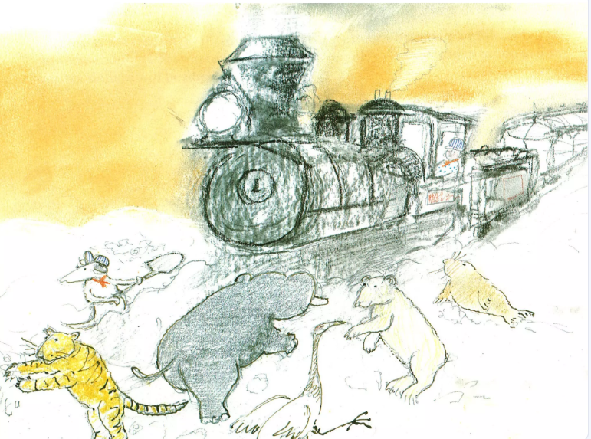
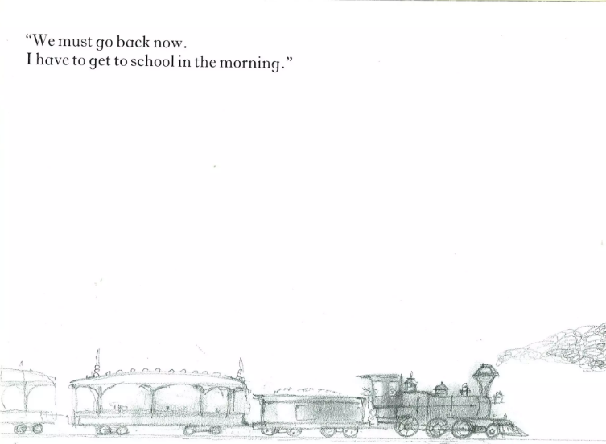
TBAT: recognise the structure of a story

Slide 48
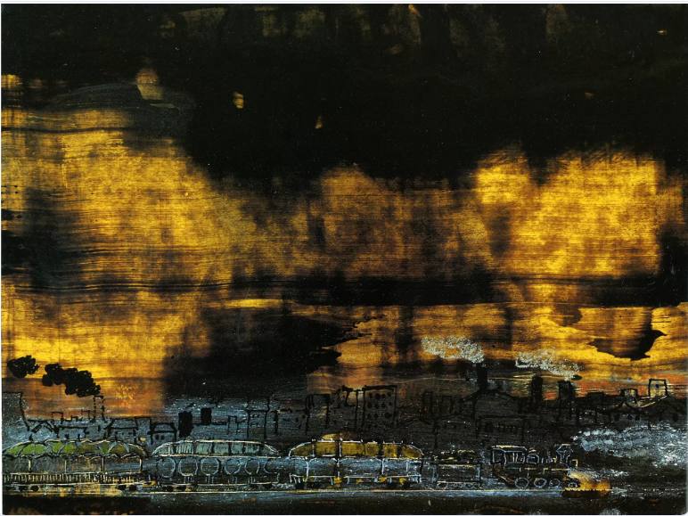

Slide 49
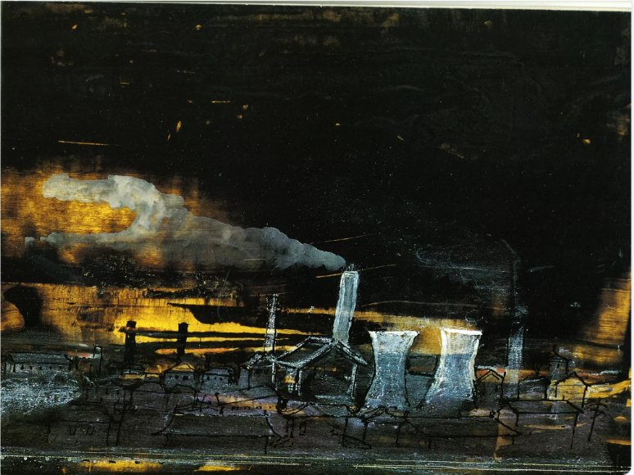

Slide 50
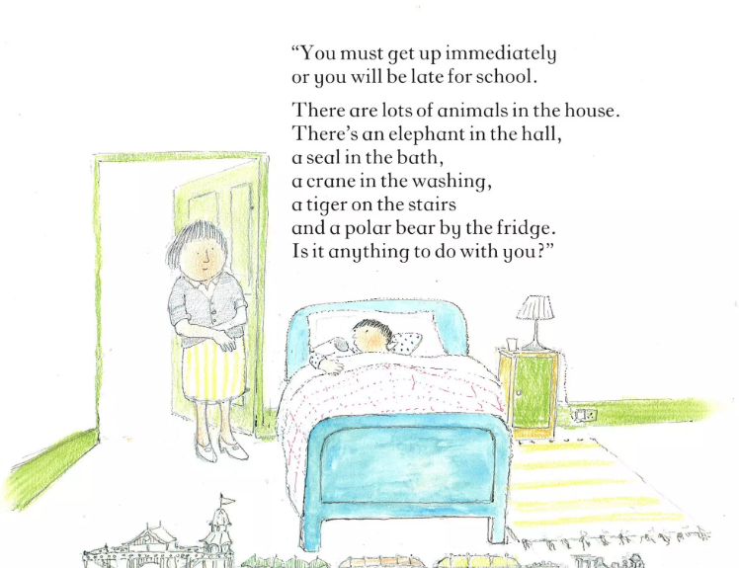
TBAT: recognise the structure of a story

Slide 51

TBAT: recognise the structure of a story
Beginning –
Boy goes to bed
The train journey begins
The weather changes and they have some fun
Someone gets on their train.
“oi, get off our train.”
The animal gives a reason to stay
The weather changes and they have some fun
Someone gets on their train.
“oi, get off our train.”
The animal gives a reason to stay
The weather changes and they have some fun
Someone gets on their train.
“oi, get off our train.”
The animal gives a reason to stay

Slide 52

Which animal do you think would board the train next? Let’s look at some examples of endangered animals.
TBAT: recognise the structure of a story
Monday 17th November 2025
Sea turtles are endangered because humans are destroying the beaches where they lay their eggs and also stealing their eggs to eat.

Slide 53

Javan Rhino
TBAT: recognise the structure of a story
Monday 17th November 2025
These are endangered because people want their horns and have cut down trees in their habitat.

Slide 54

Orangutans
TBAT: recognise the structure of a story
Monday 17th November 2025
These are also endangered because their forests are cut down and used for farming or building houses.

Slide 55

TBAT: recognise the structure of a story
Monday 17th November 2025
In groups we are going to act out your animal asking to board the train.
Why do they need to get on the train?

Slide 56
TBAT: recognise the structure of a story
Monday 17th November 2025
Someone gets on their train.
“oi, get off our train.”
The animal gives a reason to stay
The weather changes and they have some fun

Slide 57


Your task:
TBAT: recognise the structure of a story
Monday 17th November 2025
Order the events of the story
What is going to happen next in the story?

Slide 58




Independent Challenges:
Monday 17th November 2025
Narrative Zone
Maths Zone
Where would you go if you had a free train ticket and why?
Use the part whole model to practise addition and subtraction to 20.
Enquiry Zone
Creative Zone
What materials/ resources can you use to build a train?
Cutting skills

Slide 59

PSHE
KQ: How can I keep safe in school?
Monday 17th November 2025
3 in 3
Can you think of an emotion to match the pictures?

Slide 60





KQ: How can I keep safe in school?
Monday 17th November 2025
Blue/Green
Can you think of one word which fits each
of these pictures?
These pictures make me feel.........
Notes:
Ask pupils to choose one word which fits every picture and guide them if necessary to come up with ‘safe’. Ask them how the word ‘safe’ fits each picture. Discuss each picture with pupils.
In the first picture, an adult is supporting a child. Ask pupils how the child must be feeling and talk about the child being made to feel loved and protected.
The young boy on the bicycle has a helmet and stabilisers to keep him safe.
Many pupils will report that their teddy or soft toy helps them to feel safe. Ask pupils why they think that is. It’s probably because the toy smells or feels familiar and comforting, and gives them happy memories.
Ask pupils to give reasons as to how the children are keeping themselves safe in the last two pictures. (Walking on the zebra crossing, holding hands with a buddy, walking with an adult, wearing a high-visibility jacket, etc.) Help pupils to identify rules of crossing the road safely and the measures put in place to keep children safe on the road in the last picture.

Slide 61
KQ: How can I keep safe in school?
Monday 17th November 2025
Being safe in my school
When might children not feel safe at school?
Notes:
Pupils work in groups to consider this. Adults in the room can facilitate pupils’ thinking. Help them to think about feeling unsafe because of people as well as things, for example people leaving others out of games, playing too rough or being unkind, as well as things like holes in the fence or footballs flying around at lunchtime.

Slide 62
KQ: How can I keep safe in school?
Monday 17th November 2025
Being safe in my school
What keeps us safe at school?
Notes:
Pupils will probably suggest that various people keep us safe in school. Help them to name the adults they come into contact with at school, and who are there to help them. As it is still early in the term, this may be helpful for children on several levels. They may mention older children, too, especially if they have particular monitor roles. They may mention their own siblings. They could refer to things like fire alarms, school security and gates. Acknowledge all of this, but move the conversation on to rules if it doesn’t end up there naturally. Explain that school rules are in place to keep everyone safe.

Slide 63
KQ: How can I keep safe in school?
Monday 17th November 2025
Why do we have rules?
Notes:
Ask pupils to tell you some school rules and then ask the class why we have each rule. Establish that in every case, the rule is in place in school to keep everyone safe. For example, the rule ‘Don’t run in the corridor’ is there to make sure people don’t get knocked over or hurt.

Slide 64
KQ: How can I keep safe in school?
Monday 17th November 2025
School rules?
Be gentle and kind.
Be tidy.
Drop rubbish.
Listen to others.
Be honest.
Run in the classroom.
Leave people out.
Be helpful.
Tell a teacher if you’re worried.
Take other people’s things if you want them.
Look after our school.
Look after everyone’s things.
Include people.
Take turns.
Share.
Notes:
Pupils will quickly recognise the rules which are not good! Help them to focus on why they disagree. Emphasise the rule about telling a teacher if you are worried about anything and signpost pupils to people they can speak to – probably their class teacher and particular TAs, although pupils may have relationships with other adults in the school who they would choose to talk to.

Slide 65
KQ: How can I keep safe in school?
Monday 17th November 2025
School rules
Be gentle and kind.
Be tidy.
Listen to others.
Be honest.
Be helpful.
Tell a teacher if you’re worried.
Look after our school.
Look after everyone’s things.
Include people.
Take turns.
Share.
Notes:
This is the previous list with the bad rules taken out.

Slide 66

Assembly

Slide 67

Break

Slide 68
Warm Up
TBAT: explore changing directions and dodging.
Monday 17th November 2025
Me and My shadow:
One pupils moves around the space in a variety of ways (hopping, crawling, skipping) and their partner copies everything they do.

Slide 69

Skills Development
TBAT: explore changing directions and dodging.
Monday 17th November 2025
Tom and Jerry

Slide 70

Skills Development
TBAT: explore changing directions and dodging.
Monday 17th November 2025
Superheroes and Villains

Slide 71
Plenary
TBAT: explore changing directions and dodging.
Monday 17th November 2025
What top tip would you give to someone changing direction?
How can they do it safely?

Slide 72

Lunch

Slide 73
Independent Challenges:
Narrative Zone
Maths Zone
Where would you go if you had a free train ticket and why?
Use the part whole model to practise addition and subtraction to 20.
Enquiry Zone
Creative Zone
What materials/ resources can you use to build a train?
Cutting skills

Slide 74

TBAT: use tools and equipment accurately to make
part of a structure.
Monday 17th November 2025
Design & Technology Year 1 Structures: Making Sails - Kapow Primary

Slide 75

TBAT: use tools and equipment accurately to make
part of a structure.
Monday 17th November 2025
Mr Westgate (school caretaker) has asked that we make some small windmills to be placed outside so that we can tell if it is windy or not.
Design criteria
The windmills:
Should stand up on its own
Should have a standing structure
Should have a part to catch the wind
Should move in the wind
Could be decorated

Slide 76



TBAT: use tools and equipment accurately to make part of a structure.
Monday 17th November 2025
3 in 3
Design & Technology Year 1 Structures: Making Sails - Kapow Primary

Slide 77

TBAT: use tools and equipment accurately to make
part of a structure.
Monday 17th November 2025
Key vocabulary
Design & Technology Year 1 Structures: Windmills - Kapow Primary

Slide 78

TBAT: use tools and equipment accurately to make
part of a structure.
Monday 17th November 2025
Wind power
These types of windmills were used for crushing grains to create flour for making bread. The wind moves the sails that turn a grinding stone to grind the grains.

Slide 79

TBAT: use tools and equipment accurately to make
part of a structure.
Monday 17th November 2025
Teletubbies: Windmill - Full Episode... - VideoLink
What was the windmill like inside?
What might be in the sacks?
How did they start the sails moving?
What kept the sails moving?

Slide 80

TBAT: use tools and equipment accurately to make
part of a structure.
Monday 17th November 2025
Wind turbines are used for producing electricity.
Like the traditional windmill, the wind moves the rotor blades, turning something inside the structure to make electricity.

Slide 81


TBAT: use tools and equipment accurately to make
part of a structure.
Monday 17th November 2025
Each child needs a new paper cup. Puncture a hole in the middle of the base like they did last week using a sharp pencil.
Practice cutting carefully
Some children may find grip one easier and others may find that grip two provides more control. Encourage them to try both when cutting.
Provide each child with a piece of scrap paper and invite them to make small controlled cuts around the perimeter of the paper. Show them how to move the scissors around the paper while aiming to keep the cuts the same distance apart.
Model making even cuts into the paper cup.
Explain that they should make cuts that go part way down the cup but not all the way to the base.
Encourage the children to rotate the cup so they can see where they are cutting.
Explain that it is complete when they have gone all the way around the outside.
Allow the children time to complete this and assist where needed.

Slide 82

TBAT: use tools and equipment accurately to make
part of a structure.
Monday 17th November 2025
Explain that their cuts have created several flaps in the cup.
Demonstrate how to fold the flaps to create the shape of the windmill’s blades.
Model how to fold at the point where their cuts stop.
Design & Technology Year 1 Structures: Making Sails - Kapow Primary
Why might some of your sails be different sizes?
Which part of the windmill have you made?
What is it supposed to do?

Slide 83

TBAT: use tools and equipment accurately to make
part of a structure.
Monday 17th November 2025
Design criteria checklist
Which part of the design criteria have we completed today?

