Slide 1
Friday 14th November 2025

Slide 2

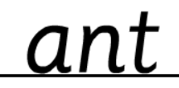

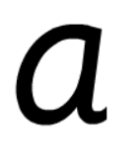
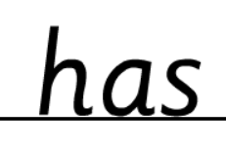
Morning Challenges:
Name writing

Slide 3
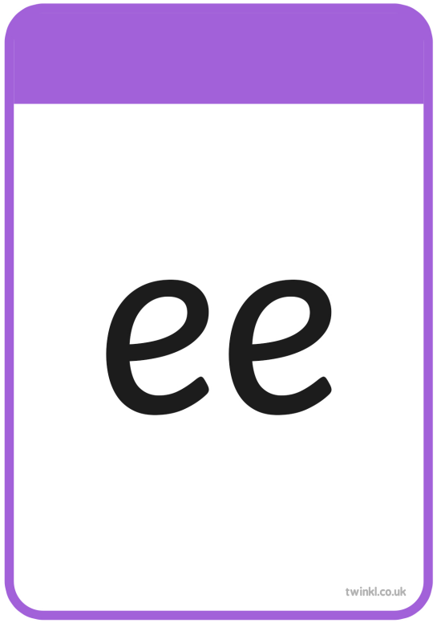

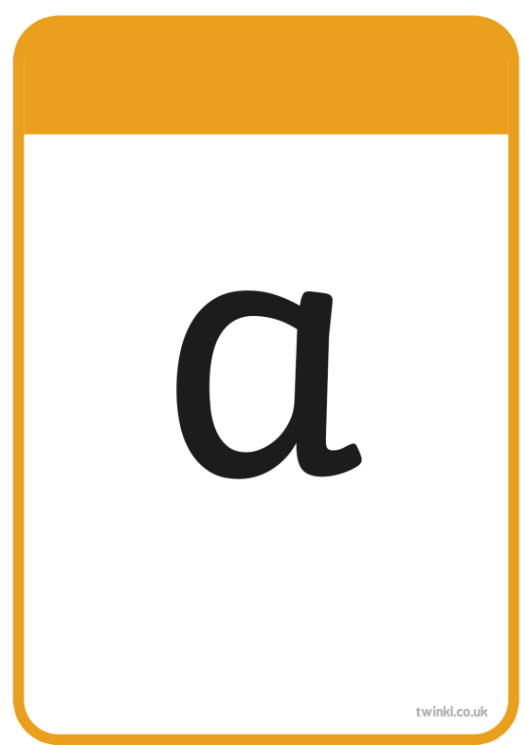




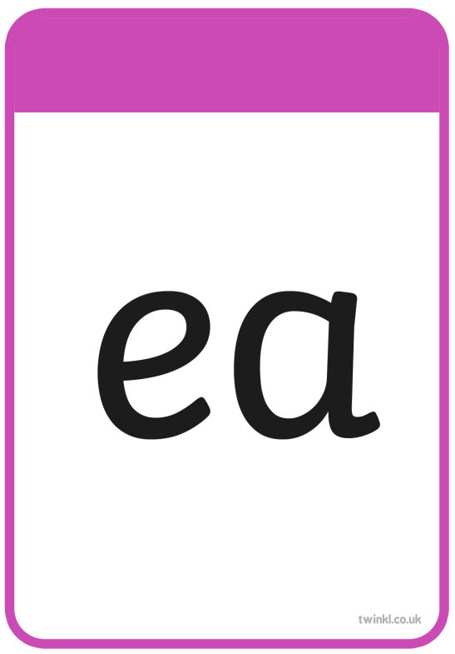
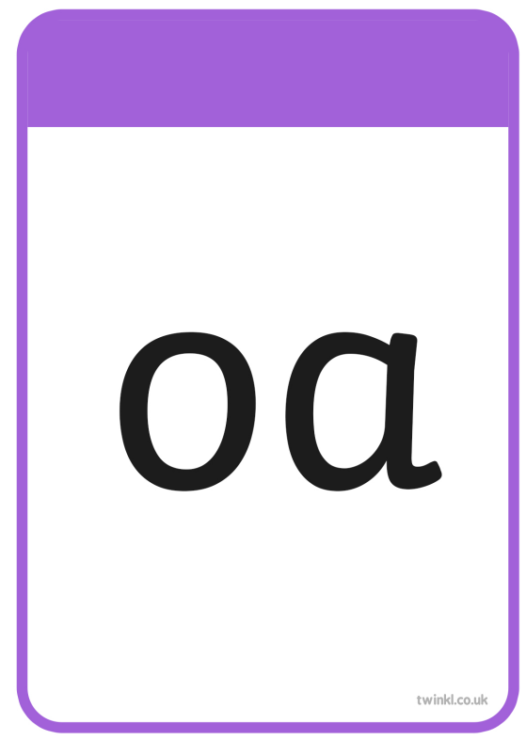




Slide 4
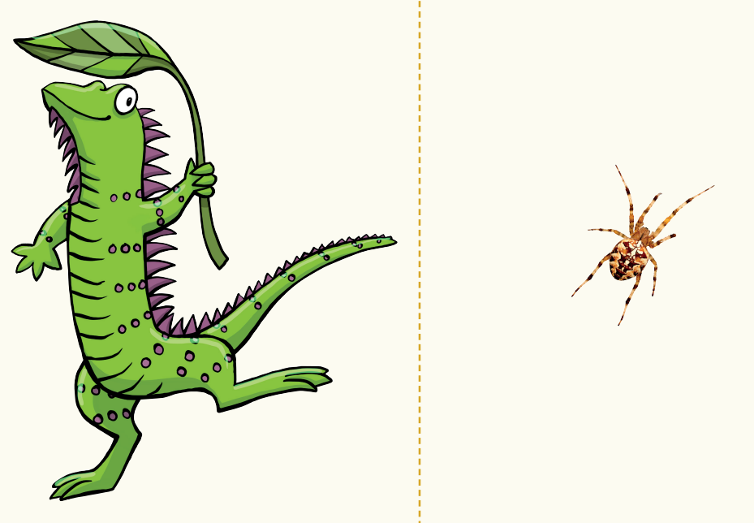
Sort the words
TBAT: review sounds learned this week
Blink
Wild
Kind
Sing
Find
unicorn

Slide 5
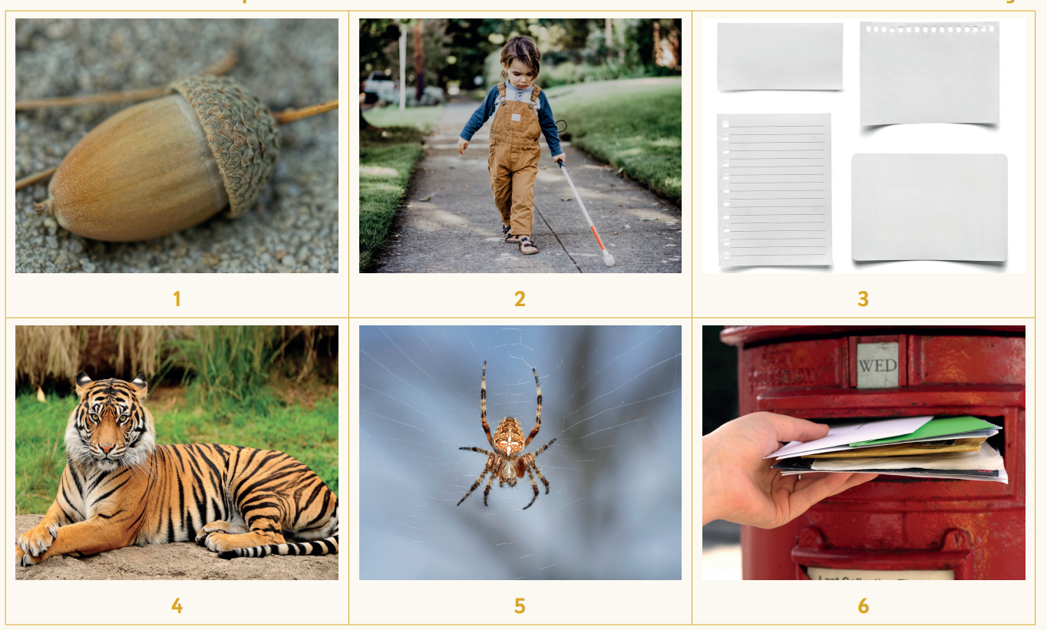
TBAT: review sounds learned this week
spider
paper
post
acorn
tiger
child
rescue

Slide 6



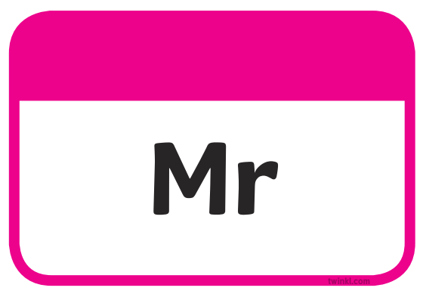
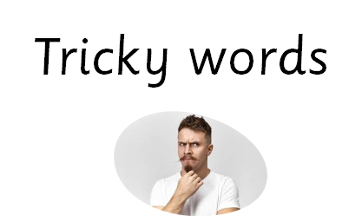


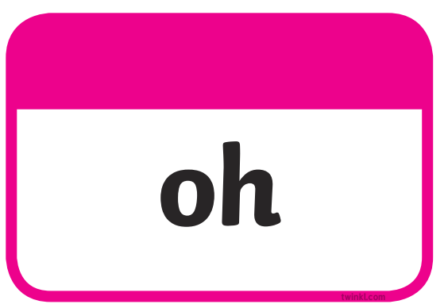
TBAT: read words containing e /ee/

Slide 7
TBAT: review sounds learned this week
most

Slide 8
TBAT: review sounds learned this week
later

Slide 9
TBAT: review sounds learned this week
open

Slide 10
TBAT: review sounds learned this week
being

Slide 11
TBAT: review sounds learned this week
fever

Slide 12
TBAT: review sounds learned this week
baking

Slide 13
TBAT: review sounds learned this week
basic

Slide 14
TBAT: review sounds learned this week
chasing

Slide 15
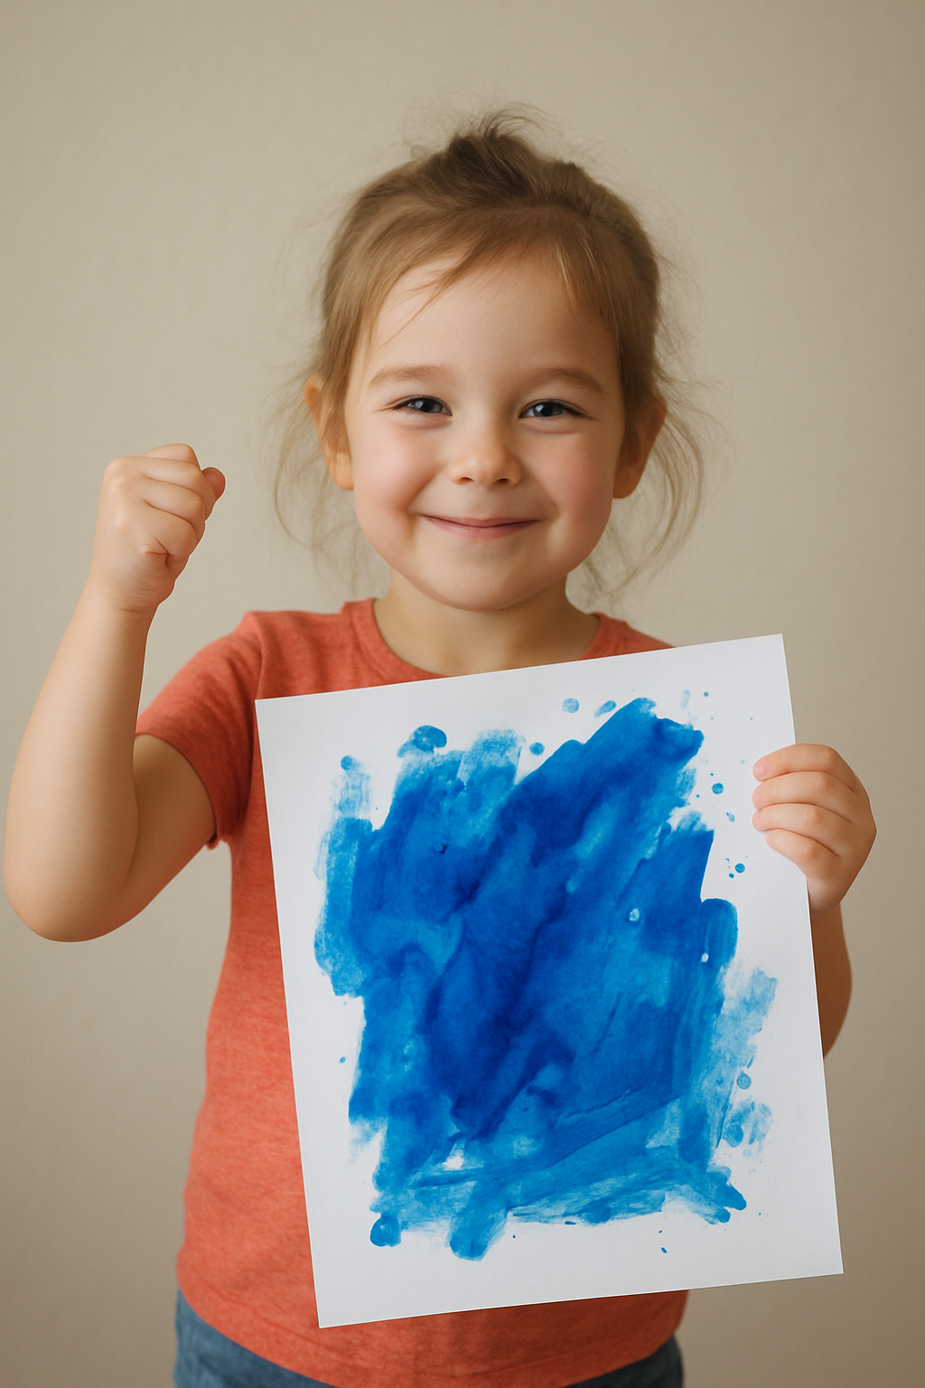
write
Notes:
I am proud of my blue painting

Slide 16
Matching numerals and words
3 in 3
17
eleven
Match the numerals to the words.
11
fourteen
Challenge:
How many tens and ones are these numbers made from?
seventeen
14

Slide 17
TBAT: find double any number to ten and half of any even number within 20
double
half
equal

Slide 18
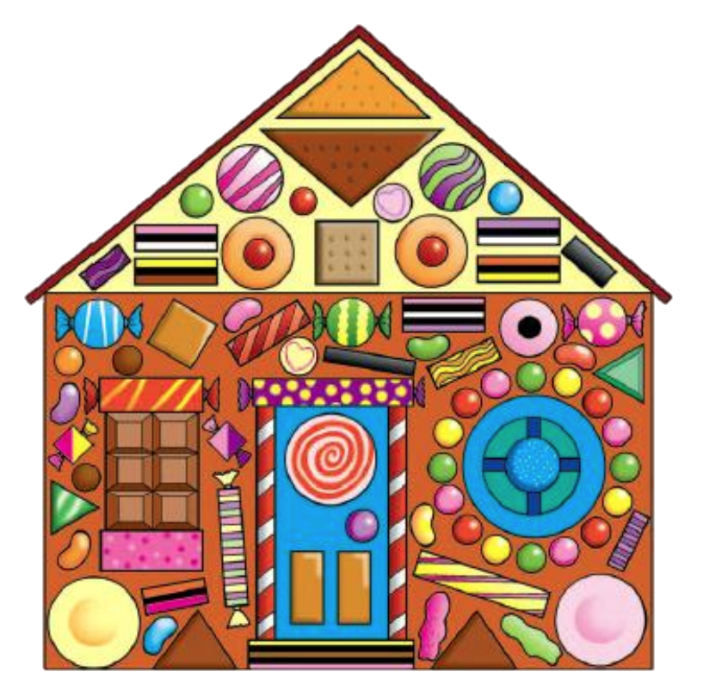

Doubling numbers to ten
paid for
free
SAM’S
SWEET SHOP
Sweets:
1 p each!
All sweets:
buy one get one free!
Sally has two pennies. How many sweets can she pay for? How many sweets will she actually get?
Notes:
Introduce the context that in a sweet shop, all of the sweets are on a ‘buy one get one free’ offer. Every sweet costs one penny. So, if you pay for one sweet, you get two sweets. Choose a pupil to come to the front of the class. Give them two 1 p coins. ? Pupil A has two pennies. How many sweets can she pay for? How many sweets will she actually get? ^ She can pay for two sweets, but she’ll get four because she gets one free for each sweet she pays for. Use a table to represent the sweets paid for and the free sweets. Link the word ‘double’ to the scenario. Explain that you get double the amount you pay for because double means ‘adding an amount to itself’. Continue calling pupils to the front and giving them between one and five 1 p coins. Repeat the questions and model using the table and using the word ‘double’. ? How many pennies does Pupil B/C/D/E have? How many sweets can they pay for? How many sweets will they actually get? ^ If they pay for three, they will get six. Six is double three. Double three is six

Slide 19





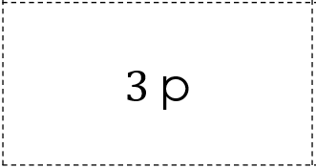
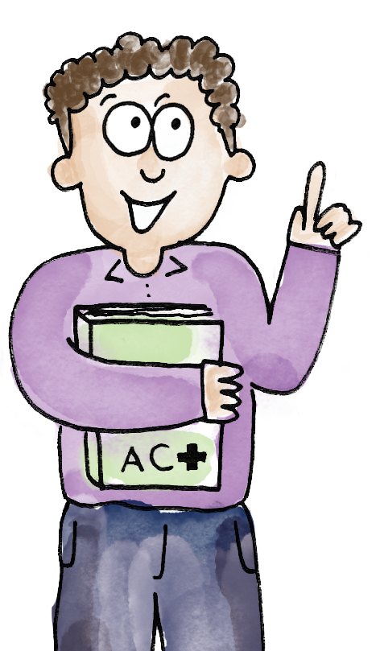
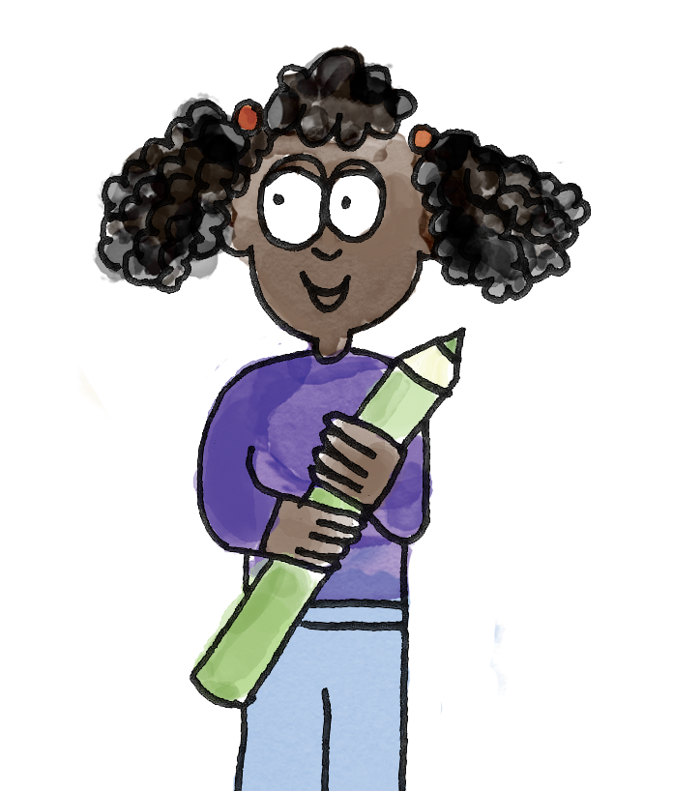
Doubling numbers to ten
I have three pence.
Blue/Green
One, two, three sweets.
Now we need another three.
Four, five, six.
You will get six sweets.
Double three is six.
So I pay three pence and get six sweets!
double half equal
Notes:
Talk Task: Doubling numbers to ten Each pair of pupils needs the Task Sheet (with the cards cut out), 20 plastic/real 1 p coins and 20 sweets (or cubes/counters). Pupil A picks up a card, counts out that number of 1 p coins and states the amount. Pupil B counts out that number of sweets and then places another sweet next to each one to double the amount and find how many sweets Pupil A can buy with the ‘buy one get one free’ offer. They state what double Pupil A’s number of pennies is. Pupil A states how much they pay and how many sweets they receive. Pupils swap roles and repeat.

Slide 20
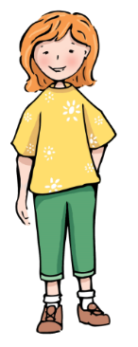
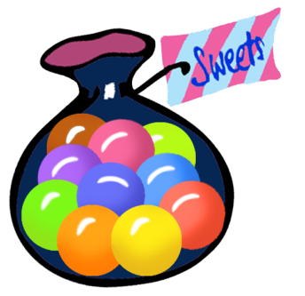
Halving even numbers to 20
Kim went to Sam’s Sweet Shop and came out with ten sweets.
How much did she pay?
How do you know?
What different ways are there of working it out?
If the offer is the same and you get two sweets for every sweet you pay for, how much must this customer pay for ten sweets?
Notes:
Develop Learning: Halving even numbers to 20 Set up a ‘sweet shop’ and ask two pupils to role play as shopkeeper and customer. ? If the offer is the same and you get two sweets for every sweet you pay for, how much must this customer pay for ten sweets? Give all pupils a chance to discuss their strategies. Make connections between methods. Establish that we are finding half of the number of sweets to find the price. ? If the customer has ten sweets, she must have spent five pence. Half of ten is five. Work through more examples. Explain that the shopkeeper wants to make a chart so that he knows how much to charge someone when they buy a given number of sweets. Model the Independent Task.

Slide 21
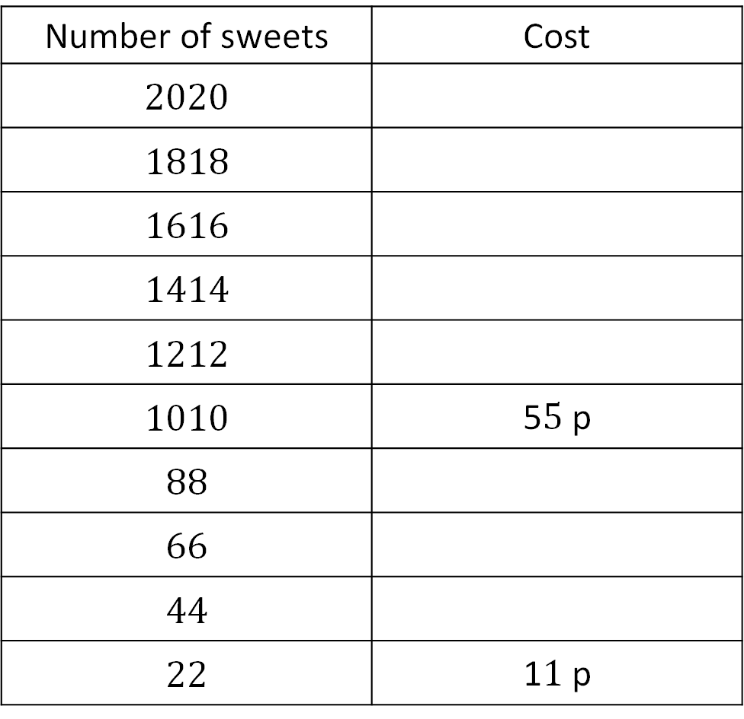
TBAT: find double any number to ten and half of any even number within 20
Number of sweets | Cost
20$20$
18$18$
16$16$
14$14$
12$12$
10$10$ | 5$5$ p
8$8$
6$6$
4$4$
2$2$ | 1$1$ p
paid for
free
Notes:
Independent Task: Recording halves systematically Pupils have the Task Sheet and 20 sweets (or cubes/counters). They represent each number of sweets in the table, find half (using the concrete sweets), and record the cost. ? Can you see any patterns in the table? Can you give a reason for what you notice? They may, for instance, notice that the number of sweets is decreasing in twos down the table and the cost decreases in ones. Can they suggest a reason for this? Possible adaptations: · Pupils could be given cards with the prices to match to the numbers of sweets. · Pupils write their own maths stories involving doubling and halving within 20.

Slide 22
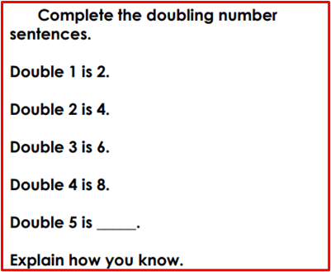
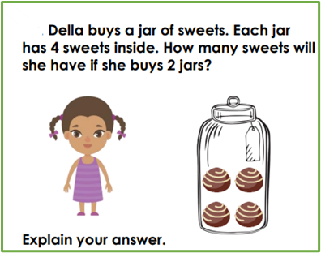
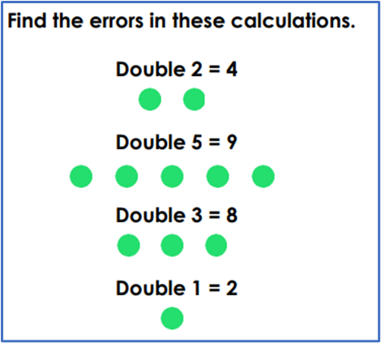
TBAT: find double any number to ten and half of any even number within 20
Challenge:
Mastery:
Mastery with greater depth:
Notes:
Independent Task: Recording halves systematically Pupils have the Task Sheet and 20 sweets (or cubes/counters). They represent each number of sweets in the table, find half (using the concrete sweets), and record the cost. ? Can you see any patterns in the table? Can you give a reason for what you notice? They may, for instance, notice that the number of sweets is decreasing in twos down the table and the cost decreases in ones. Can they suggest a reason for this? Possible adaptations: · Pupils could be given cards with the prices to match to the numbers of sweets. · Pupils write their own maths stories involving doubling and halving within 20.

Slide 23
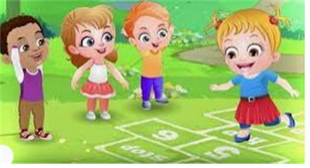
Break

Slide 24
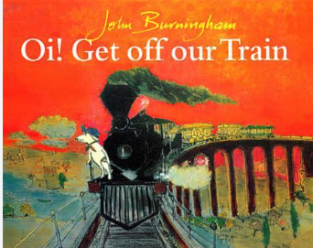
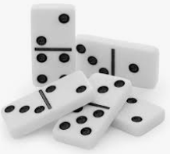

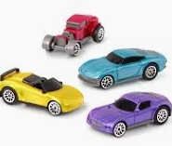
Independent Challenges:
Narrative Zone
Maths Zone
Doubles Dominoes
Write a letter to a friend, telling them what our story is about.
Enquiry Zone
Creative Zone
Do the cars travel further on the floor or carpet?
Why do you think that is?
Make a Pudsey Bear mask.

Slide 25

Lunch

Slide 26

Golden Book Assembly

