Slide 1
Wednesday 8th October 2025

Slide 2

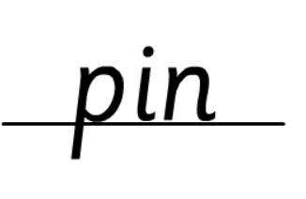


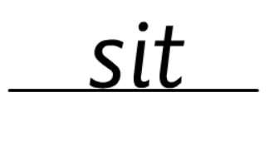
Morning Challenges:
Name writing

Slide 3












TBAT: review recently introduced phase 5 sounds.
Wednesday 8th October 2025

Slide 4
TBAT: review recently introduced phase 5 sounds.
Wednesday 8th October 2025
e-n-j-oy

Slide 5
TBAT: review recently introduced phase 5 sounds.
Wednesday 8th October 2025
a-nn-oy

Slide 6
TBAT: review recently introduced phase 5 sounds.
Wednesday 8th October 2025
ou-t

Slide 7
TBAT: review recently introduced phase 5 sounds.
Wednesday 8th October 2025
a-b-ou-t

Slide 8
TBAT: review recently introduced phase 5 sounds.
Wednesday 8th October 2025
l-ea-s-t

Slide 9
TBAT: review recently introduced phase 5 sounds.
Wednesday 8th October 2025
ea-t-i-ng

Slide 10




TBAT: review recently introduced phase 5 sounds.
Wednesday 8th October 2025
of

Slide 11
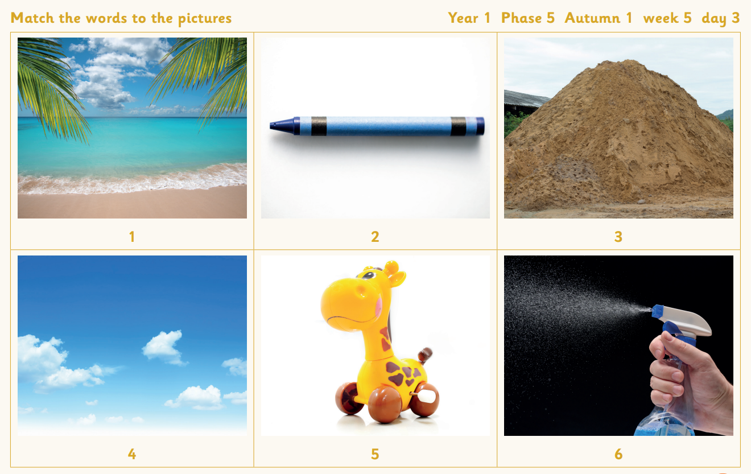
TBAT: review recently introduced phase 5 sounds.
Wednesday 8th October 2025
Match the words to the pictures
crayon
toy
cloud
spray
sea
heap

Slide 12
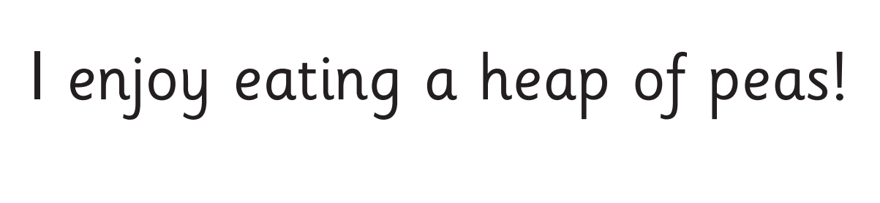
TBAT: review recently introduced phase 5 sounds.
Wednesday 8th October 2025
Now let's read this sentence!​

Slide 13
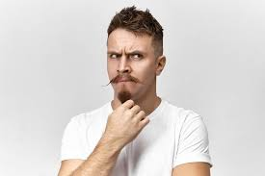
TBAT: review recently introduced phase 5 sounds.
Wednesday 8th October 2025
one
tricky word
spray toy
Dragons Den (phonicsplay.co.uk)

Slide 14
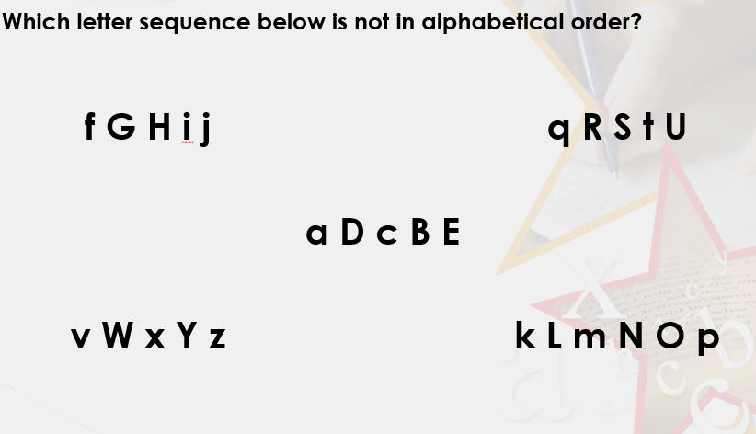
TBAT: recognise the difference between lower case and capital letters.
Wednesday 8th October 2025
5 in 3

Slide 15

TBAT: recognise the difference between lower case and capital letters.
Wednesday 8th October 2025
Blue/ Green- With your partner, explain whether you agree or disagree.
These names are written correctly because the letters are a consistent size.
sam
tim
bob
ascender
descender
lowercase
capital letter
We agree/disagree because.............

Slide 16
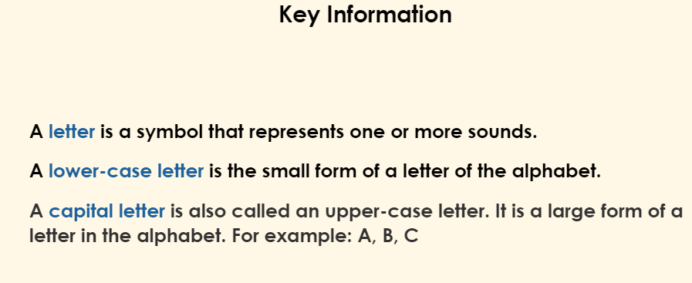
TBAT: recognise the difference between lower case and capital letters.
Wednesday 8th October 2025

Slide 17
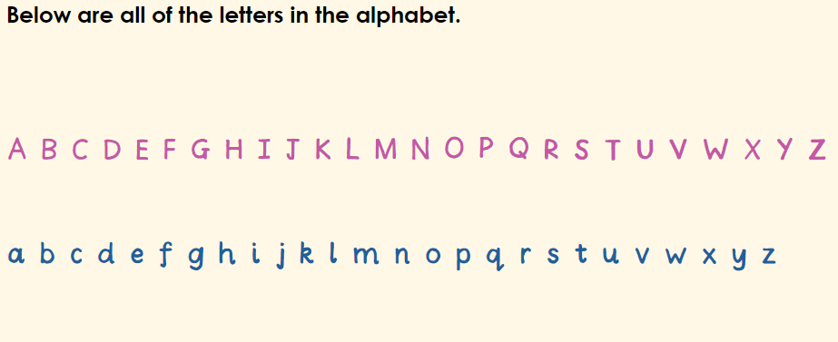
TBAT: recognise the difference between lower case and capital letters.
Wednesday 8th October 2025

Slide 18
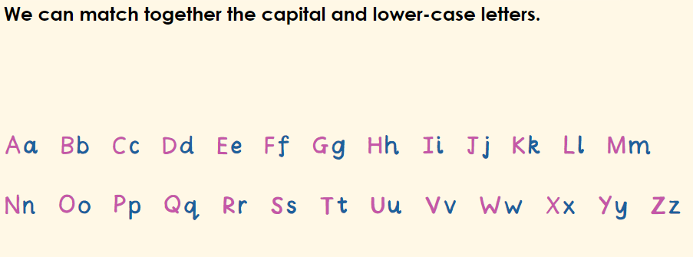
TBAT: recognise the difference between lower case and capital letters.
Wednesday 8th October 2025

Slide 19
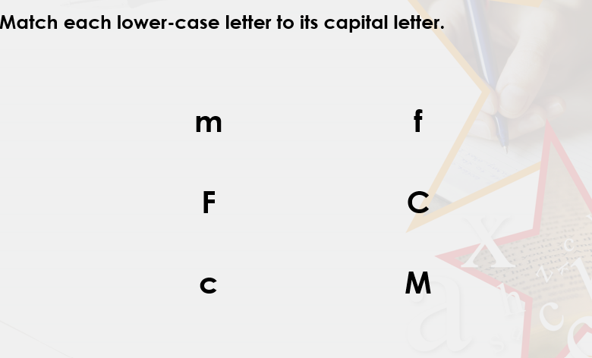
TBAT: recognise the difference between lower case and capital letters.
Wednesday 8th October 2025

Slide 20
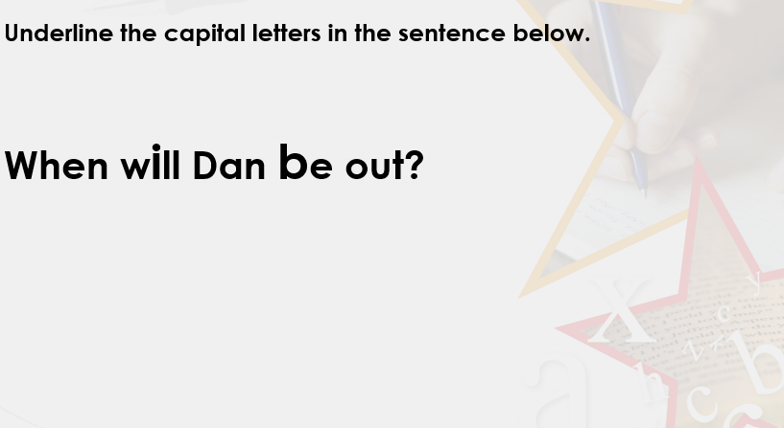
TBAT: recognise the difference between lower case and capital letters.
Wednesday 8th October 2025

Slide 21
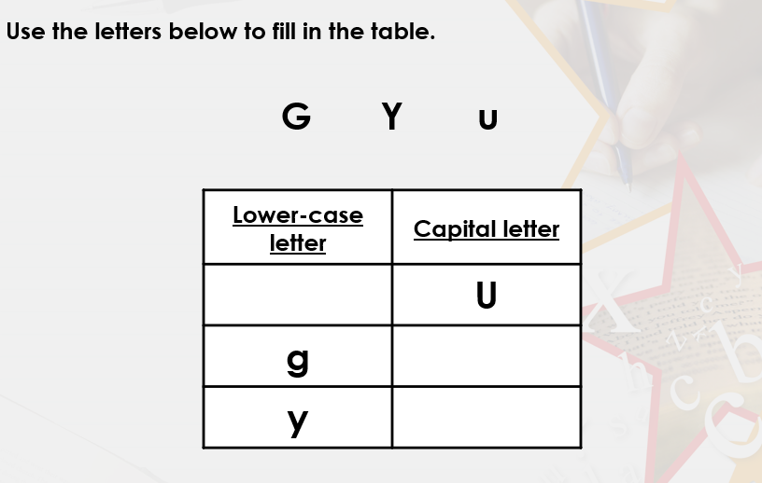
TBAT: recognise the difference between lower case and capital letters.
Wednesday 8th October 2025

Slide 22
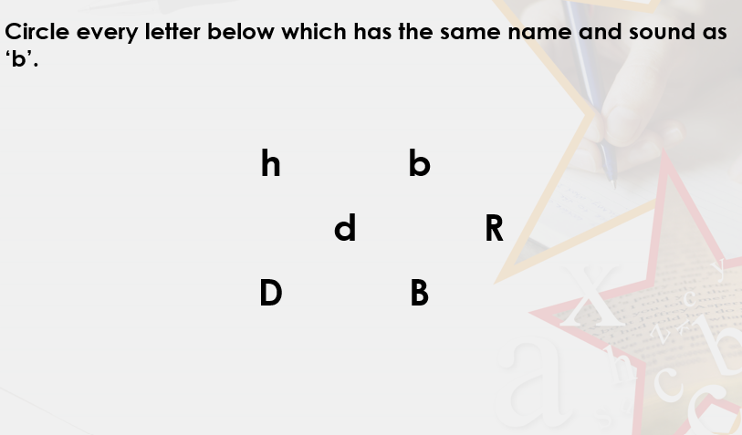
TBAT: recognise the difference between lower case and capital letters.
Wednesday 8th October 2025

Slide 23
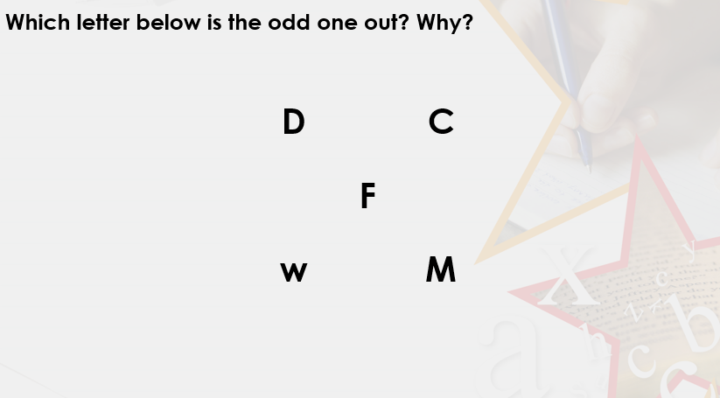
TBAT: recognise the difference between lower case and capital letters.
Wednesday 8th October 2025

Slide 24
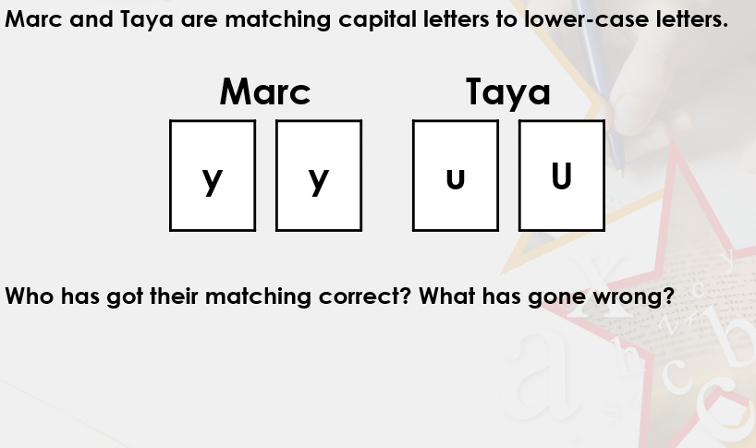
TBAT: recognise the difference between lower case and capital letters.
Wednesday 8th October 2025

Slide 25
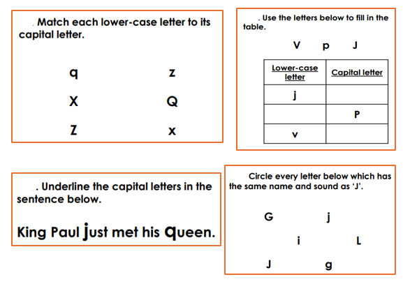
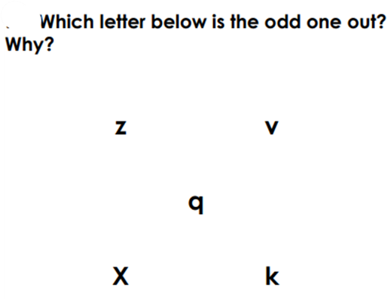
TBAT: recognise the difference between lower case and capital letters.
Wednesday 8th October 2025
Independent:
Challenges:

Slide 26
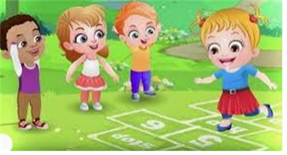
Break

Slide 27

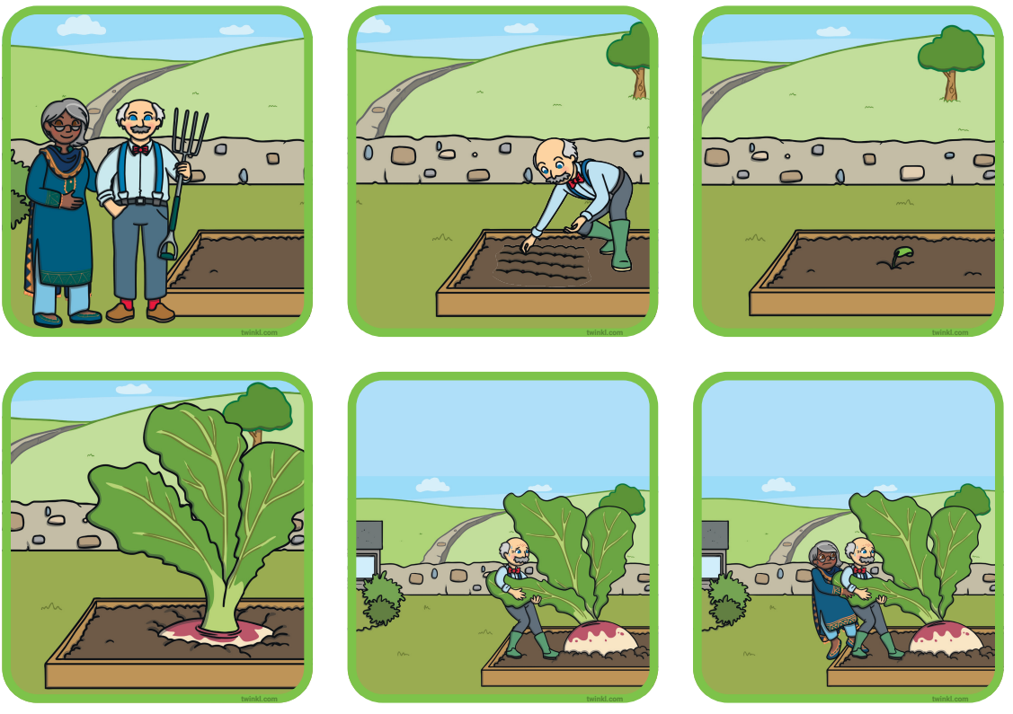
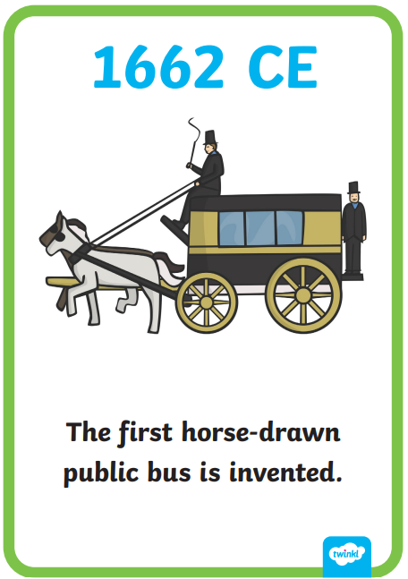

Independent Challenges:
Narrative Zone
Maths Zone
Match the sentences to the pictures of The Enormous Turnip.
Feel inside the bag and write down the shape you can feel.
No peeking!
Enquiry Zone
Creative Zone
Try to order when different types of transport were invented.
Can you create a picture inspired by Kandinksy?

Slide 28

Lunch

Slide 29

Toothbrushing

Slide 30
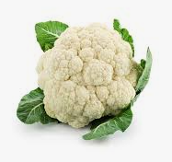
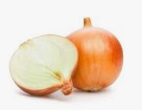
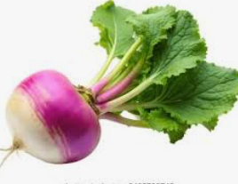
KQ: How does a turnip go from a seed to the supermarket?
Wednesday 8th October 2025
3 in 3 – Can you name these vegetables?
Challenge: Do you know where these vegetables grow?

Slide 31
KQ: How does a turnip go from a seed to the supermarket?
Wednesday 8th October 2025
Blue/Green

Slide 32
KQ: How does a turnip go from a seed to the supermarket?
Wednesday 8th October 2025
Let’s follow a turnip from seed to shop!

Slide 33
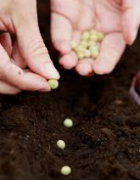
KQ: How does a turnip go from a seed to the supermarket?
Wednesday 8th October 2025
It all begins with a tiny seed in the ground.

Slide 34
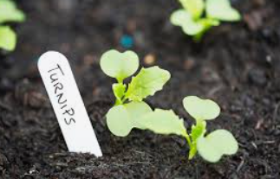
KQ: How does a turnip go from a seed to the supermarket?
Wednesday 8th October 2025
With sunshine and water, the seed starts to grow!
Do you know what else a plant needs to grow?

Slide 35
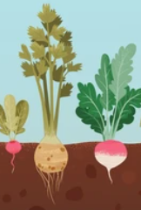
KQ: How does a turnip go from a seed to the supermarket?
Wednesday 8th October 2025
The turnip grows big and round underground.

Slide 36
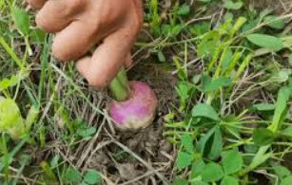
KQ: How does a turnip go from a seed to the supermarket?
Wednesday 8th October 2025
When it’s ready, the farmer pulls it out!

Slide 37
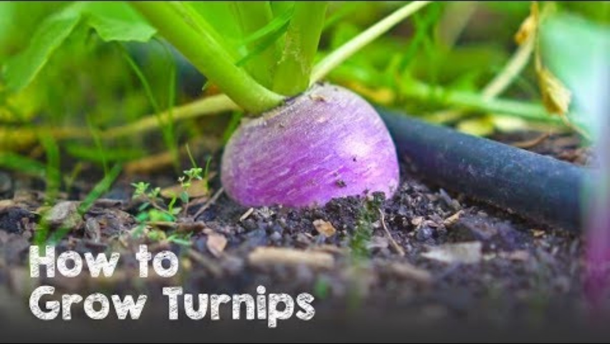
KQ: How does a turnip go from a seed to the supermarket?
Wednesday 8th October 2025

Slide 38
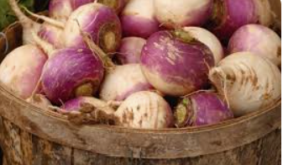
KQ: How does a turnip go from a seed to the supermarket?
Wednesday 8th October 2025
Turnips are cleaned and packed for travel.

Slide 39
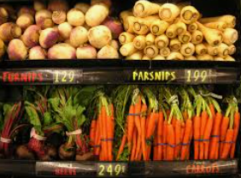
KQ: How does a turnip go from a seed to the supermarket?
Wednesday 8th October 2025
Now they’re ready for us to buy and eat.

Slide 40
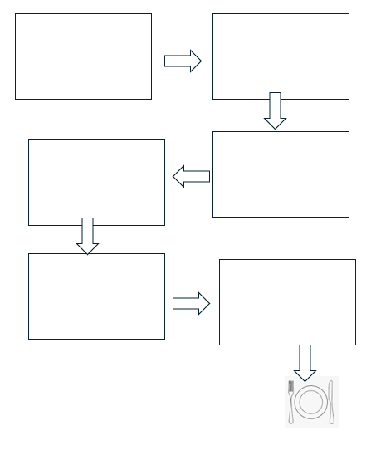
KQ: How does a turnip go from a seed to the supermarket?
Wednesday 8th October 2025
Independent: Show how the turnip goes from seed to supermarket.
Challenge:
Can you think of other ways to get vegetables, other than going to the supermarket?

