Slide 1
Wednesday 1st^{th} October 2025

Slide 2




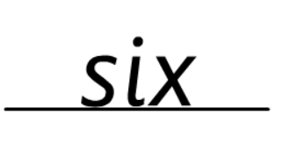
Morning Challenges:
Name writing

Slide 3
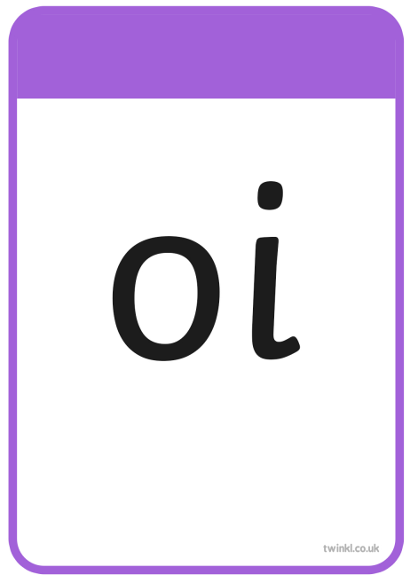





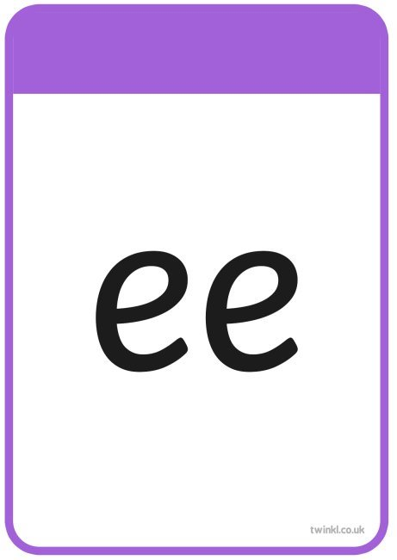

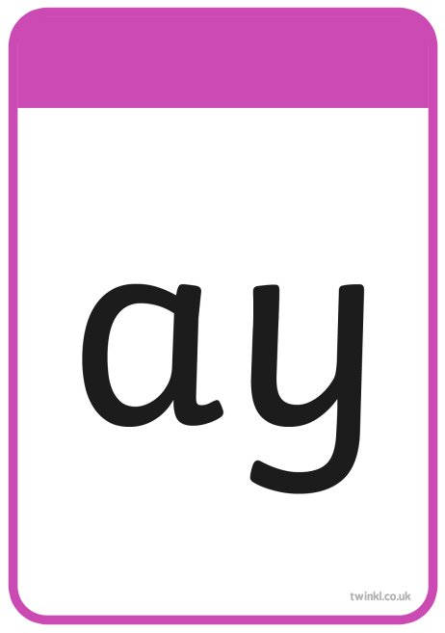

TBAT: read and write words with the alternative /oi/ grapheme /oy/.
Wednesday 1st October 2025

Slide 4
TBAT: read and write words with the alternative /oi/ grapheme /oy/.
Wednesday 1st October 2025
day

Slide 5
TBAT: read and write words with the alternative /oi/ grapheme /oy/.
Wednesday 1st October 2025
crayon

Slide 6
TBAT: read and write words with the alternative /oi/ grapheme /oy/.
Wednesday 1st October 2025
out

Slide 7
TBAT: read and write words with the alternative /oi/ grapheme /oy/.
Wednesday 1st October 2025
found

Slide 8
TBAT: read and write words with the alternative /oi/ grapheme /oy/.
Wednesday 1st October 2025
train

Slide 9
TBAT: read and write words with the alternative /oi/ grapheme /oy/.
Wednesday 1st October 2025
smear

Slide 10






TBAT: read and write words with the alternative /oi/ grapheme /oy/.
Wednesday 1st October 2025
says

Slide 11

TBAT: read and write words with the alternative /oi/ grapheme /oy/.
Wednesday 1st October 2025

Slide 12
TBAT: read and write words with the alternative /oi/ grapheme /oy/.
Wednesday 1st October 2025
b-oy

Slide 13
TBAT: read and write words with the alternative /oi/ grapheme /oy/.
Wednesday 1st October 2025
t-oy

Slide 14
TBAT: read and write words with the alternative /oi/ grapheme /oy/.
Wednesday 1st October 2025
a-nn-oy

Slide 15
TBAT: read and write words with the alternative /oi/ grapheme /oy/.
Wednesday 1st October 2025
e-n-j-oy

Slide 16
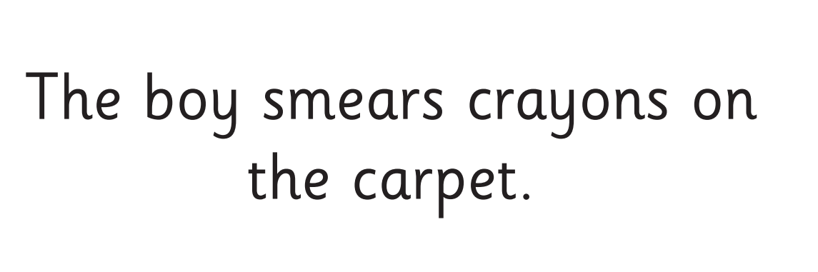
TBAT: read and write words with the alternative /oi/ grapheme /oy/.
Wednesday 1st October 2025
Now let's read this sentence!​

Slide 17

TBAT: read and write words with the alternative /oi/ grapheme /oy/.
Wednesday 1st October 2025
like
tricky word
boy joy

Slide 18


3 in 3 - Practise number bonds to eight
TBAT: explore related addition and subtraction facts
Wednesday 1st October 2025
How can we make eight?
Eight plus zero is equal to eight.
One plus seven is equal to eight …
Notes:
Do Now: Practising transitions
Practise number bonds to eight.

Slide 19
TBAT: explore related addition and subtraction facts
Wednesday 1st October 2025
equation
minus
whole
subtract
part
plus
add
related

Slide 20
Blue / Green Find the calculation that is the odd one out. 4 + 3 = 7 2 + 3 = 5 7 – 4 = 3 1 + 4 = 5 2 + 5 = 7 5 – 2 = 3 … is the odd one out because…
TBAT: explore related addition and subtraction facts
Wednesday 1st October 2025
Challenge:
Find both that could be the odd one out for different reasons.

Slide 21


Introducing related addition and subtraction facts
TBAT: explore related addition and subtraction facts
Wednesday 1st October 2025
How many yellow fish are there?
How many purple fish?
How could we represent the fish using manipulatives?
part
plus
part
is equal to
whole
+
=
part
plus
part
is equal to
whole
+
=
Notes:
New Learning: Introducing related addition and subtraction facts
Show pupils the picture of the fish and discuss the question prompts. Represent the fish concretely using two different colours of cube.
What could I write in my part-whole model to represent the two colours of fish?
Write ‘4’ and ‘3’ in the part-whole model on the slide.
How many fish are there altogether? What addition equation could I write to show that?
Is there another addition equation I could write?
Write both equations (4 + 3 = 7 and 3 + 4 = 7). Record the whole in the part-whole model.
Use the next slide to discuss subtraction equations. When discussing how many fish are purple, pupils may suggest the alternative subtraction equation (7 – 3 = 4). Emphasise that the correct equation is 7 – 4 = 3 because we start with the whole and subtract the number of yellow fish to find the number of purple. Repeat to show the number of yellow fish.
Explain that these are related addition and subtraction facts.
Why do you think we say they are related? What’s the same and what’s different?

Slide 22
Introducing related addition and subtraction facts
TBAT: explore related addition and subtraction facts
Wednesday 1st October 2025
Fact Families Song | Addition & Subtraction with Number Bonds - YouTube
What subtraction equation could I write to show how many purple fish there are?
What about for the yellow fish?
whole
subtract
part
is equal to
part
–
=
whole
subtract
part
is equal to
part
–
=
Notes:
New Learning: Introducing related addition and subtraction facts
Show pupils the picture of the fish and discuss the question prompts. Represent the fish concretely using two different colours of cube.
What could I write in my part-whole model to represent the two colours of fish?
Write ‘4’ and ‘3’ in the part-whole model on the slide.
How many fish are there altogether? What addition equation could I write to show that?
Is there another addition equation I could write?
Write both equations (4 + 3 = 7 and 3 + 4 = 7). Record the whole in the part-whole model.
Use the next slide to discuss subtraction equations. When discussing how many fish are purple, pupils may suggest the alternative subtraction equation (7 – 3 = 4). Emphasise that the correct equation is 7 – 4 = 3 because we start with the whole and subtract the number of yellow fish to find the number of purple. Repeat to show the number of yellow fish.
Explain that these are related addition and subtraction facts.
Why do you think we say they are related? What’s the same and what’s different?

Slide 23
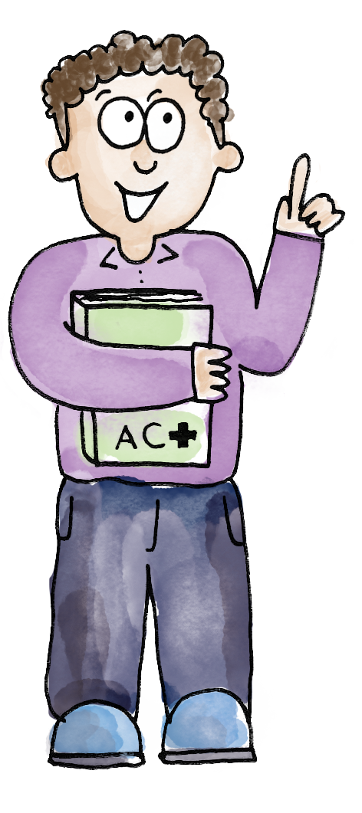
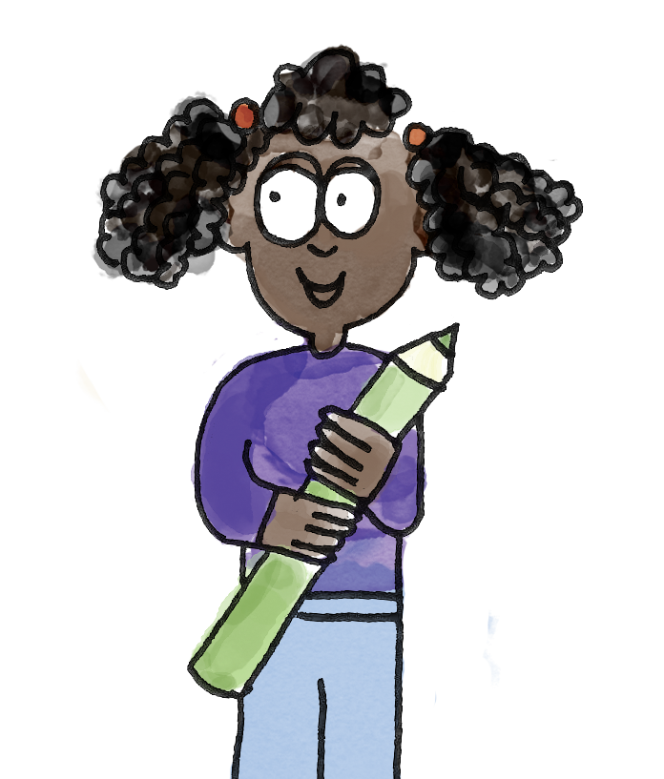
Exploring related facts
TBAT: explore related addition and subtraction facts
Wednesday 1st October 2025
3
Three plus four is equal to seven.
7
And four plus three is equal to seven.
4
Seven subtract four is equal to three.
And seven subtract three is equal to four.
add plus subtract minus whole part equation related
Notes:
Talk Task: Exploring related facts
Pupils have cubes in two different colours and both pages of the Task Sheet. They select a part-whole model and place cubes in two colours on the parts accordingly. Pupils take it in turns to identify the different addition and subtraction equations related to the part-whole model.

Slide 24
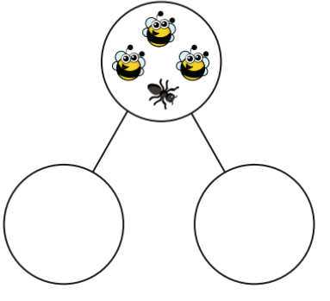
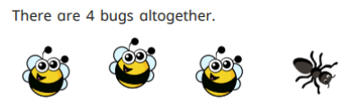


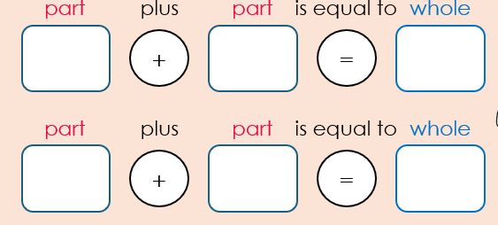
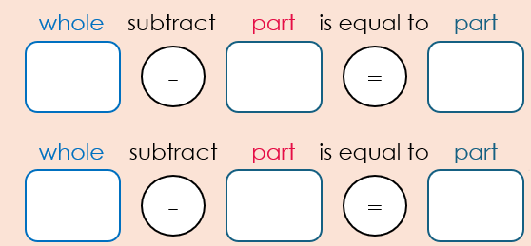
Using the part, whole model, write the fact family
4
3
1

Slide 25
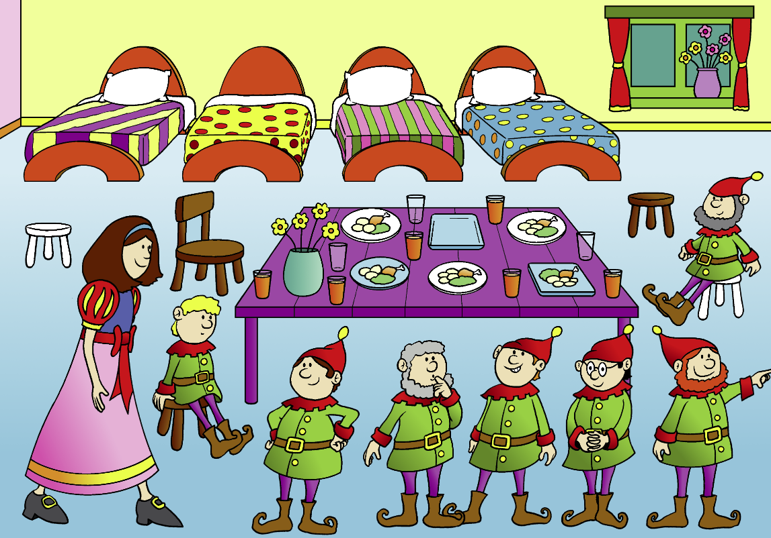
Telling stories using related facts
TBAT: explore related addition and subtraction facts
Wednesday 1st October 2025
How many dwarves are wearing a hat?
Notes:
Develop Learning: Telling stories using related facts
How many dwarves are wearing a hat?
Write ‘5’ in one part of the first part-whole model, and place five cubes in one part of the second model. Say that five is a part.
How many dwarves are not wearing a hat?
Write ‘2’ in the other part of the first part-whole model, and place two cubes of a different colour in the other part of the second model. Say that two is the other part.
How many dwarves are there altogether?
Write ‘7’ as the whole in the first model. Combine the two colours of cube in the second model and count them all again to confirm that there are seven. Say that seven is the whole.
Discuss all the different addition and subtraction equations represented by the part-whole model. Record all four equations somewhere that will be visible to the pupils during the Independent Task. Model the Independent Task.

Slide 26
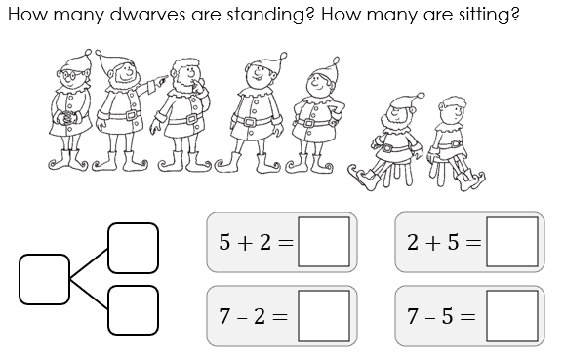
To explore related addition and subtraction facts
TBAT: explore related addition and subtraction facts
Wednesday 1st October 2025
Notes:
Independent Task: Telling stories about related facts
All the number bonds to seven are represented in the image of the dwarves, e.g. dwarves wearing hats, dwarves with beards, etc. Pupils represent the dwarves using cubes on a part-whole model, discuss the different addition and subtraction stories related to the seven dwarves and complete the related equations.
Possible adaptations:
Challenge can be provided in this task by removing the partially completed equations (or some information from them) and requiring pupils to write the equations independently.
Give pupils a set of related facts where some of the numbers have been switched arbitrarily and therefore the numbers do not balance. They identify and correct the mistakes.

Slide 27

Addressing a misconception
TBAT: explore related addition and subtraction facts
Wednesday 1st October 2025
What mistake has this boy made?
Why do you think he has made it?
Can you correct his work?
4 + 2 = 6
6 + 2 = 4
4 – 2 = 6
2 – 4 = 6
I’ve made related facts because they all have the same three numbers.
Notes:
Plenary: Addressing a misconception
Show pupils the example on the slide, which presents some incorrect ‘related’ facts, where the numbers within the equations have been arbitrarily switched around, without thinking about part-whole relationships. Discuss and correct.

Slide 28
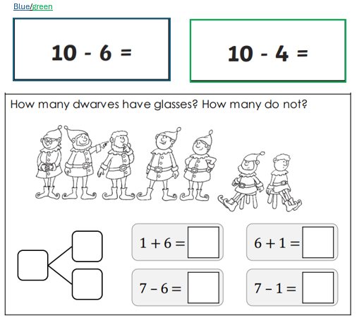
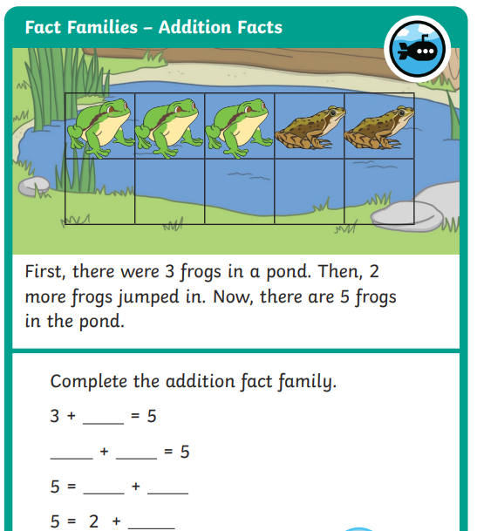
RP:

Slide 29
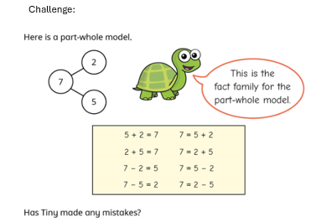
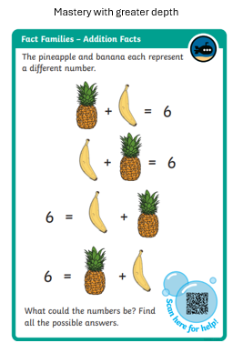
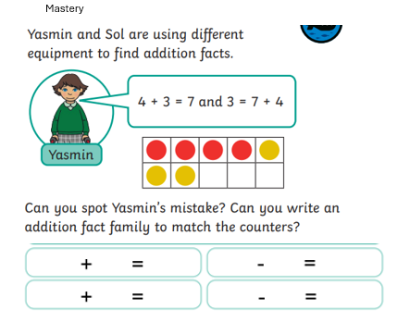

Slide 30
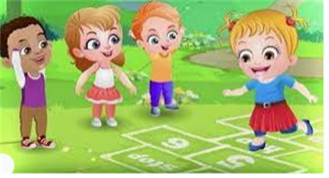
Break

Slide 31

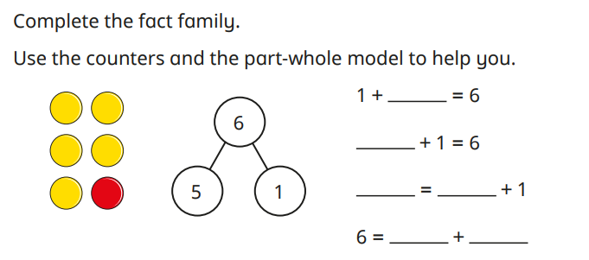
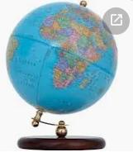
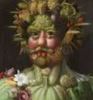
Independent Challenges:
Narrative Zone
Maths Zone
Create a shopping list of vegetables you might buy to donate to a harvest festival.
Solve the addition and subtractions using the part, whole model.
Enquiry Zone
Creative Zone
Create a picture inspired by Guiseppe Archimboldo.
Find the United Kingdom on the globe.
Are we a large country or a small one?

Slide 32

Lunch

Slide 33
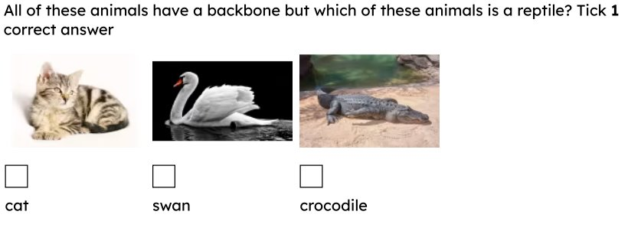
KQ: Can I name and group common animals that are fish and amphibians.
Wednesday 1st October 2025
Entry question:

Slide 34
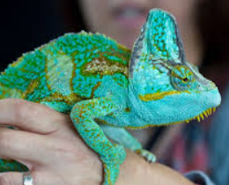
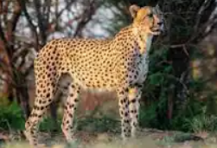
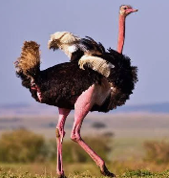
KQ: Can I name and group common animals that are fish and amphibians.
Wednesday 1st October 2025
3 in 3 : Match the animal to its group.
bird
reptile
mammal
Challenge: Explain how you know that it belongs in that group.

Slide 35
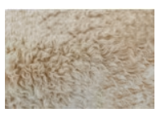
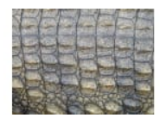

KQ: Can I name and group common animals that are fish and amphibians.
Wednesday 1st October 2025
Blue/ Green:
scales
fur
feathers
mammal
reptile
bird
This type of animal is a …................. I know this because........

Slide 36
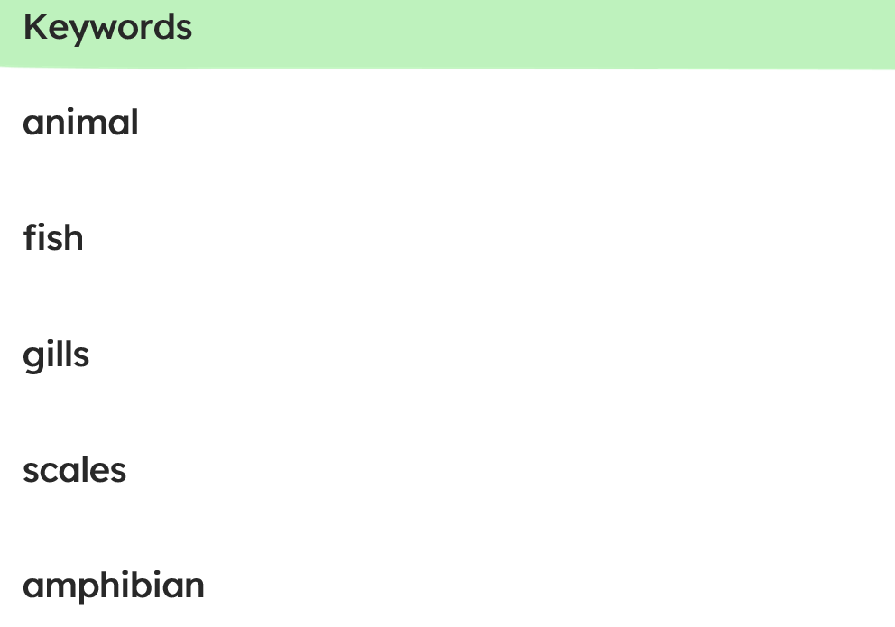
KQ: Can I name and group common animals that are fish and amphibians.
Wednesday 1st October 2025

Slide 37
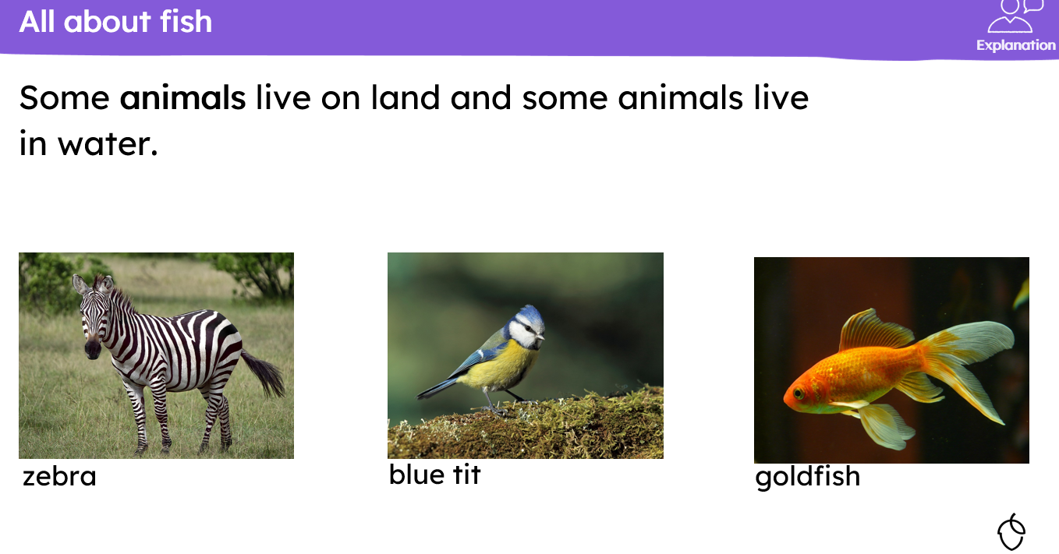
KQ: Can I name and group common animals that are fish and amphibians.
Wednesday 1st October 2025

Slide 38
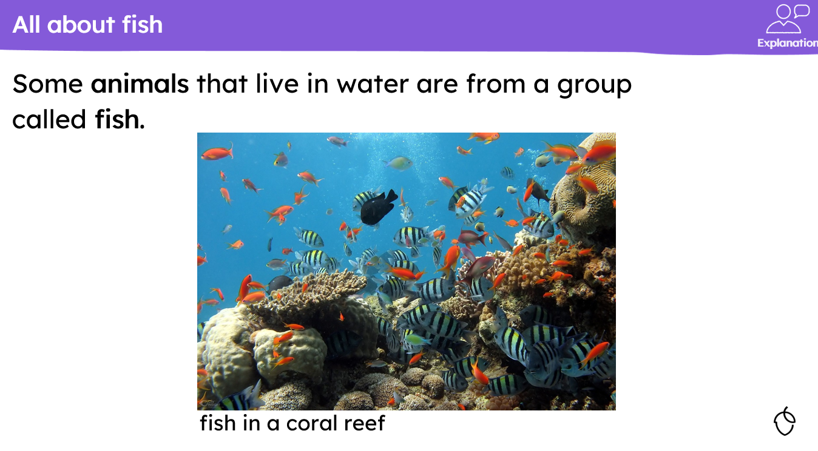
KQ: Can I name and group common animals that are fish and amphibians.
Wednesday 1st October 2025

Slide 39
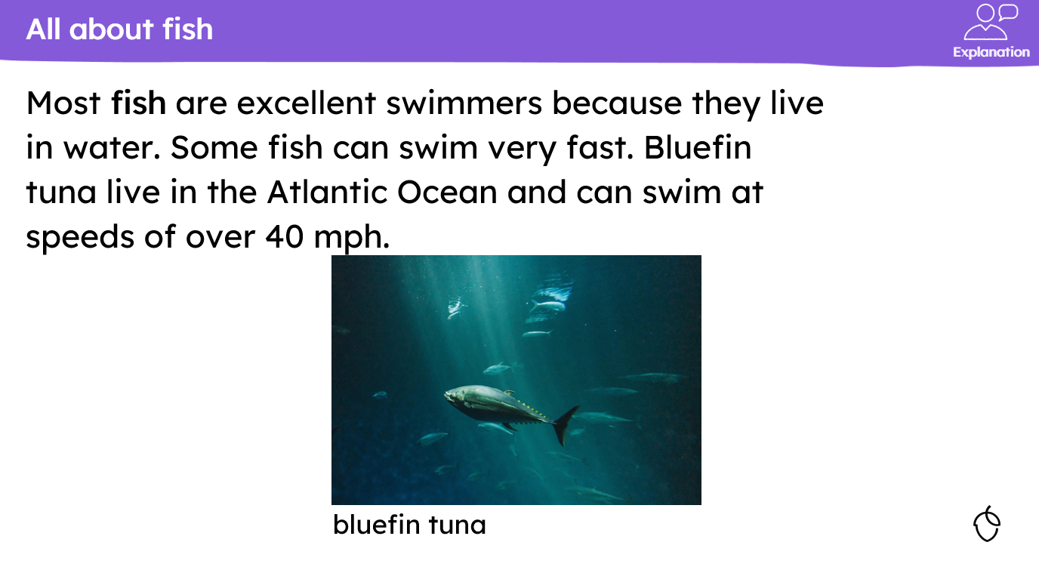
KQ: Can I name and group common animals that are fish and amphibians.
Wednesday 1st October 2025

Slide 40
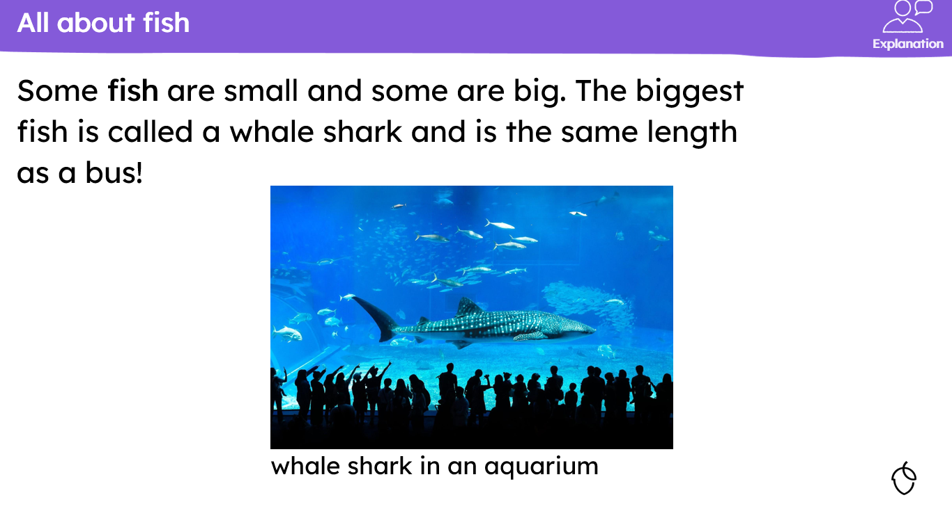
KQ: Can I name and group common animals that are fish and amphibians.
Wednesday 1st October 2025

Slide 41
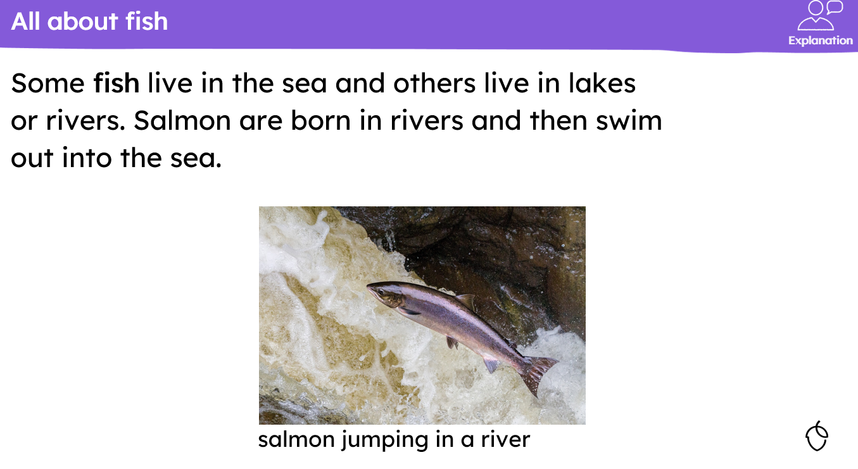
KQ: Can I name and group common animals that are fish and amphibians.
Wednesday 1st October 2025

Slide 42
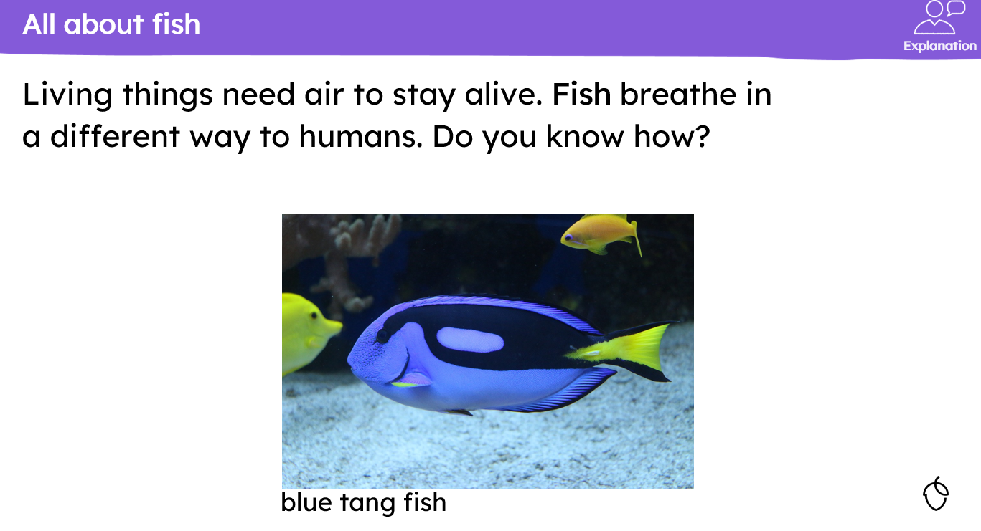
KQ: Can I name and group common animals that are fish and amphibians.
Wednesday 1st October 2025

Slide 43
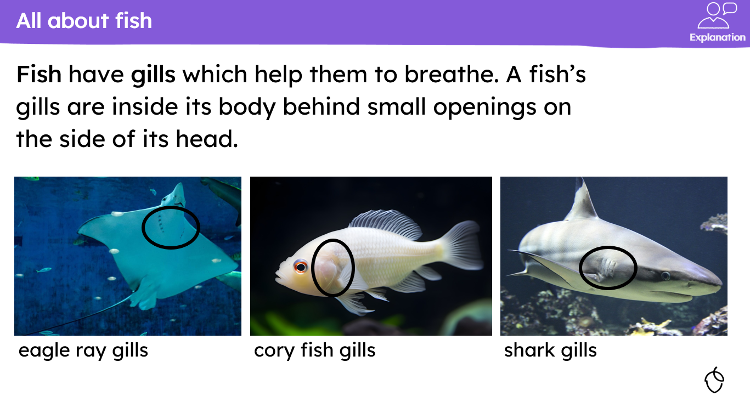
KQ: Can I name and group common animals that are fish and amphibians.
Wednesday 1st October 2025

Slide 44
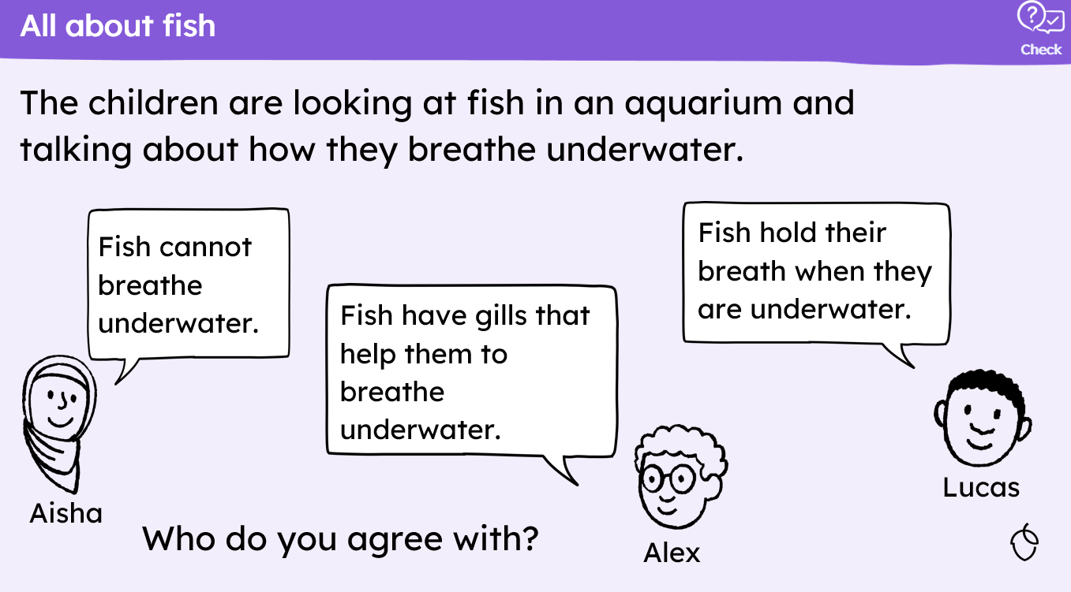
KQ: Can I name and group common animals that are fish and amphibians.
Wednesday 1st October 2025

Slide 45
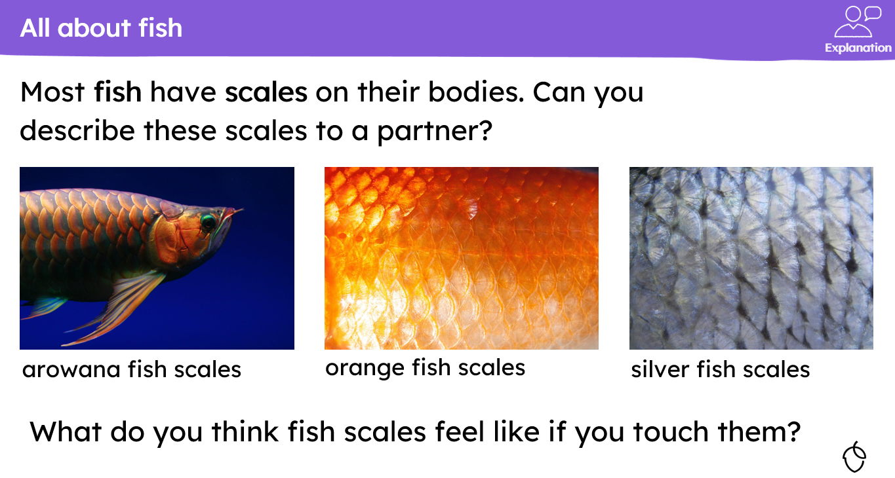
KQ: Can I name and group common animals that are fish and amphibians.
Wednesday 1st October 2025

Slide 46
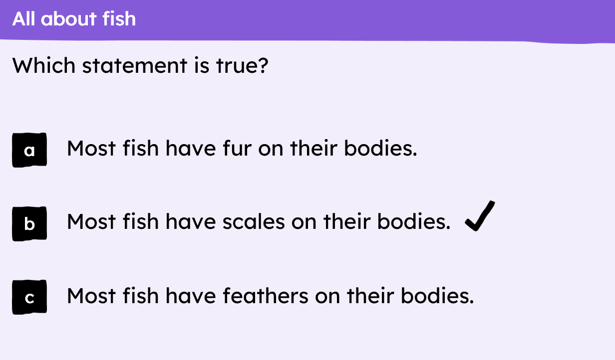
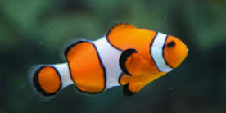
KQ: Can I name and group common animals that are fish and amphibians.
Wednesday 1st October 2025

Slide 47
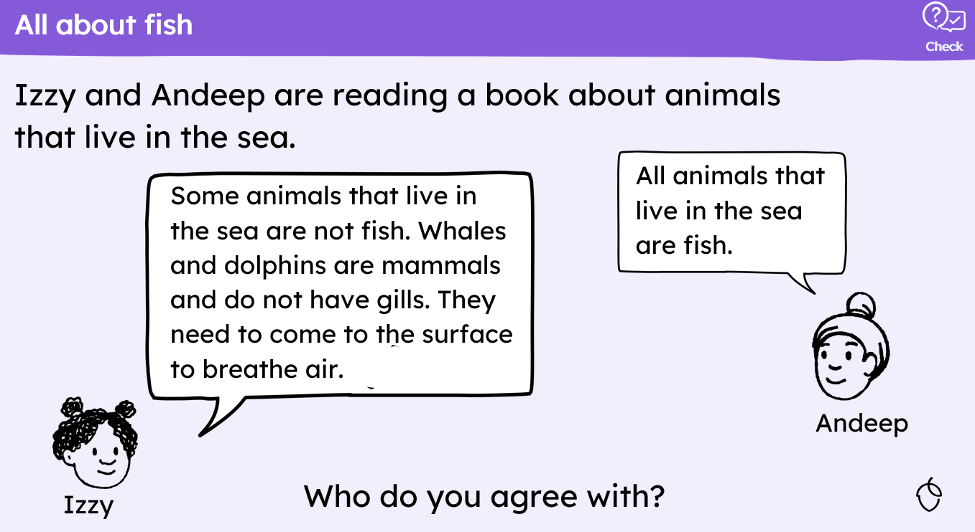
KQ: Can I name and group common animals that are fish and amphibians.
Wednesday 1st October 2025

Slide 48
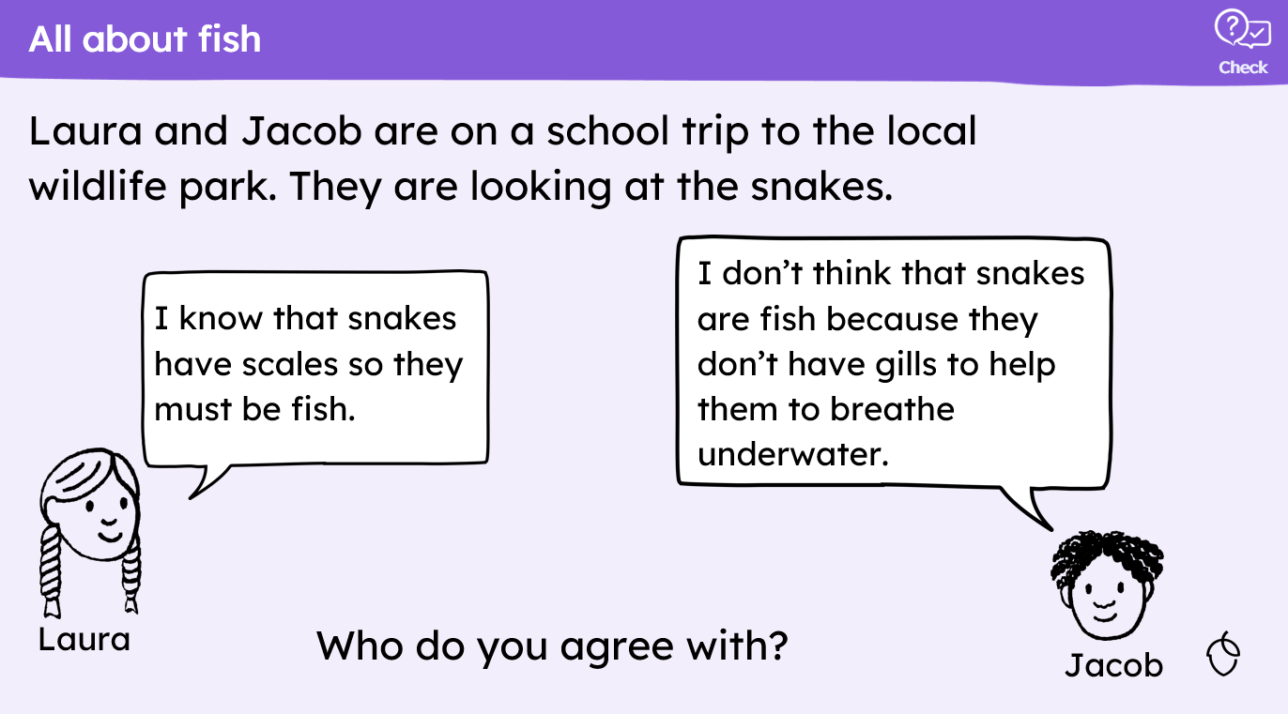
KQ: Can I name and group common animals that are fish and amphibians.
Wednesday 1st October 2025

Slide 49
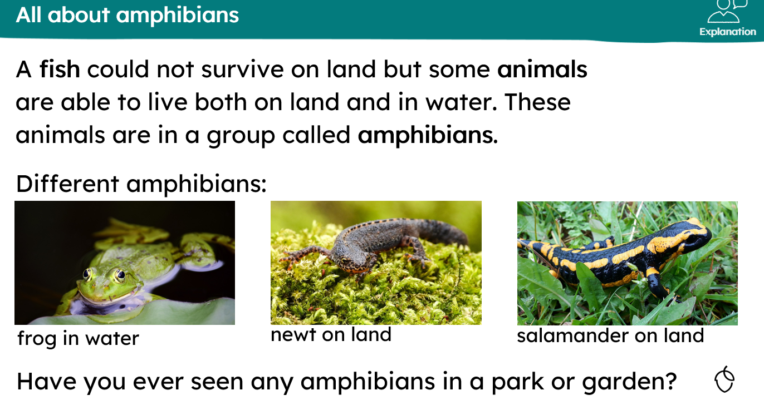
KQ: Can I name and group common animals that are fish and amphibians.
Wednesday 1st October 2025

Slide 50
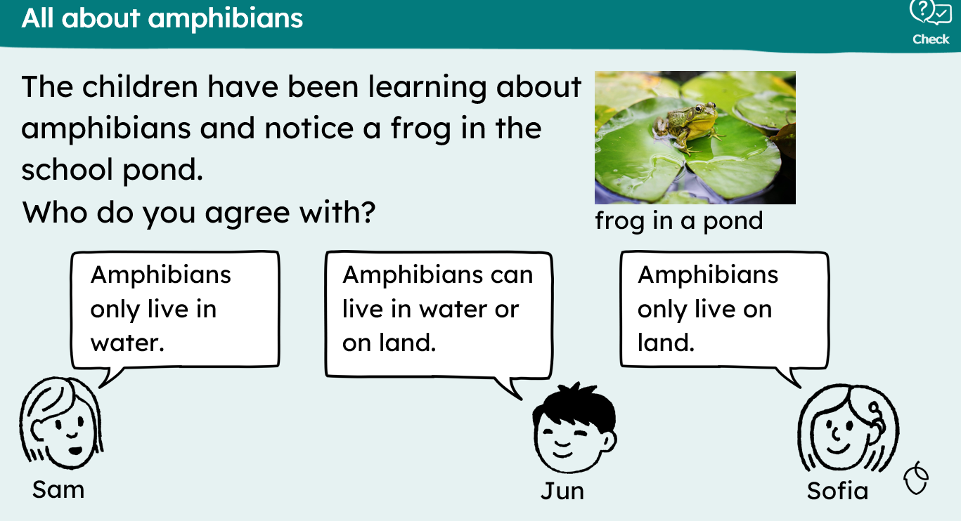
KQ: Can I name and group common animals that are fish and amphibians.
Wednesday 1st October 2025

Slide 51
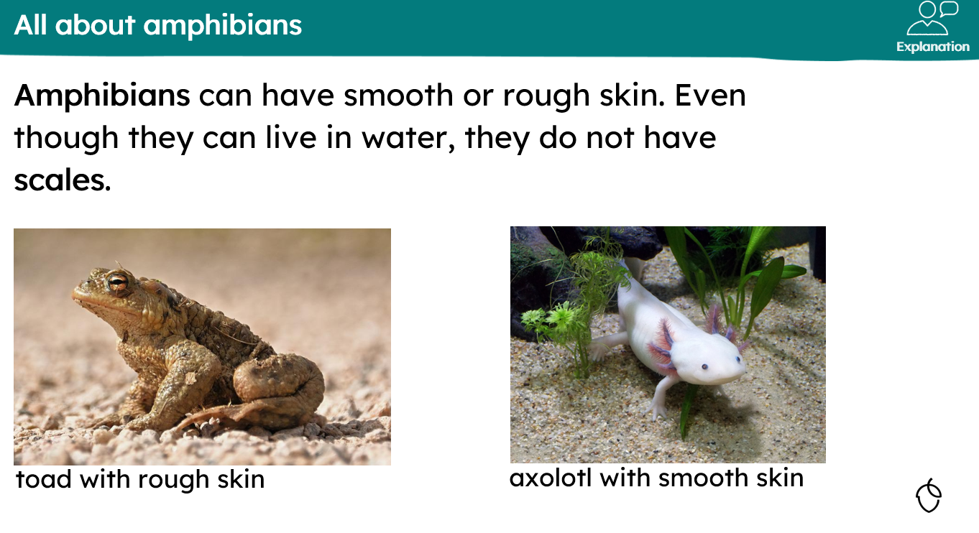
KQ: Can I name and group common animals that are fish and amphibians.
Wednesday 1st October 2025

Slide 52
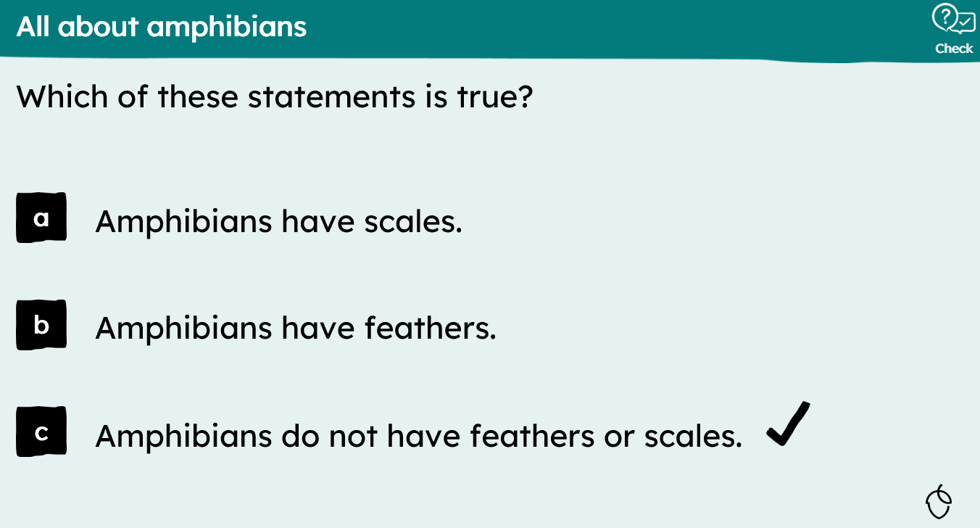
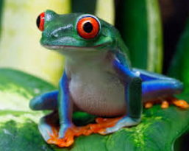
KQ: Can I name and group common animals that are fish and amphibians.
Wednesday 1st October 2025

Slide 53
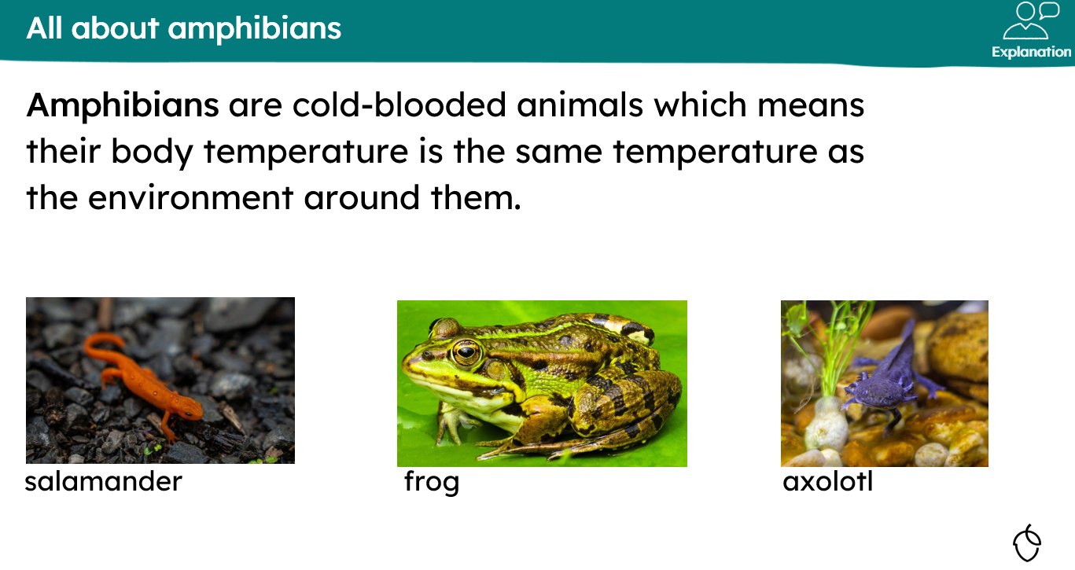
KQ: Can I name and group common animals that are fish and amphibians.
Wednesday 1st October 2025

Slide 54
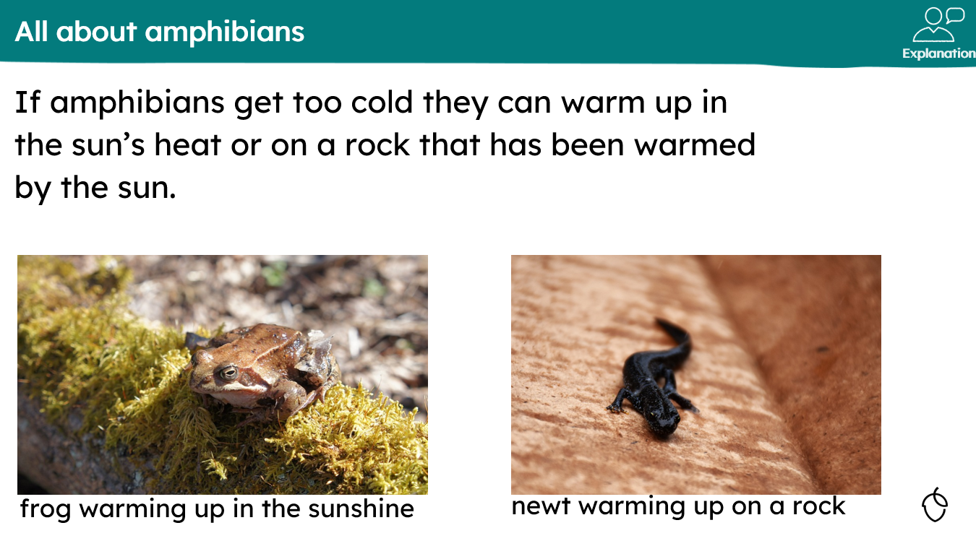
KQ: Can I name and group common animals that are fish and amphibians.
Wednesday 1st October 2025

Slide 55
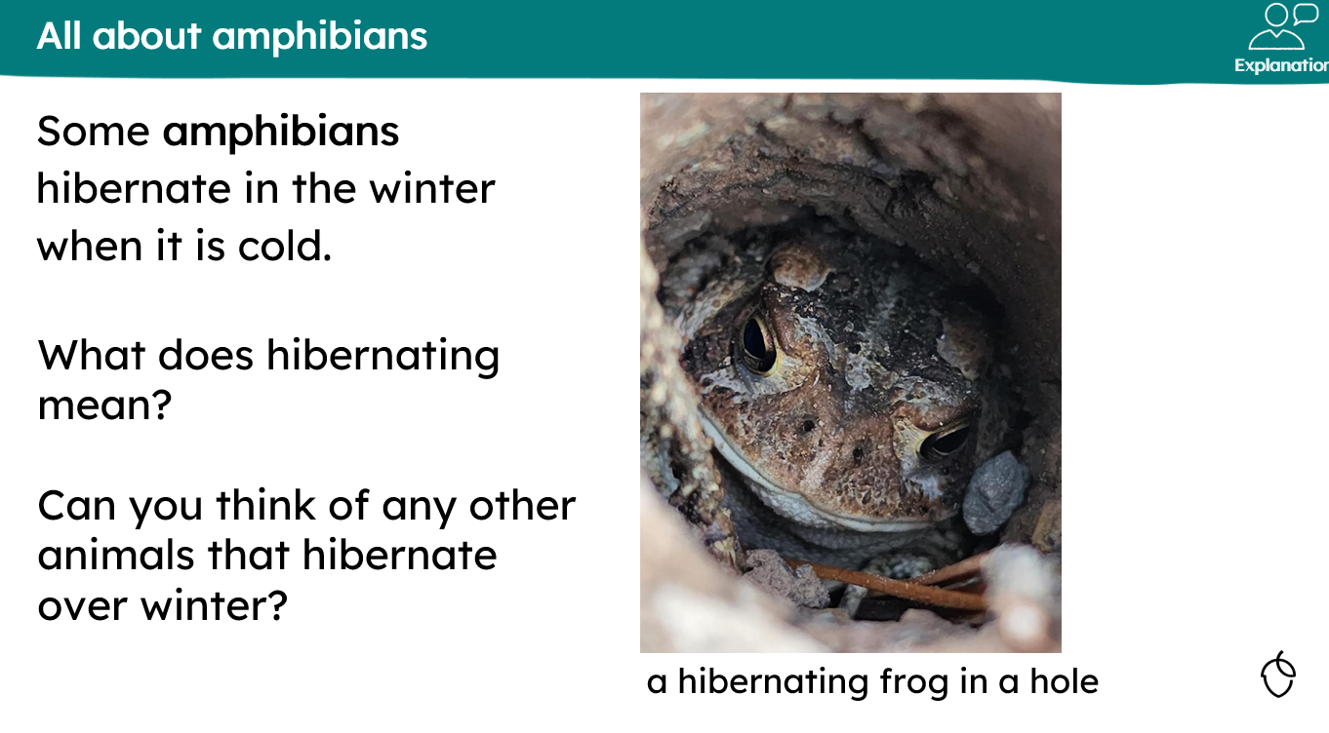
KQ: Can I name and group common animals that are fish and amphibians.
Wednesday 1st October 2025

Slide 56


KQ: Can I name and group common animals that are fish and amphibians.
Wednesday 1st October 2025
Independent:
Challenge:

Slide 57

KQ: Can I name and group common animals that are fish and amphibians.
Wednesday 1st October 2025
Exit question:

