Slide 1
Tuesday 7th October 2025

Slide 2

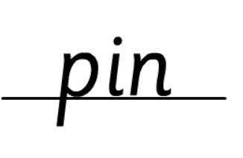



Morning Challenges:
Name writing

Slide 3
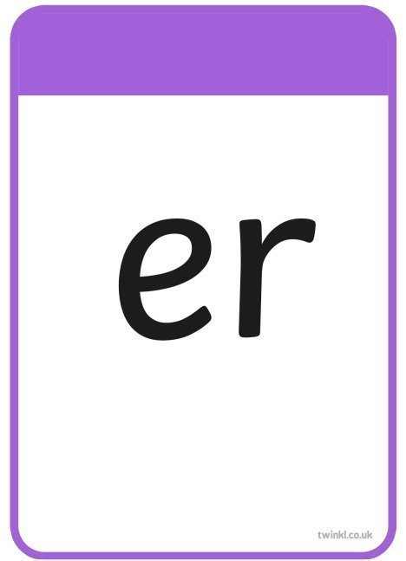





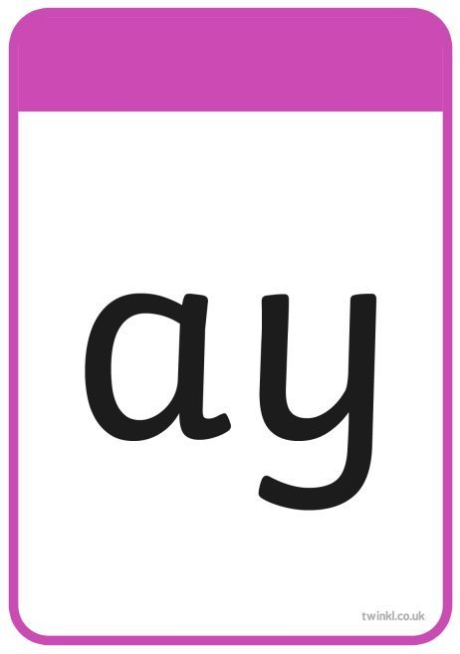




TBAT– read longer words
Tuesday 7th October 2025

Slide 4
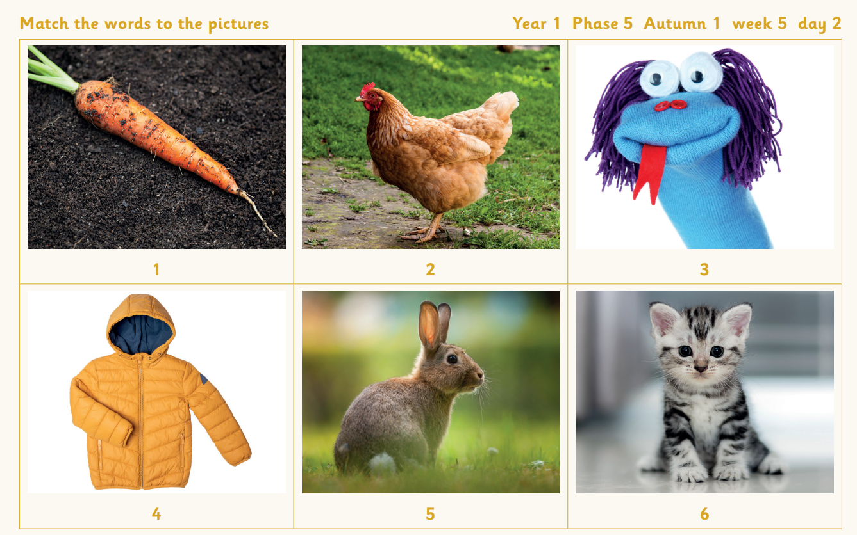

TBAT– read longer words
Tuesday 7th October 2025
Match the words to the pictures
jacket
rabbit
puppet
kitten
carrot
chicken

Slide 5



TBAT– read longer words
Tuesday 7th October 2025
of

Slide 6
TBAT– read longer words
Tuesday 7th October 2025
l-igh-t-n-i-ng

Slide 7
TBAT– read longer words
Tuesday 7th October 2025
p-ow/d-er

Slide 8
TBAT– read longer words
Tuesday 7th October 2025
f-ar-m-er

Slide 9

TBAT– read longer words
Tuesday 7th October 2025
Now let's read this sentence!​

Slide 10

TBAT– read longer words
Tuesday 7th October 2025
of
tricky word
cartoon rabbit
Dragons Den (phonicsplay.co.uk)

Slide 11
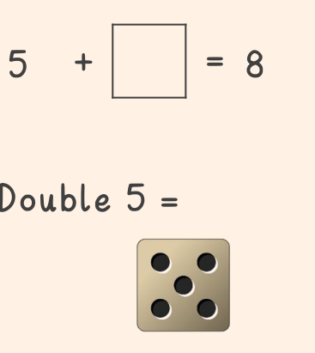

3 in 3
TBAT: recognise, name and group 3-D shapes
Tuesday 7th October 2025

Slide 12
3-D shape song
TBAT: recognise, name and group 3D shapes
Tuesday 7th October 2025
Learn the 3-D shape song!
cube
sphere
cone
cylinder
Notes:
Do Now: Practising transitions
For the first term use the Do Now part of the lesson to practise transitions. In this lesson, teach pupils the 3-D shape song.
Introduce the star words. Note: although shape names are shared here, these will be introduced throughout this lesson and the next, with examples. So for now, spend time focusing on the star words that relate to the properties of shape.

Slide 13

TBAT: recognise, name and group 3-D shapes
Tuesday 7th October 2025
face
surface
sphere
edge
straight
cone
curved
vertex
cylinder
cube
flat
vertices
pyramid

Slide 14

Blue / green What is the same? What is different?
TBAT: recognise, name and group 3-D shapes
Tuesday 7th October 2025

Slide 15
Handling 3-D shapes
TBAT: recognise, name and group 3-D shapes
Tuesday 7th October 2025
cube
cuboid
cylinders
Notes:
New Learning: Handling 3-D shapes
Show a selection of 3-D shapes. Pupils should already be familiar with these from Maths Meetings. Give pupils time to handle them in pairs or small groups and discuss what they notice about them. Describe the shapes using the vocabulary and sentence structures:
This is a __. It has __ faces and __ straight edges.
This is a sphere. It has one continuous surface.
Note: A sphere has an infinite number of flat faces and straight edges, but pupils at this age will not understand the concept of infinity so it should be described as a shape with a continuous surface. The word ‘face’ is only used to refer to plane (flat) surfaces, whereas ‘surface’ is used to refer to anything curved, e.g. cones and cylinders have curved surfaces.
When exemplifying how to count faces, edges and vertices, model holding the shape still while swiping with a palm/touching each feature. If pupils move the shapes while counting, it is easy for them to lose track of their count. Slides have been provided, which show two-dimensional images of 3-D shapes; however, pupils should have the opportunity to see and handle many different examples of actual 3-D shapes, including everyday objects which exemplify these.

Slide 16
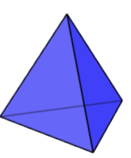
Handling 3-D shapes
TBAT: recognise, name and group 3-D shapes
Tuesday 7th October 2025
cone
sphere
pyramids
3d shape - Quiz
Notes:
New Learning: Handling 3-D shapes
Show a selection of 3-D shapes. Pupils should already be familiar with these from Maths Meetings. Give pupils time to handle them in pairs or small groups and discuss what they notice about them. Describe the shapes using the vocabulary and sentence structures:
This is a __. It has __ faces and __ straight edges.
This is a sphere. It has one continuous surface.
Note: A sphere has an infinite number of flat faces and straight edges, but pupils at this age will not understand the concept of infinity so it should be described as a shape with a continuous surface. The word ‘face’ is only used to refer to plane (flat) surfaces, whereas ‘surface’ is used to refer to anything curved, e.g. cones and cylinders have curved surfaces.
When exemplifying how to count faces, edges and vertices, model holding the shape still while swiping with a palm/touching each feature. If pupils move the shapes while counting, it is easy for them to lose track of their count. Slides have been provided, which show two-dimensional images of 3-D shapes; however, pupils should have the opportunity to see and handle many different examples of actual 3-D shapes, including everyday objects which exemplify these.

Slide 17
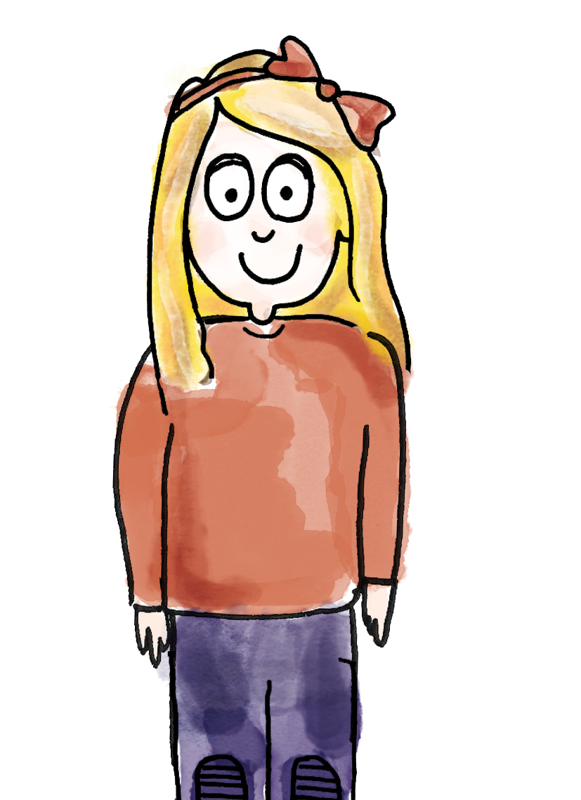
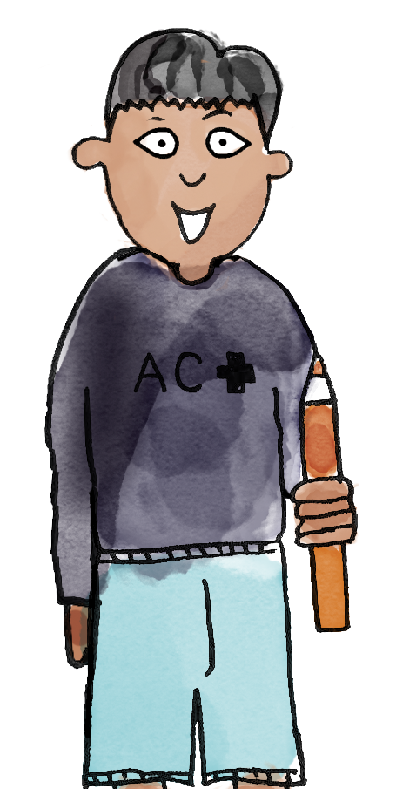
Describing 3-D shapes using their properties
TBAT: recognise, name and group 3-D shapes
Tuesday 7th October 2025
This shape has one flat face and one curved surface. The flat face is shaped like a circle.
Your shape is a cone.
face surface edge vertex vertices straight curved flat sphere cone cylinder cube cuboid pyramid
Notes:
Talk Task: Describing 3-D shapes using their properties
Pupils have a selection of 3-D objects and shapes. Pupil A selects a shape and describes it using the language of properties, introduced in the New Learning. Pupil B identifies the shape from the description. Pupils swap roles and repeat.

Slide 18
Describing 3-D shapes
TBAT: recognise, name and group 3-D shapes
Tuesday 7th October 2025
The cuboid has ___ faces.
The faces of this cuboid are _________ and _________ shapes.
It has ___ vertices.
It has ___ edges.
The cube has ___ faces.
Its faces are all _________ shapes.
It has ___ vertices.
It has ___ edges.
Notes:
New Learning: Describing 3-D shapes
Show a selection of 3-D shapes and model to the pupils how to describe some of them, e.g.
This cuboid has 12 edges. (Model running your finger along the edges.)
When modelling the above, keep the shape still, and explain to pupils that you are doing this in order to keep track of what you have counted. Make use of the sentence structures on the slide and give pupils opportunities to repeat.
Ask questions which require pupils to define why a shape cannot be a sphere/cube/pyramid, using the next slide as a prompt. Include two of the same shape, e.g. large and small cubes.
Explain that we are going to discover how many faces, edges and vertices each shape has. Pupils should sit in groups with a selection of shapes between them. Describe a shape and ask pupils to point to the shape if it fits the criteria, e.g.
Which shape has more than three faces?
Which shape has eight vertices?
Discuss the shapes of the faces, e.g. the cuboid has four faces that are rectangles and two that are squares (or six that are rectangles). Although pupils have not explicitly been taught 2-D shape language in Year 1 yet, some will be familiar with it from Reception

Slide 19
Describing 3-D shapes
TBAT: recognise, name and group 3-D shapes
Tuesday 7th October 2025
What can we say about the properties of this shape?
What is its name?
This is not a sphere because …
Notes:
New Learning: Describing 3-D shapes
Show a selection of 3-D shapes and model to the pupils how to describe some of them, e.g.
This cuboid has 12 edges. (Model running your finger along the edges.)
When modelling the above, keep the shape still, and explain to pupils that you are doing this in order to keep track of what you have counted. Make use of the sentence structures on the slide and give pupils opportunities to repeat.
Ask questions which require pupils to define why a shape cannot be a sphere/cube/pyramid, using the next slide as a prompt. Include two of the same shape, e.g. large and small cubes.
Explain that we are going to discover how many faces, edges and vertices each shape has. Pupils should sit in groups with a selection of shapes between them. Describe a shape and ask pupils to point to the shape if it fits the criteria, e.g.
Which shape has more than three faces?
Which shape has eight vertices?
Discuss the shapes of the faces, e.g. the cuboid has four faces that are rectangles and two that are squares (or six that are rectangles). Although pupils have not explicitly been taught 2-D shape language in Year 1 yet, some will be familiar with it from Reception

Slide 20
Describing 3-D shapes
TBAT: recognise, name and group 3-D shapes
My shape has six faces. It has 12 edges.
Is it a cube?
No! Four of its faces are rectangles and two are square.
Oh, a cube has all square faces!
Then it must be a cuboid, because it only has two square faces.
face surface edge vertex vertices straight curved flat sphere cone cylinder cube cuboid pyramid
Notes:
Talk Task: Describing 3-D shapes
Role play the Talk Task with another adult or pupil, making pupils’ roles and language expectations clear.
Pupil A chooses a 3-D shape and gives Pupil B clues using vocabulary modelled in the New Learning. Pupil B guesses the shape from Pupil A’s clues. Pupils swap roles and repeat.

Slide 21
Classifying 3-D shapes into two groups
TBAT: recognise, name and group 3-D shapes
Tuesday 7th October 2025
Has six faces
Does not have six faces
Challenge: How else could you sort the shapes?
Notes:
Develop Learning: Classifying 3-D shapes into two groups
Using 3-D shapes (ideally multiple examples of each shape that has been introduced so far), ask pupils for ideas about how to sort them into groups. An example is provided on the slide. Identify other ways the shapes could be sorted, e.g. by size (large, medium, small) or colour. Sort the shapes in different ways by placing them into two hoops. Give each pair a shape and ask them to discuss where their shape should go and why. Model justifying where a shape should go using sentence stems, e.g.
This cuboid goes here, because it has six faces.
Provide lots of opportunities for repetition. Model sorting the shapes incorrectly (you could use the next slide to show an example) and discuss.

Slide 22

Classifying 3-D shapes into two groups
TBAT: recognise, name and group 3-D shapes
Tuesday 7th October 2025
Has a curved surface
No curved surface
Have these shapes been sorted correctly?
Notes:
Develop Learning: Classifying 3-D shapes into two groups
Using 3-D shapes (ideally multiple examples of each shape that has been introduced so far), ask pupils for ideas about how to sort them into groups. An example is provided on the slide. Identify other ways the shapes could be sorted, e.g. by size (large, medium, small) or colour. Sort the shapes in different ways by placing them into two hoops. Give each pair a shape and ask them to discuss where their shape should go and why. Model justifying where a shape should go using sentence stems, e.g.
This cuboid goes here, because it has six faces.
Provide lots of opportunities for repetition. Model sorting the shapes incorrectly (you could use the next slide to show an example) and discuss.

Slide 23
Exploring 3-D shapes
TBAT: recognise, name and group 3-D shapes
Tuesday 7th October 2025
Which of these towers would stand up? Why?
Notes:
Develop Learning: Exploring 3-D shapes
Take each 3-D shape in turn and ask pupils to see if they can find a similar shape in the classroom. Encourage pupils to justify why the shapes are similar, using the mathematical properties of the shapes. For example:
Can you find a cube shape in the classroom? How do you know it is a cube?
The die is shaped like a cube. All of its faces are flat and square.
Repeat this process with different shapes. Ask pupils which 2-D shapes they can recognise within the 3-D shapes (2-D shapes have not been taught yet in Year 1, but some pupils will already be familiar with this vocabulary).
Show pupils a tower you have made out of a selection of 3-D shapes. Discuss which shapes are better to build with and why. Then show the images on the slide and discuss. The focus should be on pupils using the appropriate property language to justify their reasons.

Slide 24
TBAT: recognise, name and group 3-D shapes
Tuesday 7th October 2025
Can you build the tallest tower?
What makes a good tower?
Notes:
Independent Task: Exploring 3-D shapes
Give pairs of pupils a range of 3-D shapes (either as mathematical objects, everyday objects or both). The task is to build the tallest tower they can using different shapes. Encourage pupils to use trial and improvement to build the tallest tower. Get pupils to describe their towers to you using correct mathematical vocabulary.
Note: pupils will not all be confident with the new language of 3-D shape yet. It is not expected that they will be able to use it fluently by the end of the lesson, but use this task to remodel the use of the vocabulary in context.
Possible adaptations:
Constraints could be added, such as only using two different 3-D shapes to build a tower, or using at least five different shapes.

Slide 25
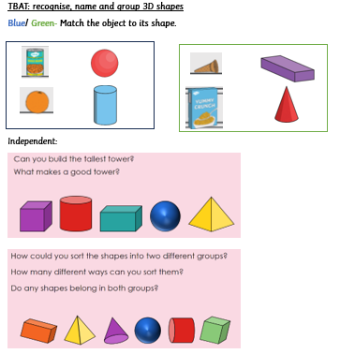
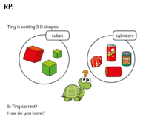
Tuesday 7th October 2025

Slide 26
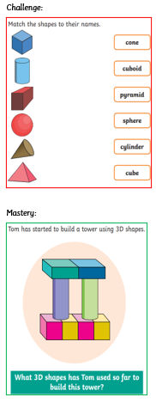
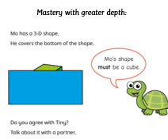

Slide 27
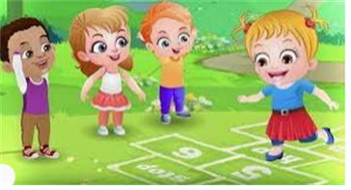
Break

Slide 28


Independent Challenges:
Narrative Zone
Maths Zone
With masks and puppets, act out the story of The Enormous Turnip.
Sort the 3D shapes using the sorting circles.
Enquiry Zone
Creative Zone
Can you create spiral trees inspired by Hundertwasser?
Can you create spiral trees inspired by Hundertwasser?
How many 3d shapes can you find around the room?

Slide 29

Lunch

Slide 30

Toothbrushing

Slide 31
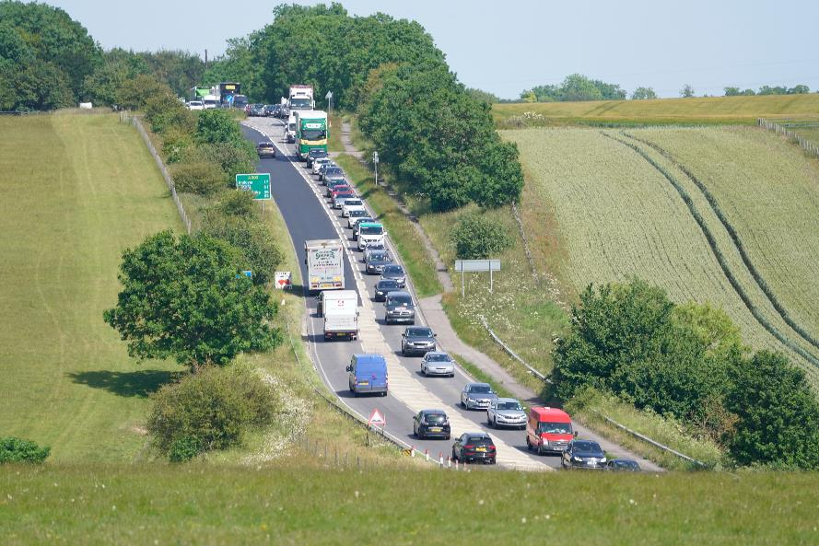
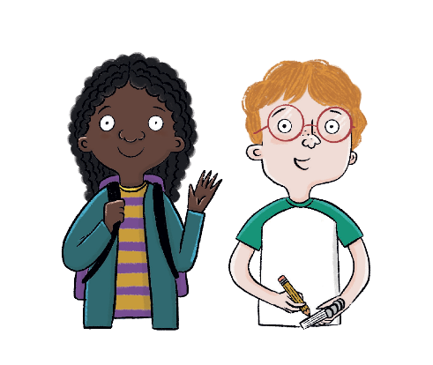
Unit 2: Transport and Travel
Tuesday 7th October 2025
Key Question: How do we travel around today?
Notes:
Hook: Prepare an engaging hook to introduce pupils to the new unit. You could share some amazing facts about transport; share a clip about different modes of transport; teach them a song (such as this transportation song: https://www.youtube.com/watch?v=Ut-HbauKzDw); read a story book about transport; or play a transport word-association game. (Oxford University Press is not responsible for content available on third-party websites. The content of these websites may have changed since publication.)

Slide 32

KQ: How do we travel around today?
Tuesday 7th October 2025
How has transport changed over time?
Notes:
Share the unit enquiry question: How has transport changed over time? and explain that all lessons in this unit will support pupils in answering this question at the very end. Each lesson has its own question, and they should be able to answer each of these individually too.

Slide 33
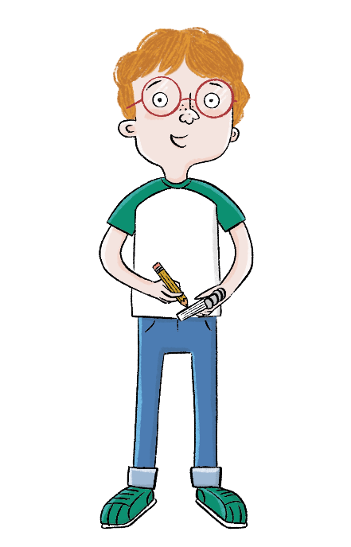
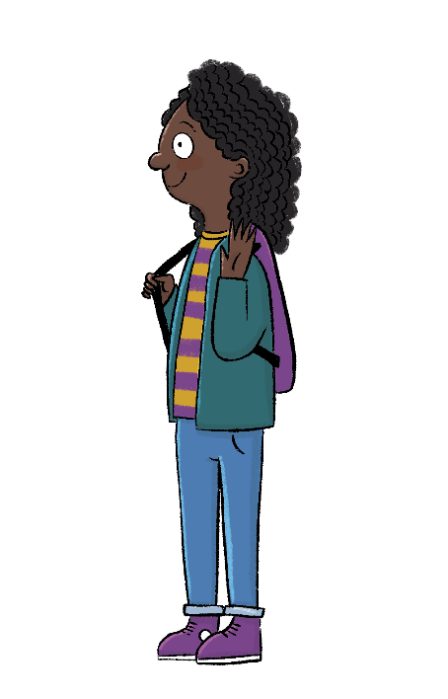
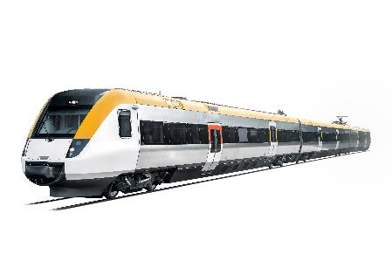
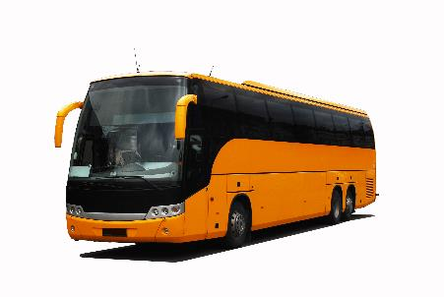
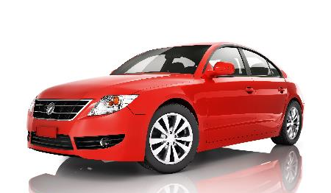
KQ: How do we travel around today?
Tuesday 7th October 2025
Lesson 1:
Blue / Green
What different types of transport do you know?
What types of transport do you use?
Notes:
Existing knowledge exercise: Briefly gauge pupils’ current knowledge of different types of transport. Ask: ‘What different types of transport do you know?’ and ‘What types of transport do you use?’. Collect responses from pupils on sticky notes and add them to a working wall.

Slide 34
KQ: How do we travel around today?
Tuesday 7th October 2025
How do we travel around today?
How has road transport changed?
1
What transport did people use in the past?
How have bicycles changed since they were first invented?
How have boats changed over time?
How has air travel changed over time?
How were the first trains different from trains today?
Why can we only find some types of transport in certain areas?
How did trains change people's lives?
How have humans travelled in space?
Notes:
Introduction: Share the learning journey, lesson question, lesson statement, and key term. Then share key knowledge and other key vocabulary with pupils—you may want to add images to the teaching slides to support exemplification and understanding of these words.

Slide 35
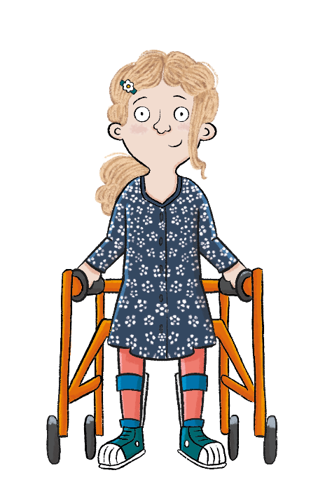
KQ: How do we travel around today?
Tuesday 7th October 2025
Lesson 1:
In this lesson, we are finding out about transport in our local area.

Slide 36
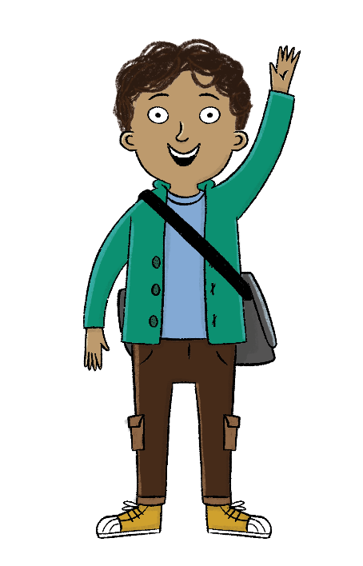
KQ: How do we travel around today?
Tuesday 7th October 2025
Lesson 1:
The key term for this lesson is
transport.
Transport is a vehicle that takes people or goods from one place to another.
Notes:
To consolidate pupils’ understanding of the key term ‘transport’, you could ask pupils how they get to school and discuss the different modes of transport they take. Note that the word ‘goods’ just means ‘things’.

Slide 37

How do we travel around today?
Tuesday 7th October 2025
Lesson 1:
Transport is a vehicle that takes people or goods from one place to another.
We can see different types of transport in our local area.
Different types of transport are suitable for different journeys.
journey
local
transport
travel
vehicle

Slide 38


KQ: How do we travel around today?
Tuesday 7th October 2025
Lesson 1:
What is transport used for?
Why do people need to make journeys?
Notes:
Talk task: Ask pupils to discuss the questions, ‘What is transport used for?’ and ‘Why do people need to make journeys?’, before taking feedback as a whole class. Pupils may discuss that transport is used so that people can travel from one place to another without needing to walk. Ideas of transporting heavy items which can’t be carried may also come up.

Slide 39
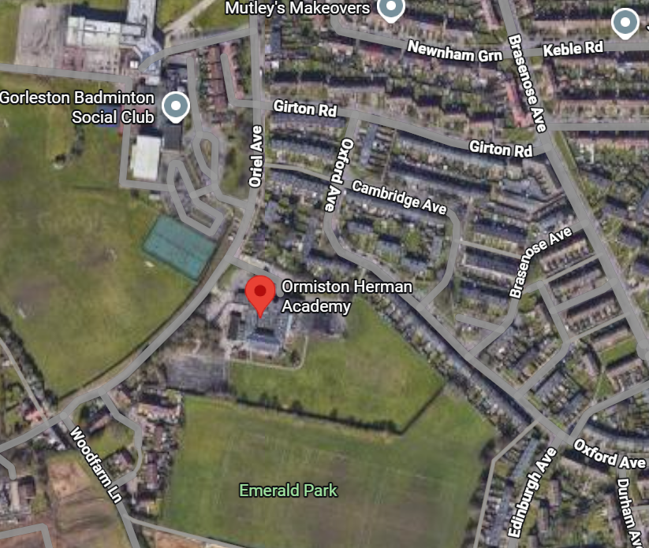
Transport in our local area
KQ: How do we travel around today?
Tuesday 7th October 2025
Lesson 1:
Notes:
Read: ‘Transport in our local area’. Using this slide, explain to the class they will be going out for a walk to spot transport in the local area. Use a map to show them the route, if one is available. Paste the map over the image on the slide to display it. (Link to ‘My Local Area’ unit in Geography.)

Slide 40
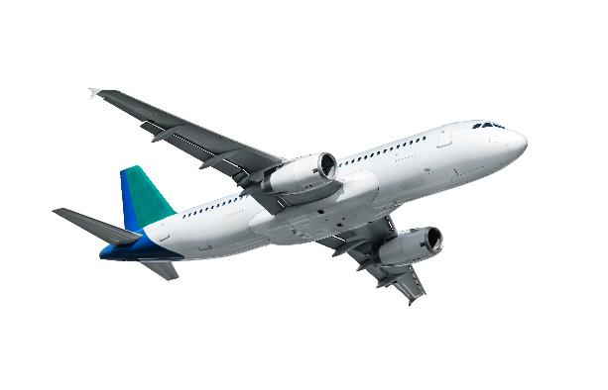
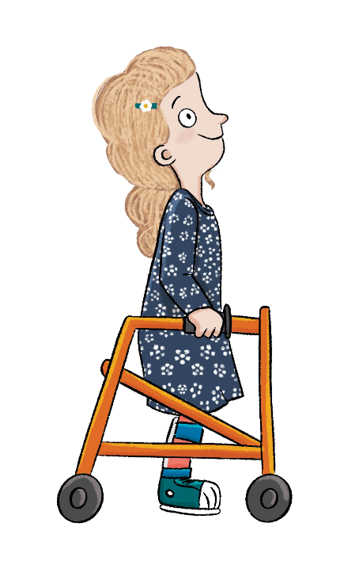
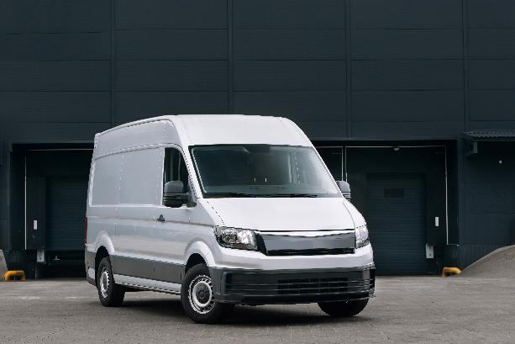
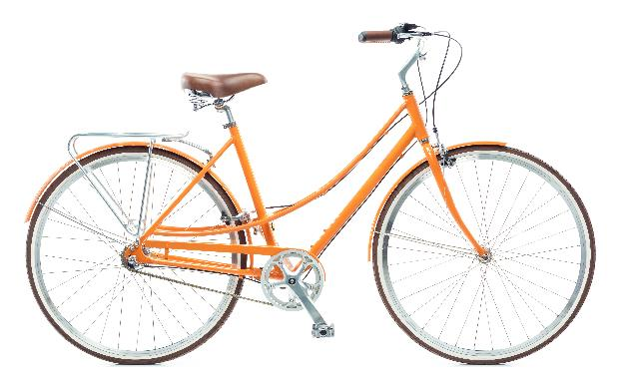
KQ: How do we travel around today?
Tuesday 7th October 2025
Lesson 1:
What types of transport do you expect to see in the local area?
Means Of Transport For Children - Land, water and air transport for kids - YouTube
Notes:
Talk task: Ask pupils, ‘What types of transport do you expect to see in the local area?’. Discuss the modes of transport pupils expect to see on their walk. Pupils will initially start by discussing that they may see planes, vans, and bikes (using the slide as a guide). Ensure pupils think and discuss their own ideas which may include cars, scooters, motorbikes, helicopters, boats, and trains (in certain areas), etc.

Slide 41
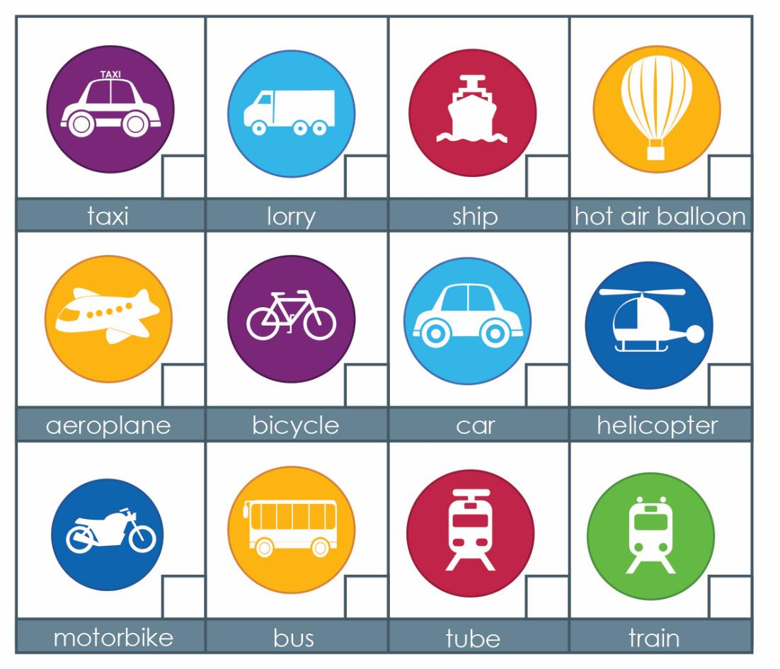
1. Which of these did we come up with?
KQ: How do we travel around today?
Tuesday 7th October 2025
Lesson 1:
Notes:
Investigation: Take pupils on a walk around your local area, ideally where you have planned to see a range of different modes of transport. Either ask pupils to tick off the modes of transport they can see while on the walk in their Workbooks, use copies of the Additional resource: Which transport did you see? sheet, or take photos of different modes of transport to reshare with pupils back in the classroom for them to complete the activity.

Slide 42
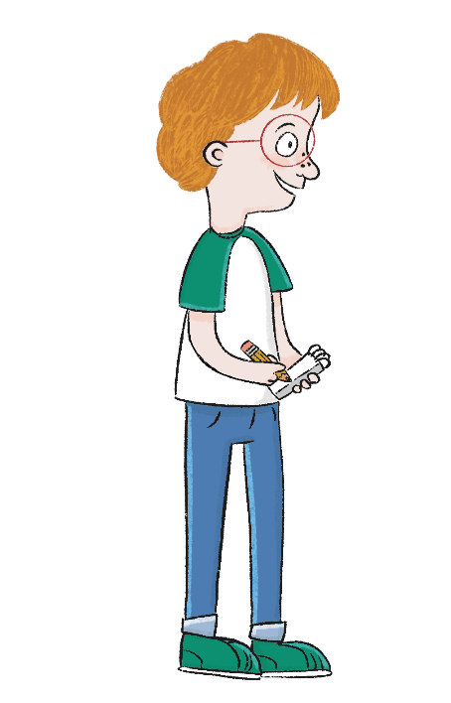
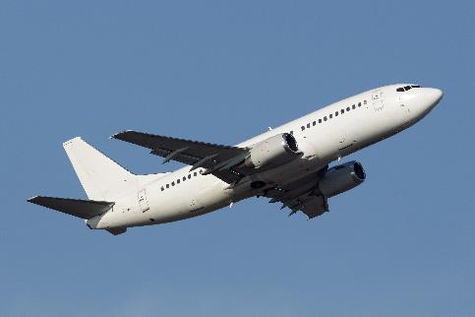

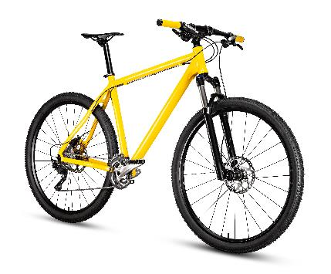
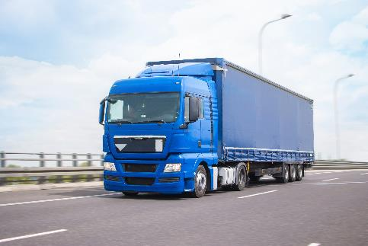
Tuesday 7th October 2025
KQ: How do we travel around today?
Which of the types of transport in the pictures is used for short journeys? Which is used for long journeys?
Which is used to carry people? Which is used for things?
Lesson 1:
Notes:
Group task: Pupils should discuss the following questions: ‘Which of the types of transport in the pictures is used for short journeys?’, ‘Which is used for long journeys?’, ‘Which is used to carry people?’, ‘Which is used or things?’. Pupils will likely discuss that a plane is used for long journeys and a bicycle used for short journeys. A car can be used for both long and short journeys unless the route is overseas. The car, plane, and bike are all used to carry people, but the lorry’s job is to transport things/goods.

Slide 43
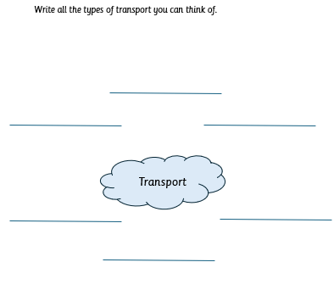
Tuesday 7th October 2025

Slide 44
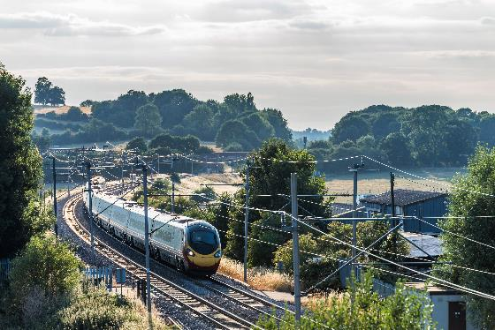

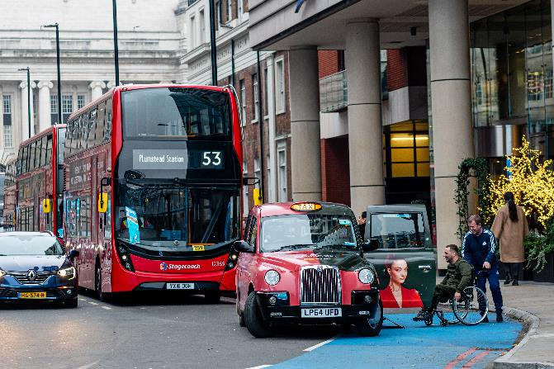
How do we travel around today?
KQ: How do we travel around today?
Tuesday 7th October 2025
Lesson 1:
What forms of transport do you see in your local area?
Which type of transport do you see the most?
Notes:
Learning review: Using the teaching slides, talk partners tell each other a response to the questions. Add further review questions if you wish to.

Slide 45
How do we travel around today?
KQ: How do we travel around today?
Tuesday 7th October 2025
Lesson 1:
Transport is a vehicle that takes people or goods from one place to another.
We can see different types of transport in our local area.
Different types of transport are suitable for different journeys.
journey
local
transport
travel
vehicle

Slide 46
Independent Challenges:
Narrative Zone
Maths Zone
With masks and puppets, act out the story of The Enormous Turnip.
Sort the 3D shapes using the sorting circles.
Enquiry Zone
Creative Zone
Can you create spiral trees inspired by Hundertwasser?
Can you create spiral trees inspired by Hundertwasser?
How many 3d shapes can you find around the room?

