Slide 1
Tuesday 21st October 2025

Slide 2




Morning Challenges:
Name writing

Slide 3

TBAT: read and write words with the /ai/ and /ay/ grapheme.
Tuesday 21st October 2025
Digital Flashcards - Teach Your Monster to Read

Slide 4


TBAT: read and write words with the /ai/ and /ay/ grapheme.
Tuesday 21st October 2025

Slide 5
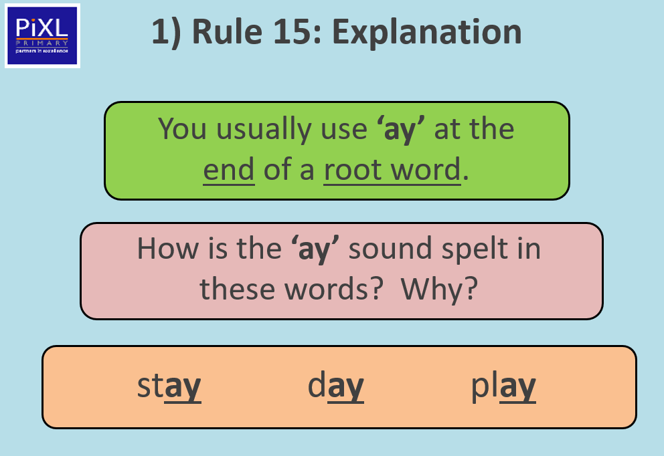
TBAT: read and write words with the /ai/ and /ay/ grapheme.
Tuesday 21st October 2025

Slide 6
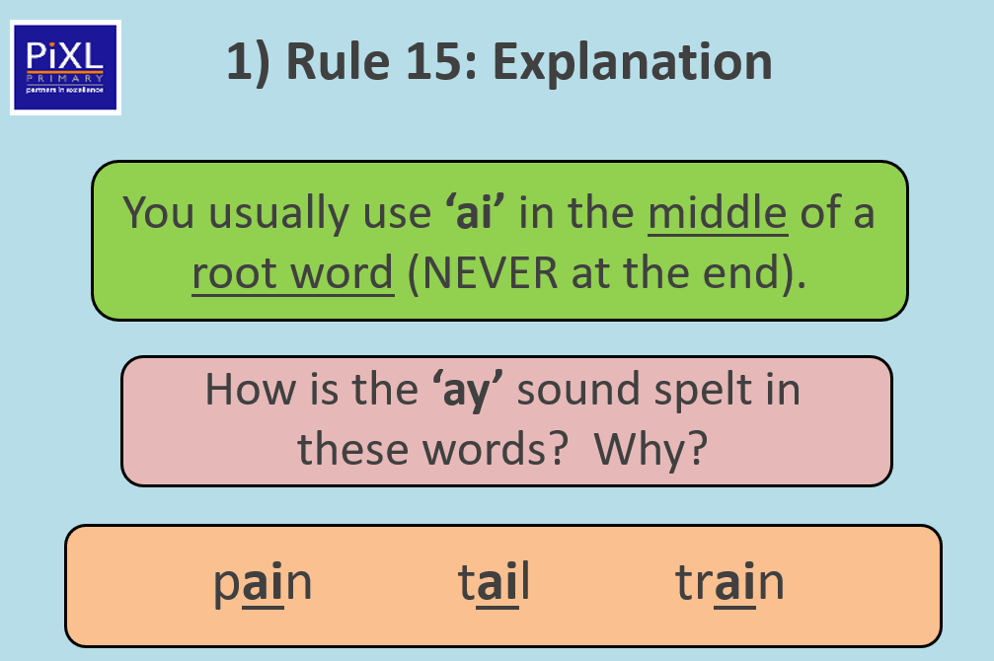
TBAT: read and write words with the /ai/ and /ay/ grapheme.
Tuesday 21st October 2025

Slide 7
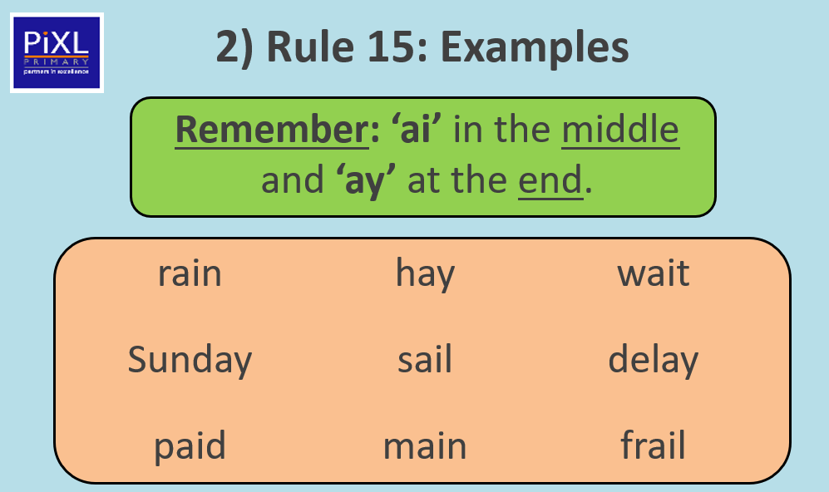
TBAT: read and write words with the /ai/ and /ay/ grapheme.
Tuesday 21st October 2025

Slide 8
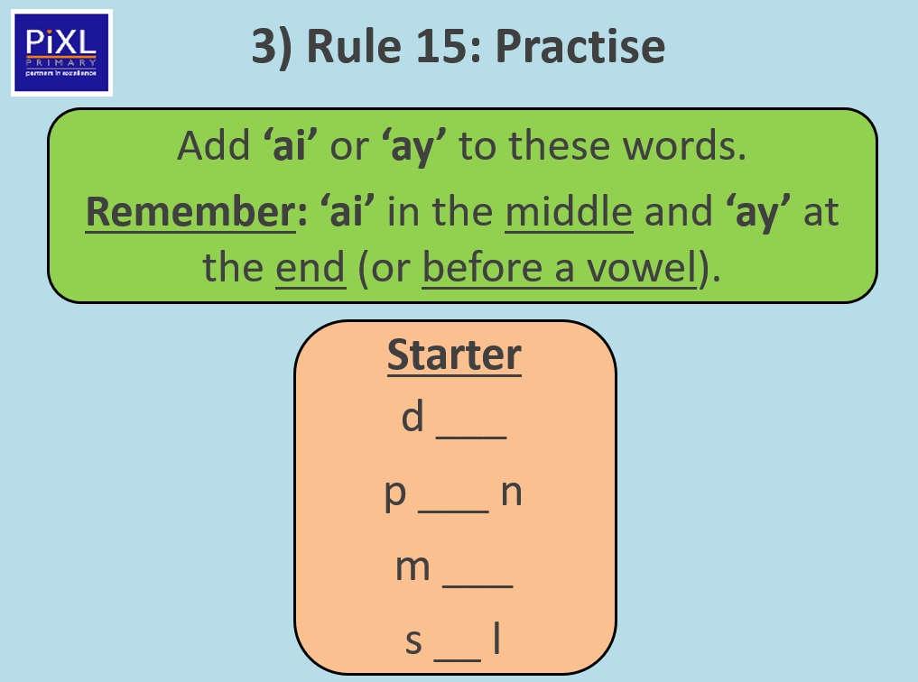
TBAT: read and write words with the /ai/ and /ay/ grapheme.
Tuesday 21st October 2025

Slide 9
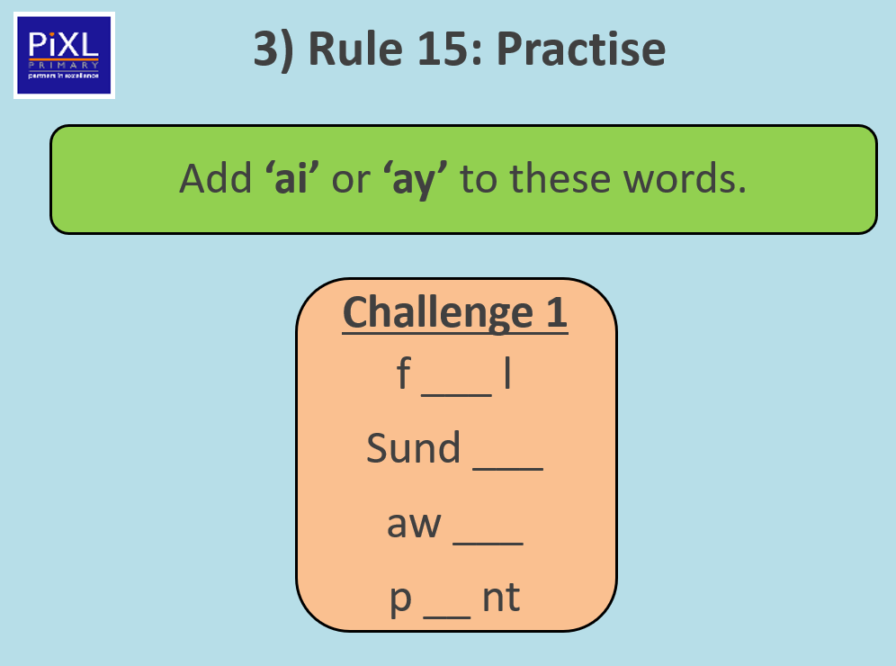
TBAT: read and write words with the /ai/ and /ay/ grapheme.
Tuesday 21st October 2025

Slide 10
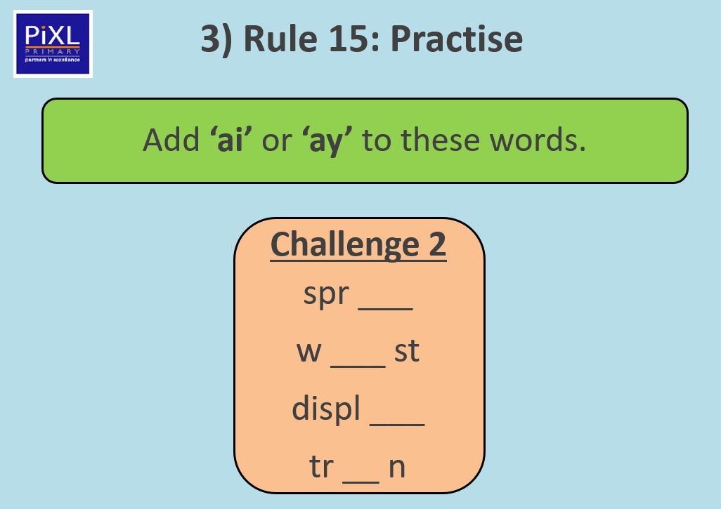
TBAT: read and write words with the /ai/ and /ay/ grapheme.
Tuesday 21st October 2025

Slide 11

TBAT: read and write words with the /ai/ and /ay/ grapheme.
Tuesday 21st October 2025
Can you find the /ai/ and /ay/ sounds in this sentence?
The snail played in the hay.

Slide 12
TBAT: read and write words with the /ai/ and /ay/ grapheme.
Tuesday 21st October 2025
Write a sentence with one or more of these words.
brain rain
clay lay

Slide 13
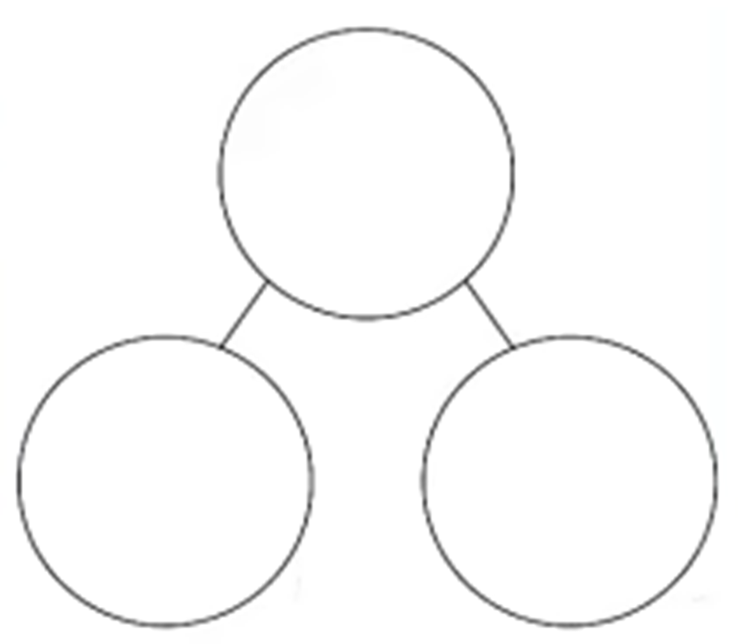
Maths- consolidation TBAT: Consolidate addition and subtraction within 10
Tuesday 21st October 2025
3 in 3
Complete the part, part whole models
5
7
3
5
5
4

Slide 14
Blue / Green
TBAT: Consolidate addition and subtraction within 10
Tuesday 21st October 2025
What would you do if you saw these symbols?
How would you work out the calculation?
Will the answer get bigger or smaller?
+ -
The symbol is a …
I would …

Slide 15
Adding & Subtracting! | Mini Math Movies | Scratch Garden
TBAT: Consolidate addition and subtraction within 10
Tuesday 21st October 2025

Slide 16
Blue/green
TBAT: Consolidate addition and subtraction within 10
Tuesday 21st October 2025
Which of these should have a subtraction symbol (-) to make it correct?
3 3 = 6
6 3 = 3
4 = 5
4 5 = 9

Slide 17
You can add and subtract using cubes, numicon, gems, base 10, your fingers or any other small objects!
TBAT: Consolidate addition and subtraction within 10
Tuesday 21st October 2025
7 - 3 = 4
3 + 4 = 7

Slide 18
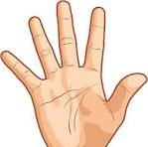
5 - 2 = __
TBAT: Consolidate addition and subtraction within 10
Tuesday 21st October 2025
Put 2 fingers down
5 + 2 =
Put 2 fingers up

Slide 19
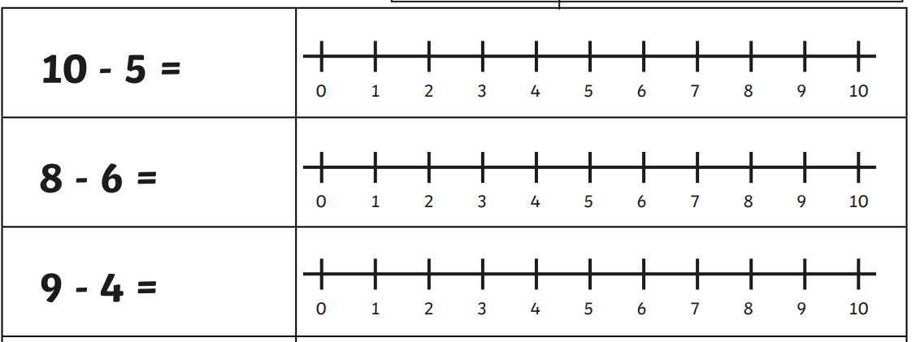

We can use a number line to add and subtract.
TBAT: Consolidate addition and subtraction within 10
Tuesday 21st October 2025
+

Slide 20
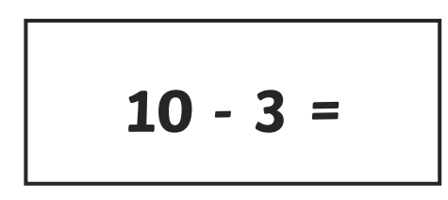
Let’s work these out in pairs using our fingers
TBAT: Consolidate addition and subtraction within 10
Tuesday 21st October 2025
3 + 5 =

Slide 21
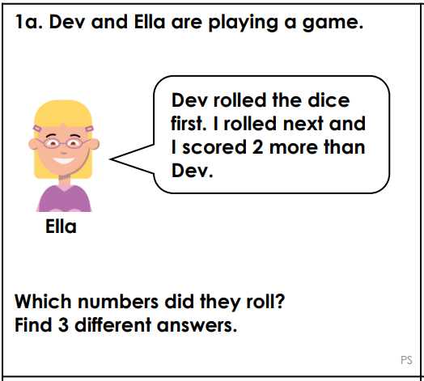

TBAT: Consolidate addition and subtraction within 10
Tuesday 21st October 2025
How could we work this out?

Slide 22
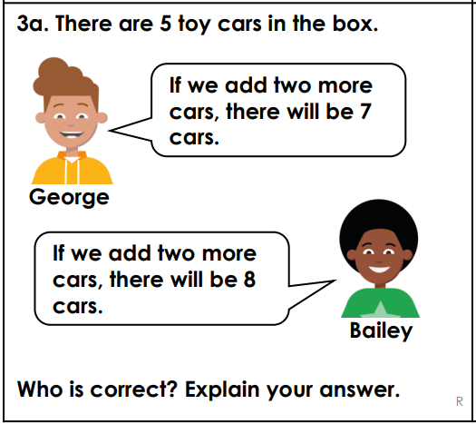

TBAT: Consolidate addition and subtraction within 10
Tuesday 21st October 2025
Hit the Button - Quick fire maths practise for 6-11 year olds

Slide 23
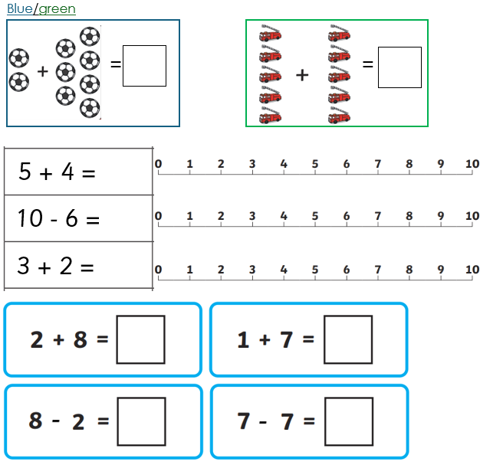
Independent:

Slide 24
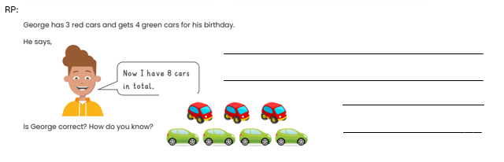
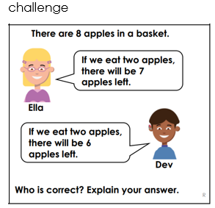
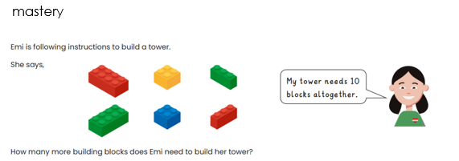
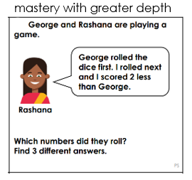

Slide 25
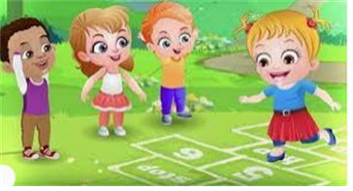
Break

Slide 26
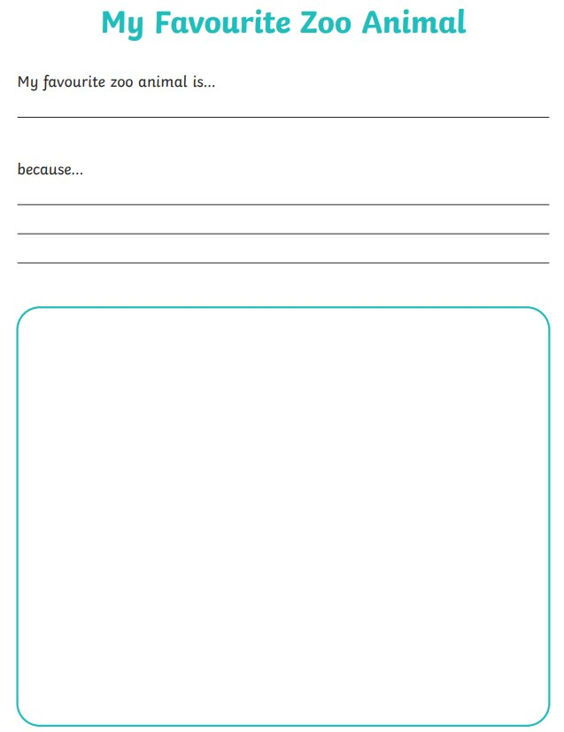
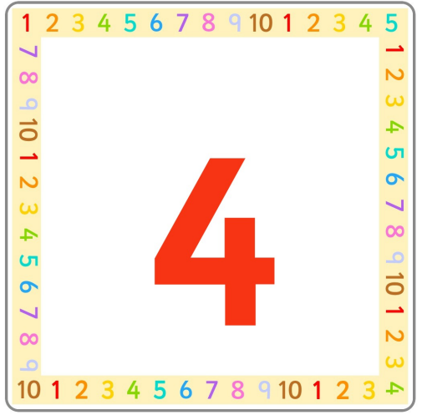
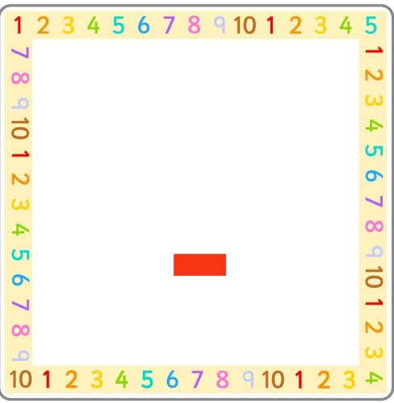
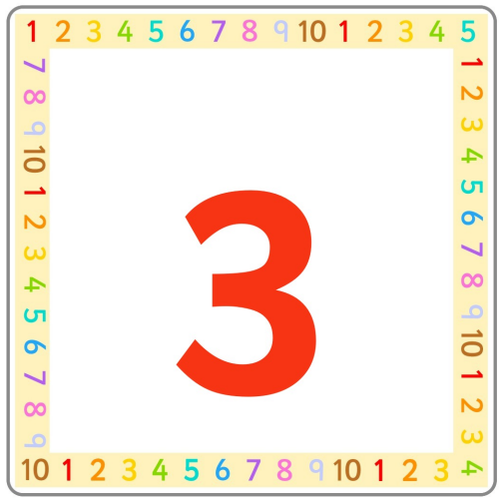
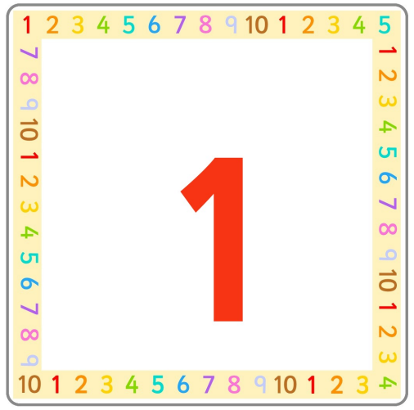



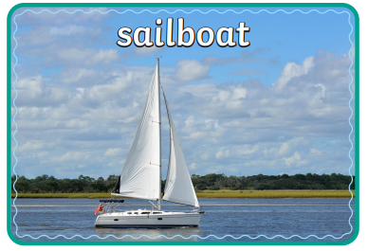
Independent Challenges:
Narrative Zone
Maths Zone
Create number sentences using the number cards. Write them on your sheet.
Write about your favourite animal.
Enquiry Zone
Creative Zone
Find the similarities and differences between the boats in the pictures.
Use junk modelling to create your favourite animal.

Slide 27

Lunch

Slide 28
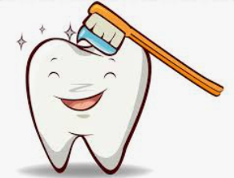
Toothbrushing

Slide 29
Tuesday 21st October 2025
KQ: How have boats changed over time?
Lesson 3:
4 in 4
Modern means ____________.
from the present from the past
The very first type of transport was the ___________.
car plane boat
Notes:
Knowledge quiz 2.2: Pupils complete this in the Additional resource: Knowledge quizzes booklet to assess their knowledge retention from the previous lesson. They write their score in the chart also provided in the additional resource.

Slide 30
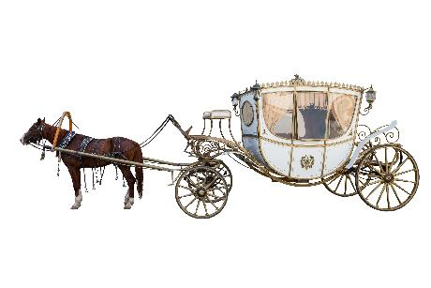
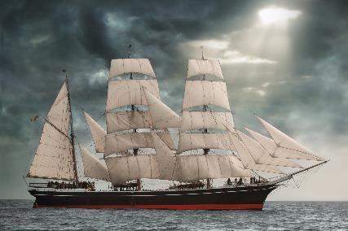
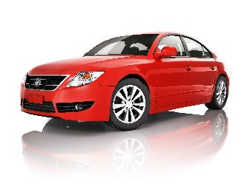
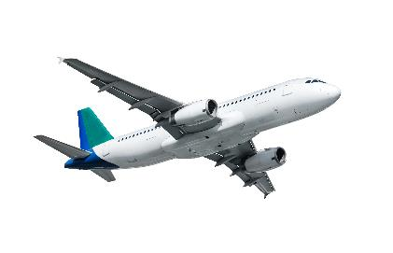
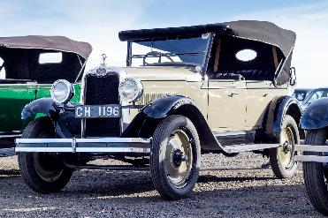
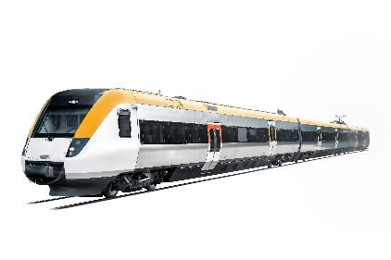
KQ: How have boats changed over time?
Tuesday 21st October 2025
Lesson 3:
4 in 4
Circle the modern type of transport.
Circle the type of transport that is from the past.

Slide 31

KQ: How have boats changed over time?
Tuesday 21st October 2025
How has transport changed over time?
Notes:
Revisit the main enquiry question and the learning journey so far.

Slide 32
KQ: How have boats changed over time?
Tuesday 21st October 2025
How do we travel around today?
How has road transport changed?
1
What transport did people use in the past?
How have bicycles changed since they were first invented?
2
How have boats changed over time?
How has air travel changed over time?
3
How were the first trains different from trains today?
Why can we only find some types of transport in certain areas?
How did trains change people's lives?
How have humans travelled in space?

Slide 33
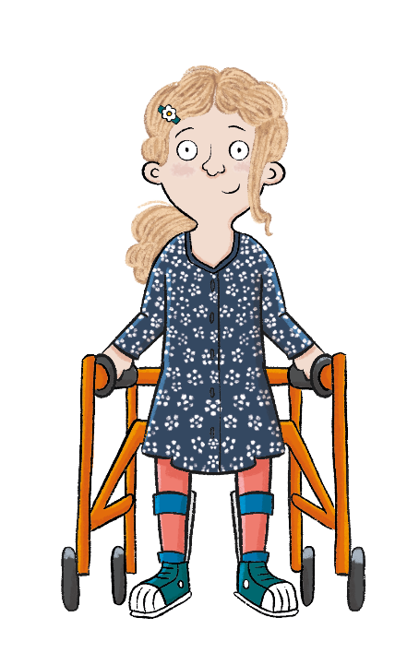
KQ: How have boats changed over time?
Tuesday 21st October 2025
Lesson 3:
In this lesson, we are learning that boats changed to become faster and safer to travel in.
Notes:
Introduction: Share the lesson statement, and key term. Then share key knowledge and other key vocabulary with pupils—you may want to add images to the teaching slides to support exemplification and understanding of these words. (You may want to explain the meaning of ‘vehicle’ here as pupils have used ‘type of transport’ until now, but ‘vehicle’ is used throughout this lesson.)

Slide 34
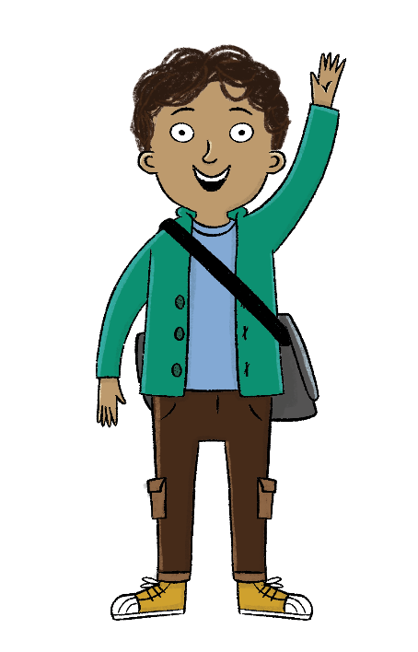
KQ: How have boats changed over time?
Tuesday 21st October 2025
Lesson 3:
The key term for this lesson is
engine.
An engine is the part of a vehicle that produces power to make it move.
Blue/green
Can you think of any modes of transport that do not have an engine?
Can you think of any modes of transport that have an engine?
Notes:
To support understanding of the key term ‘engine’ you may wish to share images of engines with pupils or play them a short video.

Slide 35

How have boats changed over time?
KQ: How have boats changed over time?
Tuesday 21st October 2025
Lesson 3:
The boat was the first type of transport.
Boats can be powered by people, engines, wind, or the Sun.
Over time, new inventions have made boat journeys faster and safer.
boat
engine
power
ship
solar

Slide 36

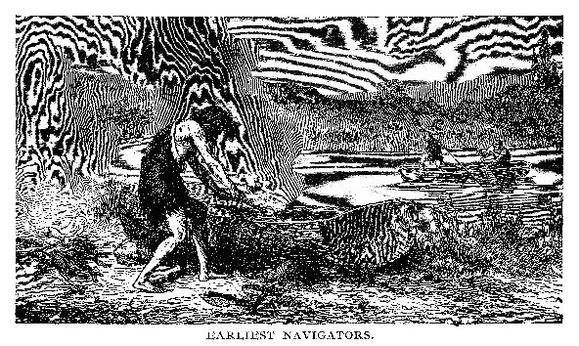
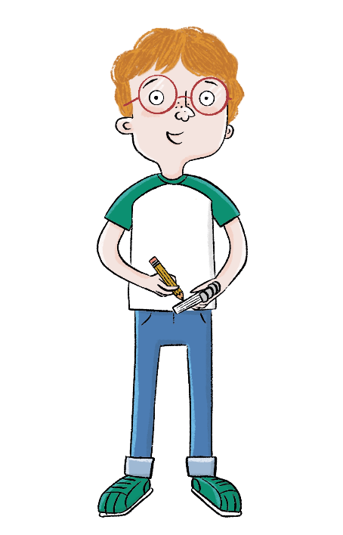
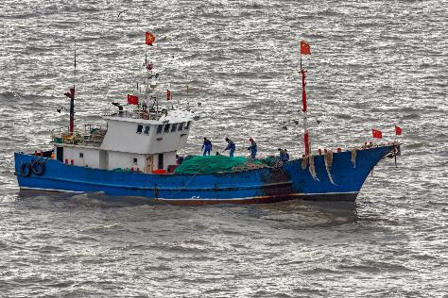
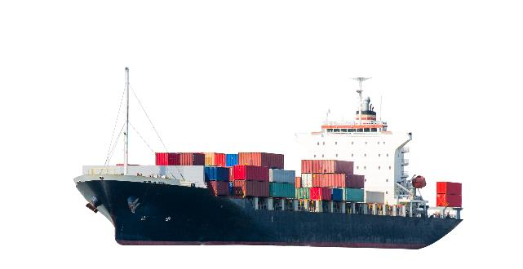
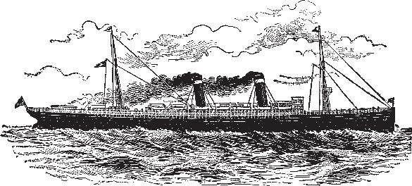
KQ: How have boats changed over time?
Blue / green
Tuesday 21st October 2025
Lesson 3:
Which of these boats do you think are from the past and which do you think are from the present? Why?
Are any types of boats from the past still used today?
Notes:
Talk task: Ask pupils to discuss the questions ‘Which of these boats do you think are from the past and which do you think are from the present?’ and ‘Why?’. Pupils should look at the images on the two slides and discuss their ideas. Another way of completing this task would be to ask pupils to sit in a circle, enlarge and print off all the images from the slides to hand around and to group as a class. Once you’ve decided on the boats in the two groups, ask pupils the question: ‘Are any types of boats from the past still used today?’. Explore ideas with pupils but don’t correct misconceptions yet as the lesson will work through boats of the past, present, and boats used in both times. Pupils will get a chance to review their thoughts from this Talk task later in the lesson so you may wish to keep a record of current ideas.

Slide 37
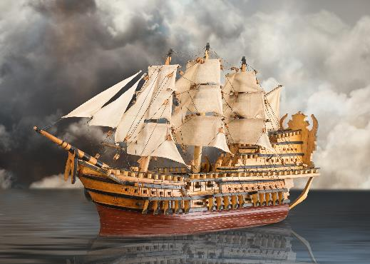
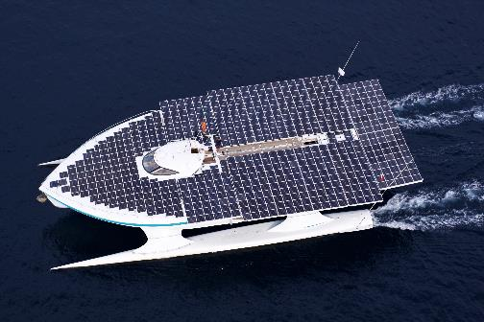
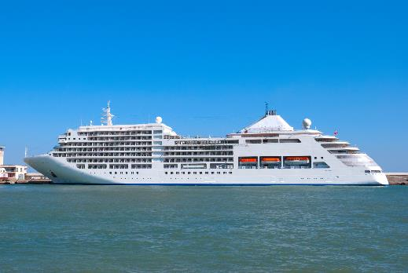
KQ: How have boats changed over time?
Tuesday 21st October 2025
Which of these boats do you think are from the past and which do you think are from the present? Why?
Are any types of boats from the past still used today?
Lesson 3:

Slide 38
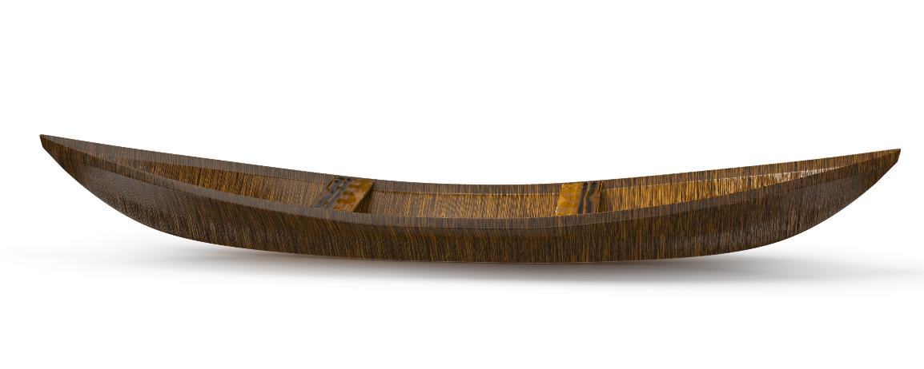
The history of boats
KQ: How have boats changed over time?
Tuesday 21st October 2025
Lesson 3:
For many, many years people have used boats to move goods and people across water.
Today the word boat means a small craft used for fun or for carrying small loads.
Notes:
Read: ‘The history of boats’. As you read through the slides you may wish to use the printed images of boats from the Talk task ordered chronologically and displayed to support pupils. As you read through the slides, stop to ask pupils questions to discuss what they have learned. These could be questions such as:
What was the first canoe made from?
Why do people use canoes and sailing boats today?
What made sailing ships move?
Can you see the steam on the steam ship image?
What do container ships carry?
Which ships have shops and cinemas?
What do fishing boats do?
What do solar-powered ships use to help them move?
More images and videos of the different boats will help understanding and consolidation.

Slide 39
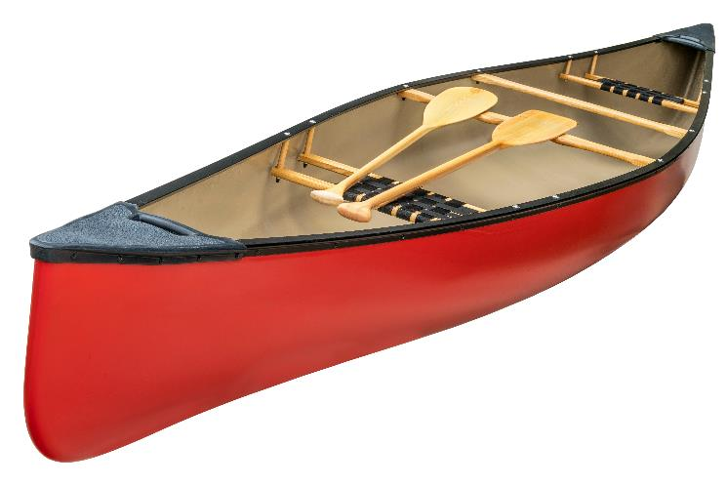
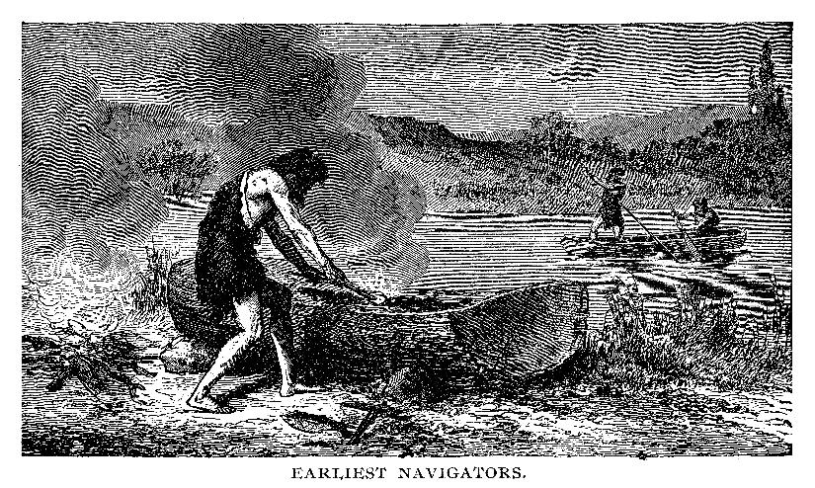
The history of boats
KQ: How have boats changed over time?
Tuesday 21st October 2025
Lesson 3:
The first boats were simple rafts made from logs tied together and wooden canoes which were carved out of logs. People used oars or paddles to move the boats.
Today people still use canoes but mostly for fun.

Slide 40
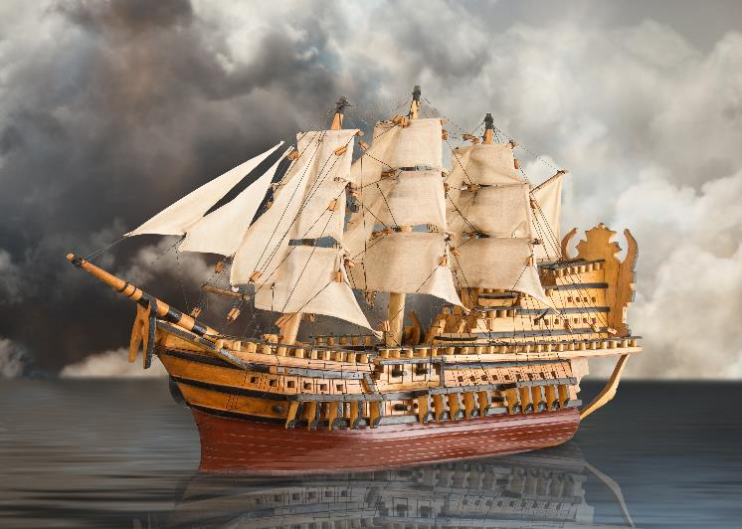
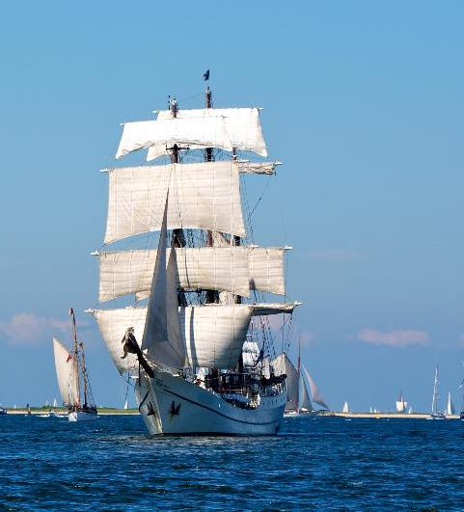
The history of boats
KQ: How have boats changed over time?
Tuesday 21st October 2025
Lesson 3:
Later, people built larger boats called ships which could travel longer distances. Sailing ships relied on the wind to move them across the sea.
Sailing boats are still used today but mostly for fun.

Slide 41
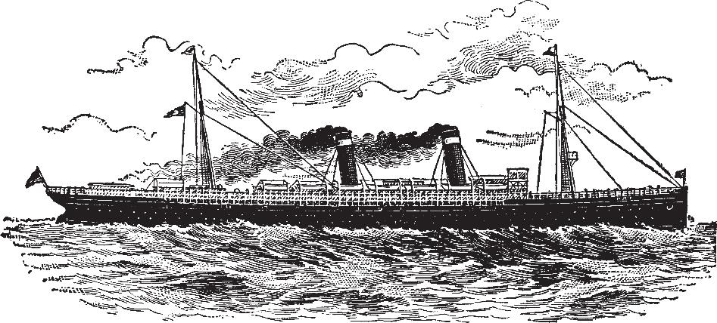
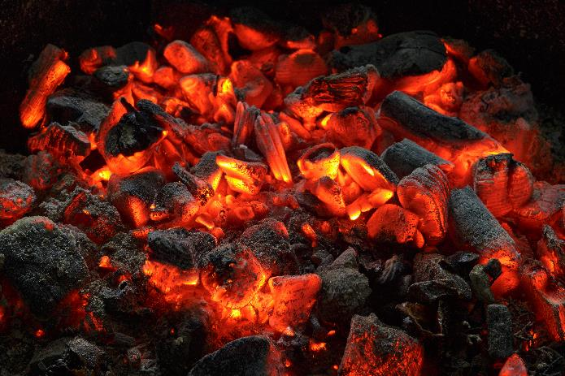
The history of boats
KQ: How have boats changed over time?
Tuesday 21st October 2025
Lesson 3:
Steamships were powered by steam engines. Steam was made from burning coal. The steam powered the ship’s engine which moved it through the water.

Slide 42

The history of boats
Tuesday 21st October 2025
Lesson 3:
Today, most ships are powered by diesel engines. Container ships travel long distances carrying goods in huge, metal boxes which are stacked on the deck.
goods

Slide 43
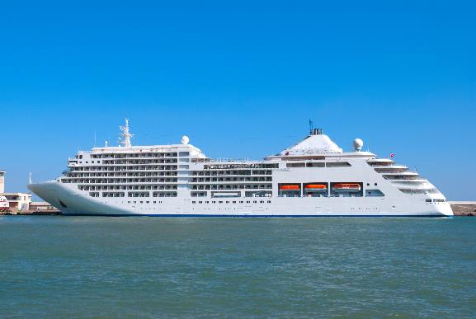

The history of boats
KQ: How have boats changed over time?
Tuesday 21st October 2025
Lesson 3:
Cruise ships are modern ships that carry many hundreds of people on floating holidays. The ship has restaurants, shops, and even cinemas!
Smaller, modern fishing boats are also powered by engines.

Slide 44
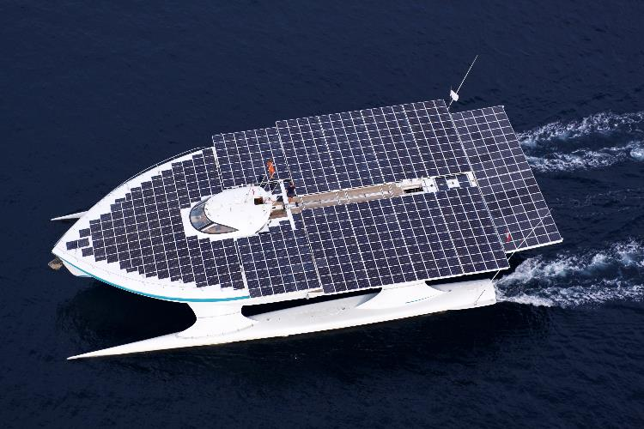

The history of boats
KQ: How have boats changed over time?
Tuesday 21st October 2025
Lesson 3:
Recently, people have invented solar-powered ships. These ships use energy from the Sun to move them through the water.
Over time, boat journeys have become faster and safer.
Video:
www.bbc.co.uk/teach/class-clips-video/articles/z2jsydm

Slide 45








Sort the boats into the diagram.
KQ: How have boats changed over time?
Tuesday 21st October 2025
Lesson 3:
Notes:
Retrieval: Working either as a whole class or in smaller groups, provide each pupil with a set of the cards from Additional resource: Boat picture cards. Challenge pupils to organise the pictures into the Venn diagram in their pupil workbooks. Pupils should sort the boats into groups of ‘Past’, ‘Present’, or ‘Both’ (where the boat is still being used today). You may wish to model this task during circle time with pupils before sending them to complete the task in their pupil workbooks. Support pupils by pre-sticking an image in each group to show example answers. Challenge pupils by asking them if they can label each type of boat and describe the job of each boat to their partner. Answers are provided on the following slide.

Slide 46







Sort the boats into the diagram.
KQ: How have boats changed over time?
Tuesday 21st October 2025
Lesson 3:

Slide 47

How have boats changed over time?
KQ: How have boats changed over time?
Tuesday 21st October 2025
Lesson 3:
Can you name a boat from the past?
Can you name a boat that is used today?
Can you name a boat that is powered by the wind?
Notes:
Learning review: Using the teaching slides, talk partners tell each other a response to the questions. Add further review questions if you wish to.

Slide 48
How have boats changed over time?
KQ: How have boats changed over time?
Tuesday 21st October 2025
Lesson 3:
The boat was the first type of transport.
Boats can be powered by people, engines, wind, or the sun.
Over time, new inventions have made boat travel faster and safer.
boat
engine
power
ship
solar
Notes:
Note: For the following lesson, you may wish to plan a trip to take pupils on a train journey, to experience trains first hand.

