Slide 1
Thursday 23rd October 2025

Slide 2




Morning Challenges:
Name writing

Slide 3
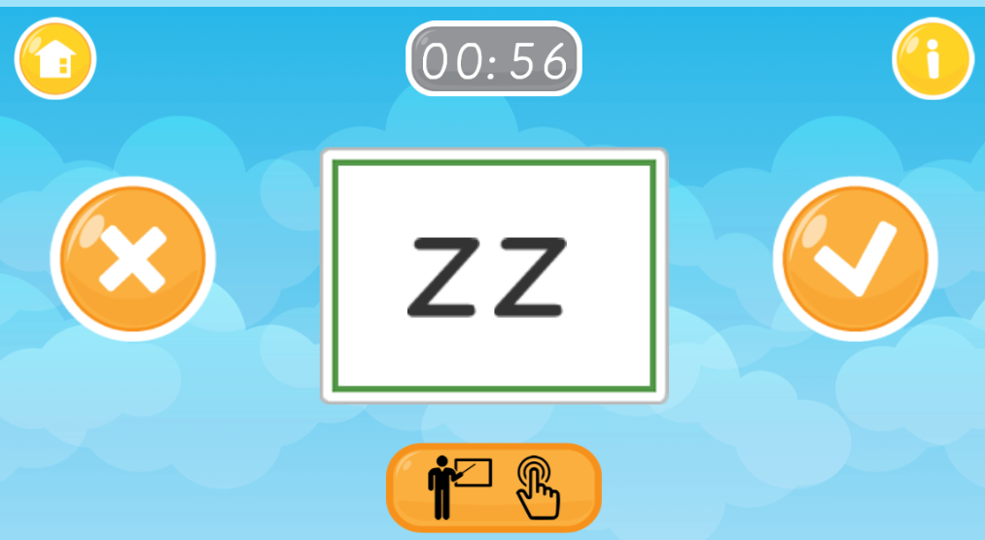
TBAT: read and write words with a /ve/ at the end.
Thursday 23rd October 2025
Flash Cards (Time Trial) (Phase 3) - Online Phonics Game

Slide 4
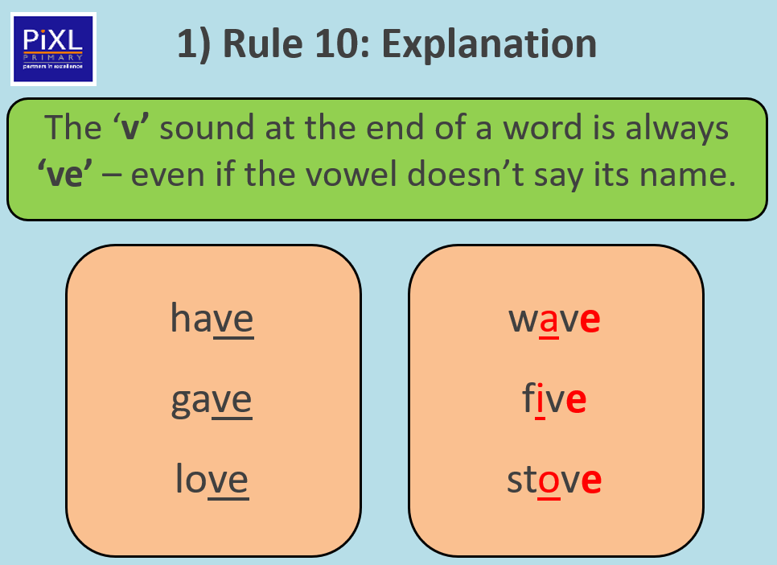
TBAT: read and write words with a /ve/ at the end.
Thursday 23rd October 2025

Slide 5
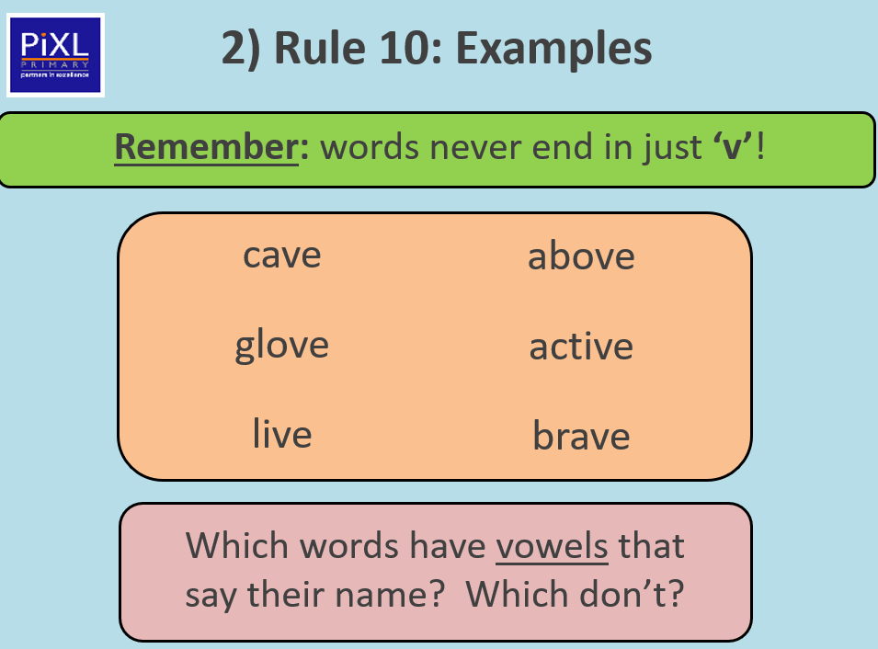
TBAT: read and write words with a /ve/ at the end.
Thursday 23rd October 2025

Slide 6
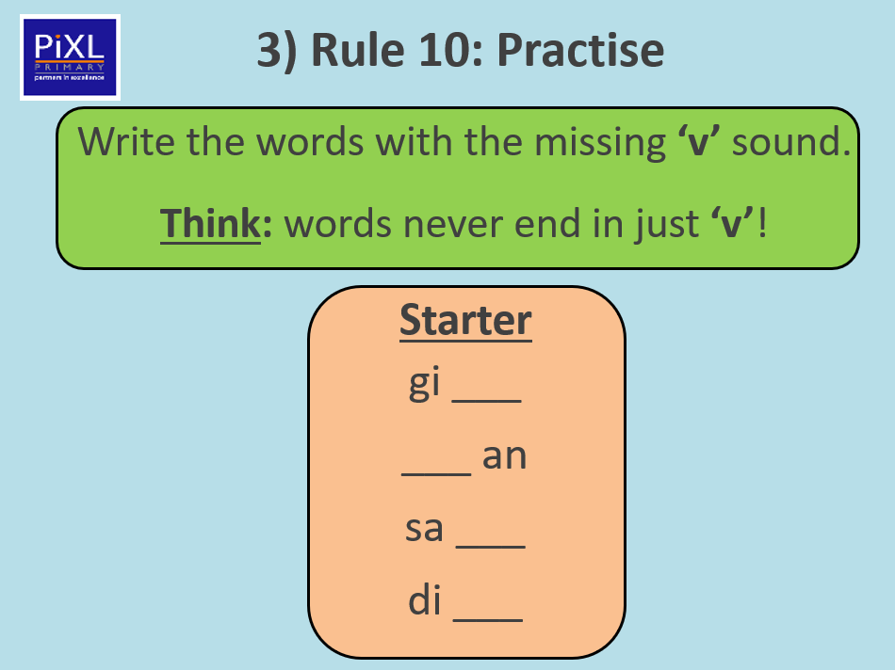
TBAT: read and write words with a /ve/ at the end.
Thursday 23rd October 2025

Slide 7
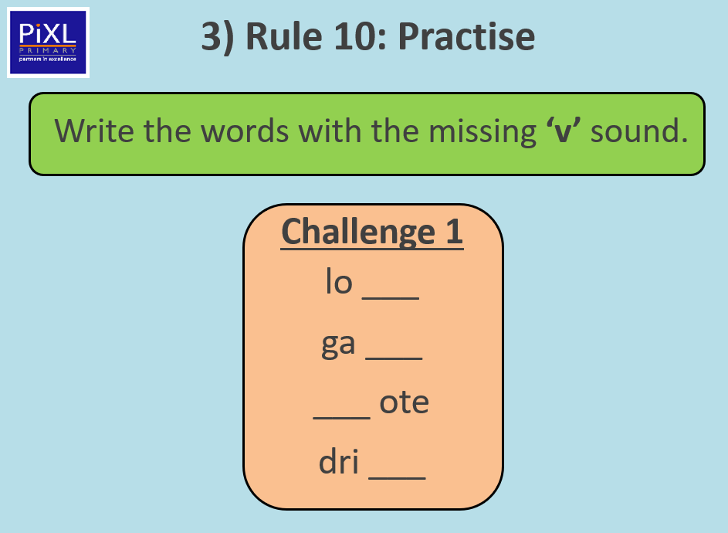
TBAT: read and write words with a /ve/ at the end.
Thursday 23rd October 2025

Slide 8
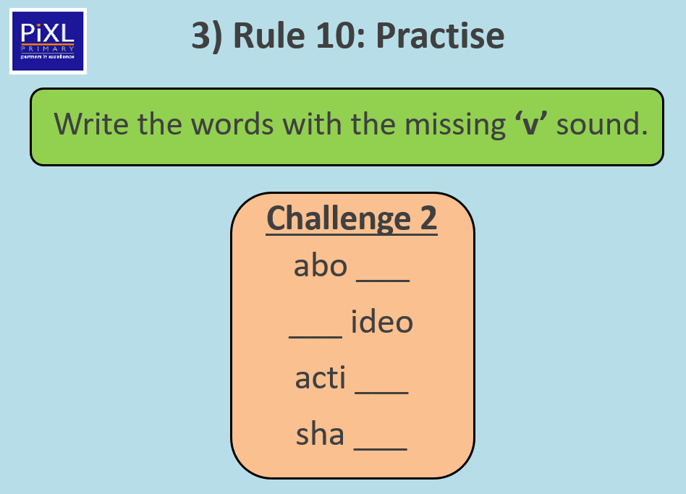
TBAT: read and write words with a /ve/ at the end.
Thursday 23rd October 2025

Slide 9
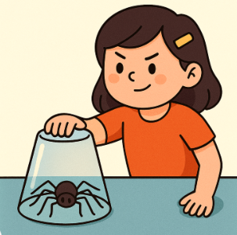
TBAT: read and write words with a /ve/ at the end.
Thursday 23rd October 2025
Can you find the /ve/ sounds in this sentence?
The girl was brave when she trapped the spider.

Slide 10
TBAT: read and write words with a /ve/ at the end.
Thursday 23rd October 2025
Write a sentence with one or more of these words.
give have live love

Slide 11

Ourselves – Glad to be me
Thursday 23rd October 2025
TBAT: Create and respond to vocal sounds and explore how to change sounds
2 in 2
What is pitch?
What is tempo?
Vocabulary:
dynamics (louder/quieter)
Improvise – make it up
Verse – a part of a song that isn’t usually repeated

Slide 12
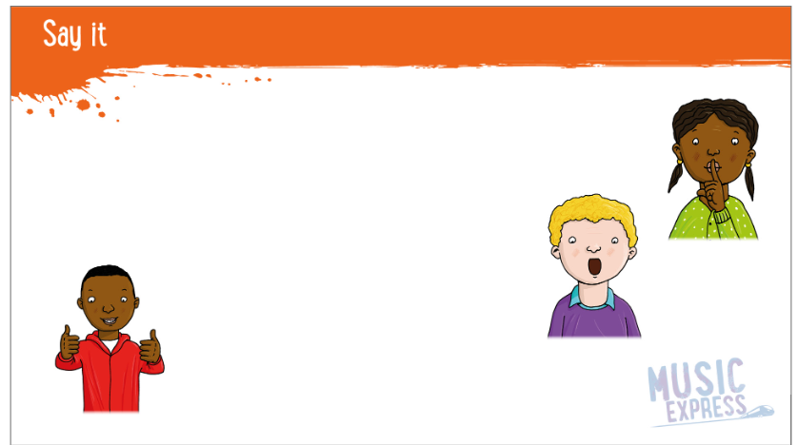
TBAT: Create and respond to vocal sounds and explore how to change sounds
Listen and repeat.
Can you hear the pitch of the voice changing?
Can you hear the tempo of the voice changing?
Why is it important to read with expression?
Thursday 23rd October 2025

Slide 13
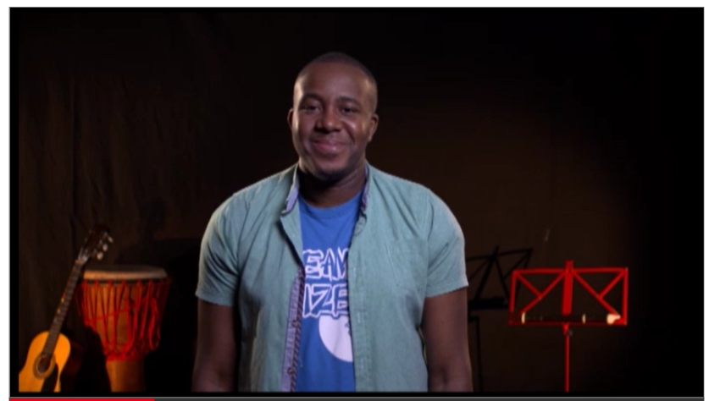
Copy the actions
TBAT: Create and respond to vocal sounds and explore how to change sounds
Thursday 23rd October 2025
Can we think of actions for the next verses?

Slide 14
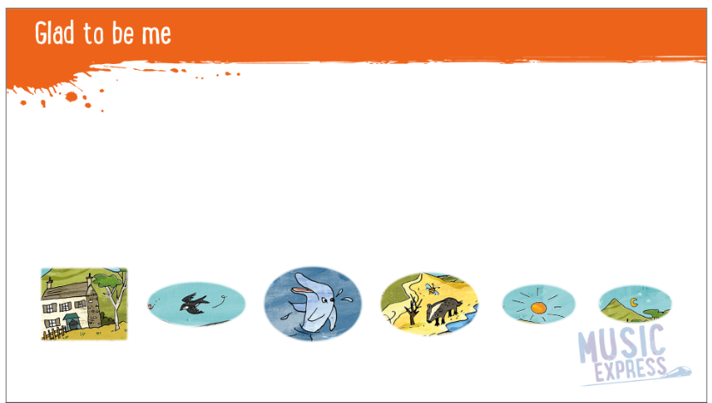
Practise the actions and sing along
TBAT: Create and respond to vocal sounds and explore how to change sounds
Thursday 23rd October 2025
Let’s perform it with just the backing track.

Slide 15
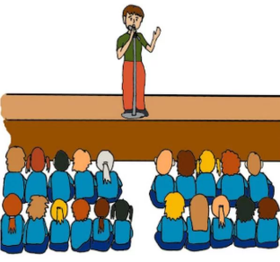
Assembly

Slide 16
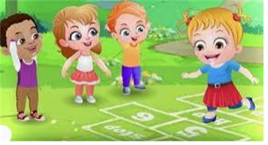
Break

Slide 17
PE- TBAT: use the teamwork skills that I have learnt
Tag
If you and your partner are tagged, make an arch. To be freed, another partner needs to go through your arch.
Team travelling. – You have three hoops. Can you get your team to the other side of the room without anyone leaving the hoops?
Mole hole and mole hills – One team needs to turn the hoops up the right way and one needs to turn them upside down. The team with the most at the end wins.

Slide 18
Plenary
What skills are needed to be a good team member?
Why is it important to communicate?
What happens if one person tries to make all the decisions and doesn’t listen?

Slide 19

Lunch

Slide 20

Toothbrushing

Slide 21

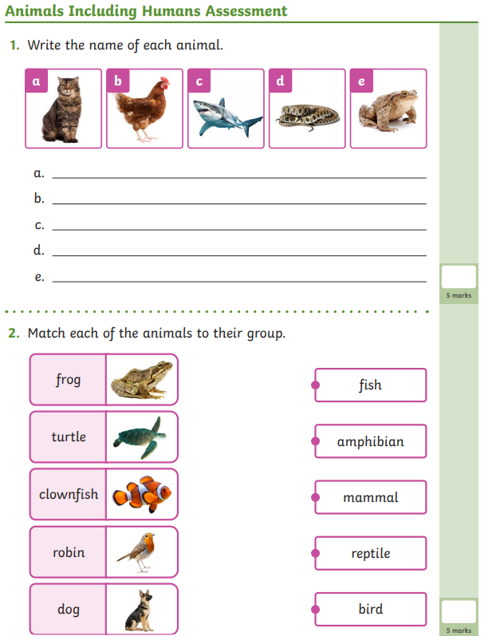
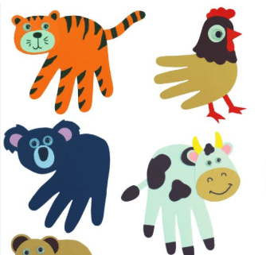
Independent Challenges:
Narrative Zone
Maths Zone
Draw or write about something you have enjoyed this half term.
Work out the doubles and halves using cubes or gems.
Enquiry Zone
Creative Zone
What can you remember about animals?
Draw around your hand.
What animal can you turn it into?

Slide 22




TBAT: double and half numbers.
Thursday 23rd October 2025
3 in 3
Which are odd?
Which are even? How do you know?

Slide 23
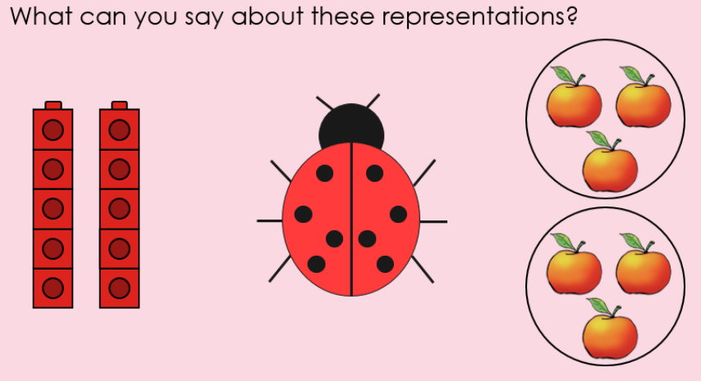
Blue / Green
TBAT: double and half numbers.
Thursday 23rd October 2025
I notice that…
I can see…
Challenge: create a part, whole model and number sentence for one of these.

Slide 24
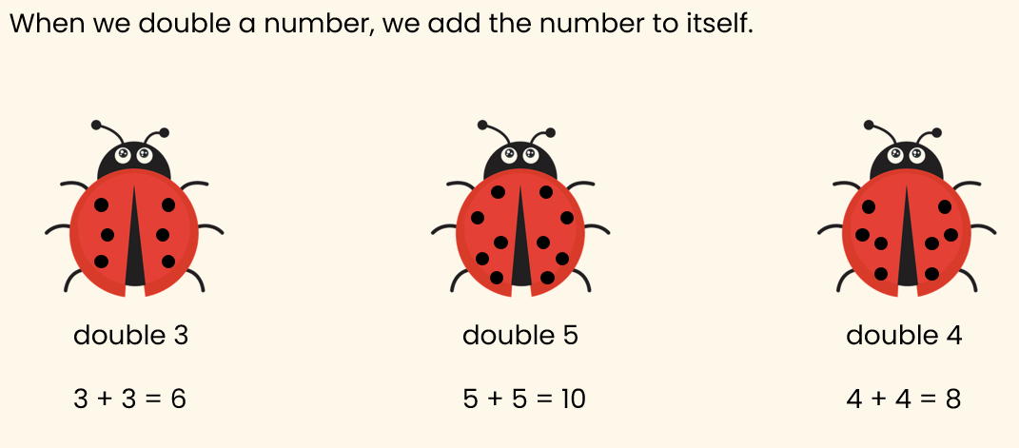
TBAT: double and half numbers.
Thursday 23rd October 2025

Slide 25
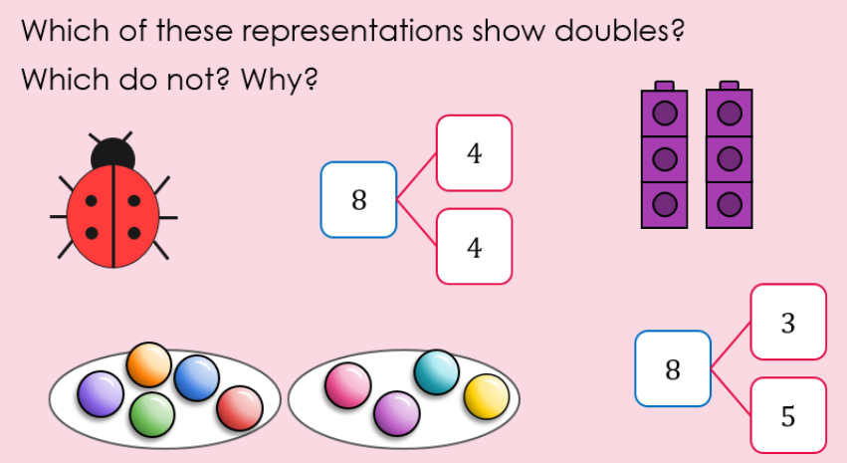
TBAT: double and half numbers.
Thursday 23rd October 2025

Slide 26
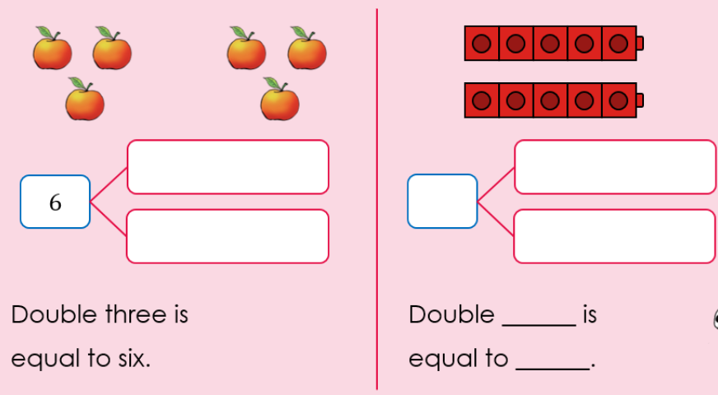
TBAT: double and half numbers.
Thursday 23rd October 2025

Slide 27
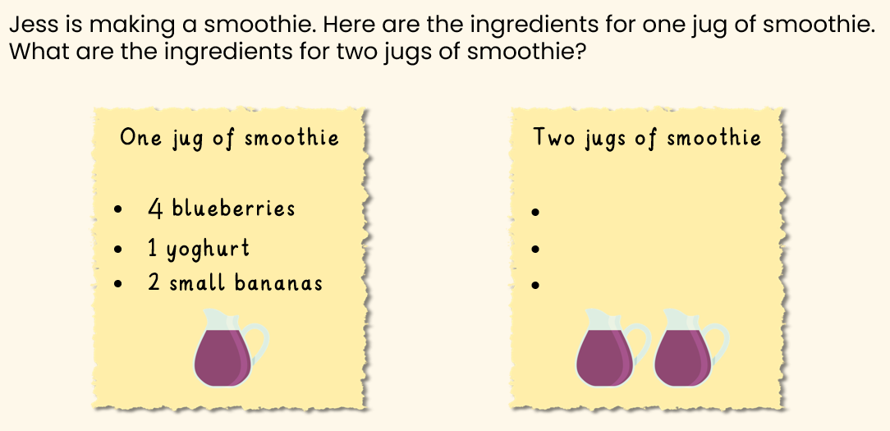
TBAT: double and half numbers.
Thursday 23rd October 2025

Slide 28
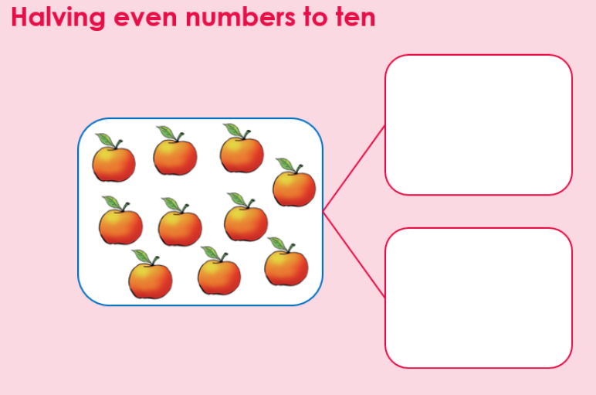
TBAT: double and half numbers.
Thursday 23rd October 2025

Slide 29
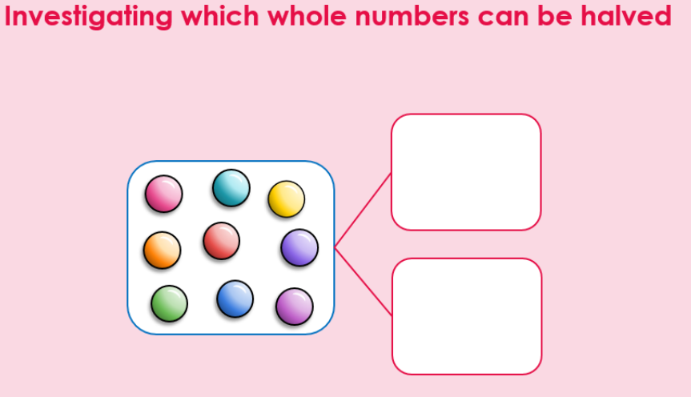
TBAT: double and half numbers.
Thursday 23rd October 2025

Slide 30
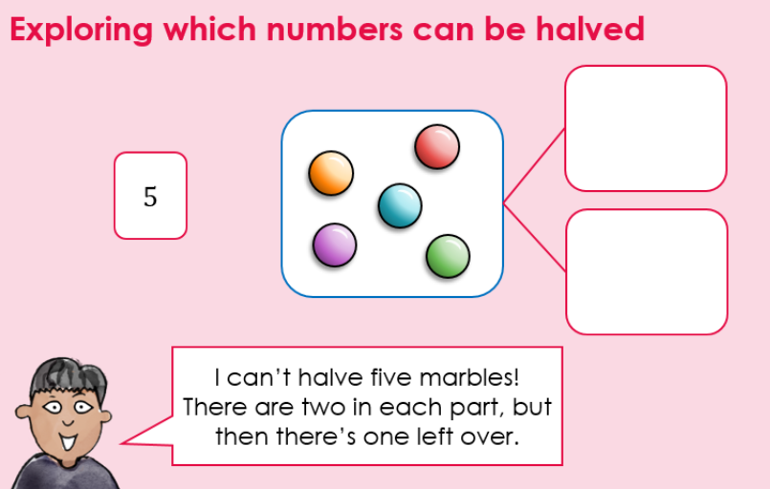
TBAT: double and half numbers.
Thursday 23rd October 2025

Slide 31
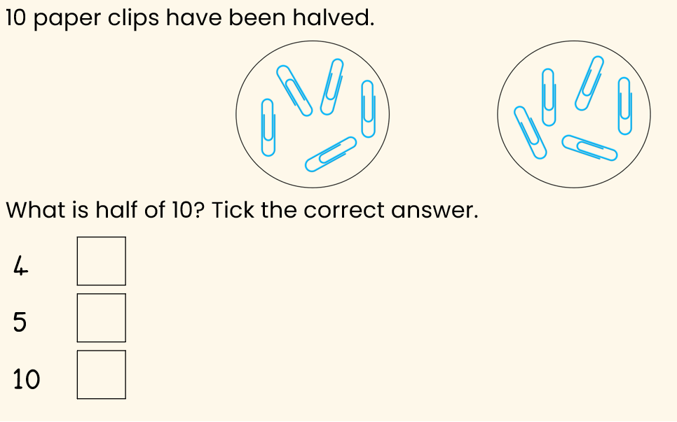
TBAT: double and half numbers.
Thursday 23rd October 2025

Slide 32
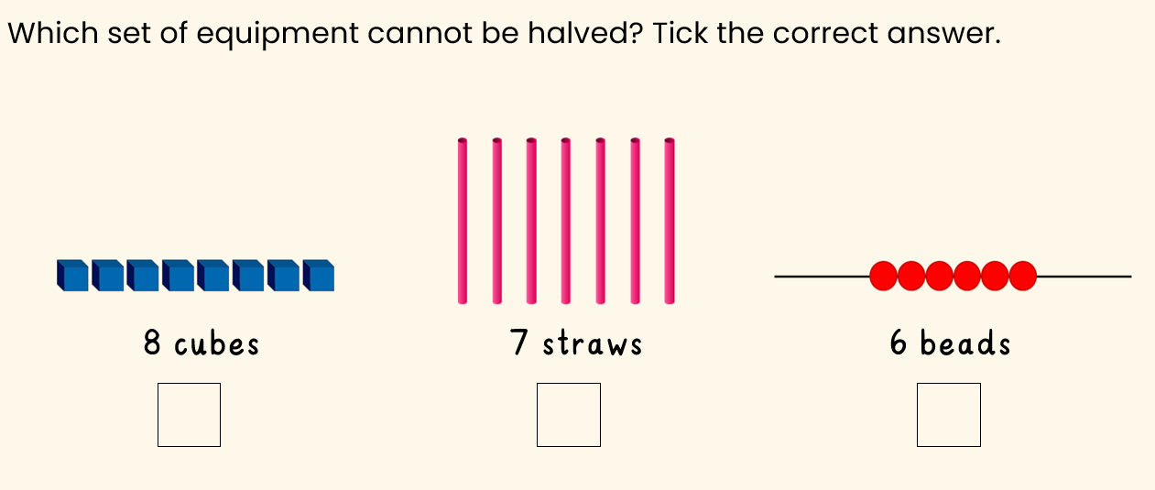
TBAT: double and half numbers.
Thursday 23rd October 2025

Slide 33
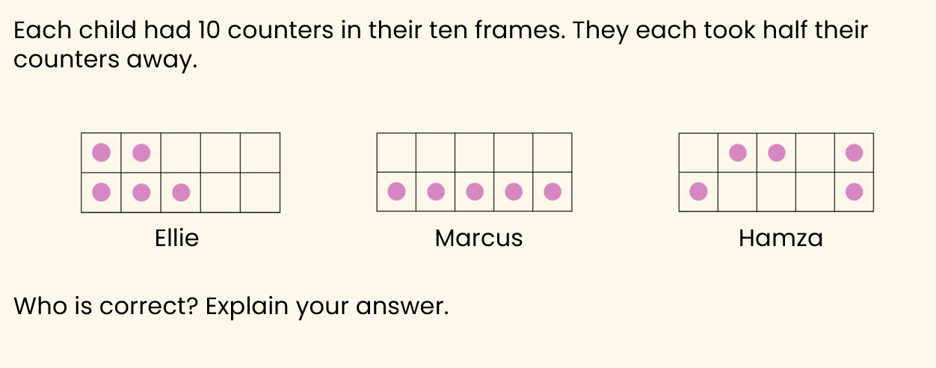
TBAT: double and half numbers.
Thursday 23rd October 2025

Slide 34
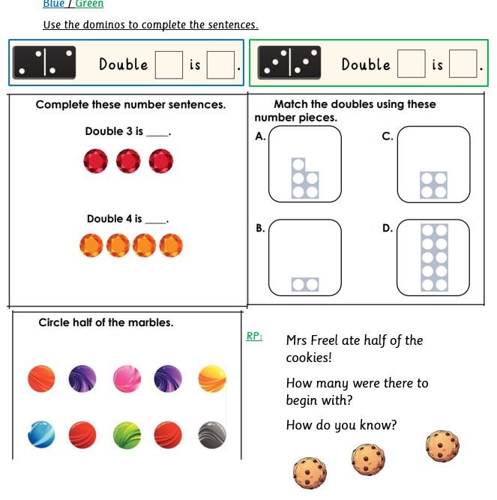
Thursday 23rd October 2025

Slide 35
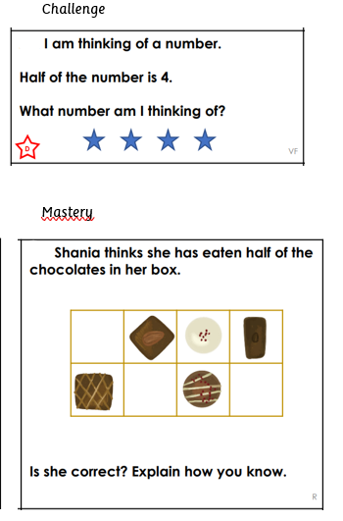
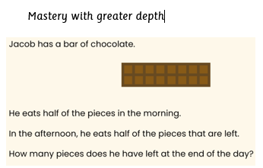
Thursday 23rd October 2025

Slide 36
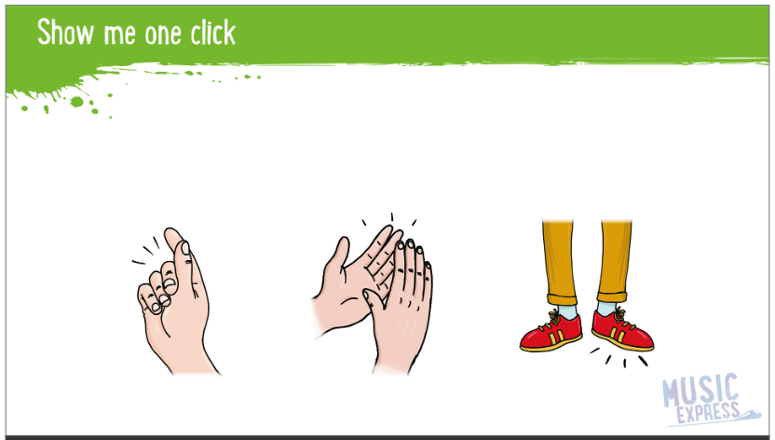
TBAT: Create vocal and body percussion sounds and explore descriptive sounds
Thursday 23rd October 2025
Join in with the body percussion and join in with the words.

Slide 37

Listen carefully to the story
TBAT: Create vocal and body percussion sounds and explore descriptive sounds
Thursday 23rd October 2025

Slide 38
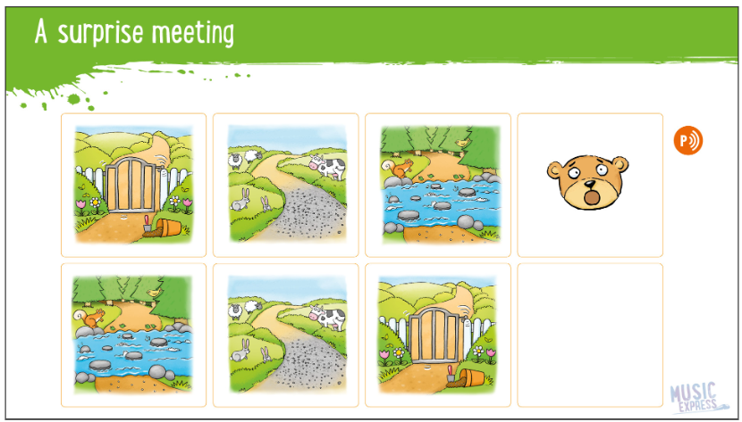
What is happening in the story board? Where is the story louder and quieter? Where is it told quicker and slower?
TBAT: Create vocal and body percussion sounds and explore descriptive sounds
Thursday 23rd October 2025
Who does the bear meet?

Slide 39
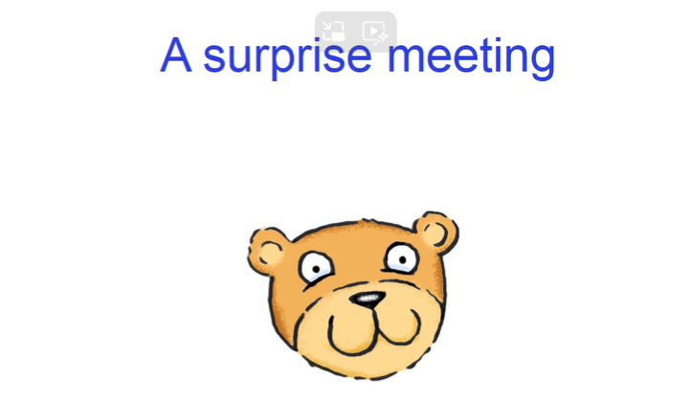
Now, we need to retell the story ourselves Let’s add vocal sounds and body percussion.
TBAT: Create vocal and body percussion sounds and explore descriptive sounds
Thursday 23rd October 2025

Slide 40
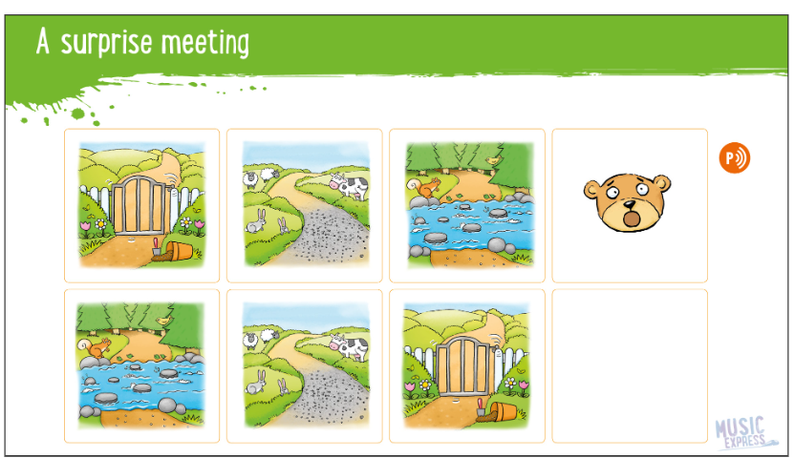
Can we give the story a surprise ending? What could happen?
TBAT: Create vocal and body percussion sounds and explore descriptive sounds
Thursday 23rd October 2025
Let’s add some percussion instruments.

