Slide 1
Monday 6th October 2025

Slide 2

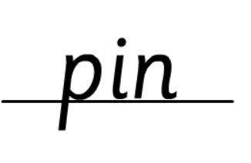


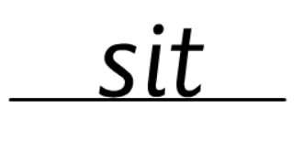
Morning Challenges:
Name writing

Slide 3
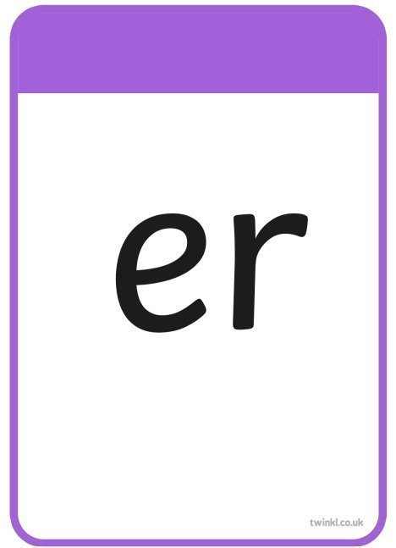


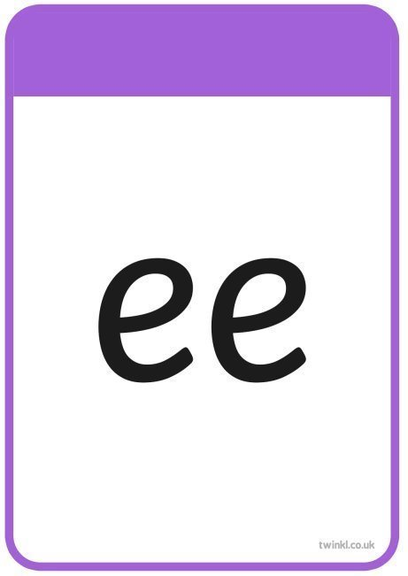







TBAT– read longer words
Monday 6th October 2025

Slide 4
TBAT– read longer words
Monday 6th October 2025
liquid

Slide 5
TBAT– read longer words
Monday 6th October 2025
packet

Slide 6
TBAT– read longer words
Monday 6th October 2025
better

Slide 7
TBAT– read longer words
Monday 6th October 2025
velvet

Slide 8


TBAT– read longer words
Monday 6th October 2025

Slide 9
TBAT– read longer words
Monday 6th October 2025
r-oo-f/t-o-p

Slide 10
TBAT– read longer words
Monday 6th October 2025
ear/r-i-ng

Slide 11
TBAT– read longer words
Monday 6th October 2025
b-e-d/r-oo-m

Slide 12
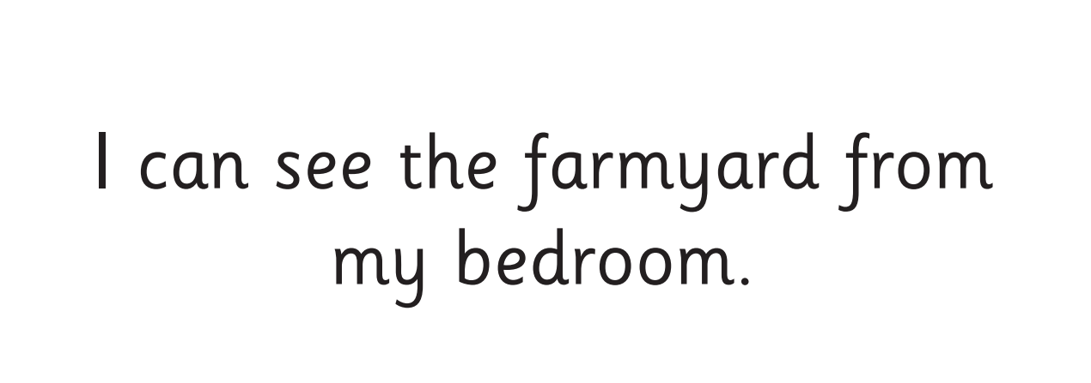
TBAT– read longer words
Monday 6th October 2025
Now let's read this sentence!​

Slide 13

TBAT– read longer words
Monday 6th October 2025
all
tricky word
magnet popcorn
Dragons Den (phonicsplay.co.uk)

Slide 14
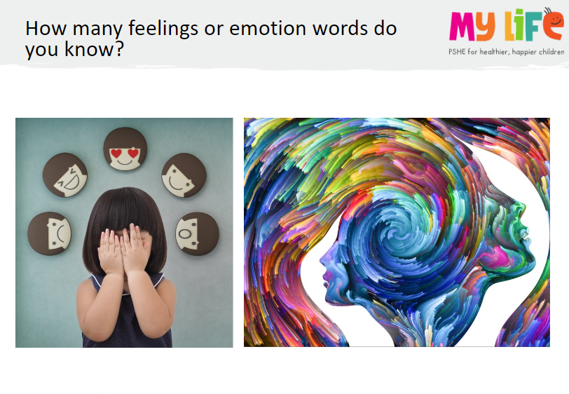

Key Question: What are feelings?
Monday 6th October 2025
Blue/ Green

Slide 15
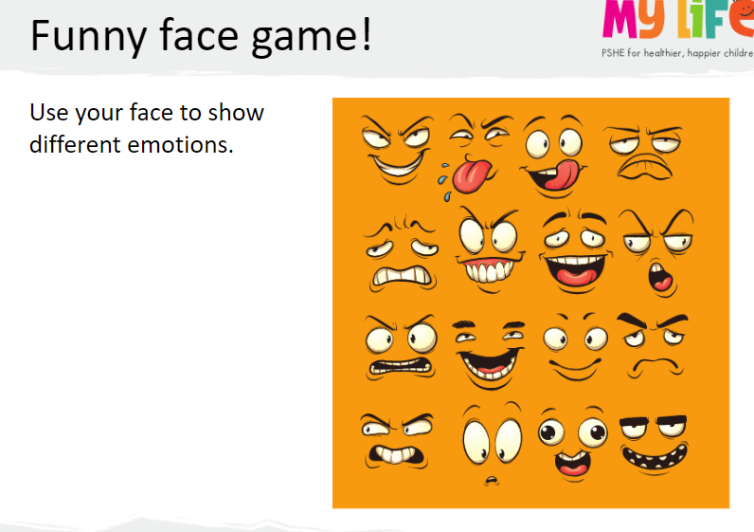
Key Question: What are feelings?
Monday 6th October 2025

Slide 16
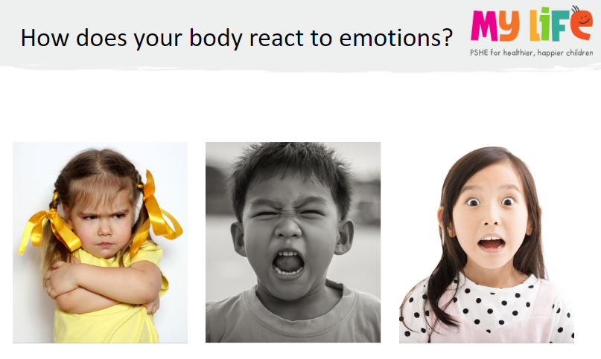
Key Question: What are feelings?
Monday 6th October 2025
Think about the zones of regulation.......

Slide 17
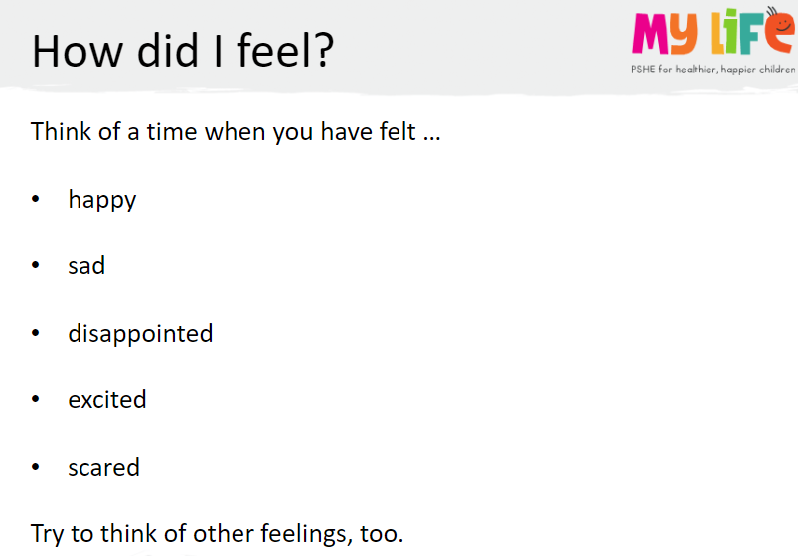
Key Question: What are feelings?
Monday 6th October 2025

Slide 18
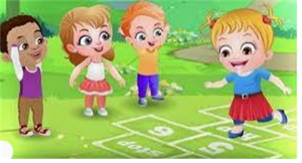
Break

Slide 19

PE TBAT: Move into a space, showing an awareness of defenders

Slide 20
Warm up: perform 5 star jumps at a cone to win a point. If you are caught, stand on one leg for 5 seconds.
Skill development: Practise the bounce pass with your partner – bouncing the ball into a hoop.
With your partner, travel around the room trying to score by bouncing the ball into as many hoops as possible.
Defenders will now try to stop you by standing in a hoop!
Start at the cone and try to bounce the ball in the hoop to score a goal.

Slide 21
Plenary
Why is it important to move into a space?
Who tried to stop you scoring?
What happened if your team mate was too far away from you?
What plan did you use to help you succeed?

Slide 22

Lunch

Slide 23

Toothbrushing

Slide 24
TBAT: create a story map for The Enormous turnip.
Monday 6th October 2025
3 in 3
beginning
Everyone had turnip soup for tea.
middle
The man saw that the turnip had grown big.
end
He could not pull it up and needed help.
Challenge: Can you make it sound more exciting by using interesting vocabulary?

Slide 25


TBAT: create a story map for The Enormous turnip.
Monday 6th October 2025
Blue/ Green- With your partner, re-tell the story of The Enormous Turnip.
At the beginning.........
After that.......
Next.......
In the end.........

Slide 26


TBAT: create a story map for The Enormous turnip.
Monday 6th October 2025
What happened at the beginning of the story?
Who was there?

Slide 27

TBAT: create a story map for The Enormous turnip.
Monday 6th October 2025
What happened next?
Why did the man need help to pull up the turnip?

Slide 28


TBAT: create a story map for The Enormous turnip.
Monday 6th October 2025
What happened after that?
Who came to help the man pull up the turnip?

Slide 29
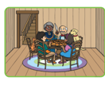
TBAT: create a story map for The Enormous turnip.
Monday 6th October 2025
What happened at the end of the story?
Can you think of an interesting word to tell the reader that the turnip tasted nice ?

Slide 30
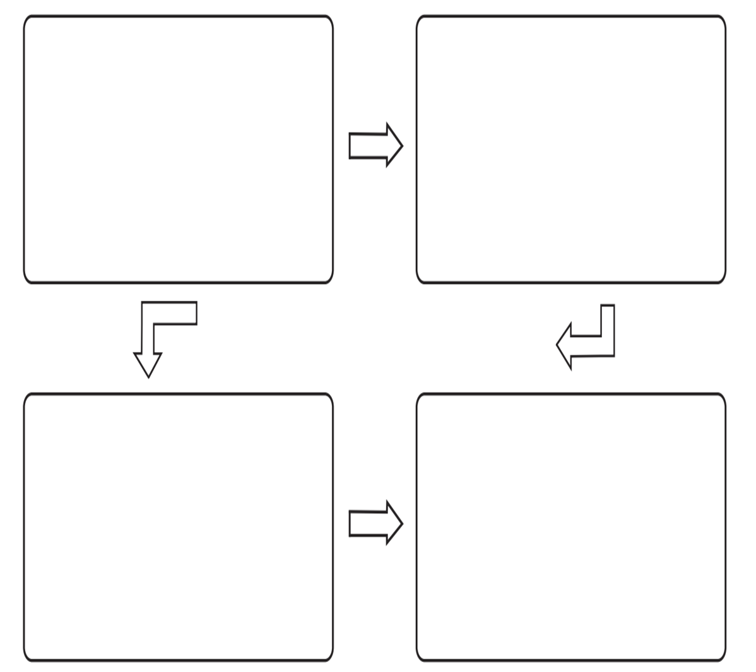
TBAT: create a story map for The Enormous turnip.
Monday 6th October 2025
Independent:
Challenge:
List some of the interesting vocabulary you will use when you re-write The Enormous Turnip.

Slide 31
Key Question: What are feelings?
Monday 6th October 2025
Blue/ Green

Slide 32
Key Question: What are feelings?
Monday 6th October 2025

Slide 33
Key Question: What are feelings?
Monday 6th October 2025
Think about the zones of regulation.......

Slide 34
Key Question: What are feelings?
Monday 6th October 2025

Slide 35

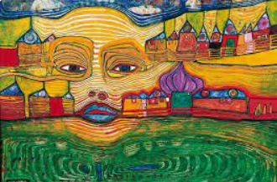
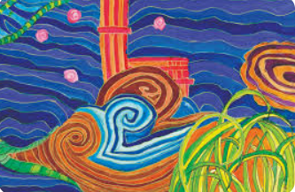
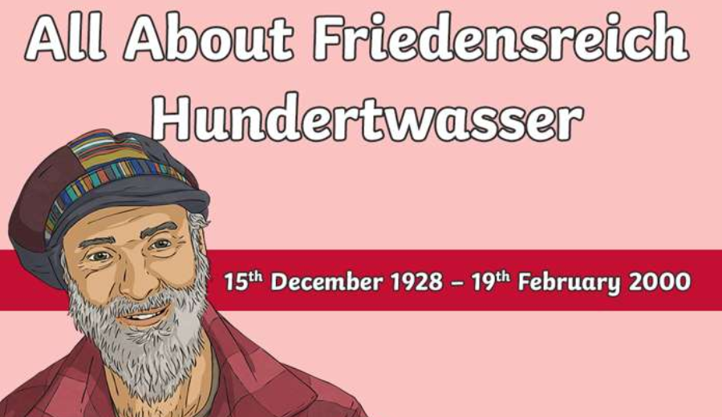
TBAT: Create a piece of artwork inspired by artist Hundertwasser. Monday 6th October
3 in 3 - Which pieces of art contain a spiral?

Slide 36

TBAT: Create a piece of artwork inspired by artist Hundertwasser. Monday 6th October

Slide 37
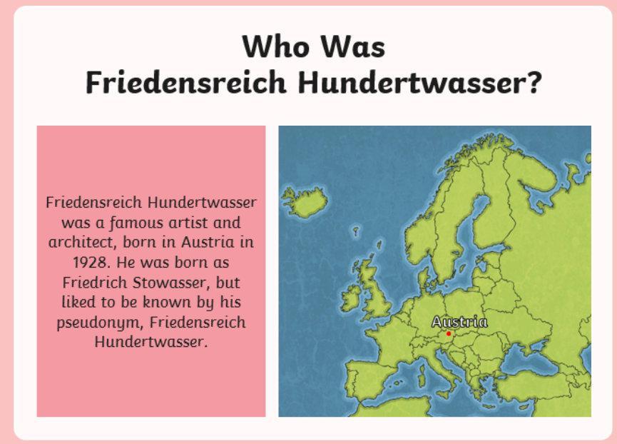
TBAT: Create a piece of artwork inspired by artist Hundertwasser. Monday 6th October

Slide 38
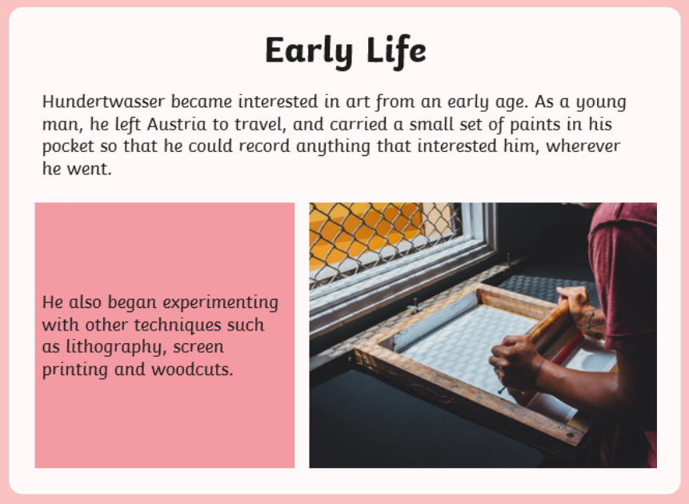
TBAT: Create a piece of artwork inspired by artist Hundertwasser. Monday 6th October

Slide 39
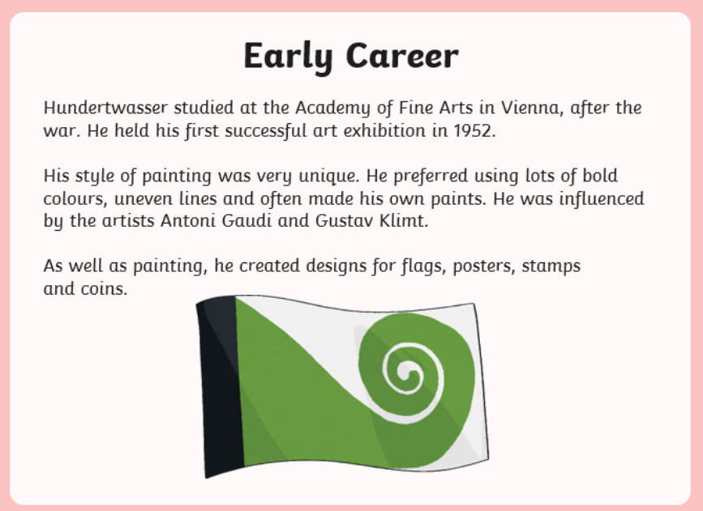
TBAT: Create a piece of artwork inspired by artist Hundertwasser. Monday 6th October

Slide 40
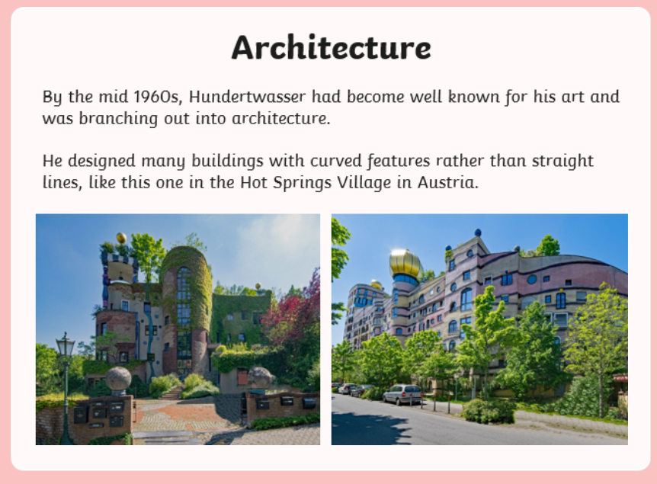
TBAT: Create a piece of artwork inspired by artist Hundertwasser. Monday 6th October

Slide 41
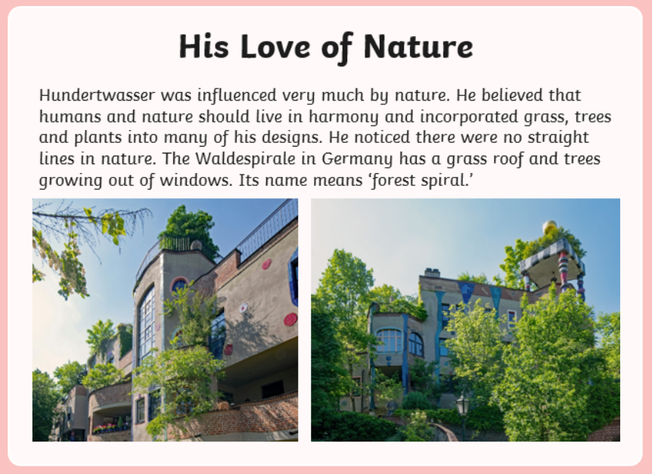
TBAT: Create a piece of artwork inspired by artist Hundertwasser. Monday 6th October

Slide 42
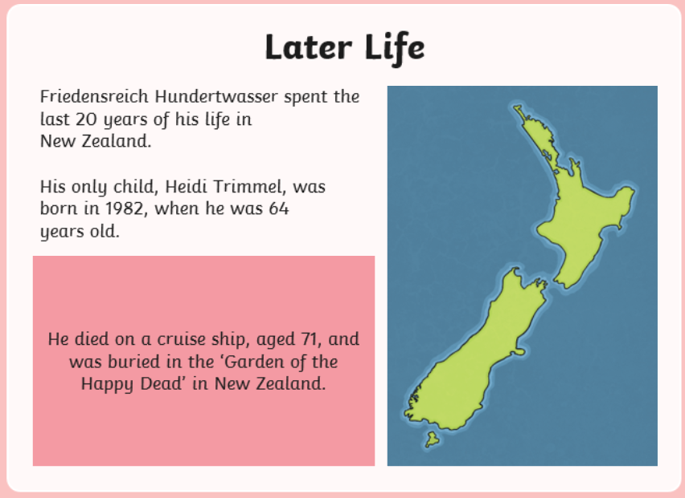
TBAT: Create a piece of artwork inspired by artist Hundertwasser. Monday 6th October

Slide 43
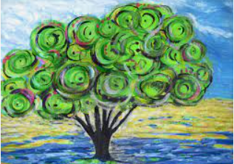
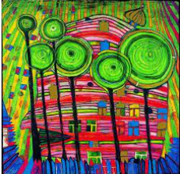
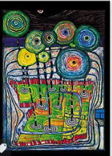
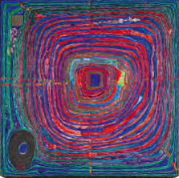
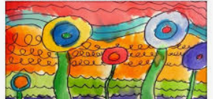
TBAT: Create a piece of artwork inspired by artist Hundertwasser. Monday 6th October

Slide 44
TBAT: Create a piece of artwork inspired by artist Hundertwasser. Monday 6th October
Draw the tree in the style of Hundertwasser.
Then, add bright colours to it.

Slide 45
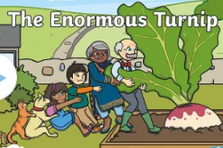
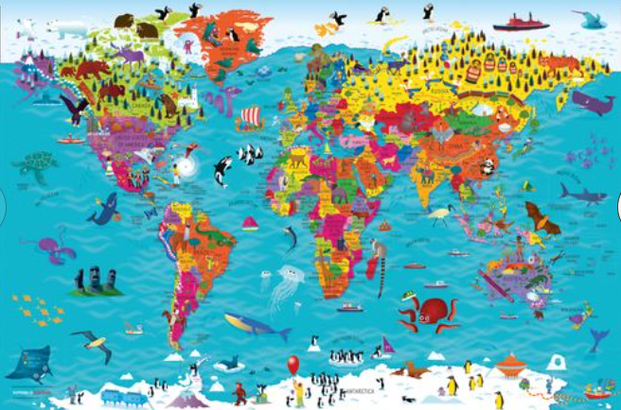
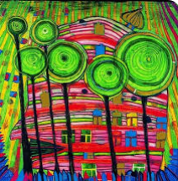
Independent Challenges:
Narrative Zone
Maths Zone
With masks and puppets, act out the story of The Enormous Turnip.
Explore the 3D shapes
How many sides do they have?
Do some have surfaces that aren’t flat?
Enquiry Zone
Creative Zone
Look at the world map and see which animals live in what parts of the world.
Do any of them surprise you?
Can you create spiral trees inspired by Hundertwasser?

