Slide 1
Monday 20th October 2025

Slide 2


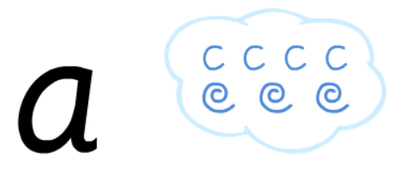
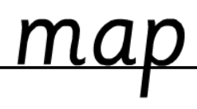
Morning Challenges:
Name writing

Slide 3
TBAT: read and write words with the /oi/ and /oy/ grapheme.
Monday 20th October 2025
Flashcards

Slide 4


TBAT: read and write words with the /oi/ and /oy/ grapheme.
Monday 20th October 2025

Slide 5
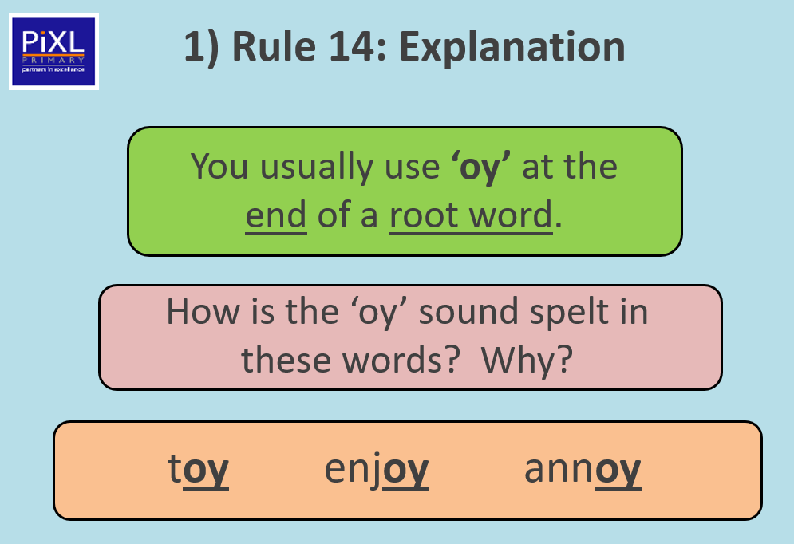
TBAT: read and write words with the /oi/ and /oy/ grapheme.
Monday 20th October 2025

Slide 6
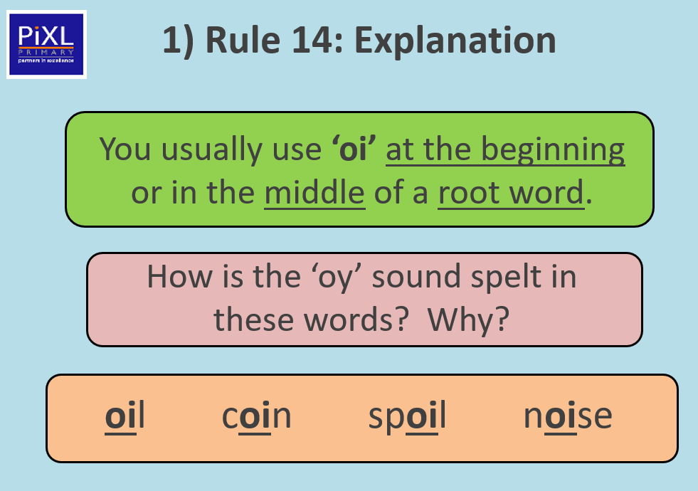
TBAT: read and write words with the /oi/ and /oy/ grapheme.
Monday 20th October 2025

Slide 7
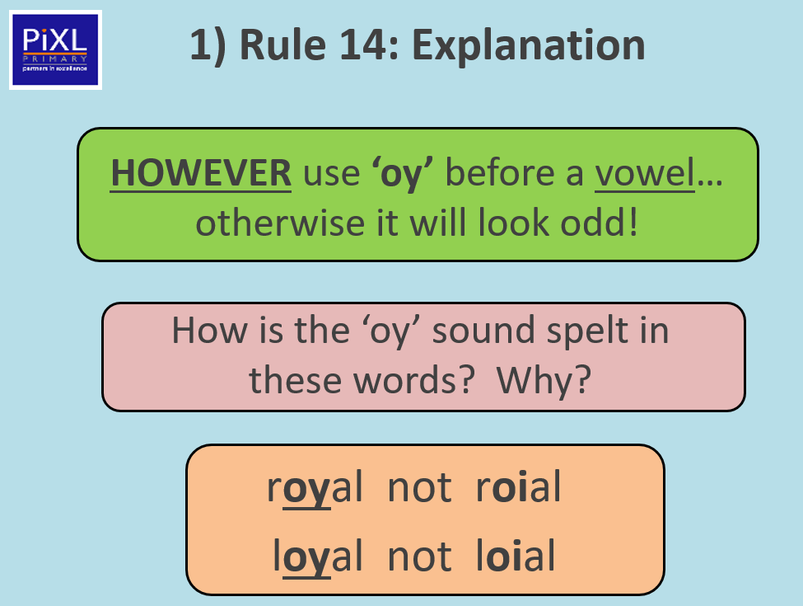
TBAT: read and write words with the /oi/ and /oy/ grapheme.
Monday 20th October 2025
Vowels are a, e, i, o, u

Slide 8
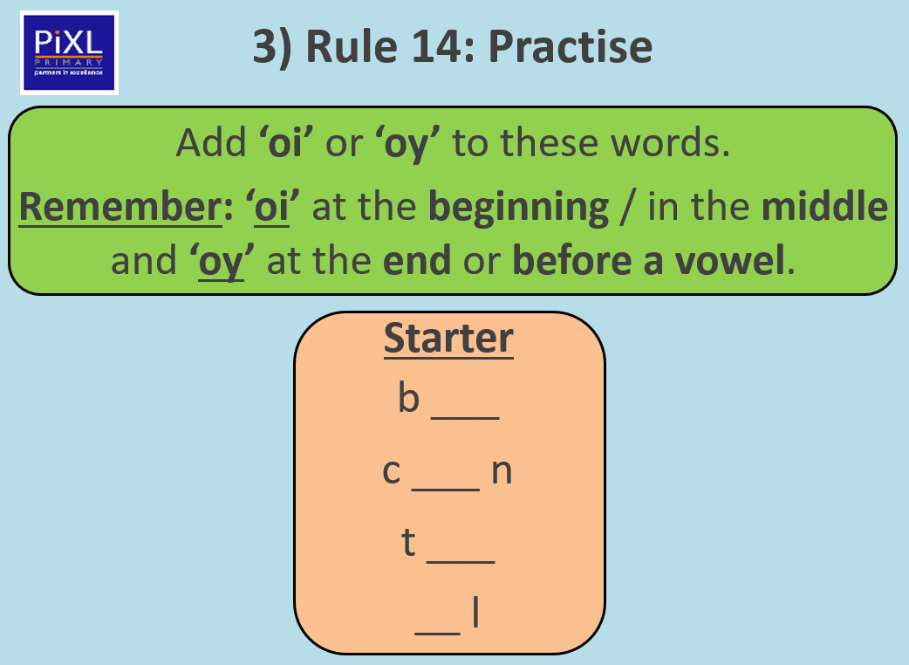
TBAT: read and write words with the /oi/ and /oy/ grapheme.
Monday 20th October 2025

Slide 9
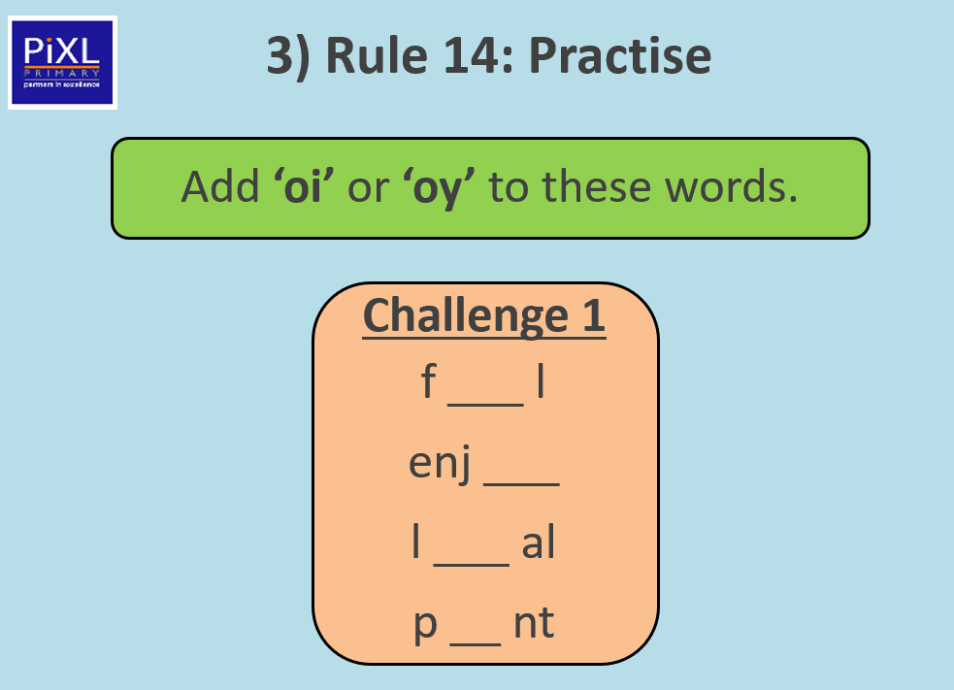
TBAT: read and write words with the /oi/ and /oy/ grapheme.
Monday 20th October 2025

Slide 10
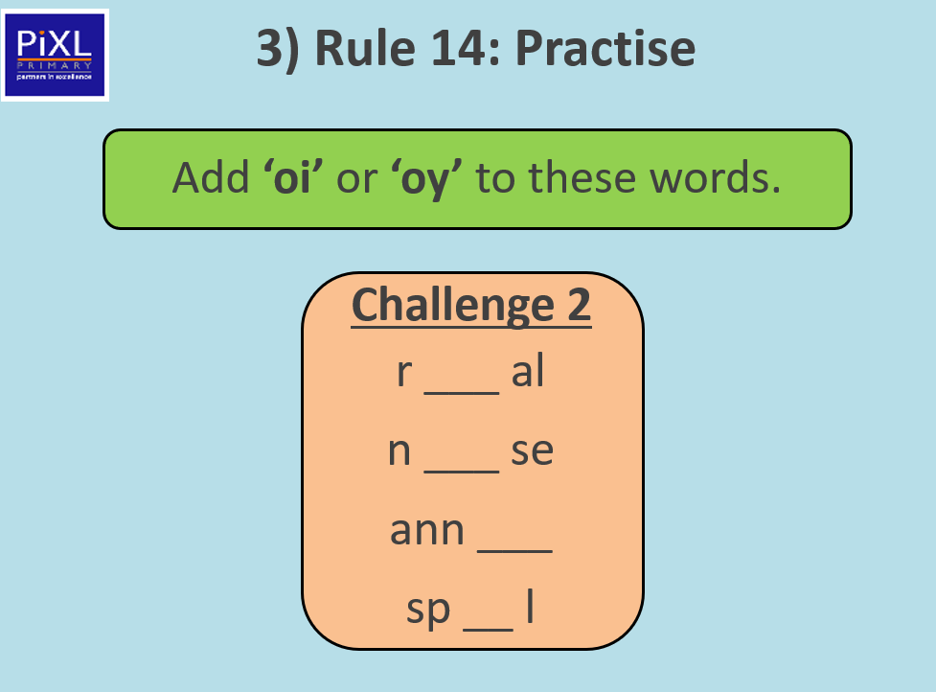
TBAT: read and write words with the /oi/ and /oy/ grapheme.
Monday 20th October 2025

Slide 11
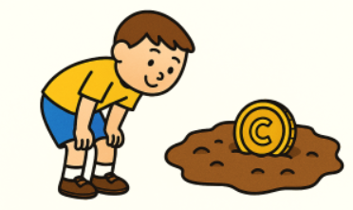
TBAT: read and write words with the /oi/ and /oy/ grapheme.
Monday 20th October 2025
Can you find the /oi/ and /oy/ sounds in this sentence?
The boy saw a coin in the soil.

Slide 12
TBAT: read and write words with the /oi/ and /oy/ grapheme.
Monday 20th October 2025
Write a sentence with one or more of these words.
coin point
cowboy enjoy

Slide 13
Key Question: How can emotions change people's behaviour?
Monday 20th October 2025
3 in 3- Match the emotion to its description.
Enthusiastic and animated about something.
upset
cross
to be very unhappy
excited
to feel or show anger

Slide 14
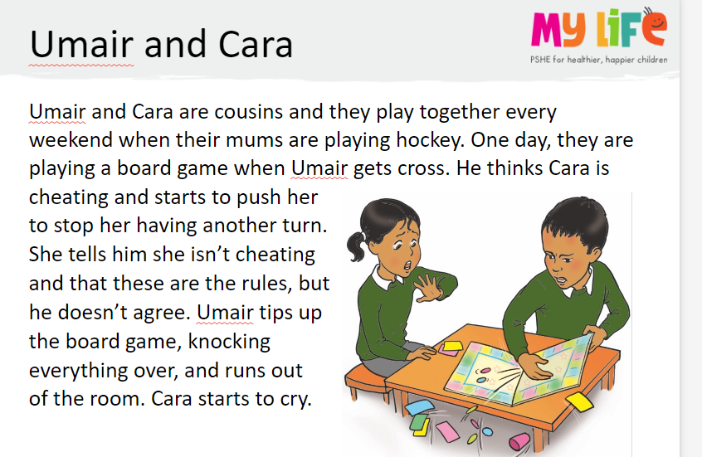
Key Question: How can emotions change people's behaviour?
Monday 20th October 2025

Slide 15
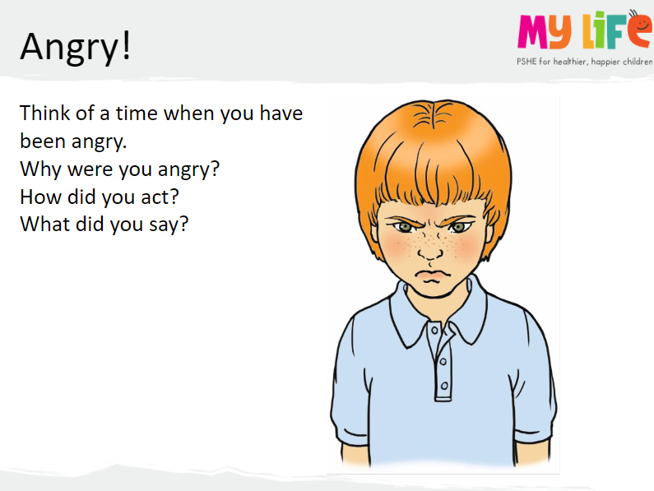

Key Question: How can emotions change people's behaviour?
Monday 20th October 2025
Blue/ Green
I felt angry when.....
mad
cross
furious

Slide 16
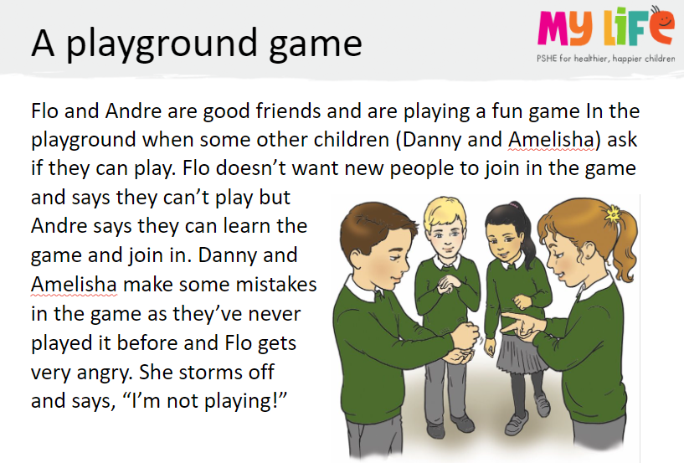
Key Question: How can emotions change people's behaviour?
Monday 20th October 2025

Slide 17
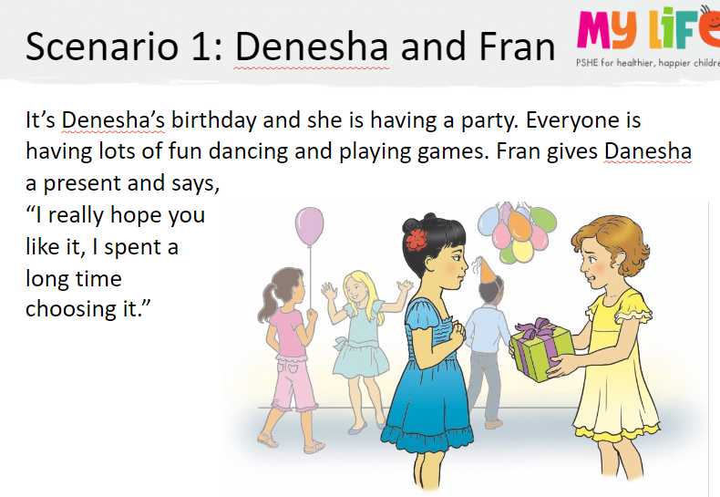
Key Question: How can emotions change people's behaviour?
Monday 20th October 2025

Slide 18
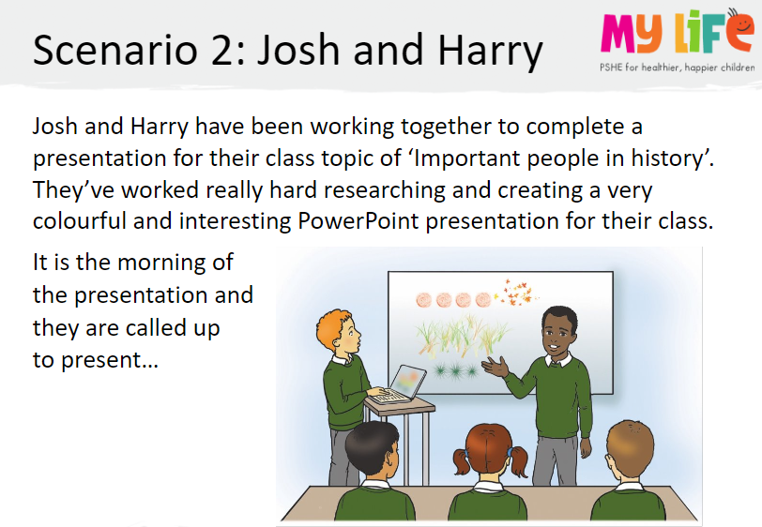
Key Question: How can emotions change people's behaviour?
Monday 20th October 2025

Slide 19
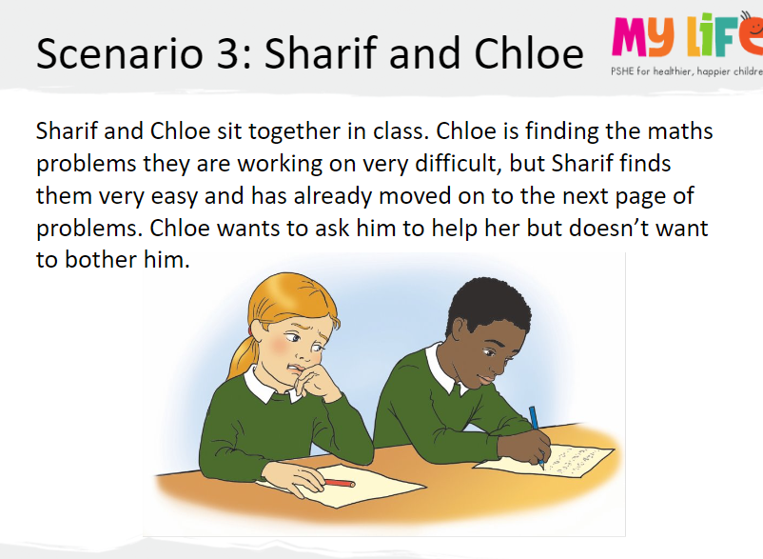
Key Question: How can emotions change people's behaviour?
Monday 20th October 2025

Slide 20
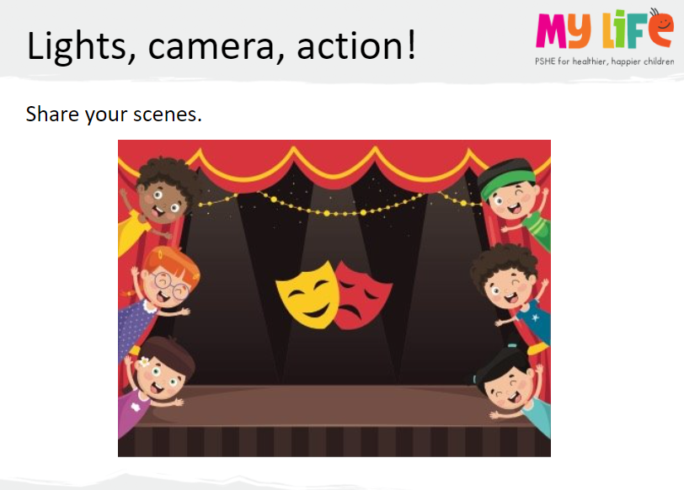
Key Question: How can emotions change people's behaviour?
Monday 20th October 2025

Slide 21
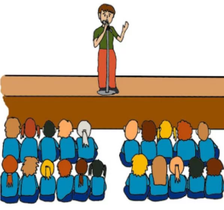
Assembly

Slide 22
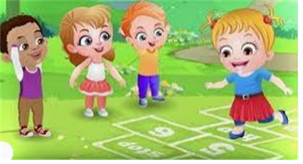
Break

Slide 23

Lunch

Slide 24

Toothbrushing

Slide 25
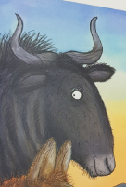
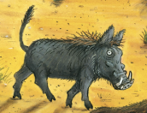
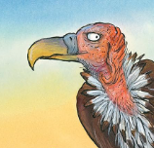
TBAT: use interesting vocabulary.
Monday 20th October 2025
3 in 3- Fill in the gaps to make a descriptive word.
lo....... t......l
sh......p h....ns
yellow b......k

Slide 26

TBAT: use interesting vocabulary.
Monday 20th October 2025
Blue/ Green- Think of a more interesting word to fill the gap in the sentence.
The wildebeest has thin legs.
The hyena laughs.
Challenge: Can you think of a word that means the opposite?

Slide 27
TBAT: use interesting vocabulary.
Monday 20th October 2025
How many other words can you think of for 'ugly'?
ugly
Challenge: Can you order these from 'least ugly' to 'most ugly'?

Slide 28
TBAT: use interesting vocabulary.
Monday 20th October 2025
How many other words can you think of for 'pretty'?
pretty
Challenge: Can you put these words in a sentence?

Slide 29
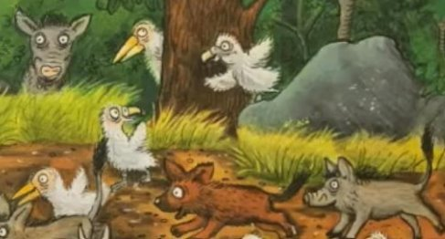
TBAT: use interesting vocabulary.
Monday 20th October 2025
How could we describe the baby animals?

Slide 30
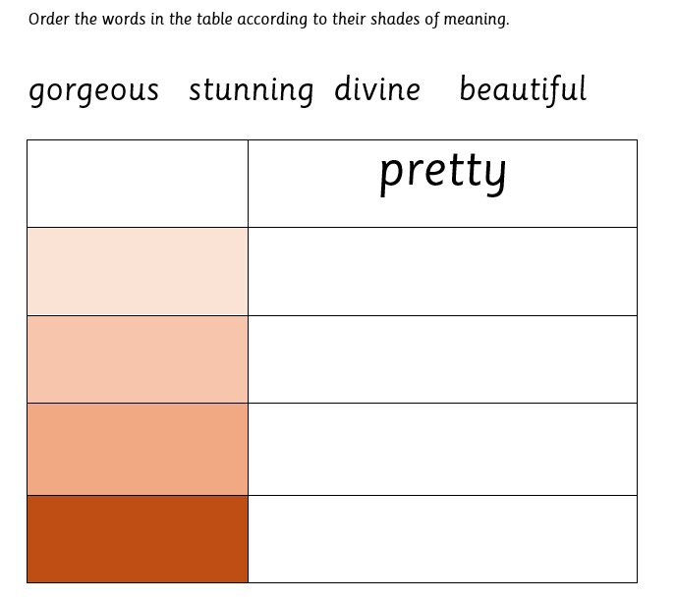
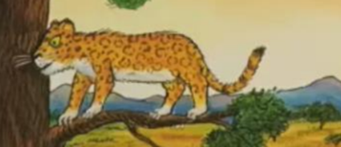
TBAT: use interesting vocabulary.
Monday 20th October 2025
Independent:
Challenge:
Use one of the words from the table above, to write a sentence about this picture.

Slide 31
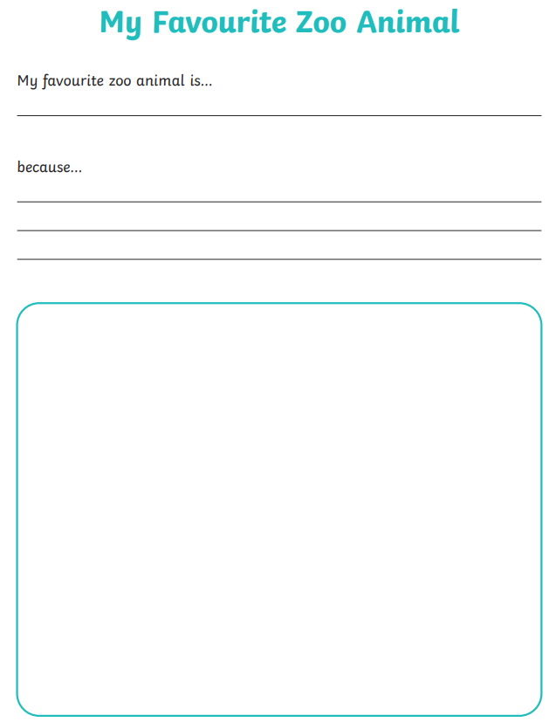
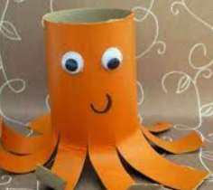
Independent Challenges:
Narrative Zone
Maths Zone
Write about your favourite animal.
Enquiry Zone
Creative Zone
Use junk modelling to create your favourite animal.

Slide 32
PE: TBAT: Use my attacking and defending skills to play a throwing and catching game
2 in 2
What is the role of an attacker?
What is the role of a defender?

Slide 33
Warm up
In pairs, follow your partner. Copy how they are travelling.
Swap over.
In threes, play piggy in the middle practising marking the player with out the ball.

Slide 34
Groups of 6
3 attackers and 3 defenders.
Place two rows of cones at each end of the playing area.
A player must catch the ball whilst standing in between the cones to score a goal.
There must be two passes before a goal is scored.

Slide 35
Plenary
How effective were you as a defender?
Did you manage to intercept the ball?
What did your team mates do to help you?

Slide 36
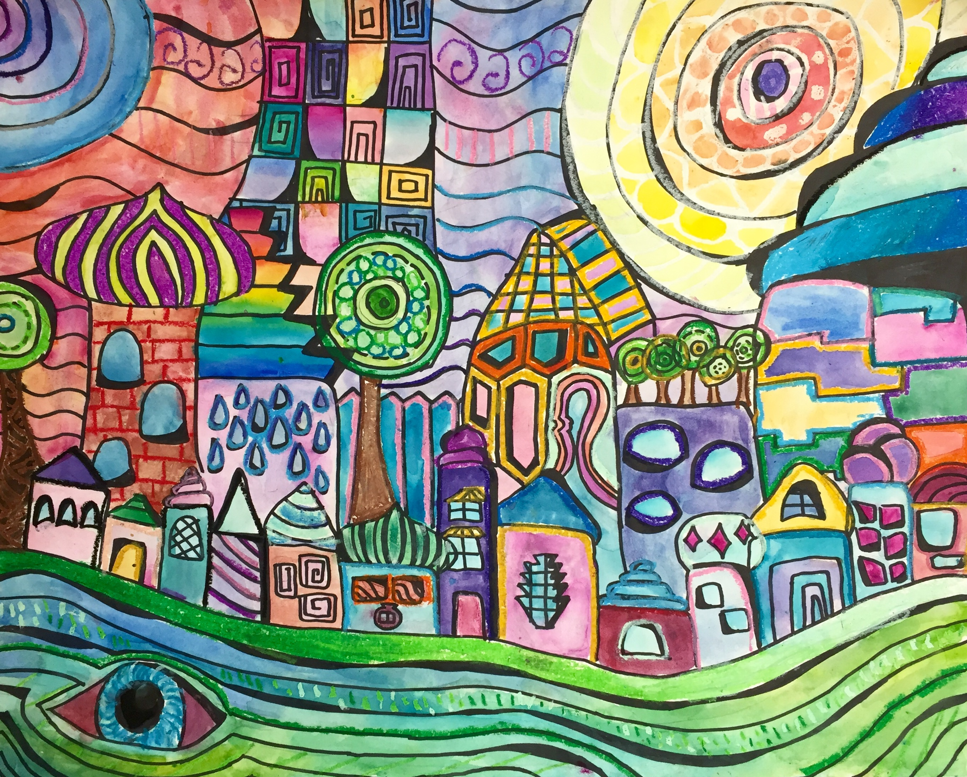

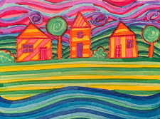
Art – TBAT: Reflect on and evaluate our work.
3 in 3:
Which of these paintings are by Alma Thomas and which are by Hundertwasser?

Slide 37
Have a look in your sketchbook at the pieces of art we have done recently. Blue / Green
Which piece of art is your favourite? Why? Tell your partner.
Look at your partner's art. Which is your favourite and why?
My favourite piece of art is this one because…
Open your book to your favourite piece of work and lay it out on the table.

Slide 38
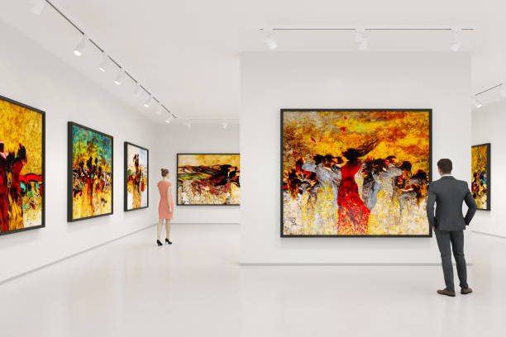
We are going to look around the room at the pieces of art work like they are in a gallery. Go and have a look!

Slide 39
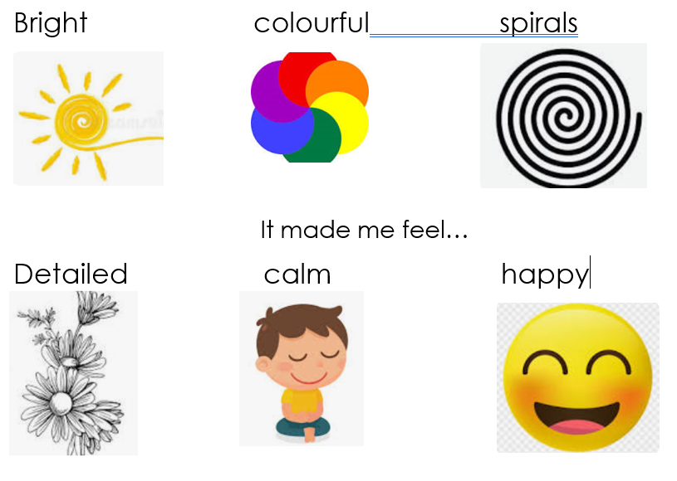
Write a sentence about your favourite piece of art work and explain why you like it!
I like the art work because ____________________________.

