Slide 1
Friday 3rd October 2025

Slide 2

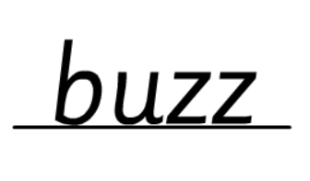

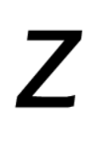
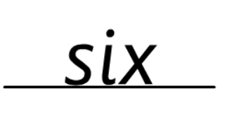
Morning Challenges:
Name writing

Slide 3
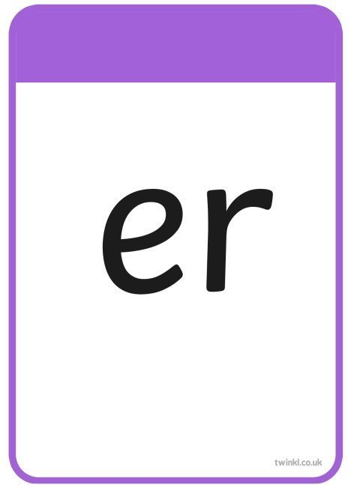

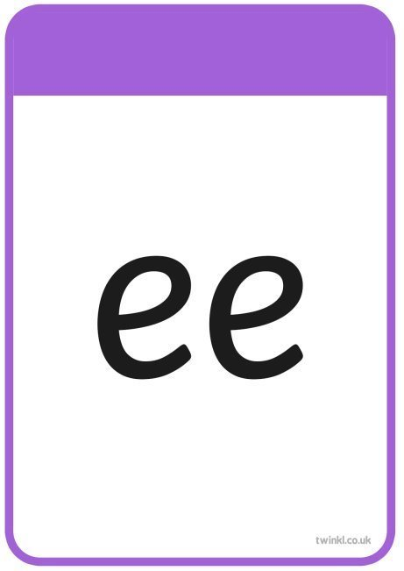

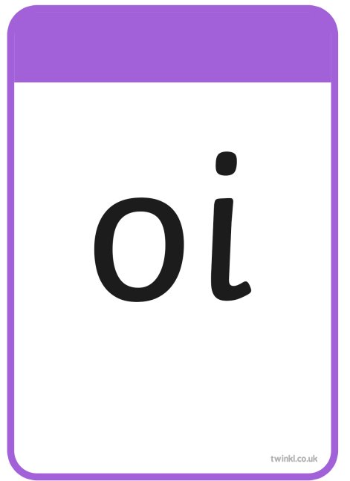
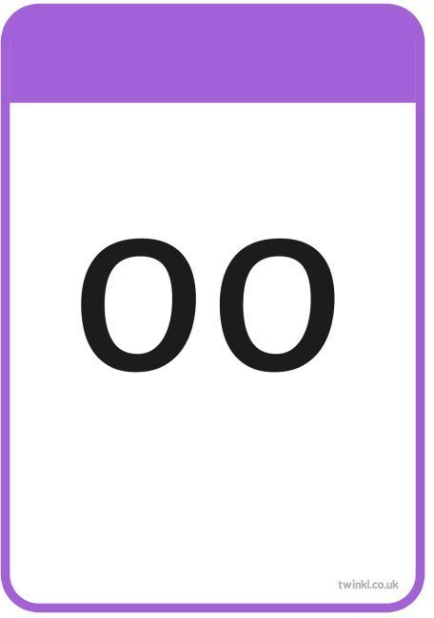
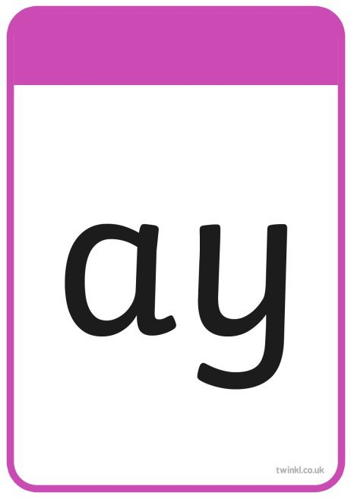
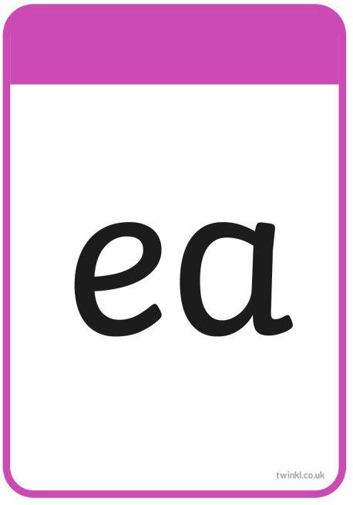


TBAT: recap /ay/ , /ou/, /oy/ and /ea/ graphemes.
Friday 3rd October 2025

Slide 4
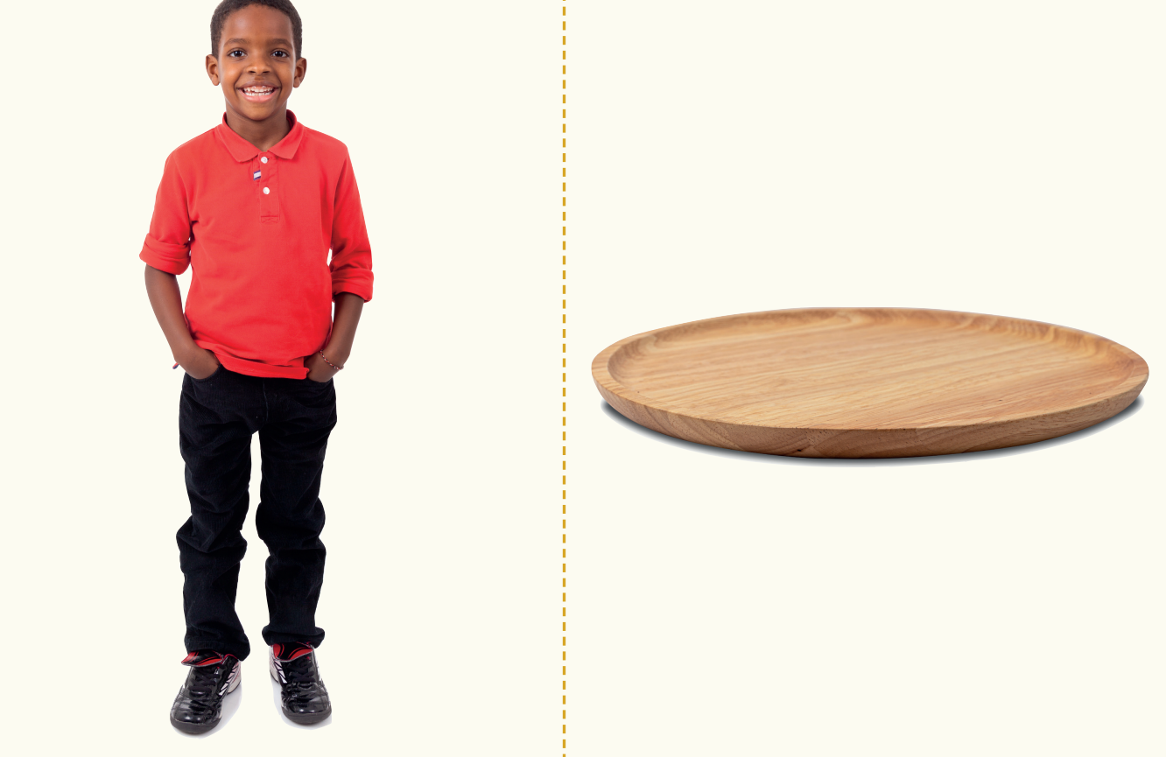
TBAT: recap /ay/ , /ou/, /oy/ and /ea/ graphemes.
Friday 3rd October 2025
annoy
play
enjoy
joy
spray
stay

Slide 5






TBAT: recap /ay/ , /ou/, /oy/ and /ea/ graphemes.
Friday 3rd October 2025
says
push
put
pull
full

Slide 6

TBAT: recap /ay/ , /ou/, /oy/ and /ea/ graphemes.
Friday 3rd October 2025
Match the words
boy
cloud
toy
children
crayon
sea

Slide 7

TBAT: recap /ay/ , /ou/, /oy/ and /ea/ graphemes.
Friday 3rd October 2025
Notes:
I like to play in the sea.

Slide 8
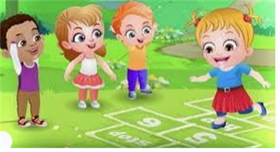
Break

Slide 9
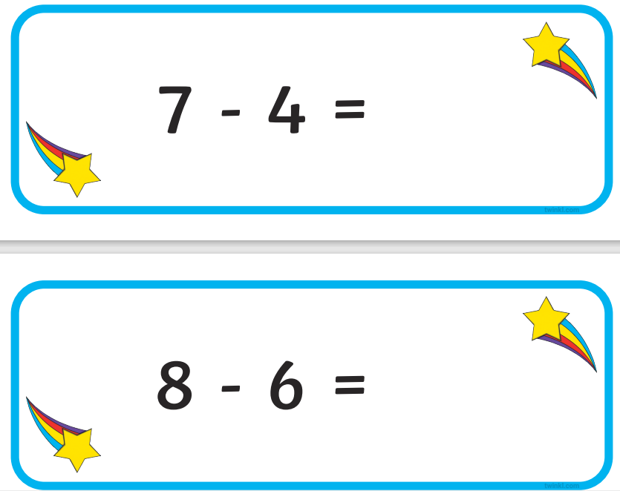
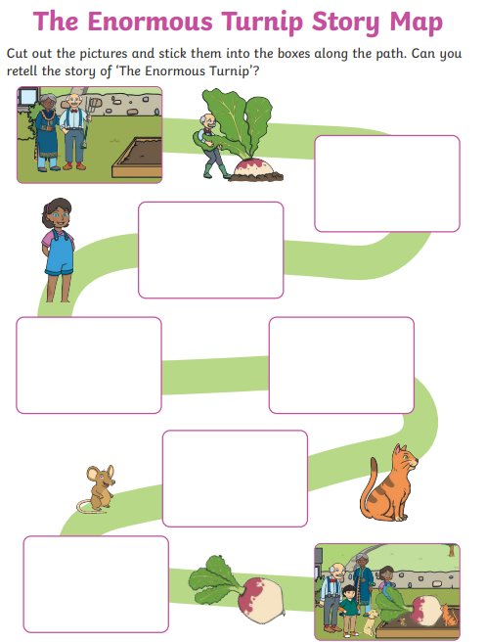
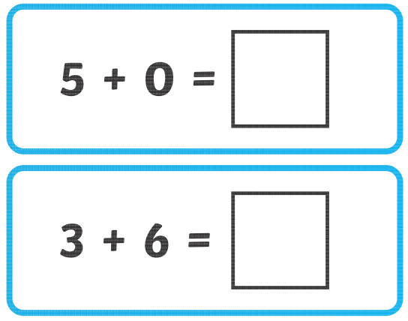
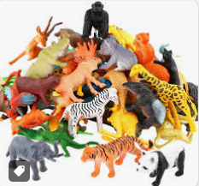
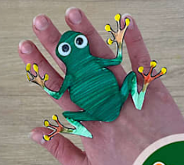
Independent Challenges:
Narrative Zone
Maths Zone
Use the pictures to make the story map of The Enormous Turnip.
Practise addition and subtraction using the bead strings.
Can you work these out?
Enquiry Zone
Creative Zone
Sort the animals into groups of mammals, reptiles, birds, fish and amphibians.
Make an amphibian finger companion

Slide 10
3 in 3 - Practise number bonds to nine
TBAT: solve a problem using addition and subtraction
Friday 3rd October 2025
0
1
2
3
4
5
6
7
8
9
0
1
2
3
4
5
6
7
8
9
0
1
2
3
4
5
6
7
8
9
0
1
2
3
4
5
6
7
8
9
0
1
2
3
4
5
6
7
8
9
0
1
2
3
4
5
6
7
8
9
0
1
2
3
4
5
6
7
8
9
0
1
2
3
4
5
6
7
8
9
0
1
2
3
4
5
6
7
8
9
0
1
2
3
4
5
6
7
8
9
Nine is made of nine and zero.
Nine is made of eight and one …
Notes:
Do Now: Practising transitions
Practise number bonds to nine.

Slide 11
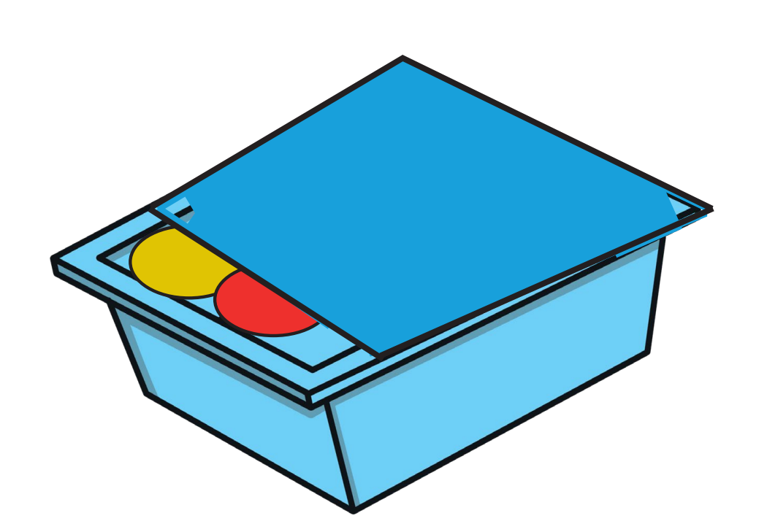
Blue / Green
TBAT: solve a problem using addition and subtraction
Friday 3rd October 2025
Peter has 5 counters in his box
How many could be red?
How many could be yellow?
Jenny has 7 counters in her box
How many could be red?
How many could be yellow?
I know this because…

Slide 12
TBAT: solve a problem using addition and subtraction
Friday 3rd October 2025
addition
subtract
subtraction
add
total

Slide 13
Introducing the problem
TBAT: solve a problem using addition and subtraction
Friday 3rd October 2025
The three numbers on the line add up to ten.
Let’s prove it using cubes!
1
6
3
Notes:
New Learning: Introducing the problem
Show pupils the slide and explain that the numbers on the line add up to ten. Show this using three different colours of cube to represent the numbers, and build the cubes together to make a train of ten, counting each one.
Use the next slide to show an example with a hidden number. Explain that there is a number concealed behind the star and that the line of three numbers still adds up to ten. Allow pupils time to discuss the questions shown. Take feedback and make connections between their ideas (note that some pupils may have mental strategies and some may use concrete manipulatives). Discuss both addition and subtraction strategies.
Work through some further examples on the next slide. Ask questions such as:
Do you notice a pattern in your answers? What is staying the same? What is changing? Can you make any of your own examples?
Show the next slide and explain that three of the lines of numbers pupils have just been working on have now been put together into a triangle. The three numbers on each side of the triangle still add together to make ten.
What are the missing numbers? Is there more than one way of working it out?
Support pupils in using concrete manipulatives to represent the numbers in the circles and then experiment with the numbers need to make each side total ten.

Slide 14
Introducing the problem
TBAT: solve a problem using addition and subtraction
Friday 3rd October 2025
The three numbers on the line add up to ten.
What number is hidden behind the star?
How many different ways can you think of to find it?
1
4
5
Notes:
New Learning: Introducing the problem
Show pupils the slide and explain that the numbers on the line add up to ten. Show this using three different colours of cube to represent the numbers, and build the cubes together to make a train of ten, counting each one.
Use the next slide to show an example with a hidden number. Explain that there is a number concealed behind the star and that the line of three numbers still adds up to ten. Allow pupils time to discuss the questions shown. Take feedback and make connections between their ideas (note that some pupils may have mental strategies and some may use concrete manipulatives). Discuss both addition and subtraction strategies.
Work through some further examples on the next slide. Ask questions such as:
Do you notice a pattern in your answers? What is staying the same? What is changing? Can you make any of your own examples?
Show the next slide and explain that three of the lines of numbers pupils have just been working on have now been put together into a triangle. The three numbers on each side of the triangle still add together to make ten.
What are the missing numbers? Is there more than one way of working it out?
Support pupils in using concrete manipulatives to represent the numbers in the circles and then experiment with the numbers need to make each side total ten.

Slide 15
Introducing the problem
TBAT: solve a problem using addition and subtraction
Friday 3rd October 2025
1
5
4
1
1
8
1
4
5
1
0
9
1
3
6
1
7
2
1
2
7
1
6
3
Notes:
New Learning: Introducing the problem
Show pupils the slide and explain that the numbers on the line add up to ten. Show this using three different colours of cube to represent the numbers, and build the cubes together to make a train of ten, counting each one.
Use the next slide to show an example with a hidden number. Explain that there is a number concealed behind the star and that the line of three numbers still adds up to ten. Allow pupils time to discuss the questions shown. Take feedback and make connections between their ideas (note that some pupils may have mental strategies and some may use concrete manipulatives). Discuss both addition and subtraction strategies.
Work through some further examples on the next slide. Ask questions such as:
Do you notice a pattern in your answers? What is staying the same? What is changing? Can you make any of your own examples?
Show the next slide and explain that three of the lines of numbers pupils have just been working on have now been put together into a triangle. The three numbers on each side of the triangle still add together to make ten.
What are the missing numbers? Is there more than one way of working it out?
Support pupils in using concrete manipulatives to represent the numbers in the circles and then experiment with the numbers need to make each side total ten.

Slide 16
Introducing the problem
TBAT: solve a problem using addition and subtraction
Friday 3rd October 2025
The three numbers on each side add up to ten.
What numbers are missing?
1
7
6
2
5
3
Notes:
New Learning: Introducing the problem
Show pupils the slide and explain that the numbers on the line add up to ten. Show this using three different colours of cube to represent the numbers, and build the cubes together to make a train of ten, counting each one.
Use the next slide to show an example with a hidden number. Explain that there is a number concealed behind the star and that the line of three numbers still adds up to ten. Allow pupils time to discuss the questions shown. Take feedback and make connections between their ideas (note that some pupils may have mental strategies and some may use concrete manipulatives). Discuss both addition and subtraction strategies.
Work through some further examples on the next slide. Ask questions such as:
Do you notice a pattern in your answers? What is staying the same? What is changing? Can you make any of your own examples?
Show the next slide and explain that three of the lines of numbers pupils have just been working on have now been put together into a triangle. The three numbers on each side of the triangle still add together to make ten.
What are the missing numbers? Is there more than one way of working it out?
Support pupils in using concrete manipulatives to represent the numbers in the circles and then experiment with the numbers need to make each side total ten.

Slide 17
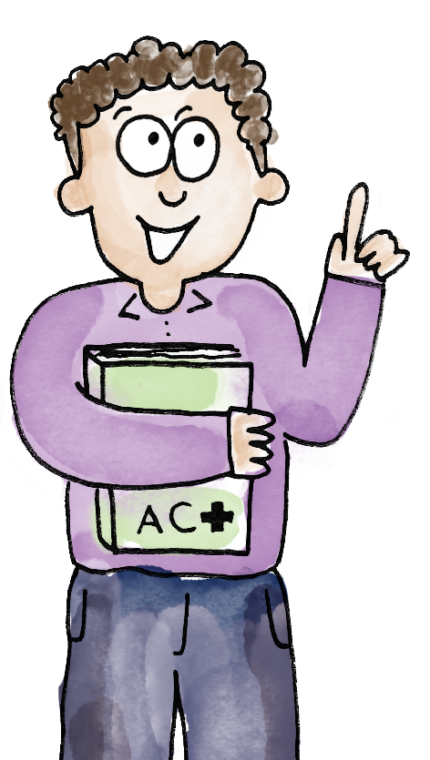
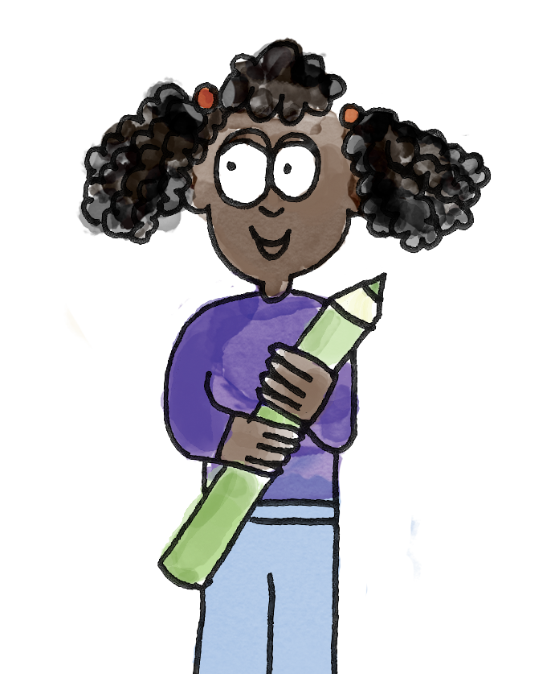
Exploring the problem
TBAT: solve a problem using addition and subtraction
Friday 3rd October 2025
There is a two in this circle and a one in this circle.
Two plus one is equal to three.
So what and three make ten? Seven and three make ten.
1
Yes, ten subtract three is equal to seven.
So the missing number on this side is seven.
2
3
add addition subtract subtraction total
Notes:
Let’s Explore: Exploring the problem
Pupils have four sticks of ten cubes in four different colours and one Task Sheet per pair. They make the numbers in the circles using cubes and then work to identify the missing numbers. It is helpful if pupils record their results in this activity, as this will enable discussion afterwards.

Slide 18
Developing the investigation
TBAT: solve a problem using addition and subtraction
Friday 3rd October 2025
Discuss your answers from the Talk Task.
How did you do it?
Do you understand all of the rules?
Try out some more examples!
1
7
6
2
5
3
Notes:
Develop Learning & Independent Task: Developing the investigation
Note: The rest of the lesson should be planned and adapted depending on the needs of pupils. Suggestions are included. Different pupils might investigate different questions and come together at the end to explain what they found.
Discuss pupils’ answers from the Talk Task, clarifying any misconceptions about the rules as well as different strategies pupils used. Remodel using both addition and subtraction.
The following are some ideas for ways in which this lesson could be developed:
Continue completing specific examples where numbers are written in the three circles.
Complete examples where there are different numbers missing, e.g. one circle is missing.
Investigate whether they can find their own sets of numbers. How many different possibilities are there? Is there a pattern? Is it possible to have a five and a six in the circles? Why not? Can they make one where each number is not used more than once?
Complete triangles where the side numbers are completed but not the circles and pupils identify the values in the circles. Is this easier or more difficult than the original task? Why?
Investigate whether number triangles can be made with a total of nine instead of ten.
Give pupils a number triangle with a mistake on one of the sides. Pupils find and correct.
Find all the possible solutions to a number triangle with a three in one circle and a four in another. There are six possible solutions (circles of 3,4,1; 3,4,2; 3,4,3; 3,4,4; 3,4,5 and 3,4,6).
Pupils investigate the number triangles, based on teacher planning and input. Encourage pupils to discuss their work and try to explain any interesting patterns they notice.

Slide 19
TBAT: solve a problem using addition and subtraction
Friday 3rd October 2025
Can you explore the number triangles further?
For example:
Find your own set of numbers
Start with numbers in the squares, and the circles blank
Make totals of nine.
1
7
6
2
5
3
Notes:
Develop Learning & Independent Task: Developing the investigation
Note: The rest of the lesson should be planned and adapted depending on the needs of pupils. Suggestions are included. Different pupils might investigate different questions and come together at the end to explain what they found.
Discuss pupils’ answers from the Talk Task, clarifying any misconceptions about the rules as well as different strategies pupils used. Remodel using both addition and subtraction.
The following are some ideas for ways in which this lesson could be developed:
Continue completing specific examples where numbers are written in the three circles.
Complete examples where there are different numbers missing, e.g. one circle is missing.
Investigate whether they can find their own sets of numbers. How many different possibilities are there? Is there a pattern? Is it possible to have a five and a six in the circles? Why not? Can they make one where each number is not used more than once?
Complete triangles where the side numbers are completed but not the circles and pupils identify the values in the circles. Is this easier or more difficult than the original task? Why?
Investigate whether number triangles can be made with a total of nine instead of ten.
Give pupils a number triangle with a mistake on one of the sides. Pupils find and correct.
Find all the possible solutions to a number triangle with a three in one circle and a four in another. There are six possible solutions (circles of 3,4,1; 3,4,2; 3,4,3; 3,4,4; 3,4,5 and 3,4,6).
Pupils investigate the number triangles, based on teacher planning and input. Encourage pupils to discuss their work and try to explain any interesting patterns they notice.

Slide 20
Discuss findings
TBAT: solve a problem using addition and subtraction
Friday 3rd October 2025
What did you learn when you were solving the problem?
What was the best way to find the missing numbers?
Did you spot any interesting patterns?
Notes:
Plenary: Discuss findings
Discuss pupils’ answers/observations, with a focus on pupils explaining how they got their answers, what they discovered, and why they think any patterns occurred.

Slide 21

Lunch

Slide 22

Golden Book assembly

Slide 23
Break

Slide 24
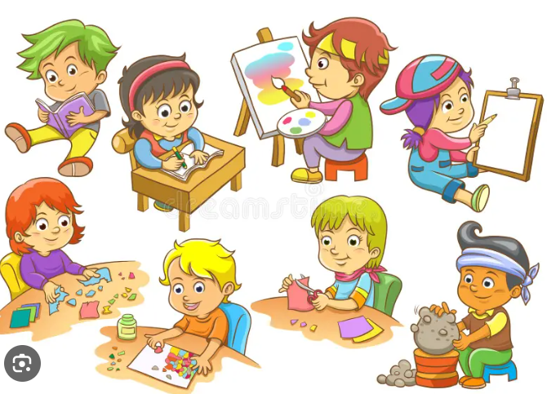
Enrichment

