Slide 1
Friday 24th October 2025

Slide 2

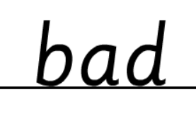
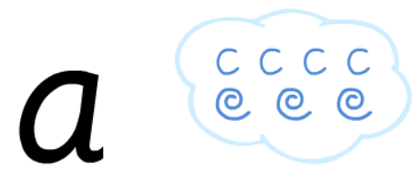
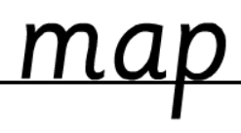
Morning Challenges:
Name writing

Slide 3
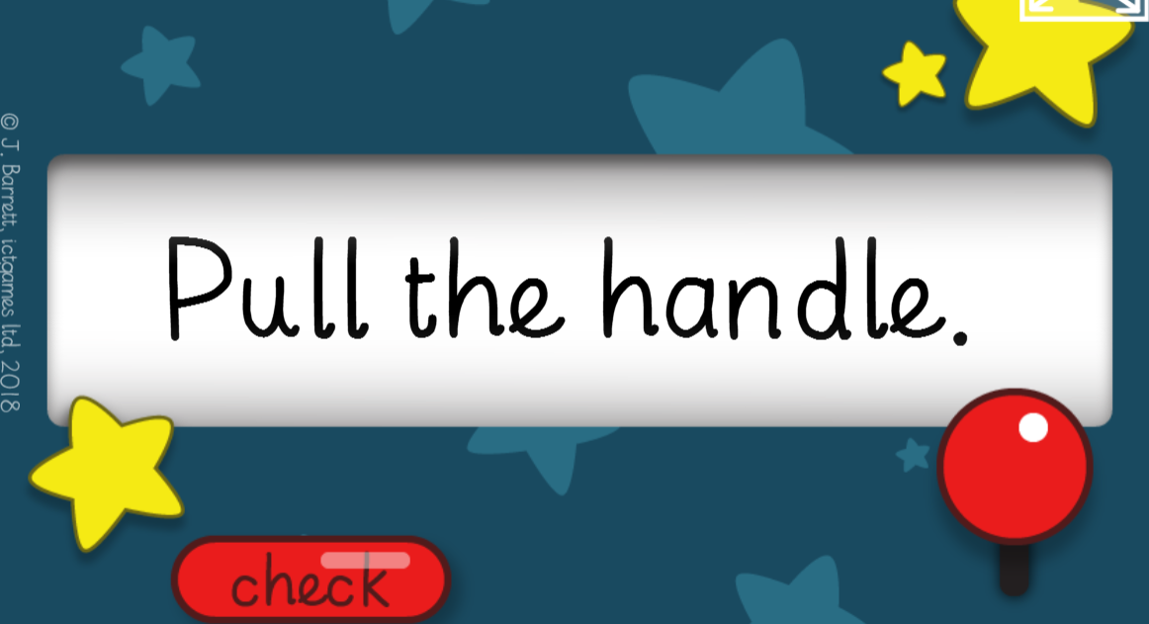
TBAT: read and write words with the /nk/ sound at the end.
Friday 24th October 2025
Read the tricky words
High Frequency Word Bingo

Slide 4
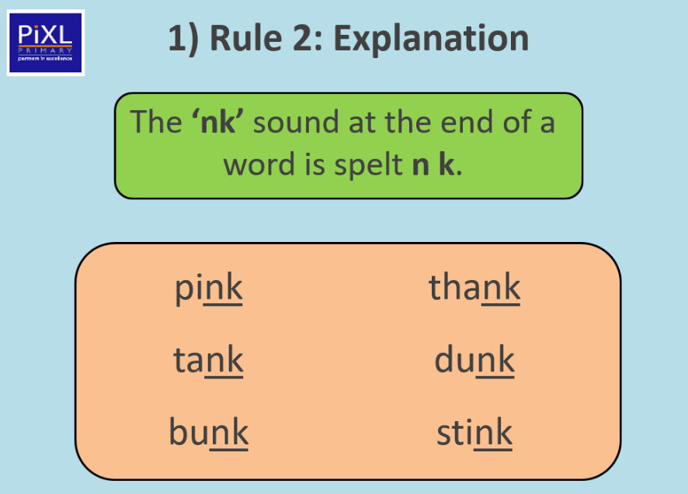
TBAT: read and write words with the /nk/ sound at the end.
Friday 24th October 2025

Slide 5
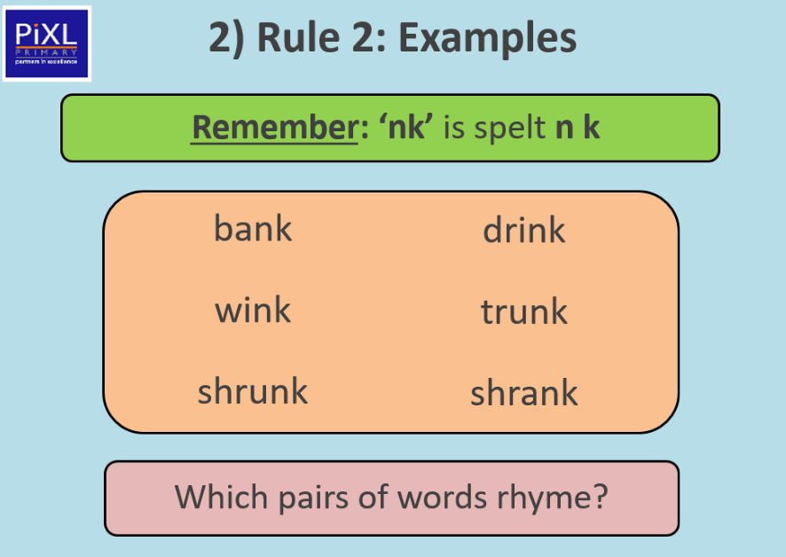
TBAT: read and write words with the /nk/ sound at the end.
Friday 24th October 2025

Slide 6
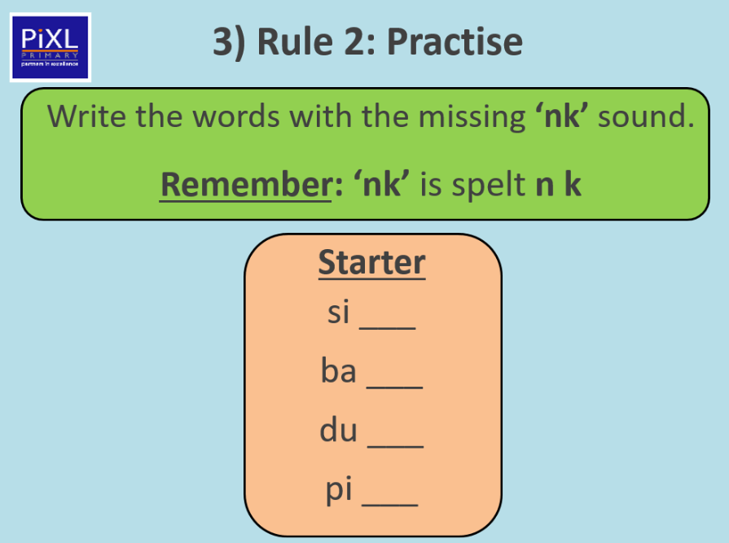
TBAT: read and write words with the /nk/ sound at the end.
Friday 24th October 2025

Slide 7
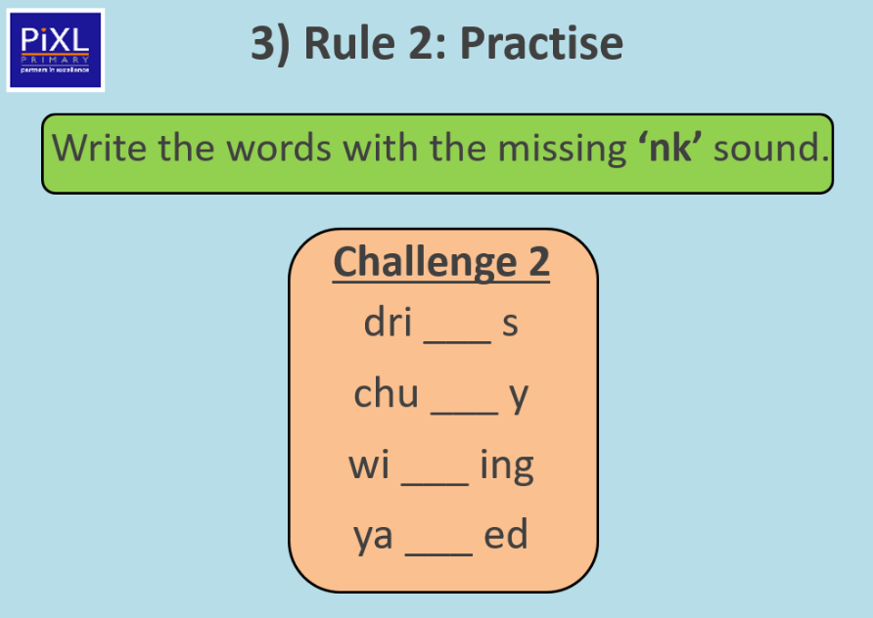
TBAT: read and write words with the /nk/ sound at the end.
Friday 24th October 2025

Slide 8
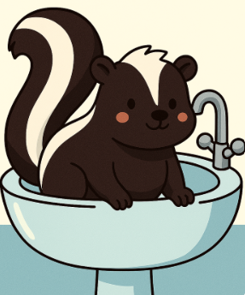
TBAT: read and write words with the /nk/ sound at the end.
Friday 24th October 2025
Can you find the /nk/ sounds in this sentence?
The skunk was in the sink.

Slide 9
TBAT: read and write words with the /nk/ sound at the end.
Friday 24th October 2025
Write a sentence with one or more of these words.
pink bank trunk

Slide 10
TBAT: write a character description, using correct full stops.
Friday 24th October 2025
3 in 3- Think of a word to complete the sentences.
The warthog has …........ tusks.
The stork has a …........... beak.
The wildebeest has ….... legs.

Slide 11

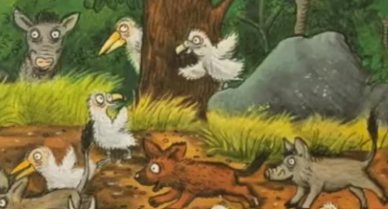
TBAT: write a character description, using correct full stops.
Friday 24th October 2025
Blue/ Green
Think of 3 words to describe the flamingos.
T
Think of 3 words to describe the baby animals.
Challenge: Put these words into a sentence.

Slide 12
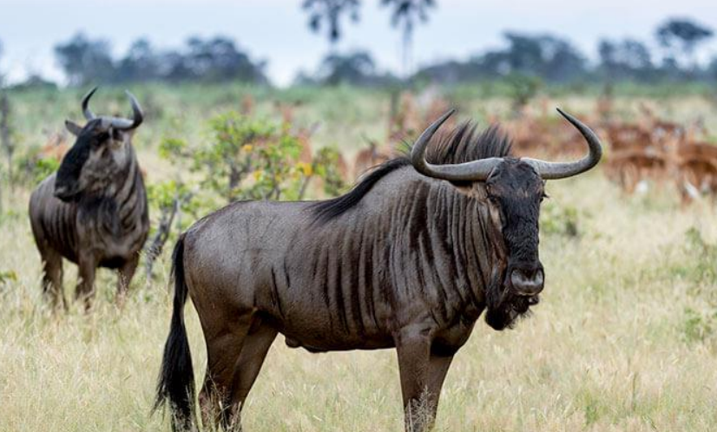
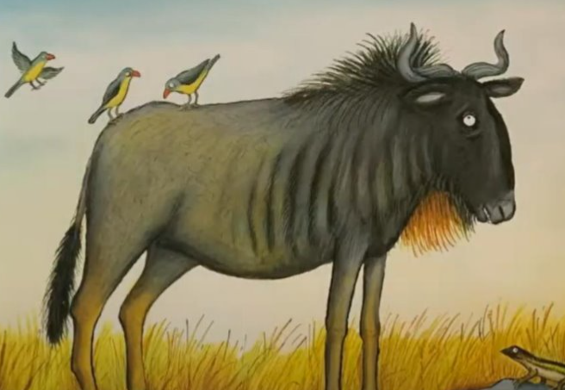
TBAT: write a character description, using correct full stops.
Friday 24th October 2025
How could you describe the wildebeest?

Slide 13
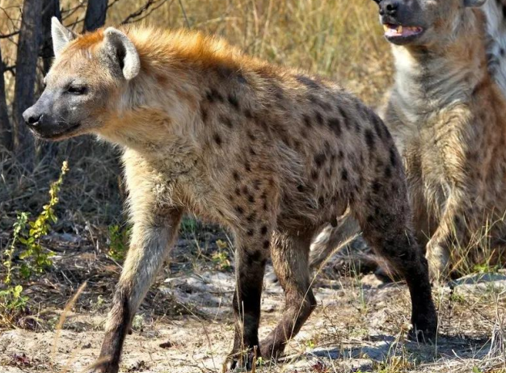
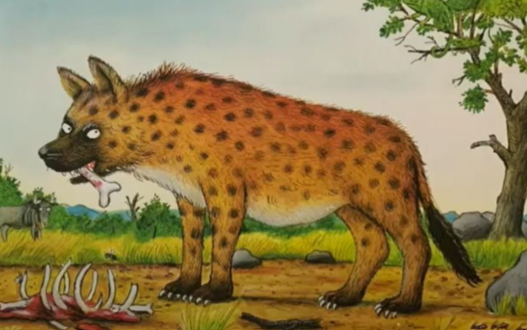
TBAT: write a character description, using correct full stops.
Friday 24th October 2025
How could you describe the hyena?

Slide 14
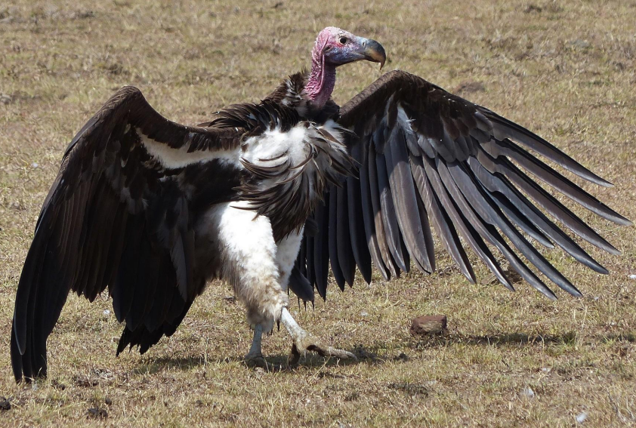
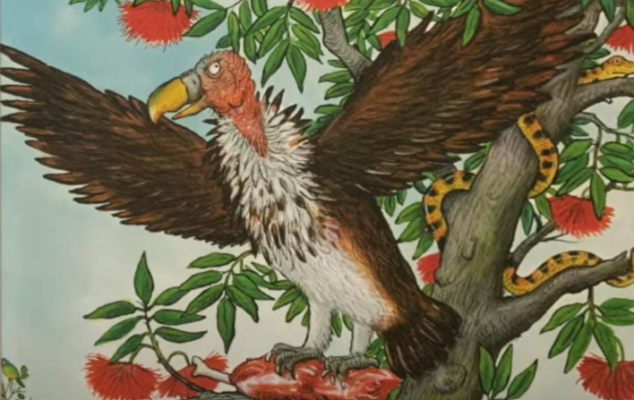
TBAT: write a character description, using correct full stops.
Friday 24th October 2025
How could you describe the vulture?

Slide 15
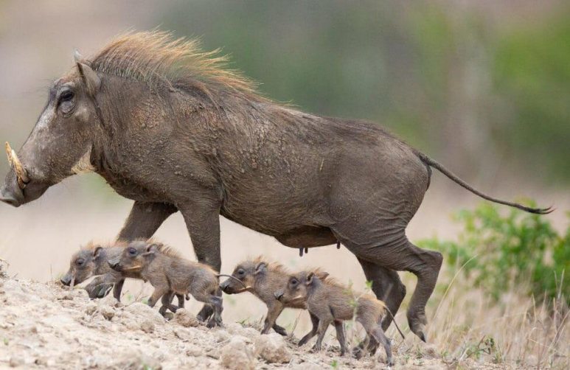
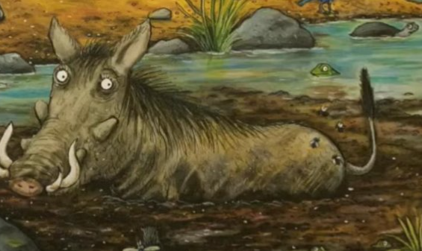
TBAT: write a character description, using correct full stops.
Friday 24th October 2025
How could you describe the warthog?

Slide 16
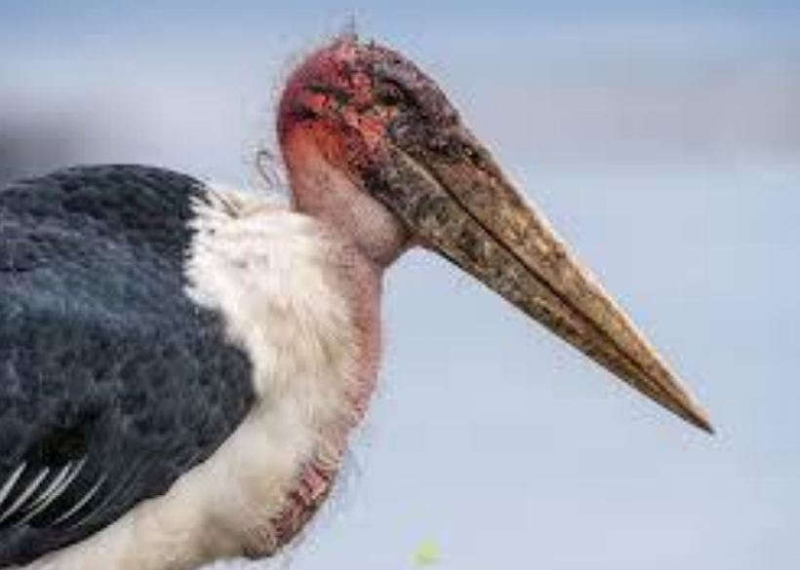
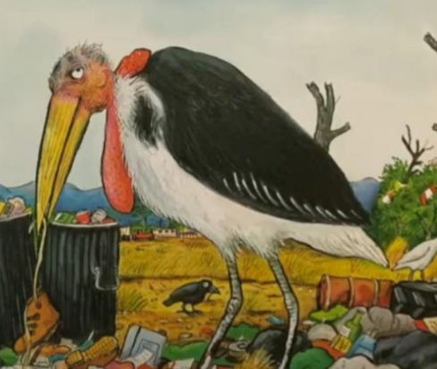
TBAT: write a character description, using correct full stops.
Friday 24th October 2025
How could you describe the marabou stork?

Slide 17

TBAT: write a character description, using correct full stops.
Friday 24th October 2025
…......................................................................
…......................................................................
….......................................................................
…........................................................................

Slide 18
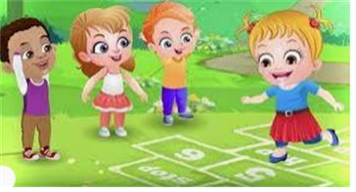
Break

Slide 19


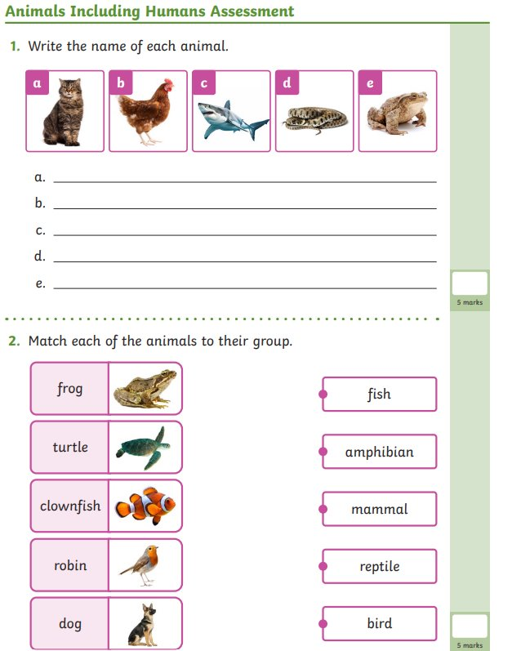
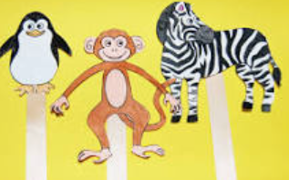
Independent Challenges:
Narrative Zone
Maths Zone
Draw or write about something you have enjoyed this half term.
Use numicon to find doubles.
Find halves using the pictures.
Enquiry Zone
Creative Zone
What can you remember about animals?
Make a stick puppet animal and retell the story of the ugly 5 with your friends.

Slide 20
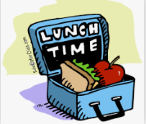
Lunch

Slide 21

Golden Book assembly

Slide 22
Break

Slide 23
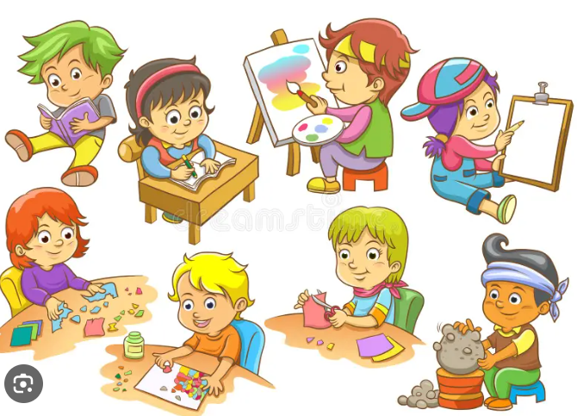
Enrichment

