Slide 1
Monday 8th September 2025

Slide 2



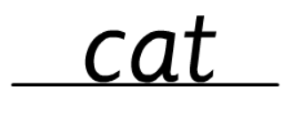

Morning Challenges:
Name writing

Slide 3
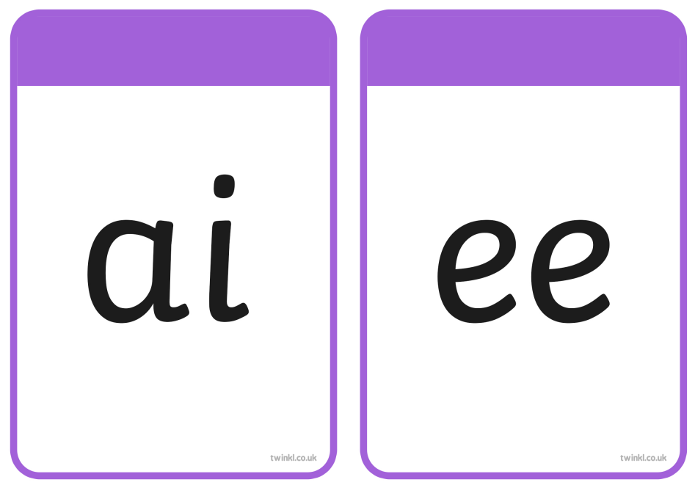



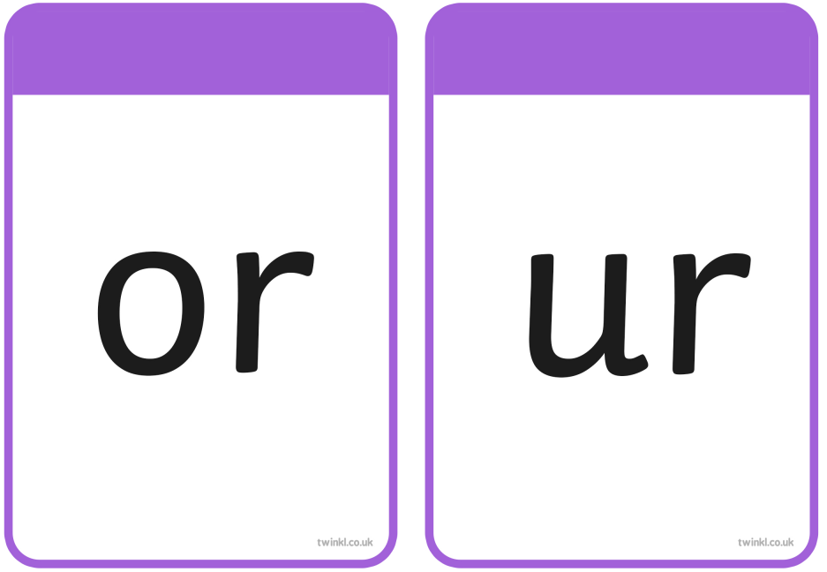



Slide 4
TBAT– read and spell words with 'ai/ee/igh graphemes
ladder
What is the digraph?

Slide 5
TBAT– read and spell words with 'ai/ee/igh graphemes
boxer
What is the digraph?

Slide 6
TBAT– read and spell words with 'ai/ee/igh graphemes
cool
What is the digraph?

Slide 7
TBAT– read and spell words with 'ai/ee/igh graphemes
toads
What is the digraph?

Slide 8
TBAT– read and spell words with 'ai/ee/igh graphemes
cards
What is the digraph?

Slide 9
TBAT– read and spell words with 'ai/ee/igh graphemes
down
What is the digraph?

Slide 10


TBAT– read and spell words with 'ai/ee/igh graphemes
so

Slide 11
TBAT– read and spell words with 'ai/ee/igh graphemes
t-ai-l

Slide 12
TBAT– read and spell words with 'ai/ee/igh graphemes
d-ee-p

Slide 13
TBAT– read and spell words with 'ai/ee/igh graphemes
r-igh-t

Slide 14
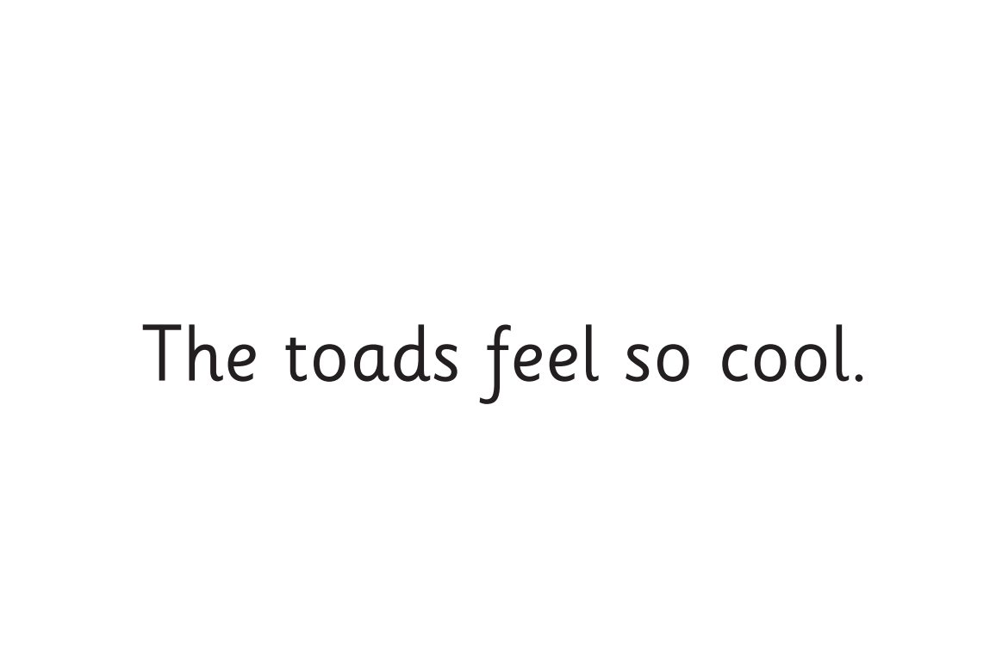
TBAT– read and spell words with 'ai/ee/igh graphemes
Now let's read this sentence!​

Slide 15
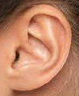
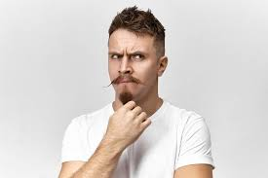



TBAT– read and spell words with 'ai/ee/igh graphemes
Teach and practise
Listen
Say it
Write it
Check it
go
tricky word
feel right

Slide 16
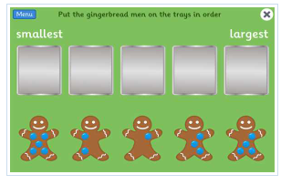
Recap:
Counting to 10 forwards and backwards
The Gingerbread Man Game - Counting, Matching and Ordering game (topmarks.co.uk)
Practice counting

Slide 17
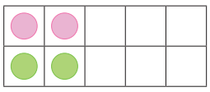
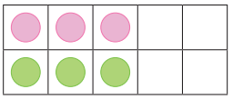
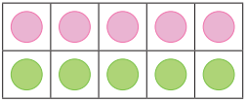
Maths
TBAT: Count sets of objects within 10
3 in 3
What is double 2?
Challenge: What is half of 10?
What is double 3?
What is double 5?

Slide 18


Blue/Green
TBAT: Count sets of objects within 10
How many balloons are there?
There are more _______ balloons.
There are less _______ balloons.
I know this because…
Challenge: How many more balloons are there?

Slide 19
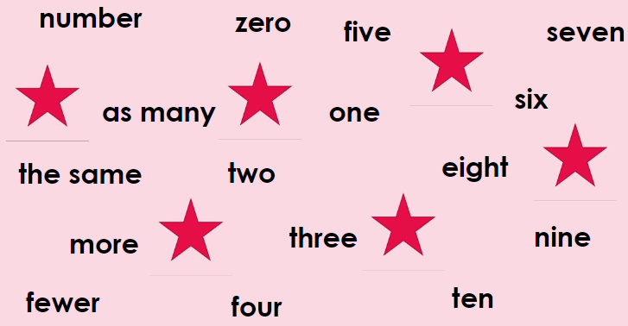
TBAT: Count sets of objects within 10
Star words

Slide 20
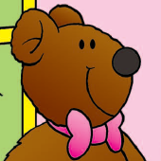
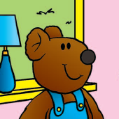
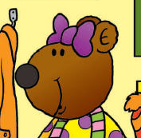
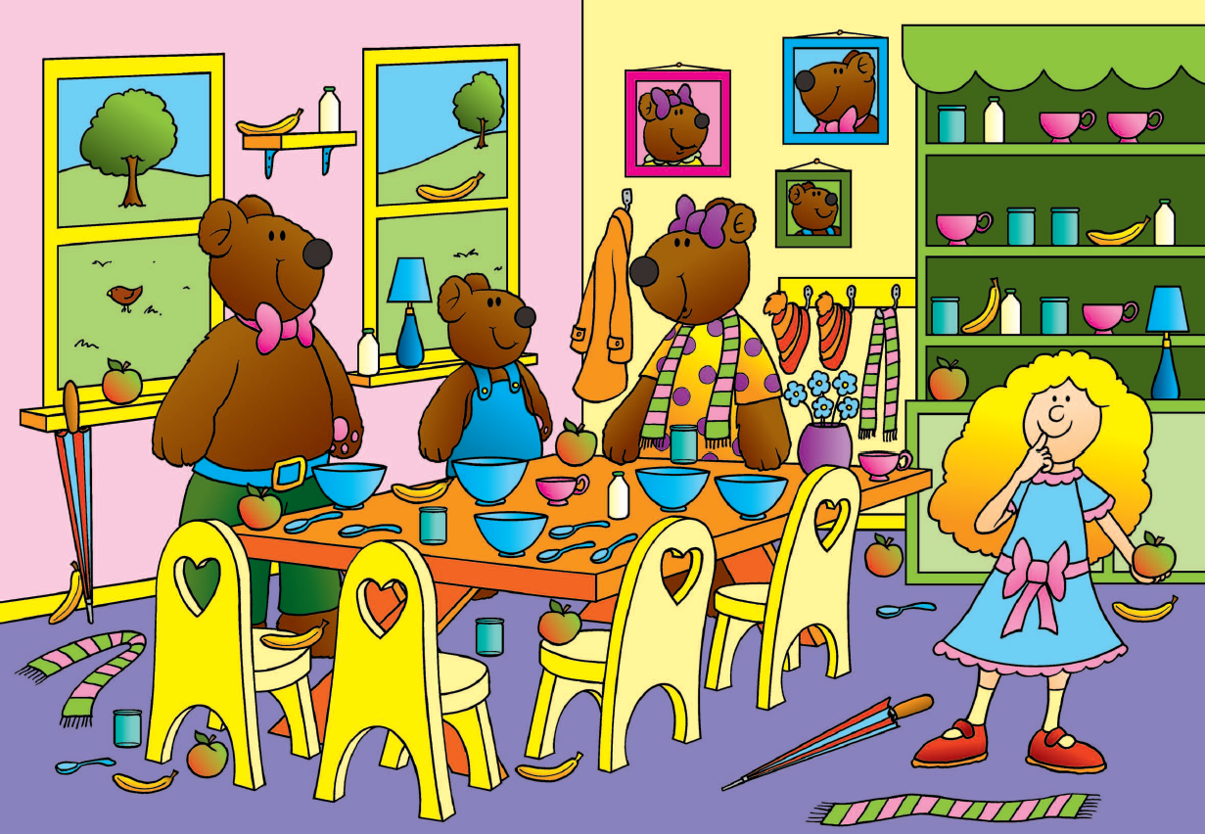
Representing numbers to ten
TBAT: Count sets of objects within 10
Monday 8th September 2025
one two three
Notes:
New Learning: Representing numbers to ten, using the context of The Three Bears
Display the Big Picture. Have some collections of objects from the Big Picture, e.g. three teddy bears, cups, bowls, spoons, apples, bananas.
How many bears are there?
Model one-to-one correspondence, counting the bears while pointing to each object as you count. Model the full sentence:
There are three bears.
Repeat this process for different sets of real objects, e.g. five bowls.
Return to the set of three bears. Introduce the ten-frame. Model counting out three counters and placing them on the ten-frame to represent the number three. Say each number as you place each counter on the ten-frame.
One, two, three. There are three counters on the ten-frame. The three counters represent the three bears.
Again, repeat for other sets of objects, sometimes placing the counters in irregular patterns.

Slide 21
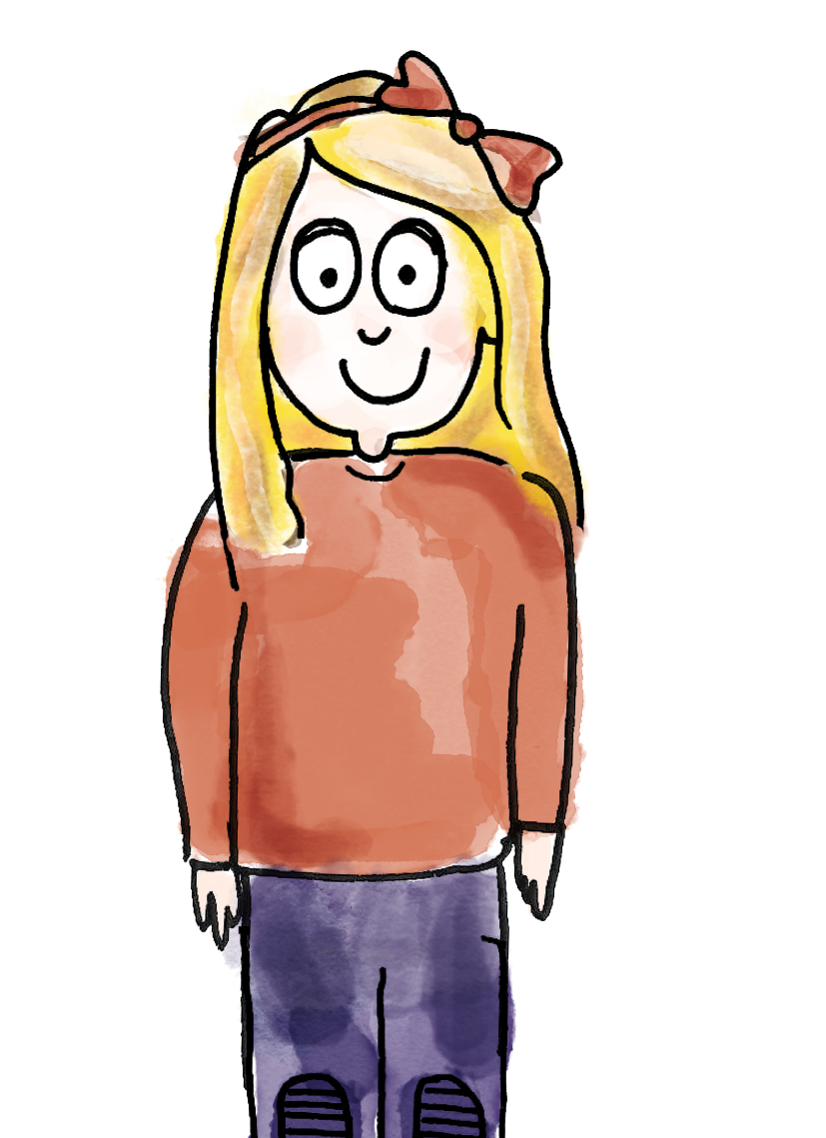
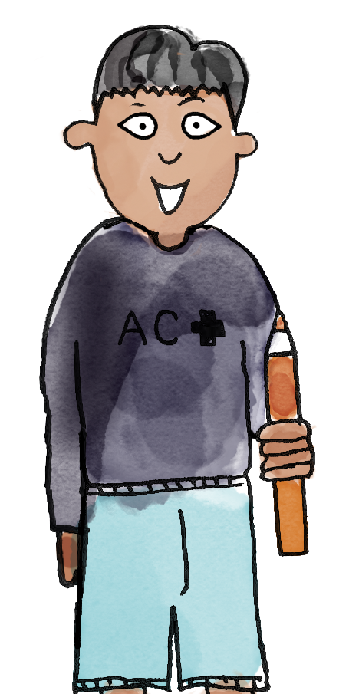

Representing numbers within ten, using a ten-frame
TBAT: Count sets of objects within 10
Sunday, September 7, 2025
One, two, three. There are three rabbits.
How many rabbits are there?
3
three
zero one two three four five six seven eight nine ten number more fewer as many the same
Notes:
Talk Task: Representing numbers within ten, using a ten-frame
Place a set of cards on each table.
Pupil A selects a card showing a set of objects and asks Pupil B how many there are. Pupil B counts the number of objects in the set, placing a counter on top of each object as they count. Pupil B counts out that number of counters on the ten-frame and explains what each counter represents. Pupils swap roles.

Slide 22
Identifying whether sets have the same number of objects
TBAT: Count sets of objects within 10
Sunday, September 7, 2025
One, two, three. There are three counters on the ten-frame.
The three counters represent the three rabbits. One counter represents one rabbit.
3
three
zero one two three four five six seven eight nine ten number more fewer as many the same

Slide 23


Identifying whether sets have the same number of objects
TBAT: Count sets of objects within 10
Sunday, September 7, 2025
How can we represent the amount of pens and pencils using cubes?
Notes:
Develop Learning: Identifying whether sets have the same number of objects
Arrange a set of four spoons (placed close together) and four bowls (spaced more widely).
Are there more spoons or more bowls?
Model one-to-one correspondence by placing each spoon in a bowl. Count the bowls and then the spoons. Model these sentence structures:
There are four bowls. There are four spoons. The number of bowls is the same as the number of spoons.
Then gather two sets of objects with different amounts. Model counting the objects using one-to-one correspondence. Represent each amount with counters/cubes.
There are five pens. There are six pencils. There are more pencils than pens. There are fewer pens than pencils.

Slide 24







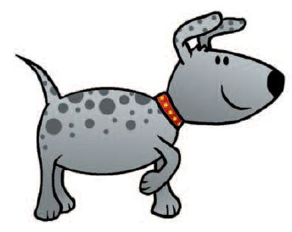


To count sets of objects within ten
There are three apples.
There are two pencils.
There are more apples than pencils.
There are fewer pencils than apples.
Notes:
Independent Task: Identifying whether sets have the same number of objects
Pupils count the number of objects in one set, placing a cube over each image. They state the number of objects in the set and place the cubes into a tower. They repeat this for another set (using cubes of a different colour), building a tower again, then say whether there are an equal number of objects in each set. A different set of images has been provided on the slides for the teacher to model the task before pupils complete it.
Possible adaptations:
Pupils select a number card and represent that number using a range of concrete materials.
Give pupils four pictures, three of which have an equal number of objects in and one with one more or fewer. Ask them to use concrete manipulatives to identify the odd one out and describe what makes it so.

Slide 25
To count sets of objects within ten
How many cups are there?
Are there more cups or more cats?
Challenge: Find the ones that are equal
Notes:
Independent Task: Identifying whether sets have the same number of objects
Pupils count the number of objects in one set, placing a cube over each image. They state the number of objects in the set and place the cubes into a tower. They repeat this for another set (using cubes of a different colour), building a tower again, then say whether there are an equal number of objects in each set. A different set of images has been provided on the slides for the teacher to model the task before pupils complete it.
Possible adaptations:
Pupils select a number card and represent that number using a range of concrete materials.
Give pupils four pictures, three of which have an equal number of objects in and one with one more or fewer. Ask them to use concrete manipulatives to identify the odd one out and describe what makes it so.

Slide 26
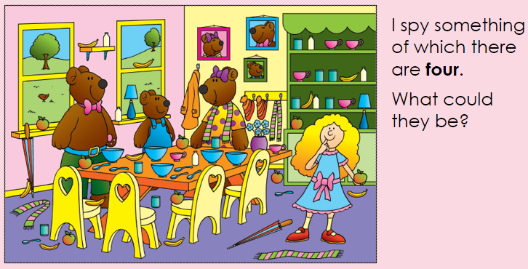
TBAT: Count sets of objects within 10

Slide 27
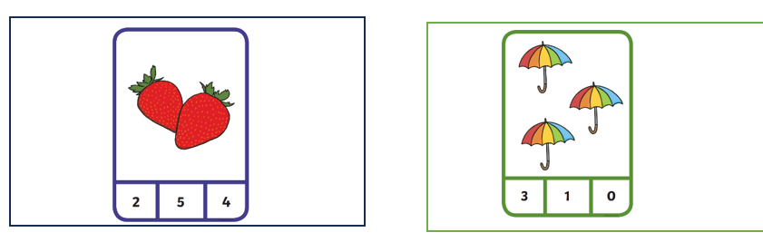
Independent:

Slide 28
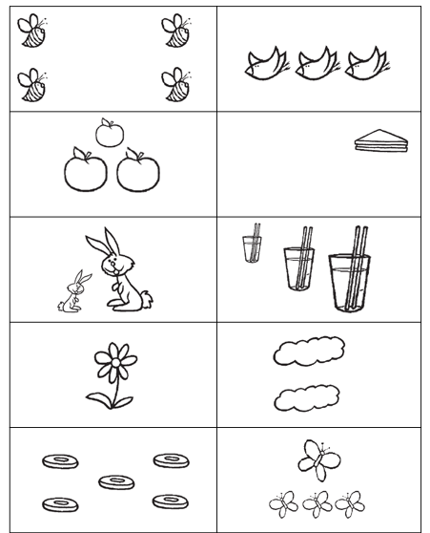
Which have the same number of objects?
Colour them the same colour.

Slide 29
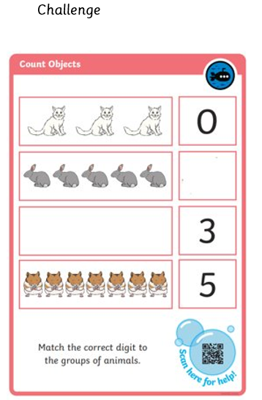
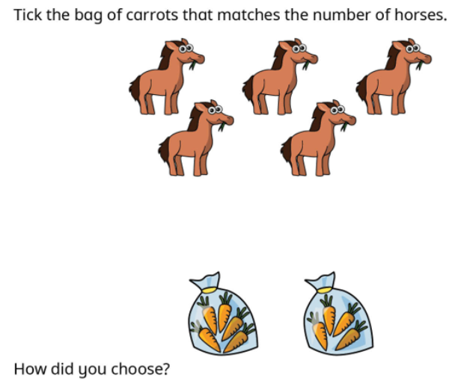
RP:

Slide 30
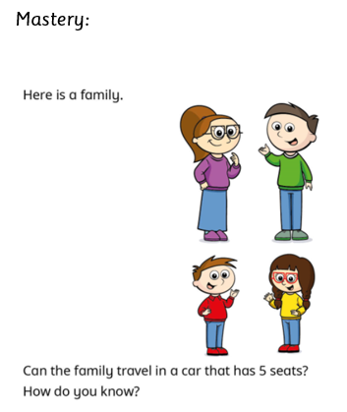
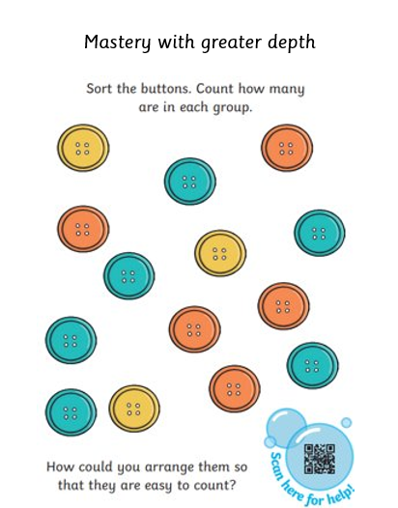

Slide 31
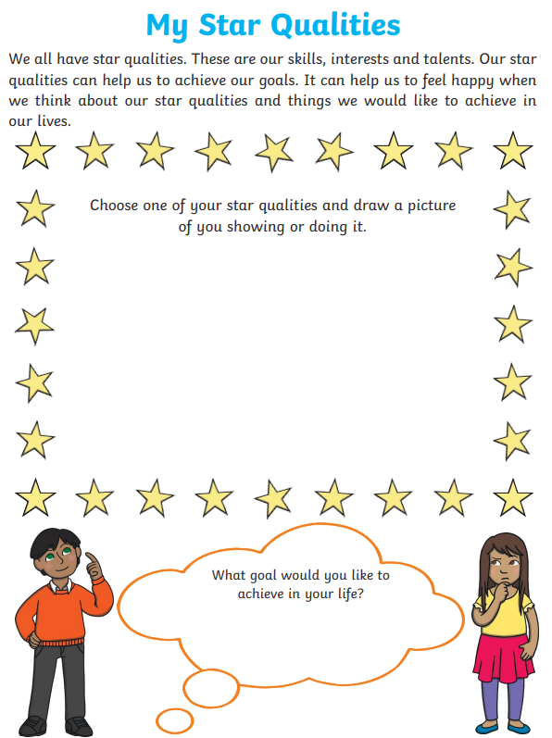

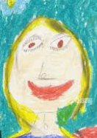
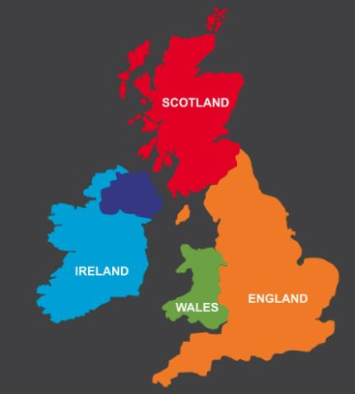
Independent Challenges:
Narrative Zone
Maths Zone
Count as many objects as you can!
Play a game of dominos, counting the spots as you join them up.
Write about or draw a picture to show what you are good at.
Enquiry Zone
Creative Zone
Can you identify the countries in the UK and put them in the correct places?
Create a self portrait.
What colour are your eyes or hair?

Slide 33
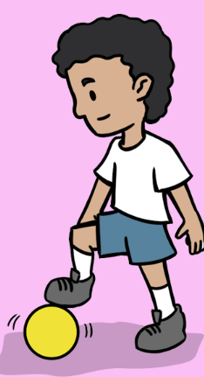
PE – TBAT: understand the role of defenders and attackers.
Success criteria: Keep the ball close to your feet using soft touches.
•Push the ball slightly ahead of you when dribbling at speed.

Slide 34
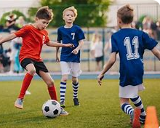
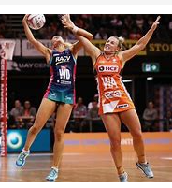
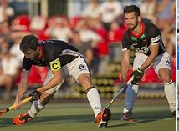
Typically invasion games have two teams and two goals. Teams try to score in the other team's goal.
Can you think of any examples?

Slide 35
Warm up
Safe space:
Stand in a safe space. Begin by walking, moving in and out of each other.
Can you move around in the space, changing direction and avoiding others?
Stay within the boundaries of the teaching area.
Can you run with small steps and large steps? Can you move around in the space in a different way?

Slide 36
Goal
Attackers move with their ball however they choose.
You might dribble with feet, hands, roll it or carry it.
Defenders jog, tapping the shoulders of the attackers they see.
When you hear 'goal', attackers give the ball to a defender and swap roles.

Slide 37
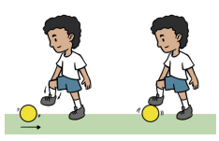
Skill Development
Stopping the ball.
Place your foot on top.
Moving with your ball.
Moe by pushing the ball with any part of your foot. When you hear ‘stop!’ stop the ball.

Slide 38
Plenary
How do you know which team is attacking? They have the ball. What is the job of an attacker? To score goals. Why should an attacker look up when moving with the ball? To see the defenders, goal and space.
What is the job of the defender? To win the ball and stop the attackers scoring. How did it make you feel when your partner congratulated you for scoring a point? Why is it important to shake hands at the end of a game?

Slide 39
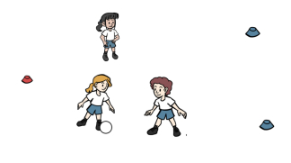
2 v 1
Attackers work together to try to score a goal.
Defender stop them.

Slide 40

Lunch

Slide 41


Unit 2: The United Kingdom
KQ: What is it like to live in Scotland?
Copyright © ArkCurriculum+ 2023

Slide 42

3 in 3
Knowledge quiz 2.1
1. ‘United’ means …
joined together split apart
2. Which countries are in the United Kingdom? (Circle four.)
England Northern Ireland France
Scotland Wales Italy
3. Which country in the United Kingdom is furthest north?
England Northern Ireland Scotland Wales
4. Which country does Wales border to the east?
England Northern Ireland Scotland Wales
Copyright © ArkCurriculum+ 2023
Notes:
Knowledge quiz 2.1: Pupils complete this in the Additional resource: Knowledge quizzes to assess their knowledge retention from the previous lesson. They write their score in the chart also provided in the additional resource.

Slide 43
Knowledge quiz 2.1
1. ‘United’ means …
joined together split apart
2. Which countries are in the United Kingdom? (Circle four.)
England Northern Ireland France
Scotland Wales Italy
3. Which country in the United Kingdom is furthest north?
England Northern Ireland Scotland Wales
4. Which country does Wales border to the east?
England Northern Ireland Scotland Wales
Copyright © ArkCurriculum+ 2023

Slide 44
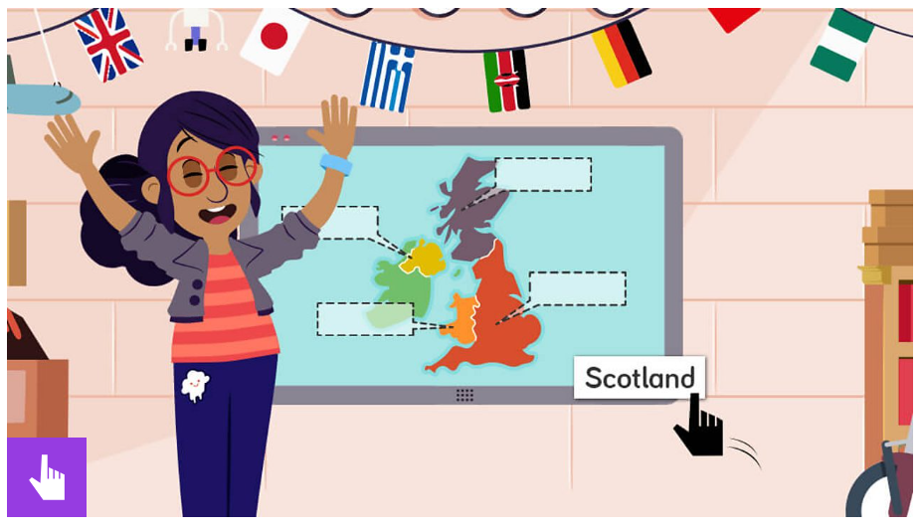
Monday 8th September 2025
Can you remember where each country is?
What is the UK? - BBC Bitesize

Slide 45
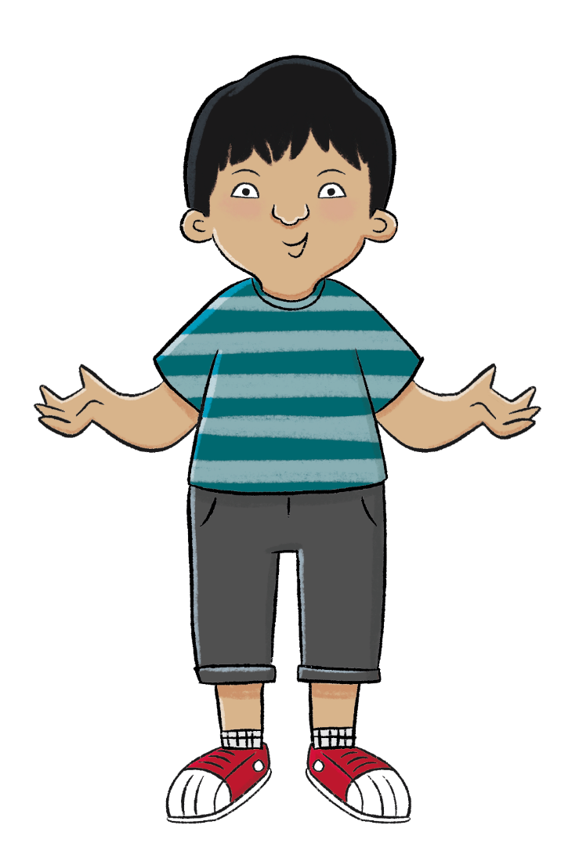
Monday 8th September 2025
What are the countries that make up the
United Kingdom like?
Enquiry question

Slide 46
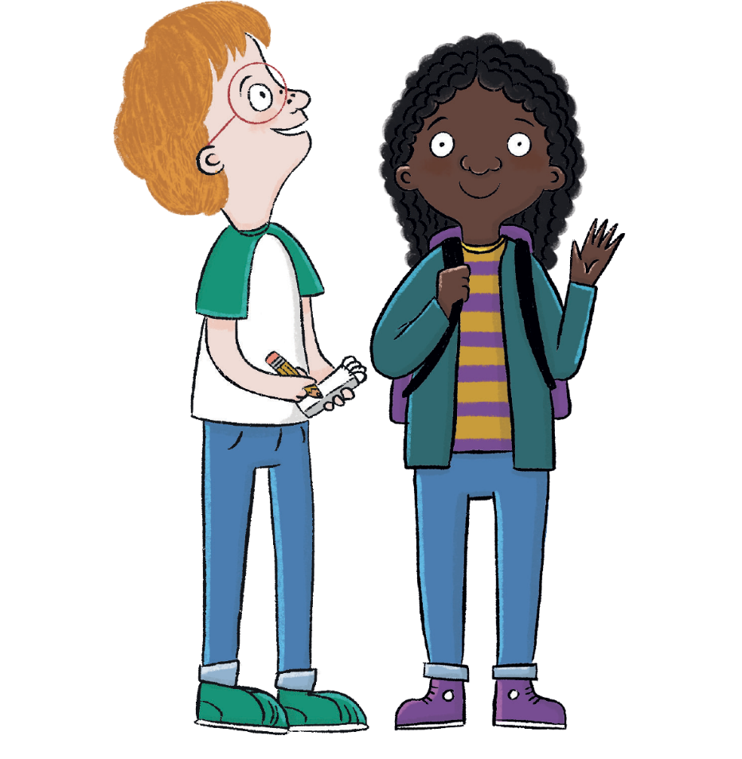
Monday 8th September 2025
In this lesson, we are going to learn about Scotland and what it is like to live there.
Copyright © ArkCurriculum+ 2023

Slide 47
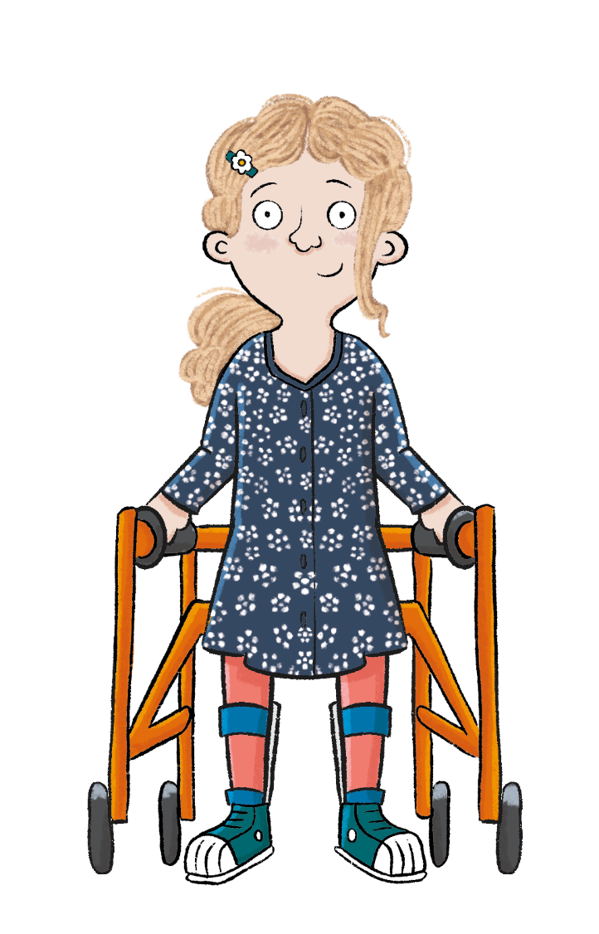
Monday 8th September 2025
The key term in this lesson is capital city.
A capital city is a large city where the country’s parliament meets.
Copyright © ArkCurriculum+ 2023

Slide 48
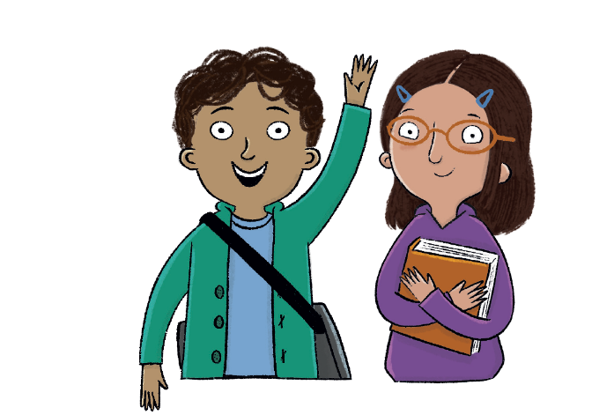
What is it like to live in Scotland?
Key knowledge
Edinburgh is the capital city of Scotland.
Edinburgh has a famous castle and is where the Scottish Parliament meets.
In the Highlands, there are large mountains and enormous lakes.
Key vocabulary
capital city
haggis
Highlands
lakes (lochs)
mountains (Munros)
Copyright © ArkCurriculum+ 2023

Slide 49
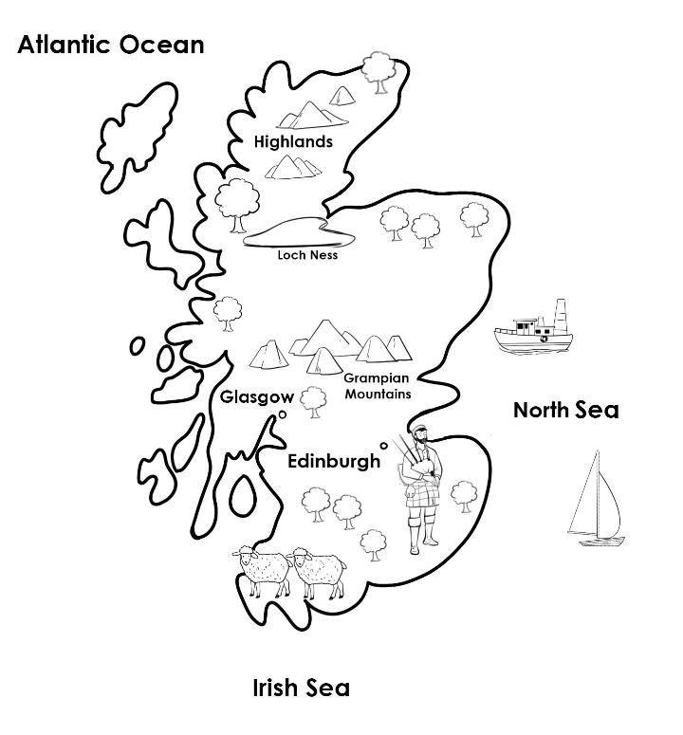
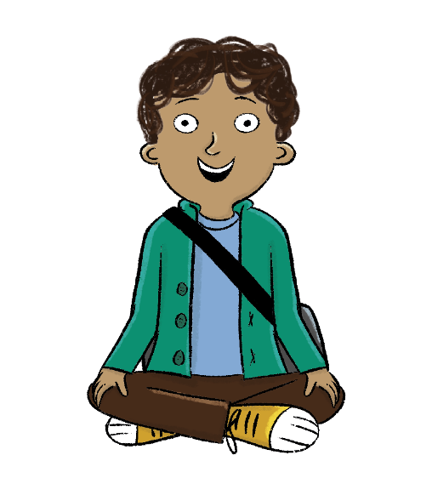
Monday 8th September 2025
Scotland is the furthest north of the four countries in the UK.
Thousands of tourists visit Scotland every year. What can you spot on the map that tourists might want to visit in Scotland?
Copyright © ArkCurriculum+ 2023
Notes:
Talk task: Discuss the map shown on the slide. Ask: ‘What can you spot on the map that tourists might want to visit in Scotland?’.

Slide 50
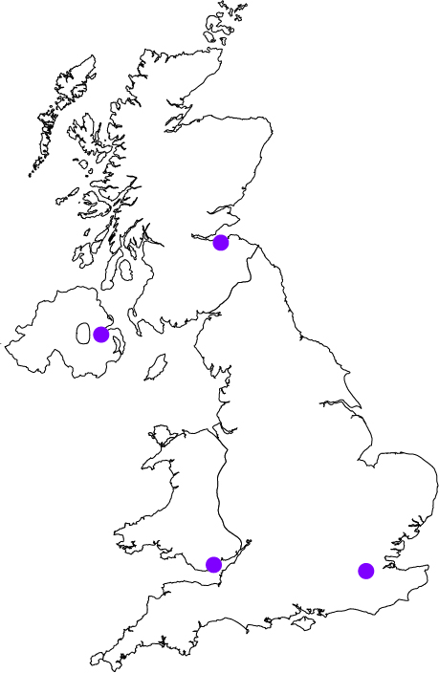
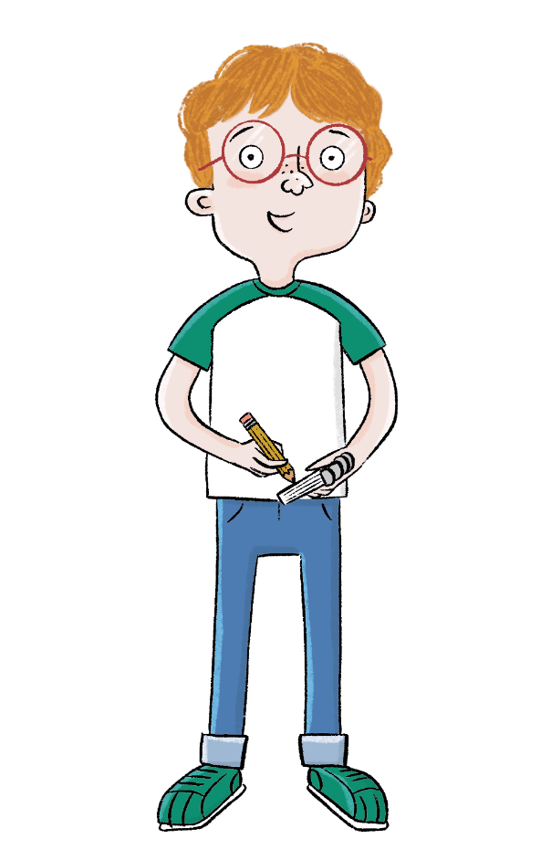
Monday 8th September 2025
Look at the map and complete the following:
1. Label Scotland on the map and colour it blue.
2. Label Scotland’s capital city.
Copyright © ArkCurriculum+ 2023
Notes:
Write: Ask pupils to look at the map in the workbook and label Scotland and Edinburgh. Then, ask them to colour Scotland blue. Model how to draw a dot to show where Edinburgh is.

Slide 51
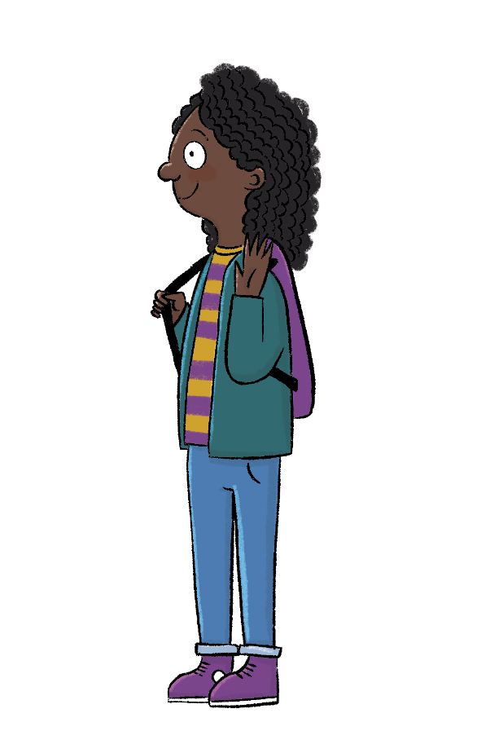

Monday 8th September 2025
Visit Scotland!
Thousands of tourists visit Scotland every year. Watch this video.
Copyright © ArkCurriculum+ 2023
Notes:
Read: Read ‘Visit Scotland!’ and explain thousands of tourists visit Scotland every year. Show the video from Visit Scotland (https://www.youtube.com/watch?v=FlG6tbYaA88&feature=emb_logo). [Oxford University Press is not responsible for content available on third-party websites. The content of these websites may have changed since publication.]

Slide 52
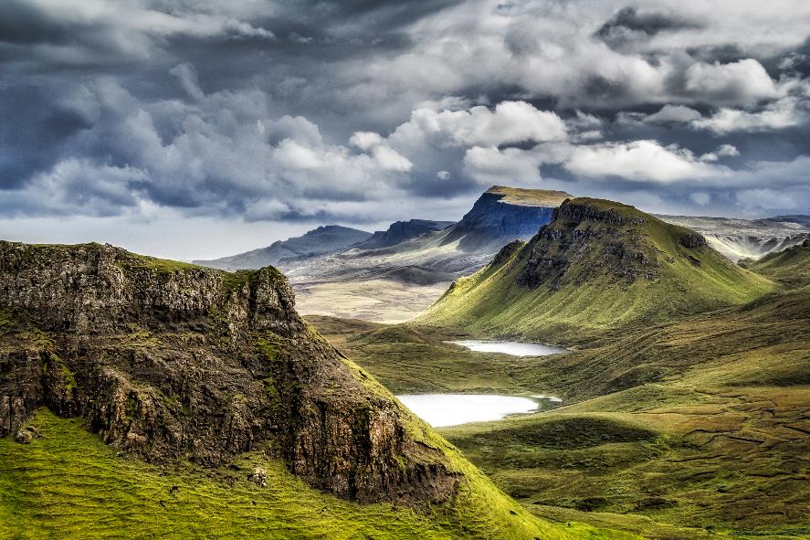
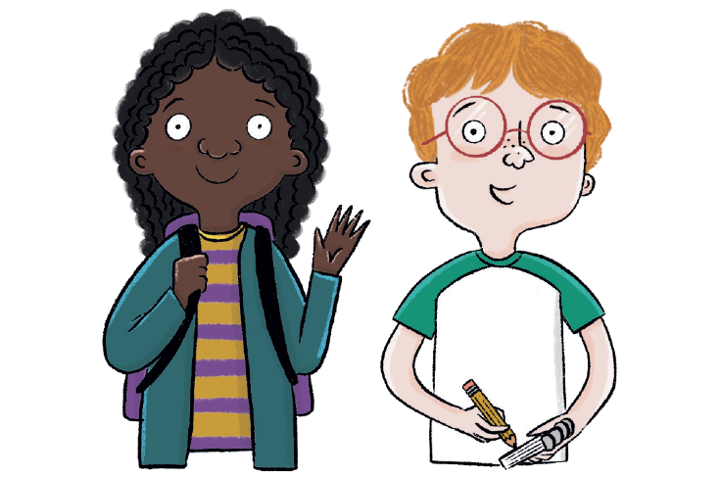
Monday 8th September 2025
Which attractions did you spot in the video about Scotland?
Blue / Green
Why do you think Scotland is a popular destination?
Which attractions did you spot?
Copyright © ArkCurriculum+ 2023
Notes:
Retrieval: Ask pupils ‘Why do you think Scotland is a popular destination? Which attractions did you spot?’. Then ask pupils to write the attractions they spotted in the video in their pupil workbooks.

Slide 53
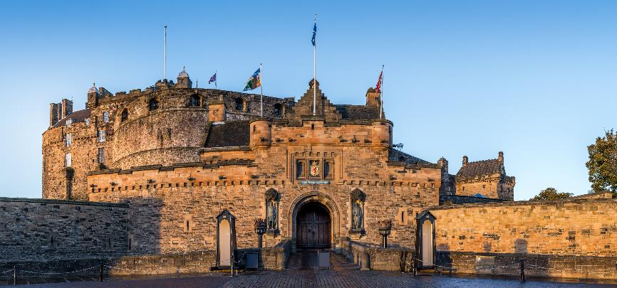
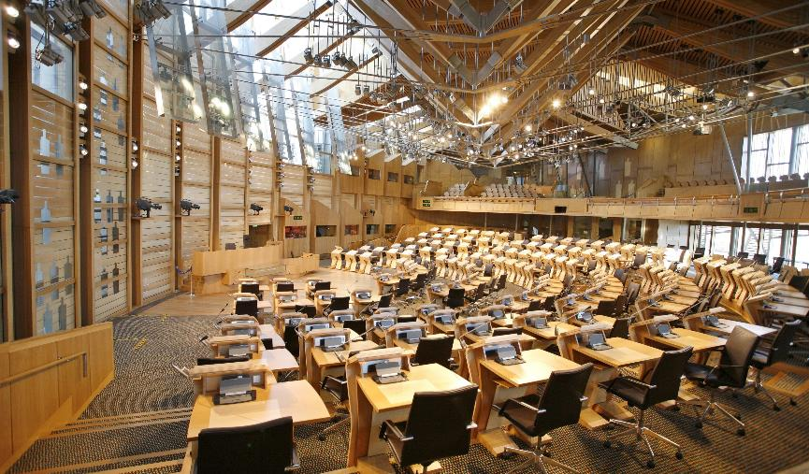
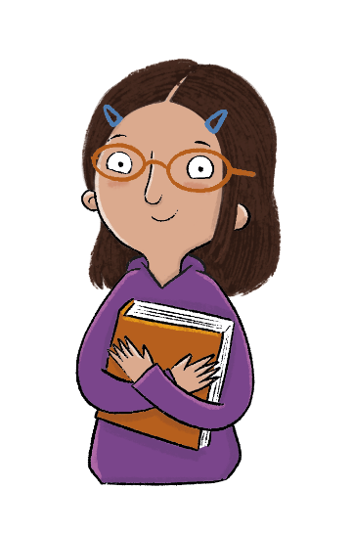
Monday 8th September 2025
What is Scotland like?
The capital city of Scotland is Edinburgh. There are lots of beautiful buildings, parks, galleries, and museums in Edinburgh.
Edinburgh has a famous castle. Edinburgh is
also where the
Scottish Parliament meets.
Copyright © ArkCurriculum+ 2023
Notes:
Read: Read ‘What is Scotland like?’ and discuss the Edinburgh landmarks. Explain the term ‘parliament’ (a group of people who run a country).

Slide 54
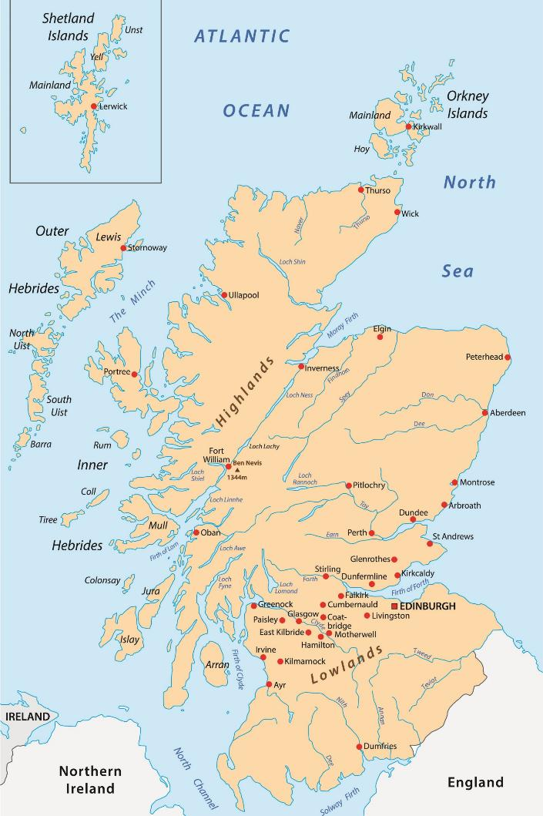


Monday 8th September 2025
Look carefully at this map.
Where are most of the cities located in Scotland?
Copyright © ArkCurriculum+ 2023
Notes:
Investigation: Ask pupils to look at the map. Ask: ‘Where are most of the cities located in Scotland?’. Highlight how most cities are located in the south of the country, whereas the Highlands (in the north) have fewer towns and more countryside.

Slide 55


Monday 8th September 2025
What is Scotland like?
Most cities in Scotland are in the south of the country, including Glasgow and Edinburgh.
The northern part of Scotland is wilder, and is called the Highlands. There are fewer towns and cities in the Highlands, and more countryside.
In the Highlands, there are large mountains, called Munros, and enormous lakes, called lochs.
Copyright © ArkCurriculum+ 2023
Notes:
Read: Read the remaining ‘What is Scotland like?’ slides to run through famous natural and human-made landmarks, and Scottish traditions (music and food). You could look up places like Loch Ness on Google Maps to show the class their locations. This learning would also be enhanced by playing pupils some bagpipe music or by bringing them some Scottish food to try. Go through the text together and practise saying the unfamiliar vocabulary out loud, such as, Ben Nevis, Loch Ness, bagpipes, kilt, and haggis.

Slide 56


Monday 8th September 2025
What is Scotland like?
Ben Nevis is the highest mountain in the United Kingdom—it is 1,345 metres above sea level! It is in the Highlands of Scotland.
Copyright © ArkCurriculum+ 2023

Slide 57



Monday 8th September 2025
What is Scotland like?
Loch Ness is one of the deepest lakes in the United
Kingdom. Some people believe that a huge monster
lives in this lake—the Loch Ness monster! Tourists
visit the loch and try to spot the famous monster.
Copyright © ArkCurriculum+ 2023

Slide 58


What is Scotland like?
What is Scotland like?
Can you see what he is wearing? It looks like a skirt, but it is actually called a kilt.
Scotland is famous for a musical instrument called the bagpipes. Here is a man playing the bagpipes.
Copyright © ArkCurriculum+ 2023

Slide 59


Monday 8th September 2025
What is Scotland like?
What is Scotland like?
Haggis is the national food of Scotland. It is a type of pudding made from bits of sheep!
Copyright © ArkCurriculum+ 2023

Slide 60




Monday 8th September 2025
Draw lines to match the information about Scotland’s landmarks.
A lake in the Highlands of Scotland.
1,345 metres above sea level.
Ben Nevis
The highest mountain in Scotland, and in the UK.
Where the Scottish Parliament meets.
Loch Ness
In the south of Scotland.
Where the Loch Ness monster lives.
Edinburgh
Copyright © ArkCurriculum+ 2023
Notes:
Retrieval: Ask pupils to draw lines to match each landmark with the correct information.

Slide 61
Draw lines to match the information about Scotland’s landmarks.
A lake in the Highlands of Scotland.
1,345 metres above sea level.
Ben Nevis
The highest mountain in Scotland, and in the UK.
Where the Scottish Parliament meets.
Loch Ness
In the south of Scotland.
Where the Loch Ness monster lives.
Edinburgh
Copyright © ArkCurriculum+ 2023

Slide 62


Monday 8th September 2025
What is it like to live in Scotland?
What is the capital city of Scotland?
Can you tell me something about Scotland?
What is the highest mountain in Scotland called?
Can you find Scotland on a map?
Copyright © ArkCurriculum+ 2023
Notes:
Learning review: Work through the review questions together as a class. Add further questions if you wish to. Note down any misconceptions or areas to address.

Slide 63
What is it like to live in Scotland?
Key knowledge
Edinburgh is the capital city of Scotland.
Edinburgh has a famous castle and is where the Scottish Parliament meets.
In the Highlands, there are large mountains and enormous lakes.
Key vocabulary
capital city
haggis
Highlands
lakes (lochs)
mountains (Munros)
Copyright © ArkCurriculum+ 2023

Slide 64

Bing Videos

Slide 65
Independent Challenges:
Narrative Zone
Maths Zone
Count as many objects as you can!
Play a game of dominos, counting the spots as you join them up.
Write about or draw a picture to show what you are good at.
Enquiry Zone
Creative Zone
Can you identify the countries in the UK and put them in the correct places?
Create a self portrait.
What colour are your eyes or hair?

