Slide 1
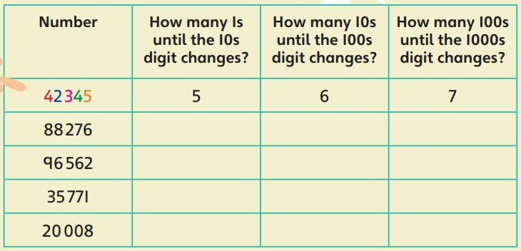
Tuesday 9th September 2025
Morning challenge
6 x 4 =
4 x 8 =
9 x 4 =
4 x ___ = 8
4 x ___ = 28
4 x ___ = 52
Once complete, please read your book and then record in your reading record.

Slide 2
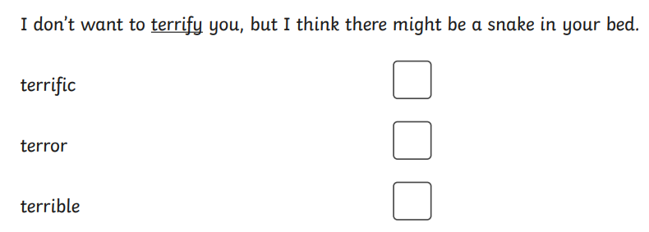
Tuesday 9th September
TBAT: Punctuate sentences correctly.
1 in 1
Challenge:
Statement | A sentence that gives an instruction.
Question | A sentence that expresses a strong feeling. It usually begins with 'how' or 'what' and is not a question.
Command | A sentence that tells the reader something.
Exclamation | A sentence that asks something.

Slide 3
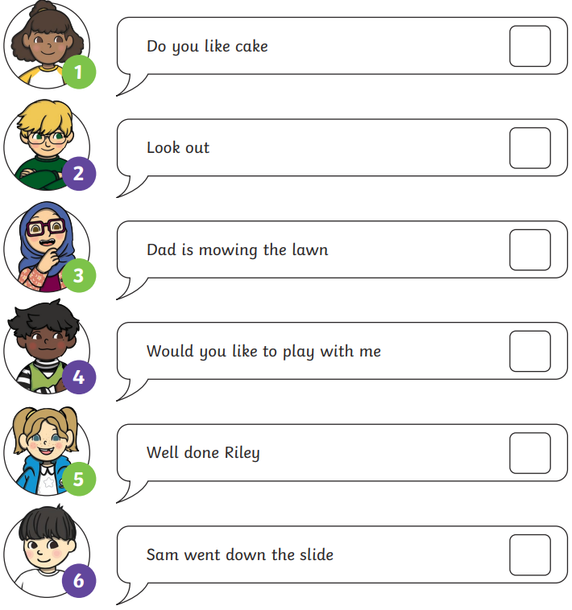
Whiteboard work:
1 = ____

Slide 4
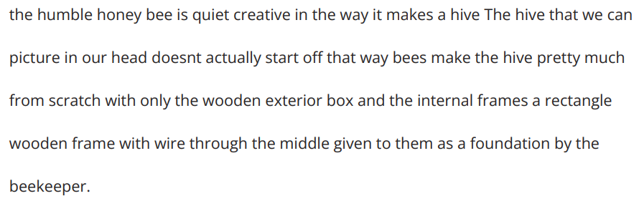
Tuesday 9th September
TBAT: Punctuate sentences correctly.
Edit the paragraph below to correct the punctuation, spelling and grammar.
Rewrite the paragraph in your handwriting book correctly.

Slide 5
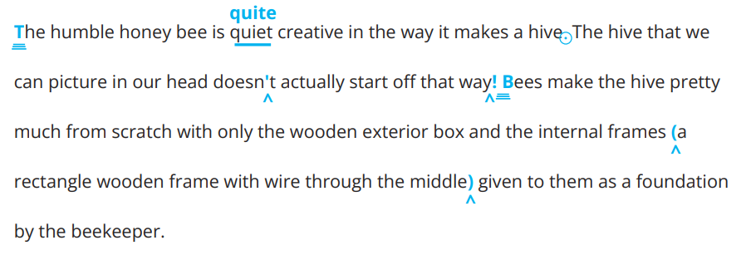
Tuesday 9th September
TBAT: Punctuate sentences correctly.
Answers:
Rewrite the paragraph in your handwriting book correctly.

Slide 6
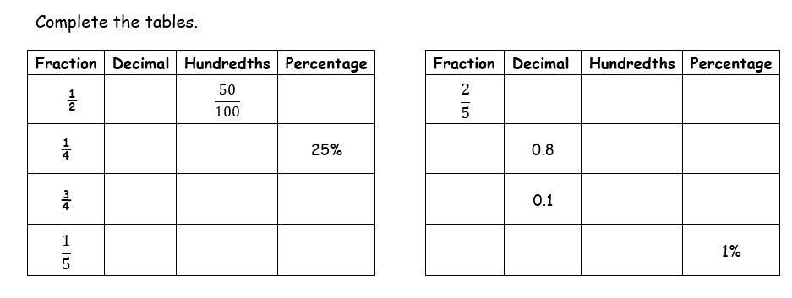
Just Know Its- solve independently

Slide 7
TBAT-use the correct symbol to compare numbers.
3 in 3
Write 'Thirty-nine thousand, five hundred and sixteen' in digits.
5, 620 – 600 =
4 x ? = 28
9.09.25
Challenge:
4 x ? = 2, 800
40 x 60 =
700 x 8 =

Slide 8
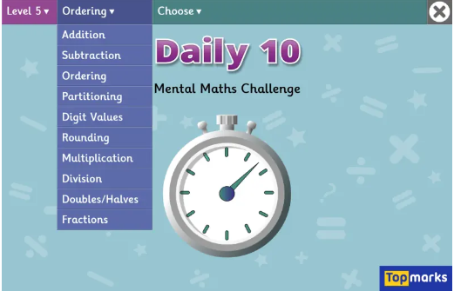
Daily 10 x 4s
Daily 10 - Mental Maths Challenge - Topmarks

Slide 9
Talk partners:
21,039
Blue Green
9 = 9 ones
1 = 10, 000
3 = 30
2 = 2, 000
Challenge: What does the digit zero represent?

Slide 10
Independent
Answer the following questions in your book.
36,107
Blue Green
What does the 3 represent?
What does the 7 represent?
What does the 1 represent?​
​
What does the 6 represent?
Challenge: What does the digit zero represent?

Slide 11
> = Greater than​
< = Less than​
​
So we can write the statement 100 > 75.
Which reads – 100 is greater than 75​
Or, 100 < 125, which reads 100 is less than 125

Slide 12
Talk partners:
What symbol must be used? How do you know?
4, 530 ____ 7, 530
0.72 ____ 0.7

Slide 13
Talk partners: How would we compare the following two numbers?
36, 754 36, 748
Now write this number sentence on your whiteboard using the correct symbol.

Slide 14
Whiteboard work: Place the following numbers in descending order.
23, 066 23, 600 23, 006 23, 666
Challenge: Which digit did you look at first? Which column helped you to solve this problem?

Slide 15
Paired Activity
Write a 5-digit number in your book and do not let your partner see it.
You can ask 3 questions. Take it in turns to ask a question (it must have a yes or no answer) to try and guess their number.
Estimate whether your number is smaller or bigger than your partners.
If you estimate correctly (bigger or smaller) then you get a point.

Slide 16
Roll the dice to make the largest number.
Teacher vs Students
10, 000s | 1, 000s | 100s | 10s | 1s
2) Write your number in words. Don't forget to include a capital letter and punctuation.

Slide 17
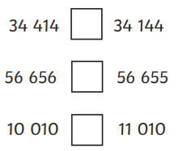
2)Order the following in descending order.
Independent: Write the questions and answers in your books.
1)
a
77, 727
27, 727
27, 227
72, 272
b
61, 234
61, 423
6, 432
62, 431
62, 143
2) True or False? Explain your answer.
I know that _______ is the largest number because...
a) 51, 788 > 50, 699 ​
b) 80, 988 < 81, 827
4) Explain how to order the following in ascending order:

Slide 18
​
Mastery: ​
34.78 < ____ < 34.89 ​
How many possibilities are there to solve this problem?
Challenge:
Susie says that 134.20 is larger than 134.2 because there are five digits. Do you agree? Explain.

Slide 19
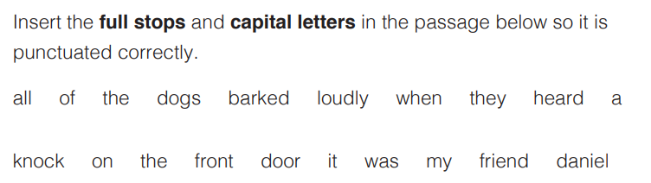
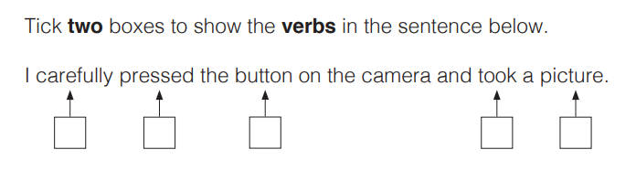
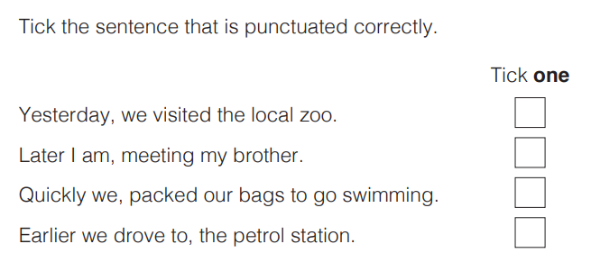
Tuesday 9th September
TBAT: Recap different word classes.
3 in 3 1.
2.
3.

Slide 20
Tuesday 9th September
TBAT: Recap different word classes.
What is an adverb?
What is an adjective?
Explain what "word classes" are. Give examples.

Slide 21
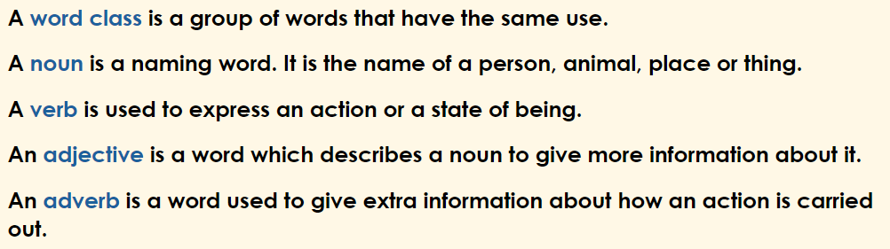
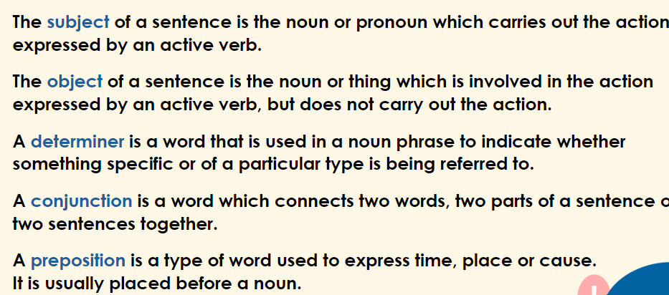
Tuesday 9th September
TBAT: Recap different word classes.

Slide 22
Tuesday 9th September
TBAT: Recap different word classes.
Underline the nouns and circle the verbs in the sentences below.
B: Gingerly, the cat crept towards the wooden gate.
G: Jessica and Rachael slowly climbed the hill.

Slide 23
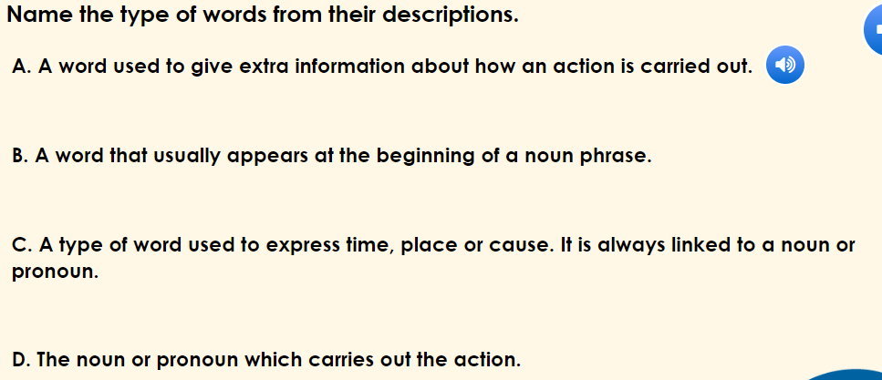
Tuesday 9th September
TBAT: Recap different word classes.
Talk partners:

Slide 24
Tuesday 9th September
TBAT: Recap different word classes.
Underline the adjectives in the sentences below.
B. My cat has pea-green eyes and a fluffy coat.
G. The freezing rain blew across the hilltops as I pulled my waterproof coat tighter around me.

Slide 25
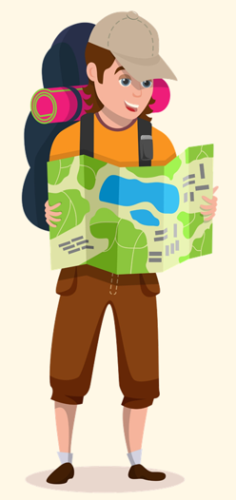
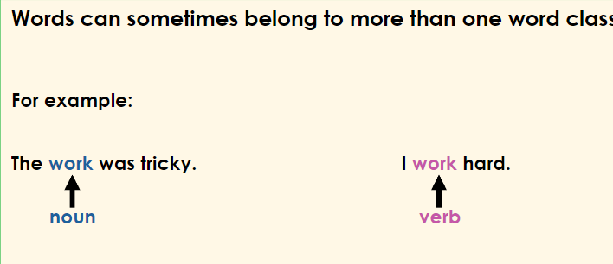
Tuesday 9th September
TBAT: Recap different word classes.
Write two sentences which use the word ‘camp’. One sentence must use the word as a verb and the other as a noun.

Slide 26
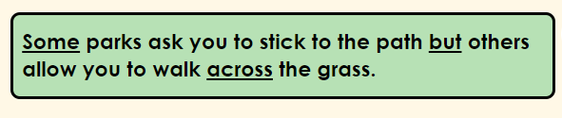
Tuesday 9th September
TBAT: recap different word classes.
Independent
Write two sentences describing a train journey including:
A noun
An adverbial
A conjunction
An adjective
Label each word class.
Challenge:
Rewrite the sentence below changing the underlined preposition, determiner and conjunction:
Explain how the meaning of the sentence has changed.

Slide 27
Tuesday 9th September
TBAT: learn to sing a song.
Match the musical word to its definition:
Dynamics how high or low a sound is.
Timbre how loud or quiet the music is.
Pitch the quality of a musical note.

Slide 28
Tuesday 9th September
TBAT: learn to sing a song.
What is the rhythm of a piece of music?
What is the beat of a piece of music?
Explain the difference.
The Collins Hub Educator > Library
Our community – Tour through time (lesson 1)

Slide 29
Independent Reading
PSHE
Geography

Slide 30
9.09.25
TBAT- consider what makes respectful listening and group-working.
2 in 2
Active listening means giving a speaker your full attention and trying to understand the complete message.
Signs of active listening can be verbal or non-verbal. They include:
positive reinforcement;
remembering;
asking questions;
smiling and nodding;
staying focused.
Being an active listener can have many benefits. As we already mentioned, active listening involves understanding the point behind what someone is saying, not just the words.

Slide 31
Reading Activity: 2 in 2
Give two examples of non-verbal active listening.
_____________________ ____________________
2) Active listening is listening to the words. What else is active listening?

Slide 32
Blue
Write a definition for 'confidential'.
Green
Write a definition for 'personal'.
Challenge: Give an example of when personal information must be shared and then kept confidential.

Slide 33
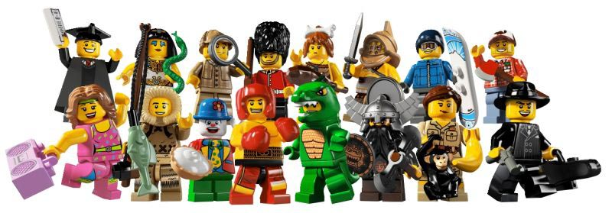
How do I listen respectfully?
Talk partners: Find out about one way they like to spend their spare time.
What do we need to do when we listen to make sure we show the other person that we value and respect them?
Notes:
Make sure you put a timer on the board and do not let this activity over-run… a quick pace is important in this activity.
When they have completed their one minute, display the question on the board and have a discussion about how we listen well.

Slide 34




Our Agenda
To consider what makes respectful listening and group-working.
.
TBAT:
Key words
Active listening
Respectful discussion and collaboration
Our rules for respect

Slide 35
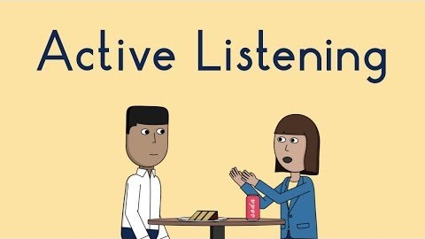
What is active listening?
Key words:
confidential
discuss
included
listen
personal
polite
questions
respect
respond
vocabulary
Watch the clip.
What tips does it give to be an active listener?
How do you know when someone is listening to you?
How does this make you feel?
What about when someone isn’t listening?
Notes:
Watch the clip with the pupils – they can make notes of the points that are made if you would like them to do so.
Answer the questions as a group discussion, ensuring that the pupils use some of the key words in their answers.
https://youtu.be/rzsVh8YwZEQ

Slide 36
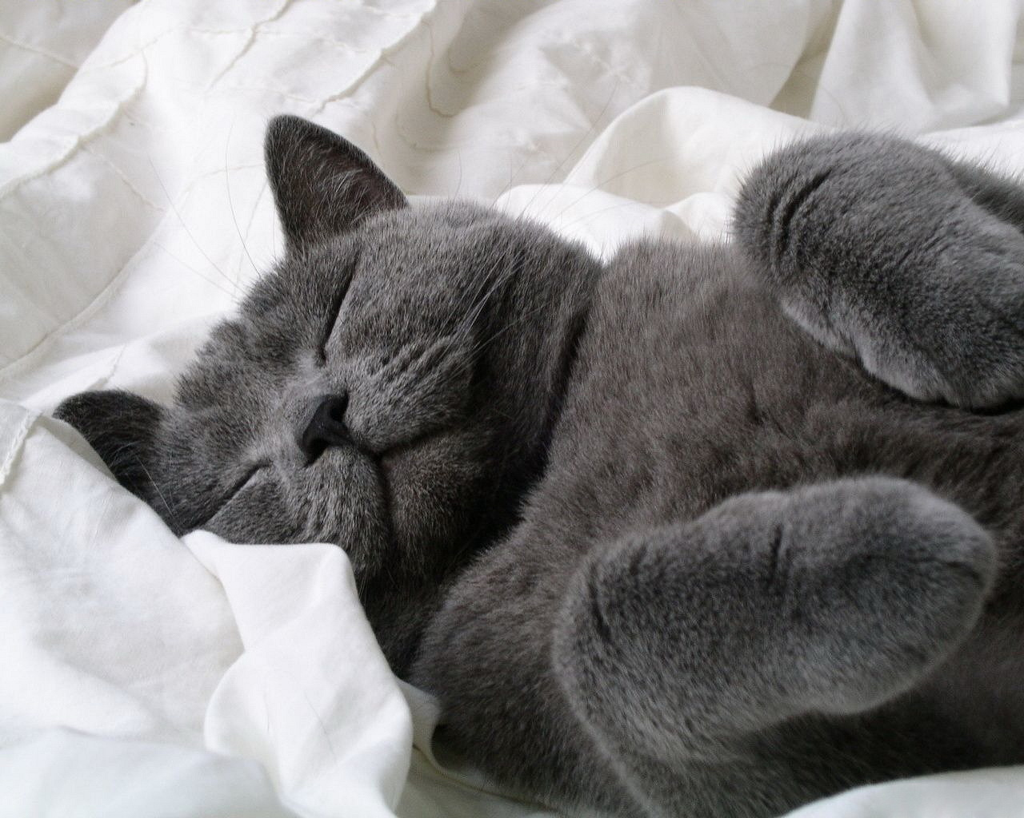

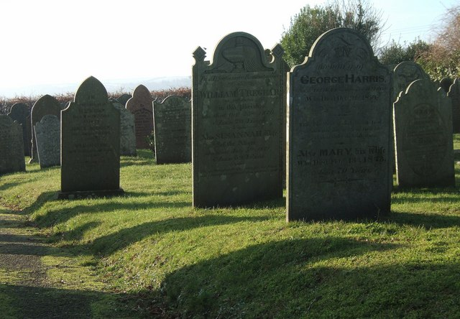

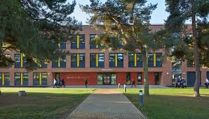


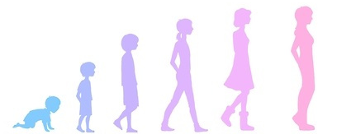
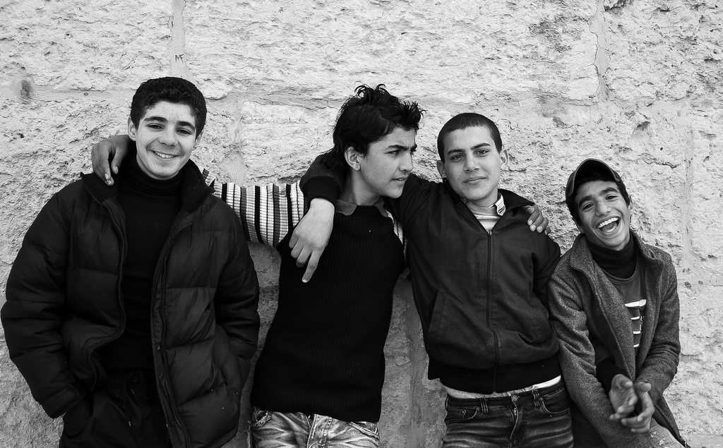
Sort the topics which we will be studying this year.
Most comfortable
My emotions (talking about how I feel) | Self-care (including diet, exercise and sleep) | Death and bereavement
Going to secondary school | When parents separate or divorce | Body image
Fake news | Body changes in puberty | Changes in friendships
Active listening is vital so that you can both agree.
Least comfortable

Slide 37
Creating our rules for respect
YOUR TASK:
The issues discussed in PSHE can be sensitive, therefore it is really important that we establish some classroom rules so that we all feel comfortable to contribute to discussions, group work and PSHE lessons.
Group Work: create a mind-map of rules for respect that we will use in PSHE lessons.
Key words:
confidential
discuss
included
listen
personal
polite
questions
respect
respond
vocabulary
What are our rules for respect in
PSHE lessons?
It is important that we respect other people’s views, even if we don’t agree with them.
Notes:
Give the pupils 5-10 minutes to have a discussion about their rules for respect.
Enlarge slide 11 to A3 and give this to each discussion group to create their notes.
My Life establishes some examples of rules for respect on page 5. These include:
Everyone has the right to be included.
Everyone has the right to be listened to.
Anything confidential that is shared in class shouldn’t be discussed with other people outside the classroom.
People have the right not to share personal experiences or take part if they don’t want to.
We will respect people’s views even if we don’t agree with them.
We will use the correct vocabulary relating to the units we are studying without people being offended.
We will agree that it’s OK to get things wrong and we shouldn’t make fun of people for this.
There are ‘no’ stupid questions and people should not be afraid to ask questions.

Slide 38
Full name
Geography
Venturers- Year 5
Mrs Longman
Knowledge Organisers – thin layer of glue along the edge so you can see both sides.

Slide 39
Tuesday 9th September
Q: Does everywhere in the world have the same climate?

Slide 40


Task: Read the text and answer the two questions.
What is climate and what is a climate zone?
When we describe the climate of a place, we are describing the average amount of rainfall and the average temperature at different times of the year, over 30 years.
Lesson 1: Read
Climate zones are large areas around the world that share a similar climate. On average, they all experience similar amounts of rainfall and similar temperatures across the year. This does not mean that the climates are exactly the same all of the time, but they do follow the same pattern. A place can have a similar climate to another place even if those places are on opposite sides of the world.
Copyright © ArkCurriculum+ 2022
Notes:
Read: Section titled—What is climate and what is a climate zone? The section explains the definition of climate—ensure pupils know it is both temperature and rainfall over a period of 30 years and not what happens on a single day in one year. Pupils may not understand the idea of average, but they will understand that it is what ‘usually’ happens or ‘most often’ happens. Make links to the typical climate in the United Kingdom. Show pupils the climate zone map and recap the name and location of the Equator and so on. Spend time exploring the climate zone map.

Slide 41
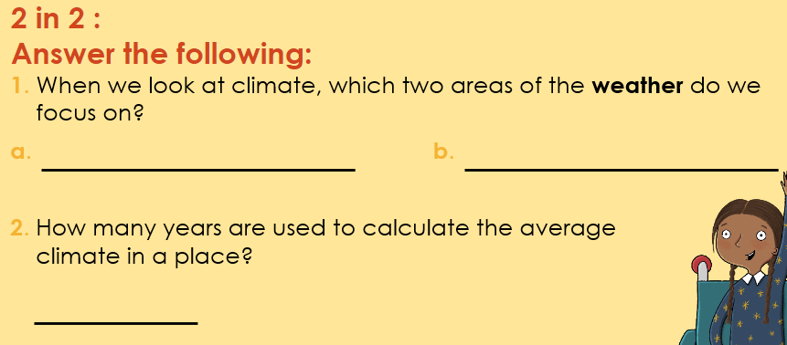

Slide 42
Blue
What is the invisible line called at the centre of Earth?
Green
How do we measure weather?
Challenge: What is the climate of the UK?

Slide 43
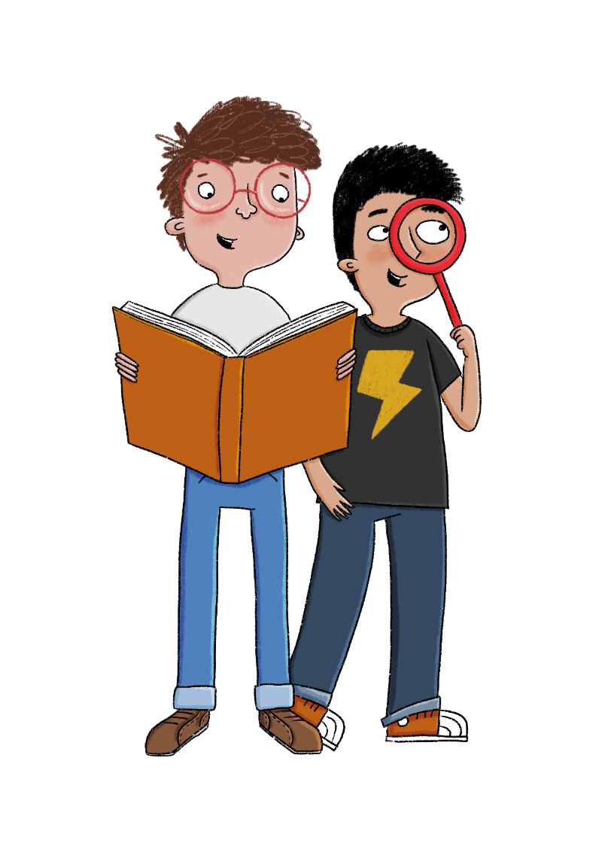

What are the different biomes of the world?
Enquiry question
Copyright © ArkCurriculum+ 2022
Notes:
Share the main unit enquiry question ‘What are the different biomes of the world?’.

Slide 44
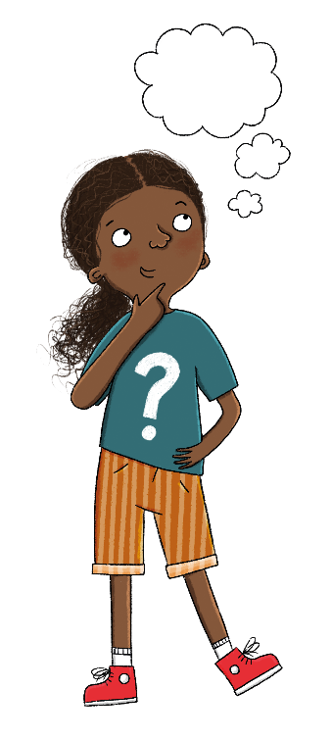
Does everywhere in
the world have the
same climate?
How have the flora
and fauna of different biomes adapted to
life there? (2)
1
4
Learning journey
  What are the different biomes of the world?
  What challenges do humans face living in each biome?
2
5
  How have the flora
  and fauna of different biomes adapted to
  life there? (1)
  Case study: What impact have humans had on the deciduous forests of the UK?
3
6
Copyright © ArkCurriculum+ 2022
Notes:
Share the Learning journey.

Slide 45
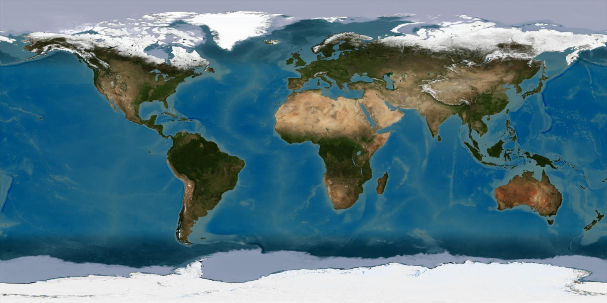
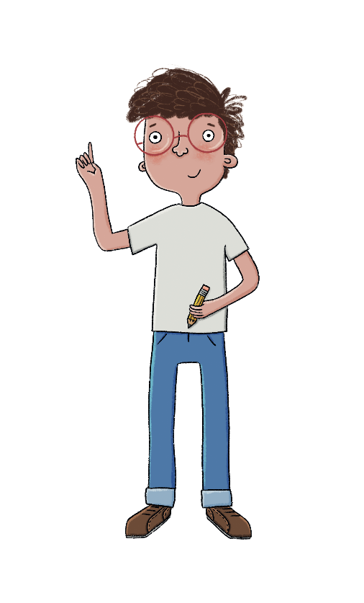
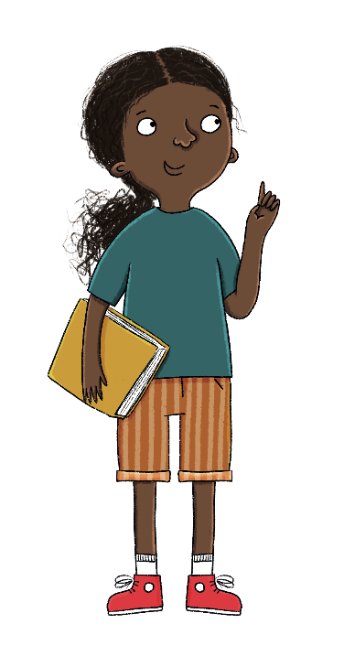
Talk partners: Name the continents.
What would you like to find out?
Lesson 1: Existing knowledge
What do you know about climate?
Copyright © ArkCurriculum+ 2022
Notes:
Existing knowledge: Gauge pupils’ current knowledge of climate zones and biomes—if necessary, you could rephrase the question ‘What do you know about climate?’ to ‘What do you know about hot and cold areas around the world?’.
Ask pupils to identify the continents on a world map. Use this as an AFL and give class feedback. You could use the flattened satellite image of Earth on the ‘Existing knowledge’ teaching slide for this lesson.

Slide 46
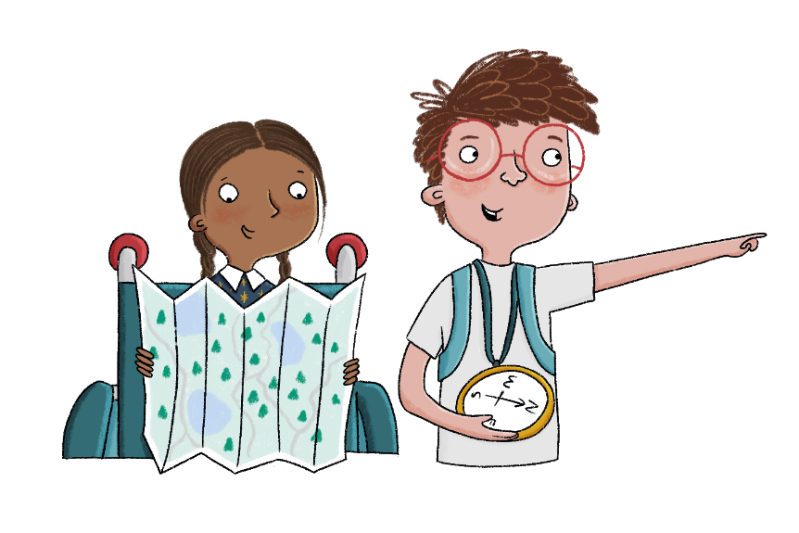

Does everywhere in the world have the same climate?
Key knowledge
The climate is the usual pattern of weather.
Places near the Equator are hot and wet.
Places get colder as you move from the tropics to the poles.
Key vocabulary
climate
rainfall
temperature
weather
Lesson 1: Key knowledge
Copyright © ArkCurriculum+ 2022
Notes:
Share the key knowledge, and vocabulary. Discuss any key words that the pupils already know and the definitions of any new words. Pupils can use their Knowledge organisers to help.

Slide 47
What is climate and what is a climate zone?
In this lesson, we look at seven different climate zones:
equatorial tropical arid Mediterranean
temperate subpolar polar
Places in climate zones along the Equator and between or close to the tropics are usually the hottest. On the map, these are the climate zones that are red, orange, and yellow. As you then move away from the tropics and either go north, to the Arctic Circle, or south, to the Antarctic Circle, places get much colder. The areas that are in the light and
dark blue climate zones are usually the coldest.
Lesson 1: Read
Copyright © ArkCurriculum+ 2022

Slide 48
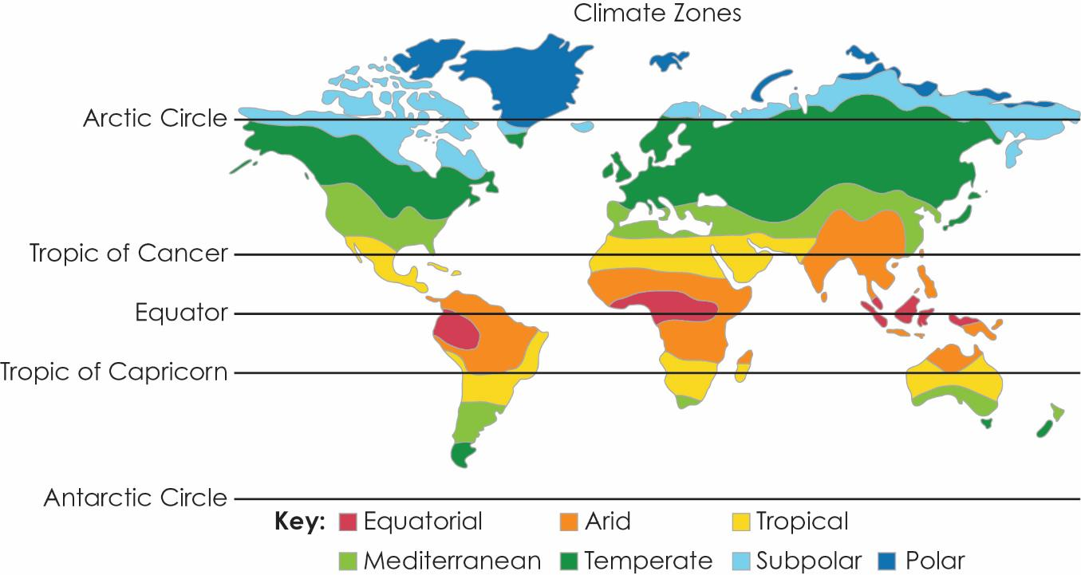
What is climate and what is a climate zone?
Lesson 1: Read
Copyright © ArkCurriculum+ 2022

Slide 49

Blue: Which places look hot and which places look cold?
Green:Which places look wet and which places look dry?
Lesson 1: Talk task
Copyright © ArkCurriculum+ 2022
Notes:
Talk task: With talk partners, pupils look at the satellite image and identify hot and cold places around the world. Can the pupils also identify wet and dry places? Discuss the thoughts that pupils share together and address misconceptions. You might want to explain that the map on the slides is made up of aerial photos taken from space—hence the white snow and ice, the green forests, and the sand-coloured deserts.

Slide 50

In groups use the clues to label each of the climate zones on the map. Use the location of the Equator, tropics, and circles to help you.
Lesson 1: Write
Polar climate zones are located the furthest north.
Equatorial climate zones are mostly located along the Equator.
Subpolar climate zones are located south of the polar zones and along
the circles.
Tropical climate zones are mostly located between or along the tropics.
Temperate climate zones are mostly located just south of the Arctic Circle or just north of the Antarctic Circle.
Arid climate zones are mostly located along or north/south of the tropics.
Mediterranean climate zones are mostly located north/south of the arid zones.
Copyright © ArkCurriculum+ 2022
Notes:
Write: Pupils work together in pairs or small groups, using the clues on Additional Resource 1A and on the teaching slides to help them label the climate zone map with the name of each climate zone.

Slide 51
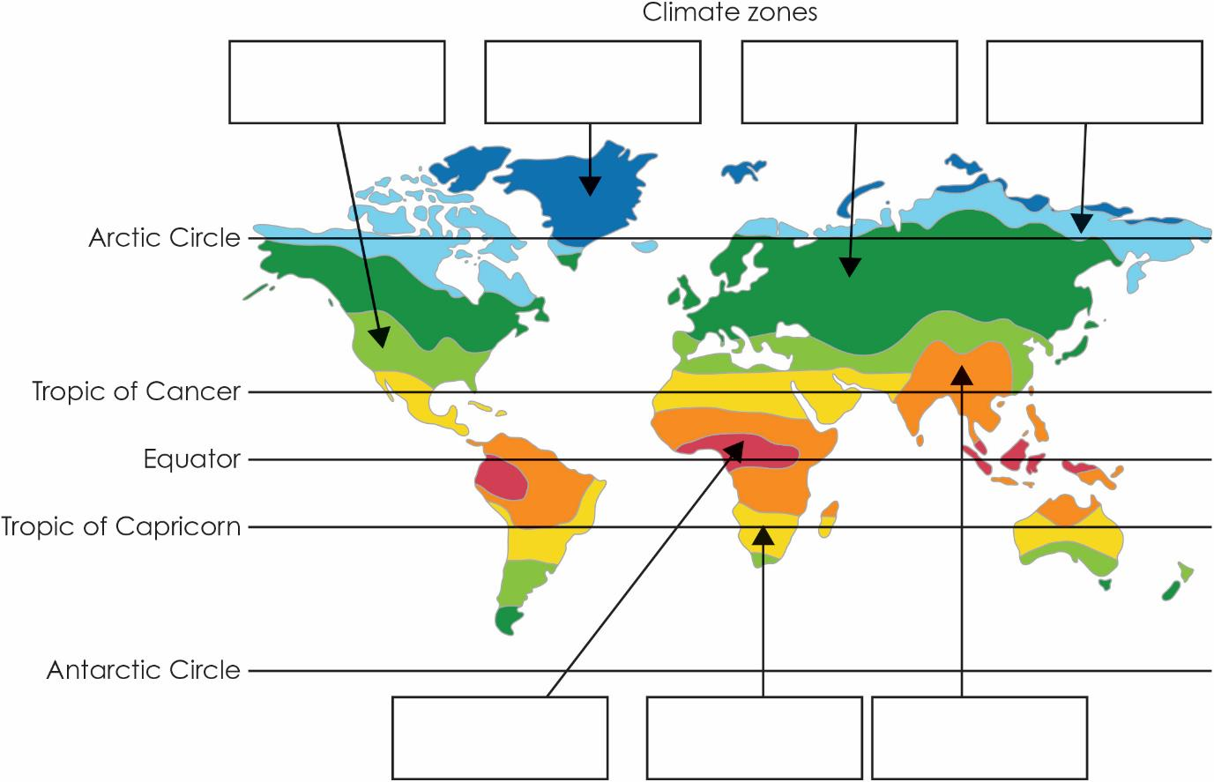
Task: Using the work you have completed in groups, label the map with the climate zones.
Where are the different climate zones located?
Lesson 1: Write
Copyright © ArkCurriculum+ 2022

Slide 52
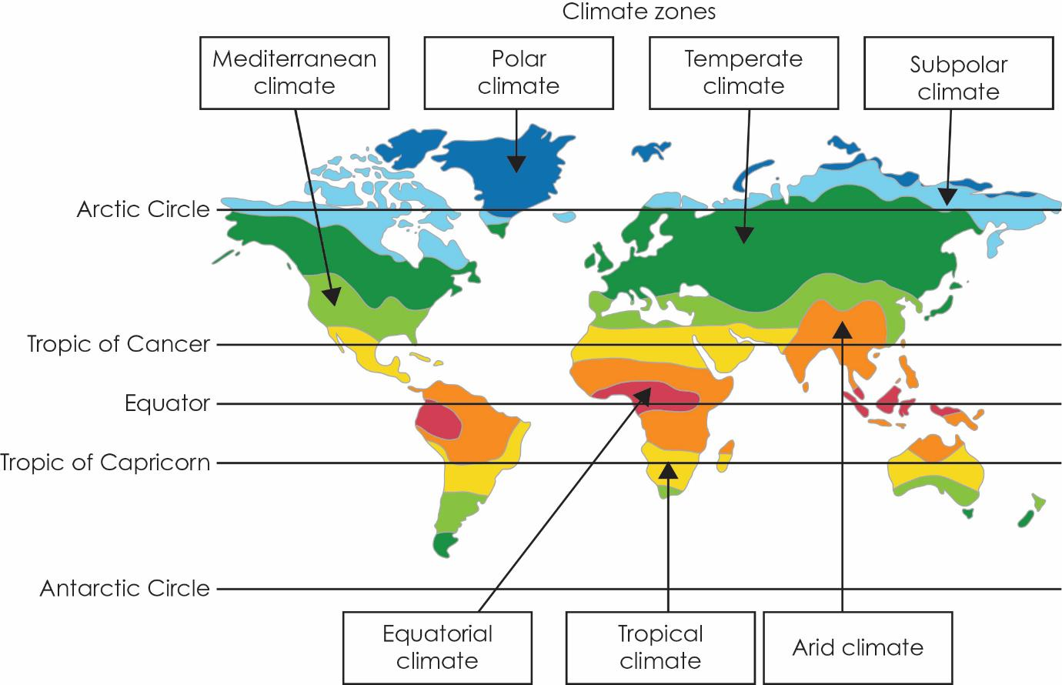
Where are the different climate zones located?
Lesson 1: Write
Copyright © ArkCurriculum+ 2022

Slide 53
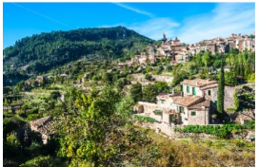

Which climate zone do you think it is and why?

Slide 54
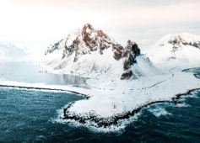
Which climate zone do you think this is and why?

Slide 55
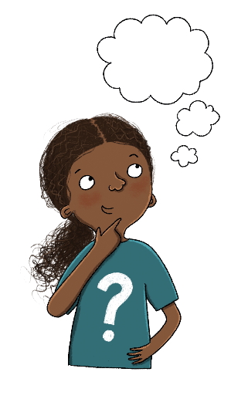
Independent Work:
Tick the boxes to show which climate zones are found in each continent.
Lesson 1: Write
 | Oceania | Africa | Asia | North America | South America | Europe
polar
subpolar
temperate | ✓
Mediterranean | ✓
arid | ✓
tropical | ✓
equatorial | ✓
Challenge: Compare the temperature and rainfall in the Polar climate and equatorial.
Copyright © ArkCurriculum+ 2022
Notes:
Write: Pupils use their labelled map to complete the table. To access this, pupils need to confidently know the names and positions of each continent. If they do not know this then this knowledge should be reviewed prior to the task, and the task could be scaffolded by providing pupils with an additional map showing the different continents. If you know that your pupils will require further support, consider asking the pupils to complete the task in pairs. An example (Oceania) has been completed to support pupils.

Slide 56
Tick the boxes to show which climate zones are found in each continent.
Lesson 1: Write
 | Oceania | Africa | Asia | North America | South America | Europe
polar |  |  | ✓ | ✓ |  | ✓
subpolar |  |  | ✓ | ✓ |  | ✓
temperate | ✓ |  | ✓ | ✓ | ✓ | ✓
Mediterranean | ✓ | ✓ | ✓ | ✓ | ✓ | ✓
arid | ✓ | ✓ | ✓ |  | ✓
tropical | ✓ | ✓ | ✓ | ✓ | ✓
equatorial | ✓ | ✓ | ✓ |  | ✓
Copyright © ArkCurriculum+ 2022

Slide 57
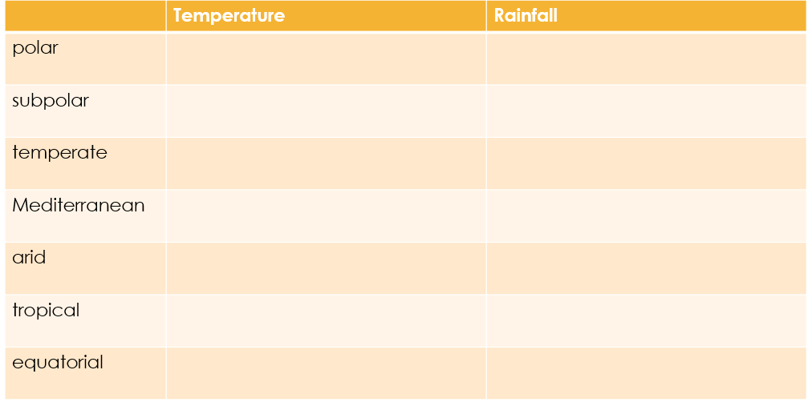
Draw a table in your book. Select three climates and write information about the temperature and the rainfall.
Time dependent

Slide 58
Complete the table to give information about each climate zone.
 | Temperature | Rainfall
polar | very cold—the coldest zone on the planet | very little rain—known as a polar desert
subpolar | below freezing for 5–7 months, cool for the remaining months | very little rain, most likely in summer months
temperate | rarely extreme hot or cold | unpredictable rain any time of year
Mediterranean | very warm summers, cool and mild winters | wet winters, dry in summer
arid | very hot during the day, very cold during the night | very dry, hardly any rain
tropical | hot or very hot | rainy in summer, dry in winter
equatorial | hot all year round | heavy rainfall throughout the year
Lesson 1: Write
Copyright © ArkCurriculum+ 2022

Slide 59
Exit Questions
1) When you think of climate, which two areas of weather do we focus on?
________________ ___________________
2) What happens to the temperature as you move from the tropics to the poles?
The temperature ___________________________________.
Challenge: Compare two climate zones.

