Slide 1
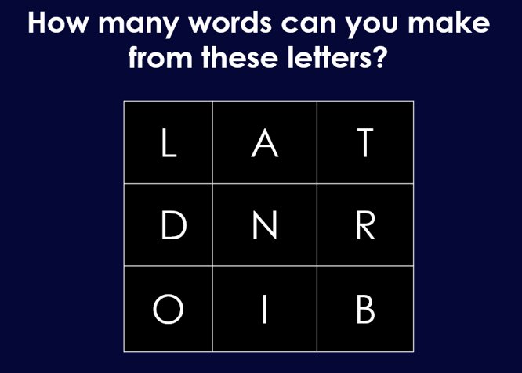
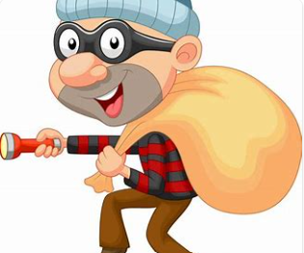
Monday 8th September 2025
Morning challenge
Some of the letters have been stolen, figure them out and spell the Y5/6 words.
ac __ i __ v e
mu __ c l __
su __ __ e s t
ve g __ t a b __ e
so l d __ __ r
re __ o g n __ __ e
r__ y __ e
o__ __ o r t u __ __ t y
f___ r t ___

Slide 2
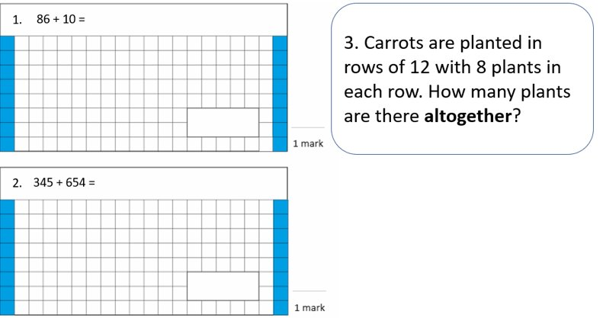
TBAT- read and write 5-digit numbers. 8/9/2025
Challenge:
3 x 5 =
30 x 5 =
? X 5 = 1, 500

Slide 3
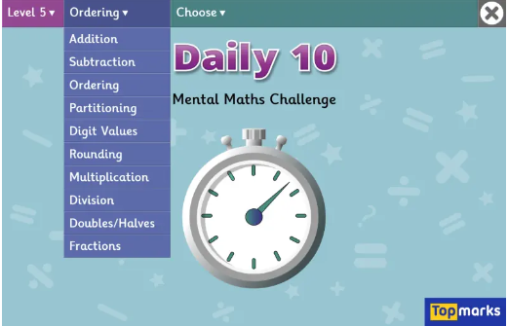
Daily 10 x 4s
Daily 10 - Mental Maths Challenge - Topmarks

Slide 4
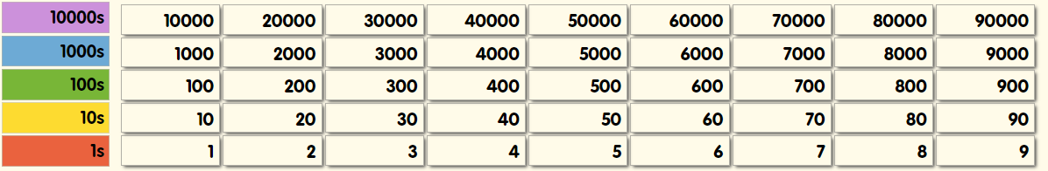
What is the missing number?
Challenge: I am thinking of a number that is 100 times smaller than 700. What is my number?

Slide 5
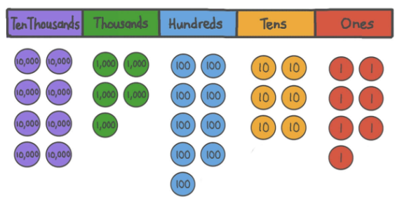
Whiteboard work: What is my number?

Slide 6
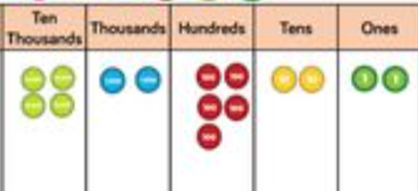
Talk partners: True or False?
Forty-two thousand, five hundred and twenty-two.
42, 522

Slide 7
Talk partners: Which number has the greater value? How do you know?
Sixty-five thousand, four hundred and two. ​
​
Sixty-five thousand, four hundred and twenty-two.

Slide 8
Paired Whiteboard work: True or false?
Sixty-five thousand, four hundred and two. ​
​ 65, 420

Slide 9
Whiteboard work: True or false?
Eighteen thousand, nine hundred and six.
​ 18, 906
Twelve thousand and forty-one.
12, 401
Challenge: Write the number in digits.
Forty-six thousand, one hundred and twelve.

Slide 10
Independent
Answer the following questions in your book.
18,762
Blue Green
What does the eight represent?
What does the two represent?
What does the seven represent?​
​
What does the six represent?
Challenge: Write the number in words.

Slide 11
Roll the dice to make the largest number.
Teacher vs Students
10, 000s | 1, 000s | 100s | 10s | 1s
2) Write your number in words. Don't forget to include a capital letter and punctuation.

Slide 12
Paired Work:
1) Roll the dice and make the largest number.
Write your number in digits and words.
2) Now make the smallest number.
Write your number in digits and words.
10, 000s | 1, 000s | 100s | 10s | 1s

Slide 13
Figures | Words
18, 827 | Eighteen thousand, eight hundred and twenty- seven.
 | Seventy-seven thousand, seven hundred and twenty-five
14, 705
8, 001
 | Nineteen thousand, two hundred and nine.
Independent:

Slide 14
2) Write the following numbers in words and digits.
Sixteen thousand, four hundred and nine.​
Thirty-two thousand and six.​
​
3) Using the following digits: 3 4 5 0 1 . ​
​
What is the largest 5-digit number you can make? ​
What is the smallest 5-digit number you can make?​
​
Write it in words and figures.

Slide 15
Challenge:
True or false? Explain your answer.
45, 809 = Forty-five thousand, and eighty-nine.
Mastery:
Sally says that it is possible to think of a 4-digit number where all the digits change when you count on 5 ones. Do you agree with her? Prove it.

Slide 16

School Council Application
1)Why would you like to represent our class?
2) How will you help improve the school?
3) What attributes do you have to be a good representative?

Slide 17

Assembly- 10.10am

Slide 18
TBAT: make predictions and use words in context.
3 in 3
Jumping on board and embarking on the best train journeys in the UK will transport you to a simpler time and a slower pace of life.
With Country Living's pick of the most breathtaking train journeys UK destinations have to offer, you can look out of the window and take in spectacular scenery, from country to coastline.
You'll pass landscapes unseen from confines of the car and can travel safe in the knowledge that you're doing your bit for the environment.
From the romance of taking you back to a bygone era, to the sheer joy and anticipation of arriving at a new station, there are many reasons to experience a train journey in the UK this year.
1. Find and copy a phrase which means belonging to an earlier time.
2. Who has written the text about breathtaking train journeys in the UK?
3. Name one reason to experience a train journey in the UK.
Monday 8th September

Slide 19

TBAT: make predictions and use words in context.
Monday 8th September
Look at the front cover:
Predict what you think this book might be about. Remember to use evidence to support your answer.
Example:
I think this book might be set in a jungle, I think this because there is a lot of greenery on the cover and animals which you might find in the jungle.
Who might the protagonist be? Why do you think this?

Slide 20
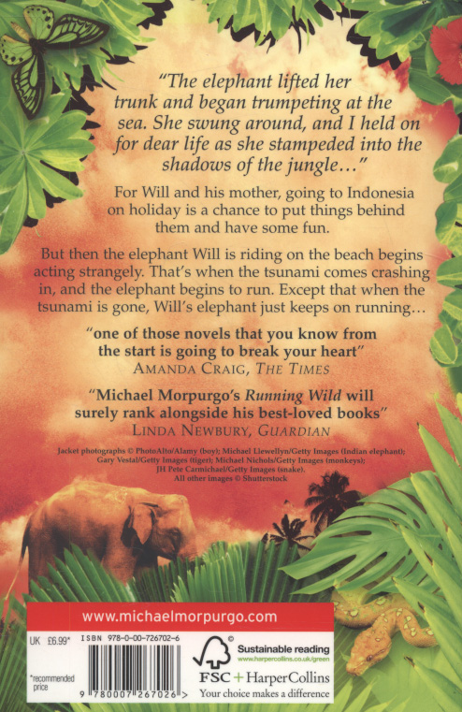
TBAT: make predictions and use words in context.
Monday 8th September
Read the blurb:
Has your prediction changed?
What do you think will happen in the text now?
Remember to give evidence to your answer.

Slide 21
TBAT: make predictions and use words in context.
Read to page 15.
Words/Phrases we will find in the text:
Murmured - say something in a low or indistinct voice.
Unconcerned - showing a lack of worry or interest, especially when this is surprising or callous.
Momentary - lasting for a very short time; brief.
Monotonous -dull, tedious, and repetitious; lacking in variety and interest.
Monday 8th September

Slide 22
TBAT: make predictions and use words in context.
Multiple choice questions:
1. Which word is closest in meaning to monotonous:
Exciting tedious thrilling compelling
2. "'Scuse me.' He says... What does the 'Scuse me translate to?
Pardon me Excuse me Rescue me
3. The train journey Will was reminiscing about passed by...
In a blur Slowly Excitedly
Monday 8th September

Slide 23
TBAT: make predictions and use words in context.
Words in context
1. Why does the author describe the sand as silent?
2. Find and copy the idiom on page 9 which says Will is faraway from real life.
3. Find and copy a word which means a momentary or partial view.
4. What does the word "runner" mean in the following sentence:
So that was when I yelled at her, and did a runner to the hay-barn...
Monday 8th September

Slide 24
TBAT: make predictions and use words in context.
Challenge
Having read the first few pages, can you edit your prediction? Who is the protagonist? What is happening in the text/ what has happened? What might happen as we progress through the text?
Monday 8th September

Slide 25
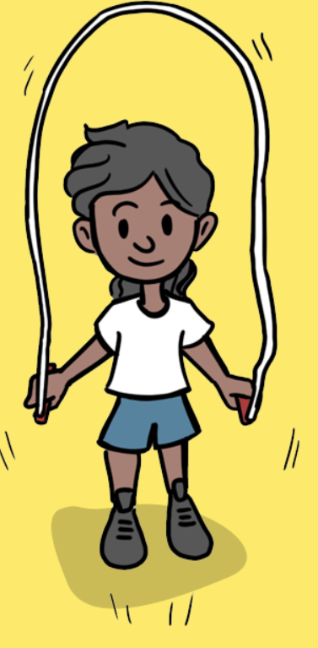
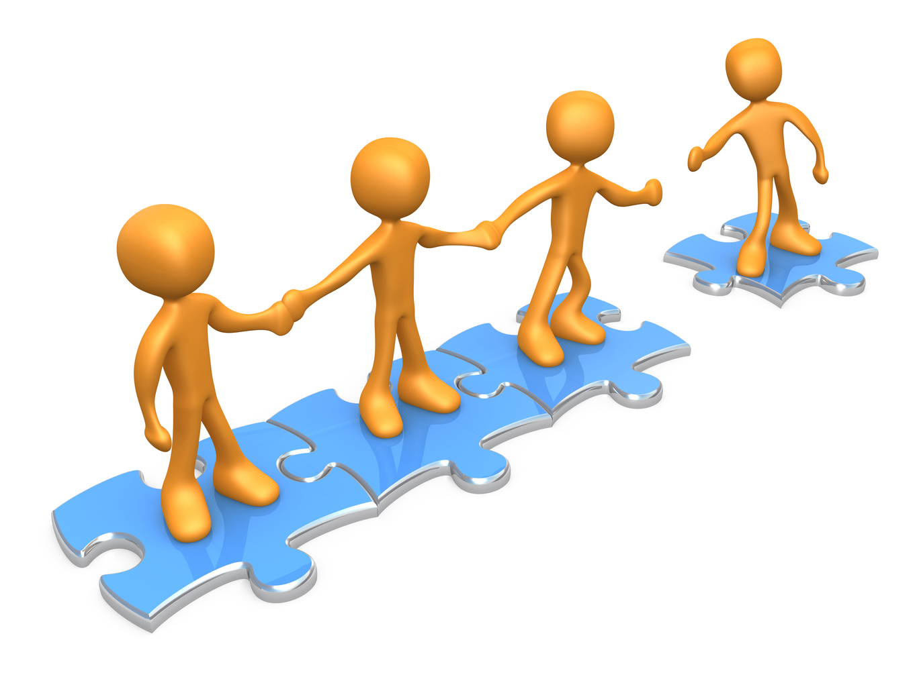
Monday 8th September 2025
08.09.25
TBAT: understand how agility helps us in everyday life.
- Changing for PE
- Rules and expectations moving to PE
- Move to the downstairs hall or outside
Get Set 4 PE - Lesson Plan -5 for Year 3 Fitness (getset4education.co.uk)

Slide 26
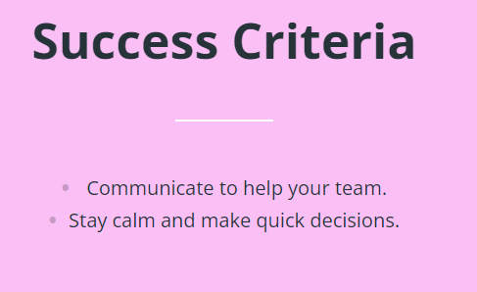
8.9.25
Blue
Why is it important to communicate to your teammates during an invasion game?
Green
Why might a player be under pressure during an invasion game?
Get Set 4 PE - Lesson Plan -2 for Year 5 Football (getset4education.co.uk)

Slide 27
TBAT- know how to keep myself safe online.
Online safety, also known as internet safety, cyber safety and e-safety, is the act of staying safe online by being aware of and protecting oneself from the risks of personal and property harm associated with using the Internet. Online safety involves using technological devices such as PCs, laptops, smartphones and tablets that have access to the internet.
2 in 2
Give two examples of devices that have access to the internet.________________ ___________
Online safety is protecting yourself from the risks of ___________________ and _______________ harm.

Slide 28

Blue
Conduct-
Content-
Green
Contact-
Safety-
Challenge: Commerce
What is the meaning of the following words?
Hint: They link to being online.

Slide 29
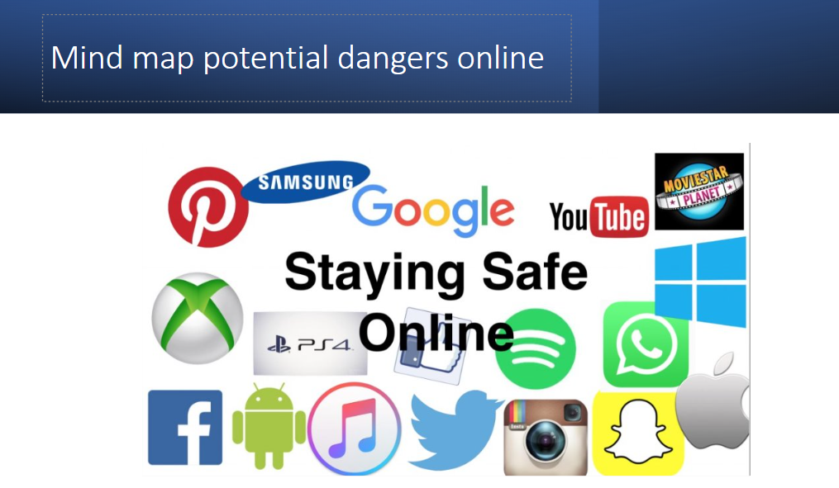
Mind map potential dangers online

Slide 30
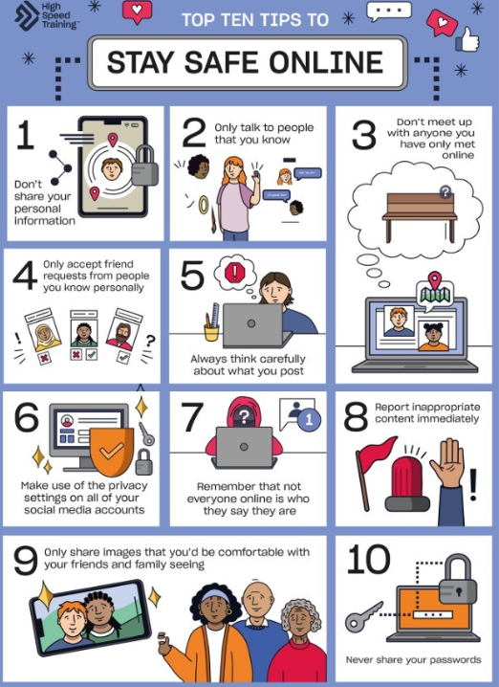


Task: Design a poster to help younger pupils stay safe online.
Can you include today's key vocabulary:
content, commerce, contact, conduct

