Slide 1
Wednesday 10th September 2025

Slide 2



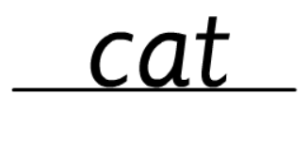
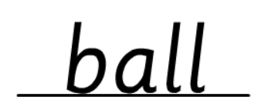
Morning Challenges:
Name writing

Slide 3
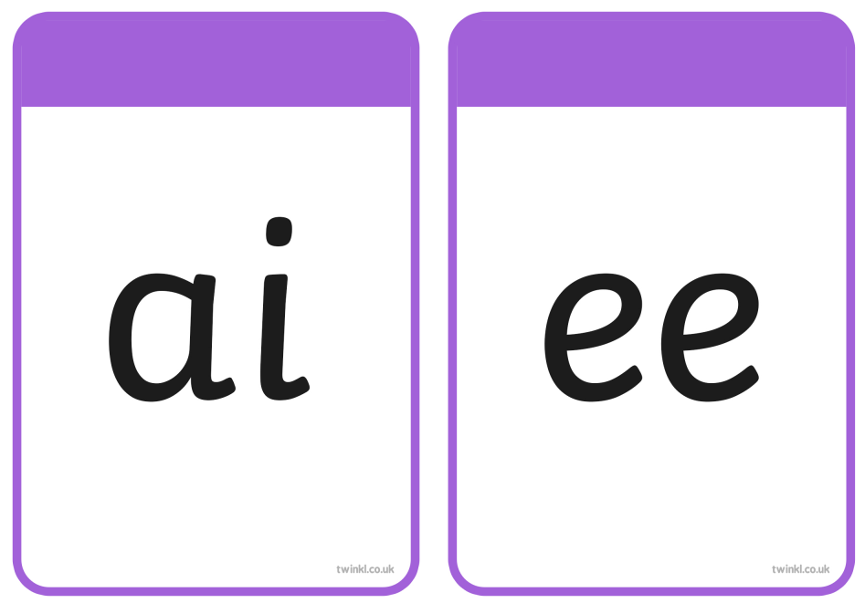
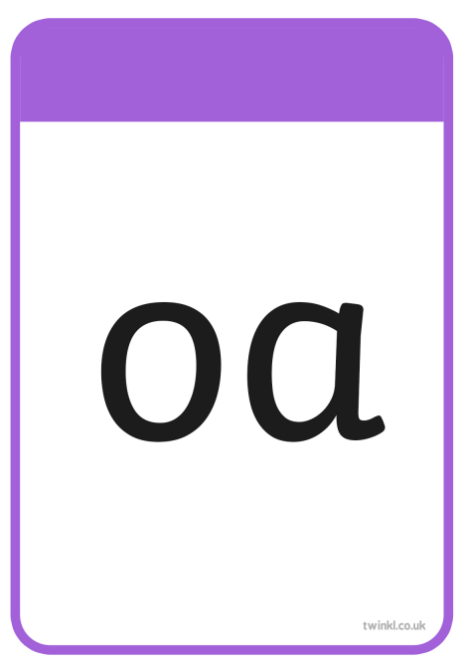

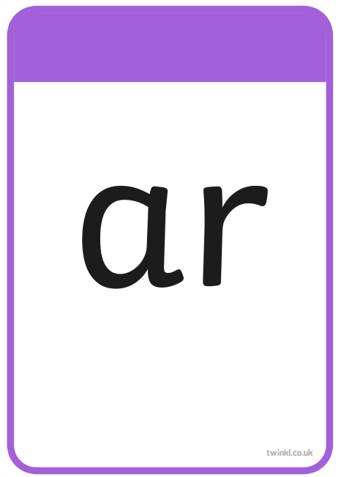
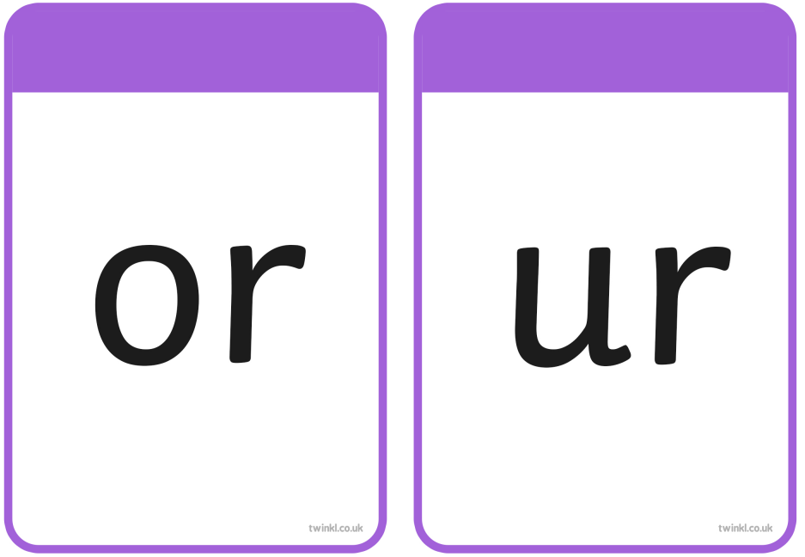
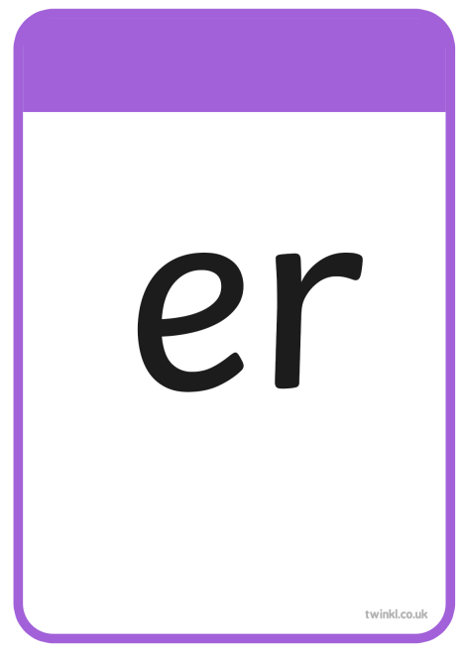

nk

Slide 4
TBAT– read and spell words with 'oo/or/ur graphemes
car
What is the digraph?

Slide 5
TBAT– read and spell words with 'oo/or/ur graphemes
light
What is the digraph?

Slide 6
TBAT– read and spell words with 'oo/or/ur graphemes
links
What is the digraph?

Slide 7
TBAT– read and spell words with 'oo/or/ur graphemes
zooming
What is the digraph?

Slide 8
TBAT– read and spell words with 'oo/or/ur graphemes
foxes
What is the digraph?

Slide 9
TBAT– read and spell words with 'oo/or/ur graphemes
looks
What is the digraph?

Slide 10





TBAT– read and spell words with 'oo/or/ur graphemes
so
by

Slide 11
TBAT– read and spell words with 'oo/or/ur graphemes
b-or-n

Slide 12
TBAT– read and spell words with 'oo/or/ur graphemes
s-ur-f

Slide 13
TBAT– read and spell words with 'oo/or/ur graphemes
f-oo-t

Slide 14
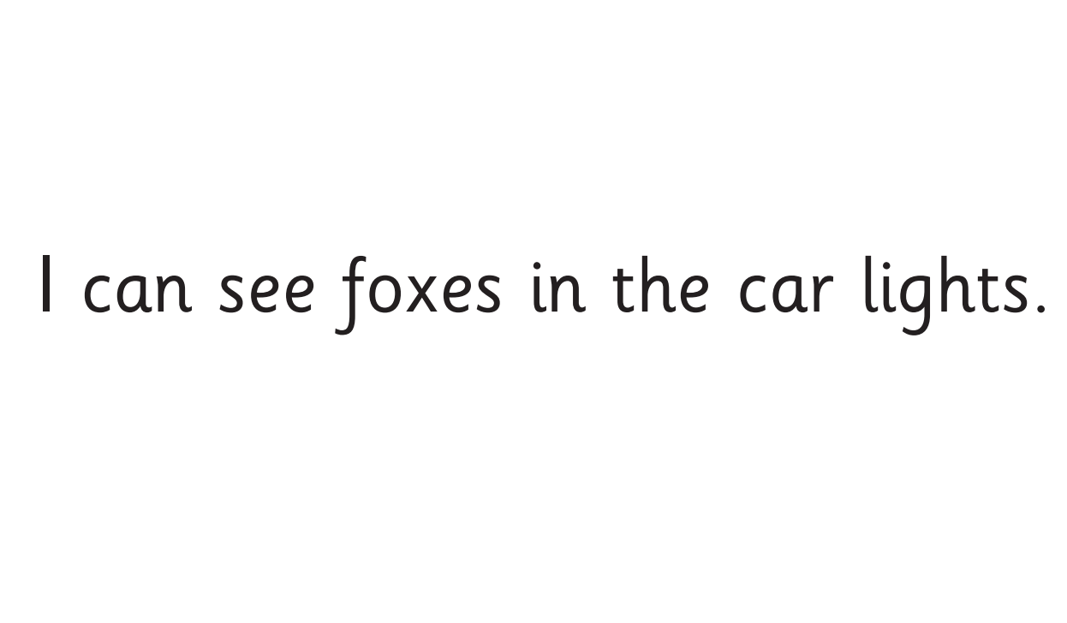
TBAT– read and spell words with 'oo/or/ur graphemes
Now let's read this sentence!​

Slide 15
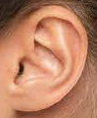




TBAT– read and spell words with 'oo/or/ur graphemes
Listen
Say it
Write it
Check it
into
tricky word
sort took

Slide 18
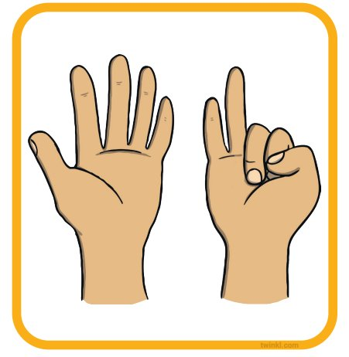
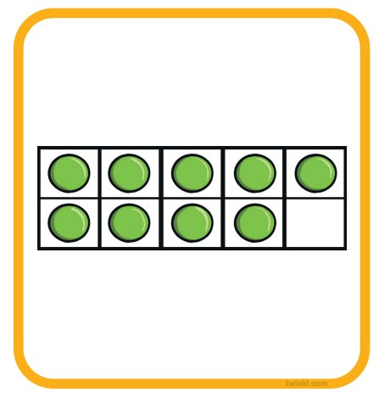
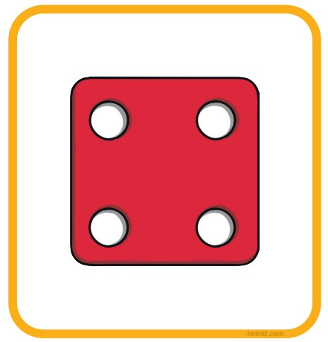
3 in 3 – Can you find one more and one less?
One less​ | ​ | One more​
​ | ​ | ​
​ | ​ | ​
​ | ​ | ​
Challenge: Can you double it?

Slide 19
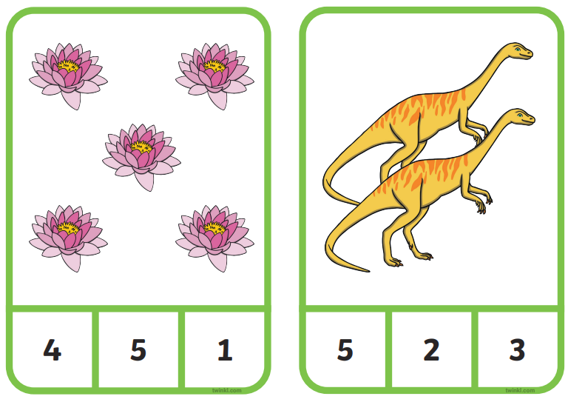
Maths
TBAT: Represent numbers within 10
Blue / Green
Which number represents the amount of objects shown?
Which has the most?
Challenge: How any more are there?
PAW Patrol: Number Bonds Interactive Game - Twinkl

Slide 20

TBAT: represent numbers within ten
number
zero
seven
five
six
one
the same value
two
eight
three
nine
as many
four
ten

Slide 21
Representing a number on the ten-frame
Challenge: Does it matter where we put the counters?
Notes:
New Learning: Representing a number on the ten-frame
Show pupils an enlarged, blank ten-frame and place five counters onto the top row. Ask pupils how many objects there are and model counting the counters from left to right.
What about if we start counting from here? Will there still be five objects?
Model counting from right to left to demonstrate that the number of objects stays the same and it does not matter which order we count them in. Move one of the counters to create a different arrangement of five and ask pupils what has changed. Explore how the number of objects remains the same even though the arrangement is different. Discuss different aspects of the composition. For example:
In this arrangement, we can see two, two and one, and that makes five.

Slide 22
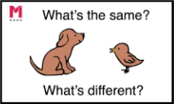



Representing a number on the ten-frame
What’s the same? What’s different?
Notes:
New Learning: Representing a number on the ten-frame
Explore other arrangements of five, discussing what’s the same and what’s different.

Slide 23
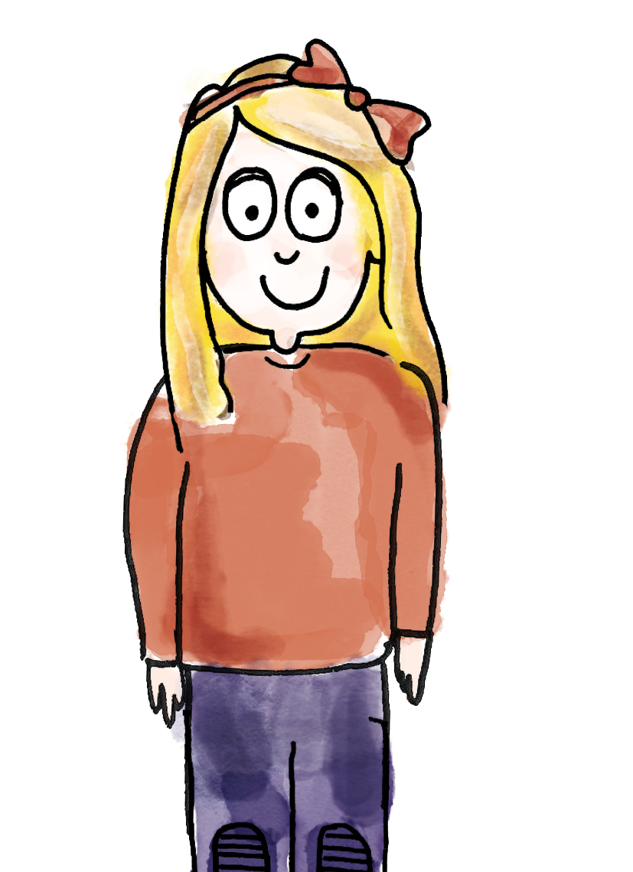
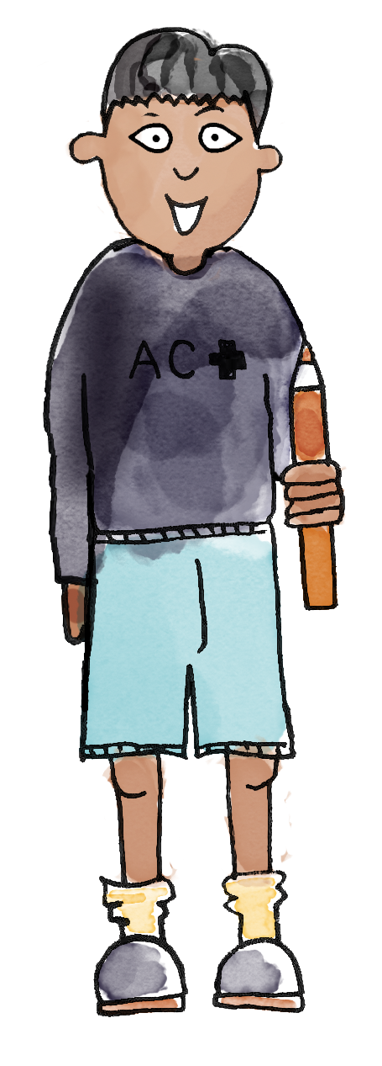
Finding different arrangements of the same number
How many counters are there?
One, two, three, four, five, six. There are six counters on the ten-frame.
zero one two three four five six seven eight nine ten number the same value as many
Notes:
Talk Task: Finding different arrangements of the same number
Place a set of number cards 0 to 10 on each table. Each pair has a ten-frame and ten counters.
Pupil A selects a number card and then represents that number on their ten-frame, using the counters. Pupil B counts the counters in the ten-frame and states what the number is. Pupil A changes the arrangement of counters. Pupil B counts the counters to check that the number has not changed.
Pupils swap roles.

Slide 24
Finding different arrangements of the same number
How many counters are there now?
One, two, three, four, five, six. There are still six counters on the ten-frame. The representations have the same value.
zero one two three four five six seven eight nine ten number the same value as many
Notes:
Talk Task: Finding different arrangements of the same number
Place a set of number cards 0 to 10 on each table. Each pair has a ten-frame and ten counters.
Pupil A selects a number card and then represents that number on their ten-frame, using the counters. Pupil B counts the counters in the ten-frame and states what the number is. Pupil A changes the arrangement of counters. Pupil B counts the counters to check that the number has not changed.
Pupils swap roles.

Slide 25

How could we represent 3?
Can you find any
other way using items around the
room?
Ten Frame Modeller (ictgames.com)

Slide 26
Exploring different arrangements on the ten-frame
What number is represented?
What does this representation tell us about the number?
This is the number seven.
I can see two and five.
Two and five make seven.
Ten Frame Modeller (ictgames.com)
practise on a ten frame
Notes:
Develop Learning: Exploring different arrangements on the ten-frame
Invite pairs to share their different ten-frame arrangements for numbers within ten and question pupils about the different arrangements. For example:
What do you notice about the number six?
What other numbers are represented on the ten-frame?
Is there another way to show the same number?
Introduce the Independent Task: ‘Ten-Frame Flash’ (https://nrich.maths.org/10742). Model the game with another adult where possible (or a pupil if not), using a ten-frame from the NRICH resource ‘Dozen Ten-Frames’.

Slide 27
To represent numbers within ten
Ten-Frame Flash
Now play ‘Ten-Frame Flash’ with your partner.
https://nrich.maths.org/10742
Notes:
Independent Task: Ten-Frame Flash
Pupils play ‘Ten-Frame Flash’ in pairs or small groups of three or four.
One pupil shows a ten-frame for a count of three, then hides it while the other pupils place counters in the same positions on their frames from memory. The pupil shows the card again and helps each pupil check their display. After three cards the next pupil has the chance to show numbers until everyone has had a turn.
Possible adaptations:
Instead of showing the ten-frame, pupils could play a barrier game where one pupil makes a concealed arrangement of counters and their partner guesses where the counters are.
Ask pupils to investigate all the arrangements they can make of a certain number, recording these with crosses on ten-frames.

Slide 28
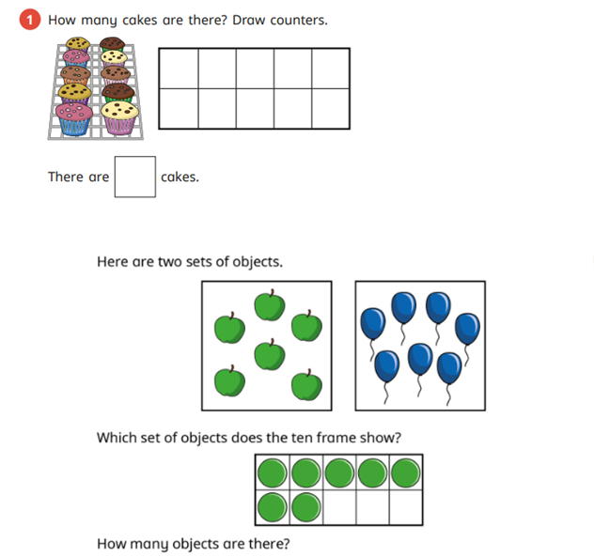
TBAT: represent numbers within ten
RP:
Notes:
Independent Task: Ten-Frame Flash
Pupils play ‘Ten-Frame Flash’ in pairs or small groups of three or four.
One pupil shows a ten-frame for a count of three, then hides it while the other pupils place counters in the same positions on their frames from memory. The pupil shows the card again and helps each pupil check their display. After three cards the next pupil has the chance to show numbers until everyone has had a turn.
Possible adaptations:
Instead of showing the ten-frame, pupils could play a barrier game where one pupil makes a concealed arrangement of counters and their partner guesses where the counters are.
Ask pupils to investigate all the arrangements they can make of a certain number, recording these with crosses on ten-frames.

Slide 29
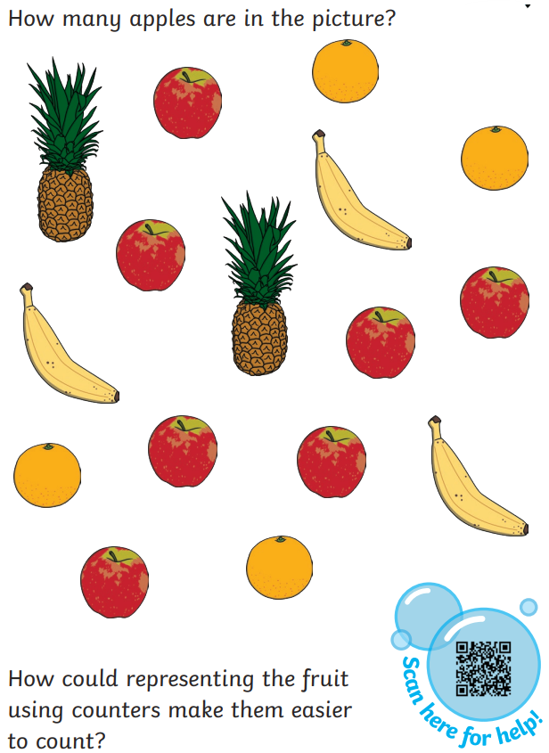
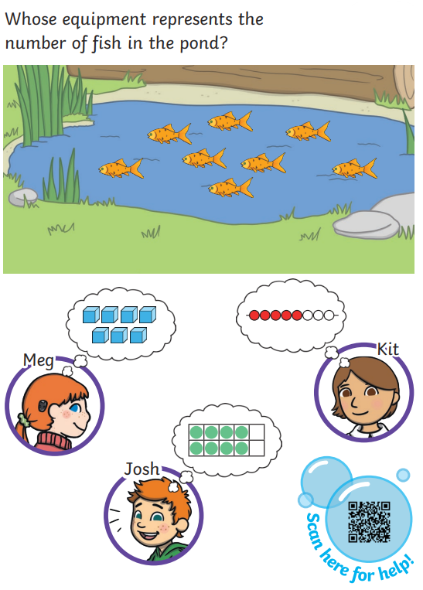
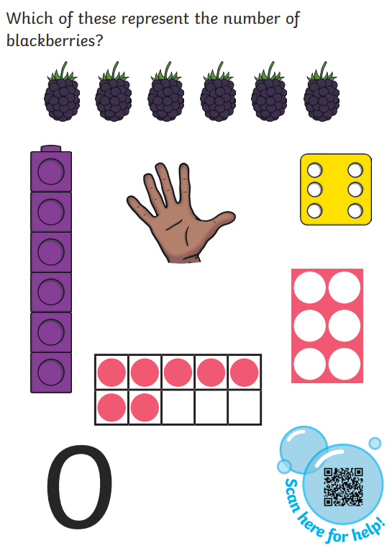
TBAT: represent numbers within ten
Challenge:
Mastery:
Mastery with
greater depth:
Notes:
Independent Task: Ten-Frame Flash
Pupils play ‘Ten-Frame Flash’ in pairs or small groups of three or four.
One pupil shows a ten-frame for a count of three, then hides it while the other pupils place counters in the same positions on their frames from memory. The pupil shows the card again and helps each pupil check their display. After three cards the next pupil has the chance to show numbers until everyone has had a turn.
Possible adaptations:
Instead of showing the ten-frame, pupils could play a barrier game where one pupil makes a concealed arrangement of counters and their partner guesses where the counters are.
Ask pupils to investigate all the arrangements they can make of a certain number, recording these with crosses on ten-frames.

Slide 30
How many can you see represented?
Notes:
Plenary: How many pennies can you hear?
Show pupils the ten-frames on the slide.
Explain to pupils that you will drop pennies into a tin so they can hear them and they must decide which ten-frame matches the number of pennies in the tin (either four, six, seven or nine).

Slide 32
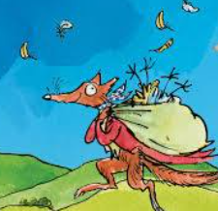

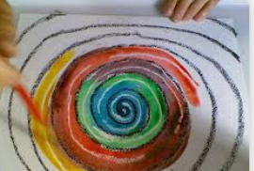
Independent Challenges:
Narrative Zone
Maths Zone
10 frame flash game.
How many ways can we represent the number on our 10 frame?
Put yours next to your name.
Write about the picture of Fantastic Mr Fox.
Enquiry Zone
Creative Zone
Can you find Scotland on the map?
What is it famous for?
Create a spiral picture, using any resources you like.

Slide 33

Lunch

Slide 34
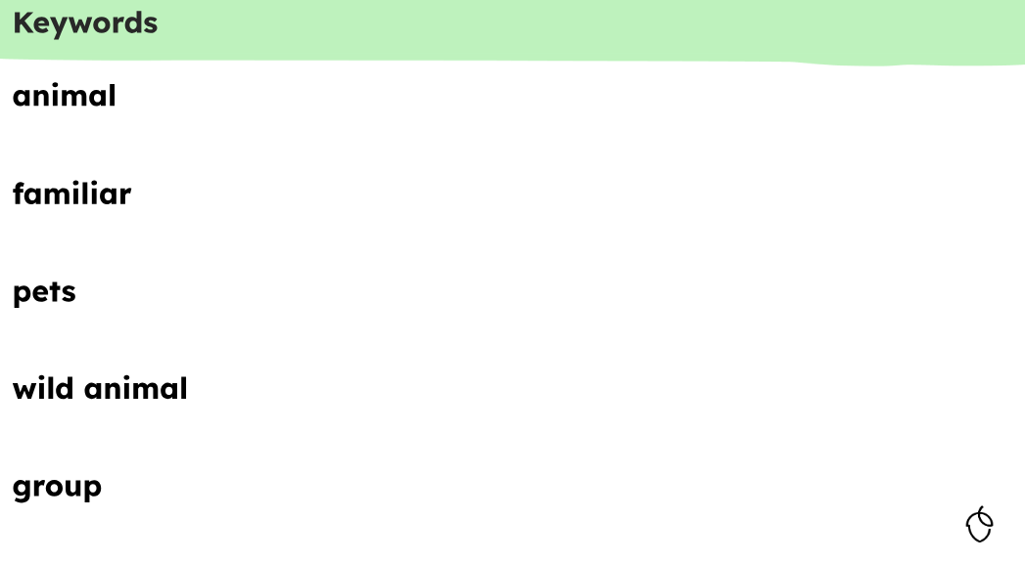
KQ: Can I name and group familiar animals?

Slide 35
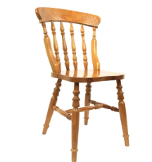
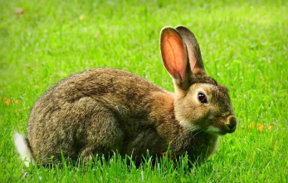
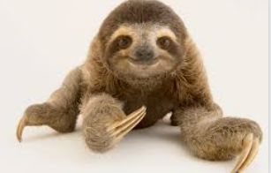
KQ: Can I name and group familiar animals?
3 in 3
Challenge: Explain how you know it is not an animal.

Slide 36

KQ: Can I name and group familiar animals?
alive
moves
eats
fluffy
scaly
Blue/Green
What is an animal?
An animal..............

Slide 37
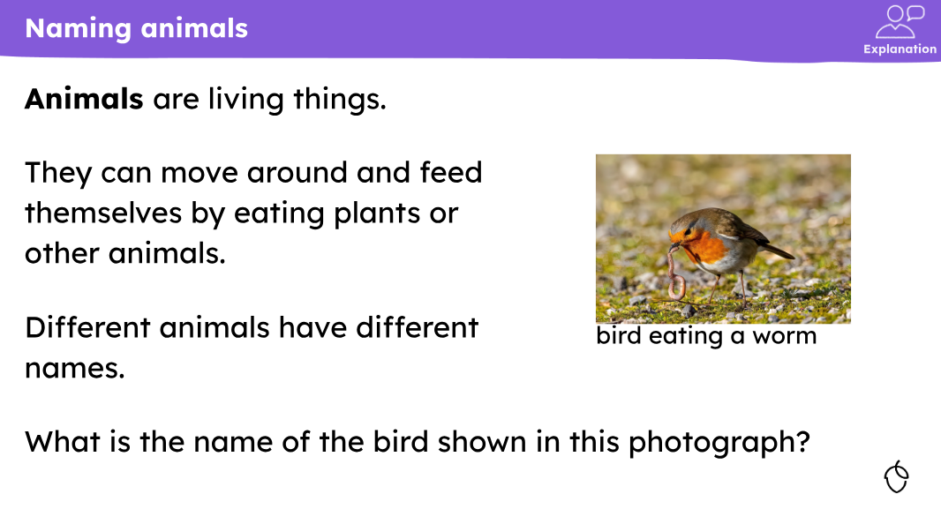
KQ: Can I name and group familiar animals?

Slide 38
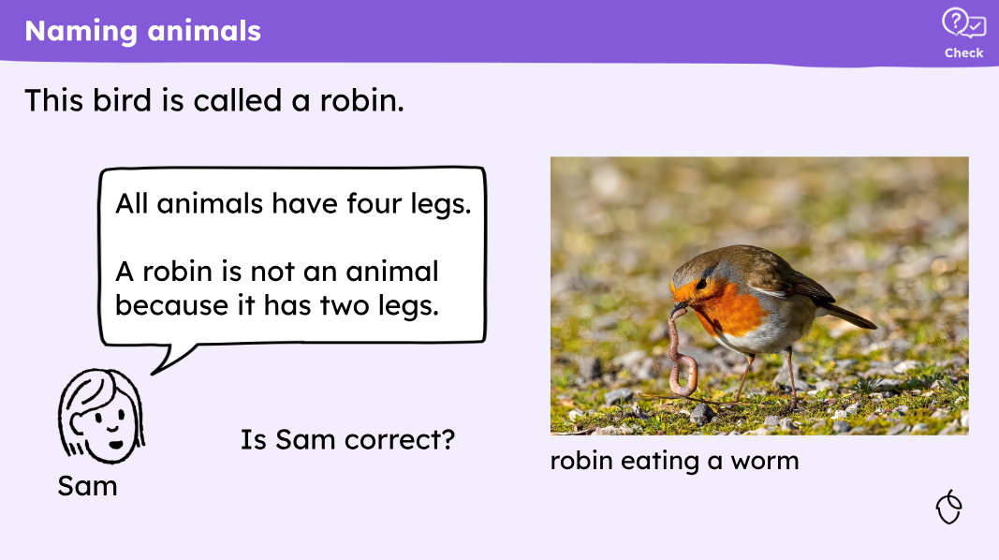
KQ: Can I name and group familiar animals?

Slide 39
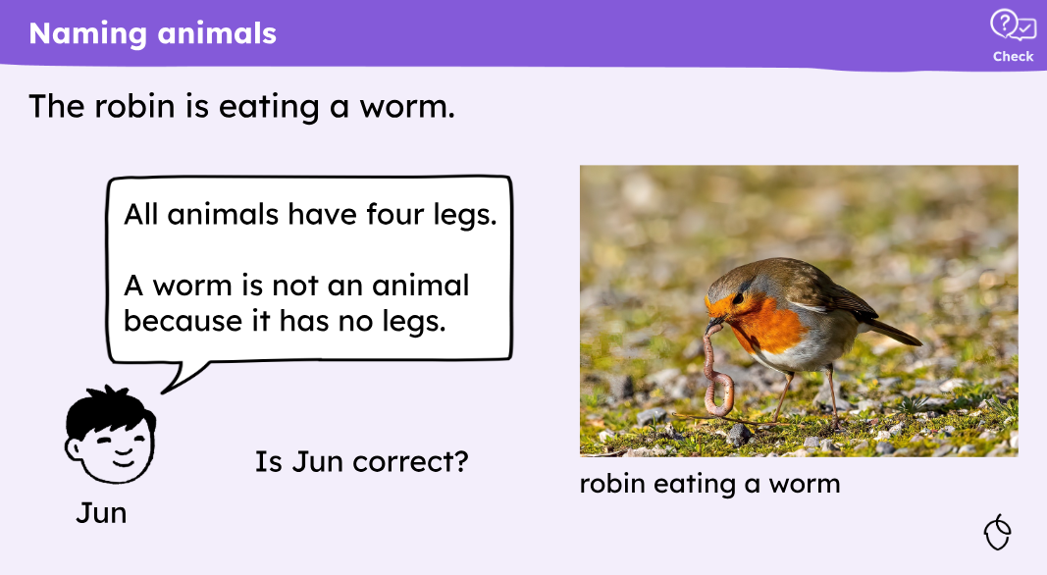
KQ: Can I name and group familiar animals?

Slide 40
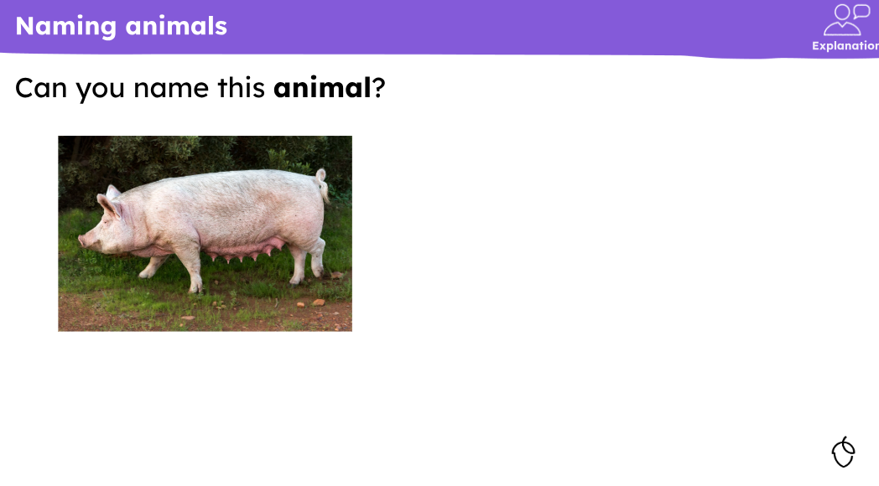
KQ: Can I name and group familiar animals?

Slide 41
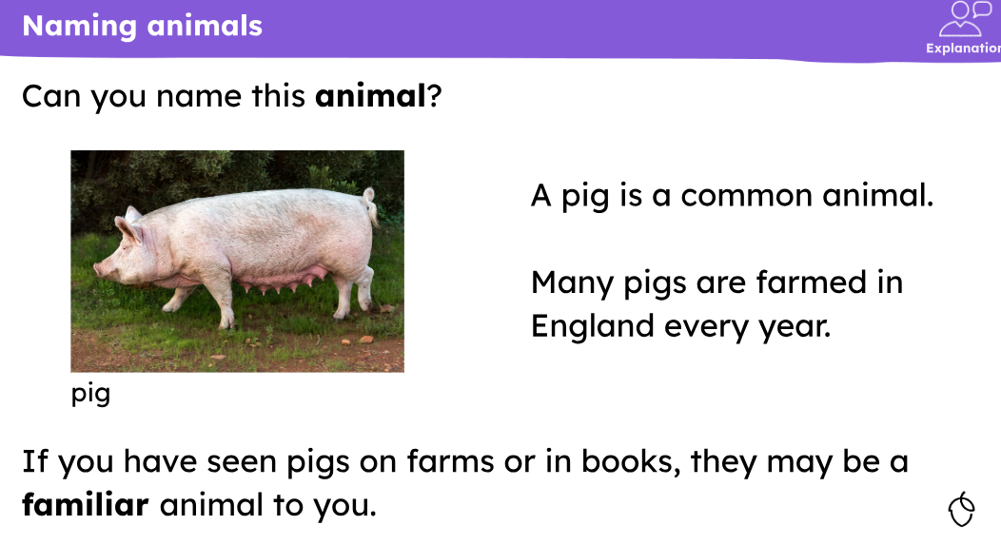
KQ: Can I name and group familiar animals?

Slide 42
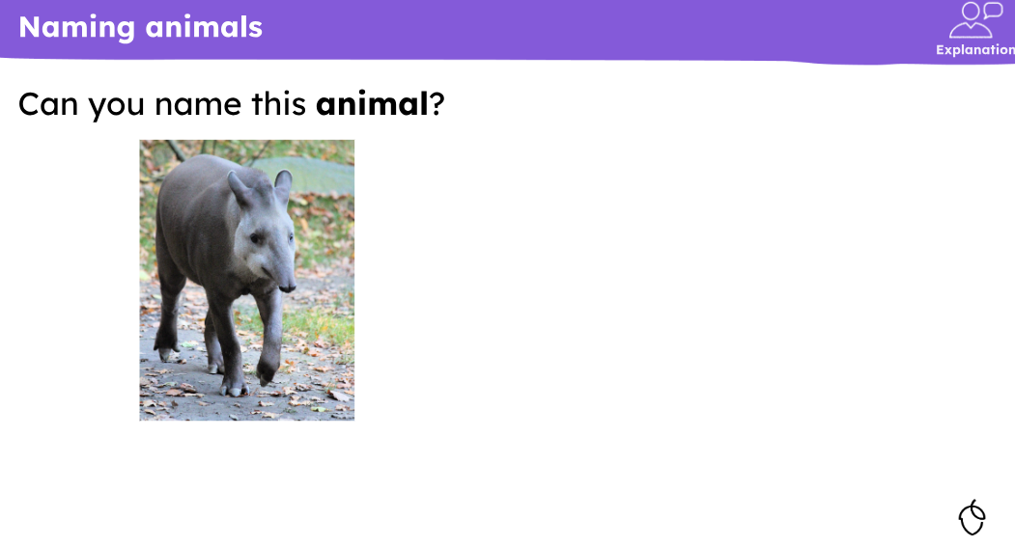
KQ: Can I name and group familiar animals?

Slide 43
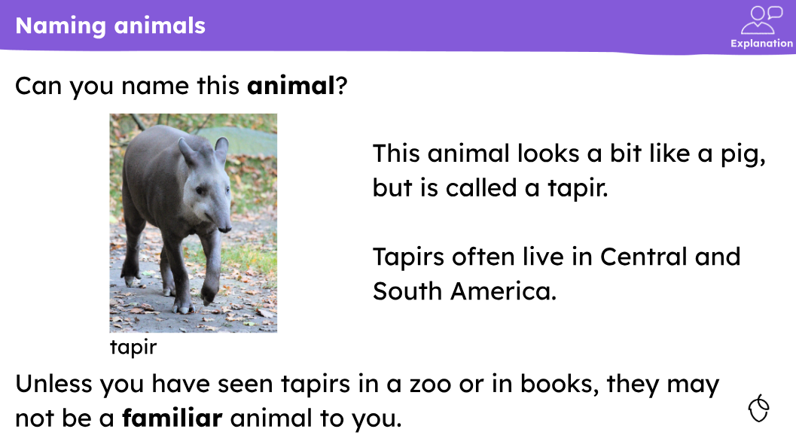
KQ: Can I name and group familiar animals?

Slide 44
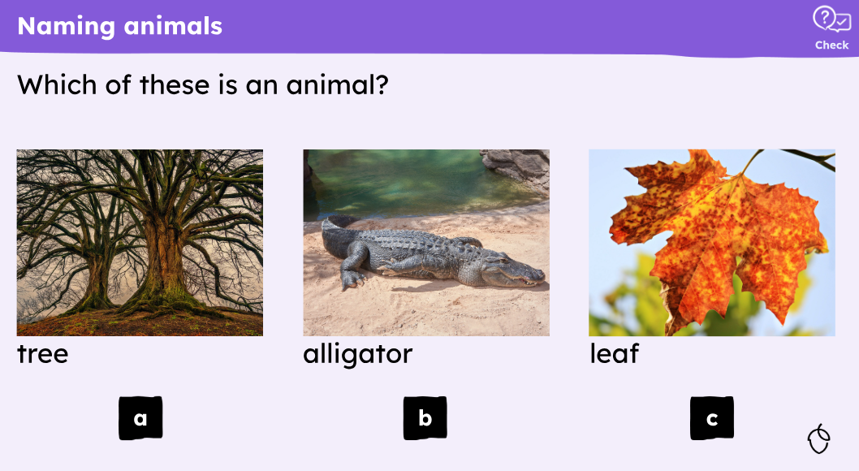
KQ: Can I name and group familiar animals?

Slide 45
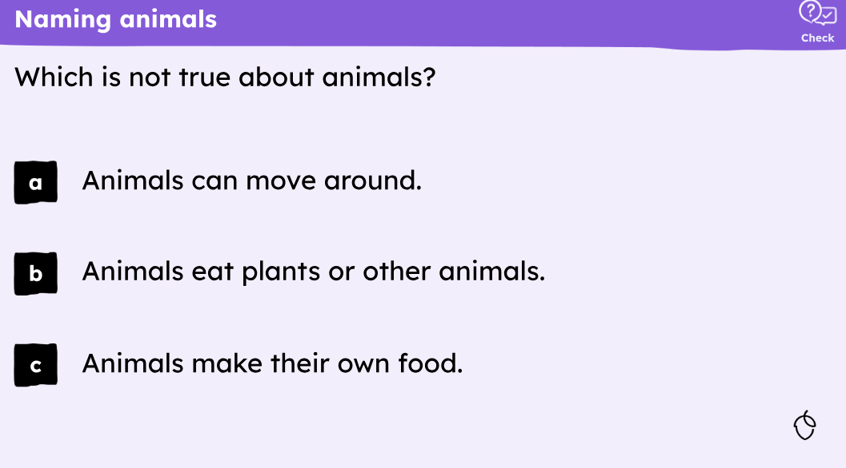
KQ: Can I name and group familiar animals?

Slide 46
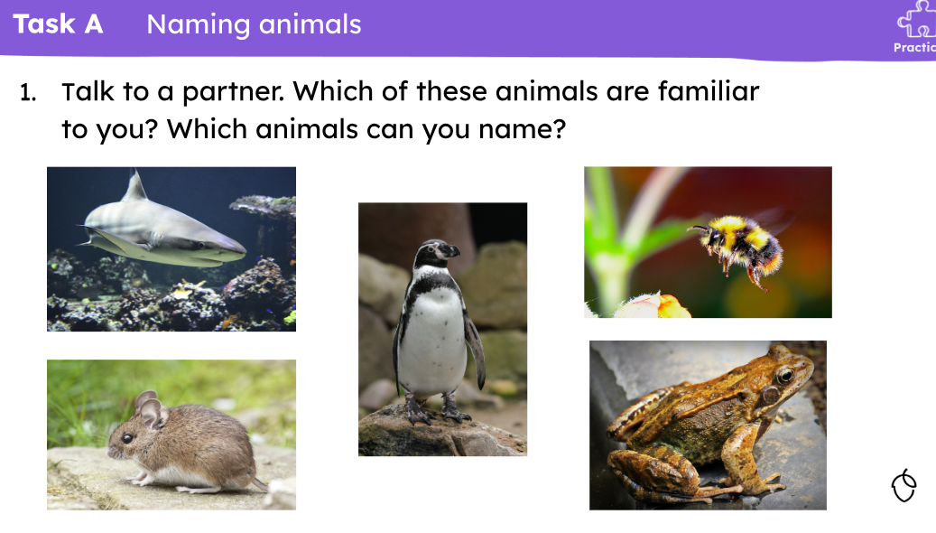
KQ: Can I name and group familiar animals?

Slide 47
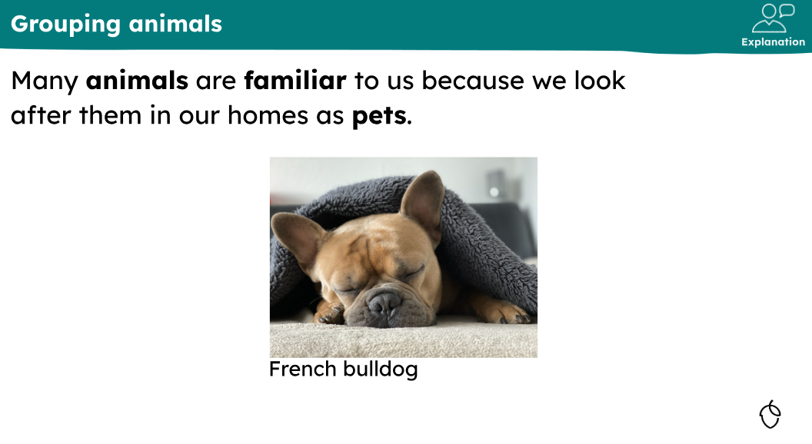
KQ: Can I name and group familiar animals?

Slide 48
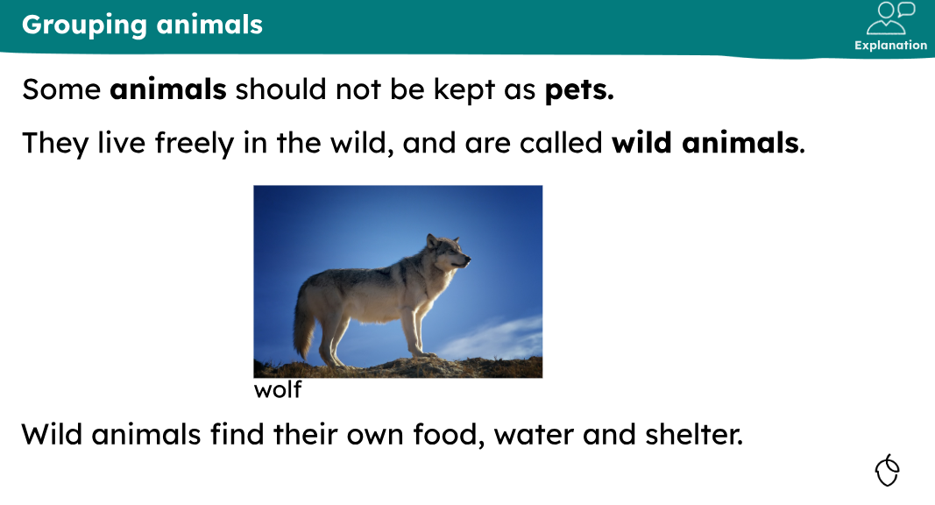
KQ: Can I name and group familiar animals?

Slide 49
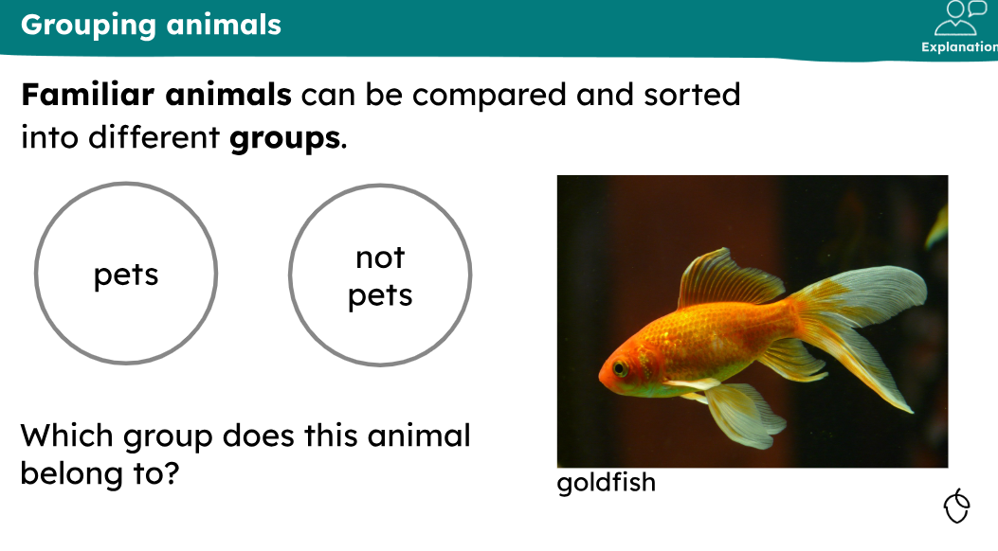
KQ: Can I name and group familiar animals?

Slide 50
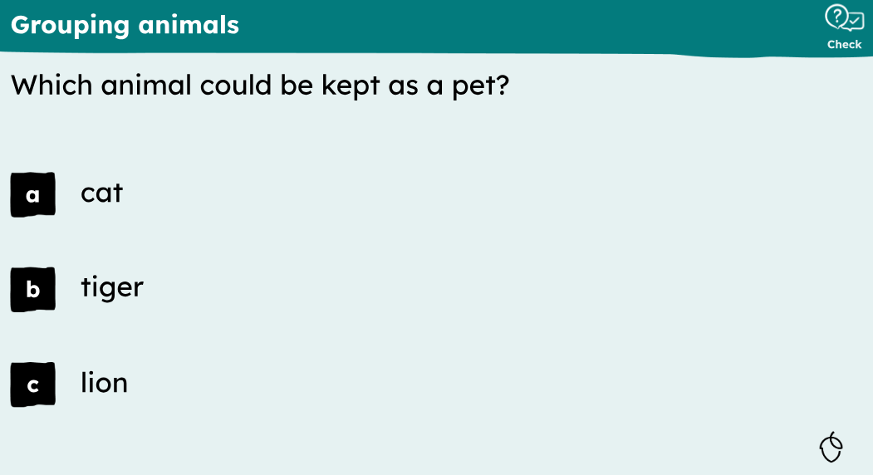
KQ: Can I name and group familiar animals?

Slide 51
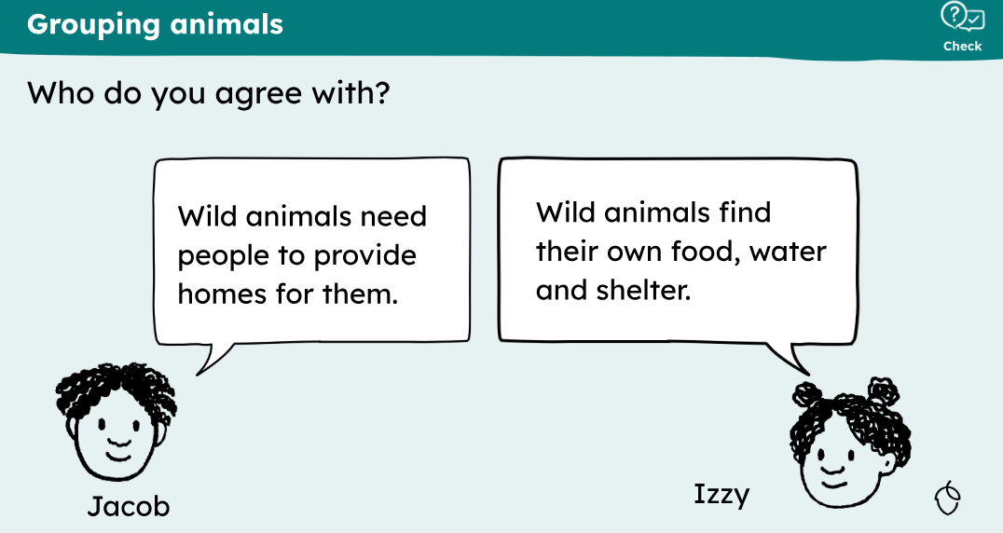
KQ: Can I name and group familiar animals?

Slide 52
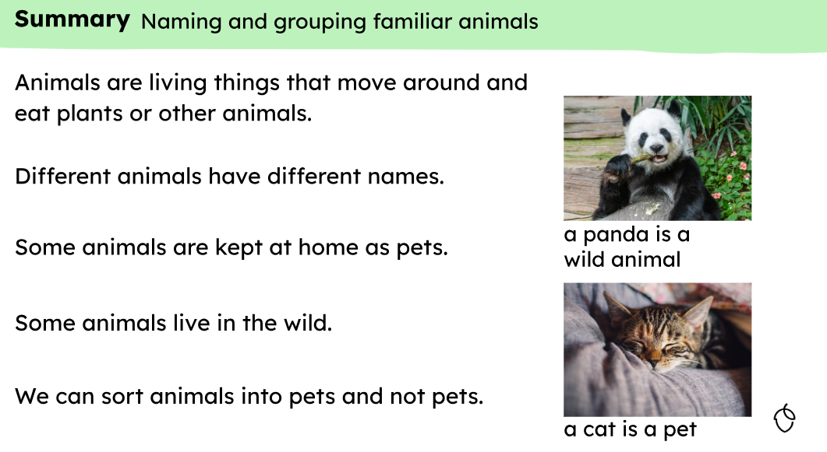
KQ: Can I name and group familiar animals?

Slide 53
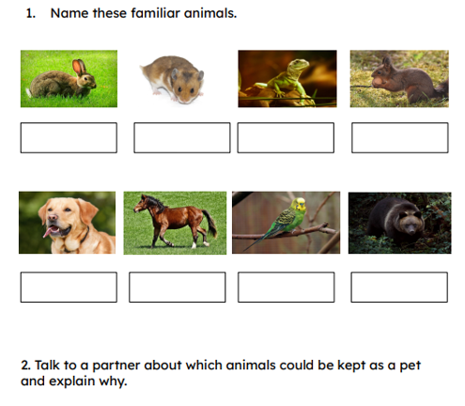
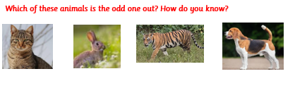
KQ: Can I name and group familiar animals?
Independent:
Challenge:

Slide 54
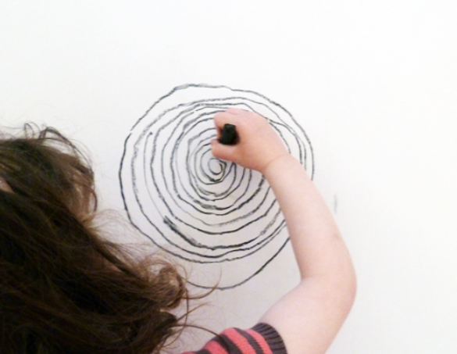
Art
3 in 3
What is a spiral?
Where might you see one?
Can you think of 3 different tools that could be used to create a spiral shape?
TBAT: make drawings using my body.

Slide 55
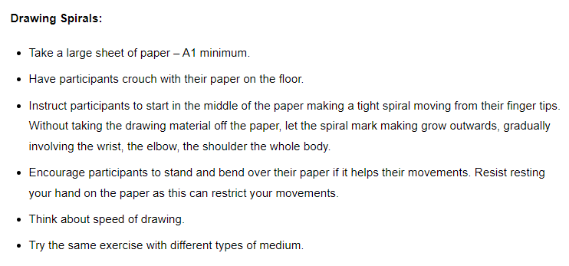
Medium: Pencil, charcoal, felt pen

Slide 56
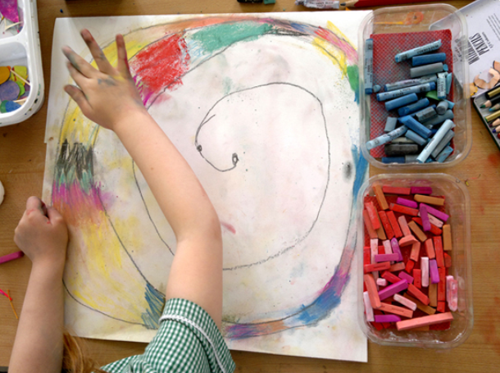
TBAT: make drawings using my body.
Drawing Spirals (accessart.org.uk)
Let's create some spirals!!!

Slide 57
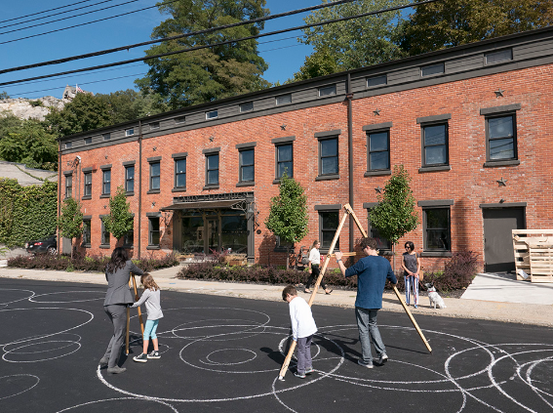
Outdoor Spirals
Use chalks outside to create:
A loud spiral
A quiet spiral
How are they different?

Slide 58
Independent Challenges:
Narrative Zone
Maths Zone
10 frame flash game.
How many ways can we represent the number on our 10 frame?
Put yours next to your name.
Write about the picture of Fantastic Mr Fox.
Enquiry Zone
Creative Zone
Can you find Scotland on the map?
What is it famous for?
Create a spiral picture, using any resources you like.

