Slide 1
Tuesday 9th September 2025

Slide 2



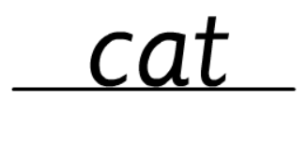
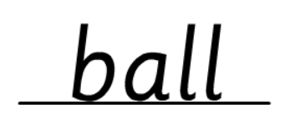
Morning Challenges:
Name writing

Slide 3
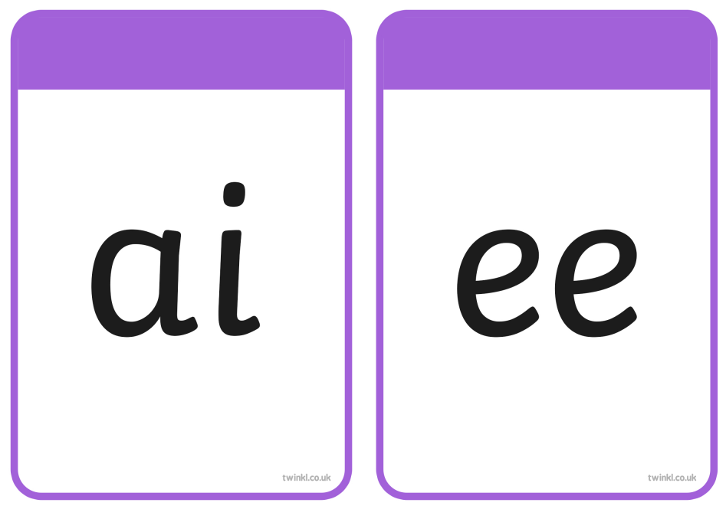



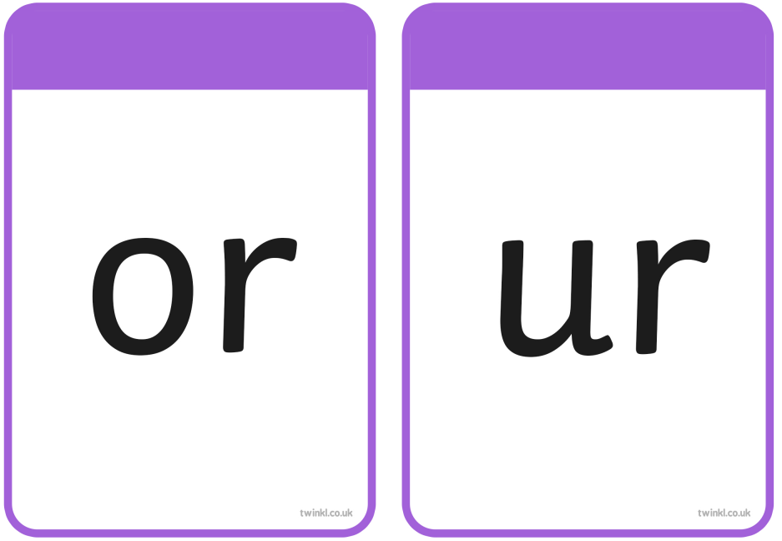



Slide 4
TBAT– read and spell words with 'oa/oo/ar graphemes
Tuesday 9th September 2025
sail
What is the digraph?

Slide 5
TBAT– read and spell words with 'oa/oo/ar graphemes
Tuesday 9th September 2025
tail
What is the digraph?

Slide 6
TBAT– read and spell words with 'oa/oo/ar graphemes
Tuesday 9th September 2025
right
What is the trigraph?

Slide 7
TBAT– read and spell words with 'oa/oo/ar graphemes
Tuesday 9th September 2025
feel
What is the digraph?

Slide 8
TBAT– read and spell words with 'oa/oo/ar graphemes
Tuesday 9th September 2025
sigh
What is the trigraph?

Slide 9
TBAT– read and spell words with 'oa/oo/ar graphemes
Tuesday 9th September 2025
week
What is the digraph?

Slide 10



TBAT– read and spell words with 'oa/oo/ar graphemes
Tuesday 9th September 2025
by
so

Slide 11
TBAT– read and spell words with 'oa/oo/ar graphemes
Tuesday 9th September 2025
r-oa-d

Slide 12
TBAT– read and spell words with 'oa/oo/ar graphemes
Tuesday 9th September 2025
f-oo-d

Slide 13
TBAT– read and spell words with 'oa/oo/ar graphemes
Tuesday 9th September 2025
h-ar-d

Slide 14
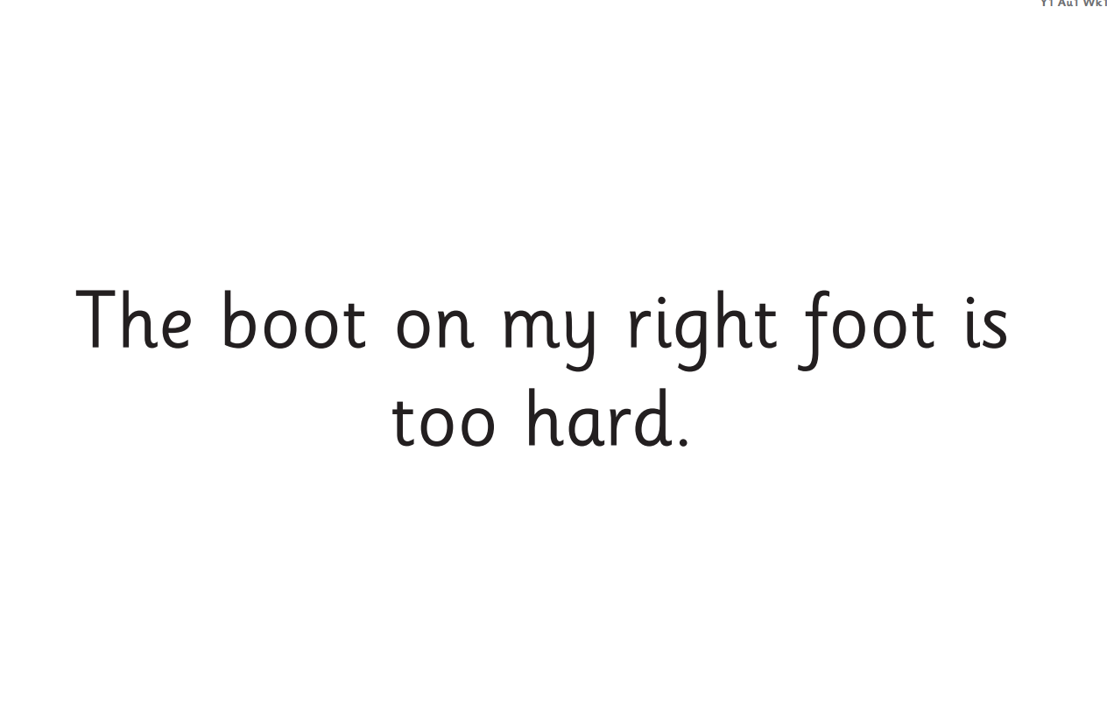
TBAT– read and spell words with 'oa/oo/ar graphemes
Tuesday 9th September 2025
Now let's read this sentence!​

Slide 15
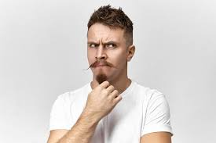
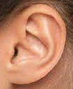


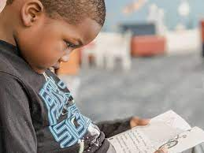
TBAT– read and spell words with 'oa/oo/ar graphemes
Tuesday 9th September 2025
tricky word
my
Listen
Say it
Write it
Check it
food hard

Slide 16
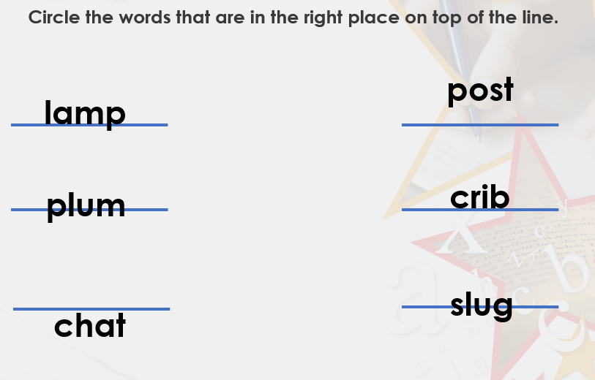
TBAT: leave appropriate spaces between words.
Tuesday 9th September 2025
6 in 3
Challenge:
Explain where the word should be.

Slide 17

TBAT: leave appropriate spaces between words.
Tuesday 9th September 2025
Blue/ Green- Can you find where there is a missing space?
I runto the shop.
The cat is on thebin.
The space should be...........

Slide 18
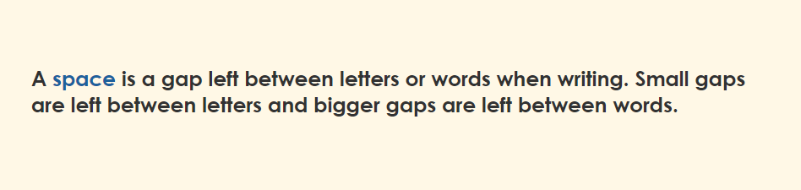
TBAT: leave appropriate spaces between words.
Tuesday 9th September 2025
Key information:

Slide 19
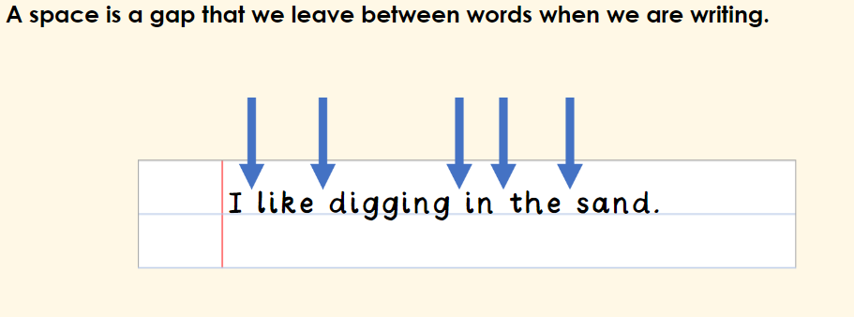
TBAT: leave appropriate spaces between words.
Tuesday 9th September 2025

Slide 20
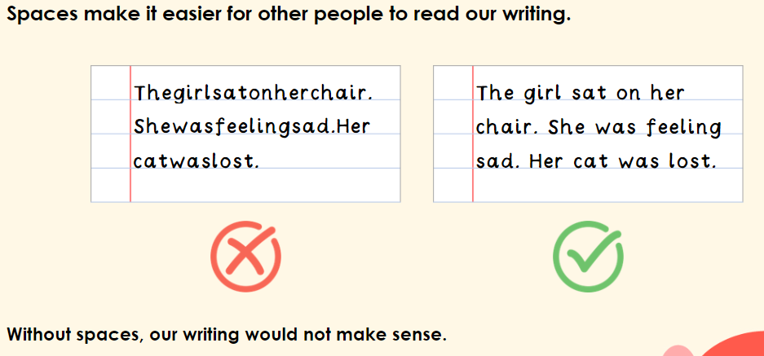
TBAT: leave appropriate spaces between words.
Tuesday 9th September 2025

Slide 21
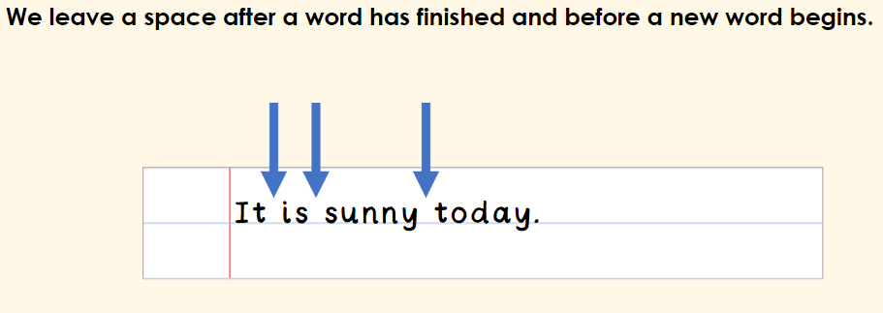
TBAT: leave appropriate spaces between words.
Tuesday 9th September 2025

Slide 22
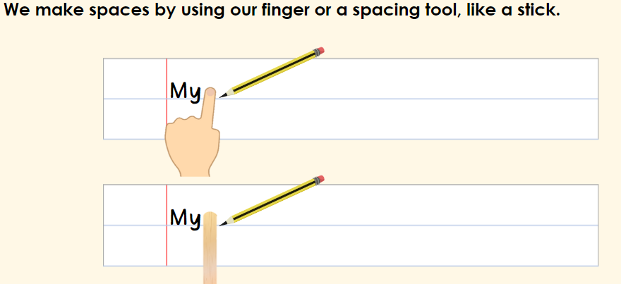
TBAT: leave appropriate spaces between words.
Tuesday 9th September 2025

Slide 23
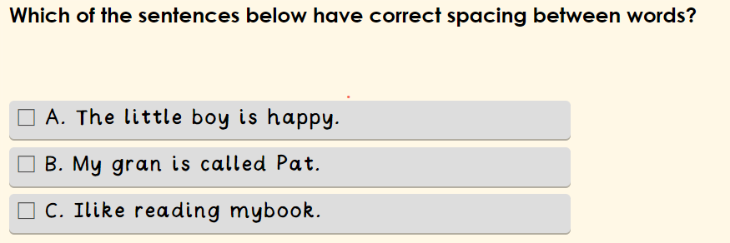
TBAT: leave appropriate spaces between words.
Tuesday 9th September 2025

Slide 24
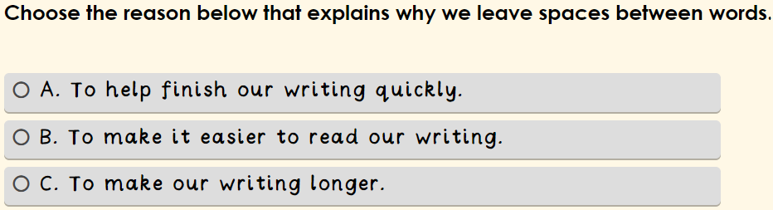
TBAT: leave appropriate spaces between words.
Tuesday 9th September 2025

Slide 25
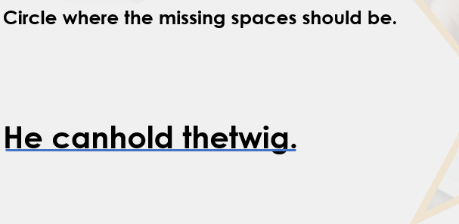
TBAT: leave appropriate spaces between words.
Tuesday 9th September 2025

Slide 26
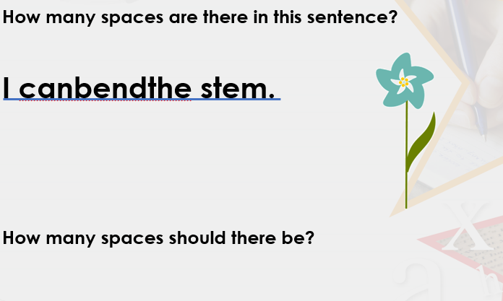
TBAT: leave appropriate spaces between words.
Tuesday 9th September 2025

Slide 27
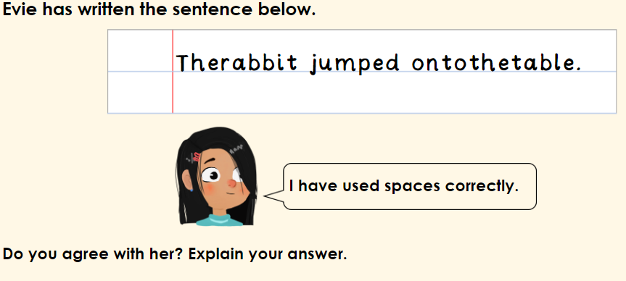
TBAT: leave appropriate spaces between words.
Tuesday 9th September 2025
I agree/disagree with Evie because..................

Slide 28
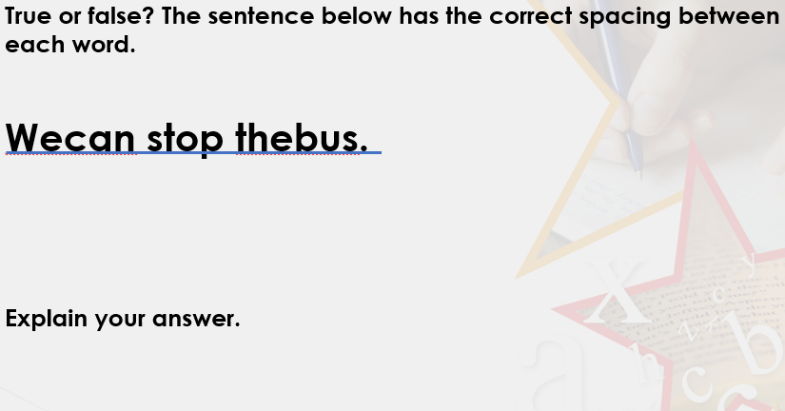
TBAT: leave appropriate spaces between words.
Tuesday 9th September 2025

Slide 29
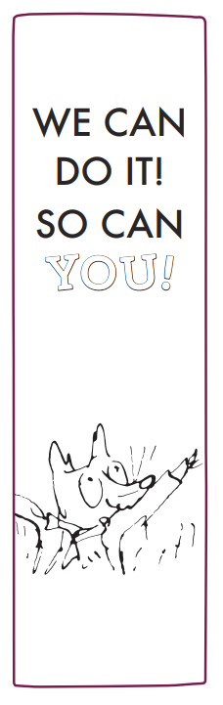


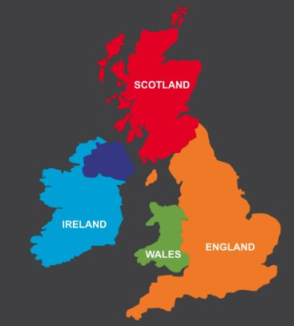
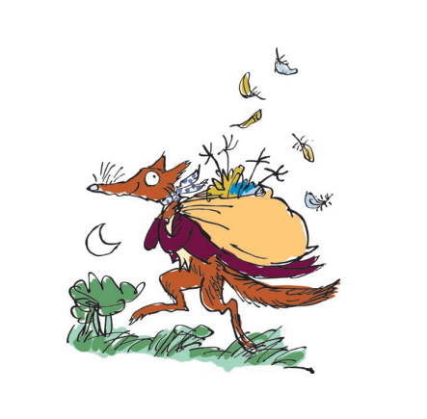
Independent Challenges:
Narrative Zone
Maths Zone
Match the balloons to their numbers.
Can you create a Fantastic Mr Fox bookmark?
Show the number using cubes or numicon.
Enquiry Zone
Creative Zone
Can you label the map with the correct countries and flags?
Can you create a Fantastic Mr Fox water colour?

Slide 32
Year 1 PSHE
Topic 1: New Beginnings
Lesson 1:
What are our ground rules in PSHE lessons?

Slide 33
Key vocabulary for this lesson
respect
manners
polite
discuss
respond
listen
Are there any word we are unsure of the meaning of?
Notes:
Key vocabulary will be green in colour throughout the presentation.
This could be used as a brief reading and comprehension activity to ensure understanding of key vocabulary. This vocabulary could be displayed throughout the lesson and children spot them throughout the lesson. This could be made into a game to tally throughout the week.

Slide 34
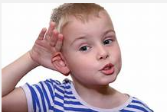
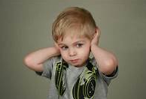
3 in 3
How do you know when someone is listening to you?
How does this make you feel?
What about when someone isn’t listening?
Notes:
Record the words they use on a large piece of poster paper to return to at the end of the lesson.

Slide 35

Blue/ Green
What is 'respect'?
How can we show respect?
Respect means............
We can show respect by............

Slide 36


With your partner decide if this is demonstrating respect
Katherine explains that she likes football better than tennis. Laura replies with you’re stupid because tennis is much better than football and anyone who likes football is an idiot. Is this demonstrating respect?
Notes:
Present some scenarios to children to challenge their understanding of rules of respect. Are these people behaving in an appropriate way in a PSHE lesson?
This can easily be adapted to address issues that arise throughout the lesson or have previously been an issue.

Slide 37
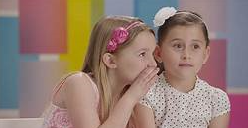
With your partner decide if this is demonstrating respect
Imogen is finding Hamish’s story about his family boring so she starts to talk to her friend about what they want to do at lunch time. Is this demonstrating respect?
Notes:
Present some scenarios to children to challenge their understanding of rules of respect. Are these people behaving in an appropriate way in a PSHE lesson?
This can easily be adapted to address issues that arise throughout the lesson or have previously been an issue.

Slide 38
With your partner decide if this is demonstrating respect
When Samir asks a question, a group of children begin laughing as they know the answer already. Is this demonstrating respect?
Notes:
Present some scenarios to children to challenge their understanding of rules of respect. Are these people behaving in an appropriate way in a PSHE lesson?
This can easily be adapted to address issues that arise throughout the lesson or have previously been an issue.

Slide 39
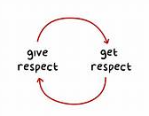
Your task:
Create a poster to remind the class what our rules for respect are.
You must:
  Include all of the agreed rules
  Make it eye catching (using colours and pictures)
  Use classroom resources to check spellings of tricky words

