Slide 1
Tuesday 30th September 2025

Slide 2





Morning Challenges:
Name writing

Slide 3







TBAT: read and write words with the alternative /ow/ grapheme /ou/.
Tuesday 30th September 2025

Slide 4
TBAT: read and write words with the alternative /ow/ grapheme /ou/.
Tuesday 30th September 2025
play

Slide 5
TBAT: read and write words with the alternative /ow/ grapheme /ou/.
Tuesday 30th September 2025
say

Slide 6
TBAT: read and write words with the alternative /ow/ grapheme /ou/.
Tuesday 30th September 2025
chair

Slide 7
TBAT: read and write words with the alternative /ow/ grapheme /ou/.
Tuesday 30th September 2025
string

Slide 8
TBAT: read and write words with the alternative /ow/ grapheme /ou/.
Tuesday 30th September 2025
thunder

Slide 9
TBAT: read and write words with the alternative /ow/ grapheme /ou/.
Tuesday 30th September 2025
quicker

Slide 10




TBAT: read and write words with the alternative /ow/ grapheme /ou/.
Tuesday 30th September 2025
says

Slide 11

TBAT: read and write words with the alternative /ow/ grapheme /ou/.
Tuesday 30th September 2025

Slide 12
TBAT: read and write words with the alternative /ow/ grapheme /ou/.
Tuesday 30th September 2025
c-l-ou-d

Slide 13
TBAT: read and write words with the alternative /ow/ grapheme /ou/.
Tuesday 30th September 2025
a-b-ou-t

Slide 14
TBAT: read and write words with the alternative /ow/ grapheme /ou/.
Tuesday 30th September 2025
p-r-ou-d

Slide 15

TBAT: read and write words with the alternative /ow/ grapheme /ou/.
Tuesday 30th September 2025
Now let's read this sentence!​

Slide 16
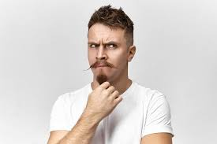
TBAT: read and write words with the alternative /ow/ grapheme /ou/.
Tuesday 30th September 2025
you
tricky word
cloud sound

Slide 17



TBAT: sequence the events of a story.
Tuesday 30th September 2025
3 in 3- Match the word the pictures to order the steps.
first
then
finally
Challenge: Can you think of any other time connective words?

Slide 18
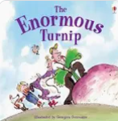

TBAT: sequence the events of a story.
Tuesday 30th September 2025
Blue/ Green- With your partner......
What do you think this story could be about?
Who might the characters be?
Where do you think the story will happen- the setting?
farm vegetable huge

Slide 19
TBAT: sequence the events of a story.
Tuesday 30th September 2025
Words you will come across in the text:
heaved: to push or pull with great effort.
budge: move or shift.
dashed: to move fast.
yanked: a strong sudden pull.

Slide 20
TBAT: sequence the events of a story.
Tuesday 30th September 2025
Let's listen to the story.
The Enormous Turnip - Kids Books Read Aloud - YouTube

Slide 21
TBAT: sequence the events of a story.
Tuesday 30th September 2025
Multiple Choice questions:
What is the first thing the old man does in "The Enormous Turnip"?
A) He calls for help.
B) He plants the turnip seeds.
C) He tries to pull the turnip out of the ground.
D) He waters the garden.

Slide 22
TBAT: sequence the events of a story.
Tuesday 30th September 2025
Multiple Choice questions:
After the old man finds the enormous turnip, who does he ask for help next?
A) The dog
B) The old woman
C) The cat
D) The children

Slide 23
TBAT: sequence the events of a story.
Tuesday 30th September 2025
Multiple Choice questions:
Which sequence of events occurs just before the turnip is finally pulled out of the ground?
A) The old man, old woman, dog, and cat all work together.
B) The children arrive to help.
C) The turnip grows even bigger.
D) The old woman decides to give up.

Slide 24
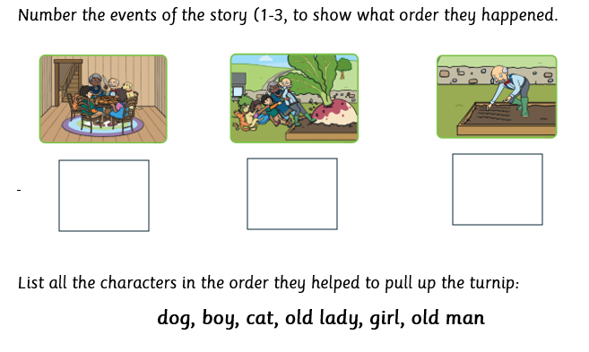
TBAT: sequence the events of a story.
Tuesday 30th September 2025
In your book:
Challenge:
Briefly re-write the story using time connectives such as first, then, next, finally etc.

Slide 25
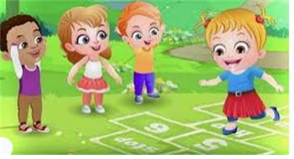
Break

Slide 26

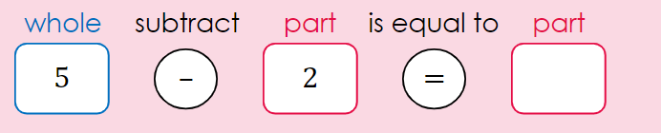
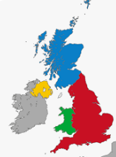

Independent Challenges:
Narrative Zone
Maths Zone
Can you use the templates to create subtraction sentences?
How many words can you think of to describe the turnip?
Enquiry Zone
Creative Zone
Can you find and name all 4 UK capital cities in an atlas?
Create a spiral picture inspired by Alma Woodsey Thomas.

Slide 27

Lunch

Slide 28
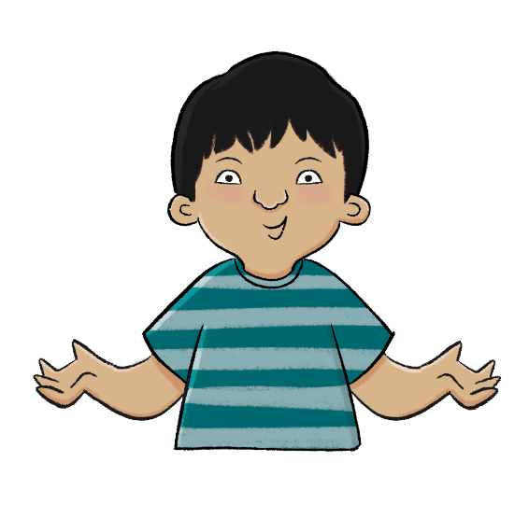

Unit 2: The United Kingdom
KQ: What is England famous for?
Copyright © ArkCurriculum+ 2023

Slide 29

4 in 4
1. The capital city of Northern Ireland is …
Cardiff Belfast
2. What is a traditional sport from Northern Ireland?
rugby swimming Gaelic football
3. What language do many people speak in Northern Ireland?
Cymraeg French Gaelic
4. A natural feature is one that is human-made.
true false
Copyright © ArkCurriculum+ 2023
Notes:
Knowledge quiz 2.4: Pupils complete this in the Additional resource: Knowledge quizzes to assess their knowledge retention from the previous lesson. They write their score in the chart also provided in the additional resource.

Slide 30
4 in 4
1. The capital city of Northern Ireland is …
Cardiff Belfast
2. What is a traditional sport from Northern Ireland?
rugby swimming Gaelic football
3. What language do many people speak in Northern Ireland?
Cymraeg French Gaelic
4. A natural feature is one that is human-made.
true false
Copyright © ArkCurriculum+ 2023

Slide 31
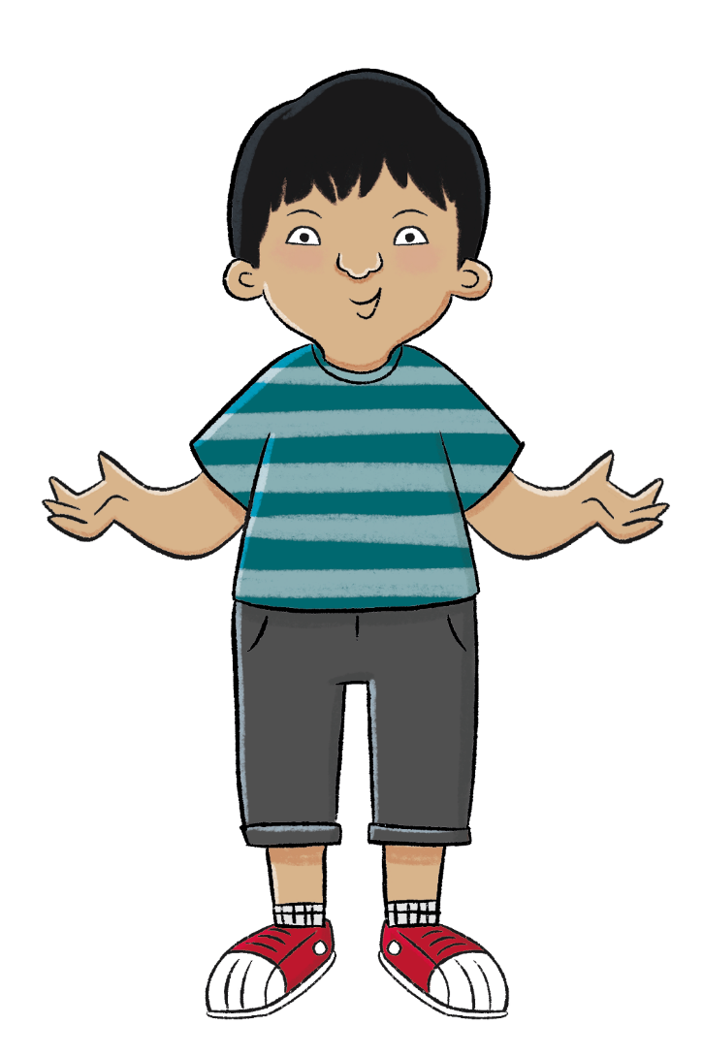

KQ: What is England famous for?
What are the countries that make up the United Kingdom like?
Blue / Green
Would you like to visit Northern Ireland?
I would / would not like to visit Northern Ireland because …
Enquiry question
Copyright © ArkCurriculum+ 2023
Notes:
Enquiry question: Share the unit enquiry question ‘What are the countries that make up the United Kingdom like?’. Explain that all lessons in this unit will support pupils in answering this question at the very end. Each lesson has its own question, and they should be able to answer each of these individually too.

Slide 32

KQ: What is England famous for?
What is the
United Kingdom?
Why do people visit Northern Ireland?
1
4
What is it like to live
in Scotland?
What is England
famous for?
2
5
3
What is special
about Wales?
What is the Union
Jack and what does
it represent?
6
Copyright © ArkCurriculum+ 2023
Notes:
Introduction: Share the learning journey, lesson question, lesson statement, and key term. Then share key knowledge and other key vocabulary with pupils—you may want to add images to the teaching slides to support exemplification and understanding of these words. Then using Google Maps, recap the location of Scotland, Wales, Northern Ireland, and their capital cities. Then locate England and London. Explain that London is the capital city of the whole of the UK, as well as the capital of England.

Slide 33
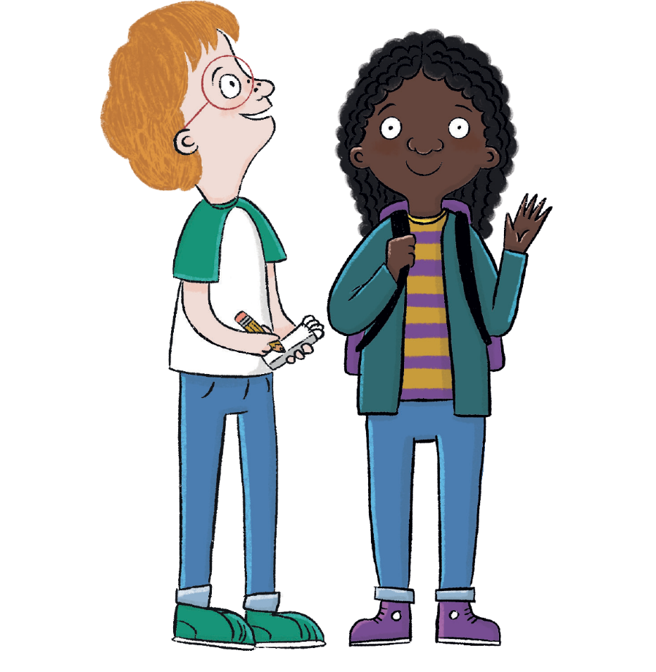
KQ: What is England famous for?
In this lesson, we are going to learn about England and what it is famous for.
Copyright © ArkCurriculum+ 2023

Slide 34
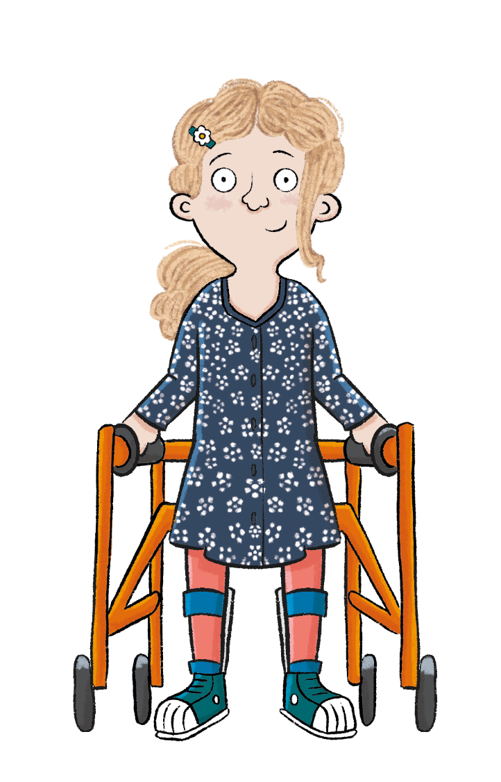
KQ: What is England famous for?
The key term in this lesson is parliament.
Parliament is a group of people who run a country.
Copyright © ArkCurriculum+ 2023

Slide 35
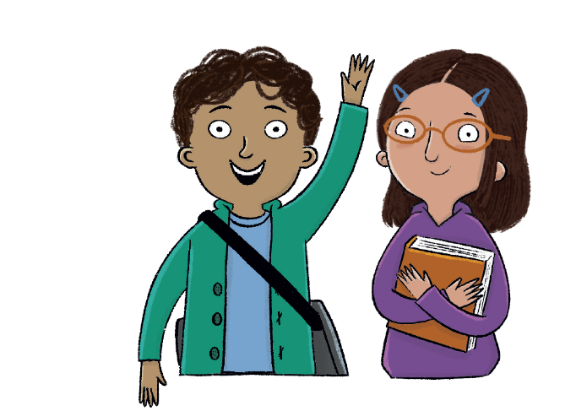
What is England famous for?
Key knowledge
England is the biggest country in the United Kingdom.
London is the capital city of England.
The tallest mountain in England is called Scafell Pike.
Key vocabulary
city
countryside
London
parliament
River Thames
Scafell Pike
Copyright © ArkCurriculum+ 2023

Slide 36
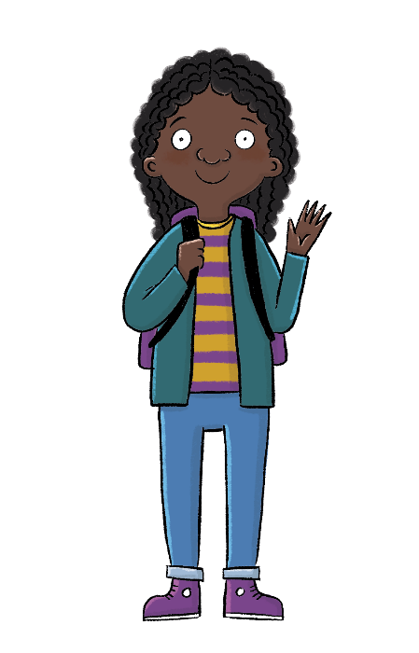
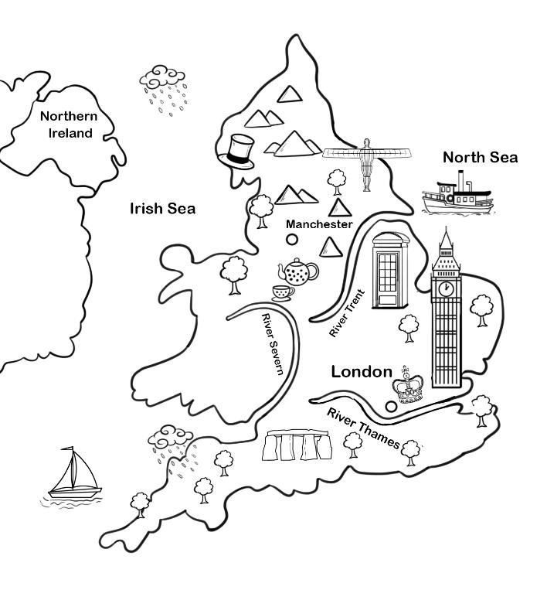
KQ: What is England famous for?
Can you find London on this map? What landmarks can you spot on the map that tourists might want to visit in England?
England is the biggest country in the UK. The capital city of England is London, which is also the capital of the whole of the United Kingdom.
Copyright © ArkCurriculum+ 2023
Notes:
Talk task: Share the illustrated map of England and discuss the images. Ask: ‘Can you find London on this map? What landmarks can you spot on the map that tourists might want to visit in England?’.

Slide 37
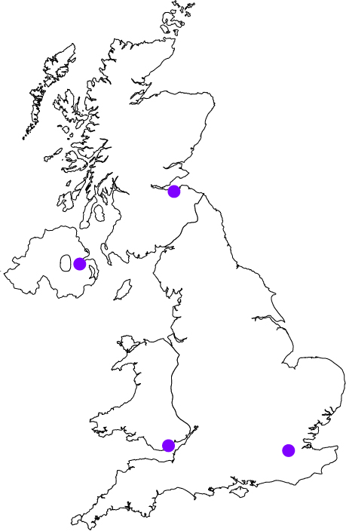
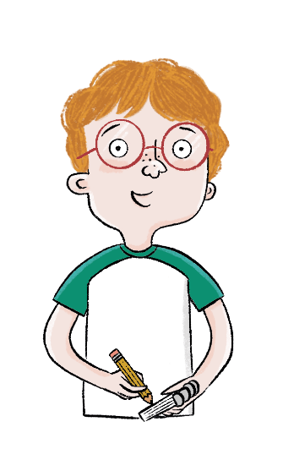
KQ: What is England famous for?
Look at the map and complete the following:
England
London
Northern Ireland
Scotland
Wales
1. Label Scotland on the map and
colour it blue.
2. Label Wales on the map and
colour it red.
3. Label Northern Ireland on the
map and colour it orange.
4. Label England on the map and
colour it yellow.
5. Label England’s capital city.
6. Label where you live on the map.
Copyright © ArkCurriculum+ 2023
Notes:
Write: Ask pupils to look at the map and to label Scotland, Wales, Northern Ireland, England, and London on the map. Then colour and label Scotland, Wales, Northern Ireland, and England.

Slide 38

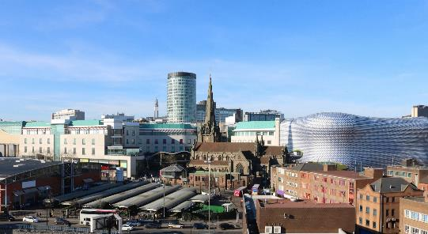
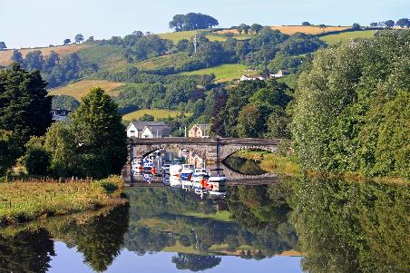
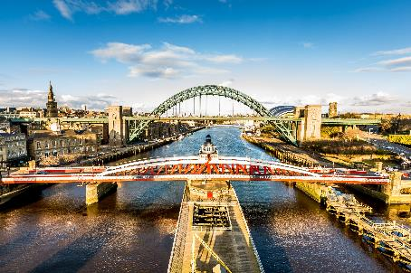
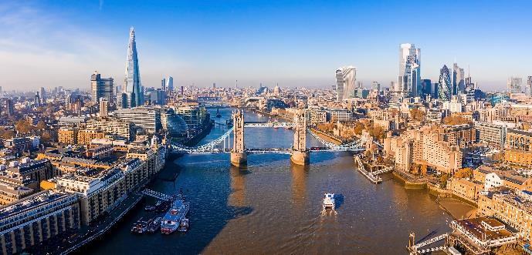
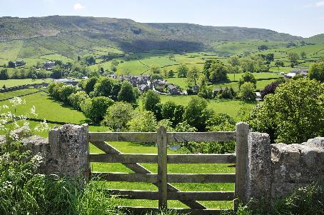
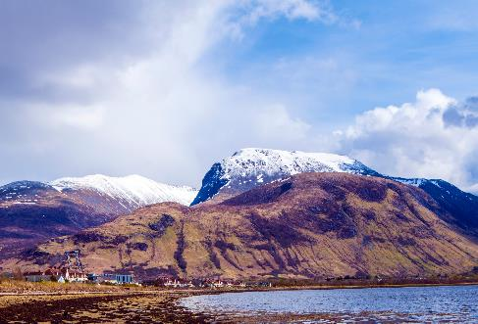
KQ: What is England famous for?
City or countryside?
Sort the images into two piles—city and countryside.
Copyright © ArkCurriculum+ 2023
Notes:
Group task: Bring the class back together. Search on Google Maps for your school and explain which country of the UK it is in. Then state a fact about that country, for example England is the biggest country in the UK or Scotland is the furthest north country in the UK. Then split pupils into small groups and give each group a hand out of Additional resource: City or countryside. Without explaining what the images are of, ask pupils to work in their groups to sort the images into two piles. Ask: ‘Why have you sorted them in that way?’. Explain that some of the pictures show cities in England, while other pictures show the countryside of England.

Slide 39
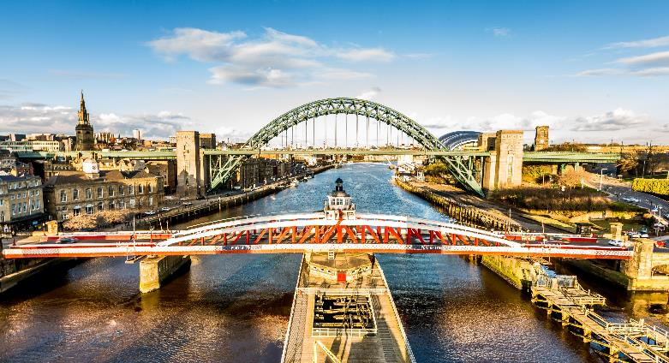
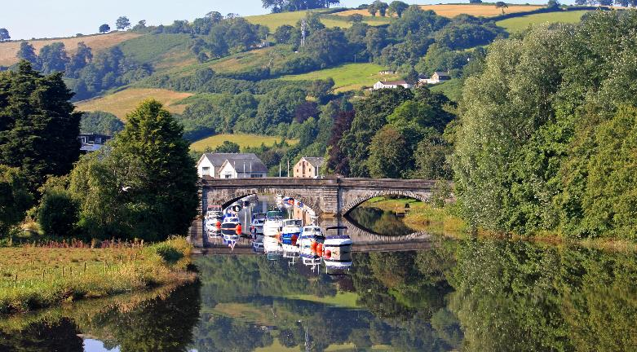
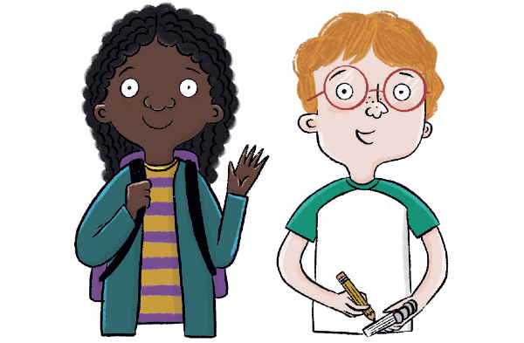
KQ: What is England famous for?
City or countryside?
Cities are places with lots of different buildings and roads.
Countryside is the land outside towns and cities, with fields, woods, and farms.
Copyright © ArkCurriculum+ 2023
Notes:
Read: Read ‘City or countryside?’ to explain the differences between cities and the countryside.

Slide 40




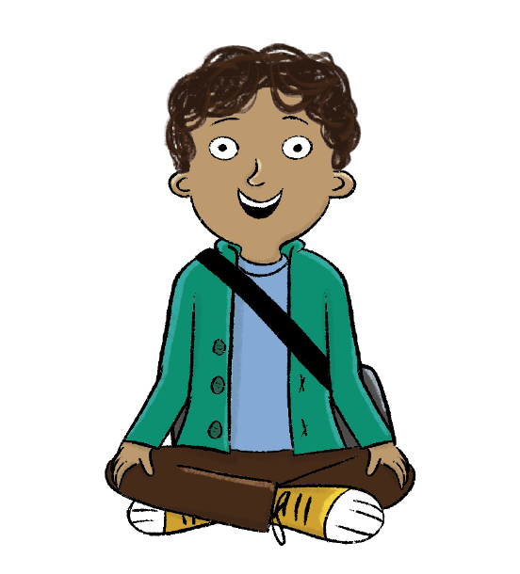
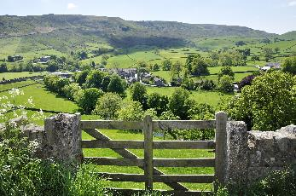
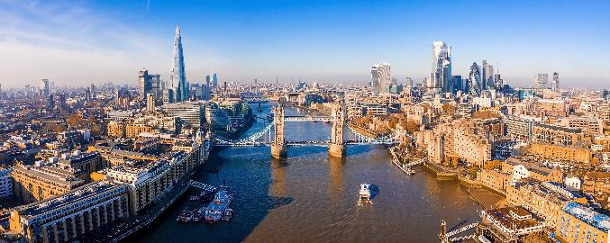
KQ: What is England famous for?
City or countryside?
City | Countryside
Why have you sorted them in that way?
Copyright © ArkCurriculum+ 2023
Notes:
Group task: Now that pupils know the difference between cities and the countryside, go through the correct answers.

Slide 41
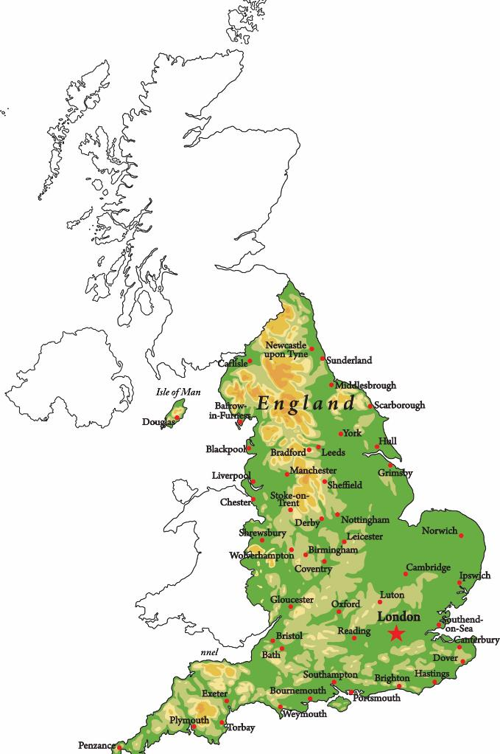
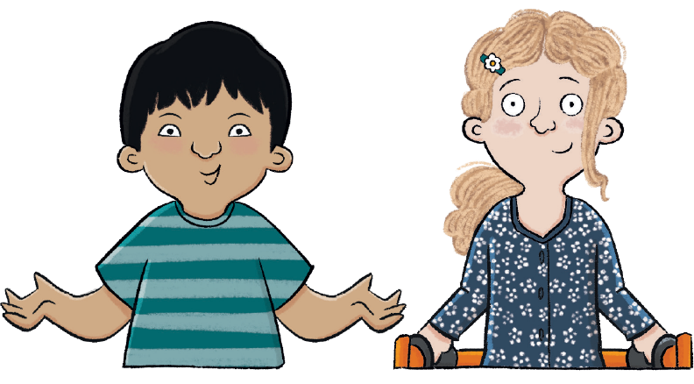
KQ: What is England famous for?
What is England like?
England is the biggest country in the United Kingdom.
Copyright © ArkCurriculum+ 2023
Notes:
Read: ‘What is England like?’. Explain thousands of tourists visit England every year. Talk about the geography of England and how it varies—from mountains like Scafell Pike to flatlands in southern England. Ask what children can see in the pictures of Scafell Pike and a southern farming field.

Slide 42
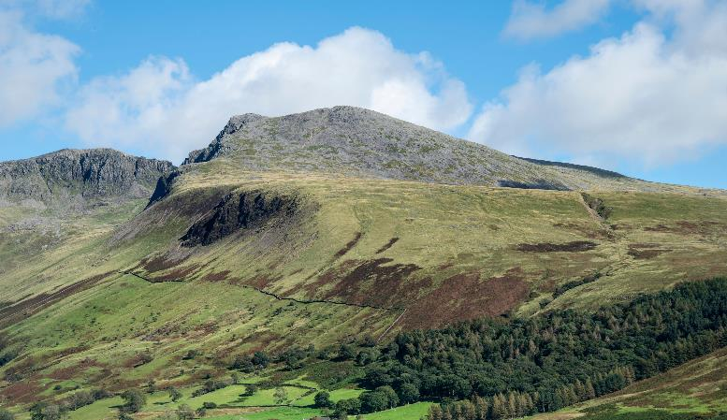

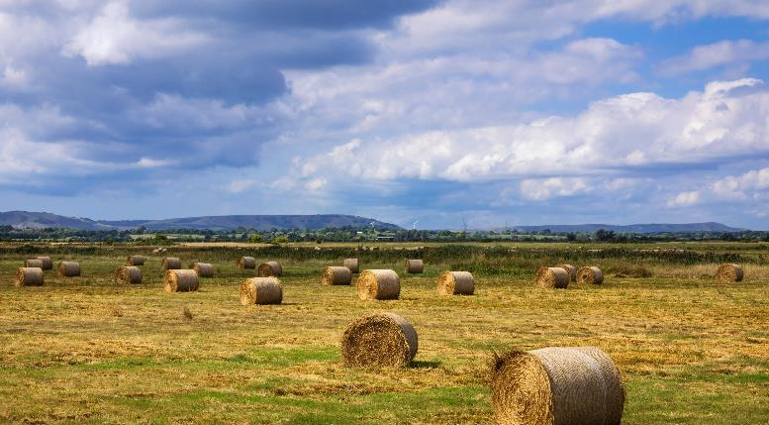
KQ: What is England famous for?
What is England like?
The north of England is much hillier than the south. The tallest mountain in England is called Scafell Pike. It is in the county of Cumbria in northern England.
The south of England is quite flat, which means it is
good land for farming
and growing food.
Copyright © ArkCurriculum+ 2023

Slide 43
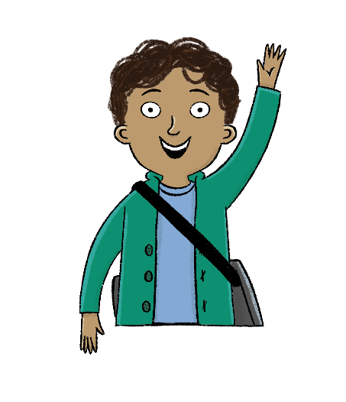
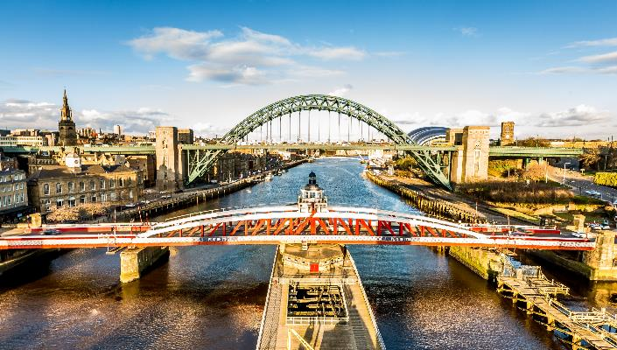

KQ: What is England famous for?
Answer the following questions in your pupil workbook.
Some parts of England, like cities and towns, are full of buildings and people. Other parts of England, like the countryside, have more wildlife and farms.
1. What do you think is good about living in the English countryside?
2. What do you think is good about living in an English city?
3. Would you rather live in the countryside or the city? Why?
Copyright © ArkCurriculum+ 2023
Notes:
Write: Explain that some parts of England, like cities and towns, are full of buildings and people. Other parts of England, like the countryside, have more wildlife and farms. Ask pupils to look at the pictures and then answer the questions in the pupil workbook—showing their opinions and preferences of city versus countryside.

Slide 44
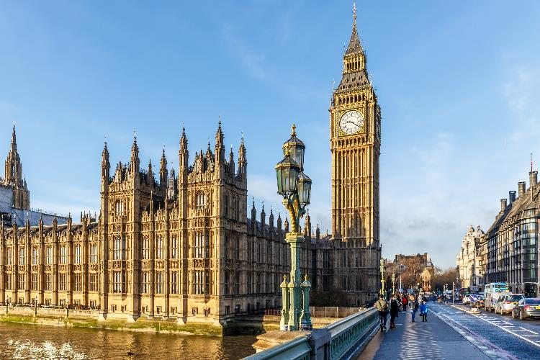

KQ: What is England famous for?
London
The capital city of England is London. London is also the capital city of the United Kingdom.
London has many famous landmarks.
The Houses of Parliament is where the government makes decisions about the rest of the United Kingdom.
Copyright © ArkCurriculum+ 2023
Notes:
Read: Read ‘London’ and share information on London and its famous landmarks. Link to learning in the previous lesson: ‘Are these landmarks natural or human-made features? How do you know?’.

Slide 45
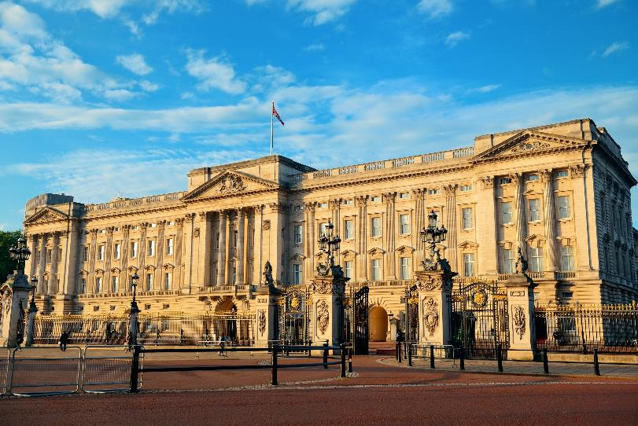

KQ: What is England famous for?
London
The capital city of England is London. London is also the capital city of the United Kingdom.
London has many famous landmarks.
Buckingham Palace is where King Charles III does his work.
Copyright © ArkCurriculum+ 2023

Slide 46
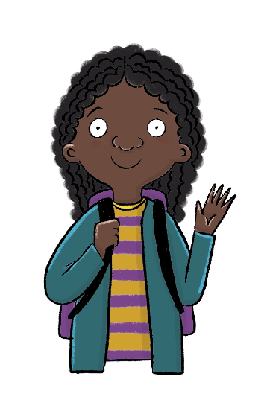
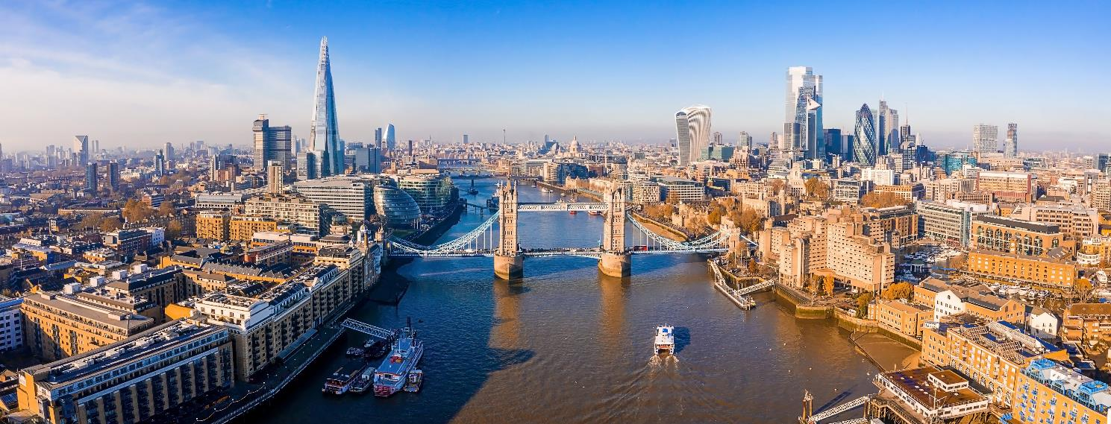
KQ: What is England famous for?
London
The River Thames runs through London.
Look at this picture. What landmarks can you spot?
List or draw them in your pupil workbook.
Copyright © ArkCurriculum+ 2023
Notes:
Retrieval: Ask pupils to look at the photograph of London and see what landmarks they can find. Then ask pupils to write or draw a list of these landmarks in their pupil workbook. Ask pupils to compare their lists—were there any their peers found that they missed?

Slide 47
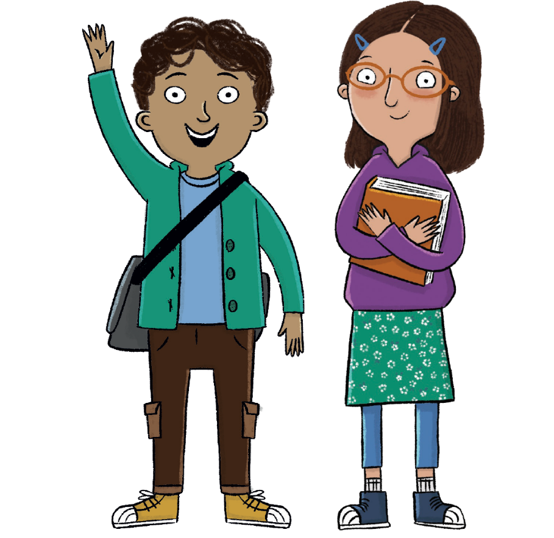
What is England famous for?
What is the capital city of England?
Can you tell me something about England?
What is the difference between a city and the countryside?
Can you find England on a map?
Copyright © ArkCurriculum+ 2023
Notes:
Learning review: Work through the review questions together as a class. Add further questions if you wish to. Note down any misconceptions or areas to address.

Slide 48
What is England famous for?
Key knowledge
England is the biggest country in the United Kingdom.
London is the capital city of England.
The tallest mountain in England is called Scafell Pike.
Key vocabulary
city
countryside
London
parliament
River Thames
Scafell Pike
Copyright © ArkCurriculum+ 2023

Slide 49
Independent Challenges:
Narrative Zone
Maths Zone
Can you use the templates to create subtraction sentences?
How many words can you think of to describe the turnip?
Enquiry Zone
Creative Zone
Can you find and name all 4 UK capital cities in an atlas?
Create a spiral picture inspired by Alma Woodsey Thomas.

