Slide 1
Thursday 11th September 2025

Slide 2



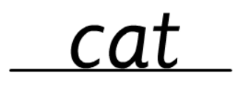
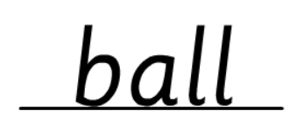
Morning Challenges:
Name writing

Slide 3

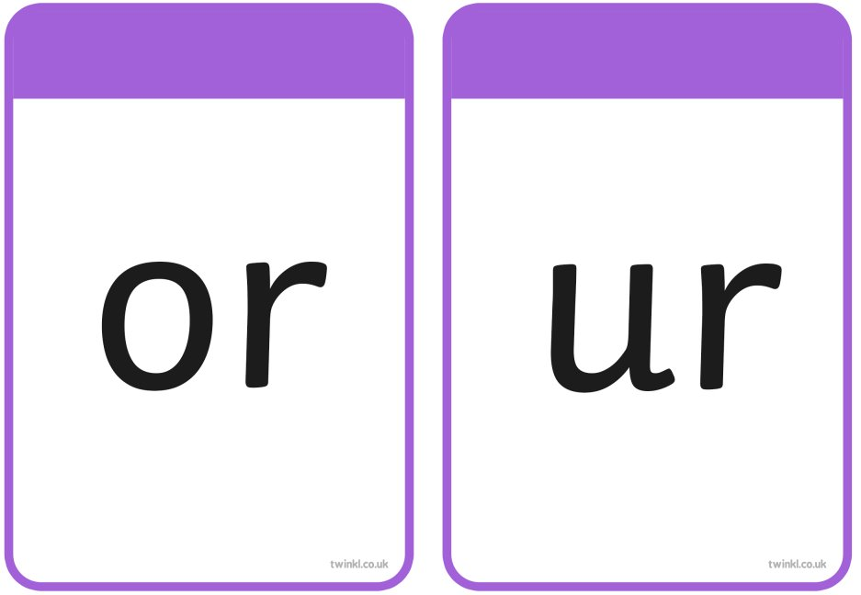

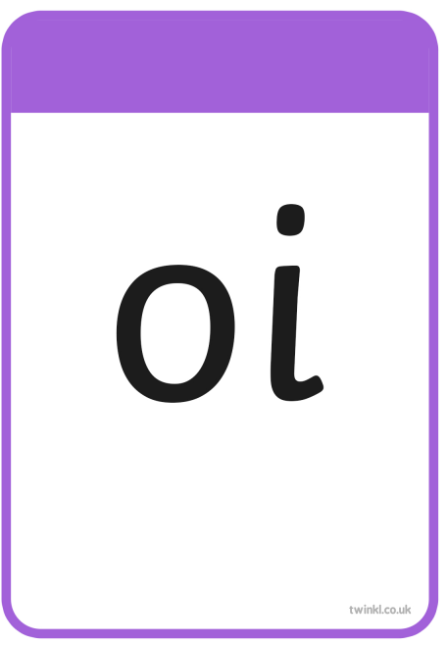
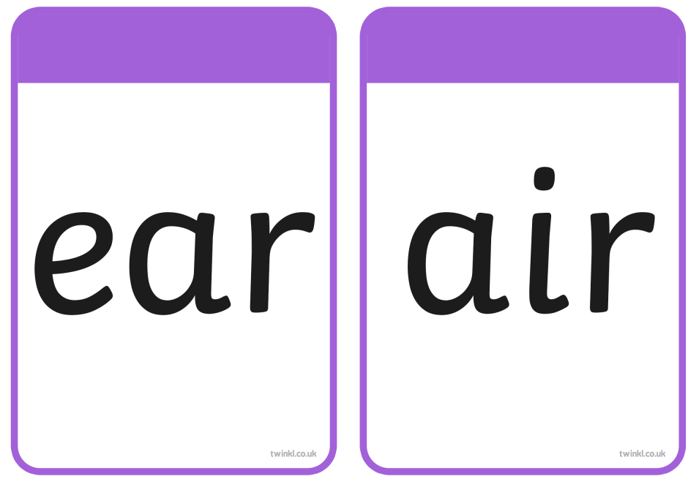
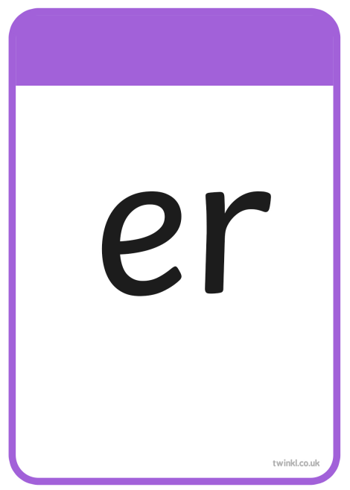

Slide 4
TBAT– read and spell words with 'ow/oi/ear graphemes
Thursday 11th September 2025
beard
What is the digraph?

Slide 5
TBAT– read and spell words with 'ow/oi/ear graphemes
Thursday 11th September 2025
coins
What is the digraph?

Slide 6
TBAT– read and spell words with 'ow/oi/ear graphemes
Thursday 11th September 2025
sighing
What is the digraph?

Slide 7
TBAT– read and spell words with 'ow/oi/ear graphemes
Thursday 11th September 2025
mixes
What is the digraph?

Slide 8
TBAT– read and spell words with 'ow/oi/ear graphemes
Thursday 11th September 2025
surfs
What is the digraph?

Slide 9
TBAT– read and spell words with 'ow/oi/ear graphemes
Thursday 11th September 2025
tails
What is the digraph?

Slide 10







TBAT– read and spell words with 'ow/oi/ear graphemes
Thursday 11th September 2025
so
by

Slide 11
TBAT– read and spell words with 'ow/oi/ear graphemes
Thursday 11th September 2025
t-ow-n

Slide 12
TBAT– read and spell words with 'ow/oi/ear graphemes
Thursday 11th September 2025
j-oi-n

Slide 13
TBAT– read and spell words with 'ow/oi/ear graphemes
Thursday 11th September 2025
h-ear

Slide 14
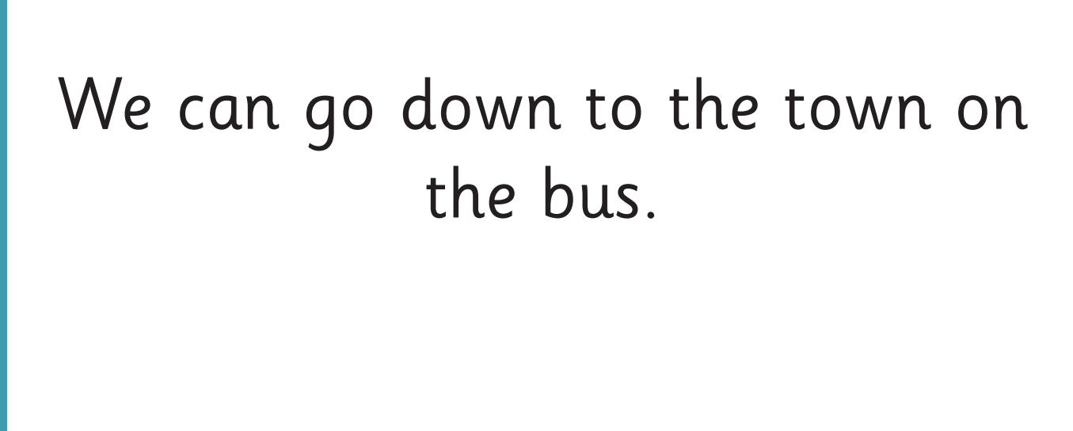
TBAT– read and spell words with 'ow/oi/ear graphemes
Thursday 11th September 2025
Now let's read this sentence!​

Slide 15
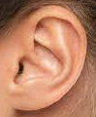



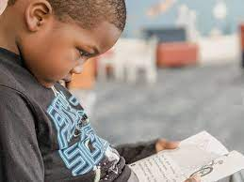
TBAT– read and spell words with 'ow/oi/ear graphemes
Thursday 11th September 2025
Listen
Say it
Write it
Check it
out
tricky word
down hear

Slide 16
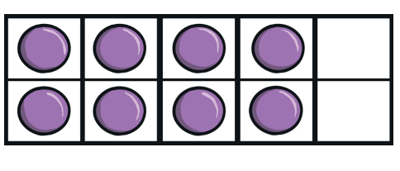
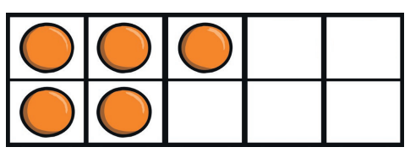
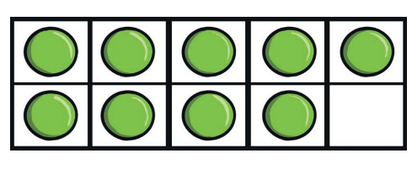
Maths
TBAT: Explore the composition of numbers
3 in 3 – what numbers are represented in the ten frames?
Challenge: Which is most? Which is least?

Slide 17
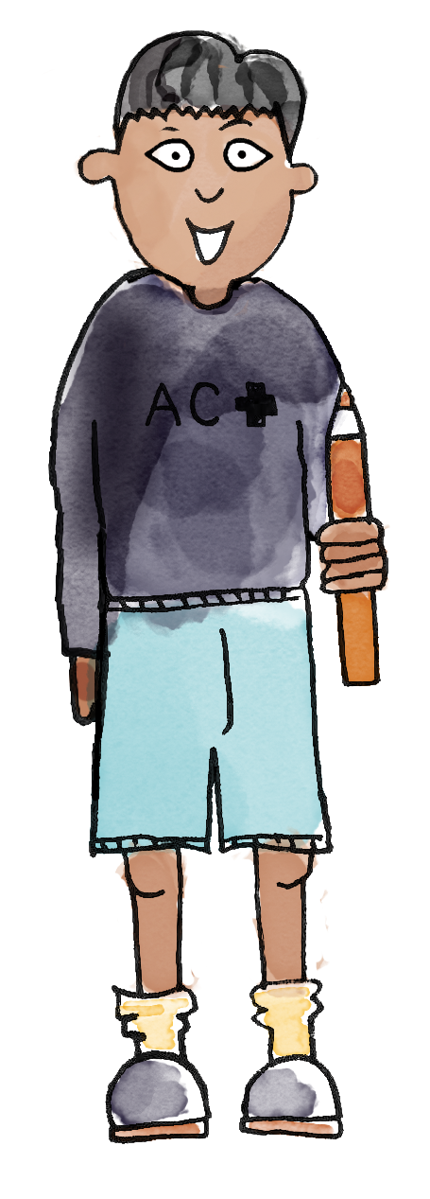
One more than …
Practise saying one more than a number within nine.
One more than zero is one.
One more than six is seven.
Notes:
Do Now: One more than
Use cubes to demonstrate adding one to numbers within nine and saying in a full sentence what it is, e.g. One more than six is seven.

Slide 18

TBAT: explore the composition of numbers
part
number bond
whole
represent

Slide 19
Composition of nine
nine
9
Blue / Green
Share your 9 cubes between you.
How many do you have each?
How many ways can you find to make 9?
Challenge: Can you make 9 with three numbers?
Nine is the whole.
What are the parts?
Notes:
New Learning: Composition of nine
Begin by creating a concrete context which shows nine partitioned into three or more parts, for example, four soft toys around a campfire, three in the tent and two in the woods. So far, pupils have likely only worked with part-whole models with two parts; however, it is important that they begin to recognise that a whole can have many parts.
Nine is the whole. Four is a part. Three is a part. Two is a part. Four, three and two make nine.
Record this on a part-whole model with three parts, drawing pupils’ attention to the three parts in comparison to the usual two.
Change the roles of the toys in the scenario, e.g., six friends sleeping, three friends awake. Discuss and record the relationship on a part-whole model with two parts.
Repeat this for other bonds to nine.

Slide 20
Composition of five
Notes:
New Learning: Composition of five
Make a large ten-frame on the carpet and position five soft toys in a row. Explain that they are sitting on the back row at the cinema. Ask a pupil to count the toys and another to check they have counted correctly. Explain that there are five toys in the back row and none in the front row. This shows us that five and zero make five. Rehearse this orally with pupils. Record the part-whole relationship for five and zero.
Now, say that one toy wants to move to the front row. Move one of the toys so that it is positioned in front of another. Explain that there are now four toys sitting on the back row and one on the row in front. This shows us that four and one make five.
Four is a part. One is a part. The whole is five.
Record on the part-whole model. Develop this, with pupils suggesting arrangements and each time discussing what the different arrangements show about the number five.
Explain that in the Talk Task, pupils will use cubes and ten-frames to explore how many different ways five friends can sit at a lunch table. Role play the Talk Task, ensuring pupils are clear on their roles and the language structures they are expected to use.

Slide 21
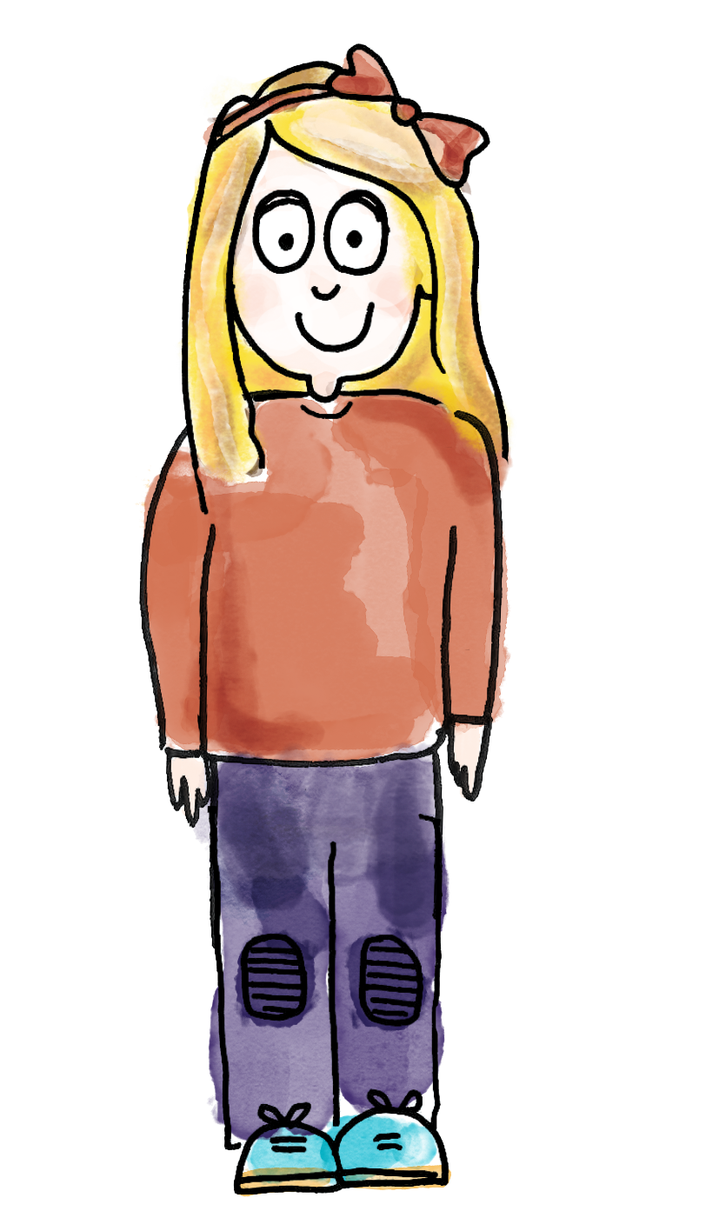
Exploring composition of five
One cube represents one friend. The five friends are sitting on one side of the table. I represented that with five cubes.
Five friends on this side of the table. No friends on the other side.
Five is a part. Zero is a part. The whole is five.
number bond part whole represent
Notes:
Talk Task: Exploring composition of five
Pupil A places five cubes in a row on a ten-frame and says what the five cubes represent in the ‘story’.
Five friends on this side of the table. No friends on the other side.
Pupil B says what they can tell about the number five from this representation.
Five is a part. Zero is a part. The whole is five.

Slide 22
Exploring composition of five
Now, I’ll move one friend to the other side. One friend is sitting on this side. Four friends are sitting on that side.
Four is a part. One is a part.
The whole is five.
number bond part whole represent
Notes:
Pupil B then moves one cube to a different place in the ten-frame and says what the cube represents in the ‘story’. Pupil A says what they can tell about the number five from the new representation. Pupils continue, swapping roles.

Slide 23
Composition of six
Challenge: draw a part, part whole model.
What is the whole?
What parts can you see?
six
6
Notes:
Develop Learning: Composition of six
Show pupils six cubes together in a tower. Explain that you could make many different shapes using six cubes. Model pulling two cubes off the top and attaching them in a different orientation. Explain that this shows you the number six in a different way. Model showing that now you can see a block of four and a block of two.
The parts are four and two. The whole is six.
Invite a pupil to alter the shape again and discuss with the class which relationships within six they can see. For example, in one shape pupils might see two, one and three as parts. It is important that pupils, who have probably only encountered two-part part-whole models so far, understand that a whole can have any number of parts.

Slide 24
Identifying missing parts
5
There are eight toys altogether.
We can see three of them.
The others are hidden under a blanket.
How many toys are under the blanket?
How do you know?
Which part-whole model shows this relationship? Why?
8
3
8
5
3
Notes:
Plenary: Identifying missing parts
Hide five toys under a blanket, without the pupils seeing how many you have hidden. Show them three different toys. Explain that there are eight toys altogether, and the others are hidden under the blanket.
How many toys are under the blanket? How do you know?
Pupils then identify the part-whole model (on the slide) which shows this number bond. Similar examples could follow.

Slide 25
Explore composition of numbers
We’re now going into groups to explore the composition of the numbers 5,6,7,8, 9 and 10
How many ways can you partition each number?

Slide 26

Exploring composition to nine
Let’s use the teddy bears. One, two, three, four, five, six, seven, eight, nine. I’ve got nine teddy bears.
number bond part whole represent
Notes:
Talk Task: Exploring composition to nine
Pupils have concrete objects at their tables and a range of part-whole models. First, they count out nine (from a larger set) and then make stories using the concrete manipulatives, focusing on the part-whole relationships between the groups in the stories. They place the concrete manipulatives in the ‘parts’ of the part-whole models to represent the parts in their story

Slide 27
Exploring composition to nine
One, two, three, four. Four teddy bears are on the bus.
One, two. Two teddy bears are waiting for the bus.
One, two, three. Three teddy bears are in the park.
number bond part whole represent
Notes:
Talk Task: Exploring composition to nine
Pupils have concrete objects at their tables and a range of part-whole models. First, they count out nine (from a larger set) and then make stories using the concrete manipulatives, focusing on the part-whole relationships between the groups in the stories. They place the concrete manipulatives in the ‘parts’ of the part-whole models to represent the parts in their story

Slide 28
Exploring composition to nine
The whole is nine. Four is a part. Two is a part. Three is a part. Altogether, the parts make nine.
Now I’ll make a different story! Nine teddy bears are in the woods ...
9
Make up your own story in the literacy area
number bond part whole represent
Notes:
Talk Task: Exploring composition to nine
Pupils have concrete objects at their tables and a range of part-whole models. First, they count out nine (from a larger set) and then make stories using the concrete manipulatives, focusing on the part-whole relationships between the groups in the stories. They place the concrete manipulatives in the ‘parts’ of the part-whole models to represent the parts in their story

Slide 29
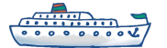
Composition of ten
ten
10
There are ten boats altogether.
Ten is the whole.
What can we say about the parts?
Notes:
Develop Learning: Composition of ten
Note: adapt the context depending on objects you have, e.g., toy cars, figures.
Lay out some ‘water’ on the carpet and place ten boats on the water, counting them one at a time with pupils. Explain that the boats sail in different formations. Sometimes they sail in twos. Place the boats in a two by five formation (in pairs).
There are ten boats altogether. Ten is the whole. What can we say about the parts?
The parts are worth two. There are five of those parts. Two and two and two and two and two makes ten.
Draw corresponding part-whole models.
Explain that the boats do not always sail in twos. Model further examples and discuss the value of the parts and the whole.

Slide 30
Exploring composition of ten
How many different ways could your boats sail?
How many different part-whole relationships can you find within ten?
10
3
3
1
3
Notes:
Independent Task: Exploring composition of ten
Pupils explore different formations in which their ten boats could sail. The focus of this task is on identifying the part-whole relationships within ten, for example, ten is made of four and six and of three, three, two and two, and so on. Pupils could record their work on part-whole models. As they will explore different numbers of parts, it is probably easiest for them to draw their own part-whole models.
Possible adaptations:
Pupils could be challenged to show the part-whole relationships using different manipulatives, for example, a bead string.
It may be appropriate for some pupils to investigate the two-part part-whole relationships within ten.

Slide 31
Identifying missing parts
There were ten boats and some sailed away.
There are four boats left.
How many boats sailed away?
How do you know?
Notes:
Plenary: Identifying missing parts
Return to the boats on the ‘water’, but this time show only four boats. Explain that there were ten, but some sailed away.
How many boats sailed away? How do you know?
Record this relationship on a part-whole model. More similar examples could follow.

Slide 32
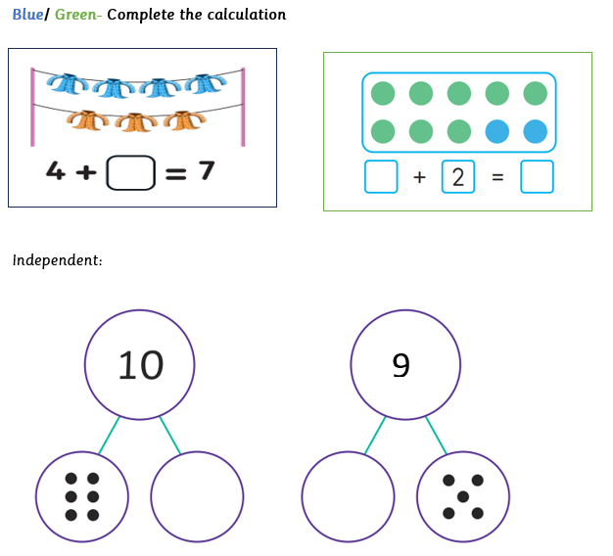
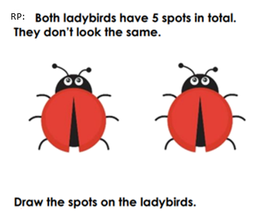
Independent:

Slide 33
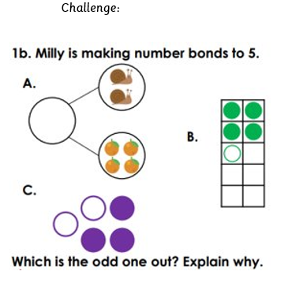
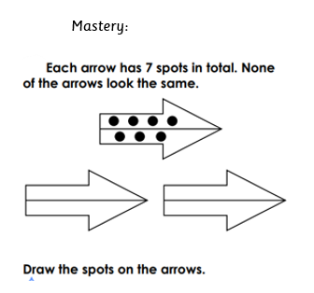
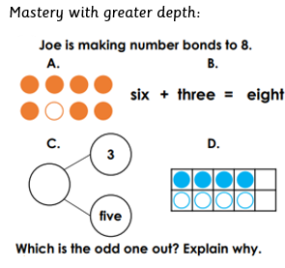

Slide 35
PE
TBAT: co-operate with a partner to complete challenges.
We will need to listen to each other and share ideas.
We are going to complete some challenges in pairs.

Slide 36

PE- Warm up
TBAT: co-operate with a partner to complete a challenge.
Body match

Slide 37
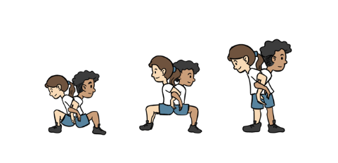
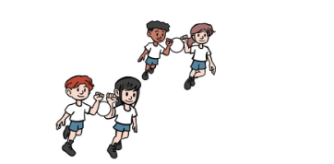
PE- Skill development
TBAT: co-operate with a partner to complete a challenge.
Partner stand
Share the load

Slide 38
Plenary
What helped you to complete the challenges?
Why is working together important?
What makes a good team player?
Are these skills the same or different to being a good friend? How?

Slide 40
Welcoming new life
New life: how is a new child welcomed?
TBAT: understand that people welcome new life in different ways.

Slide 41
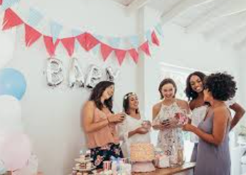
TBAT: understand that people welcome new life in different ways.
Blue / Green
How would your family welcome a new baby?
What do people do to celebrate before or after a baby is born?

Slide 42
welcome
to show you are happy to see someone
celebration
a way of marking a happy day or event
ceremony
an event to celebrate a special occasion
tradition
a way of doing something that has existed for a long time
religion
a religion is a group of people who have the same beliefs and who share the same practices.

Slide 43
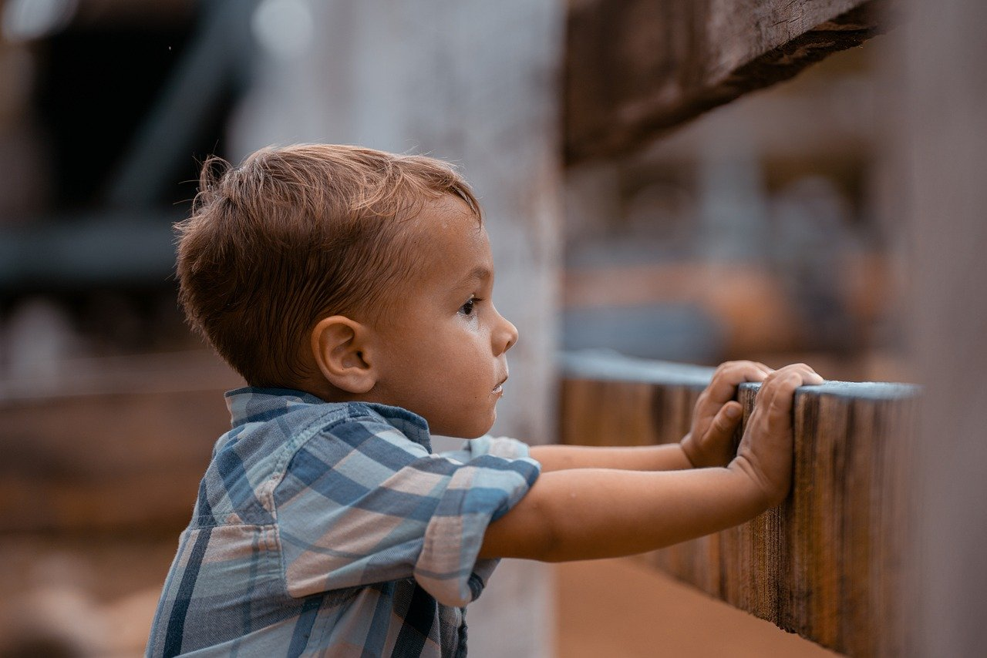
Welcoming new life
Bennie is excited because he is waiting to welcome a new arrival at home.
People often get excited when they get to meet someone new.
How is Bennie feeling waiting for a new arrival?
sad
angry
excited

Slide 44

Welcoming new life
Can you see why Bennie is excited?
His parents are bringing a new baby home from the hospital.
People often celebrate a new life with a big welcome because a new baby is a very special addition to a family.

Slide 45
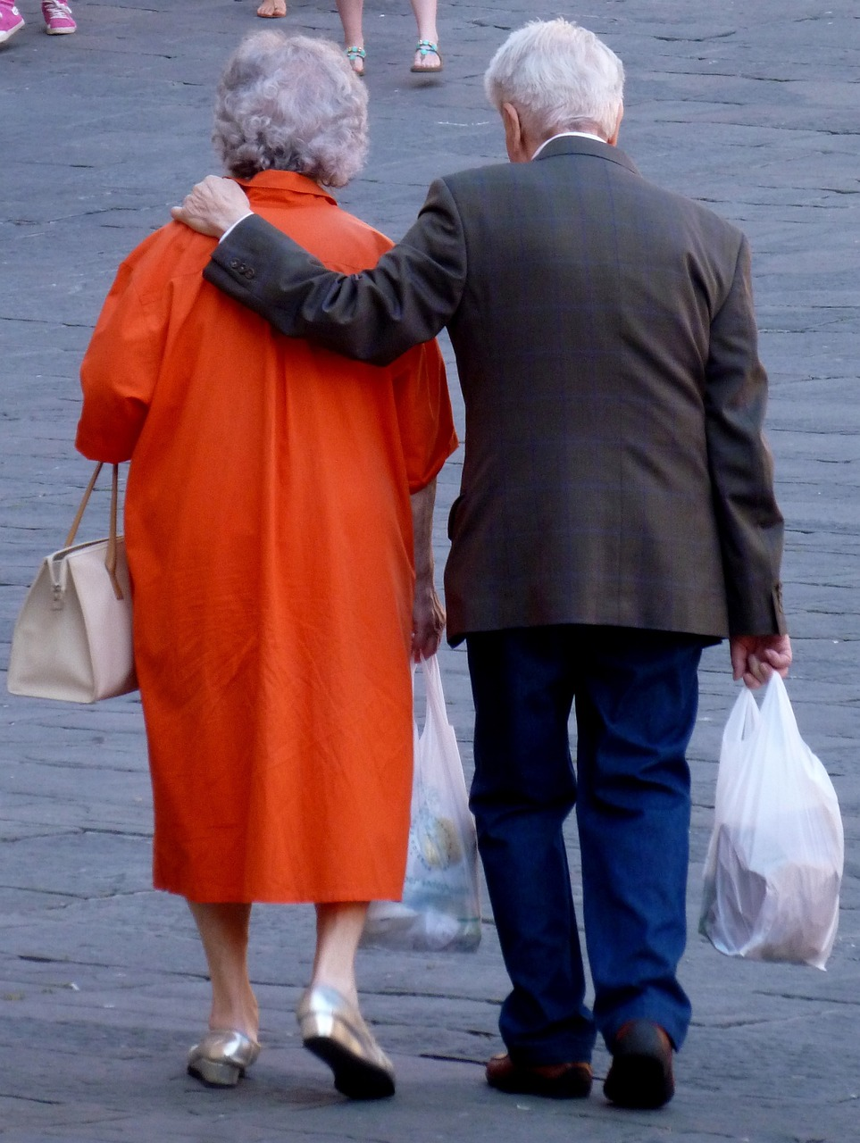

Welcoming new life
People get excited and feel happy to welcome different people and things. For example:
Grandparents a puppy a new baby
People might be excited to have someone new to love or to play with.

Slide 46

Welcoming new life
Who is Bennie excited to welcome?
His grandparents, a puppy or a new baby?

Slide 47


Welcoming new life
Sofia is wondering why some people get excited about a new baby?
Jacob tells her it is because babies are very special.
Blue / Green Can you give Sofia another two reasons?
Sofia
Jacob
Notes:
Possible reasons for why some people get excited when a new baby arrivals:
it gives you someone new to love
it gives you someone new to play with
it makes you happy to meet someone new

Slide 48


Different ways of celebrating a new life
Bennie and his grandparents have got a few things ready to celebrate the arrival of the new baby.
They have made a new baby card to welcome the new baby.
I wonder what might be in the wrapped gifts?
Jacob

Slide 49
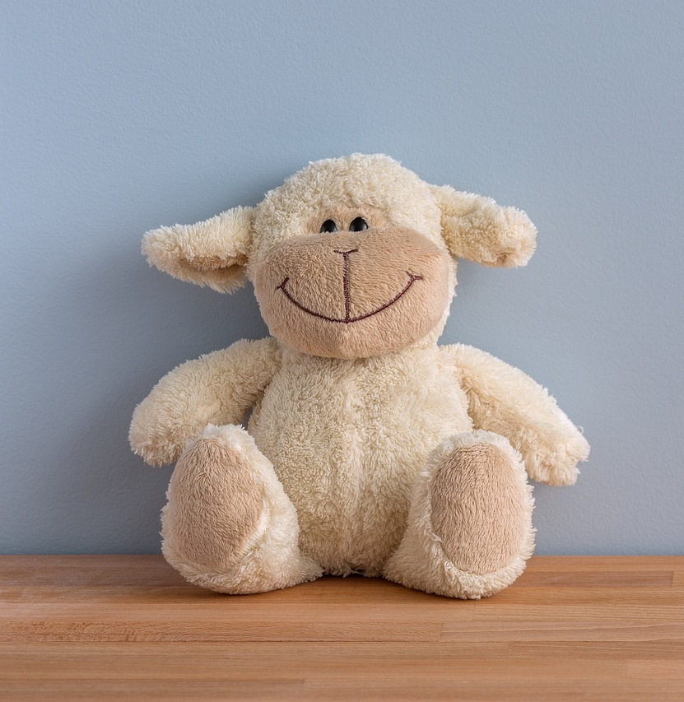
Different ways of celebrating a new life
At a celebration, people might bring a new baby card, buy presents or pass on things that have been in the family for a long time.
Bennie has chosen one of his toys, a lamb, to give to welcome the baby.

Slide 50
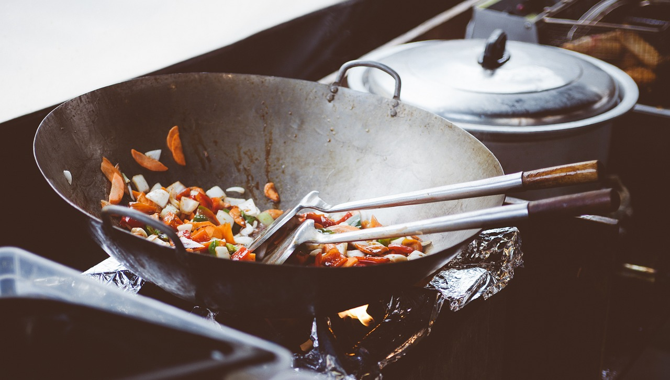

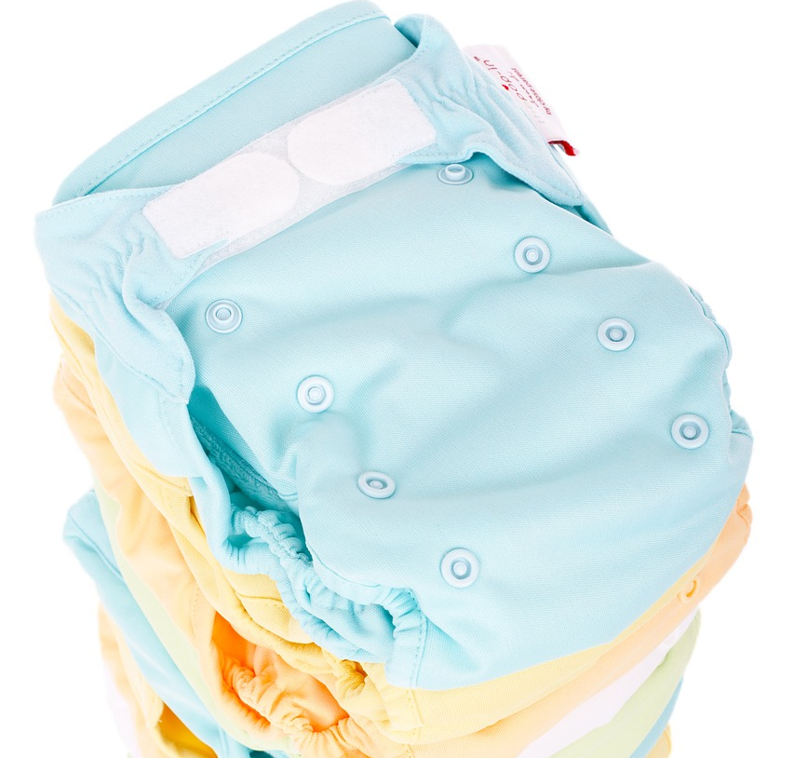
Different ways of celebrating a new life
Families and friends celebrate a new life in different ways. When this is repeated it is called a tradition.
a Japanese tradition is for grandparents to cook when a new baby is home
a British tradition is to buy a gift made of silver
a Czech tradition is to buy coloured nappies

Slide 51
Different ways of celebrating a new life
Find the correct statements.
All families use balloons to celebrate a new baby’s arrival.
Each family will have a different way to celebrate a new baby’s arrival.
Different countries have different traditions to celebrate a new baby’s arrival.

Slide 52
Different ways of celebrating a new life
Can you match these words with their description?
welcome
a way of doing something that has existed for a long time
tradition
a way of marking a happy day or event
celebration
to show you are happy to see someone

Slide 53
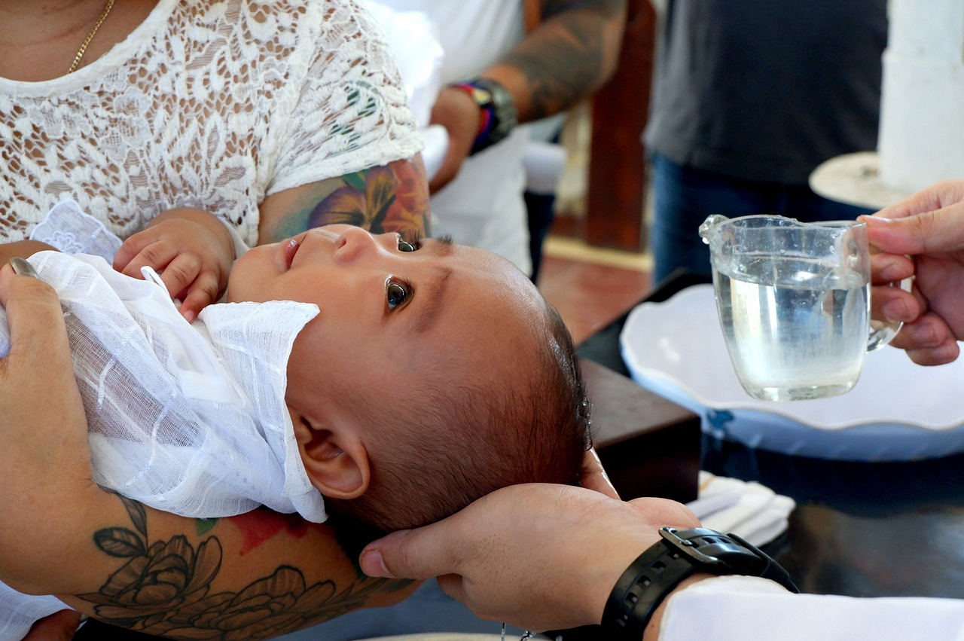
Special ceremonies to welcome a new family member
The arrival of a new baby is an exciting and special event.
Both religious and non-religious people may have a special ceremony to welcome a new baby.
A ceremony is an event to celebrate a special occasion.

Slide 54
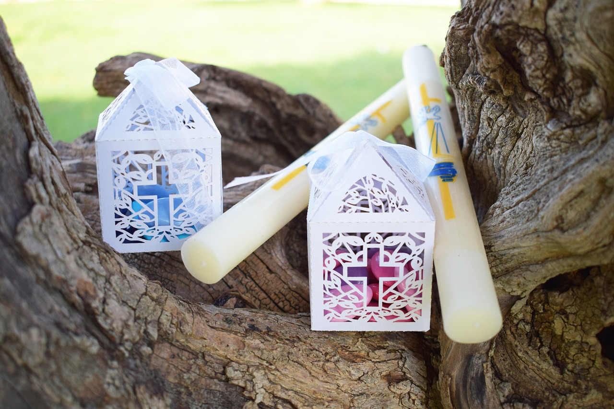
Special ceremonies to welcome a new family member
People who believe in God will often thank God for a new life in a special ceremony.
They will ask God to look after the new life and help the family to bring up the baby.

Slide 55
Special ceremonies to welcome a new family member
Bennie and his family are going to have a special ceremony to welcome the new baby. They have a Christian worldview.
A Christian might give the new baby a cross or a special candle.

Slide 56



Special ceremonies to welcome a new family member
Here are some examples of cards that welcome a new baby.
What would you write on your card to welcome a new baby?

Slide 57

Special ceremonies to welcome a new family member

Slide 58
Welcoming new life
Most people get excited about a new baby joining their family.
There are different traditions to welcome a new life.
Some people have a special ceremony to celebrate a new life.

Slide 59
Music
TBAT: Compose tapping music using different classroom soundmakers.
Blue / Green
People like different types of music.
What type of music do you like to listen to? How does it make you feel?

Slide 60
TBAT: Compose tapping music using different classroom soundmakers.
Vocabulary
Rhythm: A pattern of beats
Timbre (e.g. rustle, scrunch, tear, tap, rub)

Slide 61
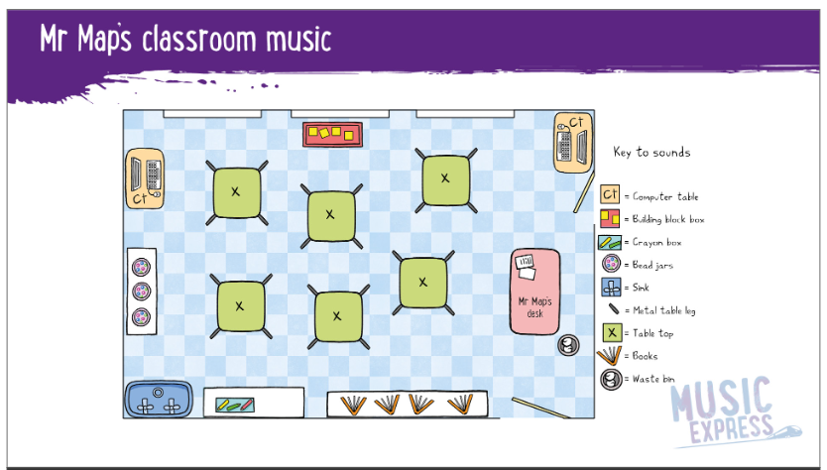
TBAT: Compose tapping music using different classroom soundmakers.
Listen to classroom sounds. What can you hear and where would they be on the map?

Slide 62

TBAT: Compose tapping music using different classroom soundmakers.
Explore sounds around the classroom.
Let’s choose our favourites and make our own classroom map.
Record and listen to the sounds.

Slide 63
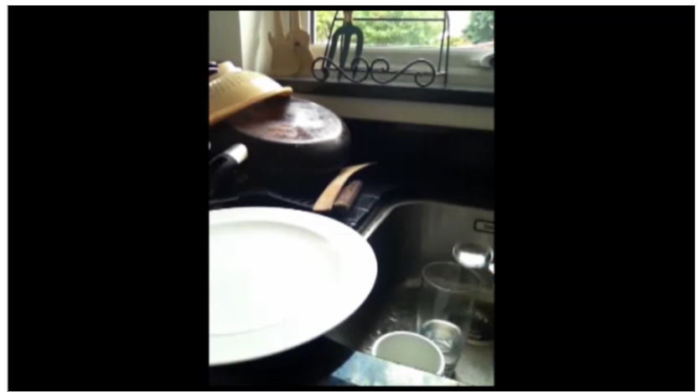
TBAT: Compose tapping music using different classroom soundmakers.
Watch the video of the objects being used as percussion.

Slide 64
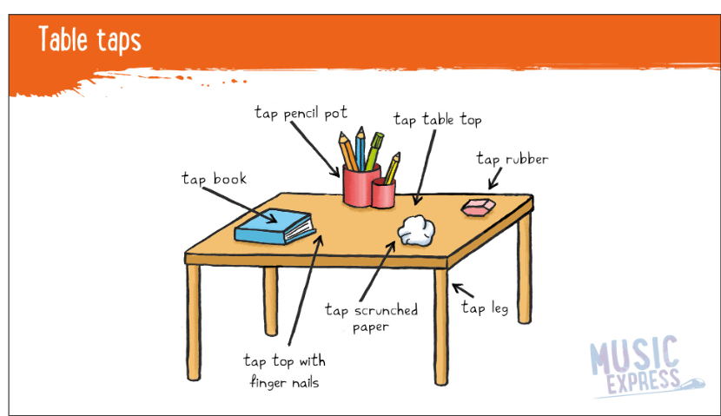
TBAT: Compose tapping music using different classroom soundmakers.
Find an object to use to create a rhythm.
Choose a leader and copy their rhythm at your table.

Slide 65
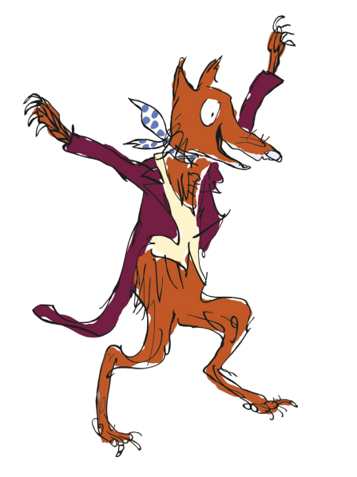
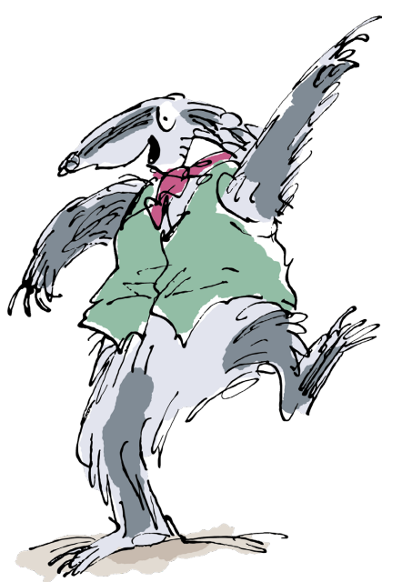
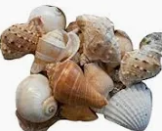


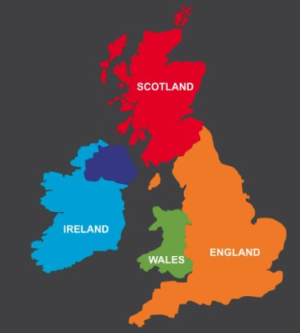

Independent Challenges:
Narrative Zone
Maths Zone
Act out a story with the characters from Fantastic Mr Fox.
Use the equipment to explore number bonds to 5, 6, 7, 8, 9 and 10
Enquiry Zone
Creative Zone
Can you identify the countries in the UK and put them in the correct places?

