Slide 1
Monday 29th September 2025

Slide 2




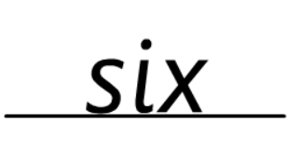
Morning Challenges:
Name writing

Slide 3
TBAT: read and write words with the alternative /ai/ grapheme /ay/.
Monday 29th September 2025
chain

Slide 4
TBAT: read and write words with the alternative /ai/ grapheme /ay/.
Monday 29th September 2025
waiter

Slide 5
TBAT: read and write words with the alternative /ai/ grapheme /ay/.
Monday 29th September 2025
chil/dren

Slide 6
TBAT: read and write words with the alternative /ai/ grapheme /ay/.
Monday 29th September 2025
spark

Slide 7
TBAT: read and write words with the alternative /ai/ grapheme /ay/.
Monday 29th September 2025
scoop

Slide 8
TBAT: read and write words with the alternative /ai/ grapheme /ay/.
Monday 29th September 2025
crowds

Slide 9

TBAT: read and write words with the alternative /ai/ grapheme /ay/.
Monday 29th September 2025
says

Slide 10

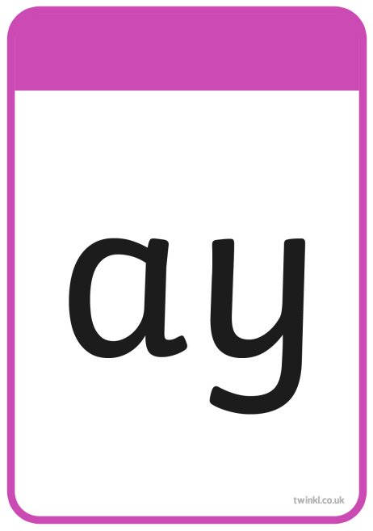
TBAT: read and write words with the alternative /ai/ grapheme /ay/.
Monday 29th September 2025

Slide 11
TBAT: read and write words with the alternative /ai/ grapheme /ay/.
Monday 29th September 2025
d-ay

Slide 12
TBAT: read and write words with the alternative /ai/ grapheme /ay/.
Monday 29th September 2025
s-ay

Slide 13
TBAT: read and write words with the alternative /ai/ grapheme /ay/.
Monday 29th September 2025
p-l-ay

Slide 14
TBAT: read and write words with the alternative /ai/ grapheme /ay/.
Monday 29th September 2025
s-p-r-ay

Slide 15
TBAT: read and write words with the alternative /ai/ grapheme /ay/.
Monday 29th September 2025
c-r-ay-o-n

Slide 16

TBAT: read and write words with the alternative /ai/ grapheme /ay/.
Monday 29th September 2025
Now let's read this sentence!​

Slide 17

TBAT: read and write words with the alternative /ai/ grapheme /ay/.
Monday 29th September 2025
said
tricky word
day play

Slide 18
3 in 3 Practise number bonds to seven
TBAT: subtract by counting back in ones
How can we make seven?
7 + 0 = 7
6 + ____ = 7
____ + 2 = 7
____ + 3 = 7
3 + ____ = 7
2 + ____ = 7
1 + 6 = 7
0 + 7 = 7
Notes:
Do Now: Practising transitions
Practise number bonds to seven.

Slide 19
TBAT: subtract by counting back in ones
equation
minus
subtract
partition
number line
count back

Slide 20


TBAT: subtract by counting back in ones
What do these symbols mean?
Challenge: Think of all the words for add

Slide 21
Blue / Green
TBAT: subtract by counting back in ones
Which symbol is missing from the calculation?
How do you know?
4 3 = 7 9 1 = 8
A ____ is missing. I know this because…
Challenge: draw a part, whole model for your calculation.

Slide 22


Introducing counting back to subtract
TBAT: subtract by counting back in ones
whole
subtract
part
is equal to
part
5
–
2
=
Notes:
New Learning: Introducing counting back to subtract
Recap subtraction from Lesson 5, beginning with a set of concrete objects, partitioning it into two parts and then writing a subtraction equation to show the relationships.
Explain that today you will count back to subtract. Set up the context of teddy bears in a tent and around a campfire again. Identify that there are five bears and explain that two are going into the tent. Use the slide to model the count-back strategy using cubes on a part-whole model: move two cubes, one at a time, to one part of the part-whole model, counting backwards as you do, e.g.
Five is the whole. (Move one cube.) There are four left. (Move a second cube.) There are three left. I can see I have subtracted two. Five subtract two is equal to three.
Ask pupils to suggest other examples for subtraction stories where zero, one, two or three bears are being subtracted, and use the next slide to model starting with the whole in a part-whole model and counting backwards, moving one cube at a time.

Slide 23
Introducing counting back to subtract
TBAT: subtract by counting back in ones
Notes:
New Learning: Introducing counting back to subtract
Recap subtraction from Lesson 5, beginning with a set of concrete objects, partitioning it into two parts and then writing a subtraction equation to show the relationships.
Explain that today you will count back to subtract. Set up the context of teddy bears in a tent and around a campfire again. Identify that there are five bears and explain that two are going into the tent. Use the slide to model the count-back strategy using cubes on a part-whole model: move two cubes, one at a time, to one part of the part-whole model, counting backwards as you do, e.g.
Five is the whole. (Move one cube.) There are four left. (Move a second cube.) There are three left. I can see I have subtracted two. Five subtract two is equal to three.
Ask pupils to suggest other examples for subtraction stories where zero, one, two or three bears are being subtracted, and use the next slide to model starting with the whole in a part-whole model and counting backwards, moving one cube at a time.

Slide 24
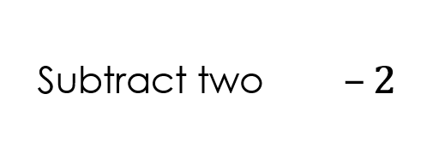
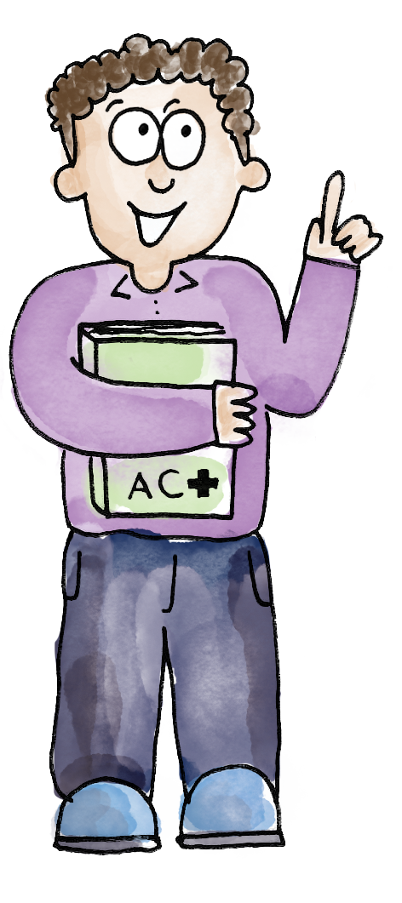
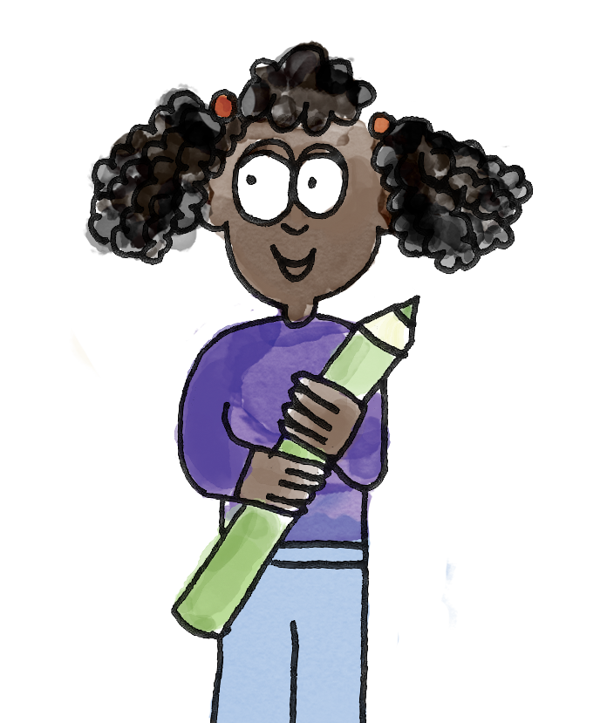
Subtracting by counting back
TBAT: subtract by counting back in ones
One, two, three, four, five, six. The whole is six.
I need to subtract two. The whole is six. I need to move two cubes to a part and count back.
6
subtract minus partition equation count back number line
Notes:
Talk Task: Subtracting by counting back
Note: You may wish to select a subtraction card for the whole class to do, to reduce printing.
Pupils have a set of digit cards 3–10, the Task Sheet (cut into cards), ten cubes and a part-whole model. They place all the cards face down on the table.
Pupil A turns over a digit card and represents that number using cubes on the part-whole model. Pupil B turns over a subtraction card. They state the whole and then move the correct number of cubes into a part of the part-whole model, counting backwards as they do. Pupil A says the whole equation at the end. Pupils swap roles and repeat.

Slide 25
Subtracting by counting back
TBAT: subtract by counting back in ones
I start with six and count back: five, four.
6
Six subtract two is equal to four.
subtract minus partition equation count back number line
Notes:
Talk Task: Subtracting by counting back
Note: You may wish to select a subtraction card for the whole class to do, to reduce printing.
Pupils have a set of digit cards 3–10, the Task Sheet (cut into cards), ten cubes and a part-whole model. They place all the cards face down on the table.
Pupil A turns over a digit card and represents that number using cubes on the part-whole model. Pupil B turns over a subtraction card. They state the whole and then move the correct number of cubes into a part of the part-whole model, counting backwards as they do. Pupil A says the whole equation at the end. Pupils swap roles and repeat.

Slide 26
Counting back on a number track and number line
TBAT: subtract by counting back in ones
whole
subtract
part
is equal to
part
2
5
–
2
=
5
1
2
3
4
5
6
7
8
9
10
0
1
2
3
4
5
6
7
8
9
10
Notes:
Develop Learning: Counting back on a number track and number line
Clarify any misconceptions noted during the Talk Task.
Explain to pupils that we can also count back using a number track and a number line, just like when we add. Show the abstract equation 5 – 2 = __ and the corresponding part-whole model. Begin with a number track and model identifying five (the whole) and then counting back two, using either a finger or a counter, saying: Four, three.
Now move to the number line. Again identify the whole, five. Explain that we can jump backwards between the numbers. Draw pupils’ attention to the fact that the numbers are on the lines, so we are counting jumps between lines rather than the spaces between the lines. Model drawing two jumps back to reach three, saying: Four, three.
I started at five and subtracted two by counting back. Five subtract two is equal to three.
Model further examples as necessary.

Slide 27
TBAT: subtract by counting back in ones
Count back on the number track or number line to find the answers.
Lay a counter of the correct colour over each square.
Do you notice any patterns?
Why do the patterns occur?
1 =
2 =
3 =
4 =
5 =
6 =
7 =
7 – 3 | 7 – 2 | 7 – 1 | 7 – 0
6 – 3 | 6 – 2 | 6 – 1 | 6 – 0
5 – 3 | 5 – 2 | 5 – 1 | 5 – 0
4 – 3 | 4 – 2 | 4 – 1 | 4 – 0
Notes:
Independent Task: Counting back using a number track/number line
Pupils count back to find the answers to the subtraction calculations on the Task Sheet using number tracks, number lines or part-whole models as appropriate and then lay a counter/cube (ideally translucent) of the correct colour over the calculation.
Possible adaptations:
Some pupils may wish to continue to partition using part-whole models. Encourage use of the count-back strategy, modelling where possible.
Ask pupils who are confident in completing the task to look at the colour patterns created. Can they think of any other calculations which would be green/white/orange, etc.?
Give pupils three subtraction equations, two with the same difference and one with a different difference. Can they explain which is the odd one out?

Slide 28
Making generalisations
TBAT: subtract by counting back in ones
Is what the boy is saying correct?
How do you know?
Can you prove it?
When we subtract, the answer is always smaller.
When we add, the answer is always greater.
Notes:
Plenary: Making generalisations
Share the statement on the slide.
Do you agree with what the boy is saying? Why/why not? Can you prove it?
Discuss ideas with pupils, and encourage use of concrete manipulatives for pupils to prove their conjectures.

Slide 29
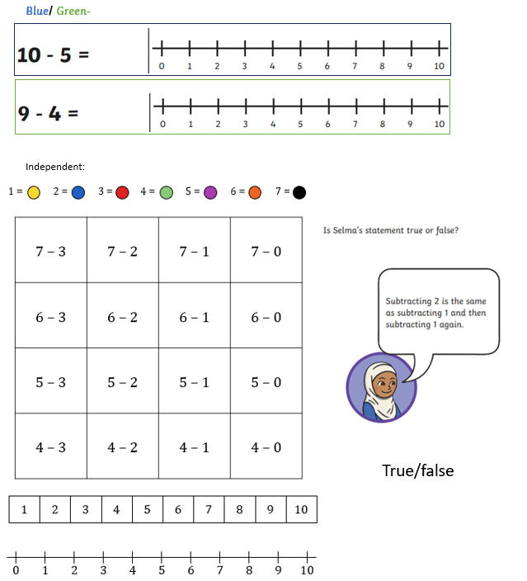

Slide 30
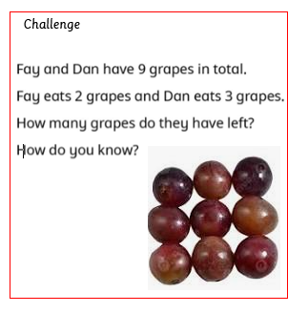
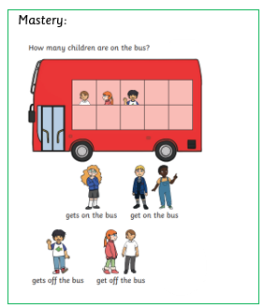
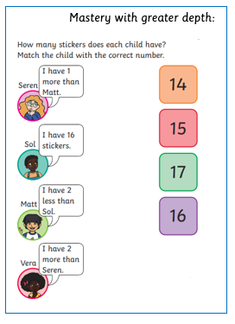

Slide 31
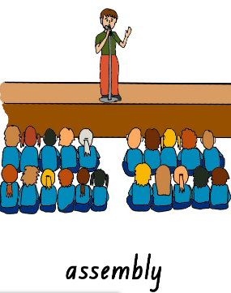
Assembly

Slide 32
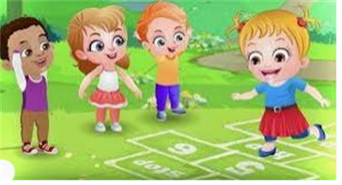
Break

Slide 33
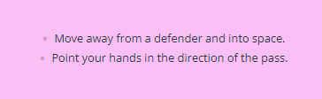
TBAT: support a team mate when playing in attack
Success Criteria:

Slide 34
Warm up
Do 5 star jumps at a cone before a defender catches you!
If you’re caught, stand on one leg for 5 seconds.
How many times can you do it?
Skill development
Practise chest pass and bounce pass
Play piggy in the middle using a chest or bounce pass. How can you work as a team?

Slide 35
Plenary
How did you support your team when playing in attack?
Was it tricky to pass the ball sometimes? Why?
Where should you move to help your team mate?

Slide 36

Lunch

Slide 37
Year 1 PSHE Topic 1: New Beginnings
Lesson 4:
How can I climb out of the learning pit? (Lesson 2)

Slide 38


Blue/ Green
KQ: How can I climb out of the learning pit?
respect
polite
kind
How many of the Rules of Respect can you remember?
Why is it important that we follow these Rules of Respect?
Notes:
It is important to regularly return to the Rules of Respect in order to ensure expectations are clear. Regularly and explicitly point out when an individual is demonstrating this explaining clearly what they had done that shows respect.

Slide 39

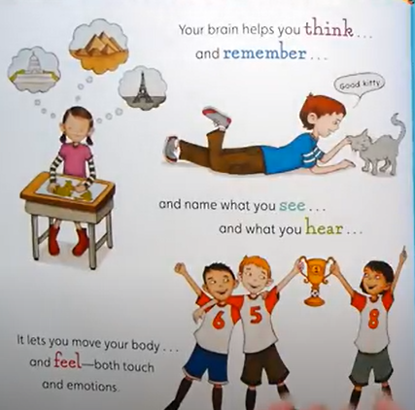

Story
KQ: How can I climb out of the learning pit?
Your Fantastic, Elastic Brain, JoAnn Deak and Sarah Ackerley
What can your brain help you to do?
How can we help our brain to stretch and learn new things?
Notes:
Some of the vocabulary in this book is challenging and there is no expectation that children understand the different parts of the brain or how neurons work but it will help children understand how their brain can grow and resilience can strengthen their brain.

Slide 40
Key vocabulary for this lesson
KQ: How can I climb out of the learning pit?
resilient
persistent
independent
challenges
The Learning Pit
difficult
pride/ proud
overcome
Are there any word we are unsure of the meaning of?
Notes:
Key vocabulary will be green in colour throughout the presentation.
This could be used as a brief reading and comprehension activity to ensure understanding of key vocabulary. This vocabulary could be displayed throughout the lesson and children spot them throughout the lesson. This could be made into a game to tally throughout the week.

Slide 41
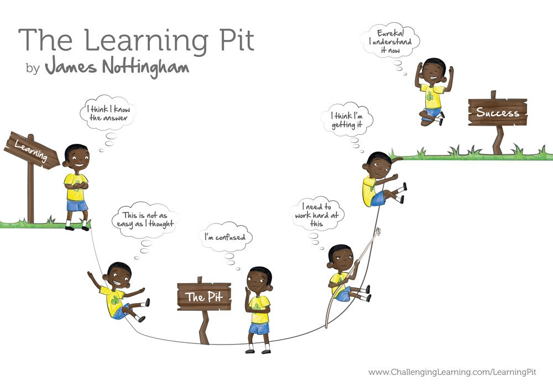
Recap: With your partner, share what you can remember about the Learning Pit.
KQ: How can I climb out of the learning pit?

Slide 42
KQ: How can I climb out of the learning pit?
How does it feel to be in the Learning Pit?
What could we do to help climb out?
Can you remember what resilience is?

Slide 43

Your task: Think of 5 things you could do if you get stuck on a challenge
KQ: How can I climb out of the learning pit?
Some ideas:
Notes:
Record some ideas to support children.
These could be laminated and stuck onto children’s desks as a visual prompt of ways to be resilient.

Slide 44
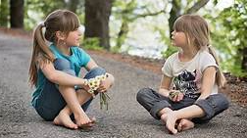
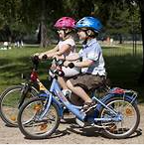
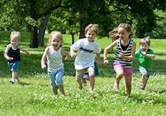


With your partner discuss this question
KQ: How can I climb out of the learning pit?
What can you do now that you couldn’t do when you were younger?
Notes:
Might be beneficial to add pictures to prompt children to think about
Running/ walking
Talking
Writing
Reading Riding a bike
Skipping

Slide 45
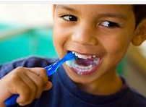
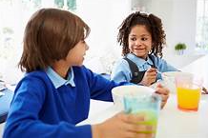
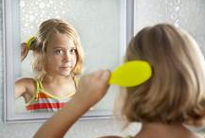
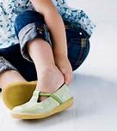
With your partner discuss these questions
KQ: How can I climb out of the learning pit?
In the morning, what do you do independently and what do you need support with?
Notes:
Might be beneficial to add pictures to prompt children to think about
Brushing hair
Brushing teeth
Getting dressed
Breakfast- making and eating

Slide 46
Plenary discussion
KQ: How can I climb out of the learning pit?
Who helps you if you need support?
What does it feel like to be independent?
How do you feel when you are able to accomplish new things?

Slide 47
Art- 2 in 2
TBAT: create a spiral picture inspired by Alma Woodsey Thomas.
What is a continuous line drawing?
a. a drawing where you move the pencil on and off the paper.
b. a drawing where you don't take your pencil off the paper.
What is a spiral?
a. a curve that moves out from a middle point and gets wider and wider
b. a zig zag drawing

Slide 48
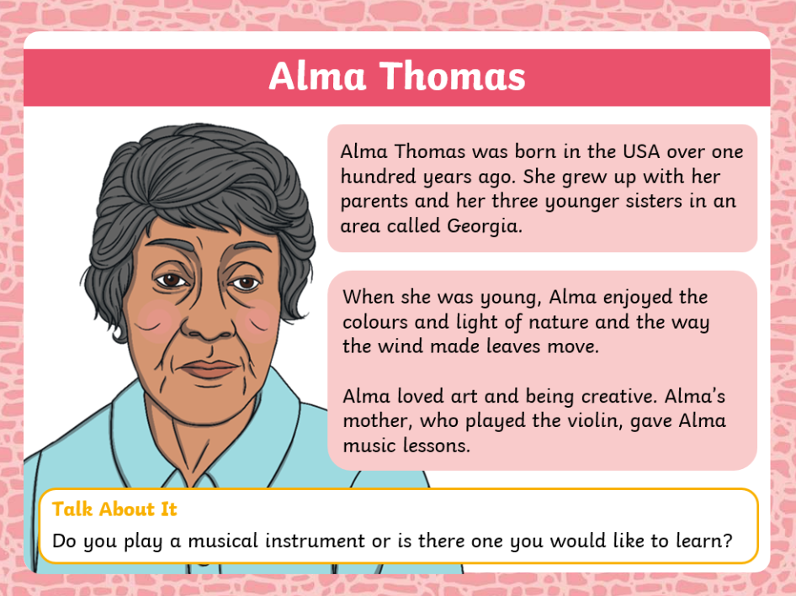
TBAT: create a spiral picture inspired by Alma Woodsey Thomas.

Slide 49
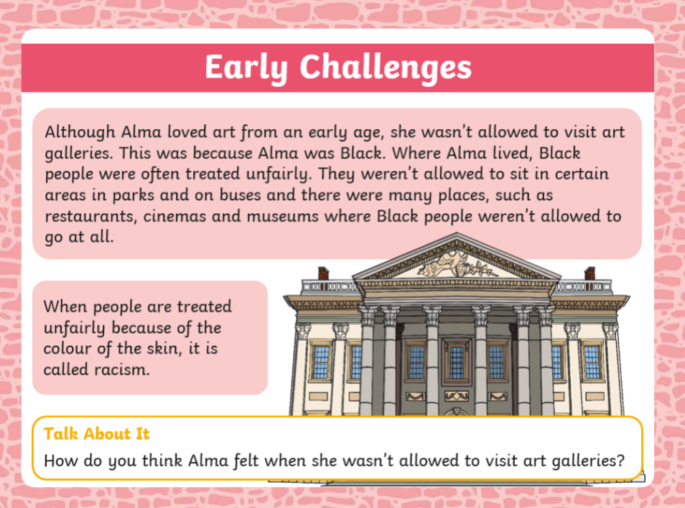
TBAT: create a spiral picture inspired by Alma Woodsey Thomas.

Slide 50
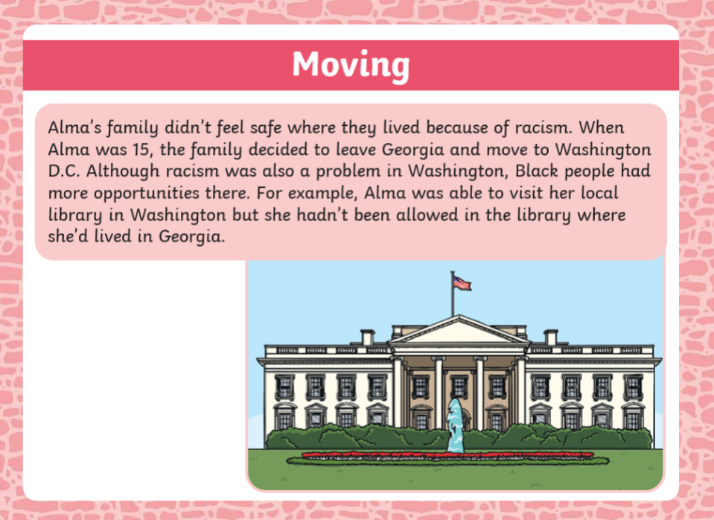
TBAT: create a spiral picture inspired by Alma Woodsey Thomas.

Slide 51
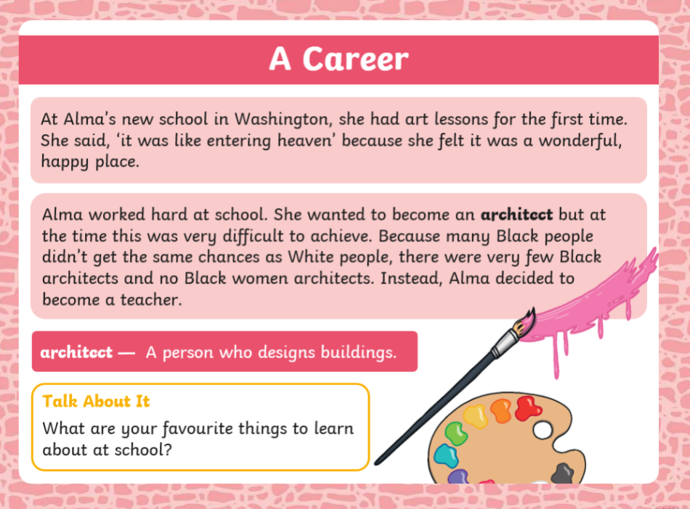
TBAT: create a spiral picture inspired by Alma Woodsey Thomas.

Slide 52
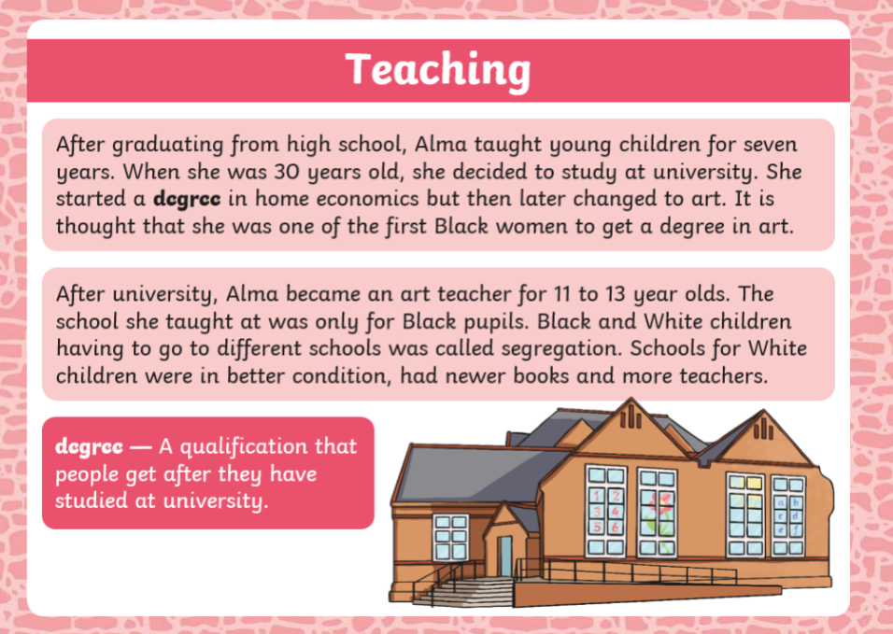
TBAT: create a spiral picture inspired by Alma Woodsey Thomas.

Slide 53
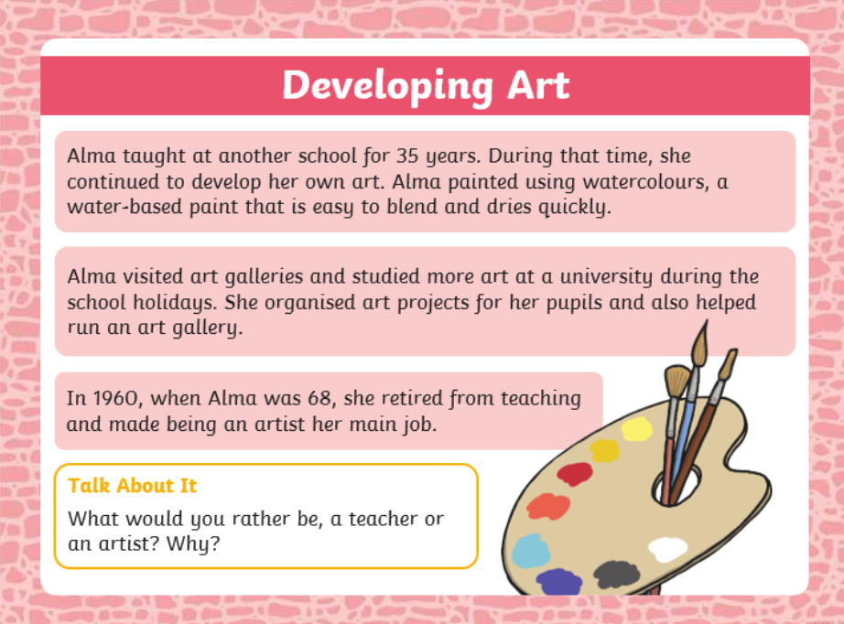
TBAT: create a spiral picture inspired by Alma Woodsey Thomas.
TBAT: create a spiral picture inspired by Alma Woodsey Thomas.

Slide 54
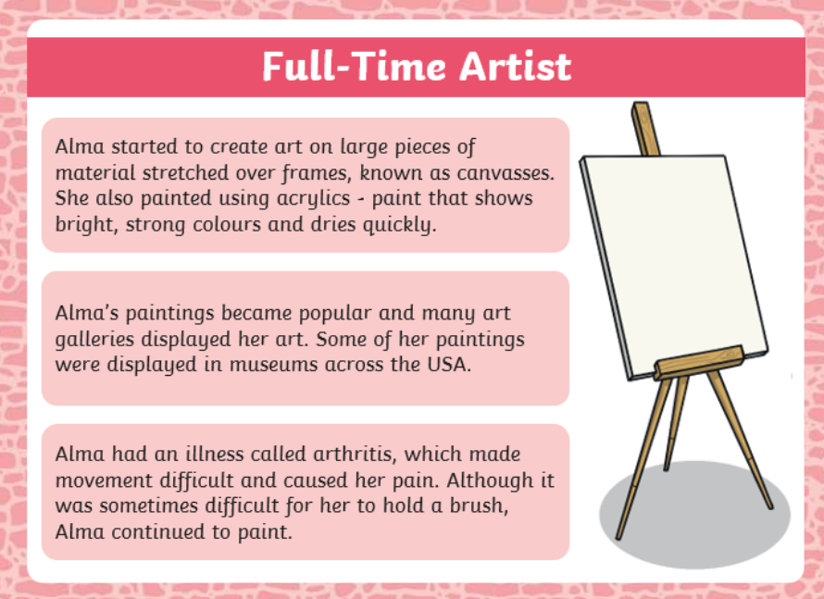
TBAT: create a spiral picture inspired by Alma Woodsey Thomas.
TBAT: create a spiral picture inspired by Alma Woodsey Thomas.

Slide 55
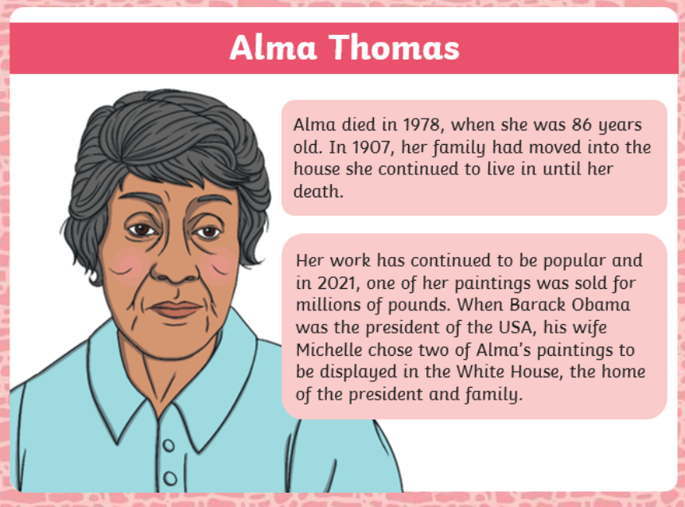
TBAT: create a spiral picture inspired by Alma Woodsey Thomas.
TBAT: create a spiral picture inspired by Alma Woodsey Thomas.

Slide 56
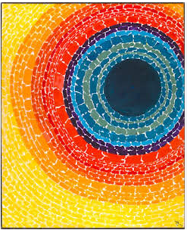

The eclipse
TBAT: create a spiral picture inspired by Alma Woodsey Thomas.
Pansies in Washington

Slide 57
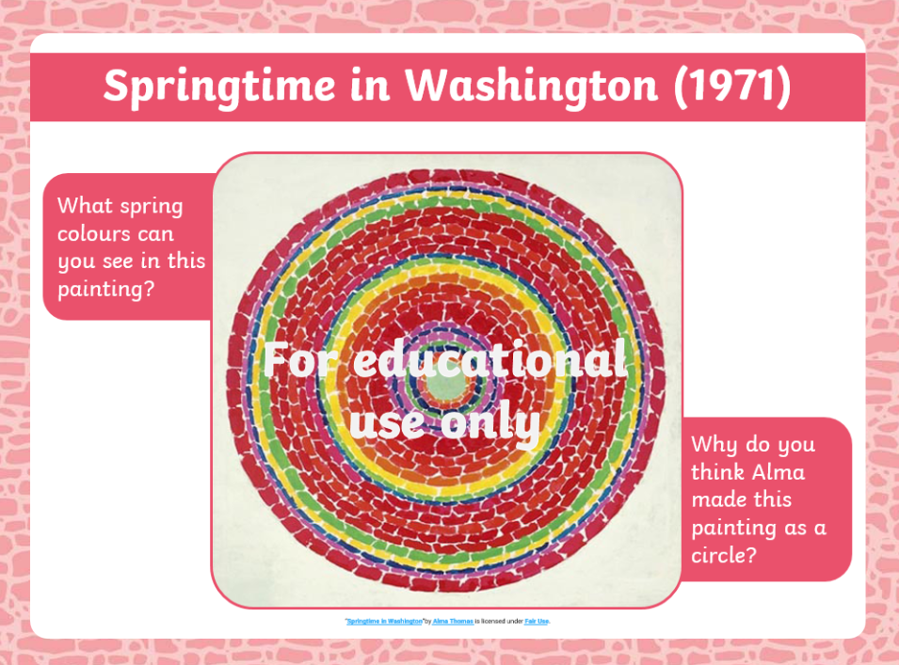
TBAT: create a spiral picture inspired by Alma Woodsey Thomas.
Use the resources provided to create a spiral picture inspired by Alma Woodsey Thomas.
What will you use as inspiration?
What colours will you use?

Slide 58

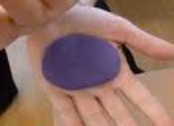
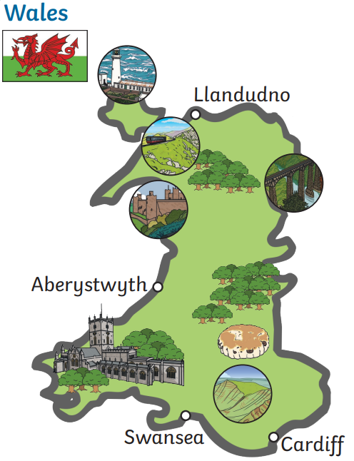
Independent Challenges:
Narrative Zone
Maths Zone
What is happening in the picture?
What can you see?
How might it feel?
Work out the subtractions using the playdough.
Enquiry Zone
Creative Zone
Look at the posters about the countries,.
What can you learn about them?
Create a spiral picture inspired by Alma Woodsey Thomas.

