Slide 1
Friday 12th September 2025

Slide 2



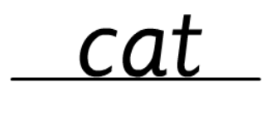
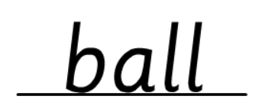
Morning Challenges:
Name writing

Slide 3
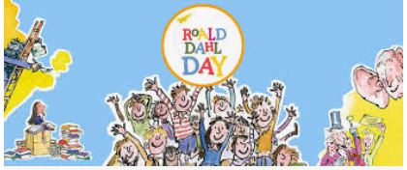
Roahl Dahl Day assembly

Slide 4
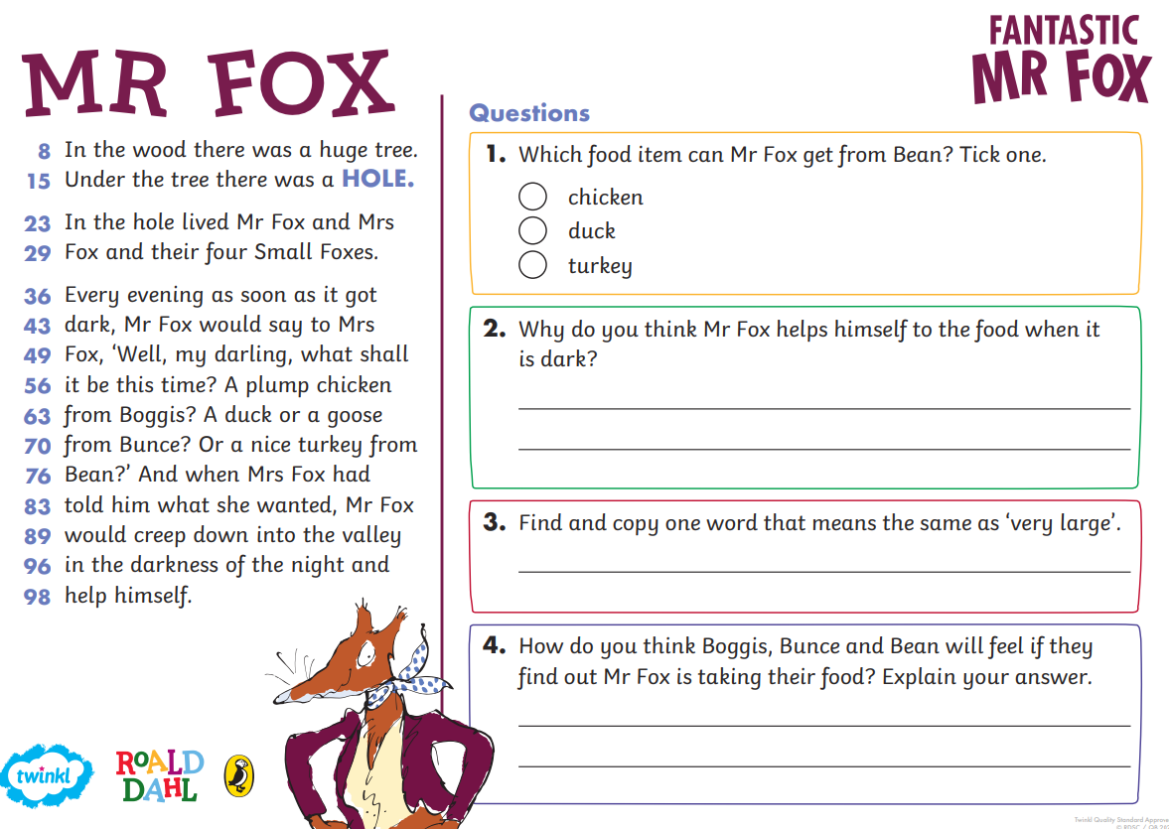
TBAT: describe a character.
3 in 3

Slide 5
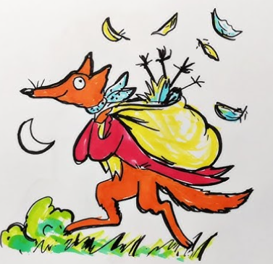

TBAT: describe a character.
Blue/ Green- With your partner discuss whether you think Fantastic Mr Fox will be a good or a bad character. Explain why you think that.
I think Mr Fox is good/ bad. I think this because........

Slide 6
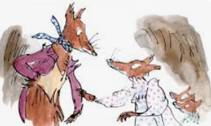
TBAT: describe a character.
Mr Fox is a smart and sneaky fox who lives in a cozy hole with Mrs Fox and their four little foxes. Every night, when the moon is high and the stars are twinkling, Mr Fox creeps out to find tasty treats for his family. He steals chickens from Farmer Boggis, ducks from Farmer Bunce, and cider from Farmer Bean. But these three farmers are mean, greedy, and very grumpy. They don’t like Mr Fox stealing their food, so they come up with a big plan to catch him!

Slide 7
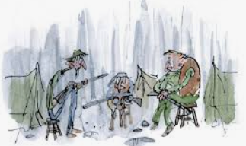
TBAT: describe a character.
The farmers dig and dig and dig, trying to reach Mr Fox’s home. But Mr Fox is much too clever. He digs faster and deeper, making secret tunnels underground. He doesn’t just think about his own family—he wants to help all the animals who are hungry and scared because of the farmers.

Slide 8
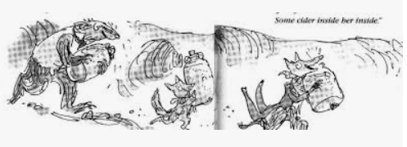
TBAT: describe a character.
With help from Badger, Rabbit, and other animal friends, Mr Fox builds a brilliant underground tunnel that leads straight to the farmers’ food! They sneak in and take just enough to share with everyone. Soon, all the animals are safe, full, and happy.

Slide 9
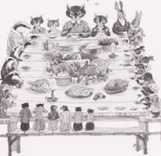
TBAT: describe a character.
At the end, Mr Fox throws a big underground feast with all his friends. The farmers are still waiting outside, grumbling and hungry, while Mr Fox and the animals laugh and enjoy their delicious dinner.

Slide 10
TBAT: describe a character.
✨ This story is all about being clever, kind, and brave—even when things get tricky. Mr Fox shows us that sharing and helping others is the best kind of cleverness!

Slide 11

TBAT: describe a character.
What does Mr Fox steal from Farmer Bunce?
A) Chicken
B)Gems
C)Ducks

Slide 12
TBAT: describe a character.
Which animals help Mr Fox dig his secret tunnel?
A)a badger and a rabbit
B) a dolphin and a shark
C) a pig and a tapir

Slide 13
TBAT: describe a character.
Where does Mr Fox's secret tunnel lead to?
A) back to his den
B) a secret island
C) the farmers food

Slide 14

Think, pair, share:
Think of three words to describe Mr Fox:
Mr Fox is..................................

Slide 15
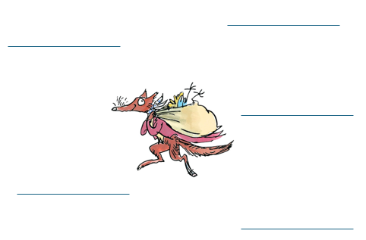
TBAT: describe a character.
Independent:
Challenge:
Write a sentence to describe Fantastic Mr Fox.

Slide 17
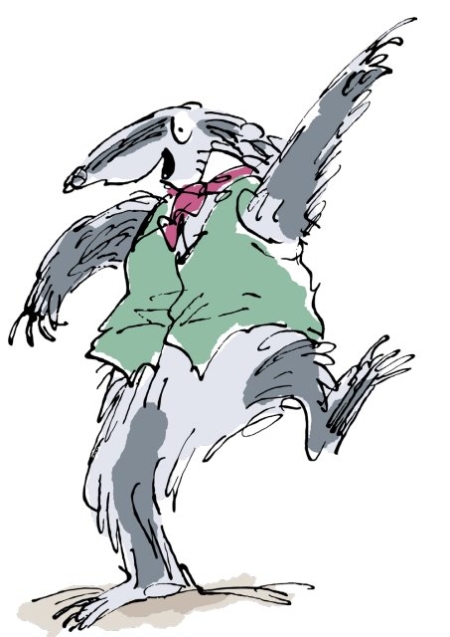

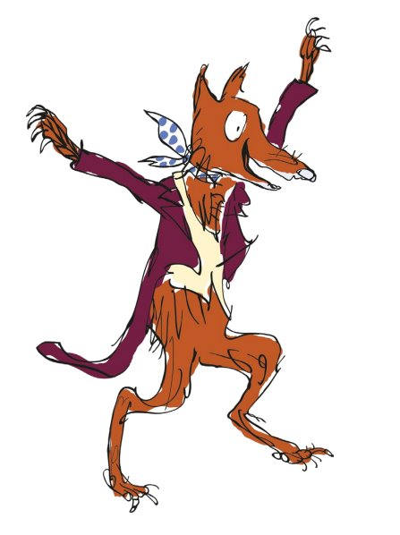
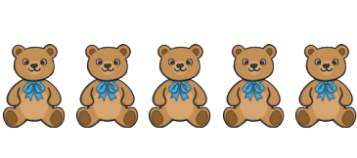
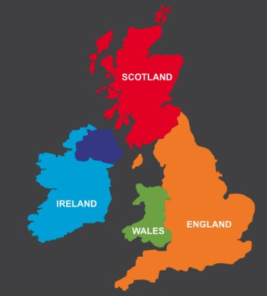
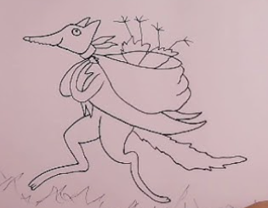
Independent Challenges:
Narrative Zone
Maths Zone
Draw counters and the number to represent the objects.
Act out a story with the characters from Fantastic Mr Fox.
Enquiry Zone
Creative Zone
Can you identify the countries in the UK and put them in the correct places?
Create a collaborative collage of a Roald Dahl character.

Slide 19

Celebration assembly

Slide 20

Enrichment

