Slide 1
456 x 6 =
2, 567 x 6 =
34.8 + 111 =
976 + 100 =
672 + ? = 1, 000
567 – 345 =
6, 736 - 1, 927 =
2, 017 - 300 =
67, 627 - 7, 826 =
546 - 162.4 =

Slide 2
Year 5 Celebration Café rehearsal (upstairs hall) Give It All You Got(Lyrics)

Slide 3
TBAT- convert fractions, decimals and percentages. 3 in 3 1) 2/3 + ½ = 2) 3/5 - 1/2 = 3) 4/5 of 200 =
Challenge:
2/5 of a 1L milk carton was used. How much milk is left?

Slide 4
Daily 10 - Mental Maths Challenge - Topmarks
X 8s

Slide 5
Blue 0.67 _______ 55% 0.89 ________ 89/100 Green 26% _____ 0.34 0.2 ______ 2/10
Challenge:
Michael says that 68% is less than 0.609 because the decimal has four digits in it.
True or false?

Slide 6
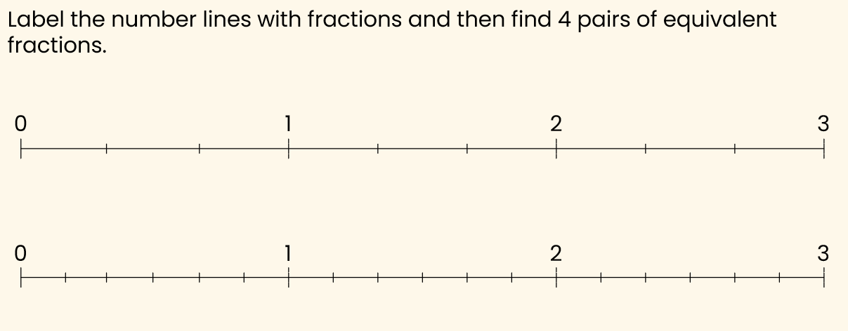
Paired Work

Slide 7
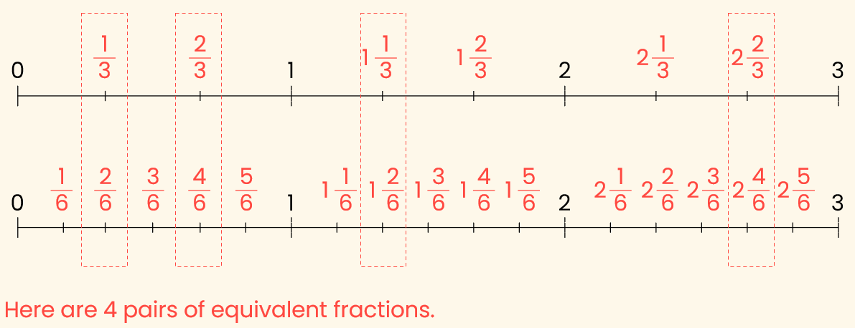

Slide 8
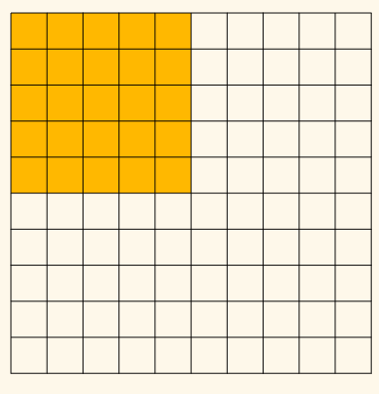
How many hundredths have been shaded in?
2) These are equivalent fractions- True or false?

Slide 9
Talk partners: Write on a wipeboard as a fraction, decimal and percentage.

Slide 10
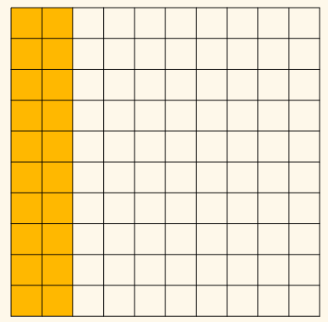
Fraction=
Write two more simplified equivalent fractions.

Slide 11
Talk partners: Write on a wipeboard as a fraction, decimal and percentage.

Slide 12
Paired Work:

Slide 13
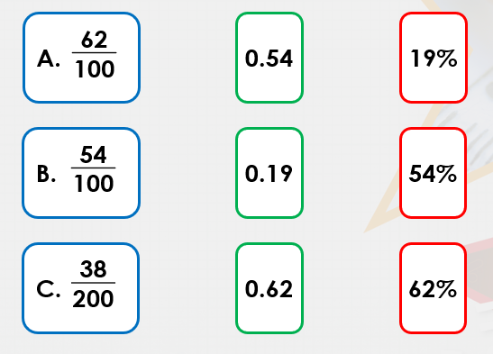
Independent: Write the correct answers on your whiteboard.

Slide 15
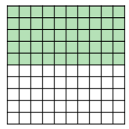
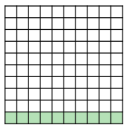
Write as a fraction, decimal and percentage. Blue Green

Slide 16
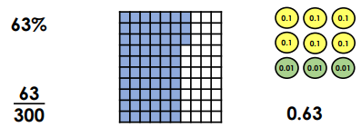
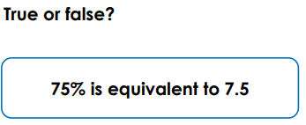
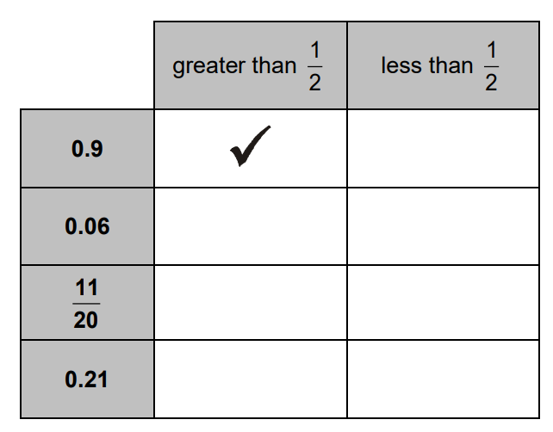
Independent:
Odd one out – explain
Write the fraction, decimal and percentage for each below:
55%
0.43
0.07
60%
5/10
2/5
0.73
Explain.

Slide 17
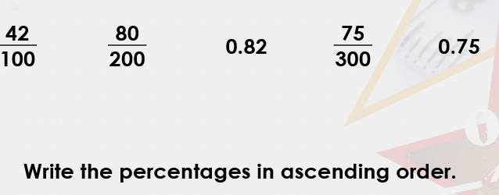
Mastery:
Challenge:

Slide 18
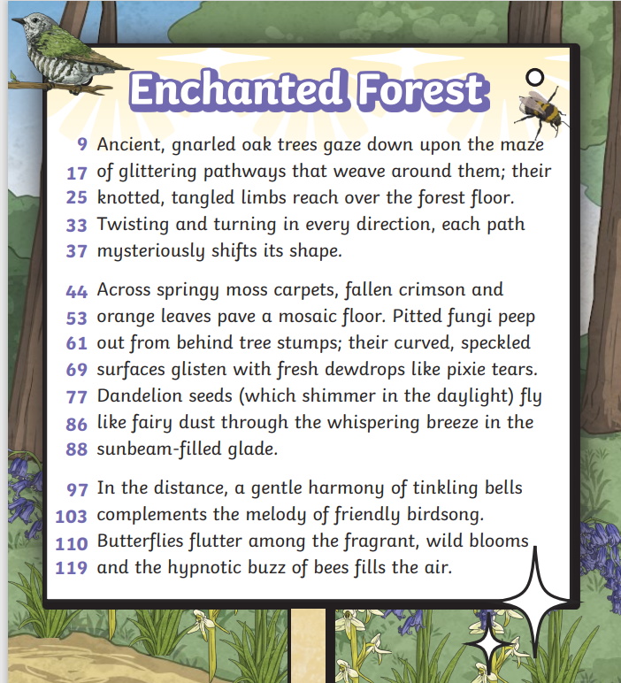
Monday 7th July TBAT: Write a setting and character description. 3 in 3 1. Name two sounds that can be heard in the forest. 2. What season do you think it is and why? 3. Find and copy one word which means the same as ‘having a pleasant smell’.

Slide 19
Monday 7th July TBAT: Write a setting and character description. Describe Odin in detail – what ambitious vocabulary can you include? Describe Asgard in detail – what ambitious vocabulary can you use? Teacher to brainstorm vocabulary for Odin and Asgard on flipchart paper

Slide 20
Monday 7th July TBAT: Write a setting and character description. Example – what features can you spot? High above the mortal world, where the sky shimmered with golden light and the clouds curled like silver smoke, stood the mighty realm of Asgard. Nestled among glistening mountains and sparkling rivers of starlight, the home of the gods gleamed with majesty and mystery. The towering walls of Valhalla were lined with spears and golden shields. Asgard was a place of beauty, power, and ancient magic. At dawn, when the sun cast a warm glow over the polished halls, a peaceful silence wrapped the city like a comforting cloak—though deep within, something stirred. For even in this land of eternal glory, not all knowledge was known, and not all questions had been answered.

Slide 21
Monday 7th July TBAT: Write a setting and character description. Example – what features can you spot? With his long, midnight-blue cloak billowing in the breeze and his silver staff tapping against the stone floor, Odin, the Allfather, stood at the edge of the Rainbow Bridge. Wise beyond measure yet restless in spirit, he was a figure of both awe and mystery. His eyes—sharp, blue, and filled with storms—searched the horizon. Beneath his broad-brimmed hat and thick, grey beard, his expression was one of quiet resolve. Although he ruled over Asgard with strength and wisdom, Odin’s thirst for knowledge burned brighter than the stars above. For he knew that somewhere, far beyond the gates of the gods, deeper than memory and time, the answers he sought waited in the waters of Mimir’s Well.

Slide 22
Monday 7th July TBAT: Write a setting and character description. Share write: Include: Fronted adverbials Expanded noun phrases Remember you are just describing the setting – you do not need to tell much of the story.

Slide 23
SPORTS DAY – afternoon outside

Slide 24
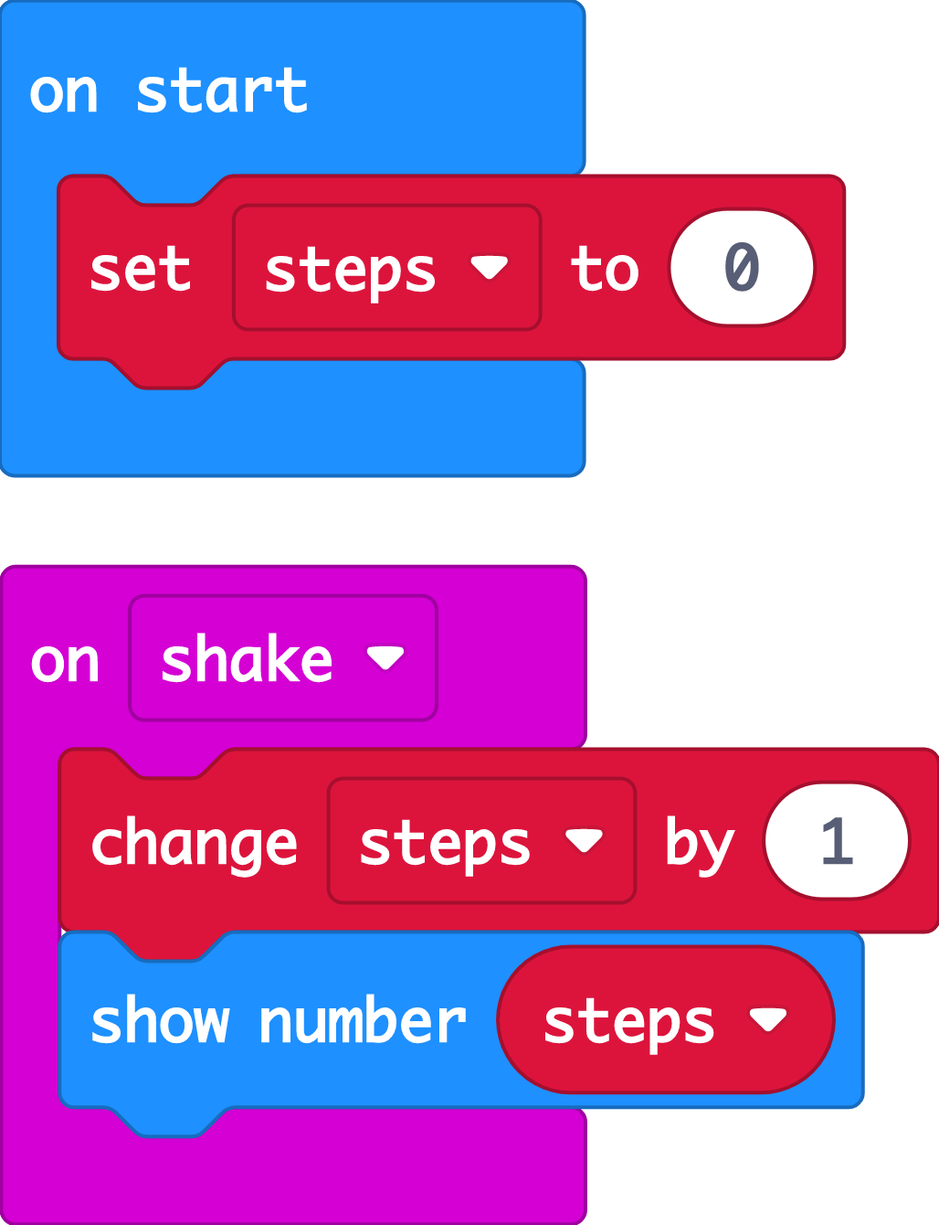
Recap: step counter
Last time we used the micro:bit’s accelerometer input sensor to make a step counter.
We used a variable to count how many steps we had taken.
We investigated how accurate the step counter was and thought about ways of improving it.
Today we’re going to use another sensor, the light sensor, to make a light that switches on automatically when it gets dark.

Slide 25
Introducing the light sensor
Notes:
This YouTube video explains
The micro:bit’s LEDs, as well as acting as an output, also can work as an input, sensing how dark or light it is
We can use this to make projects that react when it gets dark or light.

Slide 26
TBAT: successfully make a code that uses sensors and logic.
I can explain that sensors are inputs that sense things in the real world, such as movement and light.
I can explain that logic is how computers make decisions in code based on whether things are true or false.
Notes:
Explain that Sensors are inputs that measure things outside a computer, like light, or movement. Logic is a key idea in computing. It helps machines to make decisions, like turning a light on if it’s dark.
Optional: play Nightlight introduction video which also explains that the micro:bit light sensor works in a range from 0 (very dark) to 255 (the brightest it can go).

Slide 27
Think: night light introduction video
Optionally play video: https://youtu.be/6nWwnq8aYh8

Slide 28
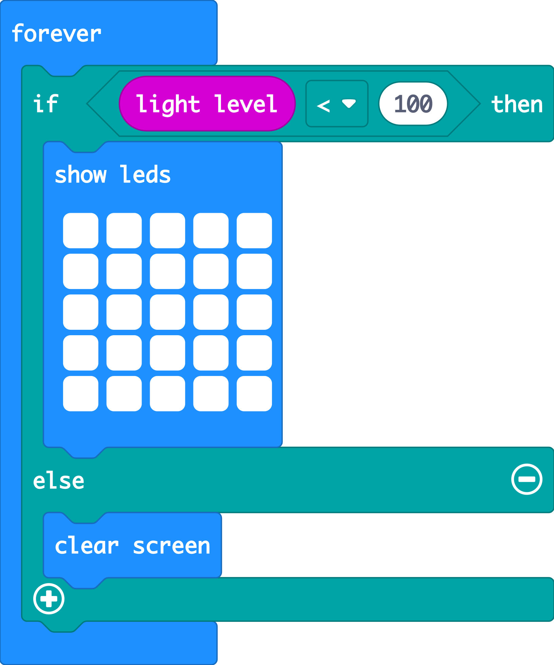
Create: examine the code
The ‘forever’ loop keeps the micro:bit checking the light level.
The logic ‘if… then’ block checks if the light level is low, less than (<) 100.
When the accelerometer input senses a shake, the ‘change’ block adds 1 to the number stored in the ‘steps’ variable.
Else (otherwise) the light level must be 100 or more. It must be light, so it turns the LEDs off with ‘clear screen’.
Teacher: open the completed code in the editor
Notes:
You can follow the link to open the completed code in the editor. Model testing it in the simulator by dragging the yellow line in the circle up and down on the micro:bit in the simulator.

Slide 29
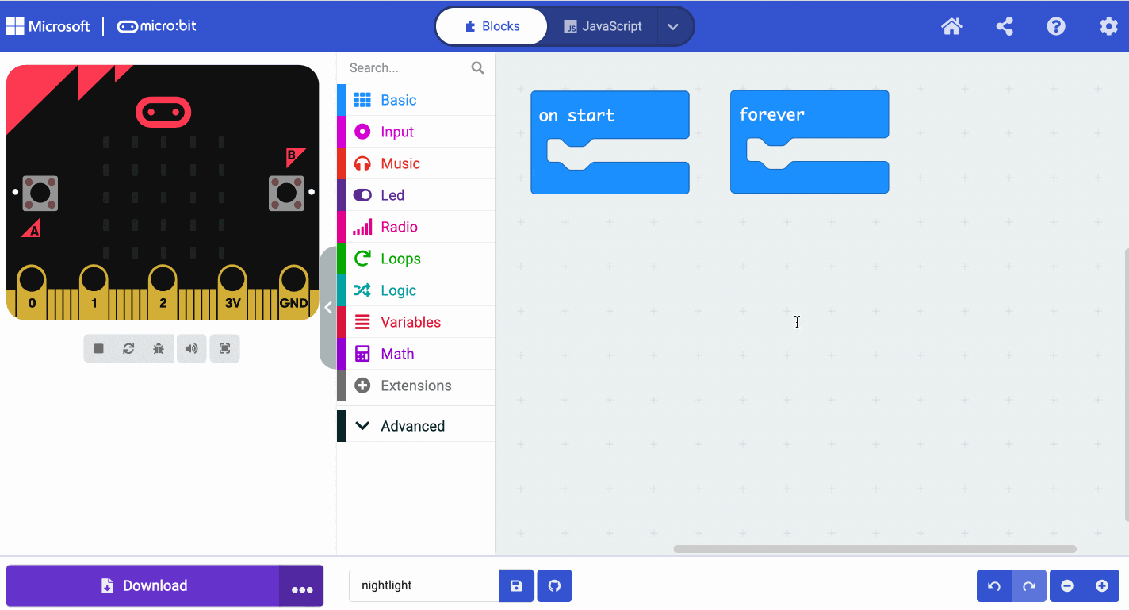
Create: coding animation
Notes:
Animated GIF of building the code you can share with your students, if YouTube is blocked in your school.

Slide 30
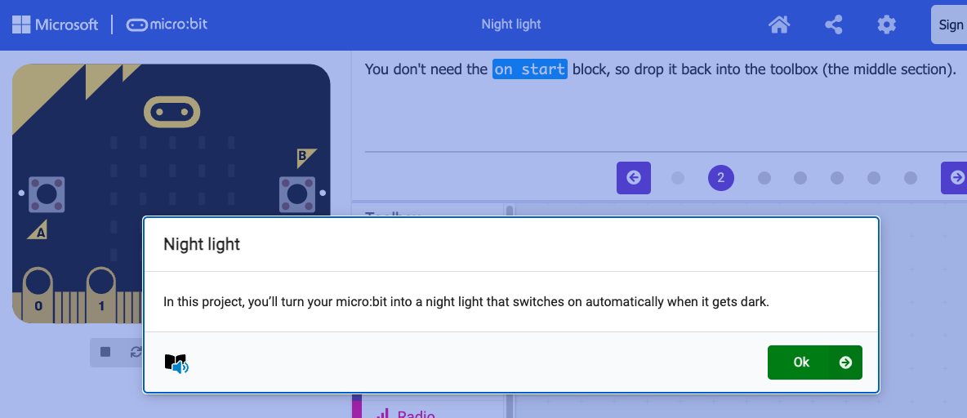
Create: step-by-step online tutorial
https://mbit.io/tutorial-night-light
Notes:
You can optionally share this online step-by-step tutorial with your students to follow individually.

Slide 31
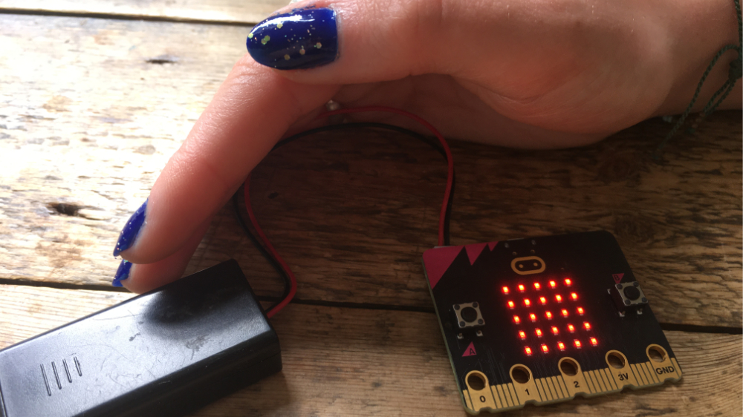
Evaluate
Download your code to a micro:bit
Does it work as you expect? Use smaller numbers if the LEDs switch on too easily, or larger numbers if it’s hard to make the lights switch on.
How good is the project?
Could it have other uses?
How does it work?
Notes:
How good is the project?
Would you recommend it to a friend?
How could you improve it?
How does it work?
Encourage students to think about how it works when holding it in their hands.

Slide 32
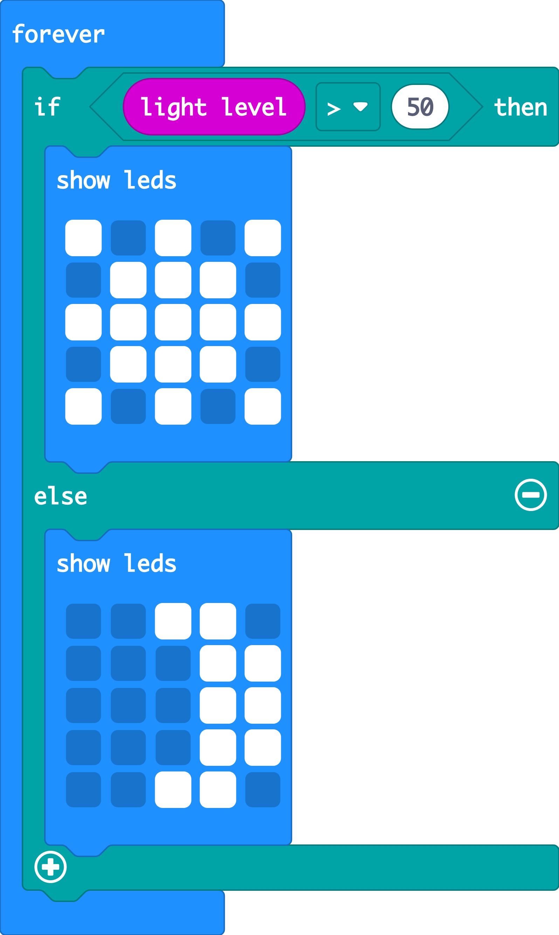
Extend
Make different pictures appear if it’s bright or dark.
You could experiment by changing the logic comparison block from less than < to greater than >
Notes:
Opportunity to reinforce mathematics learning about less than < and greater than > symbols.

Slide 33
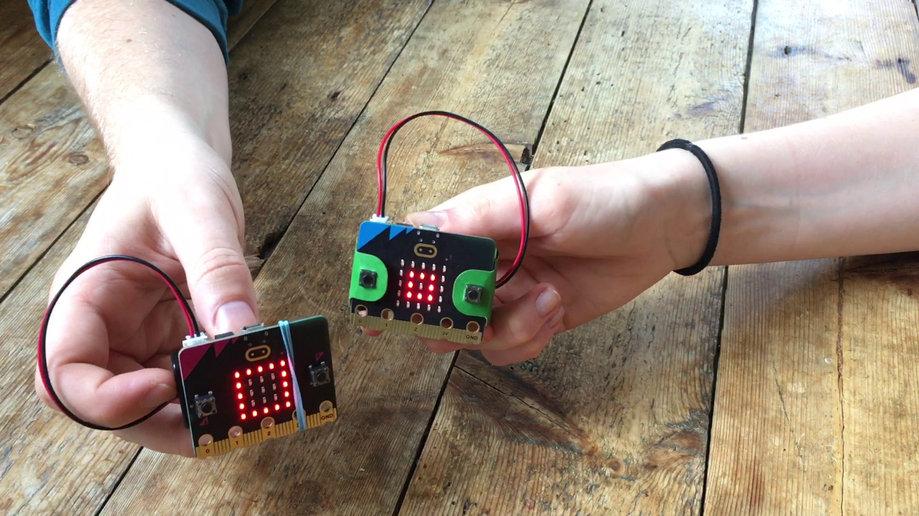
Next steps
Today we used the micro:bit light sensor and logic to turn LED lights on automatically when it gets dark.
Next time, we’ll use micro:bit sensors and logic to make a classic game of chance.

