Slide 1
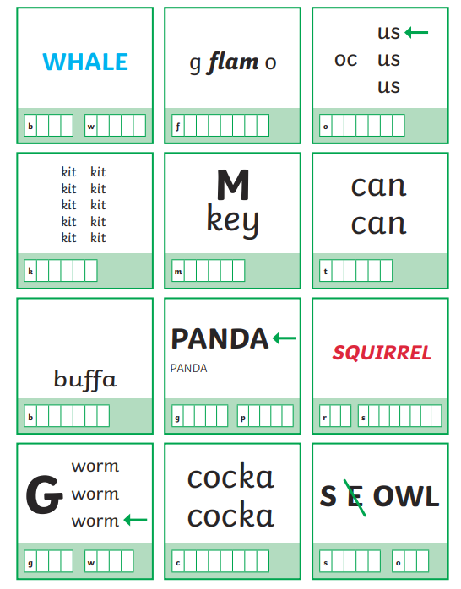
Morning Challenge

Slide 2
Year 5/ 6 spelling word
Bingo

Slide 3
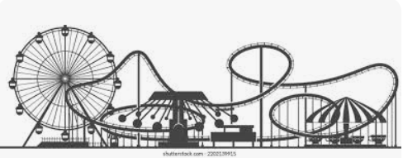
Theme Park Maths

Slide 4
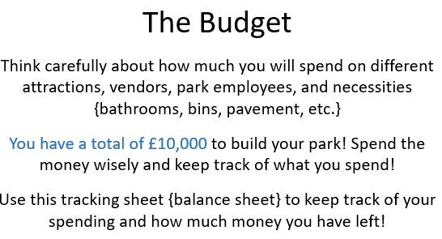

Slide 5
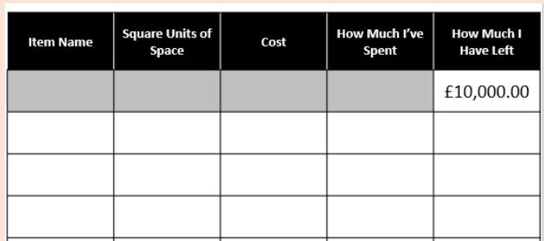
How much money have you spent so far?
How much money do you have left?

Slide 6
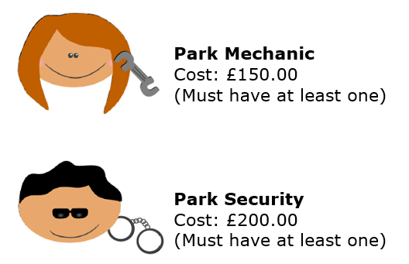
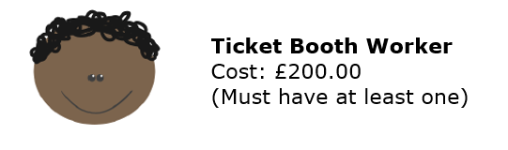
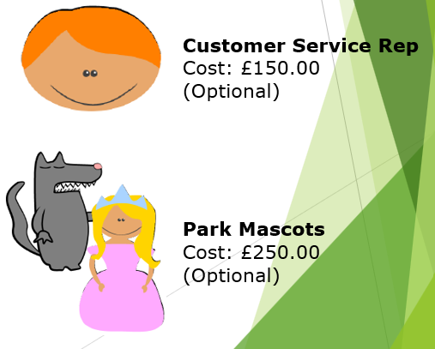
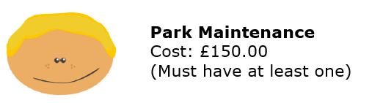
Based on what you have at the moment, what staff do you need to employ?
Add them to your costings. You will need to add others at a later stage, but for now just who you need NOW.

Slide 7
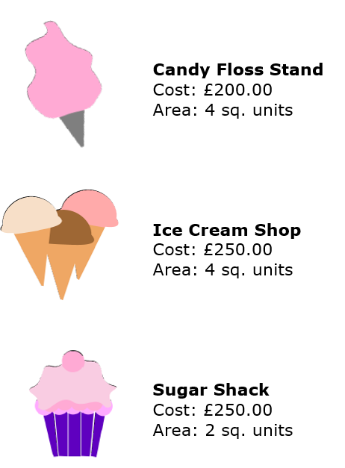
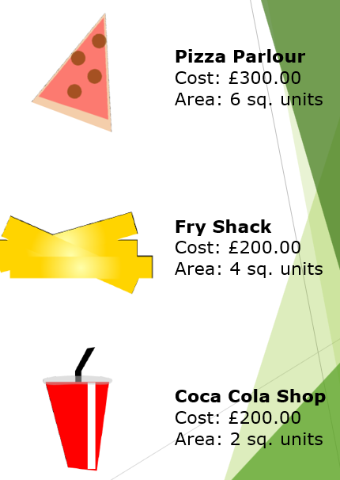
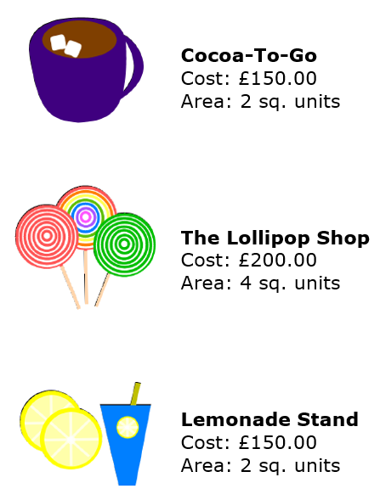
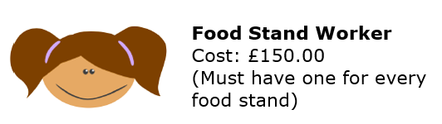
Decide on the food/drink stalls you will have.
2) Remember, each one you purchase you must also hire staff, so take that cost into consideration.
3) Calculate the costs.
4) Plot them on your planning sheet.

Slide 8
Check:
Have you included all of the park necessities?
Do you have food?
Next:
What rides will you include? Where will they be positioned? Add this to your budget.

Slide 9
Literacy
How I Changed For The Better
This year, I’ve changed for the better in so many ways. At the start of Year 5, I sometimes doubted myself and didn’t always believe I could tackle the harder work, especially in subjects like maths and writing. But as the months went on, I began to grow in confidence. I learned to keep trying, even when things felt tricky, and to be proud of small steps forward. I’ve become more independent, more focused, and more willing to challenge myself. I’ve also learned how to work better with others—listening, sharing ideas, and encouraging my classmates. Looking back, I can see how much I’ve grown not just in my learning, but in the way I see myself. Year 5 has helped me believe that I can do more than I ever thought possible.

Slide 10
One Thing The Teacher Should Change Next Year
If there’s one thing I think Miss Smith could change for Year 5 next year, it would be to let us have a few more fun Fridays—maybe with games, music, and definitely snacks involved! She makes lessons interesting but just imagine a surprise disco maths session or a “no pens” afternoon where we learn through drama or drawing! Oh, and maybe a class pet that we can look after. Just a few little changes to make an already great year even more unforgettable

Slide 11
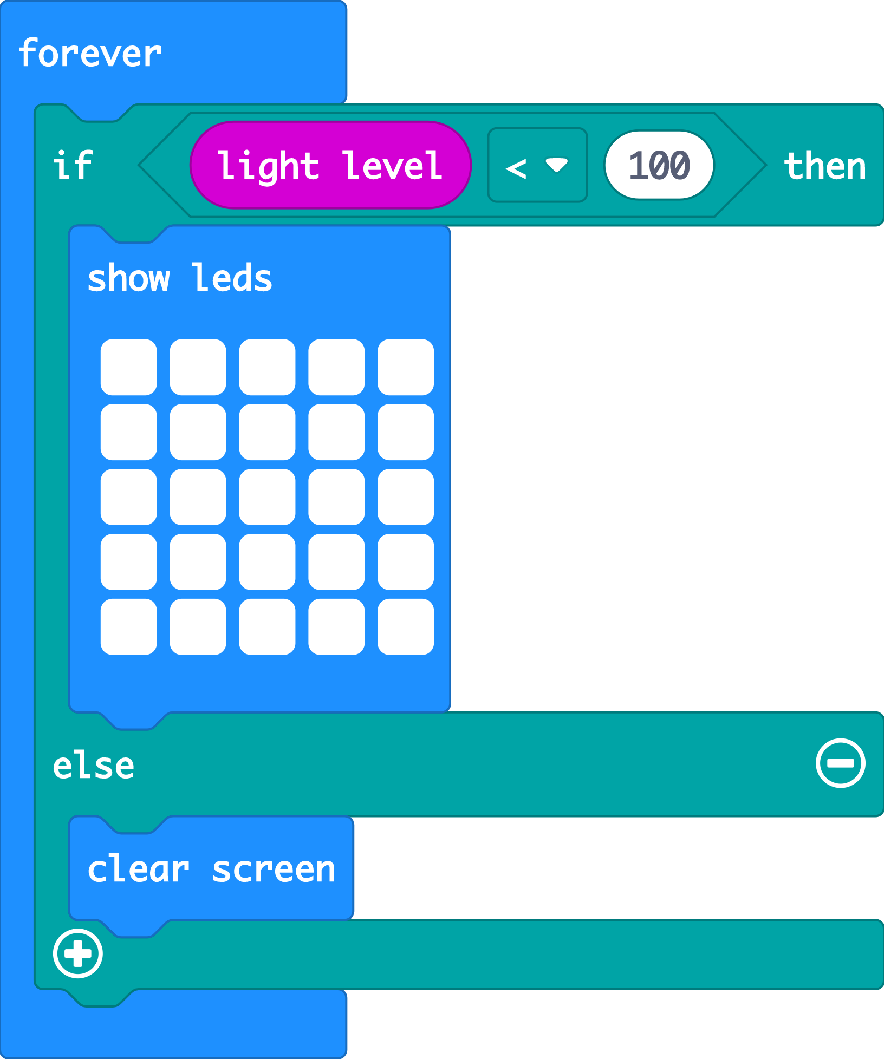
Recap: nightlight
Last time we coded our micro:bits to make a light that switches on when it gets dark using sensors and logic.
Today we’re going to use the accelerometer sensor and even more logic to make a micro:bit simulation of a well-known game.
Notes:
A simulation is a computer version, or model, of something in the real world. The MakeCode editor has a simulator of a real micro:bit, for example.

Slide 12





Think: learning objectives
I can code a micro:bit Rock, paper, scissors game using inputs, random numbers, variables and logic.
I can explain how combining inputs, random numbers, variables and logic can make a computer simulation of a real-world game.
Notes:
Ask
What is an input?
What input would be useful to use in this game? (The accelerometer is a good input to use because it can sense when we shake the micro:bit which fits the game.)
What are random numbers? (Talk about examples like dice. Is a dice more random than a human playing rock, paper, scissors? Do your students think a computer will be truly random?)
What are variables? (We used variables in the step counter project to keep track of our steps. Today we’re going to use them so we can test a random number and show different pictures depending on its value.)
What is logic? (We used logic in the nightlight project to turn the light on if it was dark. Here we’ll use logic in the form of if-then-else blocks to make different pictures appear to represent rock, paper, or scissors depending on the random number generated by the micro:bit.)
A simulation is a computer version, or model, of something in the real world. The MakeCode editor has a simulator of a real micro:bit, for example.

Slide 13
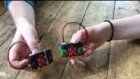



Think: rock, paper, scissors introduction video
Optionally play video: https://youtu.be/8wFIZLLBbuk

Slide 14

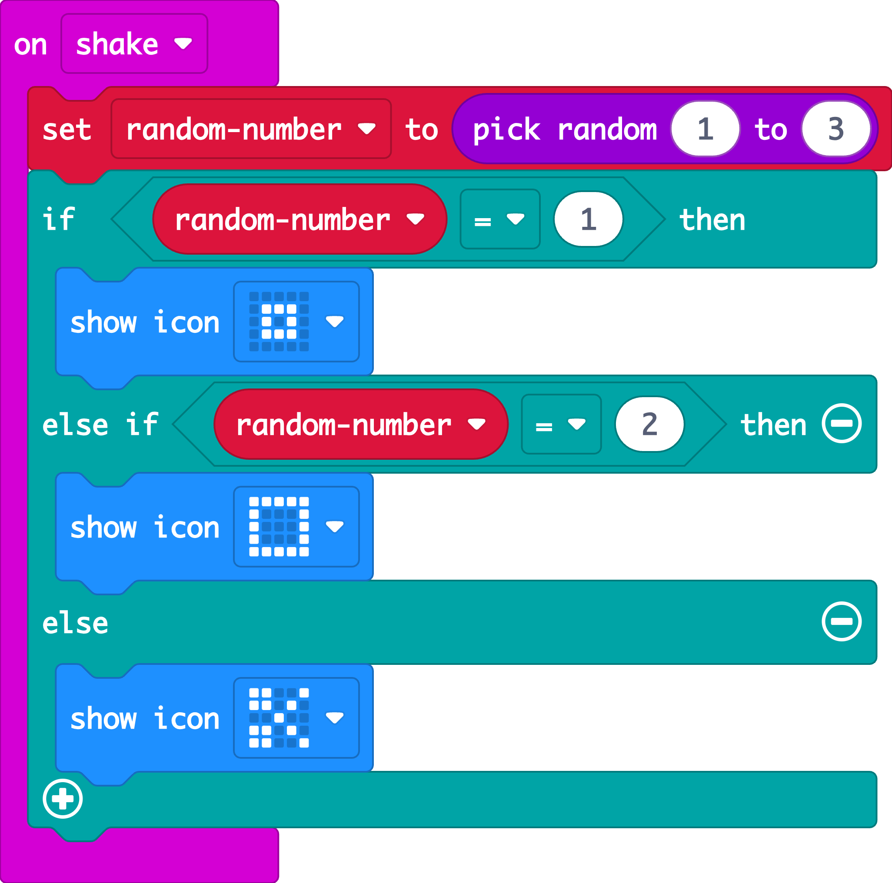

Create: examine the code
The accelerometer sensor input triggers the ‘on shake’ block.
A random number between 1 and 3 is stored in a variable called ‘random-number’
The logic ‘if… then… else’ block tests the value of the variable.
If the number is 1, it shows a rock icon.
If the number is 2, it shows a paper icon.
Else, otherwise, if the number is not 1 or 2, it must be 3, so it shows the scissors icon.
Teacher: open the completed code in the editor
Notes:
We don’t need to test if random-number = 3 because we’re using logical thinking. If the number is not 1 or 2, it must be 3.
Completed code: https://makecode.microbit.org/#pub:_4ChUTXM8od9P

Slide 15


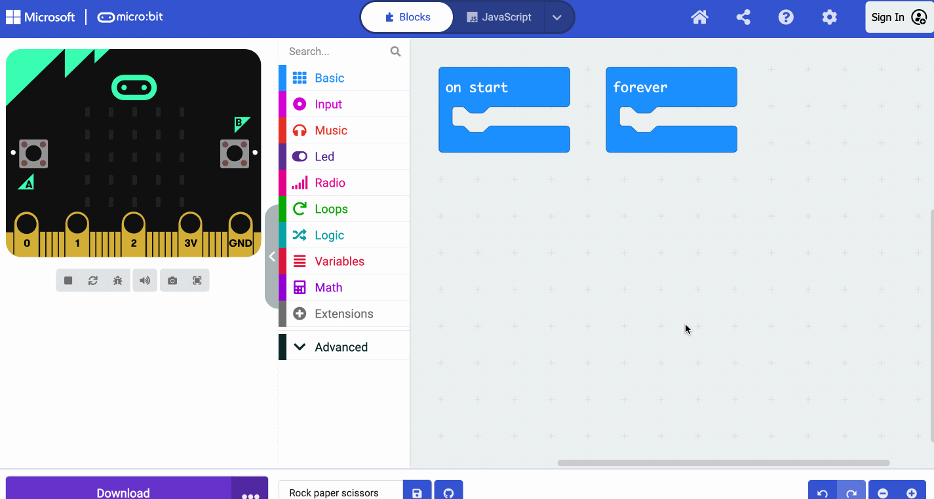
Create: coding animation
Notes:
Animated GIF of building the code you can share with your students, if YouTube is blocked in your school.

Slide 16
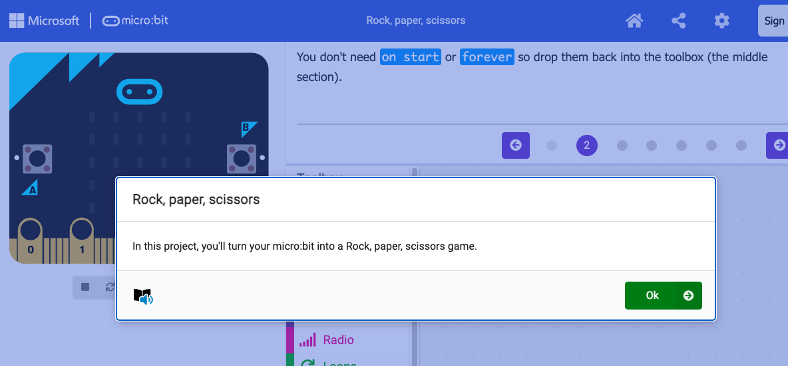
Create: step-by-step online tutorial
https://mbit.io/tutorial-rps
Notes:
You can optionally share this online step-by-step tutorial with your students to follow individually.

Slide 17


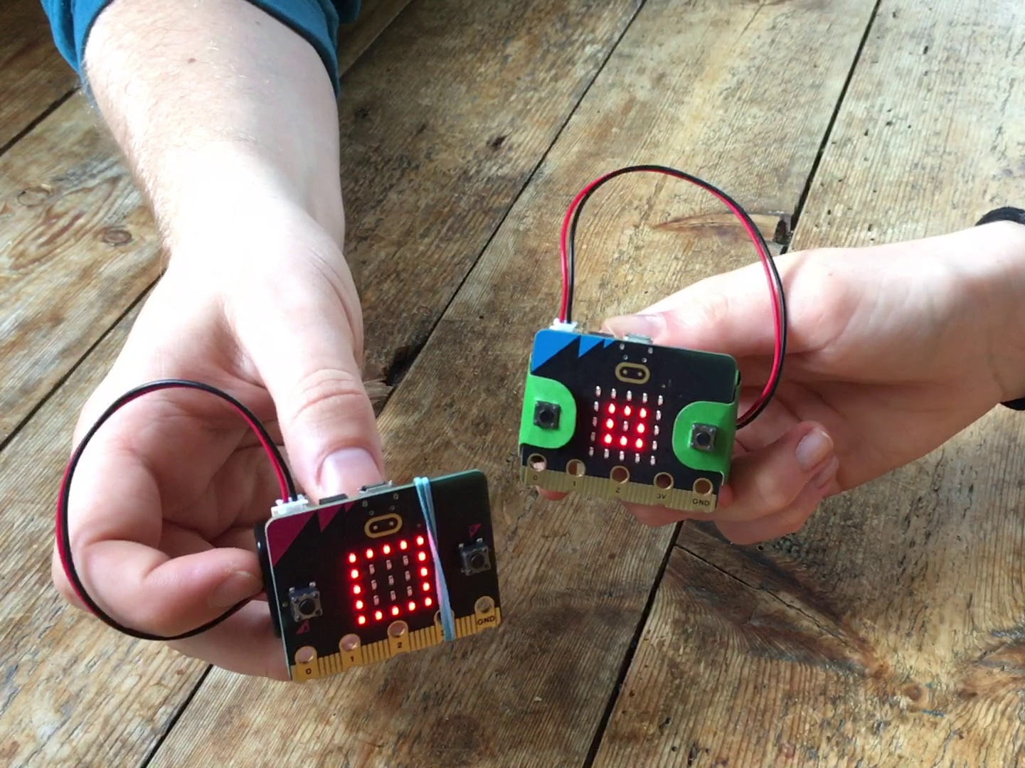

Evaluate
Download your code to a micro:bit
Does it work as you expect?
How good is the project? Do you think the micro:bit is a fair opponent? Is it a good simulation of the game?
Could it have other uses?
How does it work?

Slide 18


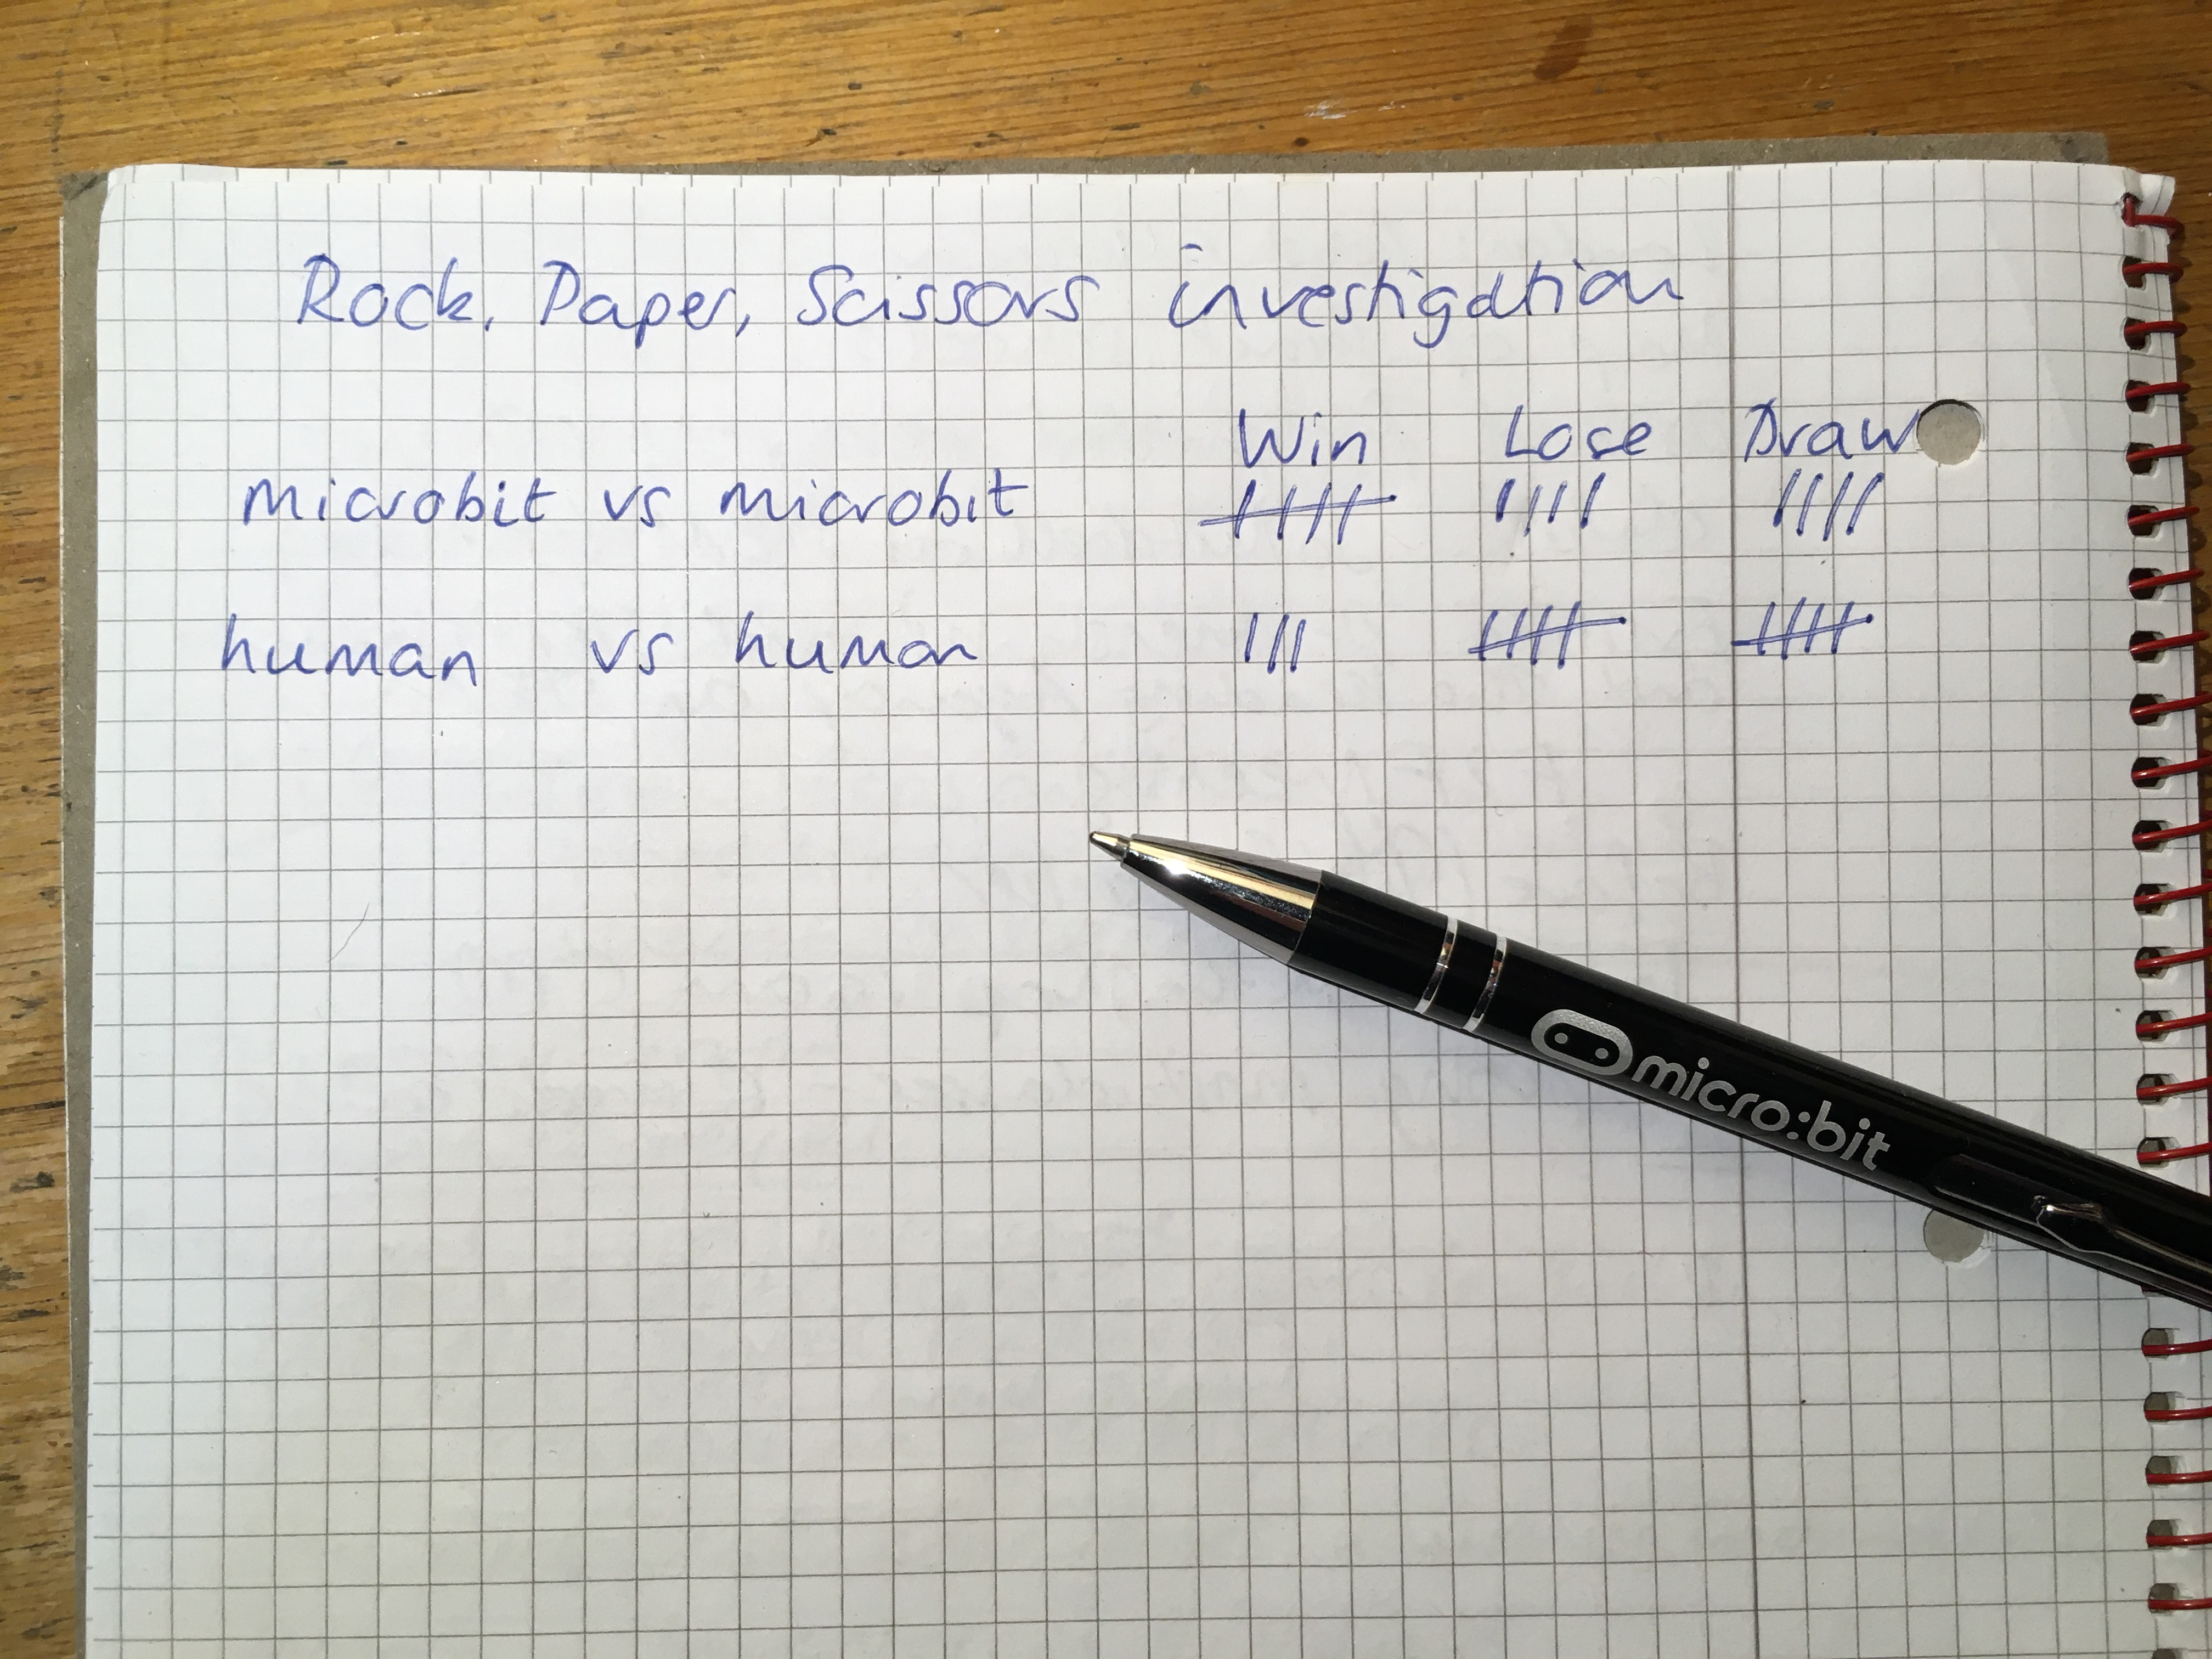
Extend
Make a tally chart to record how many games the micro:bit wins, losses or draws when playing against a human opponent… or against another micro:bit.
Can you modify the code to make your own game?
Notes:
Students might design their own icons and make new rules about which objects beat other objects.

