Slide 1
Thursday 10th July Morning challenge
Our celebration assembly will begin shortly, so please sit and read independently whilst we wait.

Slide 2
Year 5 End of Year Celebration Café 8.45am

Slide 3
Assembly 10am

Slide 4
Thursday 10th July PE Engagement activity Venturers – 10.50 - 11.35 Voyagers – 11.35 - 12.10

Slide 5
Thursday 10th July TBAT: Write about conflict and resolution.
Share your legend so far, which sentence are you most proud of? Make one edit and improvement to your legend. What is the final conflict and resolution in the legend? How might the tale end?
Think about legends teaching morals or lessons.

Slide 6
Thursday 10th July TBAT: Write about conflict and resolution.
Resolution
At last, beneath the twisting roots of Yggdrasil, Odin stood before Mimir’s Well. The air was still, yet thick with ancient power. Mist rose from the water’s surface, glowing with silver light, and beside the well stood Mimir himself—a mysterious, ageless figure whose eyes shimmered like stars and who had already seen Odin’s arrival in the waters. With a voice as deep as the earth, he spoke. “You seek the wisdom that only these waters hold. But knowledge,” he warned, “demands a price that cannot be undone.” Slowly, Odin nodded. “Then name it,” he said. Mimir's gaze did not waver. “Your right eye—for only those who give something of great value may see what lies ahead.”
Without hesitation, and though pain seared through him like fire, Odin reached up and gave what was asked. His clear, ice-blue eye fell into the well, sinking slowly into its depths. Silently, Mimir handed him a horn carved with runes older than the gods themselves. Odin drank deeply, and in an instant, visions flooded his mind—visions of battles yet to come, of songs not yet sung, of every corner of the world and every secret hidden within it. From that moment on, though he saw with only one eye, he understood more than any being alive.
And so, the legend says, Odin returned to Asgard wiser than ever before—ready to guide his people, guard the realms, and protect the balance of the world for all time.

Slide 7
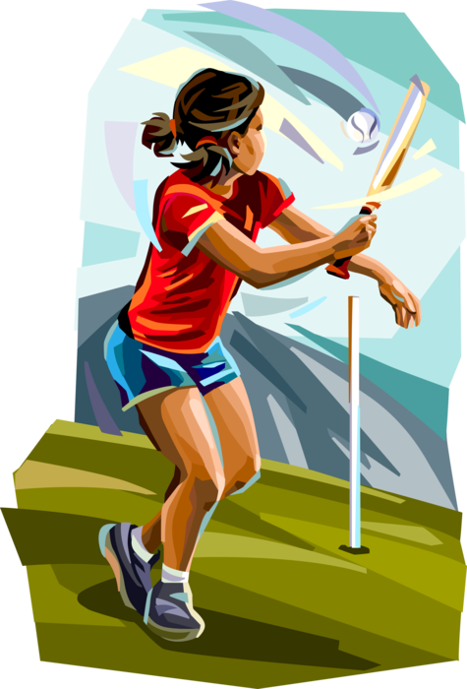
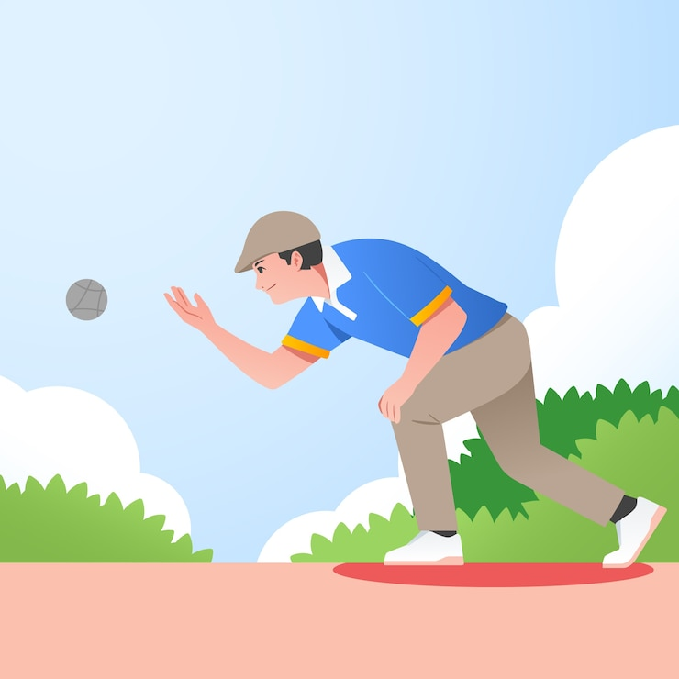
PE – House Rounders Tournament

Slide 8
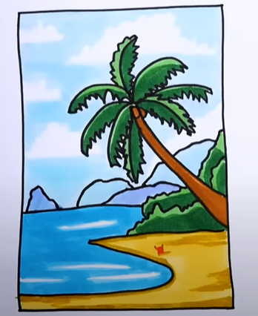
ART – Summer tutorial How To Draw A Beach Landscape If children complete this, they can work in pairs on laptops to find their own tutorials.

