Slide 1
Tuesday 15th July 2025
15/7/2025

Slide 2
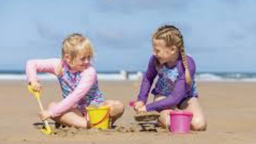
Early morning work
Imagine you are going on holiday to the seaside!
What will you need to pack?
Remember items to keep you safe in the sun!

Slide 3
Recap
Flash Cards (Time Trial) (Phase 3) - Online Phonics Game
Yes/No Yeti (Phase 5) - Online Phonics Game

Slide 4
Tricky word bingo!
Year 1 common exception word wheel - Spin the wheel

Slide 5
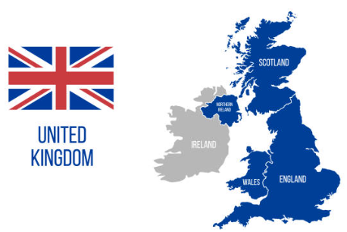
Blue/ Green
TBAT: remember what we have learned this year.
What can you remember about the United Kingdom?

Slide 6
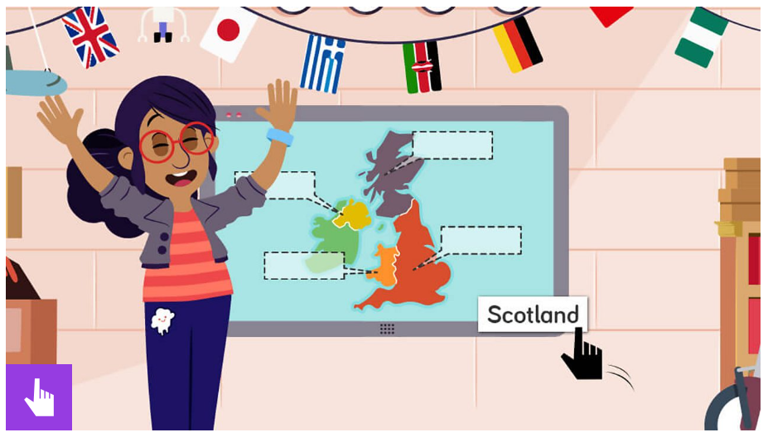
Can you remember where each country is?
What is the UK? - BBC Bitesize

Slide 7
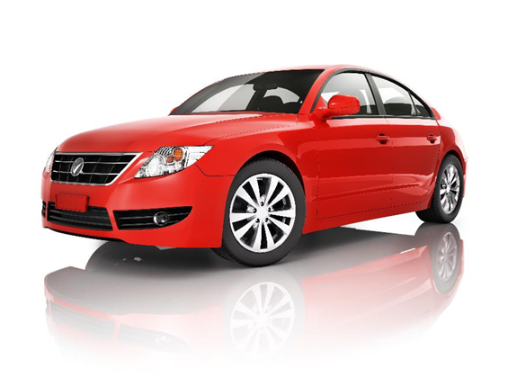
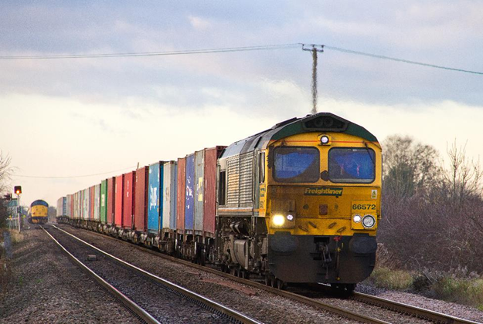
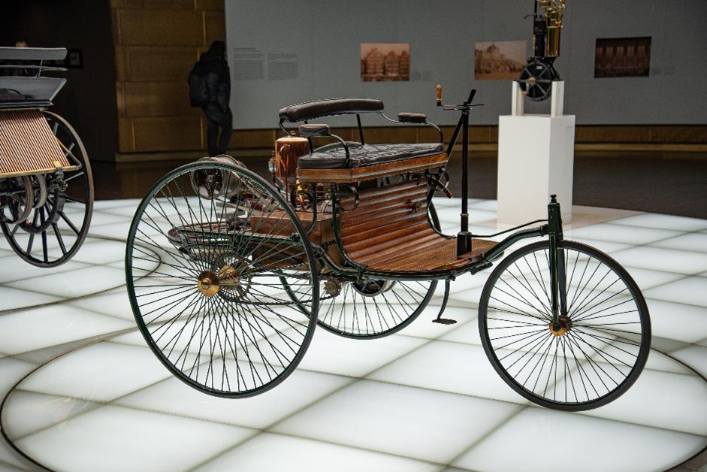
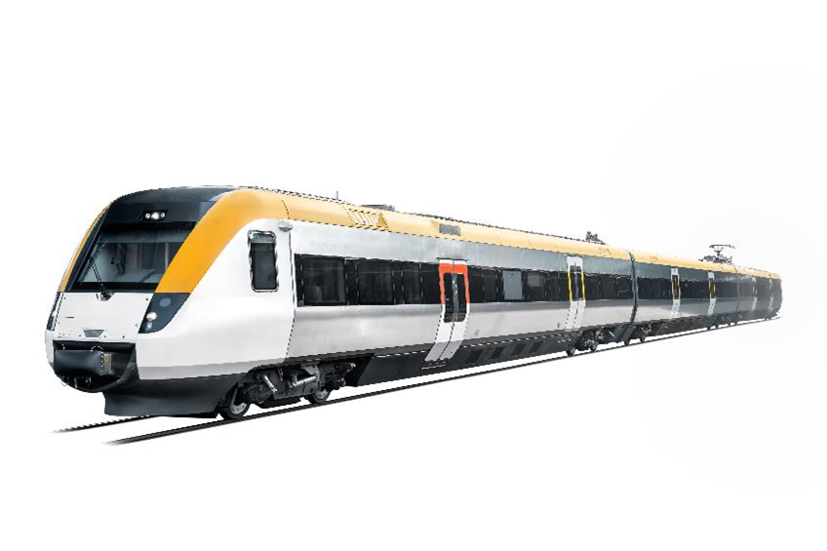
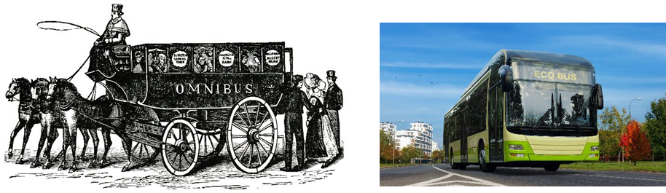
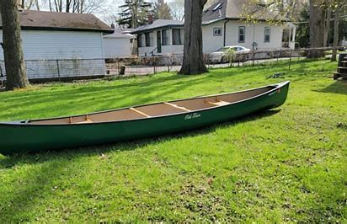
Blue / Green
What can you remember from our transport topic?

Slide 8

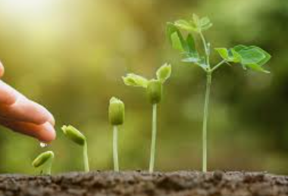
Blue / Green
What can you remember from our plants topic?

Slide 9
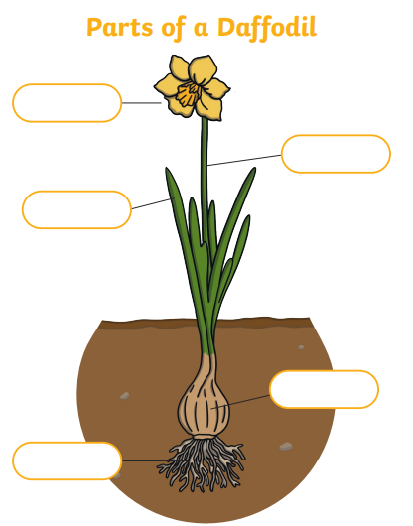
Key Question: Do plants grow and what plants grow in our local area?
Label the parts of the flower.
stem
roots
leaves
flower
Challenge: Do you know what this part is called?

Slide 10
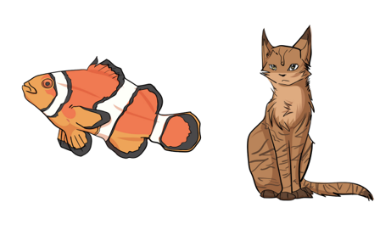
Parts of the body - Labelled diagram
What can you remember about the animals including humans topic?

Slide 11
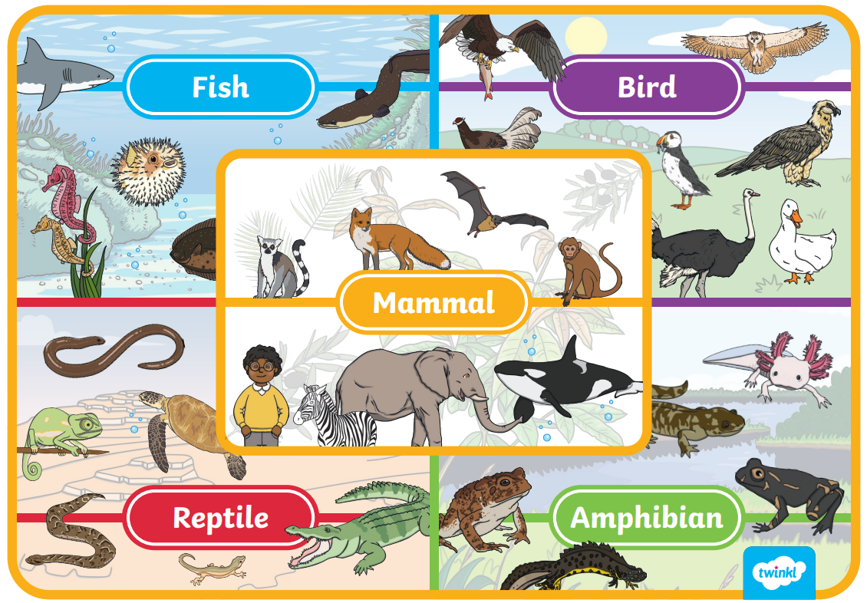
Name the animal group!

Slide 12
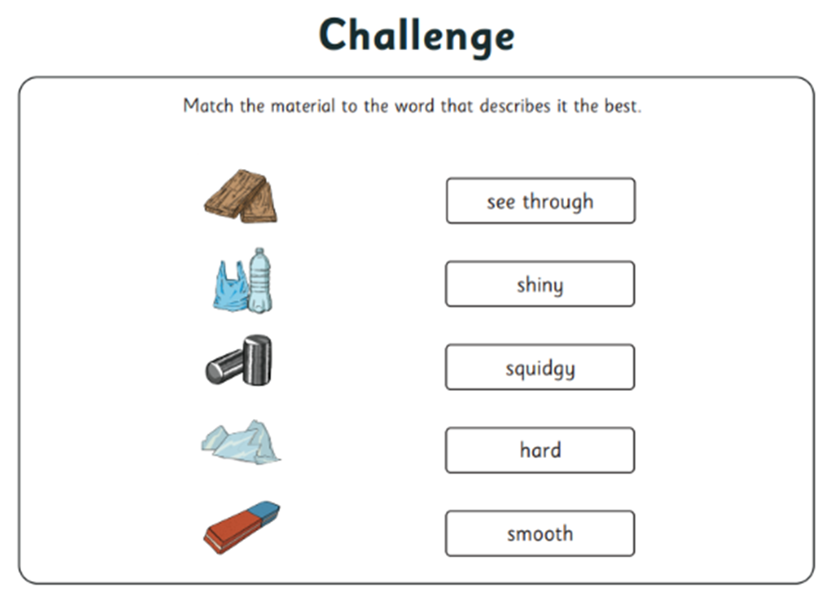
Materials
What would we make a circus tent out of?
Why?

Slide 13
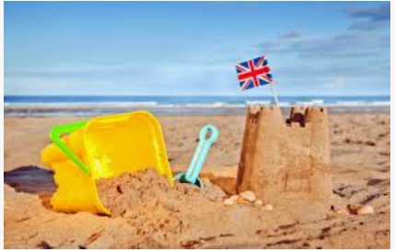
The seaside
What was your favourite part of our seaside topic?

Slide 14
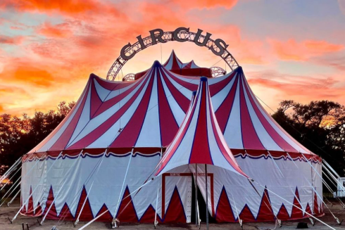
What did you learn about the Circus?

Slide 15
Blue / Green
What was your favourite thing you learnt or did this year?
My favourite thing was_____ because ___

Slide 16
Independent:
My favourite topic this year was _________________ because
I learned ________________

Slide 17
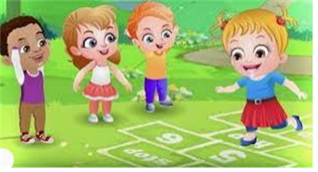
Break

Slide 18
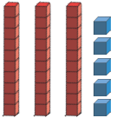
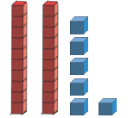
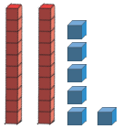
TBAT: order and compare numbers up to 20 including using <, > and =
Tuesday 15th July 2025
3 in 3- What are these numbers?
Challenge: How could these be represented on a part whole model?

Slide 19

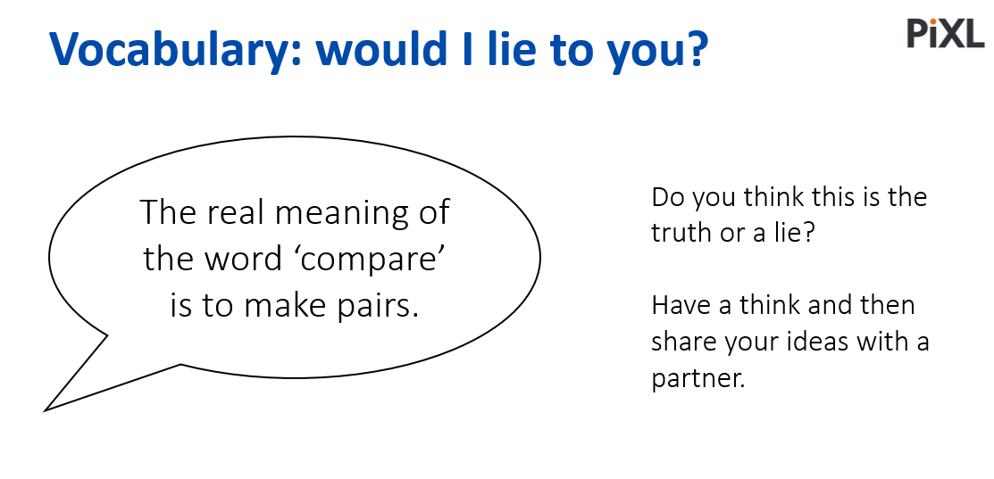
TBAT: order and compare numbers up to 20 including using <, > and =
Tuesday 15th July 2025
Blue/ Green
I think it is a truth/ lie because.......
Challenge: Why might you think that?

Slide 20
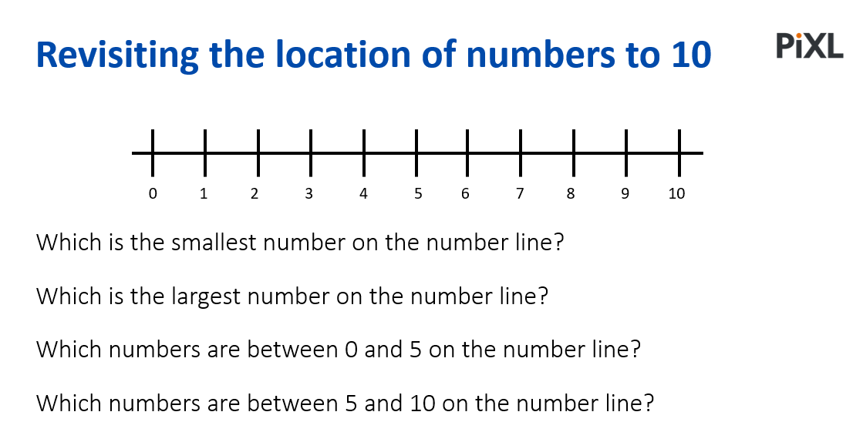
TBAT: order and compare numbers up to 20 including using <, > and =
Tuesday 15th July 2025

Slide 21
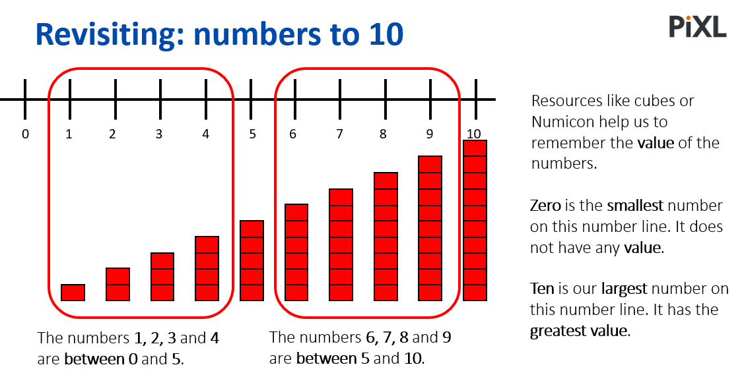
TBAT: order and compare numbers up to 20 including using <, > and =
Tuesday 15th July 2025

Slide 22
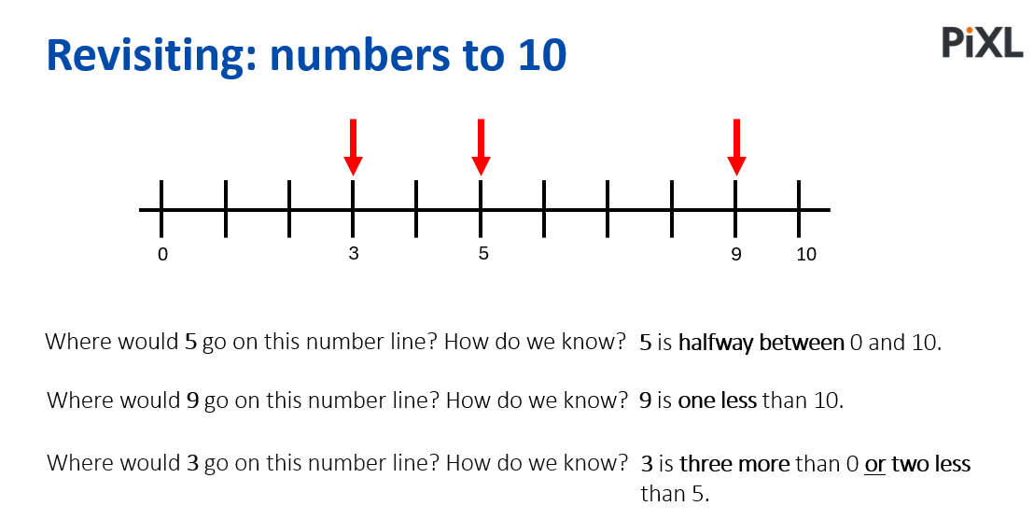
TBAT: order and compare numbers up to 20 including using <, > and =
Tuesday 15th July 2025

Slide 23
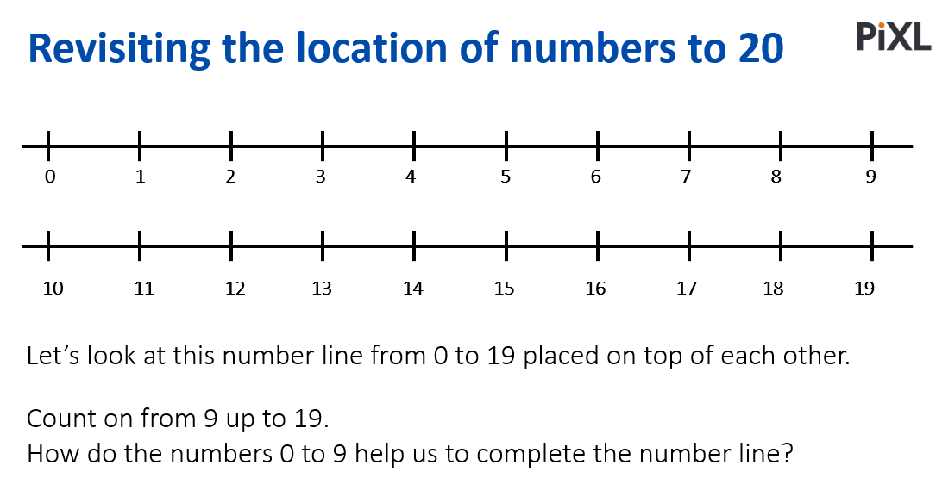
TBAT: order and compare numbers up to 20 including using <, > and =
Tuesday 15th July 2025

Slide 24
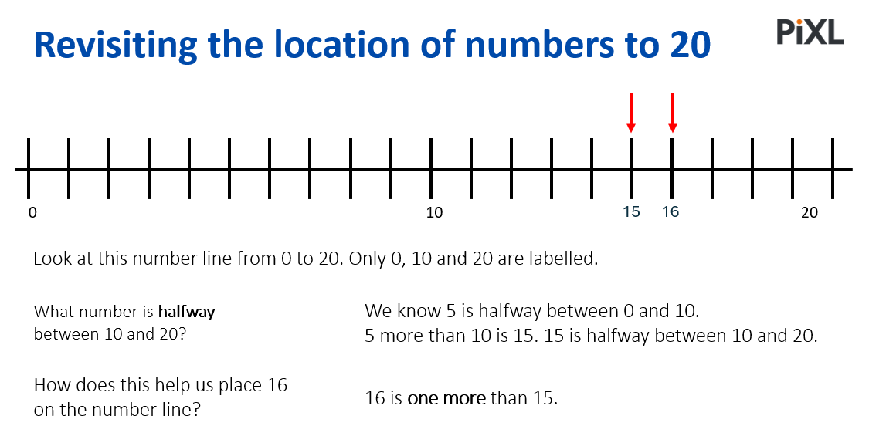
TBAT: order and compare numbers up to 20 including using <, > and =
Tuesday 15th July 2025

Slide 25
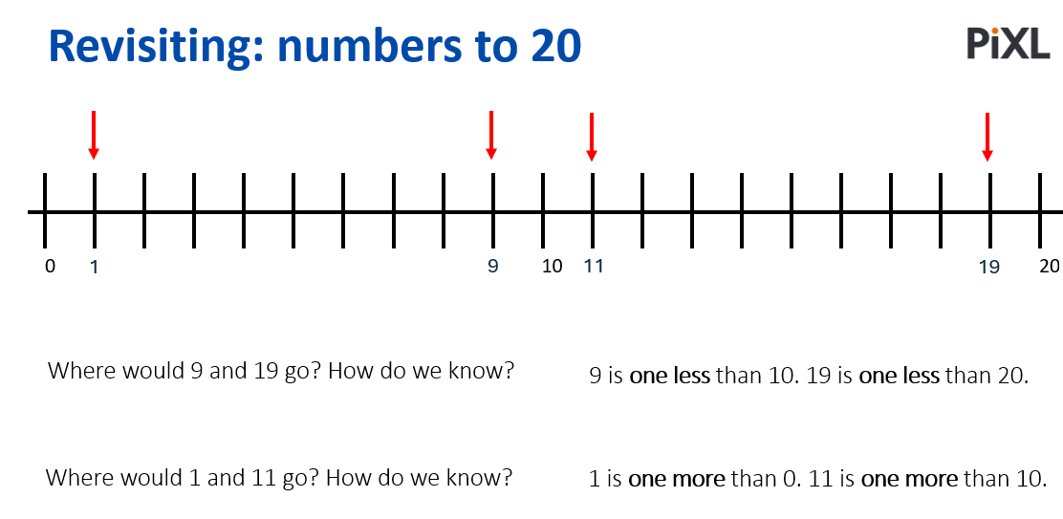
TBAT: order and compare numbers up to 20 including using <, > and =
Tuesday 15th July 2025

Slide 26
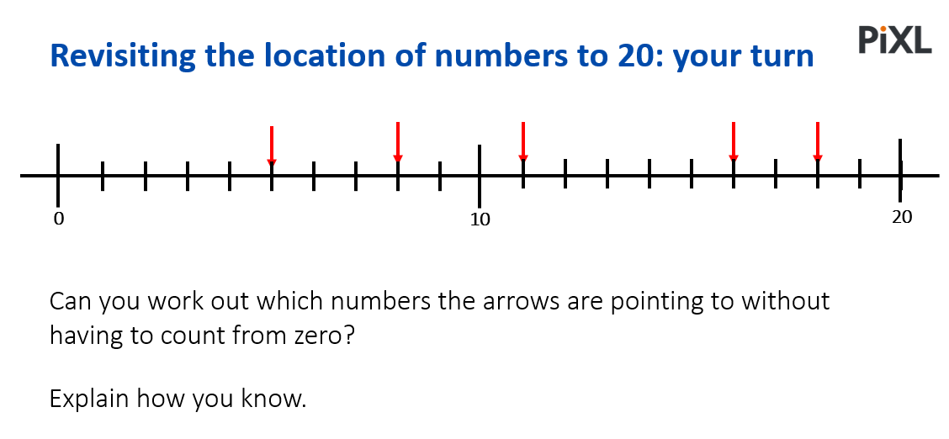
TBAT: order and compare numbers up to 20 including using <, > and =
Tuesday 15th July 2025

Slide 27
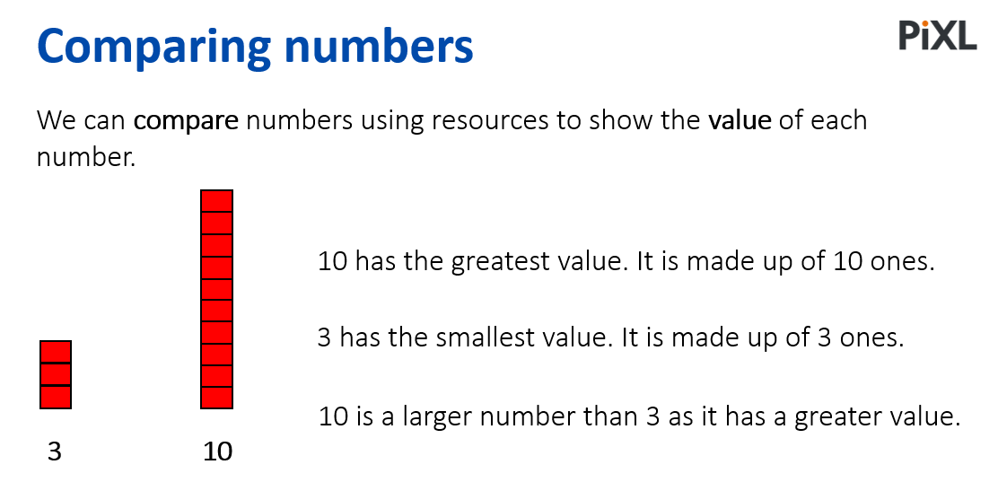
TBAT: order and compare numbers up to 20 including using <, > and =
Tuesday 15th July 2025

Slide 28
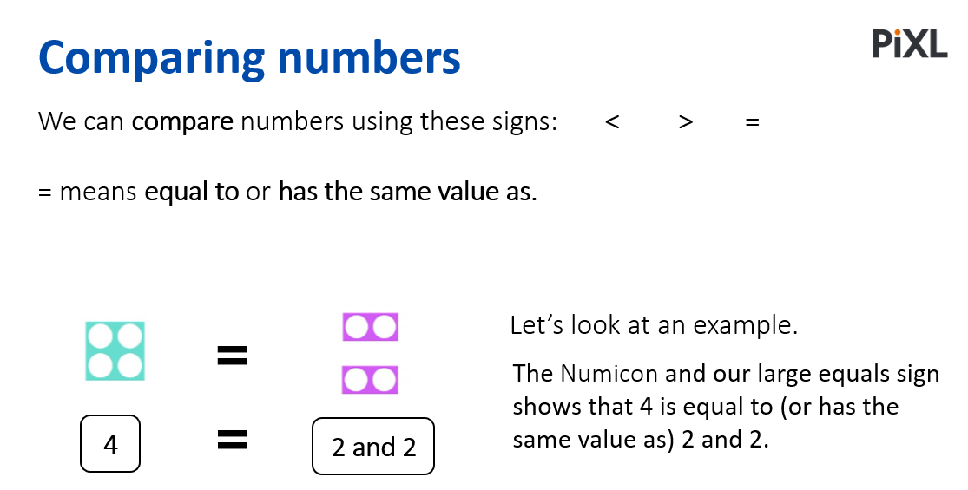
TBAT: order and compare numbers up to 20 including using <, > and =
Tuesday 15th July 2025

Slide 29
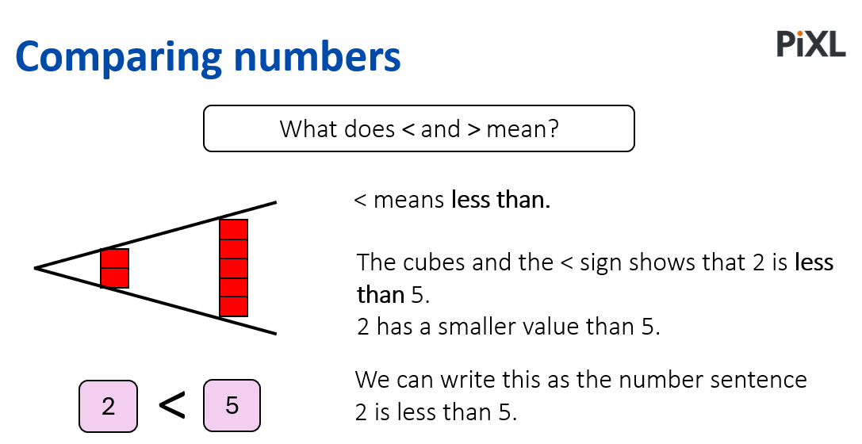
TBAT: order and compare numbers up to 20 including using <, > and =
Tuesday 15th July 2025

Slide 30
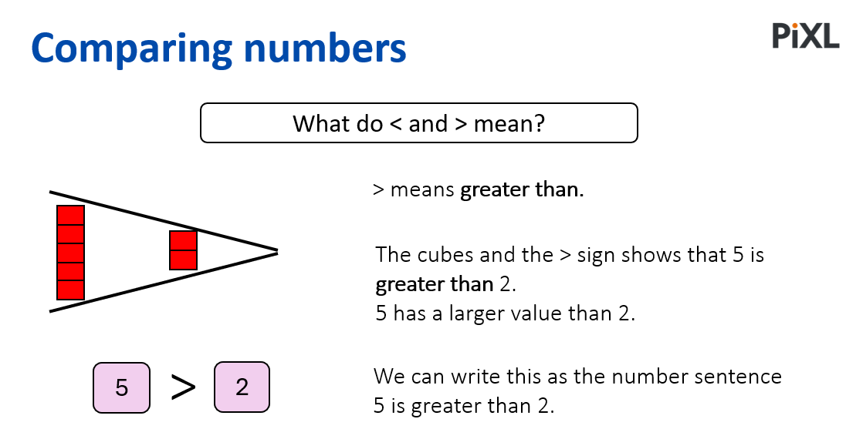
TBAT: order and compare numbers up to 20 including using <, > and =
Tuesday 15th July 2025

Slide 31
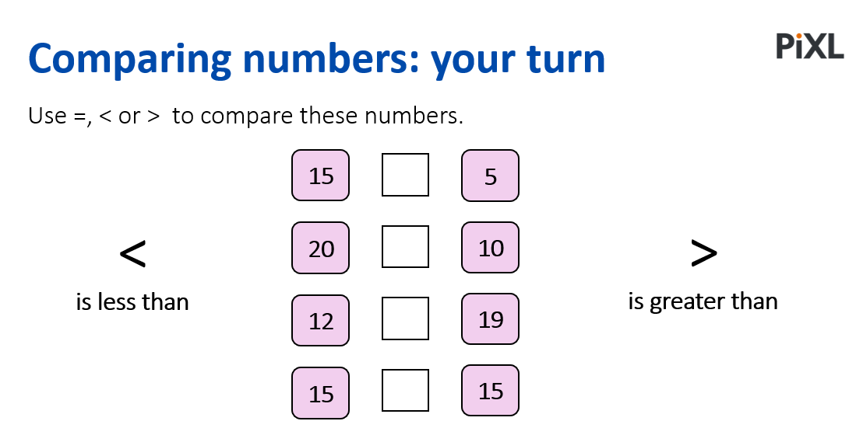
TBAT: order and compare numbers up to 20 including using <, > and =
Tuesday 15th July 2025

Slide 32
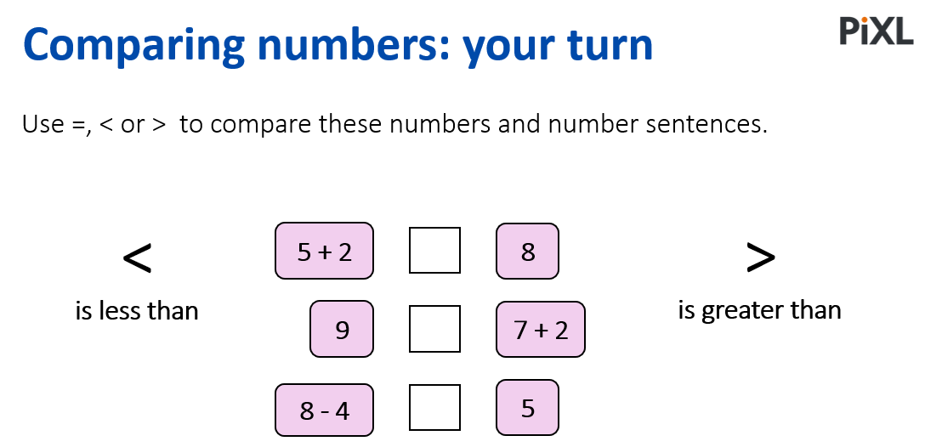
TBAT: order and compare numbers up to 20 including using <, > and =
Tuesday 15th July 2025

Slide 33
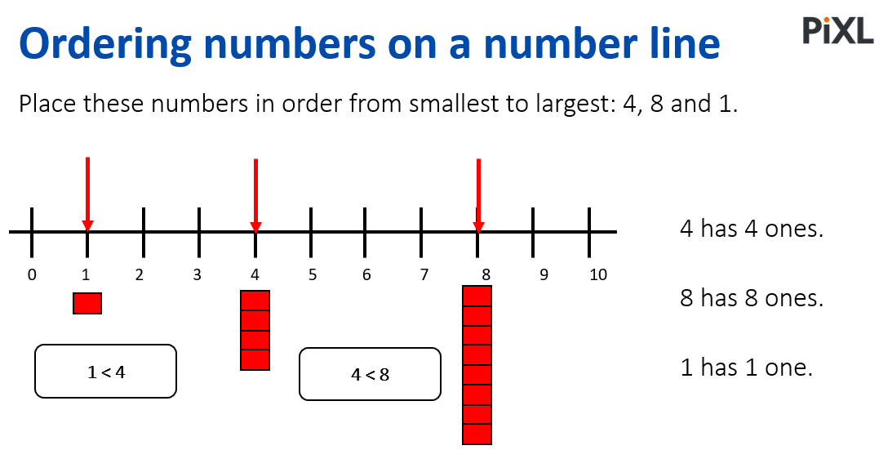
TBAT: order and compare numbers up to 20 including using <, > and =
Tuesday 15th July 2025

Slide 34
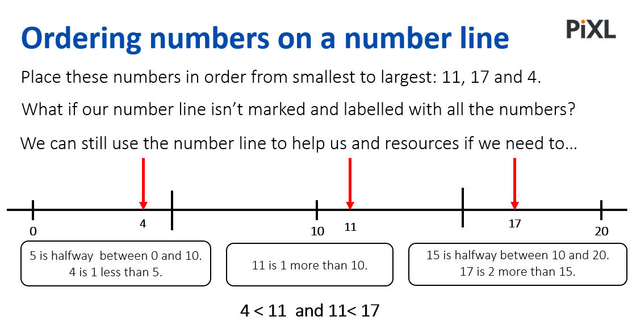
TBAT: order and compare numbers up to 20 including using <, > and =
Tuesday 15th July 2025

Slide 35
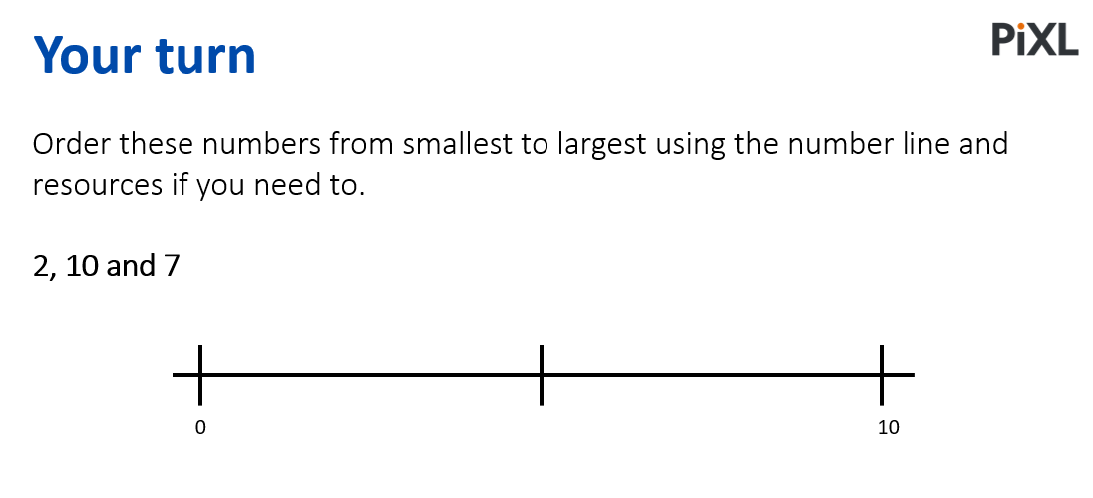
TBAT: order and compare numbers up to 20 including using <, > and =
Tuesday 15th July 2025

Slide 36
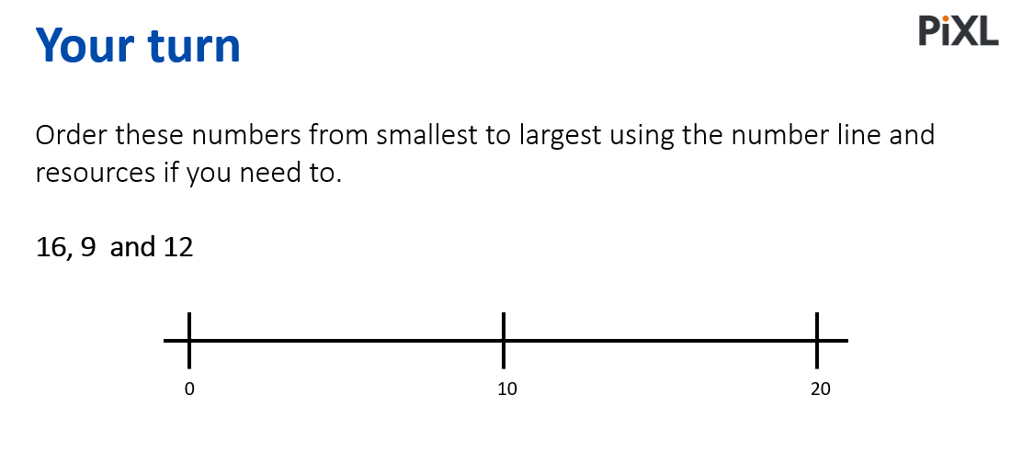
TBAT: order and compare numbers up to 20 including using <, > and =
Tuesday 15th July 2025

Slide 37
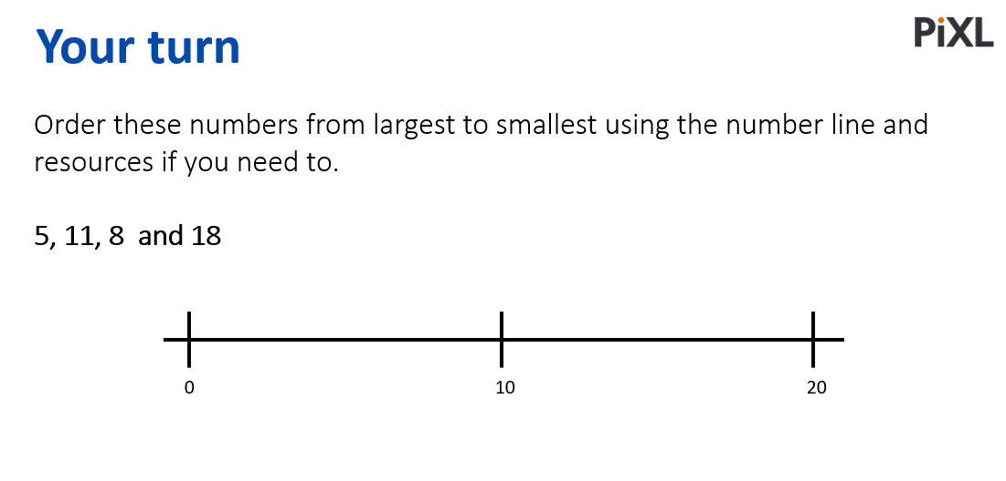
TBAT: order and compare numbers up to 20 including using <, > and =
Tuesday 15th July 2025

Slide 38
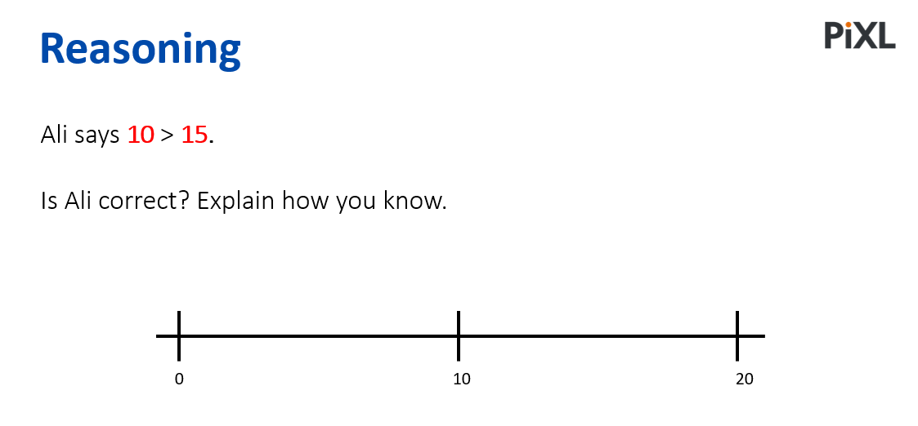
TBAT: order and compare numbers up to 20 including using <, > and =
Tuesday 15th July 2025

Slide 39
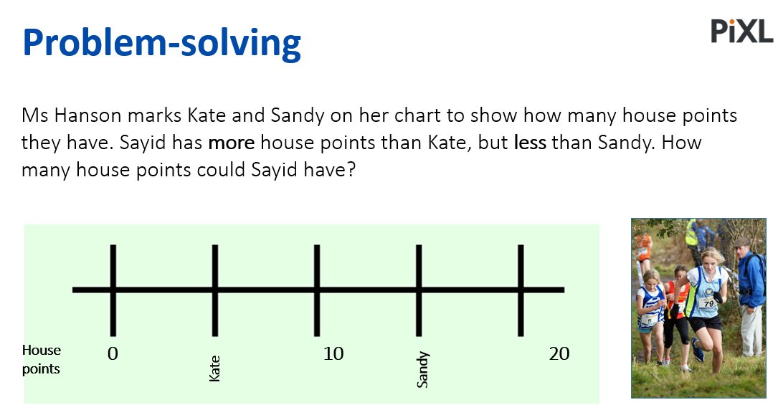
TBAT: order and compare numbers up to 20 including using <, > and =
Tuesday 15th July 2025

Slide 40
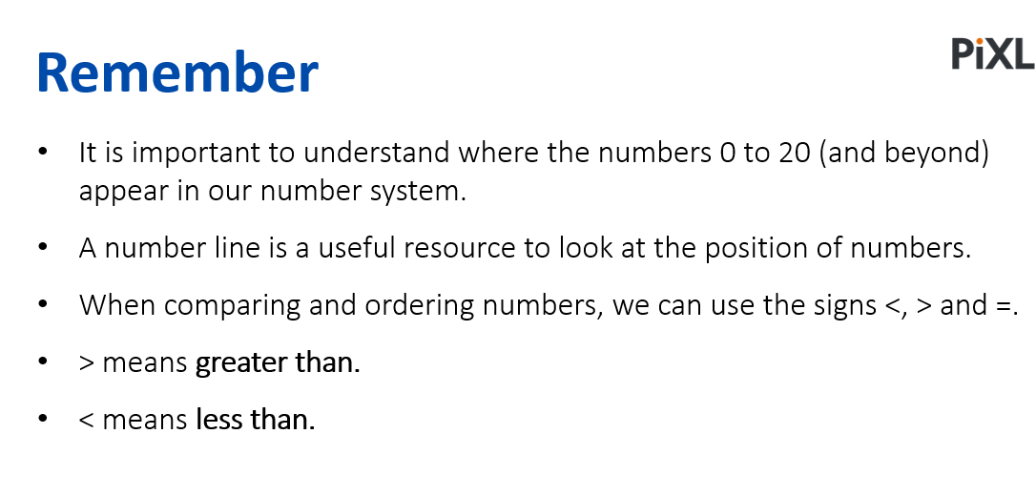
TBAT: order and compare numbers up to 20 including using <, > and =
Tuesday 15th July 2025

Slide 41

Lunch

Slide 42
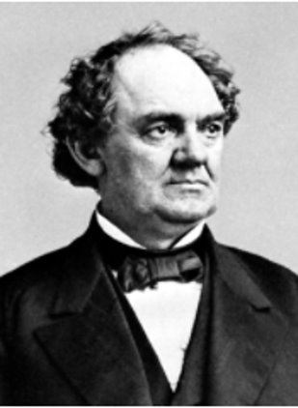
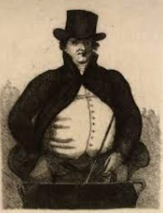
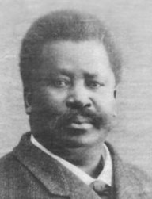
TBAT: explore the history of the circus.
Tuesday 15th July 2025
Today we are going to explore the history of the circus and people who have made the circus popular.
P. T Barnum
Phillip Astley
Pablo Fanque

Slide 43
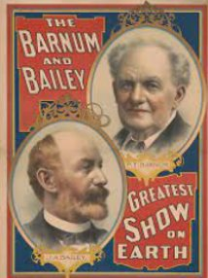
TBAT: explore the history of the circus.
Tuesday 15th July 2025
(1810–91). A master showman and lifelong entertainer, P.T. Barnum created unusual attractions that both shocked and delighted audiences. In his later years he teamed with James A. Bailey to create Barnum & Bailey’s Circus. Though Barnum did not invent the circus in ​​
the United States, he helped give the circus its ​​
widespread popularity.

Slide 44
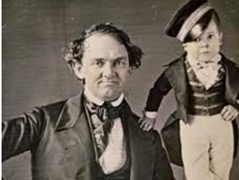
TBAT: explore the history of the circus.
Tuesday 15th July 2025
In 1841 Barnum bought the American Museum in New York City. At that time the museum was filled with common exhibits such as wax figures and stuffed animals. Barnum transformed the museum by introducing unusual and bizarre attractions—both real and fake. His first big exhibit was the Feejee Mermaid, which he claimed was the remains of a creature that was part human and part fish. Barnum’s most famous attraction was Charles Stratton, a boy who was only 25 inches (0.6 meter) tall until his teens. ​
Calling him General Tom Thumb, Barnum took him ​
on a tour of Europe that included a performance ​
for Queen Victoria of Britain.
Phineas Taylor Barnum was born in Bethel, Connecticut, on July 5, 1810. He had five brothers and sisters. When Barnum was 15, his father died. He had to support his family by working odd jobs.

Slide 45
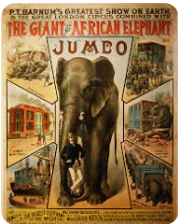
TBAT: explore the history of the circus.
Tuesday 15th July 2025
By the time Barnum’s museum closed in 1868, it had drawn 82 million visitors. However, Barnum is even more famous for his next big creation—the circus. He started his circus in 1871, when he was 60 years old. It was immediately popular. By 1872 the circus seated 10,000 people and traveled by train from city to city. Barnum called it “The Greatest Show on Earth.” In 1881 Barnum became partners with James Bailey, the owner of a rival circus. One of the star attractions of the new Barnum & Bailey Circus was a 6-ton elephant named Jumbo.

Slide 46
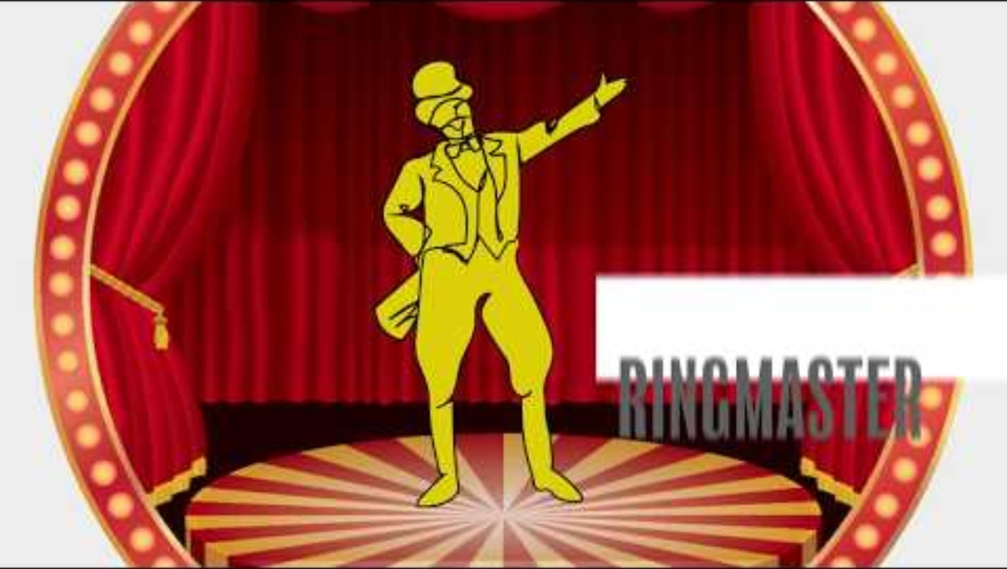
TBAT: explore the history of the circus.
Tuesday 15th July 2025
Phillip Astley is widely known as the Father of the Modern Circus.

Slide 47
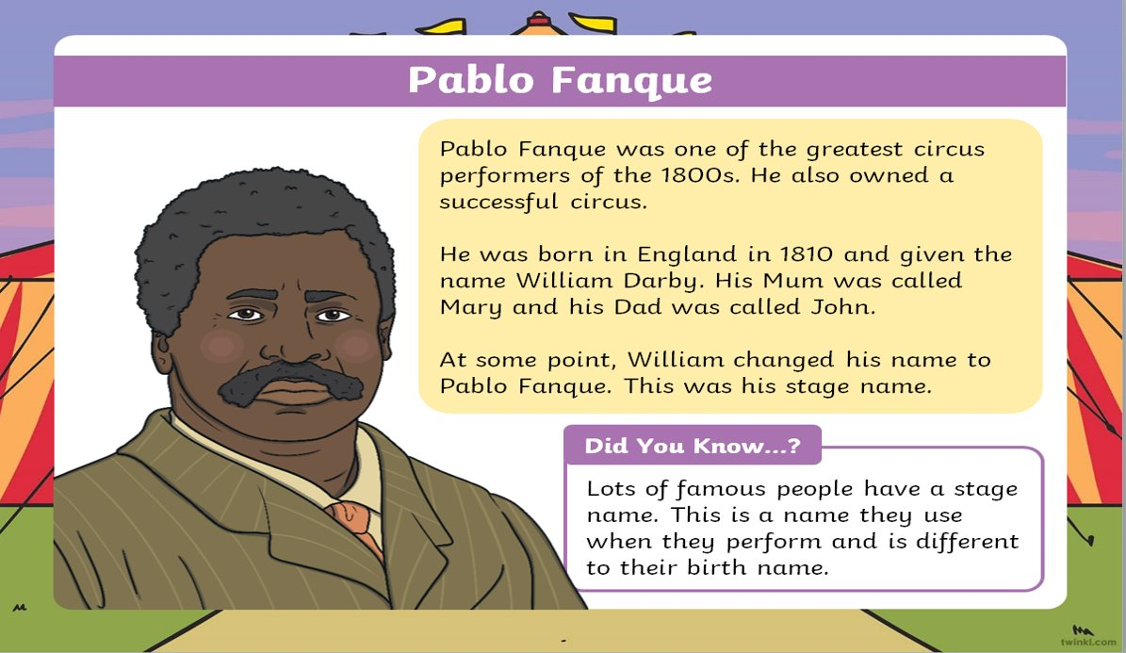
TBAT: explore the history of the circus.
Tuesday 15th July 2025

Slide 48

TBAT: explore the history of the circus.
Tuesday 15th July 2025

Slide 49

TBAT: explore the history of the circus.
Tuesday 15th July 2025

Slide 50

TBAT: explore the history of the circus.
Tuesday 15th July 2025

Slide 51

TBAT: explore the history of the circus.
Tuesday 15th July 2025

Slide 52
TBAT: explore the history of the circus.
Tuesday 15th July 2025
Think about Pablo Fanque, Phillip Astley and PT Barnum…….
What is the same in their lives?
What is different about their lives?
P. T Barnum
Phillip Astley
Pablo Fanque

Slide 53

TBAT: explore the history of the circus.
Tuesday 15th July 2025

Slide 54

Rounders

