Slide 1
Monday 7th July 2025
7/7/2025

Slide 4
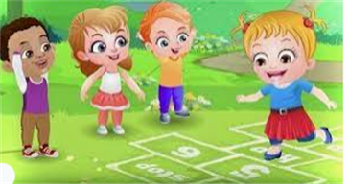
Break

Slide 5
Draw jumps between the two numbers to find the difference
3 in 3
$$0$$
$$1$$
$$2$$
$$3$$
$$4$$
$$5$$
$$6$$
$$7$$
$$8$$
$$9$$
$$10$$
$$11$$
$$12$$
$$13$$
$$14$$
$$15$$
$$16$$
$$17$$
$$18$$
$$19$$
$$20$$
What’s the same in all of the questions?
Are there other pairs of numbers that are similar?
Notes:
Do Now: Difference on a number line
Pupils have a copy of the Do Now Sheet. They find the ‘difference’ between two numbers by counting jumps on a number line. Model this, including the language, before pupils complete independently:
From two to eight is six jumps. The difference between two and eight is six.

Slide 6
TBAT: measure distance in standard and non-standard units.
distance difference
volume measure
length

Slide 7
Comparing measures of length.
We are going to measure how far we can throw a bean bag.
You will measure in steps (non standard units) and then in meters (standard units)
Notes:
New Learning: Measuring distance and discussing difference
Explain to pupils that in this lesson they will carry out some sport activities related to measure.. In the first activity, pupils throw beanbags as far as they can.
Take pupils outside and set out eight 1 metre sticks end-to-end. Draw a chalk line perpendicular to the beginning of the first stick; this is where pupils will stand to throw their beanbags. Pupils take it in turns to throw their beanbag as far as they can. Record the distance of each throw to the nearest metre (discuss the meaning of this with pupils). Utilise opportunities to practise comparative language:
Who threw their beanbag further? Who had the longest / shortest throw?
Once all pupils have thrown their beanbag and the distances have been recorded, choose four beanbags that landed relatively far from each other and collect the rest. Without altering the ‘distance thrown’, move the beanbags so they are touching the metre sticks, to make it easier to see the straight-line difference in distance.
How could you find the difference in distance between the red and green beanbags?
Draw a chalk line between the beanbags and explain this is the distance between them, so if you find the length, it will tell you the difference between the lengths of the throws.
Repeat this with another pair of beanbags, measuring the distance both ‘forwards’ and ‘backwards’ to show that the difference is the same either way.

Slide 8
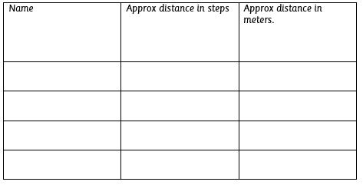
Comparing measures of length.
Independent:
RP:
Explain how measuring in steps is less accurate than measuring in meters.
Notes:
New Learning: Measuring distance and discussing difference
Explain to pupils that in this lesson they will carry out some sport activities related to measure.. In the first activity, pupils throw beanbags as far as they can.
Take pupils outside and set out eight 1 metre sticks end-to-end. Draw a chalk line perpendicular to the beginning of the first stick; this is where pupils will stand to throw their beanbags. Pupils take it in turns to throw their beanbag as far as they can. Record the distance of each throw to the nearest metre (discuss the meaning of this with pupils). Utilise opportunities to practise comparative language:
Who threw their beanbag further? Who had the longest / shortest throw?
Once all pupils have thrown their beanbag and the distances have been recorded, choose four beanbags that landed relatively far from each other and collect the rest. Without altering the ‘distance thrown’, move the beanbags so they are touching the metre sticks, to make it easier to see the straight-line difference in distance.
How could you find the difference in distance between the red and green beanbags?
Draw a chalk line between the beanbags and explain this is the distance between them, so if you find the length, it will tell you the difference between the lengths of the throws.
Repeat this with another pair of beanbags, measuring the distance both ‘forwards’ and ‘backwards’ to show that the difference is the same either way.

Slide 9
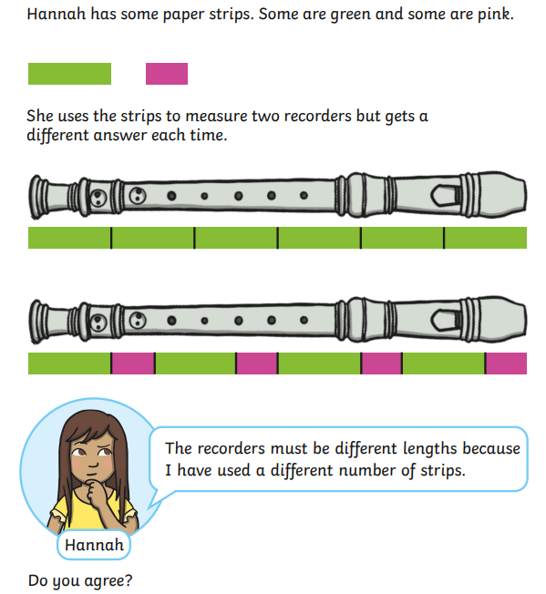
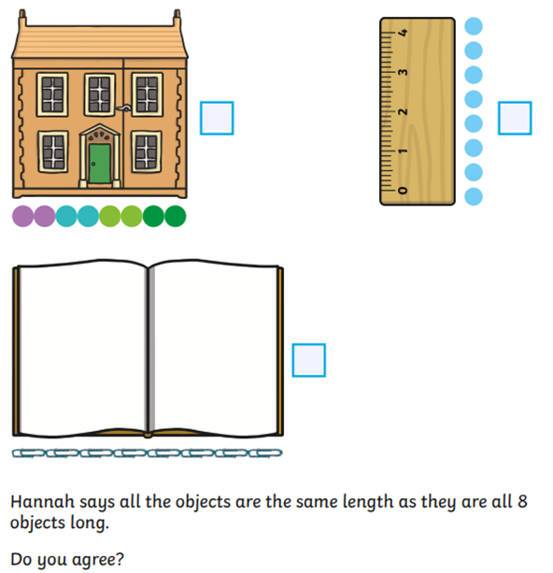
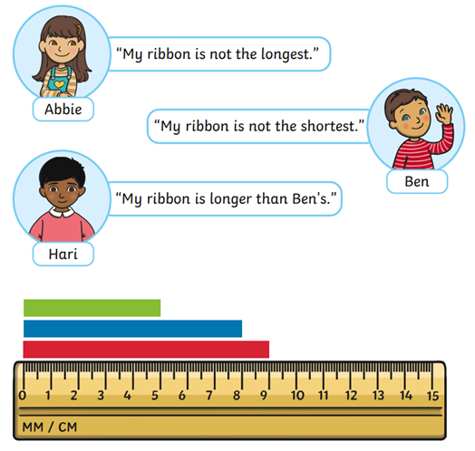
Comparing measures of length.
Challenge:
Mastery:
Mastery with greater depth:
Notes:
New Learning: Measuring distance and discussing difference
Explain to pupils that in this lesson they will carry out some sport activities related to measure.. In the first activity, pupils throw beanbags as far as they can.
Take pupils outside and set out eight 1 metre sticks end-to-end. Draw a chalk line perpendicular to the beginning of the first stick; this is where pupils will stand to throw their beanbags. Pupils take it in turns to throw their beanbag as far as they can. Record the distance of each throw to the nearest metre (discuss the meaning of this with pupils). Utilise opportunities to practise comparative language:
Who threw their beanbag further? Who had the longest / shortest throw?
Once all pupils have thrown their beanbag and the distances have been recorded, choose four beanbags that landed relatively far from each other and collect the rest. Without altering the ‘distance thrown’, move the beanbags so they are touching the metre sticks, to make it easier to see the straight-line difference in distance.
How could you find the difference in distance between the red and green beanbags?
Draw a chalk line between the beanbags and explain this is the distance between them, so if you find the length, it will tell you the difference between the lengths of the throws.
Repeat this with another pair of beanbags, measuring the distance both ‘forwards’ and ‘backwards’ to show that the difference is the same either way.

Slide 10
What did you learn from the activities?
Use the Star Words to discuss.
Notes:
Plenary: Discussion
Engage pupils in a discussion based on observations made during the lesson. These may be misconceptions or interesting observations which can be built upon as a whole class.

Slide 11
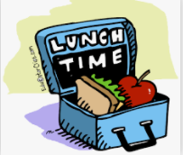
Lunch

Slide 12
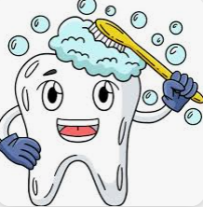
Toothbrushing

Slide 13
Key Question: What do people do at the seaside?
Monday 7th July 2025
Entry Question:
What is the difference between human and physical features?

Slide 14
Key Question: What do people do at the seaside?
Monday 7th July 2025
4 in 3

Slide 15
Key Question: What do people do at the seaside?
Monday 7th July 2025

Slide 16
Key Question: What do people do at the seaside?
Monday 7th July 2025

Slide 17
Key Question: What do people do at the seaside?
Monday 7th July 2025

Slide 18
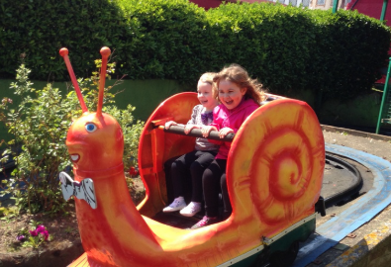
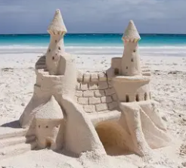
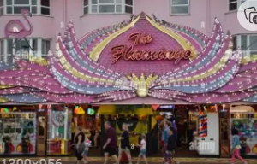
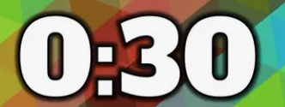
Key Question: What do people do at the seaside?
Monday 7th July 2025
Blue/ Green- What do you enjoy doing at the seaside?
sandcastles
amusements
fairground
paddling
At the seaside, I enjoy.........

Slide 19
Key Question: What do people do at the seaside?
Monday 7th July 2025

Slide 20
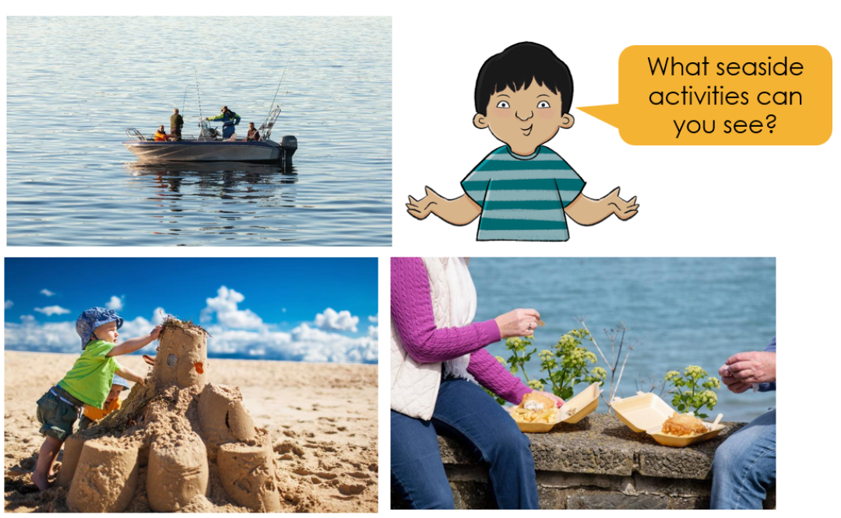
Key Question: What do people do at the seaside?
Monday 7th July 2025

Slide 21
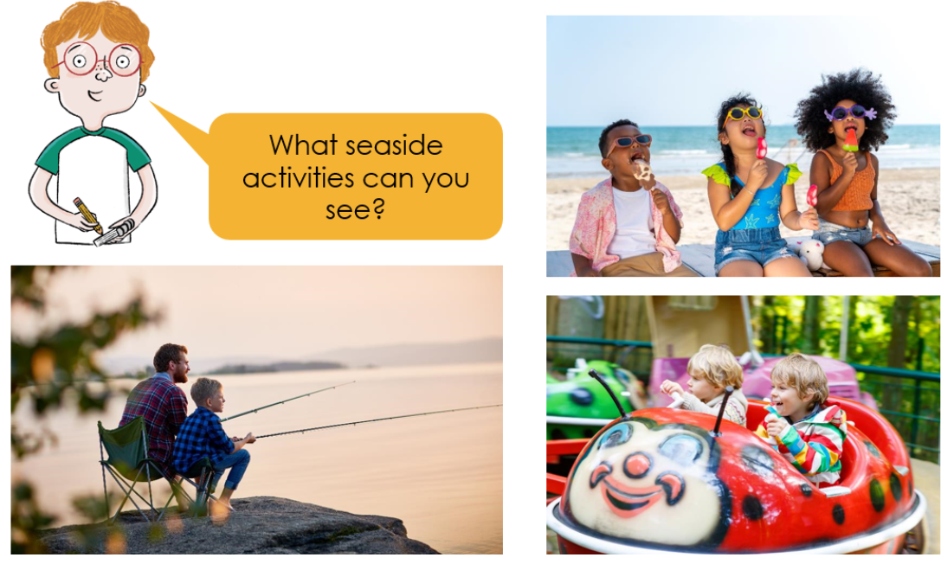
Key Question: What do people do at the seaside?
Monday 7th July 2025

Slide 22
Key Question: What do people do at the seaside?
Monday 7th July 2025

Slide 23
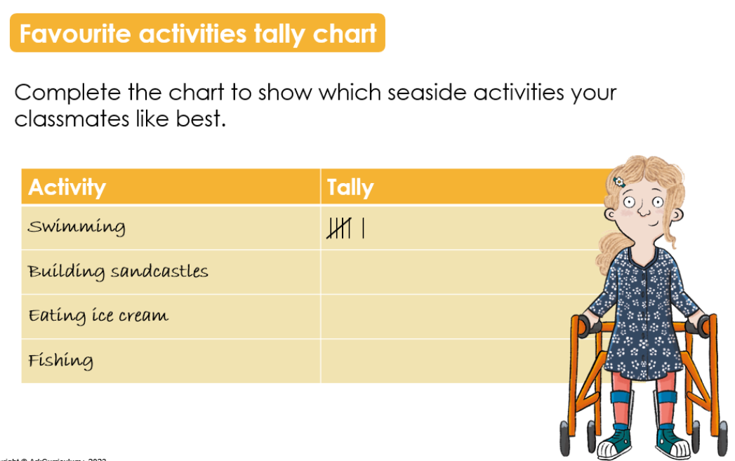
Key Question: What do people do at the seaside?
Monday 7th July 2025

Slide 24
Key Question: What do people do at the seaside?
Monday 7th July 2025

Slide 25
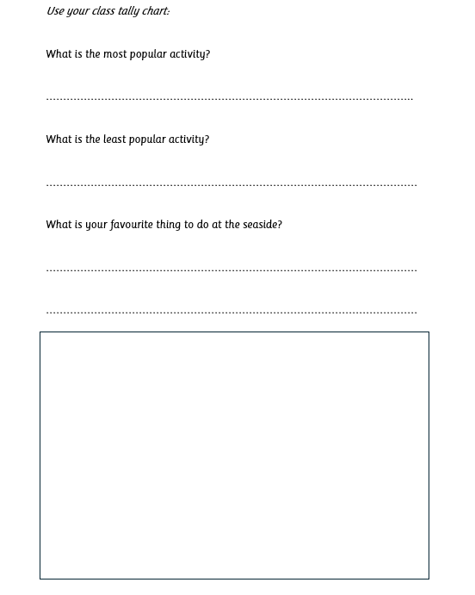
Key Question: What do people do at the seaside?
Monday 7th July 2025
Independent:
Challenge:
Write a description about a seaside activity and give to a friend to try to work out what it is.

Slide 26
Key Question: What do people do at the seaside?
Monday 7th July 2025
Exit Question:
What is your favourite thing to do at the seaside?

Slide 27
KQ: What is summer? 3 in 3
Monday 7th July 2025
Challenge: What happens to the length of the days?
What happens to the weather in each of them?

Slide 28
KQ: What is summer?
Monday 7th July 2025

Slide 29
Blue / Green
KQ: What is summer?
Monday 7th July 2025
Which is your favourite season?
Why?
My favourite season is ________________ because…

Slide 30
KQ: What is summer?
Monday 7th July 2025

Slide 31
KQ: What is summer?
Monday 7th July 2025

Slide 32
KQ: What is summer?
Monday 7th July 2025

Slide 33
KQ: What is summer?
Monday 7th July 2025

Slide 34
KQ: What is summer?
Monday 7th July 2025

Slide 35
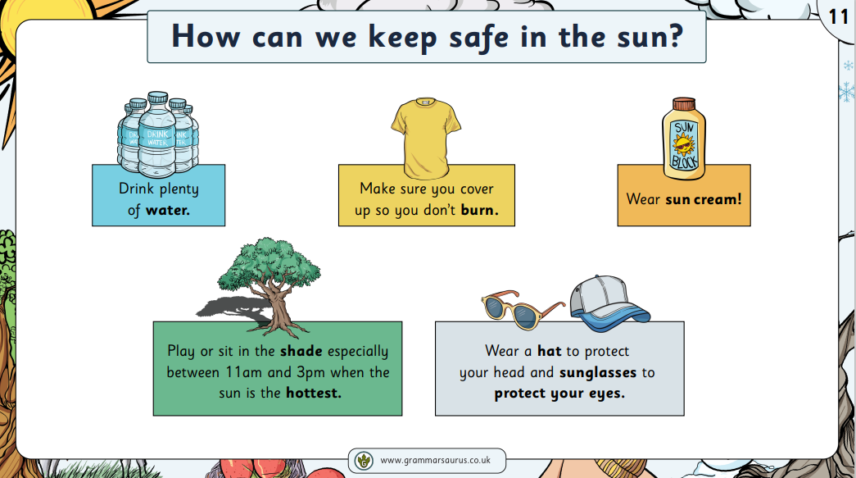
KQ: What is summer?
Monday 7th July 2025

Slide 36
KQ: What is summer?
Monday 7th July 2025

Slide 37
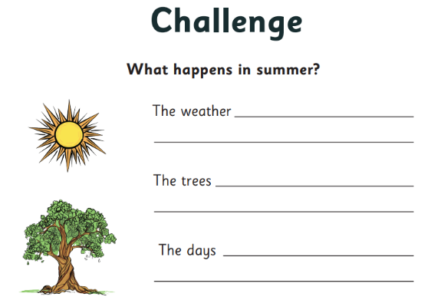
Monday 7th July 2025

Slide 38
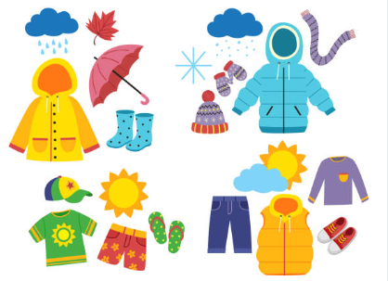
Exit question:
Which is the best clothing for summer?
Why?

