Slide 1
Monday 14th July 2025
7/7/2025

Slide 2
Phonics
Seaside Phonics Blending Game PowerPoint (teacher made)
Hook a Duck Reading Game: Phonics Level 5 – Twinkl

Slide 3
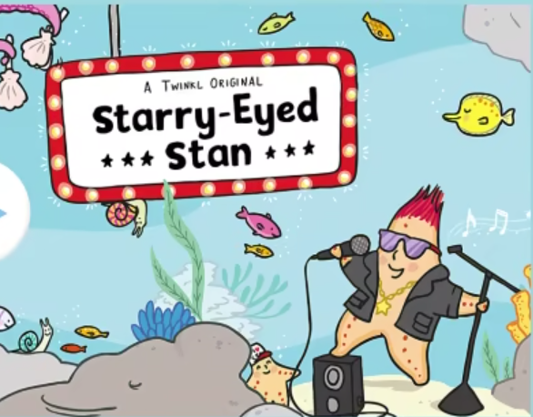
TBAT: Retrieve information from a text
Vocabulary:
Assembled – gathered around
Grouchy – grumpy
Defence – stopping the attacker
Bellowed - shouted
Starry-Eyed Stan Story PowerPoint - Seaside Story Books EYFS

Slide 6
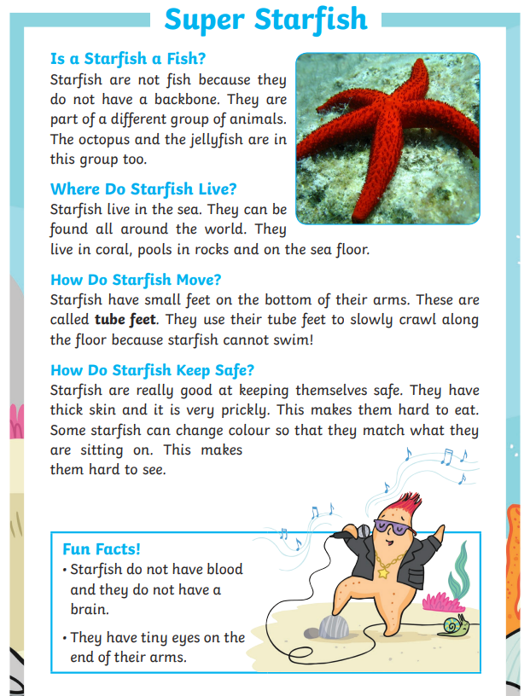
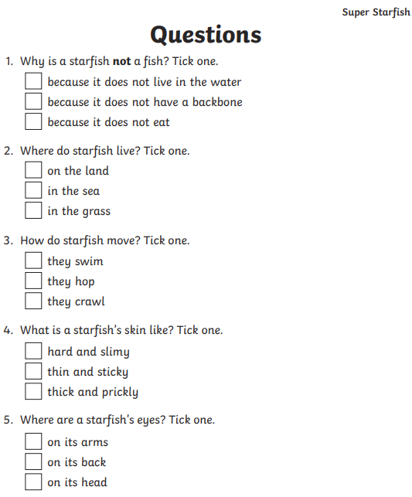

Slide 7
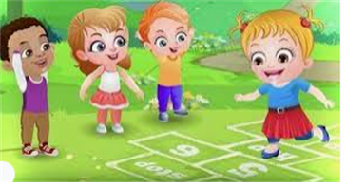
Break

Slide 8
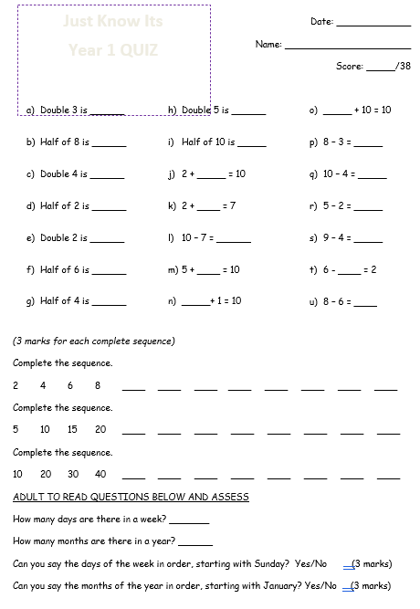
Just know its

Slide 9
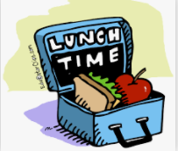
Lunch

Slide 10
TBAT: show an awareness of water and beach safety.
Monday 14th July 2025

Slide 11
TBAT: show an awareness of water and beach safety.
Monday 14th July 2025

Slide 12
TBAT: show an awareness of water and beach safety.
Monday 14th July 2025

Slide 13
TBAT: show an awareness of water and beach safety.
Monday 14th July 2025

Slide 14
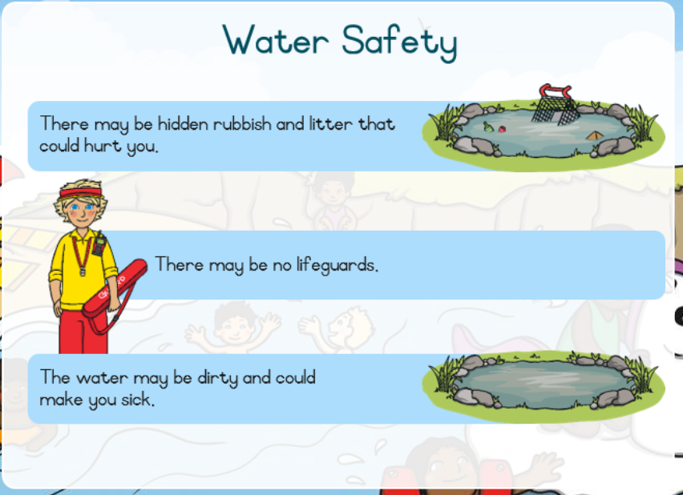
TBAT: show an awareness of water and beach safety.
Monday 14th July 2025

Slide 15
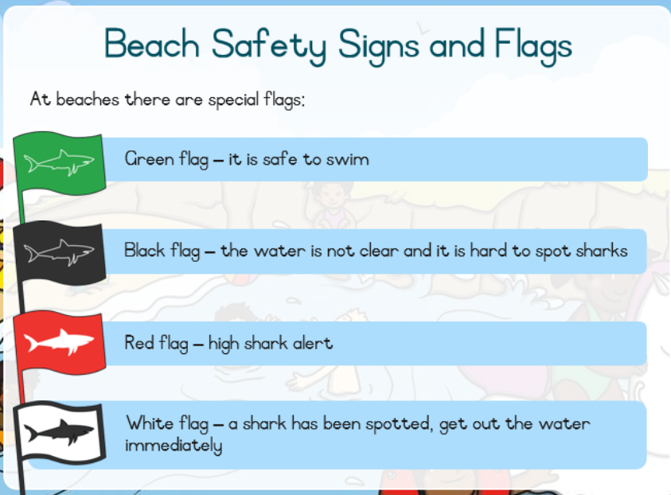
TBAT: show an awareness of water and beach safety.
Monday 14th July 2025

Slide 16
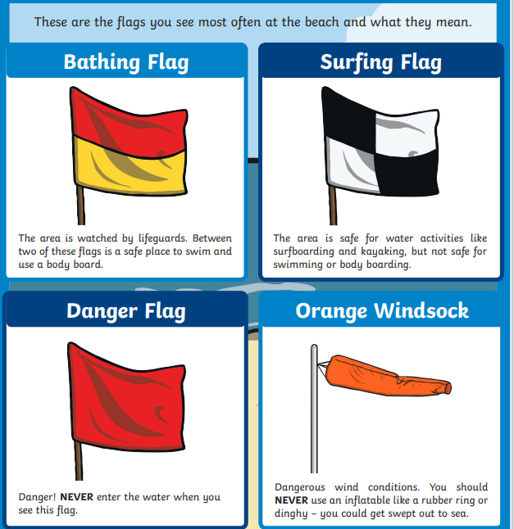

Slide 17
TBAT: show an awareness of water and beach safety.
Monday 14th July 2025

Slide 18
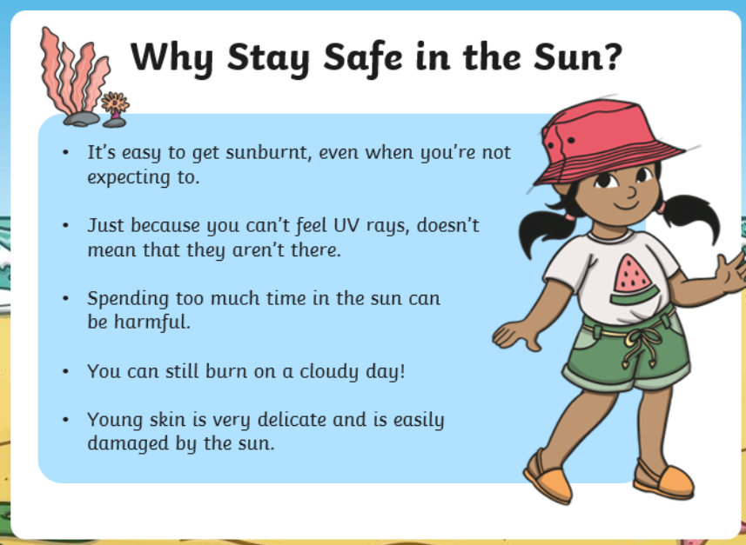
TBAT: show an awareness of water and beach safety.
Monday 14th July 2025

Slide 19
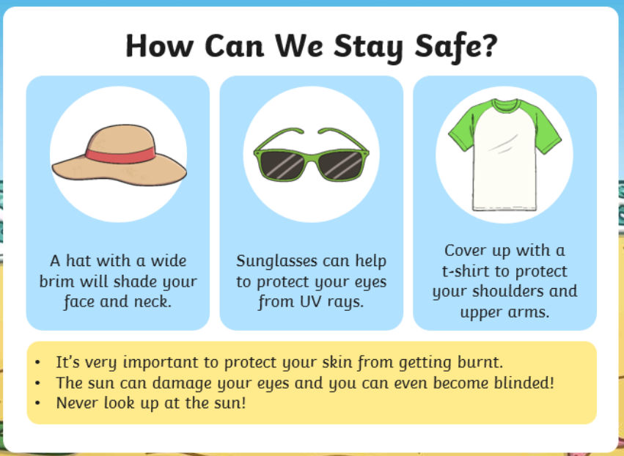
TBAT: show an awareness of water and beach safety.
Monday 14th July 2025

Slide 20
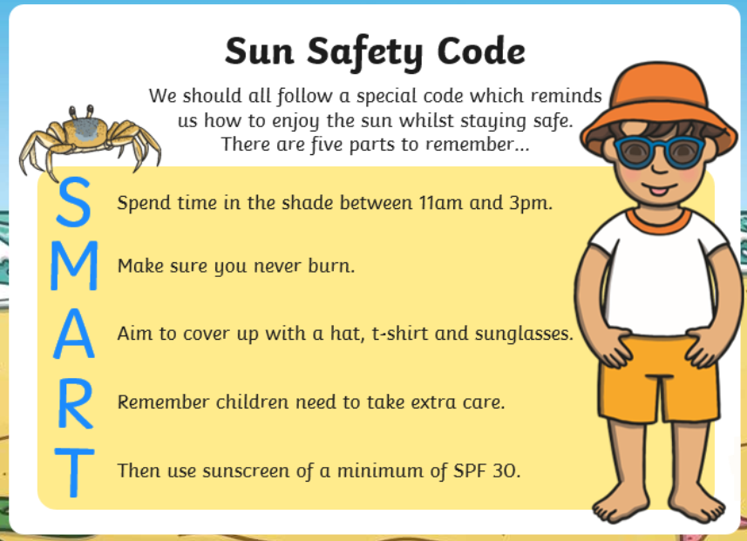
TBAT: show an awareness of water and beach safety.
Monday 14th July 2025

Slide 21
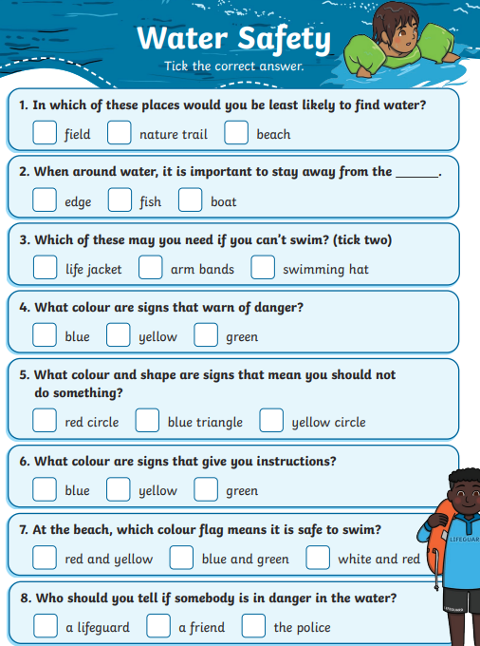
TBAT: show an awareness of water and beach safety.
Monday 14th July 2025

Slide 22
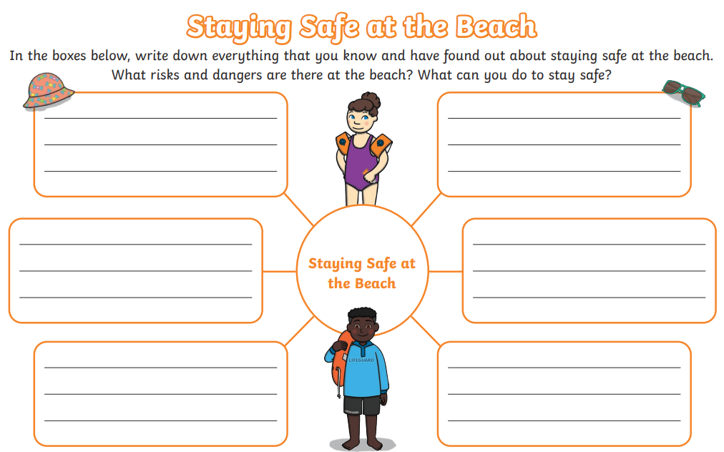
Independent:
TBAT: show an awareness of water and beach safety.
Monday 14th July 2025

Slide 23
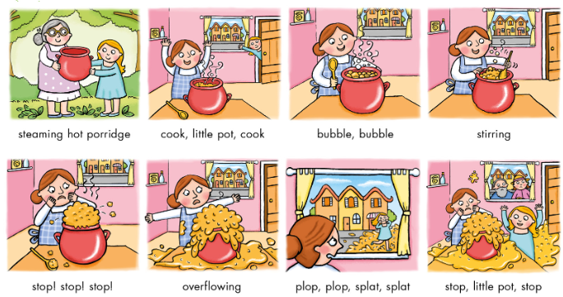
The Magic cooking pot
Blue / Green
What happened in our magic cooking pot story?
Use the pictures to retell the story.

Slide 24
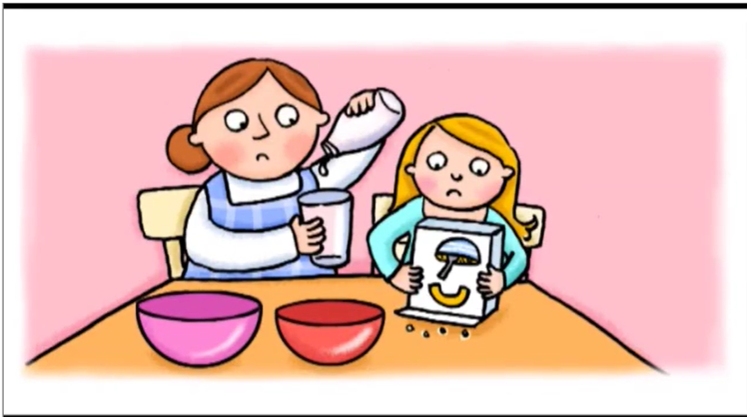
Let’s recap the story. Join in with the parts you remember.

Slide 25
Match the piece of music to the phrase.

Slide 26
We need to learn the songs and practise out percussion instruments to perform.

Slide 27
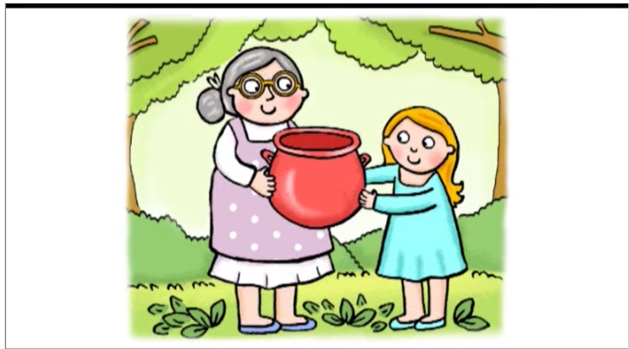
Perform!

