Slide 1
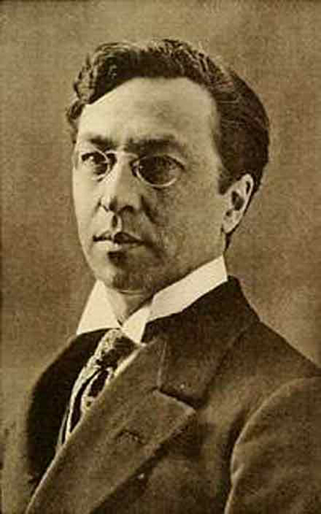
Wassily Kandinsky
Born in Moscow in 1866
Took up the study of art in earnest at age 30, moving to Munich to study drawing and painting.
Trained musician, Kandinsky approached colour with a musician’s sensibility.
Had an obsession with Monet, which led him to explore his own creative concepts of colour on canvas, which were sometimes controversial among his contemporaries and critics
Little of the work Kandinsky produced in Russia has survived, although many of the paintings he created in Germany are still extant.
In recent years, his artwork has sold for well over $20 million.
Task: Answer the questions about Wassily Kandinsky

Slide 2
Tuesday 3rd June
TBAT: Use joins consistently.
Definite Desperate
Literate
Secretary Stationary Dictionary Wednesday Familiar Original Animal Are there any words you are unsure of? Use a dictionary to look them up and then use them in a sentence.

Slide 3
X 6

Slide 4
TBAT- identify and measure angles accurately. 3 in 3 1) 67.9 + 300 = 2) 562 x 6 = 3) 6, 327 divided by 3 =
Challenge:
A show starts at 6: 15 and lasts for 1 hour 15 minutes. There is a 10 minute interval in between. At what time will the show end?

Slide 5
Daily 10 x 6s Daily 10 - Mental Maths Challenge - Topmarks

Slide 6
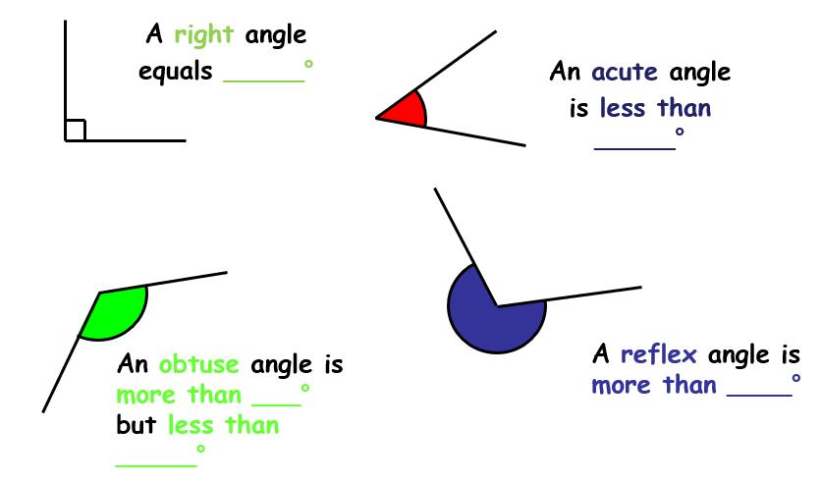
Complete the gaps in your books.
Green Blue

Slide 7
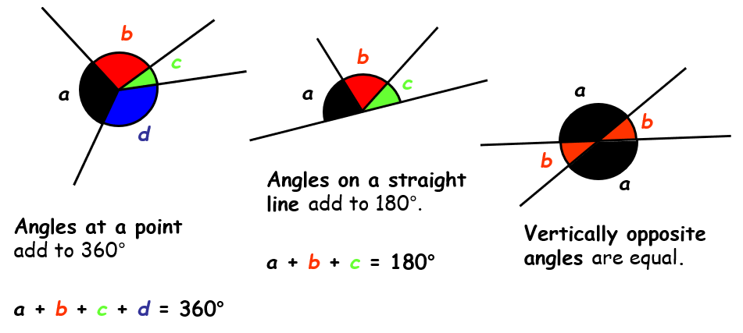
Properties of angles

Slide 8
Talk partners: Give a definition for parallel lines.

Slide 9
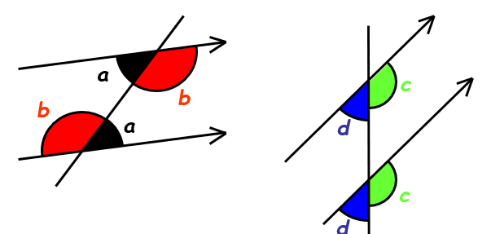
What does this show you about angles on parallel lines?

Slide 10
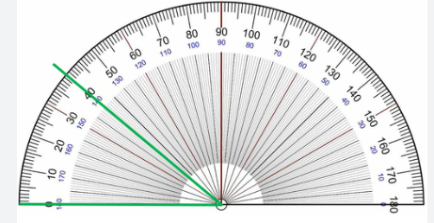
Talk partners: What are the three steps to using a protractor?

Slide 11
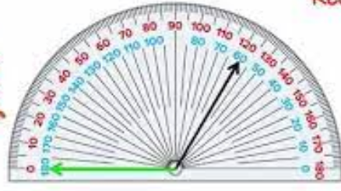
Paired work:

Slide 12
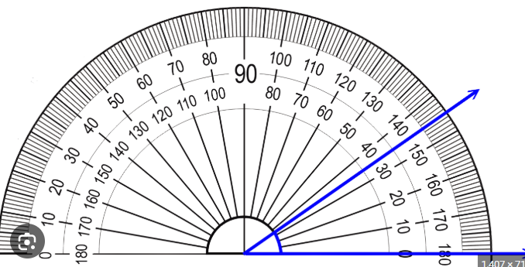
Whiteboard work:

Slide 13
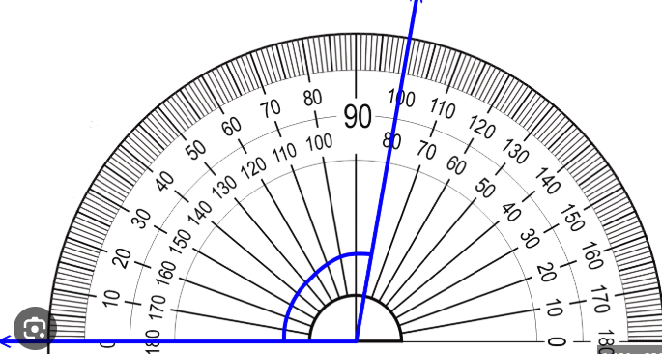
Whiteboard work:

Slide 14
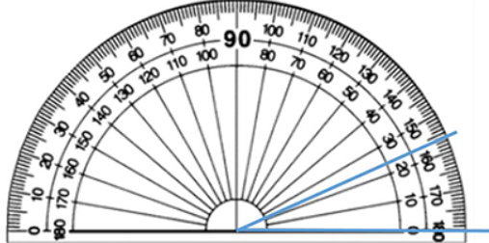
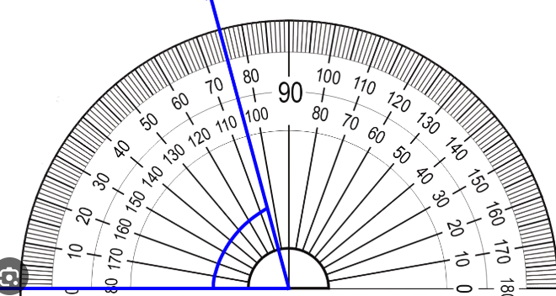
Challenge: What is the remaining angle?

Slide 15
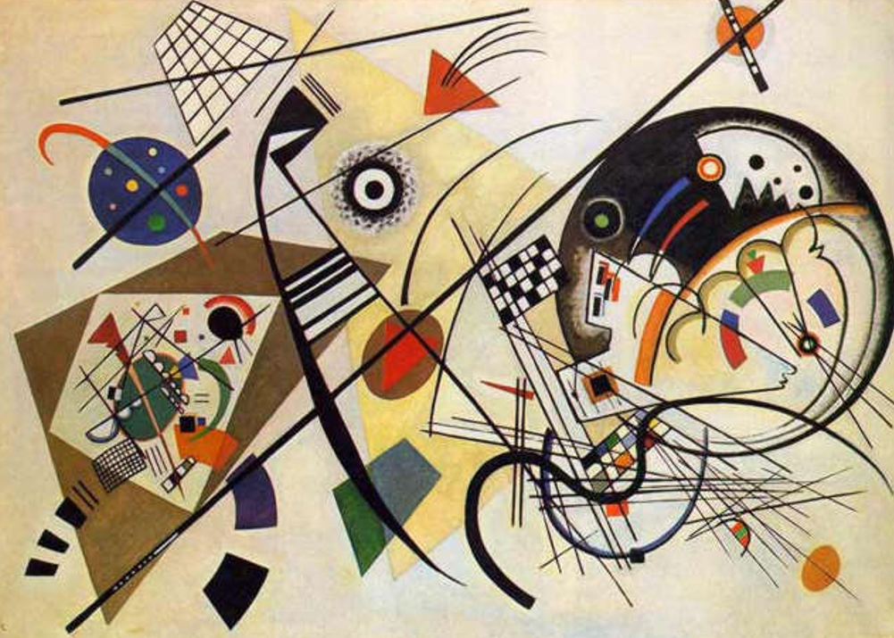
Task: Look at the painting of Wassily Kandinsky.
Kandinsky used a lot of shape throughout his art.
1: Label the with a number and underneath write the number with the angle: acute, obtuse, reflex 2: Use a protractor and measure the angle

Slide 16
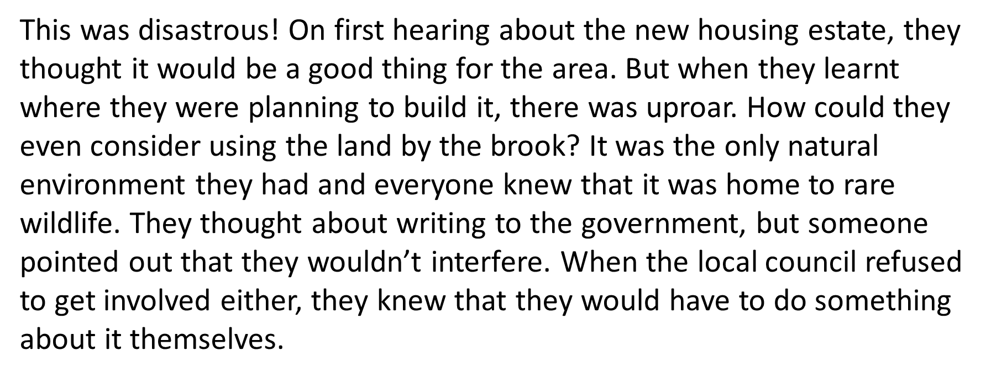
Tuesday 3rd June TBAT: use modal verbs to show degrees of possibility. 3 in 3

Slide 17
Tuesday 3rd June TBAT: use modal verbs to show degrees of possibility. 3 in3

Slide 18
Tuesday 3rd June TBAT: use modal verbs to show degrees of possibility. Which of these verbs are modal verbs? was might speak eat should could may can run have will train would try shout

Slide 19
Tuesday 3rd June TBAT: use modal verbs to show degrees of possibility. TALK PARTNERS Order these sentences and justify your order I will do my homework. I could do my homework. I should do my homework. I might do my homework.

Slide 20
Tuesday 3rd June TBAT: use modal verbs to show degrees of possibility. Change the modal verbs in these sentences to increase the possibility of them happening. GREEN I could go to the park after school. BLUE I might have a snack when I get home from school.

Slide 21
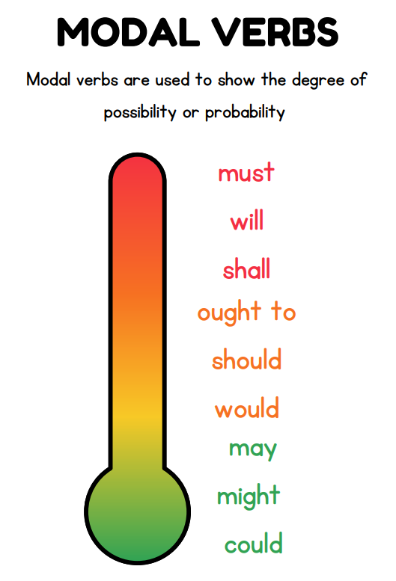
Tuesday 3rd June TBAT: use modal verbs to show degrees of possibility.

Slide 22
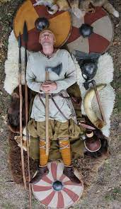
Tuesday 3rd June TBAT: use modal verbs to show degrees of possibility. Partner talk: Recall the steps involved in a Viking warrior burial Can you include adverbials in your steps? First, Next, Finally,

Slide 23
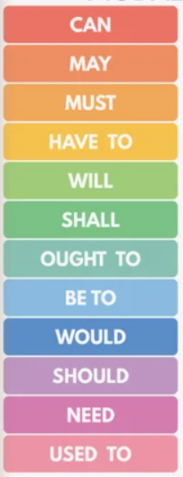
Tuesday 3rd June TBAT: use modal verbs to show degrees of possibility. Using modal verbs explain what would need to happen when a Viking Warrior is killed in battle. Think about: Where will the body go? What might be with the warrior? Who would be with the warrior?

Slide 24
Tuesday 3rd June TBAT: use modal verbs to show degrees of possibility. EXAMPLE In Viking times, warriors were honoured with special burials that celebrated their bravery and strength. If you ever find yourself needing to bury a Viking warrior, here is what you should do to give them a respectful send-off. 1. Prepare the body The warrior should be dressed in their finest clothes. You might want to place coins over their eyes or include special items that were important to them in life. 2. Gather the belongings A Viking warrior must be buried with their weapons and useful items for the afterlife. These could include a sword, shield, drinking horn, and even a favourite animal.

Slide 25
Tuesday 3rd June 2025 TBAT: learn a melody and harmony part on instruments to accompany a song, sung in unison and 3 parts. (Glockenspiels) The Collins Hub Educator > Library - Celebration – Lesson 1 – Everyone loves Saturday night
Warm up – Vocal warm up – Throw it out the window
Activity 1 - Everybody loves Saturday night Learn to sing a song with a lively celebratory mood
Children: – learn to sing a celebratory verse and chorus song;
– chant greetings in different languages as a call and response;
– perform a verse, chorus song with chanted call and response section.
Activity 2 - Everybody loves harmony Learn to sing the coda in three-part harmony
Children: – learn to sing a musical ending (coda) in three-part harmony;
– perform a song with harmony in groups.
Activity 3 - Saturday night band Add tuned instruments playing the melody and harmony line for the chorus
Children: – learn to play the chorus melody and harmony parts on tuned instruments;
– follow notation to perform tuned accompaniments;
– perform a song with tuned an accompaniment.

Slide 26
Tuesday 3rd June
Q: Who were the Vikings?
3 in 3
The Viking age was from about AD700 to 1100. Many Vikings left their homes in Scandinavia and travelled by longboat to other countries, like Britain and Ireland.
The people of Britain called the invaders 'Danes', but they came from Norway and Sweden as well as Denmark.
Vikings sailed the seas trading goods. They bought silver, silks, spices, wine, jewellery, glass and pottery to bring back home.
1) How did the Vikings travel to Britain and Ireland?
2) List three examples of treasures they brought home.
3) Why do you think Brits called them invaders?

Slide 27
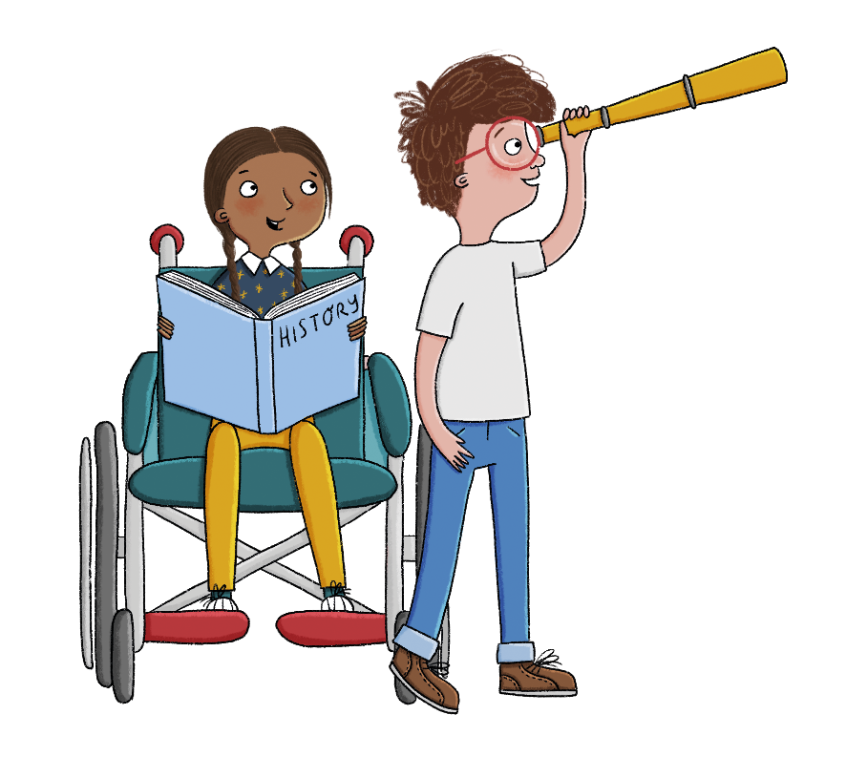
This is the enquiry question that we will be covering over this unit of work. Write down your initial ideas and we will check your answer in 6 weeks time.
Were the Vikings just invaders?
Notes:
Share the unit enquiry question: Were the Vikings just invaders? and explain that all lessons in this unit will support the pupils in answering this question at the very end. Each lesson has its own question, and they should be able to answer each of these individually too.

Slide 28
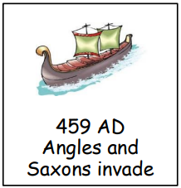
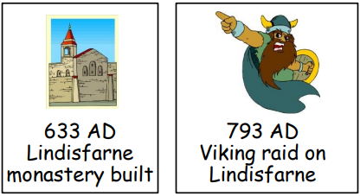
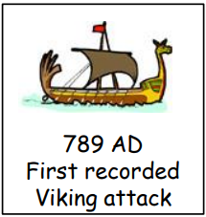
Using our learning in Autumn Term, place the events in chronological order.

Slide 29
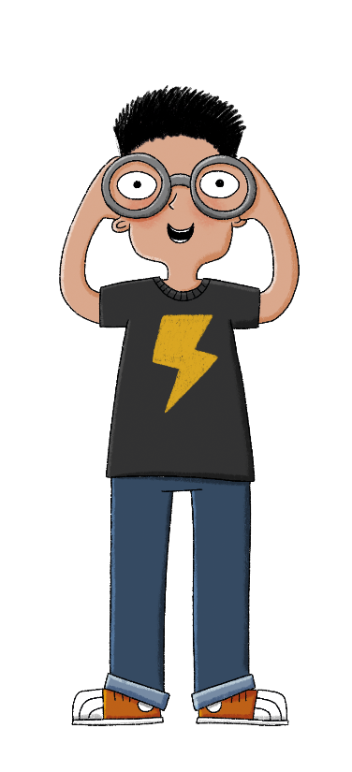
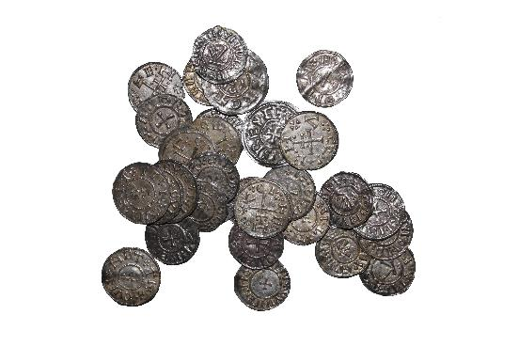
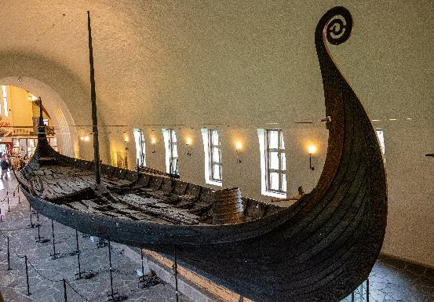
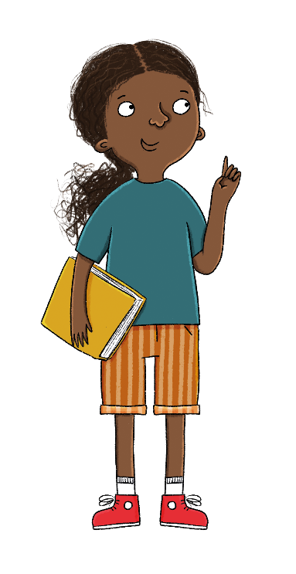
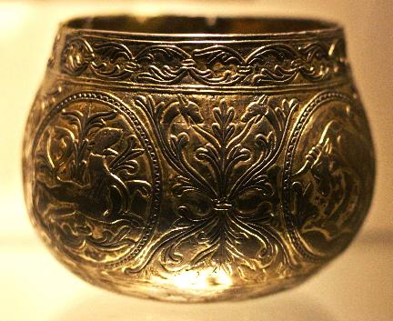
What do you know about the Vikings?
What questions do you have?
Lesson 1:
Notes:
Existing knowledge exercise: Gauge pupils’ current knowledge of the Vikings and recap their knowledge of the Anglo-Saxons from the last unit.

Slide 30
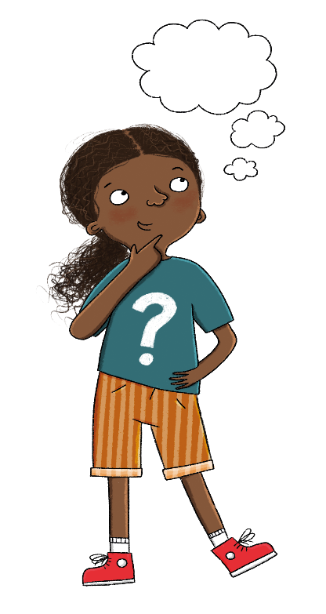
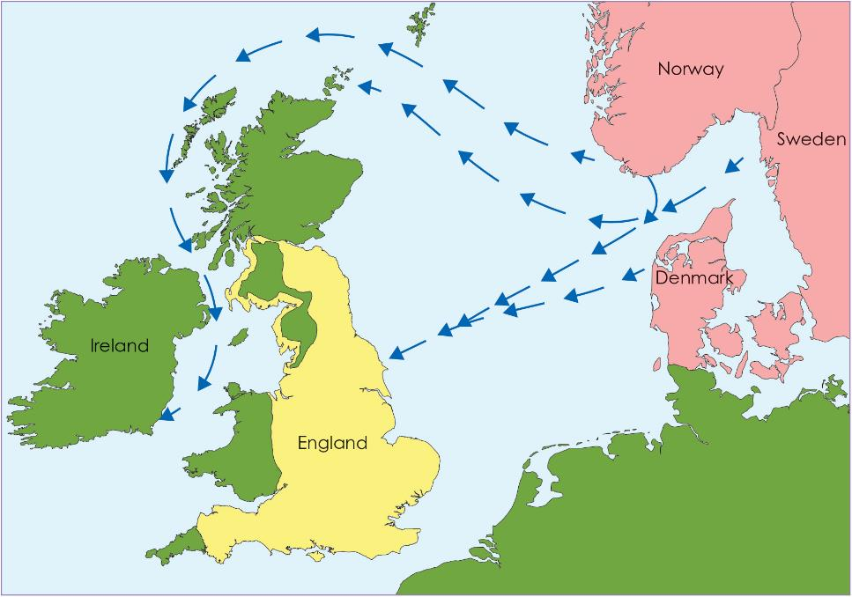
Blue
Migrated to England means...
Green
Why do you think the Vikings might have travelled to England?
Lesson 1:
Notes:
Talk task: Pupils use their knowledge from the previous unit to discuss reasons why people such as the Anglo-Saxons migrated to England in 400–600ce. Why do they think the Vikings might have travelled to England? Do they think these reasons will be similar or different to those of the Anglo-Saxons? If necessary, prompt pupils to think about reasons for short visits as well as longer ones, and to include both reasons why people might leave their homes and reasons why they are attracted to another place.

Slide 31
Who were the Vikings?
What was the Danelaw?
1
How do historians know how the Vikings traded?
How did England become a unified country?
What were the Viking raids and why were they so successful?
Did the Vikings rule England?
Notes:
Introduction: Begin by sharing the lesson statement, key term, and other key vocabulary with the pupils—you may want to add images to the teaching slides to support exemplification and understanding of these words. Before the content of the session begins, investigate the Key Stage 2 Timeline resource with pupils to ensure they know which period this unit covers and place it in relation to other units, particularly the Anglo-Saxons. The Viking Age overlaps with the later Anglo-Saxon period.

Slide 32
Lesson 1:
The key term for this lesson is longship.
A longship was a long, narrow ship, powered by both oar and sail, with many rowers.

Slide 33
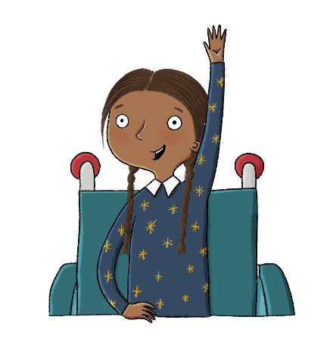
Who were the Vikings?
Lesson 1:
The Viking age in European history was from about 790ce to 1066.
Many Vikings left their homes in Scandinavia and sailed to other parts of Europe.
Vikings used their longships to travel a lot.
Longships could sail in shallow water which meant they could travel up rivers as well as across the sea.
Danes
homelands
longship
monasteries
Norse people
Scandinavia
treasure
Viking

Slide 34
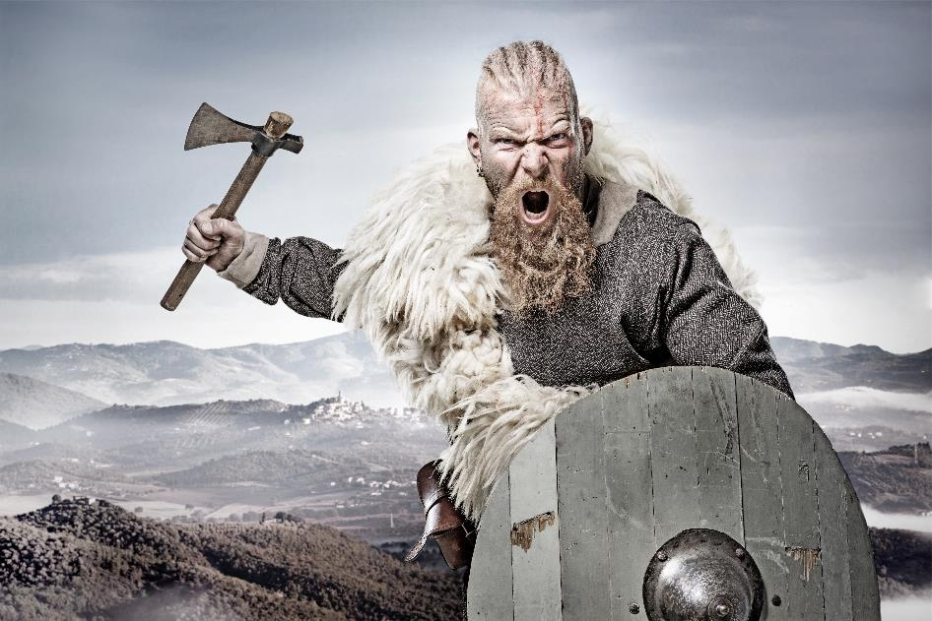
Dylan: Vikings were violent and aggressive thieves.
Lesson 1:
Mia: A lot of Vikings were farmers and very skilled.
Record your ideas about each of the two statements. I agree, I disagree...
Notes:
Talk task: Ask pupils the questions 'What does this picture tell you about what Vikings were like?' and 'Do you think this is a true representation of the Vikings?' The picture shows a stereotypical image of what the Vikings were imagined to be like. Pupils may discuss that the Vikings were violent/aggressive/thieves, etc. The lessons in this unit should challenge this view and explain how Vikings were actually mostly farmers, were complex, had many different skills (especially building boats and navigating) and had a great desire to explore the world.

Slide 35
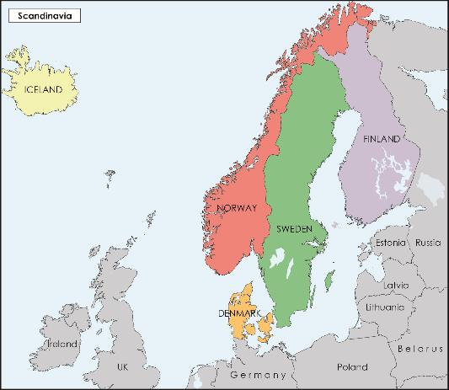
Where did the Vikings travel from?
Lesson 1:
The Viking age in European history was from about 790ce to 1066. Many Vikings left their homelands in Scandinavia during this period, like the Anglo-Saxons had 400 years earlier.
Scandinavia is an area in Northern Europe which, during the time of the Vikings, was Norway, Denmark, and Sweden.
The Vikings were great travellers and sailed all over Europe, including Britain and Ireland, and even across the Atlantic Ocean. Vikings traded, raided, and settled in many different lands.
Notes:
Read: Where did the Vikings travel from?

Slide 36
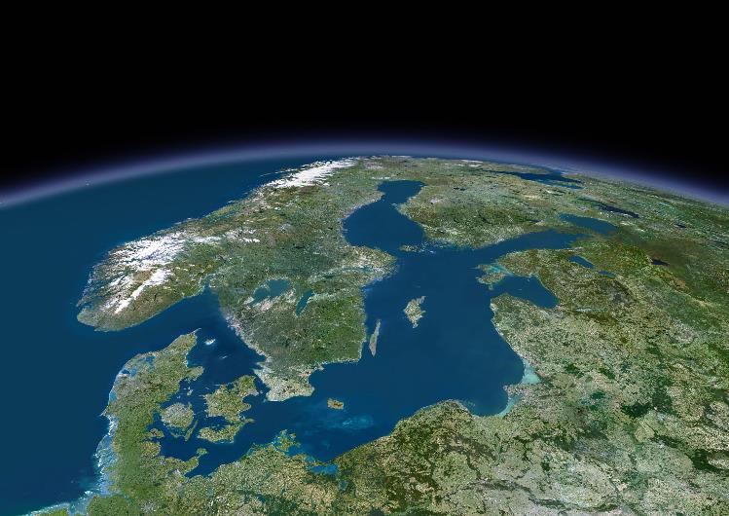
Where did the Vikings travel from?
Lesson 1:
The people of Britain called the invaders Danes, because many came from Denmark, but they also came from Norway and Sweden.
Vikings were also called Norse people, which means ‘people from the North’.

Slide 37
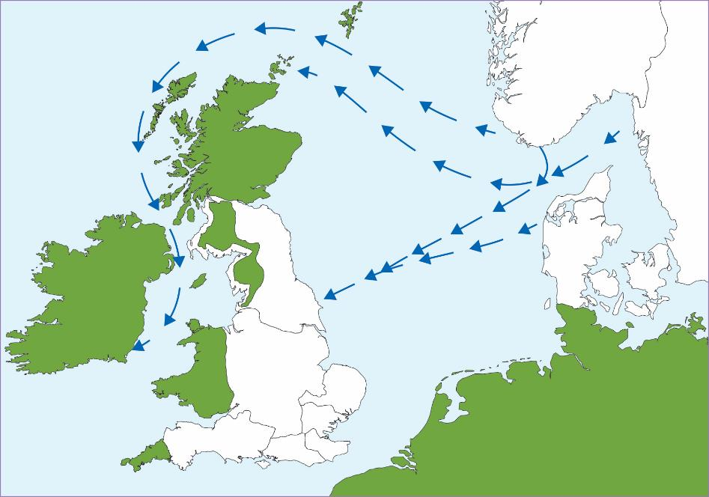
Where did the Vikings travel from?
Lesson 1:
Shade the countries where the Vikings came from in one colour or pattern and the area of the seven Anglo-Saxon kingdoms in England in another colour or pattern.
Label England, Ireland, Norway, Sweden, and Denmark.
Notes:
Retrieval: Using the map in the pupil workbook, ask pupils to shade the countries where the Vikings came from in one colour or pattern and the area of the seven Anglo-Saxon kingdoms in another colour or pattern. They should also label England, Ireland, Norway, Sweden, and Denmark. Ask pupils if this is the same or different to where the Anglo-Saxons came from. Answers are provided on the following slide. They should recognise that some of these are the same countries the Anglo-Saxons came from 400 years earlier—the Jutes and Angles came from Denmark. Pupils can refer to an atlas for this activity as necessary.

Slide 38
Where did the Vikings travel from?
Lesson 1:
Shade the countries where the Vikings came from in one colour or pattern and the area of the seven Anglo-Saxon kingdoms in England in another colour or pattern.
Label England, Ireland, Norway, Sweden, and Denmark.
Some of these are the same countries the Anglo-Saxons came from 400 years earlier—the Jutes and Angles came from Denmark.

Slide 39
How could the Vikings travel so far?
Lesson 1:
Vikings were great designers and builders of boats.
Viking longships were long, thin, and light and so could move fast. They could sail in shallow water which meant they could travel up rivers as well as across the sea. They were built from wooden planks, held together with iron rivets and wooden frames. Any gaps were sealed with animal hair to make them waterproof. They had a square sail and a mast but could also be rowed if there was no wind.
Notes:
Read: How could the Vikings travel so far?

Slide 40
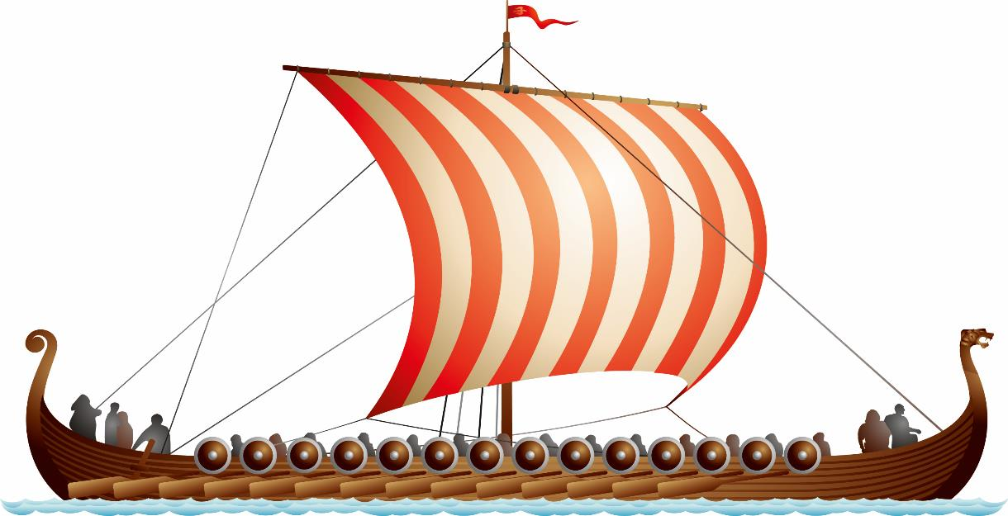
How could the Vikings travel so far?
Lesson 1:
Depending on its size, a longship had 24–50 oars.
The prow, at the front of the ship, would often be a dragon or snake head. Vikings hoped it would keep evil spirits away.

Slide 41
How could the Vikings travel so far?
Lesson 1:
Vikings were great designers and builders of boats.
Viking longships were long, thin, and light and so could move fast. They could sail in shallow water which meant they could travel up rivers as well as across the sea. They were built from wooden planks, held together with iron rivets and wooden frames. Any gaps were sealed with animal hair to make them waterproof. They had a square sail and a mast but could also be rowed if there was no wind.
Notes:
Read: How could the Vikings travel so far?

Slide 42
How could the Vikings travel so far?
Lesson 1:
Small rowing boats were carried by some larger boats and these could be rowed to shore for exploring without risking the main ship.
They also had slower and wider ships called ‘knorrs’ which had lots of room for storing things, so were particularly good for trade.
A small rowing boat.

Slide 43
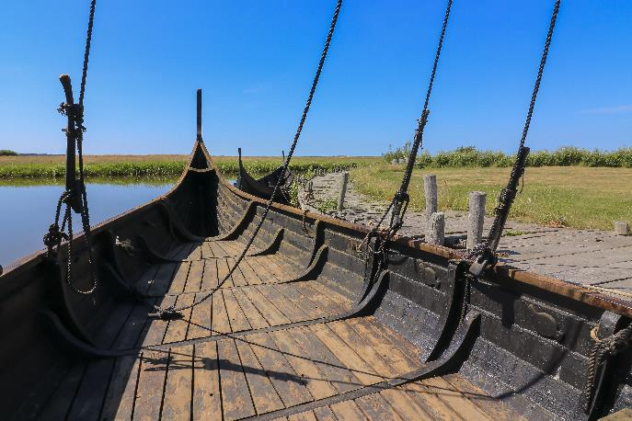
How could the Vikings travel so far?
Lesson 1:
As well as being skilled sailors and strong rowers, Vikings developed different ways of navigating. They used the sun and stars, and the direction of the waves and wind to work out where they were and how to get where they wanted to go!
A Viking knorr.

Slide 44
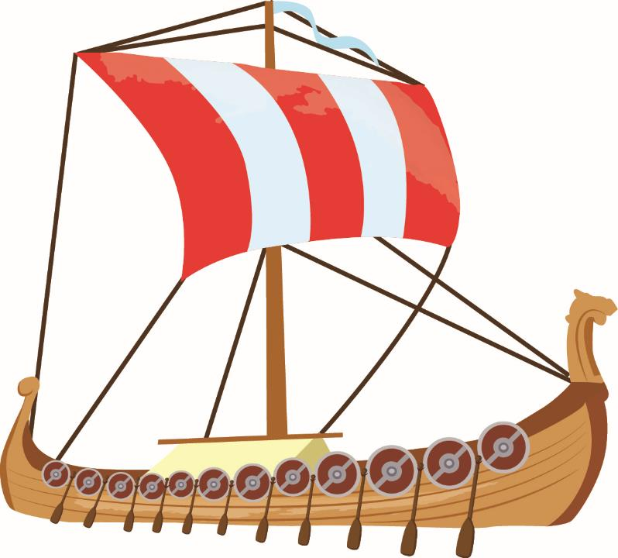
Use the vocabulary to label parts of the longboat.
Lesson 1:
mast
sail
oars
prow
Talk partners: How were the Vikings able to travel so far?
Notes:
Retrieval: Pupils label the parts of the longship using the description and the words provided. Answers are provided on the following slide.

Slide 45
Can you label the parts of the longship using the words below?
Lesson 1:
sail
mast
oars
prow

Slide 46
Read the text and answer the following questions: Give three reasons why the Vikings travelled.
Lesson 1:
1.
2.
3.
Who were the Vikings?
Notes:
Retrieval: Ask pupils to write down the three main reasons the Vikings travelled to England: over-crowding, better land, treasure to make them rich. Answers are provided on the following slide.

Slide 47
Exit Questions: Vikings came ________ years after the first Anglo-Saxon invasion. Vikings are only aggressive and are thieves. True or false? Explain.

