Slide 1
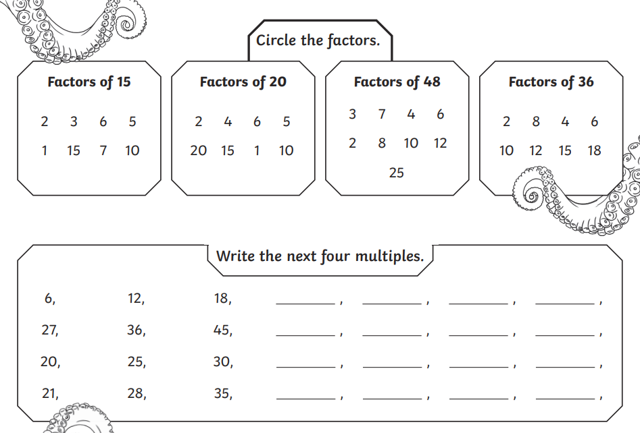
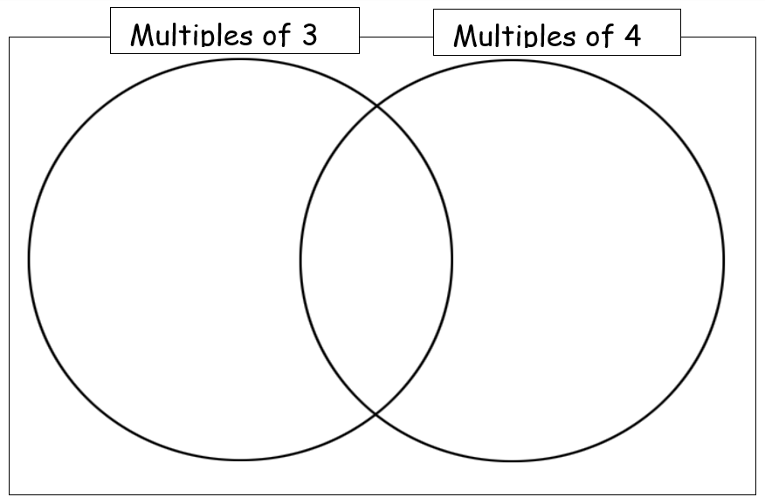
Morning Challenge 24/6/2025
16 135 21 240 84

Slide 2
Tuesday 24th June
TBAT: Use inverted commas. Talk partners: What are the steps to using inverted commas? 1. 2. 3. 4. 5.

Slide 3
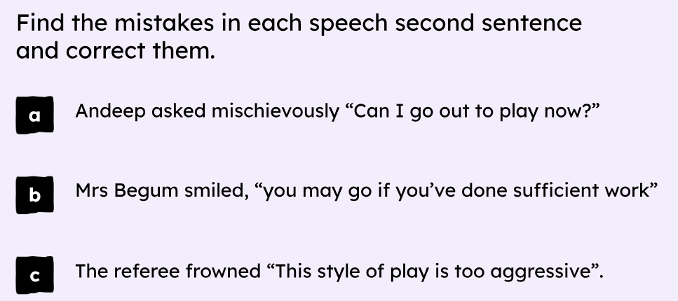
Tuesday 24th June
TBAT: Use inverted commas.

Slide 4
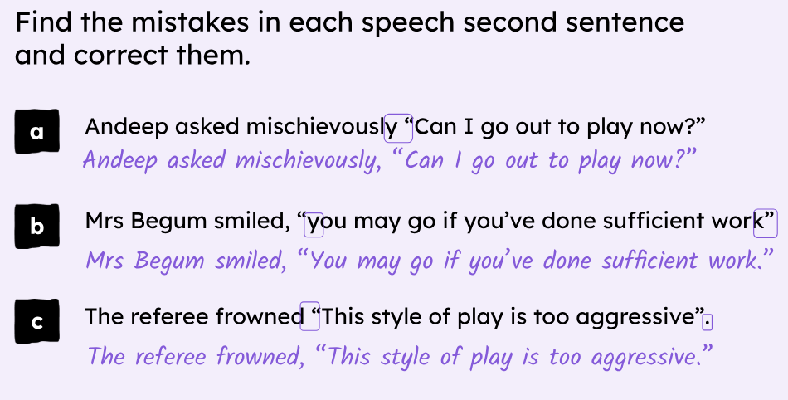
Tuesday 24th June
TBAT: Use inverted commas.

Slide 5
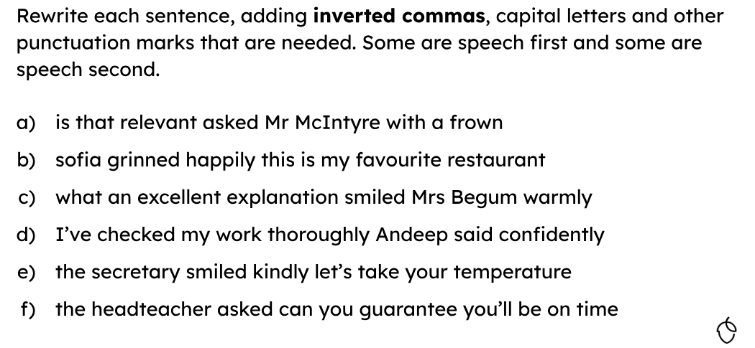
Tuesday 24th June
TBAT: Use inverted commas.

Slide 6
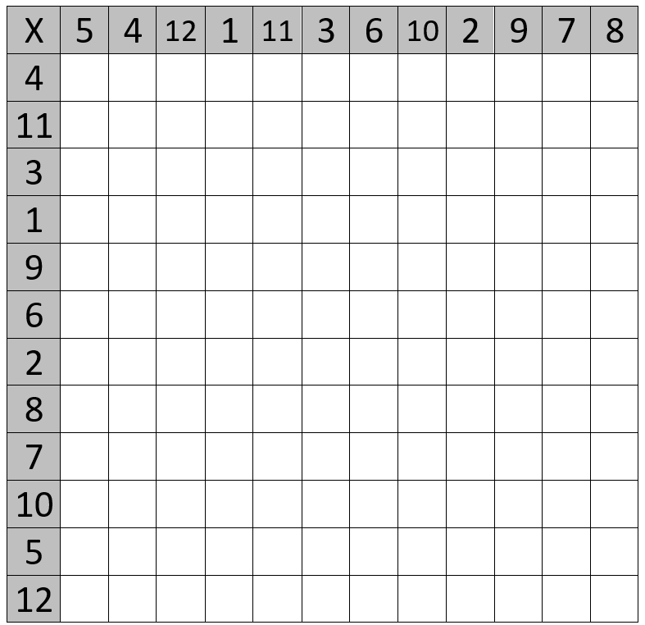
Times tables grid

Slide 7
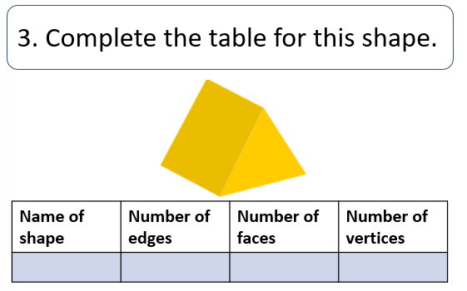
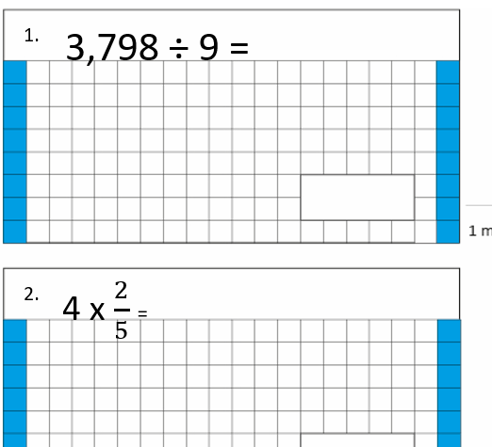
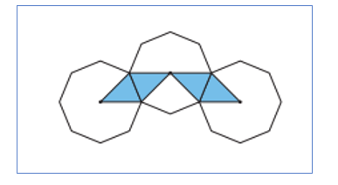
TBAT- calculate the area of compound shapes. 3 in 3
Challenge: What fraction is shaded?

Slide 9
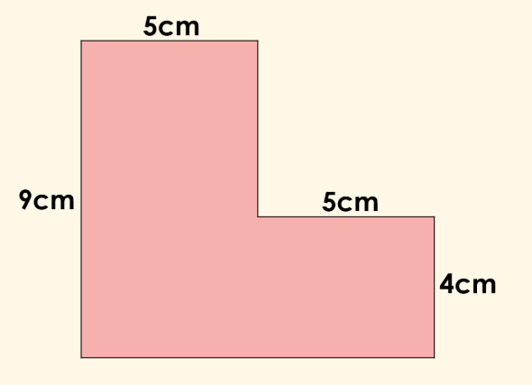
Recap: Calculate the perimeter of the compound shape.

Slide 10
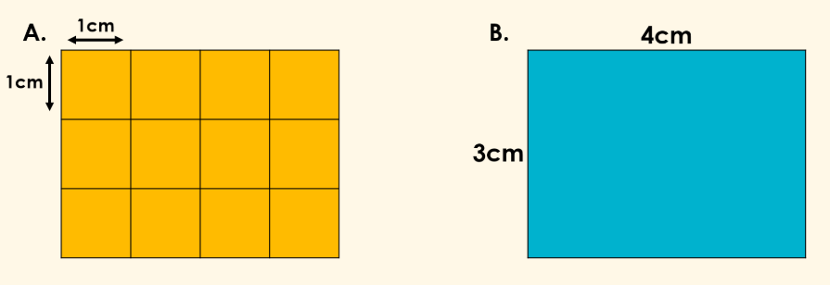
Talk partners: Calculate the area of shape A and B.
What do you notice?

Slide 11
In books: calculate the area of your rectilinear shape.
Challenge: Write the formula for calculating the area of a rectilinear shape.

Slide 12
Talk partners: How would we calculate the area of the compound shape?

Slide 13
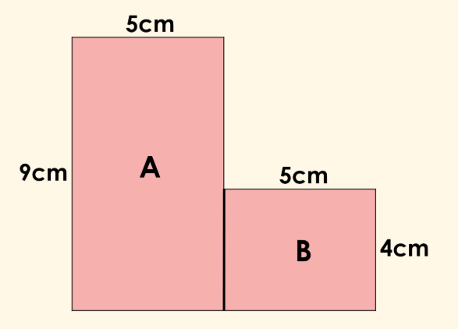
Class work:

Slide 14
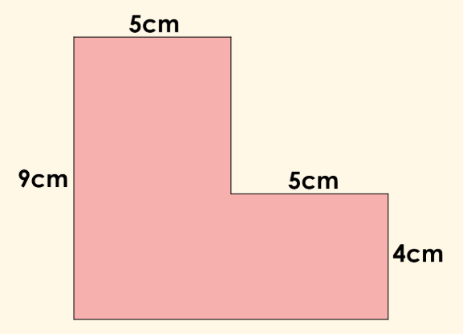
What is the first thing we must do before we can calculate the area of this shape?

Slide 15
Talk partners: In pairs decide where we would partition this shape to calculate the area.

Slide 16
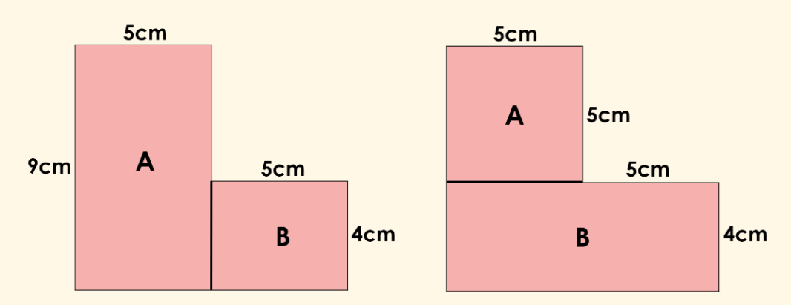
Does it make a difference to the answer?

Slide 17
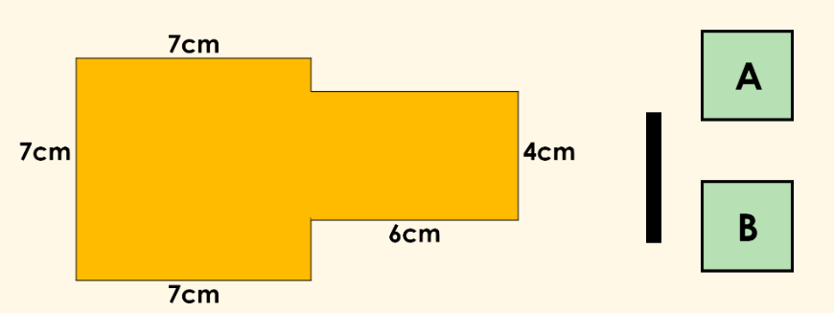
Use the labels to split the shape.

Slide 18
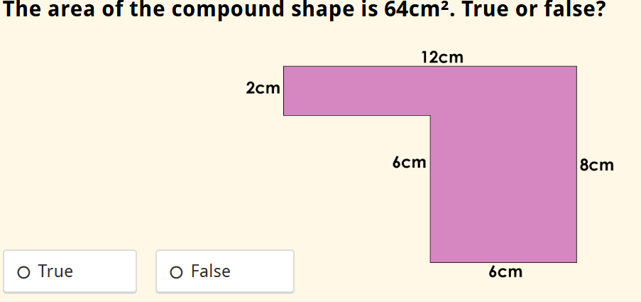
Whiteboard work:

Slide 19
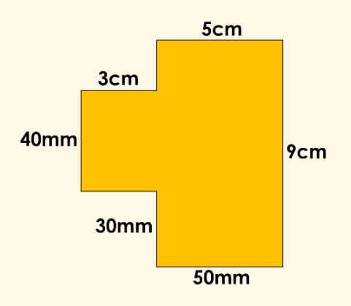
What are the steps to success to calculating the area of this shape?
Look carefully!

Slide 20
Whiteboard work:

Slide 21
Whiteboard work:

Slide 22
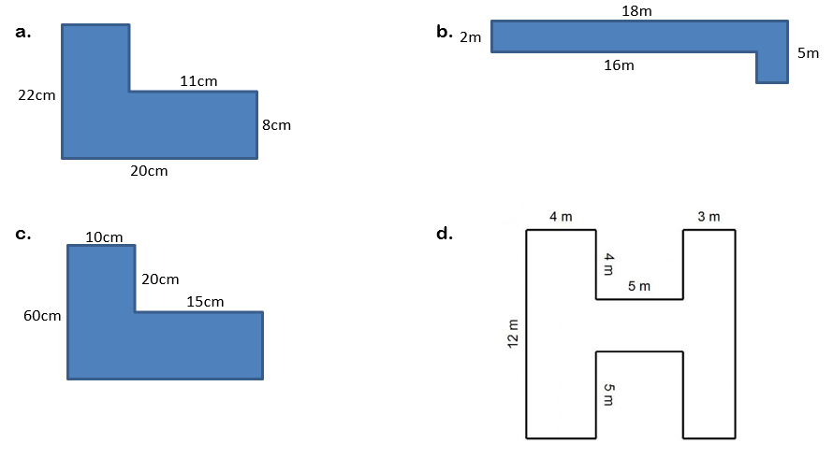
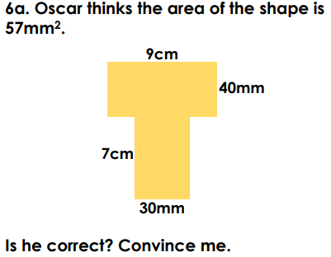
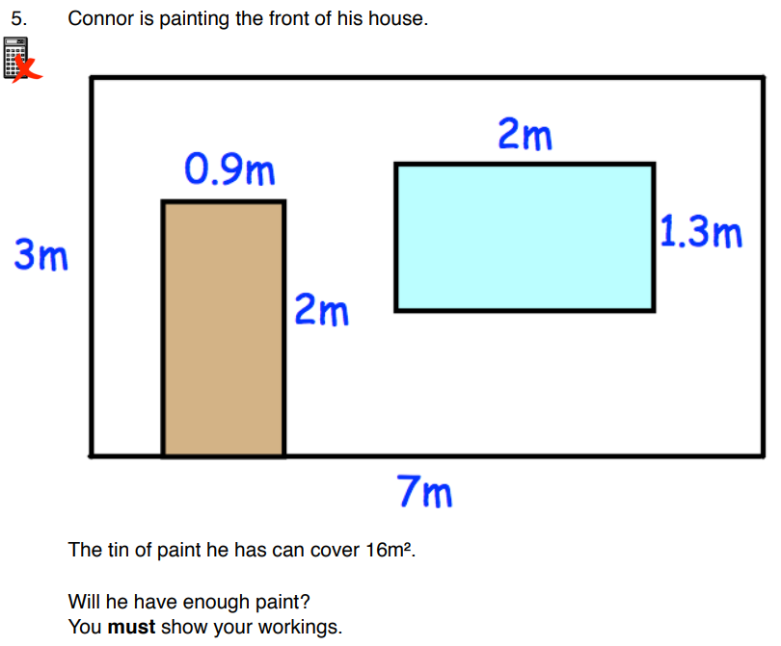
Independent:

Slide 23
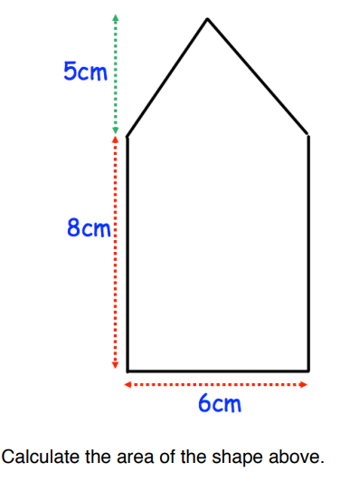
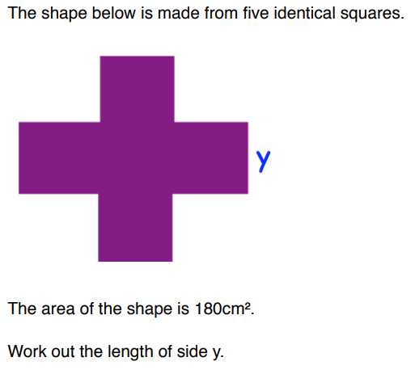
Challenge: Mastery:

Slide 24
Paint : no, only cover 16 Ch: 63 Mastery: 6

Slide 25
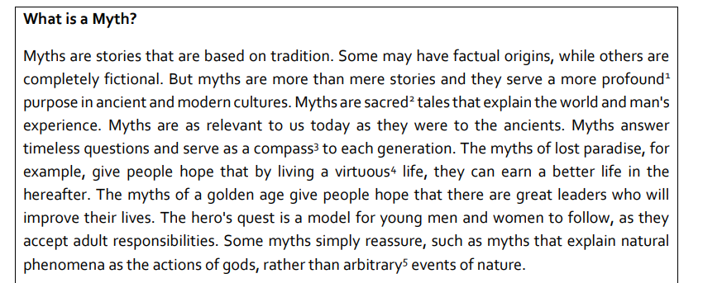
Tuesday 24th June TBAT: know the features of Viking myths and legends. 3 in 3
1. According to the source, what do myths do? 2. Are myths fact or fiction? Use a quotation from the text to support your answer.
3. What purpose does each of the kinds of myths serve?

Slide 26
Tuesday 24th June TBAT: know the features of myths and legends. What are the features of a narrative? What do you know about myths and legends? What are the features?

Slide 27
Tuesday 24th June TBAT: know the features of myths and legends.

Slide 28
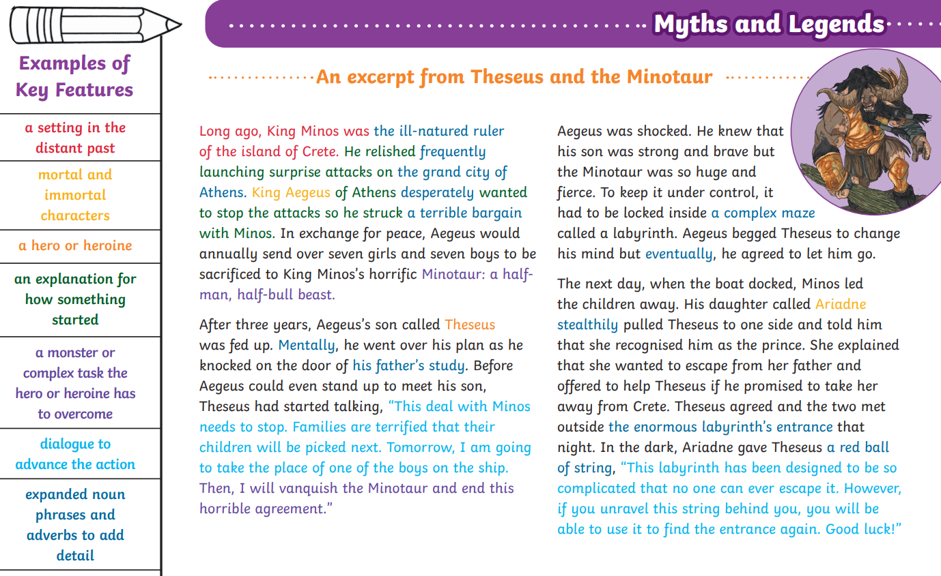

Slide 29
Talk partners: Can you think of a myth or a legend that you have heard?

Slide 30
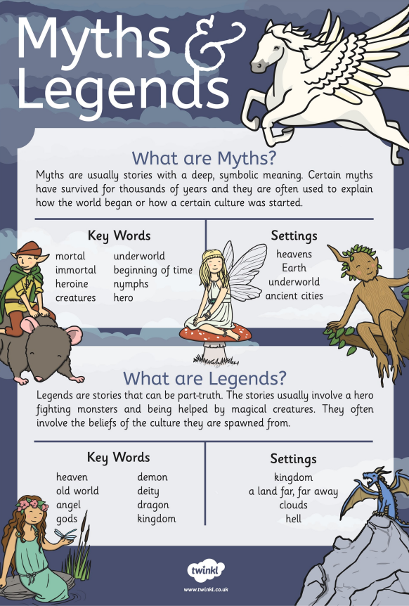
Talk partners: Can you think of a myth or a legend that you have heard?

Slide 31
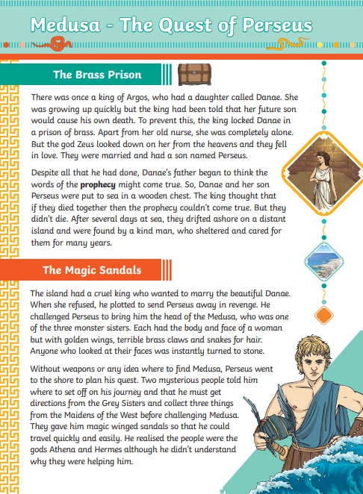
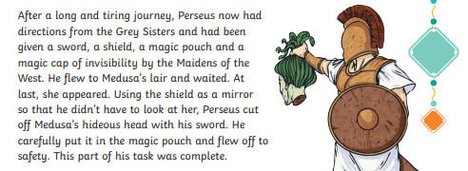
Read through the extracts – what features can you spot?

Slide 32
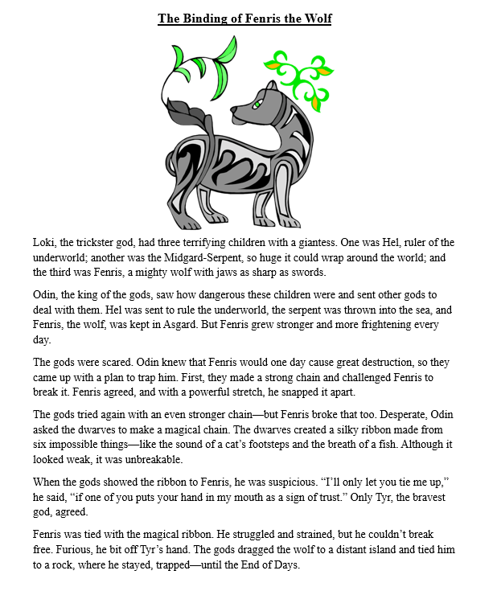
Read through the extracts – what features can you spot?

Slide 33
In your books, answer these questions about the texts you've read: 1. Identify three features of a myth or a legend from your text. 2. What is the moral of the text you have read? Challenge: Explain how the dialogue has advanced the action in the tale.

Slide 34
TBAT: Perform harmonies Celebration – Everybody loves Saturday night – Activity 3 Use Virtual Glockenspiel Online - Learn And Play Glockenspiel if there is not enough instruments.

Slide 35
TBAT- learn about the famous French celebration, La Fête des Rois.
1in 1 : translate into English.
Bonjour, je m'appelle Frank et j'ai 7 ans. J'habite dans un village avec mes parents.

Slide 36
Slide 40 and 44

Slide 38
Slide 49 Fine the 5 errors and circle them

Slide 41
Summer Fayre

