Slide 1
Tuesday 24th June 2025
24/6/25

Slide 2

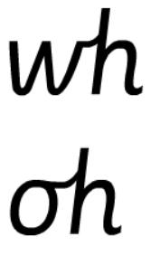
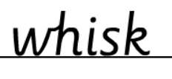


Morning Challenges:
Name writing

Slide 3
Early morning work
Complete the sequences
2 , 4, ___, ____, ____, _____, ____, _____, ____, ____, ____, 24
10, 20, ___, ____, ____, _____, ____, _____, ____, ____, ____, 110
5, 10, ___, ____, ____, _____, ____, _____, ____, ____, ____, 60

Slide 4
Revisit and review
Phonics
Lesson focus:
Review word endings ce se ze le al
Flash Cards (Time Trial) (Phase 3) - Online Phonics Game

Slide 5

Today's Grapheme
ce se ze le al

Slide 6
Recap
ee kn mb eigh eer ey gn a ay ph

Slide 7
Where in the word?
/l/:
beetle puddle bubble puzzle total equal final metal petal pedal village electrician

Slide 8
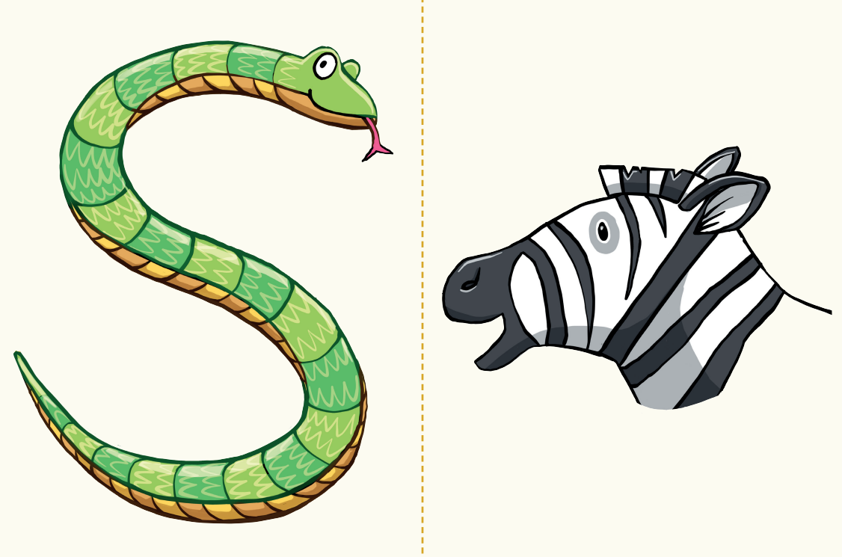
Revisit and review
Sort by phoneme
‘ze’, ‘se’ and ‘ce’
sneeze breeze freeze dance choice chance worse please noise horse

Slide 9

improve
parents
tricky words
move
thought
Read the tricky words.
shoe

Slide 10
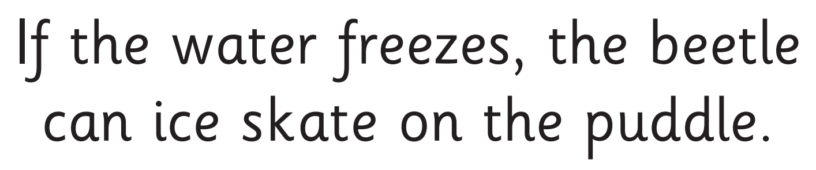
Now let's read this sentence!​
What digraphs can you see?
What tricky words can you see?

Slide 11
Let’s write a sentence.
Think it, say it, write it.
tricky words
Choice final parents
Think of all the sounds in each word.
Challenge
Extend the sentence using 'and’, ‘or’ or ‘but’

Slide 12
TBAT: Use new descriptive vocabulary.
3 in 3
What is a noun?
What is an adjective?
How does an ‘un’ prefix change the meaning of a word?

Slide 13

Today , we are going to think of strong vocabulary to use that describes the singing mermaid.
Halle Bailey - “Part of Your World” at Disneyland
Blue / Green
How can you describe the mermaid?
How can you describe the mermaid’s voice?
Challenge: Use words with the ‘un’ prefix

Slide 14
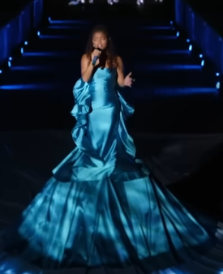
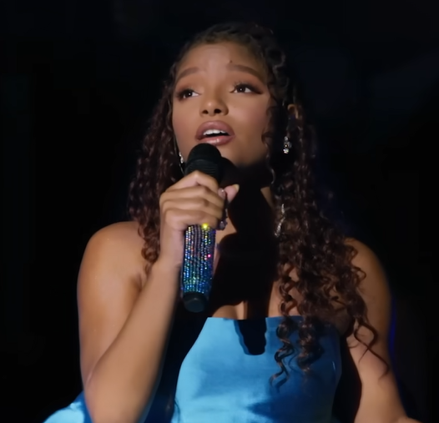
Adjectives that describe the mermaid

Slide 15
New vocabulary
Enchanting – so beautiful or special that it feels like magic.
Radiant – glowing with beauty or light
Graceful – moving in a soft, smooth, and pretty way.

Slide 16
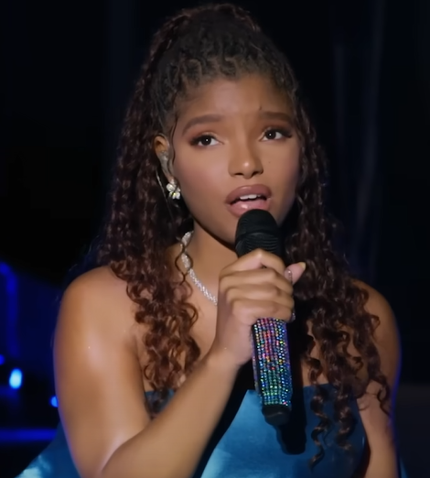
Adjectives that describe the mermaid’s voice

Slide 17
Words that mean something is really special or amazing.
Unbelievable incredible
Phenomenal sensational
Remarkable
Angelic – like an angel

Slide 18
Blue / Green
If you were Sam Sly, how would you persuade people to come and hear the mermaid sing?
Blue partner first - convince green partner to come and hear the mermaid.
Come and see the ________ mermaid because her voice is ________!
Challenge: Use more than one adjective to describe the mermaid.

Slide 19
Which words could complete the sentence correctly?
The singing mermaid is ___________________.
Ungraceful remarkable enchanting awful

Slide 20
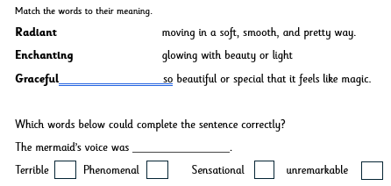




Independent

Slide 21
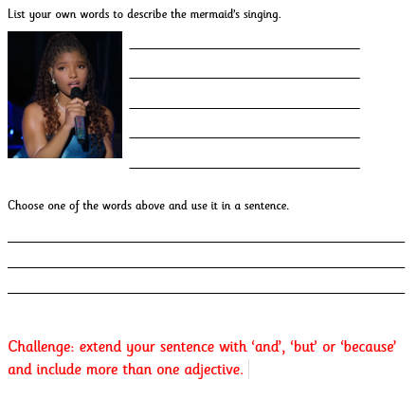

Slide 22
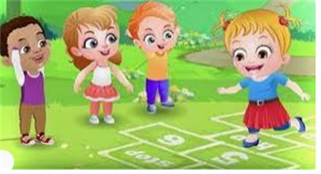
Break

Slide 23
Number patterns
What do you notice about each number?
What is next in the sequence?
3 in 3
9, 19, 29, 39, ____
16, ….... 36, 46, 56
73, 63, 53, …..., ____
Notes:
Do Now: Number patterns
Pupils each have a bead string. They represent the numbers in the sequence in turn and then continue the sequence forwards and backwards to find the missing numbers.
What is happening in the sequence? Is it increasing or decreasing? By how much?
Repeat for the second sequence.

Slide 24
To divide into equal groups and find the number of groups
equal
share
fair
equal groups
groups

Slide 25

There are 18 bananas
Let’s draw rings around them in groups of three.
How many groups can we make?
Notes:
New Learning: Connecting to arrays
Show pupils an image of 18 bananas that are more scattered than in previous examples and discuss what might be tricky with the problem. Explain that today we will be organising objects into an array to help us make equal groups.
There are 18 bananas altogether so I need 18 counters.
Model making the array using counters (concrete) by making one group of three at a time. (One column of three).
I have arranged the 18 counters into equal groups of three.
Model counting circling and counting the total number of groups.
There are six equal groups of three bananas.
Repeat with further examples as needed and model the Talk task.

Slide 26


There are 18 bananas
Let’s represent the 18 bananas with an array in groups of 3.
DYNAMIC REPRESENTATION
Build up your own representation, ‘live’ in the lesson
Notes:
New Learning: Connecting to arrays
Show pupils an image of 18 bananas that are more scattered than in previous examples and discuss what might be tricky with the problem. Explain that today we will be organising objects into an array to help us make equal groups.
There are 18 bananas altogether so I need 18 counters.
Model making the array using counters (concrete) by making one group of three at a time. (One column of three).
I have arranged the 18 counters into equal groups of three.
Model counting circling and counting the total number of groups.
There are six equal groups of three bananas.
Repeat with further examples as needed and model the Talk task.

Slide 27
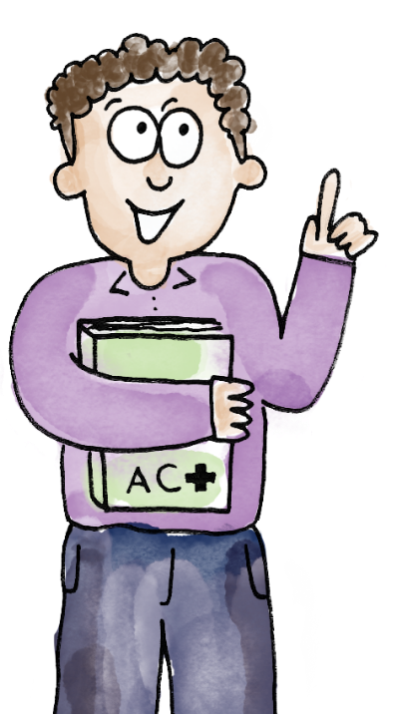
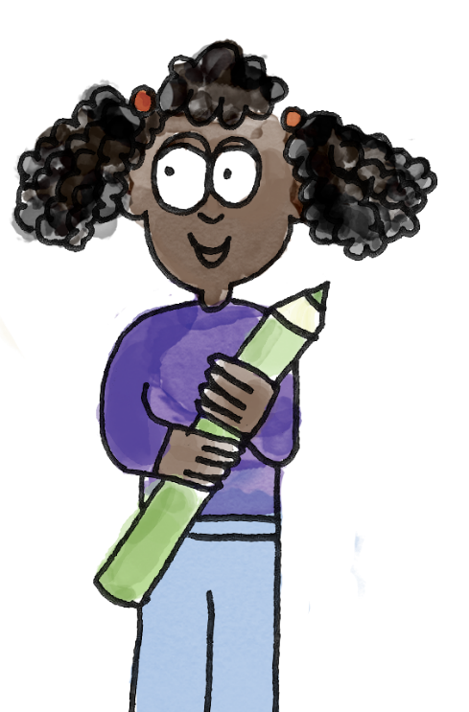


I have represented the 10 cookies in an array with equal groups of 2.
There are five equal groups of two.
B/G
Group 10 cookies into groups of 2.
equal groups share equally fair
Notes:
Talk Task: Organising objects into equal groups using an array
Partner A chooses a card and models the representation using an array on a mini whiteboard. Partner B circles the equal groups and identifies how many equal groups there are. Swap and repeat.

Slide 28
There are 16 hats.
Show them in groups of four in an array.
DYNAMIC REPRESENTATION
Build up your own representation, ‘live’ in the lesson
How many groups of four can we make?
Notes:
Develop Learning: Using an array to represent a grouping problem
Read the problem and discuss what you know.
There are 16 hats altogether. 16 is the whole.
I need to group them into groups of four.
I need 16 counters.
Model creating an array with 16 counters as in the New learning. Then draw an array and circle the groups.
I have 8 equal groups of 2 hats.

Slide 29
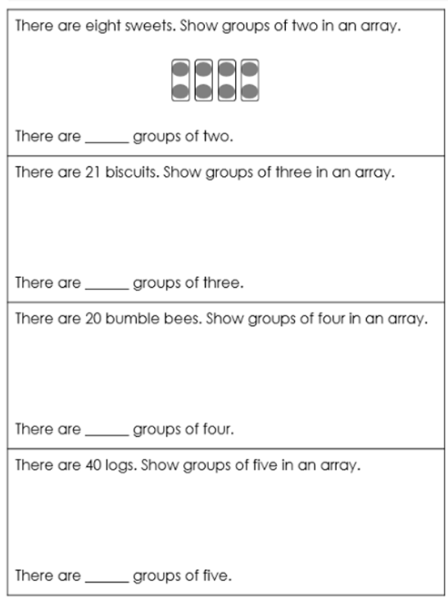
TBAT: share a total equally and find the number of groups
Independent:
Notes:
Independent Task: Division by grouping
Pupils have counters/cubes and the Task Sheet. They count out counters to represent the numbers of items in the question and then group these equally according to the instruction. They count the number of groups. They circle groups on the sheet to represent this pictorially using an array. They write down how many groups they created.
Possible adaptations:
Scaffold this by completing the grouping on the first question as an example.
Challenge pupils by removing the pictorial representations and have them draw their own.

Slide 30
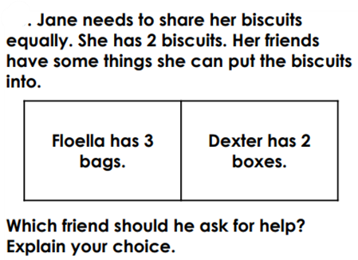
TBAT: share a total equally and find the number of groups
RP:
Notes:
Independent Task: Division by grouping
Pupils have counters/cubes and the Task Sheet. They count out counters to represent the numbers of items in the question and then group these equally according to the instruction. They count the number of groups. They circle groups on the sheet to represent this pictorially using an array. They write down how many groups they created.
Possible adaptations:
Scaffold this by completing the grouping on the first question as an example.
Challenge pupils by removing the pictorial representations and have them draw their own.

Slide 31
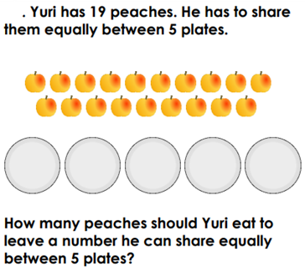
TBAT: share a total equally and find the number of groups
Challenge:
Notes:
Independent Task: Division by grouping
Pupils have counters/cubes and the Task Sheet. They count out counters to represent the numbers of items in the question and then group these equally according to the instruction. They count the number of groups. They circle groups on the sheet to represent this pictorially using an array. They write down how many groups they created.
Possible adaptations:
Scaffold this by completing the grouping on the first question as an example.
Challenge pupils by removing the pictorial representations and have them draw their own.

Slide 32
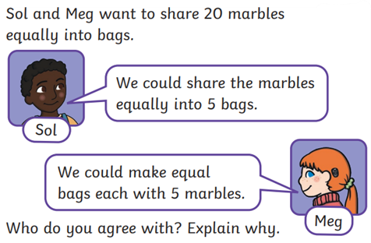
TBAT: share a total equally and find the number of groups
Mastery:
Notes:
Independent Task: Division by grouping
Pupils have counters/cubes and the Task Sheet. They count out counters to represent the numbers of items in the question and then group these equally according to the instruction. They count the number of groups. They circle groups on the sheet to represent this pictorially using an array. They write down how many groups they created.
Possible adaptations:
Scaffold this by completing the grouping on the first question as an example.
Challenge pupils by removing the pictorial representations and have them draw their own.

Slide 33
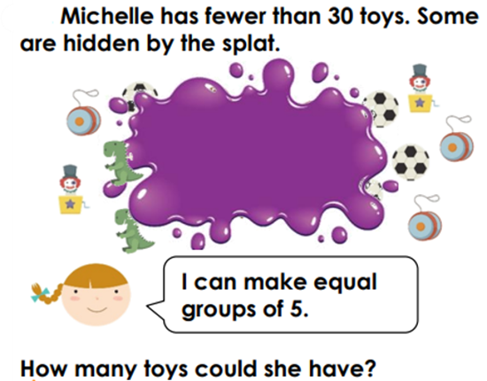
TBAT: share a total equally and find the number of groups
Mastery with greater depth:
Notes:
Independent Task: Division by grouping
Pupils have counters/cubes and the Task Sheet. They count out counters to represent the numbers of items in the question and then group these equally according to the instruction. They count the number of groups. They circle groups on the sheet to represent this pictorially using an array. They write down how many groups they created.
Possible adaptations:
Scaffold this by completing the grouping on the first question as an example.
Challenge pupils by removing the pictorial representations and have them draw their own.

Slide 34

Lunch

Slide 35
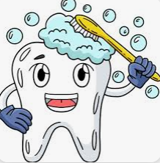
Toothbrushing

Slide 36
2 in 2
Which religion of people visit a Mosque?
What do they do at the Mosque?
What do Mosques have in common and how do they differ?

Slide 37
minaret
a tower from where the call to prayer is often made
dome
a rounded, often large roof on top of a mosque
minbar
a raised platform used by the imam to give special talk
mihrab
a niche set into the wall of a mosque to indicate the direction of Makkah

Slide 38
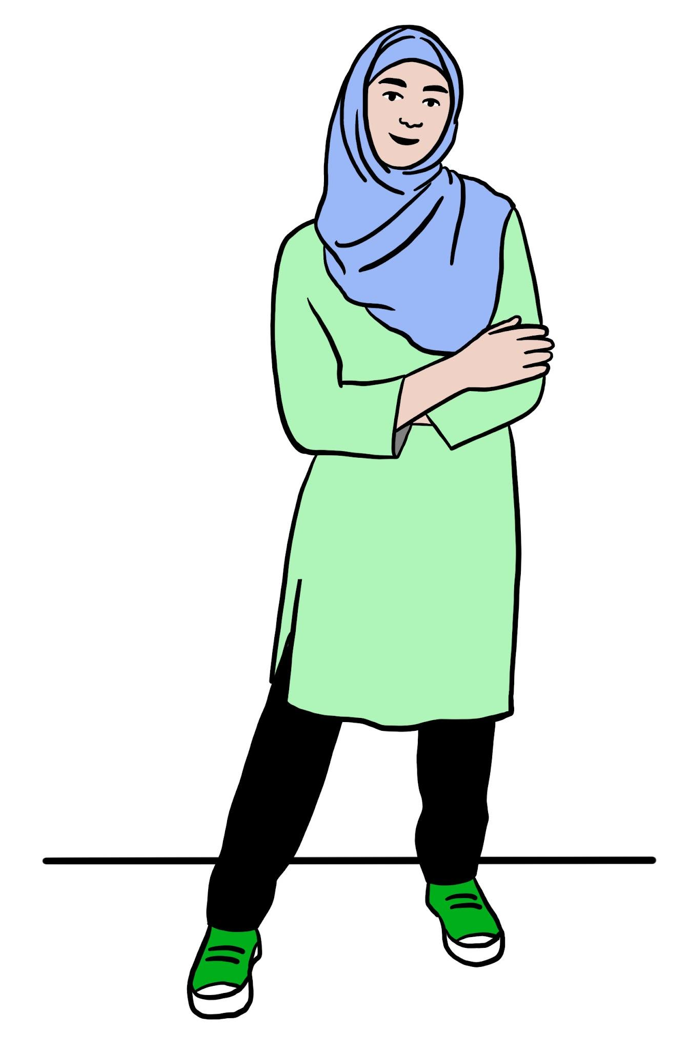
What are the different types of mosques?
This is Nadia. She is a British Muslim.
Nadia has a Muslim worldview.
Nadia

Slide 39
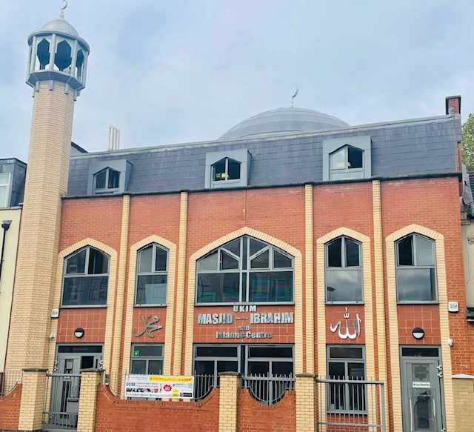
What are the different types of mosques?
This is Nadia’s mosque. It was founded in 1962 by a small group of Muslims in the community.
a minaret is a tower from where the call to prayer is often made
a dome is a rounded, large roof on top of a mosque
a prayer hall is a quiet place where people go to pray
Nadia’s mosque

Slide 40

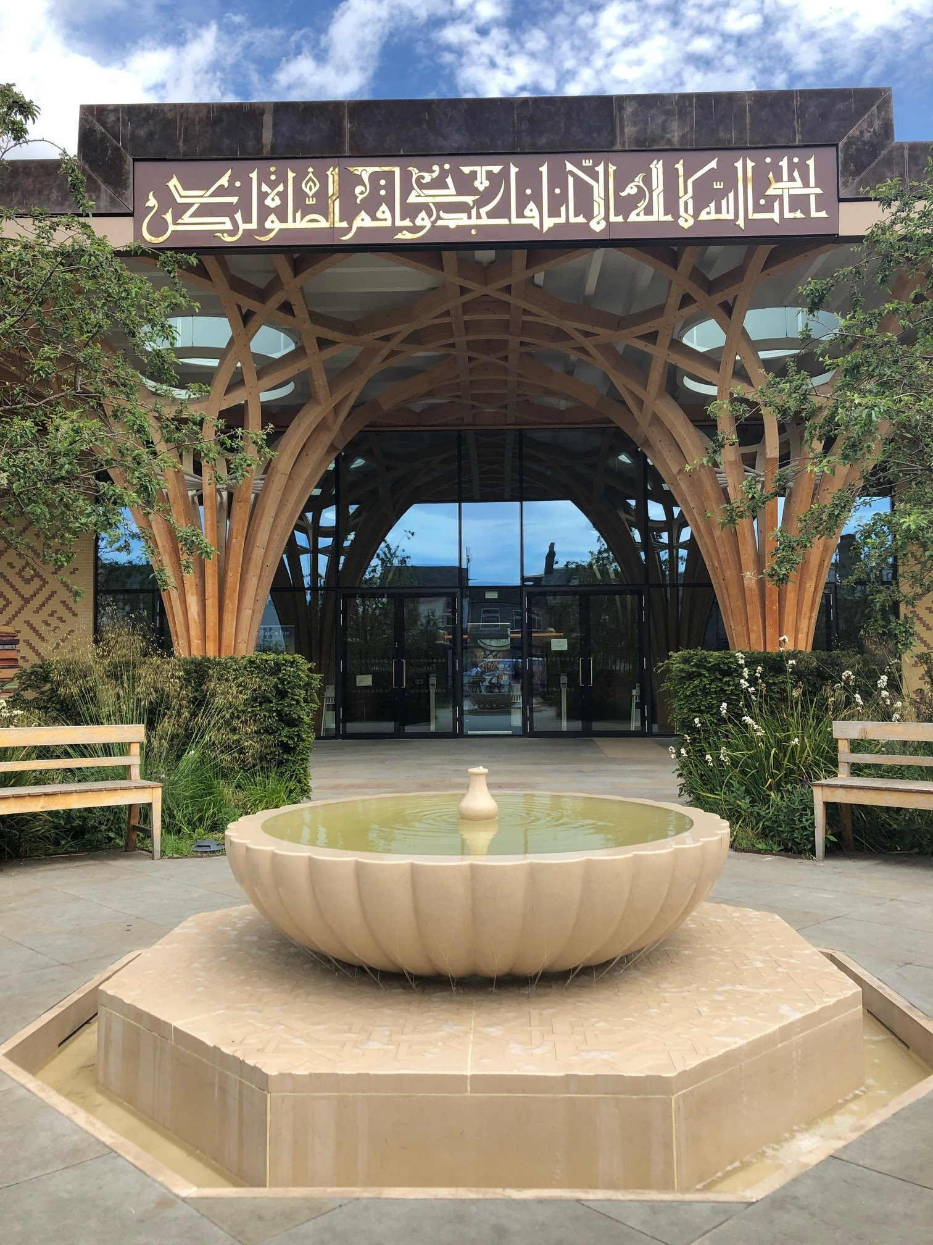
What are the different types of mosques?
This is Ahmed. He has a Muslim worldview.
He loves to go to his mosque in Cambridge every week.
Ahmed
Ahmed’s mosque

Slide 41
What are the different types of mosques?
Blue / Green
How does Nadia’s mosque look different to Ahmed’s mosque?
Nadia’s mosque
Ahmed’s mosque

Slide 42
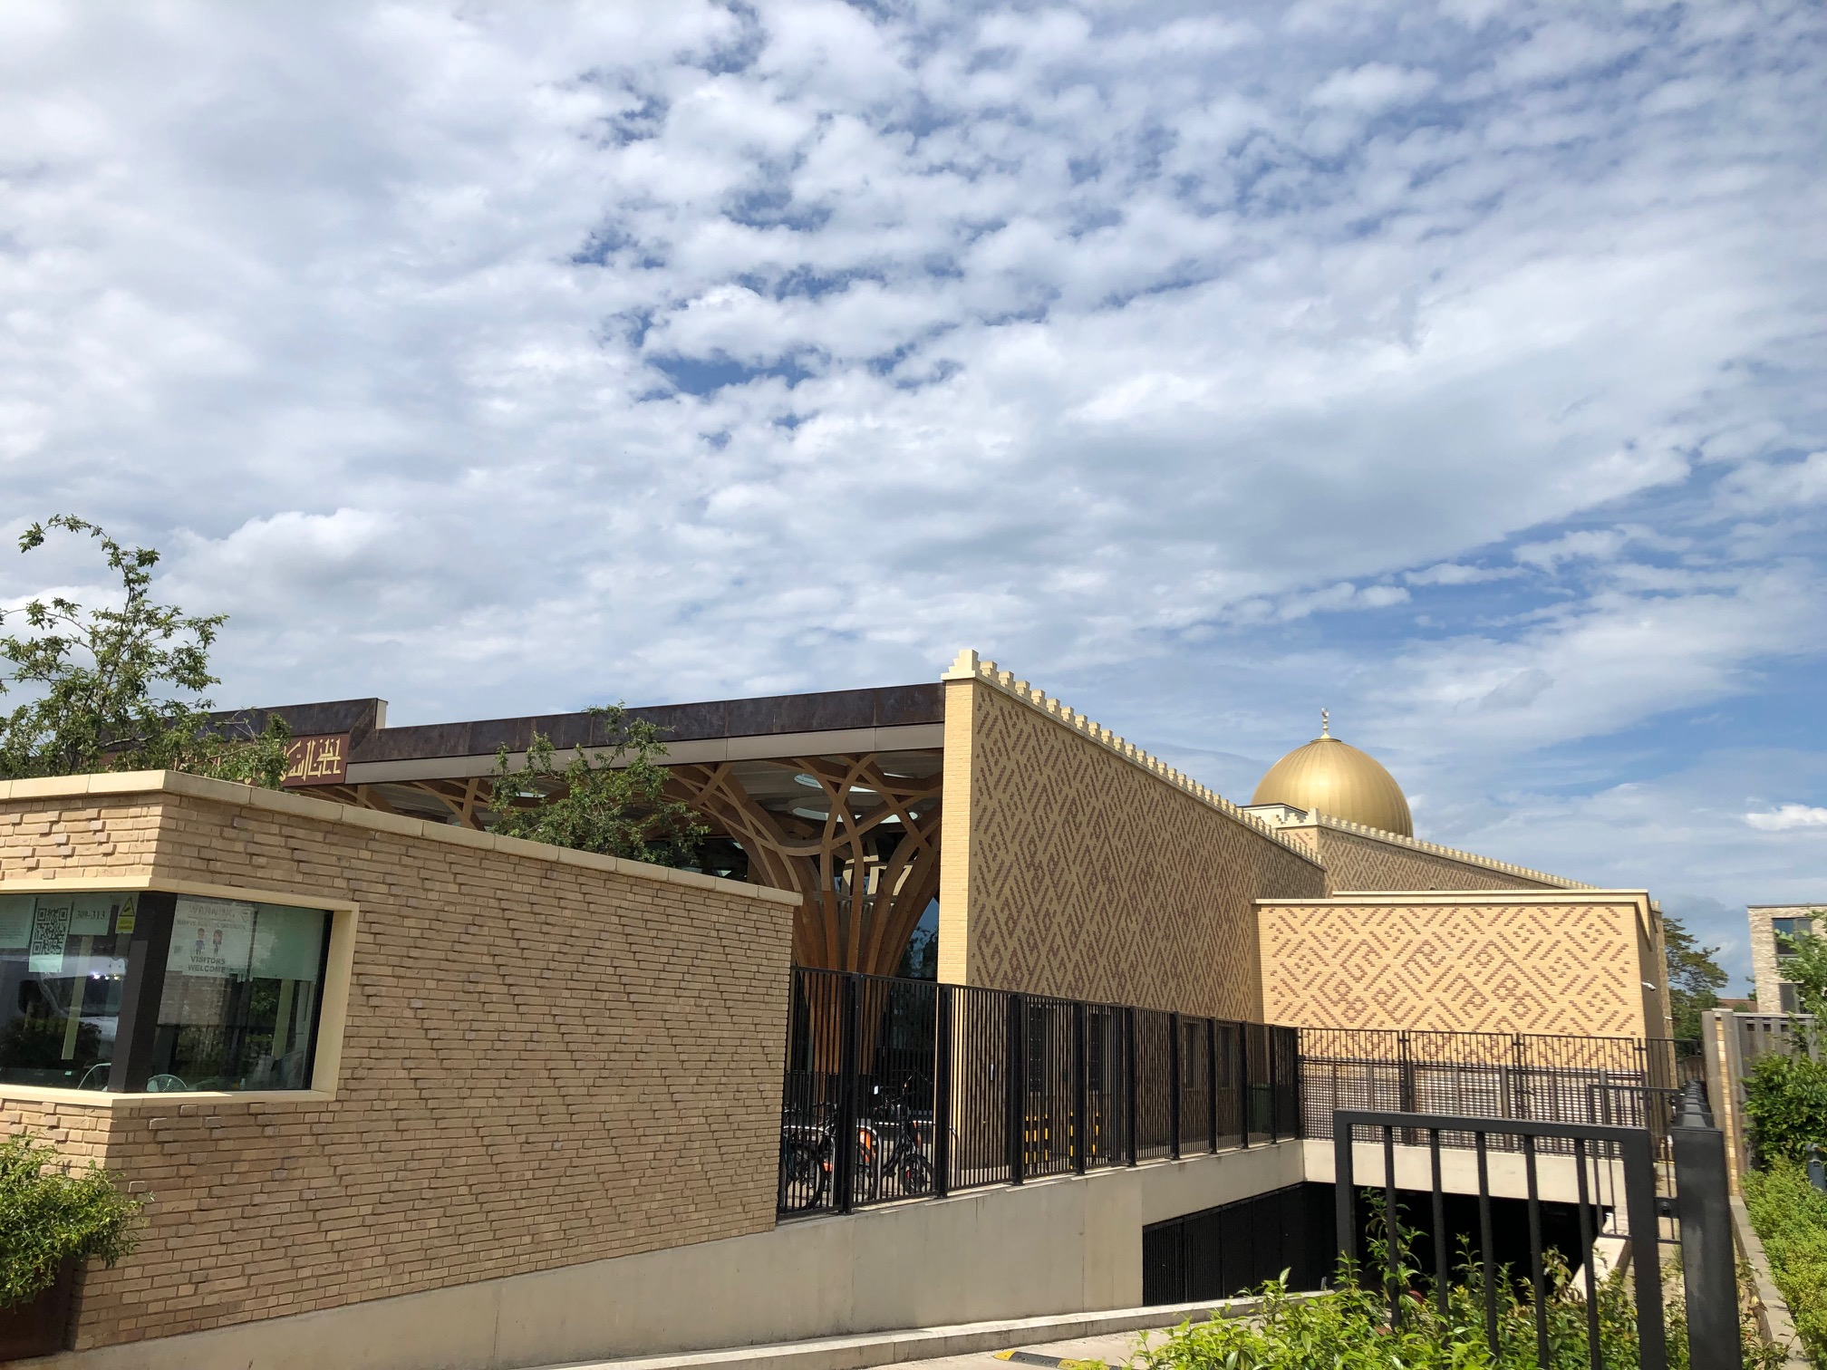
What are the different types of mosques?
Ahmed’s mosque is Europe’s first eco-friendly mosque. Outside, it has some similar features to Nadia’s mosque.
dome
prayer hall
mosque’s entrance
side view of the mosque

Slide 43


What are the different types of mosques?
Nadia and Ahmed talked about their mosque:
My mosque holds a special place in my heart. It has a tall tower called a minaret, from where a call to prayer is made. I feel calm and peaceful when I visit my mosque because it’s a safe and welcoming place.
Nadia
I love my mosque. It has a modern design with natural materials and eco-friendly features. I like the dome which shines in the sunlight. There are lots of different mosques but they are all used for the same purpose - prayer.
Ahmed

Slide 44



Which parts of a mosque are sacred?
Mosques may look different from the outside but they all have special sacred parts inside.
Did you know, taking your shoes off before entering the prayer room is about more than just cleanliness? It’s a way of showing respect.
Jun
Sofia

Slide 45
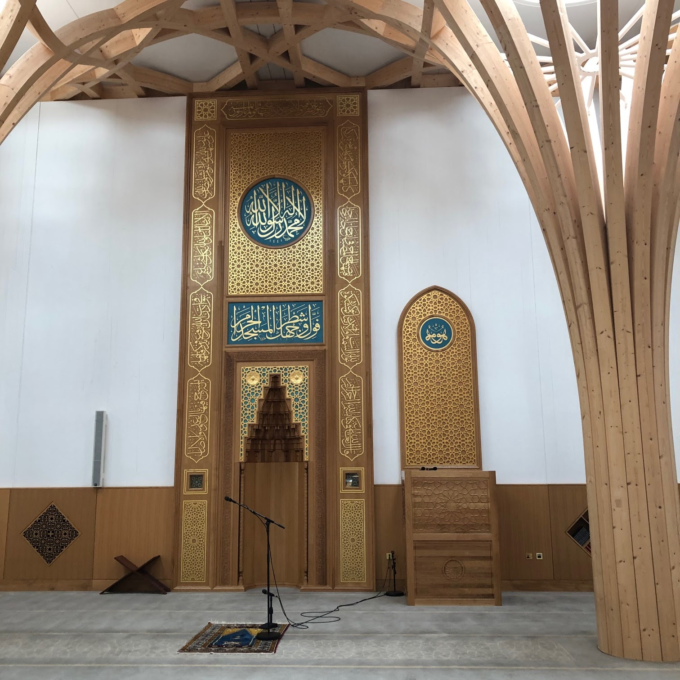
Which parts of a mosque are sacred?
This is inside Ahmed’s mosque. It has features which are found in all mosques around the world.
minbar
mihrab
prayer area
Ahmed’s mosque

Slide 46

Which parts of a mosque are sacred?
All mosques have a mihrab, minbar and a prayer area
Why?
Mosques can be big or small in size, but they always have a mihrab, minbar and a prayer area.

Slide 47
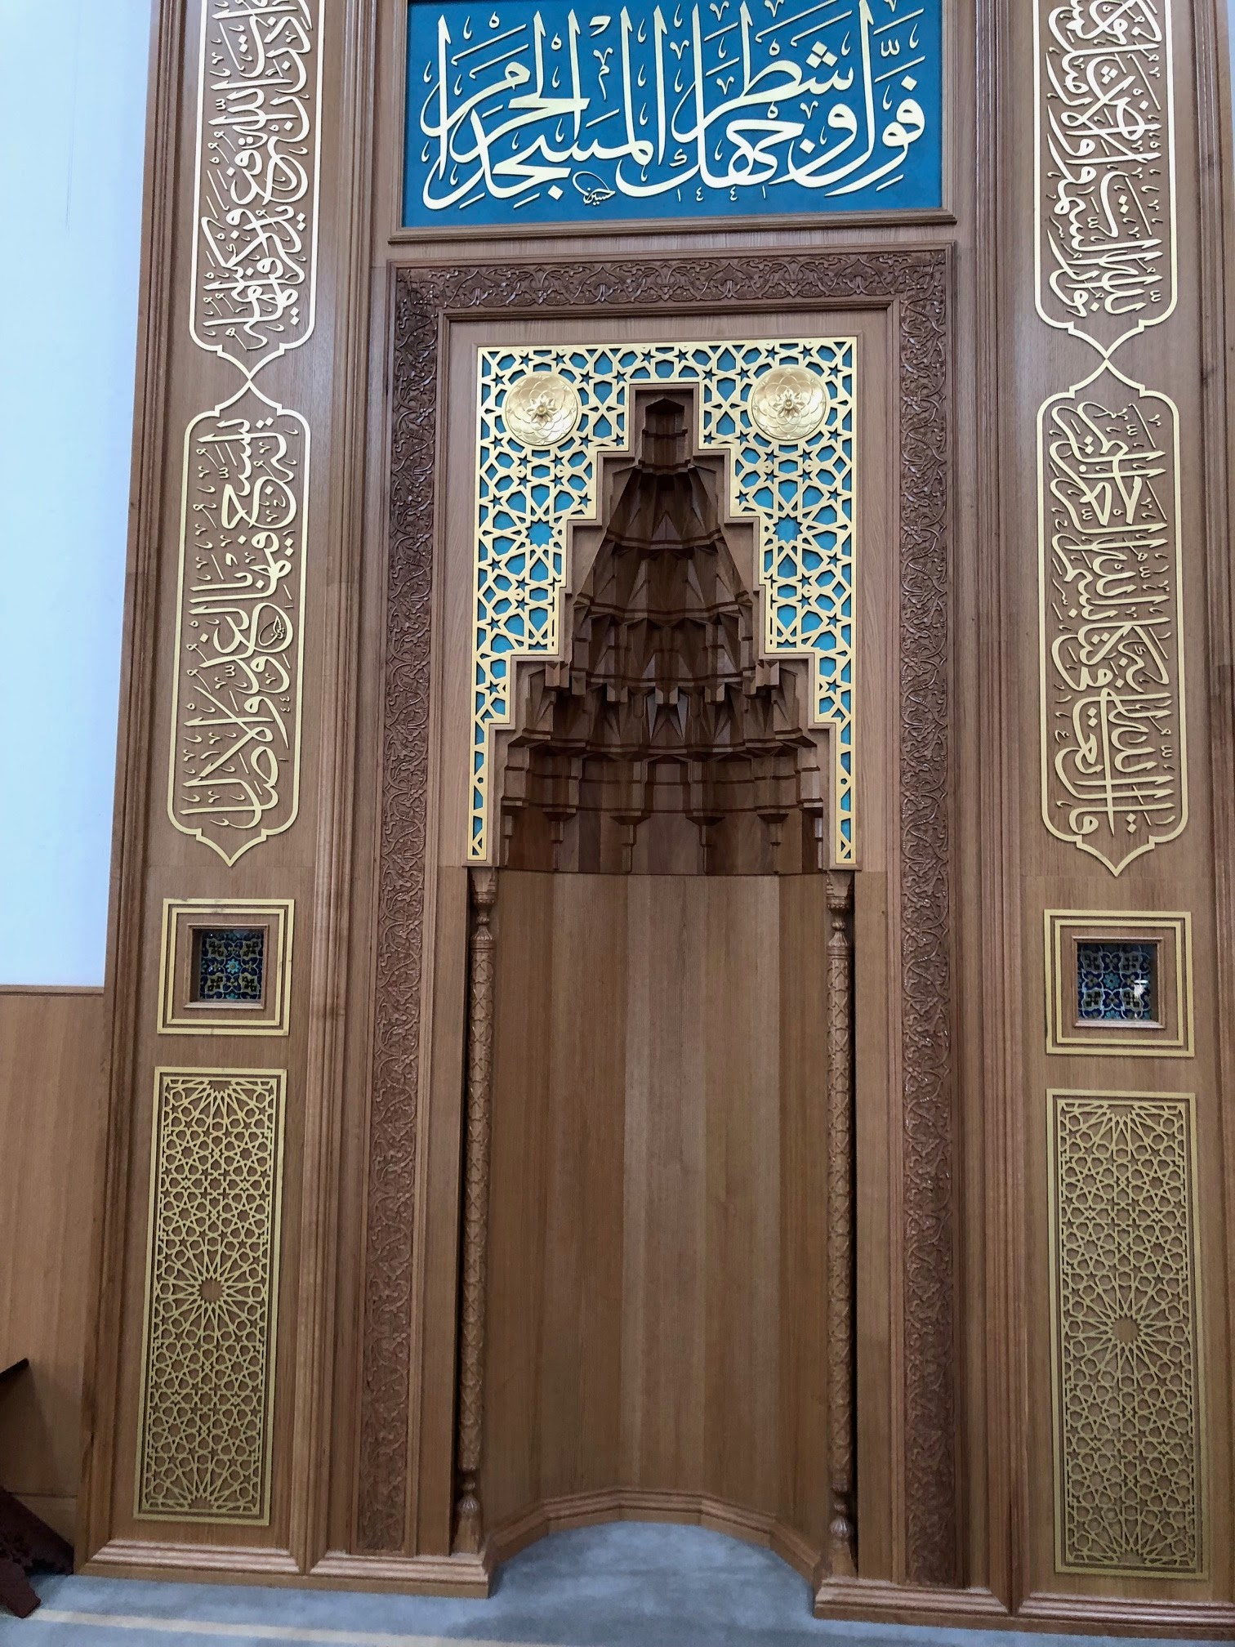
Which parts of a mosque are sacred?
This is a mihrab.
It is a niche set into the wall of a mosque to indicate the direction of Makkah.
This helps Muslims know which way to face when they are praying.
Mihrab at Cambridge mosque

Slide 48
Which parts of a mosque are sacred?
A minbar is a raised platform used by the imam to give speeches.
It helps Muslims hear important lessons and teachings about being kind, helping others and following God.
Minbar at Cambridge mosque

Slide 49
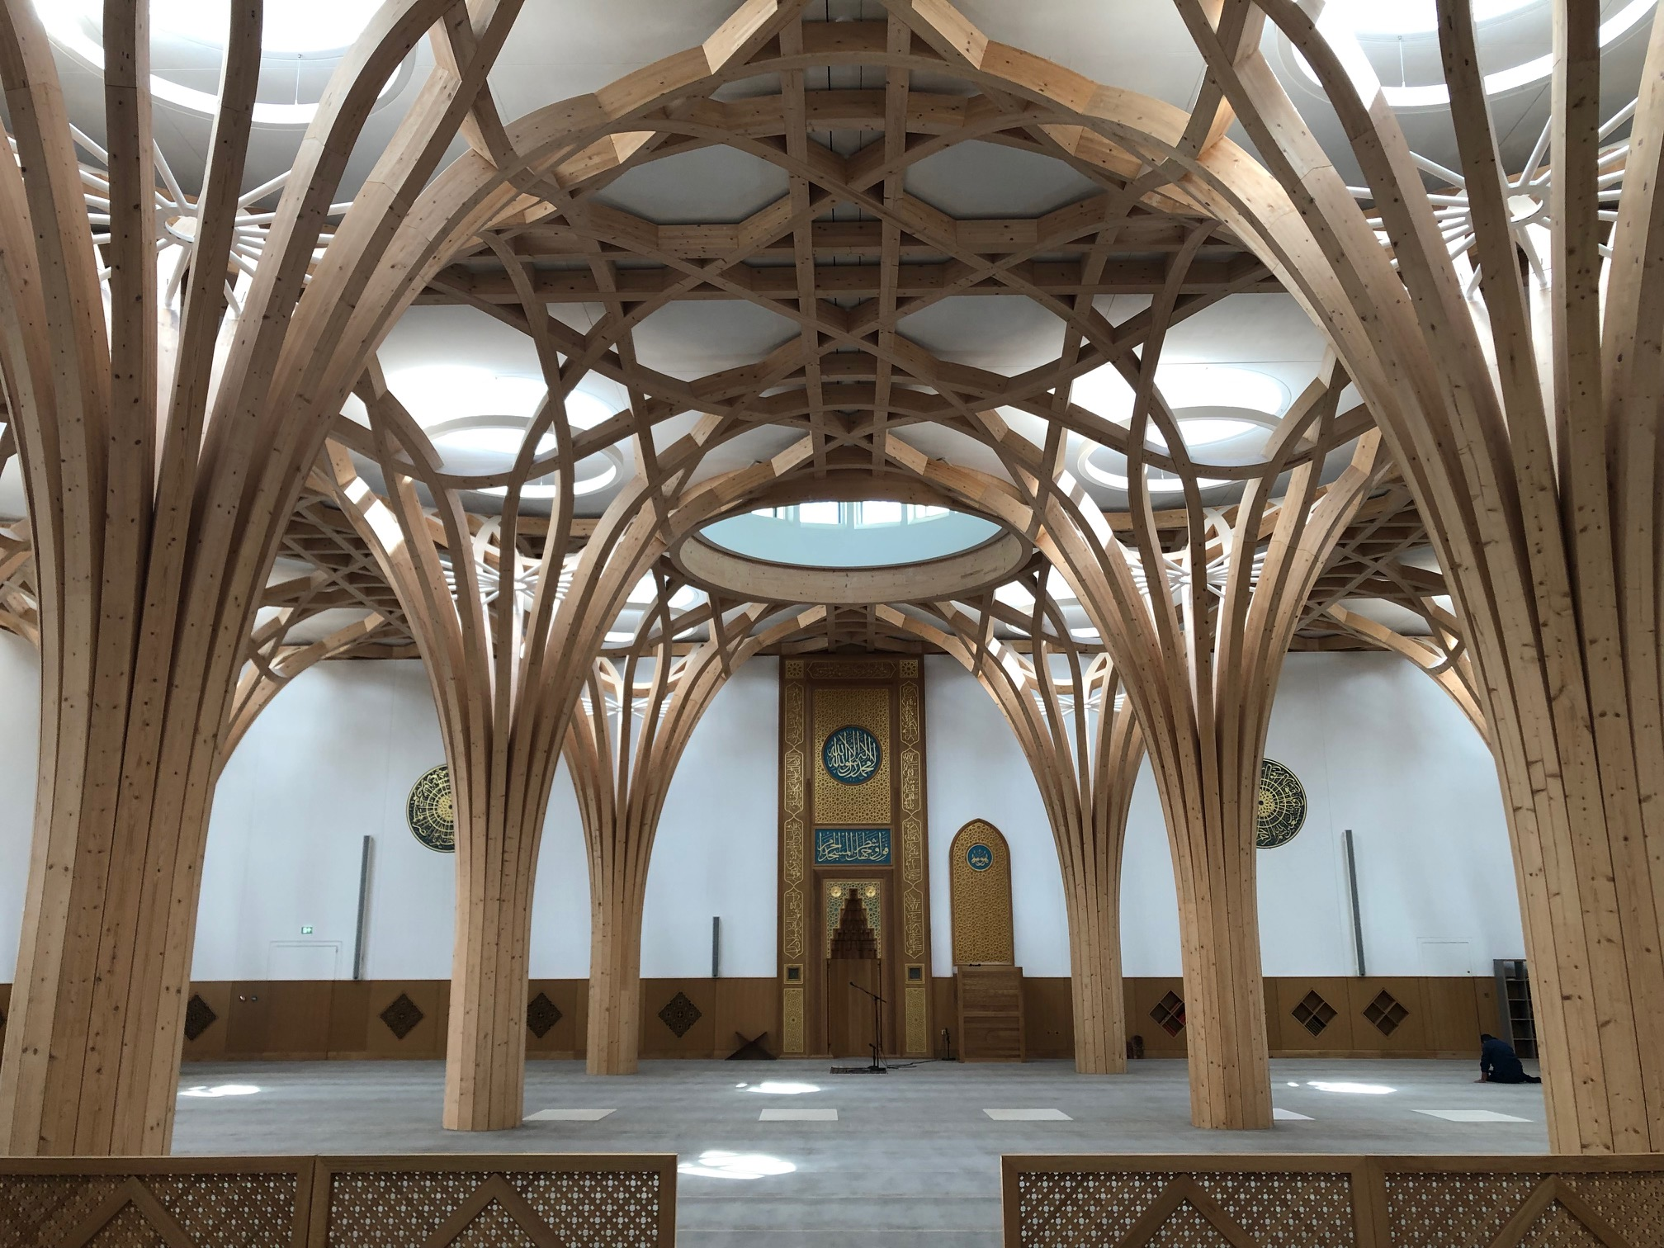
Which parts of a mosque are sacred?
The prayer area is a large open space where Muslims pray together.
Everyone takes off their shoes and the space is kept very clean.
Cambridge mosque uses wood that looks like trees as this is better for the environment.
Prayer area at Cambridge mosque

Slide 50
Which parts of a mosque are sacred?
Match the words with the correct definition.
mihrab
minbar
prayer area
a raised platform used by the imam to give speeches
a large open space where Muslims pray together
a niche set into the wall of a mosque to indicate the direction of Makkah

Slide 51
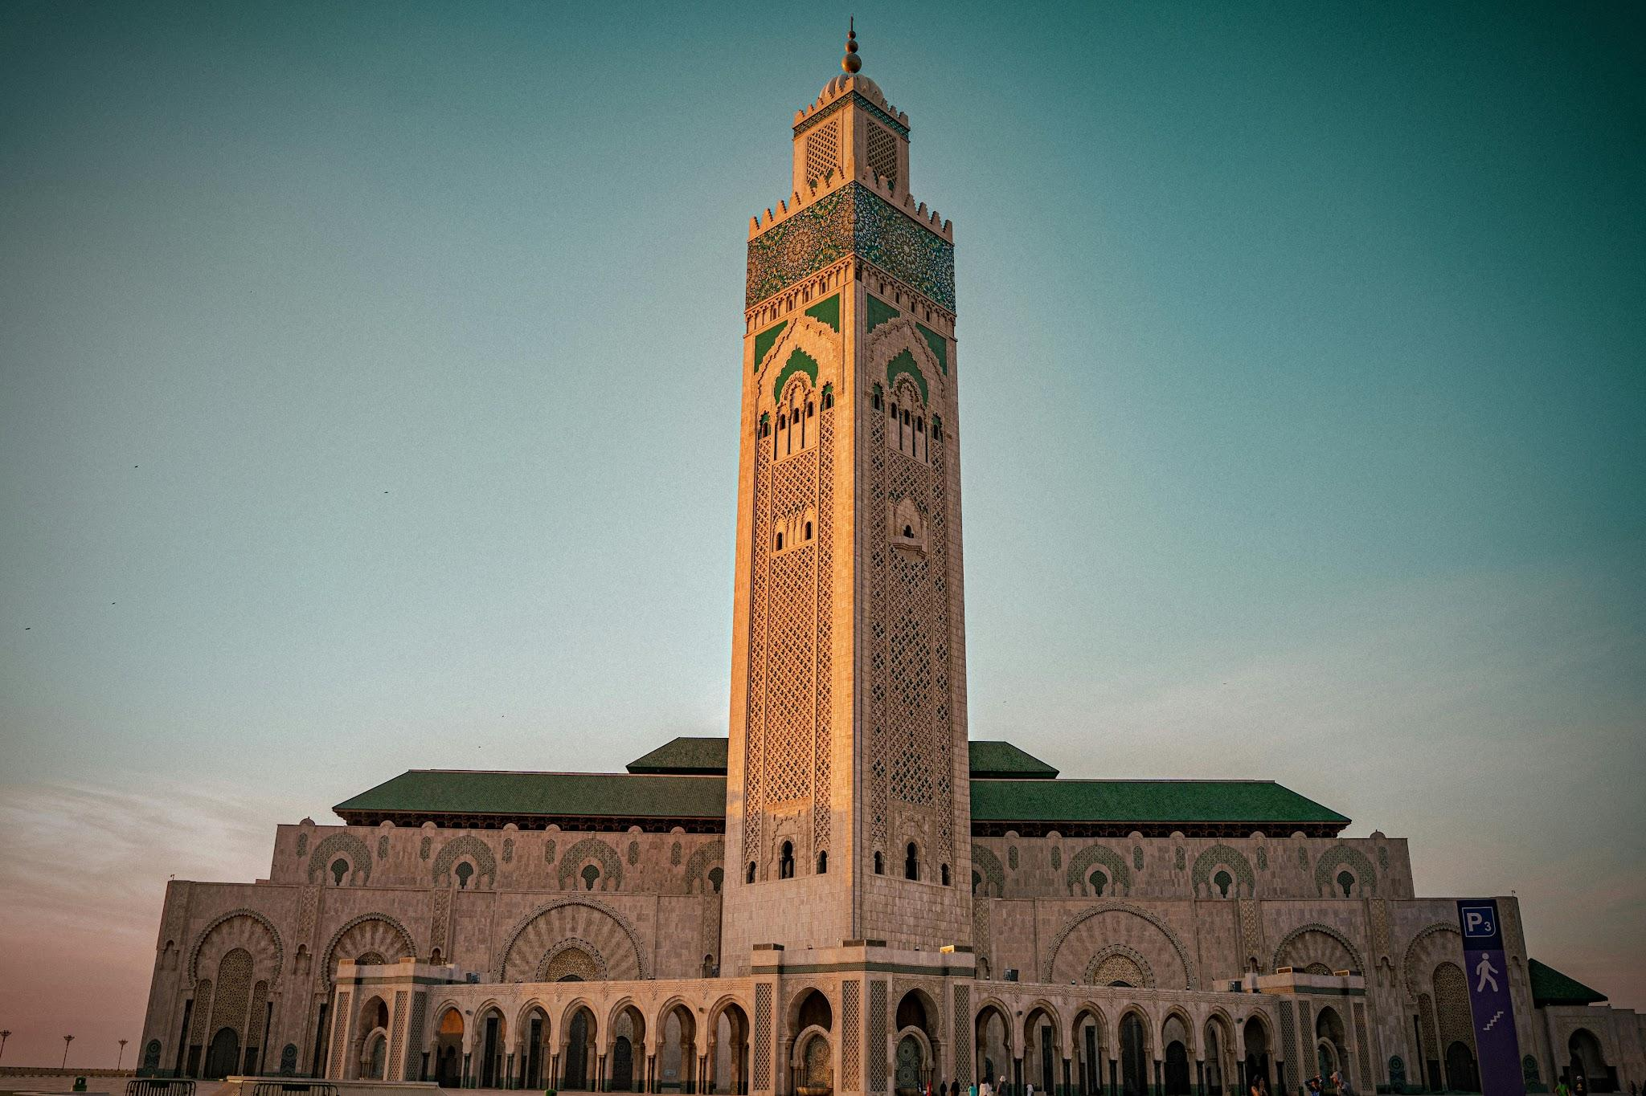
How are mosques similar and different?
You may have noticed:
It is made from stone and has a tall minaret but no obvious dome.
It has bright green, yellow and blue tiles forming beautiful geometric shapes on the walls.
This mosque is in Morocco in North Africa.
What do you notice about this mosque?

Slide 52
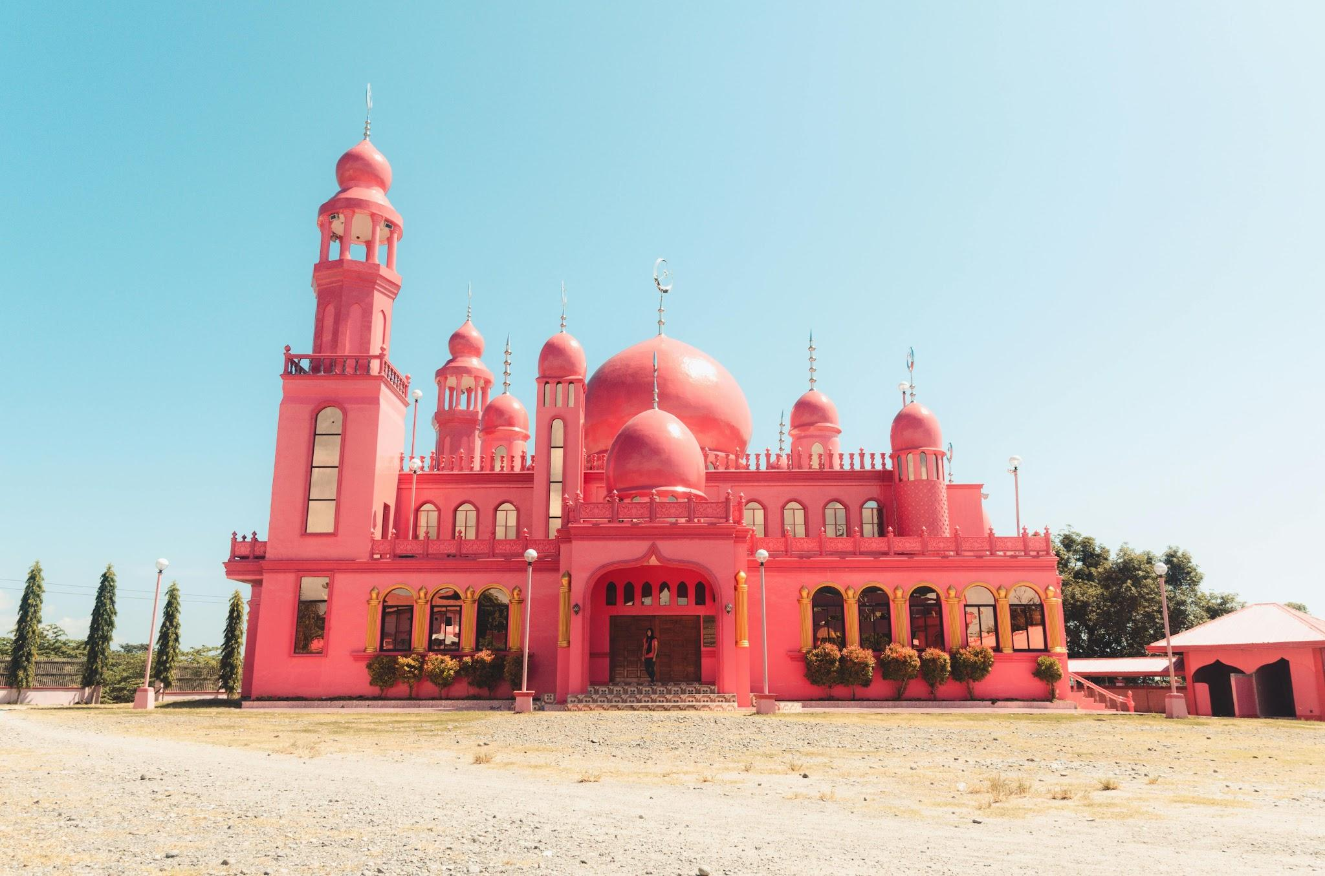
How are mosques similar and different?
You may notice:
The mosque has a minaret.
It has many domes.
The mosque is painted bright pink.
Pink represents peace and love in the community.
A mosque in Philippines

Slide 53
How are mosques similar and different?
Ahmed talked about mosques around the world:
I learnt that mosques can have different patterns, colours and designs inspired by each culture.
I also learnt that each mosque reflects its community’s traditions, while all mosques are places for prayer and worship.
Ahmed

Slide 54

Summer Fayre

