Slide 1
Monday 2nd June 2025
2/6/25

Slide 2
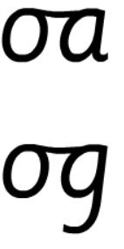
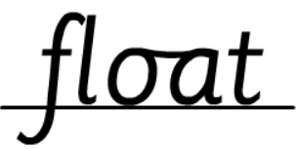
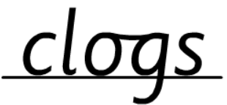
Morning Challenges:
Name writing

Slide 3
Write sentences about what is happening in this picture.

Slide 4
Revisit and review
Phonics
Lesson focus:
Read words with the /ai/ eigh, aigh, ey and ea grapheme

Slide 5
Today's Graphemes
eigh
aigh
ey
ea

Slide 6
Recap
ai ay
a-e a

Slide 7
Revisit and review
shaking stain
acorn playful
spray train
tray
take
amaze
What are the digraphs?
Segment these
words and read them
Blend and say words

Slide 8
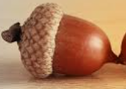
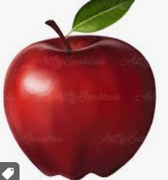
Sort the words
a a
making chasing chapter slamming paper drank

Slide 9
Focus words
eigh-t
s-t-r-aigh-t
g-r-ea-t
Sounds out these
words and read them

Slide 10
Focus words
eight
straight
break
they
grey
prey
Read, sound talk and blend
And again... FASTER!

Slide 11
their
our
two
tricky words
busy
Read the tricky words?

Slide 12
Now let's read this sentence!​
What digraphs can you see?
What tricky words can you see?

Slide 13
Let’s write a sentence.
Think it, say it, write it.
tricky words
eight great busy
Think of all the sounds in each word.
Challenge
Extend the sentence using 'and’, ‘or’ or ‘but’

Slide 14
Little Wandle Guided Reading

Slide 15
Assembly

Slide 16
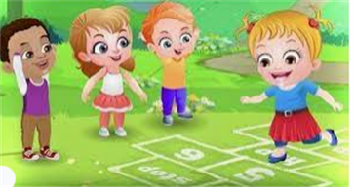
Break

Slide 17
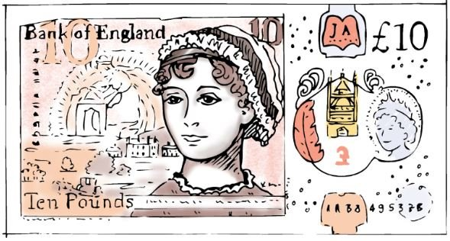
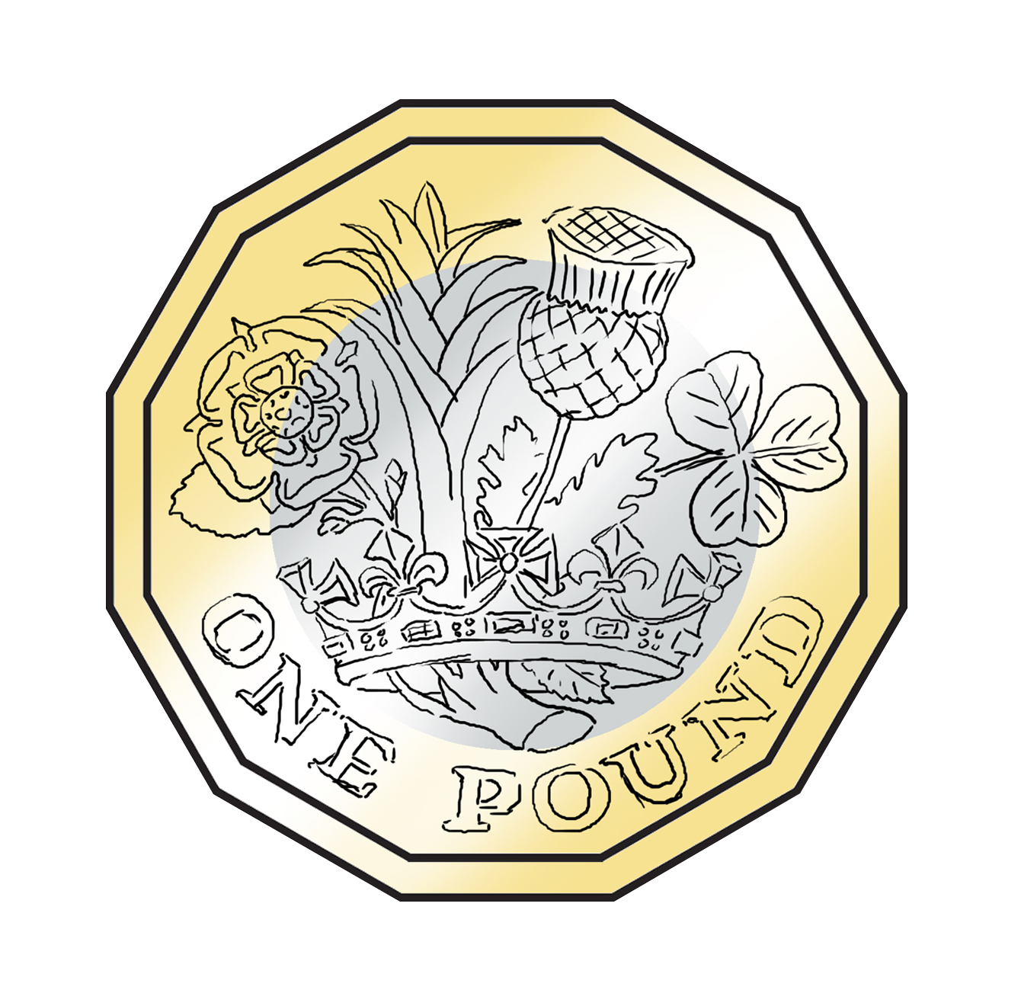
TBAT: identify the physical properties of coins
Which of these can you use to buy things with?
Do you know what they are called?
3 in 3

Slide 18
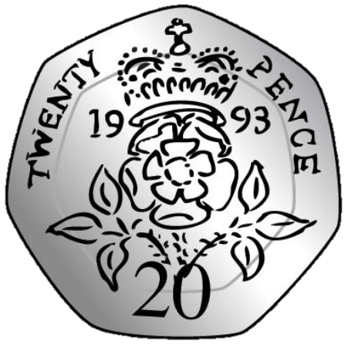
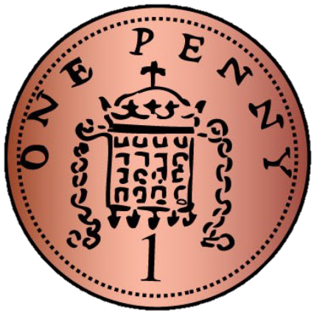
TBAT: identify the physical properties of coins
coin gold
round silver
heptagonal copper

Slide 19
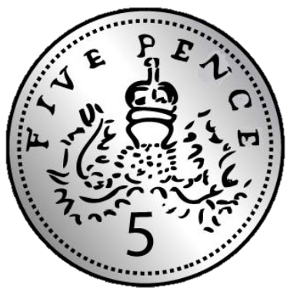
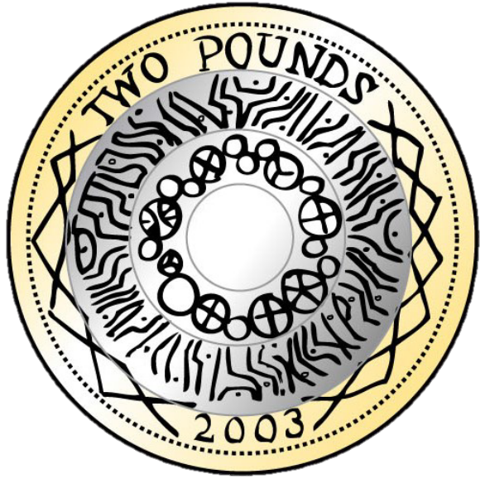
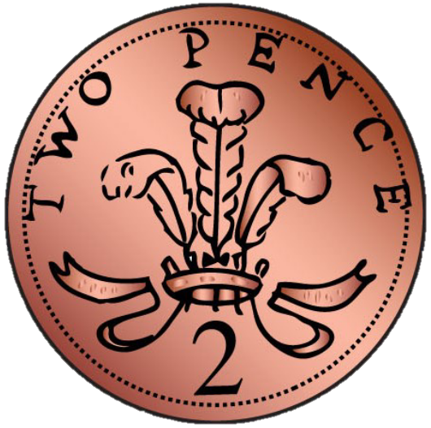
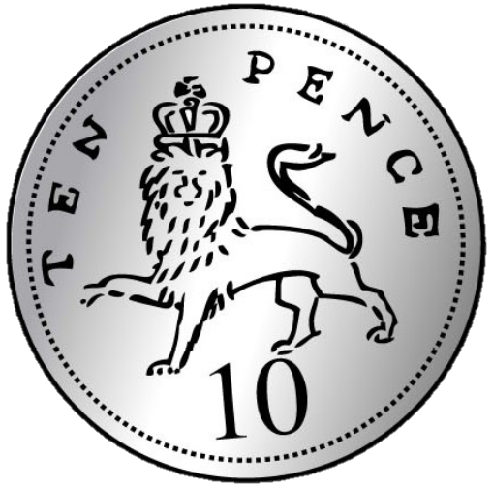
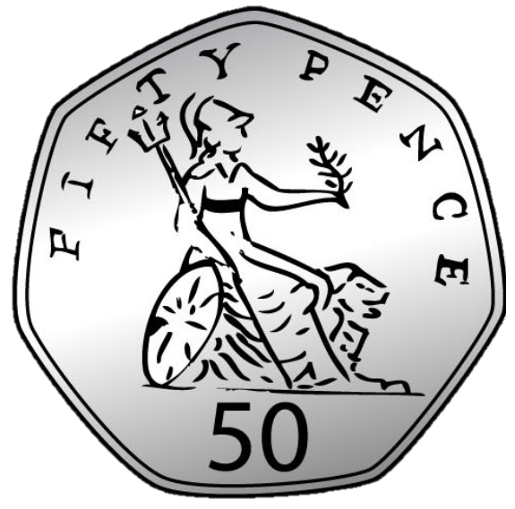
Introducing coins
one penny
five pence
twenty pence
one pound
two pence
ten pence
fifty pence
two pounds
Notes:
New Learning: Introducing coins
Note: this lesson focuses on the physical appearance of the coins and their names; their values are introduced in subsequent lessons.
Show pupils each of the eight coins used in the UK. Pass around real or plastic versions of the coins, asking pupils to pay attention to their appearance.
What’s the same and what’s different between the coins?
Give pupils chance to discuss, then take feedback. Introduce the relevant colour vocabulary (copper, silver and gold). Link this to gold, silver and bronze medals and explain that the gold (and silver) coins have the greatest value, followed by the silver, then the copper (or bronze). Draw attention to the fact they all have the King or Queen’s head on one side and that they all have different images on the other side.
Then show pupils some different groupings of coins, e.g. a set of all the silver coins and a set of the copper coins; a set of the round coins and a set of the heptagonal coins.
How have the coins been grouped? Can you group them in a different way?
Take feedback, then teach the vocabulary ‘heptagonal’ (seven-sided) and say that 20 pence and 50 pence coins have heptagonal faces. Draw attention to the circular faced coins, and engage pupils in discussion around the pound coin (12-sided).

Slide 20
Is the statement true or false? How do you know?
B/G
All coins are round.
All coins
are the same size.
This statement is true/false because.....
Notes:
New Learning: Introducing coins
Note: this lesson focuses on the physical appearance of the coins and their names; their values are introduced in subsequent lessons.
Show pupils each of the eight coins used in the UK. Pass around real or plastic versions of the coins, asking pupils to pay attention to their appearance.
What’s the same and what’s different between the coins?
Give pupils chance to discuss, then take feedback. Introduce the relevant colour vocabulary (copper, silver and gold). Link this to gold, silver and bronze medals and explain that the gold (and silver) coins have the greatest value, followed by the silver, then the copper (or bronze). Draw attention to the fact they all have the King or Queen’s head on one side and that they all have different images on the other side.
Then show pupils some different groupings of coins, e.g. a set of all the silver coins and a set of the copper coins; a set of the round coins and a set of the heptagonal coins.
How have the coins been grouped? Can you group them in a different way?
Take feedback, then teach the vocabulary ‘heptagonal’ (seven-sided) and say that 20 pence and 50 pence coins have heptagonal faces. Draw attention to the circular faced coins, and engage pupils in discussion around the pound coin (12-sided).

Slide 21
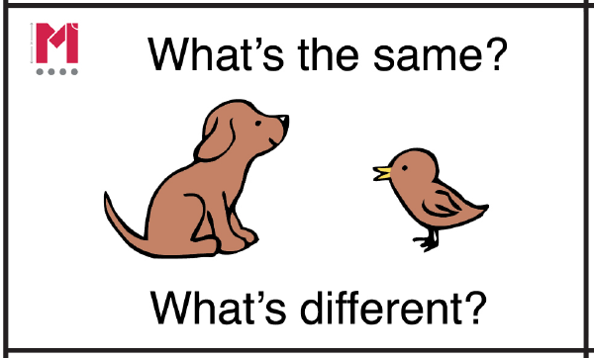
What’s the same? What’s different?
Notes:
New Learning: Introducing coins
Note: this lesson focuses on the physical appearance of the coins and their names; their values are introduced in subsequent lessons.
Show pupils each of the eight coins used in the UK. Pass around real or plastic versions of the coins, asking pupils to pay attention to their appearance.
What’s the same and what’s different between the coins?
Give pupils chance to discuss, then take feedback. Introduce the relevant colour vocabulary (copper, silver and gold). Link this to gold, silver and bronze medals and explain that the gold (and silver) coins have the greatest value, followed by the silver, then the copper (or bronze). Draw attention to the fact they all have the King or Queen’s head on one side and that they all have different images on the other side.
Then show pupils some different groupings of coins, e.g. a set of all the silver coins and a set of the copper coins; a set of the round coins and a set of the heptagonal coins.
How have the coins been grouped? Can you group them in a different way?
Take feedback, then teach the vocabulary ‘heptagonal’ (seven-sided) and say that 20 pence and 50 pence coins have heptagonal faces. Draw attention to the circular faced coins, and engage pupils in discussion around the pound coin (12-sided).

Slide 22
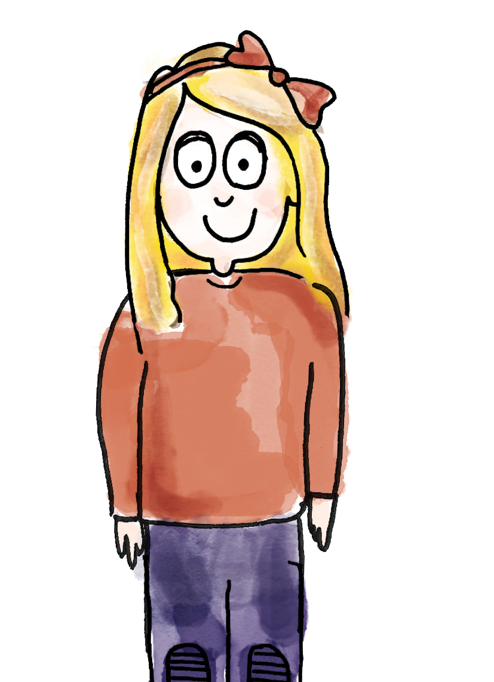
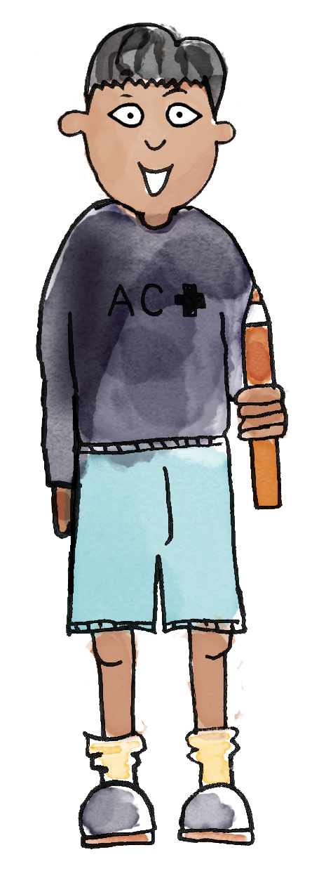
Sorting coins
I am putting this coin in this cup because it is heptagonal.
I am putting this coin in this cup because it is round.
heptagons
round
coin gold round silver heptagonal copper
Notes:
Talk Task: Sorting coins according to their physical properties
Each pair has a set of the eight unique coins and two cups. Explain that one cup is for heptagonal coins and the other is for round coins. Pupils take it in turns to pick up a coin and place it in the correct cup, explaining their reason to each other to practise key vocabulary. Once most pupils have completed the task, check with the class for consensus on which coins belong in which cup. Then relabel the cups as ‘copper’ and ‘silver or gold’ and repeat.

Slide 23
Sorting coins
The coin is silver and gold so it belongs here.
This coin belongs in the copper cup.
silver or gold
copper
coin gold round silver heptagonal copper
Notes:
Talk Task: Sorting coins according to their physical properties
Each pair has a set of the eight unique coins and two cups. Explain that one cup is for heptagonal coins and the other is for round coins. Pupils take it in turns to pick up a coin and place it in the correct cup, explaining their reason to each other to practise key vocabulary. Once most pupils have completed the task, check with the class for consensus on which coins belong in which cup. Then relabel the cups as ‘copper’ and ‘silver or gold’ and repeat.

Slide 24
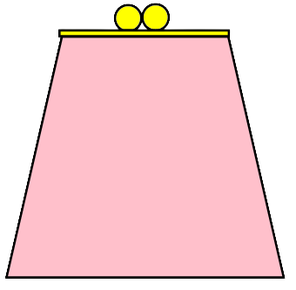
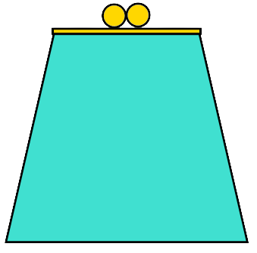
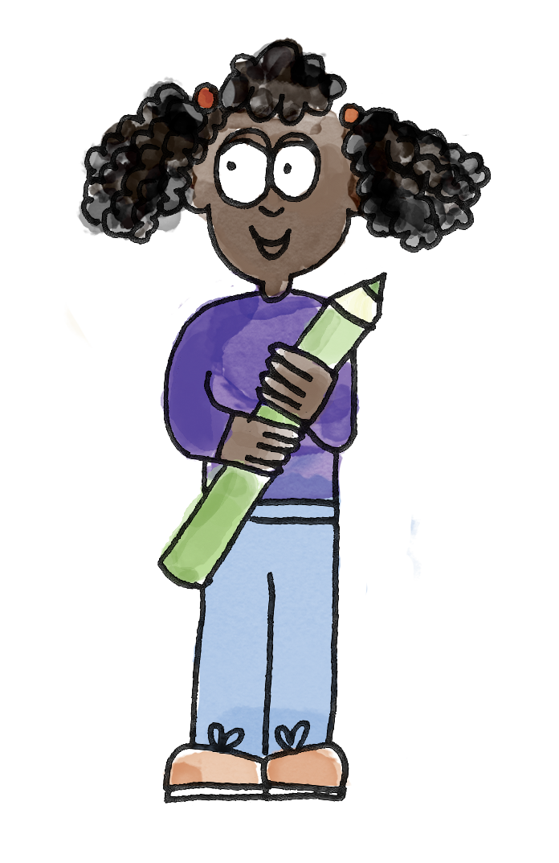
Halima sorted her coins into two purses
How has she sorted them?
Why are some coins not in a purse?
Notes:
Develop Learning: Apply knowledge of properties of coins
Recap the names of coins if necessary. There are two Develop Learning slides, each showing how someone has organised the coins into purses according to some criteria.
Halima has organised her coins into two purses. How has she organised them? Why do you think some coins are not in a purse?
Use this opportunity to discuss what happens when an item does not belong in any set (that it is left out).
One purse contains copper coins and the other has silver coins. The other coins are not copper or silver, so she has left them out.
If there is time, play ‘guess the coin’. Share specific properties and ask pupils which coin you could be thinking of.
I’m thinking of a coin. It is silver. What could it be?

Slide 25
Charlie sorted his coins in a different way
How has he sorted them?
How do you know?
Notes:
Develop Learning: Apply knowledge of properties of coins
Recap the names of coins if necessary. There are two Develop Learning slides, each showing how someone has organised the coins into purses according to some criteria.
Halima has organised her coins into two purses. How has she organised them? Why do you think some coins are not in a purse?
Use this opportunity to discuss what happens when an item does not belong in any set (that it is left out).
One purse contains copper coins and the other has silver coins. The other coins are not copper or silver, so she has left them out.
If there is time, play ‘guess the coin’. Share specific properties and ask pupils which coin you could be thinking of.
I’m thinking of a coin. It is silver. What could it be?

Slide 26
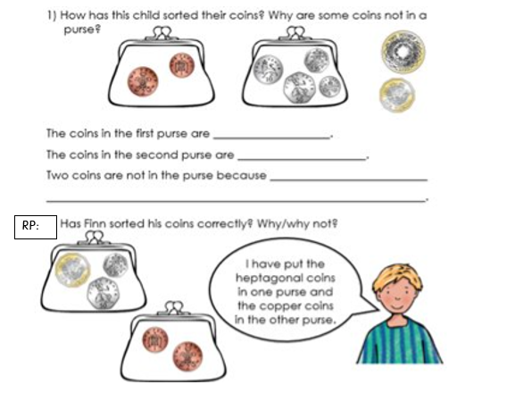
To identify the physical properties of coins
Notes:
Independent Task: Applying knowledge of the properties of coins
Pupils have a copy of the Task Sheet. They identify how the coins have been sorted, correct the errors in how coins have been sorted and suggest possibilities for the coins each child could be thinking of. Pupils could then experiment with different ways of sorting the coins. Can their partner work out how they have sorted the coins?
Possible adaptations:
Give pupils coins sorted in a variety of ways with mistakes for them to identify. With some explanation, this could include Carroll diagrams.
The Task Sheet could be adapted to make it multiple choice.

Slide 27
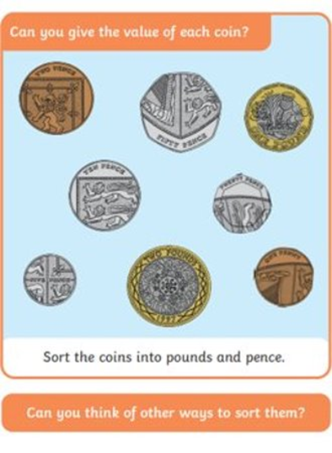
TBAT: identify the physical properties of coins.
Challenge:
Mastery:
Notes:
Independent Task: Applying knowledge of the properties of coins
Pupils have a copy of the Task Sheet. They identify how the coins have been sorted, correct the errors in how coins have been sorted and suggest possibilities for the coins each child could be thinking of. Pupils could then experiment with different ways of sorting the coins. Can their partner work out how they have sorted the coins?
Possible adaptations:
Give pupils coins sorted in a variety of ways with mistakes for them to identify. With some explanation, this could include Carroll diagrams.
The Task Sheet could be adapted to make it multiple choice.

Slide 28
TBAT: identify the physical properties of coins.
Mastery with greater depth:
Notes:
Independent Task: Applying knowledge of the properties of coins
Pupils have a copy of the Task Sheet. They identify how the coins have been sorted, correct the errors in how coins have been sorted and suggest possibilities for the coins each child could be thinking of. Pupils could then experiment with different ways of sorting the coins. Can their partner work out how they have sorted the coins?
Possible adaptations:
Give pupils coins sorted in a variety of ways with mistakes for them to identify. With some explanation, this could include Carroll diagrams.
The Task Sheet could be adapted to make it multiple choice.

Slide 29
The one pound coin is dodecagonal
A dodecagon is a 12-sided shape.
Can you count the 12 edges?
Notes:
Plenary: The dodecagonal one pound coin
Show pupils the image of the one pound coin. Have pupils practise saying ‘dodecagonal’ and explaining to a partner what it means.
Can you count the 12 edges on the front face of your one pound coin?

Slide 30
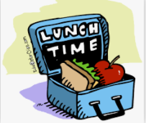
Lunch

Slide 31
Today's Alien language is.......

Slide 32
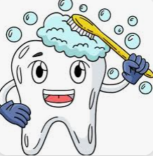
Toothbrushing

Slide 33
Key Question: What is it like to live in our local area and why is it special?
Monday 2nd June 2025
Entry Question
What is our local area called?

Slide 34
Key Question: What is it like to live in our local area and why is it special?
Monday 2nd June 2025

Slide 35
Key Question: What is it like to live in our local area and why is it special?
Monday 2nd June 2025

Slide 36
Key Question: What is it like to live in our local area and why is it special?
Monday 2nd June 2025

Slide 37
Key Question: What is it like to live in our local area and why is it special?
Monday 2nd June 2025

Slide 38
Key Question: What is it like to live in our local area and why is it special?
Monday 2nd June 2025

Slide 39
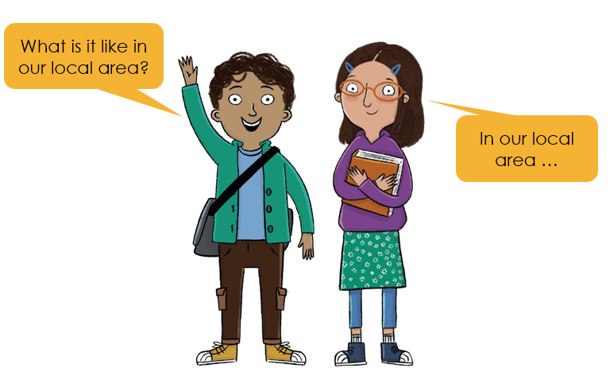
Key Question: What is it like to live in our local area and why is it special?
Monday 2nd June 2025

Slide 40
Key Question: What is it like to live in our local area and why is it special?
Monday 2nd June 2025

Slide 41
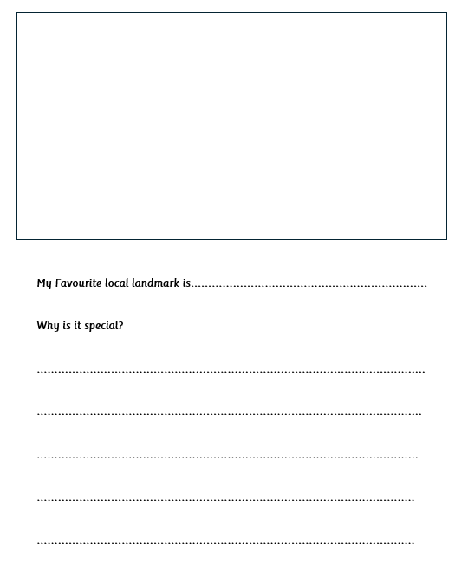
Key Question: What is it like to live in our local area and why is it special?
Monday 2nd June 2025
Independent:
Challenge:
Convince someone to come on holiday to Gorleston.

Slide 42
Key Question: What is it like to live in our local area and why is it special?
Monday 2nd June 2025
Exit question

Slide 43
KQ: What are materials?
3 in 3

Slide 44
Blue / Green
What could you use these materials to make?
Can you find anything around the room that is made of these materials?

Slide 45
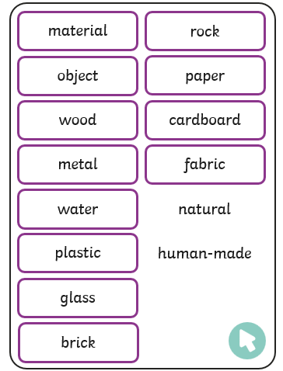
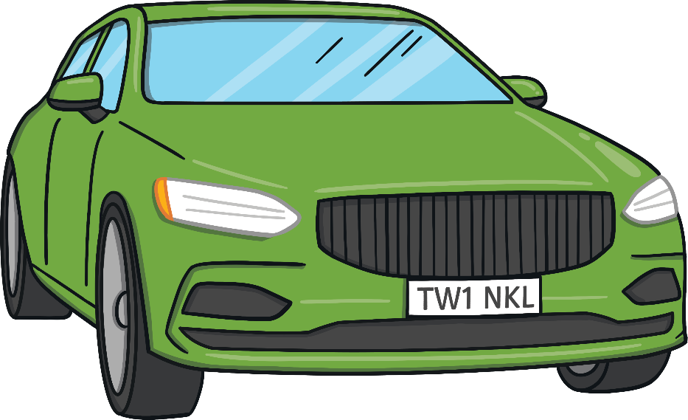
Key vocablulary
An object is a thing that can be used, touched or seen. For example, a door, a chair, a car and a marble are all objects.

Slide 46
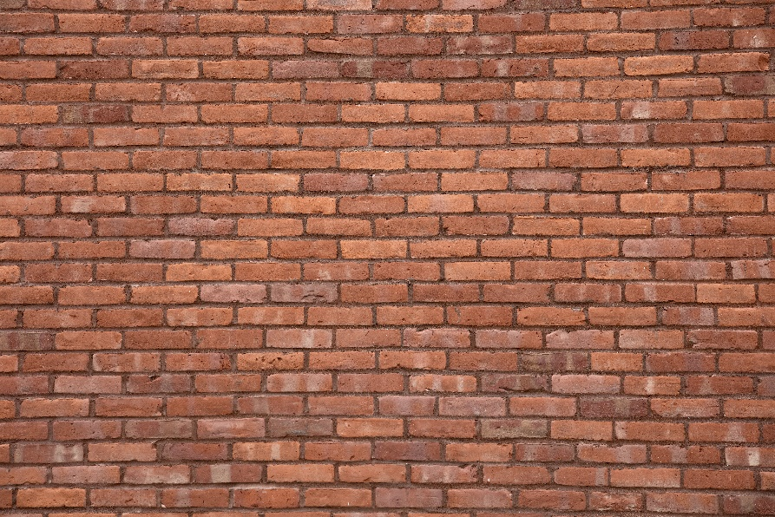
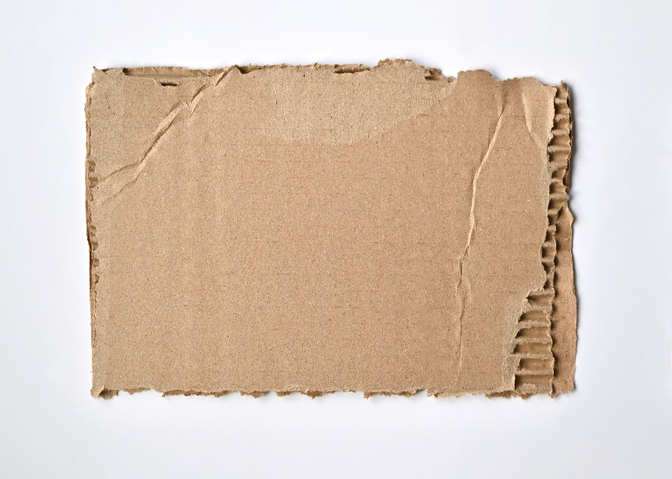
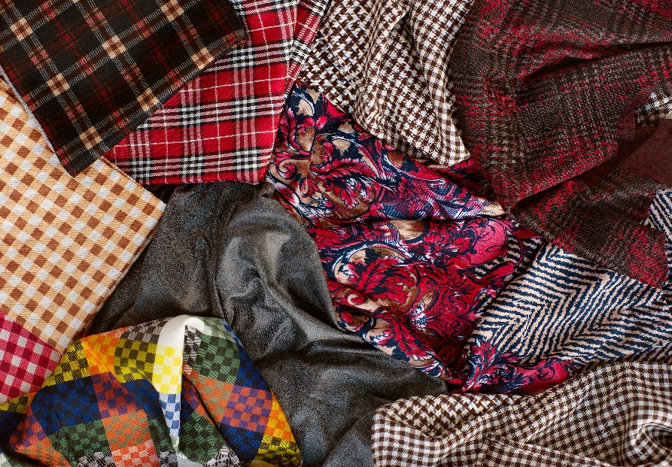
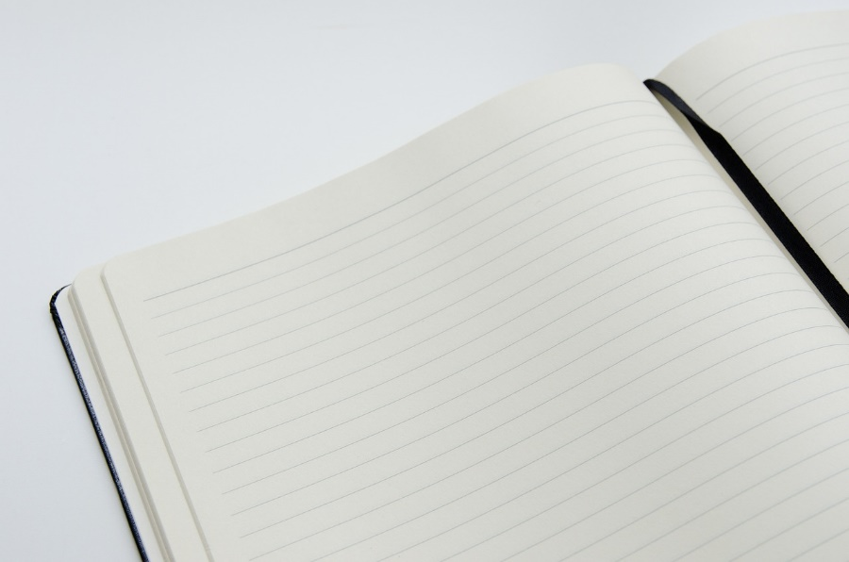
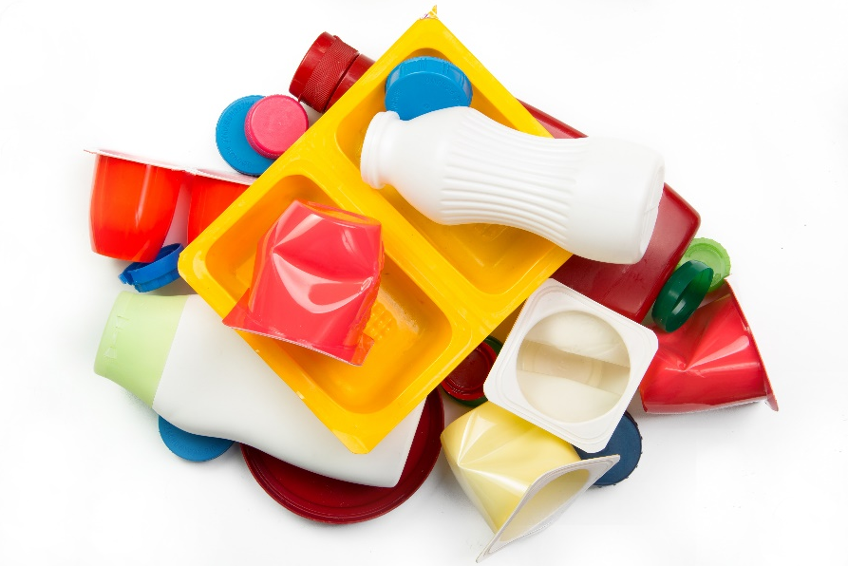
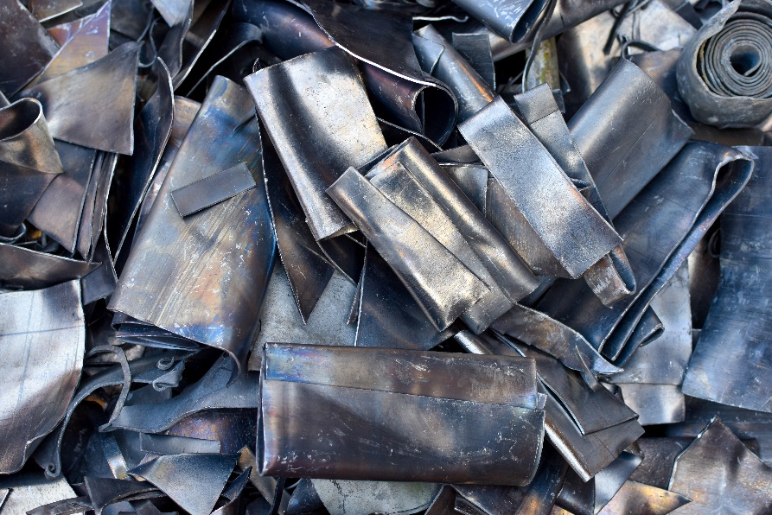
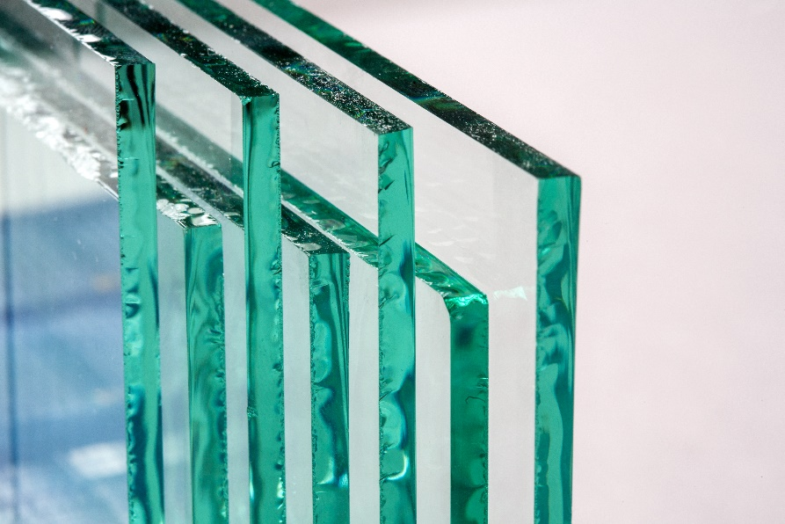
What do you think each of these materials are?

Slide 47
What do you think each of these materials are?

Slide 50
We’re going on a hunt for materials around our classroom and outside. Think about what each object is made from.

Slide 51
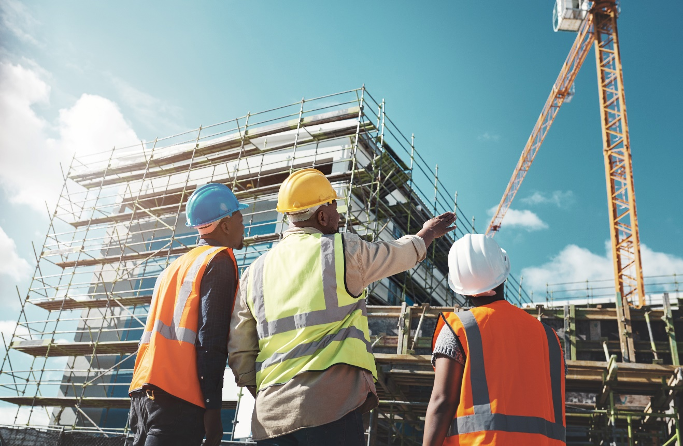
STEM/Green Careers
Structural Engineer
If you are fascinated by materials and how they are used to make different things, then you may want to learn more about a career as a structural engineer.
Structural engineers plan how to build structures such as buildings and bridges. An important part of their job is to think about which material would be best to use.
As a structural engineer, you will need to be good at things like designing, using technology and problem-solving.

Slide 52
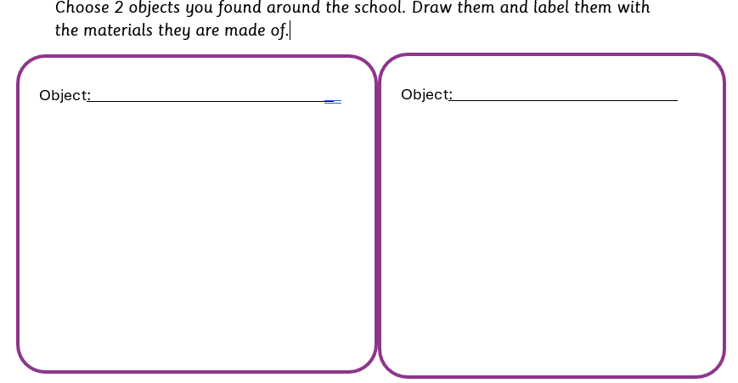
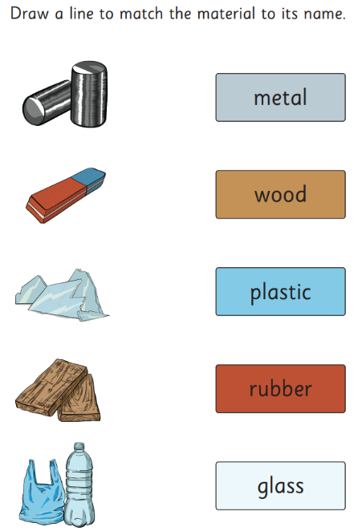
Independent:

Slide 53
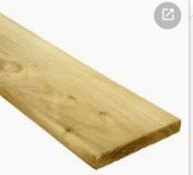
Exit Question:
Name two things that are made of wood.

