Slide 1
Monday 23rd June 2025
23/6/25

Slide 2





Morning Challenges:
Name writing

Slide 3
Revisit and review
Phonics
Lesson focus:
Read words with the /or/
augh our oar ore
Flash Cards (Time Trial) (Phase 3) - Online Phonics Game

Slide 4
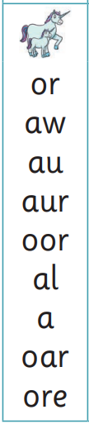

Today's Grapheme
augh our oar ore

Slide 5
Recap
or au a al aw aur oor augh our oar ore

Slide 6
Best Bets
draw popcorn sport
sort unicorn author
astronaut dinosaur poor
floor door walk water all

Slide 7

improve
parents
tricky words
move
shoe
Read the tricky words.

Slide 8
Grow the code
daughter
naughty
caught
taught
four
pour
Read, sound talk and blend
And again... FASTER!

Slide 9
Grow the code
board
roar
score
more
snore
before
Read, sound talk and blend
And again... FASTER!

Slide 10

Now let's read this sentence!​
What digraphs can you see?
What tricky words can you see?

Slide 11
Let’s write a sentence.
Think it, say it, write it.
tricky words
naughty before shoe
Think of all the sounds in each word.
Challenge
Extend the sentence using 'and’, ‘or’ or ‘but’

Slide 12

Little Wandle Guided Reading

Slide 13
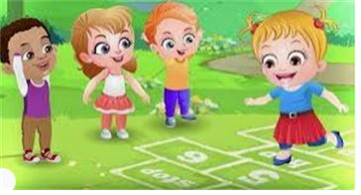
Break

Slide 14
Number patterns
What do you notice about each number?
What is next in the sequence?
3 in 3
15, 20, 25, 30, ____
6, 8, 10, 12, ____
50, …..., 60, 70, ____
Notes:
Do Now: Number patterns
Pupils each have a bead string. They represent the numbers in the sequence in turn and then continue the sequence forwards and backwards to find the missing numbers.
What is happening in the sequence? Is it increasing or decreasing? By how much?

Slide 15
TBAT: divide into equal groups and find the number of groups
equally
equal groups
groups
equal
share
fair

Slide 16

Bananas need to be sold in groups of three.
How many groups can we make?
Notes:
New Learning: Introducing division as grouping with concrete representations
Following the star words ask pupils to think about how, in the lessons so far in this unit, they have been working with equal groups.
This is what we do when we multiply and divide; we work with equal groups.
Remind pupils that, in the last two lessons, they have been sharing equally. You may want to quicky demonstrate.
When I share, I know the whole and the number of equal groups. I do not know how many in each group.
Now, explain that there is another way to divide equally. We can split a total into equal groups of a given size and then count how many groups. Show them six items from the market that you want to group (bananas are used in the slide example but it’s important at this stage that concrete items are used rather than the slide alone).
I want to sell these bananas in groups of three. How many groups of three can we make?
Model creating one group of three then another until there are no more bananas.
I had 6 bananas. I divided into groups of three. How many groups do I have?
When I group I know the whole and how many are in a group. I don’t know the number of groups.
Repeat with other examples using items from the market represented with counters.
There are 15 cookies. I can represent these with counters. I need to make equal groups of five. How many groups can I make?
Model the Talk Task.

Slide 17



Cookies are sold in packs of five.
DYNAMIC REPRESENTATION
Build up your own representation, ‘live’ in the lesson
How many packs can we make with 15 cookies?
Notes:
New Learning: Introducing division as grouping with concrete representations
Following the star words ask pupils to think about how, in the lessons so far in this unit, they have been working with equal groups.
This is what we do when we multiply and divide; we work with equal groups.
Remind pupils that, in the last two lessons, they have been sharing equally. You may want to quicky demonstrate.
When I share, I know the whole and the number of equal groups. I do not know how many in each group.
Now, explain that there is another way to divide equally. We can split a total into equal groups of a given size and then count how many groups. Show them six items from the market that you want to group (bananas are used in the slide example but it’s important at this stage that concrete items are used rather than the slide alone).
I want to sell these bananas in groups of three. How many groups of three can we make?
Model creating one group of three then another until there are no more bananas.
I had 6 bananas. I divided into groups of three. How many groups do I have?
When I group I know the whole and how many are in a group. I don’t know the number of groups.
Repeat with other examples using items from the market represented with counters.
There are 15 cookies. I can represent these with counters. I need to make equal groups of five. How many groups can I make?
Model the Talk Task.

Slide 18


One, two, three, four.
One, two, three, four.
One, two, three, four.
All the counters have been divided equally into groups of four.
I’ve chosen ‘groups of four’.
B/G
There are three groups.
12 shared equally into groups of four makes three groups.
equal groups share equally fair
Notes:
Talk Task: Organising objects into equal groups of a set amount
Each pair of pupils has 12 counters/cubes, six paper cake cases, and a cut-out copy of the Task Sheet. They place the cards face down on the table. Pupil A turns over a card and reads it out (e.g. ‘groups of four’). Pupil B lays down a cake case and puts the corresponding number of counters (e.g. four) into it. They continue until all counters have been grouped. They say the total number of counters, the size of the groups and how many groups they have made. Pupils swap roles and repeat.

Slide 19
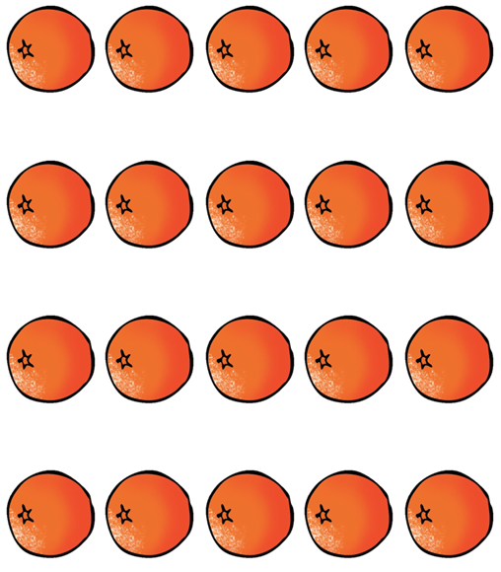
Oranges need to be sold in packs of five.
How many packs of oranges can we make?
Notes:
Develop Learning: Grouping objects pictorially
Use this part of the lesson to embed the idea of creating equal-sized groups from a pictorial representation. Demonstrate how pupils can do this by putting rings around each group and then counting how many ringed groups they have made. For each example, get pupils to form sentences describing the groups. For example:
There are 20 oranges. We have made four groups. 20 shared equally into groups of five makes four groups.

Slide 20

I want to group the socks into pairs of two.
How many pairs of socks can we make?
Notes:
Develop Learning: Grouping objects pictorially
Use this part of the lesson to embed the idea of creating equal-sized groups from a pictorial representation. Demonstrate how pupils can do this by putting rings around each group and then counting how many ringed groups they have made. For each example, get pupils to form sentences describing the groups. For example:
There are 20 oranges. We have made four groups. 20 shared equally into groups of five makes four groups.

Slide 21
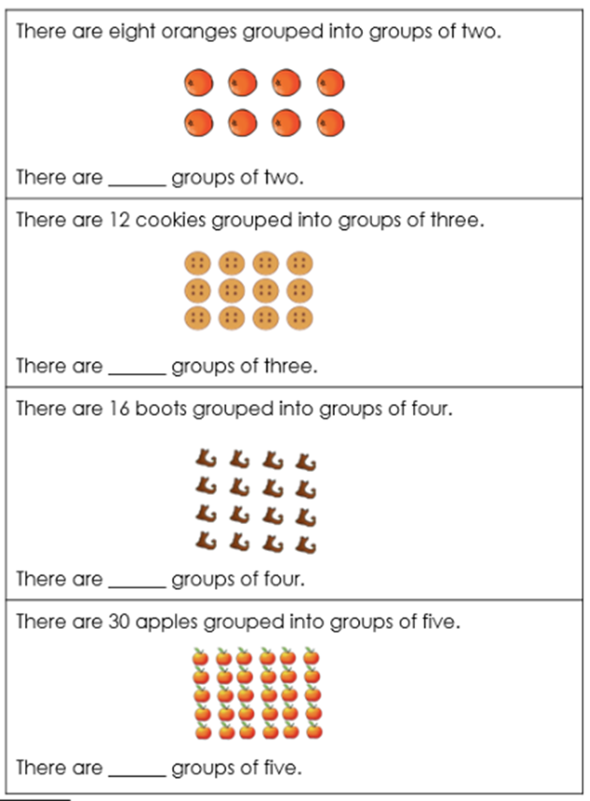
TBAT: divide into equal groups and find the number of groups
Independent:
Notes:
Independent Task: How many groups?
Pupils read the question, identify the size of the group and circle the equal groups before counting the total amount of equal groups. Pupils should be encouraged to articulate their answer as a full sentence out loud. Counters/cubes should be available to support and challenge pupils to prove their answer.
Possible adaptations:
Scaffold this by completing the grouping on the first question as an example.
Challenge pupils by giving pictorial arrangements that are more scattered and asking pupils to prove their reasoning using concrete manipulatives.

Slide 22
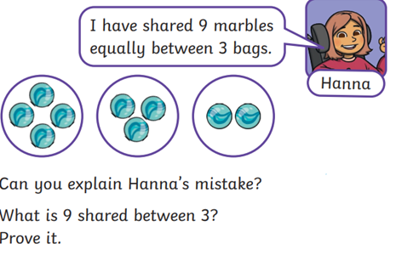
TBAT: divide into equal groups and find the number of groups
RP:
Notes:
Independent Task: How many groups?
Pupils read the question, identify the size of the group and circle the equal groups before counting the total amount of equal groups. Pupils should be encouraged to articulate their answer as a full sentence out loud. Counters/cubes should be available to support and challenge pupils to prove their answer.
Possible adaptations:
Scaffold this by completing the grouping on the first question as an example.
Challenge pupils by giving pictorial arrangements that are more scattered and asking pupils to prove their reasoning using concrete manipulatives.

Slide 23
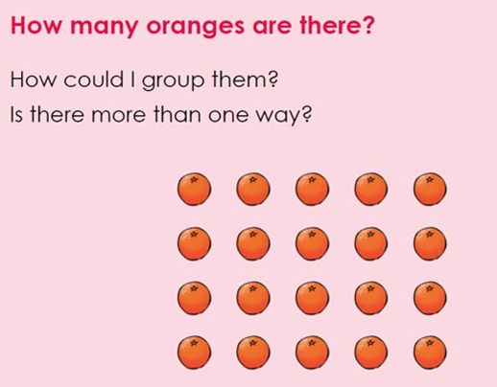
TBAT: divide into equal groups and find the number of groups
Challenge:
Notes:
Independent Task: How many groups?
Pupils read the question, identify the size of the group and circle the equal groups before counting the total amount of equal groups. Pupils should be encouraged to articulate their answer as a full sentence out loud. Counters/cubes should be available to support and challenge pupils to prove their answer.
Possible adaptations:
Scaffold this by completing the grouping on the first question as an example.
Challenge pupils by giving pictorial arrangements that are more scattered and asking pupils to prove their reasoning using concrete manipulatives.

Slide 24
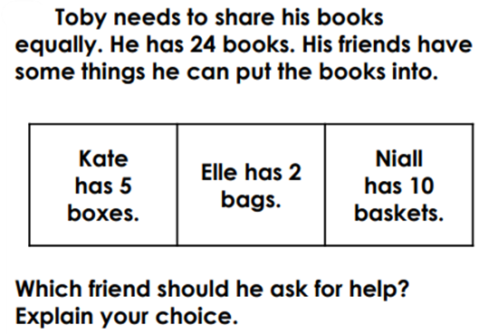
TBAT: divide into equal groups and find the number of groups
Mastery:
Notes:
Independent Task: How many groups?
Pupils read the question, identify the size of the group and circle the equal groups before counting the total amount of equal groups. Pupils should be encouraged to articulate their answer as a full sentence out loud. Counters/cubes should be available to support and challenge pupils to prove their answer.
Possible adaptations:
Scaffold this by completing the grouping on the first question as an example.
Challenge pupils by giving pictorial arrangements that are more scattered and asking pupils to prove their reasoning using concrete manipulatives.

Slide 25
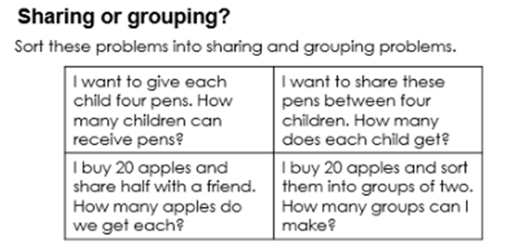
TBAT: divide into equal groups and find the number of groups
Mastery with greater depth:
Notes:
Independent Task: How many groups?
Pupils read the question, identify the size of the group and circle the equal groups before counting the total amount of equal groups. Pupils should be encouraged to articulate their answer as a full sentence out loud. Counters/cubes should be available to support and challenge pupils to prove their answer.
Possible adaptations:
Scaffold this by completing the grouping on the first question as an example.
Challenge pupils by giving pictorial arrangements that are more scattered and asking pupils to prove their reasoning using concrete manipulatives.

Slide 26

What’s the same what’s different?
I want to share these pens between four children.
How many does each child get?
I want to give each child four pens.
How many children can receive pens?
Notes:
Plenary: Sharing and grouping
Give pupils two questions that use the same context where one involves sharing and the other grouping. Ask them to discuss what’s the same and what’s different.
When I share I know the whole and the number of equal groups. I do not know how many in each group.
When I group I know the whole and how many are in a group. I don’t know the number of groups.

Slide 27

Lunch

Slide 28

Toothbrushing

Slide 29
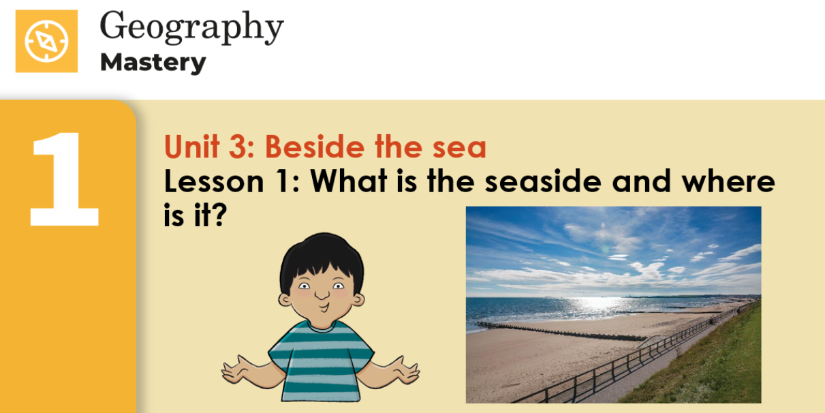
Key Question: What is the seaside and where is it?
Monday 23rd June 2025

Slide 30
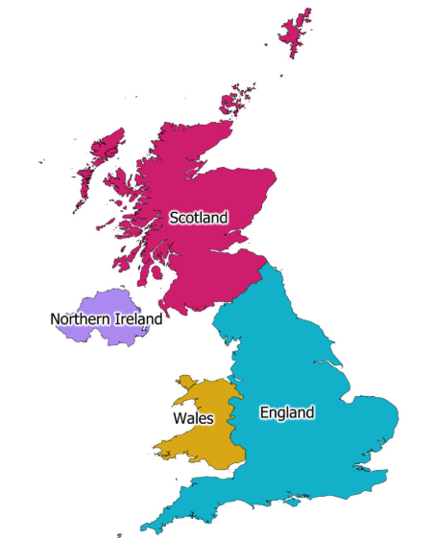
Key Question: What is the seaside and where is it?
Monday 23rd June 2025
3 in 3- Label these UK countries.
Challenge: What are the capital cities of these countries called?

Slide 31
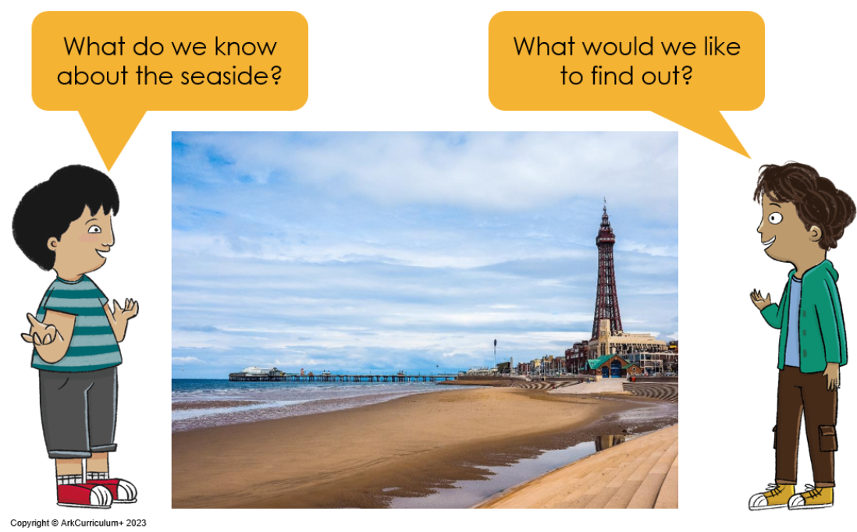
Key Question: What is the seaside and where is it?
Monday 23rd June 2025
Entry Question

Slide 32
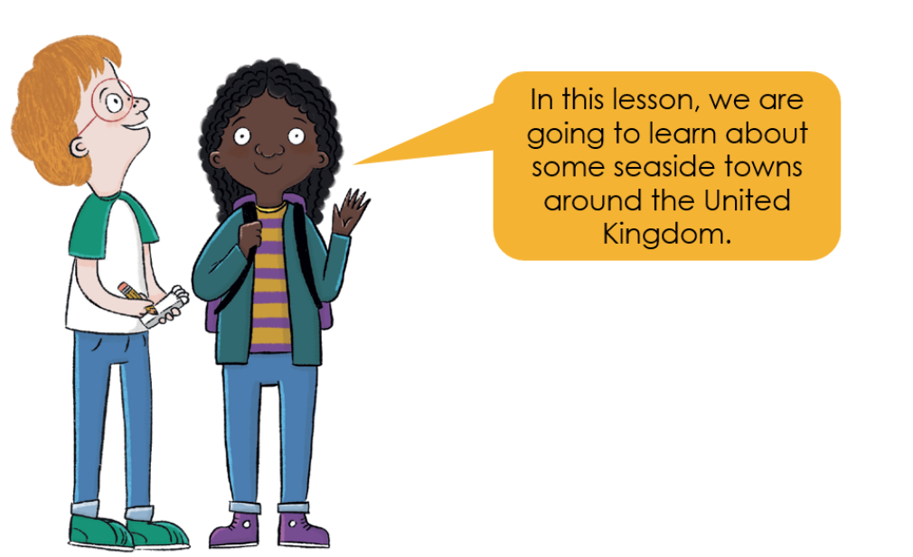
Key Question: What is the seaside and where is it?
Monday 23rd June 2025

Slide 33
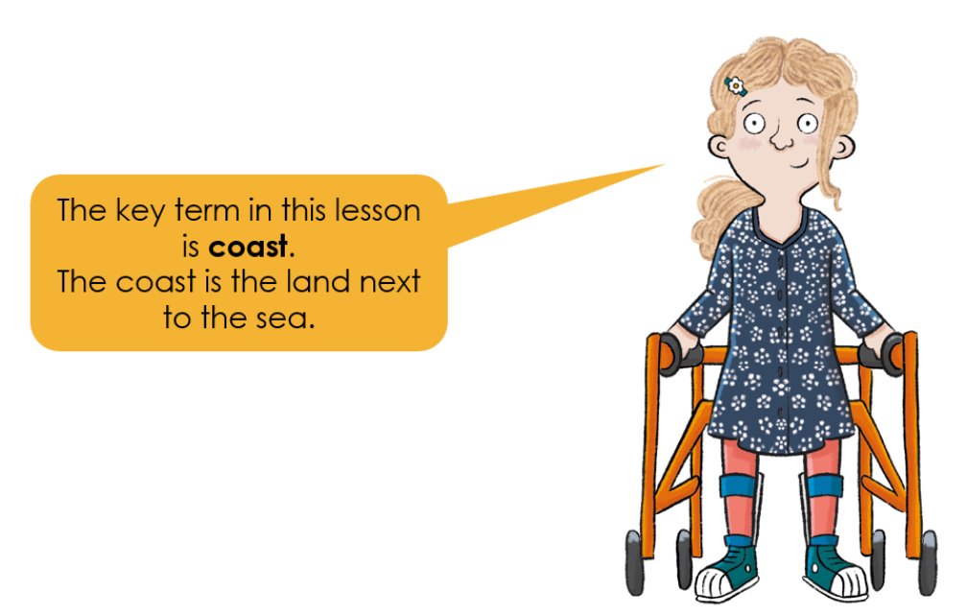
Key Question: What is the seaside and where is it?
Monday 23rd June 2025

Slide 34
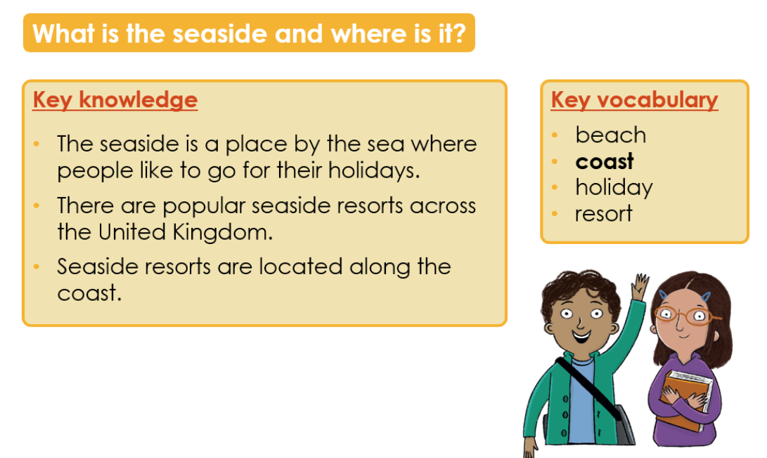
Key Question: What is the seaside and where is it?
Monday 23rd June 2025

Slide 35
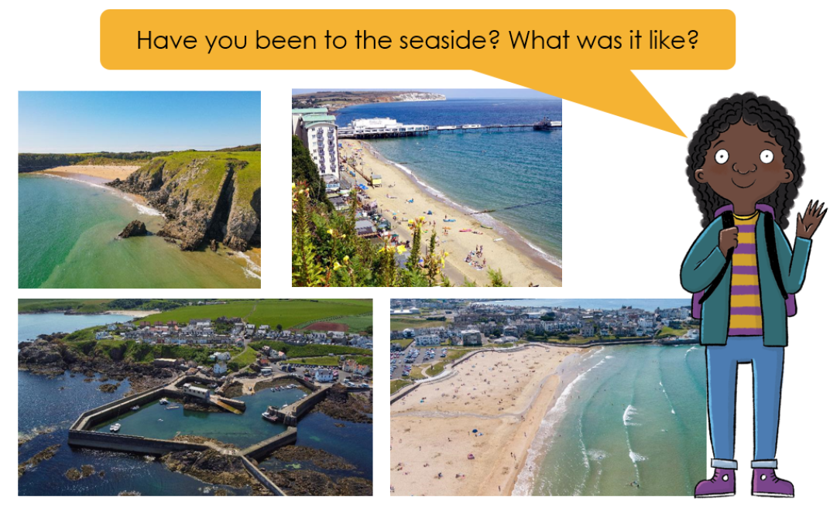

Key Question: What is the seaside and where is it?
Monday 23rd June 2025
Blue/ Green
sand
sea
beach
cliffs
I have been to the seaside. I saw............

Slide 36
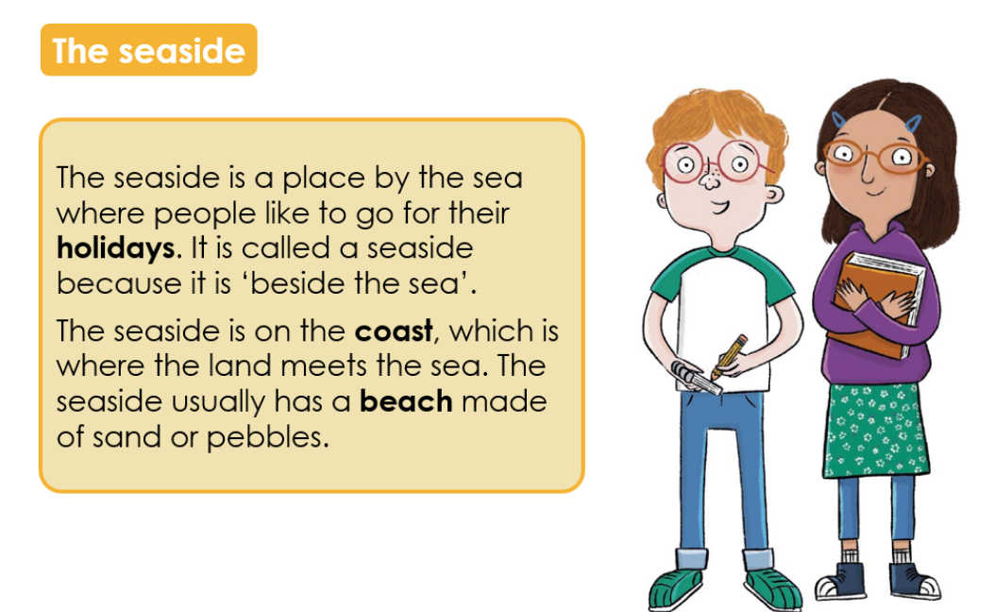
Key Question: What is the seaside and where is it?
Monday 23rd June 2025

Slide 37
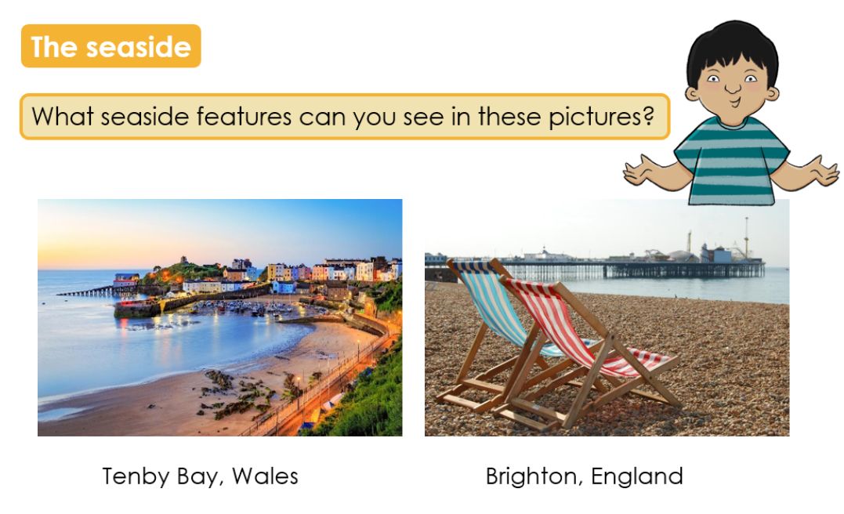
Key Question: What is the seaside and where is it?
Monday 23rd June 2025

Slide 38
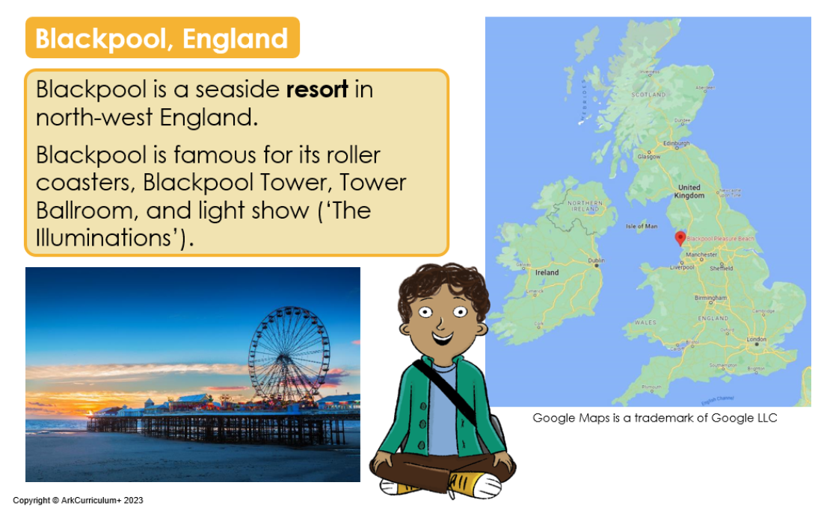
Key Question: What is the seaside and where is it?
Monday 23rd June 2025

Slide 39
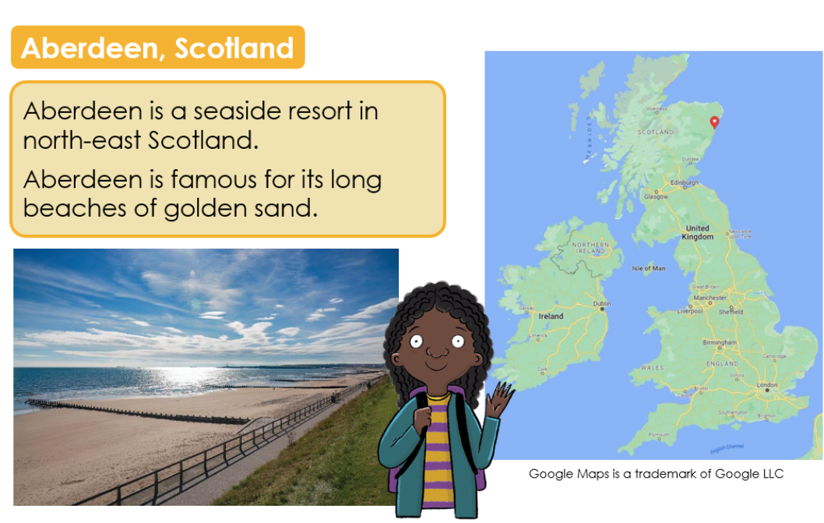
Key Question: What is the seaside and where is it?
Monday 23rd June 2025

Slide 40
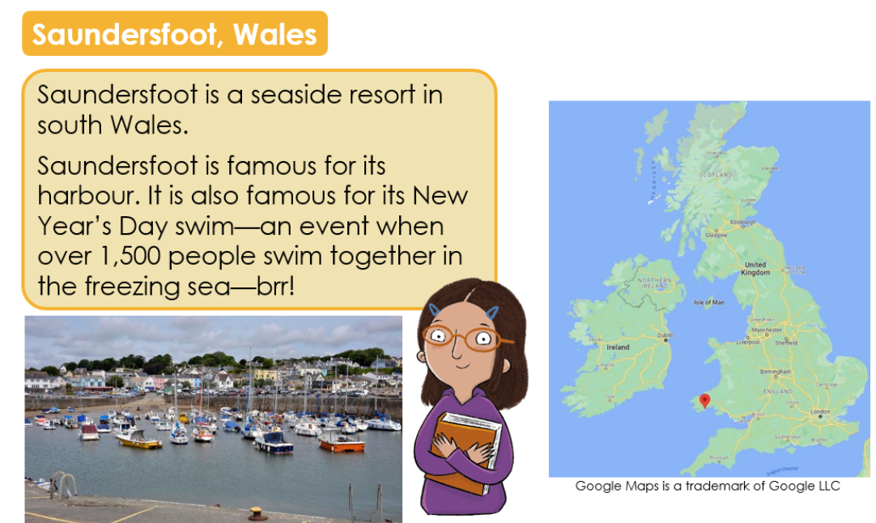
Key Question: What is the seaside and where is it?
Monday 23rd June 2025

Slide 41
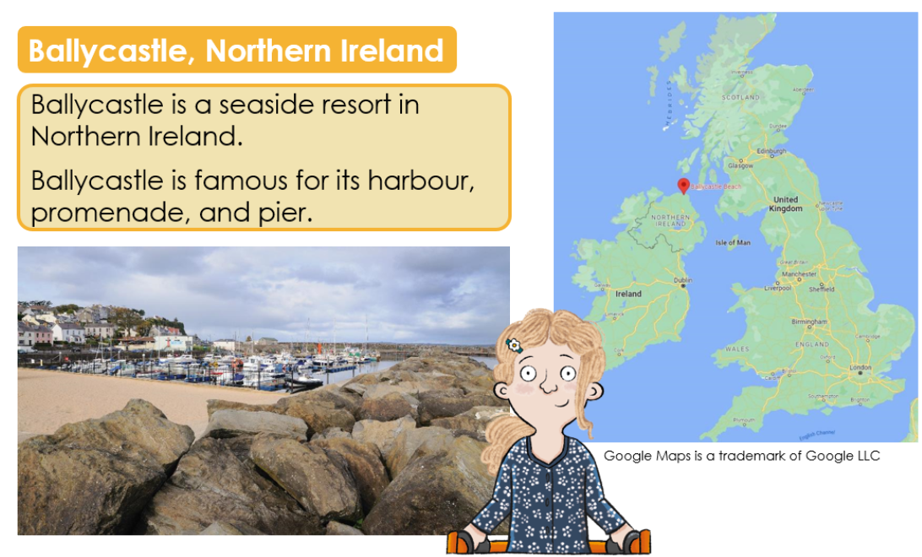
Key Question: What is the seaside and where is it?
Monday 23rd June 2025

Slide 42
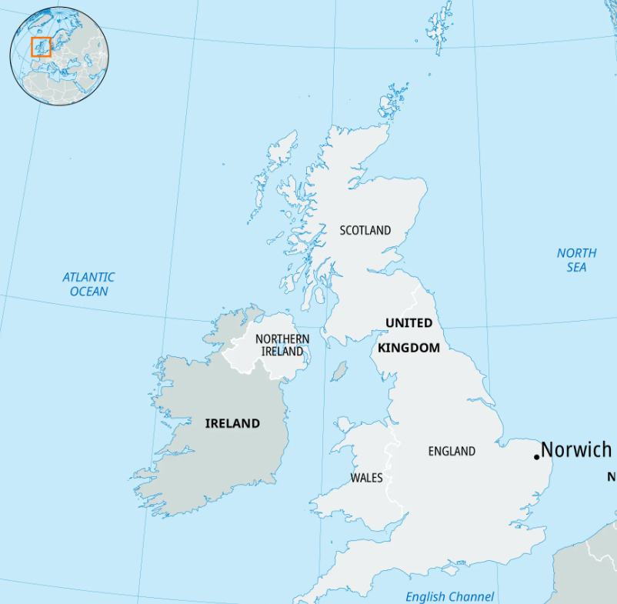
Key Question: What is the seaside and where is it?
Monday 23rd June 2025
Our local area is a seaside town. We live in Gorleston on Sea. You can see it is on the East coast.
Does our local area look similar or different to the other seaside towns?

Slide 43
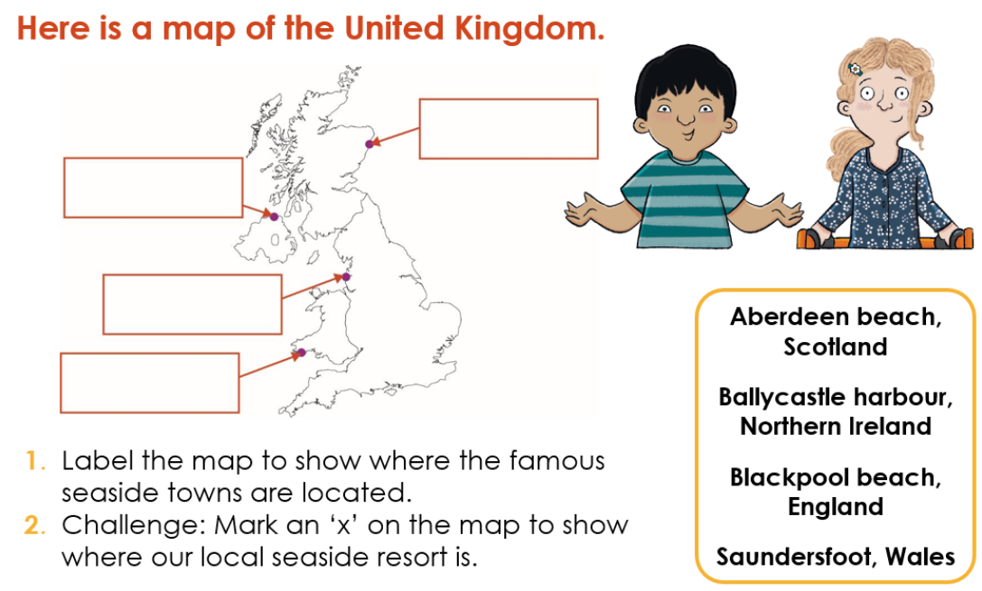
Key Question: What is the seaside and where is it?
Monday 23rd June 2025

Slide 44
Key Question: What is the seaside and where is it?
Monday 23rd June 2025
Exit question
What is the coast?

Slide 45
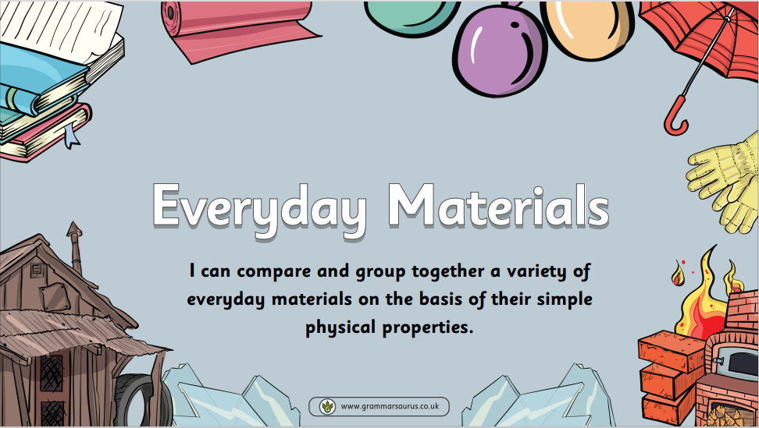
Monday 23rd June 2025
KQ: can I group materials?

Slide 46
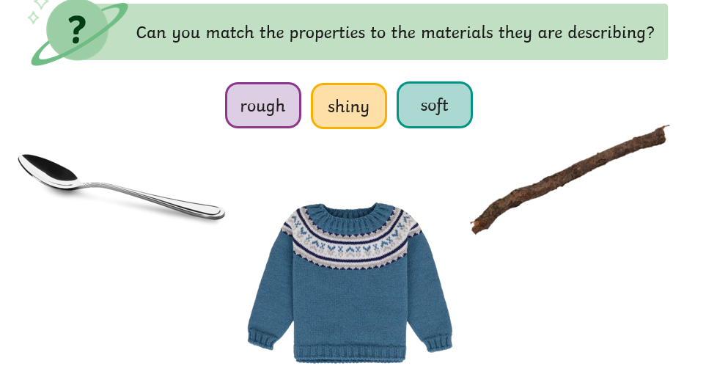
3 in 3
Monday 23rd June 2025

Slide 47
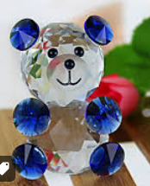
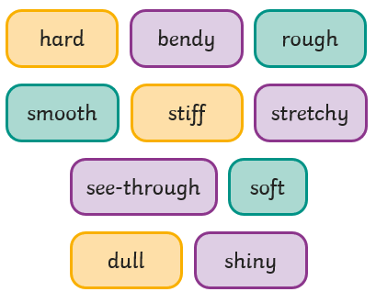
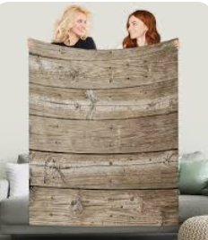
Blue / Green
Monday 23rd June 2025
Would glass be a good material to make a teddy bear out of? Why?
Would wood be a good material to make a blanket out of? Why?
It would/ would not be a good material because

Slide 48
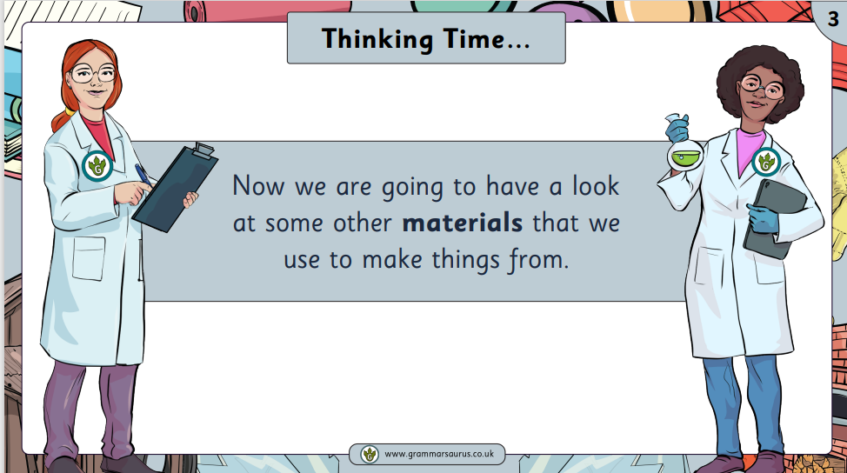
Monday 23rd June 2025

Slide 49
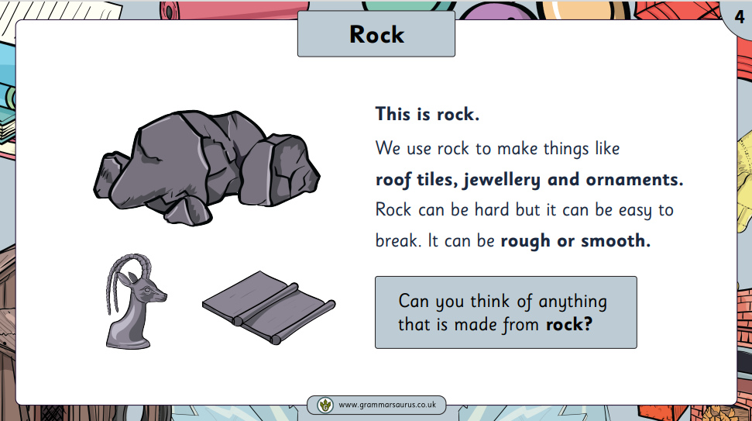
Monday 23rd June 2025

Slide 50
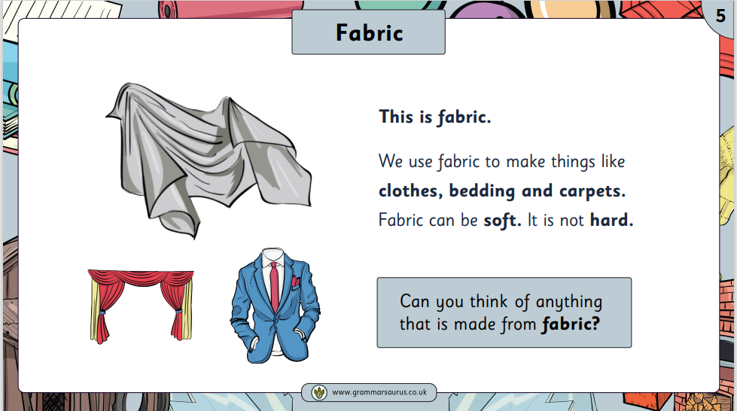
Monday 23rd June 2025

Slide 51
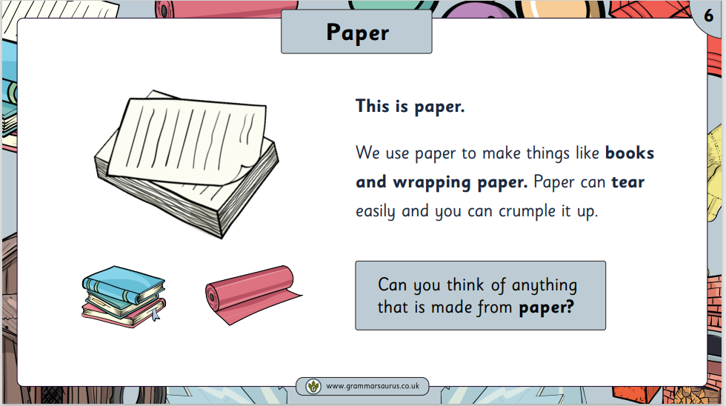
Monday 23rd June 2025

Slide 52
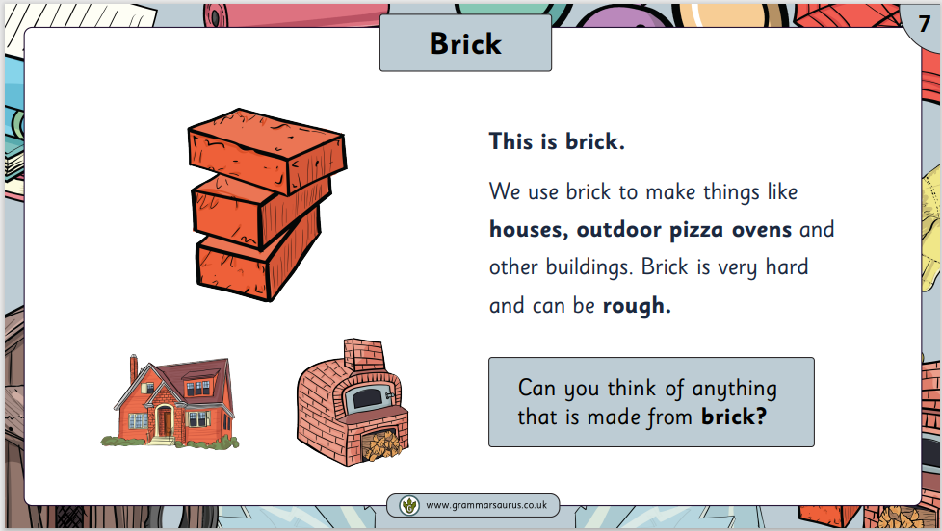
Monday 23rd June 2025

Slide 53
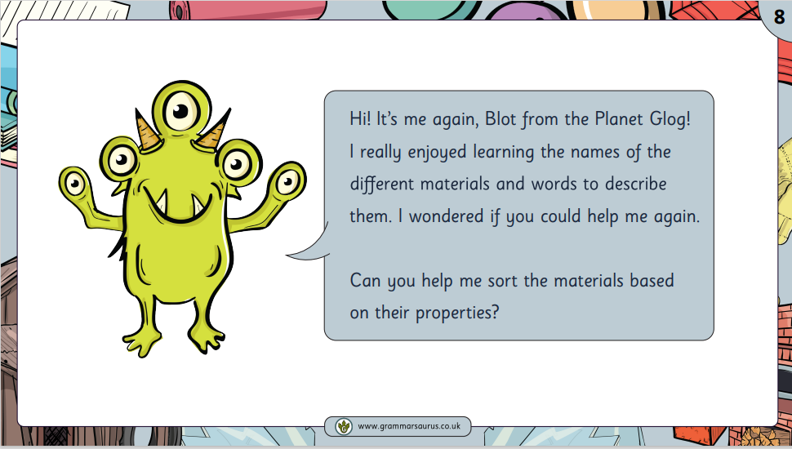
Monday 23rd June 2025

Slide 54
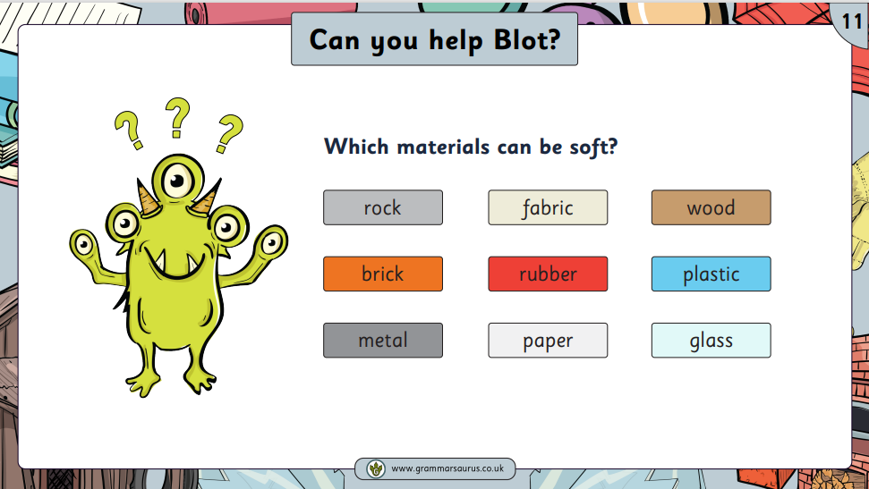
Monday 23rd June 2025

Slide 55
Monday 23rd June 2025

Slide 56
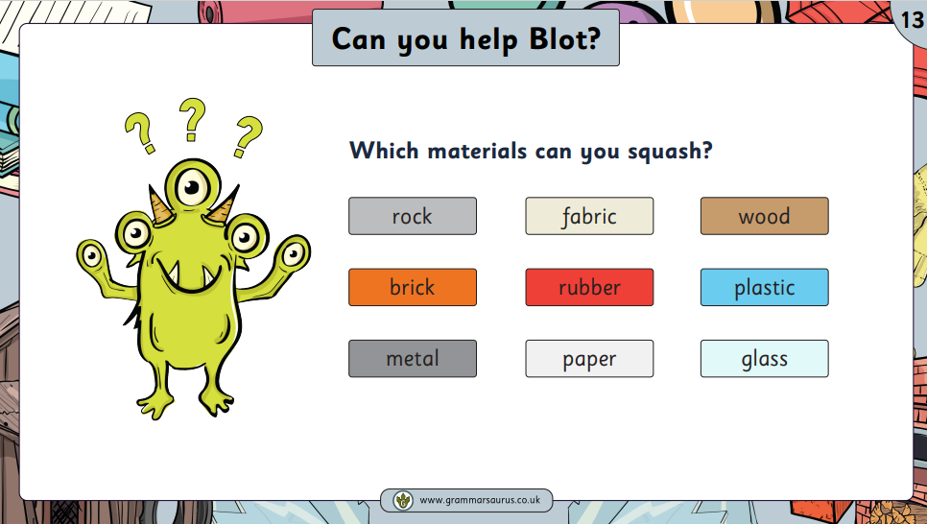
Monday 23rd June 2025

Slide 57
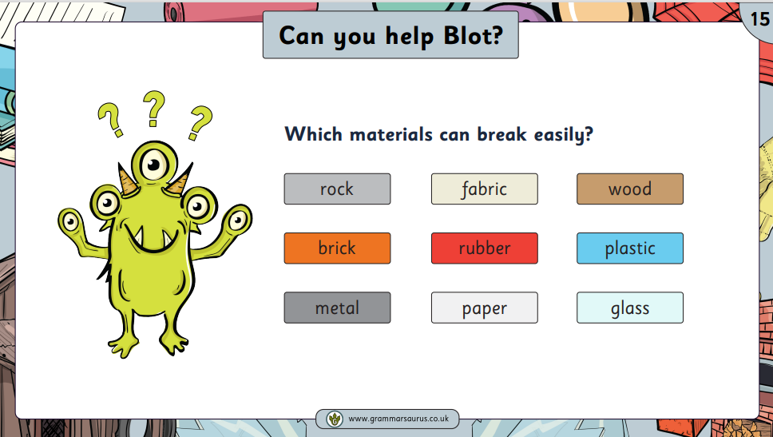
Monday 23rd June 2025

Slide 58
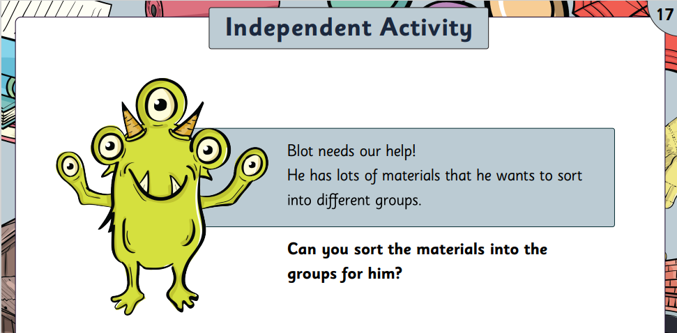
Monday 23rd June 2025

Slide 59
