Slide 1
Morning challenge

Slide 2
Spellings
sincere
2. interfere
3. sphere
4. adhere
5. severe
6. persevere
7. atmosphere
8. mere
9. hemisphere
10. austere

Slide 3
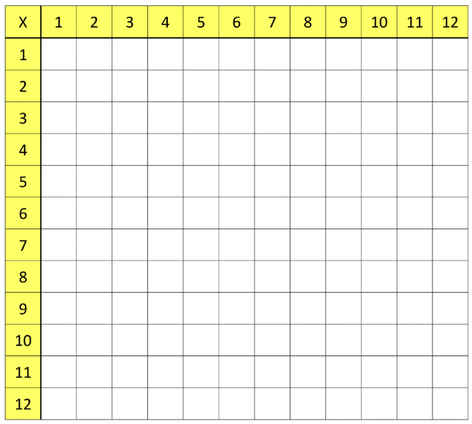
Times tables grid

Slide 4
TBAT- develop my understanding of 3D nets using 2D representations 1) 5.6 x 100 = 2) 5/6 + ½ = 3) 450, 026 + 20, 001 =
Challenge:
¾ x 5 =
6/8 divided by 2 =

Slide 5
Daily 10 x 7s Daily 10 - Mental Maths Challenge - Topmarks

Slide 6
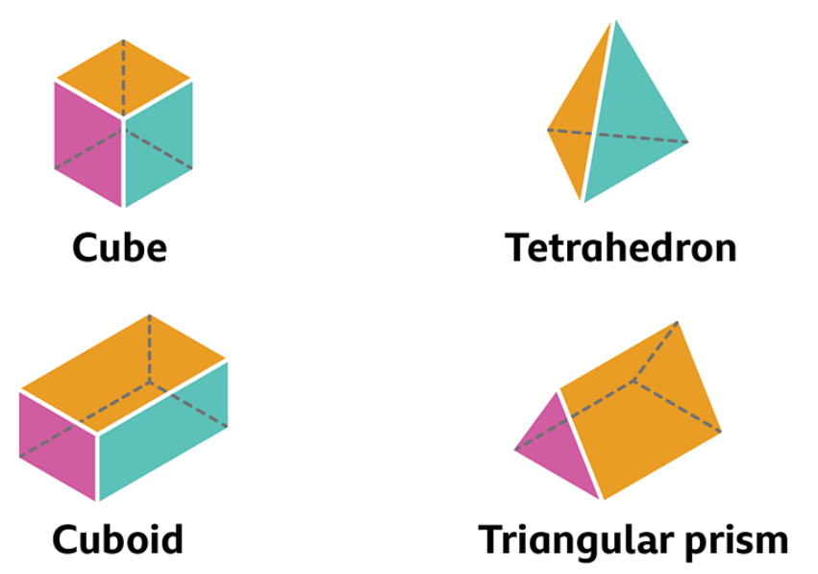
What are the properties of these shapes? Number of faces, edges and vertices.
Blue
Green

Slide 7
Talk partner: What are the faces of this net?

Slide 8
Nets of 3D shapes - KS2 Maths - Year 6 - BBC Bitesize
Show example and click through quickly to show the net folding to create the shape.

Slide 9
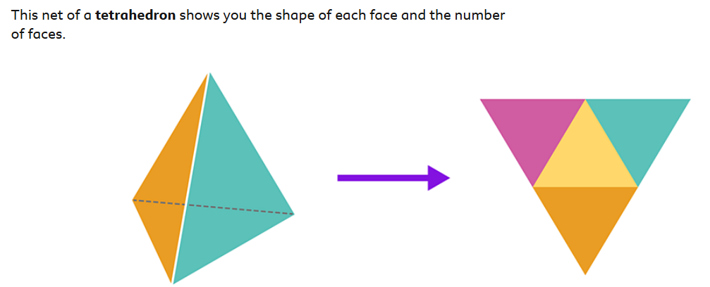
To identify the 3D shape, you must first identify the faces of the 2D net.

Slide 10
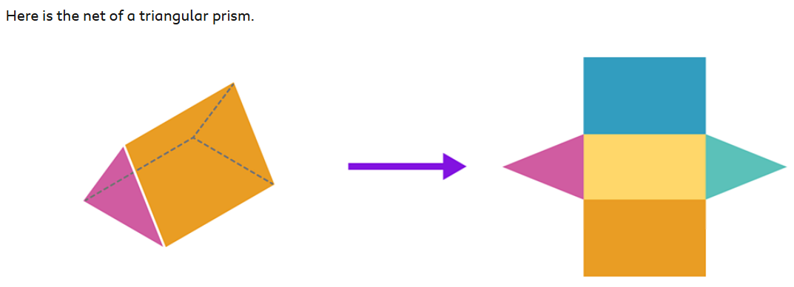
Talk partners: What faces does the shape have that help us to know the name of the 3D shape?

Slide 11
Record the answers on your whiteboards.

Slide 12
Whiteboard work:

Slide 13
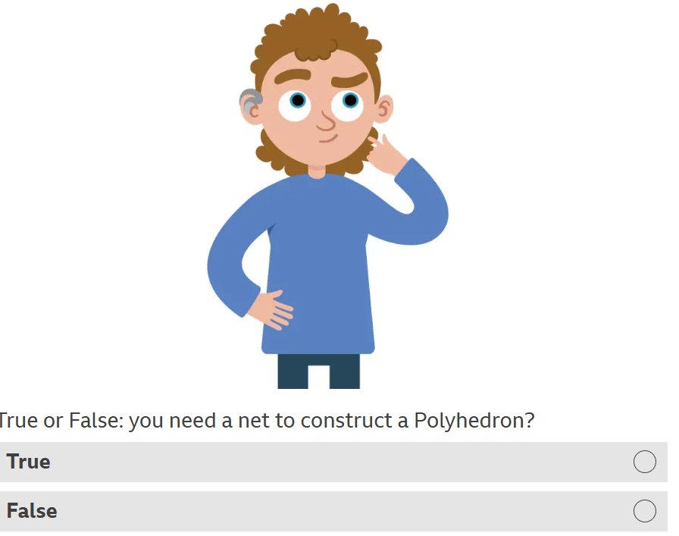

Slide 14
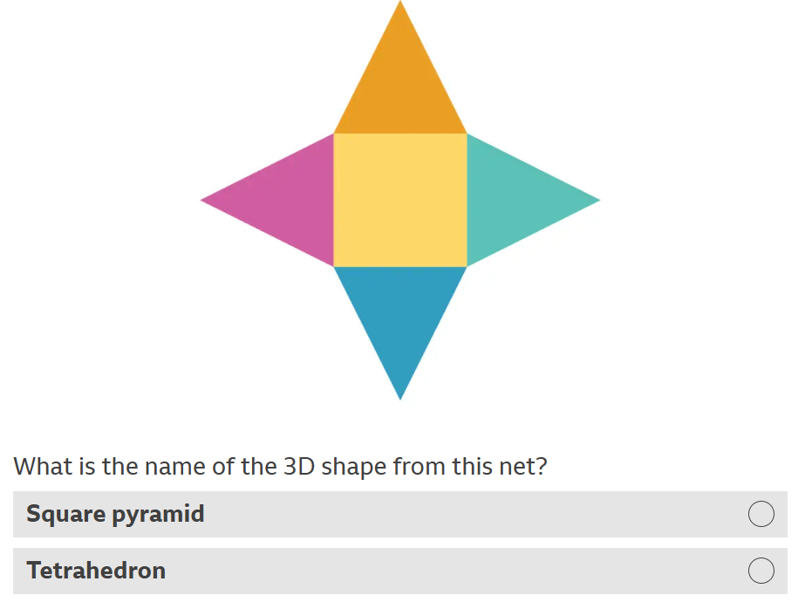

Slide 15
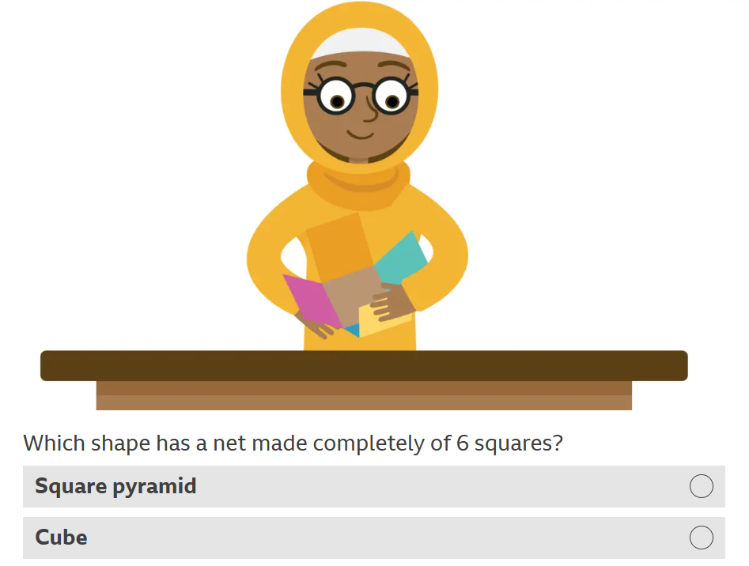

Slide 16
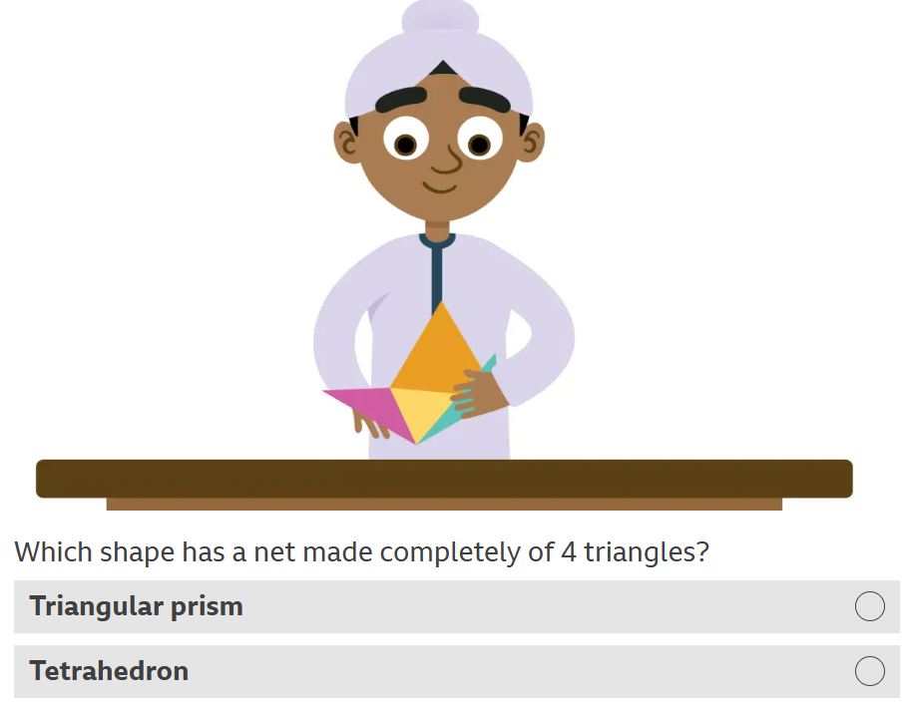

Slide 17
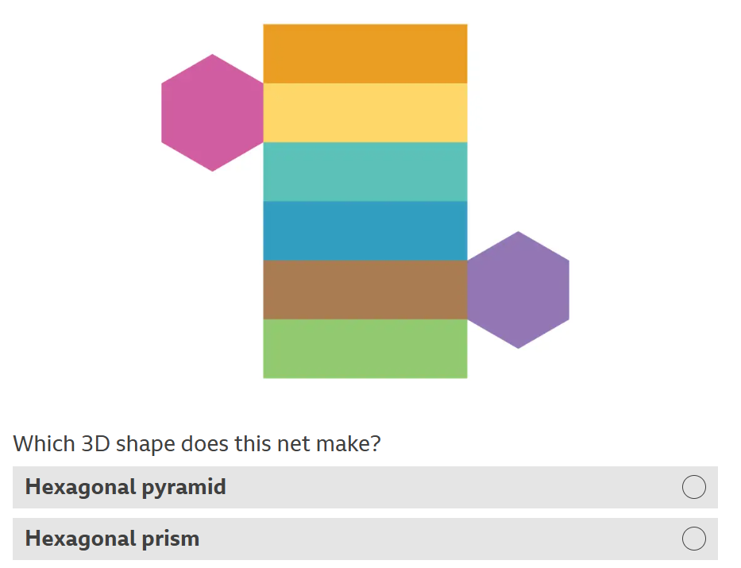

Slide 18
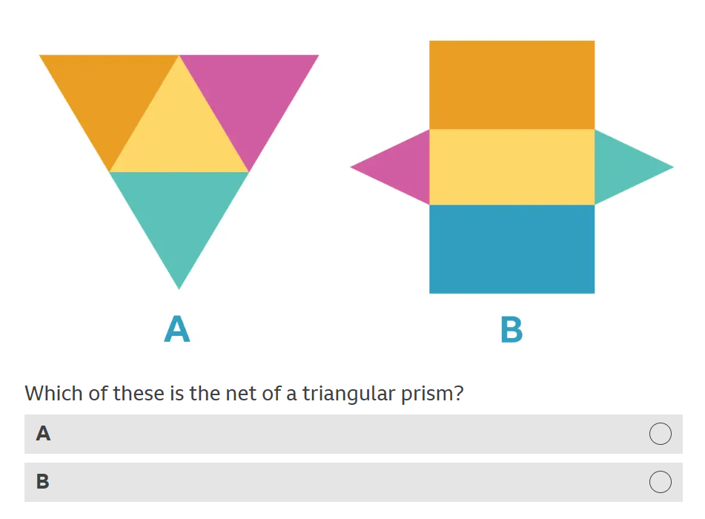

Slide 19
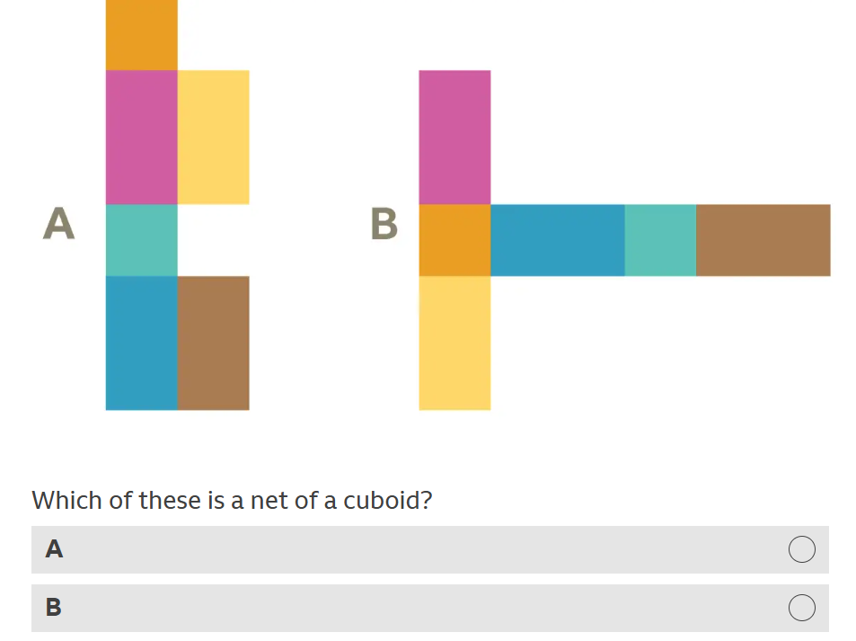

Slide 20
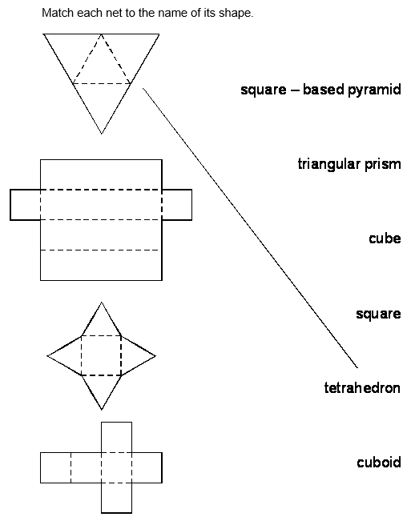
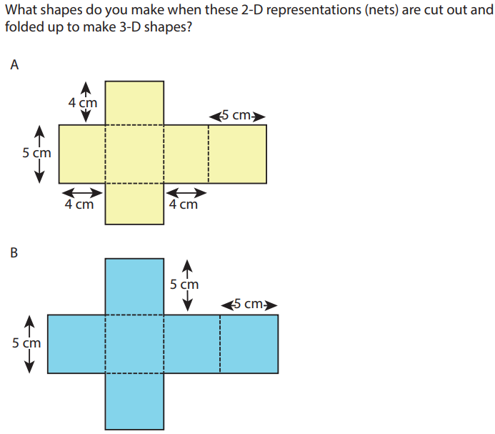
Short independent task, in books:

Slide 21
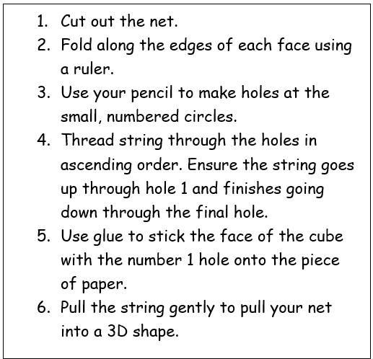
Read the instructions carefully.
Talk partners:
What is the mathematical vocabulary that you can see?
What is the meaning of the mathematical vocabulary?

Slide 22
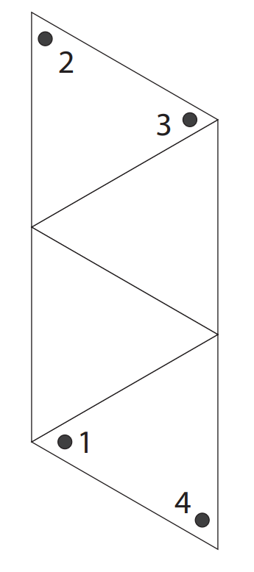
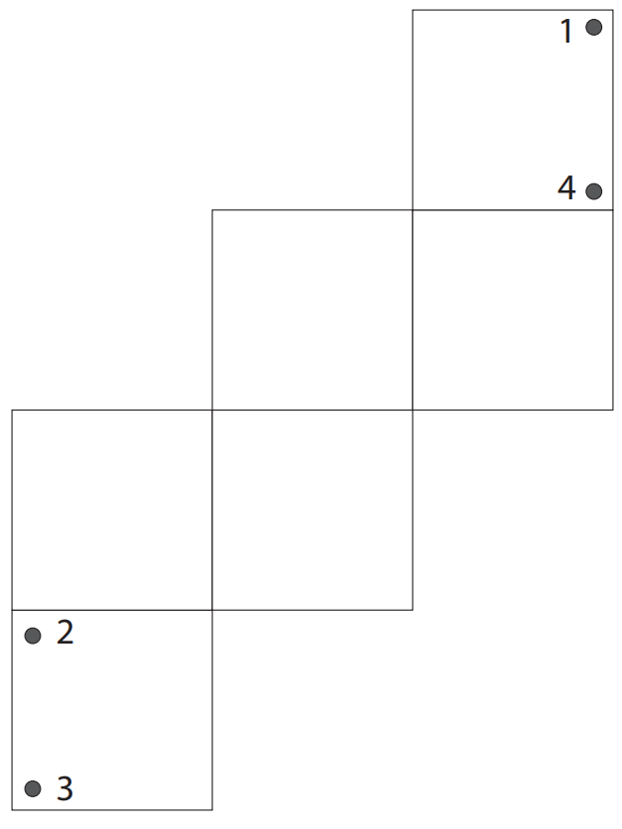
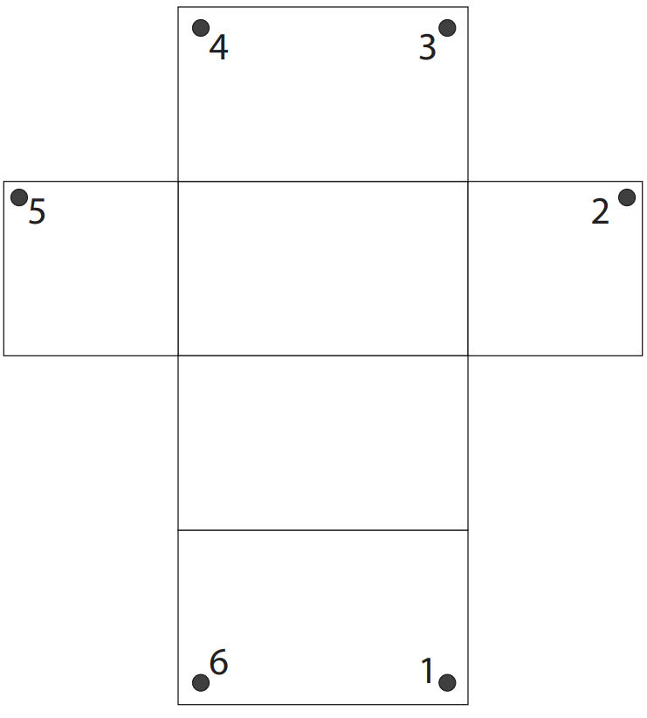
Task: follow the instructions carefully to create a pull-up net.

Slide 23
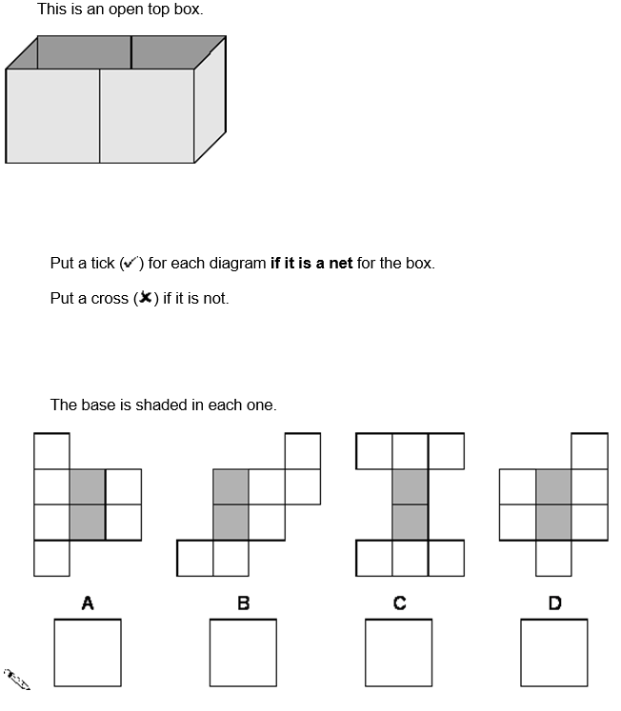
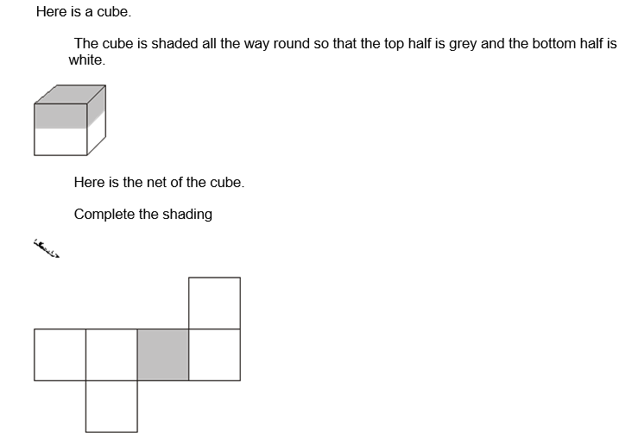
Challenge:
Mastery:

Slide 24
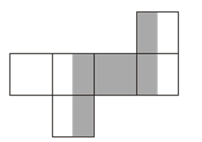

Slide 25
Friday 16th May TBAT: Recognise and use persuasive features.
3 in 3 Find three ways to improve this paragraph: Please Judge I'm inocent. Let me go. I didn't do anything wrong. Please have mercy on me. Would you really let a boy go to jail?

Slide 26
Friday 16th May TBAT: Recognise and use persuasive features.
What is the power of three? What is a rhetorical question?
Add emotive language to this sentence? I am not guilty.

Slide 27
When you set out to persuade someone, you want them to accept your opinion on an issue: you want to change that person's mind to your way of thinking.
Persuasive Techniques
writing
skills

Slide 28
This means that you need to be very aware of your audience; you want to be forging a link with them by establishing a common goal, not irritating them by completely ignoring their needs.
Persuasive Techniques
writing
skills

Slide 29
There are three areas we should attempt to appeal to when trying to get our audience on side:
APPEAL TO REASON Most people believe themselves to be reasonable, so appealing to a person's sense of reason is the most effective means of convincing them to change their way of thinking ('If we don't do this... then... ).
APPEAL TO CHARACTER We all share certain common ideas of what is just and fair! Appealing your audience’s sense of what is right and fair can be a powerful persuasive device, e.g. 'Like you, I share a sense of horror and repulsion at what is happening...'.
APPEAL TO EMOTIONS Persuasion often succeeds by the careful and considered use of emotion - especially showing how passionate you feel for
your point of view.
Persuasive Techniques
writing
skills

Slide 30
Appeal to Reason
Recognise that your audience feel they hold a reasonable view already, but try to dissuade that view by showing how much more reasonable your own position is. Provide evidence to support your ideas to suggest that they are reasonable and logical.
However ...
Because you are being persuasive, and not writing to argue, you do not have to provide entirely ‘neutral’ facts.
Persuasive Techniques
writing
skills

Slide 31
Appeal to Reason
So an effective way of appealing to your audience’s sense of reason, while still presenting your view as the only correct view, is to use emotive facts rather than objective ones.
(However, do not overuse this as it can make you seem untrustworthy/insincere.)
How can we make facts emotive?
Persuasive Techniques
writing
skills

Slide 32
Appeal to Character
You need to try to convince your audience that you and they are very similar, sharing parallel ideas and views.
One way to do this is to create a sense of a shared personal or cultural experience.
Persuasive Techniques
writing
skills

Slide 33
Appeal to Character
Be respectful... Use an appropriate tone to suit your audience and purpose.
Be generous... people often put their own interests first. What can you offer your readers to help them change their mind?
Be modest... no one will listen to an arrogant, impolite big-head.
Persuasive Techniques
writing
skills

Slide 34
Appeal to Character
Be personal... Persuasion works best when you know your audience well so consider your reader, think about what their current views are and what has brought them to think that way - think about addressing them as a 'friend using the pronoun 'You'.
Be concerned... and show that you share your reader's concerns - even if your view is different.
Persuasive Techniques
writing
skills

Slide 35
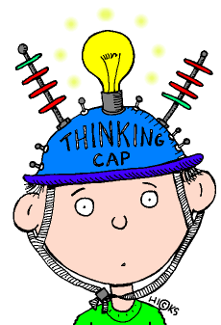
Appeal to Emotions
Some words have connotations that evoke an emotional response.
Consider the difference between the words building, house and home.
Persuasive Techniques
writing
skills

Slide 36
Appeal to Emotions
The words all come from the same semantic field, with similar denotations, however, the connotations of words are very different.
Because we often have an emotional association to words, our choice of vocabulary can be a powerful tool for persuasion. We can use words to make our audience feel guilty about a situation, angry and even hopeful.
Persuasive Techniques
writing
skills

Slide 37
Appeal to Emotions
Some words have connotations that evoke an emotional response.
Consider the difference between the words building, house and home.
Persuasive Techniques
writing
skills

Slide 38
Appeal to Emotions
The words all come from the same semantic field, with similar denotations, however, the connotations of words are very different.
Because we often have an emotional association to words, our choice of vocabulary can be a powerful tool for persuasion. We can use words to make our audience feel guilty about a situation, angry and even hopeful.
Persuasive Techniques
writing
skills

Slide 39
Think about the three key points Jabir wants to get across to the judge: - He was not stealing the stew. - His father is dead and he must provide for his family. - Religion say give to those less fortunate than yourself. Think about the persuasive devices we have looked at this lesson, using the planning sheet, complete the boxes to say how you would: Appeal to the Judge's character Appeal to the Judge's emotions Appeal to the Judge's reason 2 minutes to talk partner before sharing ideas.

Slide 40
Jabir was not stealing the stew.
Jabir's father is dead and he must provide for his family.
Religion says: give to those less fortunate than yourself.

Slide 41
Friday 16th May 2025
RE Voyagers – Complete last week's lesson Venturer's – Complete illustrations and grid from last week / independent reading/ class book

Slide 42
Friday 16th May 2025
Q - How can a mosque respond to climate change?
Blue - What is stewardship?
Green - Why does a Muslim feel a duty of stewardship?

Slide 43
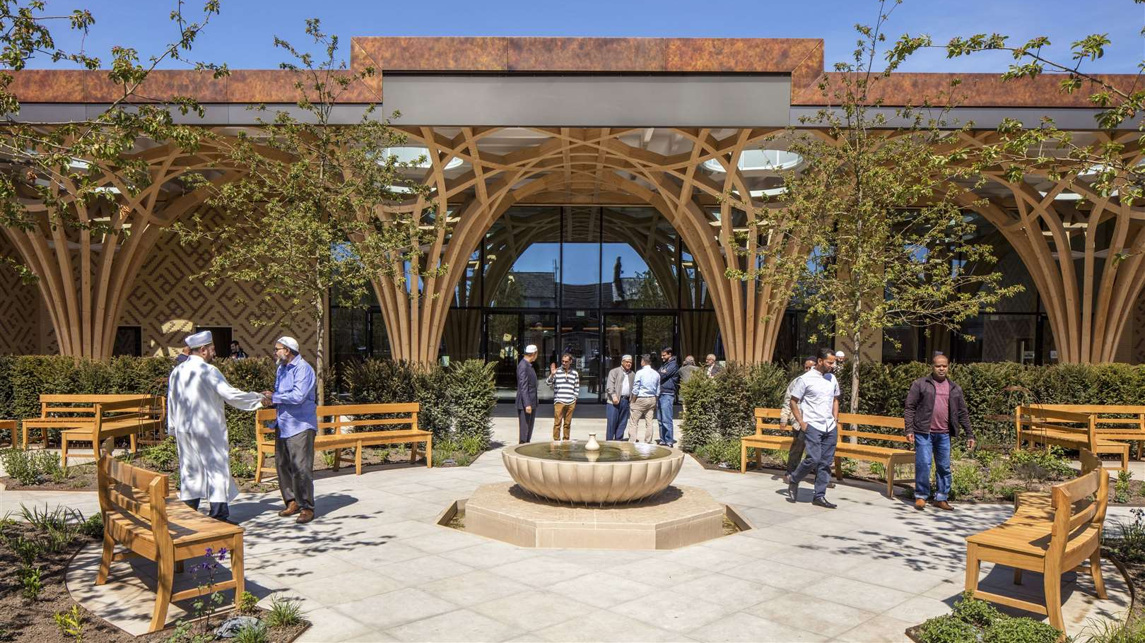
This is Cambridge Central Mosque. It was built in 2018 by the Muslim community in Cambridge. It is one of the first mosques to be built with stewardship of the environment as a priority. It has lots of environmentally friendly features that we are going to look at.

Slide 44
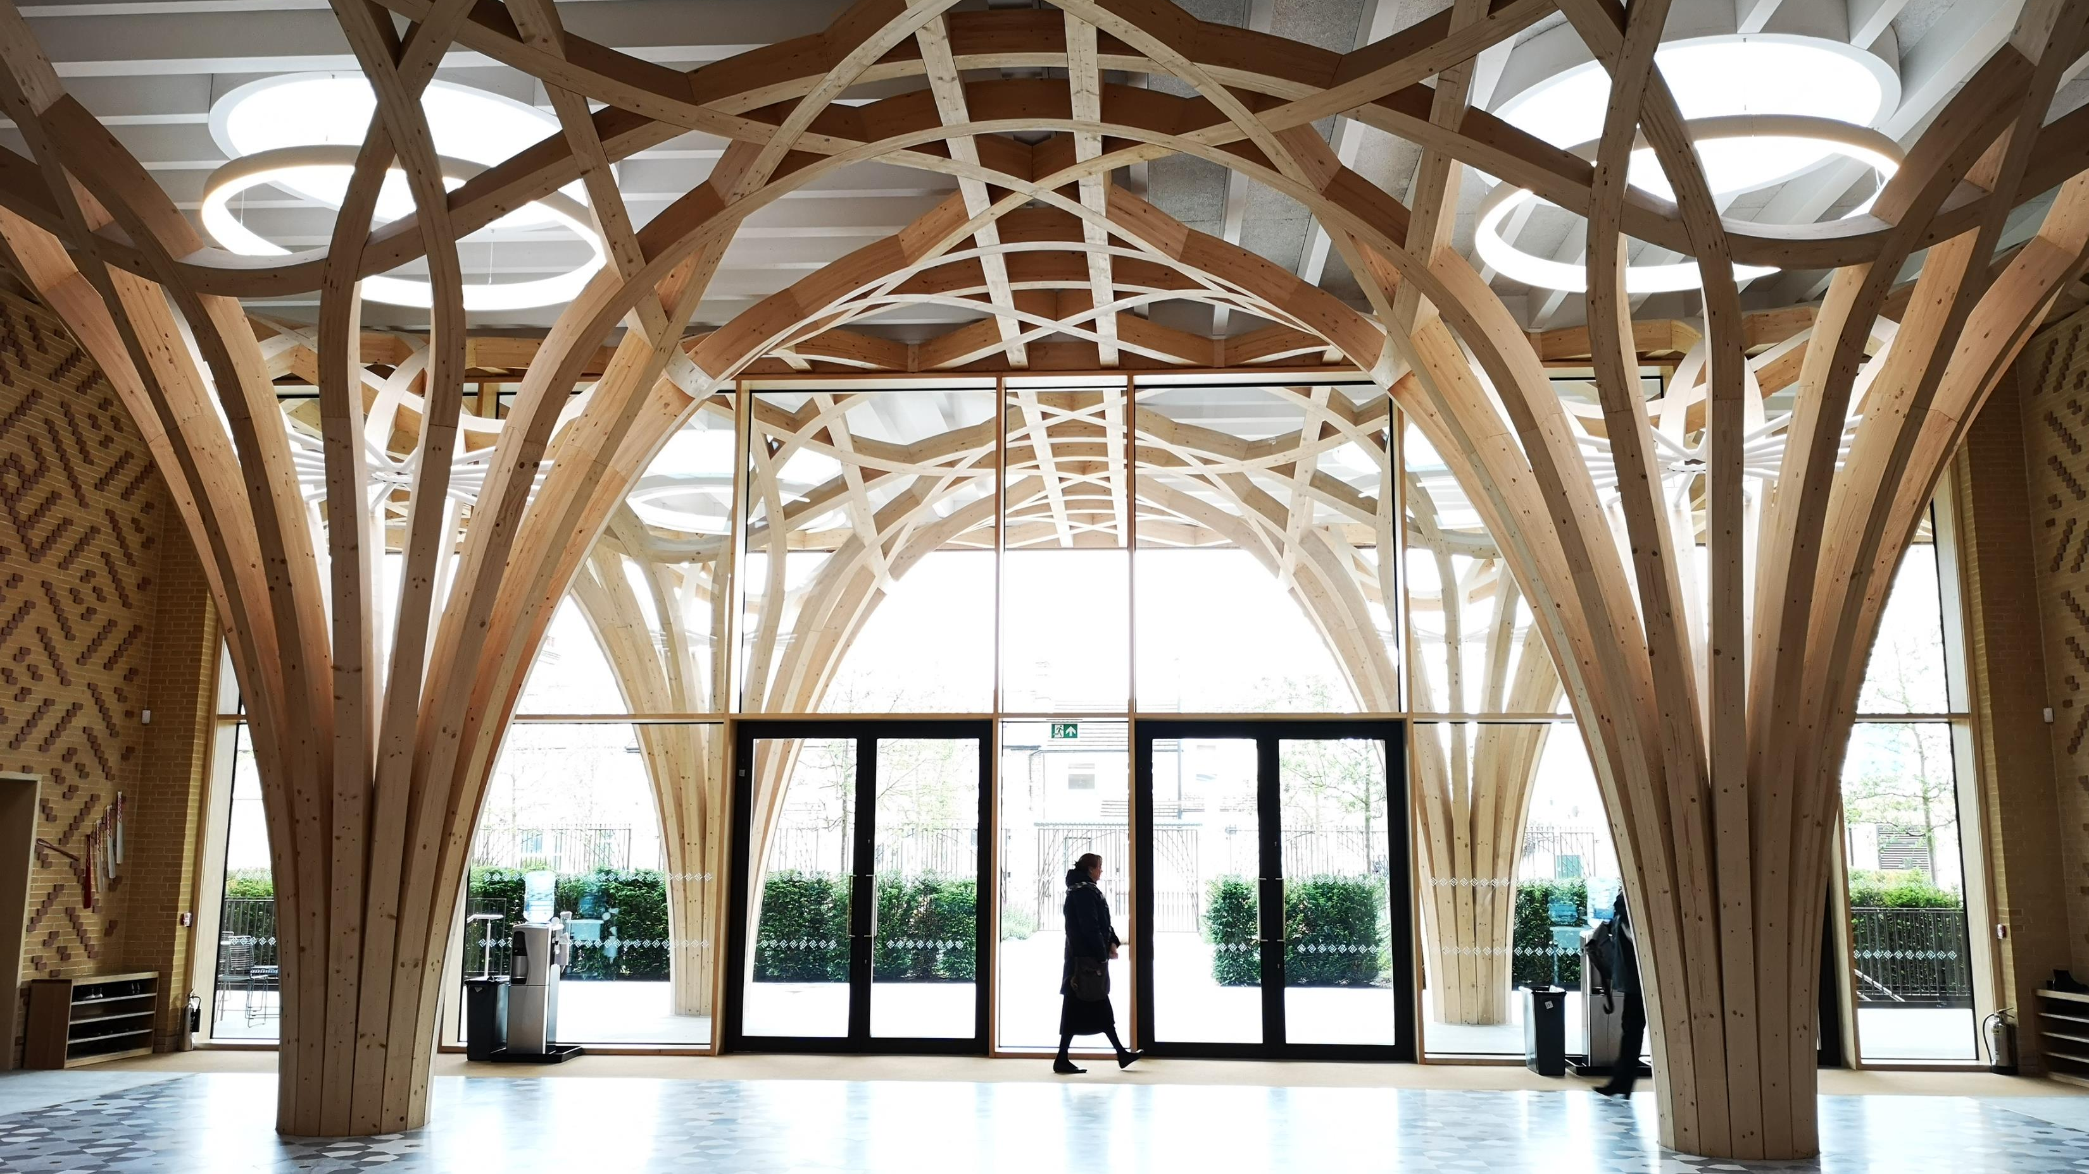
The first thing you notice in the mosque is how much sunlight is used to provide light. This means the mosque does not use very much electricity. Can you see where the sunlight is coming from in this photo?

Slide 45
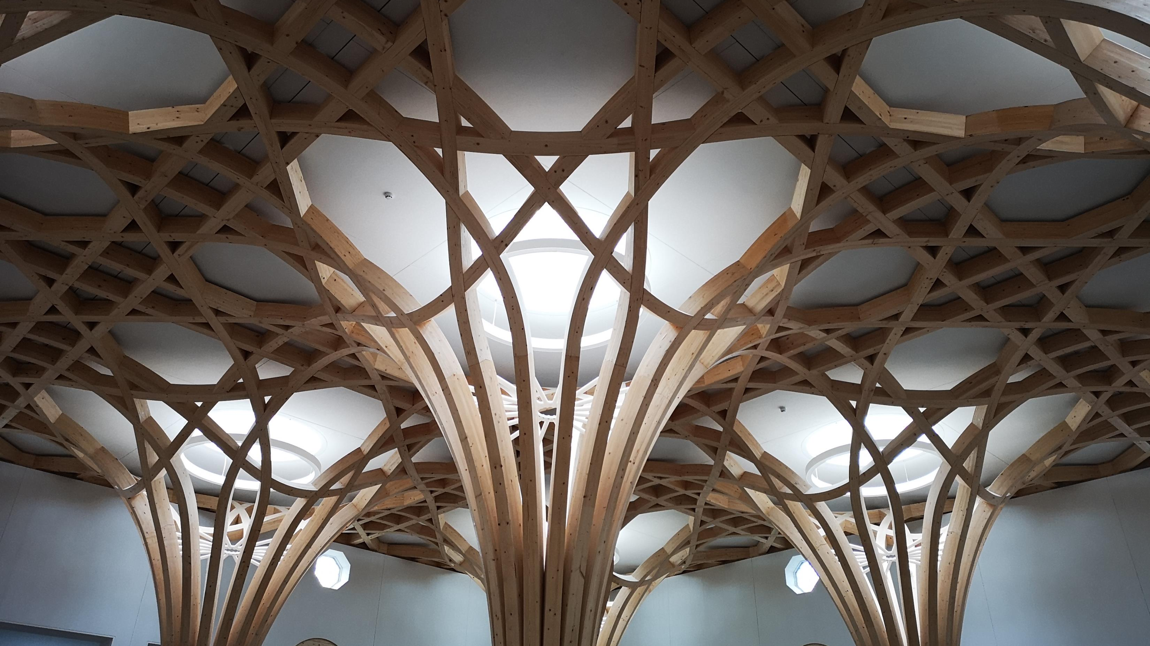
As well as coming in from the windows it also comes in through the roof.

Slide 46
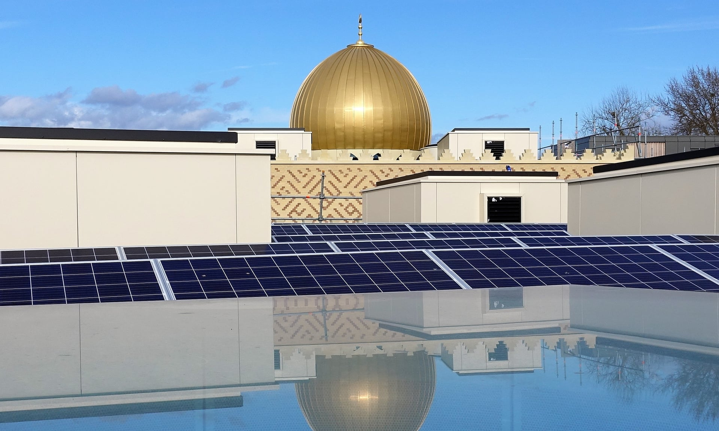
The roof is covered in solar panels to generate electricity.

Slide 47
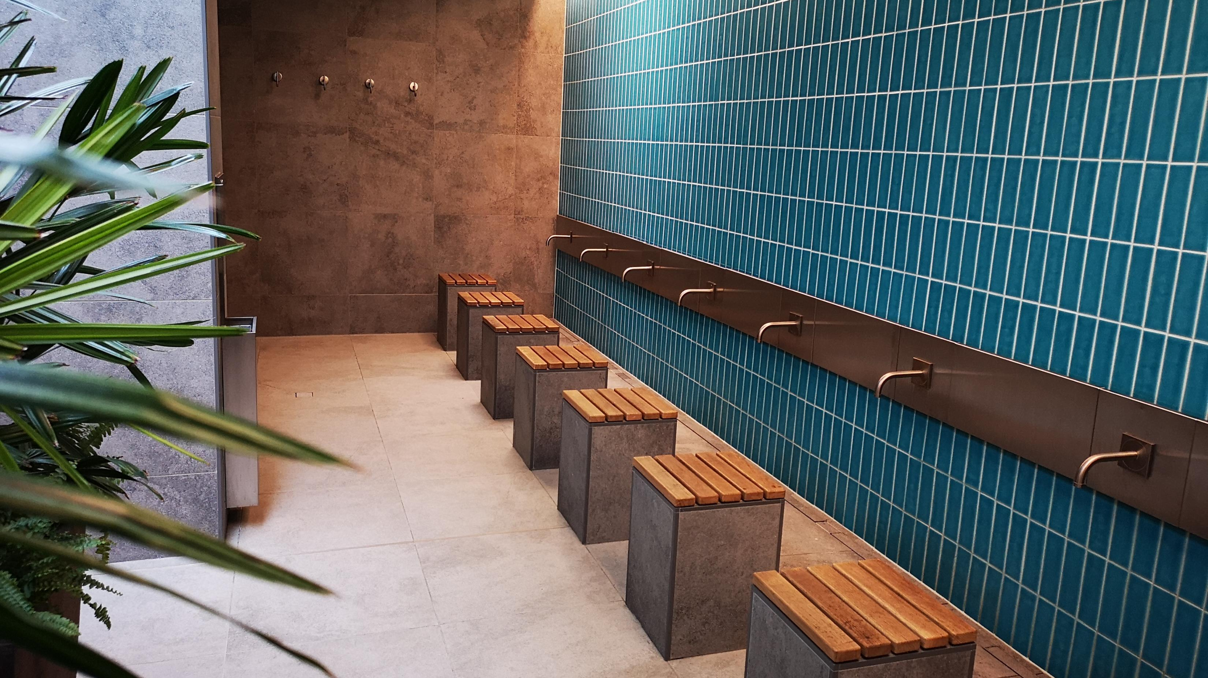
This is the area where worshippers perform wudu before entering the mosque. This is where they wash themselves to clean off the dirt from outside.
These taps turn off automatically when they are not being used.
The water then goes from the drain to be used as “grey water” to flush the toilets.

Slide 48
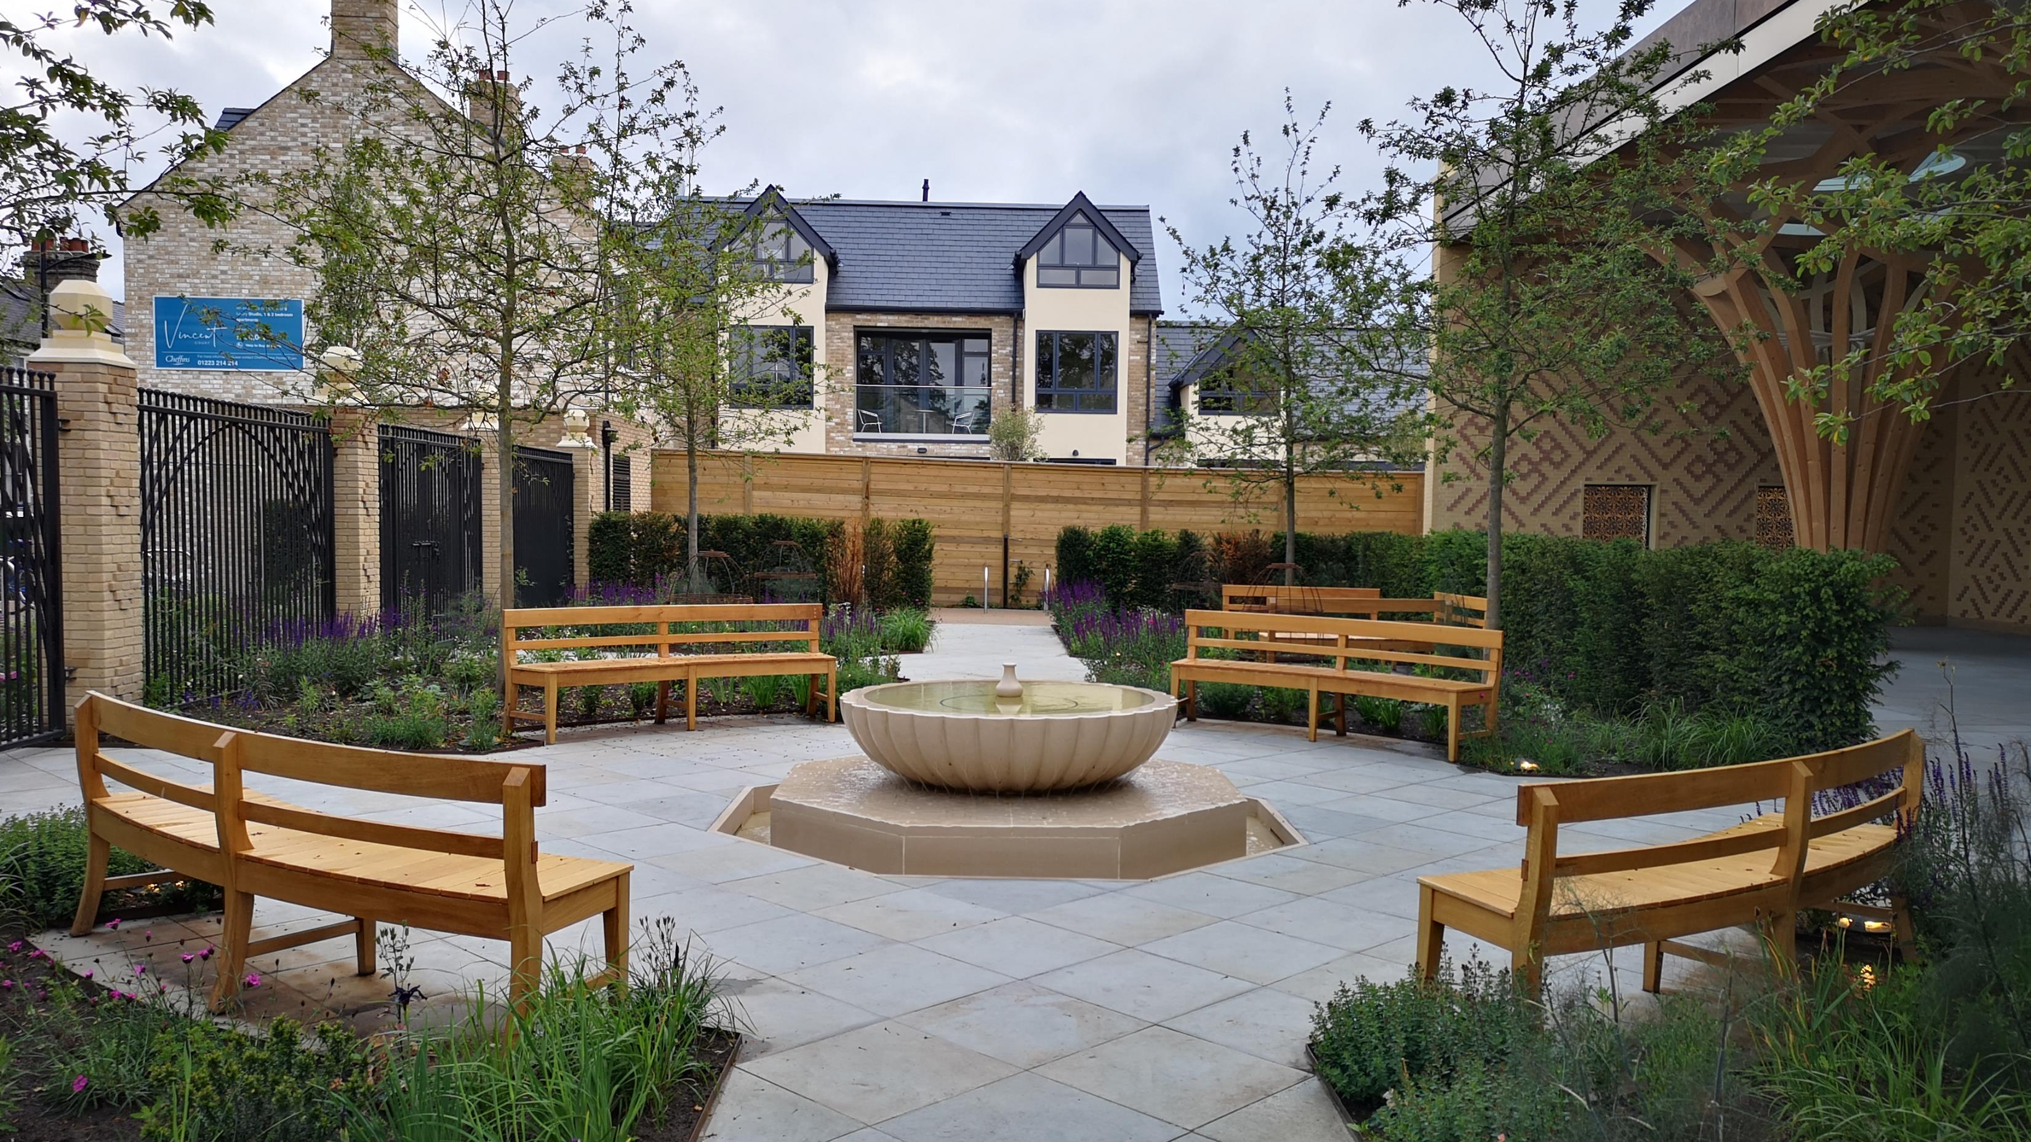
Nearly all mosques have a peaceful garden with a water feature. This mosque uses plants that are local and don’t require much watering as well as a fountain that reuses water.

Slide 49
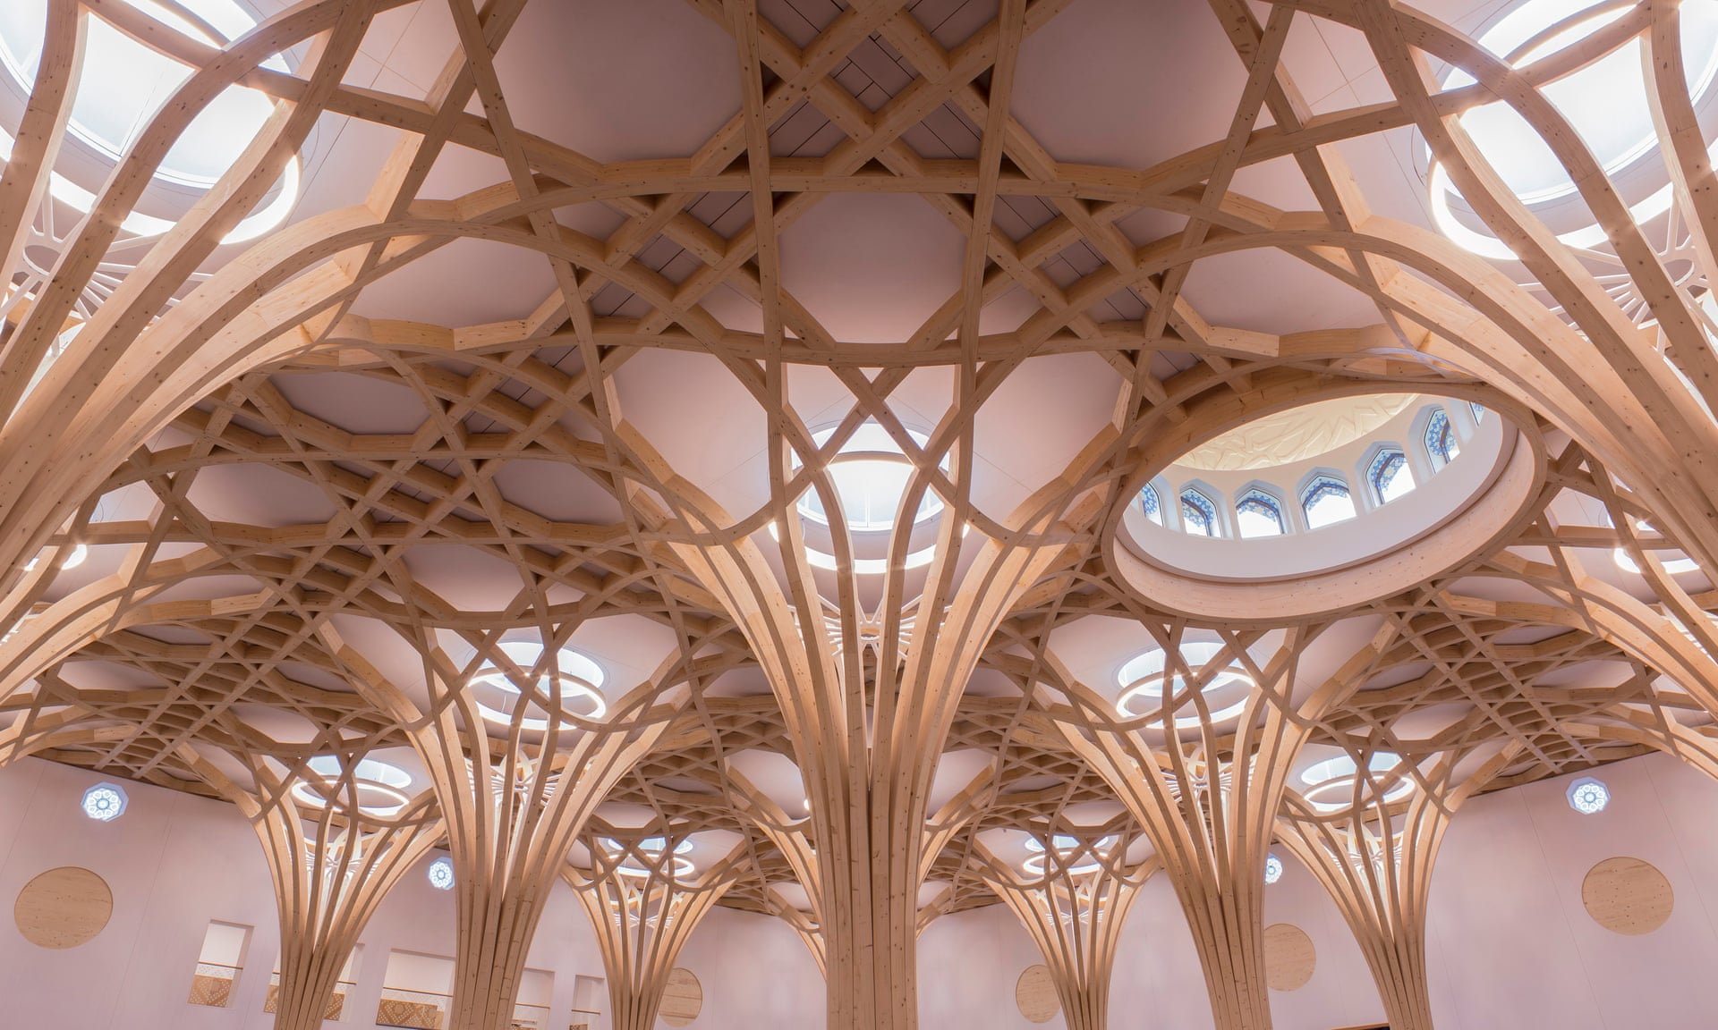
Even the wooden beams that make up the roof come from sustainable forests and trees have been planted to replace those cut down to make up the beams.

Slide 50
On your sheet, list and illustrate four ways in which Cambridge Central Mosque is trying to reduce its impact on the environment.
How does this mosque show that Muslims are fulfilling their duty of stewardship?

