Slide 2
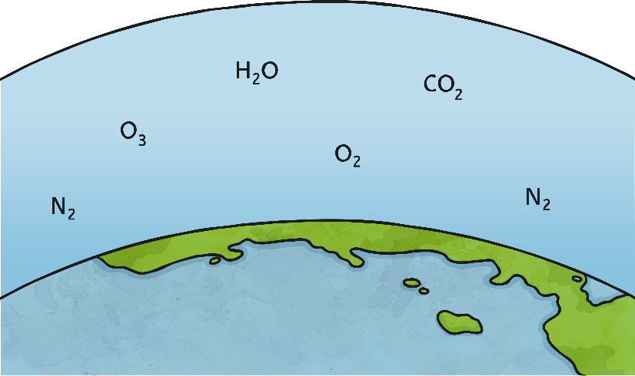
This week, we are going to look at words that have an /ear/ sound spelt using ‘ere’. This letter pattern usually appears at the end of words like:
sphere
or
atmosphere
We’ll start by practising these challenge words by trying to help out Mr Whoops…

Slide 3
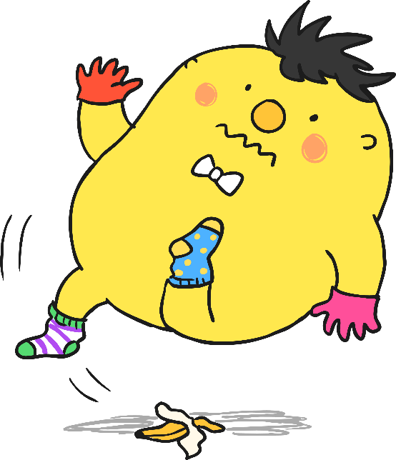
Unfortunately, Mr Whoops has got in a bit of a muddle with your spelling words. Working with a partner, can you figure them out?
Remember they all contain an /ear/ sound spelt with ‘ere’.
Click here for clue!
Clue: Measly or meagre.
e
e
r
m

Slide 4
The answer is…
m
e
r
e
Mere – to emphasis how small or insignificant something is.

Slide 5
Unfortunately, Mr Whoops has got in a bit of a muddle with your spelling words. Working with a partner, can you figure them out?
Remember they all contain an /ear/ sound spelt with ‘ere’.
Click here for clue!
Clue: Genuine and honest.
r
c
i
n
s
e
e

Slide 6
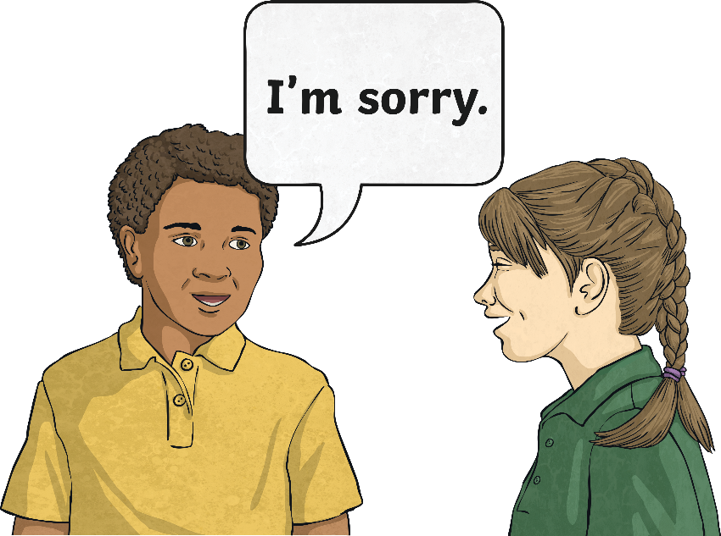
The answer is…
s
i
n
c
e
r
e
Sincere – to come from genuine feelings.

Slide 7
Unfortunately, Mr Whoops has got in a bit of a muddle with your spelling words. Working with a partner, can you figure them out?
Remember they all contain an /ear/ sound spelt with ‘ere’.
Click here for clue!
Clue: Get into someone else’s business.
e
r
e
r
f
t
e
i
n

Slide 8
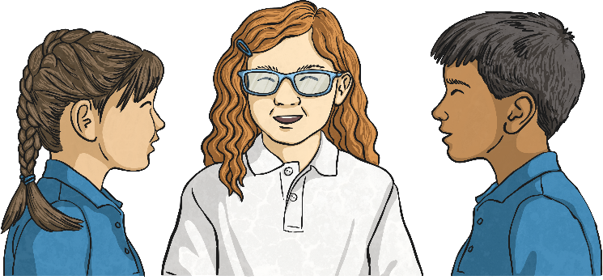
The answer is…
i
n
t
e
r
f
e
r
e
!
Interfere – to prevent something from happening.

Slide 9
Unfortunately, Mr Whoops has got in a bit of a muddle with your spelling words. Working with a partner, can you figure them out?
Remember they all contain an /ear/ sound spelt with ‘ere’.
Click here for clue!
Clue: To stick to.
a
e
r
d
h
e

Slide 10
The answer is…
a
d
h
e
r
e
adhere – to stick to something

Slide 11
Unfortunately, Mr Whoops has got in a bit of a muddle with your spelling words. Working with a partner, can you figure them out?
Remember they all contain an /ear/ sound spelt with ‘ere’.
Click here for clue!
Clue: Harsh and stern.
s
v
e
r
e
e

Slide 12
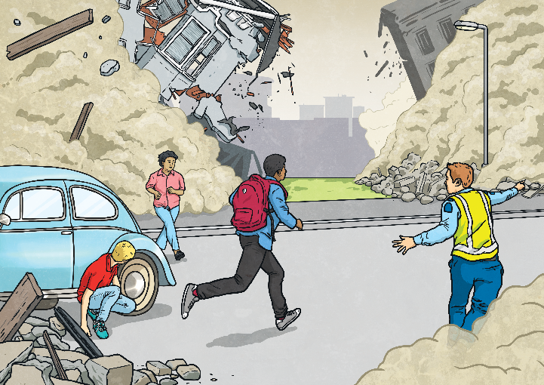
The answer is…
s
e
v
e
r
e
Severe – something bad or undesirable

Slide 13
Unfortunately, Mr Whoops has got in a bit of a muddle with your spelling words. Working with a partner, can you figure them out?
Remember they all contain an /ear/ sound spelt with ‘ere’.
Click here for clue!
Clue: To stick at something.
e
e
e
r
p
s
e
r
v

Slide 14
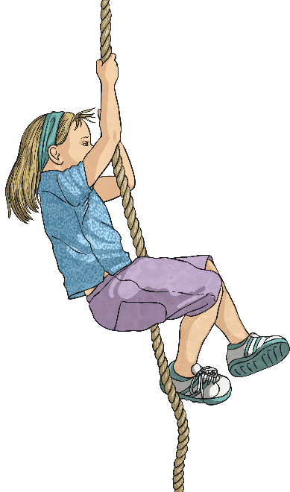
The answer is…
p
e
r
s
e
v
e
r
e
Persevere – to continue, even in the face of difficulty

Slide 15
Unfortunately, Mr Whoops has got in a bit of a muddle with your spelling words. Working with a partner, can you figure them out?
Remember they all contain an /ear/ sound spelt with ‘ere’.
Click here for clue!
Clue: Half of a curved 3D shape.
h
e
e
p
r
e
m
h
i
s

Slide 16
The answer is…
h
e
m
i
s
p
h
e
r
e
Hemisphere – a half of a sphere

Slide 17
Unfortunately, Mr Whoops has got in a bit of a muddle with your spelling words. Working with a partner, can you figure them out?
Remember they all contain an /ear/ sound spelt with ‘ere’.
Click here for clue!
Clue: Severe or strict in attitude or appearance.
e
a
u
r
s
t
e

Slide 18
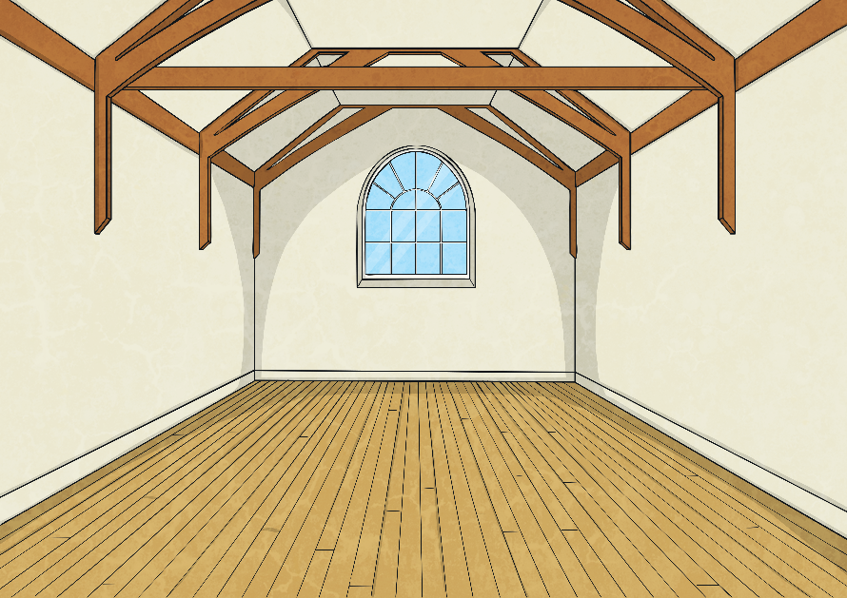
The answer is…
a
u
s
t
e
r
e
austere – having no comforts or luxuries
Notes:
Design note – Please add image from A4 poster edit

Slide 19
Times tables Bingo

Slide 20
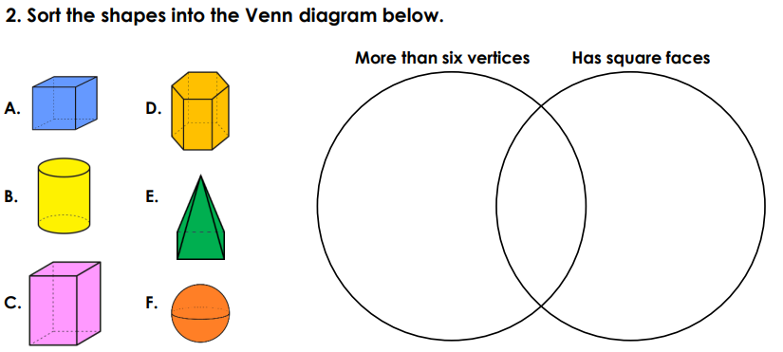
TBAT- identify 3D nets using 2D representations. 3 in 3 1) 34, 827 + ? = 50, 000 3) 60 x 4 =
Challenge:
What am I?
I have two square faces and four rectangular faces.

Slide 21
Daily 10 x 7s Daily 10 - Mental Maths Challenge - Topmarks

Slide 22
Talk partners:

Slide 23
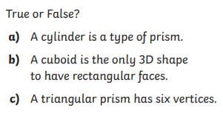
Whiteboard work:

Slide 24
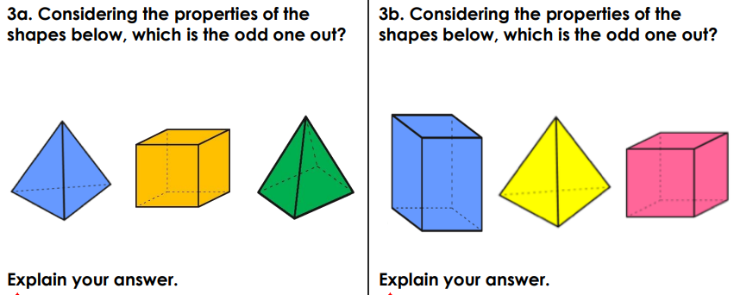
Blue Green

Slide 25
Complete in books:

Slide 27
Talk partners:

Slide 28
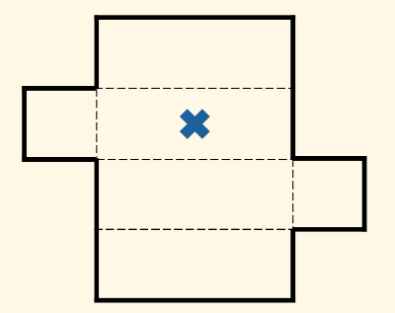
Which 3D shape will this net make?
Whiteboard work:

Slide 29
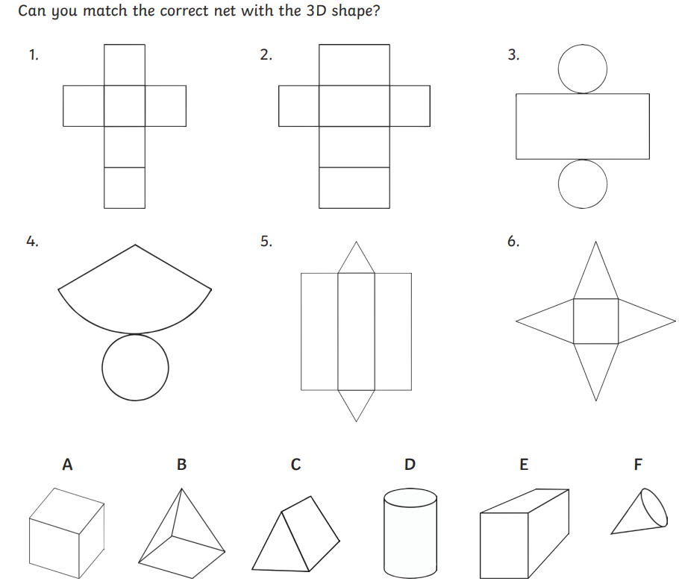
Paired Work: Record the answers in your books.

Slide 30
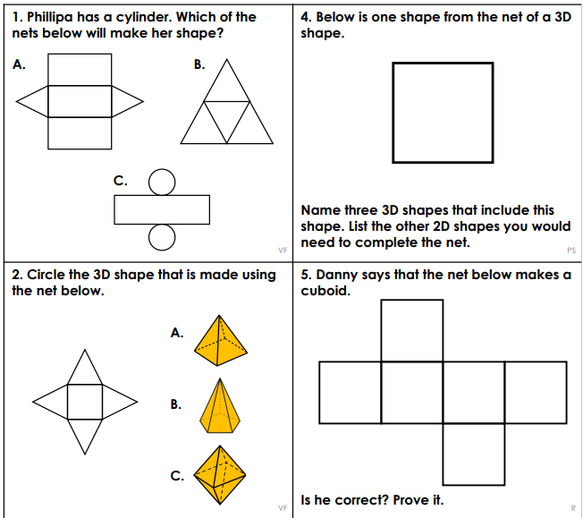
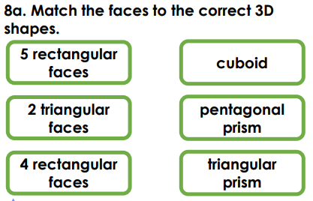
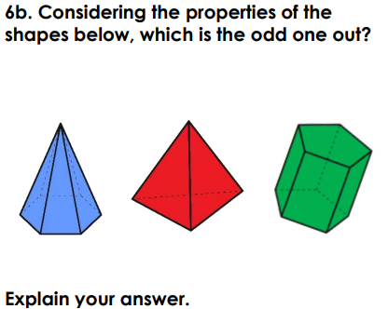
Challenge:
Mastery: Mastery with GDS:

Slide 31
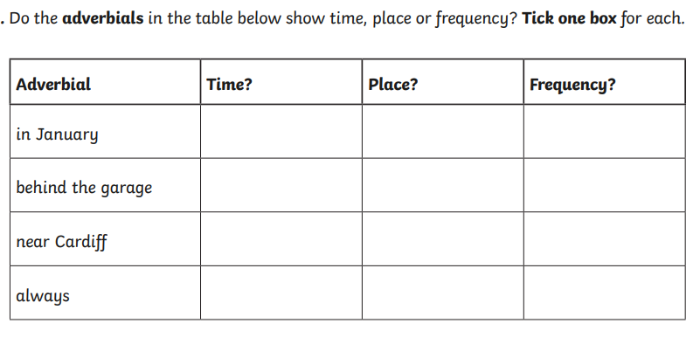
Thursday 15th May TBAT- orally rehearse what I am going to write. 3 in 3

Slide 32
Thursday 15th May TBAT- orally rehearse what I am going to write. Think of a power of three you could use in your letter to the judge. Think of a rhetorical question you could use in your letter to the judge. Is this sentence formal or informal? Explain. You wouldn't really stand by and watch a worshipper of Allah starve? Go penniless? Die?

Slide 33
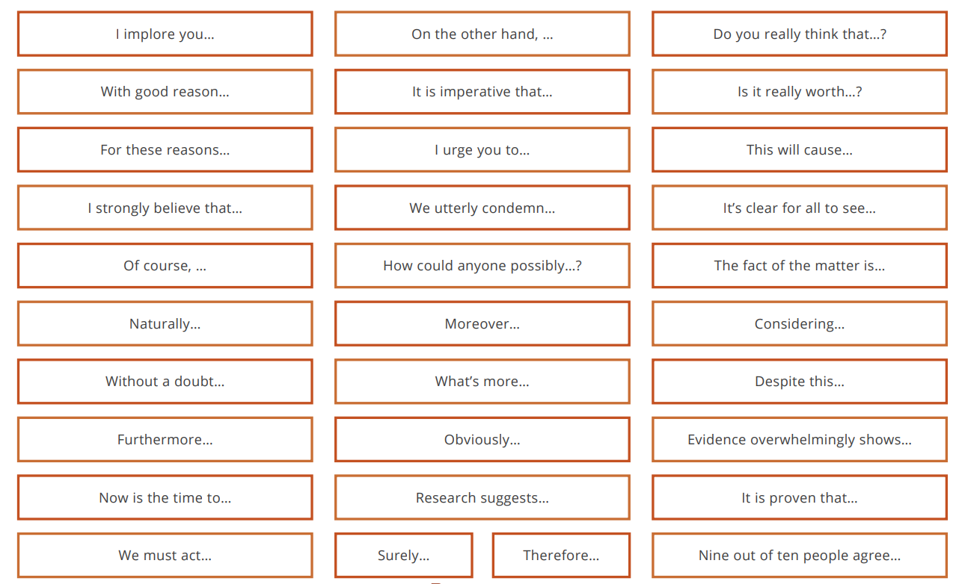
Using these sentence starters, create a sentence you could use in your writing.

Slide 34
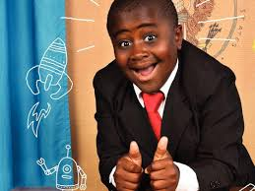
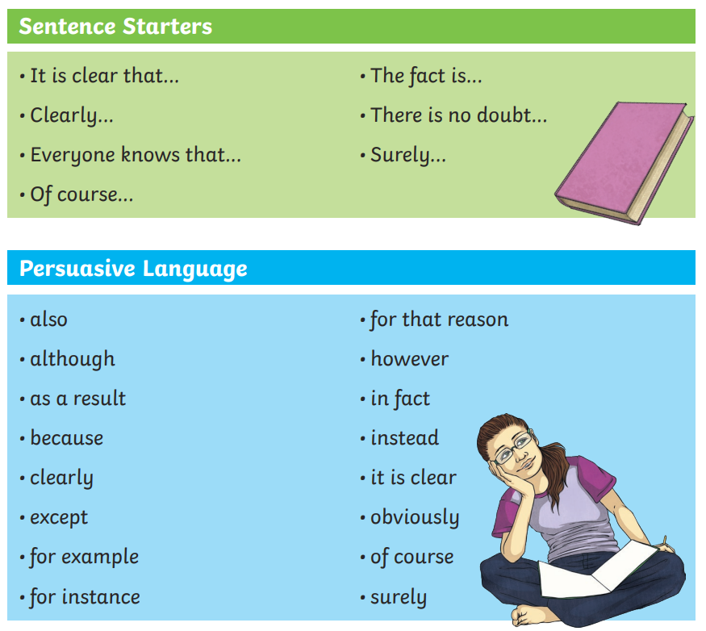
Today, you are going to channel your "inner Kid President". You are going to deliver a powerful speech to your audience persuading them for your freedom.
Pick one of the main points to rehearse your speech: - The stew would have been wasted - My father died and I must provide for my family - Our religion teaches us that we must care for those less fortunate than ourselves.

Slide 35
What features can you spot in this speech?
Please, I beg you—listen to my voice, not just the words of those who do not understand my pain. I am not a thief. I am a son, a brother, and a boy doing his best to survive.
My father is dead. He was strong, kind and brave—the heart of our family. When he died, the world felt colder, darker, and full of fear. Now it is my job to care for my mother and two younger sisters. I cannot let them starve.
I am tired, frightened and alone. But I will not give up. I am determined, honest and strong. Let me go, not because I am begging, but because it is the right thing to do.
If you were in my shoes, what would you have done?
Your turn...

Slide 36
Who will deliver the best speech? Who will add emotion in their voice? Who will make the audience feel guilty?

Slide 37
Write your speech in your book: Checklist: - sentence starters - adverbials - emotive language - the power of three - rhetorical question

Slide 38
Thursday 15th May TBAT- respond to a suggested stimulus and design and build a model set which conveys my interpretation of the narrative. 2 in 2 1. What do we have to think about when designing a stage set? 2. What enhances the audiences' enjoyment of a show?

Slide 39
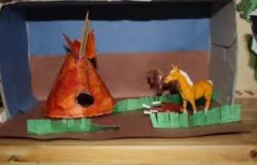
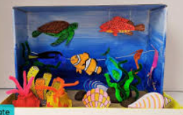
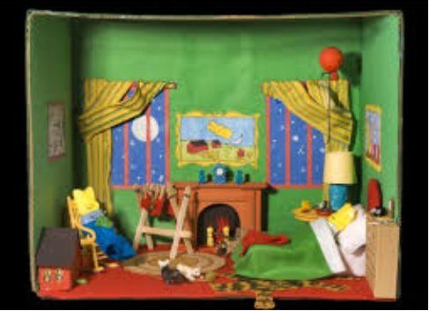
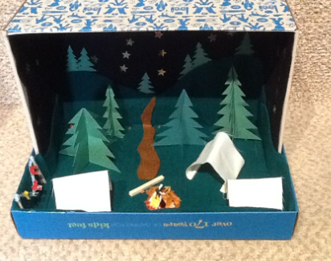
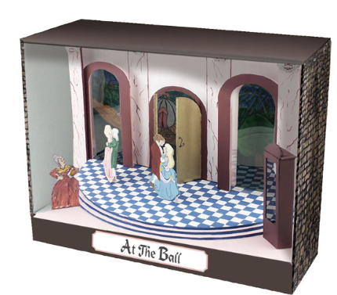
Thursday 15th May TBAT- respond to a suggested stimulus and design and build a model set which conveys my interpretation of the narrative. Using your design from last week (SHREK) begin to design your back-drop. Think about what other props would be on the stage and what would be needed on the background.

Slide 40
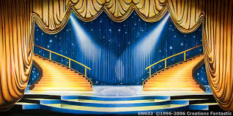
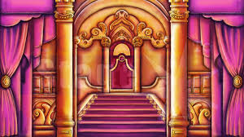
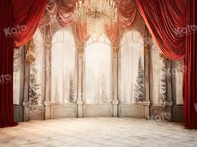
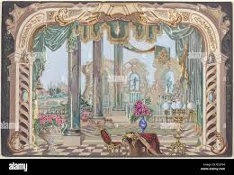
Thursday 15th May TBAT- respond to a suggested stimulus and design and build a model set which conveys my interpretation of the narrative. Using your design from last week (SHREK)begin to design your back-drop. Think about what other props would be on the stage and what would be needed on the background.

Slide 41
Thursday 15th May TBAT- respond to a suggested stimulus and design and build a model set which conveys my interpretation of the narrative. SHREK: Measure your background and ensure your paper is the same size. Think about colours and outlines. Keep objects large and bold so they can be seen No little details - as it cannot be seen from the audience THINK- what is needed in the background and what will be a prop or scenery on the stage?

Slide 42
Thursday 15th May TBAT- respond to a suggested stimulus and design and build a model set which conveys my interpretation of the narrative. Outcome: Children will have the opportunity to draw, build and paint and by the end they will have an atmospheric and dramatic set in response to text. Use sketchbooks throughout to come up with ideas, jot down thoughts, test materials and reflect

Slide 43
Get Set 4 PE - Lesson Plan -4 for Year 5 Cricket

