Slide 1
367 x 7 = 2) 345 x 12 = 3) 455 divided by 5 = 4) 1, 245 divided by 3 = 5) 1.67 + 1.89 + 2.88 = 6) 18.92 - 3.07= 7) 56, 726 + 12, 999= 8) 67, 625 – 41, 676 = 9) 4/5 + 3/5 = 10) 4/7 - 2/7 =

Slide 2
Wednesday 14th May TBAT: Recognise formal and informal language. Unjumble the 'ere' words: rspehe hhimresepe rriftneee hdaree

Slide 3
Wednesday 14th May TBAT: Recognise formal and informal language. Make this sentence more formal: I'm going to a party on Saturday. Upskill the vocabulary in this sentence to make it more formal: Are you coming to the party?

Slide 4
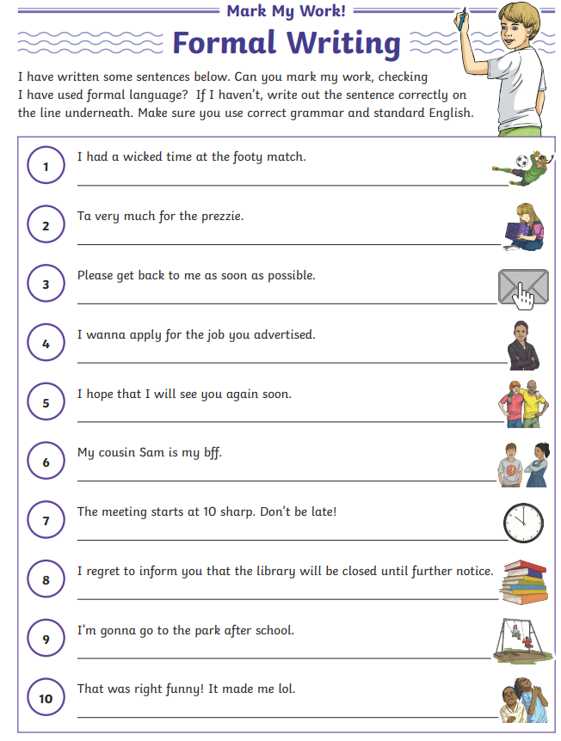
Wednesday 14th May TBAT: Recognise formal and informal language. Mark my work - Let's look at the first two together... How can we improve these sentences?

Slide 5
9:20- 9:30 Class work: Count in 7s Activity: back of books

Slide 6
TBAT- rotate shapes. 3 in 3 1) 67% = ______ = 2) 60 x 60 = 3) 2/3 x 6 =
Challenge:
A square-based pyramid has 5 edges and 5 vertices. True or false?

Slide 7
Daily 10 x 7s Daily 10 - Mental Maths Challenge - Topmarks

Slide 8
Talk partners: What is the difference between translate, rotate and reflect? Translate = Reflect= Rotate=

Slide 9
Reflection - Maths - Learning with BBC Bitesize

Slide 10
Talk partners: reflection, translation or rotation?
I think that it is _________________ because...
I agree/I disagree
Blue
Green

Slide 11
Mr Little says..... Miss Smith says.... Listen to the instruction carefully and turn the number of degrees in the correct direction.

Slide 12
Talk partners: What rotation has happened?
Word bank: clockwise anticlockwise degrees

Slide 13
Class work:

Slide 14
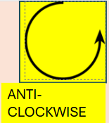
Talk partners, followed by whiteboard work:
Vertex a has been rotated 90 degrees clockwise.
True or false?

Slide 15
Whiteboard work:
The coordinates for the rotated shape are (5, 5) (5, 7) (7, 7)
(8, 6) (7, 5).
True or false?

Slide 16
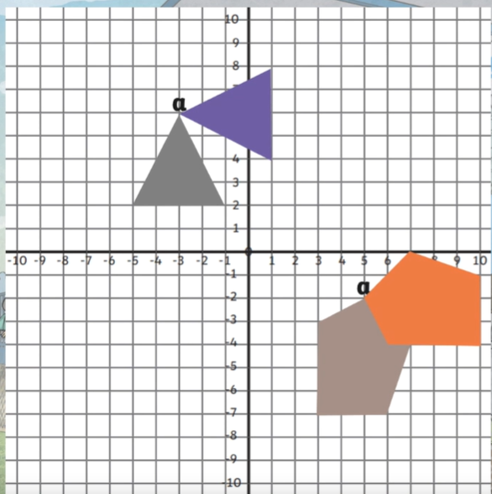
Class work: The shapes have been rotated 270degrees anti- clockwise from vertex a. True or false?

Slide 17
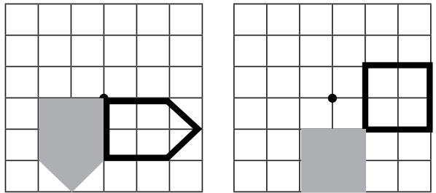
How have the shaded shapes been rotated?
Blue Green
Word bank: clockwise anticlockwise degrees

Slide 18
Rotate the shape
90˚ clockwise about the origin
Whiteboard work:
CLOCKWISE
ANTI-CLOCKWISE
Shane thought the answer was C.
Do you agree with his answer?
Why do you think he got this answer?
B
D
C
A

Slide 19
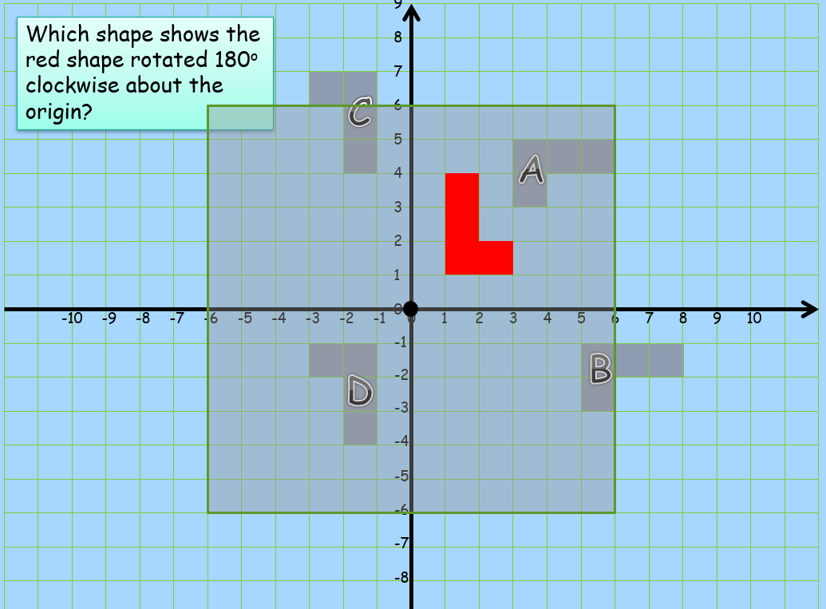
Whiteboard work:

Slide 20
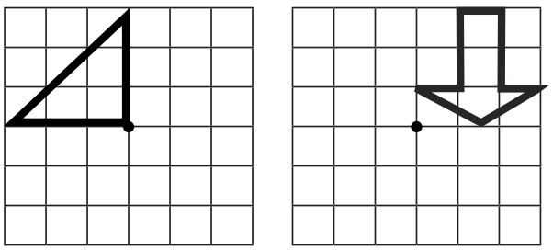
Independent: Use a ruler to rotate 90 degrees clockwise around the black dot. use a ruler to rotate the shape 180 degrees clockwise around the dot.

Slide 21
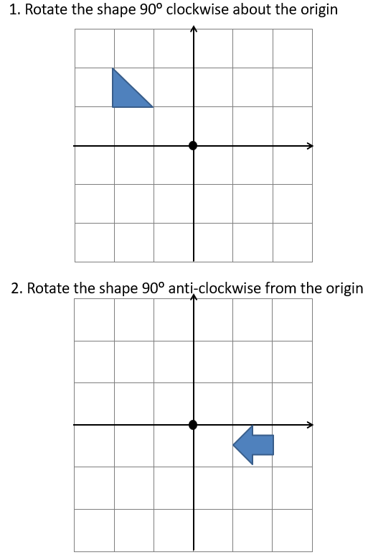
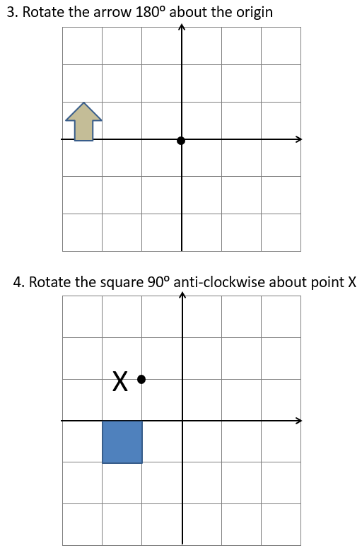
Independent:

Slide 22
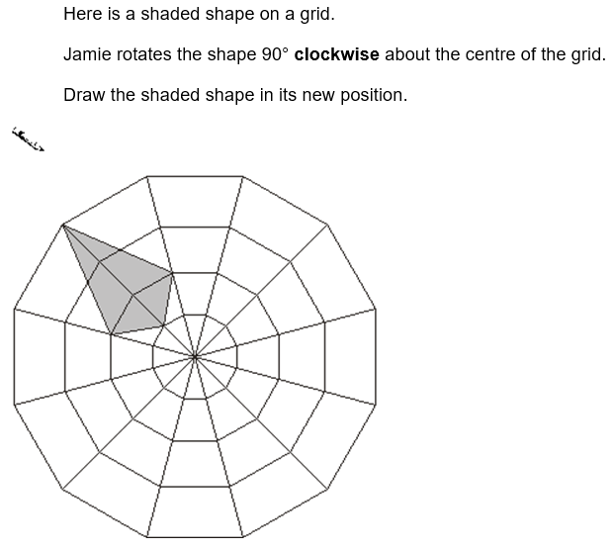
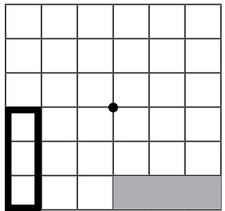
Challenge: Adam says that the best way to rotate this shape is to turn is 270 degrees clockwise. Is this the quickest rotation? Explain.
Mastery:

Slide 23
Wednesday 14th May TBAT: Recognise the features of a persuasive letter. 2 in 2 1. Rewrite the following sentence in a more formal tone: I'm writing to ya to tell ya to let me out of jail. 2. Think of an appropriate preposition to start the following sentence: _____________ I sat quietly, hoping the early morning mist would bring fish to my net.

Slide 24
Persuasive Letter Writing
There are some important things to remember when writing a persuasive letter.
You have to lay out your letter properly:
Write your address.
Write the address of who you are
writing to (the recipient’s address).
Write a greeting (the recipient’s name).
Write the full date.
Write about the topic and persuade
your reader.
Close your letter.
Write your full name.

Slide 25
Your Address
This goes on the top right-hand side of the letter:
Your house name/number,
Street,
Town/City,
County
Example:
123 Apple House,
Blueberry Road,
Exeter,
Devon

Slide 26
The Recipient’s Address
The address of who you are writing to goes on the top left-hand side of the letter:
Their house name/number,
Street,
Town/City,
County,
Example:
567 Banana House,
Raspberry Road,
Exeter,
Devon

Slide 27
The Full Date
This goes on the top right hand side of the letter, under your address.
Example:
Tuesday 1st March 2016

Slide 28
Greeting
If you do know who the letter is to, begin it with either Mr, Miss, Mrs, Ms and their surname, then a comma:
Example:
Dear Miss Smith,
If you don’t know who to address the letter to, begin it with:
Example:
Dear Sir or Madam,

Slide 29
Persuasive Argument
Introduce the topic you are writing about and state the argument– do you agree or disagree? Why?
Explain in detail, using words such as: Firstly… Secondly… In my opinion… Some believe that… I feel that… I am sure that…
Describe, using great adjectives.
Argue why it is so good or bad – be enthusiastic!
Use powerful verbs.
Give reasons for and against – use evidence.
Ask the recipient questions to get them thinking and make them realise they need this.
End with a summary of what you need.

Slide 30
Closing Farewell
If you do know who the letter is to, close your letter on the left-hand side with:
Yours sincerely,
(Your Full Name)
If you don’t know who the letter is to, close your letter on the left-hand side with:
Yours faithfully,
(Your Full Name)

Slide 31
Persuasive Letter Example Let's identify the features together...
125 Banana House,
Blueberry Road,
Exeter,
Devon
Tuesday 1st March 2016
Dear Miss Smith,
I am writing to let you know about a very serious problem: your monkey. Merlin the monkey. As you know, I absolutely love monkeys, they are beautiful, cheeky, energetic and hilarious. However, I have had enough of it stealing all my bananas and it has to go! Merlin must, must, must be given to the zoo!
Firstly, I work every day to earn enough money to buy my favourite snack, but every time I go to eat one of my precious bananas, they’ve been stolen by Merlin the monkey! Friday evening for example – he stole my best bunch! Is that fair on me?
Secondly, he is actually breaking the law by trespassing into my home uninvited. In my opinion you should only have pets that you can control. I know some believe monkeys are fun pets, but I feel that they should just be enjoyed by safely visiting them in the zoo. I am sure that you would agree. Don’t you think it would be kinder to the poor animal?
Merlin is, after all, a wild animal who should be spending his days climbing ropes, swinging on branches and chasing other glorious monkeys around. You know it’s true! Please visit the local zoo as soon as you can, I could even come with you! Do the kindest thing… not only for me, but for Merlin.
Yours sincerely,
Mr Chair (Your kind and thoughtful neighbour)
123 Apple House,
Blueberry Road,
Exeter,
Devon

Slide 32
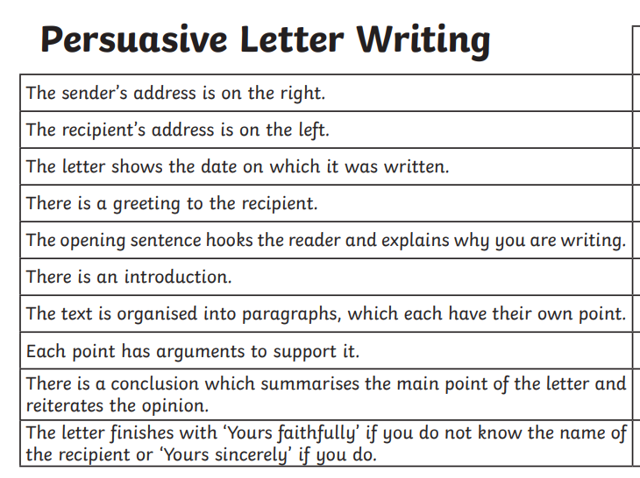
Persuasive Letter Example Your turn – identify the features of the persuasive letter using the examples on your table.

Slide 33
Using the examples given to you, begin to write your first main point to the judge. Main point 1 – Jabir was desperately hungry. He did not steal. He knew the drop of stew would be wasted: I am writing to you with deep sorrow and great hope that you will listen to my plea. I have been wrongly accused of being a thief, when all I did was catch a single drop of stew that had slipped from the tagine in Mousa’s house. That drop was not mine, but it was about to fall and be wasted on the stove. I was starving, and I acted out of desperation—not greed.

Slide 34
SCIENCE
Wednesday 14th May
TBAT: know that some materials dissolve in a liquid to make a solution.
3 in 3
Name a material which is translucent
Give 2 properties of glass
What material would be a good thermal insulator?
CHALLENGE
What are the pros and cons of a plastic chair?

Slide 35
Properties and Changes of Materials
I know that some materials dissolve in a liquid to make a solution.

Slide 36
Last Lesson Recap
1
Can you remember any magnetic materials?
Can you remember any materials that could help insulate hot drink cups?
Talk with your partner before we discuss it as a class.

Slide 37
Partner Talk
2
When someone puts sugar in a hot cup of tea, what happens to the sugar?

Slide 38
Does the sugar disappear?
3
We know the sugar doesn’t disappear
because we can taste it in the tea.
So if it doesn’t disappear, why can we not see it?
NO!
It is because the sugar has dissolved into the liquid.

Slide 39
Dissolving
4
Some materials dissolve when you mix them with a liquid. When a material dissolves in water, it may look like it has disappeared, but it has just mixed in to make a transparent (see-through) liquid called a solution.
When no more material can dissolve into the liquid, we say that it is saturated.
This is a scientific way of saying it is ‘full’ and no more material can fit into it.

Slide 40
Dissolving
5
Materials that dissolve in water are soluble. Sugar and salt are both soluble. When mixed with water, they dissolve to make a transparent solution.
Materials that do not dissolve in water are insoluble. Sand and flour are both insoluble. When mixed with water, they do not dissolve.

Slide 41
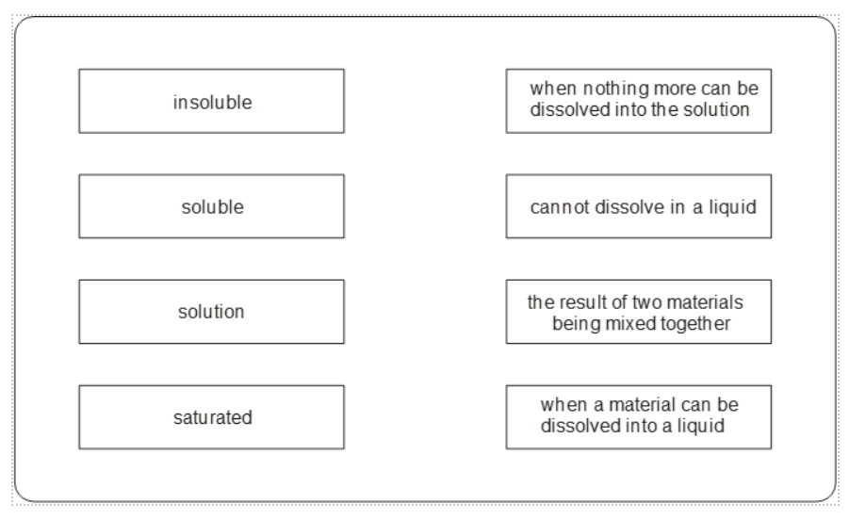
Partner Talk
6
We have just learnt some new scientific words:
dissolve, soluble, insoluble, solution, saturated
www.grammarsaurus.co.uk
Partner Activity
insoluble
when nothing more can be dissolved into the solution
With your partner, can you match up the word with its definition?
soluble
cannot dissolve in a liquid
solution
the result of two materials being mixed together
saturated
when a material can be dissolved into a liquid
www.grammarsaurus.co.uk

Slide 42
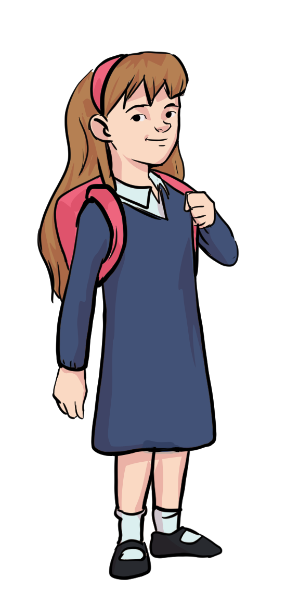
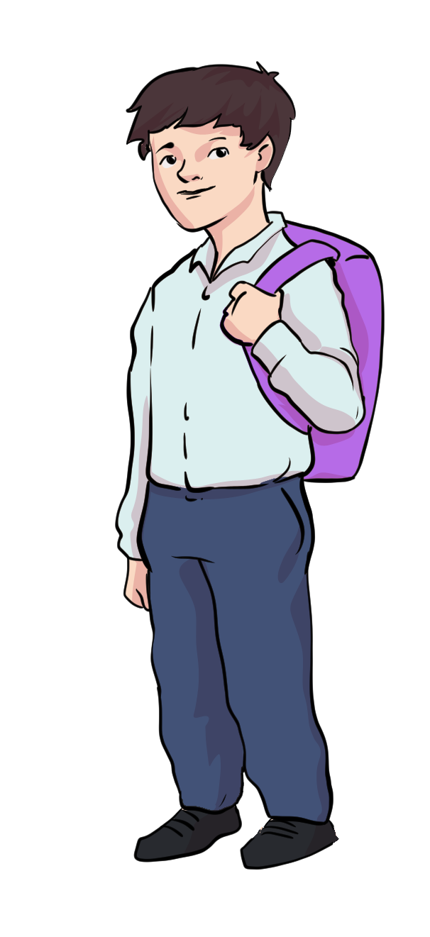
Answers
7
Partner Activity
soluble | can dissolve into a liquid
insoluble | cannot dissolve into a liquid
saturated | when nothing more can be dissolved into the liquid
solution | the result when two materials are mixed together

Slide 43
What does dissolving mean?
In your own words, write the definition of dissolving. Use the words: - Dissolve
Soluble
Insoluble
Solution
Saturated

Slide 46
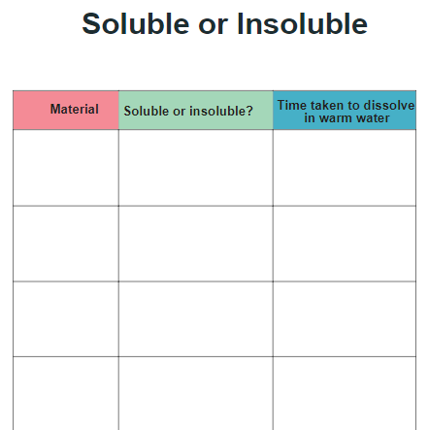
Investigation Time!
8
We will now explore different materials to see if they are soluble or insoluble.
How can we investigate if a material is soluble?
How will we know if it is soluble? What test can we do?
Use the sheet to record your findings. Draw the table in your book:

Slide 47
Thinking Time…
9
When we have dissolved sugar into a liquid
to create a solution, can we get the sugar back?

Slide 48
Thinking Time…
10
When we have dissolved sugar into a liquid to create a solution, can we get the sugar back?
YES!
If you leave the solution, the liquid will evaporate. The sugar particles cannot evaporate, so they are left behind.
You could try this as a class and see how long it takes.

Slide 49
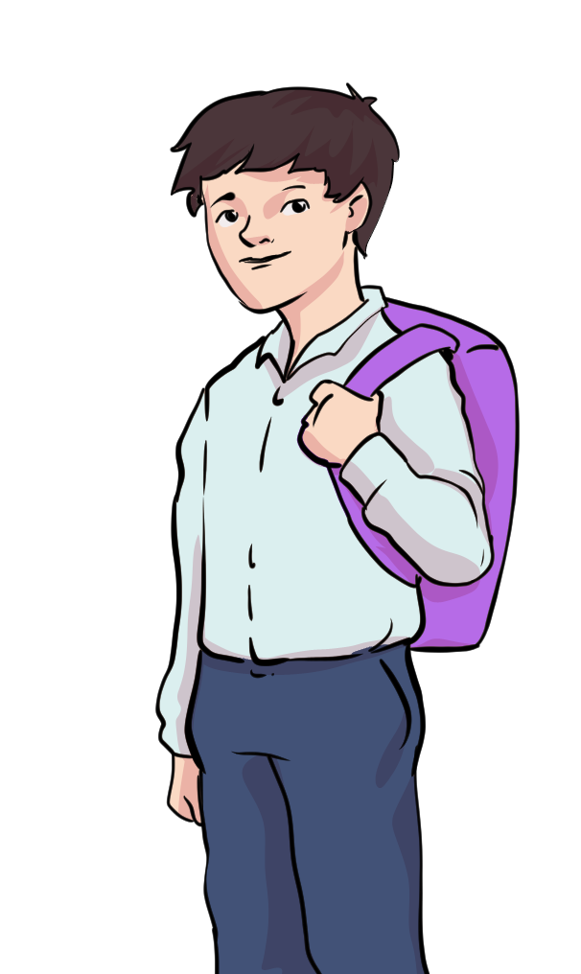
What did we find out?
11
Explain what you found out using scientific vocabulary.
dissolve, soluble, insoluble, solution, saturated

Slide 50
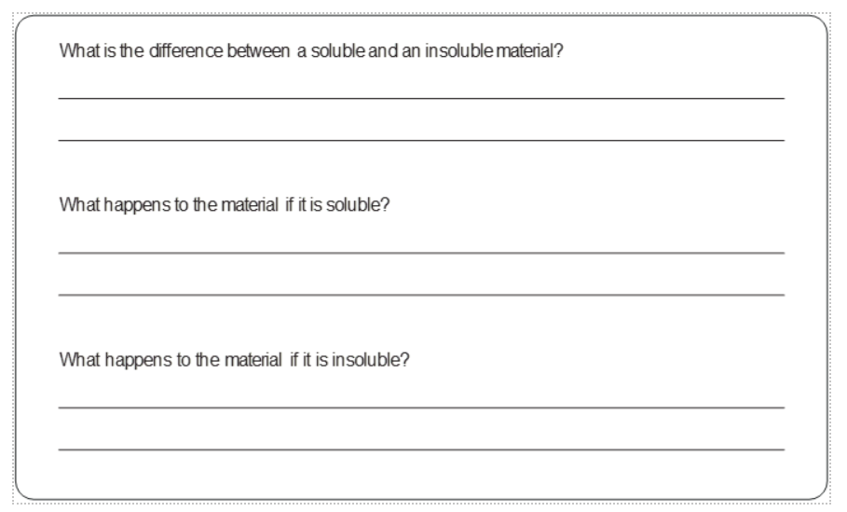
What did we find out? Exit questions
11

Slide 51
TBAT- name a further 11 items of clothing and identify their articles. La fille porte une jupe. Le garçon de 10 ans porte un pull.

Slide 52
Language Angels KS2 – Intermediate. Les Vetements (Clothing) Lesson 2

Slide 53
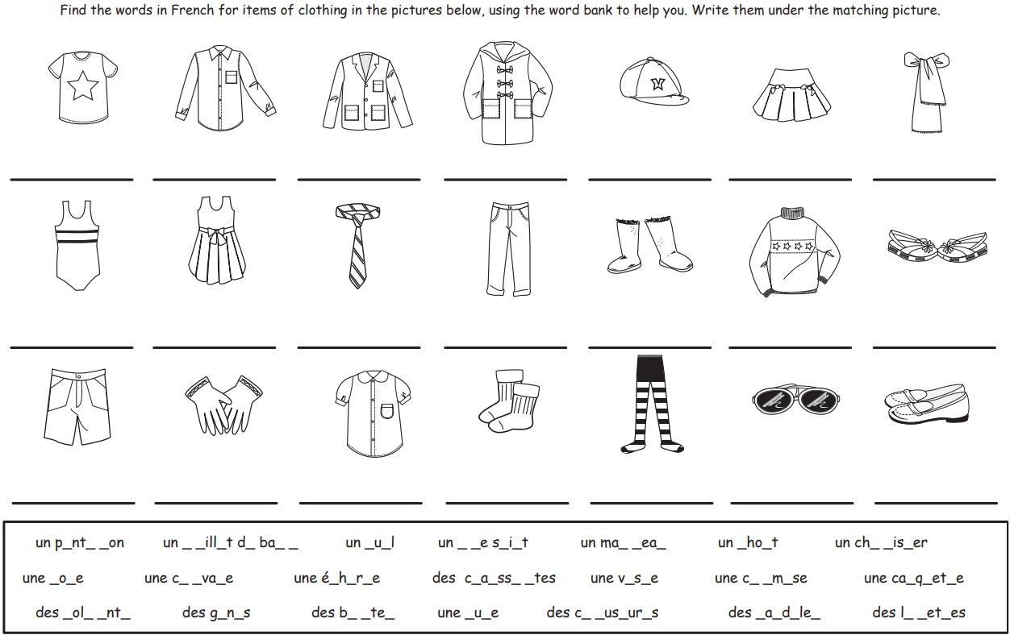

Slide 54
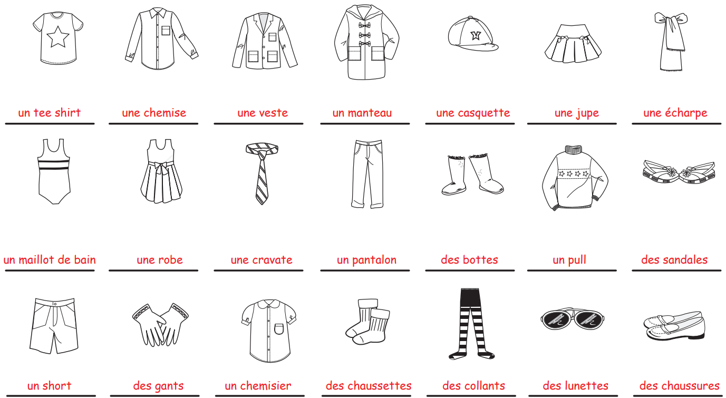

Slide 55
Slide 30 Draw the table in your books

Slide 56
