Slide 1
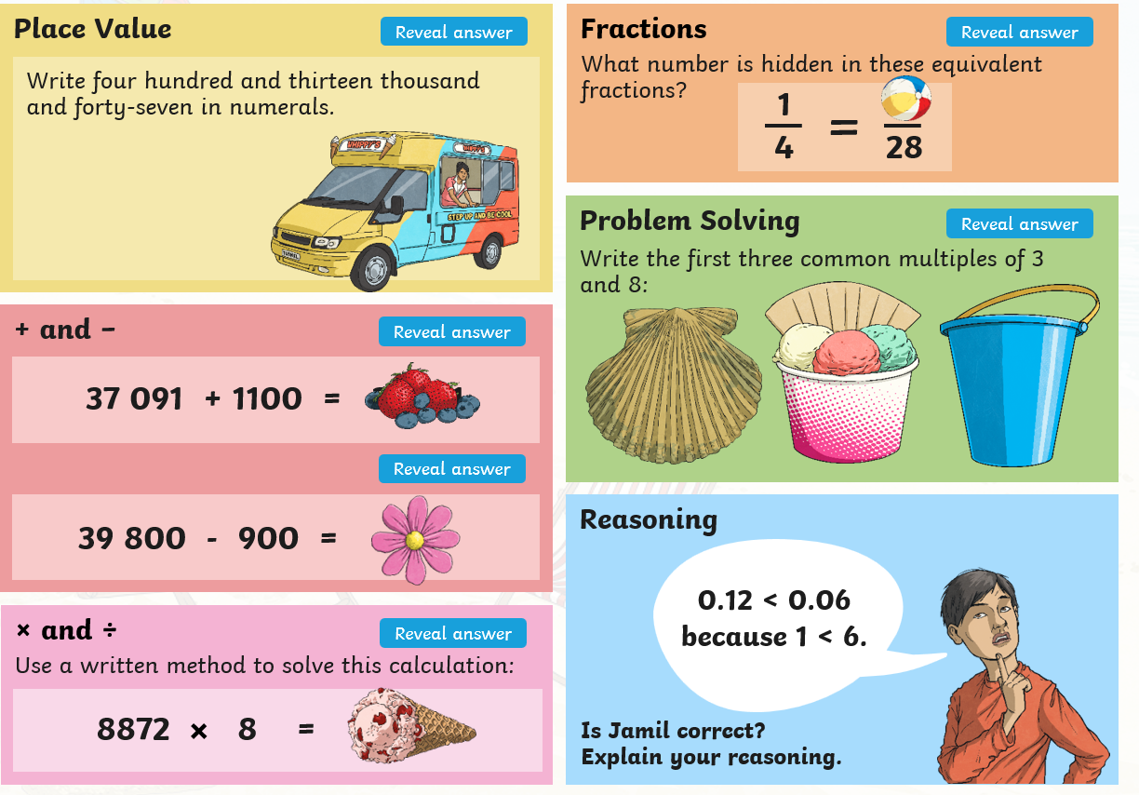
Morning challenge

Slide 2
Tuesday 13th May TBAT: Understand the difference between prepositions and subordinating conjunctions.
Spelling thief – ere words
Sp_e_e I_terf_re A_he_e At_osph_r_

Slide 3
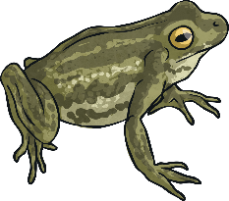
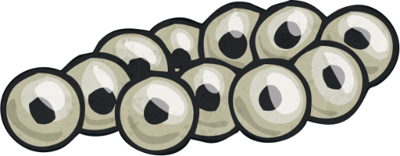
What Are Prepositions?
Prepositions are very important parts of a sentence that indicate location.
Prepositions link nouns, pronouns and phrases to other words in the sentence.
They can tell us the physical location of something, e.g.
The frog was on the lily pad.
They can tell us location in time of something, e.g.
During the spring, the frog lays frogspawn.

Slide 4
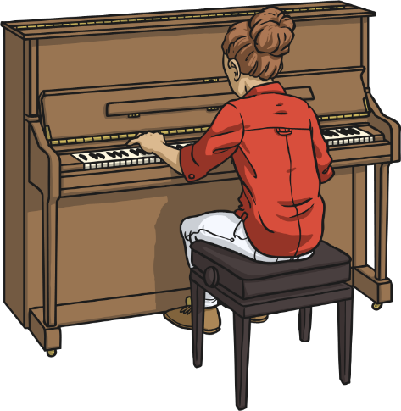
What Are Subordinating Conjunctions?
Subordinating conjunctions are the first words within a subordinate clause.
A subordinating conjunction will have both a subject and a verb following it, forming a subordinate clause, e.g.
subject
verb
Suki could pass the exam
if she practised her piano.
if she practised her piano.
subordinate clause

Slide 5
Subordinating Conjunctions to Start Sentences
Subordinating conjunctions can also be used as the first word in a multi-clause/complex sentence.
When the subordinate clause comes before the main clause, make sure you remember to use a comma to mark where the subordinate clause ends.
subject
verb
Suki could pass the exam
if she practised her piano.
subordinate clause

Slide 6
Subordinating Conjunctions to Start Sentences
Subordinating conjunctions can also be used as the first word in a multi-clause/complex sentence.
When the subordinate clause comes before the main clause, make sure you remember to use a comma to mark where the subordinate clause ends.
subject
verb
If she practised her piano, Suki could pass the exam.
subordinate clause

Slide 7
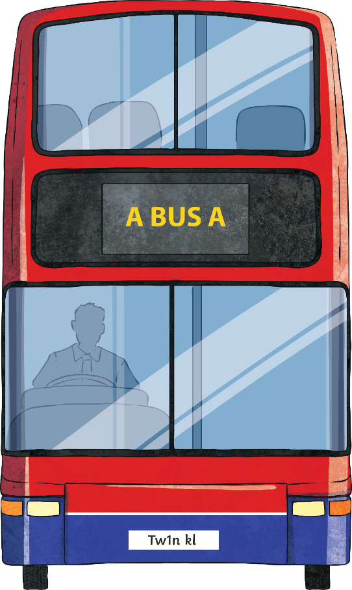
Subordinating Conjunctions to Start Sentences
Some words can act as more than one class, depending on how they are written in a sentence.
There are a number of words that can be either prepositions or subordinating conjunctions.
These are:
after
before
until
since
as
Remember ‘A BUS A’!

Slide 8
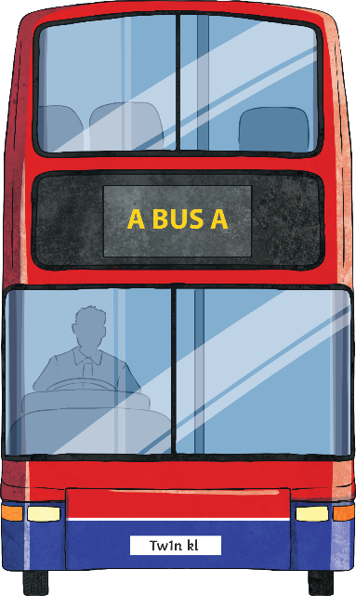
Is It a Preposition or a Subordinating Conjunction?
Remember the rules to help you decide:
A subordinating conjunction will have both a subject and a verb following it, which forms a subordinate clause, e.g.
After Sophie kissed the frog…
Before Abdul jumped on the bus…
Until your shouting stops…
Since we enjoyed the show…
As George tied his shoelaces…

Slide 9
Is It a Preposition or a Subordinating Conjunction?
If you see one of these five prepositions with a noun (with or without added determiners or adjectives before it) then you have a prepositional phrase, e.g:
After the victorious football tournament…
Before lunch…
Until Easter…
Since the trip to Disneyland…
As a helpful teammate…

Slide 10
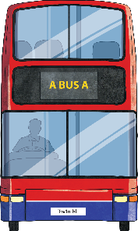
Quick Quiz: Question 1
Can you finish the following sentences with an appropriate preposition?
No one is allowed out 8 o’clock.
the winning team, it is important to shake hands with your opponents.
dinner, you must wash your hands.
I have felt sick lunchtime!
She read the book bedtime.
Remember A BUS A!

Slide 11
Answers
Can you finish the following sentences with an appropriate preposition?
after
No one is allowed out 8 o’clock.
the winning team, it is important to shake hands with your opponents.
dinner, you must wash your hands.
I have felt sick lunchtime!
She read the book bedtime.
As
Before
since
until
Remember A BUS A!

Slide 12
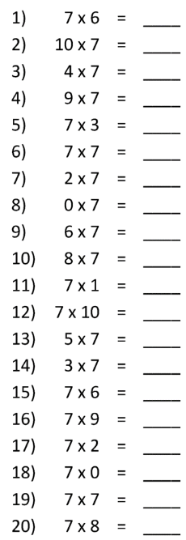

Slide 13
13.5.25 TBAT: reflect in an axis or line.
3 in 3
7/8 – ¼ = Challenge:
73 divided by 3 1.03 divided by ? = 0.103

Slide 14
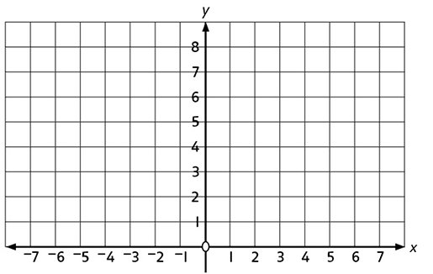
Write the coordinates for your shape.

Slide 15
Talk partners: What is the difference between translate and reflect? Translate = Reflect=

Slide 16
Class work:

Slide 17
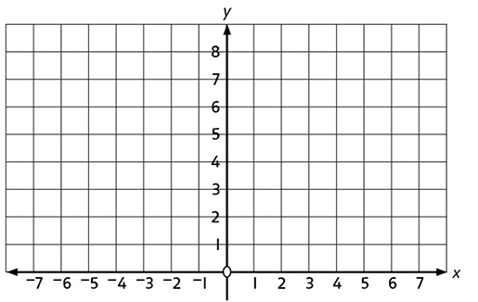
Independent practice:
Plot the point (2,3) and (3,5) and join with a line.
Now we are going to reflect this line in the y axis.

Slide 18
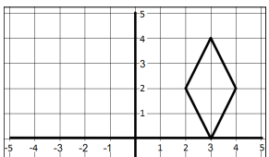
Talk partners:How would we reflect this shape?

Slide 19
Reflect your shape across the axis and write your new coordinates.

Slide 20
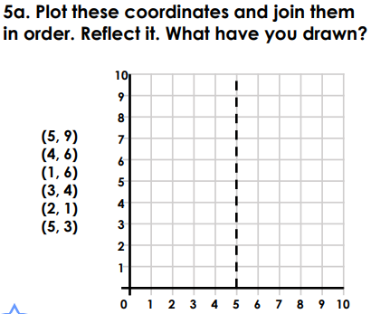
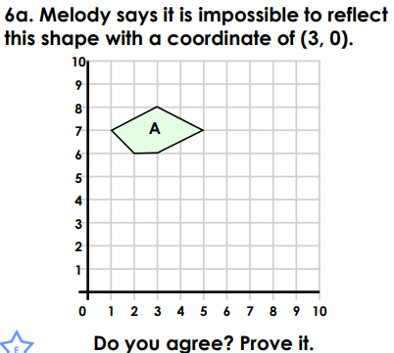
Independent:

Slide 21
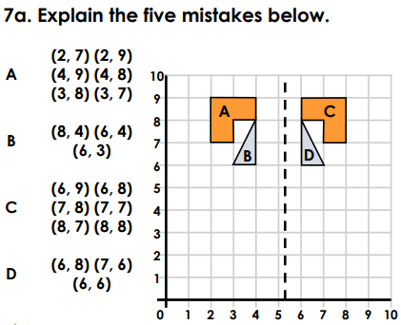
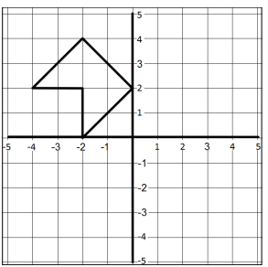
Challenge: Mastery:

Slide 22
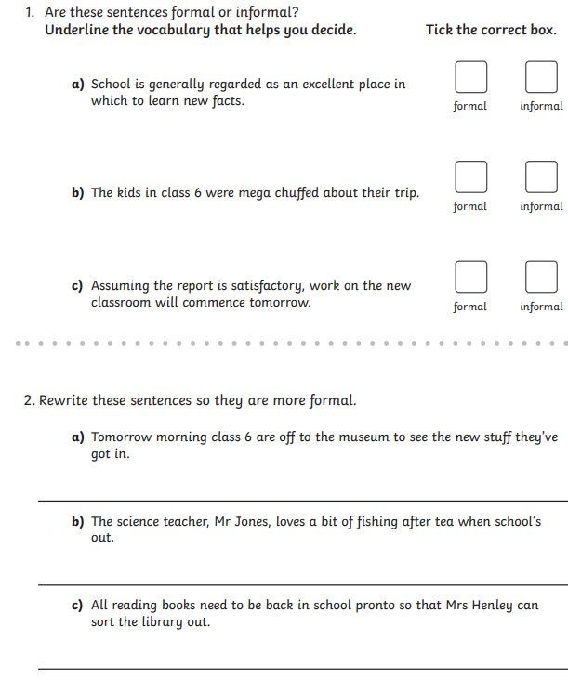
Tuesday 13th May TBAT: Recognise and use formal language. 2 in 2

Slide 23
Tuesday 13th May TBAT: Recognise and use formal language. Talk partners The following sentence is formal – true or false? Explain your answer. The white stuff has hit the UK this week and Wednesday is gonna be freezing, with temperatures nosediving to minus two degrees.

Slide 24
Standard English is the form of the English language that is accepted as the usual, correct form and does not use any slang.
‘Was’ and ‘were’ are the two simple past tense forms of the verb ‘to be’.
Was is used for first and third person singular. I was happy.
Were is used for second person singular and for plural. We were happy.
‘Did’ and ‘done’ are two forms of the verb ‘to do’. Did is the simple past form of the verb ‘to do’. I did my homework.
Done is the past participle of the verb ‘to do’ I have done my homework. used to create the perfect form.

Slide 25
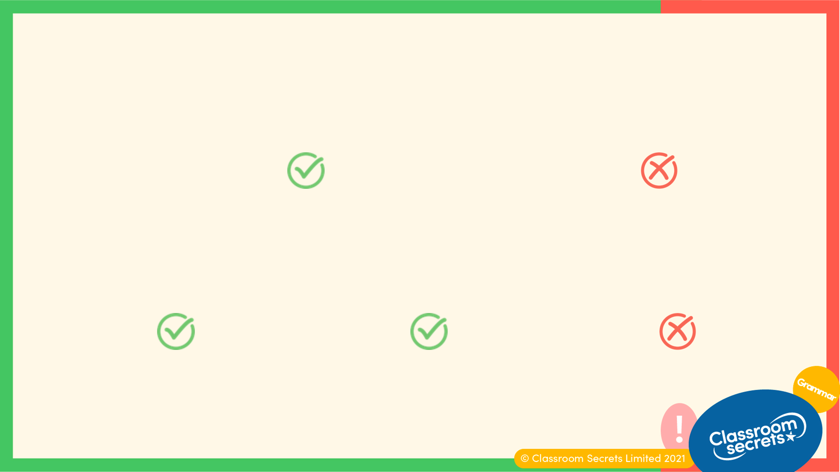
Standard English is the form of the English language that is accepted as the usual, correct form and does not use any slang.
‘Have’ and ‘of’ are commonly confused when modal verbs are followed by the verb ‘to have’.
I should have eaten my peas. I should of eaten my peas.
‘These’, ‘those’ and ‘them’ are commonly confused due to different dialects.
These oranges those oranges them oranges
Them cannot be used as a determiner.

Slide 26
Class work:
Tick the sentences that use standard English.
A. Yesterday, I were skateboarding at the park.
B. They have done all their chores for the day.
C. I wanted to write them a thank you letter.
D. We should of waited for them to catch up.

Slide 27
Tick the sentences that use standard English.
A. Yesterday, I were skateboarding at the park.
B. They have done all their chores for the day.
C. I wanted to write them a thank you letter.
D. We should of waited for them to catch up.
A should use ‘was’ instead of ‘were’ because it is first person singular. D should use ‘should have’ instead of ‘should of’.
✓
✓

Slide 28
Whether the text is formal or informal depends on the genre, purpose and audience that the piece is intended for.
Formal genres include:
newspaper articles columns, headlines
formal letters address and date at the top, greeting, closure
information texts subheadings, diagrams
They all have specific layout structures and are intended to inform people who are not familiar to the author or are in a professional position.

Slide 29
Each formal style has language appropriate to the subject, which may include factual language, sophisticated vocabulary and jargon.
An example of each of these has been taken from an information text about the heart.
factual language The heart pumps blood around the body.
sophisticated vocabulary Furthermore…
jargon cardiovascular

Slide 30
Informal writing may use a more relaxed style which may include colloquial language and slang.
An example of each of these has been taken from a postcard to a friend.
colloquial language We’re having a great time.
slang It was fab!
Informal texts are intended for people who are familiar to the author. Therefore, a conversational style is more appropriate.

Slide 31
If we compare formal and informal writing next to each other, we can identify key differences.
Formal: They were determined to succeed on this occasion.
Informal: They’re gonna thrash them.
not contracted
sophisticated vocabulary
contracted
colloquial language

Slide 32
White board work
Sort the statements into formal and informal.
Formal
Informal
That’s rubbish! Kick-off’s at 10. The presentation was excellent.
The assignment is complete. It’s a bit chilly! It requires immediate attention.

Slide 33
Sort the statements into formal and informal.
Formal
The presentation was excellent.
The assignment is complete.
It requires immediate attention.
Informal
That’s rubbish!
Kick-off’s at 10.
It’s a bit chilly!
The formal statements all include sophisticated vocabulary, for example: presentation, assignment and attention. The informal statements all include contractions and colloquial language, for example: rubbish, kick-off and chilly.

Slide 34
In books:
Ron says that Haley’s writing is too informal to send to the head teacher.
 | Dear Mrs Holland,
 | I’m writing to you because we want to have more playground equipment.
 | It’s boring at the moment at playtimes and we need to have something to
 | do. We’d like to use some school money to buy cool toys for breaktimes.
 | Thanks, Haley
Do you agree? Explain how you know, using examples.

Slide 35
Independent work: Imagine you are Jabir. Write the opening to a formal letter to the Judge asking for your freedom. Which phrases are the most appropriate to use?
I am writing to persuade you to consider... I’m sure you’ll agree with me when I say... I urge you to reflect on the importance of... You only need to open the letter and not go into too much detail. Dear Honourable Judge,
I am writing to you with a heavy heart and a plea for justice. I understand that laws must be obeyed, but I believe a terrible mistake has been made. I am just a poor fisherman’s son, and I never meant to steal. The drop of stew would have landed in the stove. I ask you, with all the respect in my heart, to reconsider my punishment, for I have been wrongly imprisoned and all I wish is to return home to care for my mother and sisters.

Slide 36
Music 13.5.25 TBAT: learn about the use of sound effects to movies
The Collins Hub Educator > Library At the movies – Lesson 2 (Abstract Albert) – Activities 1 and 2 - Which instrument plays the music track? - What do the sound effects add? Discuss the different tracks.

Slide 37
TBAT- know that companies alter images for adverts. 2 in 2 Give one way that an image can be altered. What makes our bodies amazing?

Slide 38
Which image is real? What alterations have been made?

Slide 39
Task 1: Circle the image that you believe is the original and unfiltered image. Make jottings about what changes have been made.

Slide 40
Talk partners: What makes a good advert? Think of an advert that you have seen that makes you want to purchase the item.

Slide 41
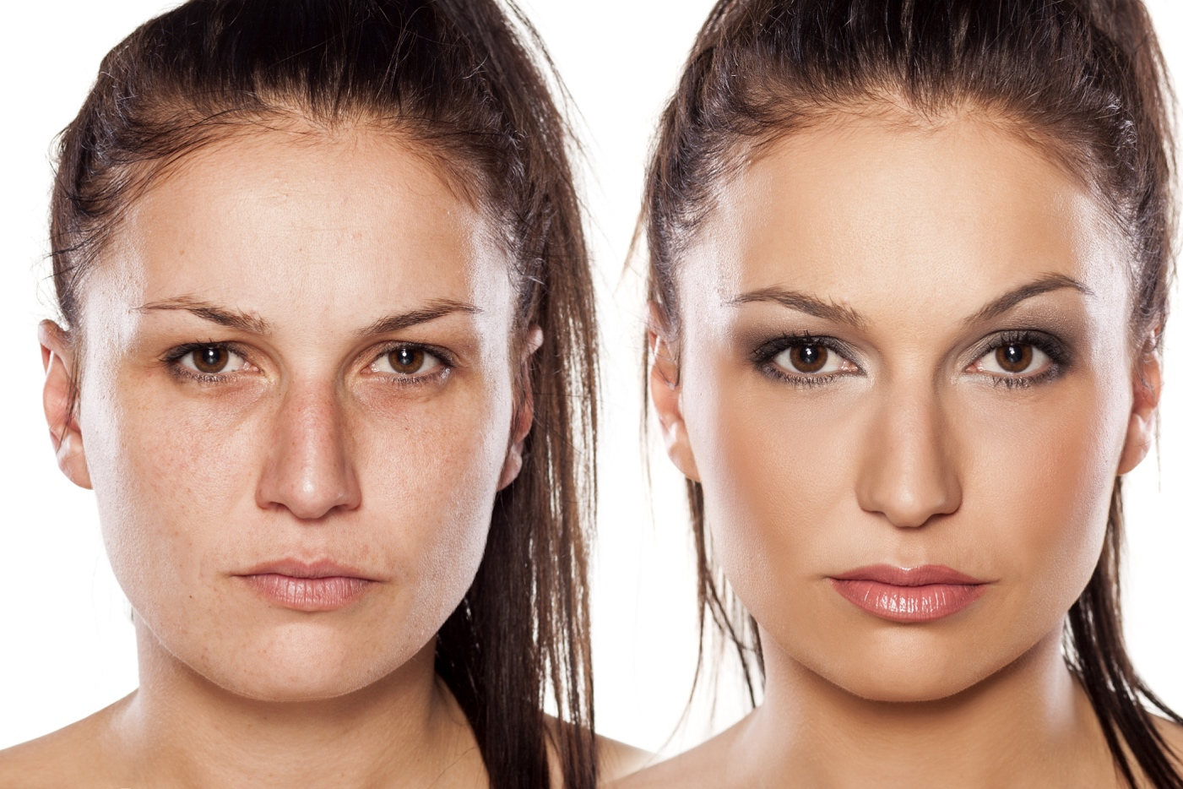
Discuss
Does it matter if images that have been significantly altered are used in adverts, online, or otherwise published?
Notes:
Ask pupils to record their initial ideas for both sides of the argument for this motion. The ‘before and after’ photos will remind them of what can be achieved.

Slide 44
Dove | Reverse Selfie | Have #TheSelfieTalk (youtube.com)

Slide 45
Write it:
Does it matter if images that have been significantly altered are used in adverts, online, or otherwise published?
I agree that companies ___________
I do not agree that companies________
Notes:
Ask pupils to record their initial ideas for both sides of the argument for this motion. The ‘before and after’ photos will remind them of what can be achieved.

Slide 46
Have you changed your mind?
Notes:
Get pupils to look back at their notes from the beginning of the lesson. Have their minds been changed, having listened to facts and information from the debate? Ask them to think about their own values in relation to body image and how the media can affect this.

Slide 47
Q: Who advanced science, mathematics, and medicine and why are they important?

Slide 48
Blue The Qur'an encourages Muslims to learn, why do you think this is? Green What was the House of Wisdom? Challenge: Why did people travel to the House of Wisdom?

Slide 50
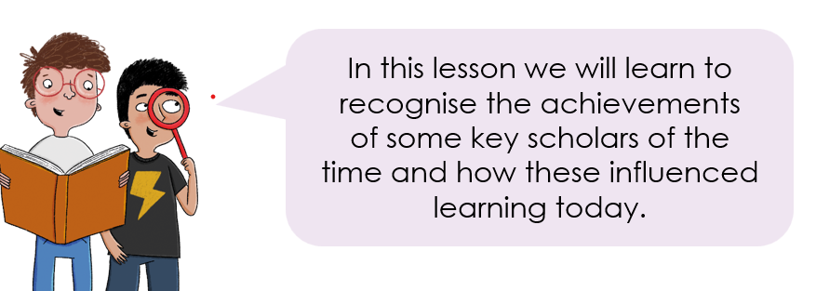
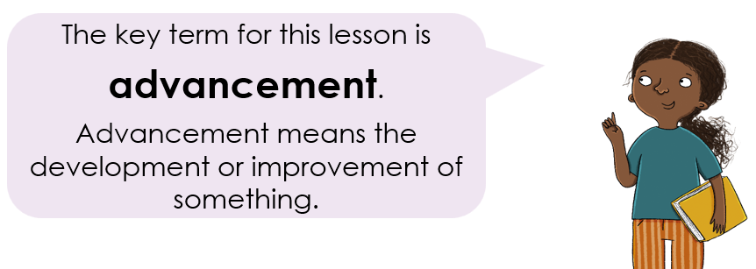

Slide 52
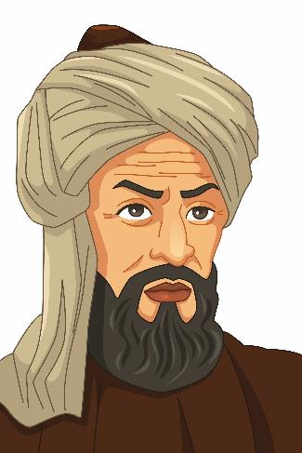
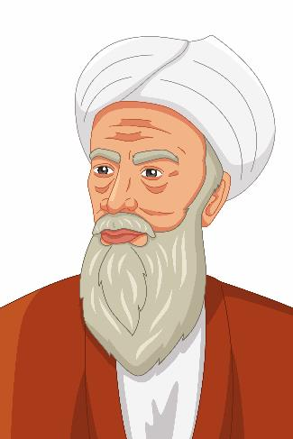
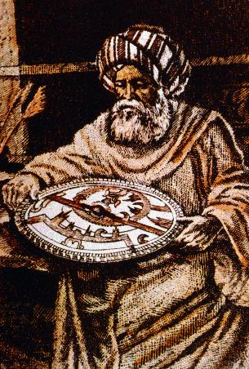
How were advances in science, mathematics, and medicine made?
Lesson 4:
Encouraging learning and providing places for people to learn soon led to many advances in knowledge.
Many people contributed to these advances, but in this lesson you will look at just three of them.
Notes:
Read: How were advances in science, mathematics, and medicine made? This slide mentions that many people contributed to advances in knowledge but in this lesson pupils will look at just three people. If time allows, you could expand this to looking at more individuals such as the men and women mentioned in the Subject Knowledge Guide.

Slide 53
Al-Khwarizmi - Arabic letters and numbers are written from right to left. Have a go at writing these numbers using the Arabic numerals.
Lesson 4:
Notes:
Write: Point out that Arabic letters and numbers are written from right to left. Pupils will have a go at changing our numerals today into Arabic numerals, which may spark discussion about how they evolved from Arabic numerals by looking at the shapes of the Arabic numerals compared to ours. Answers are provided on the following slide.

Slide 54
Arabic letters and numbers are written from right to left. Have a go at writing these numbers using the Arabic numerals.
Lesson 4:

Slide 55
Analyse this extract from the Hawi by Al-Razi.
Lesson 4:
Who?
“When the dullness and the pain in the head and neck continue for three and four and five days or more, and watering of the eyes is abundant, insomnia is severe, and extreme exhaustion occurs, then the patient will progress to meningitis … If the dullness in the head is greater than the pain, and there is no insomnia, then the fever will abate, but the throbbing will be immense and he will progress into a stupor. So when you see these symptoms, then proceed with bloodletting. For I once saved one group [of patients] by it, while I intentionally neglected [to bleed] another group. By doing that, I wished to reach a conclusion. And so all of these [latter] contracted meningitis.”
Where?
What?
Why?
Notes:
Investigation: Pupils should analyse the written source from the Hawi using the questions ‘Who? Where? What? Why?’ to guide them. Answers are provided on the following slide.
(Shortened extract of a translation by Selma Tibi from Al-Razi and Islamic Medicine in the 9th Century found at https://www.jameslindlibrary.org/articles/al-razi-and-islamic-medicine-in-the-9th-century/. The original text is held at the Bodleian Library, University of Oxford.)
Note: Oxford University Press is not responsible for content available on third-party websites. The content of these websites may have changed since publication.

Slide 56
Analyse this extract from the Hawi by Al-Razi.
Lesson 4:
Who?
“When the dullness and the pain in the head and neck continue for three and four and five days or more, and watering of the eyes is abundant, insomnia is severe, and extreme exhaustion occurs, then the patient will progress to meningitis … If the dullness in the head is greater than the pain, and there is no insomnia, then the fever will abate, but the throbbing will be immense and he will progress into a stupor. So when you see these symptoms, then proceed with bloodletting. For I once saved one group [of patients] by it, while I intentionally neglected [to bleed] another group. By doing that, I wished to reach a conclusion. And so all of these [latter] contracted meningitis.”
Written by Al-Razi
Where?
A book called the Hawi, or the Comprehensive Book on Medicine
What?
This is a description of the progression of meningitis
Why?
His book enabled his medical practices to be shared across the world
Notes:
(Shortened extract of a translation by Selma Tibi from Al-Razi and Islamic Medicine in the 9th Century found at https://www.jameslindlibrary.org/articles/al-razi-and-islamic-medicine-in-the-9th-century/. The original text is held at the Bodleian Library, University of Oxford.)
Note: Oxford University Press is not responsible for content available on third-party websites. The content of these websites may have changed since publication.

Slide 57
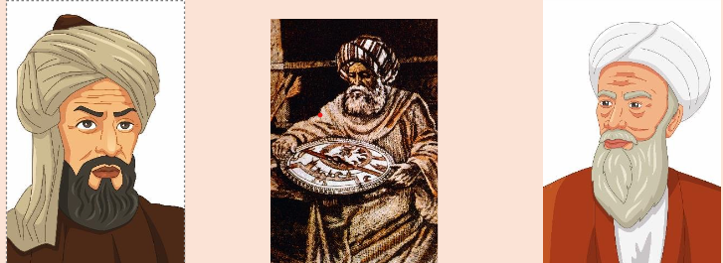
In groups you will read the information sheet and make notes that answer the key question: 1) What did Al-Khwarizmi introduce in mathematics that we still use today? 2) Why was Al-Battani's work important and what did he work out? 3) Why was Al-Razi's work important and what did he work out?
You will then rotate and add further information.

Slide 58
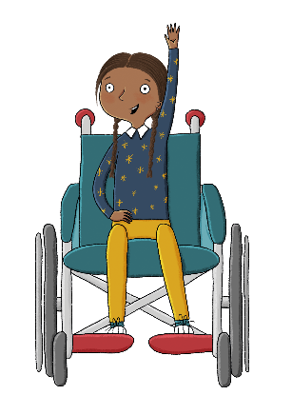
Complete this table, describing the ways in which these scholars advanced science, mathematics, and medicine.
Lesson 4:
Al-Khwarizmi | Al-Battani | Al-Razi
Notes:
Group task: Pupils will use what they have read in the workbook or on the slides to complete the table, describing the ways in which these scholars advanced science, mathematics, and medicine. You could do this either with pupils working in pairs making notes on the three scholars, or ask pupils to work in groups to research one of the scholars then present their findings back to the class. Pupils can then add notes to the scholars they didn’t research. Answers are provided on the following slide.

Slide 59
Complete this table, describing the ways in which these scholars advanced science, mathematics, and medicine.
Lesson 4:
Al-Khwarizmi | Al-Battani | Al-Razi
Al-Khwarizmi was able to create tables that predicted the position of the sun and planets. When he published these tables, they became famous and were used for a thousand years. | Al-Battani was able to refine the calculation of the length of the year. His calculation only made an error of 2.5 minutes, whereas European estimates were nearly 12 minutes wrong! | Al-Razi wrote over 200 books on medicine and other subjects. One of his books stated that the diseases smallpox and measles were very different. This helped people in later years understand how to better treat them.

Slide 60
How does this compare with London in 900CE?
Lesson 4:
In the last lesson we saw how learning and knowledge in London in 900ce was very different to learning in Baghdad.
There was little interest in the ancient Greeks and Romans. There were very few books.
Mathematics was very poor as they were still using Roman numerals, which have no zero.
The focus was almost entirely on studying the Bible and Christian teachings.
Hardly anyone challenged existing ideas or experimented to find answers to questions, as that was seen as unimportant compared with living a Christian life.
Notes:
Talk task: How does this compare with London in 900CE? This is on the teaching slides only and explains that people in London were not using Ancient Roman or Greek findings, and were still using Roman numerals. It is worth pointing out that London was very typical for the time—it was not particularly underdeveloped compared with many other parts of the world but Baghdad was extremely advanced compared with elsewhere.

Slide 61
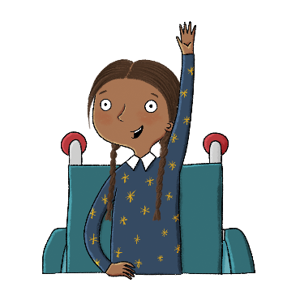
Who advanced science, mathematics, and medicine and why are they important?
Lesson 4:
There were huge advances in science, mathematics, and medicine led by many people in Baghdad.
Al-Khwarizmi is well known for his advancements in science and mathematics.
Al-Battani was an astronomer who calculated the length of the year most accurately.
Al-Razi was described as the greatest physician (doctor) of the Islamic world.
advancement
algebra
astrolabe
astrology
astronomy
observatory
telescope

Slide 62
Exit Questions: 1) Why was Baghdad known as the centre of learning? 2) Baghdad was much more advanced than the rest of the world, what does this mean?

