Slide 1
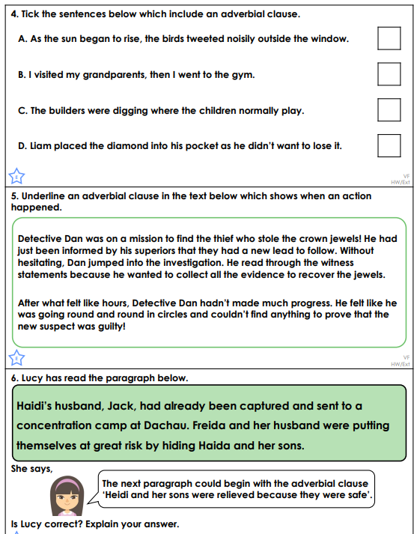
Monday 12th May Morning challenge

Slide 2
Monday 12th May 2025
TBAT: Use joins consistently.
Sincere Interfere Sphere Adhere Severe Persevere Atmosphere Mere Hemisphere Austere Are there any words you are unsure of? Use a dictionary to look them up and then use them in a sentence.

Slide 3
12.5.25 TBAT: read coordinates in 2 quadrants and reflect in an axis or line.
3 in 3
7/8 – ¼ = Challenge:
73 divided by 3 1.03 divided by ? = 0.103

Slide 4
Daily 10 x8 Daily 10 - Mental Maths Challenge - Topmarks

Slide 5
Blue
Green
What does reflection mean?

Slide 6
Reflection - Maths - Learning with BBC Bitesize

Slide 7
Talk partners: What is the difference between translate and reflect? Translate = Reflect=

Slide 8
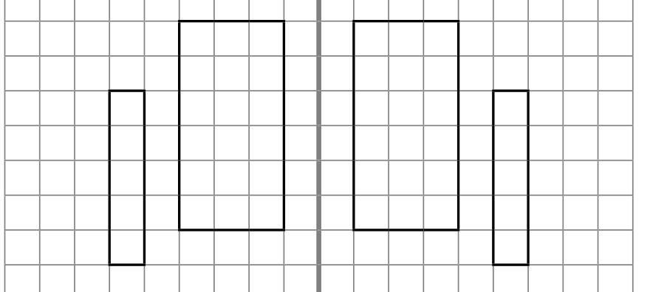
Talk partners: Have these shapes been rotated or reflected? How do you know?

Slide 9
Blue Green
This shows reflection: true or false? Convince your partner.

Slide 10
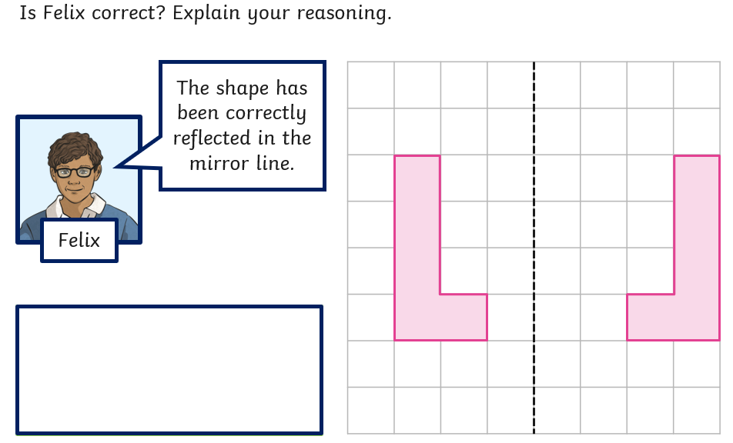
Talk partners:

Slide 11
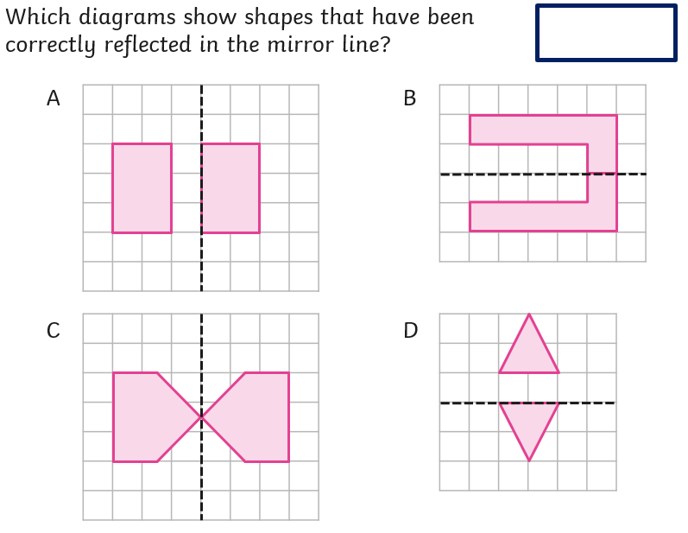
Whiteboard work:

Slide 12
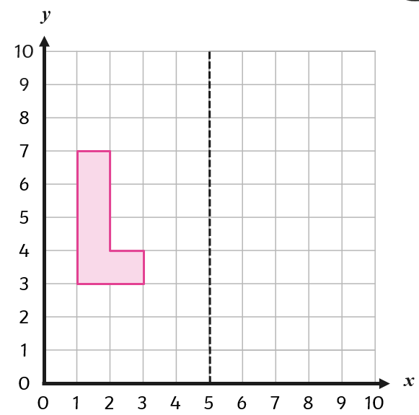
Class work:
Talk partners: How would we reflect the shape?

Slide 13
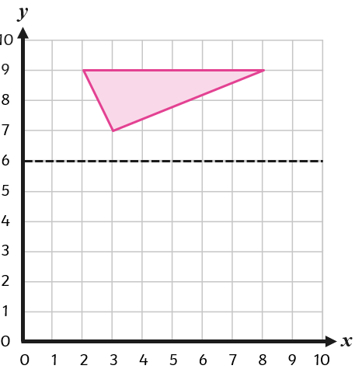
Talk partners:
What are the steps to success to be able to reflect this shape?

Slide 14
Independent practice:
Reflect the shape.

Slide 15
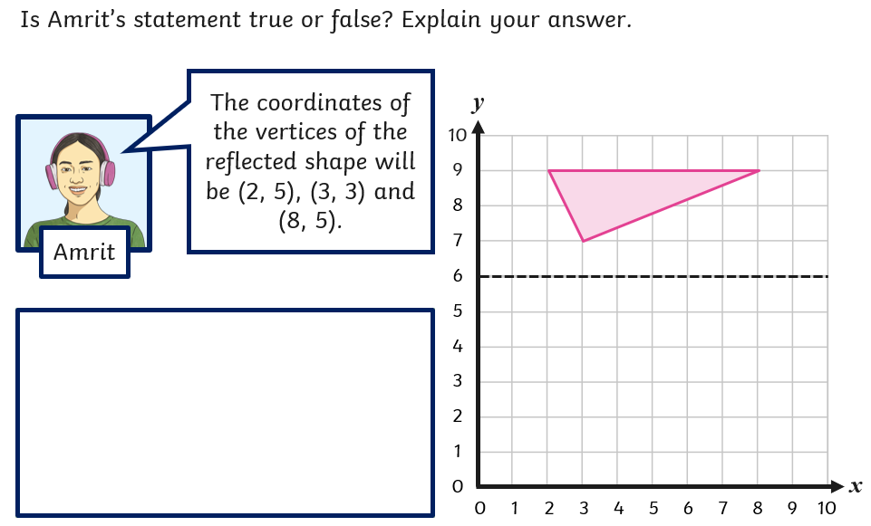
Whiteboard work:

Slide 16
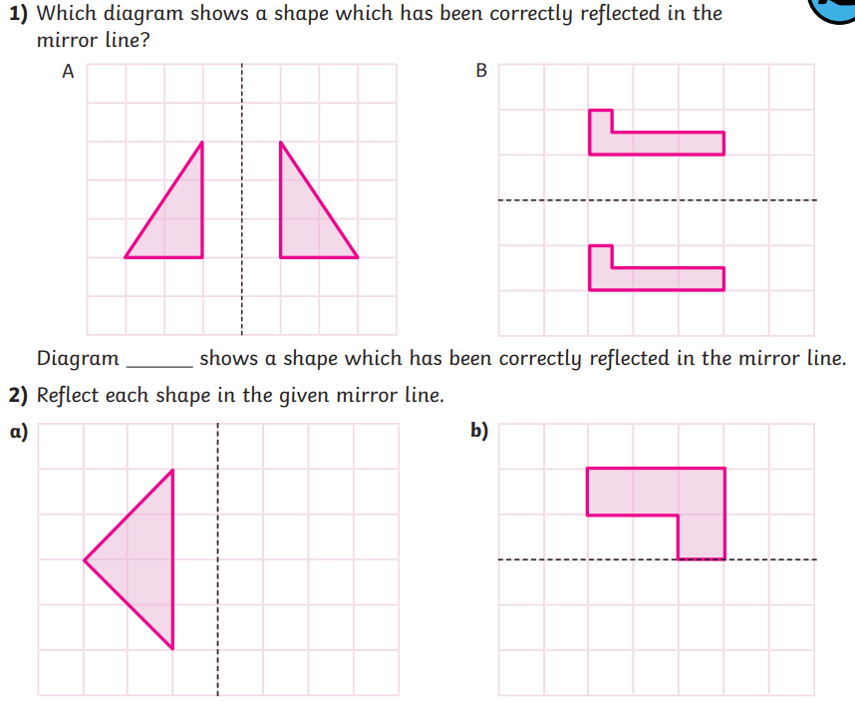
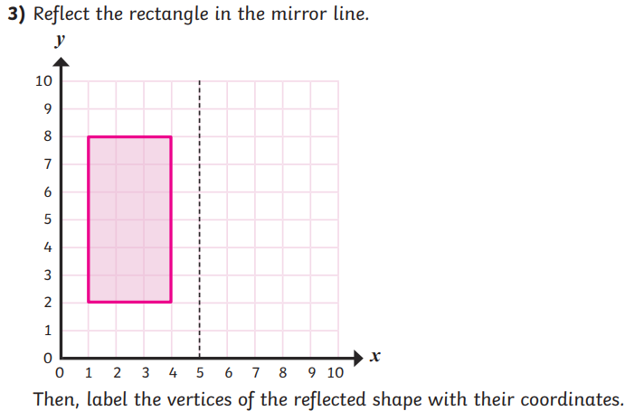
Independent:

Slide 17
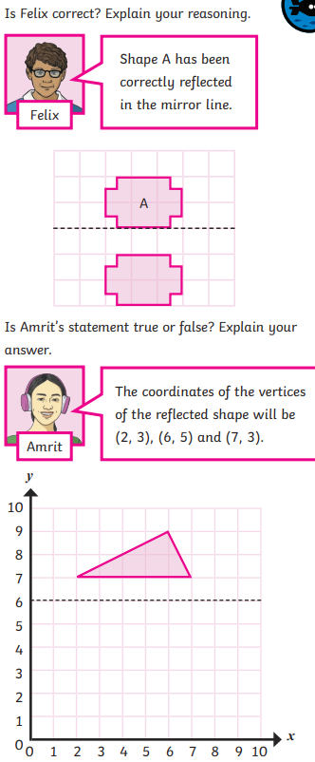
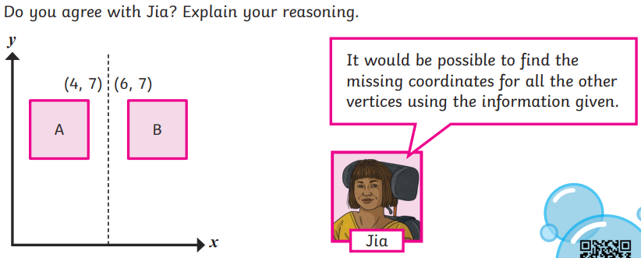
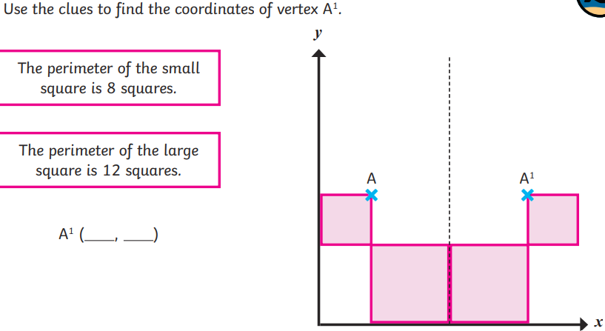
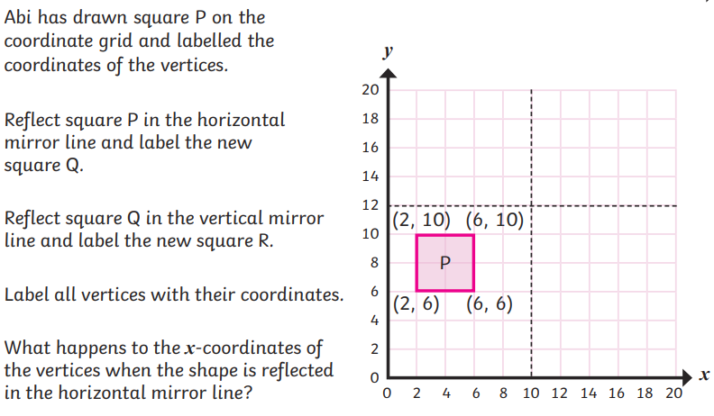
Challenge: Mastery:

Slide 18
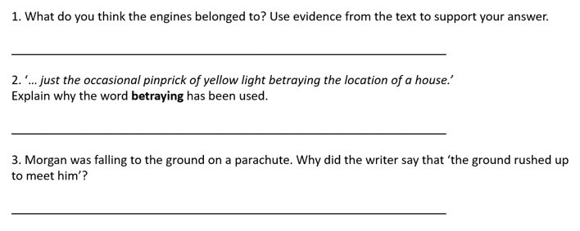
Monday 12th May TBAT: identify and explain how the meaning is enhanced through choices of words and phrases
3 in 3
There was a sudden rush of icy air as the door was opened. Standing at the front of the queue, Morgan was able to look down at the dark shapes far below; just the occasional pinprick of yellow light betraying the location of a house. Suddenly, he heard a voice yelling in his ear, ‘Go, go, go!’ and a sharp push propelled him out into mid-air. As the ground rushed up to meet him, he counted slowly to ten, then pulled the cord. With a jolt, the parachute opened, the roar of the wind and engines faded, and he began to drift downwards in near silence.

Slide 19
Monday 12th May TBAT: identify and explain how the meaning is enhanced through choices of words and phrases
How do you think Jabir will break free for the cellar?
Why is Yusuf Said being so unking to Jabir?
Challenge
How long do you think Jabir will need to spend in prison?

Slide 20
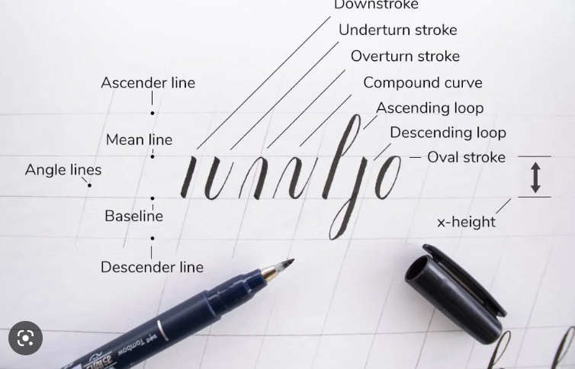
Monday 12th May TBAT: identify and explain how the meaning is enhanced through choices of words and phrases
Words we will find in the text
Expecting – to think or believe something will happen.
Forbidding – a little menacing, daunting, or even frightening.
Sumptuous – extremely costly, rich, luxurious, or magnificent.
Intention – idea that you plan (or intend) to carry out.
Calligraphy – the art of beautiful handwriting.
Evicted - to force out : expel.

Slide 21
Monday 12th May TBAT: identify and explain how the meaning is enhanced through choices of words and phrases.
Focus 1.
Words in context
Explain what is meant by: 'The sandstorm vanished almost as quickly as it had appeared'.
"Have some respect for the law!" snapped one of the guards.
What is meant by the word snapped?
Challenge​
Can you think of a synonym for the word vanished?

Slide 22
Monday 12th May TBAT: identify and explain how the meaning is enhanced through choices of words and phrases
Focus 2.
Summarise using the text
1. What impression does 'The cook dressed in a fine robe but still wearing his chef's hat hurried behind the group' give you about the chef?
2. What does the phrase 'growled the judge through an ever-present smile' tell you? Why?
3. Look on page 39, find one example of a piece of humour.
4. Explain why the word 'thoughtfully' has been used on page 40.
5. On page 40, find a word that suggests that Jabir cannot stop thinking.
Challenge
What adjectives have been used to describe the Judge? What impressions does this give the reader?
Mastery
'He thought about sending them a note but he couldn't write and he had no money to pay for a scribe. Assuming scribes were allowed to write letters for prisoners.'
What does this piece tell you about Jabir?
What does this piece of text suggest about the rights of prisoners?

Slide 23
Lesson 2: Filming techniques
Objectives
TBAT- understand filming techniques.
2 in 2
When is a video camera used?
What skill do you think you need to be able to use it?

Slide 24
Framing- Talk partners: Why would we use each of these filming techniques?
Activity 1
1. Close up
2. Mid range
2. Long shot
Notes:
Image credit: https://pixabay.com/illustrations/males-3d-model-isolated-3d-model-2364348/

Slide 25
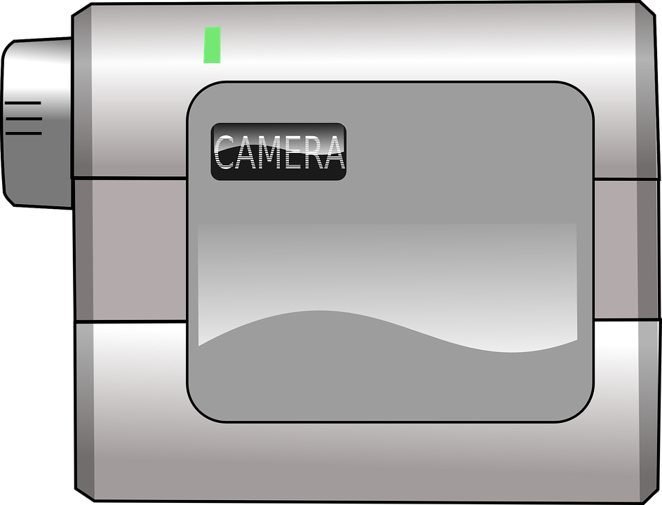
Activity 1
Framing- Talk partners: Why would we use each of these filming techniques?
High
Normal
Low
4. Moving subject
5. Side by side
6. High, low, or normal
Notes:
Image credits:
https://pixabay.com/illustrations/males-3d-model-isolated-3d-model-2364348/
https://pixabay.com/vectors/camcorder-video-camera-29929/
https://pixabay.com/illustrations/males-3d-model-isolated-3d-model-2364350/

Slide 26
Order the following for which you think would have the best sound quality.
Activity 1
1. Close up
2. Mid range
3. Long shot
High
Normal
Low
4. Moving subject
5. Side by side
6. High, low, or normal
Notes:
Image credits:
https://pixabay.com/illustrations/males-3d-model-isolated-3d-model-2364348/
https://pixabay.com/vectors/camcorder-video-camera-29929/
https://pixabay.com/illustrations/males-3d-model-isolated-3d-model-2364350/

Slide 27
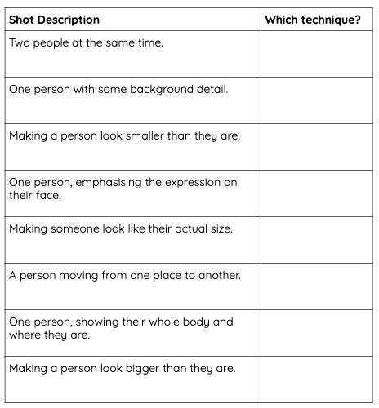
Which technique?
Activity 2
On your worksheet, match the technique described with those you have been introduced to in the previous activity.
Choose from: Close up, mid range, long shot, moving subject, side by side, high angle, low angle, normal angle

Slide 28
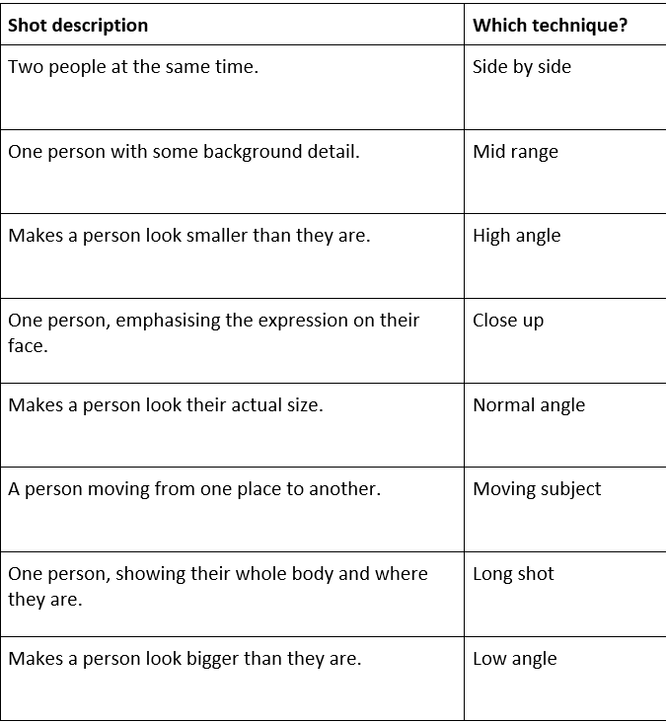

Slide 29
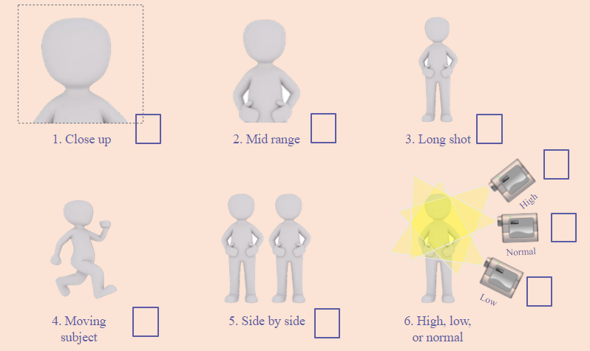
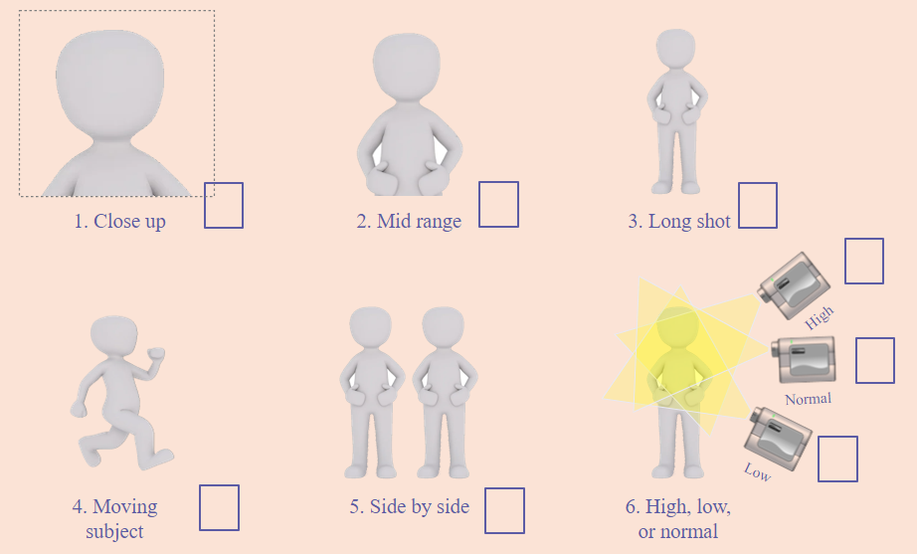
Filming techniques in a video
Activity 3
Go to the video you watched last week: Which filming techniques are being used at each of the points below and why?
Dixi - Dixi music video: Do What You Love
0:00 (the start of the video)
0:20
1:01

