Slide 1
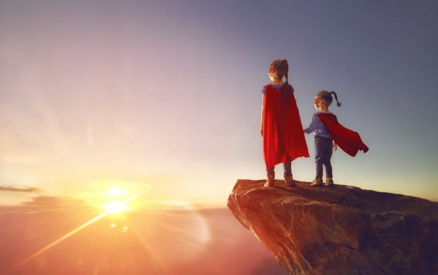
Tuesday 13th May 2025 Morning challenge
Infer
How do the children know each other?
What are their hero names?
What are their super-powers?
Why are they standing on the rock?
Where in the world is this?
Write what you think will happen next?

Slide 2
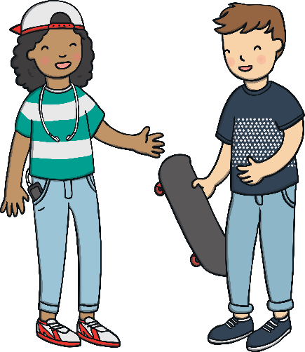
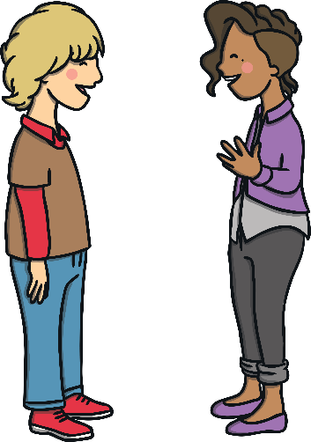
Tuesday 13th May 2025​ Word work
These children are talking very fast and squeezing together some of their words. Can you change the words that have apostrophes in them so that they are saying two words rather than one?
I can’t ride a skateboard. I’m scared of falling off.
I can not ride a skateboard. I am scared of falling off.
Don’t worry, it’s easy. I’ll show you how.
Do not worry, it is easy. I will show you how.
Do you think we’ll be taller next year?
Do you think we will be taller next year?
Yes, we’re growing all the time!
Yes, we are growing all the time!
Show answers

Slide 3
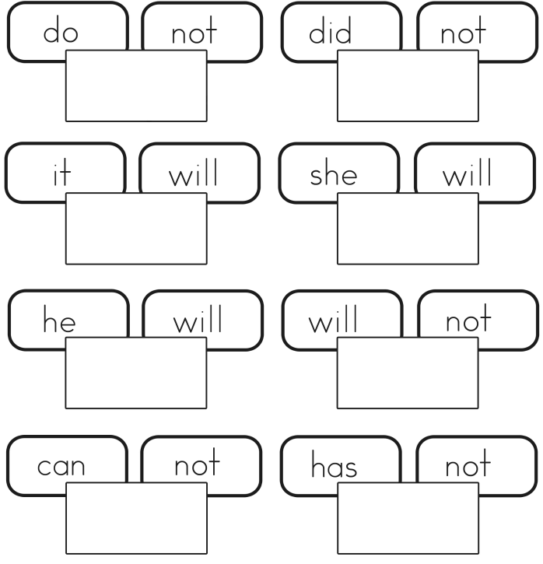
Tuesday 13th May 2025 Word work
Write the contracted form of these words in the boxes.
Remember – the apostrophe takes the place of the missing letter.

Slide 4
13.05.25 Times tables
7 X 3 =
2 X 3=
24 ÷ 3 =
11 X 3 =
3 X __ = 36
5 X 3 =
___ X 3 = 27
3 X 3 =
1 X 3 =
___ X 3 = 30
3 Times Table Song (Green Green Grass by George Ezra) - YouTube
Harry Potter maths
Around the world
Dice
Hit the button
Counting stick

Slide 5
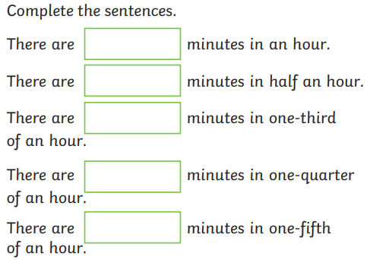
13.05.25
TBAT: interpret data in a pictogram
3 in 3
4/8 + 3/8 =
32 X 4 =
Three friends go to a theme park. If the total cost is £36, how much did each ticket cost?

Slide 6
13.05.25
Daily 10 - Mental Maths Challenge - Topmarks
3x, 4x and 8x

Slide 7
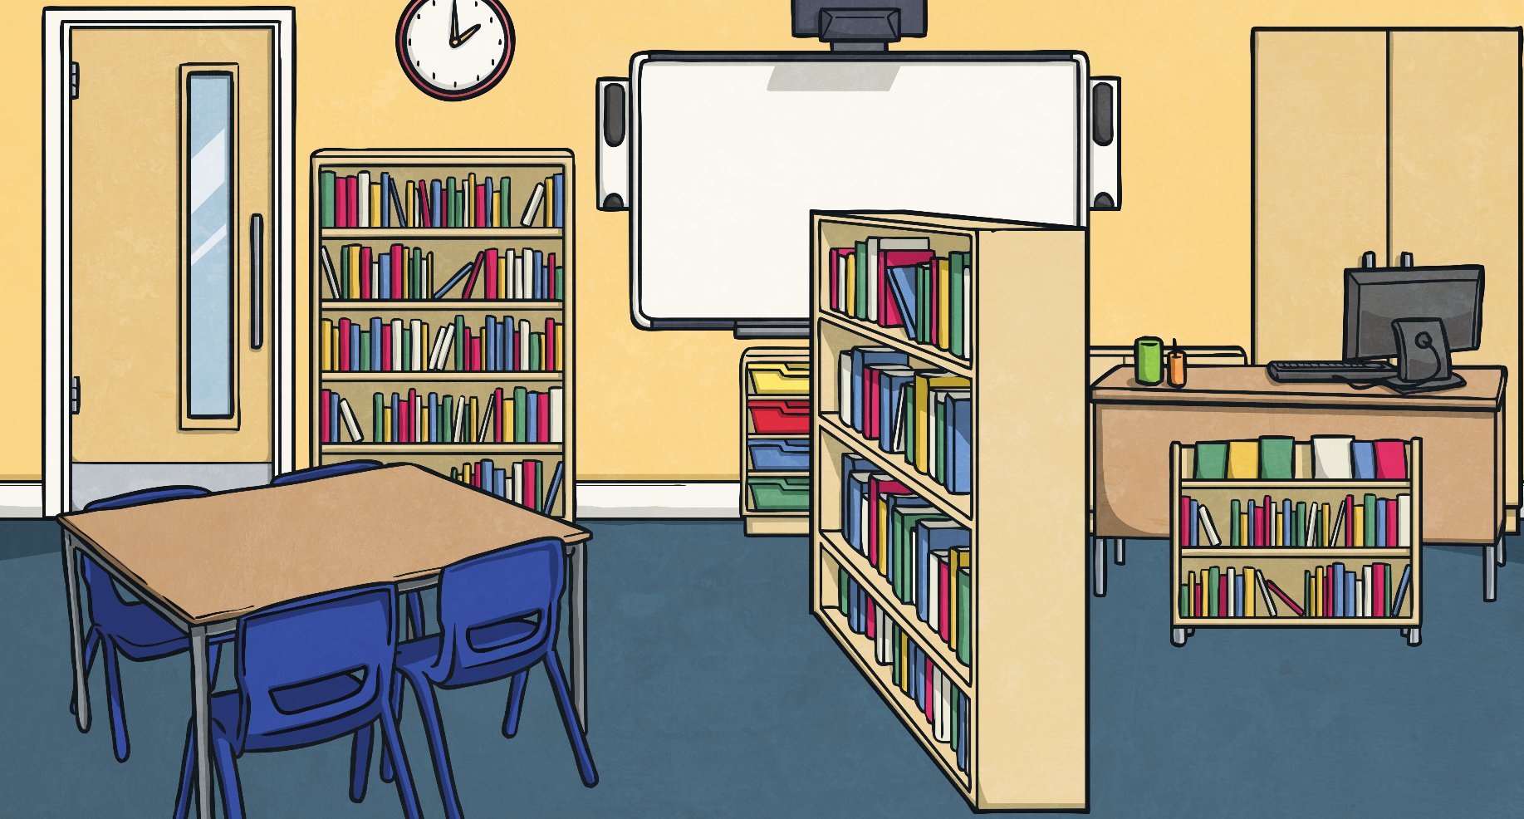
Spot the Difference
Look at the table and the pictogram.
Can you spot 4 differences between the information presented? Explain how you know.
Class 3’s Favourite Seasons
Class 2’s Favourite Seasons

Slide 8
Spot the Difference
Look at the table and the pictogram.
Can you spot 4 differences between the information presented? Explain how you know.
4: There is an extra line of data in the table which is not shown in the pictogram.
1: The titles are from different year groups.
2: The Spring total is 6 on the pictogram and 5 in the table.
3: The data for Autumn and Winter have been swapped.
Class 3’s Favourite Seasons
Class 2’s Favourite Seasons

Slide 9
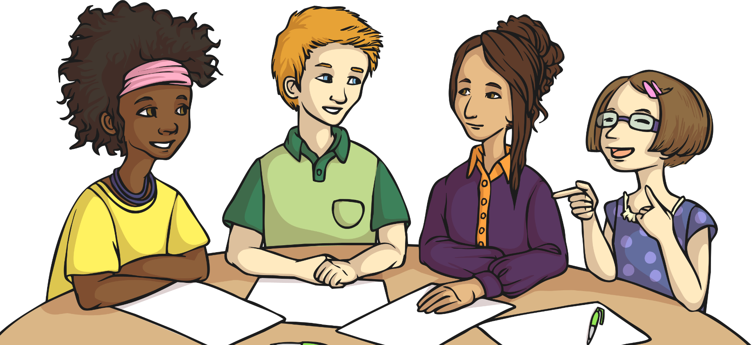
Planning a Party
What do you think the data in this table tells us?

Slide 10
Planning a Party
Use the information in the table to create a pictogram of the data.

Slide 11
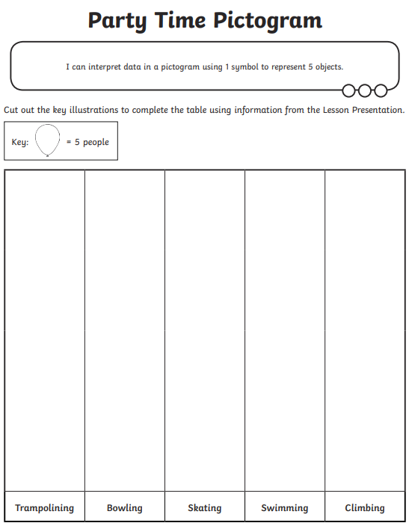
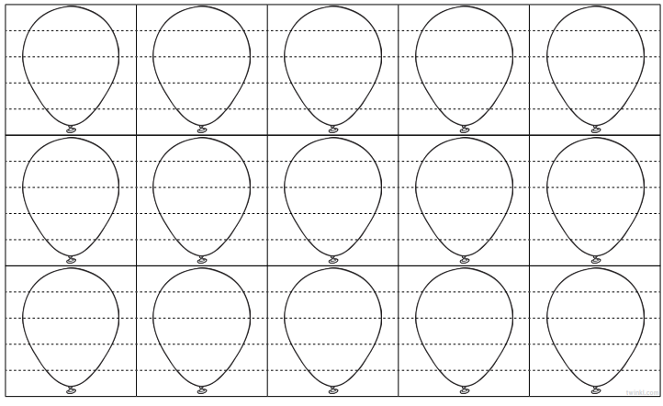
13.05.25
TBAT: interpret data in a pictogram
Using the data on the previous slide, complete the table by cutting and sticking the right number of balloons for each activity. Remember each balloon is worth 5 people.

Slide 12
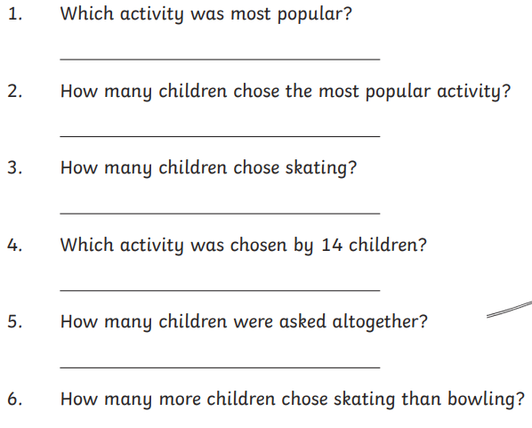
13.05.25
TBAT: interpret data in a pictogram
Use the table you have completed to answer these questions.
Challenge
Write your own question for your partner to answer.

Slide 13
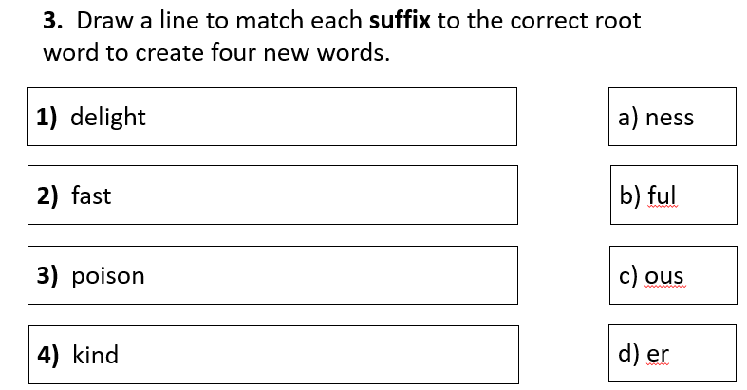
Tuesday 13 May 2025 TBAT: recognise and use determiners. 3 in 3
Challenge – Write a sentence that has a fronted adverbial at the start.

Slide 14
Tuesday 13th May 2025 TBAT: recognise and use determiners.
Blue – Tell your partner 5 synonyms for the word cold.
Green – Tell your partner 5 synonyms for the word tired.
Challenge - What is an apostrophe and where do you use them?

Slide 15
What is a Determiner?
Determiners are words that come before a noun.
the
my
Determiners
King
a
They introduce the noun and can give the reader important information about it.

Slide 16
Specific Determiners
These refer to a specific noun.
Use specific determiners when the reader knows exactly what noun you are referring to.
the
this
those
these
that
The definite article
Definite determiners
which
her
my
his
your
whose
our
their
Interrogative
determiner
Possessive determiners

Slide 17
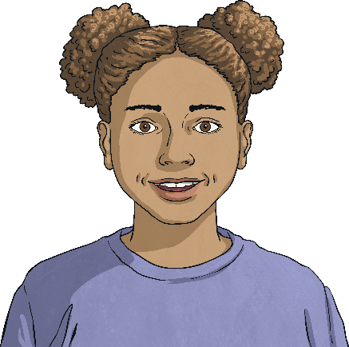
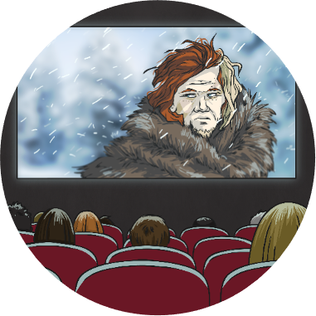
Specific Determiners in Action
Use specific determiners when the reader knows exactly what noun you are referring to.
My sister is smiling.
Which film did you go and see?
Try completing this sentence using a specific determiner:
Dad’s car broke down on the way home last night.

Slide 18
General Determiners
These refer to general nouns or nouns that the reader does not know.
General determiners can also tell the reader how many nouns you are talking about, these are called quantifiers.
a
any
some
five
few
more
an
another
all
enough
many
less
other
what
Quantifiers

Slide 19
Talk partners
Can you identify the determiners in these sentences?
The hoop rolled down the road.
Whose socks are these?
The river is just beyond those trees.
Five seagulls landed on the beach.
Any computers must be turned off.

Slide 20
Tuesday 13th May 2025 TBAT: recognise and use determiners.
Write the sentence in your book and underline the determiner in each. You have 3 minutes.
Blue Green
Those earring are beautiful!
'Whose bone is that?' he thought.
Many people have pets.
The boy replied, "That book on the shelf."

Slide 21
Tuesday 13th May 2025 TBAT: recognise and use determiners.
Add the correct determiner to each sentence. Underline the determiner.
______________book do you want to read first?
2. In Spain, ____ towns celebrate the festival of San José in March.
_________new classroom didn’t have enough chairs.
4. After sharing with her friends, Kacie only had a ______sweets left.
5. " ________dad is really funny,” said Jake to his friend Raj.
6. " ________dog is called Hugo,” said Ken and Charlie.
7. Take ________ tickets and hand them in at the entrance,” said the man at the ticket box.
our few their many which your these

Slide 22
Tuesday 13th May 2025 TBAT: recognise and use determiners.
Challenge
Write a sentence containing each of the determiners below.
Our
An
Many

Slide 23
Tuesday 13th May 2025 TBAT: perform a round in 3 parts. The Collins Hub Educator > Library Ancient worlds – Lesson 3 - Story songs

Slide 24
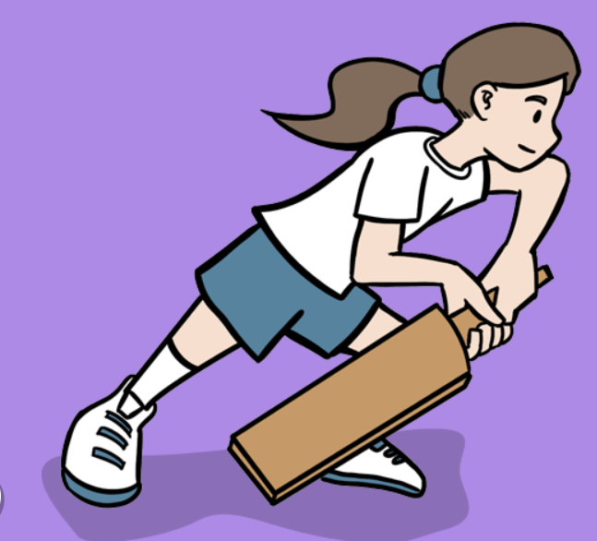
Tuesday 13th May 2025
PE – cricket
TBAT: develop fielding skills to limit the batters score.
This half term in P.E will be cricket
- Changing for PE - Rules and expectations moving to PE - Move to the downstairs hall or outside
Get Set 4 PE - Lesson Plan -3 for Year 3 Cricket

Slide 25
Tuesday 13th May 2025 Computing TBAT: recognise how digital devices can change the way that we work.
Key vocabulary
program
digital
non-digital
Learning objectives
I can explain how I use digital devices for different activities
I can recognise similarities between using digital devices and using non-digital tools
I can suggest differences between using digital devices and using non-digital tools

Slide 26
Tuesday 29th April 2025 TBAT: explain how digital devices function.
Blue – What is an input?
Green – What is an output?
Challenge – What is a process?

Slide 27
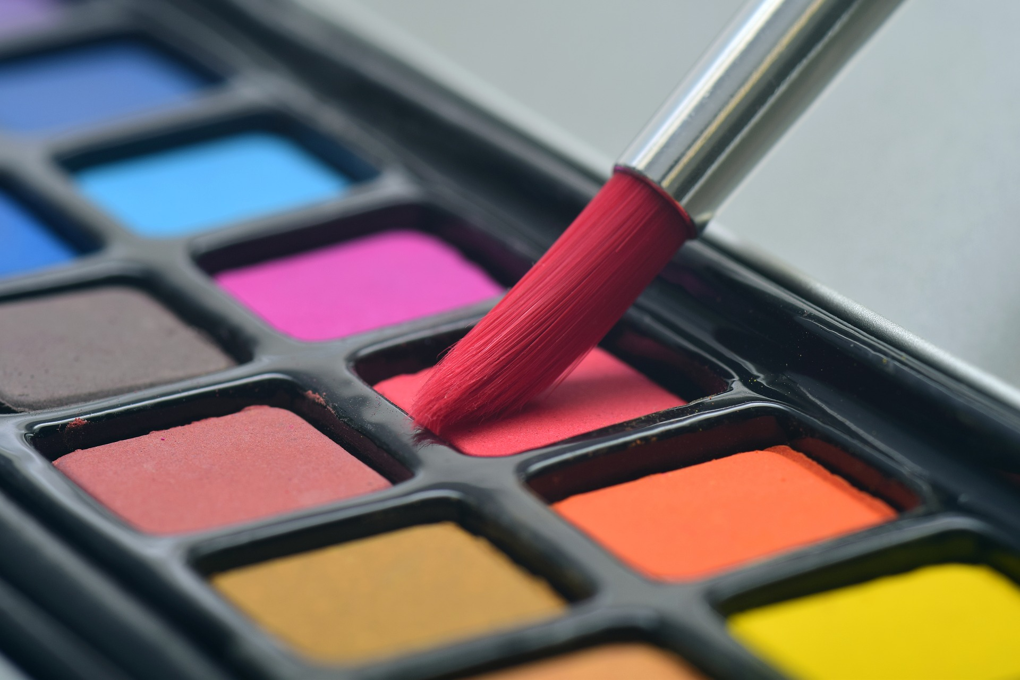
Can you think of a digital version of these two things?
Introduction
Notes:
Image sources:
https://pixabay.com/photos/brush-watercolor-paint-art-color-3445376/
https://pixabay.com/photos/paper-table-record-notebook-2541687/

Slide 28
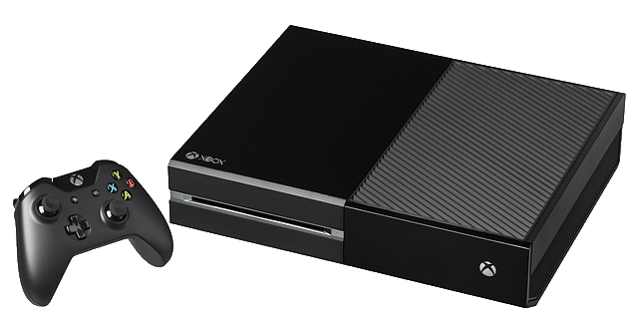
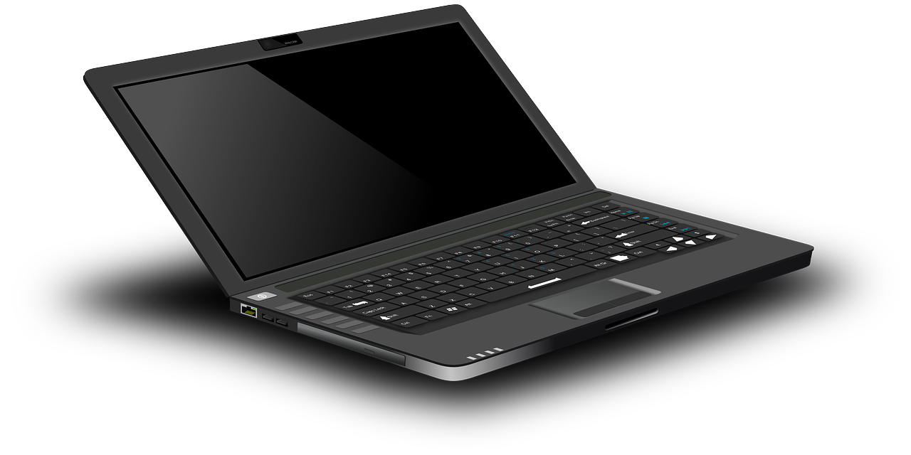
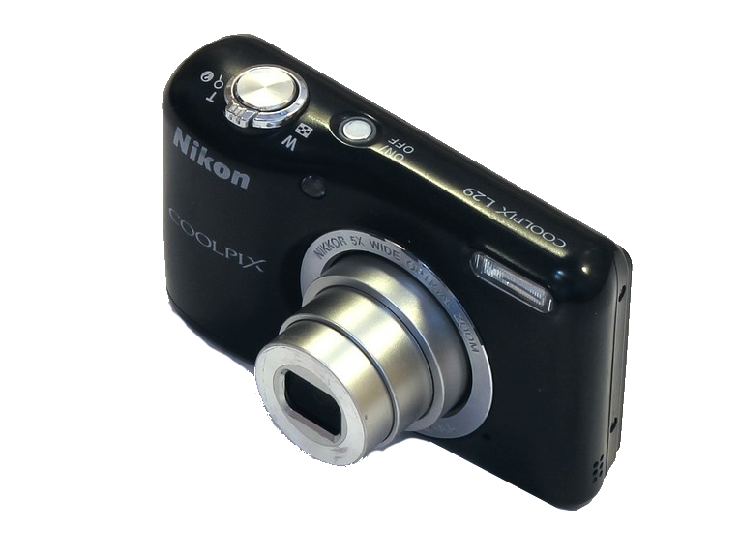
What can you use a digital device for?
Activity 1
Notes:
Image sources:
https://pixabay.com/photos/video-game-console-video-game-play-2202666/
https://pixabay.com/vectors/laptop-notebook-mobile-computer-154091/
https://pixabay.com/vectors/android-nexus-5-phone-smart-phone-1294370/
https://pixabay.com/photos/nikon-l29-digital-camera-compact-1502599/

Slide 29
Do devices have one purpose? Complete the sheet and complete some of your own.
Activity 1
 | Digital camera | Laptop computer | Games console | Smartphone
Take pictures
Write a story
Play a game
Make a phone call
Send a message
Notes:
Image sources:
https://pixabay.com/photos/nikon-l29-digital-camera-compact-1502599/
https://pixabay.com/vectors/laptop-notebook-mobile-computer-154091/
https://pixabay.com/photos/video-game-console-video-game-play-2202666/
https://pixabay.com/vectors/android-nexus-5-phone-smart-phone-1294370/

Slide 30
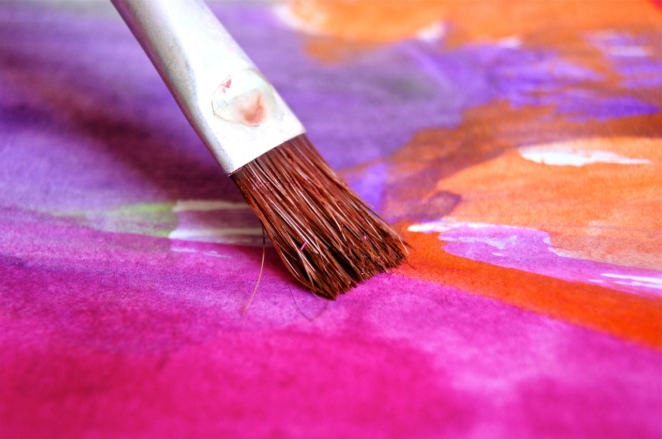
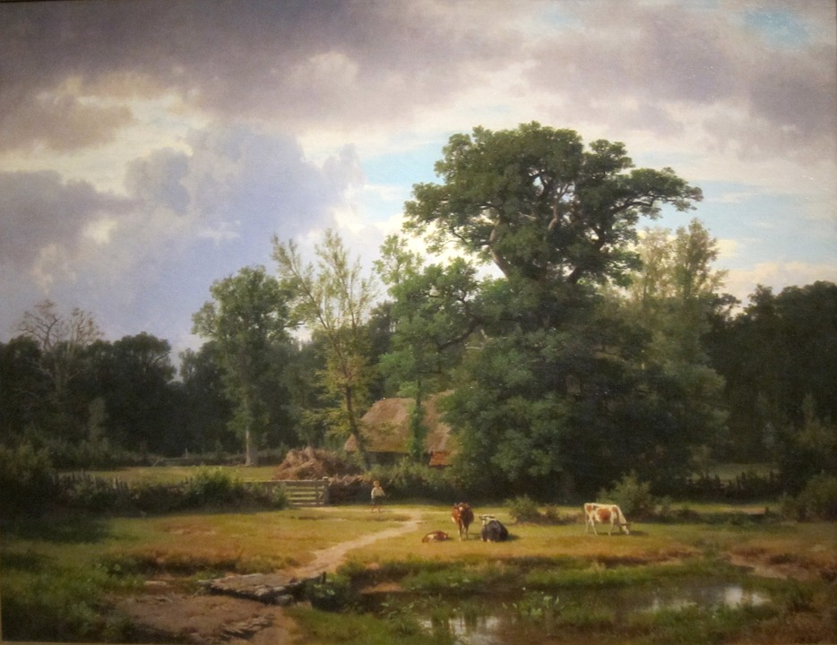
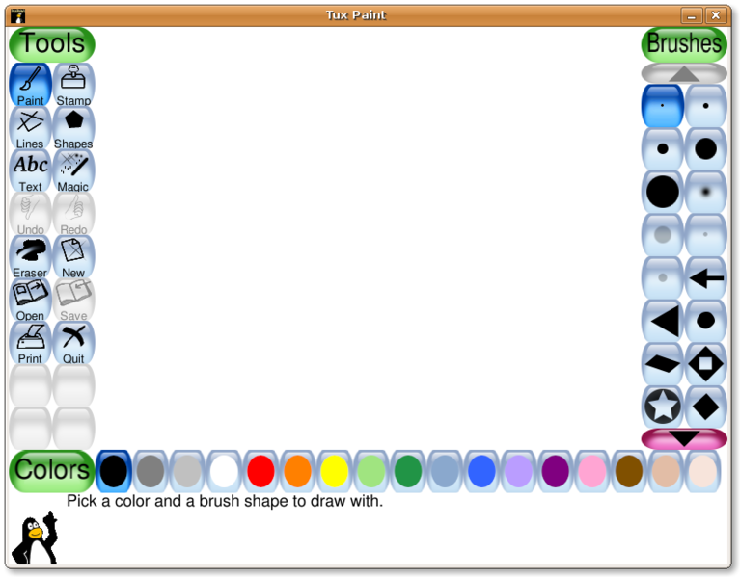
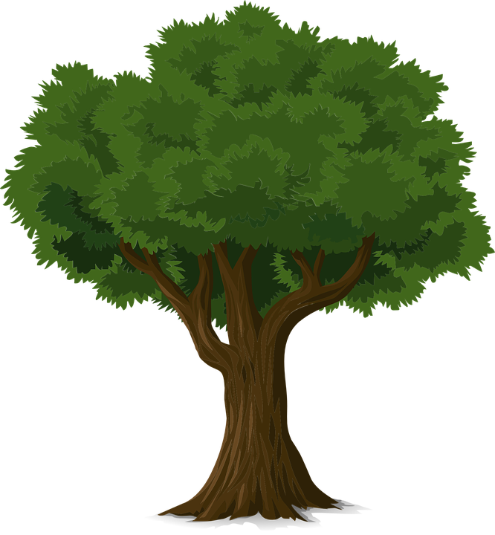
Are these paintings or digital painting? Which do you prefer?
Activity 2
Notes:
Image sources:
https://pixabay.com/photos/brush-color-paint-play-watercolor-96240/
https://pixabay.com/illustrations/painting-art-artistic-artistry-81177/
Screenshot from Tux Paint
https://pixabay.com/vectors/tree-forest-trunk-nature-leaves-576847/

Slide 31
Independent
Activity 2
You will be producing the same piece of art using felt tips and using a digital device.
Use this image as inspiration for the activity.
First, you have 15 minutes to draw and colour your tree.
Then, you will use your laptops and the 'paint program' to draw a digital tree to look as similar as possible to your hand drawn tree. You will do this via Teams.
Notes:
Image sources:
https://pixabay.com/photos/brush-color-paint-play-watercolor-96240/
https://pixabay.com/illustrations/painting-art-artistic-artistry-81177/
Screenshot from Tux Paint
https://pixabay.com/vectors/tree-forest-trunk-nature-leaves-576847/

Slide 32
Questions
Activity 3
How did you feel about doing the activities?
Which method did you prefer?
Which bits did you find easier or harder in each activity?
How did you fix mistakes in each activity?
What input devices did you use?
Do you think all artists would use a computer if they had access to one?
Do you need to be good at using a computer in order to produce good art?

Slide 33
Are there times when it’s better to use a non-digital tool rather than a digital device?
Plenary

Slide 34
How confident are you? (1–3)
Assessment
I can explain how I use digital devices for different activities
I can recognise similarities between using digital devices and using non-digital tools
I can suggest differences between using digital devices and using non-digital tools
3 – Very confident
2 – Unsure
1 – Not confident
Notes:
Image source: https://pixabay.com/vectors/thumb-up-hand-like-confirm-go-top-307176/

Slide 35
Tuesday 13th May 2025 TBAT: make a Roald Dahl character inspired by Quentin Blake.
One dark, silvery moonlit night, Sophie is snatched from her bed by a giant! Luckily, it is the Big Friendly Giant, who is no ordinary bone-crunching giant, but instead prefers snozzcumbers and frobscottle to children. But there are other giants in Giant Country. And those giants have a plan to gallop far and wide to find some tasty human beans to eat. Can Sophie and the BFG stop them?
What adjectives are used to describe the night?
What does the BFG stand for?
What do other giants eat?

Slide 36
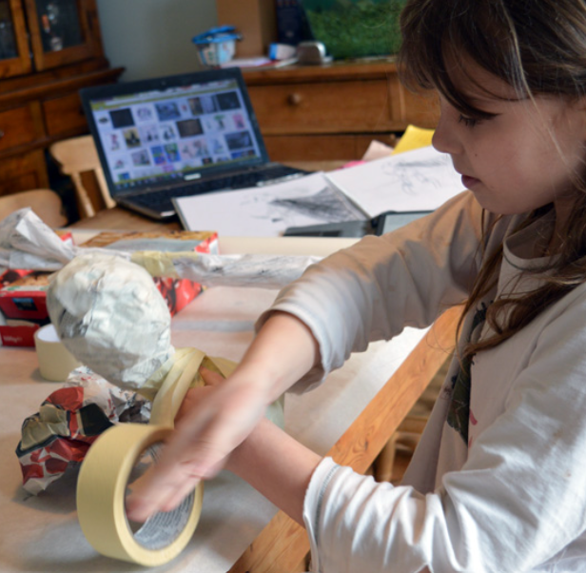
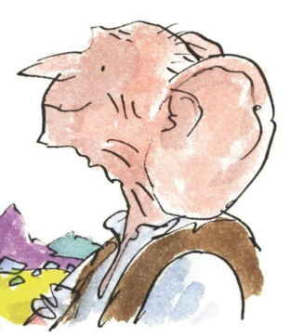
Tuesday 13th May 2025 TBAT: make a Roald Dahl character inspired by Quentin Blake.
The BFG
Portia started by making a basic form out of newspaper and wrapping masking tape around it to hold it in place.

Slide 37
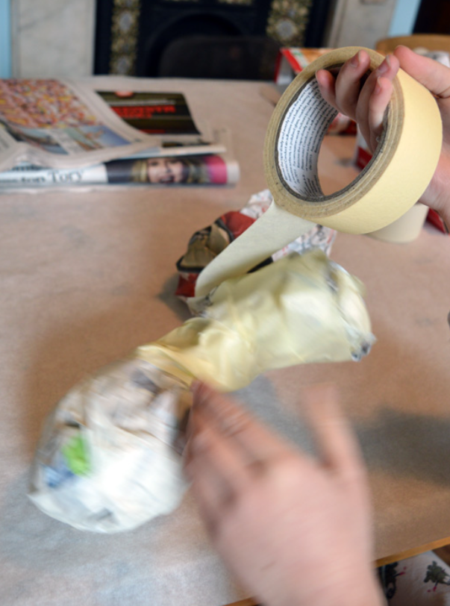
Tuesday 13th May 2025 TBAT: make a Roald Dahl character inspired by Quentin Blake.
The BFG
Making a basic torso form with newspaper and masking tape.

Slide 38
Tuesday 13th May 2025 TBAT: make a Roald Dahl character inspired by Quentin Blake.
The BFG
Using newspaper and masking tape to make the BFG’s ear and torso.

Slide 39
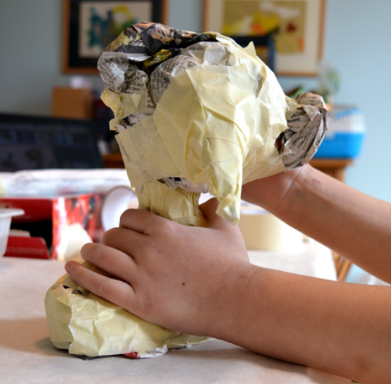
Tuesday 13th May 2025 TBAT: make a Roald Dahl character inspired by Quentin Blake.
The BFG
Adding his nose.

Slide 40
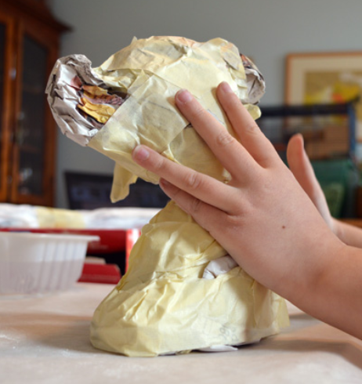
Tuesday 13th May 2025 TBAT: make a Roald Dahl character inspired by Quentin Blake.
The BFG
And getting his posture right.

Slide 41
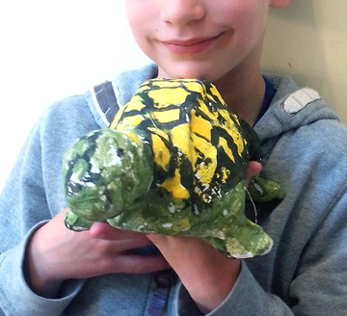
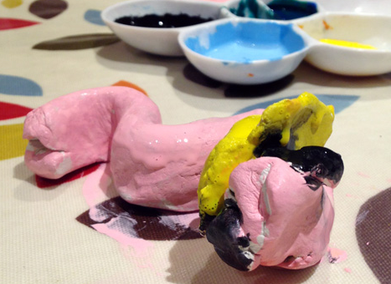
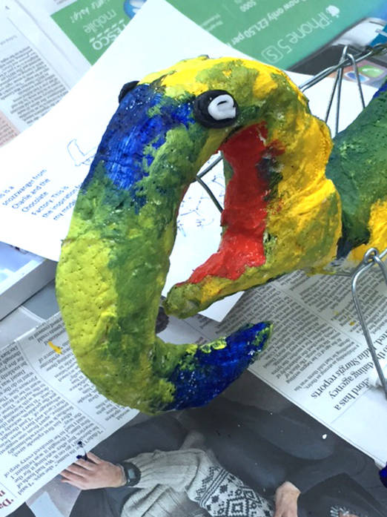
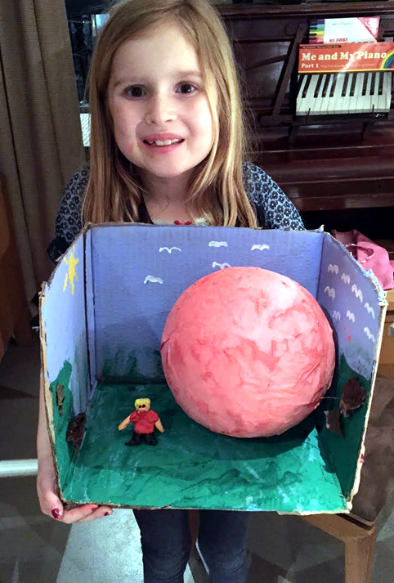
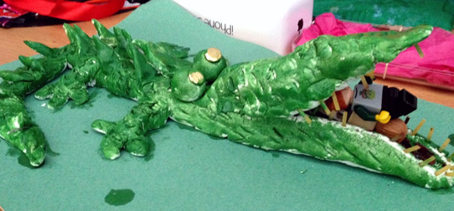
Tuesday 13th May 2025 TBAT: make a Roald Dahl character inspired by Quentin Blake.
Other characters you may choose
Earthworm
The Snozzwanger
Alfie
The Enormous Crocodile
James and the Giant Peach

