Slide 1
Tuesday 13th May 2025
13/5/25

Slide 2
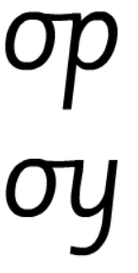
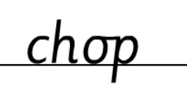
Morning Challenges:
Name writing

Slide 3
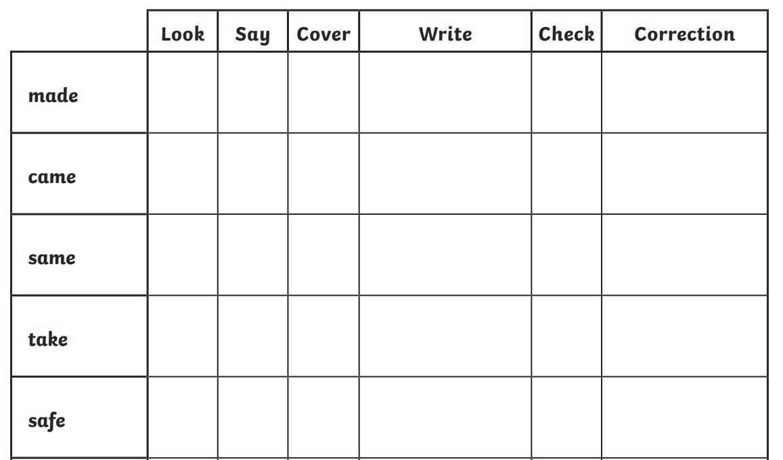
Early morning work

Slide 4
TBAT: read and write words which include the /e-e/ digraph.
Tuesday 13th May 2025
Speedy sounds
Digital Flashcards - Teach Your Monster to Read

Slide 5
TBAT: read and write words which include the /e-e/ digraph.
Tuesday 13th May 2025

Slide 6
TBAT: read and write words which include the /e-e/ digraph.
Tuesday 13th May 2025

Slide 7
TBAT: read and write words which include the /e-e/ digraph.
Tuesday 13th May 2025

Slide 8
TBAT: read and write words which include the /e-e/ digraph.
Tuesday 13th May 2025
Underline the /e-e/ graphemes in the sentence.
The athlete ate a swede before the race.

Slide 9
TBAT: read and write words which include the /e-e/ digraph.
Tuesday 13th May 2025
…......................................................................
…......................................................................
….......................................................................
…........................................................................

Slide 10
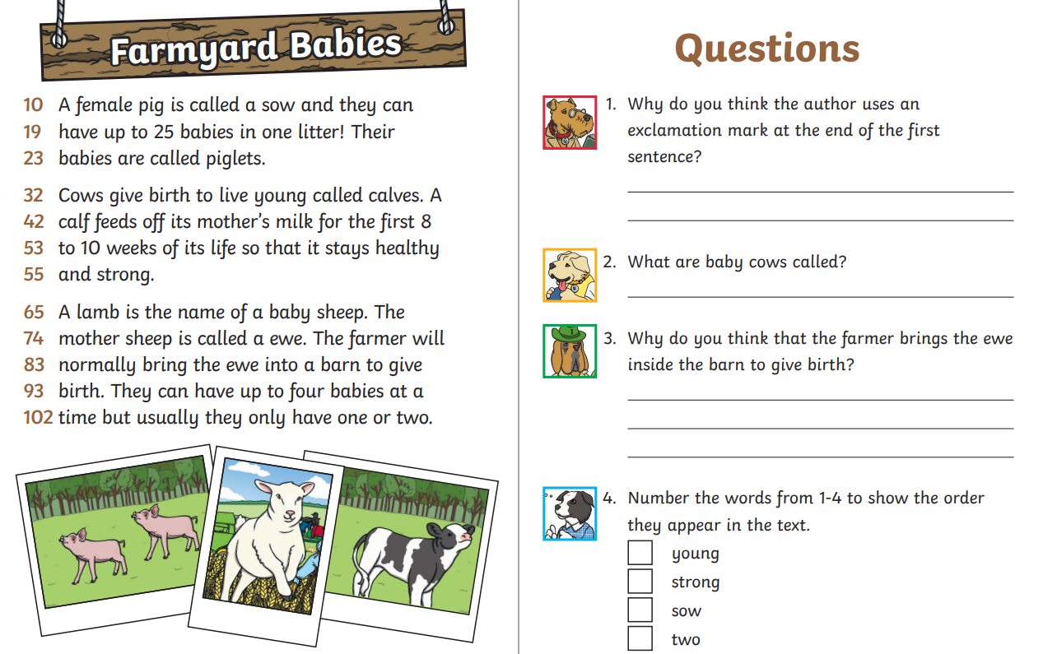
TBAT: retrieve information from a text.
Tuesday 13th May 2025
3 in 3

Slide 11
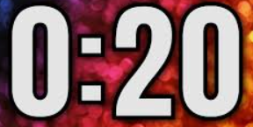
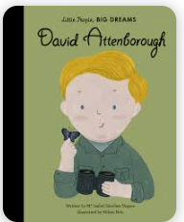
TBAT: retrieve information from a text.
Tuesday 13th May 2025
Blue/ Green- Is the statement correct or incorrect?- Discuss with your partner.
A non – fiction book contains made up stories.
A non fiction book contains true events, facts or stories.
The statement is correct/ incorrect because......

Slide 12
TBAT: retrieve information from a text.
Tuesday 13th May 2025
Words you will come across in the text:
campus: the grounds of a school or college.
curious: eager to learn and know.
naturalist: a person who studies the natural world especially plants and animals.
knighthood: a title that is given to a man by a British king or queen for his achievements or his service to his country.
David Attenborough - Little People, Big Dreams I Read Aloud I Biographies for kids

Slide 13
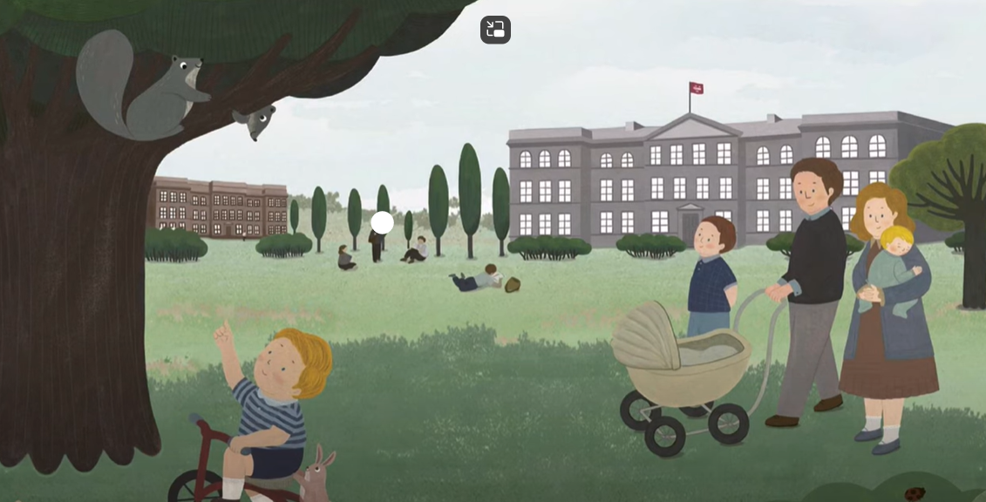
TBAT: retrieve information from a text.
Tuesday 13th May 2025
Little David grew up in Leicester, England, with his parents and two brothers. His father was the head of a local university and they lived on campus: a great place for curious minds.

Slide 14
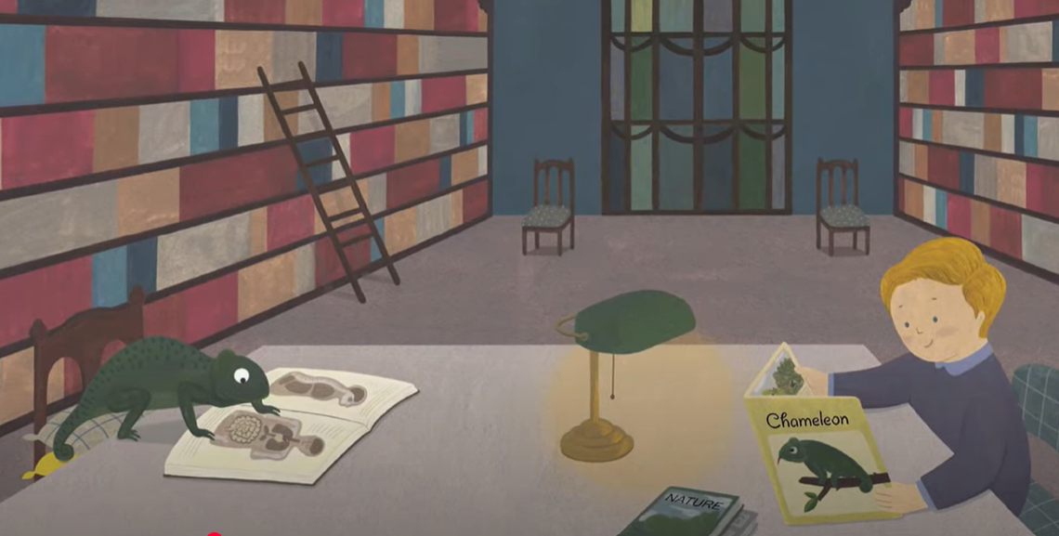
TBAT: retrieve information from a text.
Tuesday 13th May 2025
David loved nature and animals. Ants, birds, chameleons...he was fascinated by all the species he read about in books and wished he could meet them in real life.

Slide 15
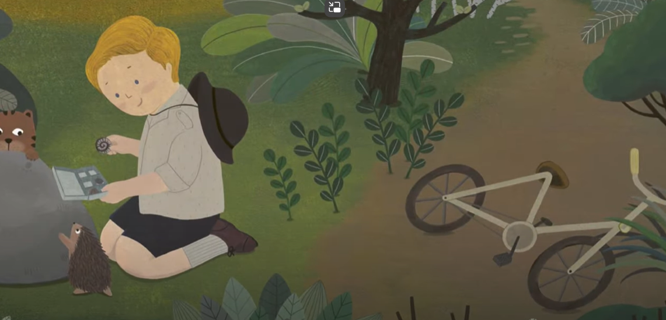
TBAT: retrieve information from a text.
Tuesday 13th May 2025
He often went for long cycling trips to find and collect fossils. There was something amazing about plants and animals that were thousands of years old.

Slide 16
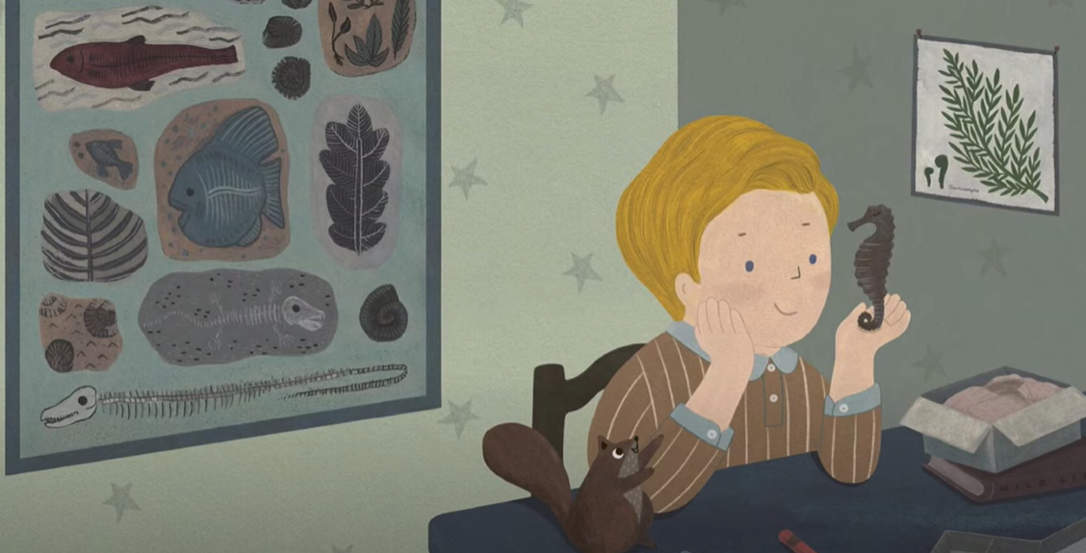
TBAT: retrieve information from a text.
Tuesday 13th May 2025
One day, David received a parcel from a friend with a new parcel for his collection- a dried seahorse! It wasn't his birthday, but it was the day he decided to become a naturalist.

Slide 17
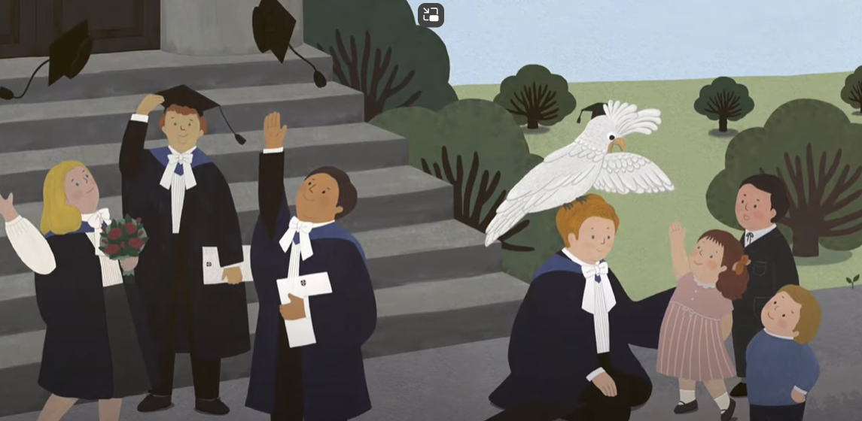
TBAT: retrieve information from a text.
Tuesday 13th May 2025
David studied geology and zoology and obtained a degree in natural science. But he didn't want to just observe animals- he wanted to meet them too.

Slide 18
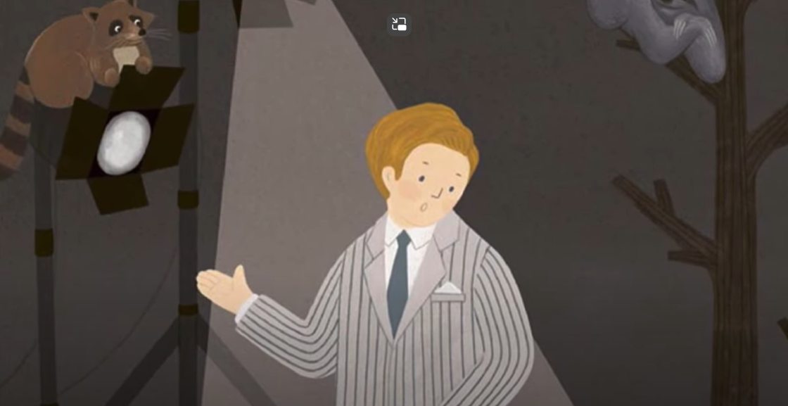
TBAT: retrieve information from a text.
Tuesday 13th May 2025
David started to work as a broadcaster in television, a new technology at the time. He brought animals from the zoo to the studio. They were very entertaining guests.

Slide 19
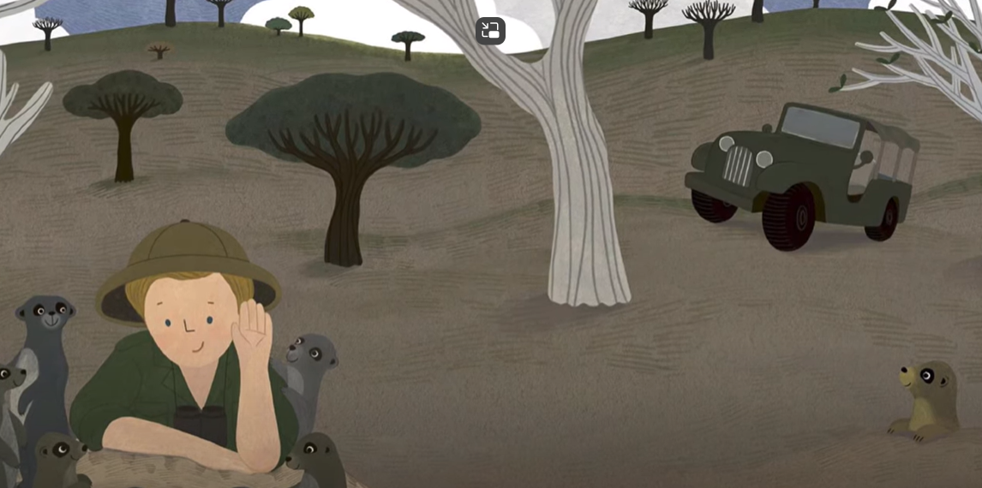
TBAT: retrieve information from a text.
Tuesday 13th May 2025
But David wanted to film the animals in their natural habitats- their homes. He started to go on trips all over the world. Wherever he went, he made new friends.

Slide 20
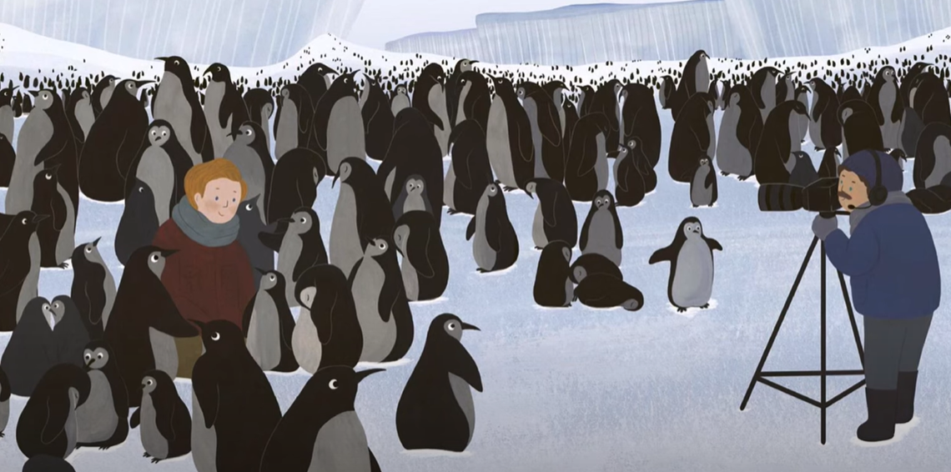
TBAT: retrieve information from a text.
Tuesday 13th May 2025
He met turtles on the Galapagos Islands and gorillas in the African jungle. When he visited Antarctica, he was introduced to all the members of a penguin family.

Slide 21
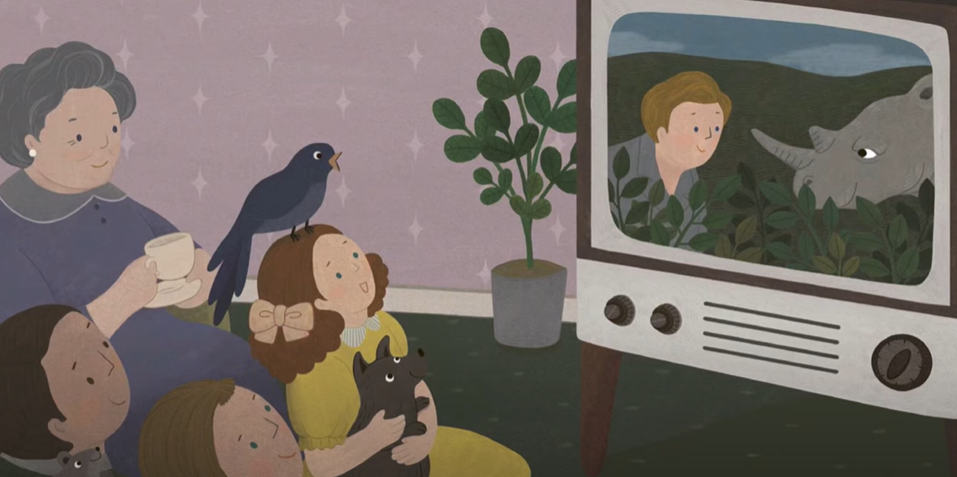
TBAT: retrieve information from a text.
Tuesday 13th May 2025
One of his programmes, 'Wildlife on One' became the most popular in British history. It was a brilliant show about biology that united audiences of all generations.

Slide 22
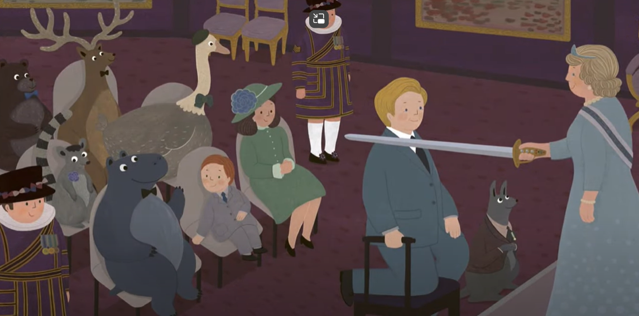
TBAT: retrieve information from a text.
Tuesday 13th May 2025
Later, David was honoured for his incredible documentaries about life on our planet. He also received a knighthood and is today called 'Sir David'.

Slide 23
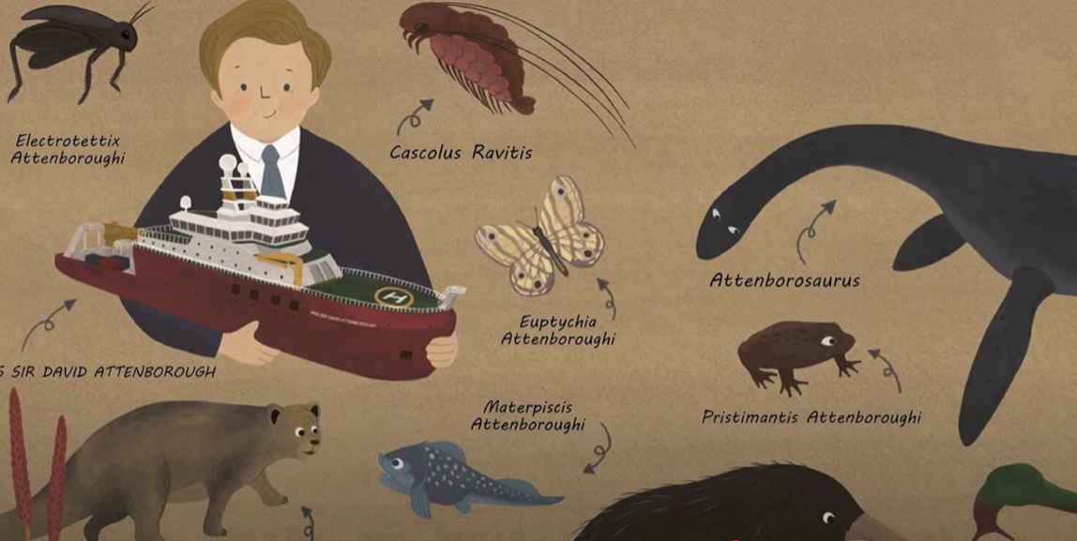
TBAT: retrieve information from a text.
Tuesday 13th May 2025
Many animals and plant were named after him: a rare butterfly, a snail, a prehistoric lion, a spider....even a carnivorous plant!

Slide 24
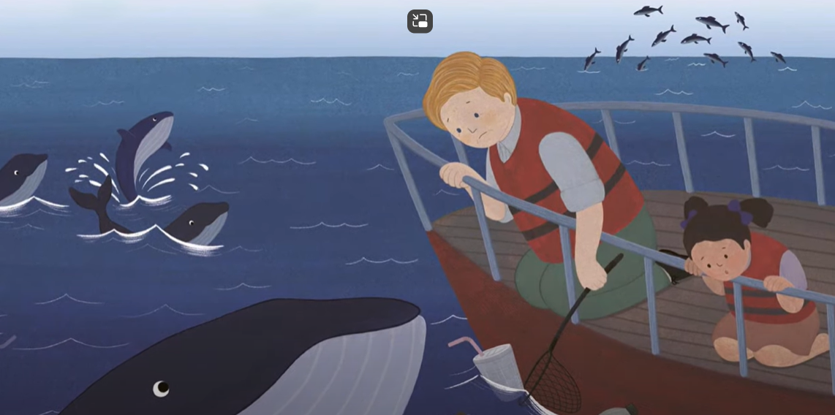
TBAT: retrieve information from a text.
Tuesday 13th May 2025
Still today, David cares about the natural world. Wherever he goes, he encourages people to do their best to look after it, and believes that humans have the power to preserve it.

Slide 25
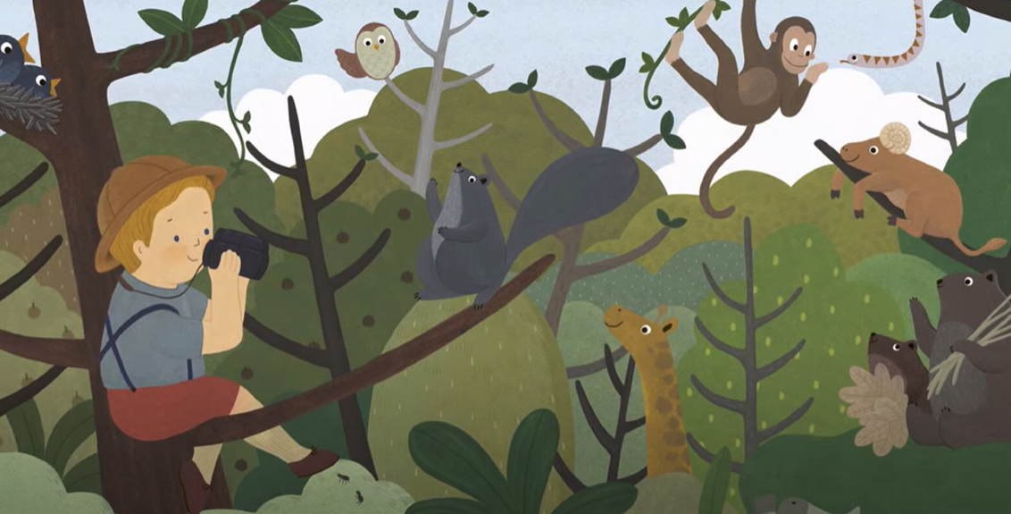
TBAT: retrieve information from a text.
Tuesday 13th May 2025
And little David still looks at the world as if it's huge and unexplored. Because there are aways new things to discover if you take the time to look for them.

Slide 26
TBAT: retrieve information from a text.
Tuesday 13th May 2025
Multiple Choice questions:
1. What inspired David Attenborough’s love for nature as a child?
Watching movies about animals
Reading books about wildlife and exploring outside
Playing football with his friends
Visiting amusement parks

Slide 27
TBAT: retrieve information from a text.
Tuesday 13th May 2025
Multiple Choice questions:
2. What does David Attenborough encourage people to do to help the planet?
Travel more often
Protect wildlife and care for the environment
Buy more pets
Build more houses

Slide 28
TBAT: retrieve information from a text.
Tuesday 13th May 2025
Multiple Choice questions:
3. Where has David Attenborough traveled to study animals?
Only forests in England
Many places around the world, including jungles, oceans, and deserts
Just the Arctic
Cities with zoos

Slide 29
TBAT: retrieve information from a text.
Tuesday 13th May 2025
Independent:
Challenge:
What gift did David receive that inspired him to become a naturalist?
What honor did David receive from Queen Elizabeth?
What was the name of one of David’s most famous programmes?
What type of animals have been named after him?
What is the word that describes where an animal lives?
How has David Attenborough’s work changed how people look at the world?

Slide 30
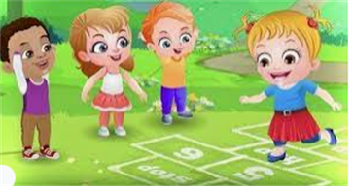
Break

Slide 31
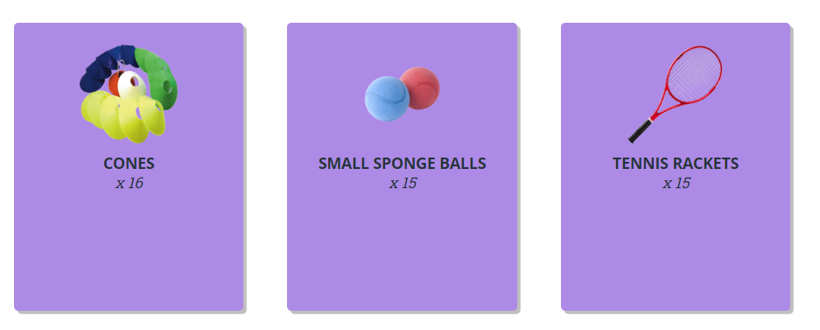
TBAT – develop hitting a ball
2 in 2
Name 1 way of throwing
How can we warm up our body?

Slide 32
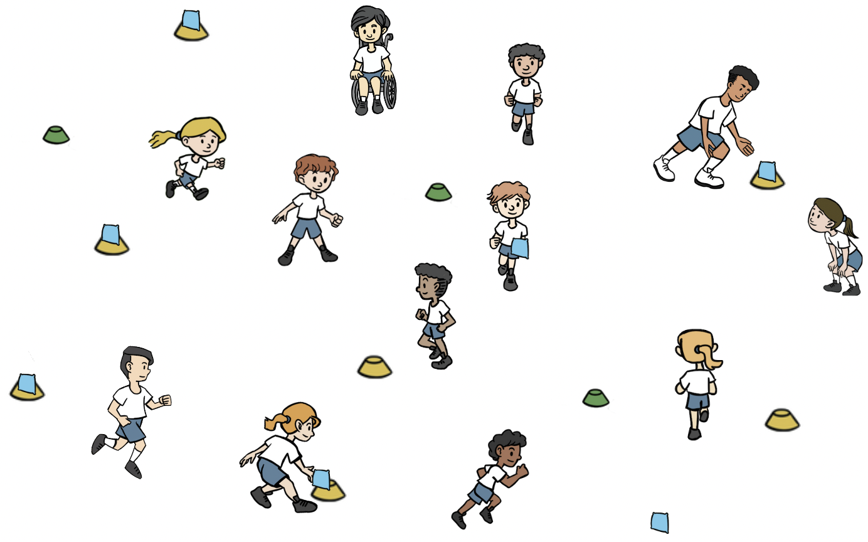
TBAT – develop hitting a ball
Warm-up
Split the class into two teams, a 'batting' and a 'fielding' team. Batting team have a cone and beanbag that they place in space (beanbag on top of cone).
Batters move from cone to cone, throwing the beanbags off the cones.
Fielders retrieve the beanbags and place them back on the cones.
Use underarm and overarm throwing.

Slide 33
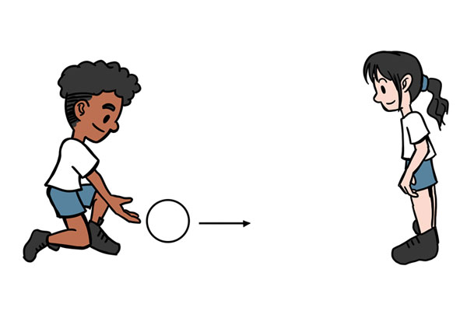
TBAT – develop hitting a ball
Skill development
Striking the ball
In pairs with one ball. Pupils begin standing opposite each other. They take turns to hit the ball to their partner.
Standing opposite each other. One pupil underarm throws the ball to their partner so that it bounces once. After one bounce, the other pupil tries to hit it with their hand.

Slide 34
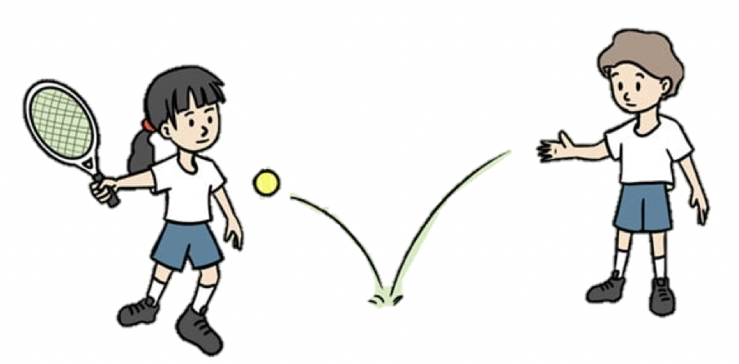
TBAT – develop hitting a ball
Skill development
Using a racket
In pairs with one racket and a sponge ball between them. Pupil A begins with the racket and ball. They drop the ball on the floor and hit it after one bounce. Pupils B runs to collect and return it. Have four turns then change over.
Watch the ball and let it bounce once. Hit the ball using the centre of the racket. Hold the racket towards the bottom of the handle.
This time, pupil A underarm throws the ball for pupil B to hit. Pupil A collects the ball and they change roles.
Stand sideways on to your partner. Watch the ball as it comes towards you. Hit after one bounce.

Slide 35
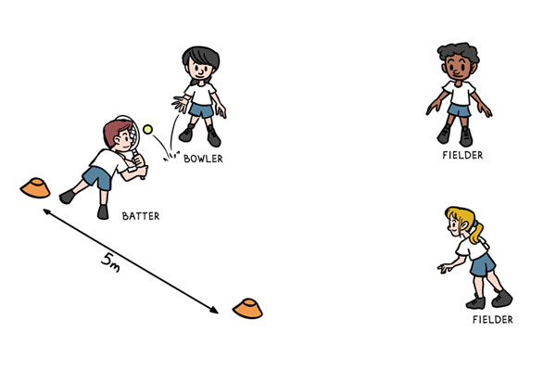
TBAT – develop hitting a ball
Skill development
Strike and field
Groups of four you need one tennis racket, one ball and two cones.
One pupil is the batter, they begin with the tennis racket, at one of the cones.
The other cone is placed 5m away.
The other three pupils are on the same team. Two of them are fielders and the other pupil is the bowler.
The bowler underarm throws the ball to the batter, who attempts to hit it with the racket.
The batter then runs between the two cones, scoring a point each time they reach a cone.
The fielders must collect the ball and return it to the bowler, who shouts 'stop' to stop the batter scoring.

Slide 36
TBAT – develop hitting a ball
Plenary
When batting, I should hit towards the fielders.
The bowler is on the fielding team.
Hitting the ball softly will make it go further.
Watching the ball as it comes towards me will help me to hit it.
My job as a fielder is to stop the batter scoring.

Slide 37
Lunch

Slide 38
Today's Alien language is.......

Slide 39
TBAT: solve word problems. 3 in 3 9 – 6 = 3 so 89 – 6 = _____ 48 + 3 = ___ one more than 35 is ___

Slide 40
Blue / Green Find the missing numbers
5, 10, 15, 20, ______, 30, 35, ______, 45, ______
10, 20, 30, ______, 50, 60, ______, 80, ______, 100
Challenge: continue the sequence
Notes:
Do Now: Missing number patterns
Pupils each have a bead string. Show pupils the number patterns on the slide. They use their bead string to make each number in the pattern and identify the missing numbers.

Slide 41
TBAT: solve word problems
part
whole
subtract
add

Slide 42
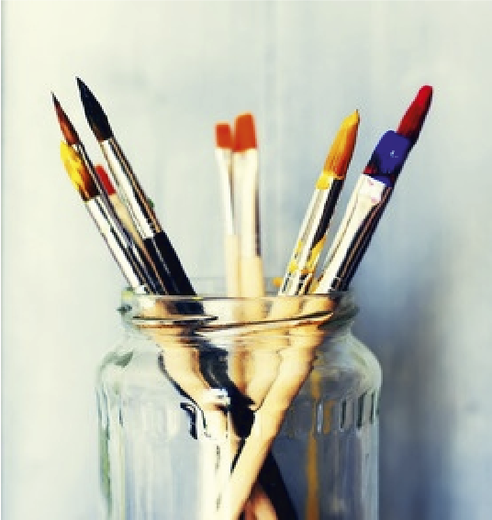
Representing word problems
Mr Geppetto has 49 paintbrushes in his workshop.
Eight of them are old so he throws them away.
How many does he have now?
Notes:
New Learning: Representing word problems
Note: this lesson provides pupils with the opportunity to apply their learning on the part-whole model, and the addition and subtraction strategies they have learnt this year, to solve problems. Make connections between different pupils’ representations and strategies.
Present the problem on the slide.
How could we represent this problem to help us to solve it?
Pupils could have different manipulatives to explore and share their ideas. Take feedback.
How could I represent this problem on a part-whole model?
Pupils may have different ideas; use this time to explore them (e.g. a discussion around whether 49 and eight are both ‘parts’ or whether one is the ‘whole’). Explain that the part-whole model can help us to work out the equation we need to solve the problem.
49 is the whole because that is the total number of paintbrushes. Mr Geppetto throws eight of them away; that is a part. We need to find the remaining part.
Record 49 and eight on the part-whole model.
What calculation will help us find the remaining part?
Record 49 – 8 = __
Note: this New Learning focuses on representing the problem and identifying the calculation. In the Develop Learning, pupils go on to solve the equations.
Repeat the process for the addition problem on the next slide.

Slide 43
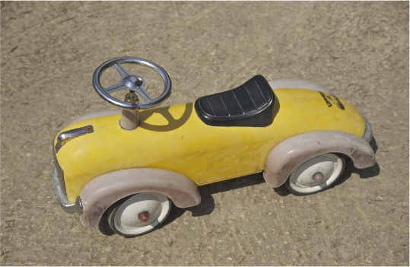
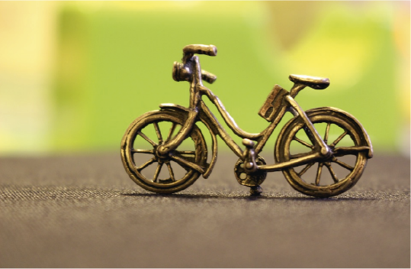
Representing word problems
Mr Geppetto is making new toys.
A toy car is 24 cubes long.
A toy bike is eight cubes long.
What is the total length of the two toys?
Notes:
New Learning: Representing word problems
Note: this lesson provides pupils with the opportunity to apply their learning on the part-whole model, and the addition and subtraction strategies they have learnt this year, to solve problems. Make connections between different pupils’ representations and strategies.
Present the problem on the slide.
How could we represent this problem to help us to solve it?
Pupils could have different manipulatives to explore and share their ideas. Take feedback.
How could I represent this problem on a part-whole model?
Pupils may have different ideas; use this time to explore them (e.g. a discussion around whether 49 and eight are both ‘parts’ or whether one is the ‘whole’). Explain that the part-whole model can help us to work out the equation we need to solve the problem.
49 is the whole because that is the total number of paintbrushes. Mr Geppetto throws eight of them away; that is a part. We need to find the remaining part.
Record 49 and eight on the part-whole model.
What calculation will help us find the remaining part?
Record 49 – 8 = __
Note: this New Learning focuses on representing the problem and identifying the calculation. In the Develop Learning, pupils go on to solve the equations.
Repeat the process for the addition problem on the next slide.

Slide 44
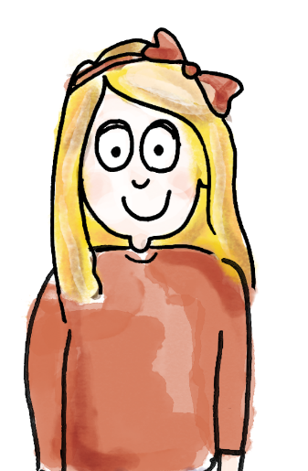
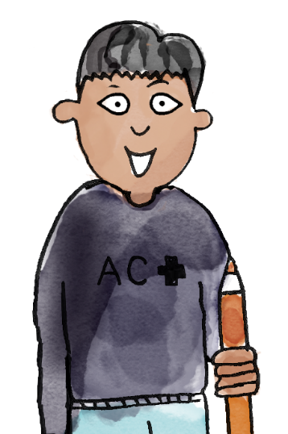
Hugo has 27 stickers.
Safiya has nine stickers.
How many stickers do they have in total?
I think this part-whole model matches the problem.
The two children represent two parts and we want to find the whole.
27
So the calculation will be 27 + 9.
9
part whole add subtract

Slide 45
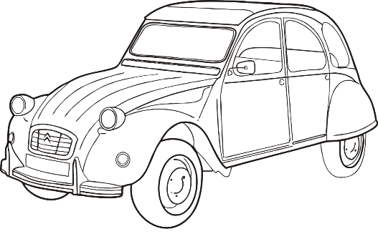
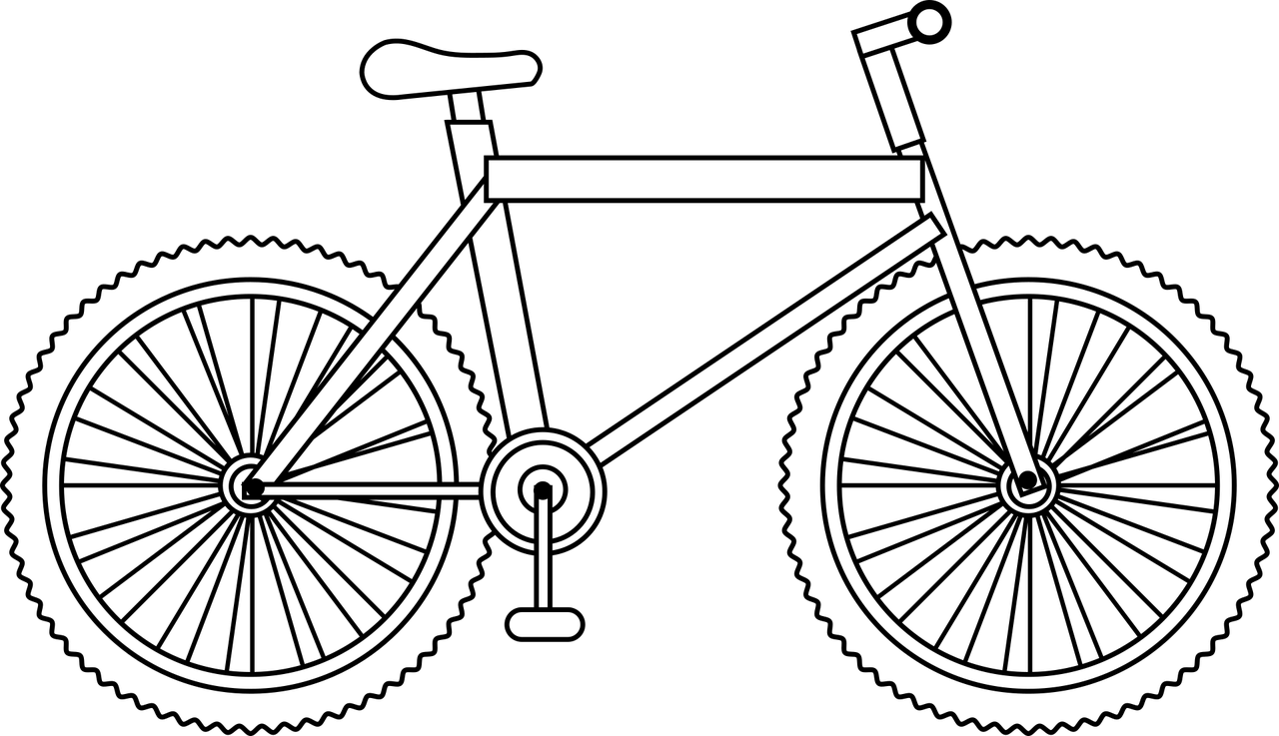
Solving word problems
Mr Geppetto is making new toys.
A toy car is 24 cubes long.
A toy bike is eight cubes long.
What is the total length of the two toys?
24 + 8 = ______
Challenge:
What is the length of 2 toy cars?
I can check my answer using the inverse.
Notes:
Develop Learning: Solving word problems
Now return to the problems from the New Learning in order to calculate the answers. Recap how you decided the correct calculation to solve the first problem, then ask:
What strategy could we use to calculate 49 subtract eight?
Give pupils an opportunity to discuss their strategies. An efficient strategy to draw attention to would be using number bonds (‘If I know that 9 – 8 = 1, then I know 49 – 8 = 41’).
How could we check our answer is correct?
Pupils may suggest doing the calculation again using a different strategy.
How can we use the inverse to check our answer?
Recap how to add our answer (one ‘part’) to the other ‘part’ to see if we find the same whole.
Repeat with the addition problem on the next slide.

Slide 46
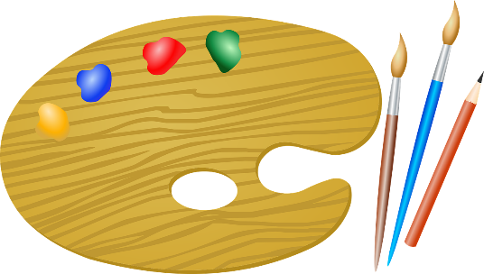
Solving word problems
Mr Geppetto has 49 paintbrushes in his workshop.
Eight of them are old so he throws them away.
How many does he have now?
49 – 8 = ______
Challenge: How many would he have left if he threw away 12?
I can check my answer using the inverse.
Notes:
Develop Learning: Solving word problems
Now return to the problems from the New Learning in order to calculate the answers. Recap how you decided the correct calculation to solve the first problem, then ask:
What strategy could we use to calculate 49 subtract eight?
Give pupils an opportunity to discuss their strategies. An efficient strategy to draw attention to would be using number bonds (‘If I know that 9 – 8 = 1, then I know 49 – 8 = 41’).
How could we check our answer is correct?
Pupils may suggest doing the calculation again using a different strategy.
How can we use the inverse to check our answer?
Recap how to add our answer (one ‘part’) to the other ‘part’ to see if we find the same whole.
Repeat with the addition problem on the next slide.

Slide 47
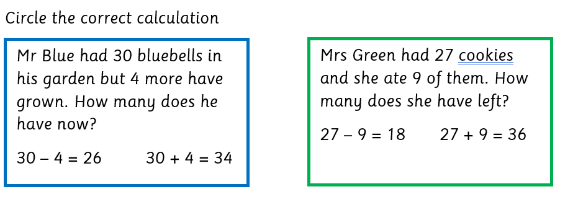
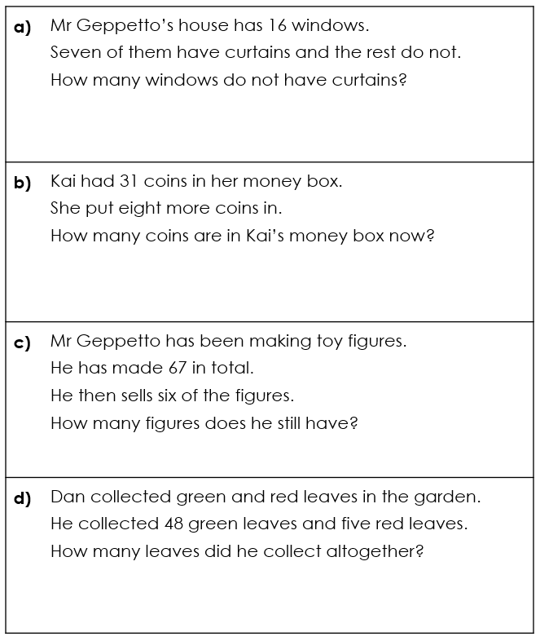
TBAT: solve word problems
For each problem:
represent it using manipulatives
create a part-whole model
write an equation
solve it using your choice of strategy
check your answer using the inverse.
Notes:
Independent Task: Solving addition and subtraction word problems
Pupils have the Task Sheet, a part-whole model and a range of manipulatives, e.g. a bead string, Dienes, interlocking cubes. They represent each of the problems and write an equation to solve each one.
Possible adaptations:
Pupils could be given increased scaffolding, e.g. a partially completed part-whole model.
Pupils could write their own problems. You could challenge them to write a problem for a specific strategy, e.g. Can you write a problem I could use the ‘Make ten’ addition to solve?

Slide 49
How did you solve …?
What manipulatives did you use?
What part-whole model did you draw?
What equation did you write?
What strategy did you use?
How did you check your answer?
Notes:
Plenary: How did you solve …?
Use this time to compare the calculation strategies pupils used to solve the problems.
What manipulatives did you use?
What part-whole model did you draw?
What equation did you write?
What strategy did you use to calculate?
Share pupils’ methods, making connections between them.

Slide 50
Lesson 4 What do Muslims do on Hajj?

Slide 51
3 in 3
Key Question: What do Muslims do on Hajj?
Tuesday 13th May 2025
What is the name of the structure that muslims walk around during Hajj?
What do Muslims wear on during Hajj?
How many times do Muslims walk between the 2 mountains during Hajj?

Slide 52
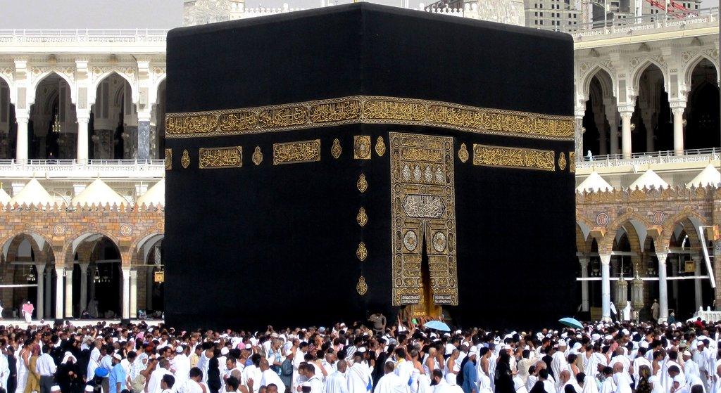
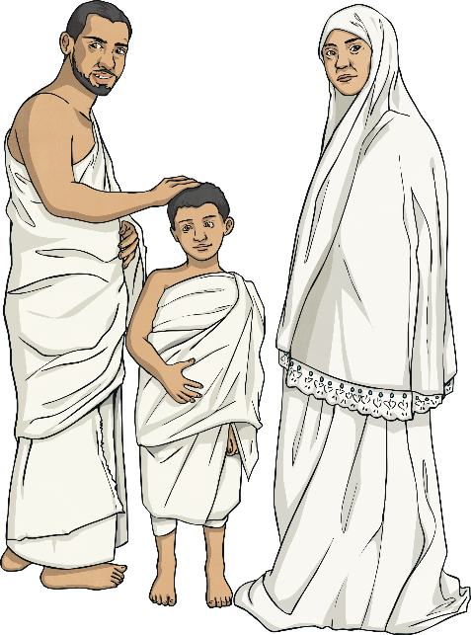
Last lesson we saw the Ka’bah they walk around seven times.

Slide 53
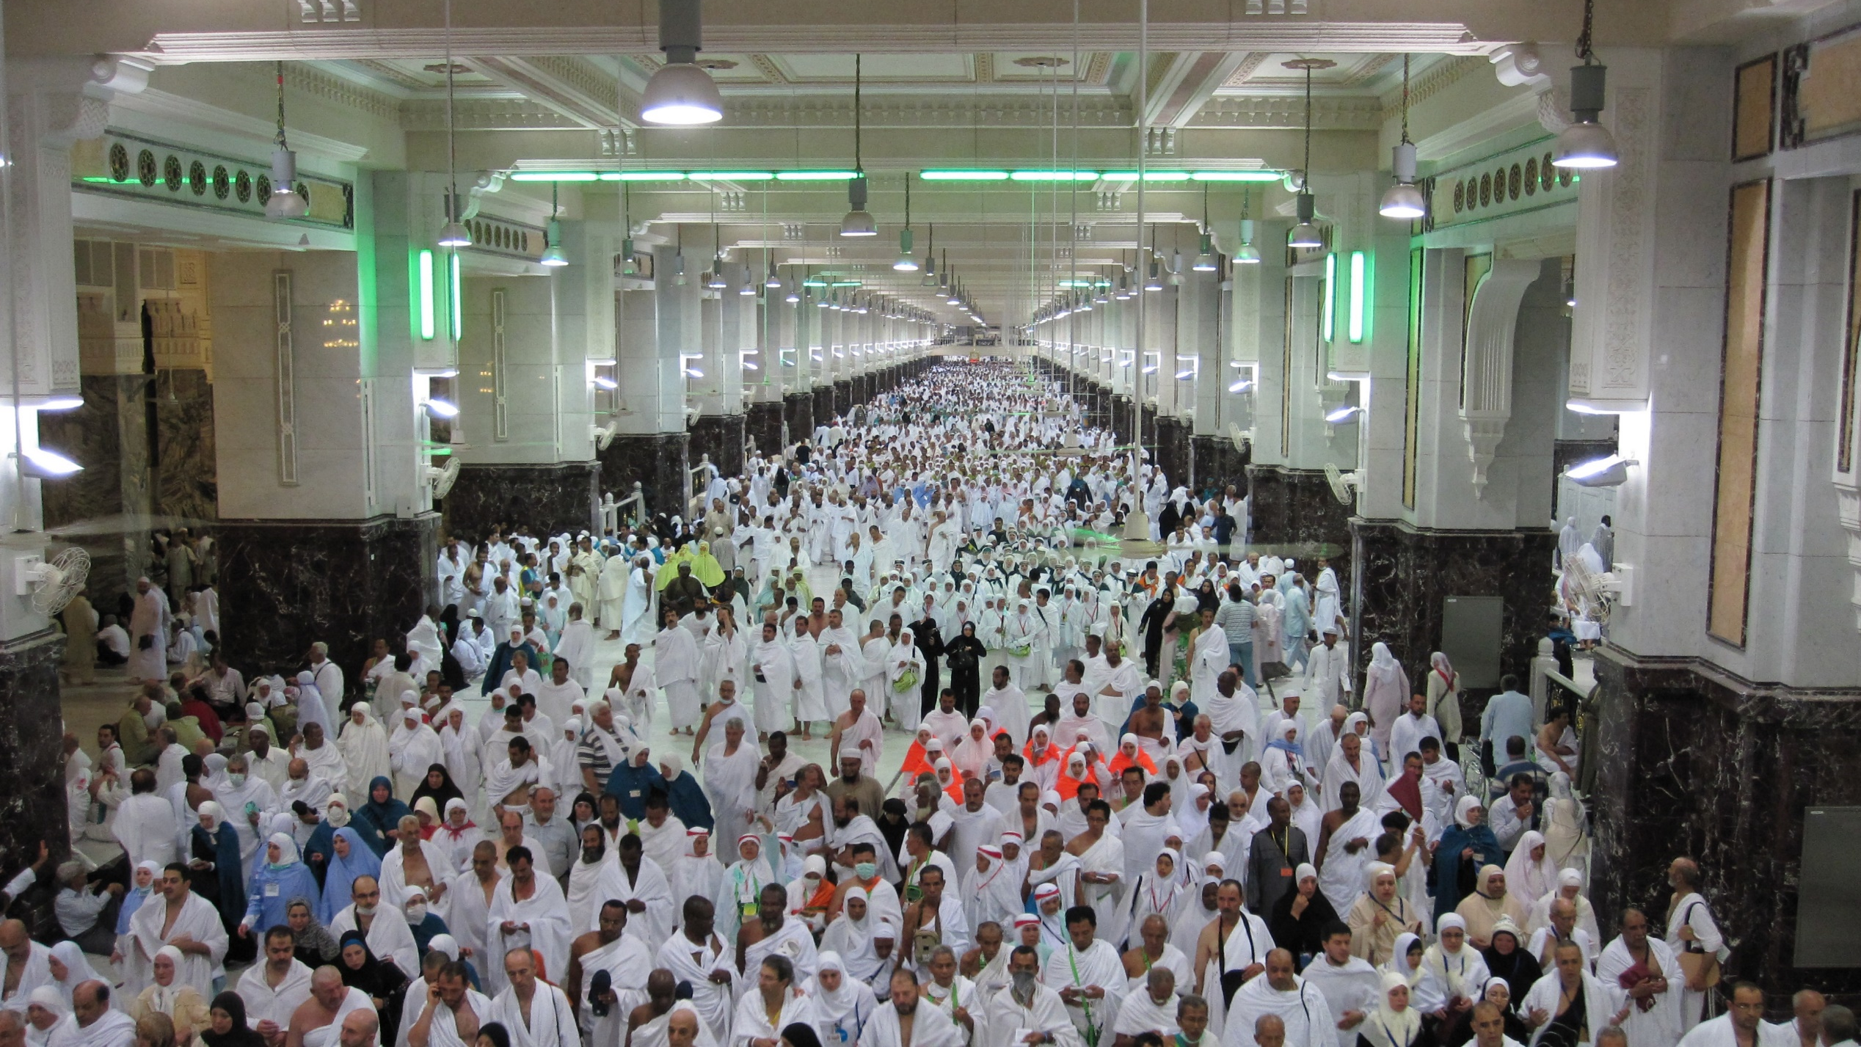
And we looked at the two special hills they have to walk between seven times.

Slide 54
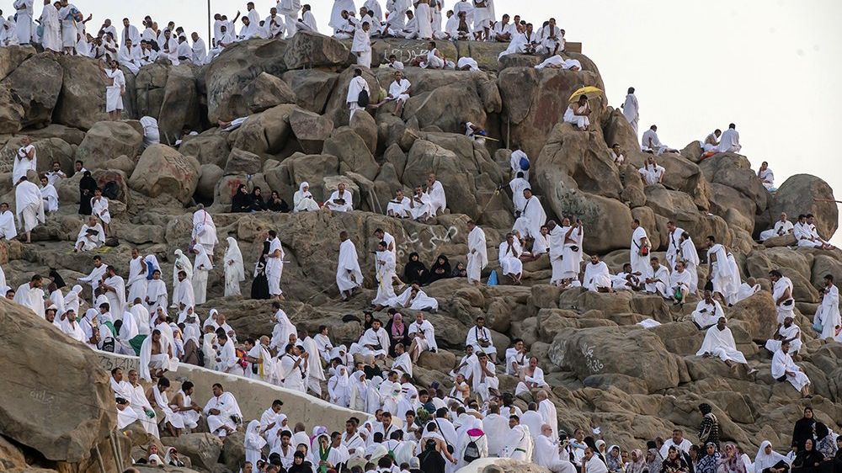
Next pilgrims at Hajj go to Mount Arafat. When they get here they pray and spend the night at this holy place.

Slide 55
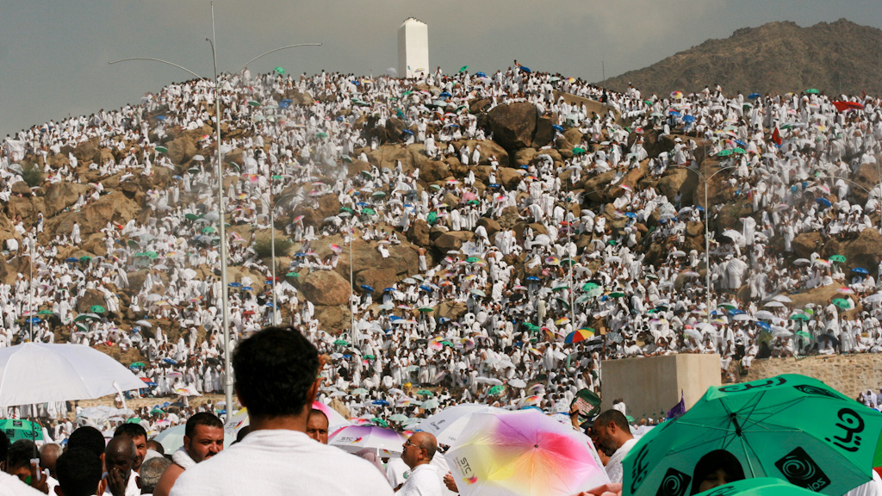
Many Muslims believe this is where the Prophet Muhammed gave his last speech

Slide 56
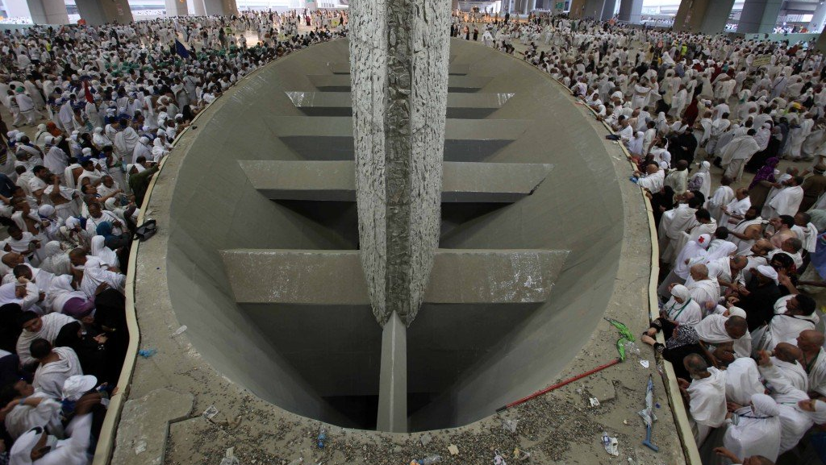
Next the pilgrims go to Mina to perform jamarat.
They throw pebbles at these huge stone pillars which represent the Devil.

Slide 57
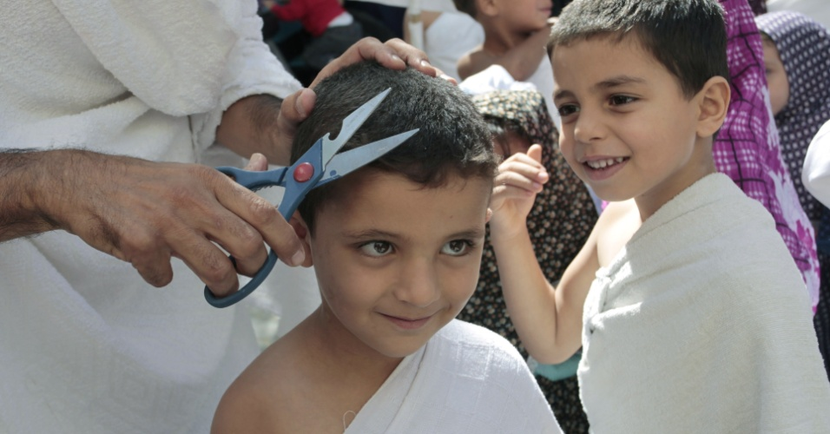
Once they have done this, pilgrims have their hair cut to show they have completed the Hajj

Slide 58
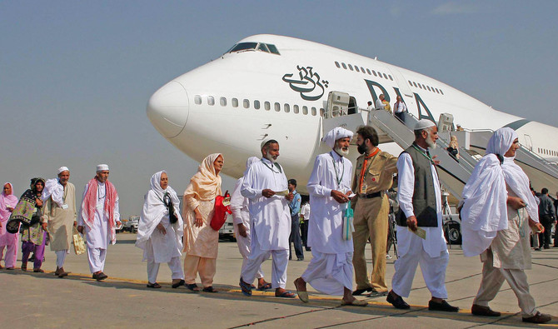
Finally pilgrims go back to the airport to head home on the special Hajj flights that are arranged.

