Slide 1
Thursday 15th May 2025
15/5/25

Slide 2
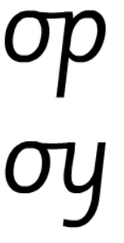
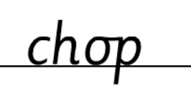
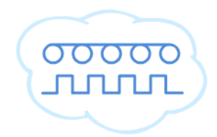
Morning Challenges:
Name writing

Slide 3
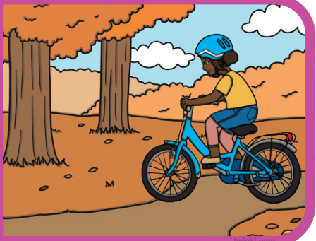
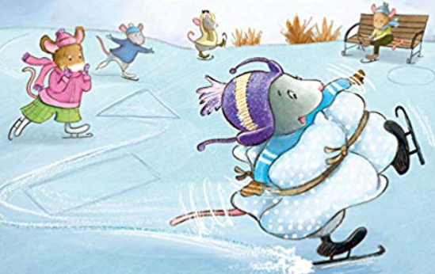
Write sentences for these pictures using i-e.

Slide 4
TBAT: read and write words which include the /o-e/ digraph.
Thursday 15th May 2025
Speedy sounds
Digital Flashcards - Teach Your Monster to Read

Slide 5
TBAT: read and write words which include the /o-e/ digraph.
Thursday 15th May 2025

Slide 6
TBAT: read and write words which include the /o-e/ digraph.
Thursday 15th May 2025
Circle the correct spelling for each word.
noas
nose
nows
bone
boan
bown
foan
phoan
phone

Slide 7
TBAT: read and write words which include the /o-e/ digraph.
Thursday 15th May 2025
Fill in the word to complete the sentence.
I had a round ...............................
I went …...................... to go to sleep.
There was a …...... by the side of the road.

Slide 8
TBAT: read and write words which include the /o-e/ digraph.
Thursday 15th May 2025
Underline the /o-e/ graphemes in the sentence.
I wrote a note to remember to get a new hose.

Slide 9
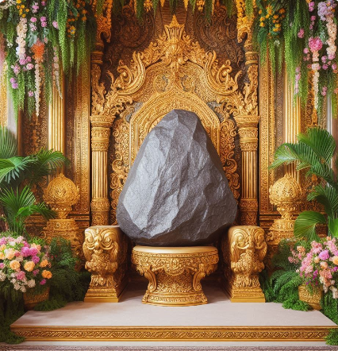
TBAT: read and write words which include the /o-e/ digraph.
Thursday 15th May 2025
…......................................................................
…......................................................................
….......................................................................
…........................................................................

Slide 10
TBAT: answer questions as a naturalist.
Thursday 15th May 2025
3 in 3- Match the question to the answer.
How old is David Attenborough?
A knighthood.
Where did David Attenborough grow up?
99 years old.
What was the honour that David received from the Queen called?
A university campus.

Slide 11
TBAT: answer questions as a naturalist.
Thursday 15th May 2025
Blue/ Green- Ask a question which would get this answer.
David got sent a dried sea horse.
David grew up on the campus of a university.
What do most questions begin with?

Slide 12
TBAT: answer questions as a naturalist.
Thursday 15th May 2025
What is hot seating?

Slide 13
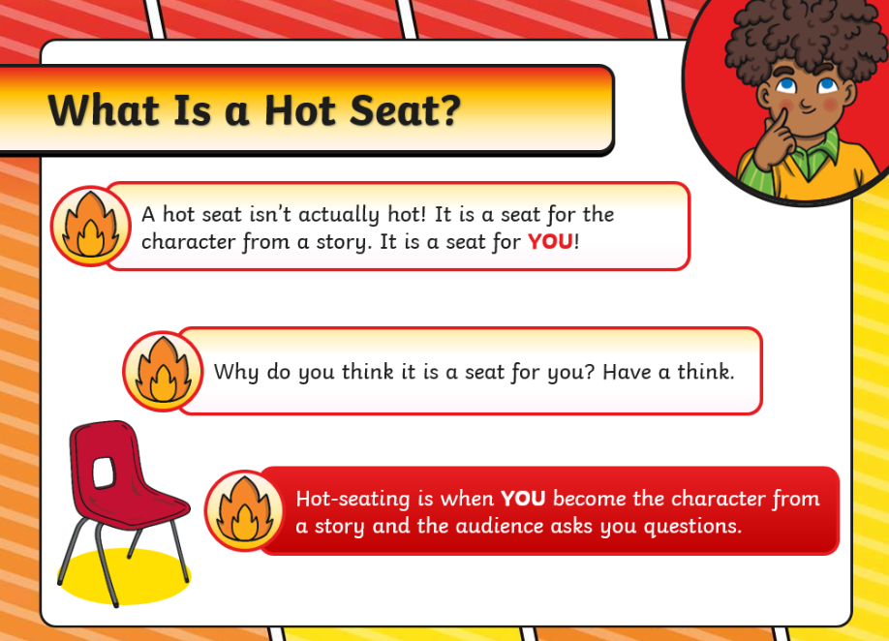
TBAT: answer questions as a naturalist.
Thursday 15th May 2025

Slide 14
TBAT: answer questions as a naturalist.
Thursday 15th May 2025

Slide 15
TBAT: answer questions as a naturalist.
Thursday 15th May 2025
What words do we usually use at the beginning of a sentence?
Challenge: What type of information do you usually get from each question start?

Slide 16
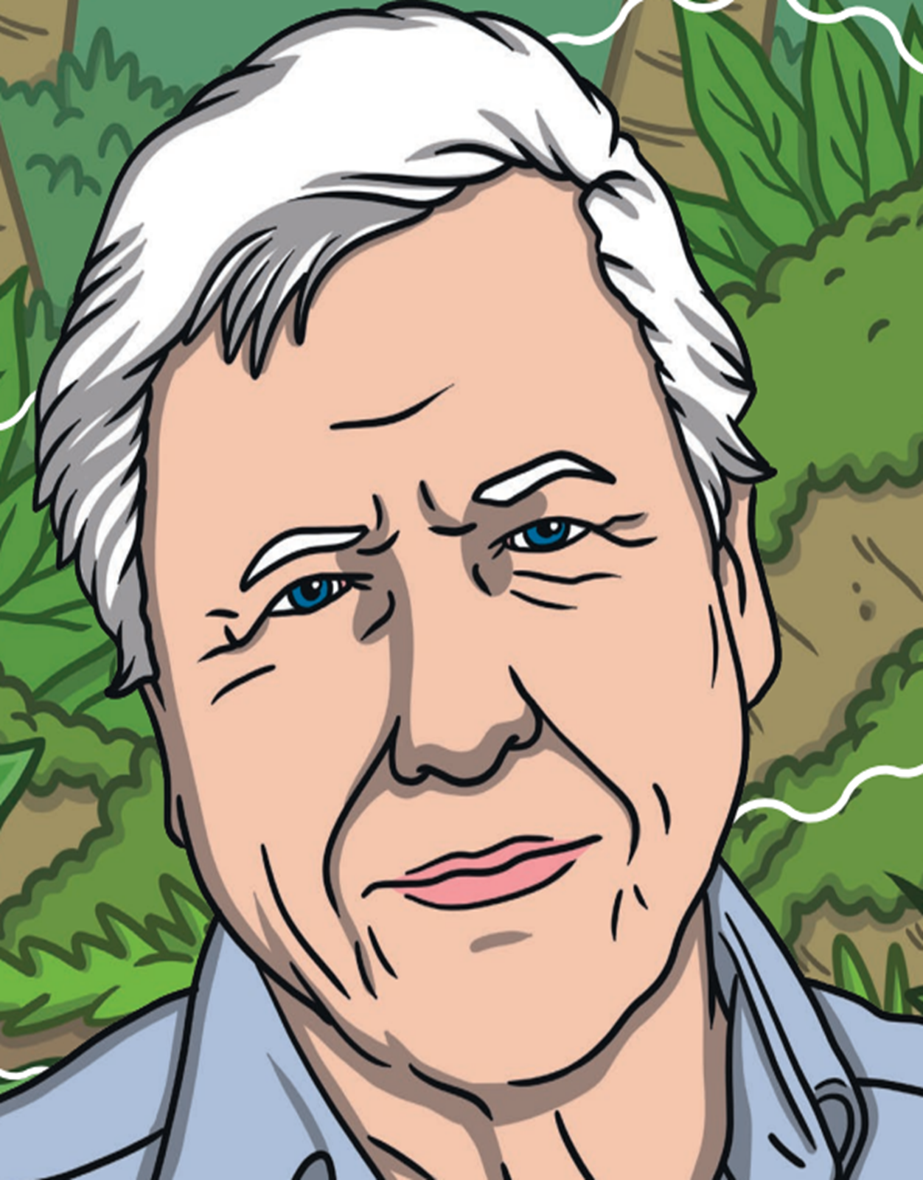
TBAT: answer questions as a naturalist.
Thursday 15th May 2025
If you could ask David Attenborough any question, what would it be?

Slide 17
TBAT: answer questions as a naturalist.
Thursday 15th May 2025
Take it in turns to pretend to be David and ask him questions. Remember to answer in full sentences and as David.

Slide 18
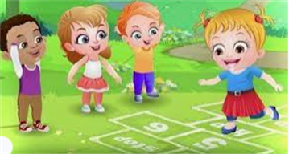
Break

Slide 19
TBAT – explore catching with two hands
Warm-up
The tortoise and the hare
Take a cone and stand in space.
You are a tortoise with a cone, resting the cone on your back as a shell.
You are a hare with a band, tucking the band in your shorts as a tail.
A On signal, tortoises move around slowly with your balanced cone on their back for 1 minute. Hares move around quickly.
.
B Swap roles
C. If you are holding a cone jump side to side over it whilst the others practice throwing and catching a band on the spot.
When you hear 'change' place your equipment on the floor and quickly change roles.

Slide 20
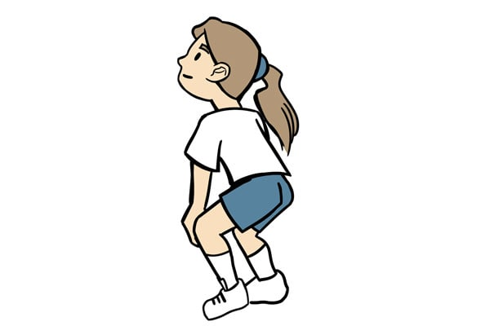
TBAT – explore catching with two hands
Skill development
Exploring catching
A Select a piece of equipment and throw and catch to yourselves in a space, exploring different catches from different heights.
B Swap your equipment and explore catching with a new item.
C Show the 'ready position' and highlight that being in this position helps to prepare to catch.

Slide 21
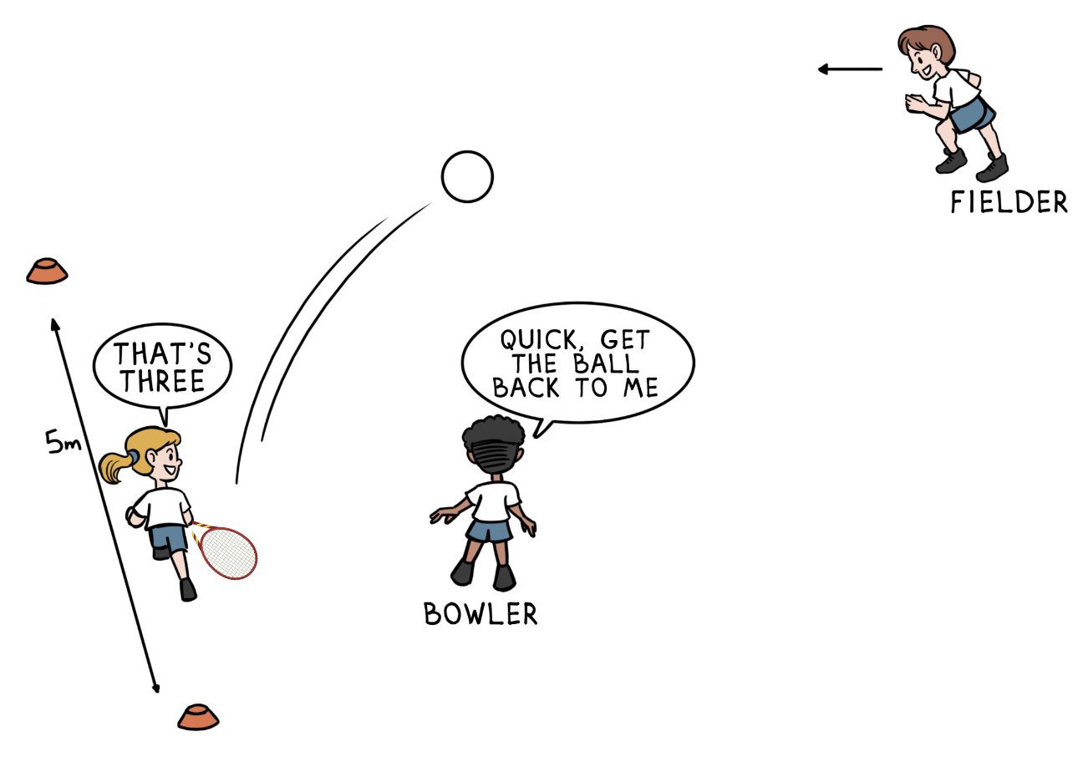
TBAT – explore catching with two hands
Skill development
Alphabet catch
In pairs with one playground ball, take turns at dropping the ball and catching it after one bounce.
If you catch the ball, you continue. After each catch your partner must say each letter from the alphabet in the correct order.
What letter can you reach?

Slide 22
TBAT – explore catching with two hands
Plenary
How can I catch safely?

Slide 23
Lunch

Slide 24
Today's Alien language is.......

Slide 25
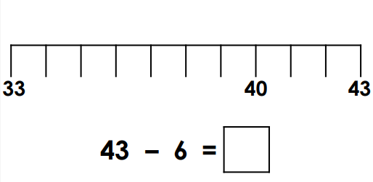
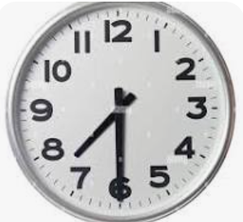
TBAT: solve problems in context using addition and subtraction
Partition 34 into tens and ones.
3 in 3
What time is it?
34

Slide 26
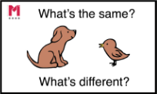
Blue / Green Use ‘Make ten’ to solve these calculations.
Challenge:
Check your answers using the inverse
18 + 7
38 + 7
28 + 7
35 – 7
45 – 7
25 – 7
Notes:
Do Now: Addition and subtraction using ‘Make ten’
Show pupils the calculations on the slide. They solve them using the ‘Make ten’ strategy on a bead string.
What will you partition seven into when you’re adding it to 18 to ‘Make ten’?
Ask pupils what similarities and differences they notice about the numbers.

Slide 27
TBAT: solve problems in context using addition and subtraction
add
‘Make ten’
subtract
cost
more
Dienes
less

Slide 28
Making bracelets for the school fair
What’s the most expensive bead? The least expensive?
 | red bead | 7 p
 | blue bead | 4 p
 | green bead | 8 p
 | yellow bead | 5 p
 | black bead | 2 p
r
b
g
y
r
g
r
g
b
b
0
10
20
30
40
50
60
70
80
90
100
Notes:
New Learning: Making bracelets at the school fair
Note: it is important that pupils are comfortable with a range of strategies, so you should consider a range of approaches with differing representations, such as number lines, part-whole models and Dienes.
Introduce the context: pupils will be making bracelets to sell at the school fair. There are different types of beads; each one has a different price. Show pupils the price list on the slide and check understanding of the context:
How much does a __ bead cost? Which is the most expensive bead? The cheapest?
Then move on to designing a bracelet and finding the cost, first with two beads. Use real beads on a string, or coloured cubes to represent the beads.
I want to make a bracelet using a red bead and a green bead. How much would it cost?
Give pupils a chance to discuss and calculate.
How did you calculate the cost of my bracelet? Did you use addition or subtraction?
Which strategy did you use?
Model using ‘Make ten’ to find the total of 7 p and 8 p.
Then add a blue bead on to the bracelet (4 p).
Do we need to add all the costs again? Why/why not?
Repeat with further examples and challenge pupils to calculate the cost.

Slide 29
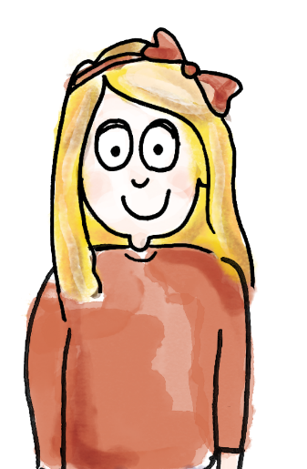
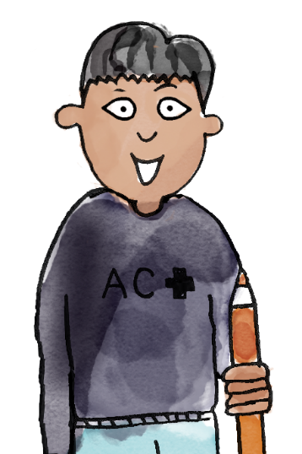
 | red bead | 7 p
 | blue bead | 4 p
 | green bead | 8 p
 | yellow bead | 5 p
 | black bead | 2 p
r
b
I choose this bracelet.
A blue bead costs 4 p and a red bead costs 7 p.
You need to calculate four plus seven.
g
y
b
b
r
I know that four plus six is ten, and seven is one more than six, so the answer is 11 p.
I used the 'Make ten' strategy.
add subtract ‘Make ten’ more less cost Dienes
Notes:
Talk Task: Finding the cost of a bracelet
Pupils have the Task Sheet (provided in colour and B&W).
Pupil A chooses a bracelet, finds the cost of each bead and tells Pupil B the calculation required. Pupil B calculates the addition and explains the calculation strategies they are using (e.g. known facts, ‘Make ten’). Pupils swap roles and repeat.
Consider whether you want pupils to calculate mentally or whether you will provide manipulatives or other representations, such as a number line.

Slide 30
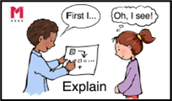
This bracelet costs 24 p
 | red bead | 7 p
 | blue bead | 4 p
 | green bead | 8 p
 | yellow bead | 5 p
 | black bead | 2 p
r
g
r
b
y
b
g
y
I no longer want the yellow bead.
How can we work out the new cost?
b
0
10
20
30
40
50
60
70
80
90
100
Notes:
Develop Learning: Removing beads and adding constraints
Use the Develop Learning to explore contexts which require subtraction, such as a bracelet from which you want to remove a bead (see the slide).
Can you think of two different ways to find the new cost of the bracelet?
Allow pupils time to discuss and take feedback. Suggestions might include adding the blue, green and red beads again or subtracting the cost of a yellow bead from 24 p.
Use the next slide to introduce the context for the Independent Task, where pupils have 20 p to design their own bracelet.
You have 20 p to spend on beads and your task is to spend all of your money. Which beads could you buy? How many different options can you find?
Give pupils an opportunity to consider the problem and then take some feedback on strategies and ideas before pupils work on the problem in the Independent Task.

Slide 31
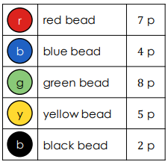
Blue / Green
Your turn.
Calculate the cost of the bracelet.

Slide 32
Independent: You have 20 p to spend
 | red bead | 7 p
 | blue bead | 4 p
 | green bead | 8 p
 | yellow bead | 5 p
 | black bead | 2 p
r
b
g
y
Your task is to spend all your money!
What beads could you buy for 20 p?
b
0
10
20
30
40
50
60
70
80
90
100
Notes:
Develop Learning: Removing beads and adding constraints
Use the Develop Learning to explore contexts which require subtraction, such as a bracelet from which you want to remove a bead (see the slide).
Can you think of two different ways to find the new cost of the bracelet?
Allow pupils time to discuss and take feedback. Suggestions might include adding the blue, green and red beads again or subtracting the cost of a yellow bead from 24 p.
Use the next slide to introduce the context for the Independent Task, where pupils have 20 p to design their own bracelet.
You have 20 p to spend on beads and your task is to spend all of your money. Which beads could you buy? How many different options can you find?
Give pupils an opportunity to consider the problem and then take some feedback on strategies and ideas before pupils work on the problem in the Independent Task.

Slide 33
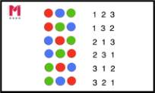
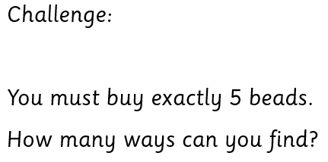
TBAT: solve problems in context using addition and subtraction
 | red bead | 7 p
 | blue bead | 4 p
 | green bead | 8 p
 | yellow bead | 5 p
 | black bead | 2 p
r
b
g
y
b
Notes:
Independent Task: Exploring addition and subtraction within a context
Pupils have the Task Sheet (provided in colour and B&W) and manipulatives such as a bead string and cubes. A pair of ten-frames may support pupils in finding beads that sum to 20 (see resource bank). This task lends itself well to having constraints added, e.g. Can you use just two different types of bead? Can you use just one type of bead? These can either simplify the task or add a challenge!
Possible adaptations:
Add constraints to provide increased or decreased challenge.
Some pupils might need a ‘way in’, e.g. a suggestion for the start of a bracelet.

Slide 34
Comparing solutions
What solutions did you find?
What calculation strategies did you use?
Notes:
Plenary: Comparing solutions
Use the Plenary to compare pupils’ different solutions and calculation strategies from the Independent Task. Address any misconceptions and share great examples.

