Slide 1
Monday 12th May 2025
12/5/25

Slide 2
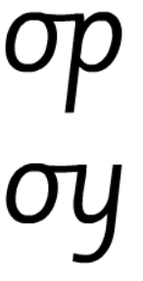
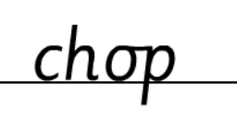
Morning Challenges:
Name writing

Slide 3
TBAT: read and write words which include the /a-e/ digraph.
Monday 12th May 2025
Speedy sounds
Digital Flashcards - Teach Your Monster to Read

Slide 4
TBAT: read and write words which include the /a-e/ digraph.
Monday 12th May 2025

Slide 5
TBAT: read and write words which include the /a-e/ digraph.
Monday 12th May 2025
Are the words real or fake?
gate
brave
pate
gabe
shame
plame
prake
male

Slide 6
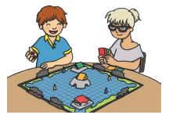
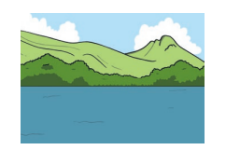
TBAT: read and write words which include the /a-e/ digraph.
Monday 12th May 2025
Label the pictures?

Slide 7
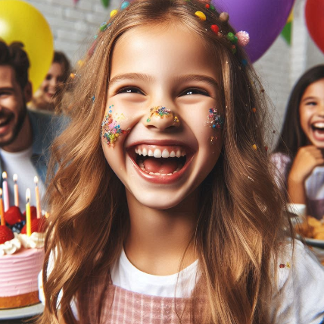
TBAT: read and write words which include the /a-e/ digraph.
Monday 12th May 2025
Underline the /a-e/ graphemes in the sentence.
The girl got cake all over her face when she ate it.

Slide 8
TBAT: read and write words which include the /a-e/ digraph.
Monday 12th May 2025
…......................................................................
…......................................................................
….......................................................................
…........................................................................

Slide 9
Little Wandle Guided Reading

Slide 10
Assembly

Slide 11
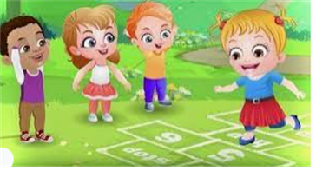
Break

Slide 12
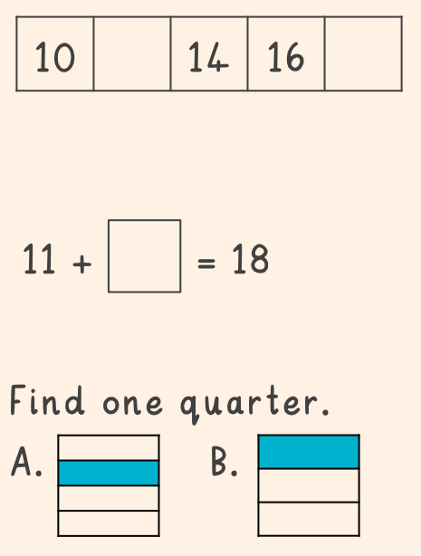
TBAT: subtract ones from a 2-digit number with regrouping 3 in 3

Slide 13
Subtraction equations Blue/ Green
What subtraction equations can you make using these ten-frames?
Example:
14 – 5 = 9
Example:
16 – 5 = 11
Challenge:
Find one more, one less and ten more and ten less than this number.
Notes:
Do Now: ‘Make ten’
Show pupils the ten-frames on the slide.
Which subtraction equations can you make that have 14 as the whole?
What will be left on the ten-frame when you have subtracted?
Give pupils a chance to explore and then take feedback.

Slide 14
TBAT: subtract ones from a 2-digit number with regrouping
subtract
‘Make ten’
group of ten
regroup
ones
Dienes

Slide 15
Which of these have an answer less than ten?
How do you know?
14 – 3
16 – 4
13 – 2
12 – 1
16 – 7
12 – 8
14 – 5
13 – 9
Notes:
New Learning: Subtracting ones from a 2-digit number using ‘Make ten’
Show pupils the expressions on the slide.
Which of these expressions have a value less than ten? How do you know?
Recap the ‘Make ten’ strategy for subtraction, modelling on a bead string.
On the next slide, ask pupils to consider how to solve the equation 32 – 5. They might suggest counting back five from 32. You could model this on a bead string, subtracting one bead at a time until you have subtracted five.
Could we use the ‘Make ten’ strategy to subtract five from 32? Explain.
Model using the ‘Make ten’ strategy, partitioning the five into two and three. Demonstrate this on a bead string, with pupils moving the beads on their own bead strings as you discuss the strategy. Use the next slide to show this on a number line. An explanation will be similar to the following:
It is easy to subtract two from 32 first. Then we must take another three from 30, as we want to subtract five altogether. 32 subtract two is 30 and 30 subtract three is 27.
Repeat with further examples, e.g. 43 – 6, 61 – 4.

Slide 16
How could we calculate the answer?
32 – 5 = ______
Notes:
New Learning: Subtracting ones from a 2-digit number using ‘Make ten’
Show pupils the expressions on the slide.
Which of these expressions have a value less than ten? How do you know?
Recap the ‘Make ten’ strategy for subtraction, modelling on a bead string.
On the next slide, ask pupils to consider how to solve the equation 32 – 5. They might suggest counting back five from 32. You could model this on a bead string, subtracting one bead at a time until you have subtracted five.
Could we use the ‘Make ten’ strategy to subtract five from 32? Explain.
Model using the ‘Make ten’ strategy, partitioning the five into two and three. Demonstrate this on a bead string, with pupils moving the beads on their own bead strings as you discuss the strategy. Use the next slide to show this on a number line. An explanation will be similar to the following:
It is easy to subtract two from 32 first. Then we must take another three from 30, as we want to subtract five altogether. 32 subtract two is 30 and 30 subtract three is 27.
Repeat with further examples, e.g. 43 – 6, 61 – 4.

Slide 17
How could we calculate the answer?
32 – 5 = ______
– 3
– 2
0
10
20
30
40
50
60
32
Notes:
New Learning: Subtracting ones from a 2-digit number using ‘Make ten’
Show pupils the expressions on the slide.
Which of these expressions have a value less than ten? How do you know?
Recap the ‘Make ten’ strategy for subtraction, modelling on a bead string.
On the next slide, ask pupils to consider how to solve the equation 32 – 5. They might suggest counting back five from 32. You could model this on a bead string, subtracting one bead at a time until you have subtracted five.
Could we use the ‘Make ten’ strategy to subtract five from 32? Explain.
Model using the ‘Make ten’ strategy, partitioning the five into two and three. Demonstrate this on a bead string, with pupils moving the beads on their own bead strings as you discuss the strategy. Use the next slide to show this on a number line. An explanation will be similar to the following:
It is easy to subtract two from 32 first. Then we must take another three from 30, as we want to subtract five altogether. 32 subtract two is 30 and 30 subtract three is 27.
Repeat with further examples, e.g. 43 – 6, 61 – 4.

Slide 18
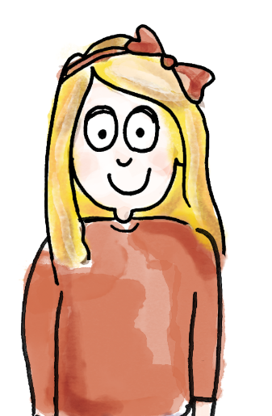
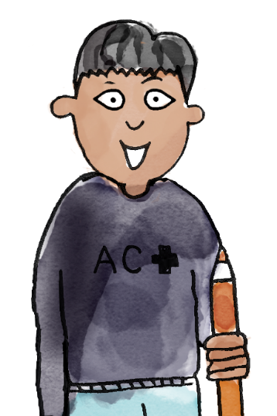
I choose 32 – 4.
I have made 32 on the bead string.
It’s easy to subtract two from 32.
Partition four into two and two.
Subtract two beads first. That makes 30.
Then subtract another two, so that you’ve subtracted four.
32 subtract four is equal to 28.
subtract ‘Make ten’ group of ten ones regroup Dienes
Notes:
Talk Task: Subtracting ones from a 2-digit number using ‘Make ten’
Pupils have the Task Sheet and a bead string.
Pupil A selects an expression from the sheet and makes the minuend on the bead string. Pupil B identifies how to partition the subtrahend (part to be subtracted) to ‘Make ten’. They tell Pupil A how to move the beads in two groups. Pupil A moves the beads and then states the whole equation. Pupils swap roles and repeat.

Slide 19
How else could we represent this equation?
32 – 5 = ______
Challenge:
Think of the different ways that you could calculate this.
Notes:
Develop Learning: Subtracting ones from a 2-digit number with regrouping
Return to the equation 32 – 5 = __ from the New Learning. Explain that we could also represent this using Dienes on a part-whole model. Model this using a visualiser or large magnetic Dienes.
How do I make 32 using Dienes? Where should I place it on the part-whole model? Why?
32 has three tens and two ones. In this equation, 32 is the whole. When we subtract, we start with the whole and subtract a part.
Model beginning to subtract five but being unable as there are only two ones.
There are only two ones in 32, but we need to subtract five ones. What could we do?
Give pupils a chance to think, discuss and share their ideas. Then explain:
We can regroup one ten for ten ones because they have an equal value. Now we have two tens and 12 ones. 12 ones subtract five ones is seven ones. Two tens and seven ones is 27. The missing part is 27.
Model this on the part-whole model to create one part of five and the remaining part of 27.

Slide 20
Using the dienes to help, work out this calculation. 45 – 7 =
Challenge:
Draw a part, whole model for this calculation.

Slide 21
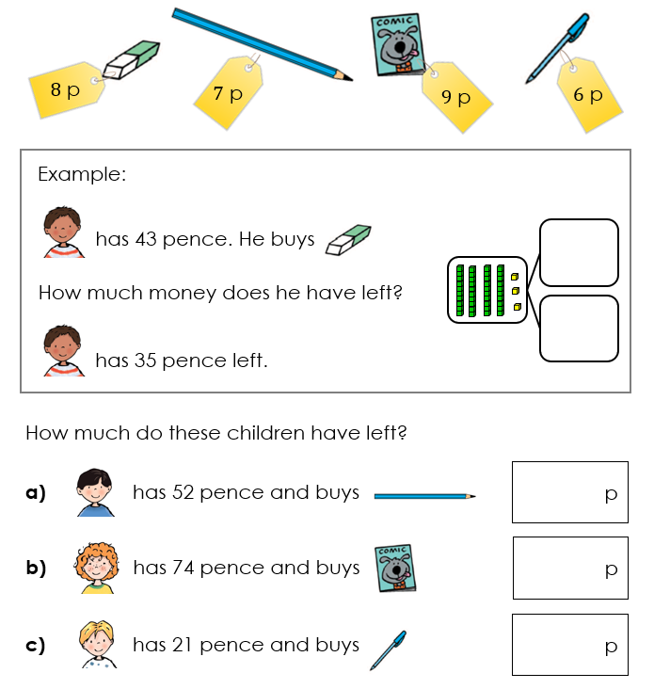
How can I work out how much he has left?

Slide 22
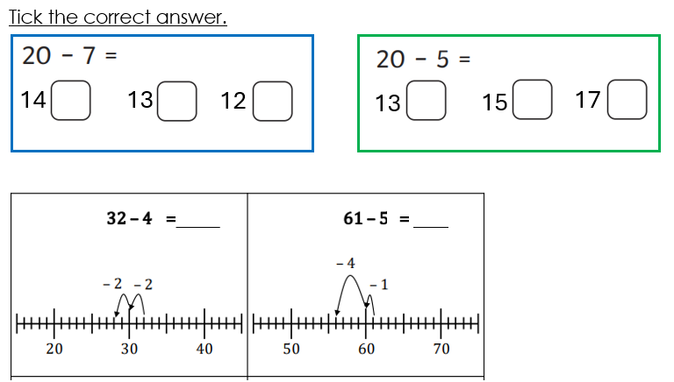

Slide 23
TBAT: subtract ones from a 2-digit number with regrouping
Use numicon to represent how much money each child has left.
Do you need to regroup one ten for ten ones?
Notes:
Independent Task: Subtracting a 2-digit number and ones with regrouping
Pupils have the Task Sheet, a large part-whole model and Dienes. They calculate how much money each pupil has left, representing each calculation with Dienes on the part-whole model. They practise regrouping one ten for ten ones, describing this to a partner.
Possible adaptations:
Pupils could continue to use a bead string and the ‘Make ten’ strategy.
Provide pupils with a pictorial representation of the Dienes to match to each problem. They then copy this with concrete Dienes to find the solution.

Slide 24
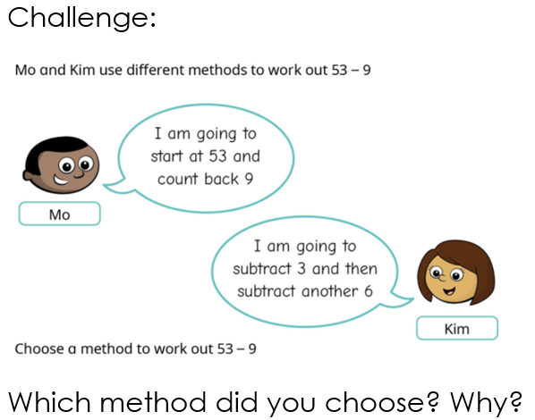
RP:

Slide 25
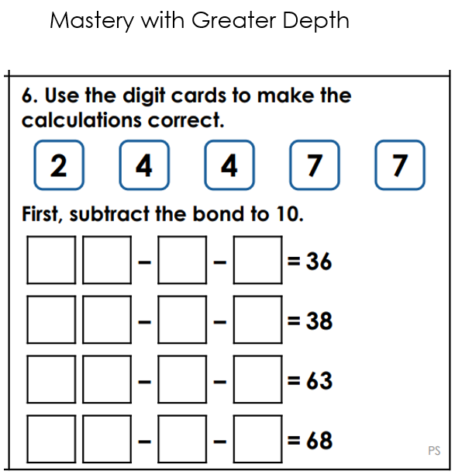

Slide 26
Represent this equation on a part-whole model
What is the whole and what is one part?
32 – 5 = 27
What other equations can you make using these three numbers?
Notes:
Plenary: Relating addition to subtraction
Return to the equation from the New Learning and Develop Learning: 32 – 5 = 27.
How can I represent this equation on the part-whole model?
What is the whole? What is a part?
Which other equations could you write using these three numbers?
Can you show me on a bead string that you are correct?

Slide 27
Lunch

Slide 28
Today's Alien language is.......

Slide 29
TBAT: explain why it important to look after our mental health.
Monday 12th May 2025

Slide 30
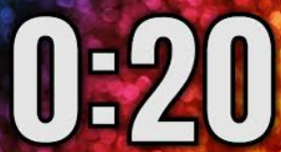
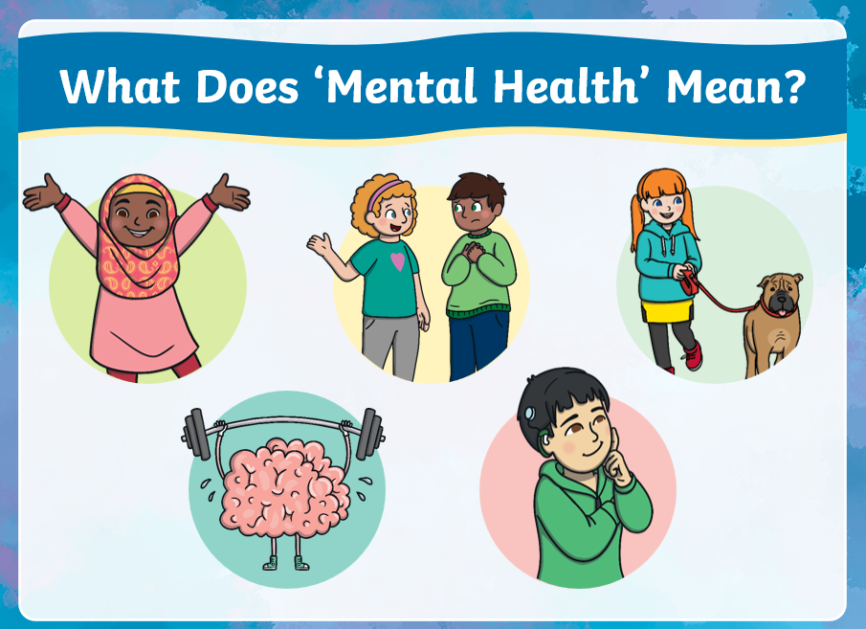
TBAT: explain why it important to look after our mental health.
Monday 12th May 2025
Blue/ Green
Mental health means...........

Slide 31
TBAT: explain why it important to look after our mental health.
Monday 12th May 2025

Slide 32
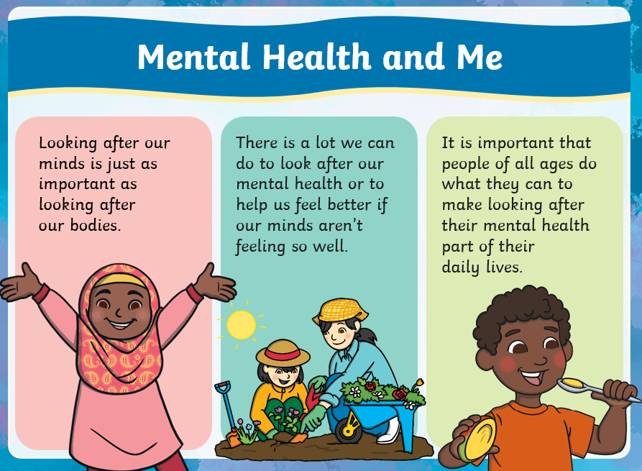
TBAT: explain why it important to look after our mental health.
Monday 12th May 2025

Slide 33
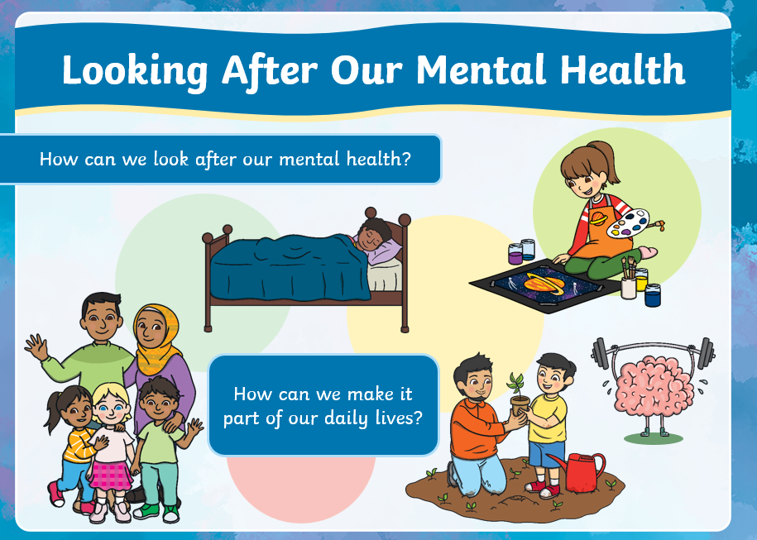
TBAT: explain why it important to look after our mental health.
Monday 12th May 2025

Slide 34
TBAT: explain why it important to look after our mental health.
Monday 12th May 2025

Slide 35
TBAT: explain why it important to look after our mental health.
Monday 12th May 2025

Slide 36
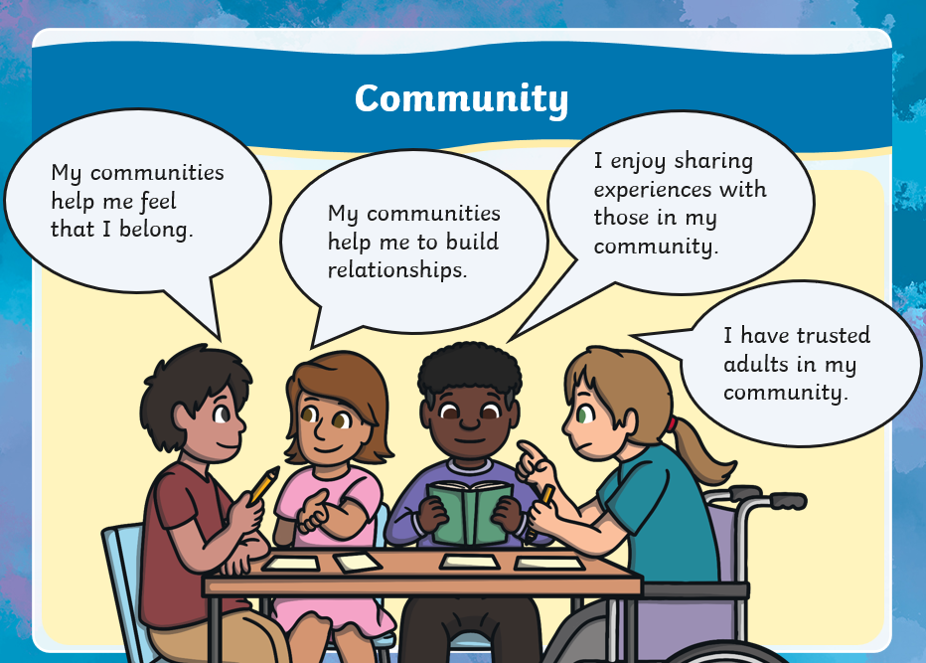
TBAT: explain why it important to look after our mental health.
Monday 12th May 2025

Slide 37
TBAT: explain why it important to look after our mental health.
Monday 12th May 2025

Slide 38
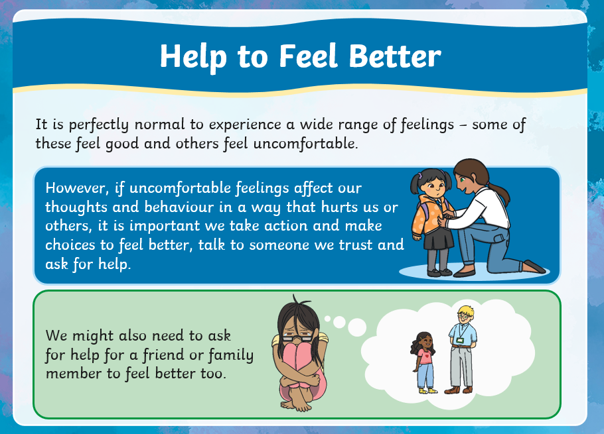
TBAT: explain why it important to look after our mental health.
Monday 12th May 2025

Slide 39
TBAT: explain why it important to look after our mental health.
Monday 12th May 2025

Slide 40
TBAT: explain why it important to look after our mental health.
Monday 12th May 2025

Slide 41
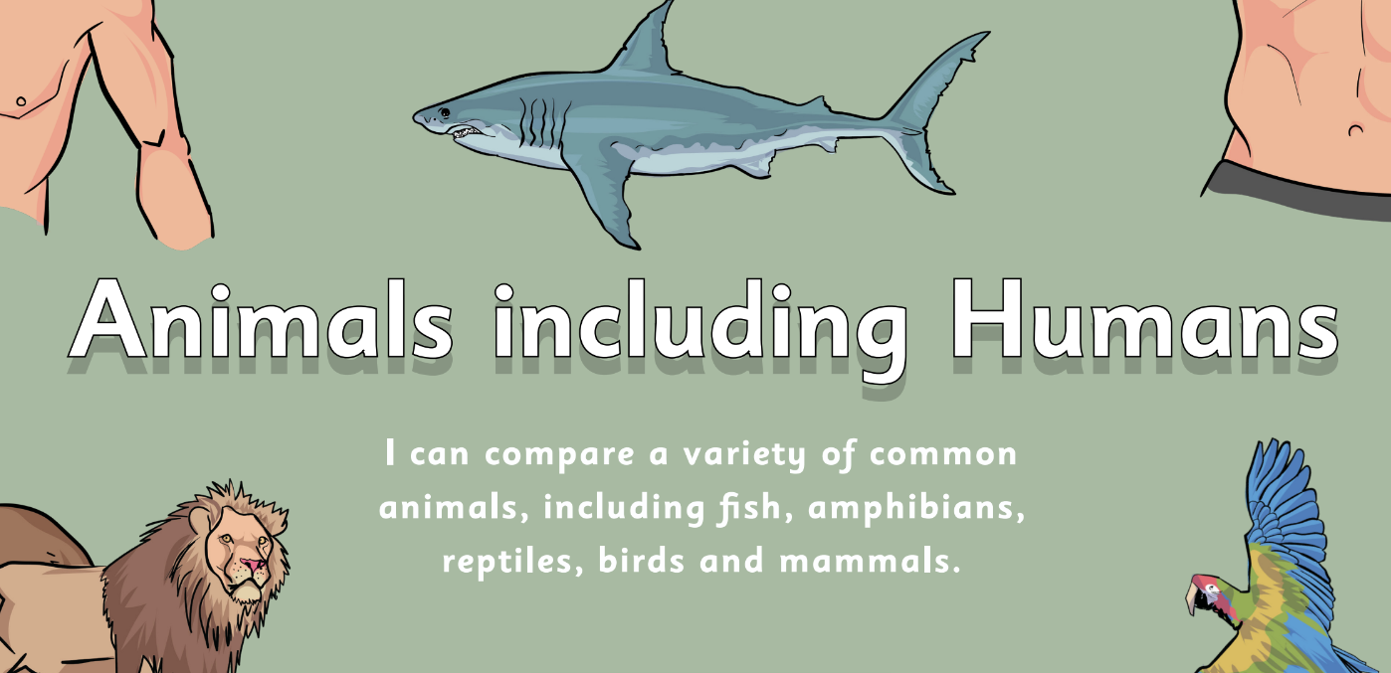
Monday 12th May 2025 12/05/2025
Key Question – Do all animals eat the same food?

Slide 42
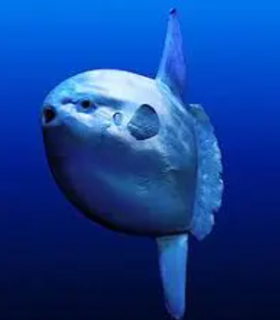
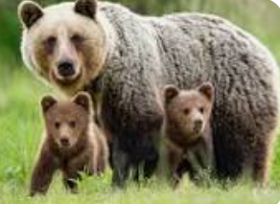
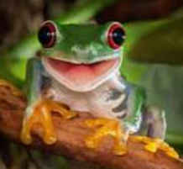
Monday 12th May 2025 12/05/2025
3 in 3
Name the animal group each animal belongs to.
How do you know that it belongs to that group?

Slide 43
Monday 12th May 2025 12/05/2025
Key Question – Do all animals eat the same food?
Key Vocabulary
Carnivore – animal that eats meat
Herbivore – animal that eats leaves
Omnivore – animal that eats meat and leaves

Slide 44
Key Question – Do all animals eat the same food?
Monday 12th May 2025 12/05/2025
Blue / Green
Think of your favourite animal.
What does it eat?
Compare with your partner. Do the animals eat the same things?
Do all animals eat the same things?

Slide 45
Key Question - Do all animals eat the same food?
Monday 12th May 2025 12/05/2025

Slide 46
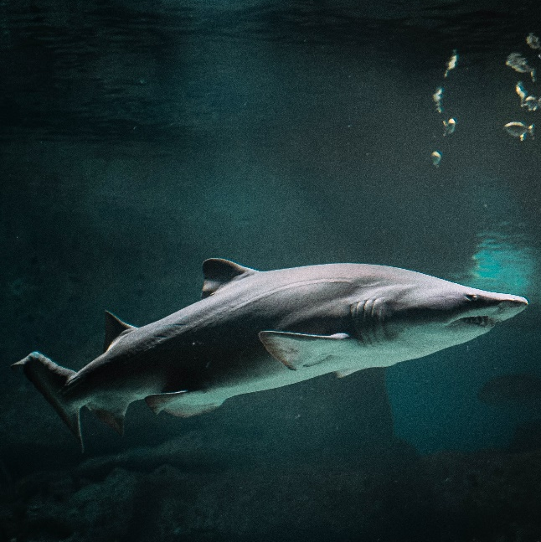
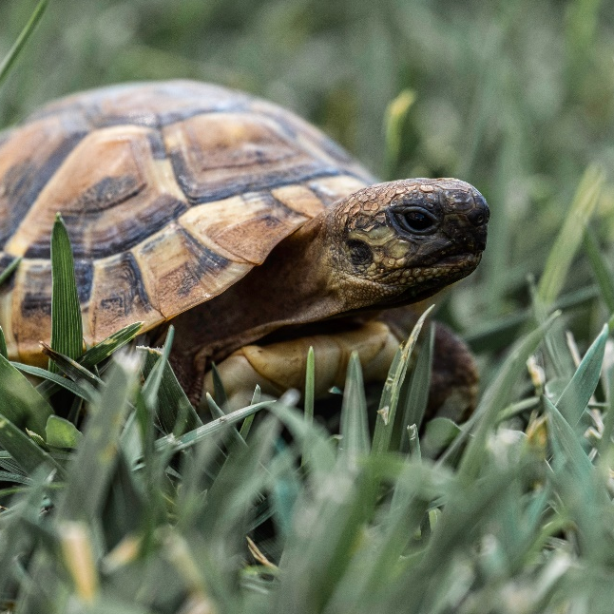
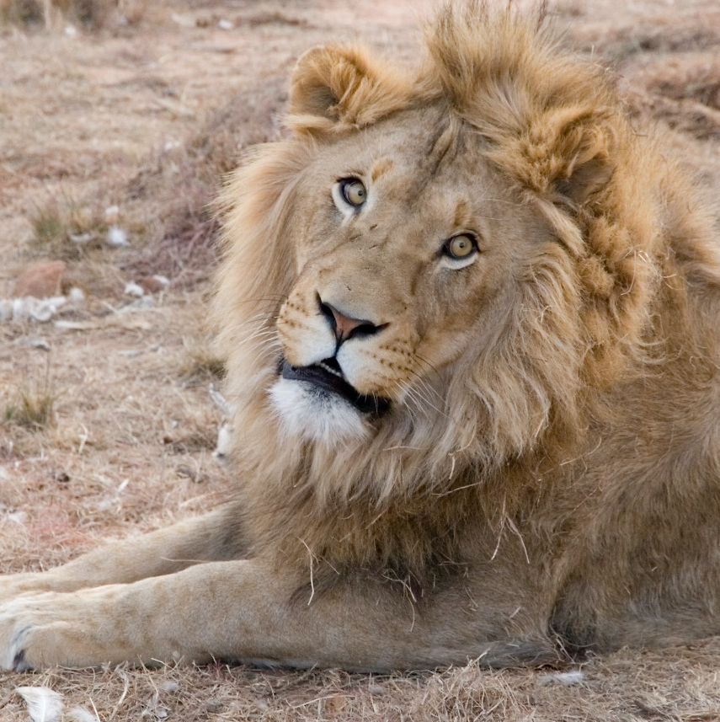
Key Question – Do all animals eat the same food?
Monday 12th May 2025 12/05/2025
All living things need to eat. We call what animals eat their diet.
What do you think these animals eat? Talk to your partner.
tortoise
shark
lion

Slide 47
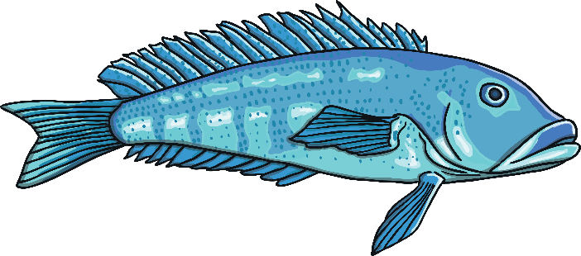
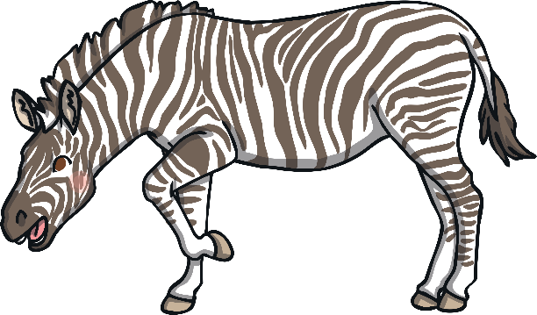
Key Question – Do all animals eat the same food?
Monday 12th May 2025 12/05/2025
tortoise
Tortoises and turtles both eat plants.
shark
Sharks eat fish and other animals that live in the sea.
lion
Lions eat other animals, such as wildebeests and zebras.

Slide 48
Key Question – Do all animals eat the same food?
Monday 12th May 2025 12/05/2025

Slide 49
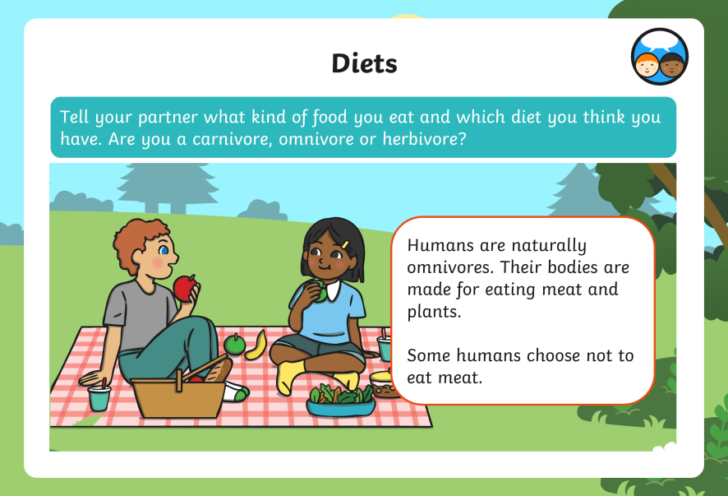
Key Question – Do all animals eat the same food?
Monday 12th May 2025 12/05/2025
?

Slide 50
Key Question – Do all animals eat the same food?
Monday 12th May 2025 12/05/2025

Slide 51
Key Question – Do all animals eat the same food?
Monday 12th May 2025 12/05/2025

Slide 52
Key Question – Do all animals eat the same food?
Monday 12th May 2025 12/05/2025

Slide 53
Key Question – Do all animals eat the same food?
Monday 12th May 2025 12/05/2025
Independent: Sort the animals into the correct group.

Slide 54
Challenge: Explain the difference between a herbivore and a carnivore.

Slide 55
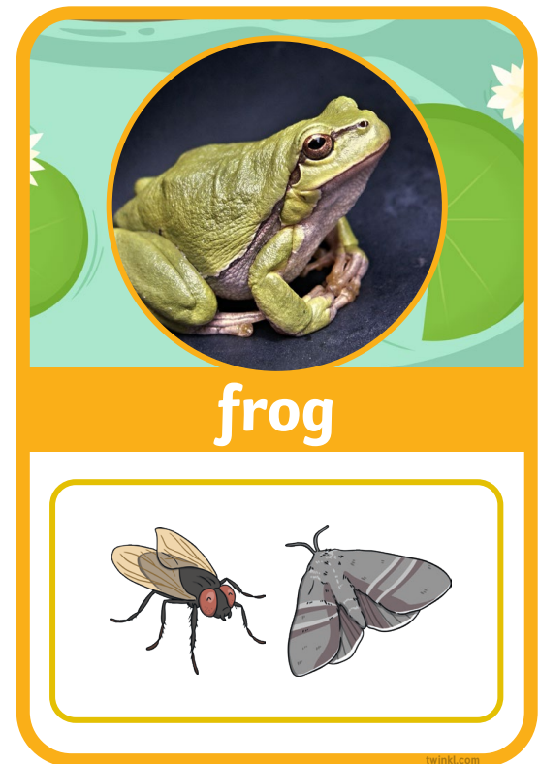
Monday 12th May 2025 12/05/2025
Key Question – Do all animals eat the same food?
EXIT Question
Is a frog an omnivore, a carnivore or a herbivore?
How do you know?

