Slide 1
Friday 16th May 2025
16/5/25

Slide 2
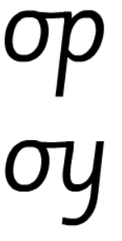
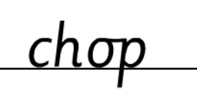
Morning Challenges:
Name writing

Slide 3
TBAT: read and write words which include the /u-e/ digraph.
Friday 16th May 2025
Speedy sounds
Digital Flashcards - Teach Your Monster to Read

Slide 4
TBAT: read and write words which include the /u-e/ digraph.
Friday 16th May 2025

Slide 5
TBAT: read and write words which include the /u-e/ digraph.
Friday 16th May 2025
Are the words real or fake?
Are the words real or fake?
blute
plume
June
trute
prune
rude
splude
thrute

Slide 6
TBAT: read and write words which include the /u-e/ digraph.
Friday 16th May 2025
Underline the /u-e/ graphemes in the sentence.
I love riding the log flume at the theme park.

Slide 7
TBAT: read and write words which include the /u-e/ digraph.
Friday 16th May 2025
…......................................................................
…......................................................................
….......................................................................
…........................................................................

Slide 8
TBAT: correctly add –s or –es to create plurals.
Friday 16th May 2025
3 in 3- Sort the words into the table.
-s | -es
dog
box
dish
sandwich
skirt
fork

Slide 9
TBAT: correctly add –s or –es to create plurals.
Friday 16th May 2025
Blue/ Green- Do you need to add an –s or –es to make a plural?
I was moving to a new house so I needed a lot of box....
The bird... in the trees were singing a lovely song.
I need to add an –s/-es because.......................................

Slide 10
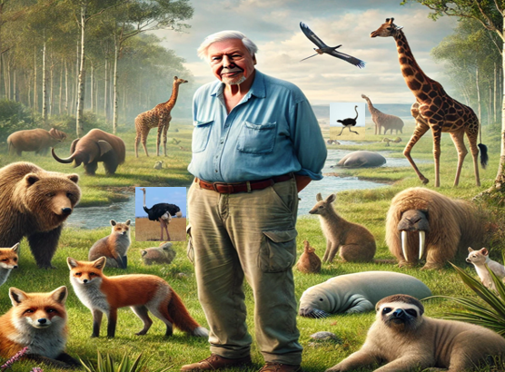
TBAT: correctly add –s or –es to create plurals.
Friday 16th May 2025
What animals can you see in this picture?

Slide 11
TBAT: correctly add –s or –es to create plurals.
Friday 16th May 2025
walrus
giraffe
bear
deer
bird
fox
ostrich

Slide 12
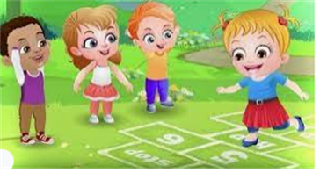
Break

Slide 13
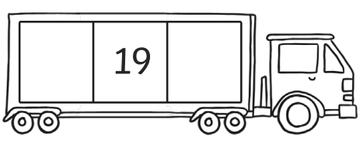
TBAT: solve problems in context using addition and subtraction.
3 in 3
Find one more and one less
Complete the number
bond to 20
Challenge: Find ten more and ten less
Complete the sequence

Slide 14
Blue / green Discuss what method you would use to calculate the missing numbers and why. I would __________ because ____
14 + 7 = ______
23 = ______ + 14
______ = 7 + 14
______ + 8 = 22
14 + ______ = 23
21 = 7 + ______
Take in turns to talk your partner through the calculations.
Notes:
Do Now: Solving missing number problems
Pupils have a manipulative such as interlocking cubes and a part-whole model. They find the missing numbers in the equations on the slide.
Do you know the whole? Do you know both parts?
Can you represent the values on a part-whole model to help you find the missing number?

Slide 15
TBAT: solve problems in context using addition and subtraction
add
total
subtract
value

Slide 16
ACP Comics are creating superhero cards
Blobman
They need your help!
Each superhero has scores for three skills.
The scores must total 20.
Skills
Strength
8
Speed
6
Intelligence
6
0
5
10
15
20
25
Notes:
New Learning: Understanding superhero cards
Introduce the context: ACP Comics are creating a new range of superhero cards and they need your help! Each superhero has scores for three skills and these must sum to 20. Show pupils an example of a superhero card on the slide and give them a chance to discuss it and ask questions.
The next slide presents three cards for discussion; these should enable pupils to further clarify the context and constraints of the task.
The Capeman card has a mistake. What is it? Can you suggest how to correct it?
The Blobman card has a missing value. Can you find it? How did you calculate it?
The Eggman card has two missing values! What might the missing values be? Is there more than one possibility? Can you find all the possibilities?
The Eggman example will prepare pupils for the Let’s Explore, where they will explore the possibilities when two values are missing. Rather than systematically finding all the possibilities here, and therefore ‘solving’ the Let’s Explore problem, you may want to model the beginning of working systematically and then introduce the Let’s Explore.
For each example discussed in the New Learning, have pupils reflect on the calculations they are doing and the strategies they are using.

Slide 17
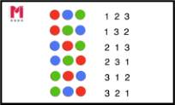
Remember: the skills must sum to 20
Capeman
Blobman
Eggman
Skills
Skills
Skills
Strength
6
Strength
4
Strength
Speed
7
Speed
8
Speed
12
Intelligence
9
Intelligence
Intelligence
Notes:
New Learning: Understanding superhero cards
Introduce the context: ACP Comics are creating a new range of superhero cards and they need your help! Each superhero has scores for three skills and these must sum to 20. Show pupils an example of a superhero card on the slide and give them a chance to discuss it and ask questions.
The next slide presents three cards for discussion; these should enable pupils to further clarify the context and constraints of the task.
The Capeman card has a mistake. What is it? Can you suggest how to correct it?
The Blobman card has a missing value. Can you find it? How did you calculate it?
The Eggman card has two missing values! What might the missing values be? Is there more than one possibility? Can you find all the possibilities?
The Eggman example will prepare pupils for the Let’s Explore, where they will explore the possibilities when two values are missing. Rather than systematically finding all the possibilities here, and therefore ‘solving’ the Let’s Explore problem, you may want to model the beginning of working systematically and then introduce the Let’s Explore.
For each example discussed in the New Learning, have pupils reflect on the calculations they are doing and the strategies they are using.

Slide 18
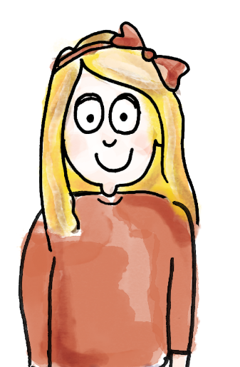
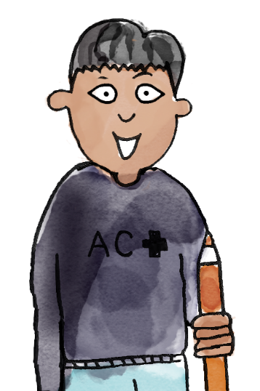
Blobman
Skills
I know that the total of all the numbers has to be 20. Six of the points have been used. 20 – 6 = 14..
Strength
6
Speed
We need to find two numbers that total 14.
I know that 8 + 6 = 14.
Intelligence
I am going to check our answer by adding all the values. 6 + 6 + 8 = 20.
add subtract total value
Notes:
Let’s Explore: Finding all the possibilities
Pupils have the Task Sheet and a suitable manipulative (e.g. 20 cubes and two ten-frames, or a bead string). They work together to find different possibilities for the missing numbers on each card. Encourage pupils to use mathematical thinking to help them to
work systematically. If pupils guess numbers, try to encourage them to consider what they learn when numbers are incorrect.
How do you know you have found all the possibilities? Convince me!

Slide 19
Let’s create a card together
Which numbers shall we use?
How will we keep count?
Skills
Strength
Speed
Intelligence
Total: 20
0
5
10
15
20
25
Notes:
Develop Learning: Creating superhero cards
Take feedback on the Let’s Explore. What strategies did pupils use to find all the possibilities? (e.g. adding one to one skill and subtracting one from the other.)
Now it is the pupils’ turn to create their own superhero cards. Remind pupils of the criterion that the sum of the skills must be 20.
Model thinking aloud to complete a sample superhero card. Explicitly show a range of strategies to calculate the four numbers. This can be through using physical representations (such as 20 cubes) or pictorial representations. This will allow pupils to see that there is more than one approach to completing the problem.
I want my superhero to be strong so I’ll give her 11 for strength. If I know 1 + 9 = 10, then I know 11 + 9 = 20, so I have nine points left to use.

Slide 20
Now, create your own on your board.
Skills
Which numbers will you use?
How will we keep count?
Strength
Speed
Challenge:
Can you include 2 odd numbers?
Can you include a number that is greater then 15?
Intelligence
Total: 20
0
5
10
15
20
25
Notes:
Develop Learning: Creating superhero cards
Take feedback on the Let’s Explore. What strategies did pupils use to find all the possibilities? (e.g. adding one to one skill and subtracting one from the other.)
Now it is the pupils’ turn to create their own superhero cards. Remind pupils of the criterion that the sum of the skills must be 20.
Model thinking aloud to complete a sample superhero card. Explicitly show a range of strategies to calculate the four numbers. This can be through using physical representations (such as 20 cubes) or pictorial representations. This will allow pupils to see that there is more than one approach to completing the problem.
I want my superhero to be strong so I’ll give her 11 for strength. If I know 1 + 9 = 10, then I know 11 + 9 = 20, so I have nine points left to use.

Slide 21
TBAT: solve problems in context using addition and subtraction
Design your own superhero cards.
Skills
Skills
Strength
Strength
Speed
Speed
Intelligence
Intelligence
Total: 20
Total: 20
0
5
10
15
20
25
Notes:
Independent Task: Applying addition and subtraction to create superhero cards
Pupils have the Task Sheet and a suitable manipulative, as in the Let’s Explore. They design their own superhero cards. You could add constraints to this task, e.g. asking pupils to create two different cards where the strength and speed are equal. You could ask whether it is possible to make a card with all even numbers. What about all odd numbers?
Possible adaptations:
Pupils could work with a higher total, e.g. 50.
Pupils could continue to explore the constraint from the Let’s Explore, where one value is given and they must find all the possibilities for the remaining values.

Slide 22
Sharing and comparing work
What superhero cards did you create?
What scores did you give them for each skill?
How did you decide?
How did you calculate?
Notes:
Plenary: Sharing and comparing work
Use the Plenary to share pupils’ work from the Independent Task. How did pupils work on the task? What calculation strategies did they use?

Slide 23
Lunch

Slide 24
Today's Alien language is.......

Slide 25
Singing and Golden Book assembly

Slide 26
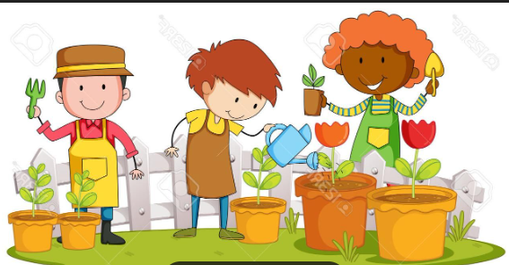
Enrichment

