Slide 1
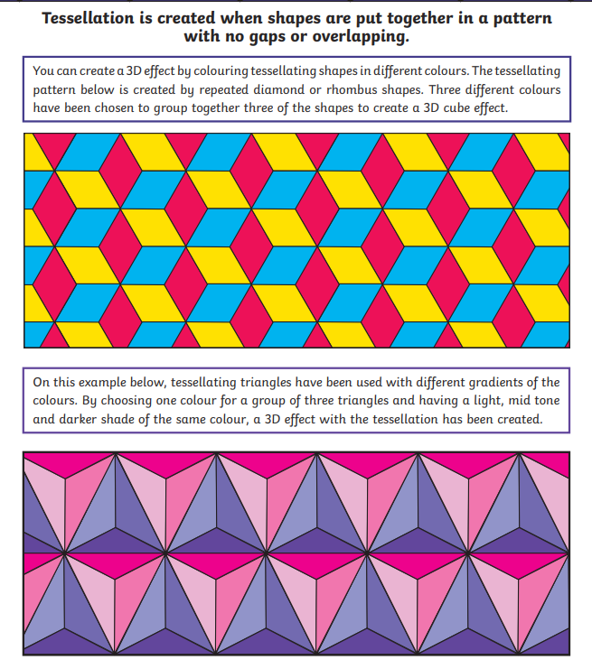
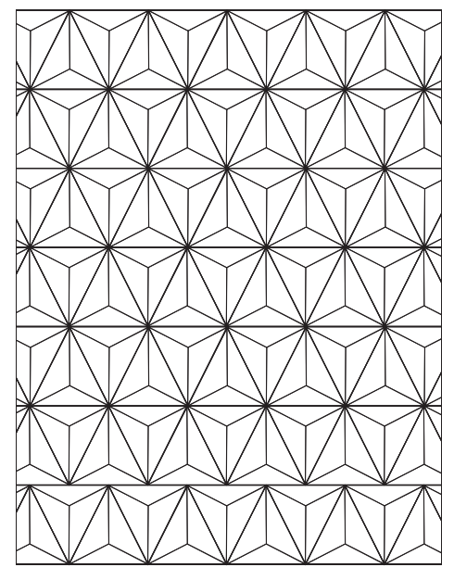
Morning challenge

Slide 2
Assembly 9am

Slide 3
Choose any 3-digit number with digits the same Add up the digits Divide the original number by the sum of the digits Your answer will be 37
Maths Challenge 1

Slide 4
Magic Subtraction
Maths Challenge 2

Slide 5
Magical Subtraction Write a 5-digit number. Rearrange the 5-digits and subtract it from your initial number. Circle one of the digits from your answer. Add the remaining digits together. Share the total of the digits. Your circled number is….

Slide 6
TBAT- understand that an unknown can be represented by a letter. 1) 67 + ? = 200 2) 16 x 5 = 3) 0.08 x 1000=

Slide 7
b + l = 8
What does b equal?
What does l equal?
Talk partners:

Slide 8
s=
b =
d=
p=
l=
c=
Instead of writing the number of legs, we are going to represent it with the first letter of the animal.

Slide 9
c + d = ?

Slide 10
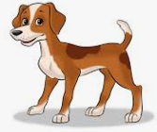
l - p = ?

Slide 11
b + l + s = p + b + c =

Slide 12
Paired whiteboard work:
Write calculations that total 10.

Slide 13
d3 = 12
Talk partners: How?

Slide 14
Work systematically to write as many calculations as you can using algebra.
Can you make it harder for yourself by using multiplication?
b4 + s = 13

Slide 15
Maths Day poem

Slide 16
Maths Day poem

Slide 17
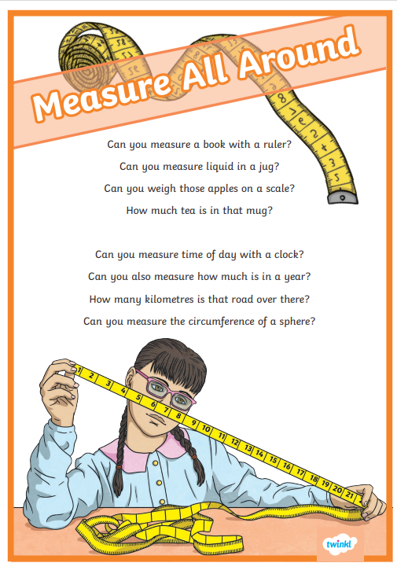
Maths Day poem

Slide 18
Maths Day poem

Slide 19
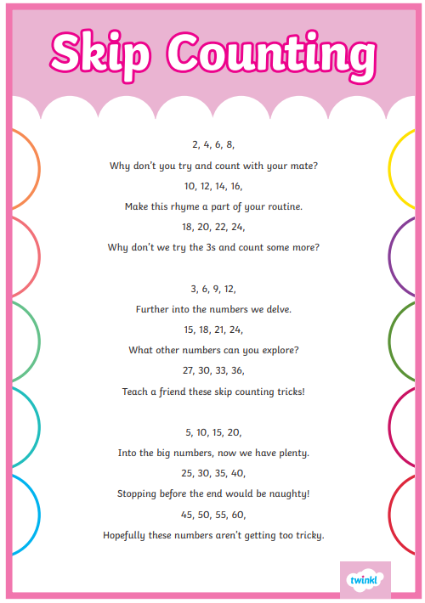
Maths Day poem

Slide 20
Maths is Magic!
Maths is magic, it’s clever and cool, We use it each day at home and at school. With numbers and symbols, we work things out, Solving each problem—there’s never a doubt!

Slide 21
For multiplication, rows and arrays, Times tables help in so many ways! “Six times eight?”—I know, it’s forty-eight, Practice and memory make maths great!

Slide 22
In addition, we line up each place, Adding the digits, we race at great pace. If numbers get big, don’t worry—don’t frown, Just carry the tens and write the sum down!

Slide 23
For subtraction, take one from another, But wait—what’s this? We need to exchange, oh brother! If the top digit’s smaller, we borrow a ten, Then subtract neatly—again and again!

Slide 24
The bus stop method helps with divide, We split up the numbers and work side by side. How many times does three fit in nine? With careful thinking, the answer’s just fine!

Slide 25
Now fractions are tricky, they can make your brain ache, They're just parts of a whole—like a slice of cake! To add them together, the bottoms must match, Find a denominator, now that’s quite the catch!

Slide 26
So, whether it’s numbers, dividing, or sums, Maths is exciting, for all—not just some! With practice and patience, you’ll soon understand, That maths is like magic—right in your hand! 🎩✨

Slide 27
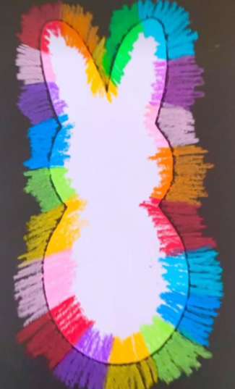
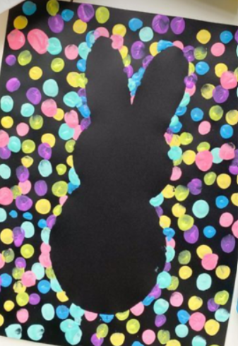
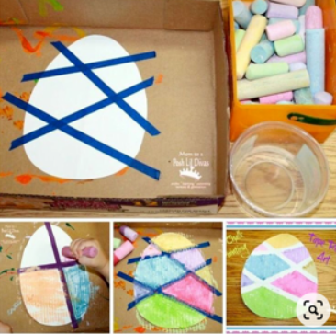
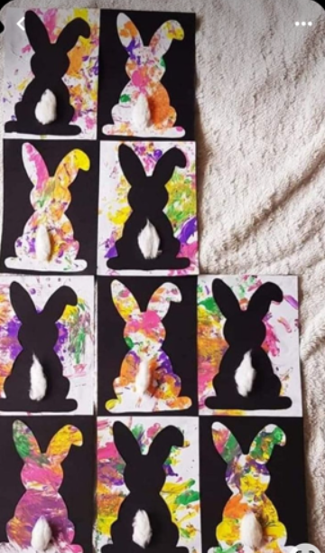
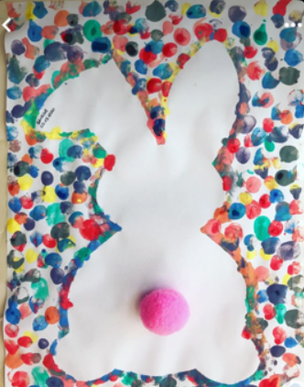
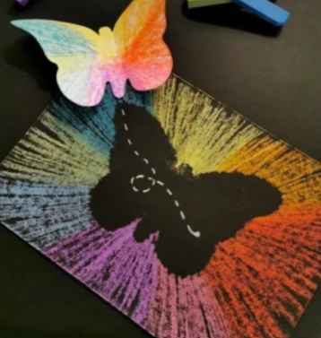
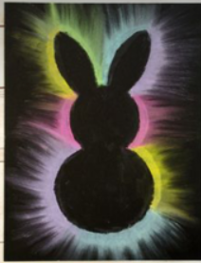
Easter crafts

Slide 28
Attendance assembly 2pm

