Slide 1
Tuesday 22nd April 2025
TBAT: Use joins consistently.
blacken
brighten
flatten
lengthen
mistaken
straighten
shorten
thicken
tighten
toughen Are there any words you are unsure of? Use a dictionary to look them up and then use them in a sentence.

Slide 2
22.04.25 TBAT- mentally add 2 place decimals in the context of money. 3in 3 1) Round the following numbers to the nearest whole number: a) 45.78 b) 23.08 c) 56.91 2) What is the value of the 7 in each number below: a) 768 b) 0.7 c) 56.007 3) How many pennies make up £3.46? Challenge: Complete the missing numbers in the sequence. 22.88, 22. 76, ______, 22.52, _____

Slide 3
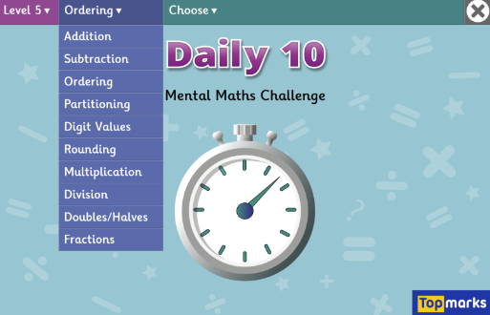
X 12 table
Daily 10 - Mental Maths Challenge - Topmarks

Slide 4
Sort the problems into mental or written methods.
Mental Method | Written Method
2.3 + 1. 4 =
359 + 7, 569 =
4 x 7 =
40 x 7 =
4, 555 + 3, 555=
456 divided by 23 =
Blue
Select one of the calulations and explain the method you would use and why.
Green
Select a different calculation and explain the method.

Slide 5
Green Use partitioning to solve the following problem. 596 + 375 = Blue Use rounding to solve the following problem: 596 + 375 = Talk partners: Which method do you think was the best method to use and why?

Slide 6
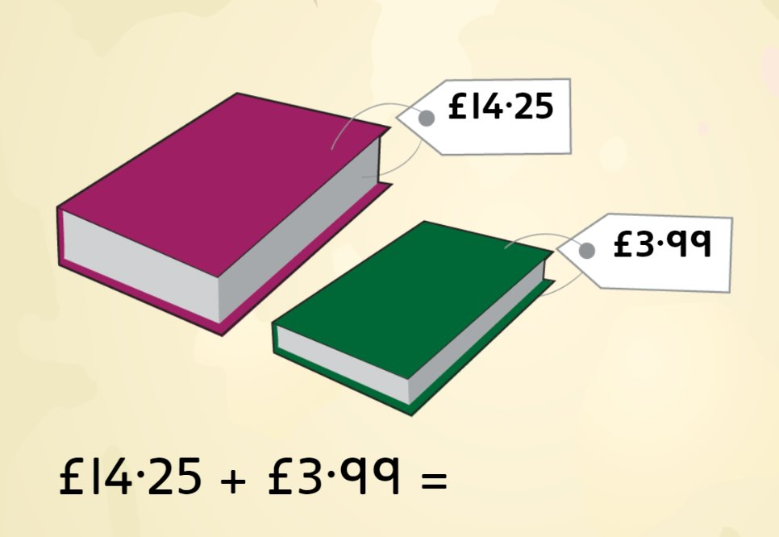
Talk partners: You are only able to use mental maths, how would you solve this problem?

Slide 7
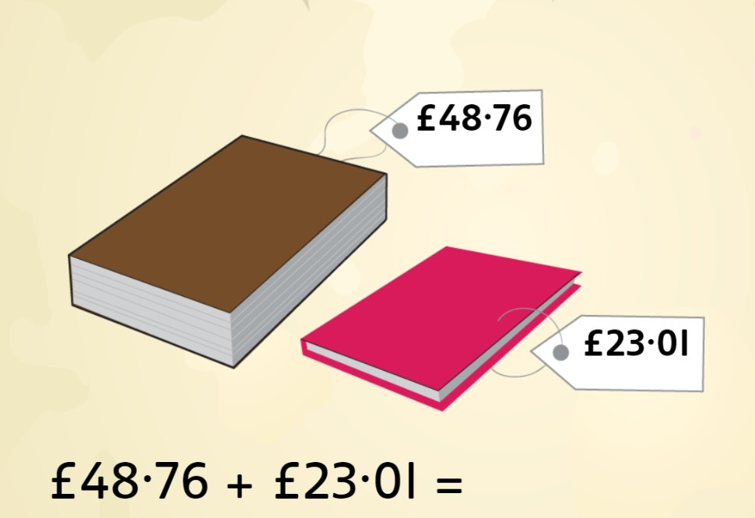
Talk partners: Which method and why?

Slide 8
Mia buys two drinks which cost £1.25 each. She also purchases an apple that costs £0.59p. How much did she spend in total? Talk partners: What information is important? Which is the best method to use and why? Paired Work: Solve the calculation.

Slide 9
Blue £3.99 + £1.99 + 50p= Green £5.01 + £1.00 + £1.99 = Tell your partner the method you have chosen to use and why.

Slide 10
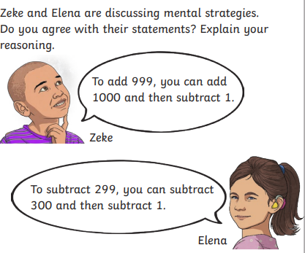
1)£2.95 + £3.50 = 2) £34.75 + £13.98=
3) £5.99 + £2.99 + £4.01 = 4) £13.80 + £0.50 = £11.90 + ?
5)Charlie wants to add £8.98 to £7.01. She adds £9 + £7 then makes what adjustment? Explain. 6) A notebook costs £2.93. A pencil costs £1.03. Anita buys two pencils and a notebook. Explain which method to use and why.

Slide 11
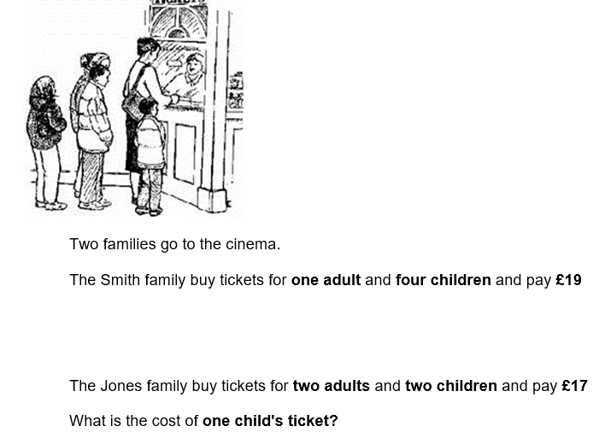
Challenge:[ ] + £6.00 = 14.00 - 1p Mastery:

Slide 12
Tuesday 22nd April TBAT: Answer comprehension questions about a text.
3 in 3
Families come in all shapes and sizes. Some kids have a brother or sister, some don't and some might have lots of brothers and sisters. Kids can live with their mum or dad, both of their parents or maybe their granny or auntie and uncle. The common saying is, “You can’t choose your family,” but, in some families, you can. Family is not defined by biological relatives. Family can be chosen, and we can add whomever we want. Family are the people who are always there for you. Family are the people who show up when someone is having a tough time. They’re the ones who you know you can always count on, no matter the distance or time between seeing each other. 1. Find and copy an informal word for children. 2. Name 2 people children can live with. 3. Which word is closest in meaning to biological? Blood-related, adopted, chosen

Slide 13
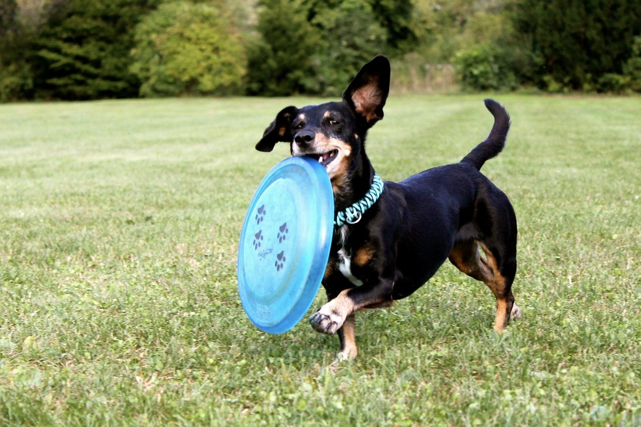
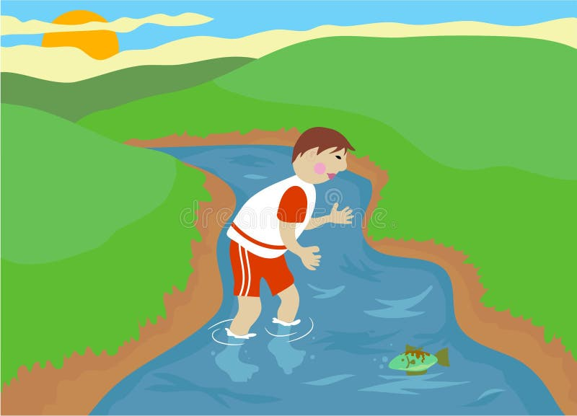
Tuesday 22nd April TBAT: Answer comprehension questions about a text.
Words/phrases we will find in the text: Precious - of great value; not to be wasted or treated carelessly. Speciality - something a person is particularly good at, a skill or subject they know a lot about, or a food or product that's well-known for being good in a particular place Frisbee - a round, plastic disk that's thrown and caught as part of a game or for fun. Waded - to walk through water that is not very deep,

Slide 14
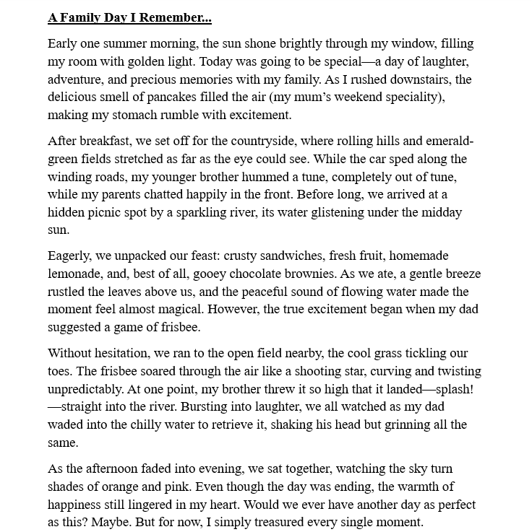
Tuesday 22nd April TBAT: Answer comprehension questions about a text.
Read the text. Can you spot: -Fronted adverbials -Parenthesis - How has cohesion been used?

Slide 15
Tuesday 22nd April TBAT: Answer comprehension questions about a text.
Multiple choice questions: 1. Where did the family go on their special day out? a) A museum in the city b) A park with a wide, grassy field and gentle river c) A busy shopping centre d) A beach by the sea
2. What did the family bring for their picnic? a) Hot dogs and lemonade b) Sandwiches, fruit, homemade lemonade, and chocolate brownies c) Fish and chips d) Sweets and fizzy drinks
3. What caused a moment of laughter during the day? a) The narrator fell in the river b) The frisbee landed in a tree c) The dad tripped over a log d) A duck stole their lunch

Slide 16
Tuesday 22nd April TBAT: Answer comprehension questions about a text.
Retrieval (Find the answer in the text):
What food did the family bring for their picnic? a) Burgers, chips, and milkshakes b) Crusty sandwiches, fresh fruit, homemade lemonade, and chocolate brownies c) Pizza, ice cream, and fizzy drinks d) Pasta, soup, and cupcakes
Where did the family go for their day out?
What happened when the brother threw the frisbee too high?
Inference (Read between the lines):
4. How do you think the family felt during their day out? Use evidence from the text to support your answer.
5. Why do you think the dad was “shaking his head but grinning” after retrieving the frisbee?

Slide 17
Tuesday 22nd April TBAT: Answer comprehension questions about a text.
Summarise the main events of the family day in three sentences.
Important information | Non-important information

Slide 18
Tuesday 22nd April TBAT: Answer comprehension questions about a text.
Challenge Why do you think the writer ended with a rhetorical question? How does it affect the reader?

Slide 19
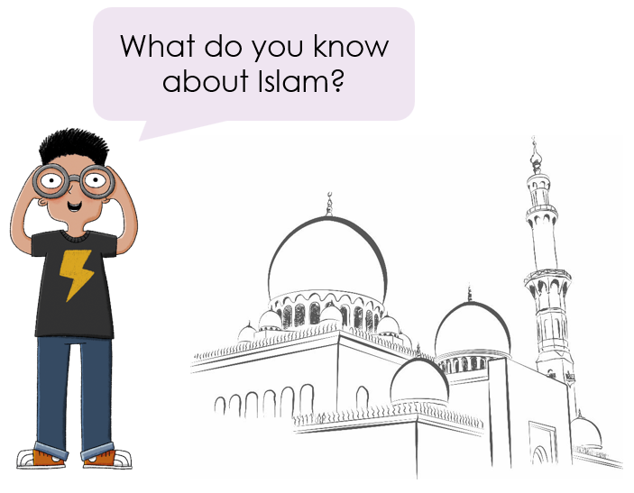
Q: How and why was Baghdad built? 1 in 1

Slide 20
How and why was Baghdad built?
Who advanced science, mathematics, and medicine and why are they important?
1
Why was this period called the Golden Age of Islam?
How did Baghdad compare to London in 900ce?
How did Baghdad become a centre of learning?
How did the Golden Age of Islam come to an end?
Notes:
Introduction: Begin by sharing the lesson statement, key term, and other key vocabulary with the pupils—you may want to add images to the teaching slides to support exemplification and understanding of these words. Before the content of the lesson begins, investigate the Key Stage 2 Timeline resource with pupils to ensure they know which period this unit covers and place it in relation to other units, particularly the Anglo-Saxons and Vikings.

Slide 21
Entry Questions – Knowledge Organiser Hunt Blue How long did it take to build the city? What did the prophet Muhammad need to do? Green What did the followers help Muhammad do? How do you know that Baghdad was important? Challenge: Write a definition for the key vocabulary.

Slide 22
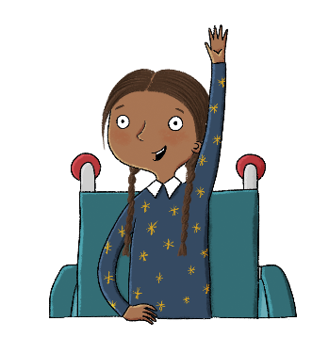
How and why was Baghdad built?
Lesson 1:
Around 1,400 years ago, a prophet called Muhammad gathered a group of faithful followers.
The followers helped Muhammad spread the religion of Islam throughout Arabia.
Baghdad became the centre of the Islamic world.
In 762ce, Al-Mansur chose to build the Round City near the River Tigris. It took four years to build.
allies
caliph
dynasty
mosque
Muhammad
Muslim
prophet
Round City

Slide 23
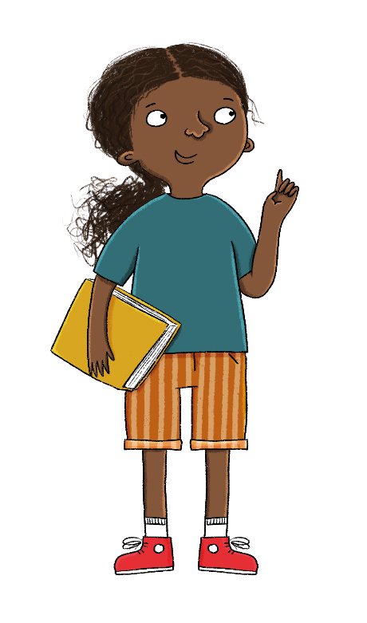
Lesson 1:
The key term for this lesson is
caliph.
The caliph was the chief Muslim ruler at the time.

Slide 24
-Ancient civilisation began in Mesopotamia.
-Mesopotamia- the place between two rivers: Tigris and Euphrates.
-After many years of civilisation, a city was built and this was called the city of Baghdad.
Talk partners: Why do you think they built a city?

Slide 26
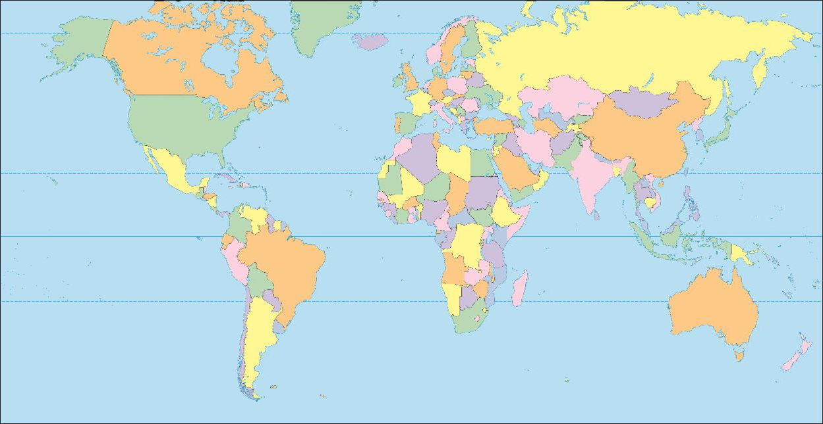
Partner Work: Use an atlas to locate Asia and identify Iraq on the map.

Slide 27
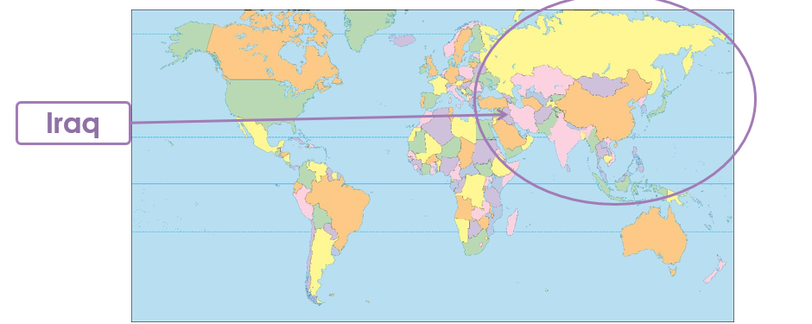

Slide 28
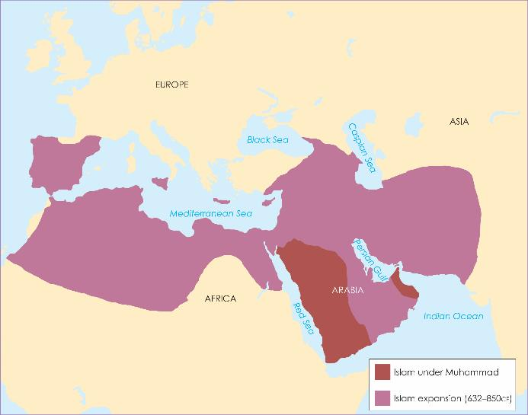
How did the Islamic Empire expand in the 7th century?
Lesson 1:
Around 1,400 years ago, a prophet called Muhammad gathered a group of faithful followers. These followers were known as Muslims. They helped Muhammad spread the religion of Islam throughout Arabia.
In 632ce, Muhammad died, and new leaders called caliphs continued his work. They spread Islam to the west and the north. The Muslim armies were fast and well organised, and their shared religion bound them together.
Notes:
Read: How did the Islamic Empire expand in the 7th century?

Slide 29
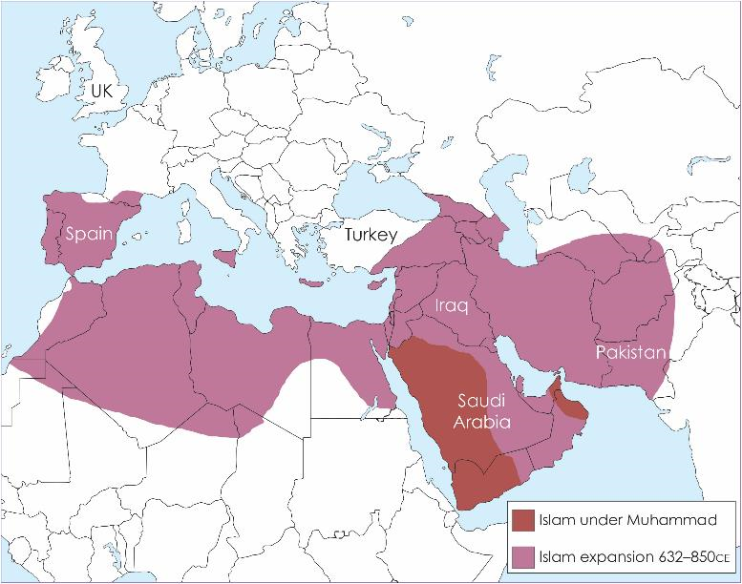

Slide 30
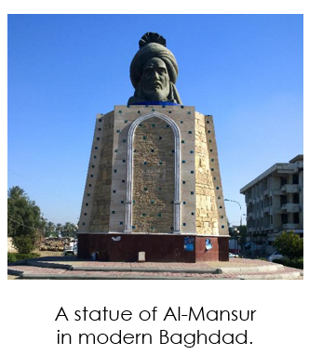
Why was the site of Baghdad chosen? By the 8th century, a new dynasty called the Abbasids took power. Caliph Al-Mansur wanted a new capital city. He decided that a small village called Baghdad would become the new capital.

Slide 31
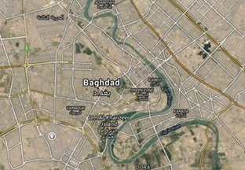
Talk partners: Why do you think Baghdad was positioned here? Hint: look at the terrain.

Slide 32
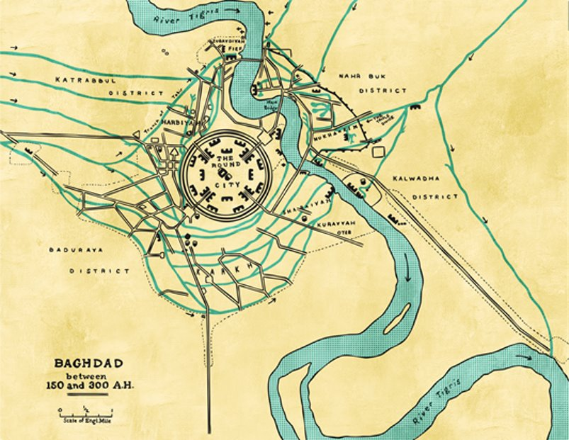
It was next to the River Tigris which would supply the city with plenty of water and fertile lands, and would be good for transport and trade.

Slide 33
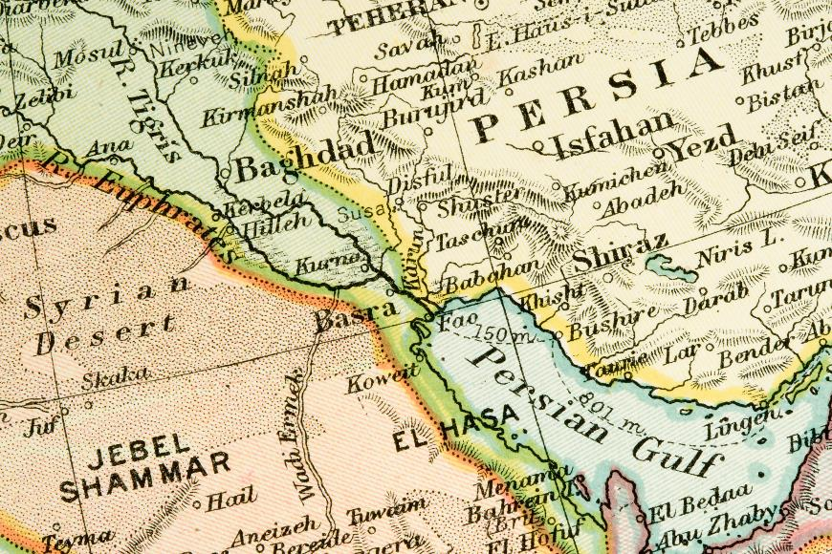
Why was the site of Baghdad chosen?
Lesson 1:
It was also in Mesopotamia (which is now Iraq) where the Abbasids had more support than in Syria, where the old capital city of Damascus was located. Baghdad was also near Persia (which is now Iran) where the Abbasids had powerful allies.

Slide 34
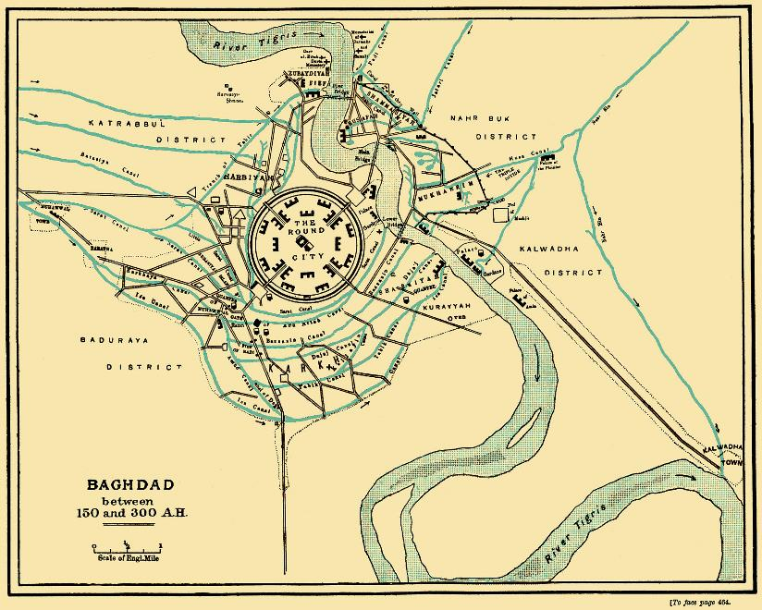
This plan of Baghdad in 767–912ce was drawn in the 1880s.
Lesson 1:
This is a secondary source as it was produced hundreds of years after the city disappeared based on what people had said that has seen the city.
William Muir created this plan from accounts describing the city as well as the remains.
Notes:
Write: Pupils should rank the different reasons for building Baghdad at this site, with 1 being the most important. They should explain their first choice. Ranking could be: 1. Good transport and trade links, 2. Fresh water supply and drainage/fertile lands, 3. Close to allies in Persia and supporters in Mesopotamia.
This map was drawn in the 1880s—hundreds of years after the Round City had disappeared—from written descriptions by people who had seen the city. Pupils should also think about whether this makes the map less useful and less valuable than if it was a primary source, created at the time.

Slide 35
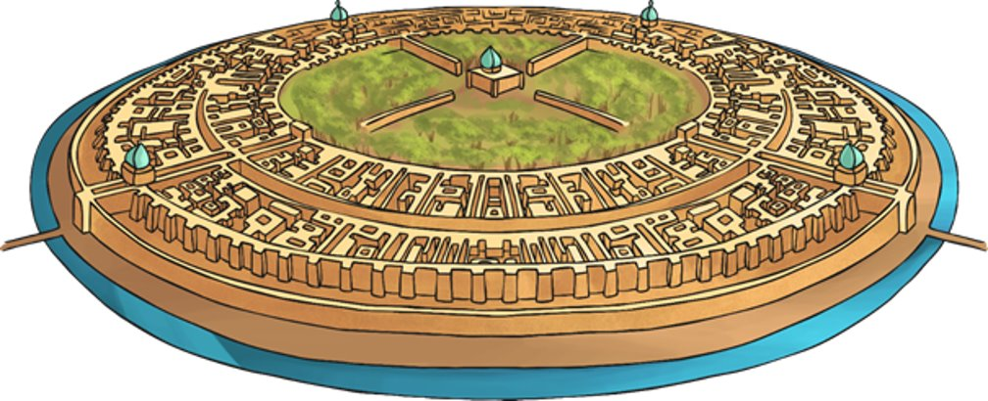
Persian villages were traditionally circular, so Al-Mansur decided that the city would be a big circle, too.
This shape was very different to the grid-like patterns of Ancient Greece or Rome or other cities in the 8th century, such as London.

Slide 36
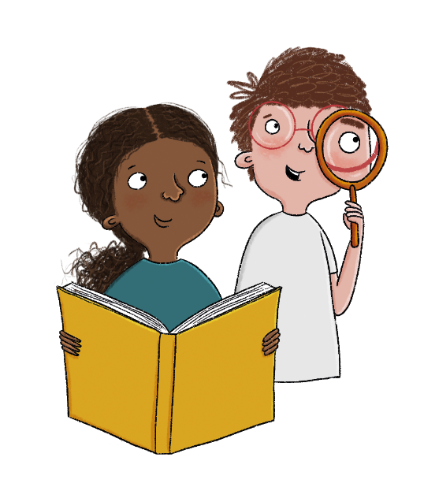
How was the Round City built?
Lesson 1:
London was also next to a river—the River Thames—which provided water and transport for the city. The Roman town of Londinium had been abandoned in the 5th century but a settlement known as London developed nearby.
There was never a formal plan, London just developed over time as people built houses wherever they wanted.

Slide 38
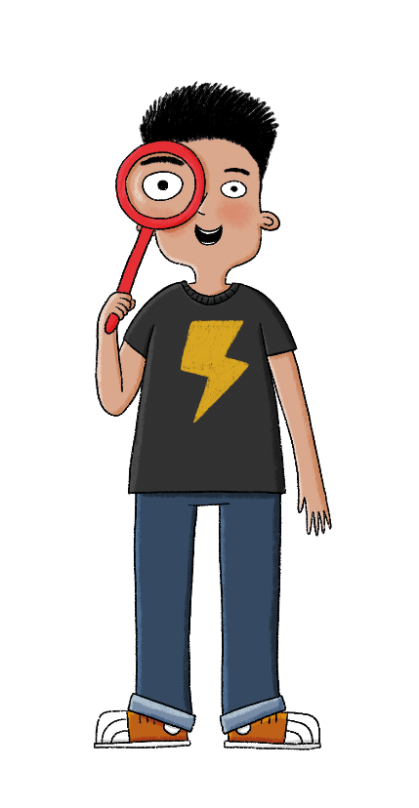
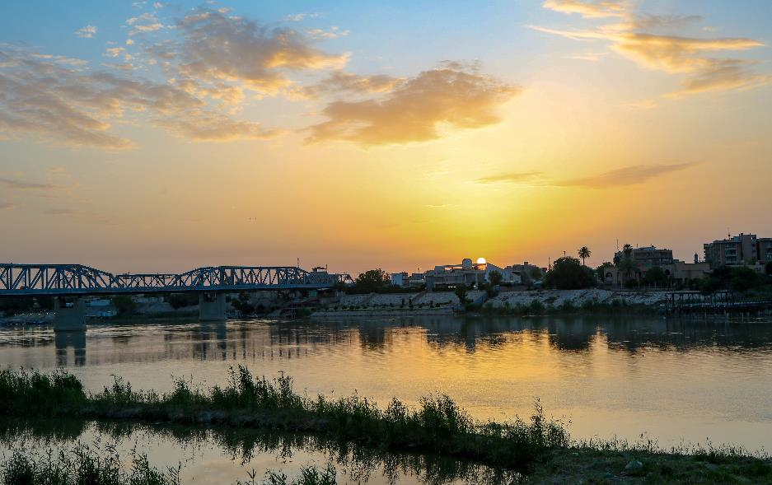
Green
Blue
Lesson 1:
What did the area around Baghdad look like?
Why was the site chosen for Baghdad?
Notes:
Talk task: Ask pupils to discuss ‘What did the area around Baghdad look like?’ and ‘Why was the site chosen for Baghdad?’ The area around Baghdad was fertile. The River Tigris was close for transport and trade as well as plenty of fresh water. This site was chosen for transport and trade links, water supply, drainage, fertile lands, and proximity to allies in Persia and supporters in Mesopotamia.

Slide 39
-The area around Baghdad was fertile. -The River Tigris was close for transport and trade as well as plenty of fresh water. -This site was chosen for transport and trade links, water supply, drainage, fertile lands, and proximity to allies in Persia and supporters in Mesopotamia.

Slide 40
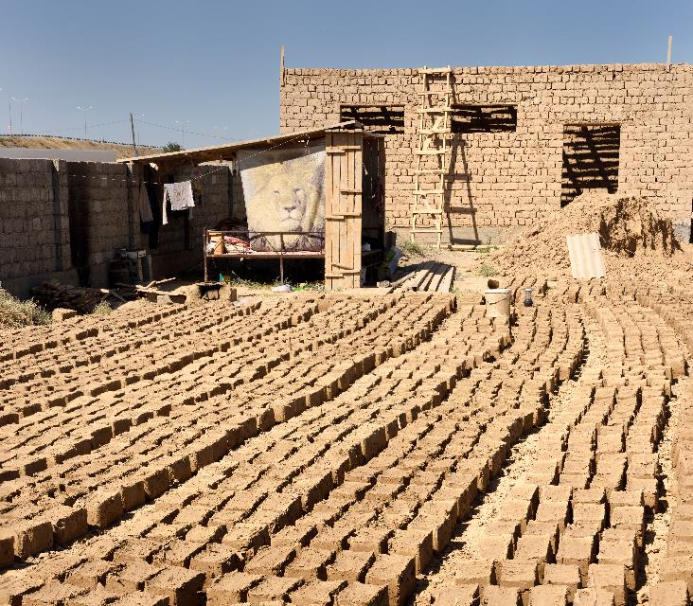
How was the Round City built?
Lesson 1:
In 762ce, Al-Mansur chose Persian architects to design the Round City and brought in around 100,000 craftspeople from surrounding countries to build it.
The city was built out of mudbricks, the traditional building material. Most buildings in London were made from wood, although some churches were built from stone.
Mudbricks are still used for building in some parts of the world today. This image shows mudbricks drying in the sun and a house being built from mudbricks in 2016.

Slide 41
How was the Round City protected?
Lesson 1:
Baghdad took around four years to build. It was known as the Round City or City of Mansur.
It is said that its creators first sketched the outline of the city on the ground. This circle on the ground became the outer wall of the city.
Surrounding the wall was a deep water-filled moat which would protect the city from attack.
Another higher outer wall was built within the first wall. This wall was 32 metres thick at the bottom and 27 metres high. The height and thickness of the walls made it difficult for attackers to climb or destroy.
Four huge iron gates were the only ways in, and it took a few guards to close them as they were so heavy. This made it difficult for attackers to get in easily.
Notes:
Read: How was the Round City protected?

Slide 42
Draw the round city and label the features. Write how three of the features strengthened the city. key Vocabulary: moat, House of Wisdom, tall walls, iron gates, mud bricks, trade routes, watch towers.

Slide 43
Exit Questions: Give two reasons why Baghdad was built where it was. What did Muhammad's followers help him do?

Slide 44
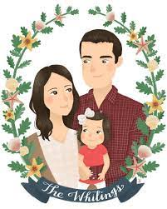
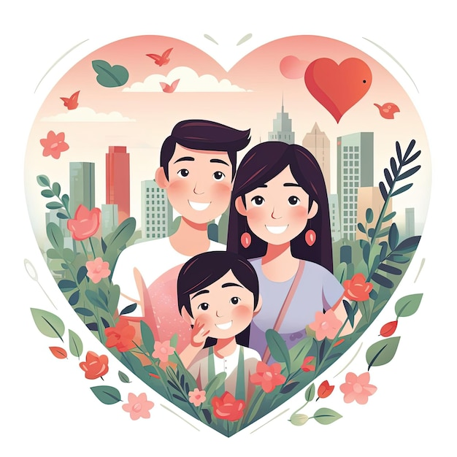
Family portraits

Slide 45
Create a border: - sketch first - when you are happy, colour using water colour.

